Slide 1

Interlinking Research Infrastructures: A Focus on Geoscience and Climate
Author(s) | Juliano Ramanantsoa
heriniaina.j.ramanantsoa@uib.no
Notes:
Title slide

Slide 2
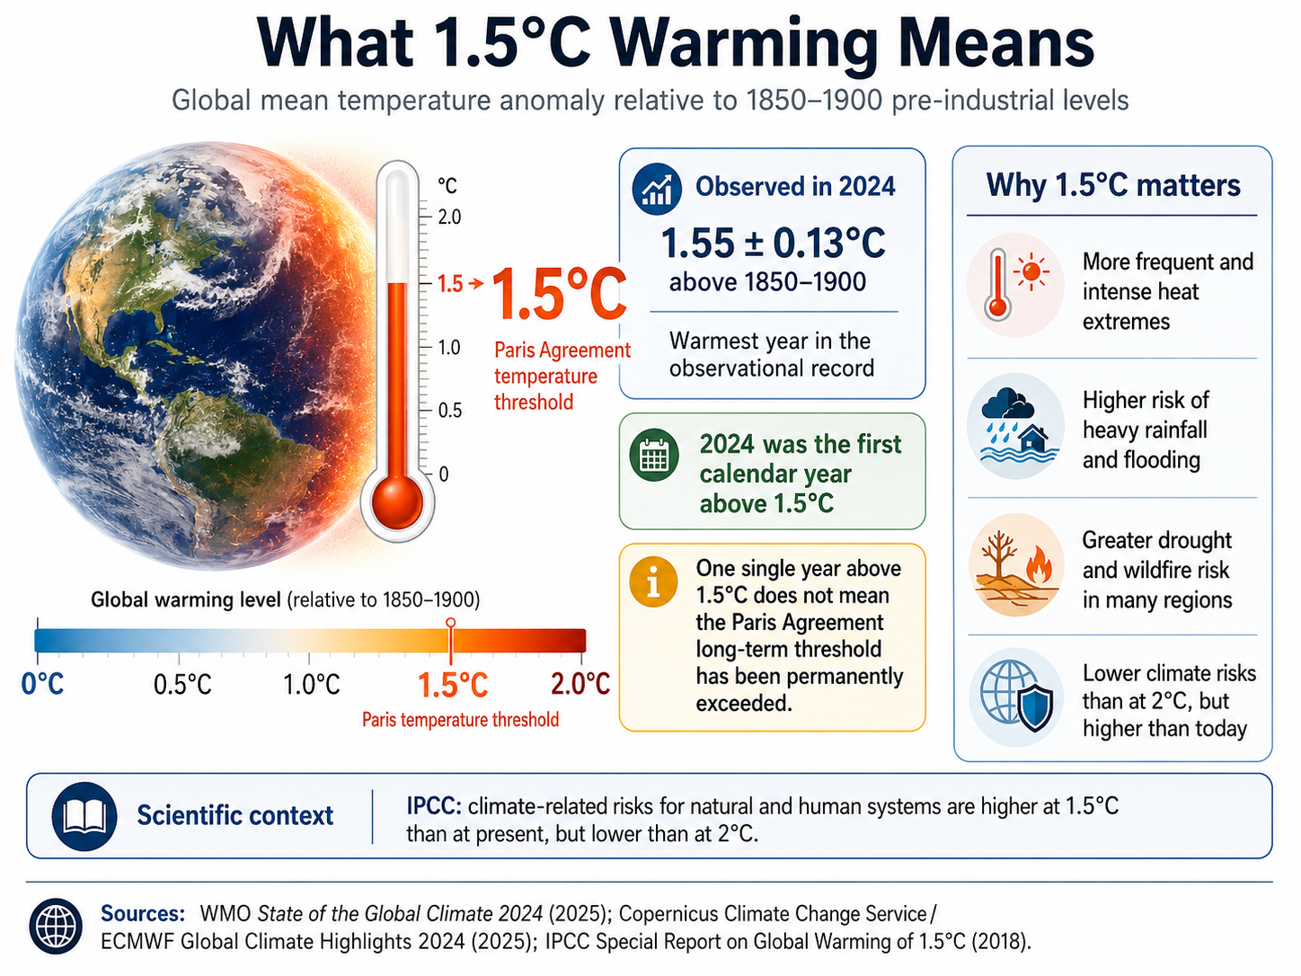
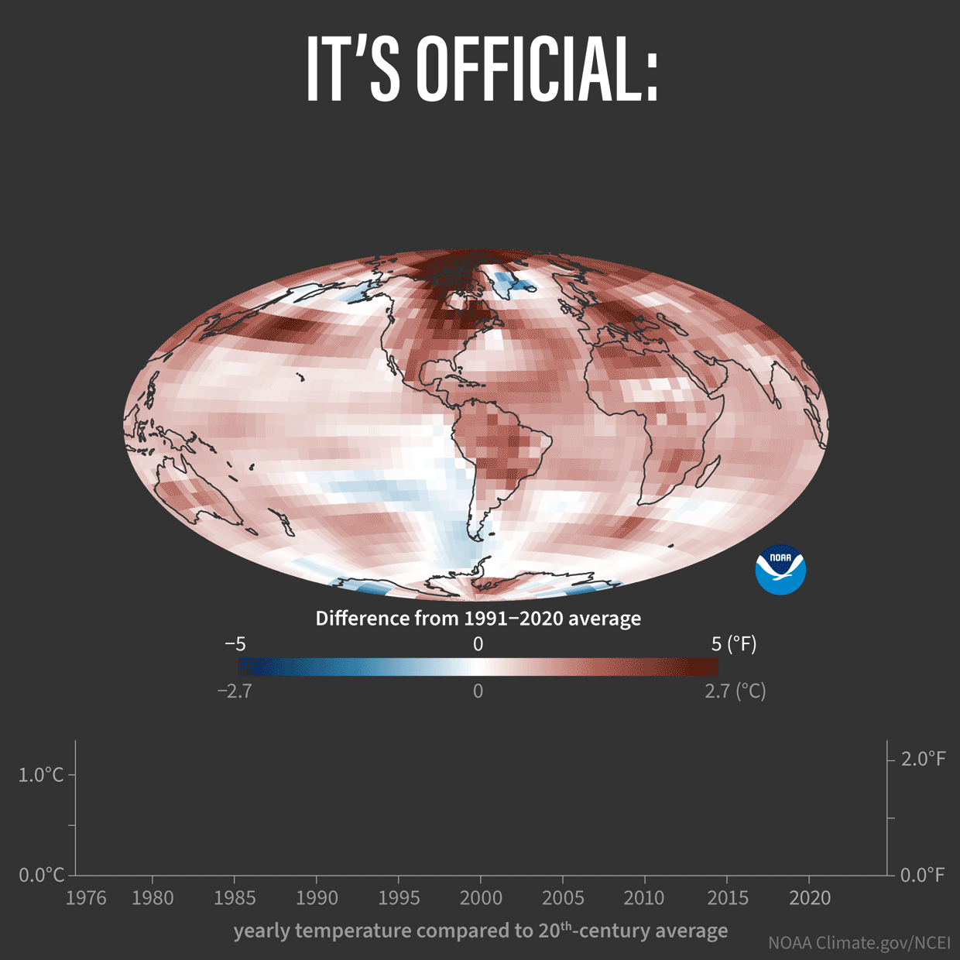
hhhh
Notes:
United Nations body established in 1988 by the World Meteorological Organization (WMO) and the United Nations Environment Programme (UNEP).

Slide 3
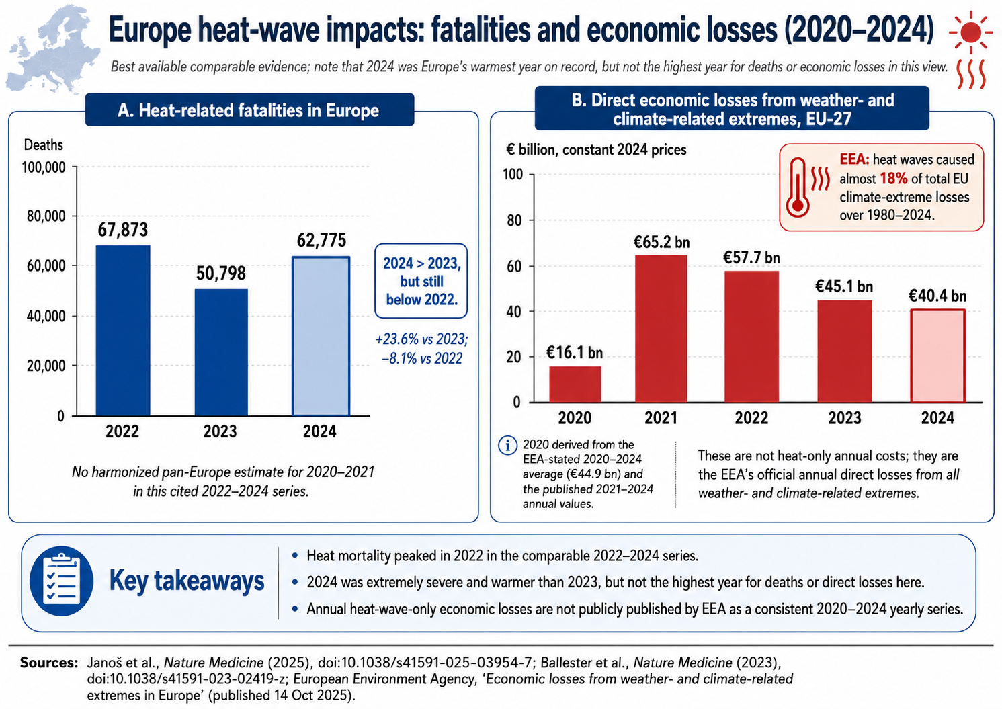

Slide 4
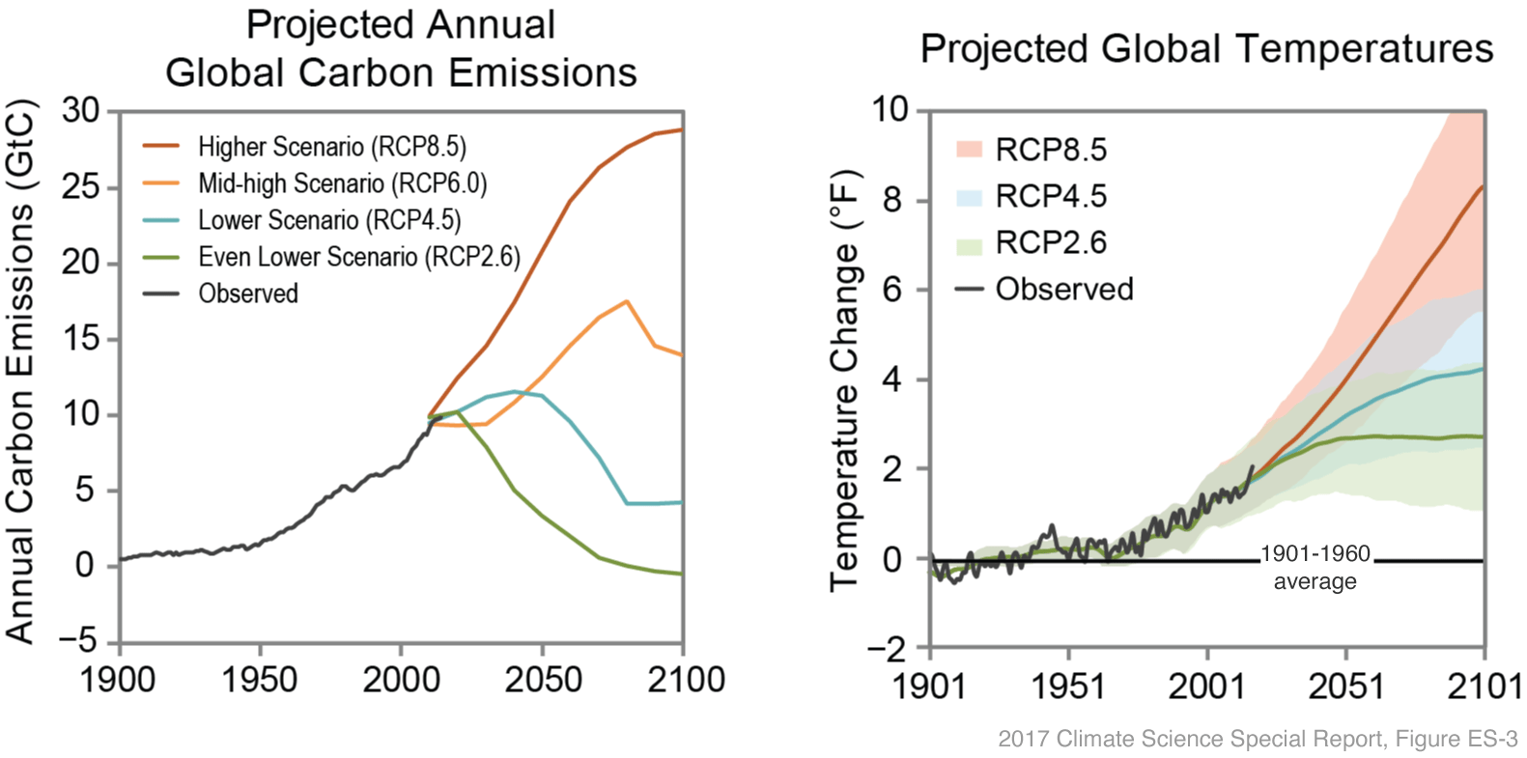
(left) Hypothetical pathways of carbon emissions ("representative concentration pathways," or RCPs) throughout the twenty-first century based on different possible energy policies and economic growth patterns. (right) Projected temperature increase relative to the 1901-1960 average depending on which RCP we eventually follow. Image by Katharine Hayhoe, from the 2017 Climate Science Special Report.
Notes:
Empty slide for large pictures, tables, maps, plots…

Slide 5
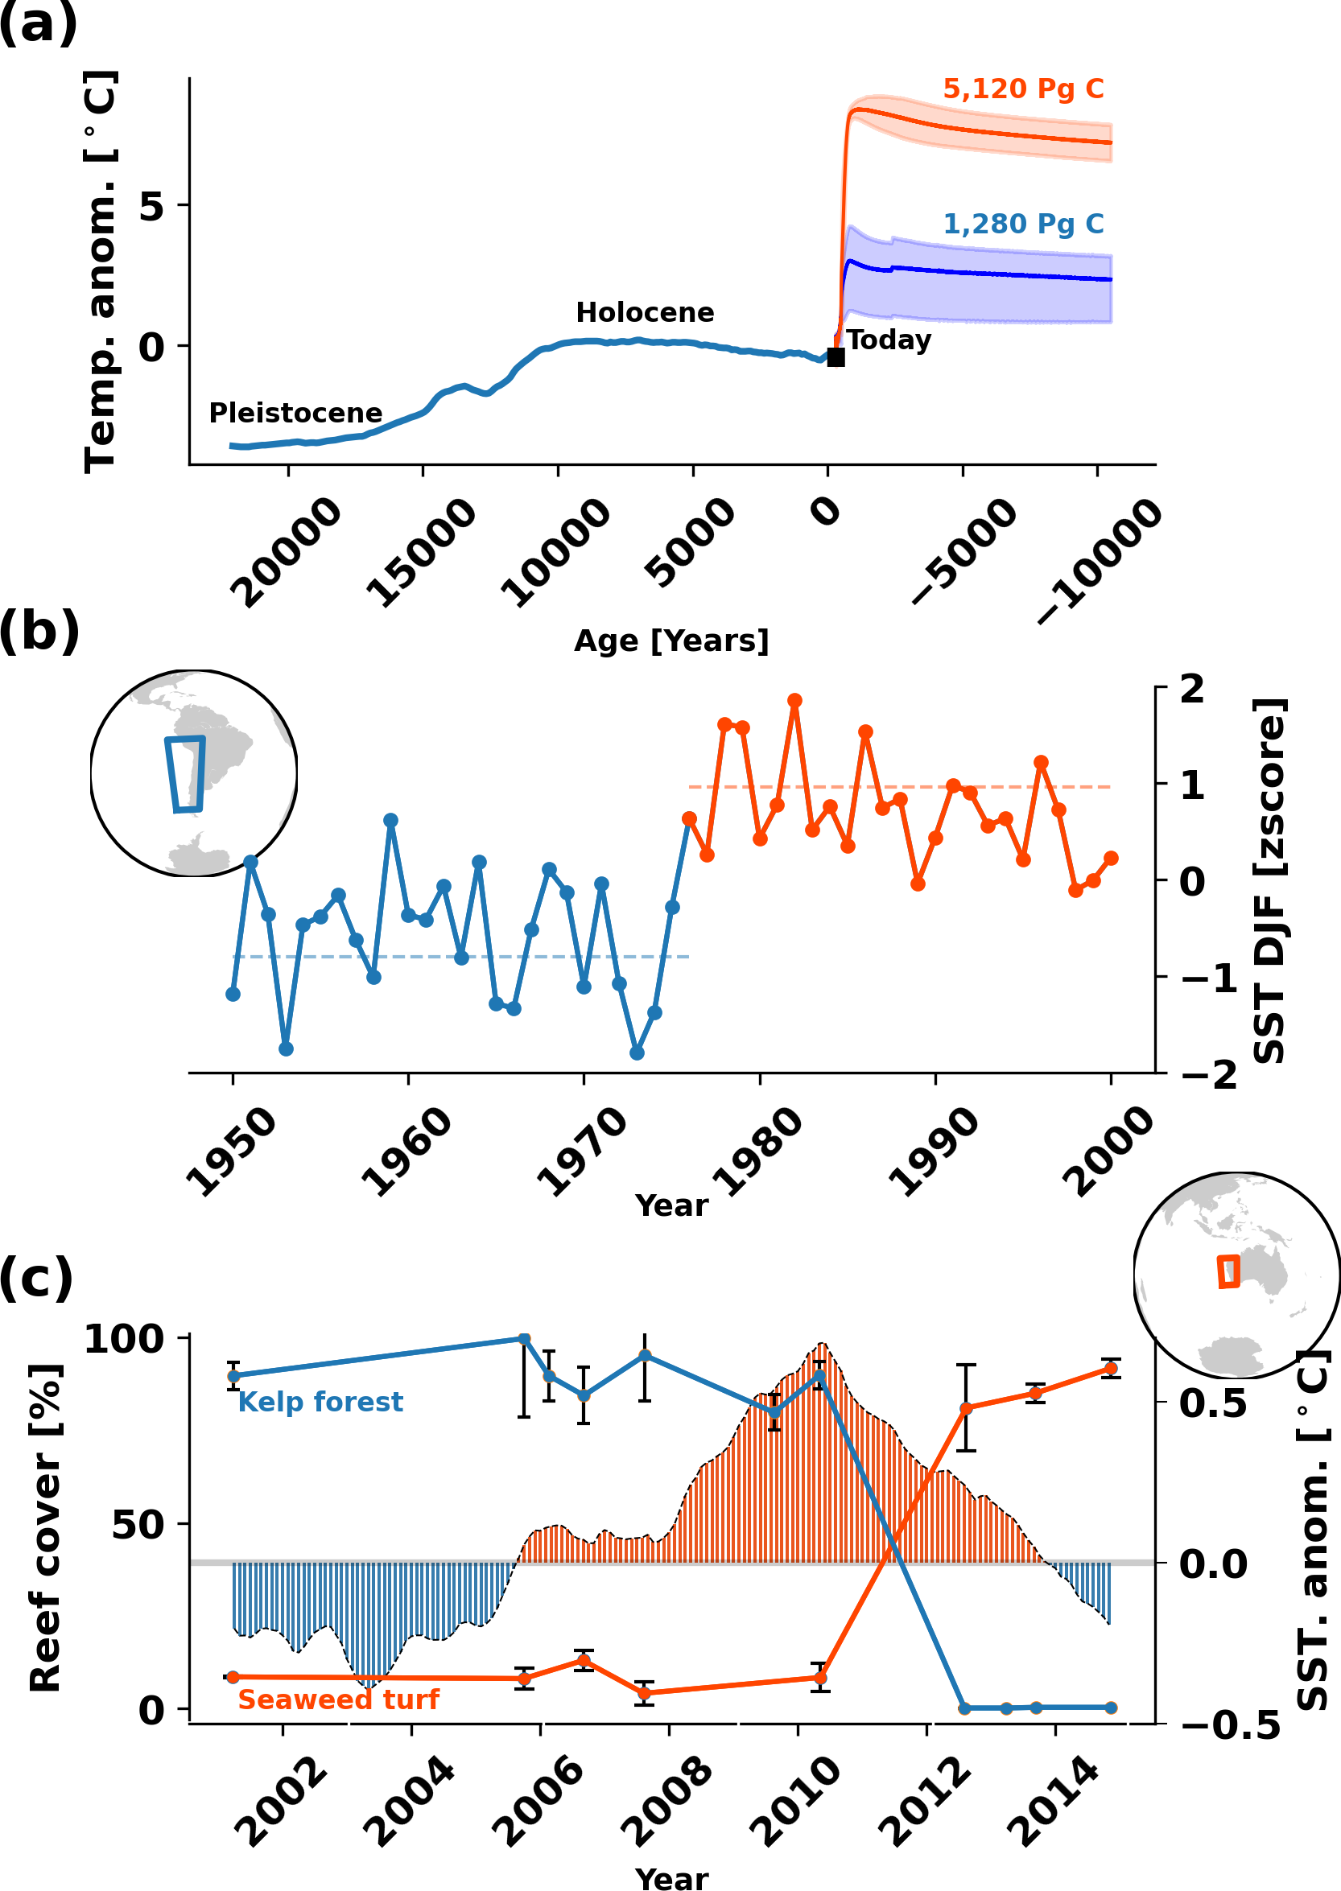
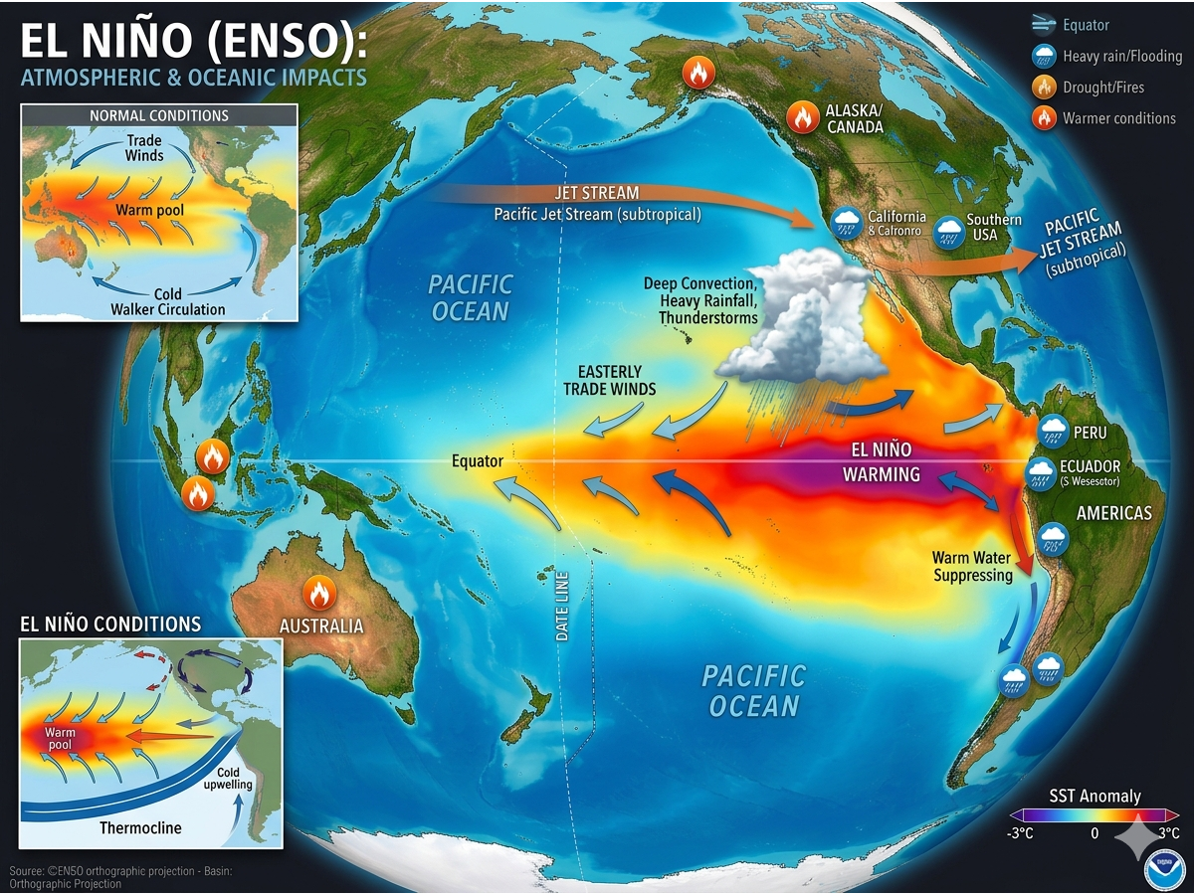
Heinze C., Federike R., Ramanantsoa J., and 32 co-authors, 2025 (Biogeochemistry Journal)
Notes:
Empty slide for large pictures, tables, maps, plots…

Slide 6

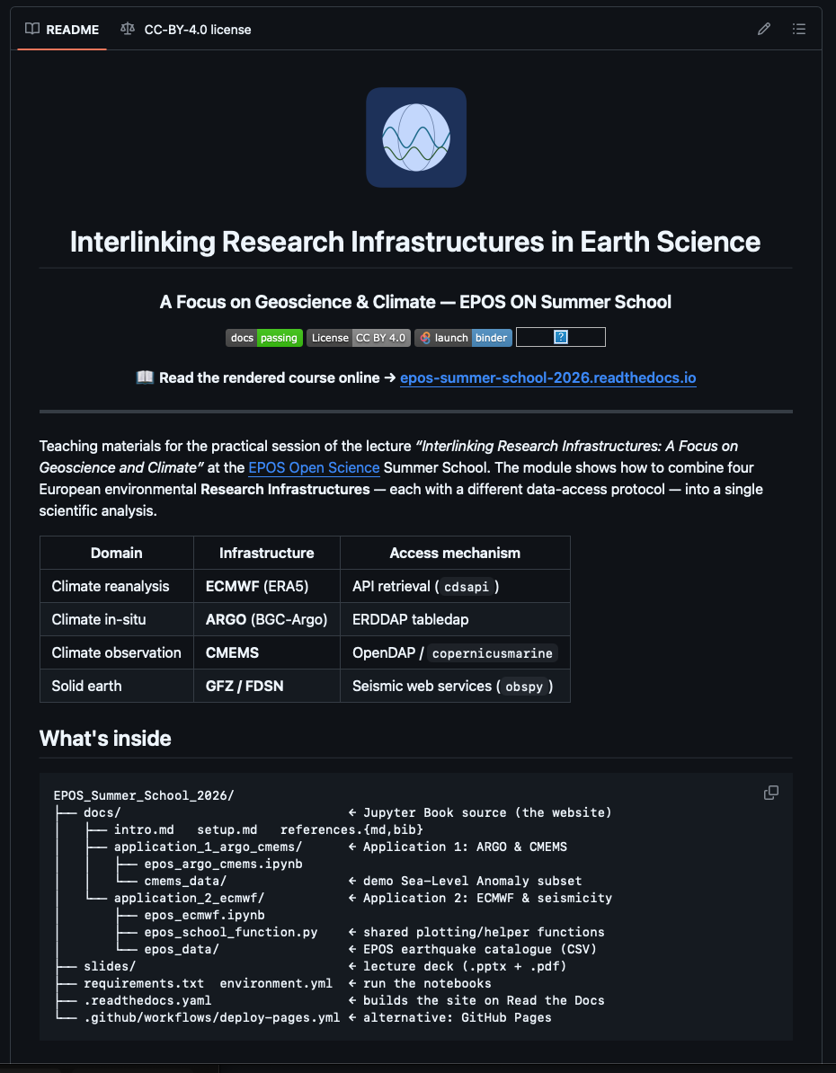
Linking EPOS and ECMWF
Geoscience and Climate
Data infrastructure
https://github.com/Juliano1111-ai/EPOS_Summer_School_2026
https://epos-summer-school-2026.readthedocs.io/en/main/intro.html

Slide 7
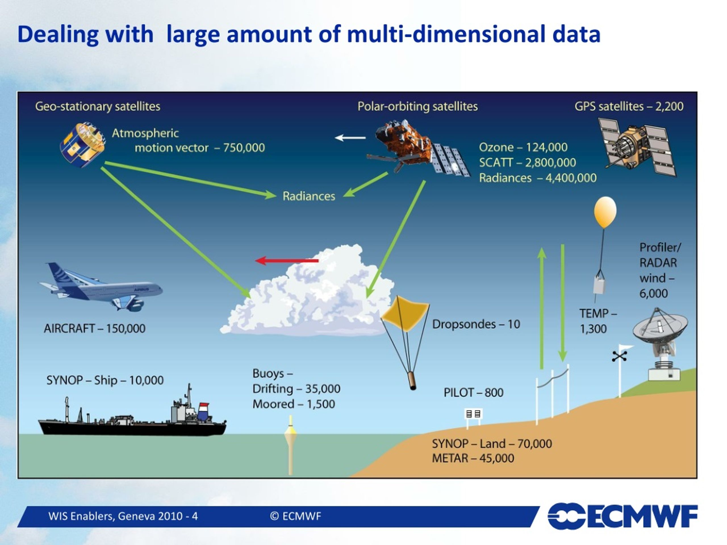

ECMWF
European Centre for Medium-Range Weather Forecasts
ECMWF provides a wide range of meteorological and climate variables, especially through datasets like ERA5 and SEAS5.
Largest data provider in ocean and atmosphere system
Science-based operational services supporting environmental monitoring and research

Slide 8
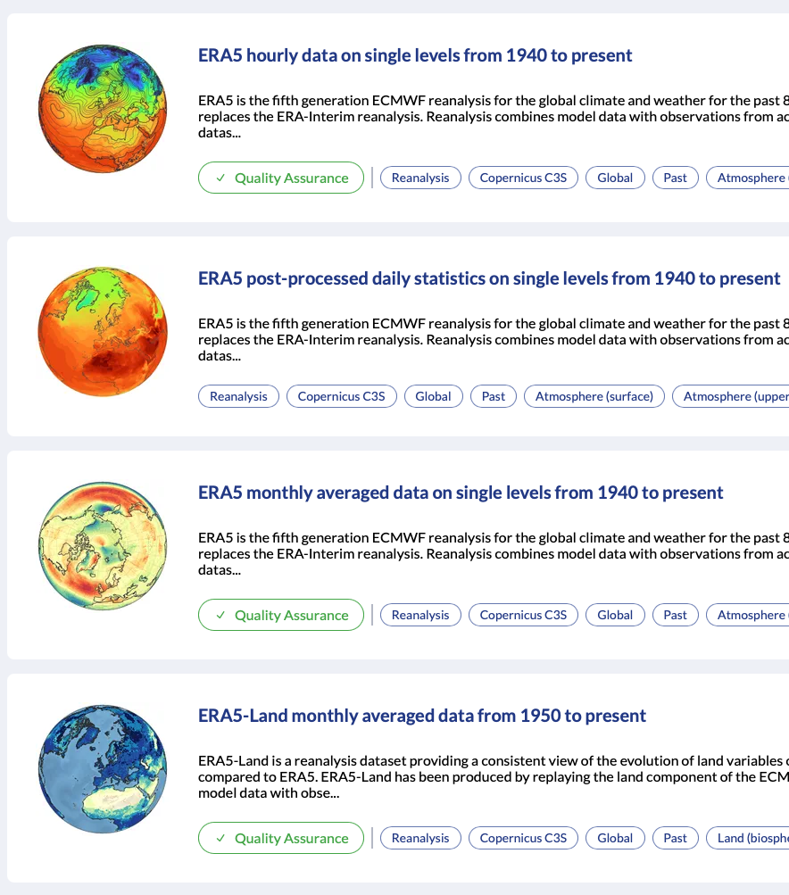
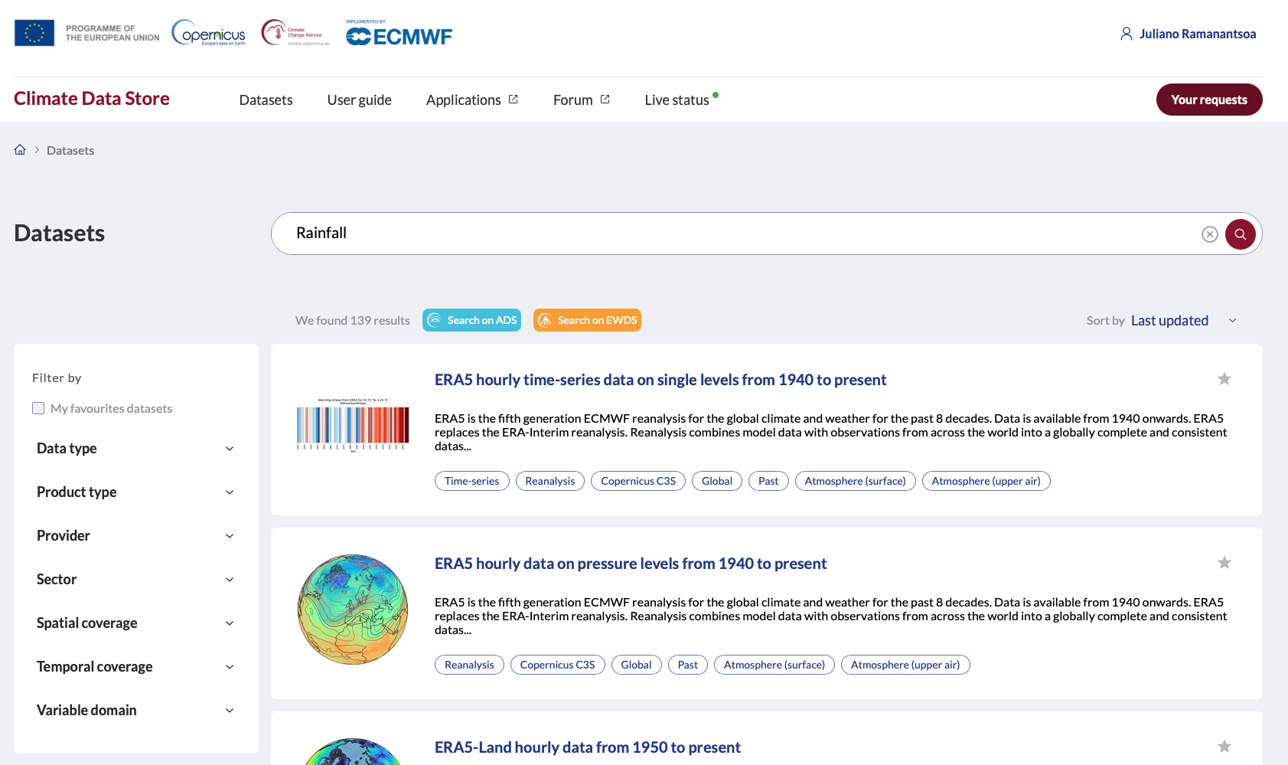
ECMWF
European Centre for Medium-Range Weather Forecasts
https://cds.climate.copernicus.eu/datasets

Slide 9
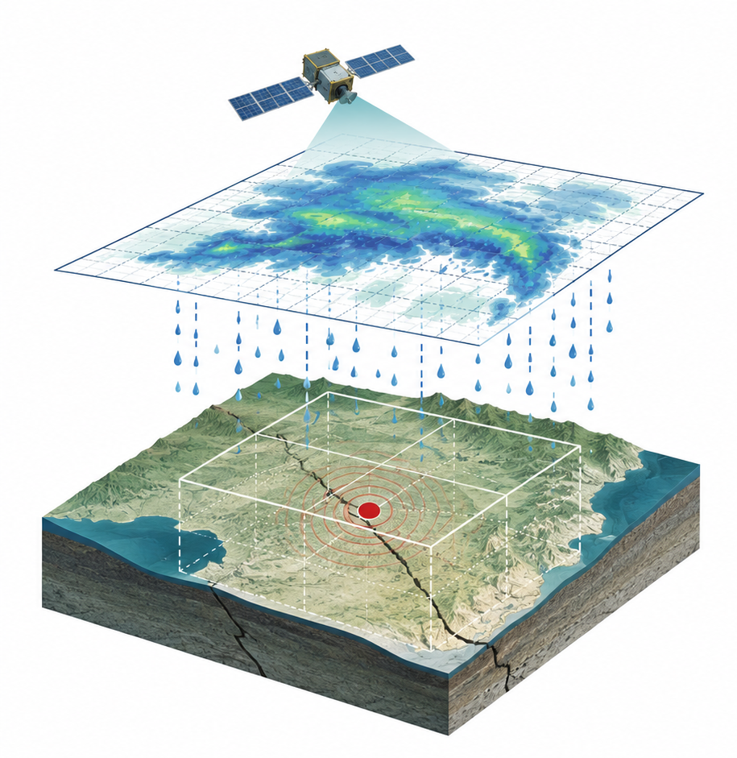
RAINFALL AND EARTHQUAKE
Earthquake and Mousson
NOTEBOOK §3
Seismic event
Rain context
Evidence chain
time · place · depth · magnitude
May–Sep rainfall · 30-yr baseline
not proof — a reproducible test
Depth ≤ 10 km
Region keyword in target belt
Month ∈ May–September
Magnitude ≥ 4.5
→ probable_climate_interaction
Exceptional
≥ 1100 mm
Earthquake triggered during the rainy months, how much water did the atmosphere put on the ground?
Wet
≥ 880 mm
area = [lat+1.5, lon-1.5, lat-1.5, lon+1.5]
dataset = reanalysis-era5-single-levels-monthly-means
variable = total_precipitation
tp.sum() × 1000 → millimetres
Normal
≥ 700 mm
Dry
< 700 mm

Slide 10
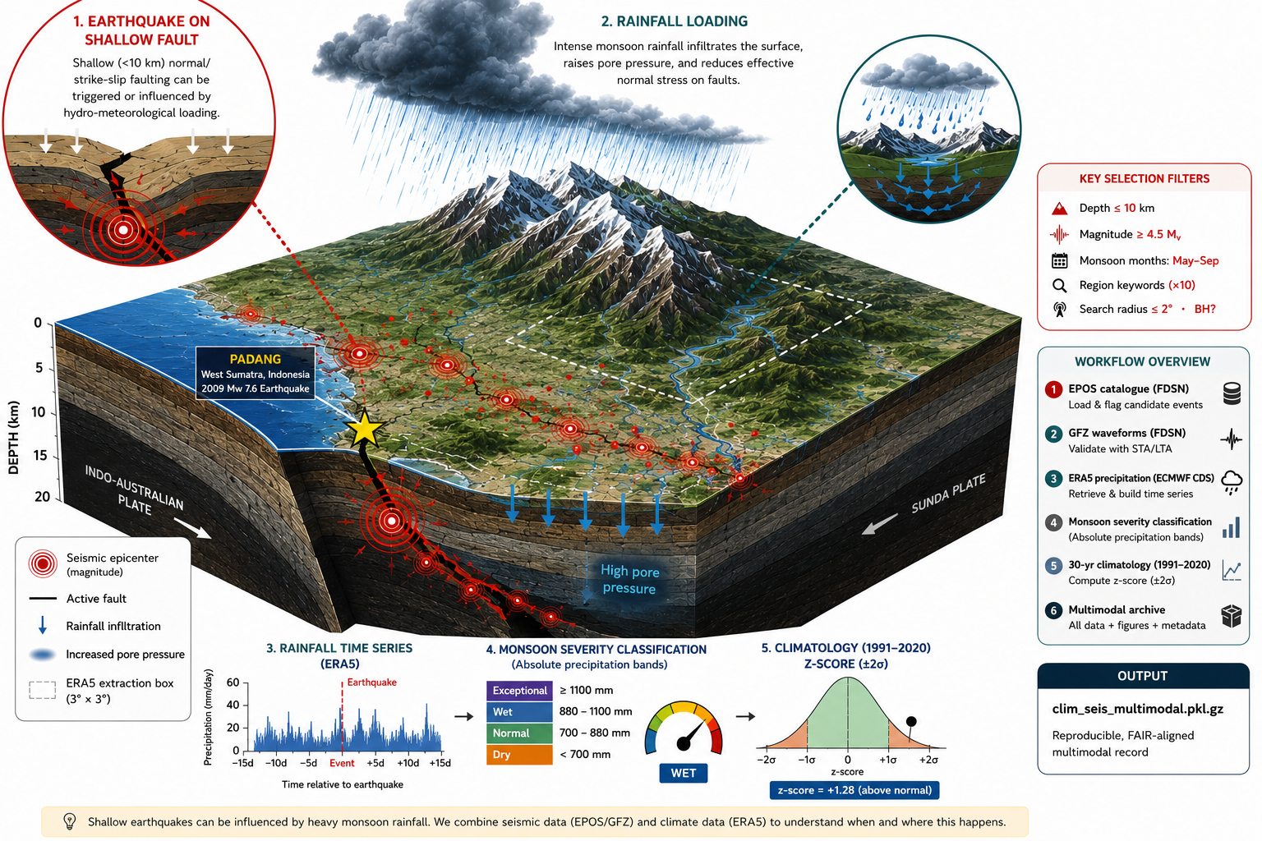

Slide 11
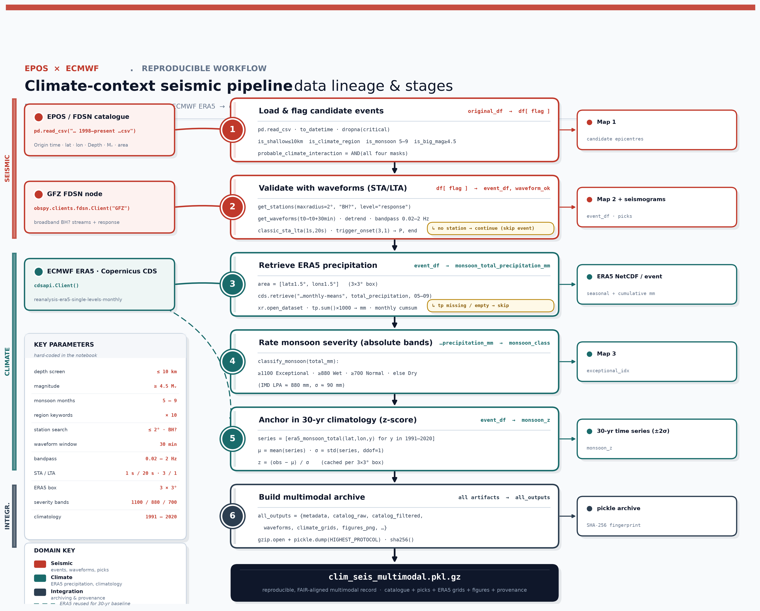
ECMWF
European Centre for Medium-Range Weather Forecasts
ECMWF:
https://cds.climate.copernicus.eu
API:
https://cds.climate.copernicus.eu/how-to-api
How to install:
https://confluence.ecmwf.int/display/CKB/How+to+install+and+use+CDS+API+on+macOS

Slide 12
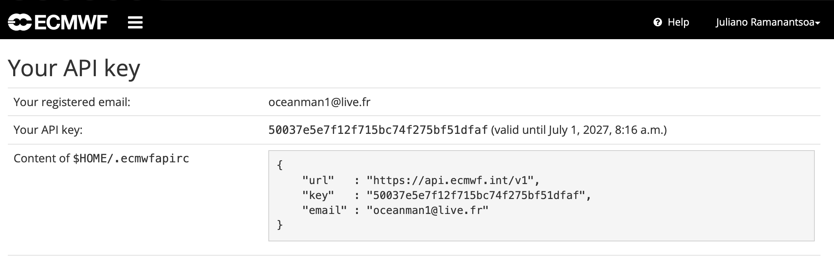

Slide 13

Thank you for your attention!
heriniaina.j.ramanantsoa@uib.no
www.epos-eu.org/on | social media #EPOSon
Notes:
Thank you slide

