Slide 1

Machine Learning
Techniques Applied
To Earth Science
Valerio Vinciarelli | Valerio.Vinciarelli@epos-eric.eu

Slide 2

What We'll Cover Today
01
Why ML Meets Earth Science
04
Applications Across Domains
The intersection of data and planetary challenges
Where ML is making a real impact
02
The Data We Work With
05
Real-World Case Studies
Understanding inputs before designing algorithms
Diving deeper into impactful applications
03
Key ML Techniques
06
Challenges & What's Next
What algorithms are used and why they fit
The road ahead for ML in Earth Science

Slide 3
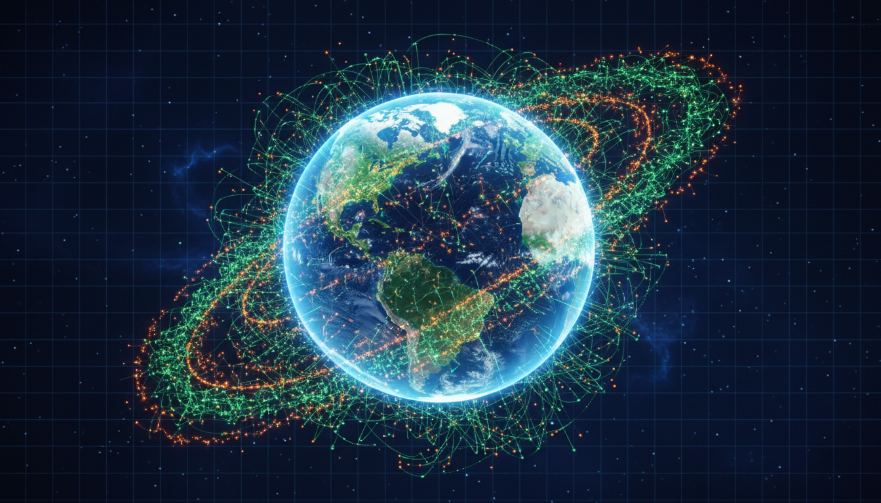
01
WHY ML MEETS EARTH SCIENCE
The intersection of data-driven methods and planetary-scale challenges

Slide 4
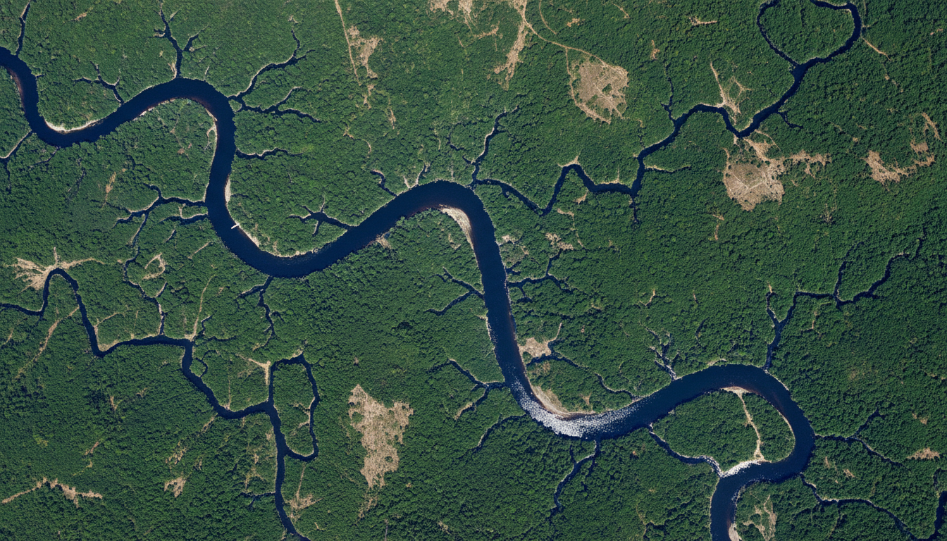
Earth Science Is a Big Data Problem
Earth generates petabytes of data daily — satellites, sensors, seismic networks, weather stations.
Traditional methods struggle with:
Volume — terabytes of satellite imagery per day
Complexity — non-linear, multi-scale processes
Speed — need for real-time disaster response
ML excels at pattern recognition in massive, high-dimensional datasets.
36 bands
Daily
Since 1972
NASA MODIS spectral coverage
Global data refresh cycle
Landsat continuous observation
Source: NASA MODIS / ESA Sentinel missions

Slide 5
From Hypothesis-Driven to Data-Driven Discovery
TRADITIONAL
ML-ENABLED
Relies on physical models and equations
Human expert interpretation of data
Hypothesis-first approach
Limited by cognitive capacity
Slow but physically grounded
Learns patterns from data automatically
Scales to massive datasets
Finds patterns humans miss
Speed: 1000x faster emulators
Hybrid: physics + data combined
Key insight: ML doesn't replace physical understanding — it complements it.

Slide 6
02
THE DATA WE WORK WITH
Understanding the inputs before designing the algorithms

Slide 7
Satellite Imagery — The Eyes in the Sky
Earth observation satellites produce terabytes of imagery daily. Key sources for ML:
Satellite | Resolution | Revisit | Key ML Applications
NASA MODIS | 250m – 1km | Daily | Vegetation indices, global climate monitoring
ESA Sentinel-2 | 10m – 60m | 5 days | Land cover classification, agriculture
Landsat | 30m | 16 days | 50+ years of change detection
Google Earth Engine provides a cloud platform for processing petabytes of satellite data with built-in ML tools.
Common vegetation index: NDVI = (NIR − Red) / (NIR + Red), ranging from −1 to 1.

Slide 8
Beyond Imagery — Multi-Source Geospatial Data
Weather Station Networks
THE CHALLENGE
Temperature, pressure, humidity, wind speed
Seismic Sensor Arrays
Working with geospatial data means dealing with:
Heterogeneous formats and resolutions
Spatial and temporal gaps
Sensor noise and calibration errors
Cloud cover in imagery
Limited labeled ground-truth data
Massive data volumes (petabytes)
Ground motion data, real-time earthquake streams
Ocean Monitoring
Sea surface height, temperature, salinity buoys
Geological Surveys
Rock composition, mineral content, drilling logs
IoT and Citizen Science
Crowdsourced observations, real-time sensor feeds

Slide 9

03
KEY ML TECHNIQUES
What algorithms are used and why they fit specific Earth problems

Slide 10
Random Forest — The Reliable Workhorse
44%
TYPICAL USE CASES
of mineral exploration studies use Random Forest
Landslide susceptibility — rainfall, slope, geology
Mineral prospectivity — predicts deposits
Vegetation classification — land cover mapping
Flood risk assessment — real-time prediction
Carbon stock estimation — biomass mapping
WHY IT WORKS
Handles non-linear relationships
Robust to noise and missing data
Built-in feature importance
Works well with limited labeled data
Pro tip: Random Forest is often the first algorithm to try — fast, interpretable, and surprisingly effective.

Slide 11
Neural Networks — From MLP to Deep Learning
MLPs (Fully Connected)
CNNs (Convolutional)
RNNs / LSTMs
Used for regression tasks:
Temperature prediction
Rainfall estimation
Soil moisture forecasting
Simple, effective baseline
For spatial data and imagery:
Land cover classification
Geological structure detection
Flood inundation mapping
Auto feature extraction
For temporal sequences:
Time series forecasting
Seasonal pattern prediction
Drought early warning
Climate trend analysis
Key advantage: Automatic feature extraction from raw data — the network learns what matters directly.

Slide 12
Spatiotemporal Models — ConvLSTM & Transformers
Earth Science data is inherently spatiotemporal — both space and time matter.
ConvLSTM
Transformers
CNN + LSTM hybrid for space-time data
Self-attention for global dependencies
Convolutional layers extract spatial features
LSTM layers model temporal dependencies
Ideal for precipitation nowcasting (0-6h)
Used for flood and typhoon prediction
Self-attention models long-range patterns
Captures global weather simultaneously
Earthformer, Rainformer SOTA
100-1000x faster than numerical methods
Emerging: Physics-Informed Neural Networks (PINNs) embed physical laws directly into the loss function.

Slide 13
Hybrid and Ensemble Approaches
Single algorithms rarely solve complex Earth problems. The winning strategy: combine multiple models.
01
Ensemble Methods
02
CNN-LSTM Hybrids
03
Multi-Modal Fusion
XGBoost + Random Forest combined for robust predictions. Each captures different patterns; voting improves accuracy.
Combine spatial CNN with temporal LSTM memory. Used for typhoon prediction from satellite + atmospheric data.
Merge satellite imagery, weather data, terrain models, and soil sensors into unified representations.
A TYPICAL ML PIPELINE
Data Collection
Preprocessing
Model Training
Validation
Deploy

Slide 14
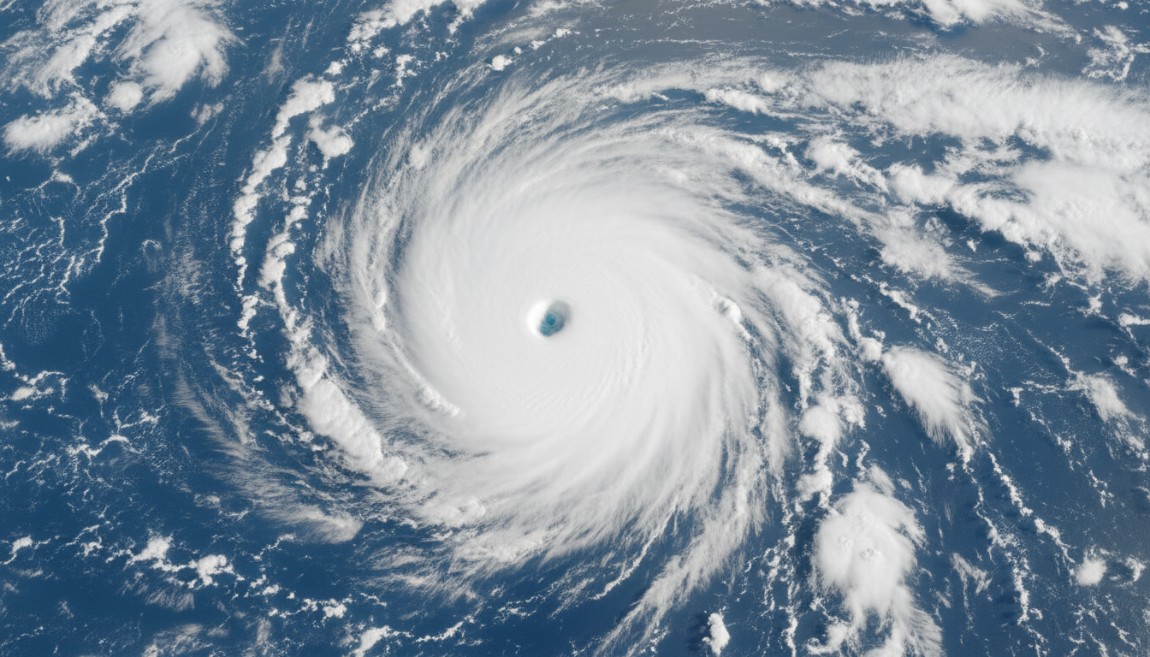
04
APPLICATIONS ACROSS DOMAINS
Where ML is making a real impact on understanding our planet

Slide 15
Weather Forecasting — From Nowcasting to Long-Range
NOWCASTING (0-6 HOURS)
MEDIUM-RANGE (8 HOURS)
SEASONAL (WEEKS-MONTHS)
ConvLSTM & Transformer models predict precipitation with 1km resolution.
Key result: 89% of cases preferred by expert meteorologists over traditional methods.
Google MetNet forecasts 8 hours ahead at 1km resolution.
Under 1 minute of computation vs. hours for traditional numerical methods.
FuXi-S2S model predicts global patterns up to 42 days ahead.
Trained on 72 years of ECMWF reanalysis data.
Key advantage: ML weather models run orders of magnitude faster — minutes on standard hardware vs. hours on supercomputers.

Slide 16
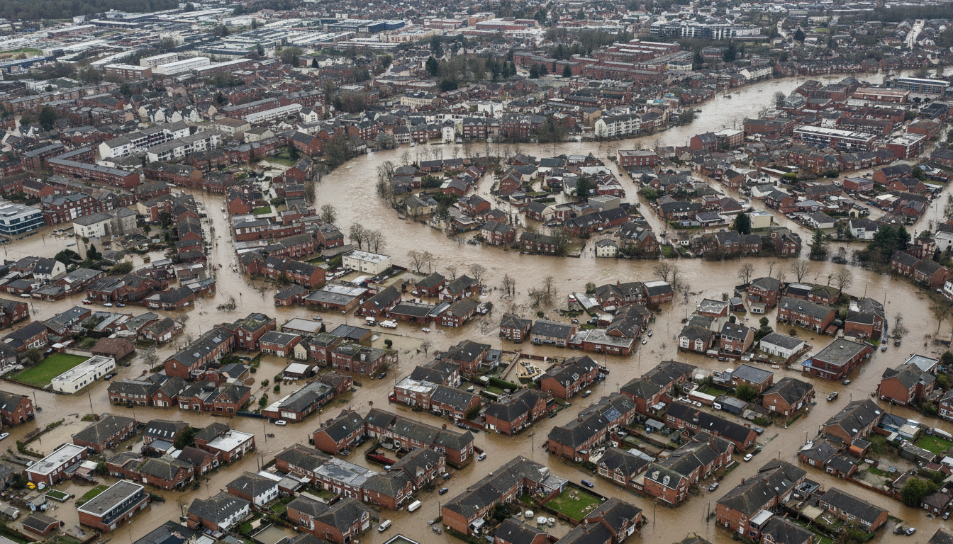
Natural Hazards — Prediction and Early Warning
Landslides: Random Forest models achieve >92% accuracy in susceptibility mapping by integrating rainfall, slope, geology, and land use.
Wildfires: SVM and Random Forest predict fire risk from weather, fuel moisture, and satellite vegetation indices.
Earthquakes: ML models on seismic data provide 10-second early warnings with 90% accuracy for magnitude 3+ events.
Multi-hazard: Integrated frameworks assess flood, landslide, and wildfire risks simultaneously.
ML-powered flood mapping from satellite imagery
Real-world impact: During Hurricane Florence (2018), ML models anticipated the storm's path, enabling effective evacuation — saving lives.

Slide 17
Climate Change Monitoring
Vegetation & Deforestation
CARBON MAPPER EXAMPLE
NDVI + LSTM detect deforestation and drought stress
The Carbon Mapper satellite constellation:
30m spatial resolution
Detects CO₂ and CH₄ emissions
25+ environmental indicators
Spectral range: 0.4 – 2.5 µm
Real-time emission alerts
ML processes hyperspectral data to identify, quantify, and attribute greenhouse gas sources.
Carbon & Methane Detection
ML detects CO₂ and methane plumes from satellites
Climate Model Emulation
DL surrogates replicate climate simulations 1000x faster
Ice & Glacier Monitoring
Automated ice sheet tracking from satellite imagery

Slide 18
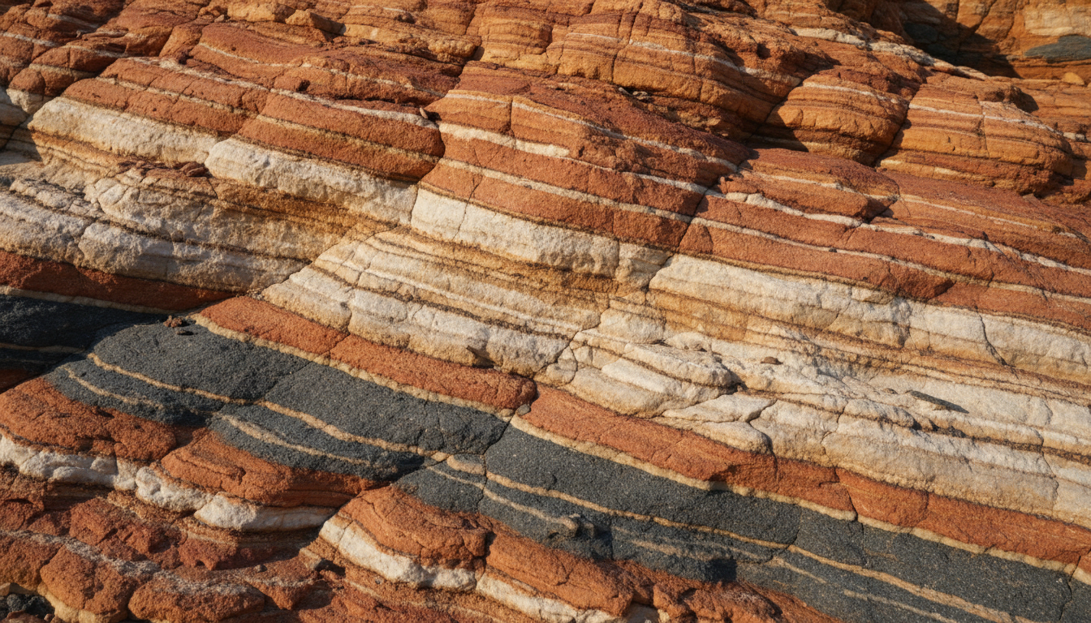
Mineral Exploration and Geology
The mining industry increasingly relies on ML:
Prospectivity mapping — ML analyzes geological, geochemical, and geophysical data
Remote sensing — CNNs process satellite imagery to detect surface mineral signatures
Core logging — CNNs automatically identify rock types, fractures, and veins
Most common: Random Forest (44%), SVM, CNNs.
CNNs identify mineral veins in geological strata
Success story: GoldSpot Discoveries used ML + 3D mapping to find 8 new gold targets in Ontario, Canada.

Slide 19
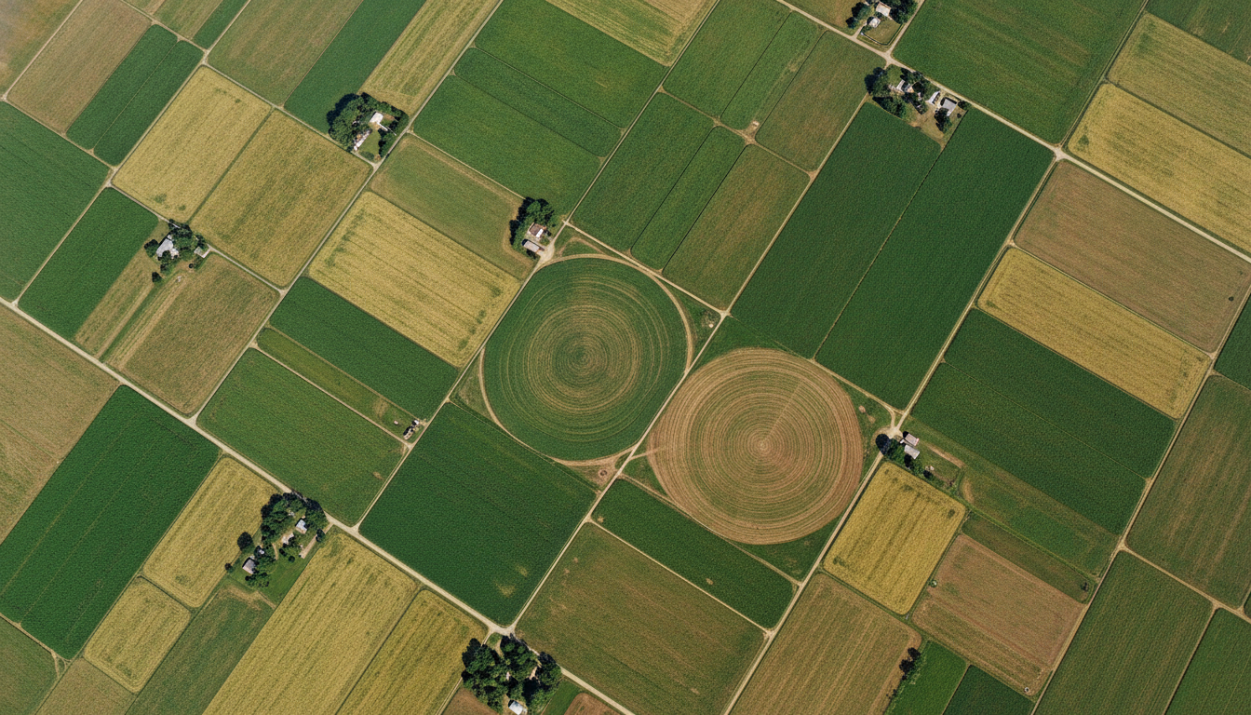
Agriculture and Land Use
Crop yield prediction: ML combines satellite imagery, weather data, and soil sensors to forecast yields weeks before harvest.
Precision agriculture: Variable-rate fertilization and irrigation, reducing water use by 20-30%.
Land cover mapping: CNNs on Sentinel-2 map urban expansion and deforestation at 10m resolution.
Soil analysis: Hyperspectral imaging + ML estimates moisture, carbon, and nutrients.
Precision agriculture from satellite-based ML analysis
Global impact: ML-powered crop monitoring covers entire countries in near real-time, enabling early famine warnings.

Slide 20
05
REAL-WORLD CASE STUDIES
Diving deeper into two impactful applications

Slide 21
Case Study — Landslide Early Warning in Italy
PROBLEM
SOLUTION
RESULTS
Traditional warnings use only rainfall thresholds, missing geological and environmental factors.
Result: high false positives, missed events, limited spatial precision.
Dynamic ML using Random Forest to generate daily Landslide Hazard Maps.
Integrates rainfall data + geoenvironmental factors (lithology, slope, land use).
Predicted the September 2015 Liguria extreme rainfall event.
Reliably distinguished stable from unstable conditions.
Partial Dependence Plots ensure geomorphological plausibility.
Key innovation: Daily dynamic hazard maps instead of static zones — updating as weather changes.

Slide 22
Case Study — Weather Prediction with FuXi
Problem: Traditional weather prediction requires supercomputers and hours of computation.
THE SOLUTION
IMPACT
FuXi — ML weather forecasting system:
Trained on 72 years of ECMWF reanalysis data
Global daily forecasts up to 42 days ahead
0.25-degree spatial resolution
Runs on standard hardware in minutes
Outperforms ML models on precipitation and MJO
FuXi-ENS: 15-day ensemble forecasts
Democratizes weather forecasting worldwide
Why it matters: FuXi proves ML can surpass supercomputer-based forecasting — at a fraction of the cost.

Slide 23
06
CHALLENGES & WHAT'S NEXT
The road ahead for ML in Earth Science

Slide 24
Key Challenges in Geoscience ML
01
Data Quality & Availability
02
Multicollinearity
03
Generalizability
Inconsistent sensors, missing data, cloud cover, limited labeled samples. Preprocessing consumes 60-80% of project time.
Earth variables are strongly interdependent, making feature importance unreliable and interpretation difficult.
Models trained in one region often fail in others. Transfer learning and domain adaptation are active research areas.
04
The "Black Box" Problem
05
Computational Scale
Scientists need to understand why a model predicts. Interpretability methods (SHAP, LIME) are essential but imperfect.
Processing petabytes requires cloud infrastructure (GEE, AWS, Azure). Not all institutions have equal access.
Bottom line: Each challenge is a door for innovation — better algorithms, new data fusion, more accessible platforms.

Slide 25
The Future — Trends and Opportunities
1
Foundation Models for Earth
Large pre-trained models (like GPT) fine-tuned for specific Earth observation tasks — one model, many applications.
2
Physics-Informed ML
Combining deep learning with physical laws for more robust, interpretable models.
3
Real-Time Global Monitoring
Integrating satellite streams, IoT sensors, and edge computing for continuous planetary observation.
4
Multi-Modal Fusion
Combining satellite imagery, ground sensors, social media, and meteorological data for holistic understanding.
5
Open Science & Democratization
Platforms like Google Earth Engine and open datasets democratize access to data and computing worldwide.

Slide 26
Thank you for your attention!
valerio.vinciarelli@epos-eric.eu
www.epos-eu.org/on | social media #EPOSon
Notes:
Thank you slide

