Slide 1

Introduction to
Machine Learning
Valerio Vinciarelli | Valerio.Vinciarelli@epos-eric.eu

Slide 2

OVERVIEW
What We'll Cover
01
What is Artificial Intelligence?
04
Deep Learning & Language Models
02
Generative vs. Non-Generative AI
05
Agentic AI
03
How Machines Learn
06
Real-World Applications
07
Getting Started with ML
No prior technical knowledge required — just curiosity!
From core concepts to real-world impact — a complete beginner's guide to AI and Machine Learning

Slide 3
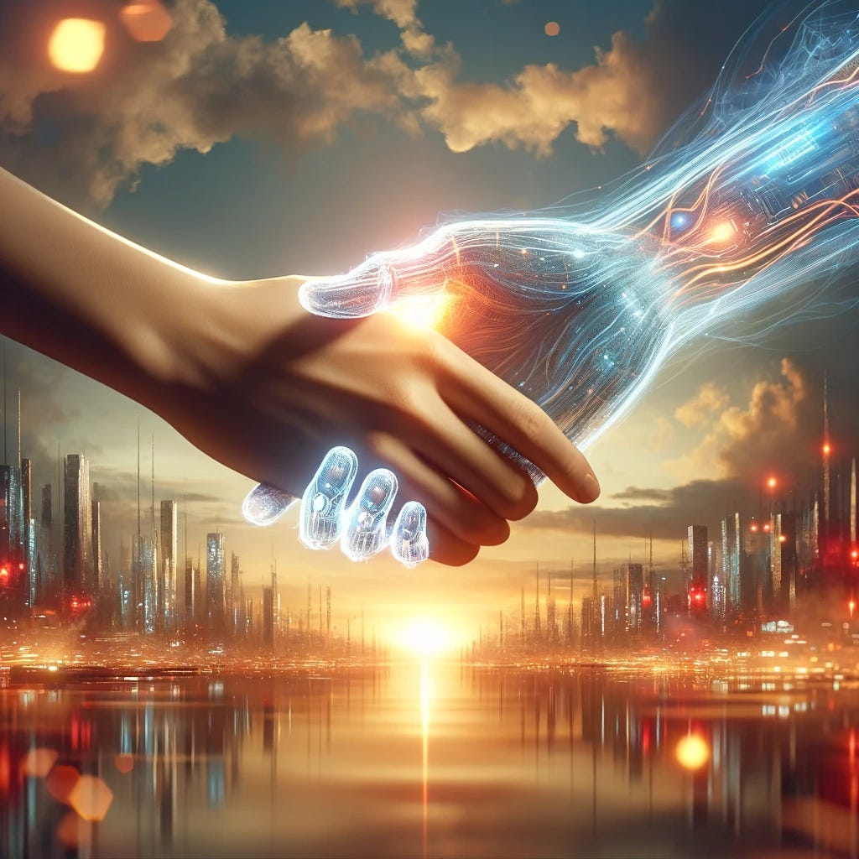
01
What is Artificial Intelligence?
From science fiction to everyday reality.

Slide 4
Defining Artificial Intelligence
AI is the simulation of human intelligence processes by computer systems. It includes learning, reasoning, and self-correction — creating systems that perform tasks requiring human intelligence.
Key Capabilities of AI:
Learning — Acquiring information and rules from data
Reasoning — Using rules to reach conclusions
Self-correction — Improving performance over time
Perception — Interpreting sensory input (vision, sound)
Language — Understanding and generating human language
THINK OF IT LIKE THIS
AI is like teaching a child to recognize animals. At first, you show many examples and label them. Over time, the child learns patterns and can identify new animals they've never seen before.
Similarly, AI systems learn from examples rather than following rigid, pre-programmed rules for every scenario.
Coined in 1956 at the Dartmouth Conference

Slide 5
A Brief History of AI
1950s Birth of AI — Alan Turing proposes the "Imitation Game" (Turing Test)
1960s–70s First wave of optimism, government funding, early expert systems
1980s Expert systems emerge — rule-based AI for specific domains like medicine
1990s–2000s Machine learning gains traction with statistical, data-driven approaches
2010s Deep learning revolution — AI beats humans at Go, image recognition
2020s Generative AI explosion — ChatGPT, DALL-E, Midjourney enter mainstream
AI has gone through multiple "winters" and "springs"

Slide 6
The AI Landscape Today
AI is everywhere — often invisible. Here are examples you use every day:
Spell-Check
Netflix Recommendations
Face ID Unlock
Your word processor suggests corrections using natural language processing
ML algorithms analyze your viewing history to suggest shows you'll enjoy
Neural networks recognize your face pattern to securely unlock your phone
$1.8 Trillion
Major tech companies — Google, Microsoft, Meta, OpenAI — are investing billions. AI is becoming a general-purpose technology like electricity or the internet.
Projected global AI market value by 2030
What is Artificial Intelligence?

Slide 7
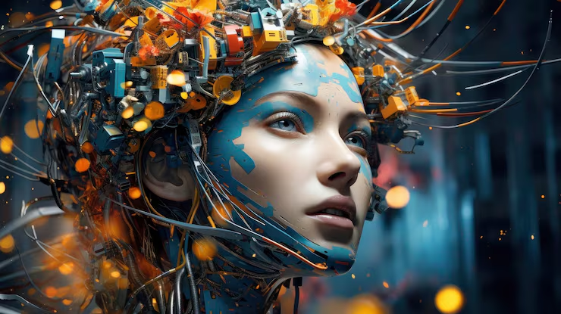
02
Generative vs. Non-Generative AI
Understanding two major branches of artificial intelligence.

Slide 8
What is Non-Generative AI?
Also called Discriminative AI or Traditional AI
Focuses on analyzing, classifying, and making decisions based on existing data. It answers questions like "Is this spam?" or "What object is in this photo?"
Spam Filters
Fraud Detection
Classify emails as spam or legitimate based on content patterns
Identify suspicious transactions by learning spending patterns
Recommendation Engines
Autonomous Driving
Suggest products and content based on past behavior
Process sensor data to navigate and detect obstacles
Key characteristic: Learns patterns from data to make predictions or classifications — but does not create new content.

Slide 9
What is Generative AI?
Generative AI creates new content — text, images, audio, video, code — that did not exist before. It learns patterns and generates novel outputs.
ChatGPT/Claude/Gemini/Grok
DALL-E / Midjourney / Nano Banana
Writes essays, answers questions, and generates code from text prompts
Create original images from simple text descriptions in seconds
Sora/Veo
GitHub Copilot
Generates realistic video clips from text descriptions
AI-powered coding assistant suggesting code completions
Key characteristic: Powered by neural networks (transformers and diffusion models) that learn to produce original content rather than just analyze it.

Slide 10
Generative vs. Non-Generative: Key Differences
Dimension | Non-Generative AI | Generative AI
Purpose | Analyze, classify, and predict based on existing data | Create, synthesize, and produce new content
Output | Labels, decisions, confidence scores | Text, images, audio, video, code
Training | Learns boundaries between categories | Learns the full data distribution
Examples | Spam detection, medical diagnosis, fraud alerts | ChatGPT, DALL-E, Sora, Copilot
Both types are powerful and often work together in real-world systems. For example, a fraud detection system (Non-Generative) might use a Generative AI to create synthetic training data.

Slide 11
How Generative AI Actually Works
TEXT GENERATION (LLMs)
IMAGE GENERATION (DIFFUSION)
User prompt
Tokenize input
Predict next
Text prompt
Add noise
Remove noise
1. Break the prompt into tokens (word pieces)
2. Process through transformer layers
3. Predict the next most likely token
4. Feed the prediction back as input
5. Repeat until the response is complete
Example: "The cat sat on the..." → "mat" → "." → [end]
1. Convert the text prompt to a latent representation
2. Start with pure random noise
3. Iteratively denoise the image
4. Guide each step with the text prompt
5. After ~50 steps, a clear image emerges
Analogy: Like a sculptor revealing a statue from marble
THE SCALE
100B+
Parameters in GPT-4
Trillions
of words in training data
~50 Steps
To generate an image
Models don't "understand" like humans — they recognize statistical patterns in data at massive scale.

Slide 12
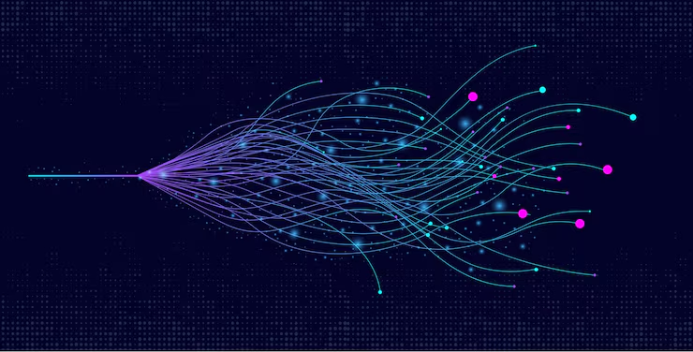
03
How Machines Learn
Core algorithms behind machine learning.

Slide 13
The Three Types of Machine Learning
Supervised
Unsupervised
Reinforcement
Learning with an answer key
Exploring without a map
Learning by trial and error
The algorithm learns from labeled examples — input-output pairs.
Examples:
Predicting house prices
Diagnosing diseases
Sentiment analysis
Email classification
The algorithm finds hidden patterns in unlabeled data.
Examples:
Customer segmentation
Anomaly detection
Clustering similar articles
Market basket analysis
The algorithm learns by trial and error, receiving rewards or penalties.
Examples:
Game playing (AlphaGo)
Robotics
Self-driving cars
Resource management
How Machines Learn

Slide 14
Supervised Learning in Action
HOW IT WORKS
1. Training data includes both inputs and correct outputs → 2. The model learns the mapping from input to output → 3. It predicts outputs for new, unseen data
COMMON ALGORITHMS
Linear Regression
Logistic Regression
Decision Trees
Neural Networks
Predicts continuous values like house prices or temperature
Predicts categories: spam or not spam, yes or no
Flowchart-like models that split data into branches
Layered models for complex pattern recognition
Real-world example: Email spam filters learn from millions of labeled emails (spam / not spam). Over time, they recognize patterns — suspicious keywords, sender reputation, formatting — to automatically sort your inbox.

Slide 15
Unsupervised Learning in Action
HOW IT WORKS
The algorithm receives data without labels and discovers the inherent structure and groupings within it.
COMMON ALGORITHMS
Clustering
Dimensionality Reduction
K-Means, DBSCAN — groups similar data points together
PCA, t-SNE — simplifies complex data preserving structure
Association Rules
Anomaly Detection
Finds relationships between variables (market basket analysis)
Identifies unusual data points (fraud, defects, outliers)
Real-world example: Streaming services group users with similar viewing habits into clusters. If you watch sci-fi shows, you'll be grouped with other sci-fi fans and receive recommendations tailored to that cluster.

Slide 16
Reinforcement Learning in Action
HOW IT WORKS
Agent observes the environment
Takes action based on policy
Receives reward or penalty
Updates policy to maximize reward
KEY ALGORITHMS
Q-Learning — Learns action values
Deep Q-Networks (DQN) — Combines RL with deep learning
Policy Gradient — Optimizes action policies directly
PPO — State-of-the-art for many tasks
AlphaGo Breakthrough
Defeated the world champion at Go by playing millions of games against itself, learning strategies no human had discovered.
OTHER APPLICATIONS
Robotics — robots learn to walk, grasp, and navigate | Autonomous vehicles — self-driving cars learn road rules | Resource management — optimizing data centers and energy grids | Game AI — NPCs that adapt to player strategies

Slide 17
Supervised Learning in Action
WHAT YOU ARE SEEING
1. Data points appear on a plane, each already labeled with a color
2. The algorithm searches for a decision boundary that best separates the groups
3. The line adjusts until it correctly classifies as many training points as possible
4. Once trained, new unlabeled points are classified by which side of the boundary they fall on
Key idea: The model learns from labeled examples — input-output pairs provided during training. Like a student learning with an answer key.

Slide 18
Unsupervised Learning in Action
WHAT YOU ARE SEEING
1. Unlabeled data points appear — all the same color, no categories assigned
2. The algorithm identifies natural groupings by measuring distances between points
3. Cluster centers emerge and points are assigned to their nearest group
4. The algorithm discovers structure in the data without any human labels
Key idea: The algorithm finds hidden patterns in unlabeled data — like organizing a mixed pile of photos into albums without knowing what's in them.

Slide 19
Reinforcement Learning in Action
WHAT YOU ARE SEEING
1. An agent (glowing dot) explores a grid environment
2. Correct moves earn a green reward; wrong moves get a red penalty
3. Over many trials, the agent learns which actions lead to the best outcomes
4. Eventually, it finds the optimal path — the fastest route to the goal
Key idea: The agent learns by trial and error, receiving rewards or penalties — like training a dog with treats, or a child learning to ride a bike.

Slide 20
Classification vs. Regression
Classification
Regression
"Is the answer a category?"
"Is the answer a number?"
Predicts a category or class. The output is discrete.
Examples:
Spam or not spam
Cat, dog, or bird
Positive or negative sentiment
Algorithms: Logistic Regression, Decision Trees, SVM, Neural Networks
Predicts a continuous numerical value.
Examples:
House price: $450,000
Temperature: 22.5°C
Stock price tomorrow
Algorithms: Linear Regression, Polynomial Regression, Random Forest Regressor
Tip: Ask yourself — is the answer a category or a number? That determines which approach to use.

Slide 21

04
Deep Learning & Language Models
Technology powering current AI revolution.

Slide 22
What is Deep Learning?
Deep Learning is a subset of machine learning using neural networks with many layers — hence "deep." Inspired by the human brain's interconnected neurons.
NEURAL NETWORK STRUCTURE
Input Layer
Receives raw data
Hidden Layers
Extract features & patterns
(can be 10s to 100s)
Output Layer
Produces the result
WHERE IT EXCELS
Image Recognition
Identifying objects, faces, medical scans
Natural Language
Translation, chatbots, text analysis
Speech Recognition
Voice assistants, transcription
Game Playing
Chess, Go, complex strategy games
Why it works now: Three factors converged — Massive datasets + Powerful GPUs + Better algorithms. The more layers, the more complex patterns the network can learn.

Slide 23
Neural Networks: A Visual Guide
HOW IT WORKS
KEY CONCEPTS
1
Forward Pass — Input data flows through the network to make a prediction
Neurons — Process information and decide whether to "fire"
Weights — Determine how strongly one neuron influences another
Activation Function — Decides if the signal passes forward
Backpropagation — The learning algorithm that adjusts weights
2
Calculate Error — Compare prediction to the correct answer (loss)
3
Backward Pass — Adjust weights to reduce error (backpropagation)
4
Repeat — Millions of iterations until the model converges
Analogy: A neural network is like a massive voting system where each neuron has a weighted say in the final decision. Training adjusts these weights so the network gets better at its task.

Slide 24
Large Language Models Explained
LLMs are deep learning models trained on vast text data. They power ChatGPT, Claude, and Gemini.
HOW THEY WORK
CAPABILITIES
Transformer architecture processes text as "tokens" (words or word pieces)
Attention mechanism lets the model focus on relevant parts of the input
Trained to predict the next token in a sequence
Emergent abilities arise from scale — not explicitly programmed
Text generation and summarization
Translation between languages
Question answering
Code writing and debugging
Creative writing and brainstorming
LIMITATIONS
Can "hallucinate" (make up facts) • Reflects biases in training data • Lacks true understanding • Cannot reason about the physical world

Slide 25
From GPT-1 to GPT-4: The Evolution
WHAT IS GPT?
GPT = Generative Pre-trained Transformer. It is a type of Large Language Model trained to predict the next word in a sequence. "Generative" because it creates new text. "Pre-trained" because it learns from vast data before being fine-tuned. "Transformer" refers to the neural network architecture that powers it.
2018
2019
2020
2023
GPT-1
GPT-2
GPT-3
GPT-4
117M parameters
1.5B parameters
175B parameters
~1.7T parameters
Proved transformers could generate coherent text
Surprisingly good text generation; initially withheld
Few-shot learning; writes essays, code, answers
Multimodal (text + images); passed bar exams
The trend: Each generation is 10–100x larger, with emergent capabilities that weren't explicitly programmed. Scale has been the key driver of capability improvement in LLMs.

Slide 26
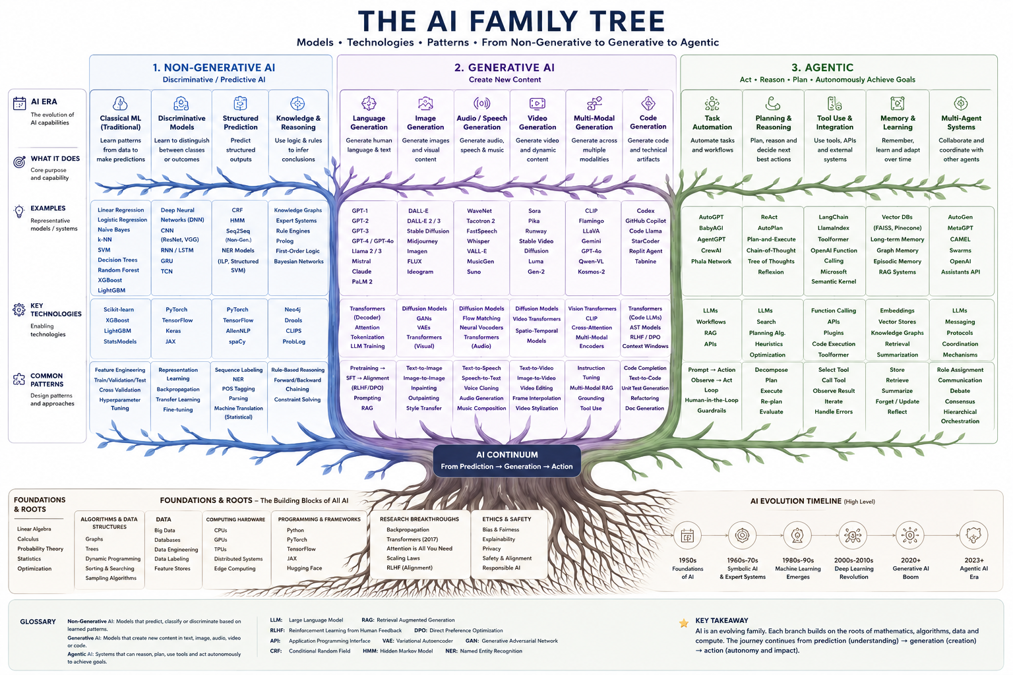

Slide 27
AI Approaches & Techniques at a Glance
Non-Generative Techniques
Generative Techniques
Agentic Techniques
Classification — Predict categories (spam, disease)
Regression — Predict numbers (price, temp)
Clustering — Group similar data (K-Means)
Anomaly Detection — Find outliers (fraud)
Dimensionality Reduction — Simplify data (PCA)
Reinforcement Learning — Learn by trial (Q-Learning)
Transformers — Predict next token (GPT, BERT)
Diffusion Models — Denoise to image (DALL-E)
GANs — Generator vs. Discriminator
VAEs — Encode-decode data
Autoregressive — Build sequentially (MIDI, pixels)
Fine-Tuning / RLHF — Align to human preference
Tool Calling — LLM invokes APIs and functions
Chain-of-Thought — Step-by-step reasoning
ReAct Pattern — Reasoning + Acting loop
Multi-Agent — Teams of specialized agents
RAG — Retrieve info, then generate
Computer Use — Control screen and mouse
Key insight: Non-Generative analyzes data. Generative creates content. Agentic takes action. Often combined in real-world systems.

Slide 28
The Modern AI Ecosystem
How Generative, Non-Generative, and Agentic AI work together
Large Language Model (LLM)
Non-Generative AI
Generative AI
Agentic AI
Classifies, predicts, filters. Powers search, recommendations, fraud detection behind the scenes.
Creates text, images, code. The interface users see and interact with directly.
Plans, acts, uses tools. Executes multi-step workflows autonomously with reasoning loops.
Example: A Travel Booking Agent
Generative: Chat with user about preferences
Agentic: Search flights, compare hotels
Non-Gen: Validate, rank by price
All Three: Confirm booking
Modern AI systems increasingly combine all three paradigms: Generative for the interface, Agentic for execution, and Non-Generative for validation and ranking.

Slide 29
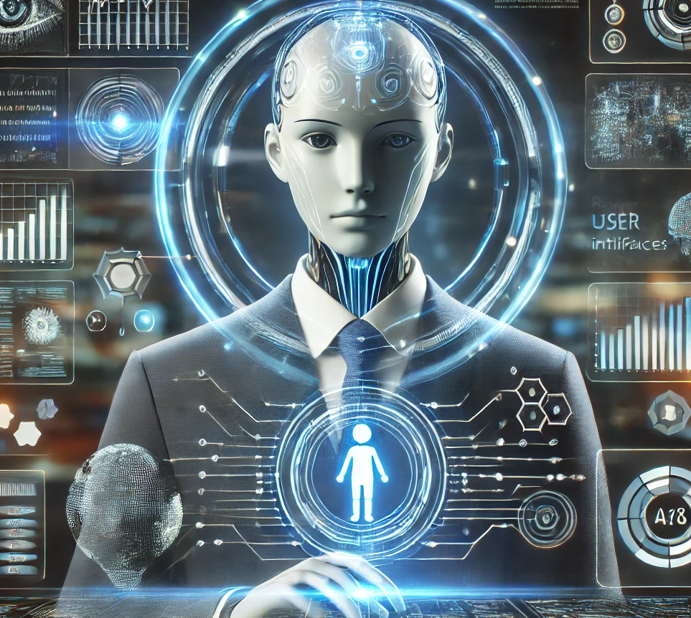
05
Agentic AI
Autonomous agents that plan, act, and reason.

Slide 30
What is Agentic AI?
Agentic AI refers to systems that can autonomously plan, reason, and execute multi-step tasks by combining LLMs with tools — going beyond simple Q&A.
TRADITIONAL LLM
AGENTIC AI
Passive Assistant
Autonomous Agent
You ask a question → it gives an answer
Single-turn interaction
No access to external tools
Cannot take actions
Limited to training data
You give a goal → it plans and executes
Multi-step reasoning
Uses tools (APIs, browser, code)
Takes actions in the world
Learns from feedback
The shift from passive Q&A to active problem-solving

Slide 31
How Agentic AI Works
Planning
Memory
Tool Use
Reasoning Loop
Breaks a complex goal into smaller, actionable steps
Creates a plan before acting
Short-term: remembers the current task context
Long-term: recalls past interactions and solutions
Calls APIs, browses the web, runs code, queries databases
Extends capabilities beyond training data
Observes results, reflects, and self-corrects
Iterates until the goal is achieved
The Agent Loop: Plan → Act (use tools) → Observe (results) → Reflect → Repeat. This cycle allows agents to handle complex, open-ended tasks that would be impossible in a single step.

Slide 32
Examples of Agentic AI
AutoGPT
Devin
Autonomously breaks down tasks and chains LLM calls to complete goals end-to-end
AI software engineer that plans, writes, debugs, and deploys code independently
OpenAI Operator
Anthropic Computer Use
Uses a browser to navigate websites, fill forms, and complete online tasks
Controls a computer by viewing the screen and issuing keyboard/mouse commands
Why It Matters
Agentic AI represents the next frontier: systems that don't just answer questions but get things done. From booking flights to writing software, agents are poised to become our digital collaborators.

Slide 33
From Assistants to Agents to Multi-Agent Systems
1
2
3
Assistants
Agents
Multi-Agent Systems
Respond to user prompts
Single-turn conversations
No external tool access
Example: ChatGPT answering questions
Complete tasks autonomously
Multi-step planning
Use tools and take actions
Example: AutoGPT, Devin
Multiple agents collaborate
Each specializes in a role
Shared goals and workflows
Example: CrewAI, Microsoft AutoGen
The trend is clear: we're moving from passive Q&A → active task completion → collaborative AI teams. The future of AI is not a single chatbot, but ecosystems of specialized agents working together.

Slide 34
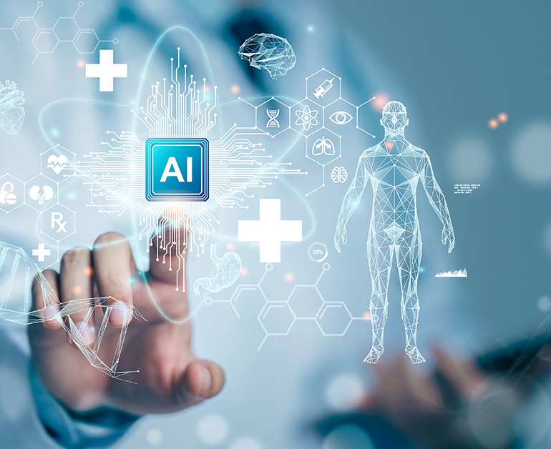
06
Real-World Applications
How AI and ML are transforming industries.

Slide 35
AI in Healthcare
Medical Imaging
Drug Discovery
AI detects cancers in X-rays, MRIs, and CT scans with accuracy matching radiologists
ML accelerates identifying drug candidates, reducing development time from years to months
Personalized Medicine
Predictive Analytics
AI analyzes genetic data to tailor treatments to individual patients
Hospitals use ML to predict patient deterioration and readmission risk
Administrative Automation
AI handles scheduling, billing, documentation, and clinical notes — reducing administrative burden on healthcare professionals.

Slide 36
AI in Business & Finance
Fraud Detection
Algorithmic Trading
Banks use ML to identify suspicious transactions in real-time, saving billions annually
AI-powered systems make split-second trading decisions based on market patterns
Customer Service
Supply Chain Optimization
Chatbots and virtual assistants handle millions of customer inquiries 24/7
AI predicts demand, optimizes inventory, and reduces waste across logistics
20–30%
Productivity gains reported
Companies using AI in automated processes report significant productivity improvements and cost savings.

Slide 37
AI in Daily Life
Most people interact with AI dozens of times per day without realizing it.
Smartphones
Social Media
Navigation
Entertainment
Face ID, voice assistants, photo enhancement, predictive text
Content recommendation algorithms on TikTok, Instagram, YouTube
Real-time traffic prediction and route optimization in Google Maps
Netflix and Spotify personalize content recommendations
Smart Home
Translation
Thermostats, lighting, and security systems learn your preferences over time
Real-time language translation breaks down communication barriers worldwide

Slide 38
AI in Science & Research
Climate Modeling
Astronomy
AI improves weather forecasts and climate change predictions with greater accuracy
ML analyzes telescope data to discover exoplanets and classify galaxies
Materials Science
Particle Physics
AI accelerates discovery of new materials with desired properties for industry
AI helps analyze particle collision data from CERN experiments
AlphaFold Breakthrough
Predicted the 3D structure of 200 million+ proteins — a scientific breakthrough that would have taken humans centuries. Solving the "protein folding problem" is accelerating drug discovery across the globe.

Slide 39
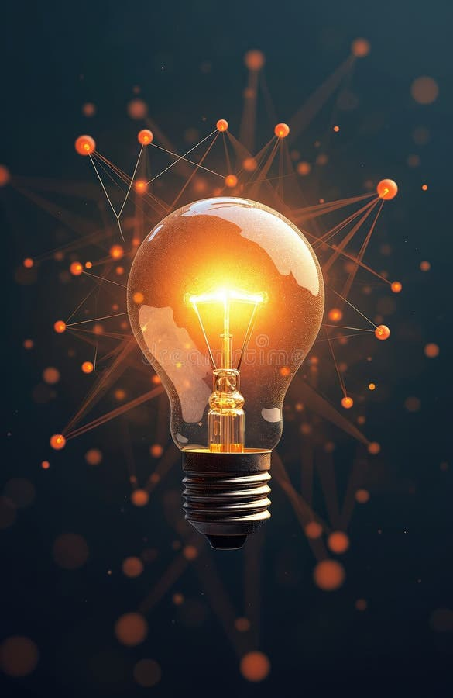
07
Getting Started
How to begin your journey into machine learning.

Slide 40
Key Takeaways
1
AI is a broad field focused on creating intelligent machines that can perceive, reason, and act
2
Machine Learning is a subset of AI where systems learn from data rather than explicit programming
3
Deep Learning uses neural networks with many layers for complex pattern recognition tasks
4
Generative AI creates new content; Non-Generative AI analyzes and classifies existing data
5
Three learning types: Supervised (labeled data), Unsupervised (pattern discovery), Reinforcement (trial and error)
6
AI is transforming healthcare, finance, science, and daily life — with much more to come
You don't need to be a programmer to benefit from or understand AI.

Slide 41
How to Learn More
For Everyone
For Beginners in Code
For Students
Follow AI news (MIT Technology Review)
Try ChatGPT, Claude, Gemini
Take online courses (Coursera, Khan Academy)
Learn Python — the lingua franca of ML
Explore Fast.ai, Google's ML Crash Course
Practice on Kaggle Learn (free)
Consider CS, statistics, or data science
Join AI communities (Reddit, meetups)
Contribute to open-source projects
Best Advice: Learn by Doing
Start with simple projects and build from there. The AI community is welcoming, and resources are more accessible than ever before.

Slide 42
Thank you for your attention!
valerio.vinciarelli@epos-eric.eu
www.epos-eu.org/on | social media #EPOSon
Notes:
Thank you slide

