Slide 1


Data discovery and visualisation using AI
Juliano Ramanantsoa | heriniaina.j.ramanantsoa@uib.no
University of Bergen

Slide 2
Outlines
Context of the use of AI: discovering data
How use AI for finding data: Geoscience data discovery tool
Use of AI browser agent for data listing and visualisation: EPOS data platform

Slide 3
Data discovery tool using AI
Major issue when multidisciplinary
Complexity of understanding different type of data
Complexity to find data provider
Find data in Earth Science
Find locations of available data from different domain (landing pages)
Trackability of “Dark Data”, and acquisition

Slide 4
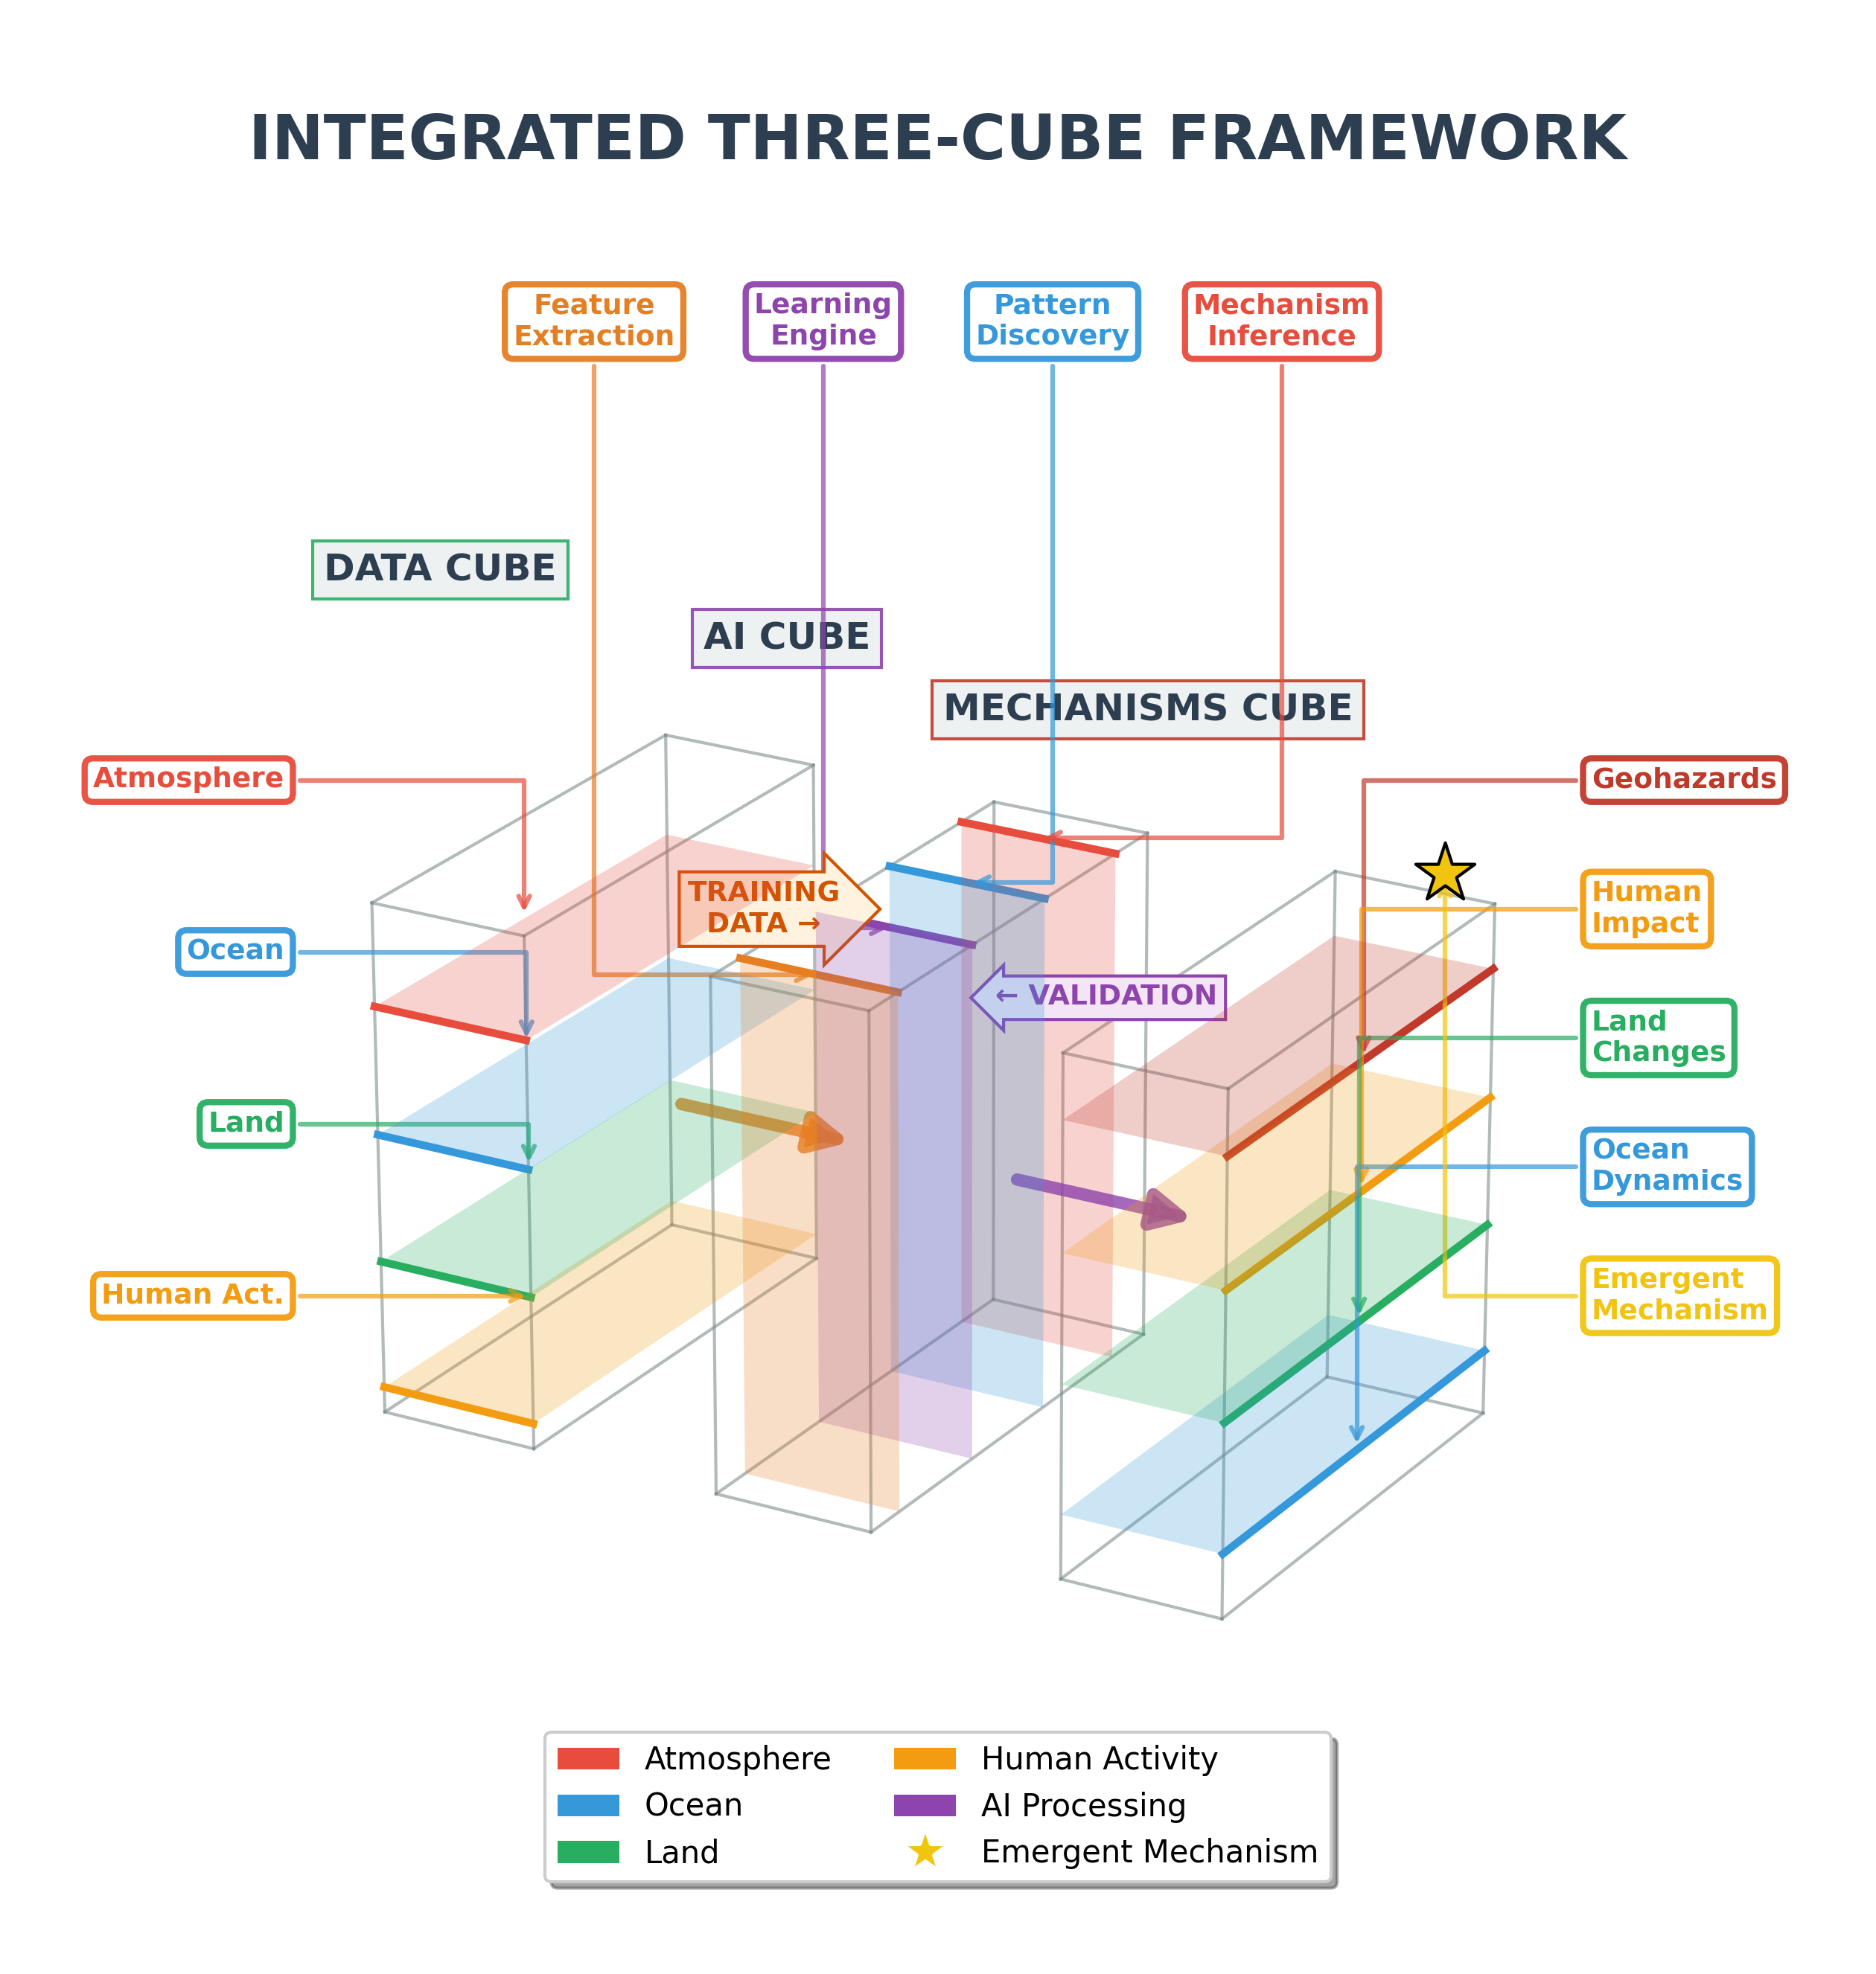

AI-Driven multi-hazard cascades forecasting for Norwegian early warning system
Norwegian Research Council Proposal
Joint proposal: KUAS, UiB, UiO, (CICERO, NVE, BJERKNESS)
Objectives
Deliver an operational AI-driven multi-hazard early warning service for Norway (to Scandinavian countries) that predicts cascade effects of multi-hazard across Earth system processes and human systems, providing actionable forecasts to emergency management agencies with measurable improvements over existing single-hazard systems.
Ambitions
Construct a harmonized multimodal data cube integrating atmospheric, oceanic, cryosphere, geophysical, ecological, and socio-economic variables on common spatiotemporal grids.
Develop hybrid AI models combining physical constraints with data-driven learning.
Deploy a decision-support platform providing probabilistic cascade forecasts to Norwegian emergency management agencies.
Figure: Simplified workflow for integrating multimodal geoscientific data into a structured cube for AI learning, with validation against physics-based mechanisms.

Slide 5
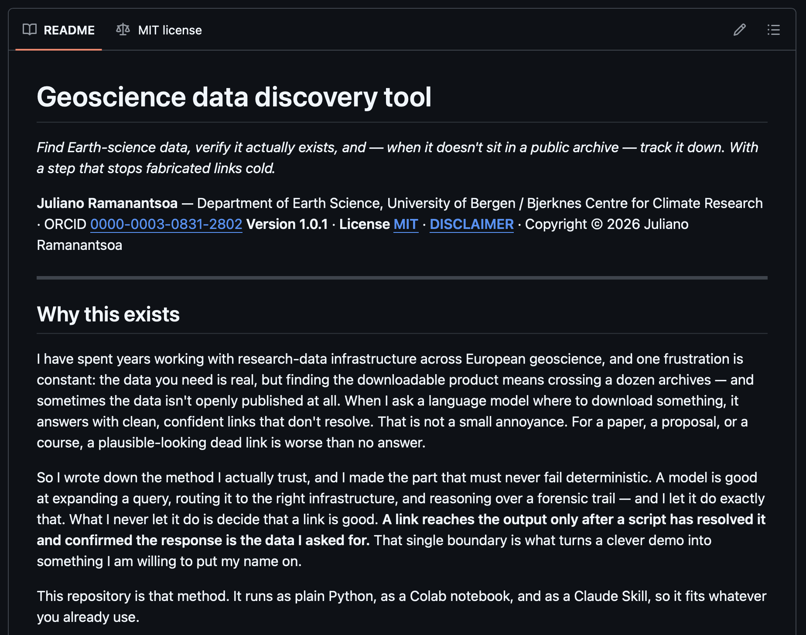
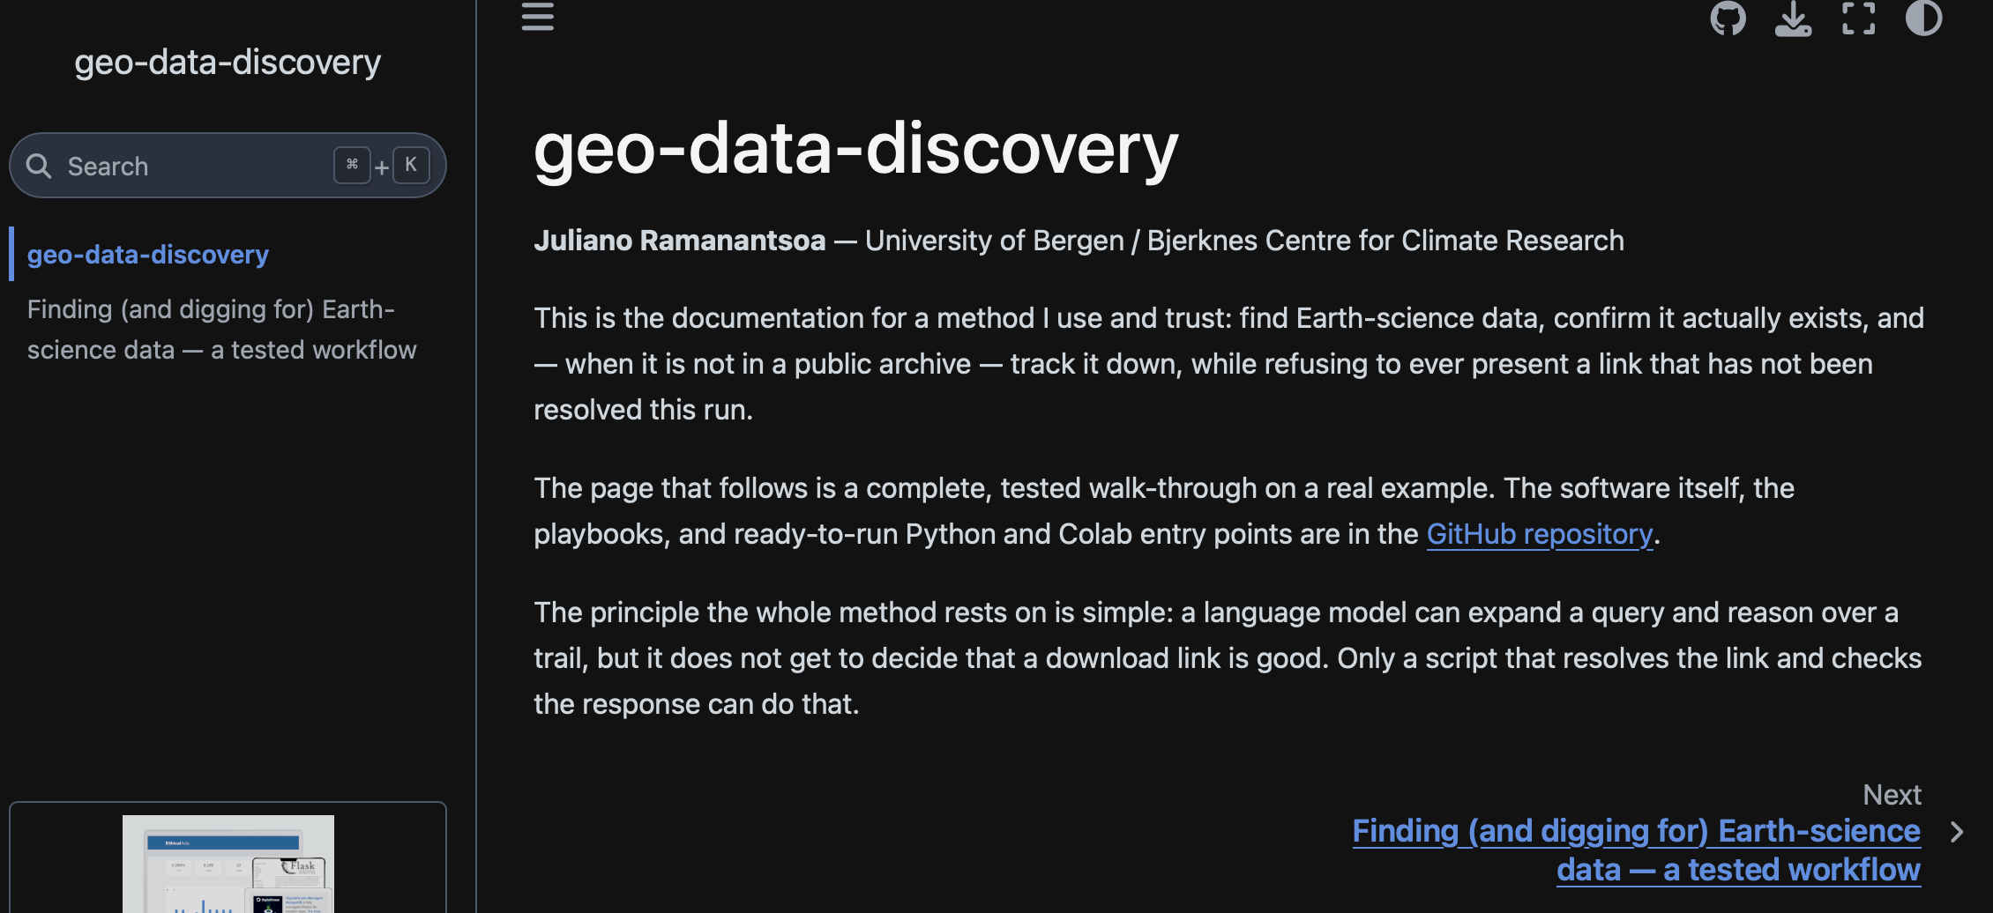
https://github.com/Juliano1111-ai/geo-data-discovery
https://geo-data-discovery.readthedocs.io/en/stable/intro.html

Slide 6

AI Responsible
Disclaimer - This tool and its prompts locate and verify geoscience data; they do not host or redistribute any data, and a passing check means a link resolved at that moment, not that the data are correct, complete, current, or fit for your purpose.
Your responsibility - The AI step can miss sources or surface false leads, so review every result, respect each source's licence and access terms, and validate the data before research use; leads and proxies are evidence, not proof. Provided as-is, no warranty, no affiliation with the providers or projects named - AI-assisted, so verify before relying on it.

Slide 7
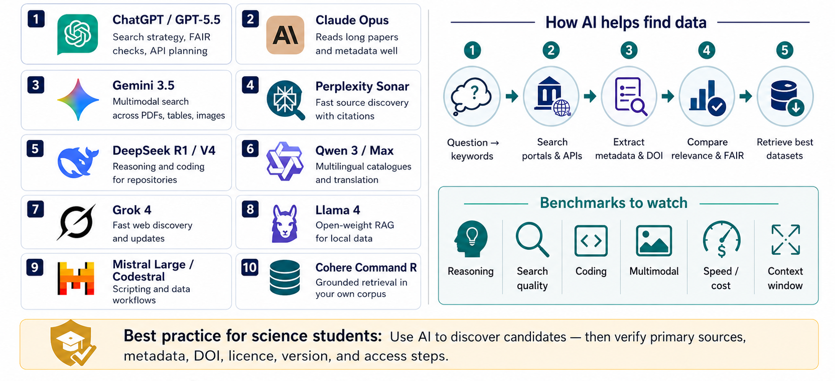

Slide 8
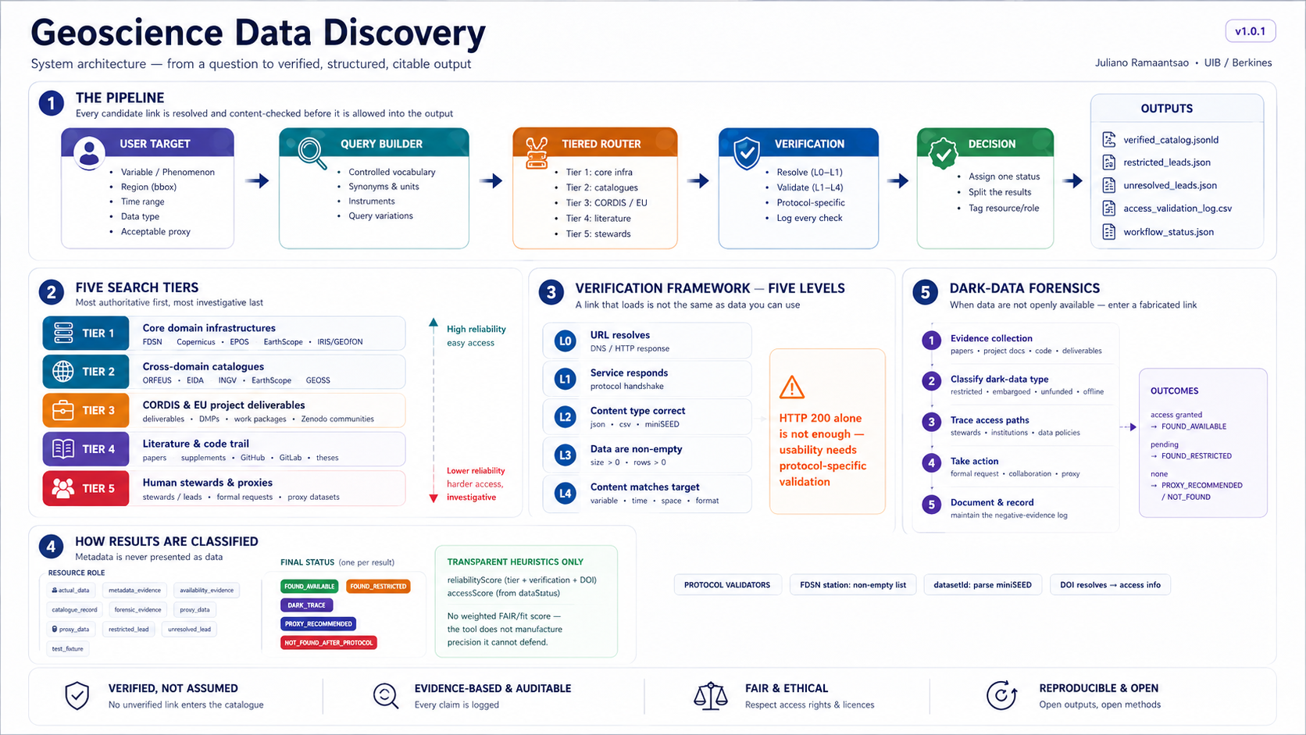

Slide 9
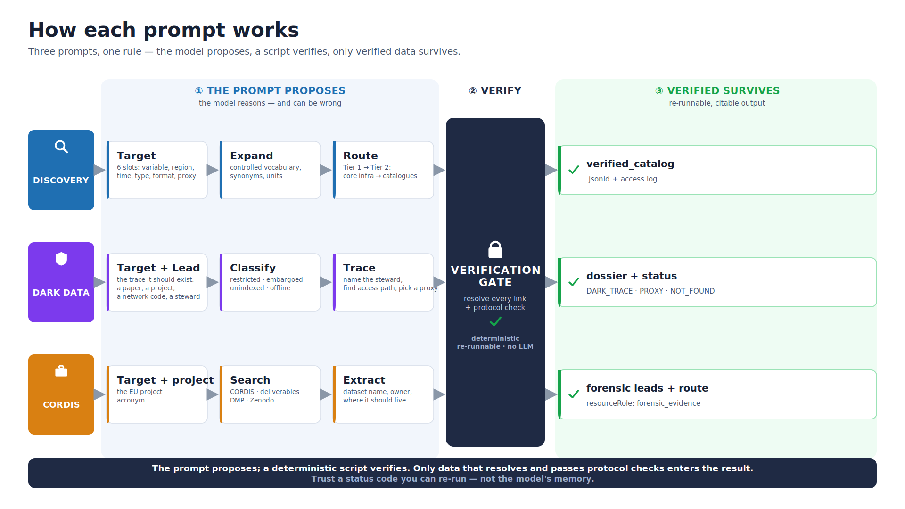
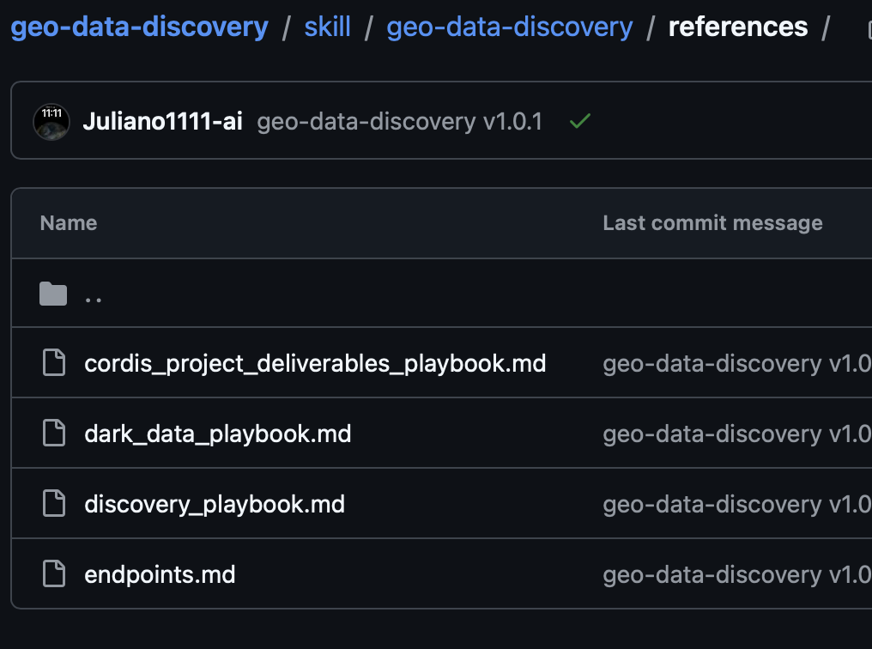

Slide 10
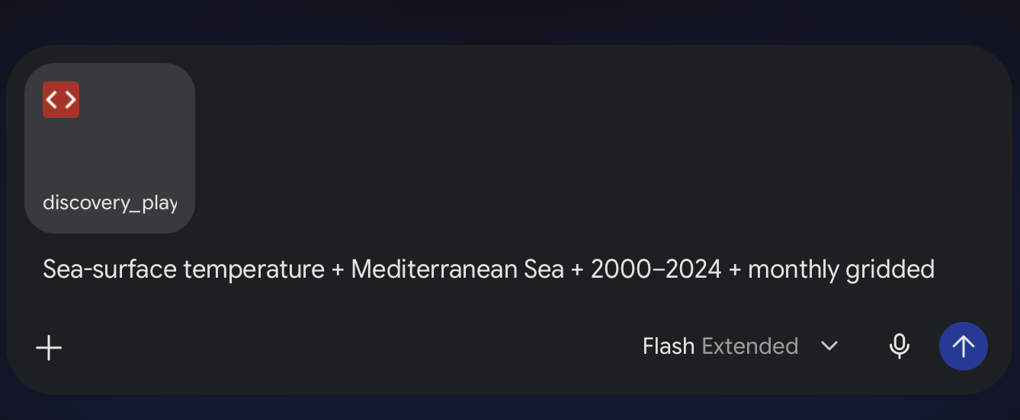
Applications: Explanation of the process
Connect to your favourite AI chatbot (Gemini, ChatGPT, …)
Upload Markdown master prompt
Stay on search mode
Place your query following this standard command structure
Gemini Chatbot executing Search from “discovery_playbook.md” guardrail command (agent activated for data searching)
Variable + Region + Time + Type + Format/Resolution + Acceptable-proxy

Slide 11
Variable + Region + Time + Type + Format/Resolution + Acceptable-proxy
Variable / phenomenon: the "event" (seismic events, SST, ground motion, bathymetry…)
Region: bounding box / area
Time range
Data type: the "product" (event catalogue, raw waveform, gridded field, time series…)
Format / resolution: CSV / miniSEED / NetCDF; daily / monthly; grid spacing
Acceptable proxies: the fallback you'll accept if the exact data is locked
Dark data = the same six, plus one trace slot:
Lead / trace: the evidence it should exist: a paper, a project/deliverable, an FDSN network code, an instrument, or a named steward.

Slide 12
Application 1: Discoverable data discovery_playbook.md (data that should exist in a known infrastructure)
Earthquake catalogue + Italy + 1950–2024 + M ≥ 5 events
Sea-surface temperature + Mediterranean Sea + 2000–2024 + monthly gridded
GNSS position time series + Northern Apennines + 2015–2024 + daily (RINEX / tenv3)
Raw seismic waveforms + Mt Etna + 2024 + continuous broadband (miniSEED)
Interseismic strain rate + Central Apennines + 2014–2024 + GNSS velocity field + Sentinel-1 InSAR (LOS)

Slide 13
Application 2: Dark Data
Dark_data_playbook.md (data traced through an EU project)
Seismic waveforms + Andaman backarc + 2019 + raw miniSEED + "used in a 2019 paper, never deposited"
Seafloor pressure + North Atlantic observatory + 2018–2023 + raw time series + "named in a Geo-INQUIRE deliverable" + proxy: nearby tide gauge
Ocean bottom seismometer waveforms + Mid-Atlantic Ridge + 2016 + raw waveform + "temporary OBS deployment, not on EIDA"
Multibeam bathymetry + Norwegian margin + 2015–2019 + gridded swath + "acquired on a named research cruise, no DOI"
Borehole strainmeter + Apennines + 2012–present + raw strain + "operated by a national agency, embargoed" + proxy: nearby open GNSS
Sea surface temperature (in-situ) + Mozambique Channel + 1998–2005 + CTD/thermosalinograph + "in a decommissioned regional archive (OpenGrey-era)"

Slide 14
Application 3: Data from projects cordis_project_deliverables_playbook.md (data that can not be traced in a known infrastructure)
Published datasets + any region + 2022–2026 + open + project GEO-INQUIRE
Service / DDSS data descriptions + pan-European + 2015–2019 + metadata + project EPOS-SP
HPC simulation outputs (PTHA / tsunami) + Mediterranean + 2023–2026 + project ChEESE-2P
Multidisciplinary observatory time series + EMSO regional nodes + 2015–2024 + project EMSO-Link
Infrasound array + stratosphere / atmospheric dynamics + 2014–2018 + raw + processed + project ARISE2

Slide 15
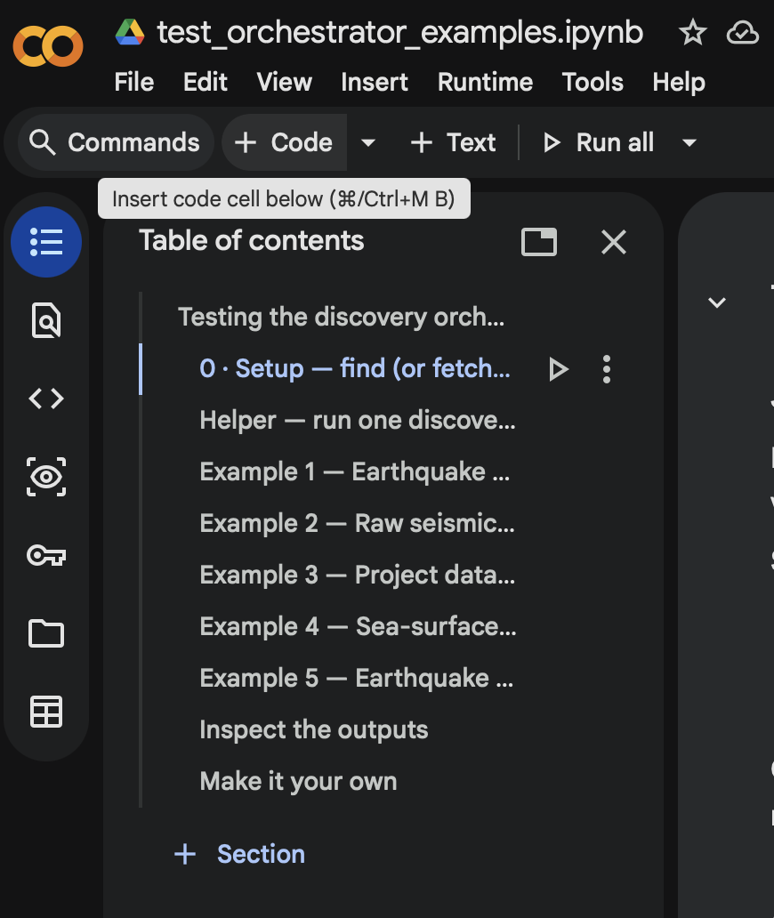
Application 4: Data with details discovery_orchestrator.py (data discovery using source code)
python discovery_orchestrator.py \
--query "Raw seismic waveforms Etna 2024 miniSEED broadband" \
--bbox "14.8,37.6,15.2,37.9" --start 2024-01-01 --end 2024-12-31 \
--network IV --outdir out2_etna_waveforms
python discovery_orchestrator.py \
--query "Raw seismic waveforms Etna 2024 miniSEED broadband" \
--bbox "14.8,37.6,15.2,37.9" --start 2024-01-01 --end 2024-12-31 \
--network IV --outdir out2_etna_waveforms
python discovery_orchestrator.py \
--query "Raw seismic waveforms Etna 2024 miniSEED broadband" \
--bbox "14.8,37.6,15.2,37.9" --start 2024-01-01 --end 2024-12-31 \
--network IV --outdir out2_etna_waveforms

Slide 16
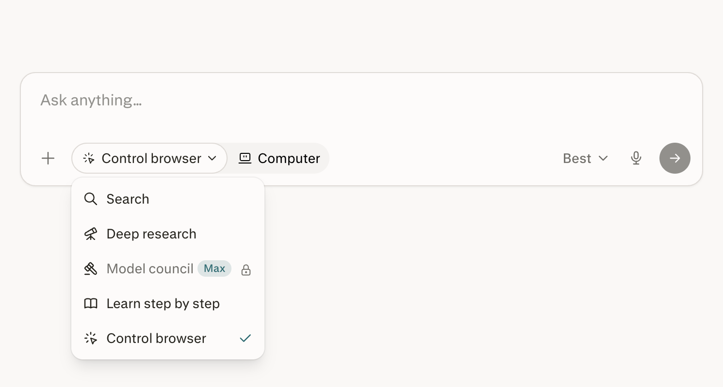
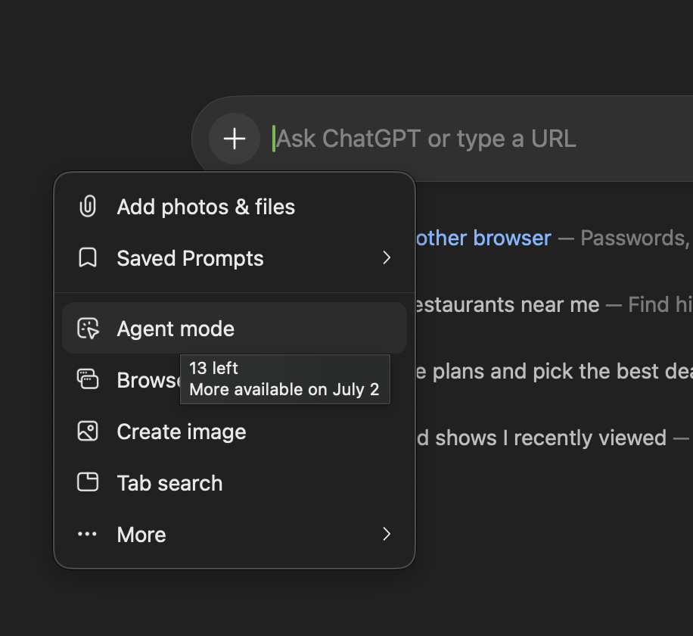


EPOS data discovery
Web browser interactive

Slide 17
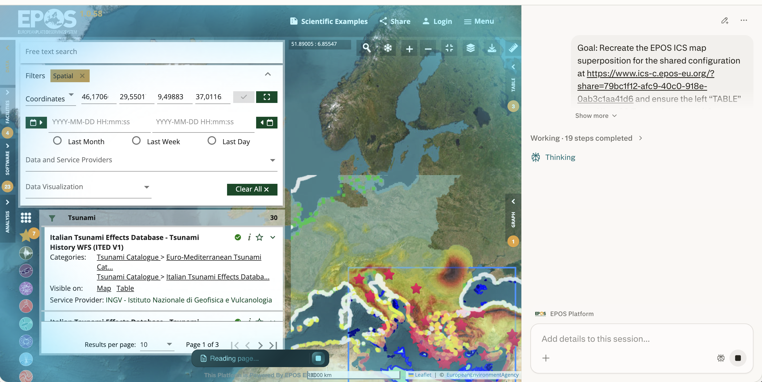
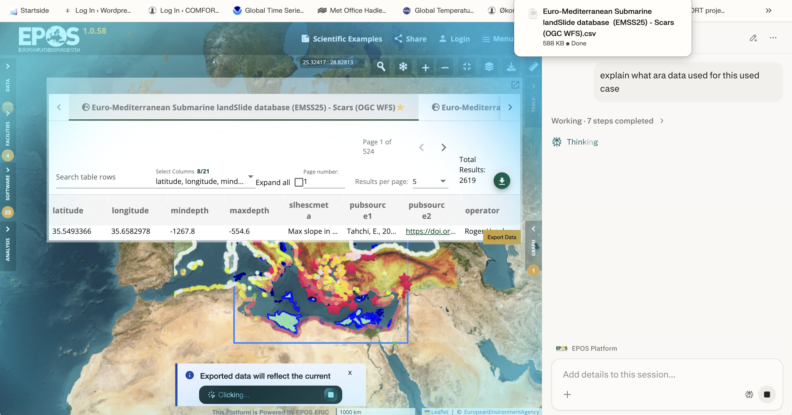

Slide 18
