Slide 1
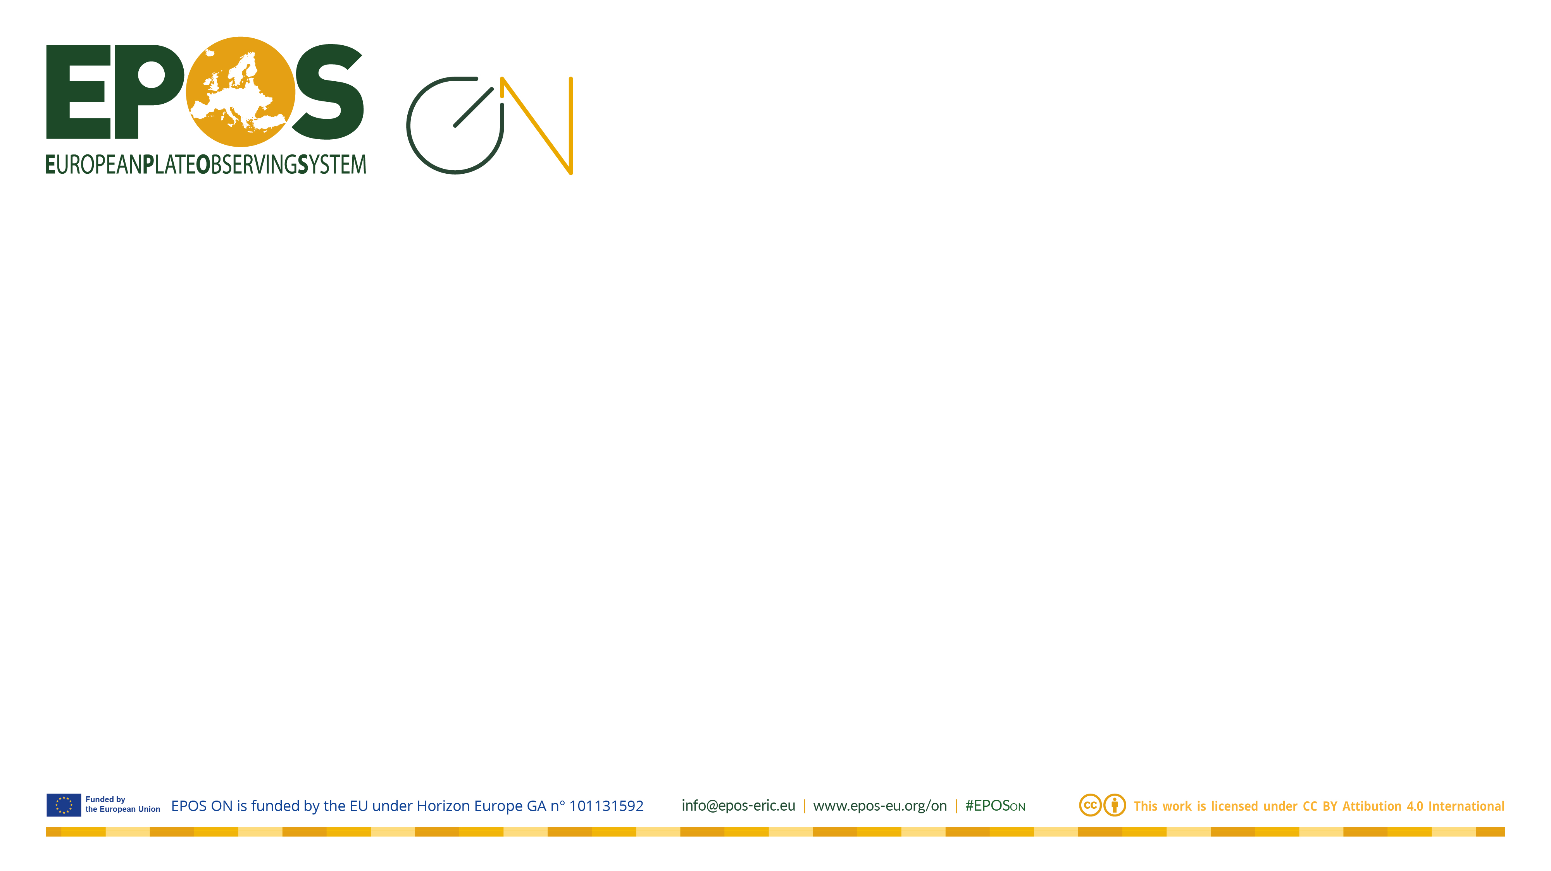

EPOS Data Supply
The Community Model, Its Gaps and Constraints
Henning Lorenz | henning.Lorenz@geo.uu.se
Uppsala University, Sweden

Slide 2
Overview
Your data and research products
How EPOS works and what it means for data provision
Ways of adding new content to EPOS
Some examples

Slide 3
What about your data and research products?
=> Let’s start with a short survey

Slide 4
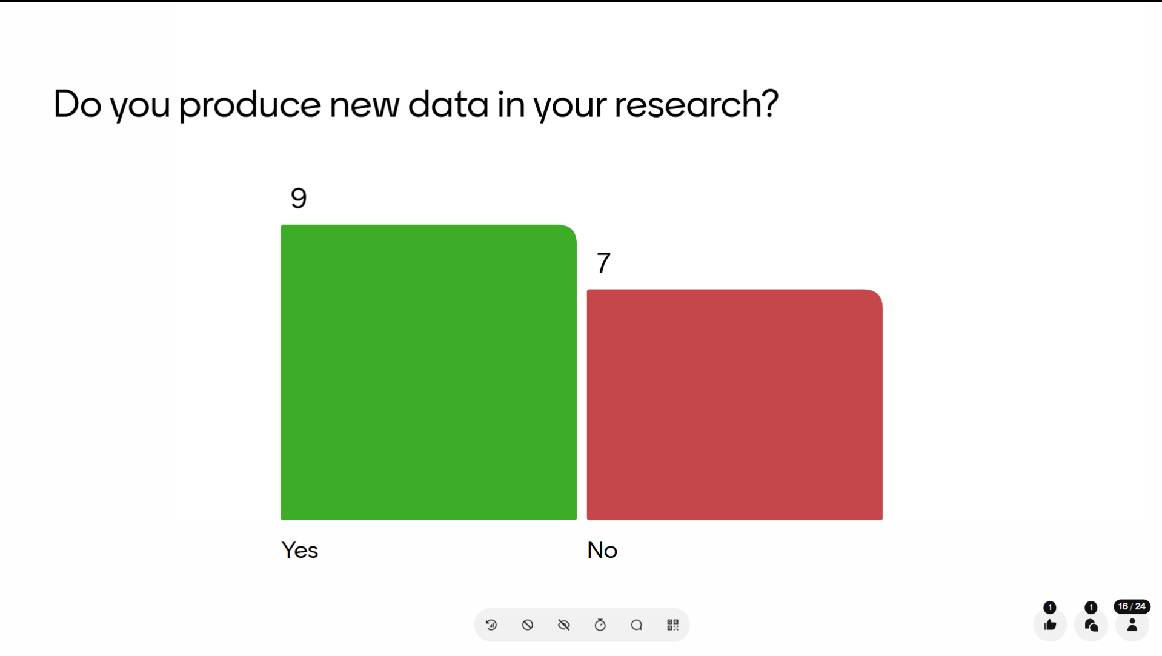

Slide 5
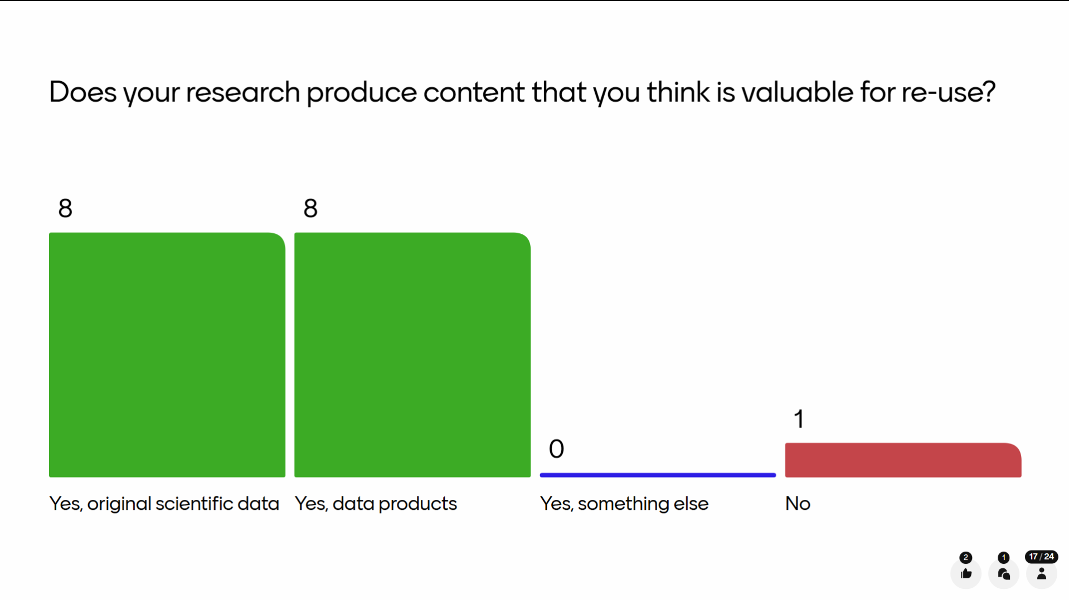

Slide 6
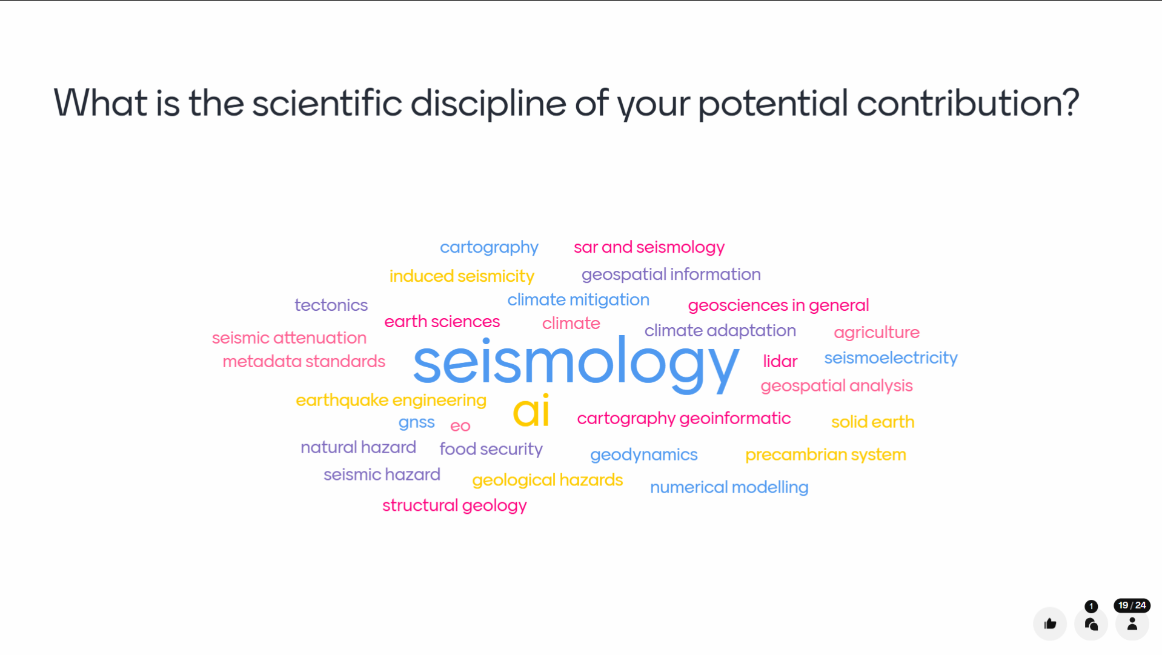

Slide 7
Can we get your data and research products into EPOS?
=> Let’s have a look at how EPOS works

Slide 8
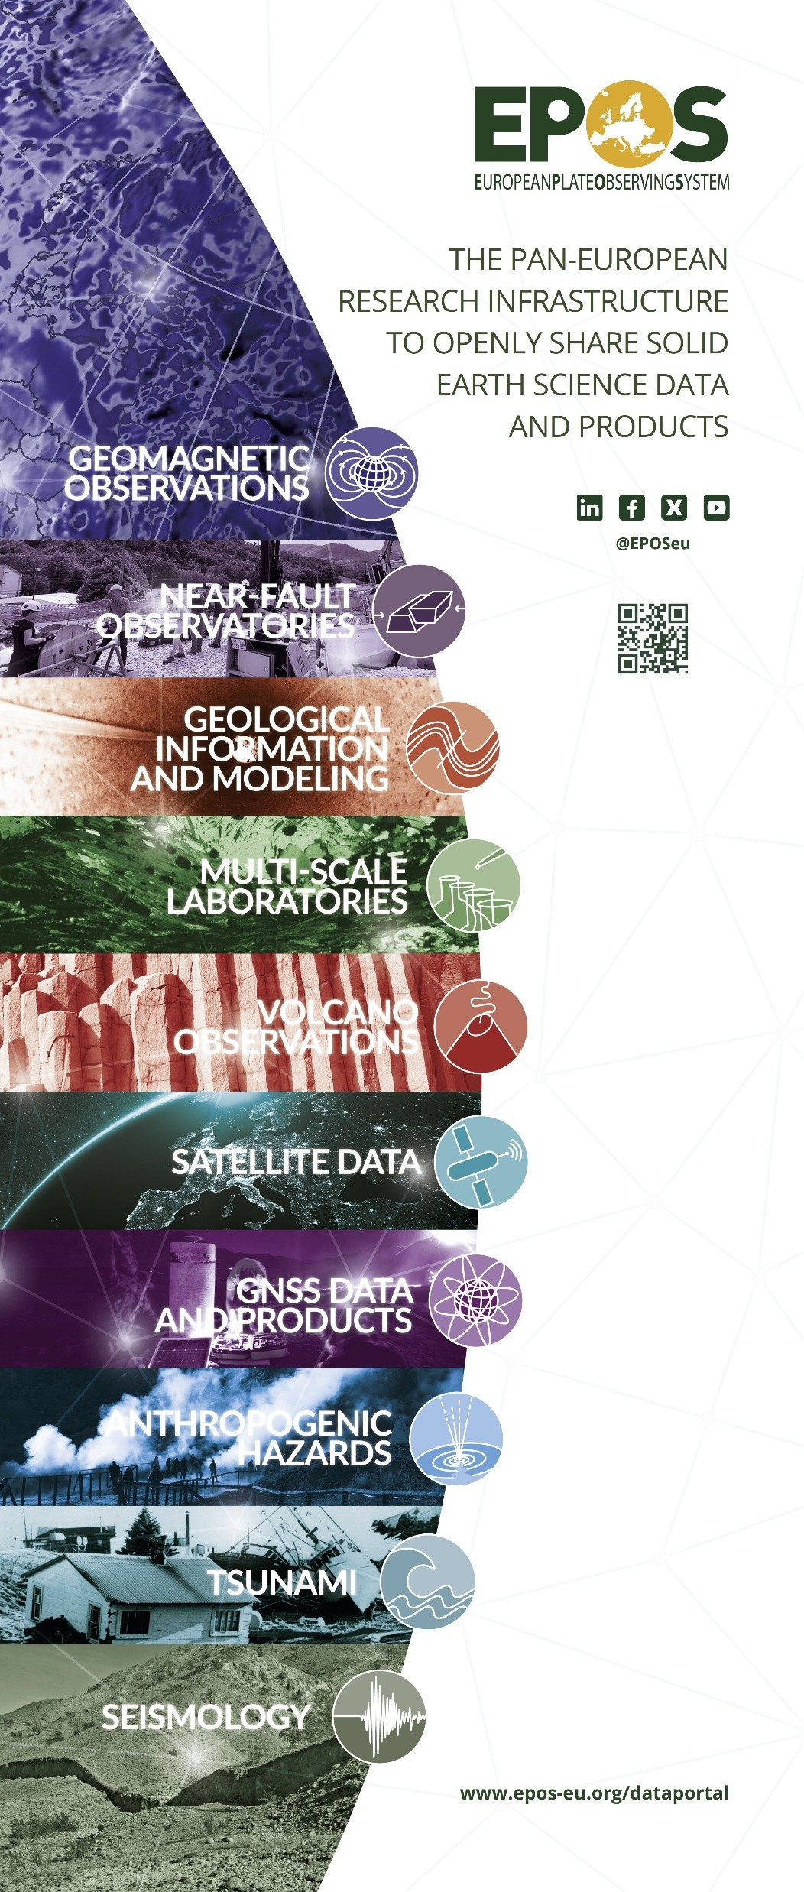
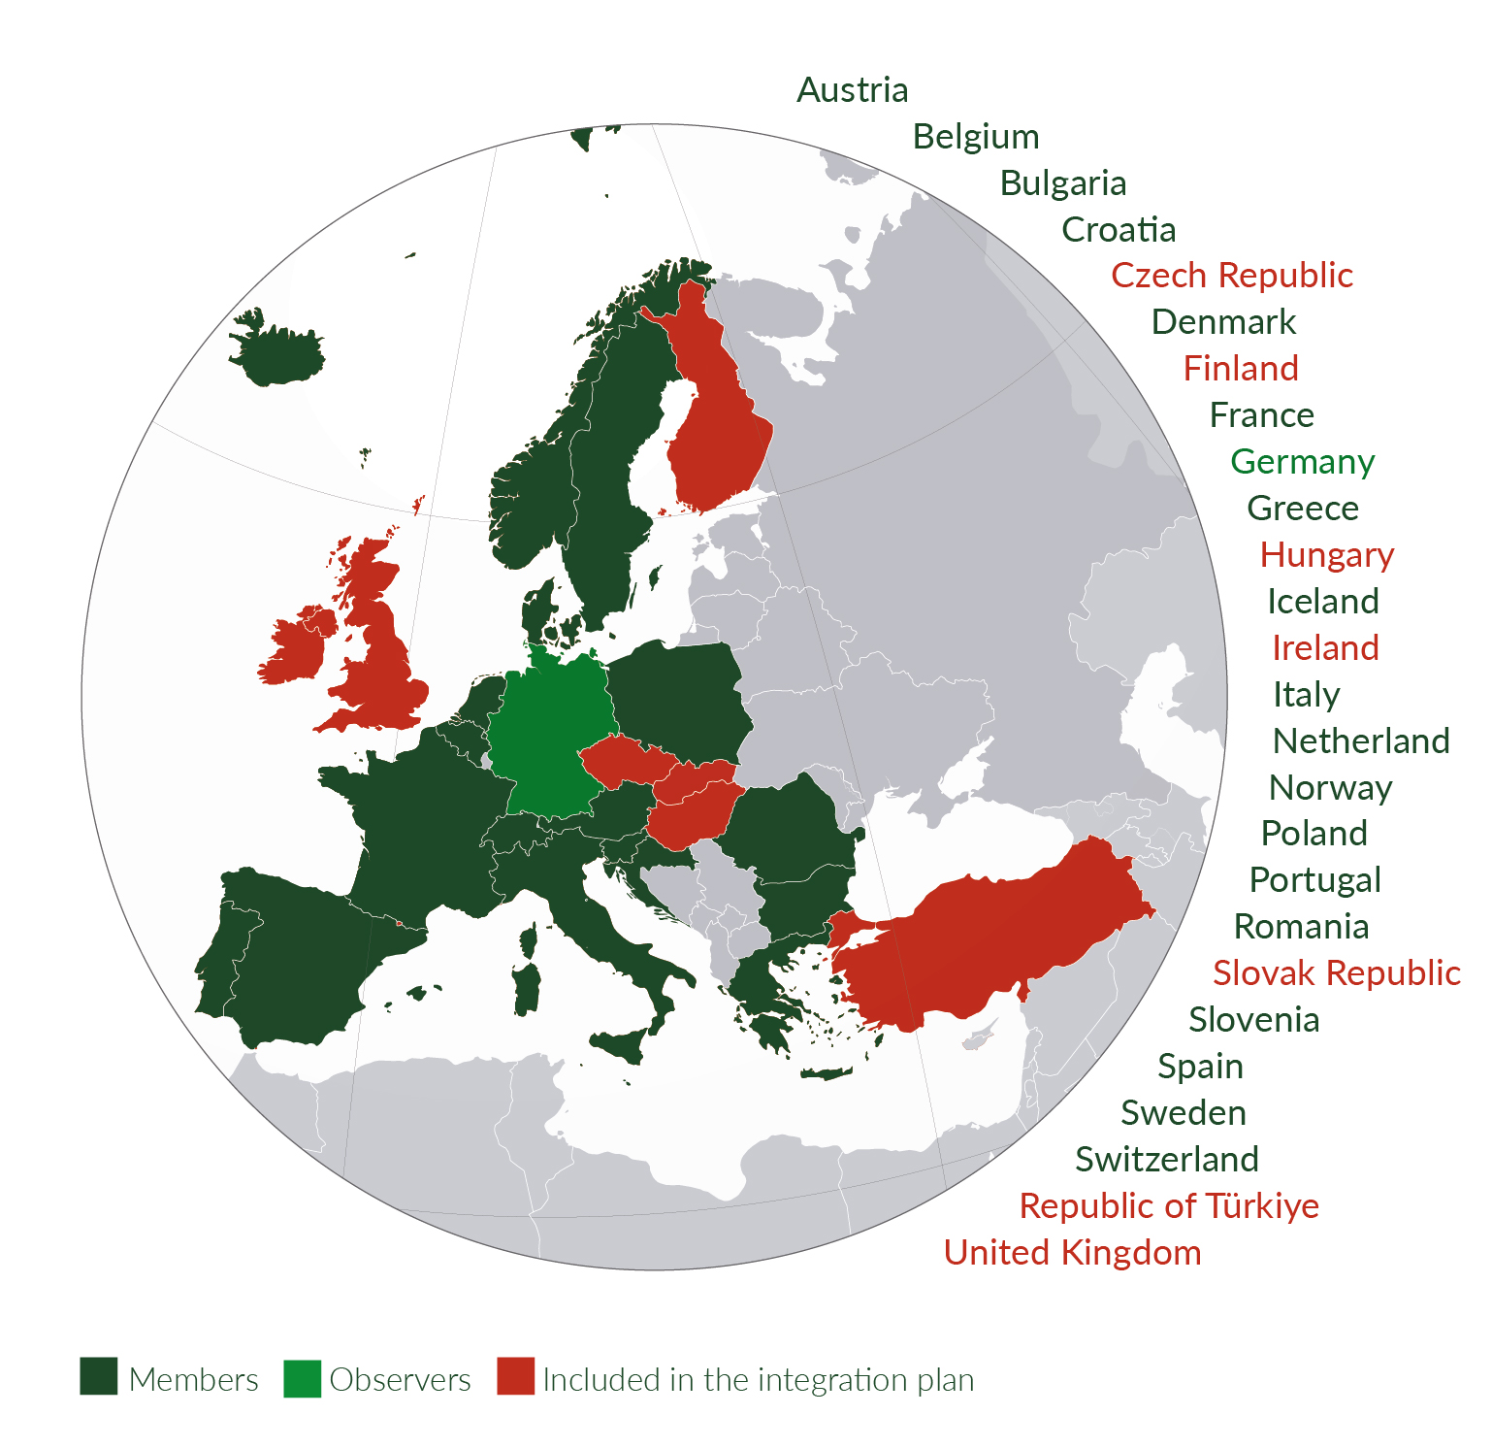
EPOS, the European Plate Observing System, is a multidisciplinary, distributed research infrastructure that facilitates the integrated use of data, data products, and facilities from the solid Earth science community in Europe.
distributed data
-
single access point

Slide 9
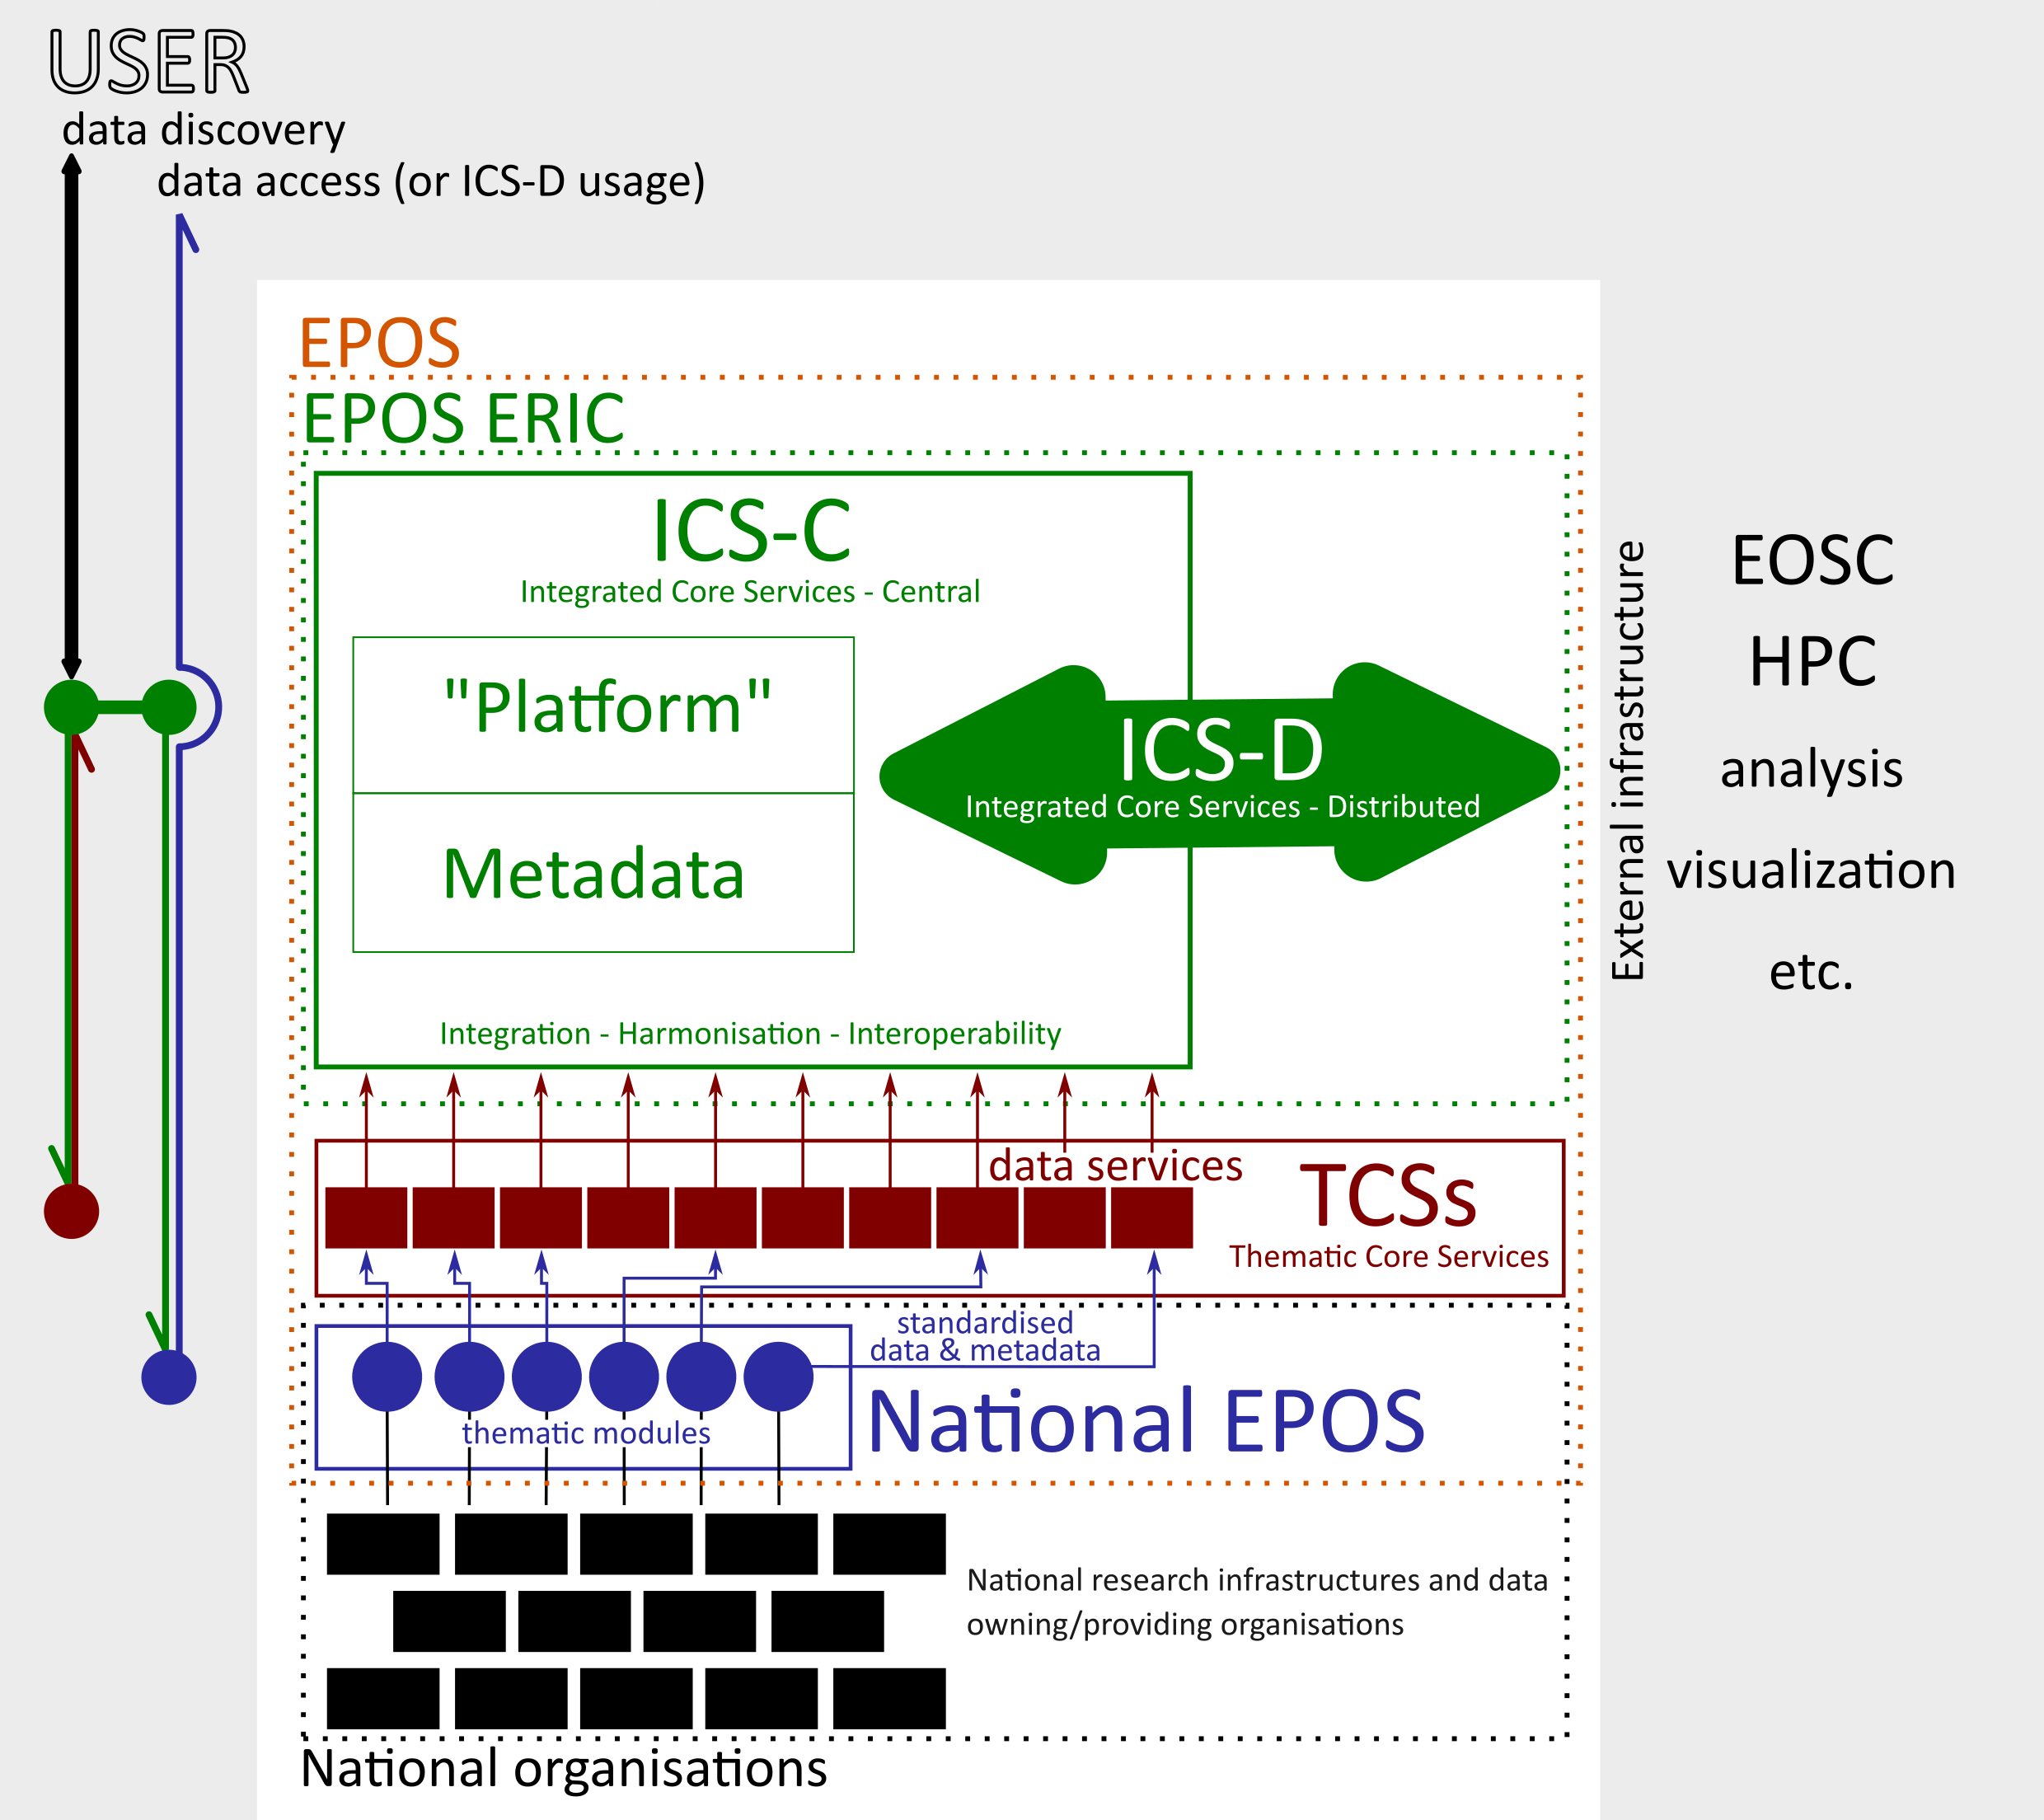
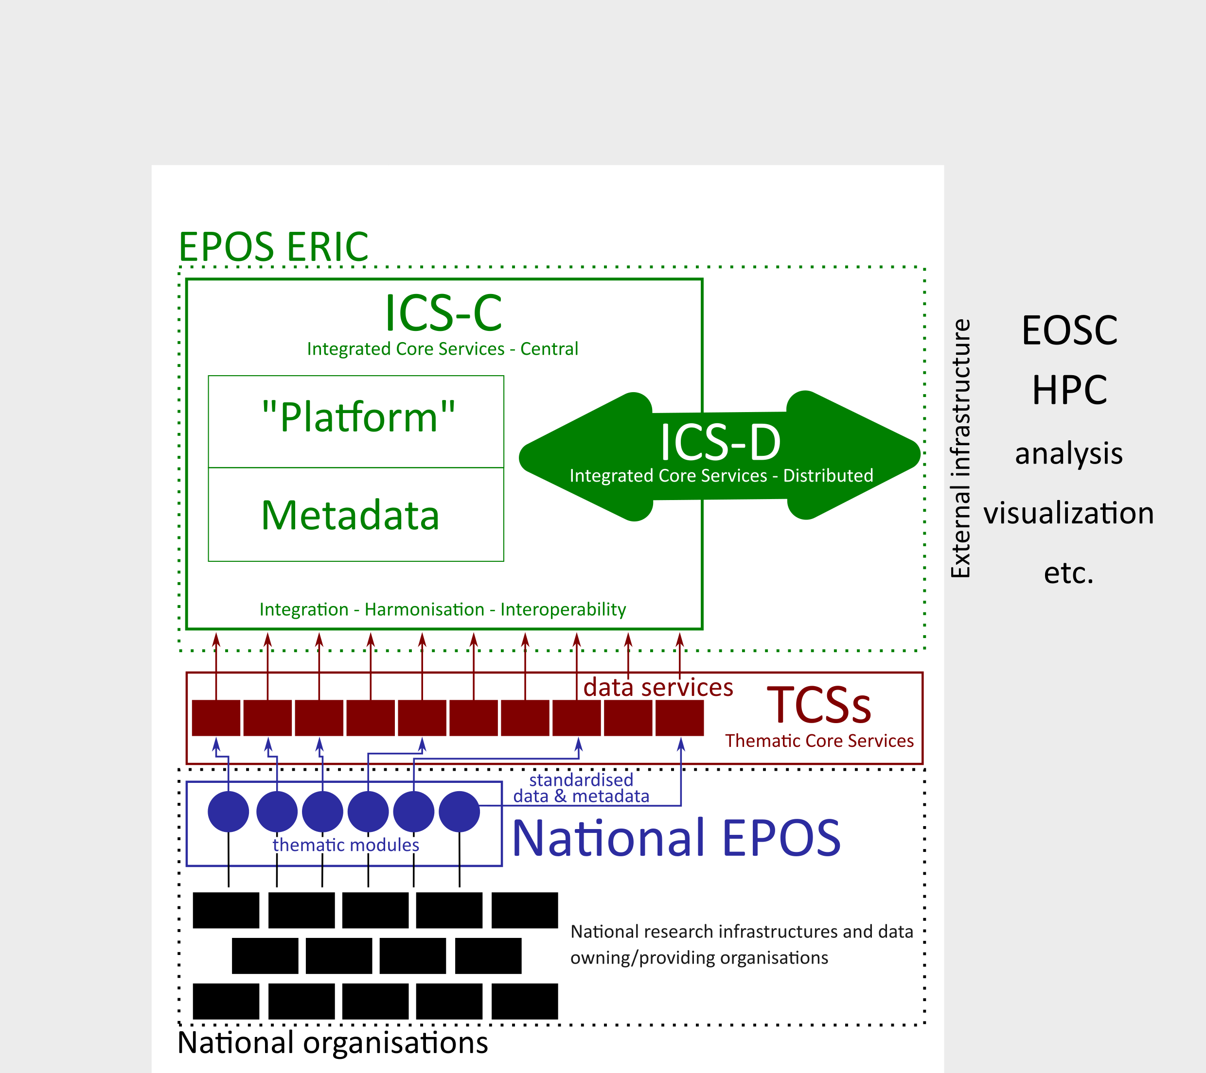

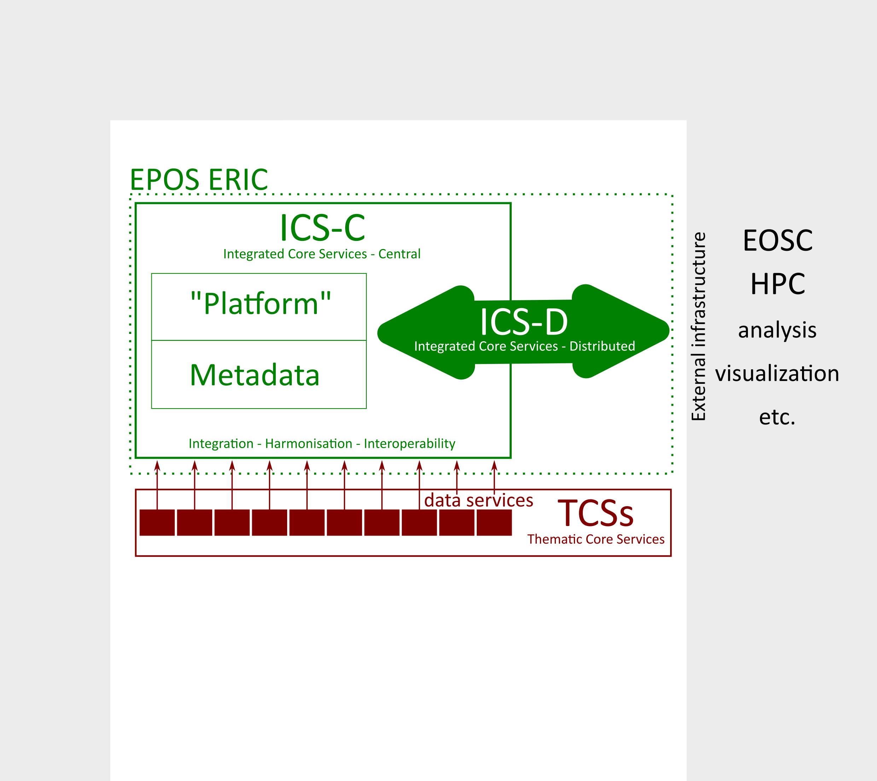
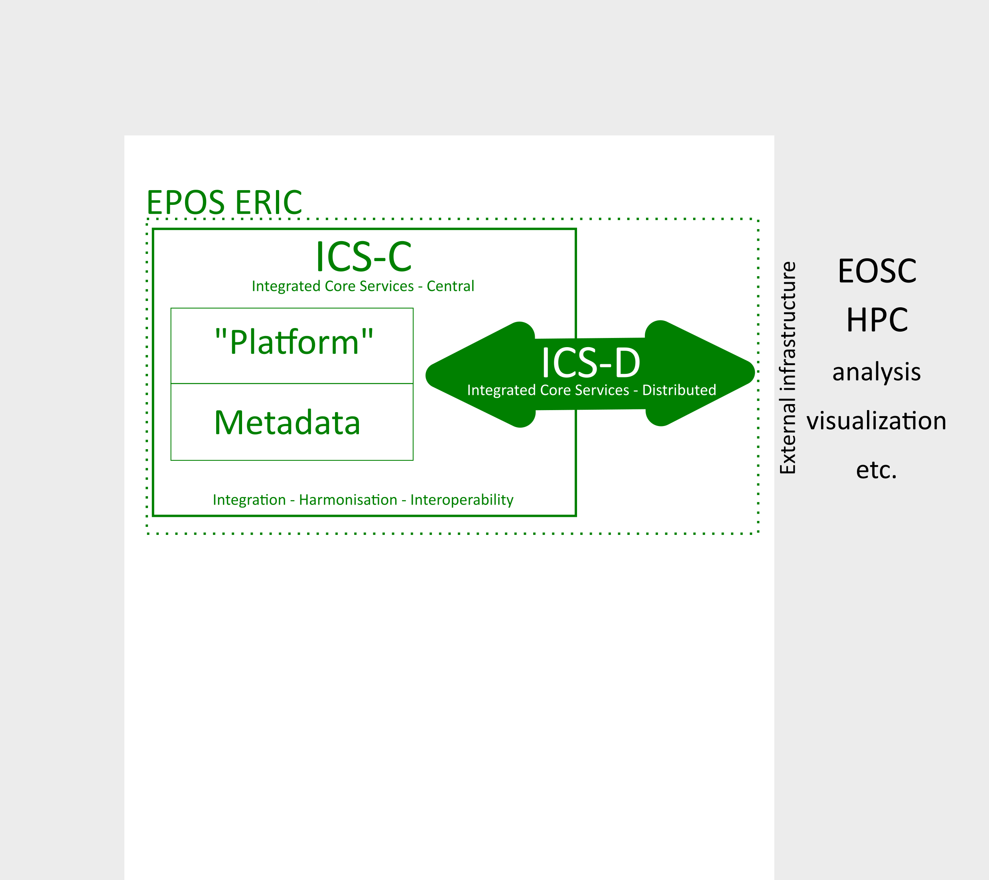
EPOS in a nutshell
Each TCS is a
consortium
bound by
contract to
EPOS ERIC.

Slide 10
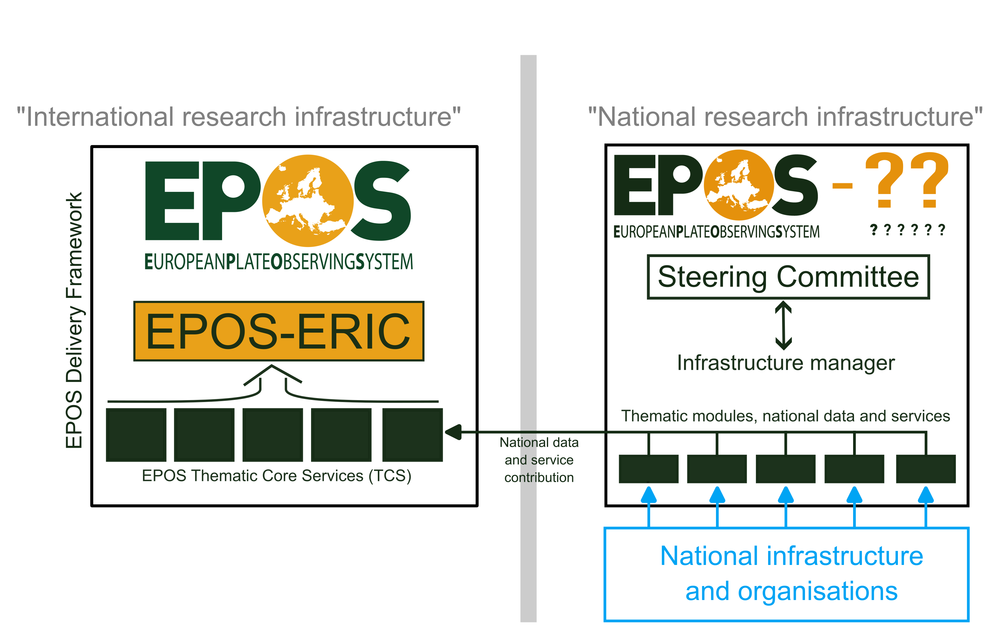
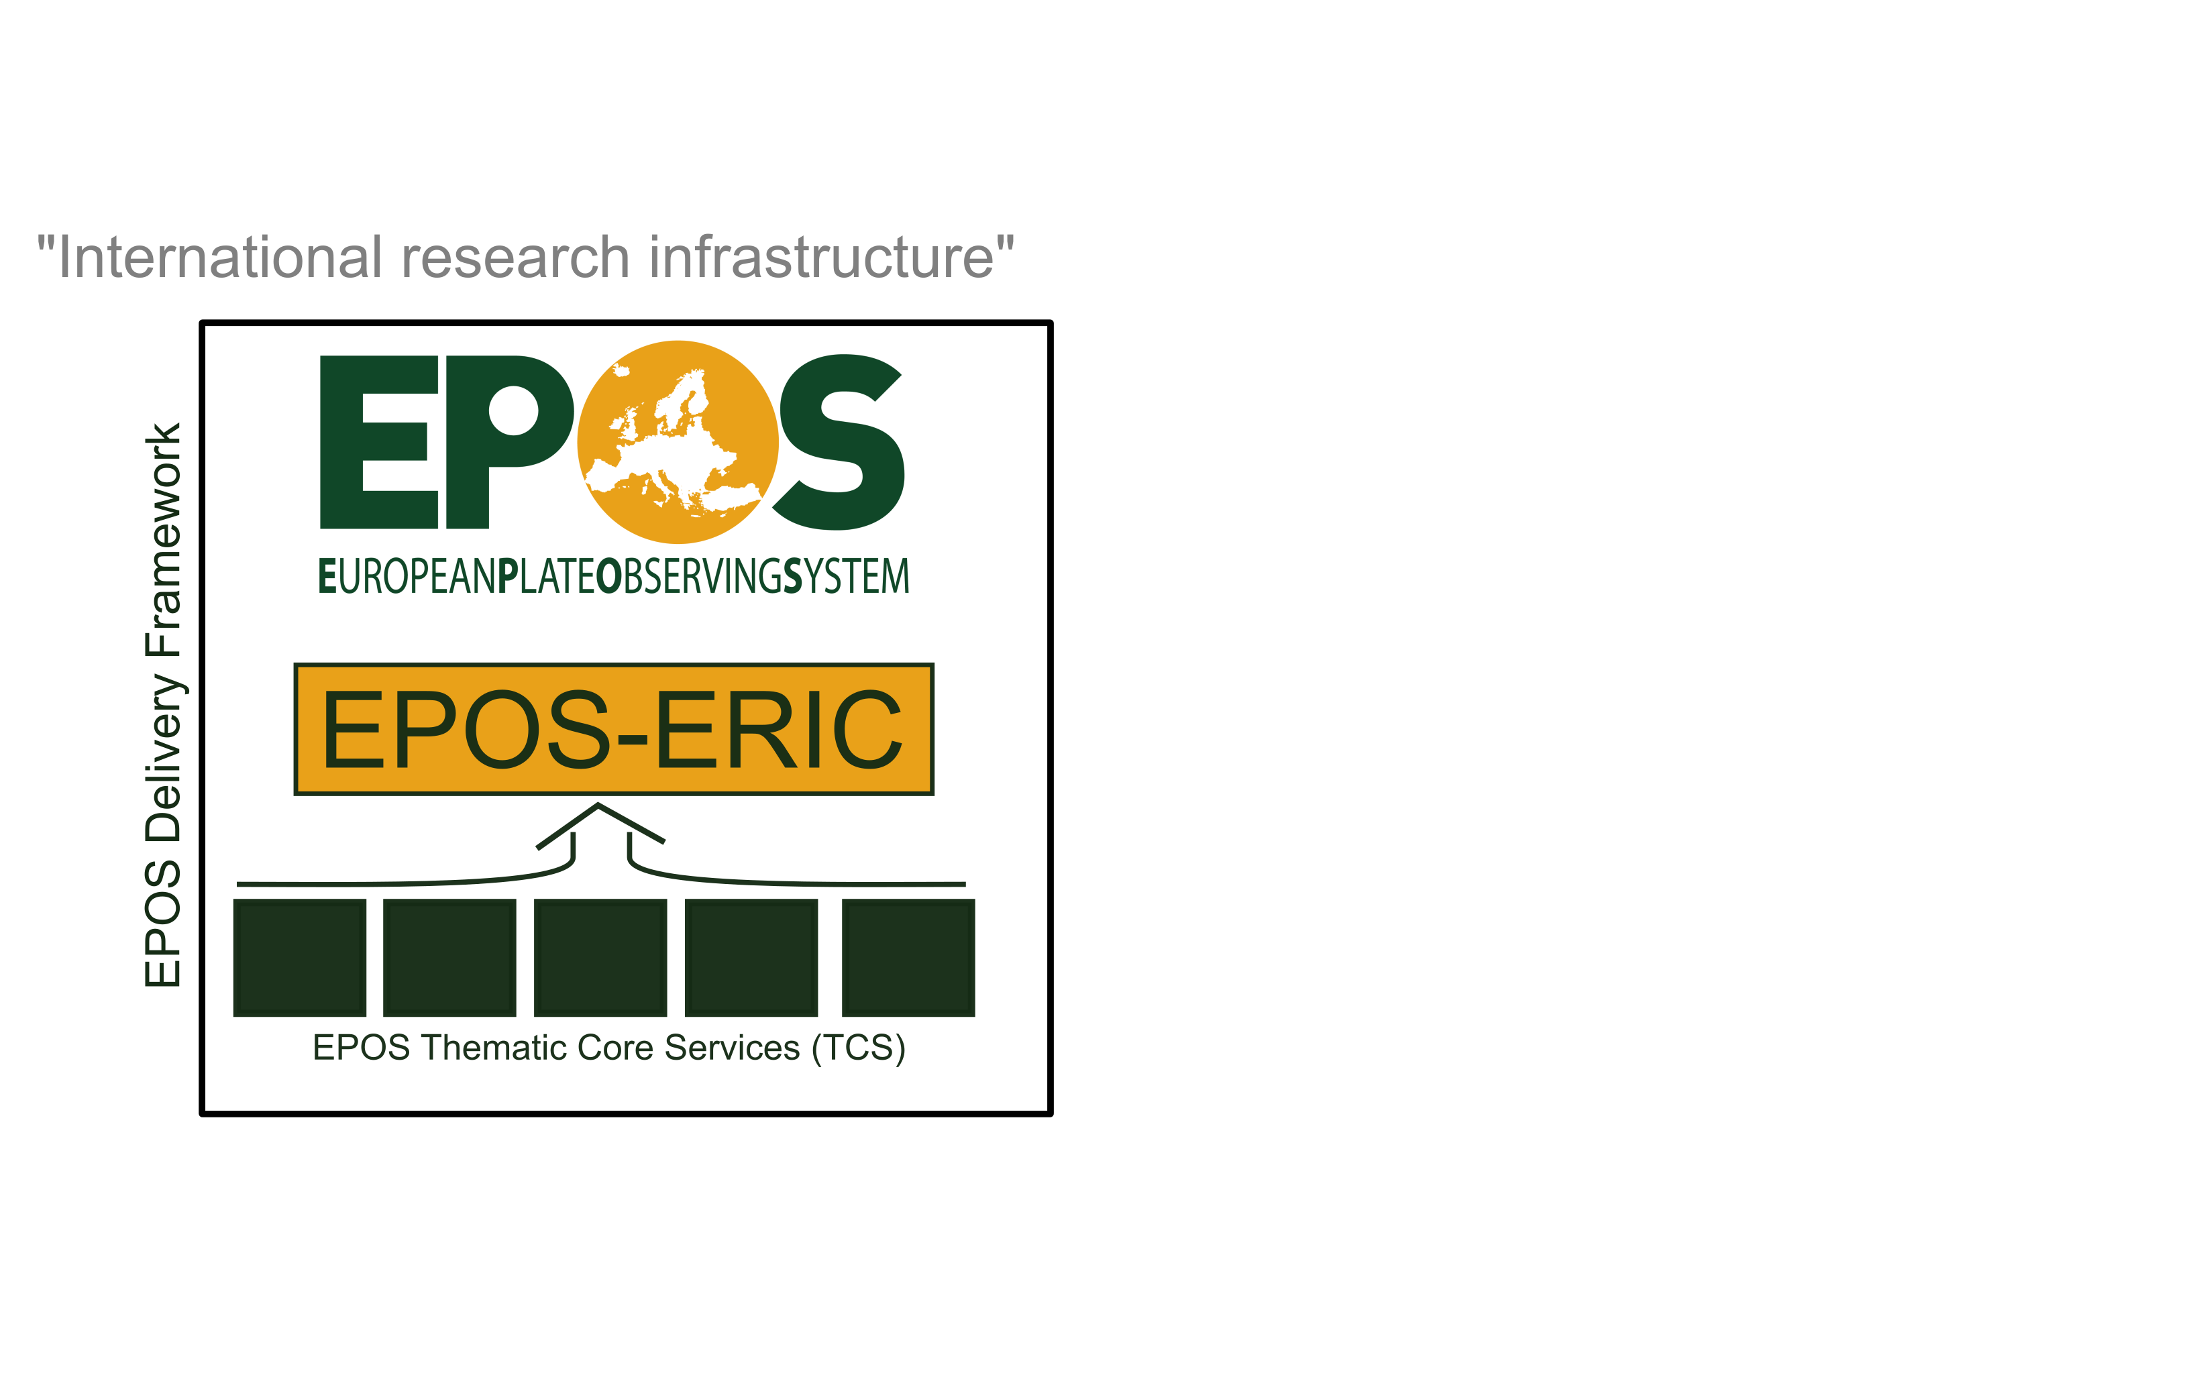
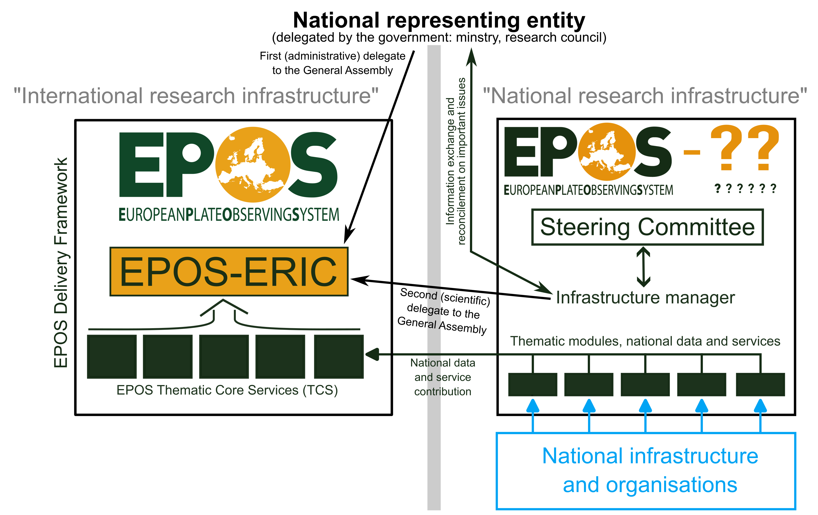
EPOS in a nutshell

Slide 11

EPOS in a nutshell

Slide 12
EPOS in a nutshell
Governance:
(highest decision-making body)
General Assembly
Approves
Reviews and approves
Actions
EPOS Strategy
Develops
Suggest
and implement
Suggest
and review
Thematic Communities
(”bottom up”)
+ host premium ”management”: INGV, Rome, Italy
+ host premium ”IT”: BRGM, Orléans, France
(+ all the work done at community/national level,
funded elsewhere)

Slide 13
What about your data and research products?
=> A few more questions

Slide 14
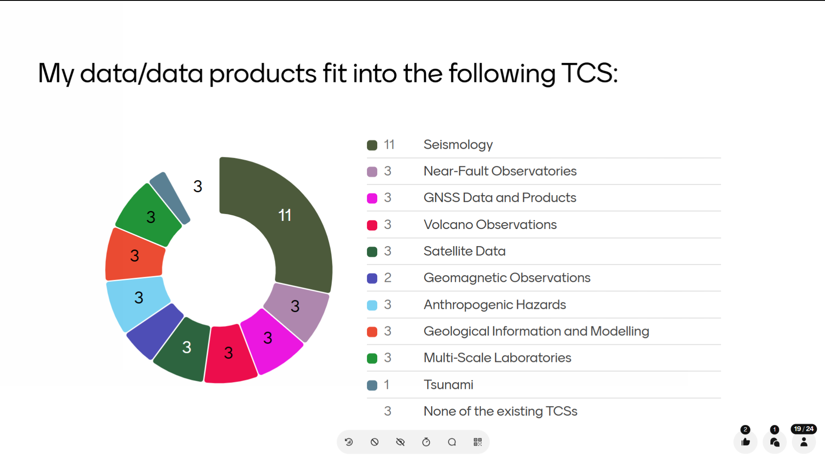

Slide 15
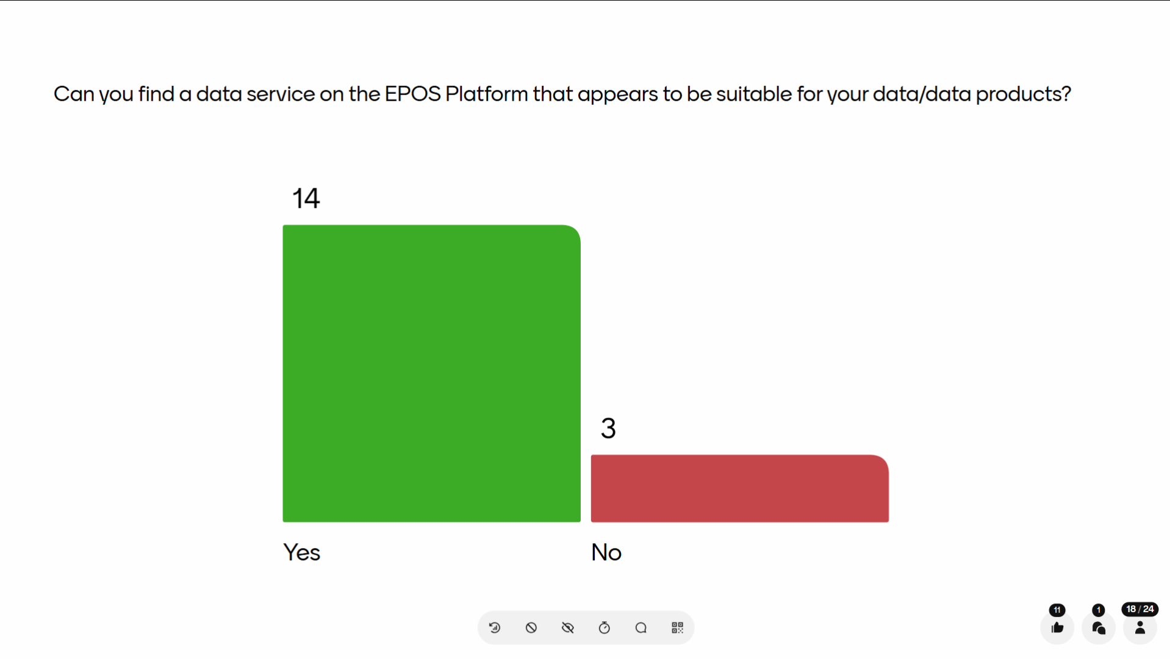

Slide 16
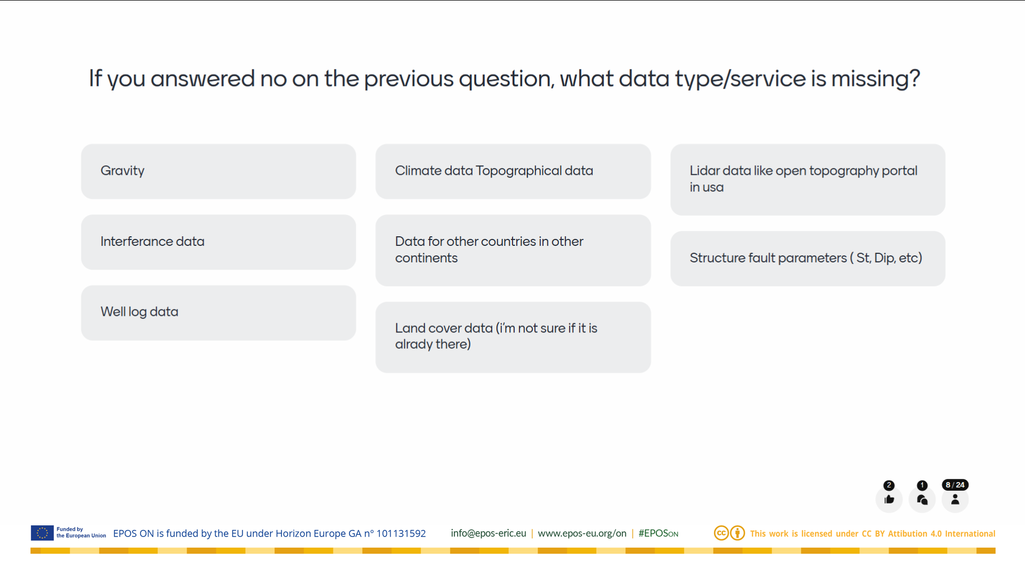

Slide 17
Boundary conditions for adding new (your?) data:
Support by a thematic community
Does a suitable data service/product already exist?
Do the data/data products fit an existing thematic community?
Is the community willing to support these new data/data products?
(internal strategy, financial situation, prioritisation)
EPOS ERIC Strategic and financial prioritisation

Slide 18
Can we get your data and research products into EPOS?
=> Let’s have We had a look at how EPOS works
Possibly!
But the required effort depends on the type of the data (product).

Slide 19
Can we get your data and research products into EPOS?
Easy: Data/data products fit with existing data service.
Relatively easy: The topic is already covered by a TCS and the TCS has procedures for inclusion of new data.
=> diverse laboratory data in TCS MSL
Advanced: A new TCS!
Requires community building development work, strategic
decisions at higher level.

Slide 20
Basic ingredients of a TCS
Represents a wider subject area
Is supported by a community (=> consortium)
Responsible for selecting and developing data/metadata/transfer standards
Responsible for data provision
A substantial workload
  Management of TCS, relation to EPOS ERIC
  ICS-TCS interaction
  Continued technical and thematic development
  Data provision (depending on internal organisation)

Slide 21
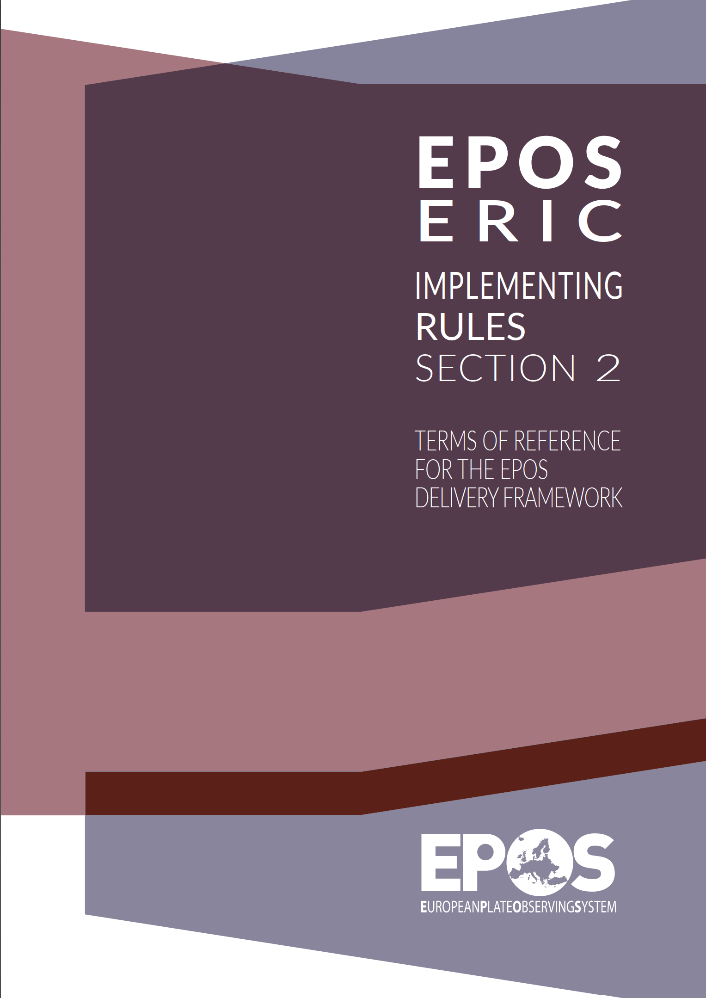
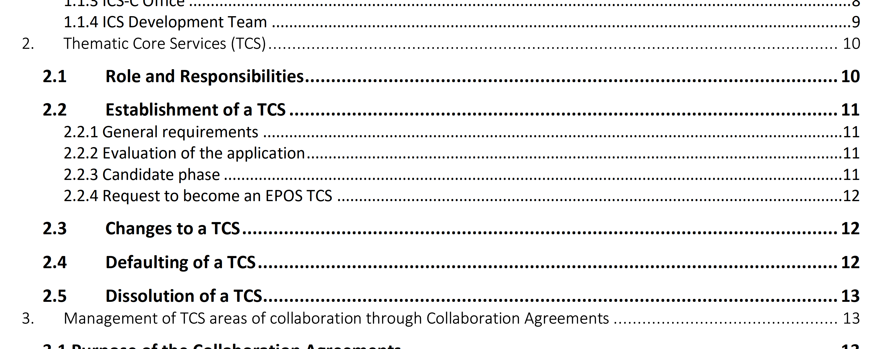
How to make a new TCS
EPOS ERIC has
Statutes (the ”Constitution/Basic Law”), and
Implementing Rules (the ”legislation”).
Section 1: Rules of Procedure (governance & management)
Section 2: Terms of Reference for the EPOS Delivery Framework

Slide 22
A new TCS
The proposed thematic community shall offer pan-European services that are relevant for but not yet available through EPOS.
The process to become a TCS starts with the application to become a Candidate TCS, which includes
  a list of supporting organisations,
  a list of initial pan-European data, data products, software, and services, and
  an indication of the financial sustainability of the proposed services, including an initial estimate of the costs and funds (including in-kind) for operating each service.

Slide 23
A new TCS
NOT FOR THE
FAINT-HEARTED
Enter the “Candidate Phase” upon approval of the application
(Evaluation in EPOS ERIC and by Science Board, decision by GA)
  Up to three years of “TCS-like” operation until all requirements for becoming a TCS are fulfilled (management, sustainability, technical, …)
=> Huge amount of work before even becoming a ”Candiate TCS”.
=> Substantial effort to keep the thing running and developing.
=> Large ”overhead” in addition to the work that is related to data provision.
=> The process assures relevance, quality and sustainability.

Slide 24
Thoughts? Questions?
---
Not all communities can cope with the challenge of building a TCS, nor is it always reasonable to do so.
Two examples (from own experience)

Slide 25
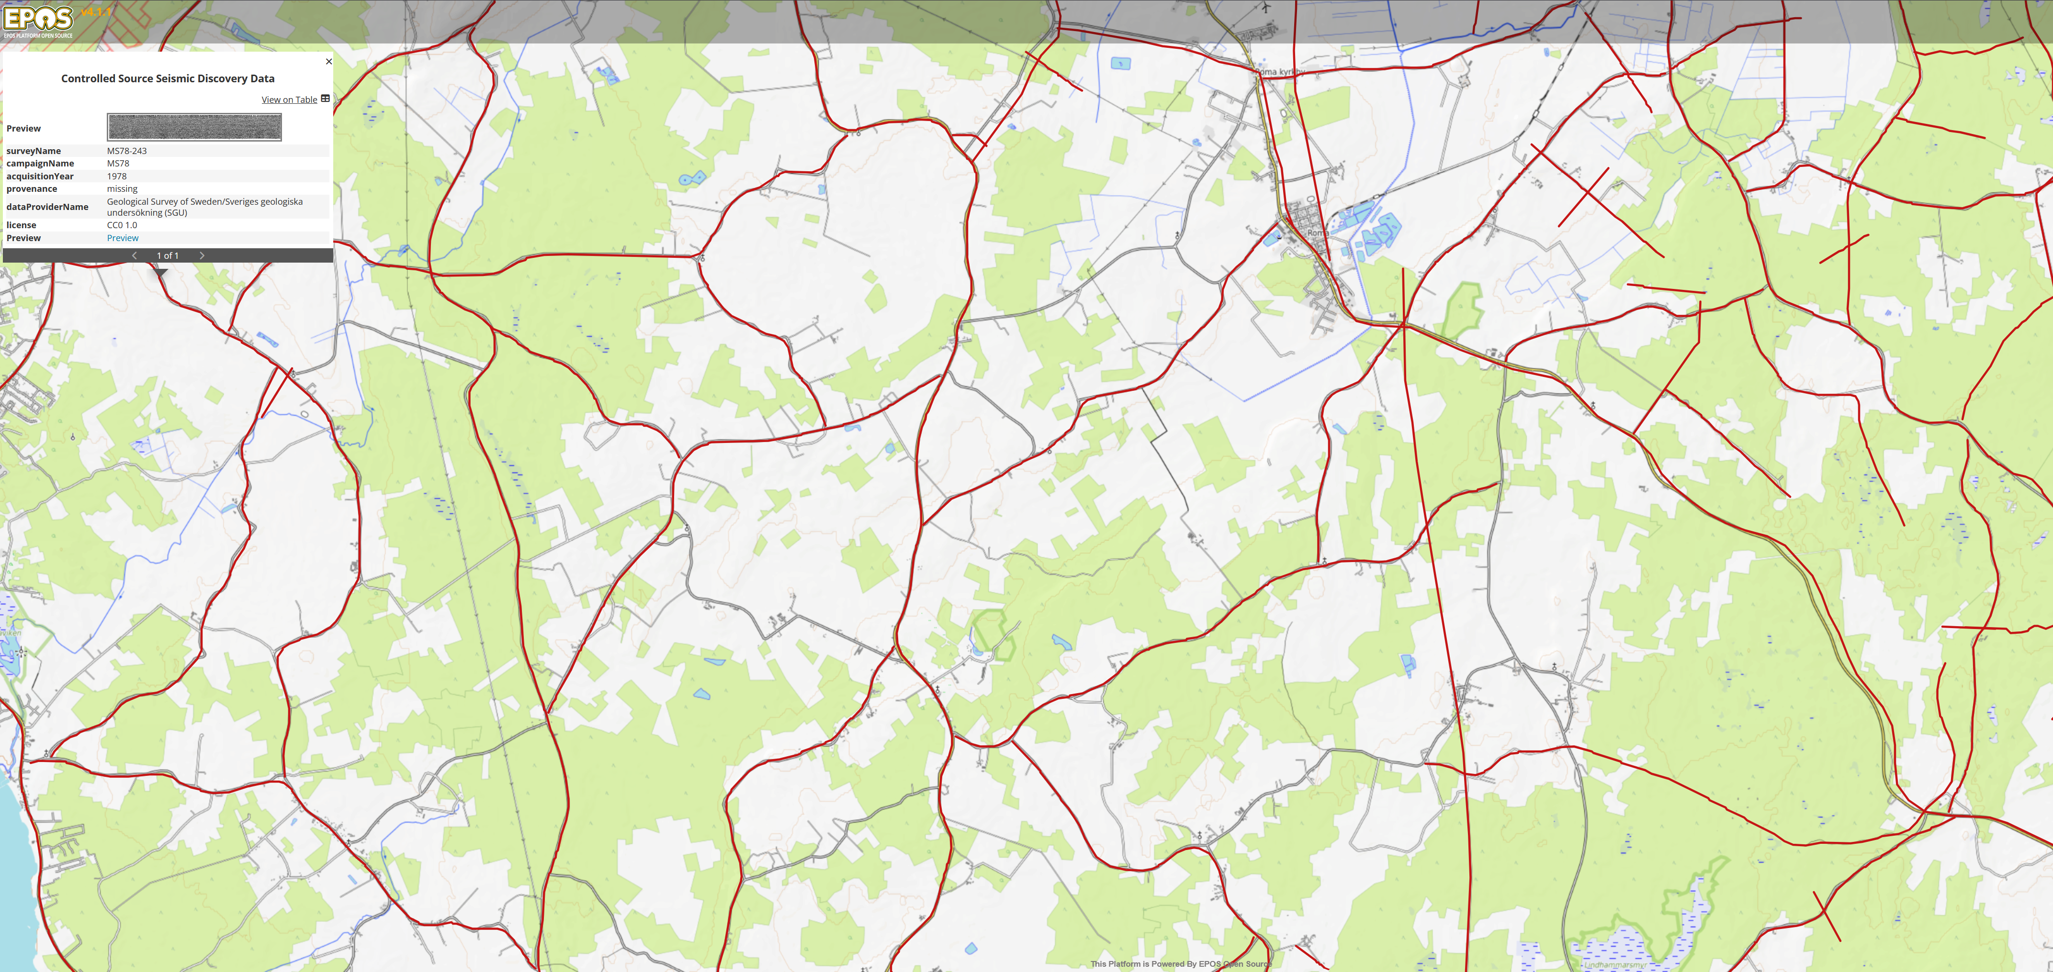
EPOS CSS
Facilitating the discovery and reuse of Controlled Source Seismic data

Slide 26
?
<= CSS data

Slide 27
CSS data are high value data sets for reuse.
Where do we find them?
(What do we do with our data?)
ACADEMIC
RESEARCH
EXPLORATION
INDUSTRY
GEOLOGICAL SURVEYS
100 years of legacy data that have no value without proper data descriptions (metadata)
CURATED
DATA
DATA
PUBLICATION
SOMEWHERE
ON A DISK

Slide 28
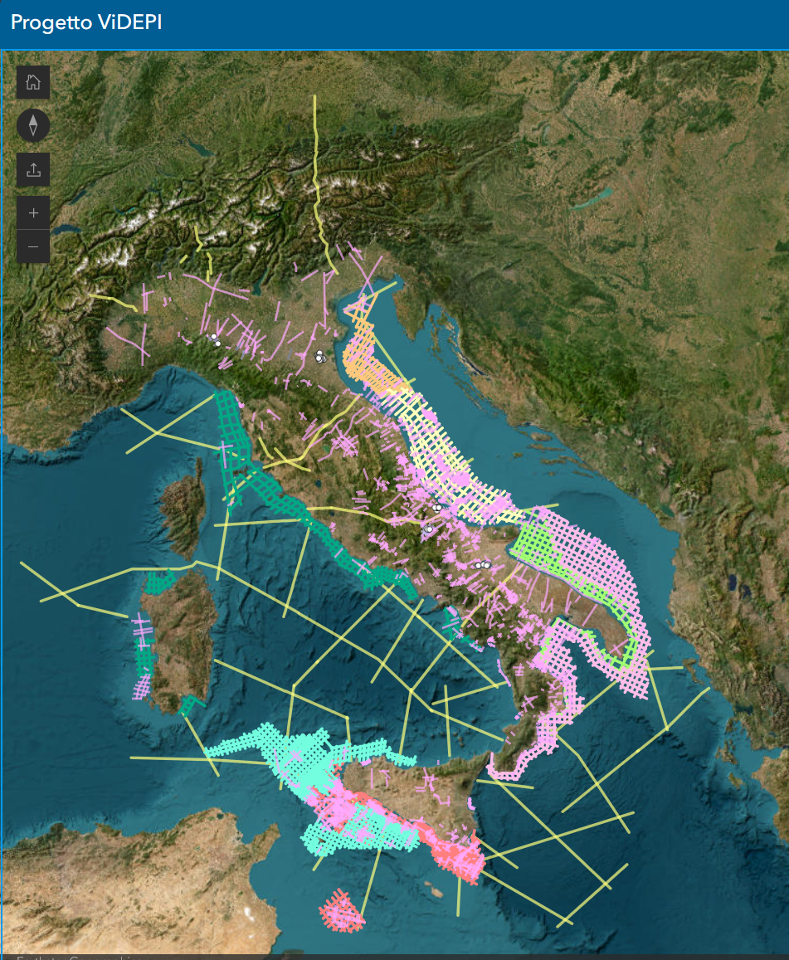
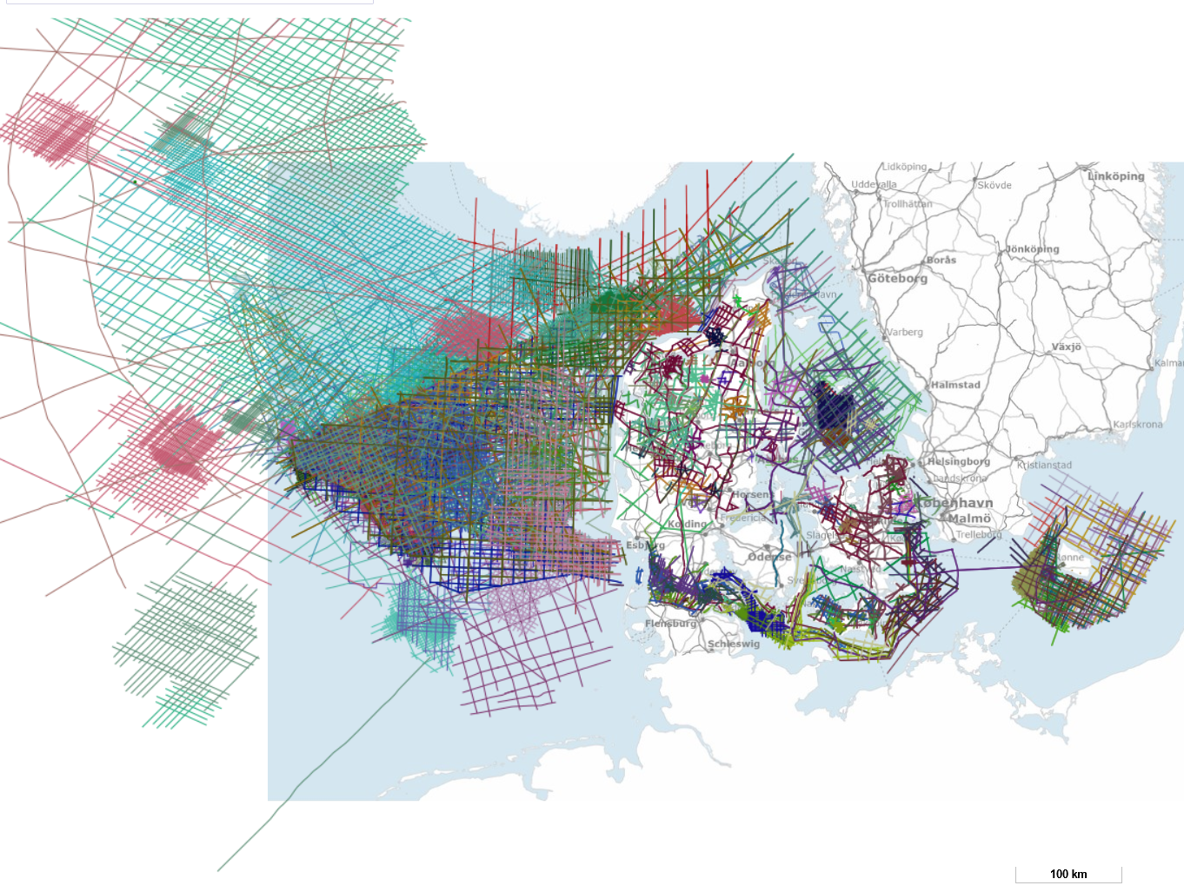
←ViDEPI: Saving legacy seismic data in Italy
↓ Subsurface Data Denmark
(GEUS national database)

Slide 29
No community for CSS
Community
building
Avoid
”Yet another (meta)data standard”
EGU2024 SP75
SEISMIX 2024 conference,
direct outreach
> 25 scientists from > 10 countries
EPOS CSS
Use it.
If necessary, extend it.
Do standards
exist?
Development work

Slide 30
Development by the community
Input:
Expert knowledge
Existing data models of e.g. national and organisational databases
Complementary information (previous work, data formats, community sources)
Key evaluation:
Which attributes are useful for an informed decision by the scientist?
Which attributes are available in existing data sources?
Output:
CSS discovery metadata model
Corresponding controlled vocabularies
A scientist can tell whether a data set is “fit for purpose” or not
Avoid shutting potential data providers out

Slide 31
The CSS discovery data model
DESCRIPTIVE attributes:
[0..1]
Setting, equipment, documentation
DATA PROVISION attributes:
[1] or [0..1]
Details about the data provider
CORE
Attributes
[1]
Key information that is expected to be available from all sources
TECHNICAL attributes:
[0..1]
Technical details on the survey
DATA attributes:
[0..1]
Details about the data set

Slide 32
A potential community standard
Community-driven scientific metadata model (conceptual to logical models) implemented
in JSON-Format (ISO/IEC 21778:2017; RFC 8259)
  as GeoJSON (RFC 7946),
  the content and structure is defined by a JSON-Schema (json-schema.org).
Controlled vocabularies as SKOS-Turtle files (RDF -> W3C standards)
Documentation
Version control of the model and metadata catalogue on GitHub
Publication of releases on the community data centre “GFZ Data Services”
=> Presented at EGU 2026
=> Paper just submitted to the Journal ”Earth System Science Data”

Slide 33

Implementation for data discovery
Discovery data curation, attribute mapping, harvesting from data providers (TBD)
Discovery metadata model => physical database (PostGIS/PostgreSQL)
Data transfer by data service
Web Feature Service - international standard by OGC, ISO 19142
Data discovery
Data integration
Data analysis (Virtual Research Environment)
PLATFORM
USER

Slide 34
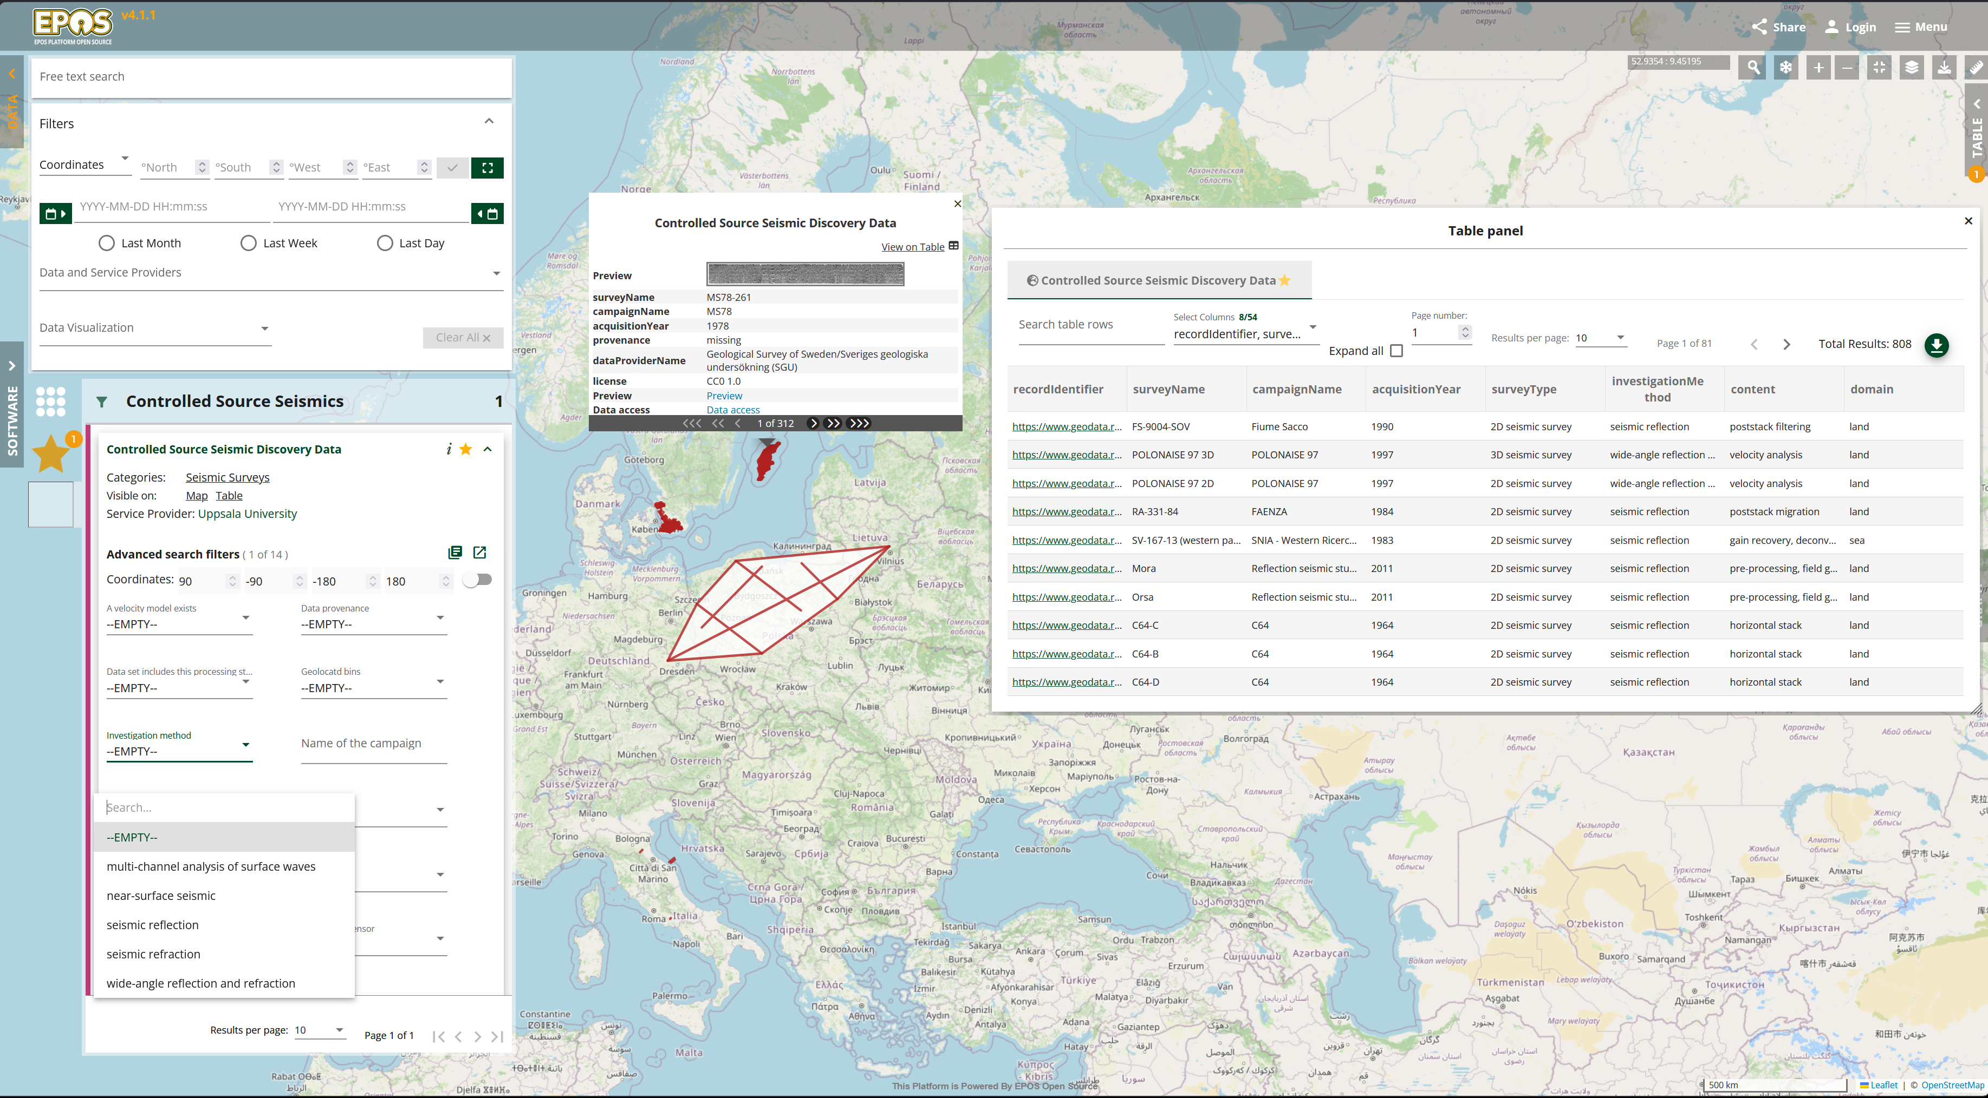

Slide 35
The major remaining challenge:
How to integrate with EPOS ERIC ICS-C?
Find a TCS that is prepared to accept the data service.
(Presently, there are no other alternatives.)

Slide 36
A different situation:
A data set that (potenially) is relevant to EPOS.
An existing community that maintains the data set, which has
No direct interest to actively engage in EPOS.

Slide 37
The ”Post-Glacial Fault Database”
Curated by a thematic community that is not connected to
or dependent on EPOS.

Slide 38
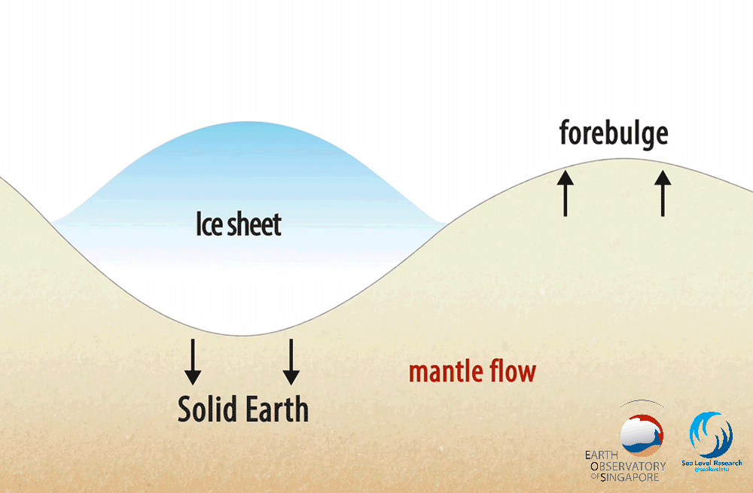
Glacial isostatic adjustment
”Post-glacial faulting”
or (better)
Glacially Induced Faulting
is the
reactivation of crustal-scale faults caused by the melting of a major ice sheet.
~ M8.0 (Pärvie, Sweden; Lindblom et al. 2015)
~13000 - < 500(!) years
(in Europe; youngest age Olesen et al. 2023)
Close to infrastructure like water/tailing dams and mines.
Movie courtesy of Tanghua Li

Slide 39
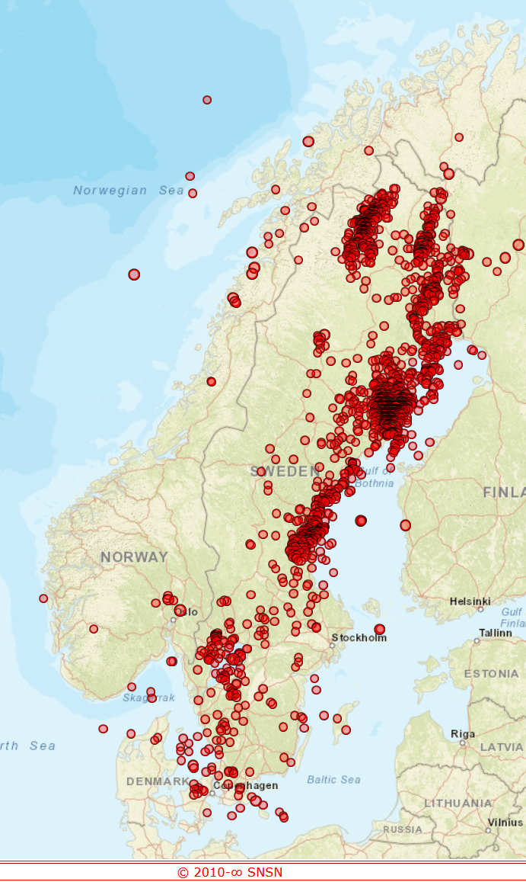
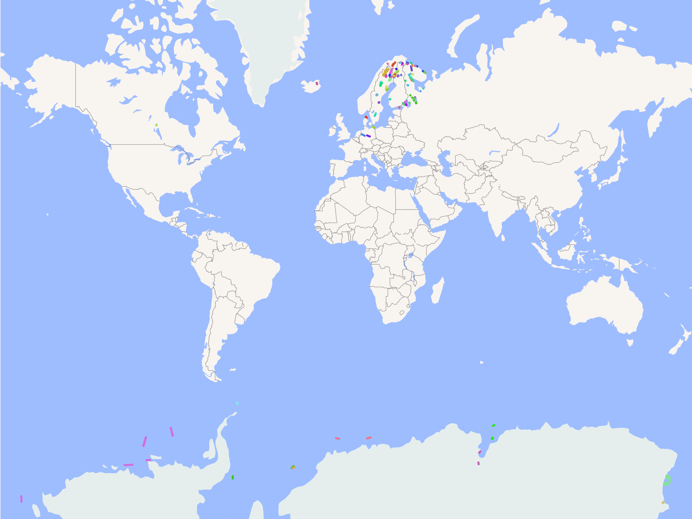
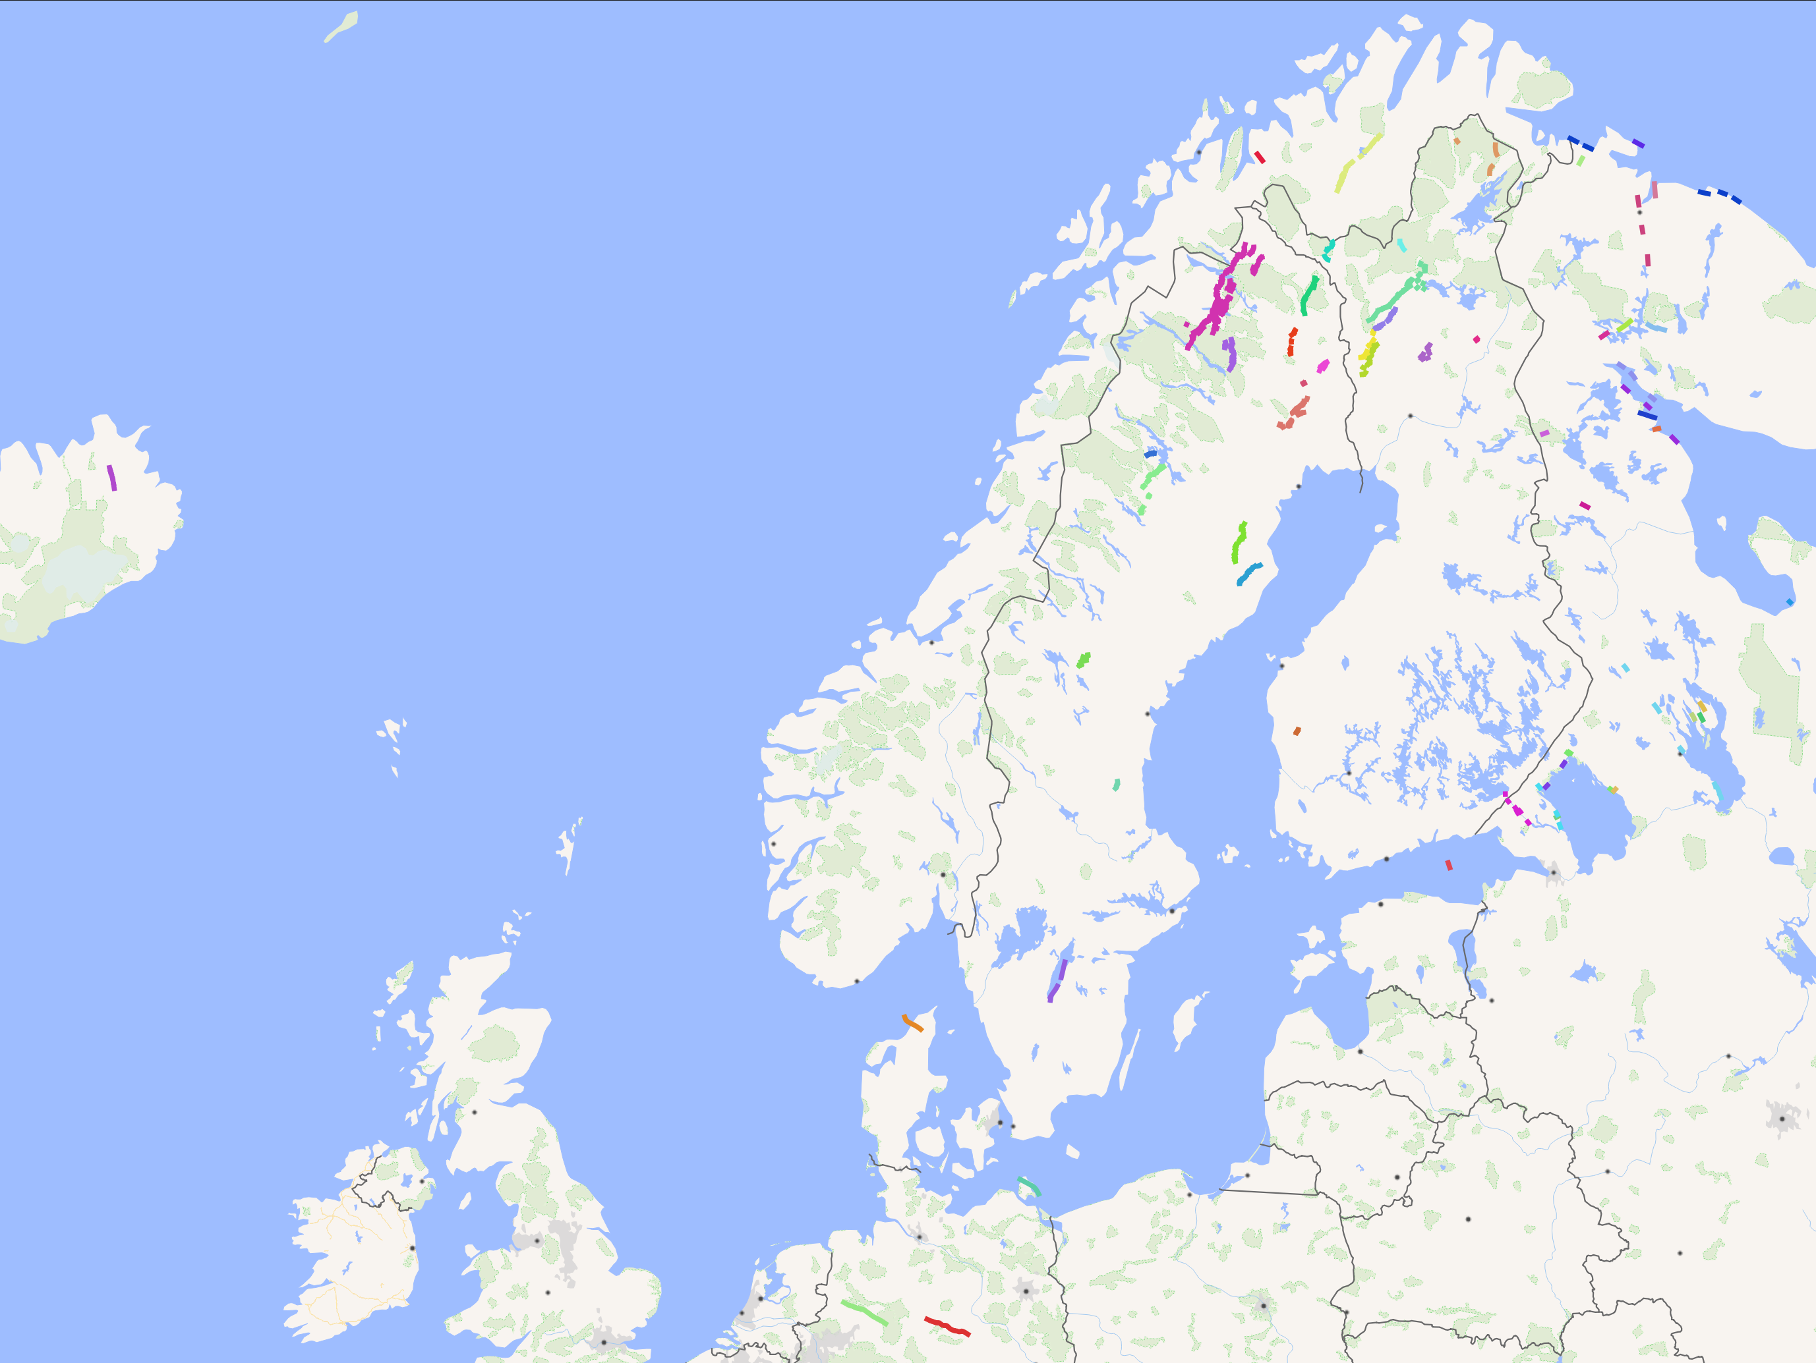

Slide 40
How to integrate the PGF database?
Update of the data set every second year at a community meeting.
On-going discussion between the PGF community and EPOS Sweden.
Integrate the data with one of the existing fault databases?
  “European Databases of Seismogenic Faults” (EPOS TCS Seismology)
  (high metadata detail, focus on seismic risk)
  “HIKE Fault Database” (EGDI)
  (high metadata detail; could be provided by TCS GIM)
  “Pan-European Faults 1:5M” (IGME, EGDI)
  (no detail; could be provided by TCS GIM)
Provide a separate data service and convince a TCS to host it?
=> The PGF database is based on a few thematic attibutes
that are not present in any of the other models.
Future unclear.
Further discussions at several levels needed.

Slide 41
---
Final thoughts and questions?
Summary:
Not all data that appear to be relevant can also become part of EPOS.
The mode of integration is not always obvious and straight forward.
FAIR solid Earth science data require a fair amount of dedication.
The thematic communities need motivated scientists at all career levels!
But it’s not always easy to find a way to get engaged.

