Slide 1
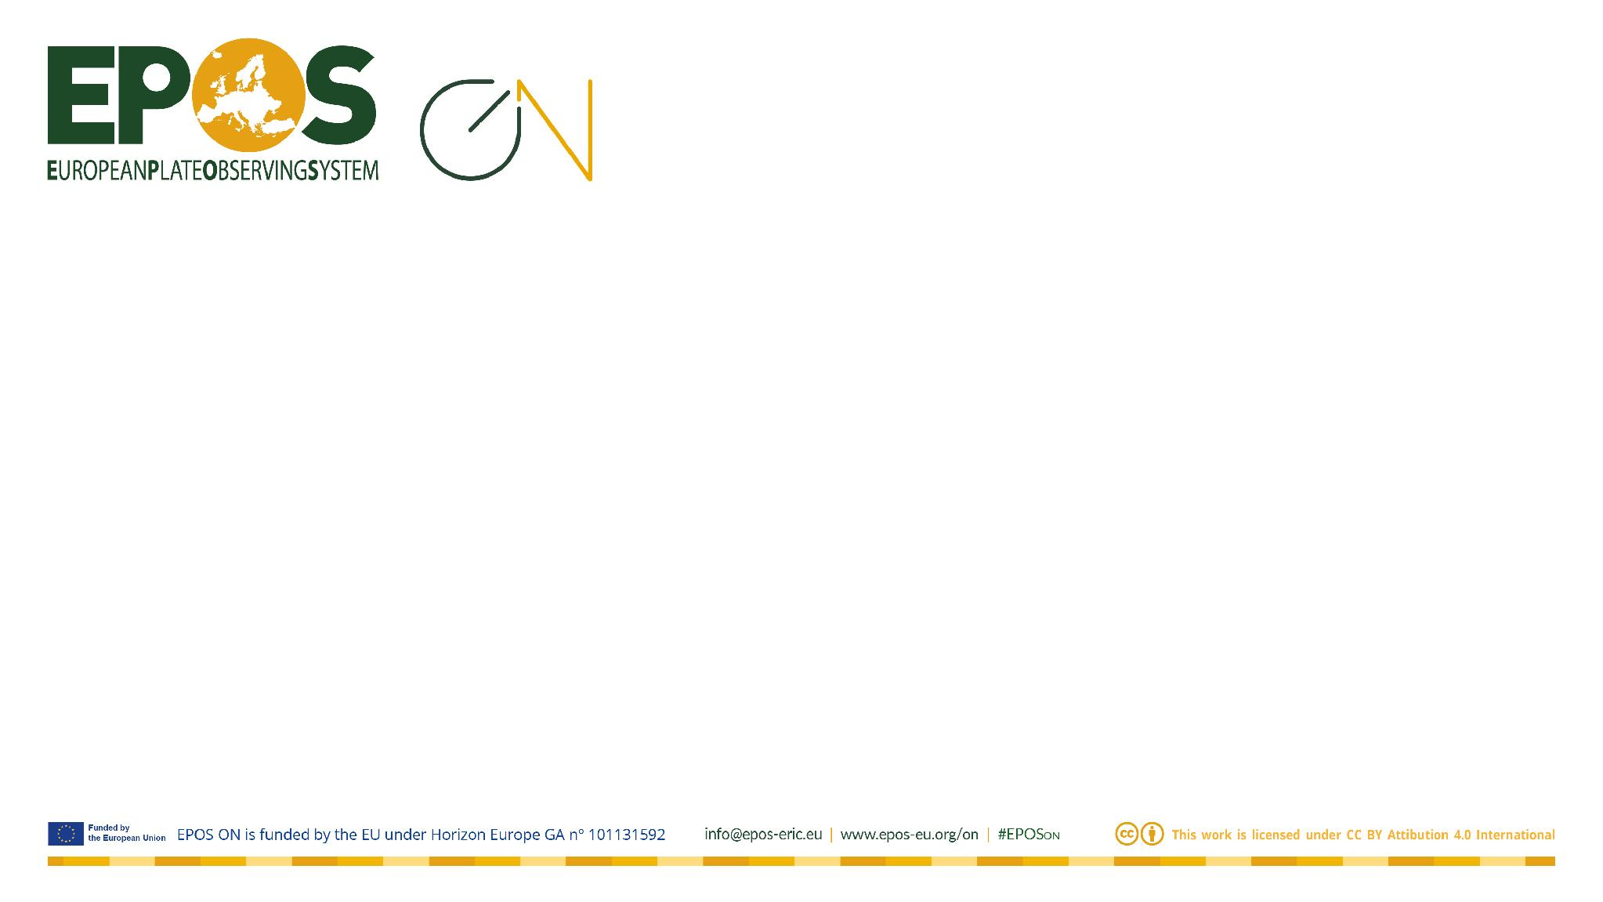

Getting Started with the EPOS Platform
Mario Malitesta| mario.malitesta@epos-eric.eu

Slide 2
Session Agenda
Part 1 — Platform Overview (~20 min)
· What is the EPOS Platform GUI?
· Exploration Modules: Data Panel, Facilities Panel, Software Panel
· Visualisation Types: Map, Table, Graph
· Analysis Section & VRE Integration
· Favourites & Sharing
· Filters
Part 2 — Hands-on Challenge (~20 min)
· Guided challenge to explore the interface
Q&A (~5 min)

Slide 3
What is the EPOS Platform GUI?
A unified web-based interface to access multidisciplinary Earth Science data
Key features:
· Single entry point to heterogeneous datasets across EPOS communities
· Integrated modules for data discovery, visualisation, and processing
· Interoperable with Virtual Research Environments (VREs)
· Designed to support researchers, ECRs, and data providers
Today you will learn to navigate the platform end-to-end

Slide 4
1. Exploration Modules
Data Panel · Facilities Panel · Software Panel
How to discover and browse available resources on the platform

Slide 5

Data Panel
The main entry point to search and filter Earth Science datasets
Key functionalities:
· Full-text and faceted search (by domain, format, time range, spatial extent)
· Preview Distribution metadata and access links
· Add Distribution to your active session or favourites
· Filter by community, data provider, or data type
Tip: Use the spatial filter to narrow results to your area of interest

Slide 6
Facilities Panel
Browse and query the EPOS registry of services and resources
Key functionalities:
· Explore available:
Laboratories
Mobile Equipment
Sensors
Use case: find available facilities

Slide 7

Software Panel
Discover and access scientific softwares through EPOS Platform
Key functionalities:
· Browse available notebooks
· Add them to Analysis panel to be used in VREs
Example: find a Python notebook for earthquake catalogue analysis

Slide 8
2. Visualisation Types
Map · Table · Graph
Multiple ways to explore and interpret your data directly in the platform

Slide 9



Visualisation Types
Map View
· Interactive geospatial display of datasets on a base map
· Layer control, zoom, and click-to-inspect features
· Supports point, line, polygon, and raster data
Table View
· Tabular display of dataset records with sortable columns
· Useful for inspecting metadata and attribute values at a glance
Graph View
· Time series, scatter plots, and statistical charts
· Interactive zoom, pan, and export options

Slide 10
3. Analysis Section
Processing data and integrating with Virtual Research Environments (VRE)
From raw data to scientific insight — without leaving the platform

Slide 11

Analysis Section & VRE Integration
The Analysis section enables data processing directly within the platform
Workflow:
1. Select resource from the Software Panel
2. Add it Analysis tab ( besides “Download” button of the card)
3. Launch execution in the Virtual Research Environment (VRE)
4. Navigate to VRE
VRE: a cloud-based computational environment
Results can be saved, shared, or exported

Slide 12
4. Favourites & Sharing
Save, organise, and collaborate on your work within the platform
Keep track of what matters and share discoveries with your team

Slide 13


Favourites & Sharing
Favourites
· Bookmark datasets, services, and software tools
· Build personal collections for quick access
Sharing
· Generate shareable links to datasets or views
· Share saved sessions with collaborators
All features are accessible via your user profile

Slide 14
5. Filters
Spatial & Temporal · Data & Service Provider · Visualisation Type
Narrow down what you see — and how you see it

Slide 15

Filters
Spatial & Temporal Filters
· Draw a bounding box or select a region on the map
· Set a date/time range to restrict results to a specific period
· Combine both for precise spatio-temporal queries
Data & Service Provider Filters
· Filter datasets by originating institution or data provider
Visualisation Type Filter
· Show only datasets compatible with Map, Table, or Graph view
· Helps identify which data can be visualised interactively

Slide 16
Hands-on Challenge
Complete all steps to explore the platform end-to-end
You have ~20 minutes — good luck!

Slide 17
Exploration Challenge
Step 1 — Log in
Sign in with your Google account or create a new one.
Step 2 — Set a spatio-temporal filter
Define a spatial bounding box and a time range of your choice.
Step 3 — Add 3 services to your Favourites
Pick one from each panel: Data, Facilities, and Software.
Step 4 — Create a VRE environment
Open the Analysis panel, create a new environment, and add the Software resource you saved.
Note: environments are personal and tied to your account — they won't appear in the shareable link you'll generate in Step 5.
Step 5 — Share your work
Generate a shareable link and send it to a classmate.

Slide 18
Wrap-up & Q&A
What we covered today:
· Exploration Modules: Data Panel, Facilities Panel, Software Panel
· Filters: Spatial & Temporal, Data & Service Provider, Visualisation Type
· Visualisation Types: Map, Table, Graph
· Analysis Section & VRE Integration
· Favourites & Sharing
· Hands-on Challenge

