Slide 1
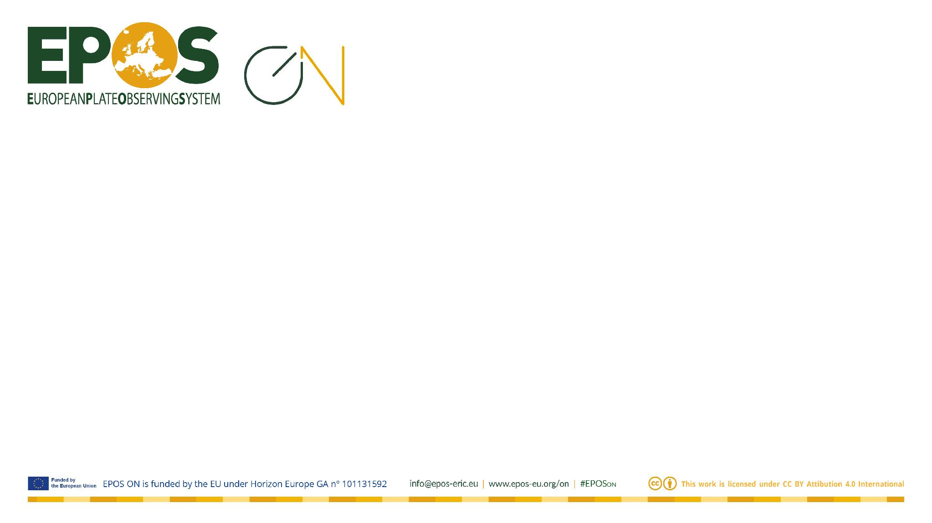

The EPOS Data Lifecycle
Valerio Vinciarelli | Valerio.Vinciarelli@epos-eric.eu

Slide 2
Data Lifecycle in Research Infrastructure
Data Access & Reuse
Data Provision
Data Integration

Slide 3
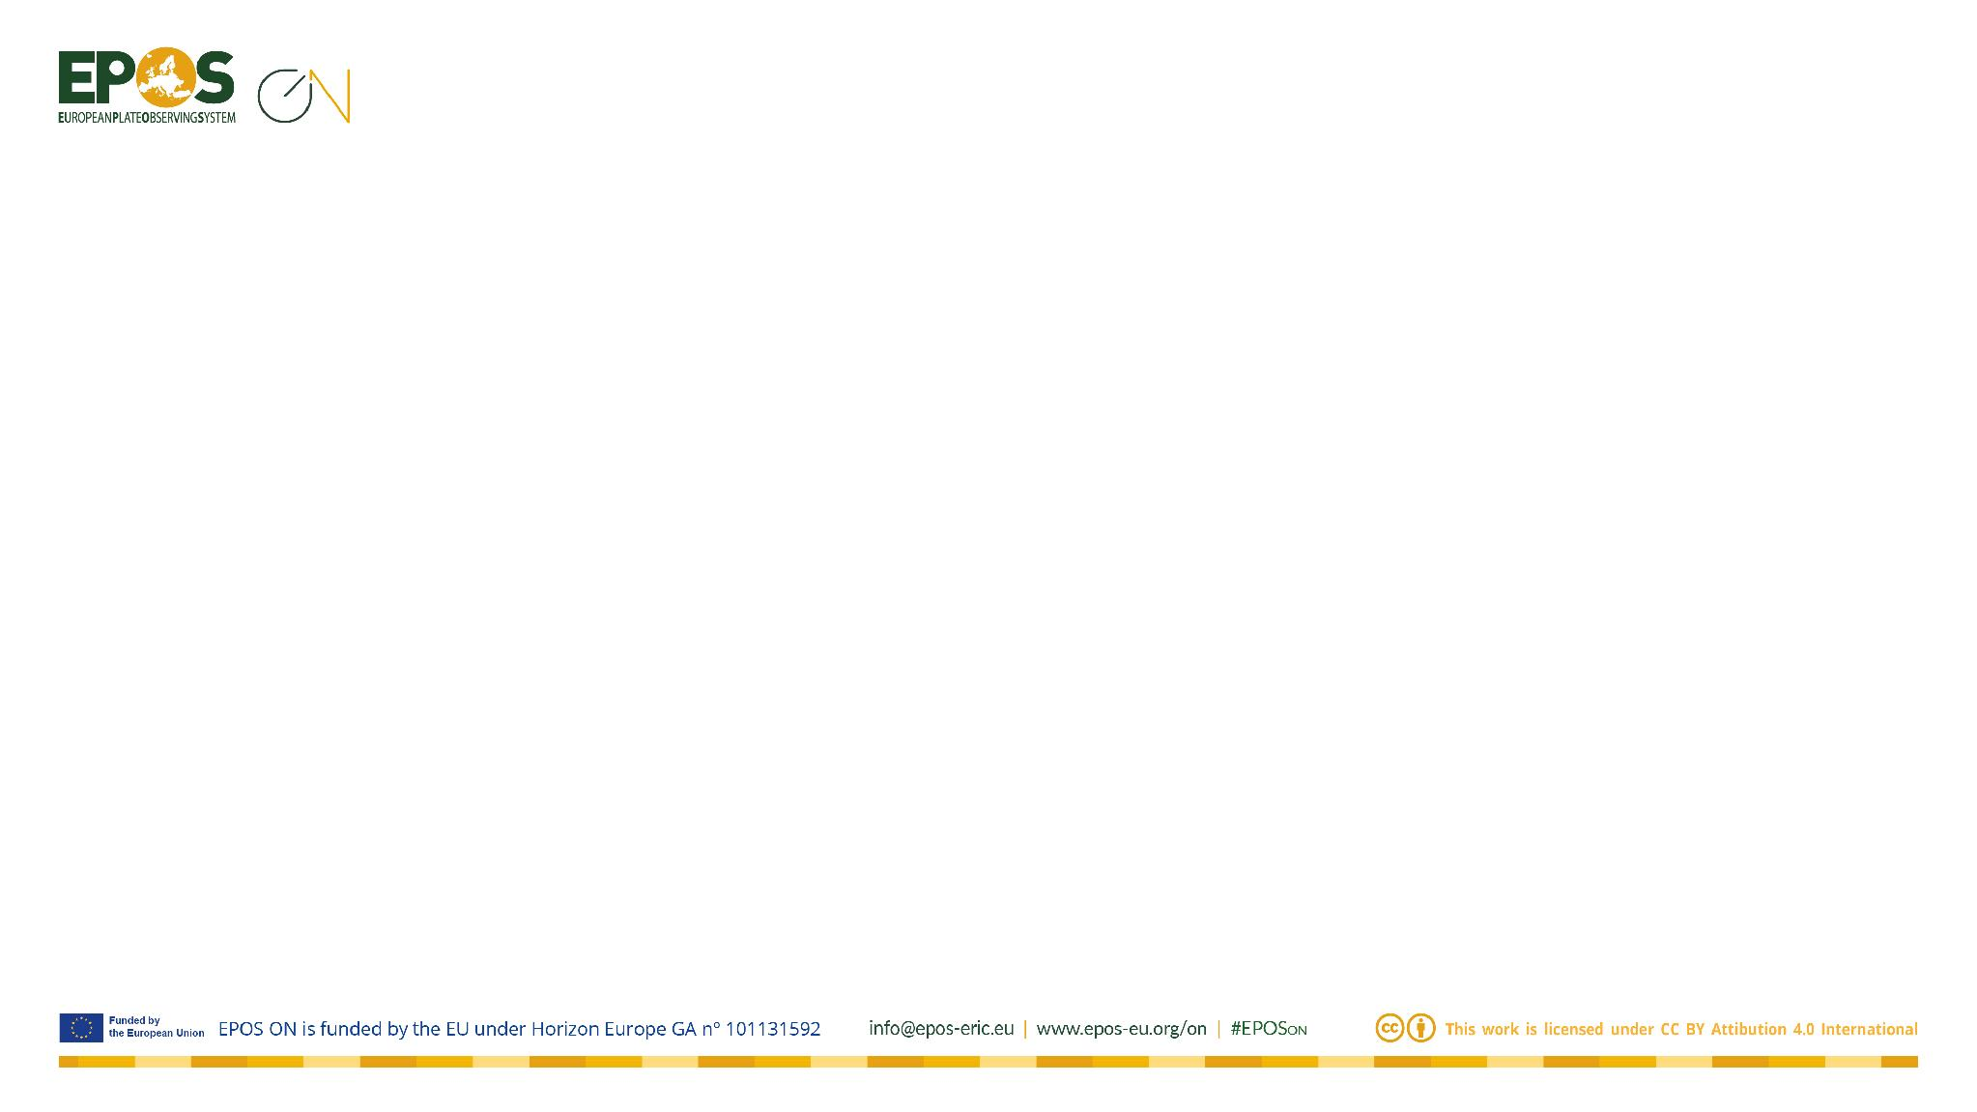
Overview
01
Understanding the Data Lifecycle
02
Data Management in Research Infrastructures
03
The Data Lifecycle Stages
04
Putting It All Together

Slide 4
01
Understanding the Data Lifecycle
From data creation to long-term preservation — a journey through research data management

Slide 5
What is the Data Lifecycle?
The Data Lifecycle describes the complete journey of data from creation to archival. Each stage is an opportunity to add value.
Generation & Collection
Creating and gathering raw data from instruments, observations, and experiments.
Storage & Quality
Preserving data securely and ensuring accuracy through validation.
Standardization
Harmonizing formats and metadata across domains and communities.
Integration
Combining data from multiple sources through interoperable services.
Processing
Transforming raw data into value-added products through workflows.
Distribution
Sharing data with the community through portals, APIs, and DOIs.

Slide 6
The Multi-Level Data Lifecycle
Data flows through multiple organizational levels in a Research Infrastructure:
1. Institutional Level (Local)
Raw data generation, storage, and initial quality control. Institutional standards and policies apply.
2. Domain Level (Thematic)
Domain-specific processing and standardization. Community vocabularies and formats are adopted.
3. Integration Level (Cross-domain)
Interoperability across disciplines. Unified discovery and access services for all users.

Slide 7
02
Data Management in Research Infrastructures
How distributed research institutions collaborate to manage geoscience data

Slide 8
Data Management in Research Infrastructures
Data Providers
Universities, data centers, observatories, and monitoring networks distributed across institutions
Integrated Services
Harmonising data from different sources and formats into unified access points
User Community
Scientists, experts, government bodies, and private sector accessing multidisciplinary data
Core Principle: Services are integrated to make multidisciplinary data
Findable, Accessible, Interoperable and Reusable
through a single, digital platform

Slide 9
03
The Data Lifecycle Stages
Nine essential stages every researcher should know

Slide 10
1. Generation and Collection
Data generated by distributed research infrastructures from various sources.
Sources: seismometers, GNSS, geochemical labs, satellite sensors, drilling cores
Core Insight
Document provenance from day one. Rich metadata at the source ensures long-term reusability.
Best Practice
Record instrument type, calibration, location, and date/time for every measurement.
What to document at generation:
Who collected the data (person/institution/orcid)
What instruments and methods were used
When the data was collected (date, time, timezone)
Where the data was collected (coordinates, elevation, depth)
How the data was processed (raw vs processed, calibration steps)

Slide 11
2. Storage
Data stored by each institution on databases or cloud solutions.
Metadata stored in central searchable catalogues for discovery and access.
Core Insight
Balance accessibility with security. Maintain backups and version control.
Best Practice
Use institutional repositories with persistent identifiers. Separate raw and processed data.
Storage considerations:
Redundancy: Keep at least 3 copies in 2 different locations
Metadata catalogues: Enable cross-domain search and discovery
Version control: Track changes and maintain data lineage
Access policies: Define open, restricted, and embargoed data tiers
Long-term formats: Prefer open, non-proprietary file formats

Slide 12
3. Data Quality
Ensuring data is accurate, complete, and reliable through validation, cleaning, and verification.
Quality control at community and domain level ensures trust in the data.
Core Insight
Quality control is ongoing. Use automated validation and document all procedures.
Best Practice
Define quality metrics upfront. Flag uncertainties rather than hiding them.
Quality control techniques:
Automated validation: Range checks, format checks, consistency checks
Manual review: Domain experts review critical datasets
Cross-validation: Compare with independent datasets or methods
Documentation: Record all QC steps, flags, and known issues
Community standards: Follow domain-specific QC guidelines

Slide 13
4. Maintenance
Managing data over time to keep it relevant, up-to-date, and accessible.
Data management plans ensure continuity; metadata curation evolves over time.
Core Insight
Curation is a long-term commitment. Define roles, policies, and review metadata periodically.
Best Practice
Assign data stewards. Schedule periodic reviews of datasets and metadata.
Maintenance activities:
Data management plans (DMPs): Define roles, responsibilities, and timelines
Metadata curation: Update metadata as understanding evolves
Format migration: Convert to newer formats as technology changes
Access review: Periodically audit who can access what data
Preservation policy: Define retention periods and archival procedures

Slide 14
5. Standardization and Harmonization
Aligns formats, vocabularies, and units across domains. Ensures compatibility and reduces inconsistencies.
Core Insight
Adopt community standards early for cross-domain interoperability.
Best Practice
Use existing standards (XML, JSON, OGC, StationXML) rather than creating new ones.
Common geoscience standards:
Data formats: XML, JSON, MiniSEED, NetCDF, HDF5
Metadata: StationXML, QuakeML, ISO 19115
Protocols: OGC WMS/WFS, FDSN web services, RESTful APIs
Vocabularies: Gemeinsame Normdatei (GND), INSPIRE themes
FAIR principles: The guiding framework for all standardization efforts

Slide 15
6. Integration
Aggregation of multi-disciplinary resources. Interoperability layer bridges domain-specific APIs and services.
Core Insight
Semantic interoperability requires shared vocabularies and metadata mapping.
Best Practice
Map local schemas to common standards. Provide clear API documentation.
Integration challenges and solutions:
Semantic gap: Different domains use different terms for the same concept
Technical heterogeneity: Different APIs, formats, and protocols
Metadata mapping: Create crosswalks between local and common schemas
Unified discovery: Common metadata profiles enable cross-domain search
Virtual observatories: Federated access to distributed resources

Slide 16
7. Security
Access control, encryption, and audit trails protect data integrity.
Federated access via institutional authentication; compliant with GDPR and policies.
Core Insight
Embed security at every stage. Use role-based policies and encryption.
Best Practice
Define access levels (open, restricted, embargoed) from the start.
Security layers:
Authentication: Federated identity via institutional credentials
Authorization: Role-based access control (RBAC) for data resources
Encryption: In-transit (TLS) and at-rest encryption
Audit trails: Log all access, modifications, and downloads
Compliance: GDPR, institutional policies, and domain-specific regulations

Slide 17
8. Processing
Platforms support user-driven processing (Jupyter Notebooks, web services).
Domain-specific pipelines transform raw observations into value-added products.
Core Insight
Make processing reproducible. Share workflows, not just results.
Best Practice
Use notebooks, containers, and workflow engines for reproducibility.
Processing approaches:
Interactive notebooks: Jupyter, Google Colab for exploratory analysis
Containerization: Docker/Singularity for reproducible environments
Workflow engines: Snakemake, Nextflow, Apache Airflow
Web services: OGC WPS, REST APIs for on-demand processing
Provenance tracking: Record every step from raw data to product

Slide 18
9. Distribution
Making data available through appropriate channels (portals, APIs, DOIs).
Data exposed via standard WebServices and APIs for maximum accessibility.
Core Insight
Use DOIs, clear licenses, and open access to maximize data impact.
Best Practice
Choose the right license (CC-BY, CC0). Always cite data sources.
Distribution channels:
Data portals: Unified access points with search and visualisation
Web services: OGC WMS, WFS, FDSN for programmatic access
Persistent identifiers: DOIs ensure long-term citability
Licences: CC0 (public domain), CC-BY (attribution), custom
Data citation: Always cite data sources in publications

Slide 19
04
Putting It All Together
The complete picture — from raw observations to reusable science

Slide 20
The Data Lifecycle: A Unified View
Generation → Storage → Quality → Maintenance → Standardization → Integration → Security → Processing → Distribution
Connected Stages
Each stage feeds into the next. Quality at one stage prevents problems downstream.
Metadata is the Thread
Metadata connects all stages. Document provenance, quality, and context at every step.
Early Investment Pays Off
Investment in generation, storage, and quality pays dividends in integration and distribution.
Community-Driven
Standards, quality, and curation are community efforts. Collaboration amplifies impact.
"The goal is not just to manage data, but to create a sustainable ecosystem where
data flows seamlessly from generation to reuse, maximizing scientific impact."

Slide 21
Thank you for your attention!
valerio.vinciarelli@epos-eric.eu
www.epos-eu.org/on | social media #EPOSon
Notes:
Thank you slide

