Slide 1
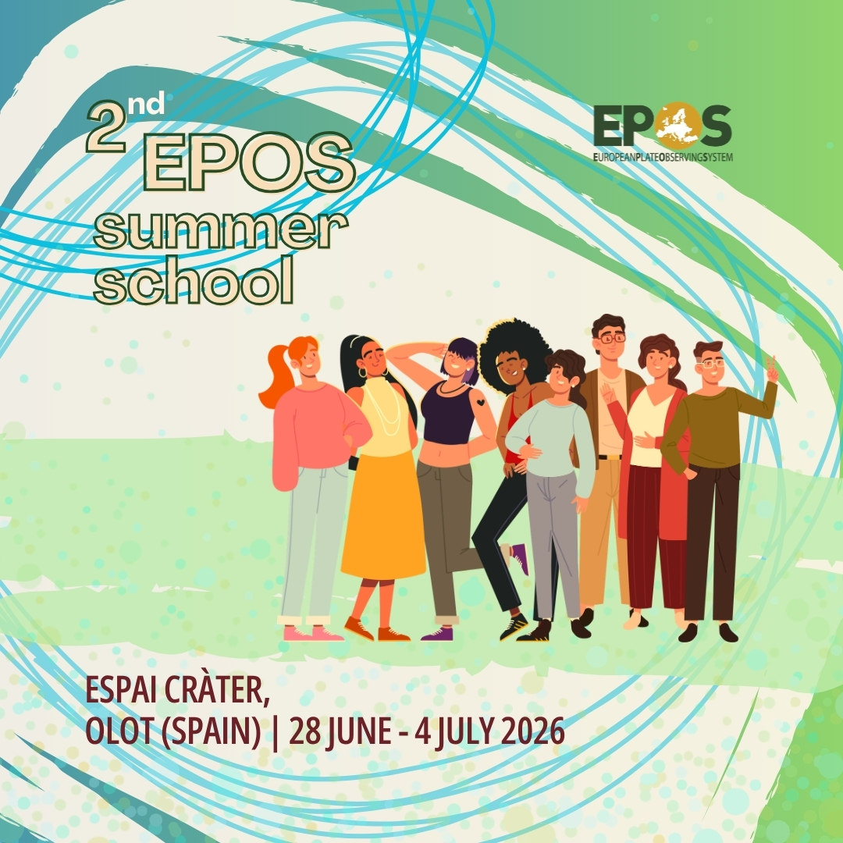
Introducing EPOS, Europe’s unique Research Infrastructure for solid Earth science
Federica Tanlongo | federica.tanlongo@epos-eric.eu
Notes:
Title slide

Slide 2
Part 1: Research Infrastructure

Slide 3
Definitions: #1
Research Infrastructures
“Research Infrastructures are facilities that provide resources and services for research communities to conduct research and foster innovation”
European Commission definition
Many forms from tangible, single-sited, unique laboratories (e.g. CERN) to distributed, knowledge-based infrastructures like EPOS.
What they all have in common?
All RIs are long-term, strategic investments providing the facilities, resources, and services that scientific communities use to conduct research and foster innovation across all scientific domains.
Notes:
I will start my lecture with some definitions, that might be unfamiliar to some of you, especially for those who come from outside the EU. The first one is that of “Research Infrastructure”.
According to the European Commission’s definition, research infrastructures are facilities that provide resources and services for research communities to conduct research and foster innovation. This is a very broad definition and it encompasses so many different things that, at first sight, it can be difficult to understand what they all have in common: Research Infrastructures can take many forms, from large tangible, single-sited laboratories such as the Large Hadron Collider at CERN to distributed, knowledge-based infrastructures like EPOS.
What they all do have in common is that they are long-term, strategic investments.

Slide 4
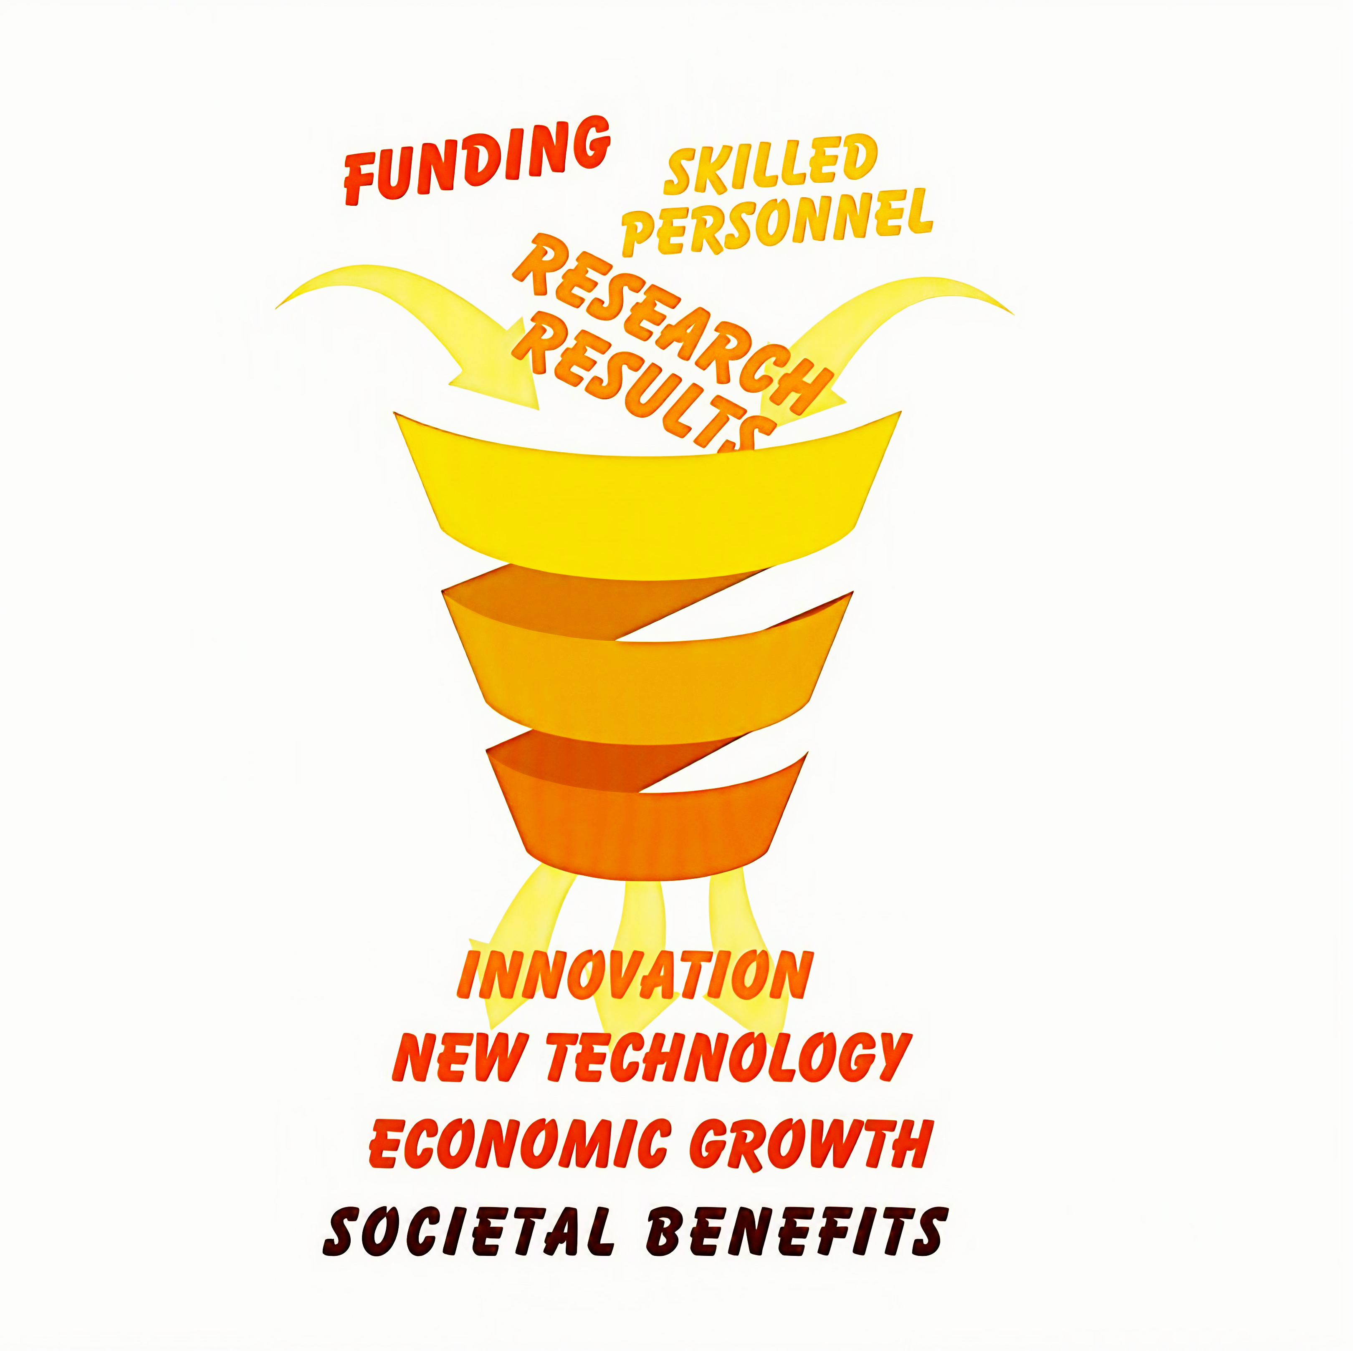
The Strategic Role of RIs
Enabling frontier research and innovation
Long-term planning across Europe through the ESFRI roadmap: https://www.esfri.eu/esfri-roadmap
Supporting scientific excellence and industrial competitiveness.
  Recognised in EU strategic reports: Draghi, Letta, Heitor.
  Prioritised by EU leaders including President von der Leyen and Commissioner Zaharieva.
“A key pillar of the fifth freedom is the empowerment of our research infrastructures. By facilitating access to laboratories, digital platforms, and cutting-edge equipment across Europe, we equip our research community to take on complex, multidisciplinary challenges vital to our collective future.”
[E. Letta , “Much More than a Market - Speed, Security, Solidarity. Empowering the Single Market to deliver a sustainable future and prosperity for all EU Citizens”, April 2024]
Notes:
In other words, Research Infrastructures are enablers that provide essential, often cutting-edge services that scientific communities rely on to conduct research and drive innovation across all domains.
This role of Research Infrastructures as a strategic asset that while not carrying out research themselves play an essential role in accelerating research and innovation and enabling the Research Community to tackle grand societal challenges is increasingly recognised in Europe (as well as in other countries). A European roadmap for strategic Research Infrastructures is maintained by ESFRI, the European Strategy Forum on Research Infrastructures, and it is a joint instrument Member States use to plan their investments in shared Research Infrastructures.
The importance of RIs has also been increasingy recognised in the wider policy arena, as shown in recent strategic reports. Here’s a short abstract from the Letta Report just as an example. This is reflected also in the legal instruments at our disposal to implement and operate Research Infrastructures, as we will see in a while.

Slide 5
Big challenges…
→ Integrated, multidisciplinary research is key
to understand the Earth’s chemical and physical processes
to forecast the events
to assess hazards and mitigate risks
to sustainably exploit geo-resources
To unlock this potential, researchers require access to multidisciplinary data and products generated by different communities in different data formats and with different procedures and are managed by hundreds of national research organizations in Europe
Natural processes do not respect national nor disciplinary boundaries: To study them we need cross-disciplinary approaches and global scope
Notes:
A vision, indeed, that despite dating back some decades is very much in line with OECD’s latest recommendations about Research Infrastructure Ecosystems. Why do we need one RI for Solid Earth Science?

Slide 6
Big challenges… for an ambitious vision
The challenge:
  Move from disconnected, heterogeneous data to open, integrated, multidisciplinary research
  Unlocking scientific discovery through shared, interoperable data
The EPOS vision:
To ensure sustainable and universal use and re-use of multidisciplinary solid Earth science data and products fostering state-of-the-art research and innovation.
Notes:
A vision, indeed, that despite dating back some decades is very much in line with OECD’s latest recommendations about Research Infrastructure Ecosystems. Why do we need one RI for Solid Earth Science?

Slide 7
Part 2: EPOS…

Slide 8
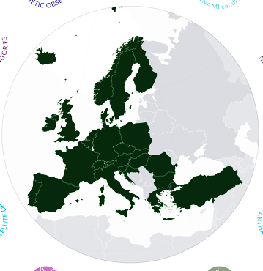
EPOS in a nutshell
Brings together MS and research communities around the Open Science paradigm
Integrates geoscientific data generated across Europe and makes them universally accessible
767 Data and Service Providers
172 Research Organisations
26 European Countries
(19 part of the ERIC)
10+1 Scientific Domains
800+PB of integrated data
Enables Excellent Science and Innovation in the domain of the Geosphere
Supports scientists in developing tools to address societal challenges

Slide 9


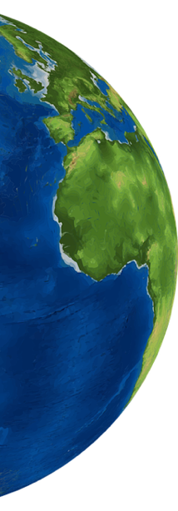









“RIs should, where appropriate, include in their objectives the task of developing shared digital platforms and data access mechanisms and policies as well as standardised data formats to enhance the usefulness of the data produced by their members.”
OECD (2025), “Fostering research infrastructure ecosystems for addressing complex scientific and societal challenges”, OECD Science, Technology and Industry Policy Papers, No. 183, OECD Publishing, Paris, https://doi.org/10.1787/34797721-en.
Seismology
Near Faults Observatories
GNSS Data and Products
Volcano Observations
Satellite Data
Geomagnetic Observations
EPOS is the reference RI for
solid Earth science in Europe
EPOS harmonizes and integrates
multidisciplinary solid Earth data acquired through
diverse scientific systems and disciplines and
ensures open and FAIR access to them
Anthropogenic Hazards
Geological Information and Modeling
Multi-scale Laboratories
Tsunami
Notes:
EPOS’ Mission is embodied in the EPOS platform, that acts as a single access point to all this wealth of quality-controlled, FAIR scientific data and products. This focus on the data platform is something that was indirectly endorsed in OECD’s latest policy paper on Research Infrastructures as a driving force to address complex challenges. But EPOS is not just about the data: Its main strength lies in bringing together the different solid Earth science communities and giving them both visibility and influence with national governments and the EU

Slide 10

“RIs should, where appropriate, include in their objectives the task of developing shared digital platforms and data access mechanisms and policies as well as standardised data formats to enhance the usefulness of the data produced by their members.”
OECD (2025), “Fostering research infrastructure ecosystems for addressing complex scientific and societal challenges”, OECD Science, Technology and Industry Policy Papers, No. 183, OECD Publishing, Paris, https://doi.org/10.1787/34797721-en.
Seismology
Near Faults Observatories
GNSS Data and Products
Volcano Observations
Satellite Data
Geomagnetic Observations
EPOS is the reference RI for
solid Earth science in Europe
EPOS harmonizes and integrates
multidisciplinary solid Earth data acquired through
diverse scientific systems and disciplines and
ensures open and FAIR access to them
Anthropogenic Hazards
Geological Information and Modeling
Multi-scale Laboratories
Tsunami
NEW!!!
Built Environment Data
Notes:
EPOS’ Mission is embodied in the EPOS platform, that acts as a single access point to all this wealth of quality-controlled, FAIR scientific data and products. This focus on the data platform is something that was indirectly endorsed in OECD’s latest policy paper on Research Infrastructures as a driving force to address complex challenges. But EPOS is not just about the data: Its main strength lies in bringing together the different solid Earth science communities and giving them both visibility and influence with national governments and the EU

Slide 11
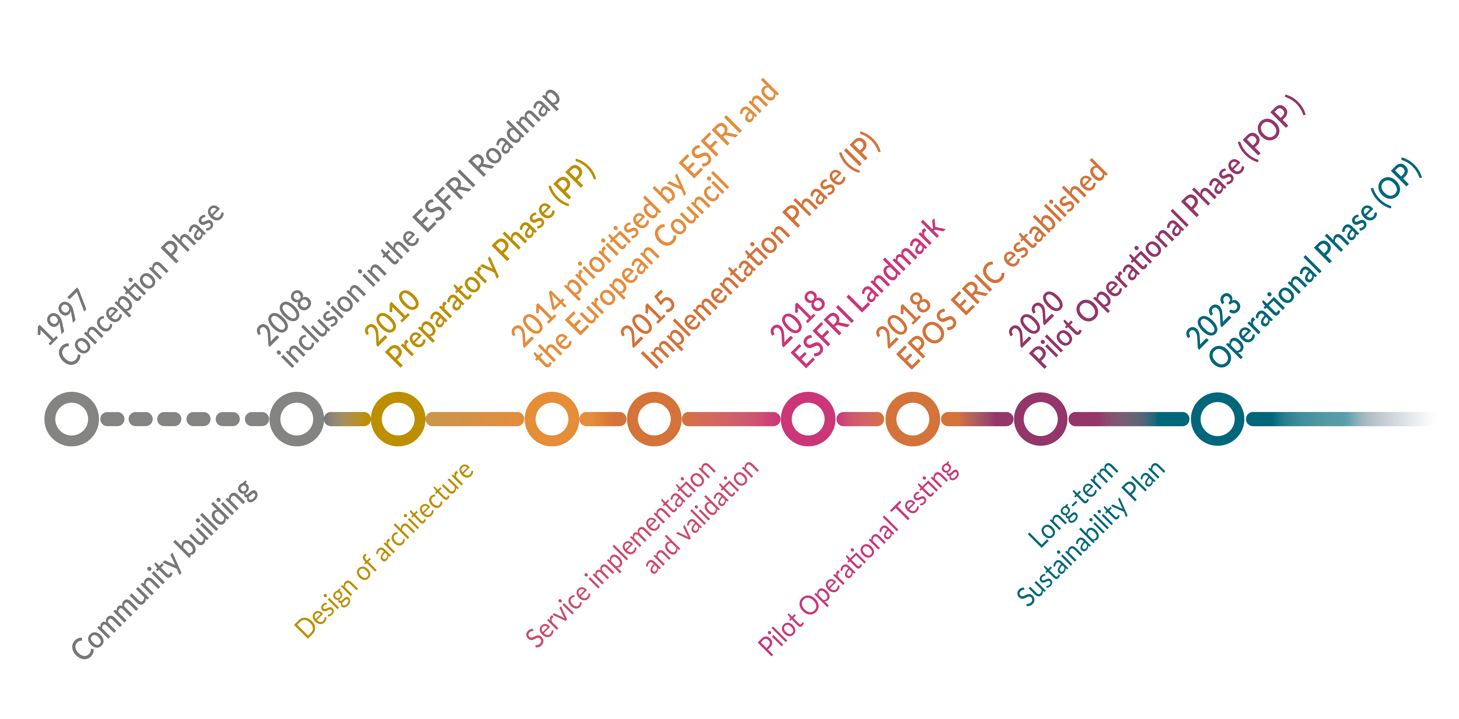
A long journey…
Notes:
The journey to reach this (moving) target has been a long one, with the initial conception of the infrastructure dating back to the mid nineties and the shift to full operation at the beginning of 2023…

Slide 12
… for a long-term strategic investment
2016 - The FAIR Guiding Principles for scientific data management and stewardship
Wilkinson et al.
Notes:
As strong practitioners of Open Science, EPOS has been promoting since its first steps open and universal access to high-quality, harmonized data and services, focussing on aspects such as findability, accessibility, interoperability and usability as the key for enabling scientists to tackle complex societal challenges and ensuring that research data and services are transparently and freely accessible, reusable, and impactful for the scientific community and society at large. And again you can see that we really where ahead of times, since the first formal definition of FAIR dates back to 2016, when we were midway to our operational phase (and of course participating in the conversations that brought FAIR principles to the forefront in the last decade.

Slide 13
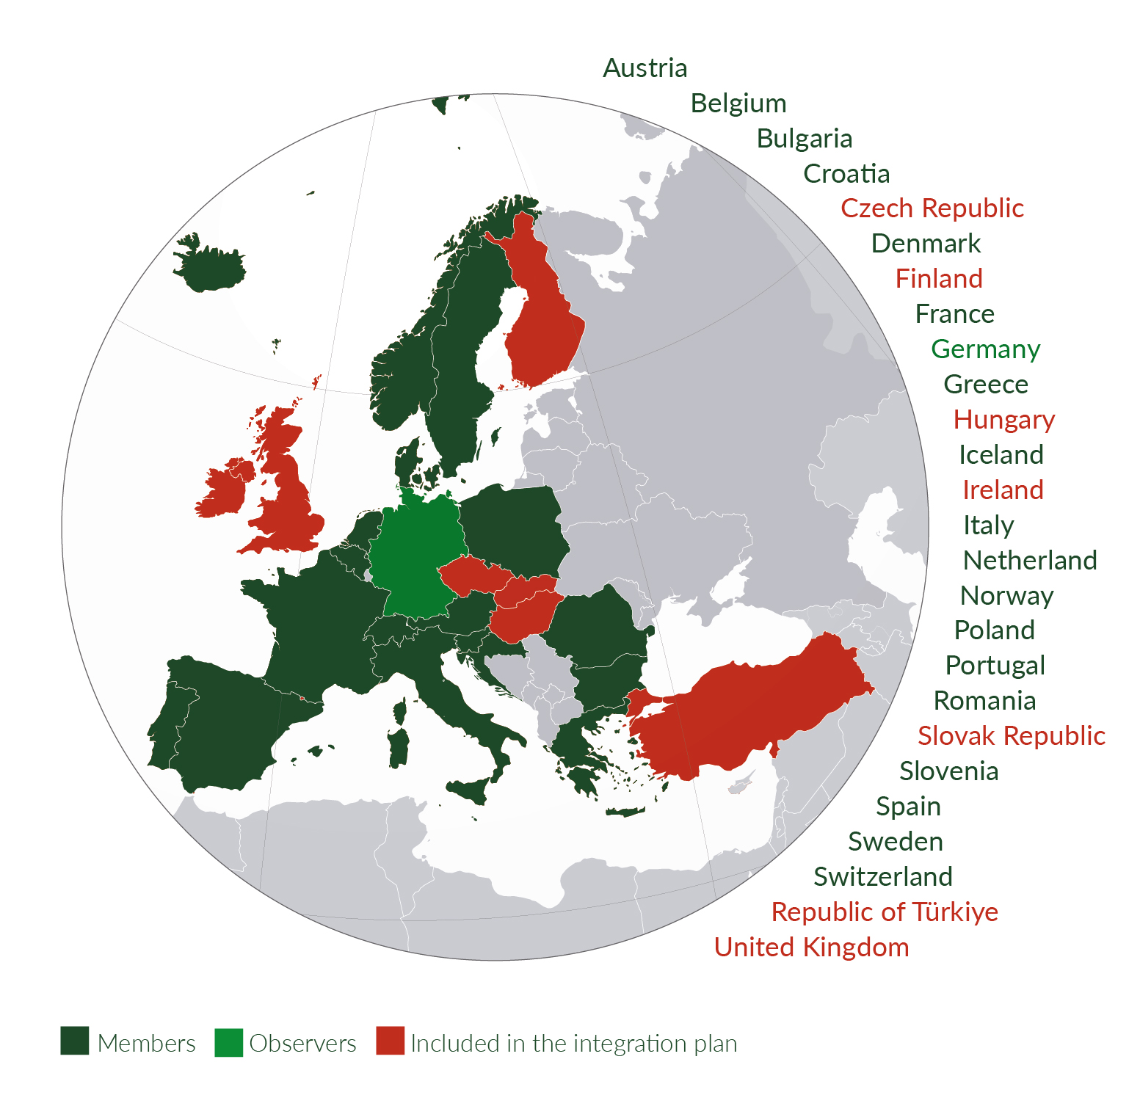
A pan-European infrastructure…
Since October 2018, EPOS is an ERIC (European RI Consortium), an entity under European law whose main purpose is to establish and operate a Research Infrastructure.
19 Countries are currently part of EPOS ERIC
*List of ERIC Members:
https://www.epos-eu.org/epos-eric/epos-eric-members
Notes:
EPOS ERIC is currently one of the most widespread ERICs in operation, with involves 20 countries, a testimony to their commitment and to the strategic relevance of our infrastructure in EU and national Research Infrastructures roadmaps. As you saw in the timeline, it took us decades to arrive where we are, and coordinating the contributes from many different communities and countries is no trivial work that needs appropriate governance.
Overall, EPOS ERIC ensures joint strategies to achieve scientific and technological innovation across all stakeholders involved, and tackles sustainability with harmonized approaches
In the picture you can see in dark green the ERIC’s member countries (dark) and the one observer (light); while in red, the countries that are not members of the ERIC, but still participate to the EPOS Delivery Framework providing scientific data and services. Some of them are in the process or have expressed interest in becoming full members, so we hope to see our membership enlarged in the years to come.

Slide 14
Definitions #2:
European Research Infrastructure Consortium (ERIC)
[An ERIC] is a specific legal form that facilitates the establishment and operation of Research Infrastructures with European interest.
European Commission definition
ERICs are a powerful tool to ensure the RI’s long-term sustainability
Legal capacity recognised across EU countries
Fast-Track establishment
Flexibility to adapt to specific requirements of each RI
Some fiscal benefits
Notes:
An important step in EPOS’ journey was its establishment as an ERIC, another term that deserves some definition.
We said before that Research Infrastructures are long-term, strategic investments. Being something that is build with sustainability in mind, they need to be incorporated and have a legal form that is recognised across the different countries and regulations. An ERIC - – a European Research Infrastructure Consortium - is just that: a specific legal framework created under EU laws that facilitates the establishment and operation of Research Infrastructures, ensuring long-term sustainability, flexibility, and recognition across EU countries. Following Europe’s recommendations about this, EPOS was established as an ERIC since 2018.

Slide 15













…with a global vision…
EPOS fosters international collaborations to serve the interest
of science and society at global level
Europe
USA
Australia
New Zealand
Promote Open Science and FAIR principles at the global level to enable equitable and inclusive research
Activate a global network of collaborations to capitalize on joint investments and expertise
Federate research platforms to maximize the benefits of integrating multidisciplinary DATA to excellent science and innovation for responding to societal needs at global level
Notes:
But Natural phenomena such as those studied by Solid Earth sciences do not stop at national, nor continental borders. Nor do they respect disciplinary boundaries.
EPOS is part of a wider ecosystem made of a number of international organisations and sister infrastructures with similar missions and scope in the field of geosciences and other environmental disciplines. Collaboration and sharing of best practices and technical solutions among these players is vital to ensure global interoperability of data and services and enable equitable and inclusive geoscience research.
A special place in this complex geography of collaboration belongs to three leading Research Infrastructures focussing on solid Earth sciences: EarthScope, AuScope, and Earth Science NZ.
EPOS, AuScope, and EarthScope, recently joined by New Zealand’s GNS, have created a partnership to promote common Open Science and FAIR practices, solutions, and services and enable open, interoperable access to multidisciplinary geoscience data and services across the research infrastructures. The long term vision is to create a globally federated research infrastructure extensible to other world regions.
The benefits are huge for all stakeholders:
•capitalizing on joint investments and expertise;
• maximizing the benefits of integrating data fostering FAIR data stewardship,
•and above all allowing equal opportunities for all researchers around the Globe.

Slide 16

Why it matters:
Acting for a Global Roadmap for RIs
Global RIs are vital tools for achieving the UN Sustainable Development Goals and enhancing disaster resilience. (e.g. UN Sendai Framework)
They foster science diplomacy by maintaining international dialogue even amid geopolitical tensions
Policy support is essential: Align roadmaps, reduce regulatory barriers, fund infrastructure and mobility, and support global standards
Investing in global RI collaboration is not optional: it’s a strategic necessity for a sustainable, secure, and equitable future
Notes:
Global Research infrastructures are key instruments for achieving the UN Sustainable Development goals and enhancing societal resilience, effectively supporting international and national policy frameworks, such as the UN Sendai Framework for Disaster Risk Reduction. By providing sustained observations, interoperable data, and advanced analytical services, research infrastructures enable the generation of robust scientific evidence that underpins policy implementation. In this way, they act as a bridge between science and policy, translating research outputs into actionable knowledge that supports risk assessment, preparedness, and long-term resilience strategies.
They can also be instrumental in maintaining international dialogue through science diplomacy, even amid geopolitical tensions.
On the other hand, to perform this important job well they need policy support to align roadmaps, reduce regulatory barriers, fund infrastructure and mobility, and support global standards.
In the face of societal challenges such as climate change, climate change, natural hazards, clean energy and sustainable use of georesources, investing in global RI collaboration – and doing so despite the volatile political climate - is not optional: it’s a strategic necessity for a sustainable, secure, and equitable future

Slide 17
Part 3: EPOS…And its key components

Slide 18
EPOS’ Key components: scientific communities,
or the Thematic Core Services
EPOS is the reference RI for solid Earth science in Europe
10 solid Earth science domains are harmonized across EPOS into the Thematic Core Services (TCS)
  Extensible: Communities from different subdomains can join and form a new TCS
TCS are transnational governance frameworks enabling community-specific integration and coordination across different domains in solid Earth science
++
Notes:
The first and foremost stakeholder are scientific communities. EPOS is a bottom-up endeavour, building on the needs of researchers: scientific communities (also known as Thematic Core Services, or the “TCS” in the EPOS’ jargon) are therefore at the very centre of the EPOS Research Infrastructure.
EPOS’ flavour of Open Science and FAIR is very much specific to the data the TCS handle and it spans three different levels of interoperability: syntactic, semantic and across organisational domains. The latter in particular has made it necessary to build a framework for collaboration and concertation among the Scientific, IT and governance components that co-exhist in the communities, an aspect that is peculiar to EPOS’ recipe to Open Science, and that proved to be critical for its success as a Research Infrastructure.
The engagement of the communities has been instrumental to ensure the harmonisation of data, processes and standards and to create an infrastructure that is scientifically relevant to the reference communities.

Slide 19
EPOS’ Key components: scientific communities,
or the Thematic Core Services
EPOS is the reference RI for solid Earth science in Europe
10 solid Earth science domains are harmonized across EPOS into the Thematic Core Services (TCS)
  Extensible: Communities from different subdomains can join and form a new TCS
TCS are transnational governance frameworks enabling community-specific integration and coordination across different domains in solid Earth science
TCS are designed to:
operate under a common governance at TCS level and within EPOS (Consortium Agreement)
provide the community-specific data /products / services
foster discussion and development of best practices for data harmonization and interoperability
ensure joint strategies to tackle scientific, technical, financial, legal and ethical issues
Inclusive and adaptive governance model
to manage the diverse scientific communities’ interests and operations
++
Notes:
The first and foremost stakeholder are scientific communities. EPOS is a bottom-up endeavour, building on the needs of researchers: scientific communities (also known as Thematic Core Services, or the “TCS” in the EPOS’ jargon) are therefore at the very centre of the EPOS Research Infrastructure.
EPOS’ flavour of Open Science and FAIR is very much specific to the data the TCS handle and it spans three different levels of interoperability: syntactic, semantic and across organisational domains. The latter in particular has made it necessary to build a framework for collaboration and concertation among the Scientific, IT and governance components that co-exhist in the communities, an aspect that is peculiar to EPOS’ recipe to Open Science, and that proved to be critical for its success as a Research Infrastructure.
The engagement of the communities has been instrumental to ensure the harmonisation of data, processes and standards and to create an infrastructure that is scientifically relevant to the reference communities.

Slide 20
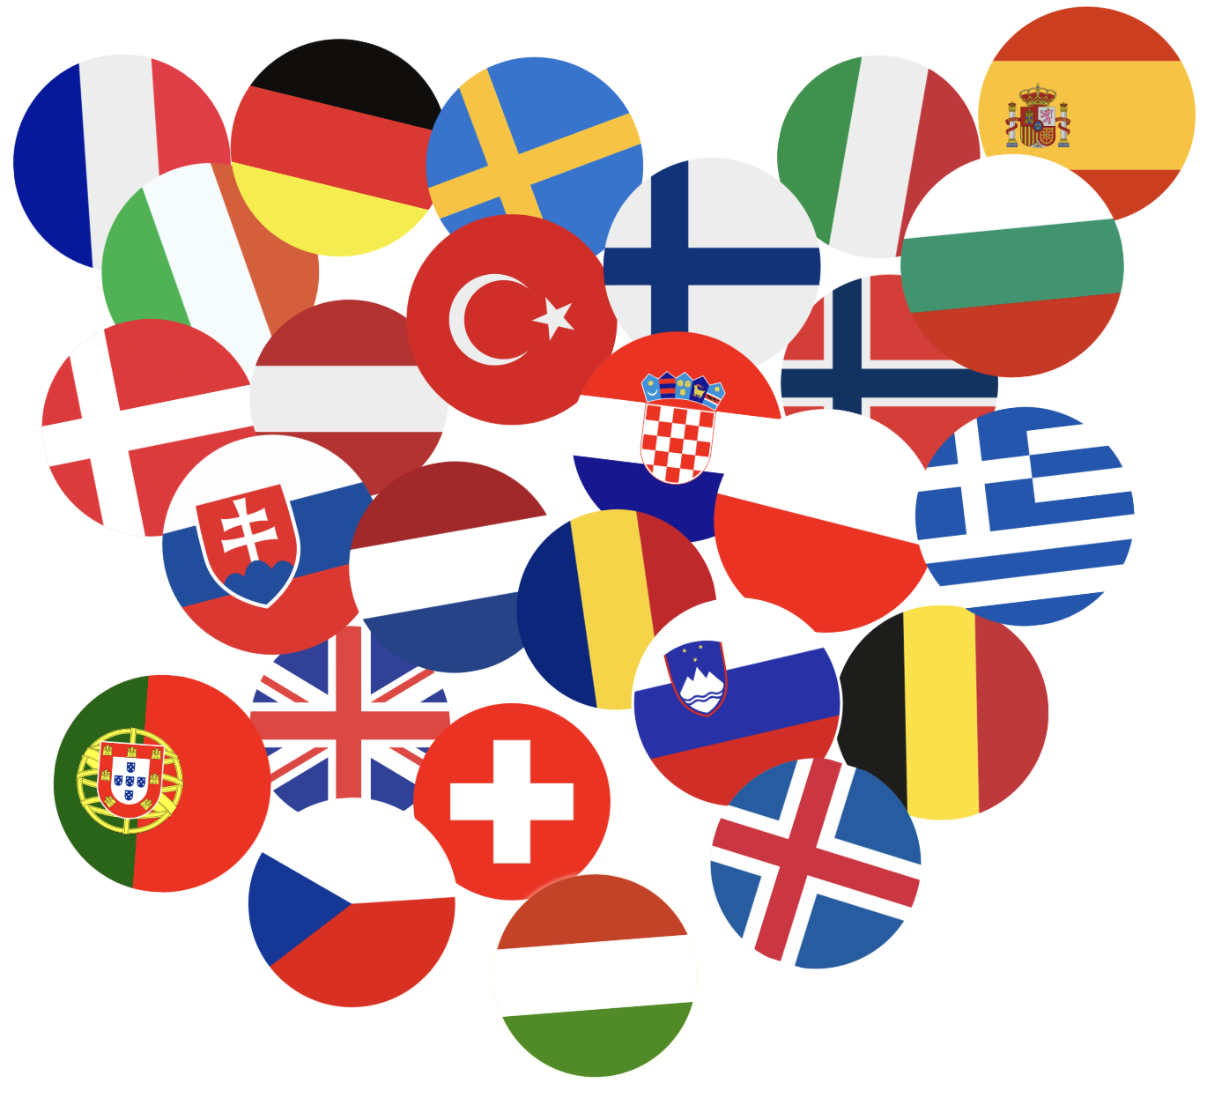
EPOS’ Key components:
National contributions to EPOS
“National Clusters” : aggregate National Research Infrastructures (NRI) across one country.
Can take different forms:
  single existing organisations appointed at the ministry level,
  Joint Research Units
  Consortia
  Nationally funded projects…
Have a key role in involving and engaging with data providers and ensure the provision of quality-controlled data from authoritative national sources
Data ownership remains with the data provider, and the
same apply to data curation responsibilities. Data is distributed and made discoverable though EPOS and proper citation of data and service providers is ensured.
Notes:
Another key aspect is coordination at the national level. As we saw, at the policy level Member States are committed to sustain Research Infrastructures in several ways, from the payment of membership fees to cover the ERIC operations, to the inclusion of the contribution to a certain RI in their national roadmaps (which often include funding at the national level). The participation of the national scientific communities though is as important as the policy and financial commitment.
In some countries, national (and sometimes regional) participation in EPOS is organised through participation to “national clusters” , which aggregate National Research Infrastructures (NRI) across one country.
Depending on the country, national clusters can take different forms:
single existing organisations appointed at the ministry level,
Joint Research Units
Consortia
Nationally funded projects…
They have a key role in involving and engaging with data providers and ensure the provision of quality-controlled data from authoritative national sources
Data ownership remains with the data provider, and the same apply to data curation responsibilities. Through EPOS, data are distributed and made discoverable across disciplines. Proper citation of data and service providers is part of the EPOS’ data policy

Slide 21




Data Types
Data, Data products, Software and services provided by 10 different communities
  Georeferenced data - (e.g., maps, seismic stations)
  Time series data - (e.g., GPS, geomagnetic stations)
  Non-georeferenced data - (e.g., software packages, reports)
Notes:
But which data exactly can be found in the EPOS platform?
As mentioned, the solid Earth science community presents a complex scenario with heterogeneous data types, various data taxonomies and processing levels, different community standards, formats and vocabularies.
In EPOS we deal with many different data types, which can be broadly classified into three large categories:
Georeferenced (or geospatial) data, is data having an implicit or explicit association with a location relative to Earth. This spatial information can be represented in many different ways: coordinates, grids, maps, vectors and so on… Examples of this data that are common in solid Earth sciences are for instance geological maps or seismic stations.
Time series data are sequences of data points collected over an interval of time, indexed in time order. Examples of this category include GPS data, volcanic activity, geomagnetic measurements…
Non-georeferenced data, encompass all data and data products that do not refer explicitly or implicitly to a location. Examples may span from software packages, to reports.

Slide 22
Data Taxonomies and Processing Levels
Data level | Definition
0 | raw data, or basic data e.g: seismograms, accelerograms, time series, ...
1 | data products coming from nearly automated procedures e.g.: earthquake locations, magnitudes, focal mechanisms, shakemaps, ....
2 | data products resulting by scientists’ investigations e.g: crustal models, strain maps, earthquake source models, ...
3 | integrated data products coming from complex analyses or community shared products e.g.: hazards maps, catalogue of active faults, ...
Notes:
Looking at this from the point of view of Data Taxonomies, we can see that - as in many other domains- the EPOS scientific data and data products can have different processing levels, going from the raw, unprocessed data to very sophisticated products that are the result of different layers of processing by humans and machines.
This table shows the EPOS Data taxonomy. We can distinguish four levels based on the degree of processing and interpretation involved.
Data Level 0: Refers to raw or basic data collected directly from instruments. These include unprocessed recordings like seismograms, accelerograms, and time series. This is the foundational layer from which all other data products are derived.
Data Level 1: Includes data products generated through nearly automated procedures, such as earthquake locations, magnitudes, focal mechanisms, and shakemaps. These products are typically produced using standardized processing algorithms and involve minimal human interpretation.
Data Level 2: Represents data products resulting from scientific analysis and interpretation. Examples include crustal models, strain maps, and earthquake source models. These are developed through detailed investigations by researchers and incorporate more sophisticated methodologies.
Data Level 3: Comprises integrated data products derived from complex analyses or collaborative efforts. This includes community-shared resources such as hazard maps and catalogues of active faults. These products synthesize information from multiple sources and often serve broader scientific or public safety purposes.

Slide 23
Heterogenous Landscape
Data
types & formats
Service
types & standards
Data and services highly heterogeneous in terms of formats, vocabularies, standards and protocols
Notes:
The last aspect I’d like to highlight is the data formats and sevice standards. This slide presents at a glance the view of different data representations and standards across the EPOS community: you can see that there’s a wide variability not only in the data types (and consequently handled data formats), but also in the data standards adopted or developed by different communities and their diffusion.
Managing data in this context implies integrating diverse data sources, each with unique data formats and standards, and an extensive collaboration among scientific communities. That’s why concertation is needed to ensure adhering to international best practices and agreed (meta)data and protocols standards from different scientific disciplines. The interoperability of diverse data standards and representations across communities is one of the key challenges for solid Earth sciences RIs - and the raison d’être of large-scale infrastructures such as EPOS or its international counterparts.

Slide 24
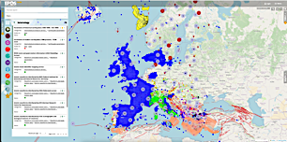
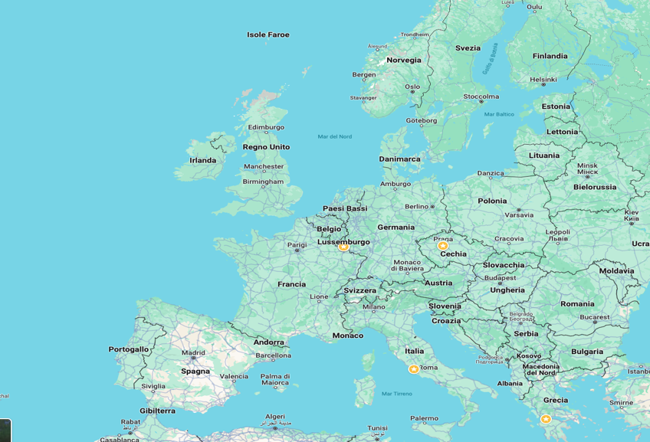
1. Data Management
Distributed Data Provision
EPOS Platform
Notes:
And this is how the data provision from all these different stakeholders looks like on the EPOS platform…

Slide 25
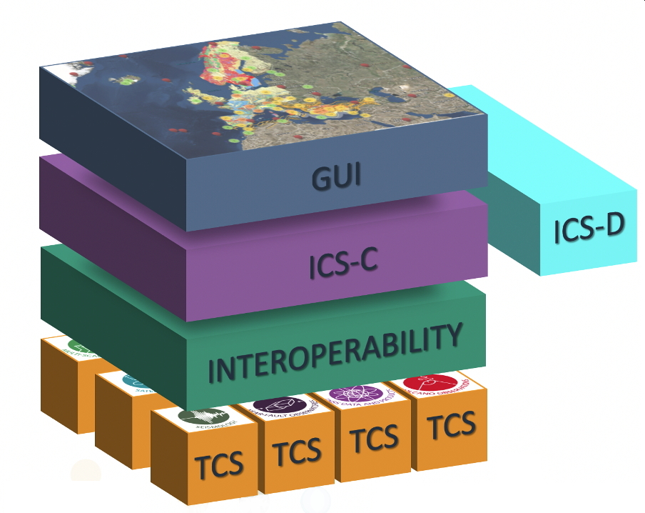
Integrating EPOS’ components
EPOS’ different components and stakeholders are integrated through a single IT hub: the ICS (Integrated Core Services)
The ICS provides the core of
the EPOS e-infrastructure, ensuring interoperability between the data and services provided by the TCSs and the National Research Infrastructures (NRIs) and their discoverability and accessibility.
Notes:
The last, key element of the recipe is the ICS, or Integrated Core Services
This is the single IT hub: that ensures the integration of EPOS’ different components and stakeholders.
The ICS provides the core of the EPOS e-infrastructure, ensuring interoperability between the data and services provided by the TCSs and the National Research Infrastructures (NRIs) and their discoverability and accessibility.

Slide 26
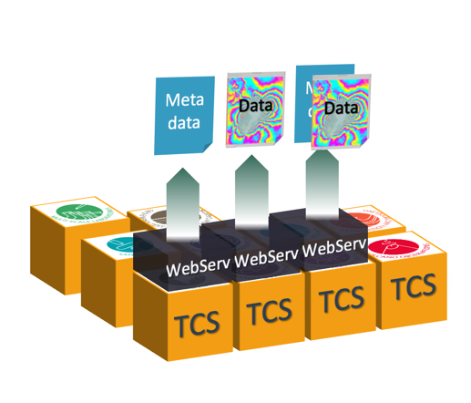
Data Access
Data provisioning and access in EPOS
Datasets are provided by Thematic Core Services (TCS), acting as domain-specific data providers
Datasets and metadata are heterogeneous, reflecting community-specific standards and formats
Data and metadata are accessed via standardized, machine-readable web services
Web services are described using a common, machine-readable standard (EPOS-DCAT-AP)
Notes:
So this is how we make sense and organize this complexty through the EPOS Platform
Metadata & Semantic Driven Approach that allows to describe datasets and access protocols in a formal and canonical language, using a common vocabulary and serialized in a machine-readable format.
Service-based approach that allows to access datasets abstracting from the TCS-specific technologies. This approach allows to ‘leave data where they are’.
Micro-service inspired architecture (for the central platform), that implements modularity, enables scalability and allows interoperability with underlying data services provided by TCS.

Slide 27
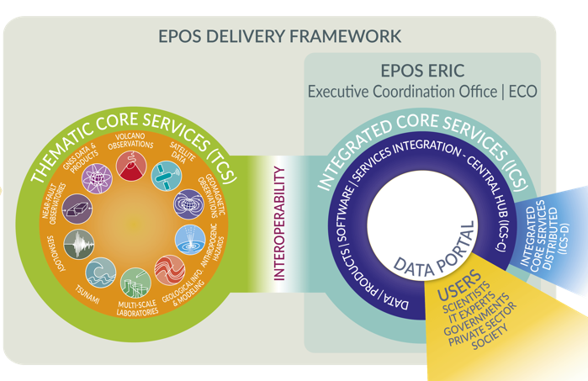
From Strategy to Practice: collaborating in the EPOS ecosystem
EPOS has been built by assembling key elements
to allow the whole system to work as a single, but distributed, sustainable research infrastructure
DATA Integration
DATA Access
Notes:
Let’s now see as these elements interact in the EPOS Ecosystem. This is a picture we use to describe the EPOS Architecture. It’ s very information packed so we shall analyse one element at a time.

Slide 28

From Strategy to Practice: collaborating in the EPOS ecosystem
DATA Integration
DATA Access
NRIs and other organisations generate and manage data for science and society
Notes:
The first element we are going to consider are National Research Infrastructures, i.e. all the infrastructures in research organisations, universities etc which have in their mission to collect, store and curate Solid Earth Science Data.
They are the providers of scientific data and products, and they ensure they are quality-controlled, up-to-date and curated. They do not interact directly with EPOS per se, but through the TCS

Slide 29
From Strategy to Practice: collaborating in the EPOS ecosystem
DATA Integration
DATA Access
NRIs and other organisations generate and manage data for science and society
TCS provide the governance framework necessary to ensure
that data and metadata, from different sources and in different formats,
are harmonised and made accessible through services on the Platform
Notes:
The Thematic core services, or TCS for brief, provide the governance framework necessary to ensure that data and metadata, from different sources and in different formats, are harmonised and made accessible through services on the Platform. The TCS play a key role in ensuring the thematic ommunity adopts and implements shared standards in line with the principles of FAIR data management.

Slide 30
From Strategy to Practice:
collaborating in the EPOS ecosystem
DATA Integration
DATA Access
ICS integrate data and services and make them FAIRly accessible through a single-access point
NRIs and other organisations generate and manage data for science and society
TCS provide the governance framework necessary to ensure
that data and metadata, from different sources and in different formats,
are harmonised and made accessible through services on the Platform
Notes:
The TCS is responsible for integrating these harmonised thematic services and ensuring their interoperability. In this way, multidisciplinary data become Findable, Accessible, Interoperable and Reusable through a single, digital platform

Slide 31
From Strategy to Practice: collaborating in the EPOS ecosystem
DATA Integration
DATA Access
ICS integrate data and services and make them FAIRly accessible through a single-access point
NRIs and other organisations generate and manage data for science and society
users exploit the EPOS Platform to
access, visualise, combine, download data from different scientific domains
TCS provide the governance framework necessary to ensure
that data and metadata, from different sources and in different formats,
are harmonised and made accessible through services on the Platform
Notes:
Now end-users can exploit the platform to access, visualise, combine, download and now also compute data from different domains.

Slide 32
Part 4: The EPOS Platform

Slide 33
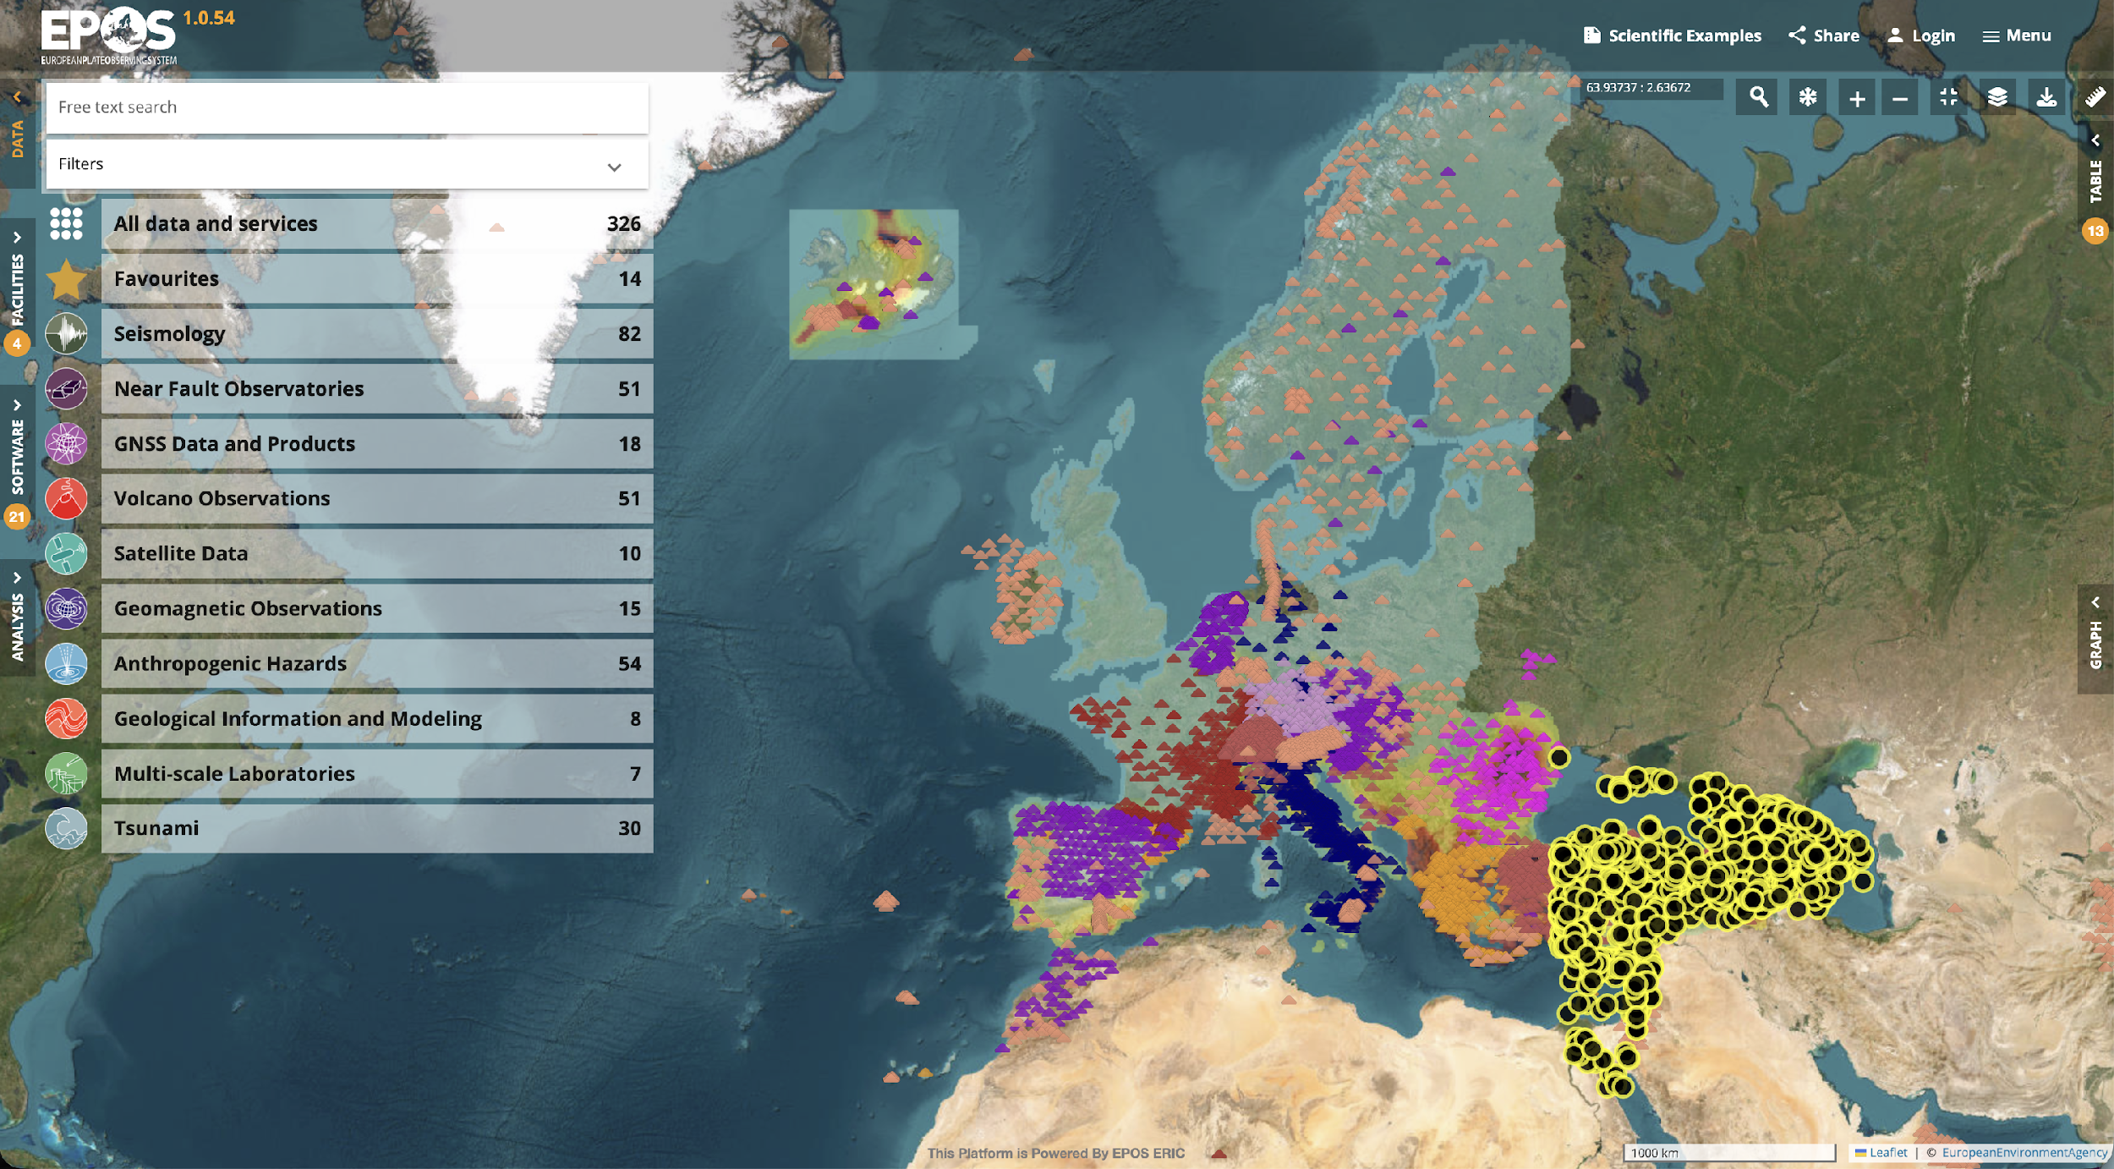
The result: EPOS Platform
One-stop shop platform enabling any user to openly access to standardized, interoperable, quality-controlled data from 10 different disciplines and >500 data sources across Europe
www.epos-eu.org/platform
Notes:
And this is how all this looks like.
The EPOS Platform offers access to multidisciplinary, standardised and interoperable data and resources from community-vetted sources with a service-driven approach. Different data can be discovered, visualised, combined, and downloaded and new data processing services and manipulation tools are being now included directly in the platform, with the idea that in a near future the EPOS platform will become one of the tools used regularly by researchers in their daily work.

Slide 34
The EPOS Platform today
🌐 329 Services
📈 767 Data and Service Providers
🧾 ~329,000 lines of source code developed
🔧 ~30,000 GitLab commits every year
🐞 ~20,056 known bugs fixed
☕ ~150 liters of coffee drunk every year per developer
💾 8+Petabytes of data integrated
www.epos-eu.org/platform
Notes:
And this is how all this looks like.
The EPOS Platform offers access to multidisciplinary, standardised and interoperable data and resources from community-vetted sources with a service-driven approach. Different data can be discovered, visualised, combined, and downloaded and new data processing services and manipulation tools are being now included directly in the platform, with the idea that in a near future the EPOS platform will become one of the tools used regularly by researchers in their daily work.

Slide 35
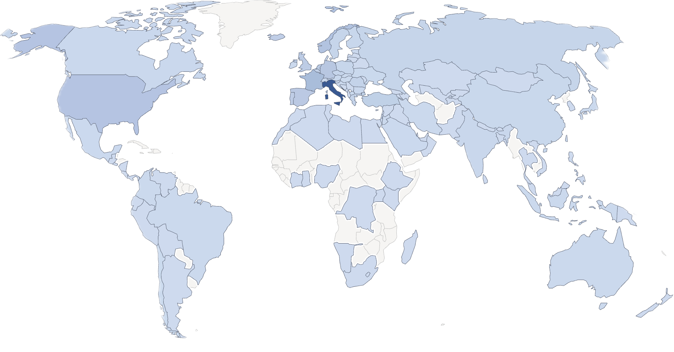
The EPOS Platform: global access
Global access to the EPOS Platform
40,574 visitors from 124 Countries … …and growing
(updated: 25/05/2026)
www.epos-eu.org/platform
Notes:
And this is how all this looks like.
The EPOS Platform offers access to multidisciplinary, standardised and interoperable data and resources from community-vetted sources with a service-driven approach. Different data can be discovered, visualised, combined, and downloaded and new data processing services and manipulation tools are being now included directly in the platform, with the idea that in a near future the EPOS platform will become one of the tools used regularly by researchers in their daily work.

Slide 36
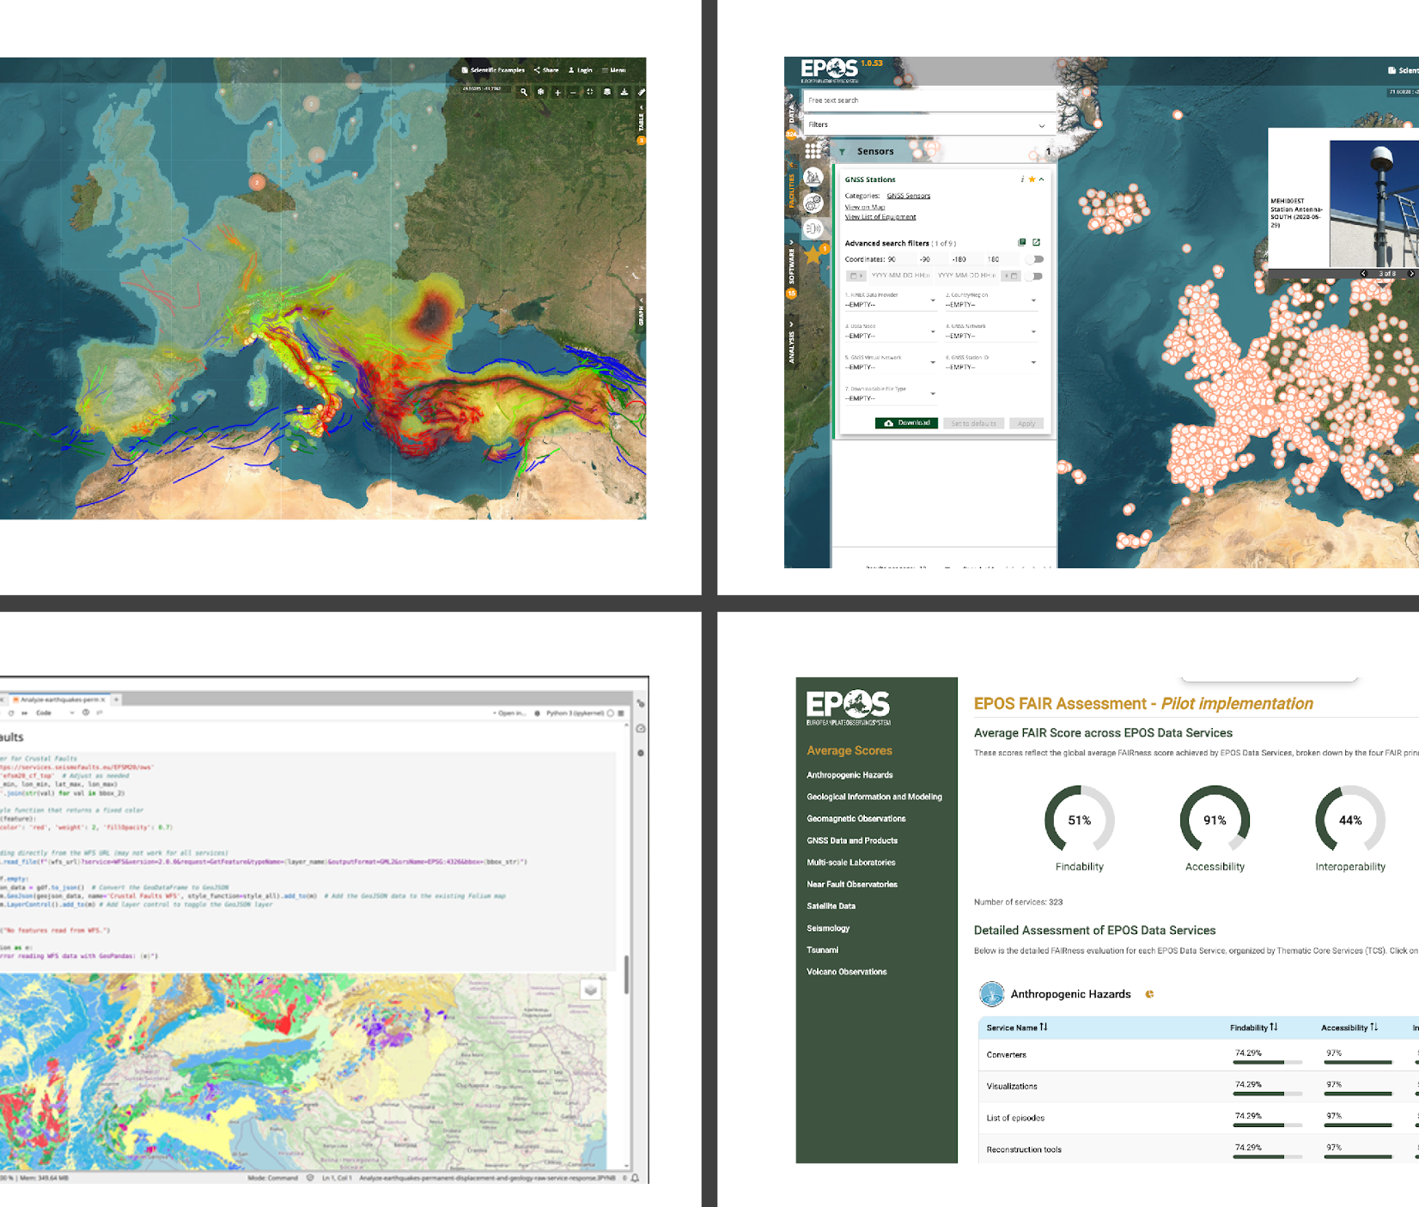
The EPOS Platform evolution: not just data
The EPOS Platform is in continuous evolution
Integrating new data and products
Integrating new types of information (e.g. equipment, facilities…)
FAIR Assessment tool for services
Computational tools to complement data discovery/access and offer users a more complete one-stop-shop experience
Data Discovery and Access
Facilities and Equipment
Data Processing and Analysis
FAIR Assessment

Slide 37
Addressing societal challenges
Moving from “culture of reaction to culture of prevention”
Integration and combination of the multidisciplinary data to generate products to forecast the events, assess natural hazard and mitigate the risk, sustainably exploit geo-resources
Supporting scientists in developing tools for societal resilience against natural and anthropogenic hazards and for sustainable exploration and exploitation of geo-resources
Assisting decision-makers in the areas of land-use, urban planning, disaster risk reduction, use of geo-resources
Notes:
The EPOS Platform supports knowledge transfer from science to society, fostering in turn the impact that research infrastructures such EPOS can make on societal challenges. Thanks to the streamlined procedures within the community, the openness underpinned by the EPOS community and the seamless integration of the data services, new data and scientific products can be made available to scientists and other societal actors in real time or with minimum delay, fostering the timely creation of new knowledge and its harnessing to practical purposes.
And here are a few examples of how EPOS facilitates the development of innovative concepts and products to assist decision-makers in the areas of land-use, urban planning and disaster risk reduction.

Slide 38
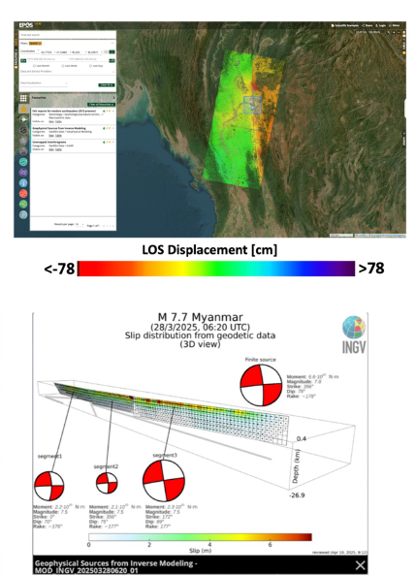
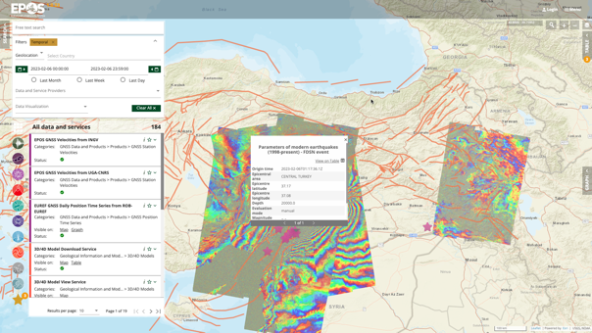
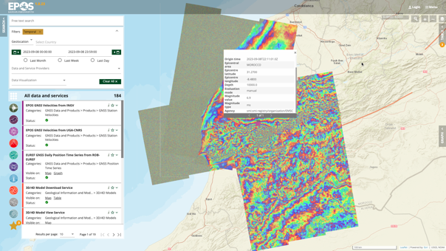
Making data count:
Data and data products rapidly available
Myanmar
28th March 2025
South-East Türkiye 6th February 2023
Southern Morocco 8th September 2023
Notes:
Software is one of the tangible outputs EPOS is openly providing in the real world, but it is not the main one. A key aspect is what we could call “time-to-data”, which, while not part of the FAIR principles, is an important aspect of Open Science and supports Knowledge transfer from science to society, fostering in turn the impact that research infrastructures such EPOS can make on societal challenges.
Thanks to the streamlined procedures within the community, the openness underpinned by the EPOS community and the seamless integration of the data services, new data and scientific products can be made available to scientists and other societal actors in real time or with minimum delay, fostering the timely creation of new knowledge and its harnessing to practical purposes. Here you can see some examples: data on dramatic phenomena like the earthquakes that struck south-eastern Turkey and southern Morocco in 2023, or the one that struck Myanmar only last march were made available almost immediately to the scientific community.

Slide 39
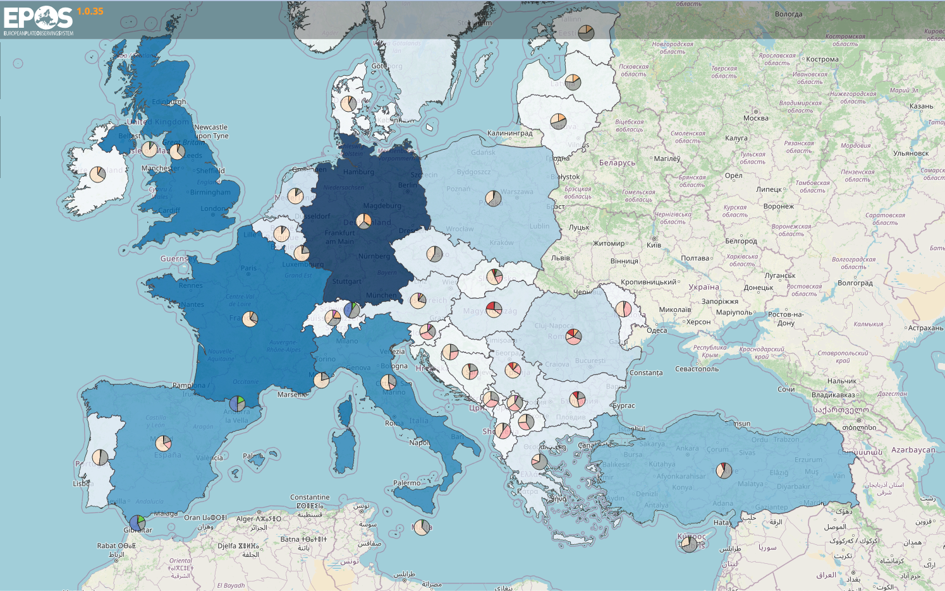
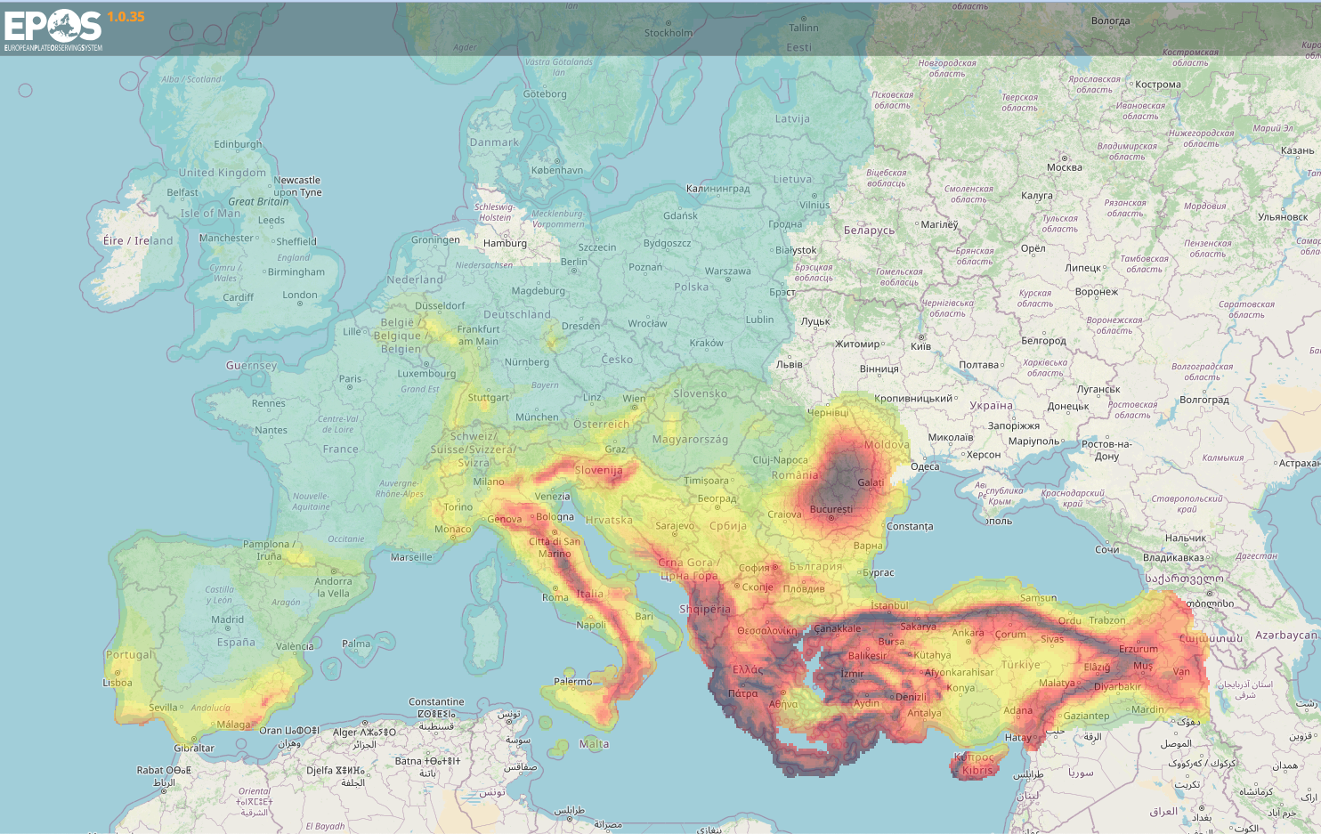
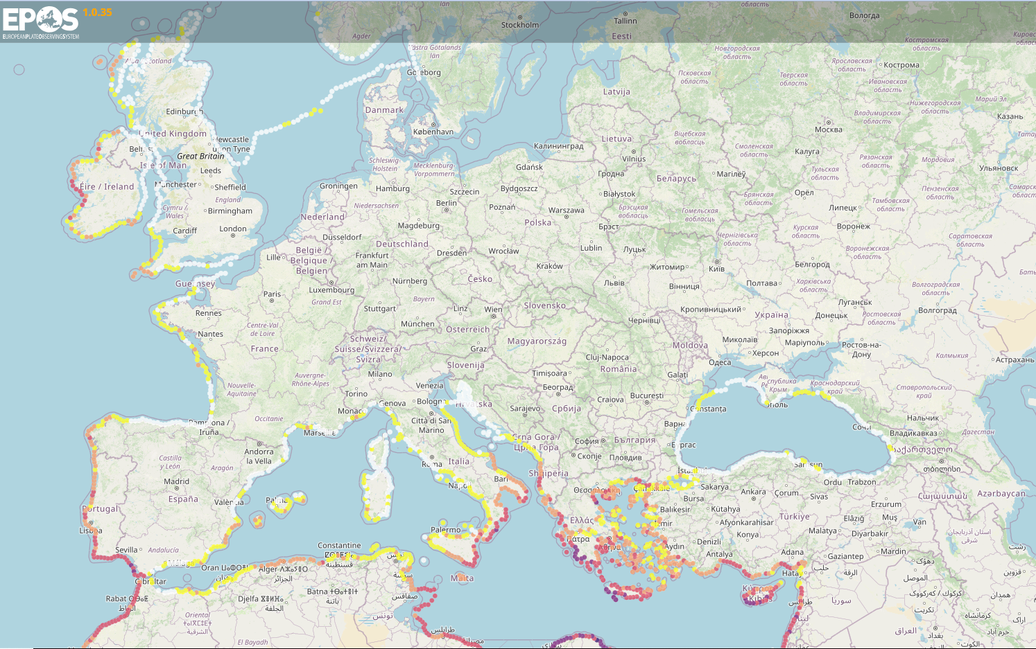
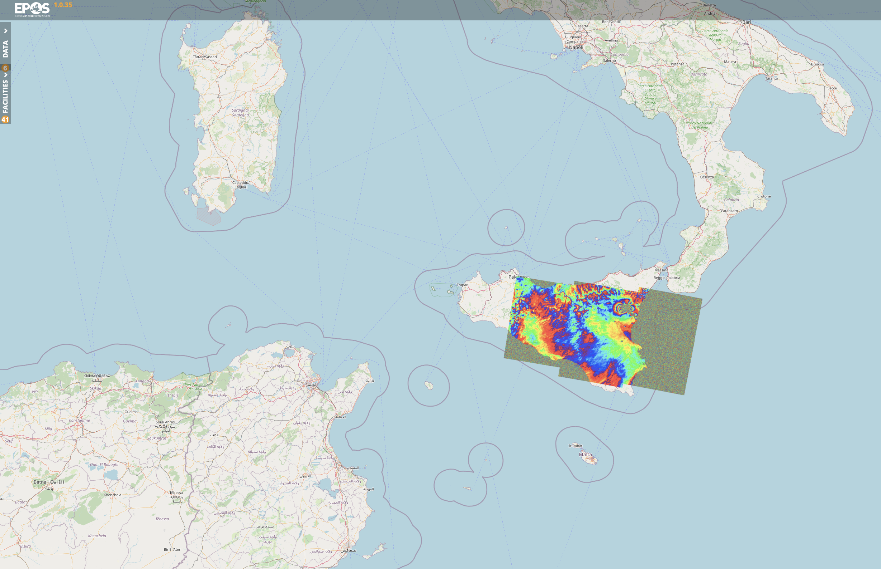
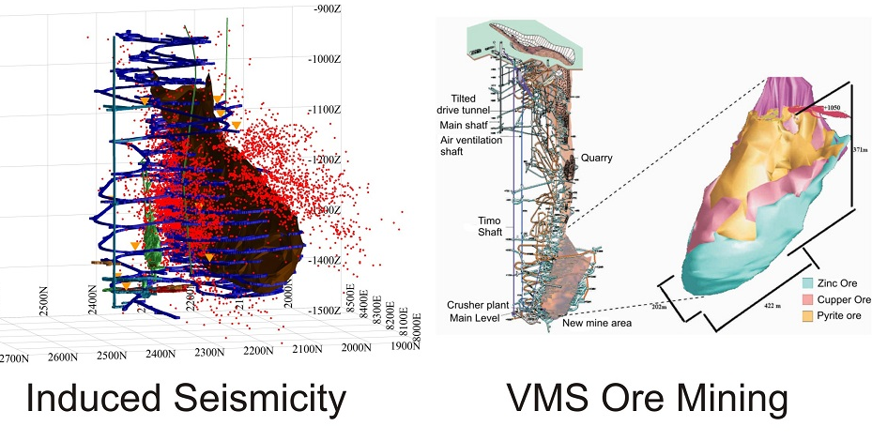
…to make an impact in real life
EPOS facilitates the development of innovative concepts and products
to assist decision-makers in the areas of land-use, urban planning and disaster risk reduction
Exposure Model
Earthquakes Hazard Map
Tsunami Hazard Map
Surface displacements
Anthropogenic Hazards
Improving performance
of mining operation
Monitoring hazards induced
by exploitation of geo-resources
Contributing to address
future scientific and
societal challenges
induced by magma intrusions
Mt. Etna - 24December2018
Induced seismicity VMS ore mining
Pyhäsalmi Mine, Finland
Notes:
And here are a few examples of how EPOS facilitates the development of innovative concepts and productsto assist decision-makers in the areas of land-use, urban planning and disaster risk reduction.
Info on the examples
Exposure Model describes the spatial distribution of residential, commercial and industrial building classes in terms of building count, area, occupants and replacement cost. (country-level distribution of population, total replacement cost of buildings, and total number of buildings (residential, commercial, industrial), and their distribution between lateral load resisting system construction material, within the European Exposure Model).
Earthquakes Hazard Map shows expected level of ground shaking at a specific location due to future potential earthquakes that might occur locally or at a greater distance. Ground shaking is expressed as Peak Ground Acceleration (PGA), normally given in the percentage of "g", the Earth's gravitational acceleration. The values displayed on the earthquake hazard map of Europe are based on the calculations of Europe’s updated earthquake hazard model (ESHM20).
Tsunami Hazard Map is a probabilistic hazard model for tsunamis generated by earthquakes. It covers the coastlines of the North-East Atlantic, the Mediterranean, and connected Seas (NEAM).
Surface displacement - InSAR radar data used to measure surface displacements with centimeter precision - Wrapped Interferogram​, Sentinel 1 - Descending pass 22 December 2018 – 28 December 2018
VMS (value stream mapping) help improving the performance of mining operations.

Slide 40
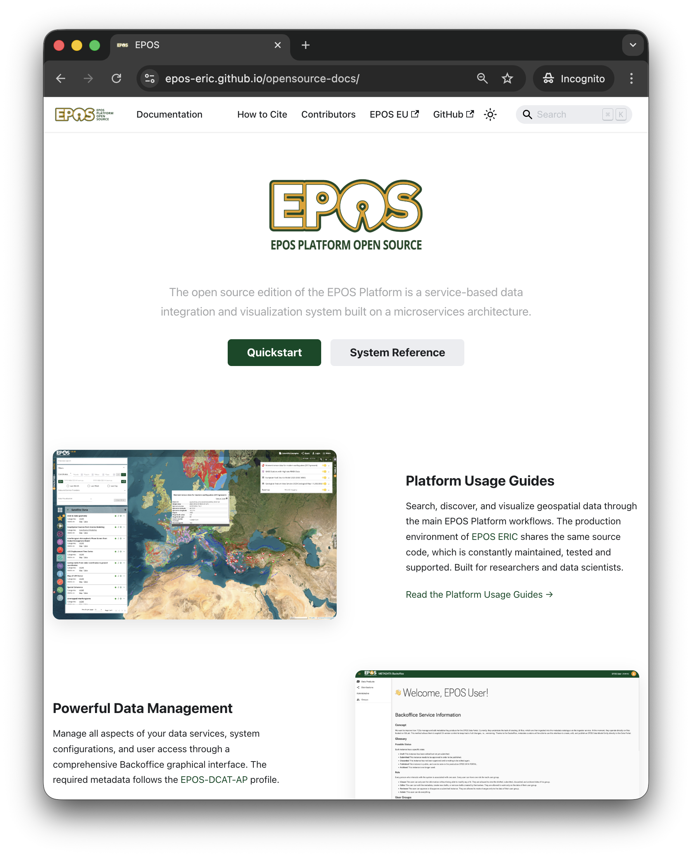
EPOS Open source
The EPOS Platform Open Source is released under the GPLv3 license.
Open-source, service-based data integration and visualization system built on a microservices architecture.
Technical documentation on the platform's architecture and source code for each microservice is available online
https://epos-eric.github.io/opensource-docs/
Notes:
The EPOS Platform is an open-source, service-based data integration and visualization system built on a microservices architecture. It is fully developed in house and released under the GPLv3 license to anyone interested
Users can download the installer to start using the platform right away, or selectively download specific
Download area.
developed in-house and its code is licensed undet a GNU license and available to anyone interested. Several projects, national platforms, or other infrastructures are already using it.

Slide 41

Thank you for your attention!
federica.tanlongo@epos-eric.eu
www.epos-eu.org/on | social media #EPOSon
Notes:
Thank you slide

