Slide 1
Notes:
Good morning everybody
First of all thank you very much for coming
I am very happy that a lot of people are interested in this topic
So, just few words about the structure of this workshop
We will have the first part, a little bit of theory but not so much formulas or something like that
We will go straight on the processing on the Distributed environment, I will show you the services developed by me and my team on GPOD and GEP platform
You will have also the possibility to ask questions
I am Claudio De Luca and I come from the Institute of Electromagnetic Sensing of Environment (IREA)
We work since a long time on RADAR data acquired by satellites and we work basically on SAR Interferometry that is the technique that I will go to explain you
That permits us to detect the ground deformation of the Earth surface

Slide 2
Key points of Radar (SAR) Imaging from space
Active sensors
Microwave sensors
Coherent sensors

Slide 3
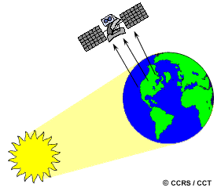
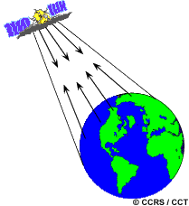
Key points of Radar (SAR) Imaging from space
Capability to "observe" during day and night
Passive sensors use solar radiation (light) or the one emitted by the observed object as source of illumination. Typically they operate in the optical or infrared.
Active sensors have their own source of illumination. Typically they operate in the microwave.

Slide 4
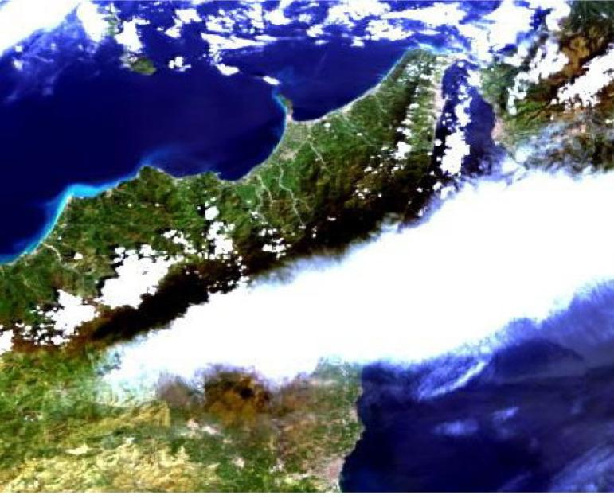
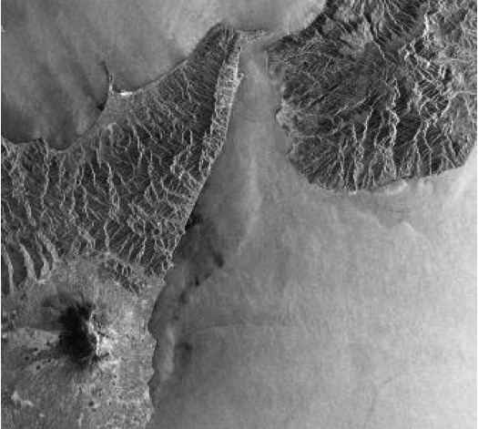
Key points of Radar (SAR) Imaging from space
Capability to "observe" even in presence of clouds
Optical image
Radar (SAR) image
same moment of acquisition

Slide 5
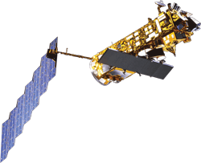
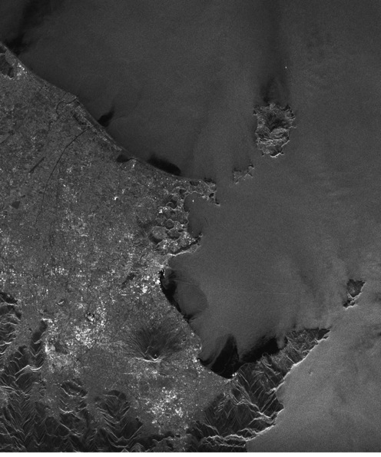
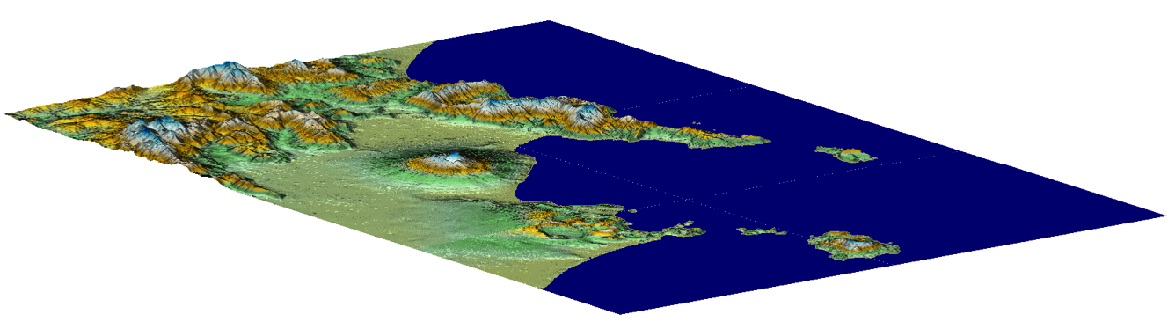
Key points of Radar (SAR) Imaging from space
Coherent sensors
Synthetic Aperture
SAR image
Notes:
Another important aspect of the as said before is that the radar is coherent
The coherence is a concept that came from the phisics that is related to the optical interferometry and subsequently trasled in the radar field
What means coherent? It means that you have a sensor, you have a transmitted signal and you know exactly the signal, in particula the phase of your signal
In this slide I show you a radar moving on the orbital path, sending a signal and reciving it along the path. At the end you can combine all these recived signals along the
Lenght of the Synthetic Aperture.

Slide 6
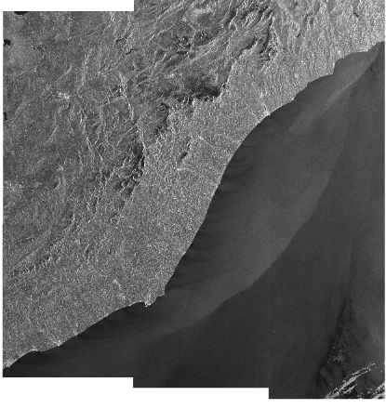
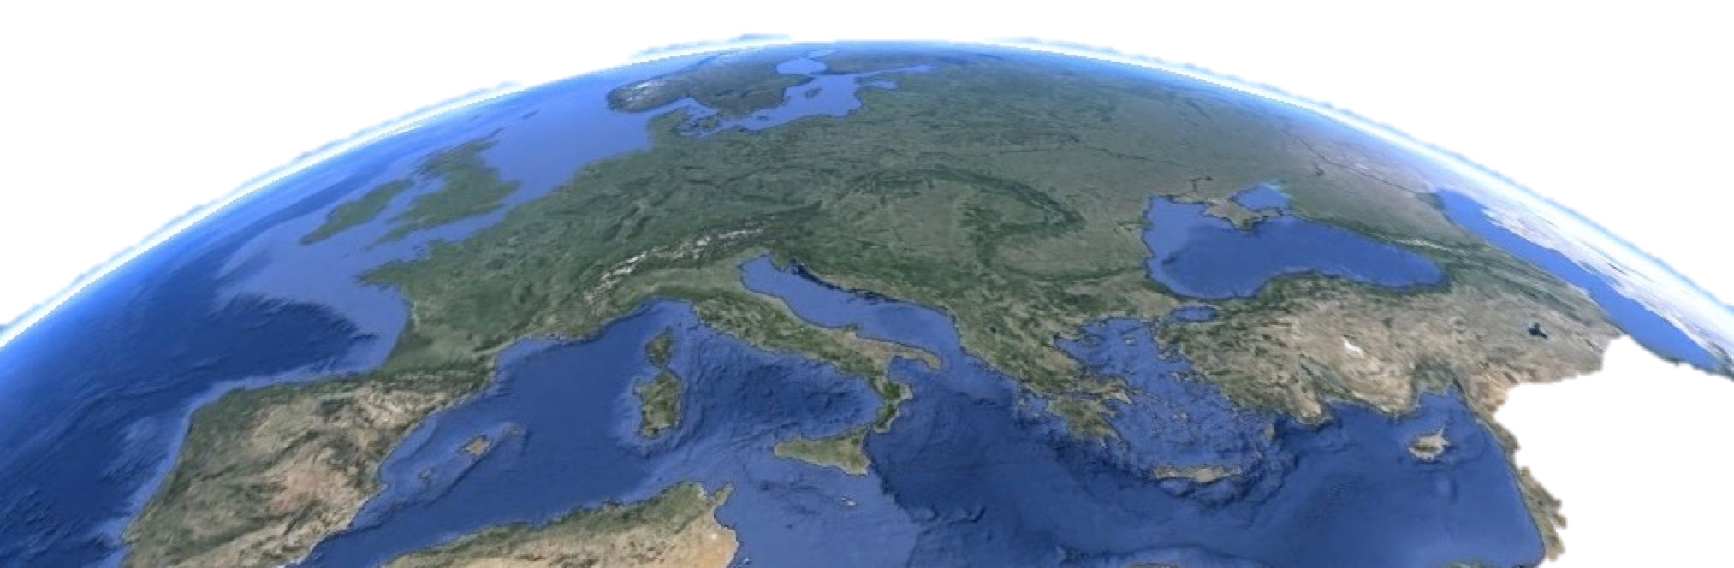
Differential SAR Interferometry (DInSAR)
SAR Image @ t0

Slide 7
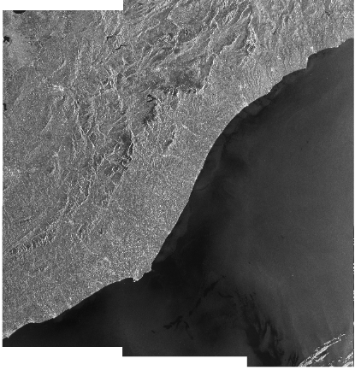
Differential SAR Interferometry (DInSAR)
Baseline
SAR Image @ t0
SAR Image @ t1

Slide 8
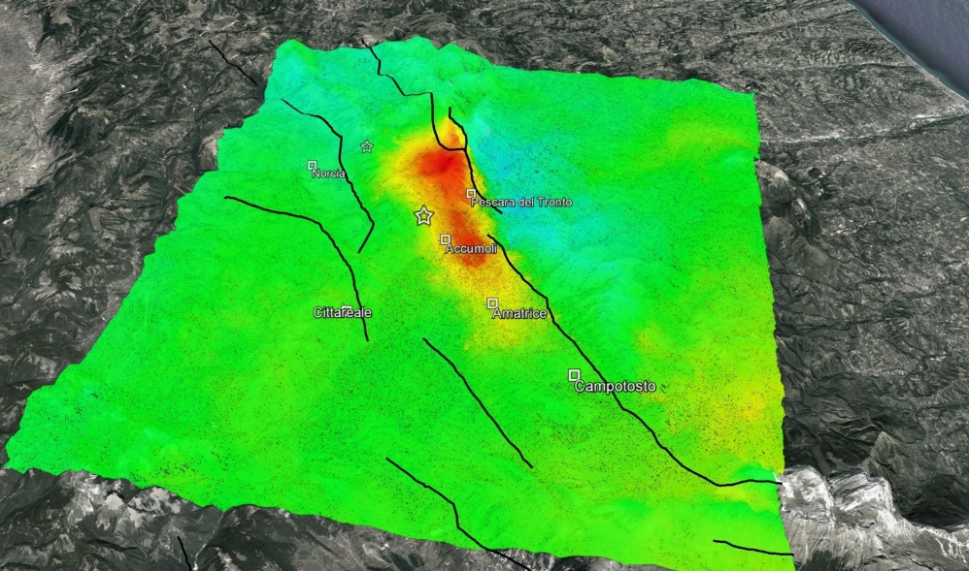

Differential SAR Interferometry (DInSAR)
> 20
Displacement [cm]
Ground Displacement
(Amatrice Earthquake - 24/08/2016)
< - 20

Slide 9
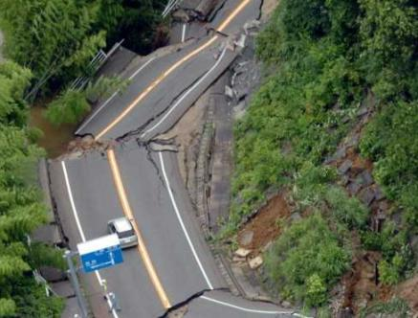
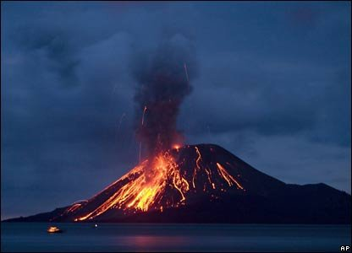
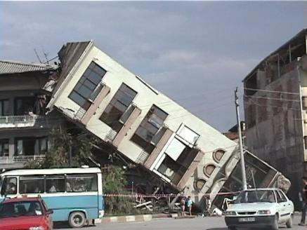
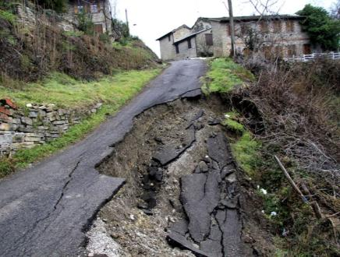
DInSAR can play a key role in many contexts
SEISMIC
VOLCANIC
URBAN
LANDSLIDES

Slide 10
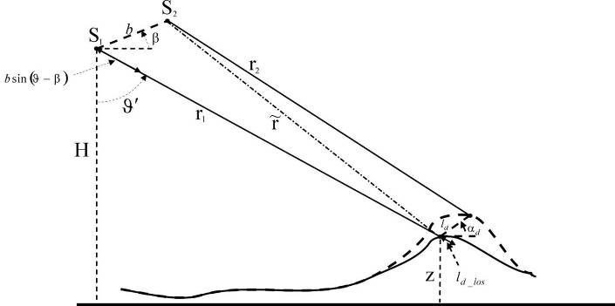
Differential SAR Interferometry (DInSAR)
Observations are done at different epochs and from different orbital positions (real case)
LOS: Line Of Sight
Topographic Phase
Deformation Phase
Notes:
10

Slide 11
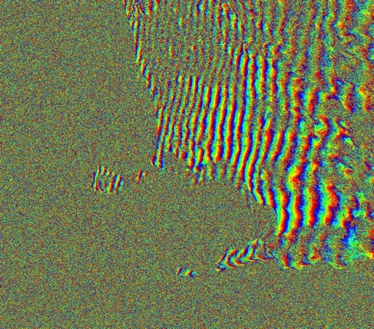
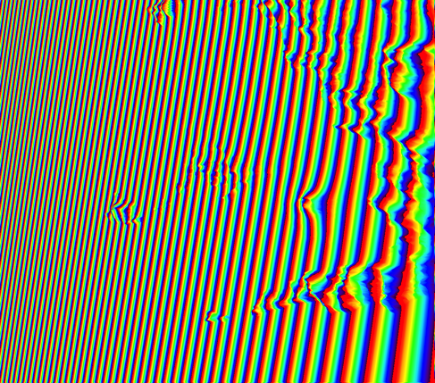
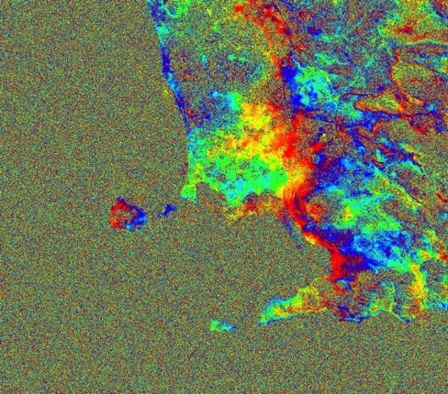
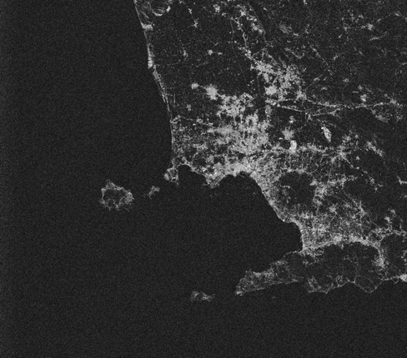
Differential SAR Interferometry (DInSAR)
Topographic
Interferogram
(DEM & orbital
information are
needed)
15042009_20052009_bperp=20m
DInSAR
Interferogram
Generation
(Flattening)
Coherence
Map

Slide 12
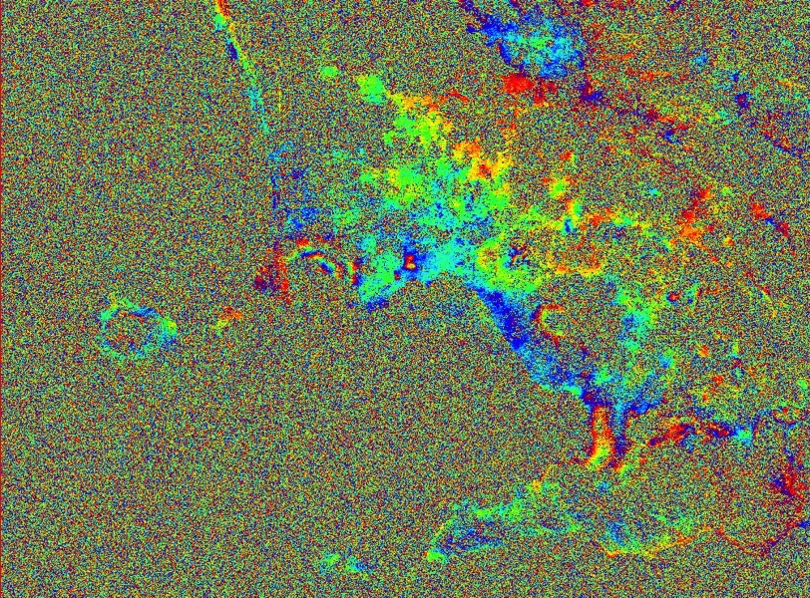



Differential SAR Interferometry (DInSAR)
$$l_{d_los}:Line of Sight Displacement$$
$$φ_{_d}:differential Phase$$
ERS wavelenght: 5.6 cm
Campi Flegrei (3-7/2000)
Centimetric displacements (in some cases even sub-centimetric) can be measured in “coherent” areas!
π
π
-

Slide 13
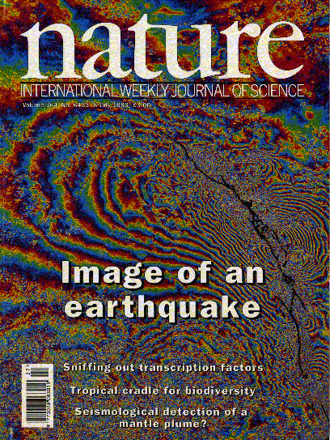
Studying Earthquakes with DInSAR
Landers earthquake, 1992 was the first interferogram of an earthquake using ERS images.
Co-seismic interferogram using ERS data (92/4/24-93/6/18).

Slide 14
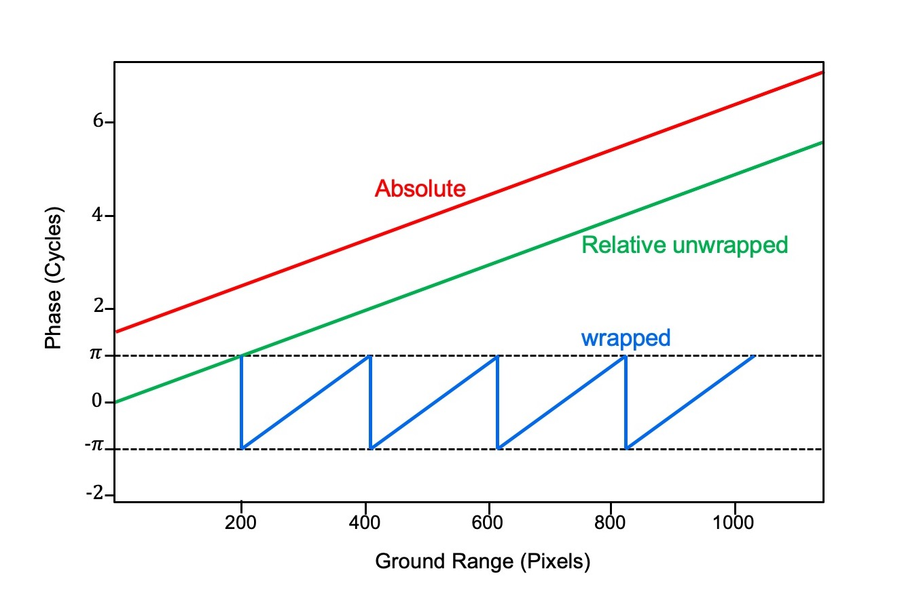
Phase Interpretation

Slide 15

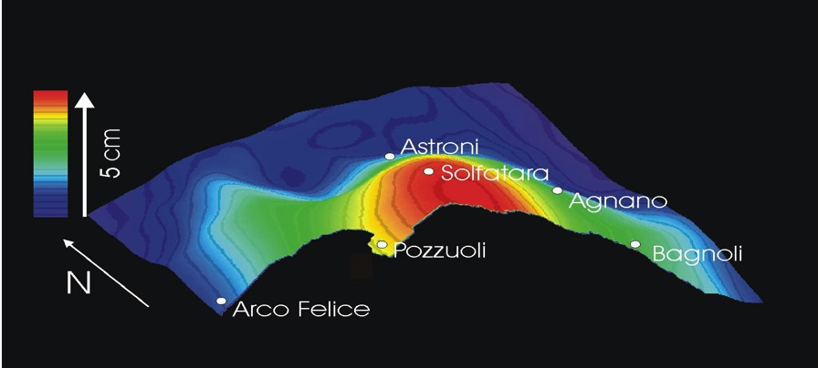
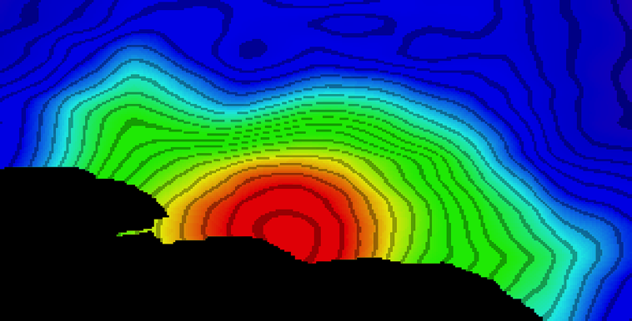

Differential SAR Interferometry (DInSAR)
Wrapped Phase (−π, π)
Phase Unwrapping Operation
3/2000-7/2000
Astroni
40°30’ N
Arco Felice
Solfatara
Agnano
0
2.8
cm
Bagnoli

Slide 16
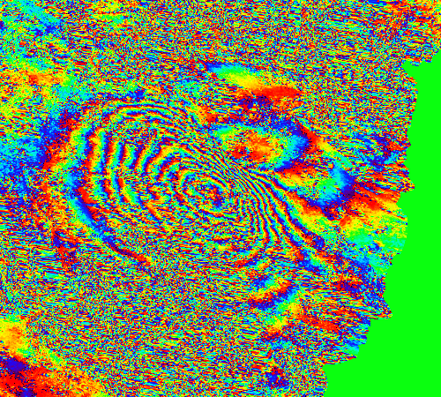
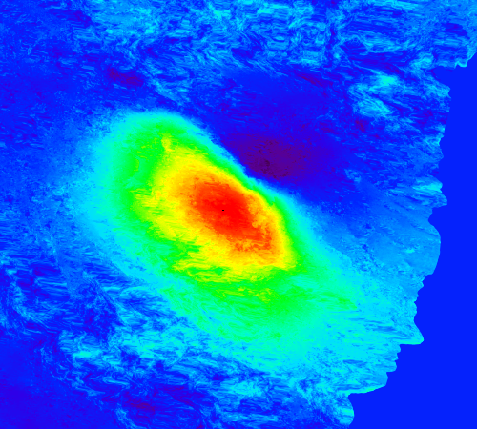

PhU: Phase Unwrapping
Wrapped Phase
Unwrapped Phase
PhU
- π
π
- 27
4
rad
cm
Notes:
Aquila 2009

Slide 17

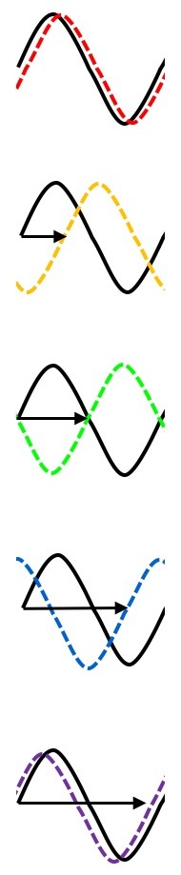
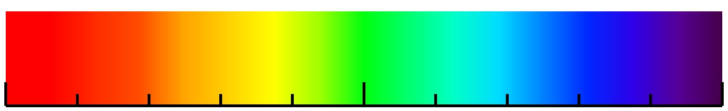
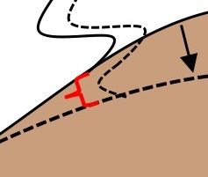

The Interferometric Phase (interpretation)
ground motion
(relative to the satellite)
away from
$$−π$$
cm
$$π$$
0 cm
towards
$λ$/2 cm
phase
difference
pass 1
pass 2
Initial ground surface
Subsided ground surface

Slide 18
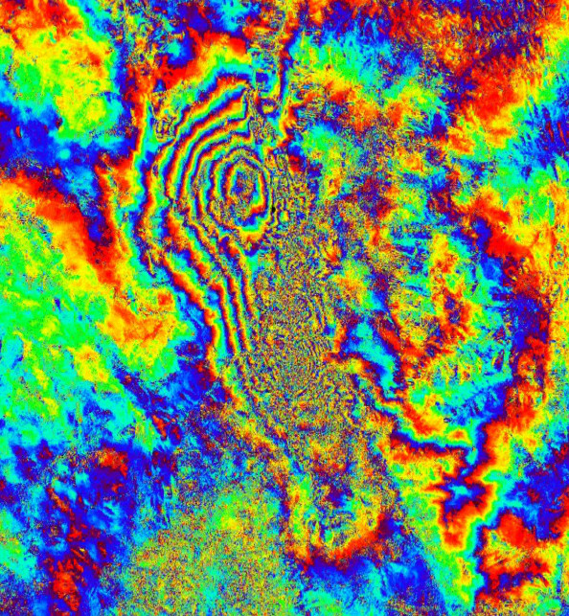
Fringe analysis
Sentinel-1: 21082016–27082016
C-band:
= 5.5 cm
2.8
[cm]
0
Descending

Slide 19
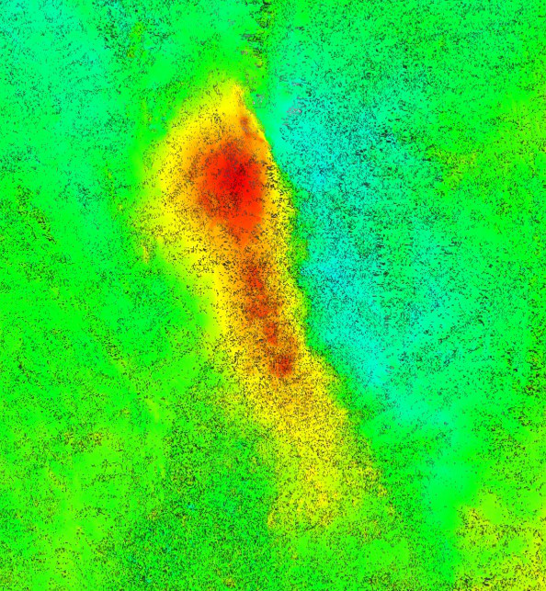
Fringe analysis
Sentinel-1: 21082016–27082016
C-band:
= 5.5 cm
8
[cm]
-21
Descending

Slide 20
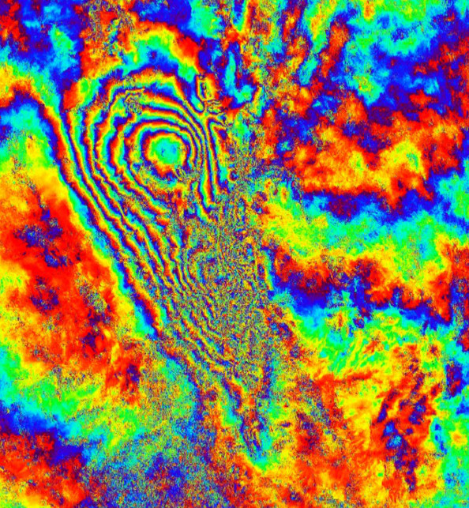
Fringe analysis
Sentinel-1: 15082016–27082016
C-band:
= 5.5 cm
2.8
[cm]
0
Ascending

Slide 21
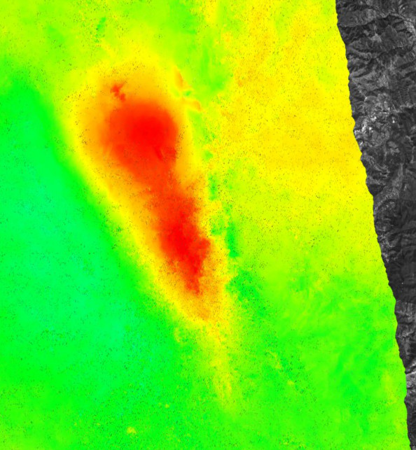
Fringe analysis
Sentinel-1: 15082016–27082016
C-band:
= 5.5 cm
5
[cm]
-22
Ascending

Slide 22
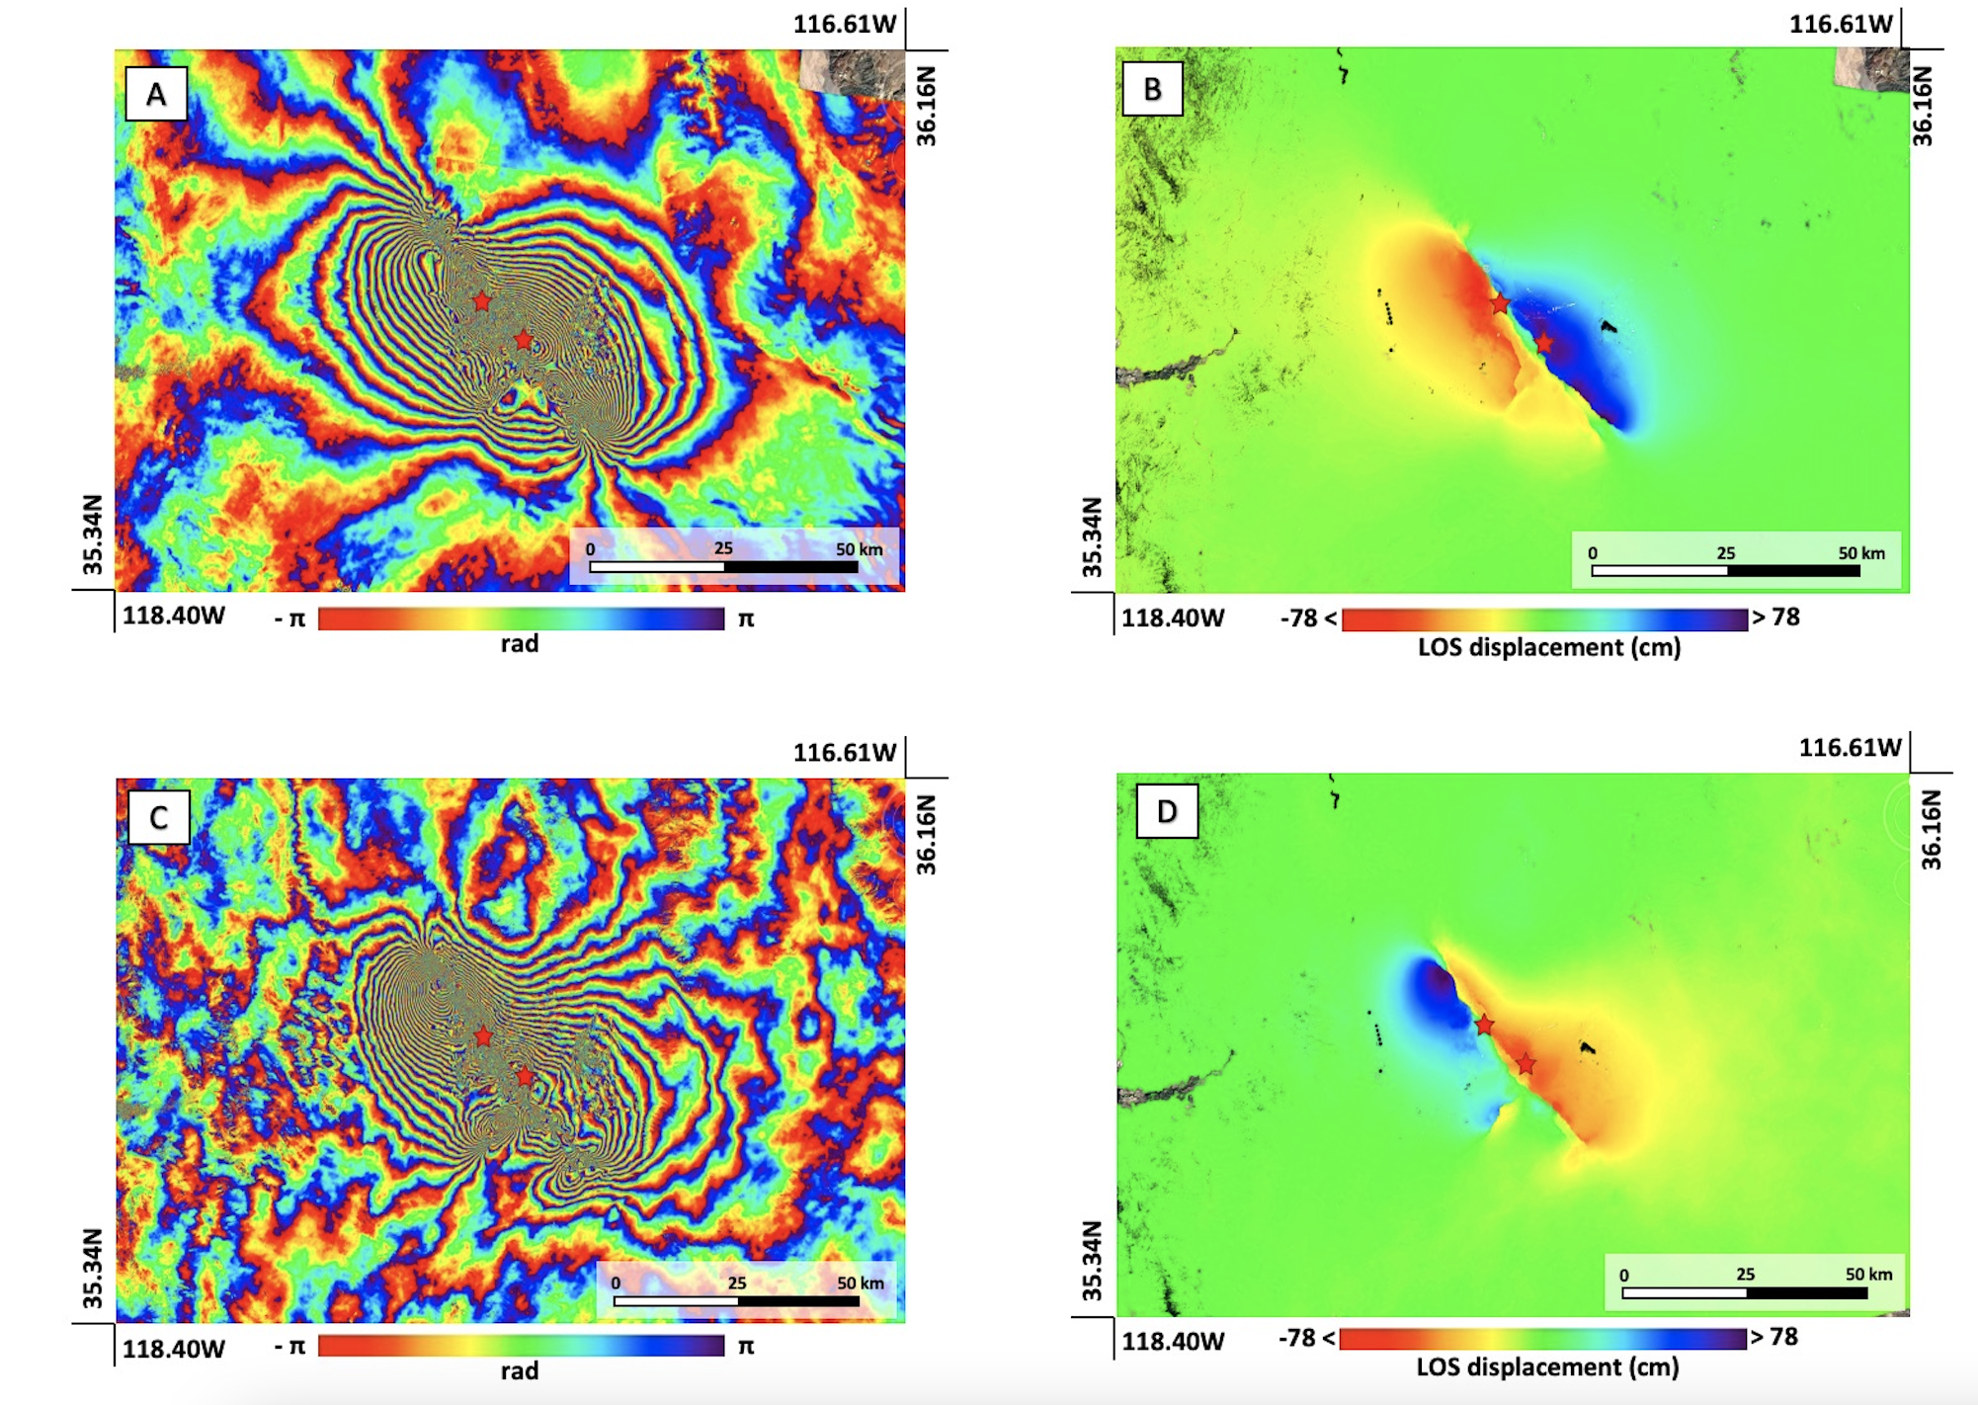
Fringe analysis

Slide 23
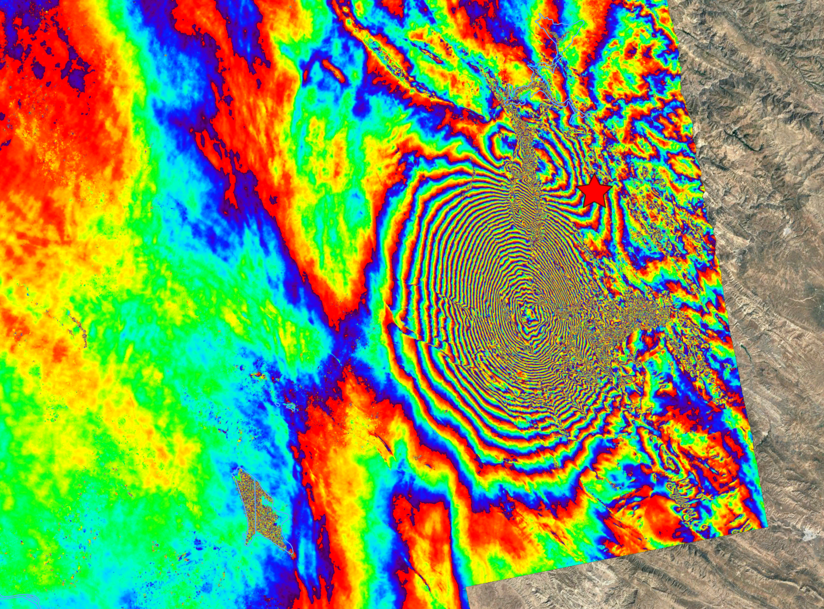
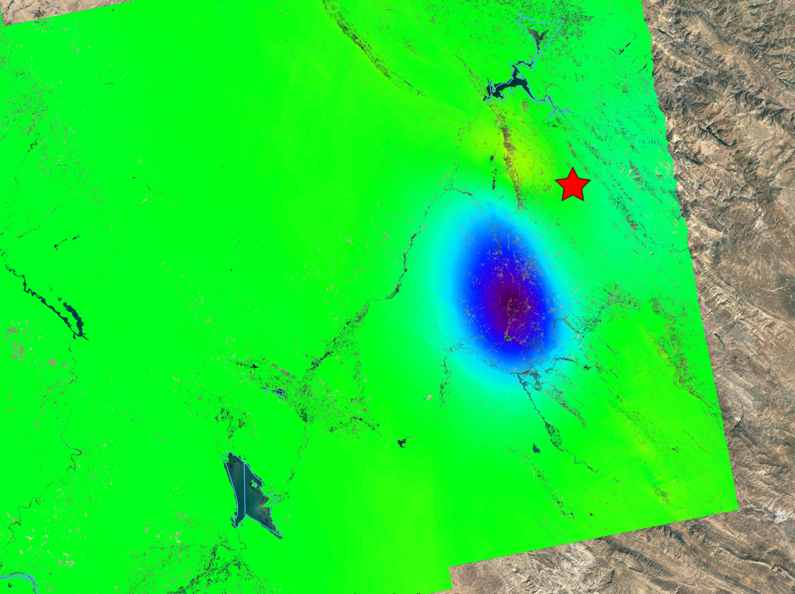

Fringe analysis
A
35.33N
B
46.60E
35.33N
46.60E
.33.97N
0
30
80 km
44.29E
- π
.33.97N
π
0
30
80 km
rad
44.29E
-89 <
> 89
LOS displacement (cm)

Slide 24
Multi-orbit LOS displacement combination
Asc
Desc
θ
z
P
East
$$d_{los}=\left(\cos{θ} −\sin{θ}\cos{α} \sin{θ}\sin{α }\right)\left(\begin{matrix}d_{U} \\ d_{E} \\ d_{N}\end{matrix}\right)$$

Slide 25
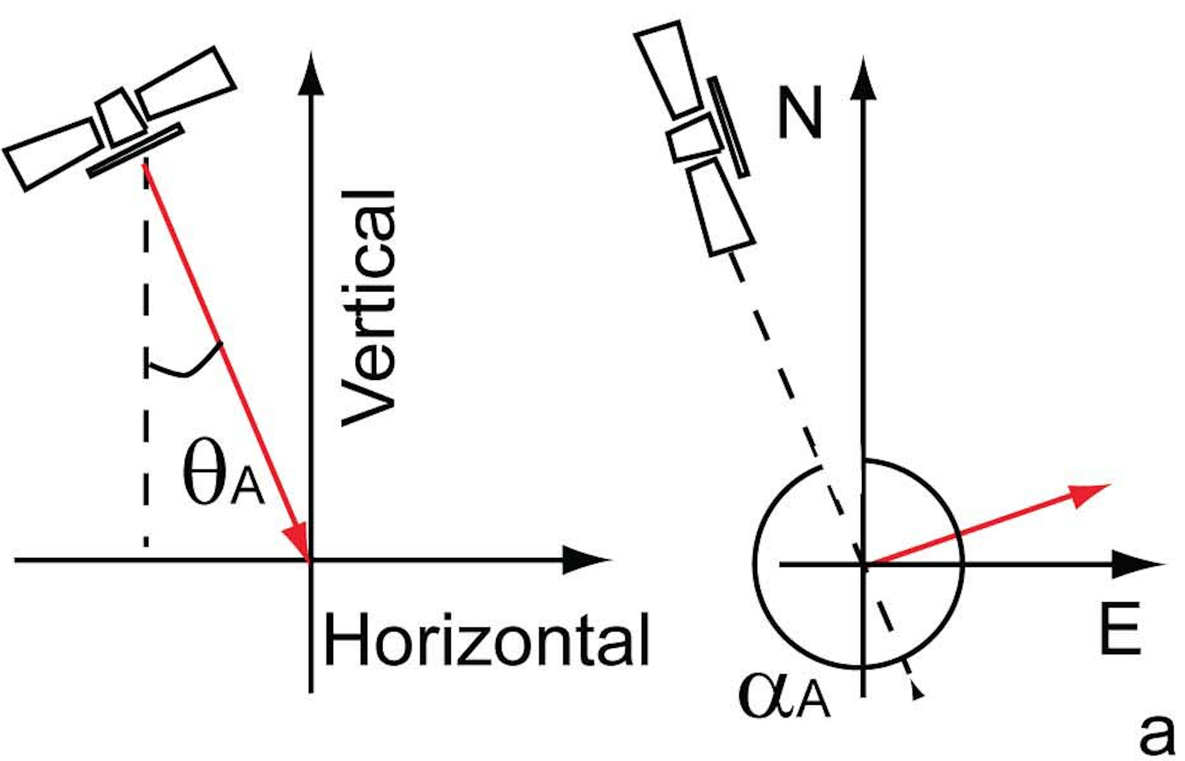
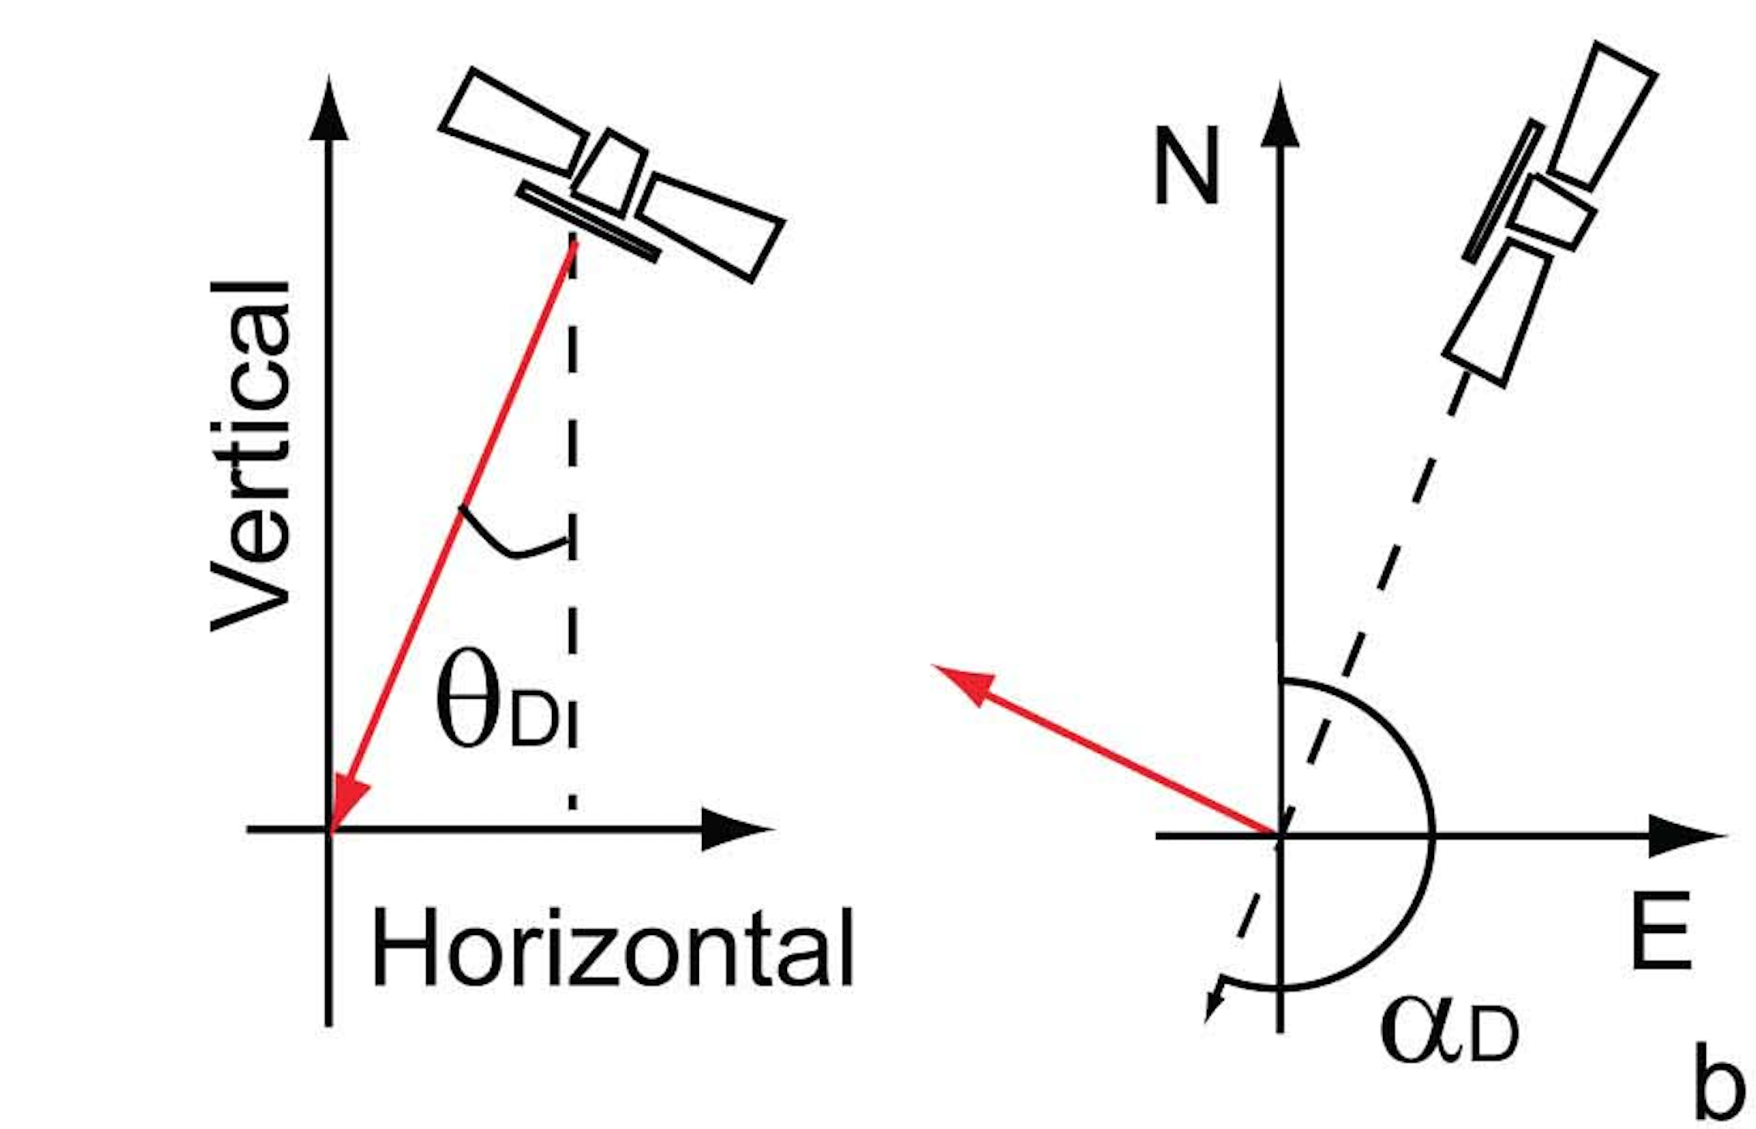
Multi-orbit LOS displacement combination
Ascending Orbit
Descending Orbit
$$\left\{\begin{aligned}&d_{losA} = d_{U}\cos{θ_{A}−d_{E}\sin{θ_{A}\cos{α_{A}−d_{N}sinθ_{A}sinα_{A}}}} \\ & \\ &d_{losD} =d_{U}\cos{θ_{D}−d_{E}\sin{θ_{D}\cos{α_{D}−d_{N}sinθ_{D}sinα_{D}}}} \\ &\end{aligned}\right.$$

Slide 26

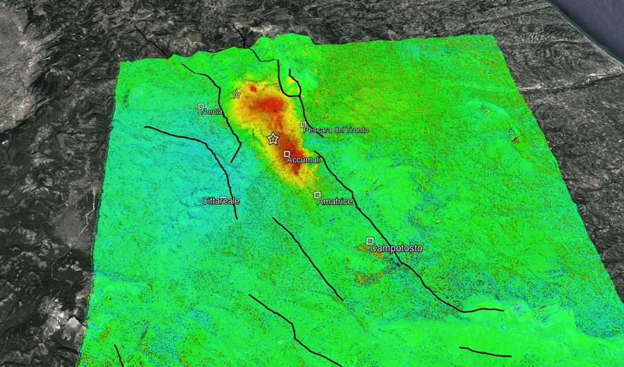
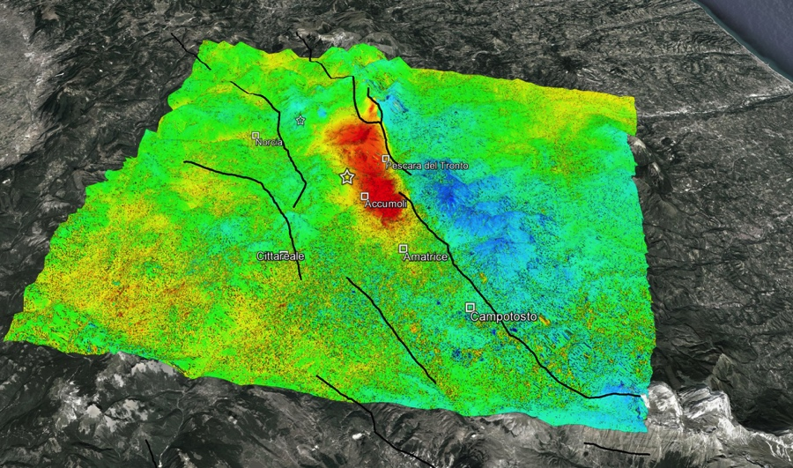
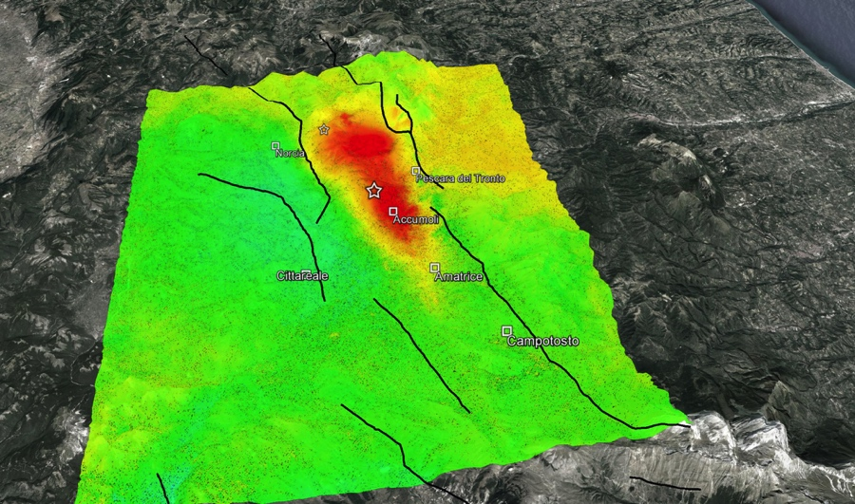


Amatrice earthquake (24/08/2016): DInSAR analysis
ALOS-2 ASC (09092015 – 24082016)
ALOS-2 DESC (25052016 – 31082016)
Sentinel-1 ASC (15082016 – 27082016)
Sentinel-1 DESC (21082016 – 27082016)
LOS Deformation [cm]
<-20 >20

Slide 27
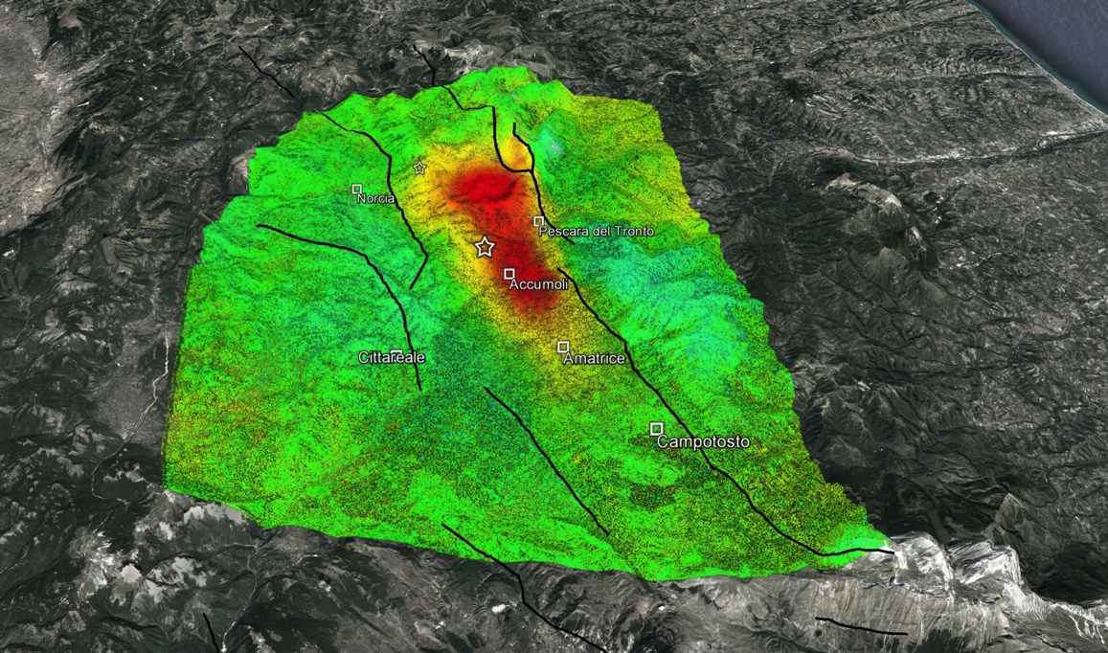
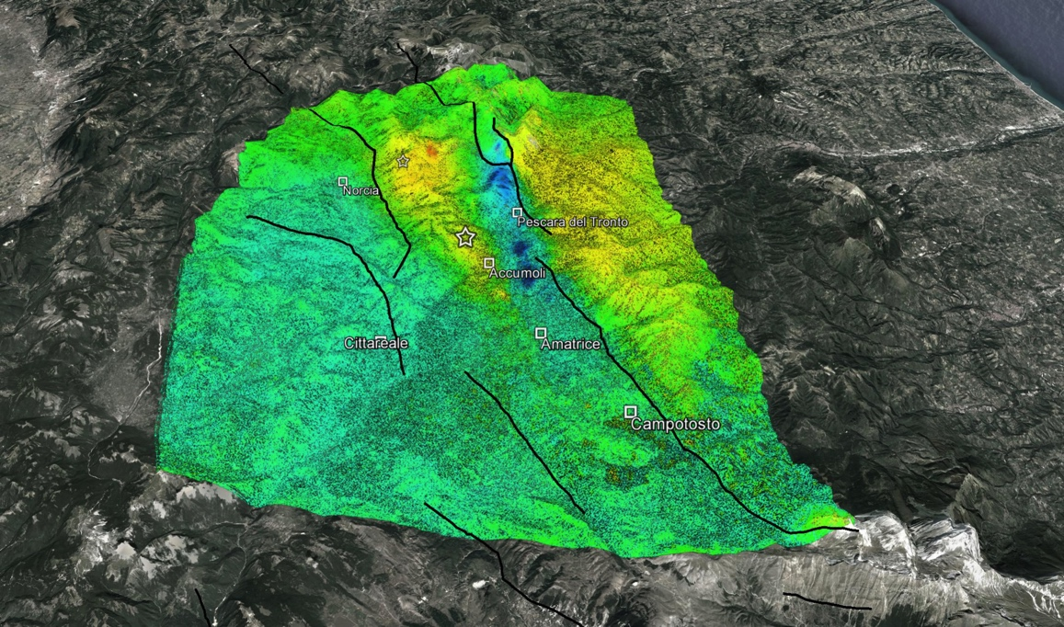

Amatrice earthquake: Vertical and East-West components
> 20
Up
[cm]
Down
< - 20
> 20
East
[cm]
West
< - 20

Slide 28
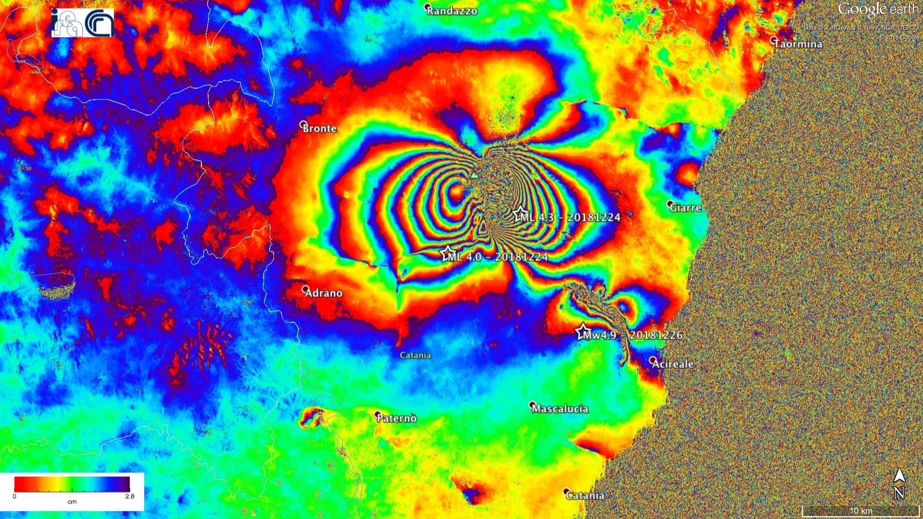
Etna summit eruption and Fiandaca Earthquake
Sentinel-1 descending orbits: 22 – 28 december 2018
Azimuth

Slide 29
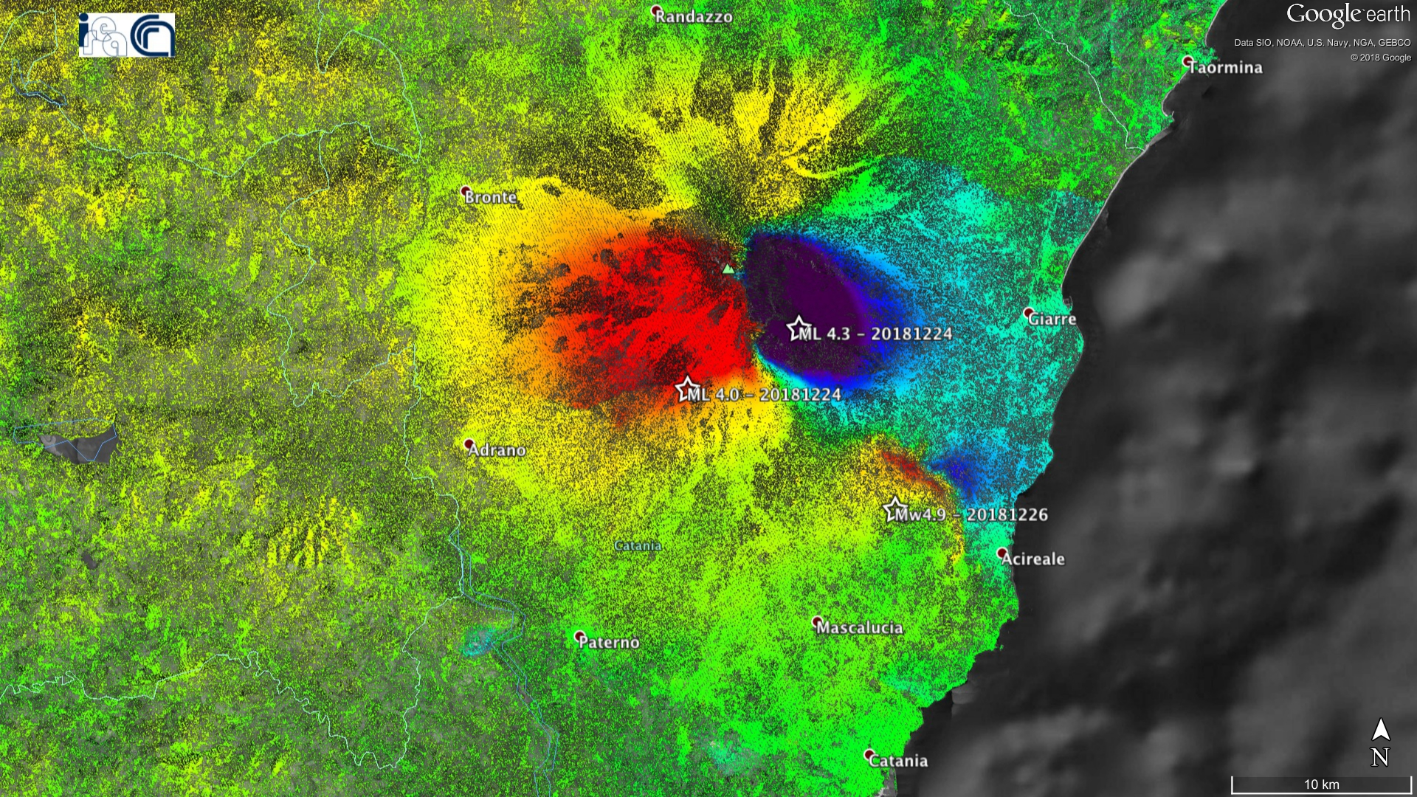
Etna summit eruption and Fiandaca Earthquake
Sentinel-1 descending orbits: 22 – 28 december 2018
Azimuth
<-10
cm
>10
Cm

Slide 30
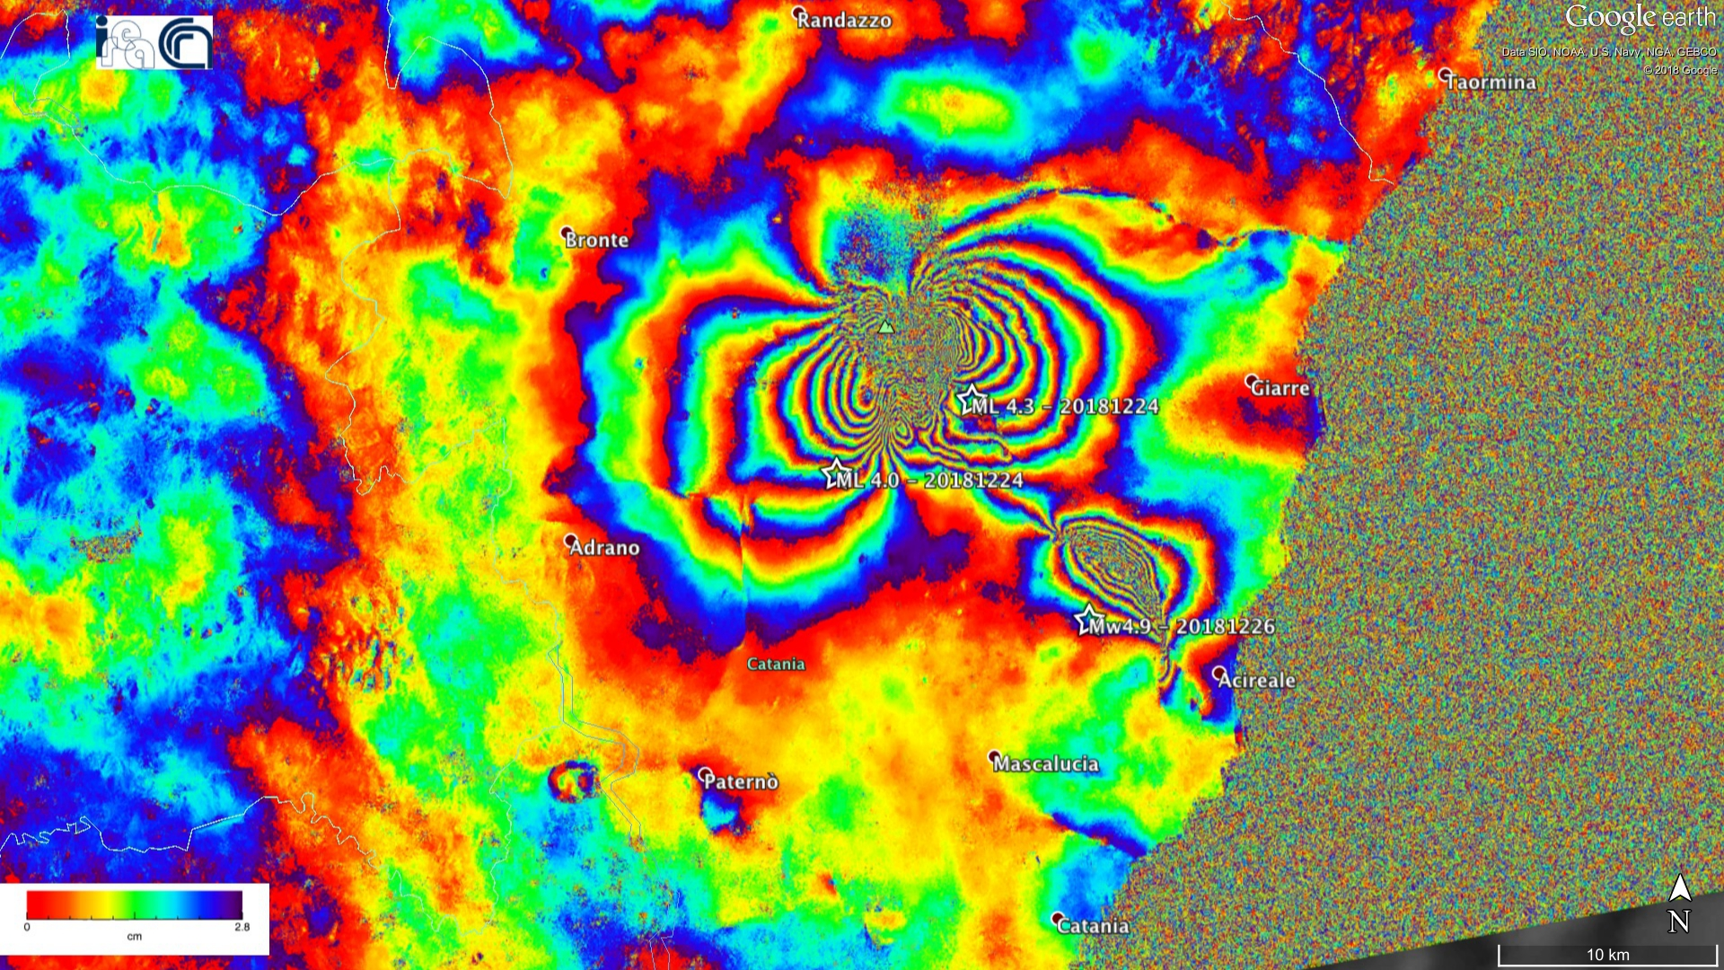
Etna summit eruption and Fiandaca Earthquake
Sentinel-1 ascending orbits: 16 – 28 december 2018
Azimuth

Slide 31
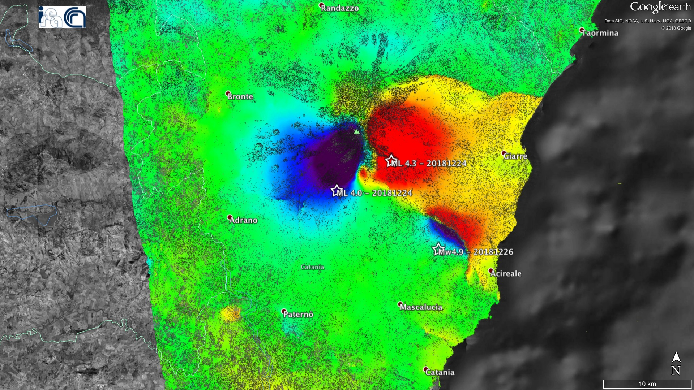
Etna summit eruption and Fiandaca Earthquake
Sentinel-1 ascending orbits: 16 – 28 december 2018
Azimuth
<-10
cm
>10
Cm

Slide 32
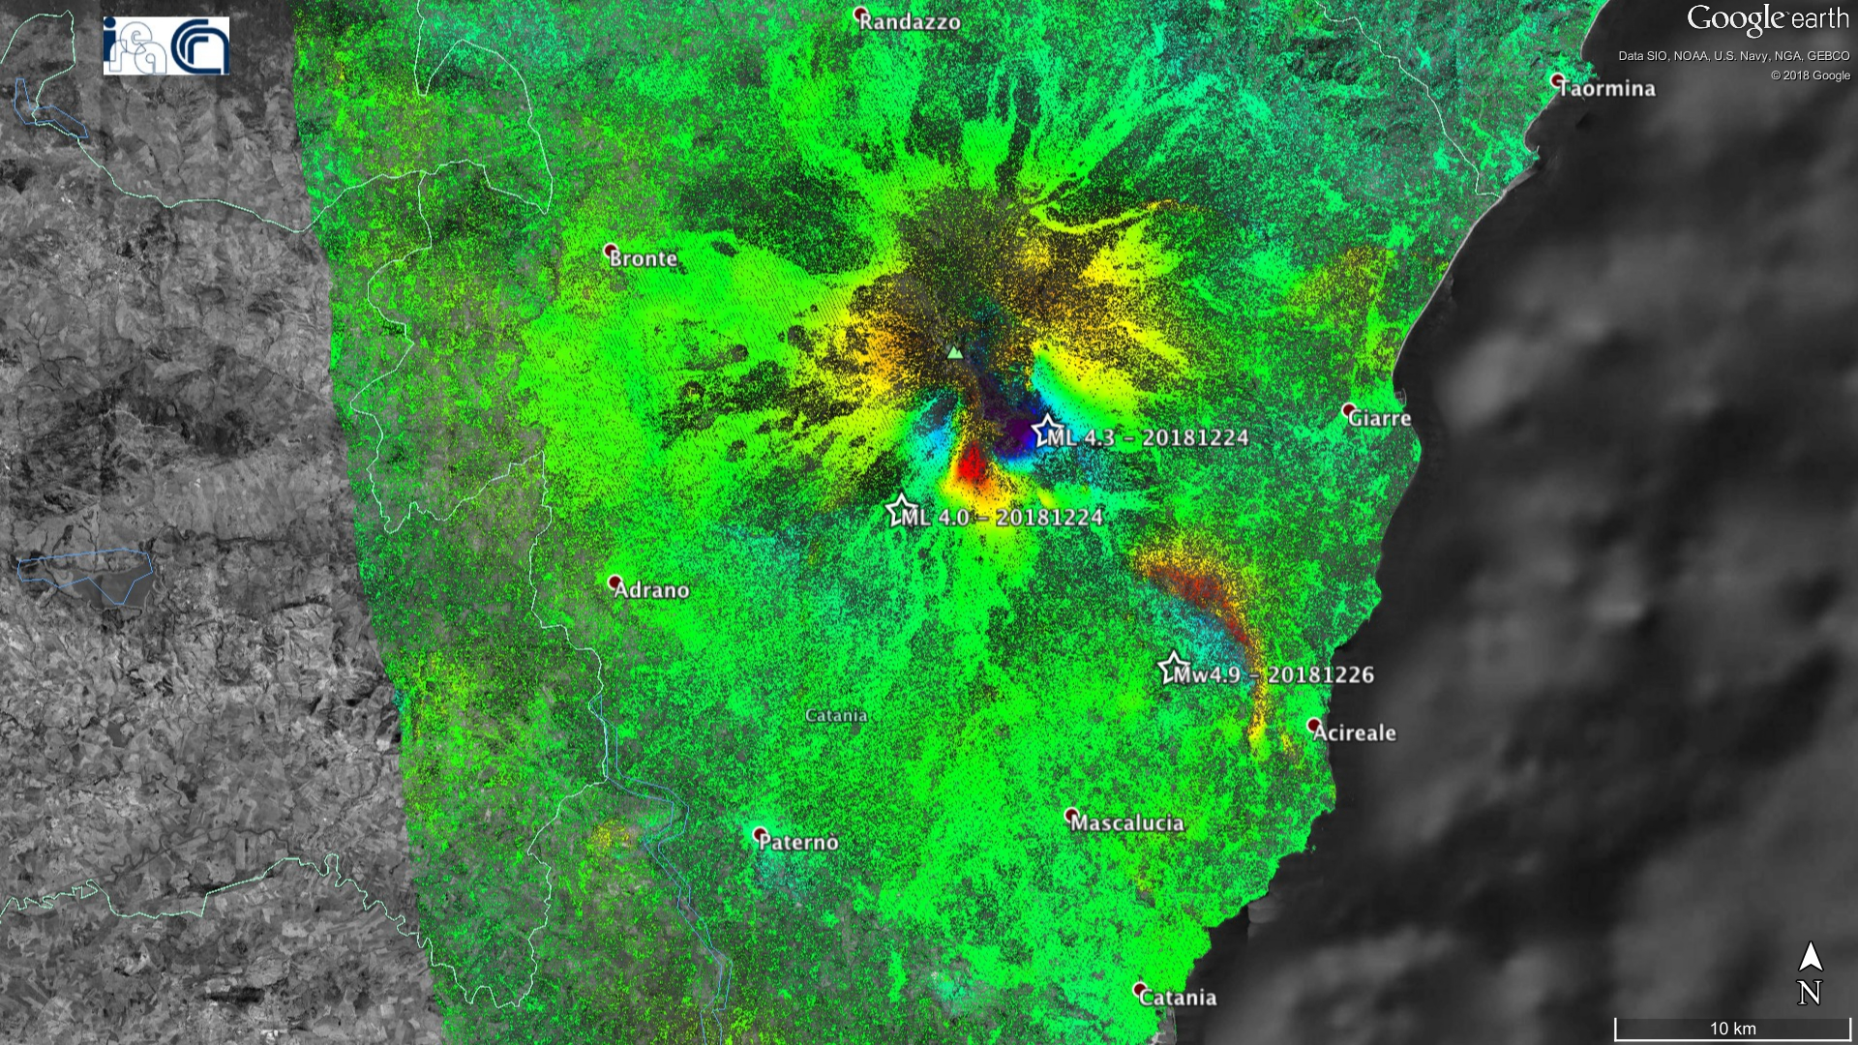
Vertical component
Down
Up
Cm
<-10
cm
>10

Slide 33
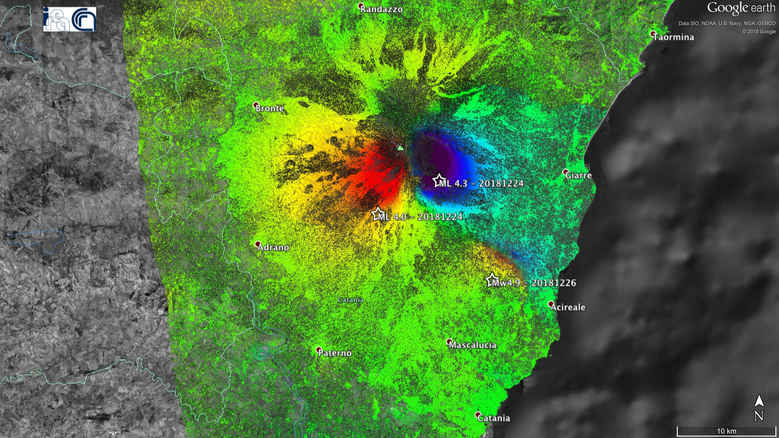
East-West component
West
East
Cm
<-30
cm
>30

Slide 34

DInSAR Limitations
Different Atmospheric Conditions from one image to another lead to artifacts in the generated interferograms. Such effects can be reduced by properly averaging independent interferograms (stacking).

Slide 35


DInSAR Limitations: atmospheric conditions
Mt. Etna – Sentinel-1 Descending Orbit: 15.02.2021 – 21.02.2021
Azimuth
-π
rad
+π
Baseline Perp. $≈$ 92m
Cm

Slide 36


DInSAR Limitations: atmospheric conditions
Mt. Etna – Sentinel-1 Descending Orbit: 15.02.2021 – 27.02.2021
Azimuth
-π
rad
+π
Baseline Perp. $≈$ 5m
Cm

Slide 37


DInSAR Limitations: atmospheric conditions
Mt. Etna – Sentinel-1 Descending Orbit: 21.02.2021 – 27.02.2021
Azimuth
-π
rad
+π
Baseline Perp. $≈$ 98m
Cm

Slide 38


DInSAR Limitations: atmospheric conditions
Mt. Etna – Sentinel-1 Ascending Orbit: 15.02.2021 – 27.02.2021
Azimuth
-π
rad
+π
Baseline Perp. $≈$ 43m
Cm

Slide 39


DInSAR Limitations: atmospheric conditions
Mt. Etna – Sentinel-1 Ascending Orbit: 21.02.2021 – 27.02.2021
Azimuth
-π
rad
+π
Baseline Perp. $≈$ 0.3m
Cm

Slide 40



DInSAR Limitations: atmospheric conditions
Stromboli – Sentinel-1 Descending Orbit
31.08.2019 – 06.09.2019
06.09.2019 – 12.09.2019
12.09.2019 – 18.09.2019
Azimuth
2.8
N
cm
0

Slide 41



DInSAR Limitations: atmospheric conditions
Stromboli – Sentinel-1 Descending Orbit
18.09.2019 – 24.09.2019
24.09.2019 – 30.09.2019
12.10.2019 – 18.10.2019
Azimuth
2.8
N
cm
0

Slide 42



DInSAR Limitations: atmospheric conditions
Stromboli – Sentinel-1 Descending Orbit
21.01.2021 – 03.02.2021
28.01.2021 – 09.02.2021
03.02.2021 – 15.02.2021
Azimuth
2.8
N
2.8
N
2.8
N
cm
cm
cm
Atmospheric artefacts are typically not correlated in time!
0
0
0

Slide 43



DInSAR Limitations
Spatial Decorrelation Effects depend on the perpendicular baseline of the used SAR data pairs. To reduce such effects the use of small spatial baseline couples is required.
Napoli Bay (ERS Multi-look image)
ERS2_31/08/1995 - ERS2_ 15/08/1996 baseline=10 m
ERS1_01/05/1996 - ERS2_15/08/1996 baseline=950 m
Notes:
43

Slide 44
DInSAR Limitations
Temporal Decorrelation Effects are due to temporal reflectivity changes of the imaged scene. Such effects can be mitigated by using small temporal baselines or long wavelength signals.
Possible causes of reflectivity changes:
Vegetation
Meteorology (snow, ice, …)
Eruptions (erupted material deposit, lava flows, …)
Fires
Hydrogeology (floods, landslides, sinkholes, …)
Anthropogenic (building construction/demolition, …)
…

Slide 45



DInSAR Limitations: temporal decorrelation
Mt. Etna – Sentinel-1 Descending Orbit
14.05.2018 – 20.05.2018
14.05.2018 – 13.06.2018
14.05.2018 – 11.10.2018
N
N
N
6 days
36 days
150 days
-π
rad
+π
Cm

Slide 46



DInSAR Limitations: temporal decorrelation
Stromboli, 3rd July 2019 paroxysm – Sentinel-1 Descending Orbit
Pre-event
Co-event
Post-event
20 Jun 2019 – 26 Jun 2019
26 Jun 2019 – 8 Jul 2019
8 Juò 2019 – 14 Jul 2019
Azimuth
N

Slide 47



DInSAR Limitations: temporal decorrelation
Stromboli, 3rd July 2019 paroxysm – Sentinel-1 Descending Orbit
Pre-event
Co-event
Post-event
20 Jun 2019 – 26 Jun 2019
26 Jun 2019 – 8 Jul 2019
8 Juò 2019 – 14 Jul 2019
Azimuth
N

Slide 48


DInSAR Limitations: temporal decorrelation
Mt. Etna – Sentinel-1 Ascending Orbit: 28.01.2021 – 09.02.2021
Pre-event
SEC
Azimuth
0
1
Cm
Baseline Perp. $≈$ 5m

Slide 49


DInSAR Limitations: temporal decorrelation
Mt. Etna – Sentinel-1 Ascending Orbit: 03.02.2021 – 21.02.2021
Co-event
~4 km
SEC
Azimuth
0
1
Cm
Baseline Perp. $≈$ 26m

Slide 50
Thank you!
monterroso.f@irea.cnr.it

