Slide 1

Programming and Practicalities Overview
Karl Christian Stuebe | karl.stuebe@epos-eu@gmail.com

Slide 2



Our Program
Notes:
Content slide

Slide 3
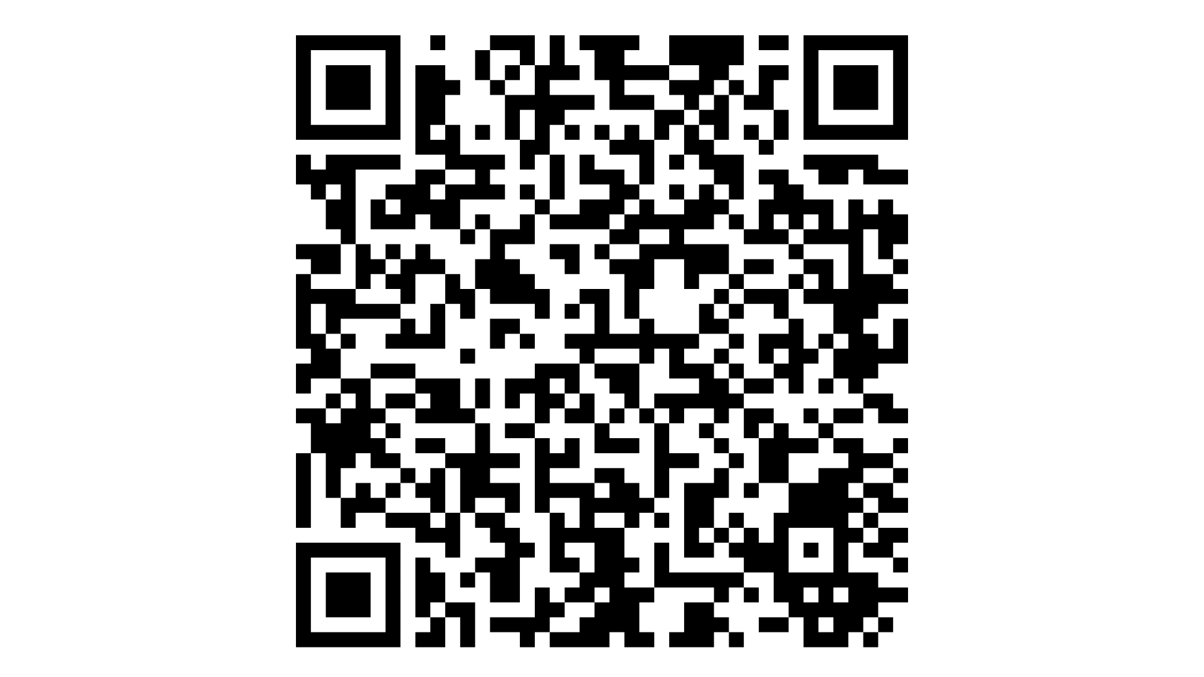
Our Program
Our Program
Follow along
Notes:
Content slide

Slide 4
Remote Participants
We have some remote participants so we will be passing the microphone to ensure everyone is audible in the room and online.
If you want to follow along the presentations via zoom here is the link:
tiny.cc/Day1EPOSSummerSchool
Notes:
Content slide

Slide 5

What We Stand For: Respect, Integrity, Inclusion
Karl Christian Stuebe | karl.stuebe@epos-eu@gmail.com

Slide 6
Welcome & Purpose
Goal: Cultivate a respectful, inclusive, and safe learning environment.
Everyone here contributes to a shared academic and social experience.
This code of conduct sets expectations for behavior and communication that prioritize well-being, equity, and personal integrity.
Notes:
Content slide

Slide 7
Core Values and Community Well-Being
Summer School community members must not engage in behavior that compromises their own or others' sustained effectiveness, mental or physical health, safety, or academic welfare. The community’s well-being is a priority.
We are committed to a community where everyone can thrive intellectually, emotionally, and physically.
Notes:
Content slide

Slide 8
Respect for All – Nondiscrimination
Discrimination based on race, color, sex, sexual orientation, gender identity, religion, differing ability, age, or national/ethnic origin is strictly prohibited in all activities and environments of the EPOS Summer School.
Every participant has equal rights to learn and engage, regardless of above characteristics or background.
Notes:
Content slide

Slide 9
Discrimination and Discriminatory Harassment
Discriminatory harassment includes conduct that targets individuals because of characteristics such as race, sexual orientation, gender, or religion, and creates an intimidating, hostile, or abusive environment. This includes verbal abuse, exclusion, or unequal treatment based on identity.
Discrimination and harassment are serious violations of community standards.
Notes:
Content slide

Slide 10
Racist Conduct
Racist speech or actions—whether intentional or not—are unacceptable.
We explicitly prohibit any conduct that undermines a person’s wellbeing on the basis of race. Even subtle or systemic behaviors that interfere with someone’s work or educational progress are violations and will be addressed accordingly.
Notes:
Content slide

Slide 11
Harassment
Harassment is defined as severe or pervasive unwelcome conduct that a reasonable person would find intimidating or abusive. Examples include repeated insults, public humiliation, threats, and intentional misgendering.
Any repeated, unwelcome conduct that harms another’s ability to participate or feel safe will not be tolerated.
Notes:
Content slide

Slide 12
Harassment and Sexual Misconduct
Sexual misconduct includes nonconsensual contact, coercion, exploitation, and sexual harassment. Consent must be informed, freely given, and can be withdrawn at any time. Silence or lack of resistance does not equal consent
Any repeated, unwelcome conduct that harms another’s ability to participate or feel safe will not be tolerated.
Notes:
Content slide

Slide 13
Consent and Boundaries
Boundaries are about comfort, safety, and autonomy.
They vary from person to person and may change depending on the situation. For example, someone may be happy to chat casually during breaks but prefer not to be hugged or asked personal questions. If someone asks you not to sit too close, not to touch them (even playfully), or not to make jokes about a sensitive topic they are expressing a boundary. Respecting that means not doing it again, even if you unintentionally didn’t mean any harm.
Everyone has the right to set personal boundaries and to have those boundaries respected. This includes physical, emotional, and social space.
Notes:
Content slide

Slide 14
Disorderly Conduct
Disorderly conduct includes reckless or unreasonable behavior that disrupts events, creates hazards, or endangers others. Examples: shouting during sessions, obstructing movement, or creating unsafe situations.
Disruptive or unsafe behavior that interferes with the learning environment is prohibited.
Notes:
Content slide

Slide 15
Reporting & Confidential Support
Individuals may confidentially report incidents to designated contacts or coordinators. There will be no retaliation for reporting. Confidential advisors are here to support individuals without initiating formal processes unless requested as local laws permit.
If something happens, you are not alone. Help is available and confidential.
Notes:
Content slide

Slide 16
Your Role
You are expected to act with integrity, civility, and accountability. Speaking up when something is wrong and modeling respectful conduct helps ensure everyone feels safe and included.
Everyone has a role in upholding community values.
Notes:
Content slide

Slide 17
Ice Breaker!
Speed Networking
aka
Meet in Minutes
Karl Christian Stuebe | karl.stuebe@epos-eu@gmail.com

Slide 18
Rules
You have a question assigned to you
You will ask your colleagues your question 1:1 and they will ask you their question
3-4 minutes for both questions to be answered then you move on to the next people
Mark off the name of the person as you meet them on the sheet I will give you
Notes:
Content slide

Slide 19

Thank you for your attention!
karl.stuebe@epos-eric.eu
www.epos-eu.org/on | social media #EPOSon
Notes:
Thank you slide

Slide 20
Notes:
Logo only

