Slide 1

Understanding and applying the CARE principles introduction to research data sharing regulations in Europe (and elsewhere)
Federica Tanlongo | federica.tanlongo@epos-eric.eu
Notes:
Title slide

Slide 2
Part 1: an introduction to CARE principles

Slide 3
Not only FAIR: why we need CARE principles?
Over 370 million Indigenous persons
5.000 cultures in 90 countries
Data inequities, data exploitation
Epistemicide (suppression and co-optation of Indigenous knowledges and data systems)
Decolonisation
Plural knowledges
Data have an impact on real life: they generate value, impact on decision making, and allocation of resources, etc.
As such, data have important implications for Indigenous Peoples’ ability to exercise their individual and collective rights to self-determination.
Indigenous Peoples and local communities are often excluded from decision-making and their knowledge marginalised.
Adapted from: CARE about and with communities – a Discussion – Wolter, A., 2025 - presented at the EPOS Summer school 2025
Notes:
Whether existing knowledge is digitised or new data are ‘born digital’, the impact they have on decision-making, allocation of resources, and innovation is significant. Data have important implications for Indigenous Peoples’ ability to exercise their individual and collective rights to self-determination. Indigenous Peoples are often excluded from decision-making fora and their knowledge when such knowledge exists only as part of an oral tradition. The UN Declaration on the Rights of Indigenous Peoples (UNDRIP) reaffirms Indigenous rights to self-governance and authority to control their Indigenous cultural heritage embedded in their languages, knowledge, practices, technologies, natural resources, and territories (i.e., Indigenous data). Indigenous data, which include data collected by governments and institutions about Indigenous Peoples and their territories, are intrinsic to Indigenous Peoples’ capacity and capability to realise their human rights and responsibilities to all of creation.

Slide 4
Not only FAIR: why we need CARE principles?
Indigenous data sovereignty reinforces the rights to engage in decision-making in accordance with Indigenous values and collective interests.
  The UN Declaration on the Rights of Indigenous Peoples (UNDRIP) reaffirms “Indigenous rights to self-governance and authority to control their Indigenous cultural heritage embedded in their languages, knowledge, practices, technologies, natural resources, and territories (i.e., Indigenous data)”.
  Indigenous data, which include data collected by governments and institutions about Indigenous Peoples and their territories, are intrinsic to Indigenous Peoples’ capacity and capability to realise their human rights and responsibilities to all of creation.
Notes:
Whether existing knowledge is digitised or new data are ‘born digital’, the impact they have on decision-making, allocation of resources, and innovation is significant. Data have important implications for Indigenous Peoples’ ability to exercise their individual and collective rights to self-determination. Indigenous Peoples are often excluded from decision-making fora and their knowledge when such knowledge exists only as part of an oral tradition. The UN Declaration on the Rights of Indigenous Peoples (UNDRIP) reaffirms Indigenous rights to self-governance and authority to control their Indigenous cultural heritage embedded in their languages, knowledge, practices, technologies, natural resources, and territories (i.e., Indigenous data). Indigenous data, which include data collected by governments and institutions about Indigenous Peoples and their territories, are intrinsic to Indigenous Peoples’ capacity and capability to realise their human rights and responsibilities to all of creation.

Slide 5
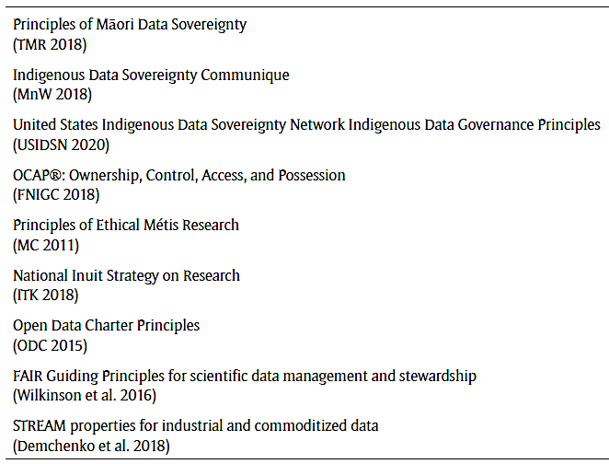
A long journey
1992
Kari-Oca Declaration
2007
UNDRIP
1994
Hopi, Apache opt-out
SCdlS Statement
1988
Declaration
of Belém
2023
Māori Data Gov Model
1970s
Discourse starts (again)
2002
Kimberley Declaration
2019
CARE principles
1998
OCAP®
1980
Traditional Elders Circle
1995
Tambunan Statement
Suva Statement
1993
Lakota Declaration,
Mātaatua Declaration, Julayinbul Statement
CARE about and with communities – a Discussion – Wolter, A., 2025 - presented at the EPOS Summer school 2025
Carroll et al. (2020)

Slide 6
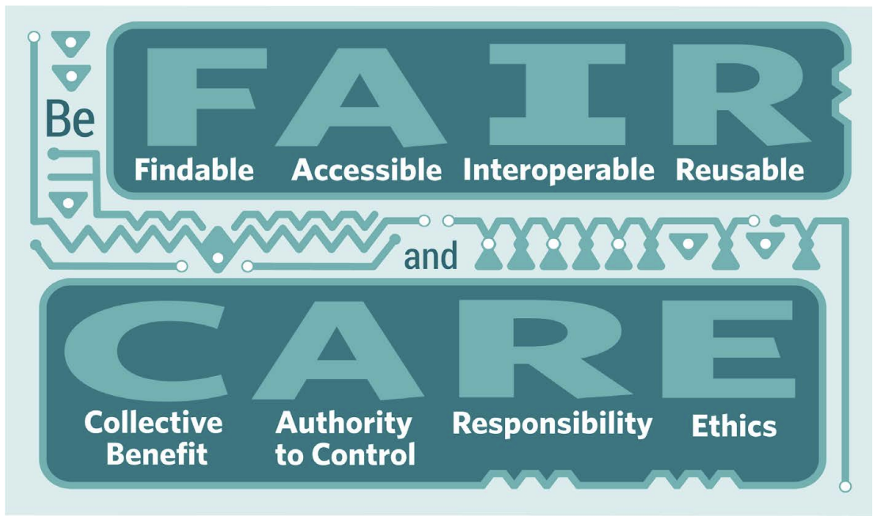
The CARE Principles
Collective Benefit
Authority to Control
Responsibility
Ethics
Research Data Alliance International Indigenous Data Sovereignty Interest Group. (September 2019). “CARE Principles for Indigenous Data Governance.” The Global Indigenous Data Alliance. GIDA-global.org
https://www.rd-alliance.org/wp-content/uploads/2024/03/CARE20Principles20for20Indigenous20Data20Governance_OnePagers_FINAL20Sept2006202019.pdf

Slide 7

C: Collective Benefit
Data ecosystems shall be designed and function in ways that enable Indigenous Peoples to derive benefit from the data.
C1 For inclusive development and innovation
Governments and institutions must actively support the use and reuse of data by Indigenous nations and communities, facilitating indigenous innivation and self-determined development.
C2 For improved governance and citizen engagement
Ethical use of open data should be used to improve transparency and decision-making and provide Indigenous nations and communities with a better understanding of their peoples, territories, and resources, and of policies and programmes that affect Indigenous Peoples.
C3 For equitable outcomes
Value created from Indigenous data should benefit Indigenous communities in an equitable manner and contribute to Indigenous aspirations for wellbeing.
Notes:
Data ecosystems shall be designed and function in ways that enable Indigenous Peoples to derive benefit from the data.
C1 For inclusive development and innovation Governments and institutions must actively support the use and reuse of data by Indigenous nations and communities by facilitating the establishment of the foundations for Indigenous innovation, value generation, and the promotion of local self-determined development processes.
C2 For improved governance and citizen engagement Data enrich the planning, implementation, and evaluation processes that support the service and policy needs of Indigenous communities. Data also enable better engagement between citizens, institutions, and governments to improve decision-making. Ethical use of open data has the capacity to improve transparency and decision-making by providing Indigenous nations and communities with a better understanding of their peoples, territories, and resources. It similarly can provide greater insight into third-party policies and programs affecting Indigenous Peoples.
C3 For equitable outcomes Indigenous data are grounded in community values, which extend to society at large. Any value created from Indigenous data should benefit Indigenous communities in an equitable manner and contribute to Indigenous aspirations for wellbeing

Slide 8
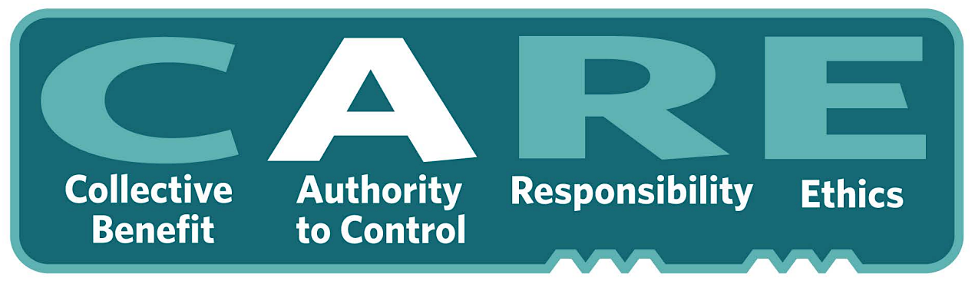
A: Authority to Control
Indigenous Peoples’ rights and interests in Indigenous data must be recognised and their authority to control such data be empowered.
A1 Recognizing rights and interests
Indigenous Peoples have rights and interests in both Indigenous Knowledge and Indigenous data, and collective and individual rights to free, prior, and informed consent in the collection and use of such data, including the development of data policies and protocols for collection.
A2 Data for governance
Indigenous Peoples have the right to data that are relevant to their world views and empower self-determination and effective self-governance.
A3 Governance of data
Indigenous Peoples have the right to develop cultural governance protocols for Indigenous data and be active leaders in the stewardship of, and access to, Indigenous data especially in the context of Indigenous Knowledge.
Notes:
Indigenous Peoples’ rights and interests in Indigenous data must be recognised and their authority to control such data be empowered. Indigenous data governance enables Indigenous Peoples and governing bodies to determine how Indigenous Peoples, as well as Indigenous lands, territories, resources, knowledges and geographical indicators, are represented and identified within data.
A1 Recognizing rights and interests Indigenous Peoples have rights and interests in both Indigenous Knowledge and Indigenous data. Indigenous Peoples have collective and individual rights to free, prior, and informed consent in the collection and use of such data, including the development of data policies and protocols for collection.
A2 Data for governance Indigenous Peoples have the right to data that are relevant to their world views and empower self-determination and effective self-governance. Indigenous data must be made available and accessible to Indigenous nations and communities in order to support Indigenous governance.
A3 Governance of data Indigenous Peoples have the right to develop cultural governance protocols for Indigenous data and be active leaders in the stewardship of, and access to, Indigenous data especially in the context of Indigenous Knowledge.

Slide 9

R: Responsibility
Those working with Indigenous data have a responsibility to share meaningful and openly available evidence on how data are used to support Indigenous Peoples’ selfdetermination and collective benefit.
R1 For positive relationships
Indigenous data use is unviable unless linked to relationships built on respect, reciprocity, trust, and mutual understanding. Those working with them are responsible for ensuring that their creation, interpretation, and use respect the dignity of Indigenous nations and communities.
R2 For expanding capability and capacity
Use of Indigenous data implies the responsibility to enhance data literacy within Indigenous communities, supporting the development of Indigenous data and data infrastructure.
R3 For Indigenous languages and worldviews
Resources must be provided to generate data grounded in the languages, worldviews, and lived experiences (including values and principles) of Indigenous Peoples.
Notes:
Those working with Indigenous data have a responsibility to share how those data are used to support Indigenous Peoples’ selfdetermination and collective benefit. Accountability requires meaningful and openly available evidence of these efforts and the benefits accruing to Indigenous Peoples.
R1 For positive relationships Indigenous data use is unviable unless linked to relationships built on respect, reciprocity, trust, and mutual understanding, as defined by the Indigenous Peoples to whom those data relate. Those working with Indigenous data are responsible for ensuring that the creation, interpretation, and use of those data uphold, or are respectful of, the dignity of Indigenous nations and communities.
R2 For expanding capability and capacity Use of Indigenous data invokes a reciprocal responsibility to enhance data literacy within Indigenous communities and to support the development of an Indigenous data workforce and digital infrastructure to enable the creation, collection, management, security, governance, and application of data.
R3 For Indigenous languages and worldviews Resources must be provided to generate data grounded in the languages, worldviews, and lived experiences (including values and principles) of Indigenous Peoples.

Slide 10

E: Ethics
Indigenous Peoples’ rights and wellbeing should be the primary concern at all stages of the data life cycle and across the data ecosystem.
E1 For minimizing harm and maximizing benefit
Ethical data fairly portray Indigenous Peoples, cultures, or knowledges, and are collected and used in ways that align with Indigenous ethical frameworks and with rights affirmed in UNDRIP.
E2 For justice
Ethical processes address imbalances in power, resources, and how these affect the expression of Indigenous and human rights, and must include representation from relevant Indigenous communities.
E3 For future use
Data governance should take into account the potential future use (and future harm ) based on ethical frameworks grounded in the relevant Indigenous communities’ values and principles. Metadata should acknowledge the provenance and purpose and any limitations or obligations in secondary use.
Notes:
Indigenous Peoples’ rights and wellbeing should be the primary concern at all stages of the data life cycle and across the data ecosystem.
E1 For minimizing harm and maximizing benefit Ethical data are data that do not stigmatize or portray Indigenous Peoples, cultures, or knowledges in terms of deficit. Ethical data are collected and used in ways that align with Indigenous ethical frameworks and with rights affirmed in UNDRIP. Assessing ethical benefits and harms should be done from the perspective of the Indigenous Peoples, nations, or communities to whom the data relate.
E2 For justice Ethical processes address imbalances in power, resources, and how these affect the expression of Indigenous rights and human rights. Ethical processes must include representation from relevant Indigenous communities.
E3 For future use Data governance should take into account the potential future use and future harm based on ethical frameworks grounded in the values and principles of the relevant Indigenous community. Metadata should acknowledge the provenance and purpose and any limitations or obligations in secondary use inclusive of issues of consent.

Slide 11
Part 2: Illustrating the application of CARE principles through a success story

Slide 12
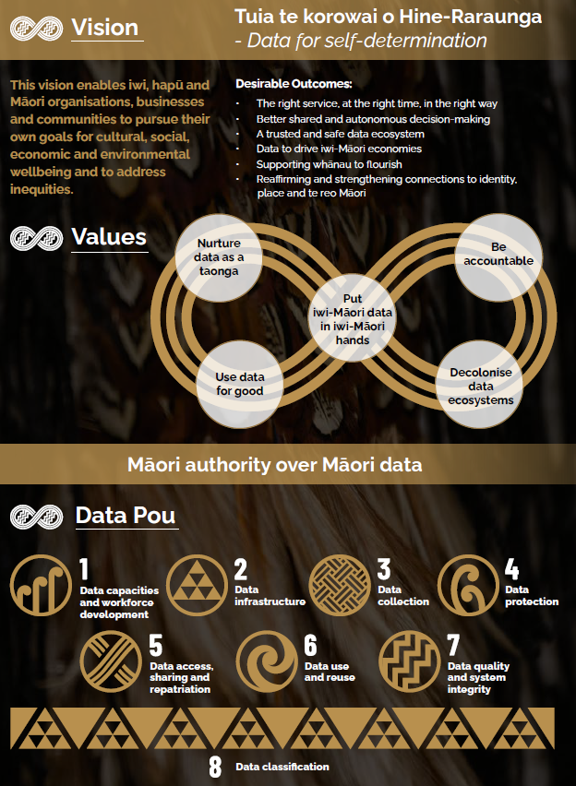
A success story:
The Māori Data Governance Model
Co-design process included iwi and national Māori leaders, representatives of Māori organisations with data interests, individual Māori data experts, and senior representatives of 16 public service agencies.
For use across the Aotearoa New Zealand public service.
Data as a “Taonga”
“Those things and values that we treasure, both intangible and tangible”
Motivation: the Aotearoa indigenous communities felt that existing government data processes and practices were failing to meet Māori informational needs, while Data governance arrangements often lacked clarity about what is being governed and why governance is needed.
The Māori Data Governance model aims at changing this state of things.

Slide 13
A success story:
The Māori Data Governance Model
The model is based on 8 data Pous (i.e. “pillars”)
Each Pou is provided with:
  exemplars (best practices) and examples
  action points
  guiding questions

Slide 14
Guiding questions
Have you any experieces of sharing your research results with local communities?
How do your experiences relate to Indigenous data/knowledges?
What can we do to advocate for Indigenous data sovereignty and governance?
What is the capability of your organisation to govern, manage, use and interpret Indigenous data in culturally safe ways?
What roles and responsibilities are needed to ensure culturally safe data practices? (e.g. cultural mediators, honest brokers…?)

Slide 15
Resources
The CARE Principles for Indigenous Data Governance(practice paper) https://datascience.codata.org/articles/10.5334/dsj-2020-043 | DOI: https://doi.org/10.5334/dsj-2020-043 Indigenous Collaboratory: https://indigenousdatalab.org/
RDA CARE principles one-pagers: https://www.rd-alliance.org/wp-content/uploads/2024/03/CARE20Principles20for20Indigenous20Data20Governance_OnePagers_FINAL20Sept2006202019.pdf
GIDA - Global Indigenous Data Alliance https://www.gida-global.org/
IEEE Provenance of Indigenous Data Standard (IEEE 2890-2025) https://www.gida-global.org/ieee-provenance
CARE resources on Australian Research Data Commons: https://ardc.edu.au/resource/the-care-principles/
UN Declaration on the Rights of Indigenous Peoples: https://www.un.org/development/desa/Indigenouspeoples/wp-content/uploads/sites/19/2018/11/UNDRIP_E_web.pdf
First Nations Information Governance Centre: https://fnigc.ca/
GEO (Group on Earth Observation) Indigenous Alliance: https://earthobservations.org/groups/geo-indigenous-alliance

Slide 16
Resources: NZ and the Maori Data Governance
Kukutai, 2024 - How Indigenous communities in New Zealand are protecting their data, Science,
https://doi.org/10.1126/science.ado9298
Te Kāhui Raraunga Maori Data Governance Model - https://www.kahuiraraunga.io/maoridatagovernance
  Full paper: https://www.kahuiraraunga.io/_files/ugd/b8e45c_803c03ffe532414183afcd8b9ced10dc.pdf
  PID: https://hdl.handle.net/10289/17807

Slide 17

Thank you for your attention!
federica.tanlongo@epos-eric.eu
www.epos-eu.org/on | social media #EPOSon
Notes:
Thank you slide

