Slide 1

Understanding the Ethical dimension of producing, using and openly distributing geoscientific data:
Introduction and guided discussion
Federica Tanlongo | federica.tanlongo@epos-eric.eu
Notes:
Title slide

Slide 2
Part 1: From FAIR to Responsible: the ethical dimension of sharing Solid Earth Science data

Slide 3
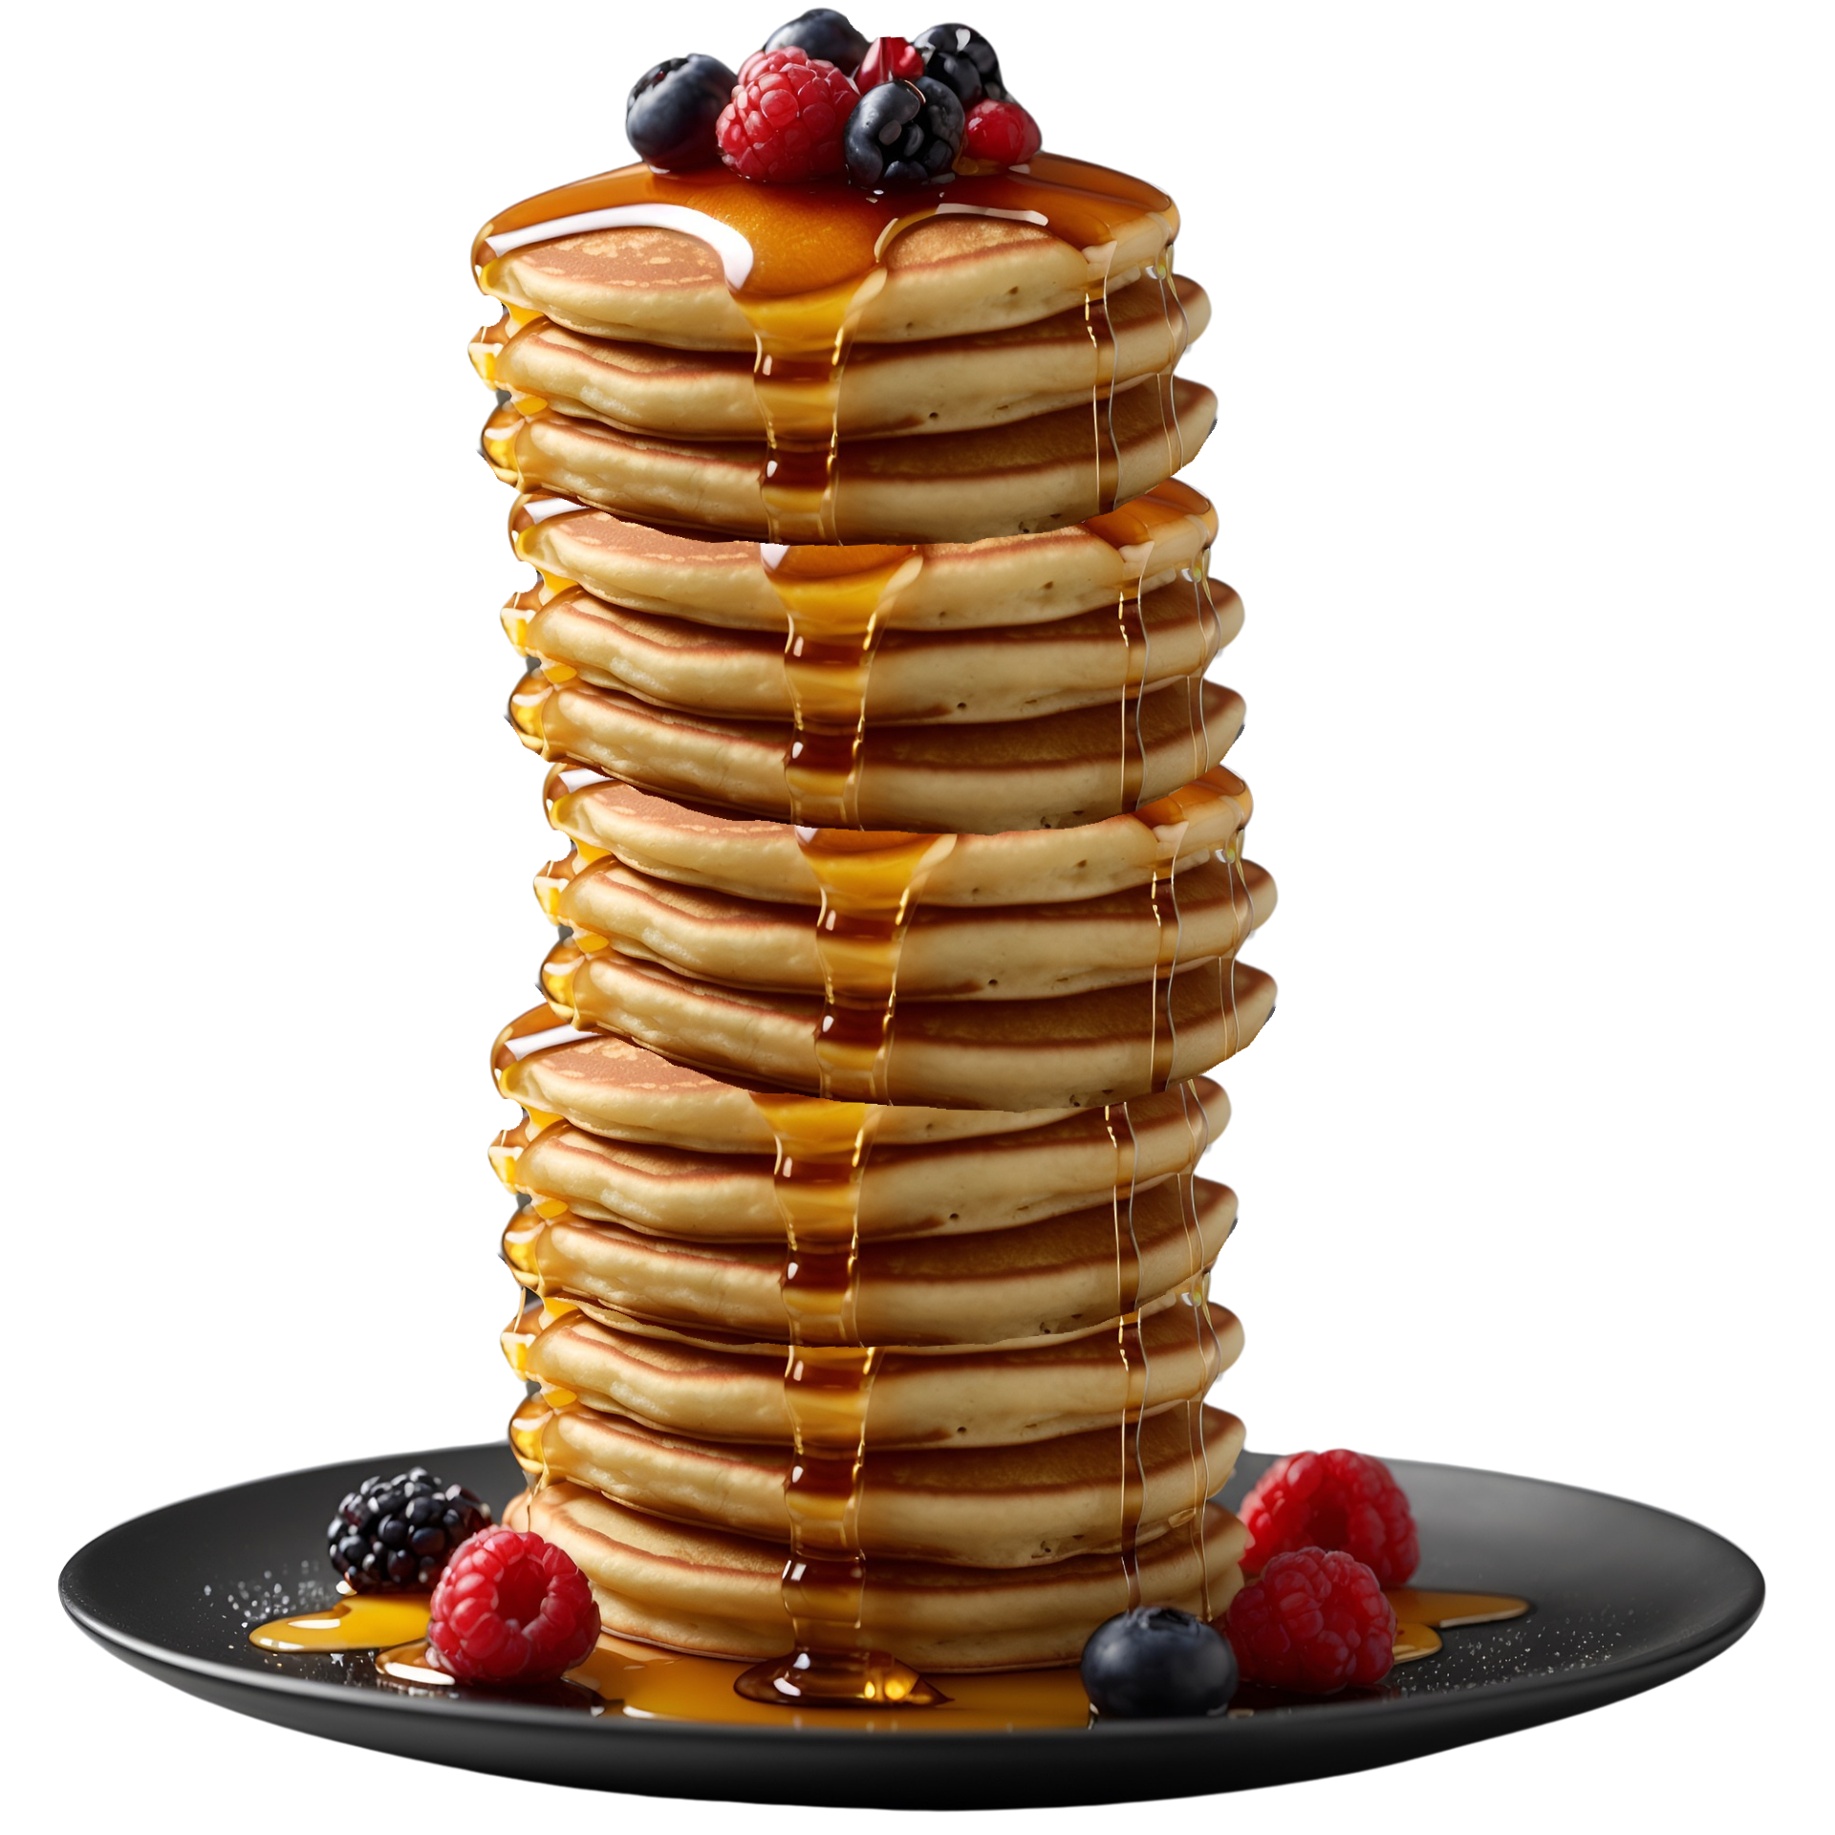
Why are we talking about ethics (or ELSI)?
Openness:
Too much of a good thing?
Open Science mandates to openly share data as one of the key assets of modern research
The idea is that high-value datasets can bring value to society at large, not just research
…But when Earth science data are used for hazard assessment, risk communication and policy decisions, ELSI aspects perforce enter into play
  Not just legal compliance: ethical and social aspects become part of the scientific practice
  ELSI as an ecosystem rather than a checklist
“As Open as possible, as closed as necessary”
Image by Kalpesh Ajugia on Pixabay, modifed.

Slide 4
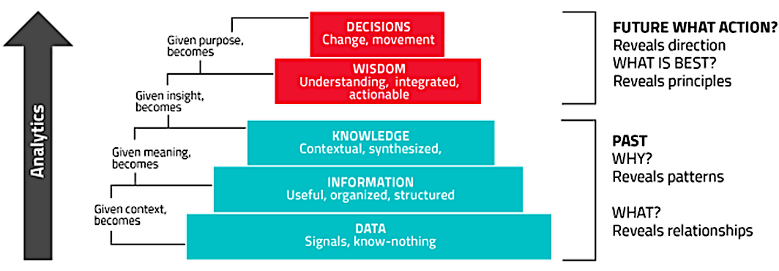
Ethics and the journey of a dataset
Does the ethical responsibility stay the same along the journey across the data lifecycle?
We do not decide based on data, we decide based on knowledge
Picture: https://electronics360.globalspec.com/article/4890/optimal-analysis-algorithms-are-iot-s-big-opportunity

Slide 5
Slide 3 – Ethics changes with the level of the data
Data level | Example | Main ethical concern
Raw data | Seismogram | openness, quality
Processed data | catalogue | provenance
Scientific products | Hazard map | interpretation
Integrated products | Risk scenarios | societal consequences
Services | Decision-support tools | appropriate use
Take-home message:
The higher the level of interpretation, the greater the ethical responsibility.

Slide 6
The ELSI landscape
LEGAL
GDPR
Intellectual property
Licensing
SOCIETAL
Misuse
Risk communication
Decision making
Public trust
Balancing uncertainty, accountability and trust
Compliance,
Best Practices
SCIENTIFIC
Research integrity
Data quality
Traceability
Reproducibility
GOVERNANCE
Roles
Accountability
Data stewardship
Research infrastructure
Ethical approach across the entire data lifecycle
Responsible science,
Responsible AI

Slide 7

3 key ethical questions
1. Impartiality for the public good
Public research organizations must remain independent of political and economic pressures.
2. Responsibility vs openness
Not every product should be equally open if misuse could create harm.
3. Experts versus decision makers
Scientists provide evidence—not political decisions.

Slide 8
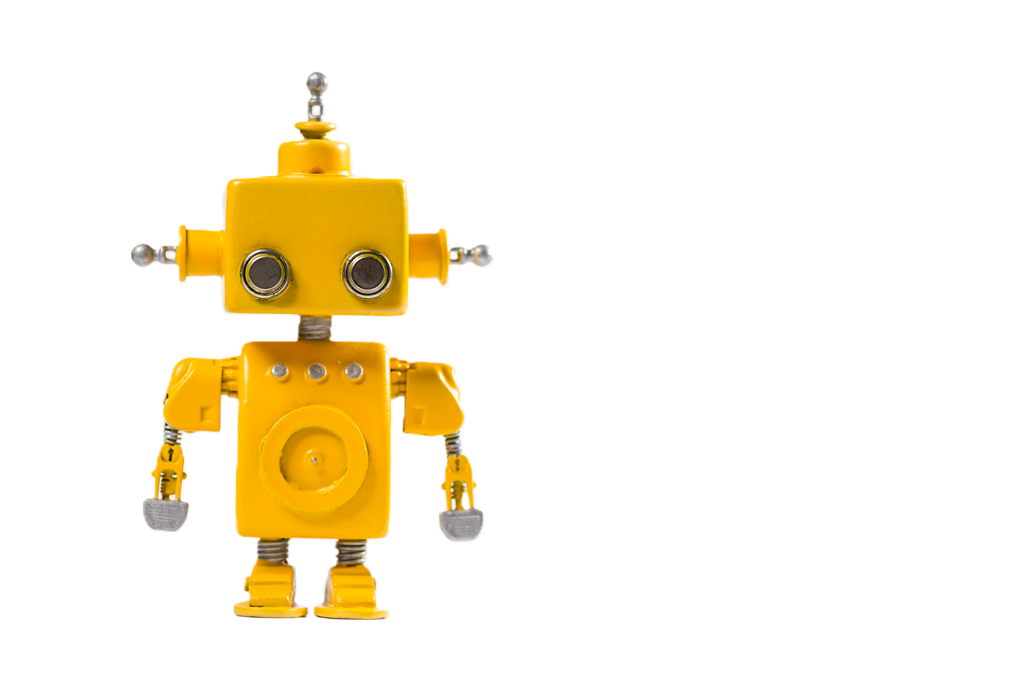

AI changes the picture
AI introduces new ethical challenges
  Biases in training datasets
  Explosion of AI-generated scientific products
  Explainability and transparency
  Algorithmic accountability
  (beyond explainable AI)
    model cards
    provenance of AI outputs
    auditability
    reproducibility of AI-assisted science
Question for discussion:
  How do we preserve trust when AI becomes another producer of scientific products?

Slide 9

…and other emerging issues in the ELSI literature
Responsible communication
under uncertainty
  Not simply communicating hazards, but communicating uncertainty honestly
  This is becoming increasingly important in the context of EIDM, even more so with the explosion of AI-generated probabilistic products.
Equity of access
  Open data does not necessarily mean:
  equal ability to use data
  computational equity
  access to digital infrastructures
  capacity building
  This is becoming a major conversation in EOSC, UNESCO and CODATA.
Environmental sustainability of AI
and data infrastructures
  Large AI models and increasingly intensive data infrastructures have a non-negligible energy and carbon footprint.
  This is becoming part of responsible research discussions.
Indigenous and local knowledge
  indigenous knowledge
  community governance and data sovereignty
  equitable benefit sharing
Tribal icon created by Solid Icon Co - Flaticon

Slide 10
Part 2: Guided discussion

Slide 11
Some guiding questions…
When does openness become harmful?
Who is responsible when scientific products are reused outside their intended context?
Can AI remain compatible with scientific accountability?
How should research infrastructures balance openness, trust and public safety?

Slide 12
Resources
General
UNESCO (2021). Recommendation on Open Science.(explicitly links Open Science to equity, inclusion, public good, and responsible research) - https://www.unesco.org/en/open-science/about |DOI https://doi.org/10.54677/MNMH8546 (English version)
Group on Earth Observations (GEO) Data Sharing Principles - https://gkhub.earthobservations.org/packages/pxdag-hq931 /DOI https://doi.org/10.60566/pxdag-hq931
Research Integrity
European Code of Conduct for Research Integrity (ALLEA), 2023).
https://allea.org/code-of-conduct/ | DOI https://doi.org/10.26356/ECOC
AI:
UNESCO Recommendation on the Ethics of AI (2021) - https://www.unesco.org/en/artificial-intelligence/recommendation-ethics
Assessment List for Trustworthy Artificial Intelligence (ALTAI) for self-assessment https://digital-strategy.ec.europa.eu/en/library/assessment-list-trustworthy-artificial-intelligence-altai-self-assessment
UNESCO Ethical Impact Assessment tool https://www.unesco.org/ethics-ai/en/eia
EPOS’ perspective:
Article: the Ethical Dimension of Sharing Solid Earth Science Data - https://www.journalofgeoethics.eu/index.php/jgsg/article/view/64 | DOI https://doi.org/10.4401/jgsg-64
EPOS Code of Ethics https://www.epos-eu.org/sites/default/files/2025-09/EPOS%20ERIC%20Code%20of%20Ethics%20%7C%20v%2027%20May%202025.pdf

Slide 13

Thank you for your attention!
federica.tanlongo@epos-eric.eu
www.epos-eu.org/on | social media #EPOSon
Notes:
Thank you slide

