Slide 1

Metadata and data standards – why are they important?
Kirsten Elger| kelger@gfz.de
With contributions from Lesley Wyborn (AU)
Notes:
Title slide

Slide 2

What do we mean by Open Science?
Open science is about making sure that not only scientific knowledge is accessible but also that the production of that knowledge itself is inclusive, equitable and sustainable.
In other words, Open Science also requires identification of any actor and tools used to process and model these along the full Research Workflow, starting from acquisi-tion of the Primary Observation Datasets (PODs) and samples, through initial data calibration and then sub-sequent generations of subsamples and digital outputs.
UNESCO and Canadian National Commission for UNESCO, 2022. An Introduction to the UNESCO Recommendation on Open Science.https://doi.org/10.54677/XOIR1696
Courtesy: Lesley Wyborn (NCI)

Slide 3
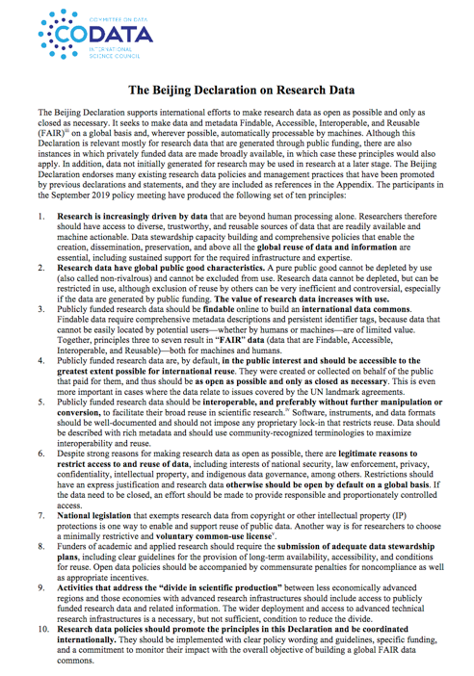
THE DRIVER: THE CODATA BEIJING DECLARATION ON RESEARCH DATA RELEASED NOVEMBER 2019: PRINCIPLE 5
http://www.codata.org/uploads/Beijing%20Declaration-19-11-07-FINAL.pdf
https://doi.org/10.5281/zenodo.3552330
Publicly funded research data should be interoperable, and preferably without further manipulation or conversion, to facilitate their broad reuse in scientific research.
Software, instruments, and data formats should be well-documented and should not impose any proprietary lock-in that restricts reuse.
Data should be described with rich metadata and should use community-recognized terminologies to maximize interoperability and reuse.
Courtesy: Lesley Wyborn (NCI)
Wyborn Geo-INQUIRE June 2026

Slide 4
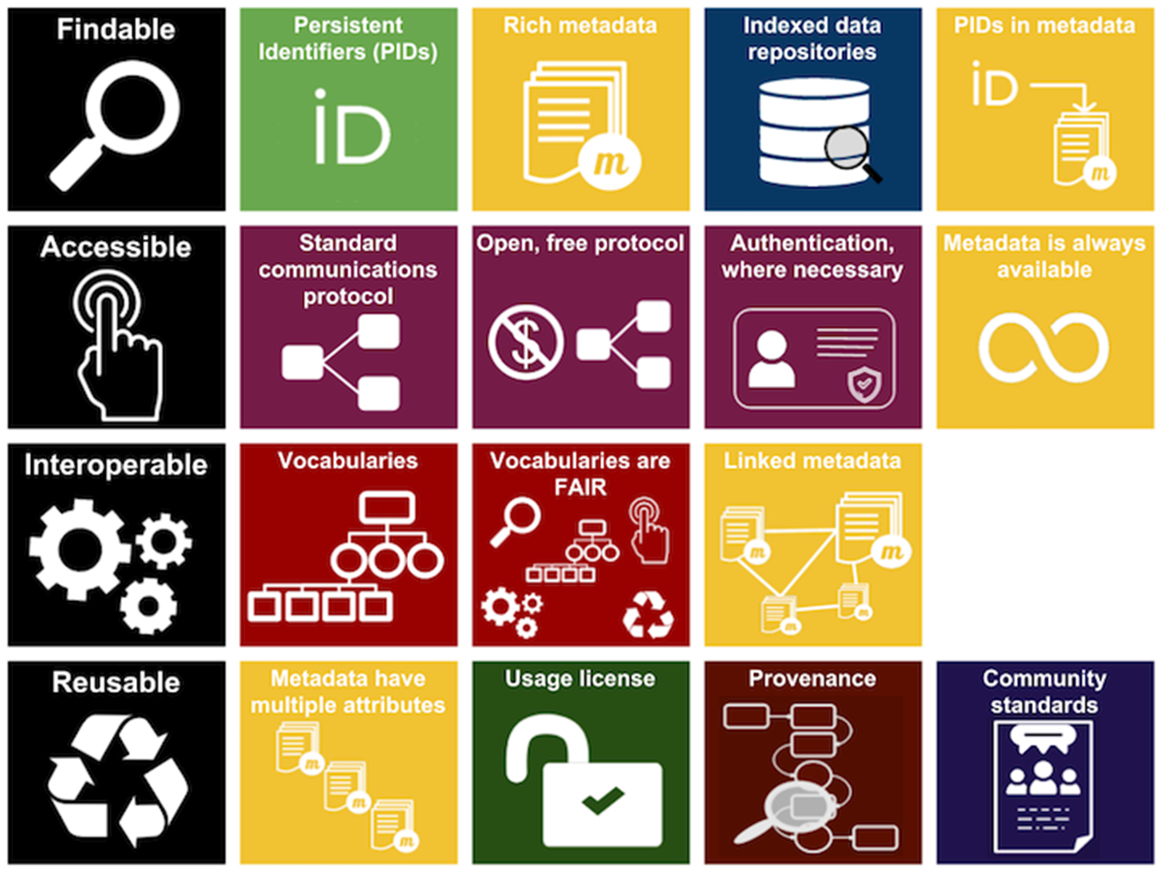
The task: FAIR Data
The FAIR Principles (Wilkinson et al., 2016) ensure that data are Findable, Accessible, Interoperable and Reusable by humans and machines
The FAIR Principles address data and metadata and form the basis for data-driven, interdisciplinary research
Key elements of FAIR data are persistent identifiers (PIDs), machine-readable vocabularies, and researchers' awareness of the opportunities they provide.
Image source: ARDC ands.org.au/working-with-data/fairdata
Credit: Icons made by Freepik are licensed by CC BY 3.0 Entire FAIR resources graphic is licensed under a Creative Commons Attribution 4.0 International License

Slide 5

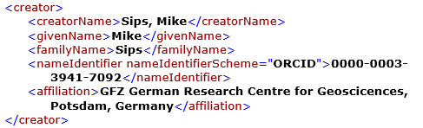
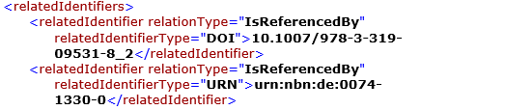
The role of metadata schemas
Metadata schemes define standards to and provide and exchange information about data (metadata)
Information is provided in machine-readable formats (e.g., XML, JSON)
The definition and construction plan of XML metadata schemes are provided as XSD (XML Schema Definition)
Automated metadata exchange via standard application programming interfaces (API)
DataCite Schema: metadata for
citation (DOI) and basic data discovery
XML = machine-readable!!

Slide 6
Community-derived, disciplinary metadata standards
SensorML = OGC Sensor Model Language Standard: structured description of sensors and their variables https://www.ogc.org/standards/sensorml/ (e.g. hydrology, climate stations…)
FDSN StationXML = structured description of seismic stations according to international conventions (FDSN = Federation of Digital Seismic Networks) https://www.fdsn.org/xml/station/ (seismology)
GeodesyML = structured description of GNSS Stations (will replace existing sitelogs) https://github.com/International-GNSS-Service/GeodesyML (GNSS)

Slide 7


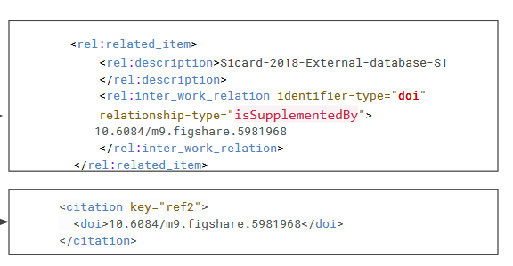
FAIR: Connecting data and literature via metadata
To make digital connections between data publications and literature, repositories, data centres, and journals provide information about the links between literature and data (= citations) in the machine-readable metadata (XML, JSON). Researchers should make sure to always cite all sources in both, journal articles and data publications
metadata schema
metadata schema
<relatedIdentifiers>
<relatedIdentifier relatedIdentifierType="DOI" relationType="Cites">10.1016/j.quaint.2015.03.007
</relatedIdentifier>
<relatedIdentifier relatedIdentifierType="DOI" relationType=„IsSupplementTo">10.2113/gsjfr.47.2.175
</relatedIdentifier>
</relatedIdentifiers>
Paper citation in a data publication
data citation in a paper

Slide 8






FAIR: Persistent Identifier
Rich metadata supports a full provenance chain that enables tracking through the collection, analysis, storage research data lifecycle. Through PIDs verifiable documentation of any activity and any actor involved in any transformation is provided
Only when PIDs are applied to all data (from the beginning on), machines can make the full connection between all samples, data, software, data, models, projects, researchers, institutions

Slide 9
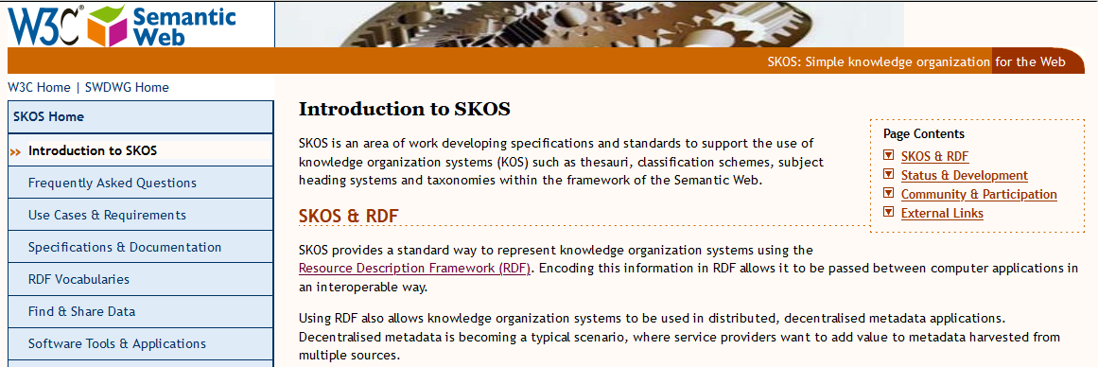
Metadata Elements: Controlled Vocabularies (SKOS/RDF)
In brief:
RDF vocabularies are machine-actionable and provide links to the definitions of each term (sometimes in different languages) → stop endless discussions about who is right
RDF vocabs can be added to XML and JSON metadata

Slide 10
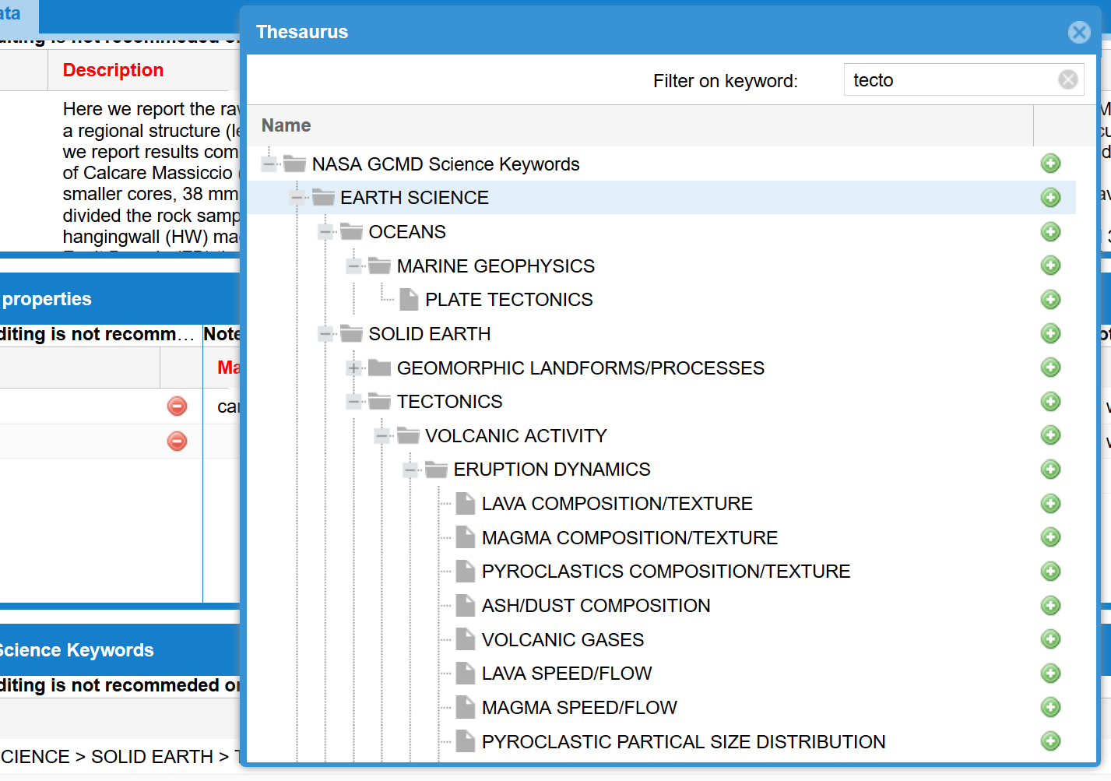


Controlled vocabularies in a metadata editor
NASA Global Change Master Directory (GCMD) Keywords
Example: EARTH SCIENCE > SOLID EARTH > TECTONICS > VOLCANIC ACTIVITY > ERUPTION DYNAMICS
SKOS → URI to the definition of the term

Slide 11

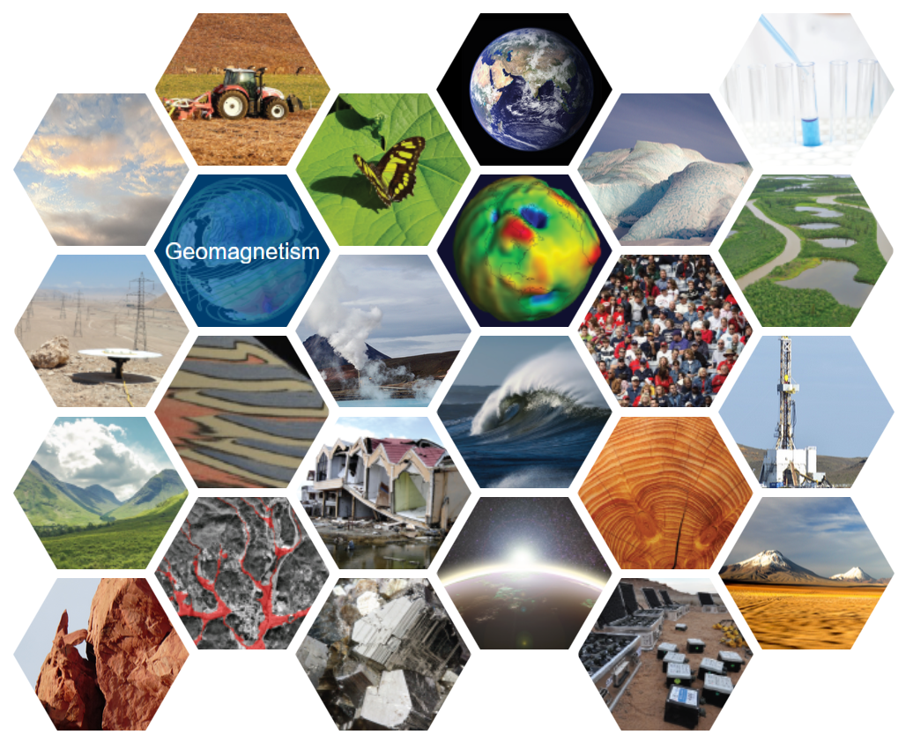
Controlled vocabularies support data discovery…
search facettes
Global Change Master Directory (GCMD) Keywords
… form the basis for ontologies,
and are essential for machine-actionability
Key elements of FAIR data are persistent identifiers (PIDs), machine-readable vocabularies, and researchers' awareness of the opportunities they provide.

Slide 12
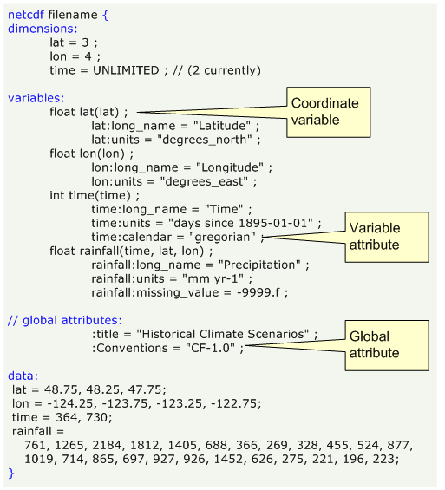
Data standards: NetCDF – self describing format
Flexible header plus gridded data
multidimensional, multi-variables
„NetCDF is a great format, I can freely compose the header and use it for so many data types“
Source: https://pro.arcgis.com/de/pro-app/latest/help/data/multidimensional/fundamentals-of-netcdf-data-storage.htm
However….
How much flexibility is reasonable for interdisciplinary, computer-driven data analyses?
How much experience do researchers have with describing their data for external use?

Slide 13
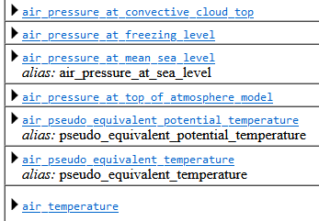
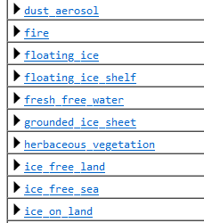
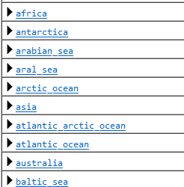
Standards for NetCDF
NetCDF Climate and Forecast (CF) Metadata Conventions
The CF metadata conventions are designed to promote the processing and sharing of files created with the NetCDF API. The conventions define metadata that provide a definitive description of what the data in each variable represents, and the spatial and temporal properties of the data. This enables users of data from different sources to decide which quantities are comparable, and facilitates building applications with powerful extraction, regridding, and display capabilities. The CF convention includes a standard name table, which defines strings that identify physical quantities.
CF Standard Name Table
CF Area Type Table
CF Standardized Region List
It is work to apply the standards, but worthwile for interoperability!
https://cfconventions.org/ and subpages

Slide 14

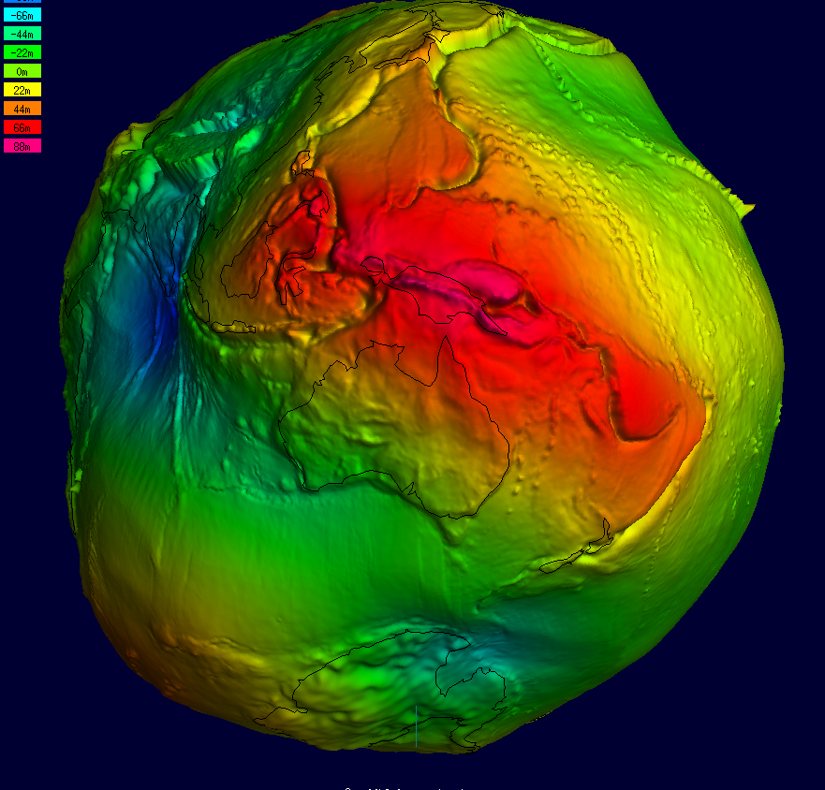
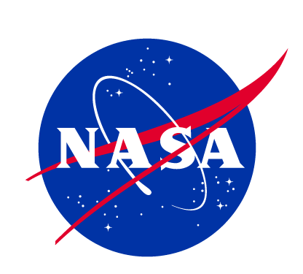

Data Standards: Level definition (GRACE-FO)
Level-0: Unprocessed, raw binary telemetry data directly downlinked from the twin satellites,
including housekeeping and instrument data streams.
Level-1A: Raw telemetry converted into scientific engineering units (e.g., temperatures in
Celsius) and time-tagged.
Level-1B: Corrected, calibrated, and time-reduced observations. This includes precise inter-
satellite microwave/laser measurements, accelerometer readings, GPS data, and star camera data.
Level-1B is the standard starting point for independent scientific modeling.
Level-2: Gravity field solutions derived from Level-1B data. The results are typically provided as spherical harmonic coefficients, representing the spatial variations of Earth's gravity field over time.
Level-3: Gridded data products that map gravity anomalies into interpretable Earth surface mass changes. They are frequently expressed in units of "equivalent water height" (cm or meters) and are typically easier for general scientific and climatological research to use directly.
Level-4: Highly processed, value-added products that combine GRACE-FO data with other models (such as ocean bottom pressure or hydrological models) to separate specific climate components, like separating deep-ocean signals from surface mass changes.
sources:

Slide 15
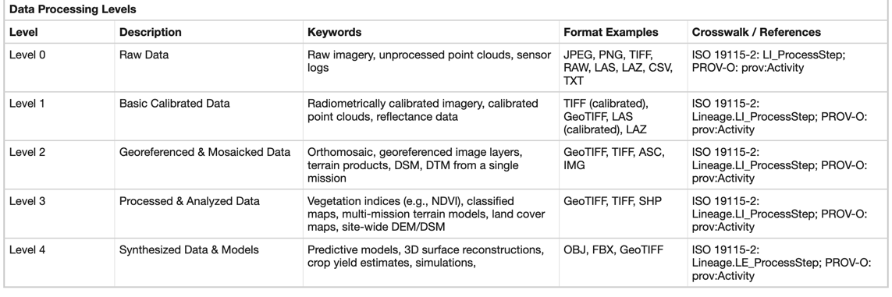
Data standards: Processing Levels for Drone Data
Ellsäßer, F.J., Nikuze, A. Towards a FAIR metadata framework for drone and uncrewed aerial vehicle data. Sci Data 13, 57 (2026). https://doi.org/10.1038/s41597-025-06376-9
Courtesy: Lesley Wyborn (NCI)

Slide 16
The question: Is FAIR enough? What else do we need?
The FAIR Principles (Wilkinson et al., 2016) ensure that data are Findable, Accessible, Interoperable and Reusable by humans and machines
Few realise that much described as fully FAIR compliant is not, because it is
  NOT fully machine-actionable
  NOT Interoperable or reusable
Machine-actionable: a dataset or file format that is structured in such a way as to allow machines to automate programmed actions (CODATA RDM https://zenodo.org/records/10626170
Image source: ARDC ands.org.au/working-with-data/fairdata
Credit: Icons made by Freepik are licensed by CC BY 3.0 Entire FAIR resources graphic is licensed under a Creative Commons Attribution 4.0 International License
Courtesy: Lesley Wyborn (NCI)

Slide 17
The Continuum: Machine-readable → -interpretable→ -actionable
Source: Peng et al. in prep. ESIP Data Stewardship Committee
Term | Machine-readable | Machine-interpretable | Machine-actionable
High-level Definition | A machine can parse the crosswalk | A machine can understand the structure and intended relationships | A machine can automatically perform an operation based on the crosswalk
JSON Example | { "EntryTitle": "name", "DOI": "identifier" } | { "sourceField": "EntryTitle", "targetField": "schema:name", "mappingRelation": "exactMatch" } | { "sourcePath": "$.EntryTitle", "targetProperty": "schema:name", "mappingRelation": "exactMatch", "required": true, "transform": "string" }
What software can do | Software can read the file and understand that mappings exist. This is simple machine readability. | Software can determine: source field, target field, semantic relationship, This goes beyond simple machine readability. | Software can now: locate the source field, transform the metadata, validate the result, populate the target schema, with little or no human intervention. This is machine actionability.
Courtesy: Lesley Wyborn (NCI)

Slide 18
What are the largest challenges for FAIR?
Interoperability
Interoperability is still the hardest to achieve, especially across disciplines!
Principle I2 states “I2. (meta)data use vocabularies that follow FAIR principles”
→ FAIR vocabularies!
Reuseability
Data documentation
The average researcher does not understand the need for licences that are open!!!
Becoming essential for AI-readine
Image source: ARDC ands.org.au/working-with-data/fairdata
Credit: Icons made by Freepik are licensed by CC BY 3.0 Entire FAIR resources graphic is licensed under a Creative Commons Attribution 4.0 International License
Courtesy: Lesley Wyborn (NCI)

Slide 19
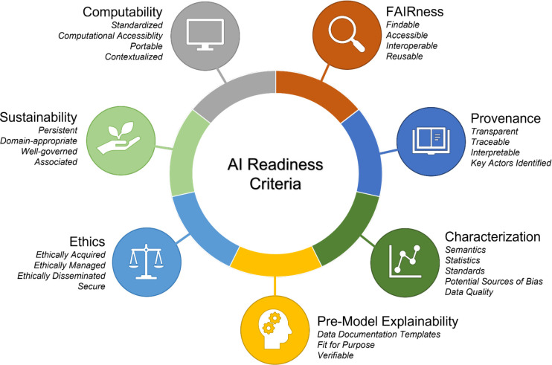
AI-ready is much more than FAIR
Example:
AI-readiness for Biomedical data
CLARK, Timothy, et al. AI-readiness for biomedical data: Bridge2AI recommendations. bioRxiv, 2024 . https://doi.org/10.1101/2024.10.23.619844

Slide 20


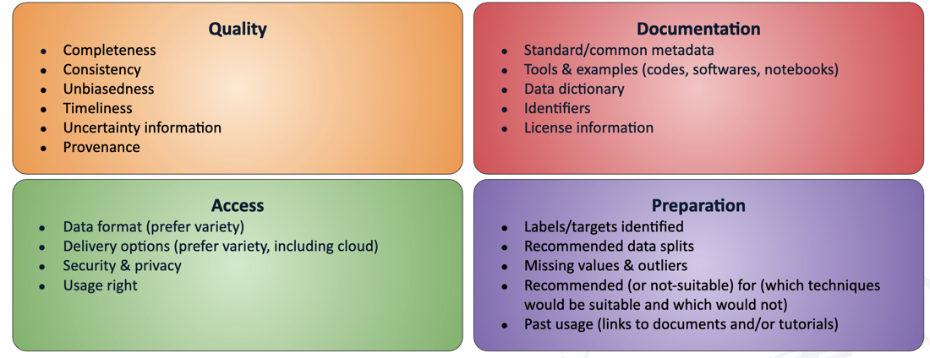
AI-Readiness – the Importance of Provenance
Checklist for AI-ready data: metadata must include provenance information
Wyborn Geo-INQUIRE June 2026
https://www.esipfed.org/checklist-ai-ready-data/

Slide 21
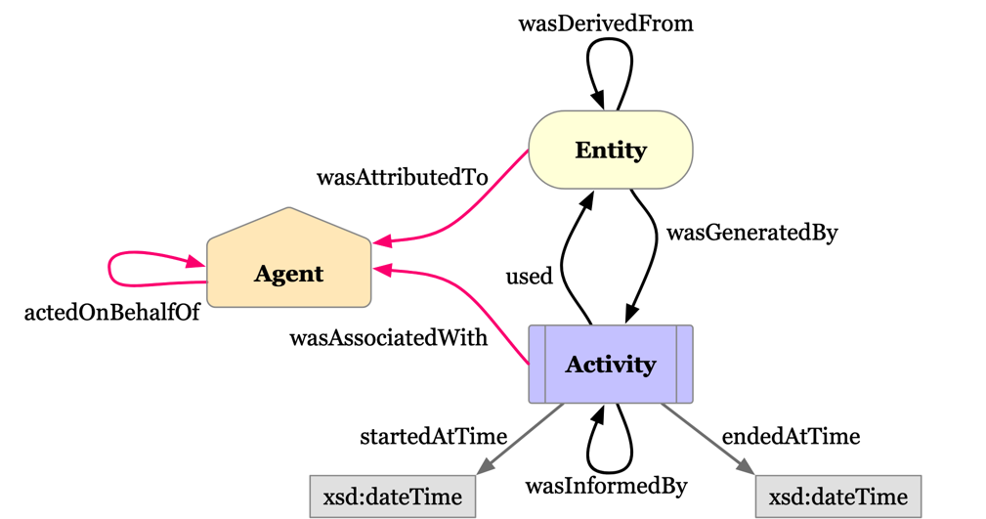
Moving on from Lineage Statements to Machine Actionable Provenance
Most Provenance in Metadata is currently described in Text-rich Lineage Statements.
We need to start moving to Machine-actionable Provenance statements based on the W3C Prov-O Ontology.
Not easy to deploy, but knowledge graphs can be built that will track input data sets and activities (services, software, etc) used to transform the dataset.
IEEE P2890-2025 provides considerations for changing agents (both Human and Machine) along any Research Data Workflow.
https://www.w3.org/TR/prov-o/
Courtesy: Lesley Wyborn (NCI)
Wyborn Geo-INQUIRE June 2026

Slide 22
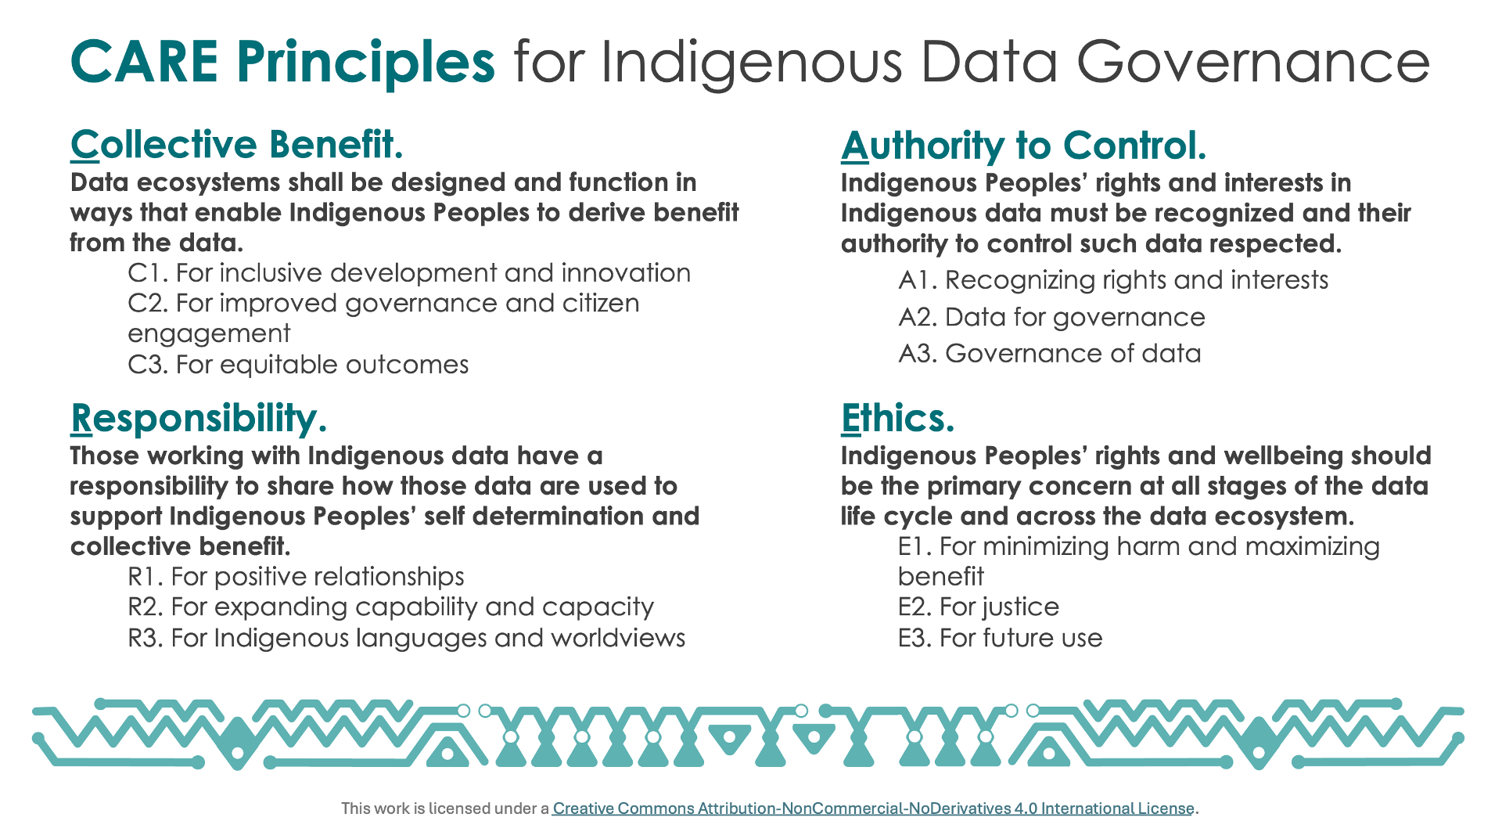
Ethics: the CARE principles
Courtesy: Lesley Wyborn (NCI)

Slide 23

Summary: FAIR is not the end, but the beginning
Decision Ready
Highest level of trust: data can be used in a court of law. Rich metadata supports a full provenance chain that enables tracking through the collection, analysis, storage research data lifecycle. Through PIDs, provides verifiable documentation of any activity and any actor involved in any transformation.
Fully FAIR with additional standards-compliant metadata on quality, documentation, access and provenance. Facilitates compliance with CARE Principles (particularly with IEEE P2890 - Recommended Practice for Provenance of Indigenous Peoples' Data).
AI-Ready + CARE
Increasing Richness of Metadata Required
Fully FAIR compliant and machine-actionable data: follows community agreed international technical and domain standards (particularly for vocabs) that enable machine actionable metadata and data
FAIR
Courtesy: Lesley Wyborn (NCI)
Wborn et al. EGU26-18847
nci.org.au
Wyborn Geo-INQUIRE June 2026
Notes:
Increasing complex metadata/provenance chains are needed for analysis, AI, decision ready data…

