Slide 1

The rules of data sharing introduction to research data sharing regulations in Europe (and elsewhere)
Federica Tanlongo | federica.tanlongo@epos-eric.eu
Notes:
Title slide

Slide 2
Part 1: the EU regulatory framework

Slide 3
A Shared approach
Compared to other world regions, EU tend to have a common approach to regulation and has worked to harmonise the regulations concerning data sharing and reuse.
Useful for cross-border collaboration

Slide 4
The EU Research Data regulatory landscape
Rules that…
…Enable data sharing
European Data Strategy (vision)
Open Data Directive (2019/1024)
Data Governance Act (2022/868)
Data Act (2023/2854)
INSPIRE Directive (2007/2/EC)
Interoperable Europe Act (2024/903)
2. …Limit data sharing
GDPR (2016/679)
Access to Environmental Information Directive (2003/4/EC)
Restrictions related to:
  personal data
  public security
  defence and national security
3. …Protect creators/ innovators
Database Directive (96/9/EC)
Software Directive (2009/24/EC)
Copyright in the Digital Single Market Directive (2019/790)
Facilitating access, interoperability, and reuse of data across Europe
Protecting people and sensitive information
Protecting IPR and software, ensuring attribution, legal certainty and sustainable reuse

Slide 5

Data strategy in the Digital Single Market
The European Data Strategy aims to make the EU a leader in a data-driven society.
A single market for data will allow it to flow freely within the EU and across sectors.
Data, especially when generated using public funding,
should benefit businesses, researchers, public
administrations and society.
Image by Nuthawut Somsuk
at https://www.vecteezy.com/
Adapted from: Data Governance and Legislative Strategies for FAIR Research - Brizioli, S., Cacciaguerra, S., Colcelli, V., Locati, M., Schirru L., 2024

Slide 6
Data that must not, should be, and must be shared
As open as possible,
as closed as necessary
Sharing
LIMITATIONS for:
Personal data
Data related to public security, defence and national security
Data Governance and Legislative Strategies for FAIR Research - Brizioli, S., Cacciaguerra, S., Colcelli, V., Locati, M., Schirru L., 2024

Slide 7
Protecting personal info: the GDPR
When we collect data that include personal information we need to comply with the GDPR (General Data Protection Regulation) principles.
  Data Minimization
  Transparency
  Security
  Purpose Limitation
  Appropriate Retention Periods
The GDPR:
identifies roles and responsibilities in the handling of personal data
grants Data Subject (i.e. the persons whom the data are about) rights concerning their data, across the whole data lifecycle:
  Access
  Rectification
  Erasure

Slide 8
Data that must not, should be, and must be shared
As open as possible,
as closed as necessary
Sharing
LIMITATIONS for:
Personal data
Data related to public security, defence and national security
Sharing
RECOMMENDED for:
Data generated using
public funding
No re-use limitations, even for commercial purposes
Data Governance and Legislative Strategies for FAIR Research - Brizioli, S., Cacciaguerra, S., Colcelli, V., Locati, M., Schirru L., 2024

Slide 9
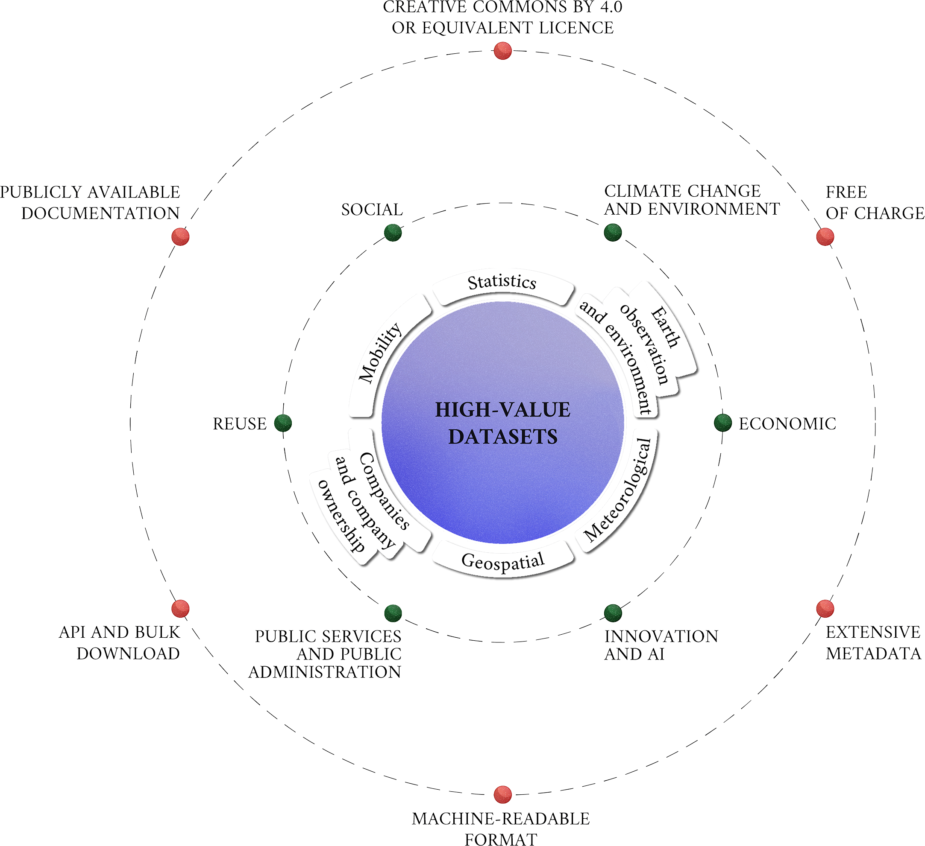
Data that must not, should be, and must be shared
As open as possible,
Sharing is
COMPULSORY for:
as closed as necessary
High-value
Dataset
Sharing
LIMITATIONS for:
Personal data
Data related to public security, defence and national security
Sharing
RECOMMENDED for:
Data generated using
public funding
No re-use limitations, even for commercial purposes
Re-usable dataset that may generate important benefits for society, the environment and the economy, in particular because of their suitability for the creation of added-value services, applications, and new, high-quality and decent jobs for many potential beneficiaries.
Data Governance and Legislative Strategies for FAIR Research - Brizioli, S., Cacciaguerra, S., Colcelli, V., Locati, M., Schirru L., 2024

Slide 10
High-value datasets
CLIMATE CHANGE &
ENVIRONMENT
SOCIAL
COMPULSORY sharing
Domains with high potential for societal impact
High-value
Dataset
REUSE
ECONOMIC
PUBLIC SERVICES & PA
INNOVATION & AI
Adapted from: Data Governance and Legislative Strategies for FAIR Research - Brizioli, S., Cacciaguerra, S., Colcelli, V., Locati, M., Schirru L., 2024
Notes:
six categories from Regulation 2023/138: geospatial, earth observation/environment, meteorological, statistics, companies/company ownership, mobility

Slide 11
High-value datasets
CC BY 4.0 OR EQUIVALENT LICENSE
CLIMATE CHANGE &
ENVIRONMENT
SOCIAL
FREE OF CHARGE
COMPULSORY sharing
PUBLICLY AVAILABLE DOCUMENTATION
Requirements:
free of charge
open data licence
downloadable in bulk (where relevant) and through application programming interfaces (APIs)
extensive metadata
machine readability
availability of public documentation
High-value
Dataset
REUSE
ECONOMIC
API & BULK DOWNLOAD
EXTENSIVE METADATA
PUBLIC SERVICES & PA
INNOVATION & AI
Adapted from: Data Governance and Legislative Strategies for FAIR Research - Brizioli, S., Cacciaguerra, S., Colcelli, V., Locati, M., Schirru L., 2024
MACHINE-READABLE FORMAT

Slide 12

INSPIRE
INfrastructure for SPatial InfoRmation in Europe)
Directive that requires Member States to establish and operate a network of services related to spatial datasets and to ensure their interoperability.
Applies to
  EU public authorities that create, hold or use spatial data in the performance of their public tasks.
  Third parties accessing the network according to the directive's provisions.
Objective: to make spatial data accessible, interoperable, and useful.
Notes:
INSPIRE is the EU directive that regulates Data Sharing for geospatial information. It has been implemented in phases and basically requires Member States to establish and operate a network of services related to spatial data sets and to ensure that spatial data sets and services can be linked to this national network. The directive aims to harmonize and share publicly-generated spatial data to support environmental decision-making and management.
The INSPIRE directive primarily applies to European public authorities that hold spatial data or use it in the performance of their public tasks. It also applies to third parties accessing the network according to the directive's provisions. Public research organizations within the European Union are generally mandated to adhere to the INSPIRE (Infrastructure for Spatial Information in Europe) Directive if they manage spatial data that are relevant to environmental policies or activities.

Slide 13
INSPIRE principles
Data should be collected once and kept where it can be maintained most effectively.
It should be possible to combine seamless spatial information from different sources across Europe and share it with many users and applications.
Information should be shareable at different levels (e.g. detailed for research, general for strategic purposes).
Geographic information needed for good governance should be readily and transparently available.
It should be easy to find what geographic information is available, and how and under which conditions it can be used.
Notes:
INSPIRE is based on a number of common principles:

Slide 14

INSPIRE in a Nutshell
Application: spatial data in electronic format that falls under the jurisdiction of MS
Environmental Focus: emphasis on spatial data related to environmental policies and activities.
Network Services: MS required to operate a network of services for spatial data, (including discovery, view, download, transformation, and invoke services.)
Harmonization: requirement of documenting data though metadata, expose it through network services, and harmonize it according to common data models.
Relevance to Research:
As a data provider: RPO often generate/manage valuable spatial data and INSPIRE ensures they’re available in a standardized and usable format.
As a user: facilitating environmental research by improving accessibility and interoperability
Sources:
https://wetransform.to/learn-about-inspire/#:~:text=The%20INSPIRE%20directive%20is%20a,access%2C%20find%2C%20and%20process.
https://ec.europa.eu/info/law/better-regulation/have-your-say/initiatives/12111-Open-data-availability-of-public-datasets_en
Picture: adaptation from amonrat rungreangfangsai

Slide 15
INSPIRE standards
INSPIRE dictates standards and specifications for different levels
of the infrastructure:
Metadata: metadata are created for the spatial data sets and services
(corresponding to themes listed in the directive)
Data specification: common data models, code lists, map layers and additional metadata on the interoperability to be used when exchanging spatial datasets
Network services: common interfaces for web services.
Data and service sharing: rights and obligations regarding the sharing of spatial data sets and services between all levels of government.
Spatial data services: specify rules for the interoperability of spatial data services.
Monitoring and reporting: ensure that MS monitor the implementation and use of their infrastructures for spatial information and report to the EC
Source(s): https://knowledge-base.inspire.ec.europa.eu/index_en

Slide 16
Part 2: protecting the data producers’ rights

Slide 17
Making data reusable does NOT imply not protecting IPR
Making data/products Open does NOT mean not attributing a work and recognising the data producers’ rights
Using open licenses does NOT mean that no restrictions apply to the usage of data/products

Slide 18
What is copyright?
One form of IPR (compare with trademark and patents)
Grants a set of exclusive rights to copyright holders:
one cannot copy, distribute, publicly perform, adapt, etc
without permission of the copyright holder.
?

Slide 19
What is copyright?
One form of IPR (compare with trademark and patents)
Grants a set of exclusive rights to copyright holders:
one cannot copy, distribute, publicly perform, adapt, etc
without permission of the copyright holder.
Utilitarian rights: gain for one’s work
Moral rights: right to attribution and integrity of the work

Slide 20

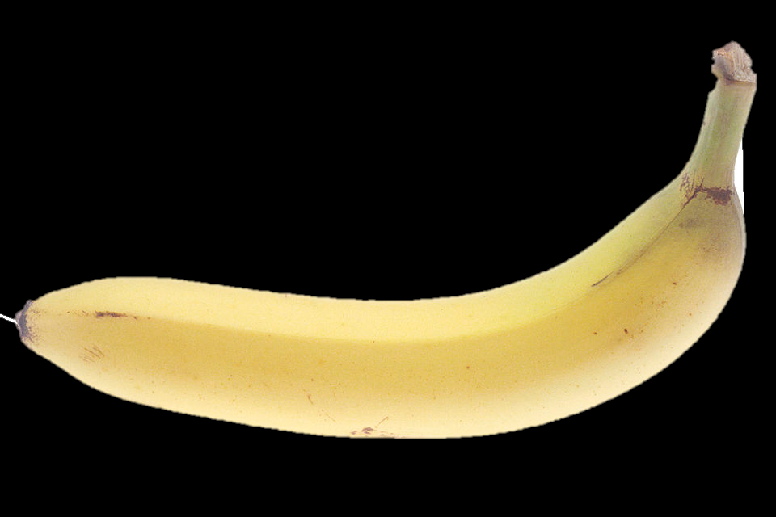
What is copyright?
One form of IPR (compare with trademark and patents)
Grants a set of exclusive rights to copyright holders:
one cannot copy, distribute, publicly perform, adapt, etc
without permission of the copyright holder.
Applies to works (including scientific works) that are original.
Some things (e.g. facts, ideas) are not copyrightable
Is effective regardless the registration of the work
Balances against other public interests

Slide 21
But... Who’s the copyright holder of scientific data?
?
Raw Data & Facts: measurements, observations and facts belong to everyone.
No one can hold the copyright (public domain)
Databases, collections, compilations and other organised data:
  The organization that funds and/or manages the research generally holds the IPR.
  The researchers who produce the data fall under the "work made for hire" doctrine.
  Funding agencies may dictate specific data-sharing mandates or ownership clauses.
Published Articles:
  Researchers (authors) or publishers hold the IPR

Slide 22
Which copyright law?
Laws of copyright are locally implemented by every Country, and they can vary (sometimes dramatically)
Some aspects of copyright law are harmonized through international agreements and treaties, ensuring that some basic standards are enforced everywhere.
  Many countries enact laws that grant protections above what is required.
Berne convention (2024)
  all countries must give foreign works the same protection they give works created within their borders, assuming the other country is a signatory.
  minimum term of copyright: life of the author + 50 years.
International public licenses such as CC are designed to be enforceable everywhere

Slide 23
Licensing: different legal tools for different products

Slide 24
Licensing: different legal tools for different products
Standard license: A set of predefined re-use conditions in a digital format, preferably compatible with standardised public licences available online.
Allow authors to chose, based on the specific scientific products they need to protect, which conditions should be applied to its use and distribution.
Different licenses adapt to different scientific products.
  IMPORTANT! Not all public licenses are necessarily in line with Open Science (including CCs!)

Slide 25
Licenses:
Raw data and Metadata
Raw data: Public domain
Data and metadata produced by public bodies, including research organisations and cultural heritage institutions, should be distributed without restrictions
In this form, data are not covered by copyright
Metadata and unstructured (raw) data should be licensed using Public Domain licenses such as CC0 (Creative Commons Zero dedication to the public domain) or similar.
Whenever possible, attribution is recommended anyway (“CC0 +credits”)

Slide 26
Licenses:
Raw data and Metadata
Raw data: Public domain
Data and metadata produced by public bodies, including research organisations and cultural heritage institutions, should be distributed without restrictions
In this form, data are not covered by copyright
Metadata and unstructured (raw) data should be licensed using Public Domain licenses such as CC0 (Creative Commons Zero dedication to the public domain) or similar.
Whenever possible, attribution is recommended anyway (“CC0 +credits”)
Important note:
while facts/raw observations are generally not protected by copyright, databases may have copyright or sui generis database rights in the EU

Slide 27
Licenses:
Raw data and Metadata
Raw data: Public domain
Data and metadata produced by public bodies, including research organisations and cultural heritage institutions, should be distributed without restrictions
In this form, data are not covered by copyright
Metadata and unstructured (raw) data should be licensed using Public Domain licenses such as CC0 (Creative Commons Zero dedication to the public domain) or similar.
Whenever possible, attribution is recommended anyway (“CC0 +credits”)
  Some examples:
Creative Commons 0 (CC0)
Public Domain Mark
Public Domain Dedication
Open Data Commons Public Domain Dedication and license (PDDL)

Slide 28
Licenses:
Datasets and other scientific products
Creative and Academic works: Attribution
This category includes datasets, databases and processed scientific products (e.g. in the geosciences, a seismic risk map);
They are recognized as intellectual creations and therefore subject to copyright.
As a rule, in an Open Science context, we use licenses that ensure attribution to the author and allow the use, modification, and sharing of the scientific product.
The most common licenses are those by Creative Commons, particularly CC BY International 4.0.
More restrictive conditions are acceptable if justified, following the principle of "as open as possible, as closed as necessary."

Slide 29
Licenses:
Datasets and other scientific products
  Some examples:
  Datasets and other scientific products:
Creative Commons Attribution (CC BY)
Open Data Commons Attribution licence
Other content (e.g. documentation)
Creative Commons Attribution (CC BY)
Digital Peer Publishing Licences (DPPL)
GNU Free Documentation Licence (GFDL)
Creative and Academic works: Attribution
This category includes datasets, databases and processed scientific products (e.g. in the geosciences, a seismic risk map);
They are recognized as intellectual creations and therefore subject to copyright.
As a rule, in an Open Science context, we use licenses that ensure attribution to the author and allow the use, modification, and sharing of the scientific product.
The most common licenses are those by Creative Commons, particularly CC BY International 4.0.
More restrictive conditions are acceptable if justified, following the principle of "as open as possible, as closed as necessary."

Slide 30
Licenses: Software
Software: Open Source Licenses
  Comply with the Open Source definition.
  Allow software to be freely used, modified and shared.
  Must be approved by the Open Source Initiative (OSI) through a codified review process.

Slide 31
Licenses: Software
Software: Open Source Licenses
  Comply with the Open Source definition.
  Allow software to be freely used, modified and shared.
  Must be approved by the Open Source Initiative (OSI) through a codified review process.
CC
  Some examples
    MIT license,
    Apache License 2.0,
    Mozilla Public License 2.0,
    GNU General Public License (GPL)
    Common Development and Distribution License
    more on: opensource.org/licenses

Slide 32
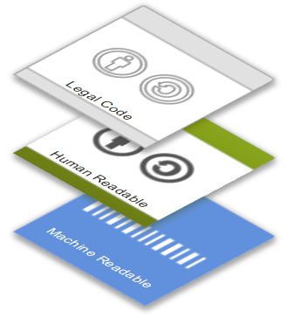
How does a public license work? CC
Creative Commons is a nonprofit organization that enables the sharing and use of creativity and knowledge through free legal tools.
https://creativecommons.org/
Licenses are offered through a three-layer design
Legal Code layer for lawyers
Common Deed or “Human Readable” layer for creators, educators, and scientists
Machine Readable layer for the web
Basili, R. - Building and using databases in Earth Sciences - Creazione e uso dei database nelle Scienze della Terra - Corso di Dottorato in Scienze Della Terra - Sapienza Università di Roma, 2024

Slide 33
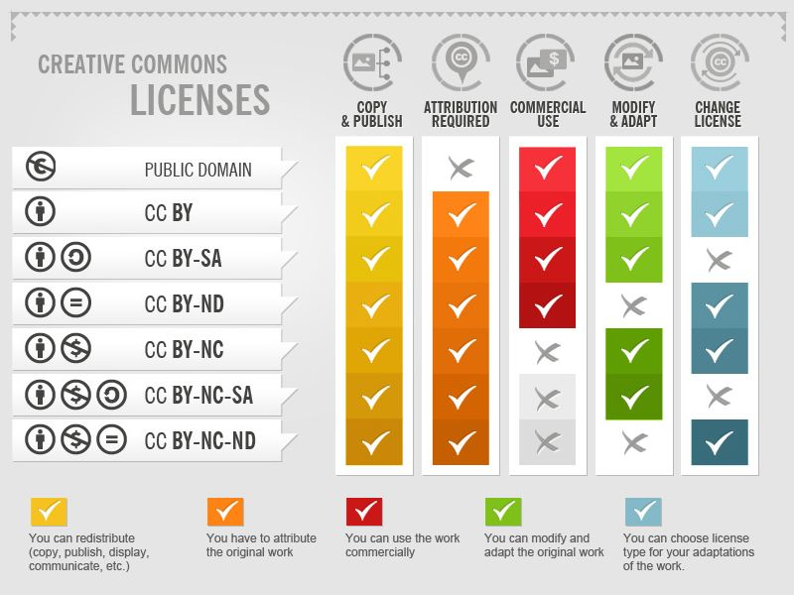
Licenses: conditions
Authors can condition the reuse of a creative work to:
Providing proper attribution (BY)
Redistributing with same license (SA)
Not modifying the original work (ND)
Not using for commercial purposes (NC)
A combination of these conditions
https://creativecommons.org/licenses/
Creative Commons licenses by Foter (CC-BY-SA)

Slide 34
Licenses: conditions …& Open Science compliance
Authors can condition the reuse of a creative work to:
Providing proper attribution (BY)
Redistributing with same license (SA)
Not modifying the original work (ND)
Not using for commercial purposes (NC)
A combination of these conditions
Creative Commons licenses by Foter (CC-BY-SA)
https://creativecommons.org/licenses/
Notes:
I

Slide 35
Part 3: Providing Recognition

Slide 36
Providing Recognition: Citation
WHY
HOW
Most licenses require attribution, but even if it is not strictly required, it is a best practice!
Proper citation provides value to our research and supports the work of our favourite data/service providers.
  By openly sharing information about data and methodologies we use, we support Open Science, transparency and accountability. → TRUST MAKER!
Most repositories/portals provide automated citation or require specific formats.
Regardless of the style, citation should include:
  author(s),
  publication year,
  output title, journal/source name
  PID (e.g. DOI)
Reference management tools like Zotero help formatting in-text citations and bibliographies according to specific guidelines.
Notes:
By openly sharing information about data and methodologies used in our research, we actively support the establishment of Open Science and make a statement about our commitment to transparency and accountability
Thus, openness about the data used in your work is not just a matter of etiquette, nor a mere administrative task: it is a “trust marker”, i.e. an indicator that allows you and your research team to state that you are open to the scrutiny of peers. This helps you and your team to establish trust not only within your scientific field, but with the public, industry, and funders. By helping us to assess our impact you also support EPOS’ work in bringing to you more data and services to boost your research.

Slide 37
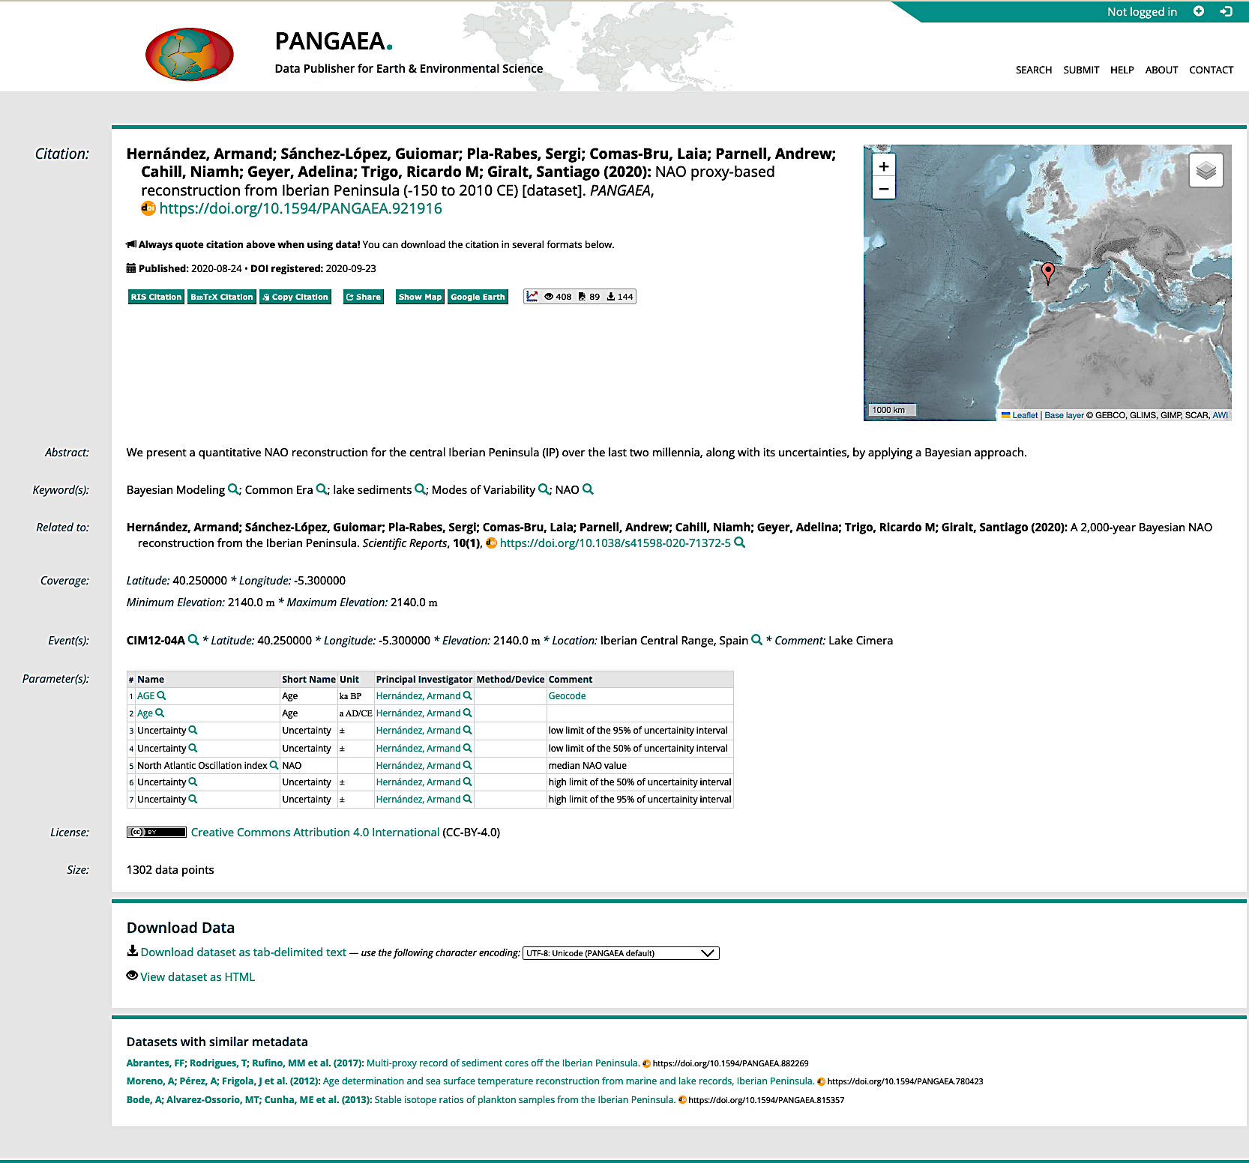
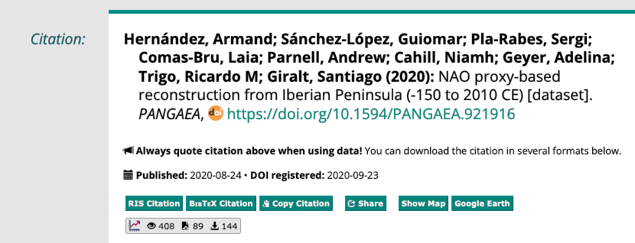
Licenses and citations: examples

Slide 38
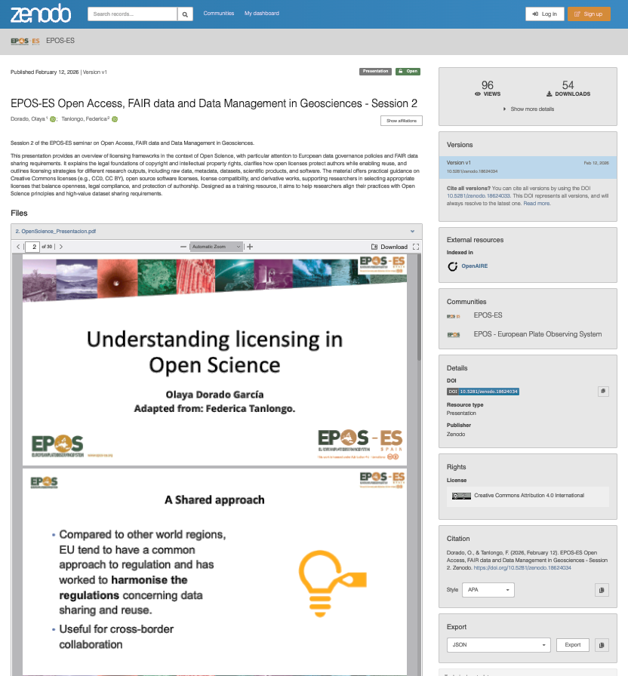
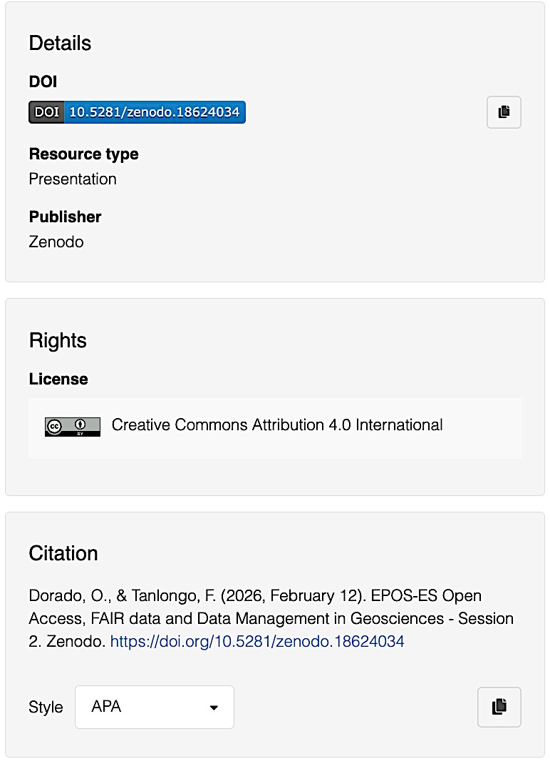
Licenses and citations: examples

Slide 39
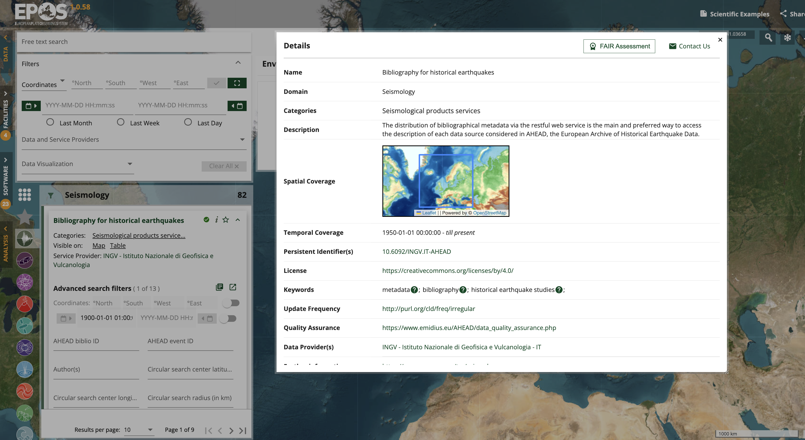
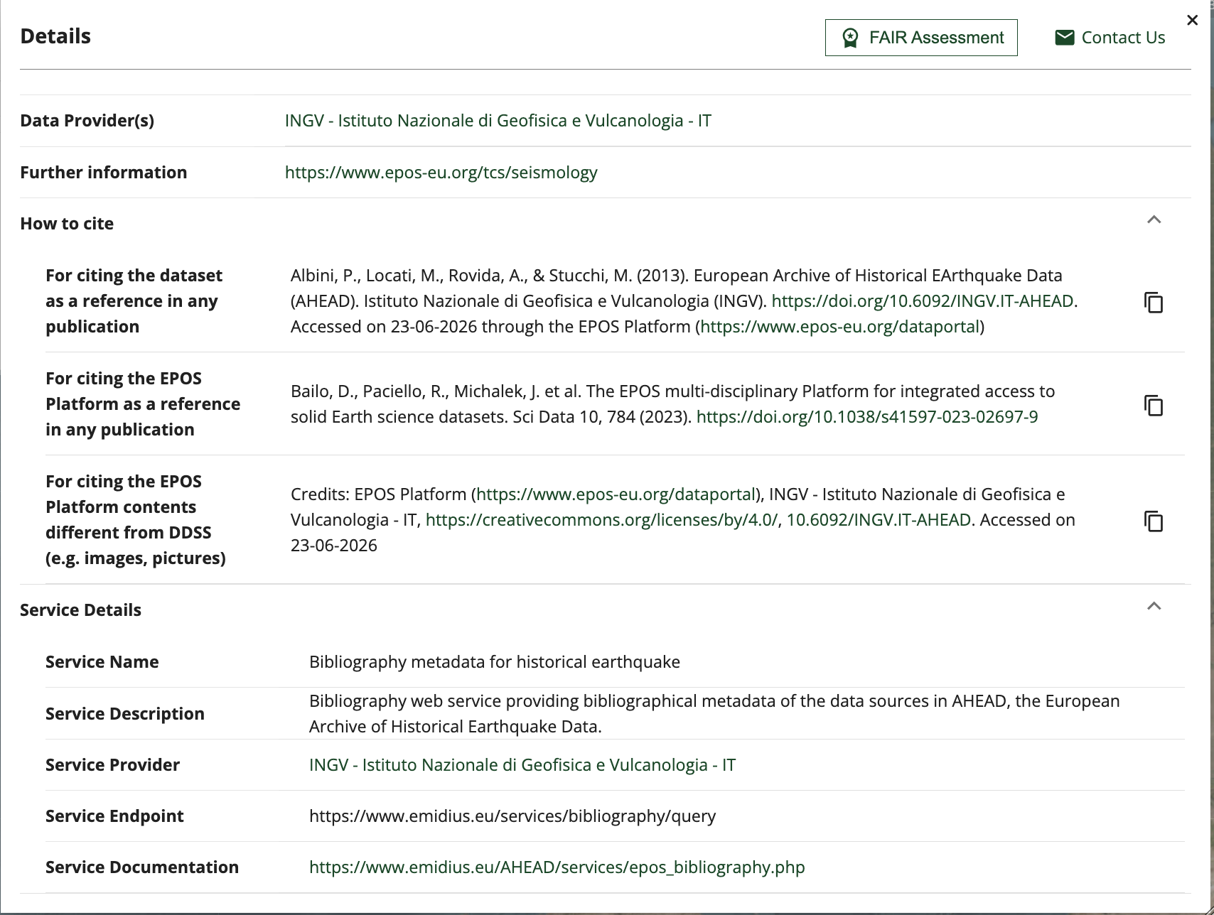
Licenses and citations: examples

Slide 40
Part 4: building on others’ works: licensing for adaptations and derivative works

Slide 41
Derivative works
THIS IS THE PART THAT IS SOMETIMES DIFFICULT TO DETERMINE!
Adaptation (…) or derivative work a new work that is created from a copyrighted work and is sufficiently original to itself be protected by copyright.
The definition of what is an adaptation or not can vary depending
on jurisdiction and context
to constitute an adaptation, the resulting work itself must be considered based on or derived from the original.
Collection: provide attribution and licensing information about the individual works that are part of the collection Vs adaptation: new license. Attribution of original work(s) must be provided for both.
Notes:
Copying a CC licensed work and sharing it is pretty simple. Just make sure to provide attribution and refrain from using it for commercial purposes if it is licensed with one of the NonCommercial licenses.
But what if you are changing a CC licensed work or incorporating it into a new work? First, remember that if your use of someone else’s CC licensed work falls under an exception or limitation to copyright (like fair use or fair dealing), then you have no obligations under the CC license. If that is not the case, you need to rely on the CC license for permission to adapt the work. The threshold question then becomes, is what you are doing creating an adaptation?

Slide 42
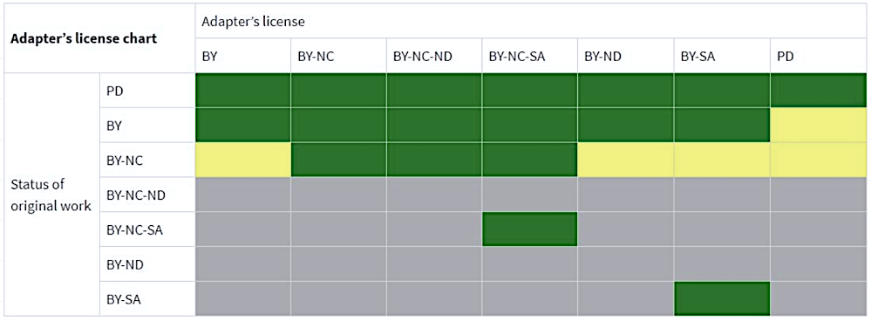
The Adapter’s chart
CC Adapters License Chart / CC BY 4.0

Slide 43
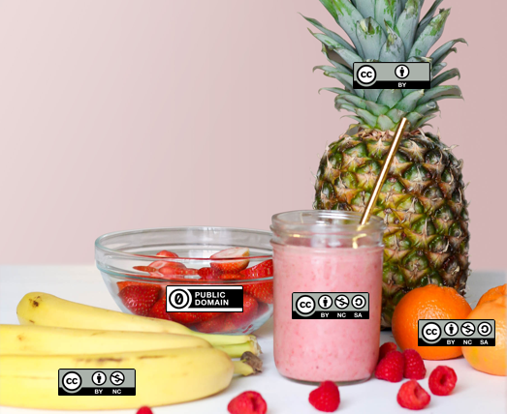
In practice: License mixology
CC BY
Adaptation/Remix: CC BY – NC - SA
Attributions: “CC Smoothie” by Nate Angell. CC BY. Derivative of “Strawberry Smoothie On Glass Jar”
by Element5 in the public domain, and various Creative Commons license icons by Creative Commons used under CC BY.
Public domain
CC BY – NC
CC BY – NC - SA

Slide 44
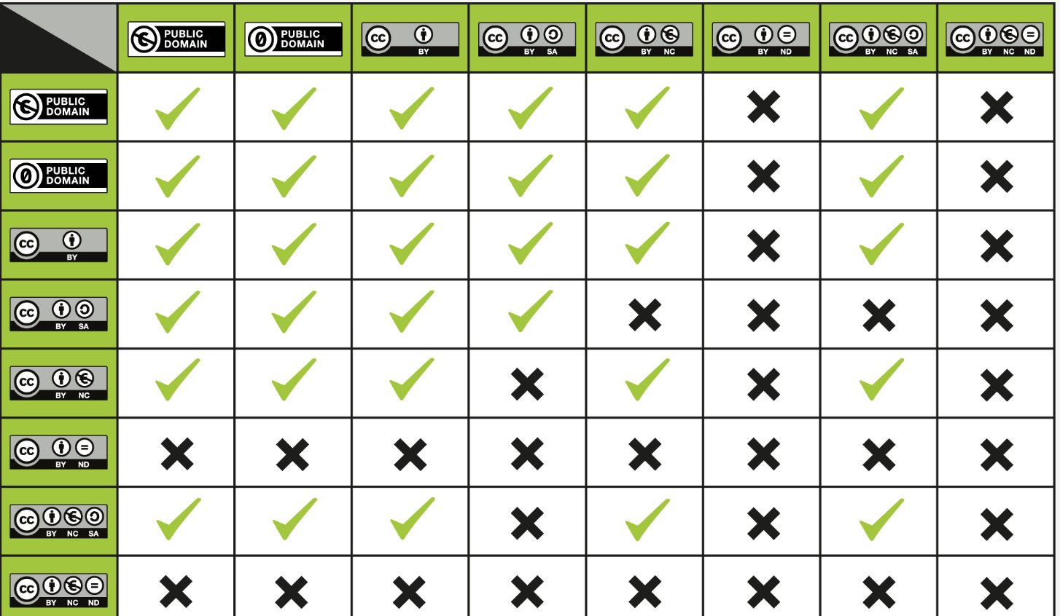
License compatibility chart
When mixing 2 works with different licenses in an adaptation, we generally are safe by selecting the more restrictive of the two
CC License Compatibility Chart / CC BY 4.0

Slide 45
Summarising: remix & compatibility with CC
Underlying work licensed under ND: we can make and use changes privately but not share adaptations with others
Underlying work licensed under SA: ShareAlike applies to our adaptation and derivative work must be shared with same/ compatible license
Underlying works licensed under different licenses: new license must consider license compatibility.

Slide 46
Derivative works: SW and how to prevent others close it off
Best practice: SW providers can adopt copyleft licenses (e.g., GPL) to prevent that others modify and redistribute their software under more restrictive terms (tipically for commercial gain).
  Require modifications/derivative works to be licensed under the same copyleft terms, thereby ensuring continued openness, reuse, and redistribution, including in for-profit contexts.
  Fully compliant with OSI
A common strategy for SW providers is also dual licensing (Open for non-commercial, restrictive for commercial uses)
  Must be introduced outside through a separate commercial license with dual licensing framework, since it field of use-based are not permitted in OSI licenses
  .
Notes:
Organizations providing software who are concerned that companies may adopt, modify, and redistribute their software under more restrictive terms, particularly for commercial gain, are encouraged to adopt copyleft licenses (e.g., GPL). These licenses require that any modifications or derivative works remain under the same copyleft terms, thereby ensuring continued openness, reuse, and redistribution, including in for-profit contexts. Copyleft is generally considered best practice when the goal is to prevent software from being closed off or relicensed under more restrictive conditions (Free Software Foundation, 202323). It supports broad reuse while safeguarding the collaborative and open nature of the software ecosystem. However, if the provider wishes to impose additional conditions on commercial use, it may consider adopting a dual licensing scheme. Using this approach, the software can be distributed under an opensource license for non-commercial purposes (e.g., academic or educational contexts), while a separate, more restrictive license, can be offered to commercial users. It is important to note that Open Source Initiative (OSI) approved licenses do not permit restrictions based on fields of use, such as “non-commercial use only”. Therefore, any limitations on commercial usage must be introduced outside the scope of the OSI-approved license through a separate commercial license with a dual licensing framework.

Slide 47
Resources: the EU Regulatory Framework 1/2
INSPIRE Directive (2007/2/EC) | Establishes an Infrastructure for Spatial Information in the European Community, aimed at making environmental spatial data more accessible and interoperable across Europe. It includes the INSPIRE implementing rules and technical implementations. | https://eur-lex.europa.eu/eli/dir/2007/2/oj/eng (EUR-Lex) https://inspire.ec.europa.eu/legislation/implementing-rules (EUR-Lex) https://knowledge-base.inspire.ec.europa.eu/technical-guidance_en
Access to Environmental Information Directive (2003/4/EC) | Implements the Aarhus Convention in the EU, ensuring public access to environmental information held by public authorities. | https://eur-lex.europa.eu/eli/dir/2003/4/oj/eng (EUR-Lex)
GDPR (Regulation (EU) 2016/679) | While not specifically environmental, this regulation governs the processing of personal data and is relevant for environmental data involving personal information | https://eur-lex.europa.eu/eli/reg/2016/679/oj/eng (EUR-Lex)
Open Data Directive (EU) 2019/1024 | Promotes the availability of public sector information (PSI) for reuse, which includes environmental data, and encourages making this data available in open formats. | https://eur-lex.europa.eu/eli/dir/2019/1024/oj/eng
Data Governance Act (EU) 2022/868) | Establishes a framework for data sharing and governance across the EU, including environmental data, to facilitate reuse, promote research and innovation, and ensure responsible data handling. | https://eur-lex.europa.eu/eli/reg/2022/868/oj/eng

Slide 48
Resources: the EU Regulatory Framework 2/2
High-Value Datasets Regulation (EU) 2023/138) | Defines a set of high-value datasets, ensuring their free publication and reusability to boost transparency, innovation, and economic growth across the EU. | https://eur-lex.europa.eu/eli/reg_impl/2023/138/oj/eng
Data Act (EU) 2023/2854) | Entered into force on January 11, 2024, applies from September 12, 2025, fostering digital innovation in the EU and facilitating data sharing and access, including for environmental data | https://eur-lex.europa.eu/eli/reg/2023/2854/oj/eng
Interoperable Europe Act (EU) 2024/903) | Establishes measures to enhance cross-border interoperability of digital public services across the EU, promoting seamless data exchange and cooperation among public administrations | https://eur-lex.europa.eu/eli/reg/2024/903/oj/eng
AI Act (EU) 2024/1689) | lays down harmonized rules on artificial intelligence– phased application, some rules already apply, most from 2 Aug 2026. | https://eur-lex.europa.eu/eli/reg/2024/1689/oj/eng
Database Directive (96/9/EC) | Provides legal protection for databases through copyright and sui generis rights, safeguarding against unauthorized extraction and reuse of substantial parts of databases. | https://eur-lex.europa.eu/eli/dir/1996/9/oj/eng
Software Directive (2009/24/EC) | Provides legal protection for computer programs, ensuring that software, including those used for environmental data management, is protected under EU copyright law. | https://eur-lex.europa.eu/eli/dir/2009/24/oj/eng

Slide 49
Resources: other references
European Data Strategy | https://digital-strategy.ec.europa.eu/en/policies/strategy-data
Horizon Europe Open Science requirements | https://research-and-innovation.ec.europa.eu/strategy/strategy-research-and-innovation/our-digital-future/open-science_en
EOSC (European Open Science Cloud) | https://eosc.eu
Aarhus Convention | https://unece.org/environment-policy/public-participation/aarhus-convention/introduction

Slide 50
Resources: licenses
https://creativecommons.org/faq/
https://certificates.creativecommons.org/cccertedu/
https://opensource.org/licenses

Slide 51

Resources: the EPOS data policy
The EPOS Data Policy
defines the roles and responsibilities of key stakeholders within the EPOS RI who are involved in the data lifecycle,
establishes the core principles governing the provision, integration, sharing, access, use and exploitation of data, ensuring its effective management and utilization.
https://shorturl.at/u59G7
DOI: 10.5281/zenodo.17287074

Slide 52
Resources: data sharing cheatsheet for data regulation compliance - part1
Step 1: Can I openly share it?
Step 2: Do I own the rights to share it?
Step 3: What type of research output is it?
Did I create the work?
☐ Yes
☐ Partially (co-authors/collaborators)
☐ No
If collaborators are involved:
☐ Rights and responsibilities are clearly agreed
☐ Permission has been obtained before publication
Does the work contain third-party material?
☐ No
☐ Yes
( e.g. figures, maps, images, datasets, software libraries, documentation…)
→ Check licence compatibility before sharing.
☐ Raw data/Metadata (Examples: observations, measurements, instrument readings
metadata records….)
→ Goal: maximise reuse and
interoperability.
Recommended licenses:
    ☐ CC0
    ☐ PDDL
☐ Dataset / database / scientific product
(Examples: curated dataset, database, susceptibility map, hazard map, model outputs…)
Recommended:
☐ CC BY 4.0
Possible alternatives:
☐ ODC-BY
Avoid unless justified:
☐ CC BY-SA
☐ CC BY-NC
☐ CC BY-ND
☐ Documentation / reports / training material
Recommended:
☐ CC BY 4.0
Avoid unless justified:
☐ CC BY-SA
☐ CC BY-NC
☐ CC BY-ND
☐ Software
→ Use an OSI-approved licence:
☐ MIT
☐ Apache 2.0
☐ GPL
☐ MPL
☐ BSD
⚠ Do not use Creative Commons licences for software.
Does it contain personal information?
Can the data be fully anonymised?
Is there a legal basis for sharing?
Would sharing create risks for data subjects?
Does it contain sensitive or restricted information?
☐ Public security / defence
☐ Critical infrastructure
☐ Commercially confidential information
☐ Third-party confidential information
☐ Indigenous or community-sensitive knowledge
☐ Export-controlled or dual-use information

Slide 53
Resources: data sharing cheatsheet for data regulation compliance – part2
Step 4: is the licence compatible with Open Science?
Step 5: Can others understand and reuse it?
Step 6: Final OS/FAIRcheck
Fully Open Science compatible
☐ CC0
☐ CC BY
☐ MIT
☐ Apache 2.0
☐ GPL
Potentially problematic for Open Science
☐ CC BY-SA
☐ CC BY-NC
☐ CC BY-ND
These restrict reuse and may reduce interoperability.
Use only when justified.
Are these elements provided?
☐ Rich metadata
☐ Documentation
☐ Provenance recorded
☐ Persistent Identifier (DOI, Handle, etc.)
☐ Machine-readable format
☐ Open, non-proprietary formats when possible
☐ Licence clearly displayed
☐ Citation required and clearly displayed
Can a researcher:
☐ Find it?
☐ Access it?
☐ Understand it?
☐ Reuse it?
☐ Cite it?
If any answer is "No", improve documentation, metadata, access conditions, or licensing before publication.
The Golden Rule
As open as possible, as closed as necessary.
Share the maximum amount of data and research outputs that can be made available without violating privacy, security, confidentiality, contractual obligations, or intellectual property rights.

Slide 54

Thank you for your attention!
federica.tanlongo@epos-eric.eu
www.epos-eu.org/on | social media #EPOSon
Notes:
Thank you slide

