Slide 1

Stories about Metadata: introduction, types, role, elements
Kirsten Elger| kelger@gfz.de
Notes:
Title slide

Slide 2
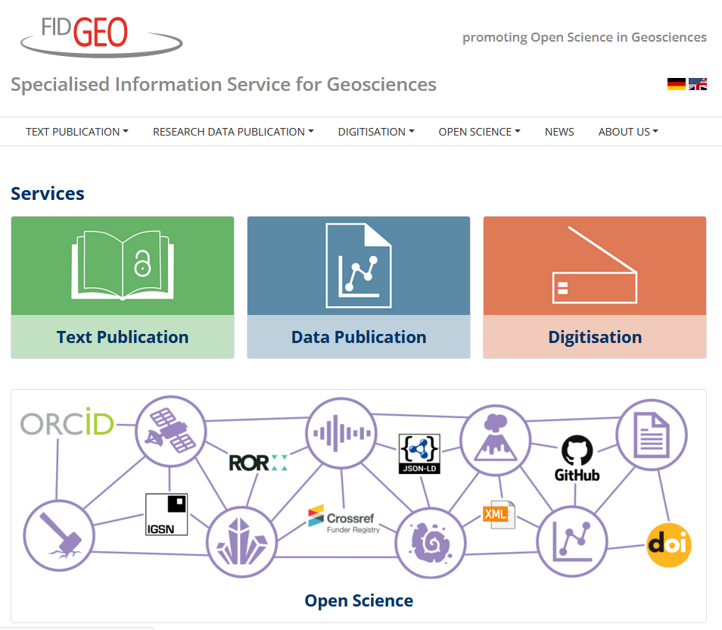



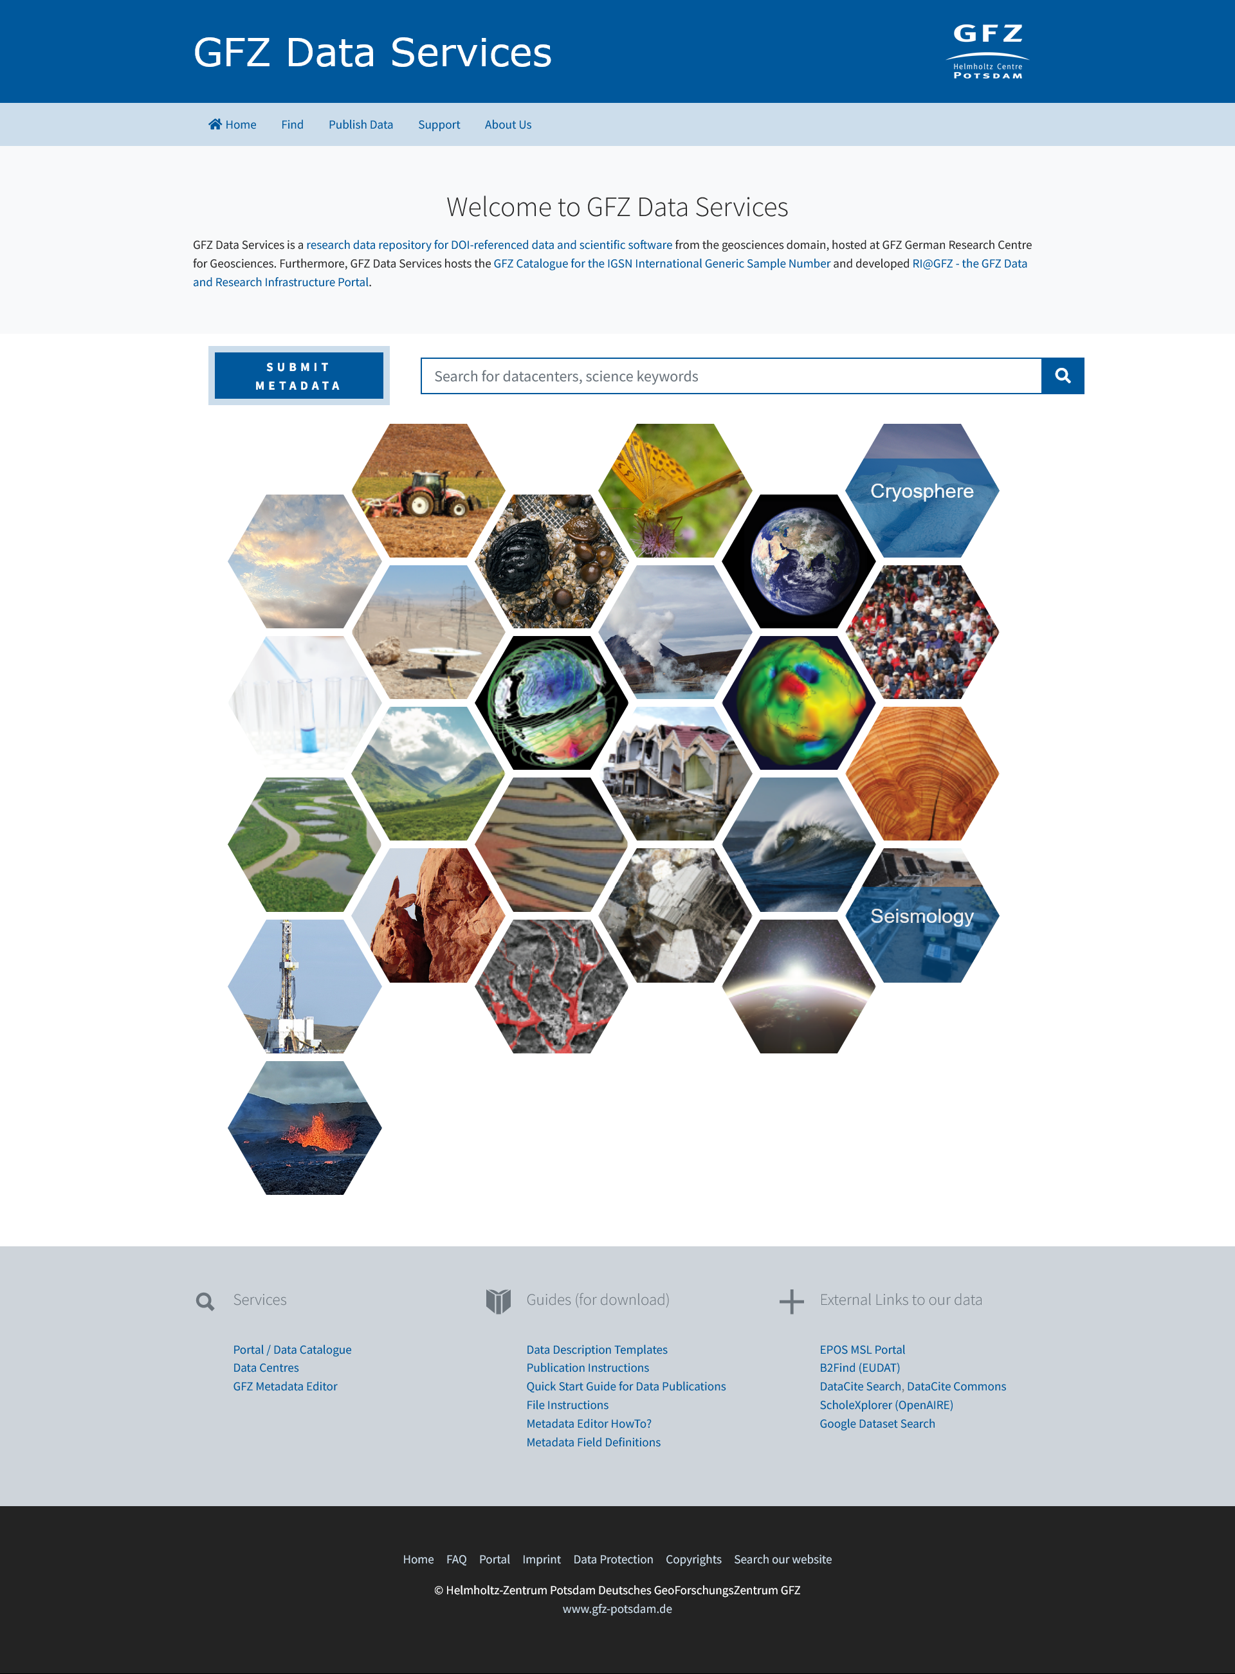



Who am I?
Kirsten Elger: geologist, data and repository manager, editor
Notes:
Content slide

Slide 3
Stories about metadata: outline
Intro: a data management horror story from the NYU Health Sciences Library
What are metadata, why are they important and what types of metadata exist ?
Persistent Identifier (PIDs) – what are they and how do these help for making my research more visible?

Slide 4
https://www.youtube.com/watch?v=N2zK3sAtr-4

Slide 5
Metadata – some definitions
Metadata are „data about data“ or „information about information *
Metadata are data that describes other data. They are structured in nature and are used to discover, audit, manage, or help identify the attributes of the data that they represent. Metadata can be a by-product of an automated transaction, or can be manually added to describe data. **
*NISO Primer (2017) Understanding Metadata: https://groups.niso.org/apps/group_public/download.php/17443/understanding-metadata
** https://blog.infuseai.io/everything-about-metadata-and-its-meaning-for-machine-learning-practitioners-cd353ca160d1

Slide 6
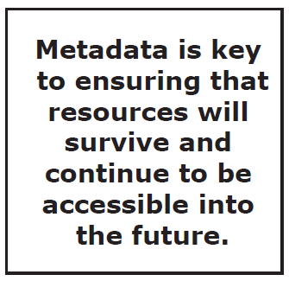
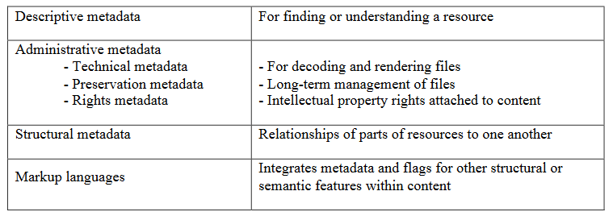
Metadata are everywhere
NISO Primer (2017) Understanding Metadata: https://groups.niso.org/apps/group_public/download.php/17443/understanding-metadata

Slide 7
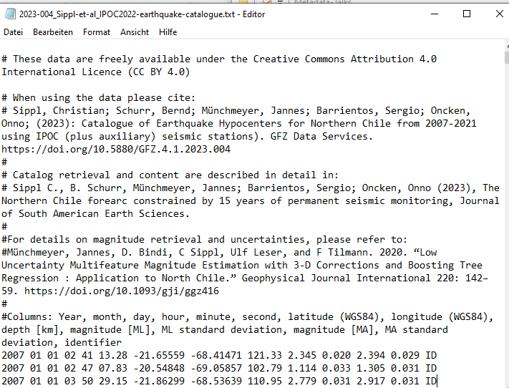
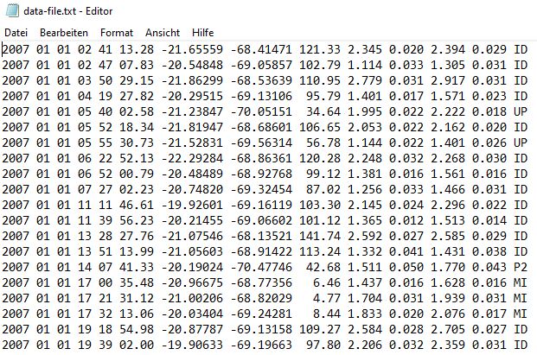
Why are metadata important? An example…
meaningful file name
license information
citation
related articles
What is the content of this table?
definition of colums
After curation by a data steward
Notes:
Title slide for large pictures, tables, maps, plots…

Slide 8
FAIR Principles - Guiding Principles for Findable, Accessible, Interoperable and Re-usable Data
Findable – Data Discovery | Accessible | Interoperable | Reusable
Metadata for data discovey in public domain | Data is accessible by humans and machines | Open formats | Data rights and licences
Metadata catalogues of data repositories | Standard protocols | Machine actionable metadata standards | Full record on data provenance
Metadata harvesting by data portals | Authorisation | Consistent vocabulary/ ontology | Rich metadata enabling to link data with other sources
Persistent Identifier |  | Documented workflows
Data citation
simplified
Wilkinson et al., 2016 https://doi.org/10.1038/sdata.2016.18

Slide 9
FAIR Principles - Guiding Principles for Findable, Accessible, Interoperable and Re-usable Data
Findable – Data Discovery | Accessible | Interoperable | Reusable
Metadata for data discovey in public domain | Data is accessible by humans and machines | Open formats | Data rights and licences
Metadata catalogues of data repositories | Standard protocols | Machine actionable metadata standards | Full record on data provenance
Metadata harvesting by data portals | Authorisation | Consistent vocabulary/ ontology | Rich metadata enabling to link data with other sources
Persistent Identifier |  | Documented workflows
Data citation
simplified
Wilkinson et al., 2016 https://doi.org/10.1038/sdata.2016.18

Slide 10
Metadata are everywhere
NISO Primer (2017) Understanding Metadata: https://groups.niso.org/apps/group_public/download.php/17443/understanding-metadata

Slide 11
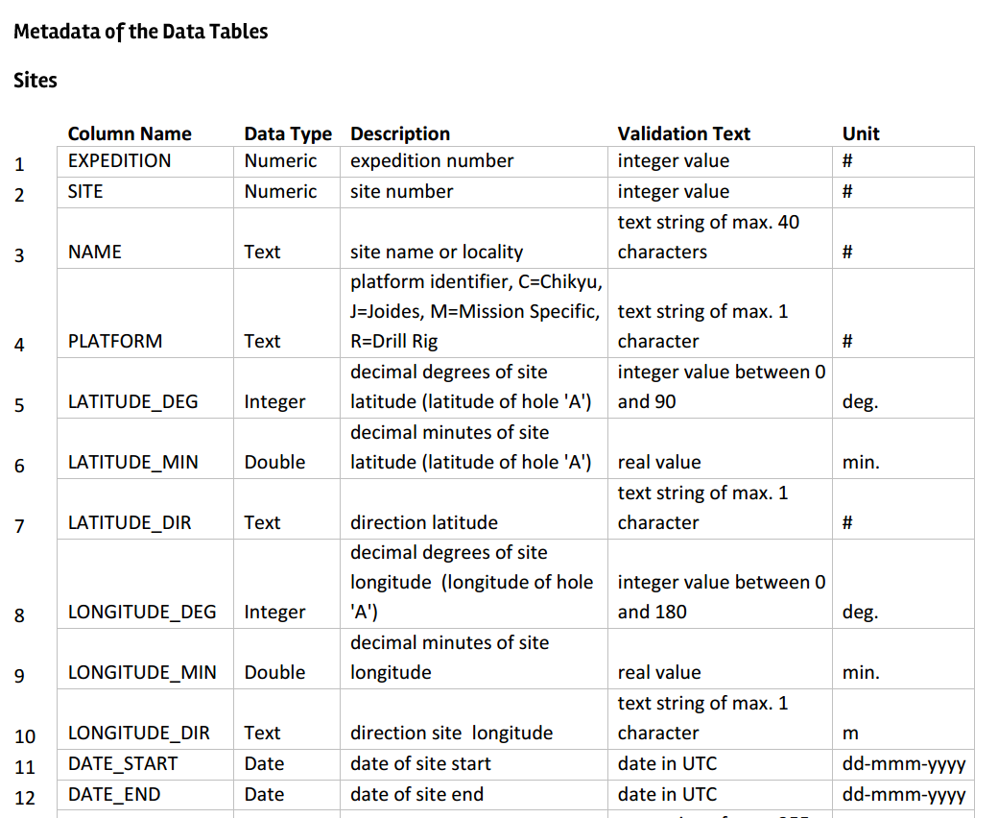
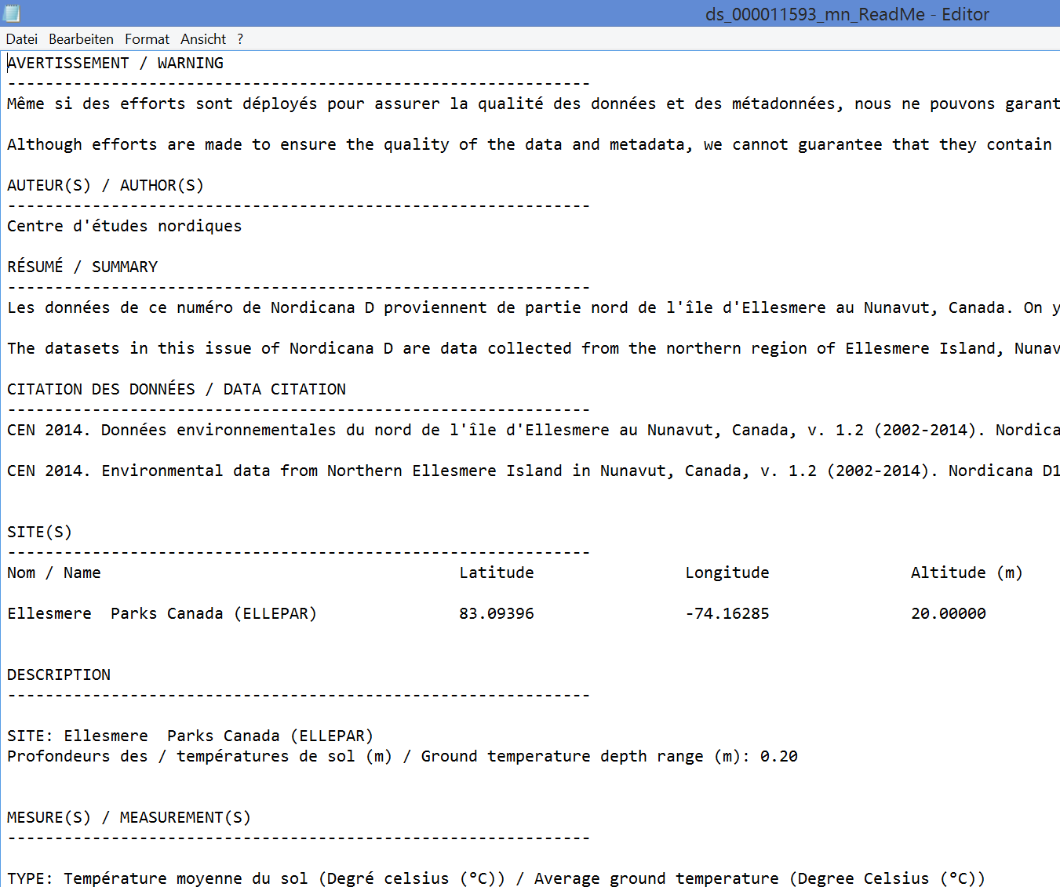

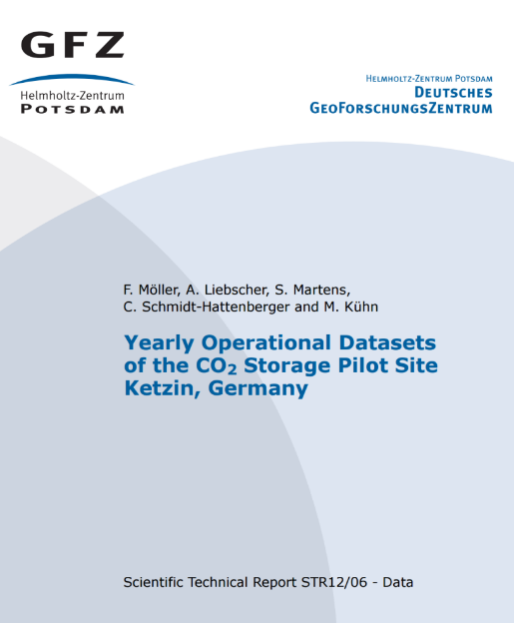

Descriptive Metadata 1: Contextual Metadata
Definition of data labels
  highly variable between the disciplines but key information for data reuse
Data Articles/ Reports
README

Slide 12

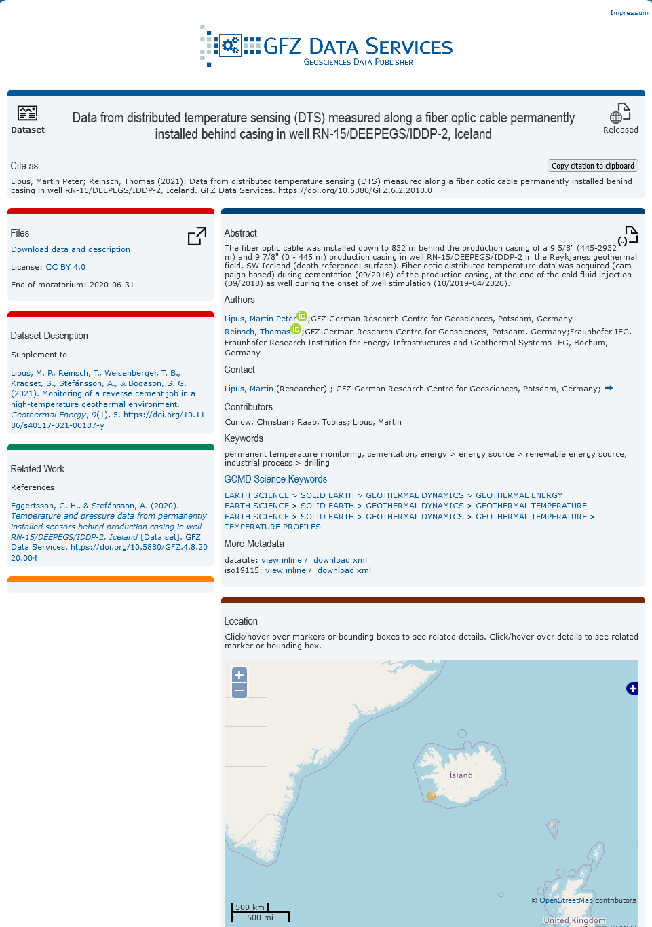

Descriptive Metadata 2: Metadata for data discovery
Who? What? When? Where? Why?
  Essential for data discovery, DOI registration, etc: international standards across all disciplines
title citation
download data
description/abstract
authors/ ORCID
key paper
affiliations/ROR
Typical metadata standards for data discovery: DataCite, ISO19115, Dublin Core
keywords/control-led vocabularies
related work
Example: DOI Landing Page
spatial coverage
Image source: https://www.pnp.de/archiv/1/wer-ist-wer-in-der-sesamstrasse-6851597

Slide 13



What is a PID and how do they work?
A persistent identifier (PID) is a unique code of a digital resource that can be permanently referenced on the Internet. This prevents dead links from being created if, for example, publishers change the Internet address of a server. (modified after Forschungsdaten.info)
Example: URL change due to name change:
https://gfz-potsdam.de
https://gfz.de
URL redirection of the DOI-referenced data publications by the publisher (= repository)
https://doi.org/
10.5880/GIPP.201712.1
https://dataservices.gfz-potsdam.de/gipp/showshort.php?id=828c...
https://dataservices.gfz.de/gipp/showshort.php?id=828c...
The DOI link remains valid even when the URL changes → always use DOIs when you cite something!

Slide 14






Common PIDs in the data curation world
for texts, data, software
List of funders with DOIs
https://doi.org/10.5880/fidgeo.2021.049 (Data)
http://doi.org/10.13039/501100001659 (DFG)
uniquely identifying persons
Persistent Identification of Instruments (PIDinst)
https://hdl.handle.net/11708/37B4E3C1-3DCC-4B7B-B475-87A3177F6030 (Broadband seismic sensor @ GIPP, GFZ)
https://orcid.org/0000-0001-5140-8602 (Kirsten Elger)
PID for physical samples, cross references to data with samples
PID for Institutions
https://ror.org/04z8jg394 (GFZ)
https://igsn.org/GFFJH00AD (Rock sample)
→ PIDs are resolvable and machine-actionable

Slide 15


When do I come across these PIDs?
What can I do to use them best?

Slide 16

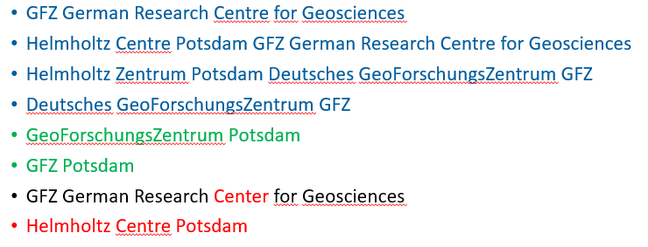
Research Organisation Identifier
provide unique references to research institutions and to funding agencies
Why do we need them?
Example: the „world“ of names for GFZ, outdated again!
Challenges for machines:
Different names for the same institution (even officially)
Institutes are changing names over time
Typos and use of „inofficial“ or incomplete names
→ 1 institute for people – 8 for machines

Slide 17
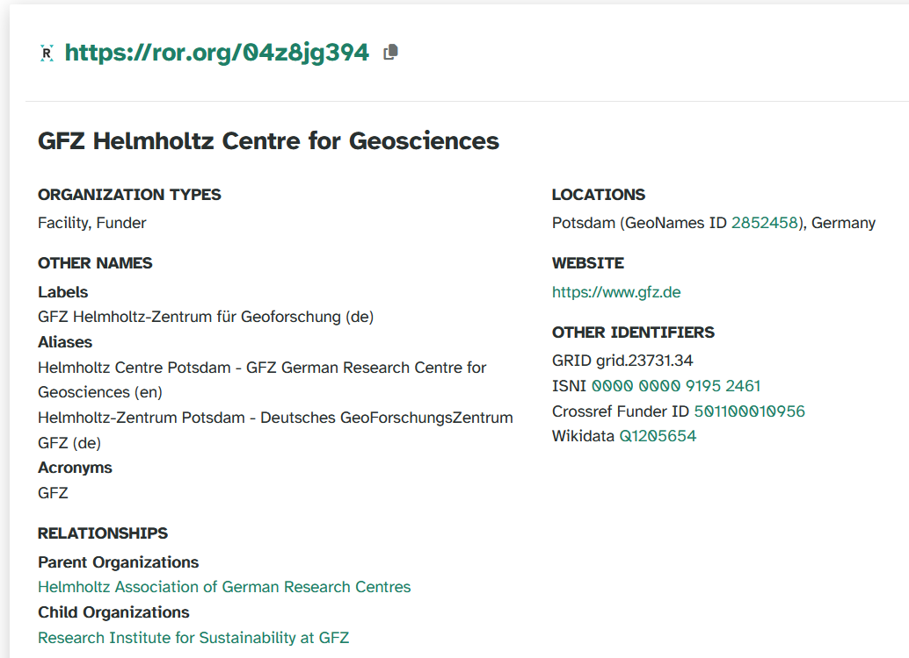
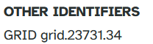
How does a ROR identifier look like?
URL = machine actionable and resolvable
Human readable legal name (preferred label)
Other names of GFZ (official name, aliases, acronyms)
Integration of already existing institutional identifiers
institutional relationships
https://ror.org/search

Slide 18
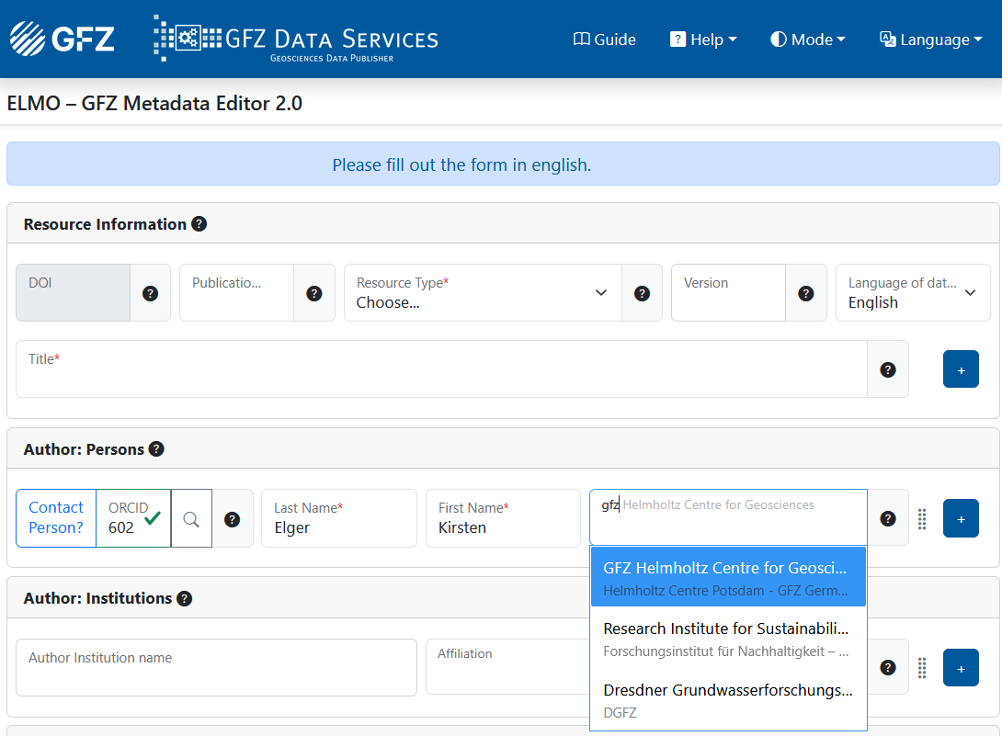
When can/ should I use a ROR?
In many repositories you can select your institution via a list.
This usually means that the ROR identifier is added to the DOI metadata – even if you don‘t see it!
Keep in mind: ROR only identifies the top-level institution, no faculty, no department!
Example: Metadata provision for a data publication
Source: ELMO (new metadata editor of GFZ Data Services, https://dataservice.gfz.de/elmo)

Slide 19

Example 2:
global, non-for-profit, free
Mission:
ORCID strives to enable transparent and trustworthy connections between researchers, their contributions, and their affiliations by providing a unique, persistent identifier for individuals to
use as they engage in research, scholarship, and innovation activities.
ORCID offers three interrelated services:
The ORCID iD: a unique, persistent identifier free of charge to researchers (0000-0001-5140-8602)
An ORCID record (profile) connected to the ORCID iD, and
A set of Application Programming Interfaces (APIs), as well as the services and support of communities of practice that enable interoperability between an ORCID record and member organizations so researchers can choose to allow connection of their iD with their affiliations and contributions
https://info.orcid.org/what-is-orcid/

Slide 20

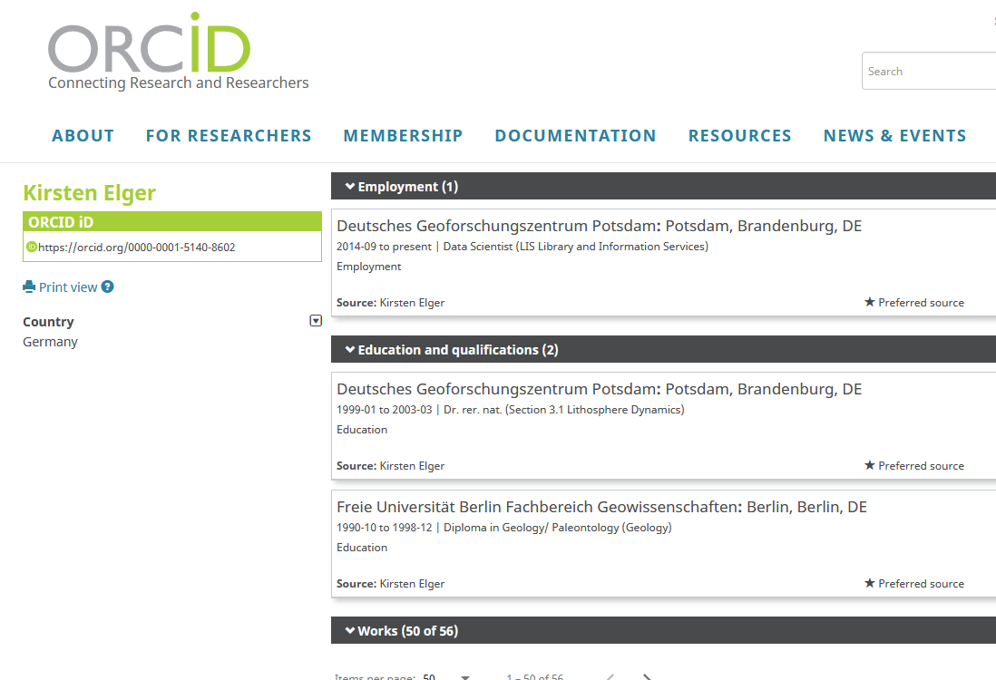
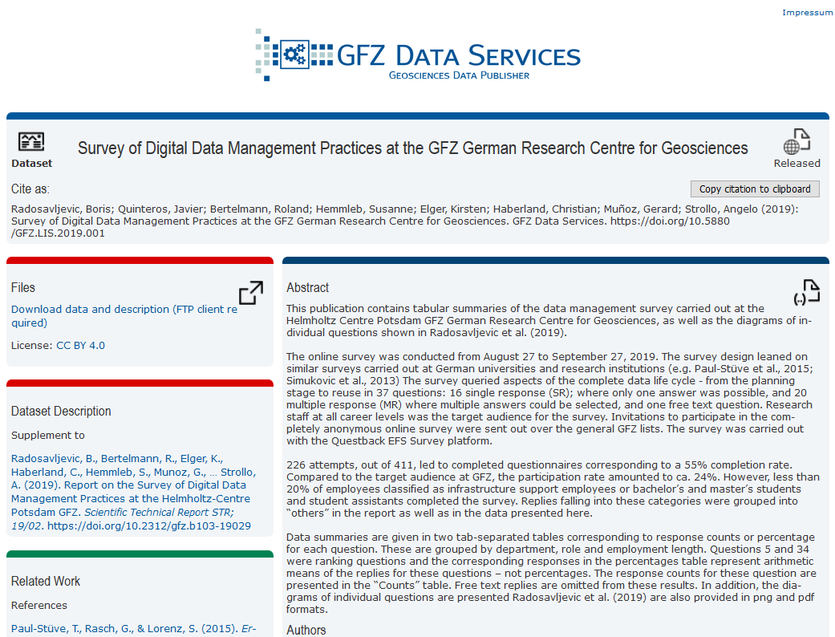
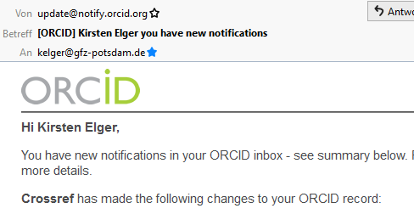
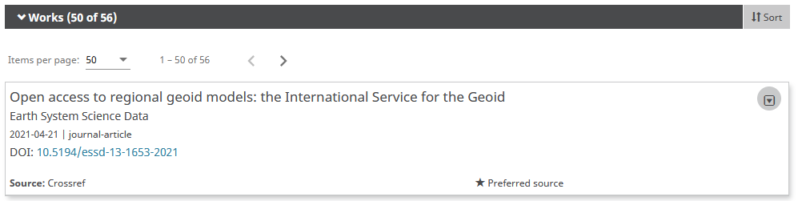
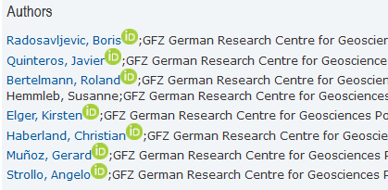
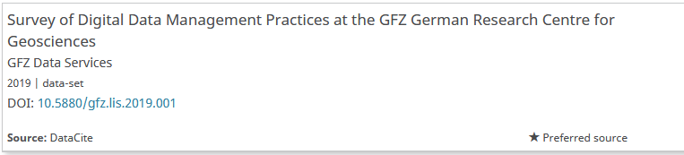
Benefits of including ORCIDs in the DOI metadata
(1) Data publication with ORCiD: authors are linked to ORCID profiles on DOI landing pages
(3) Email notification from orcid.org
Add your ORCID iD to all publications!
(2) Data publication is automatically included in the ORCiD record
Notes:
If your DOI metadata identifies the data creators with ORCIDs, the data publication can automatically be included in the creator‘s ORCID profile (if you allow this in the ORCID settings). ORCID is even informing you about an update via an email.

Slide 21
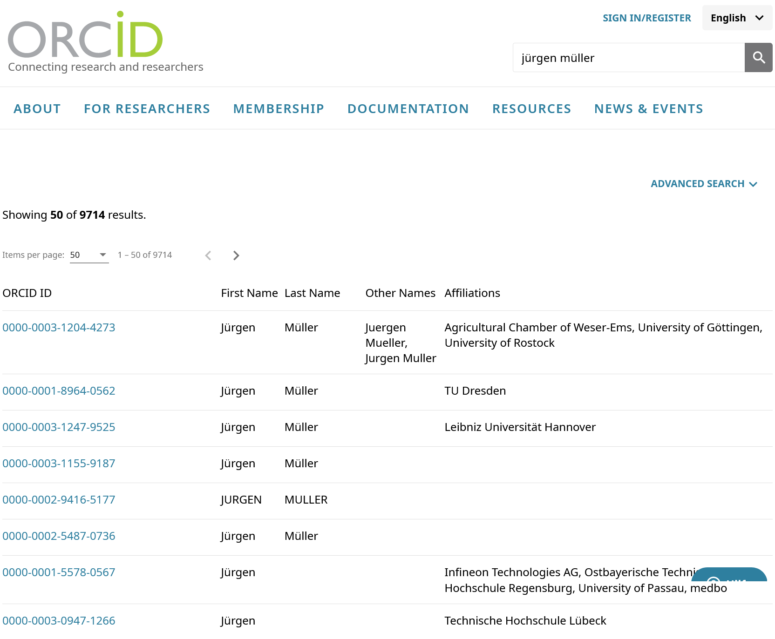
Make the best of your ORCID – existing issues
Results of the ORCID search for „Jürgen Müller“
I am looking for the professor for geodesy at the Leibnitz University Hannover)

Slide 22
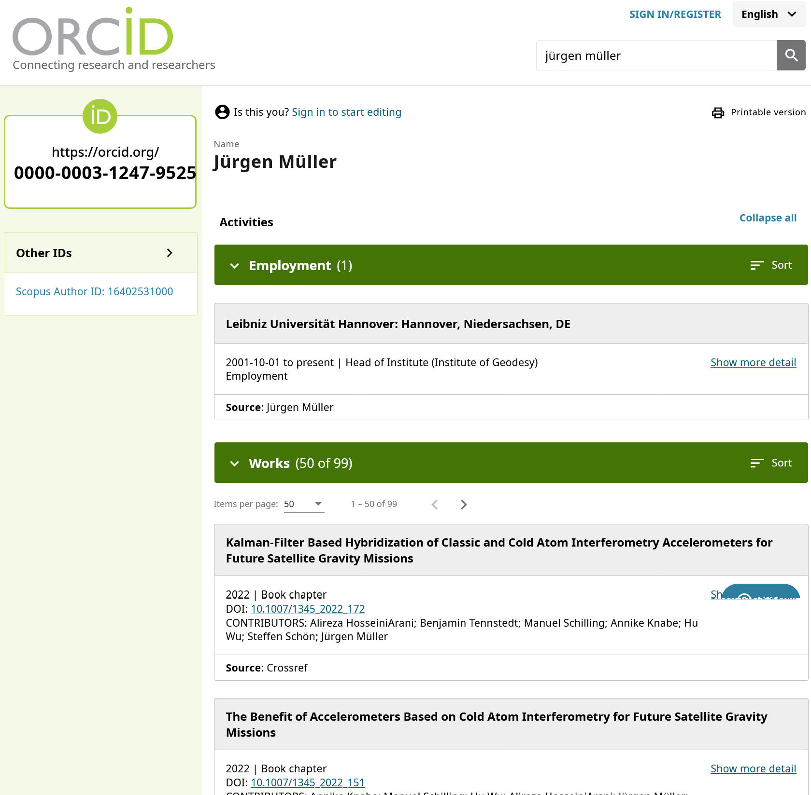
Example for a very good maintained ORCID profile!
All relevant informa-tion is visible to the public:
name, affiliation, other IDs (e.g,. Scopus Author ID), works = publications

Slide 23
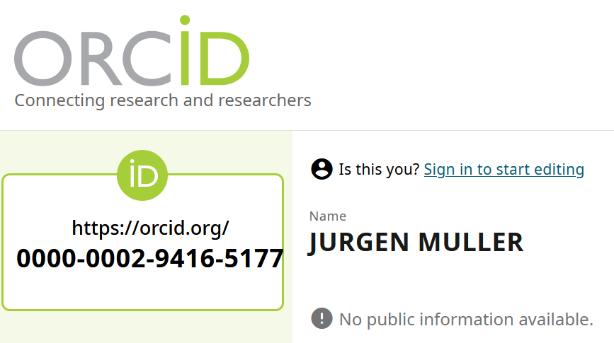
Make the best of your ORCID – existing issues

Slide 24


Make the best of your ORCID – summary
make sure that a miminum of personal information is publicly visible, e.g.:
first name, last name, affiliation, works. New: you can also use ROR now!
Always include your ORCID in articles, data publications, code publications, metadata of data…
Allow DOI registration agencies, like DataCite and CrossRef, to automatically fill your ORCID record (you save a lot of time)
Publishers or institutions might also request to fill your ORCID: Please don‘t forget to verify your ORCID when they ask, otherwise your ORCID will not appear on the paper!
ORCID recommendations: Lorenz, M., Elger, K., Meistring, M. (2022): FID GEO latest: Recommendations for using ORCID iD. In: Geowissenschaftliche Mitteilungen GMIT, GMIT 87 30-31, DOI:, 87, 30-31. https://doi.org/10.23689/fidgeo-5832

Slide 25
DOI example: Citations
Good scientific practice: cite all sources! But how can I do it?
Cite data or code in papers exacly as you would cite any other publication
Cite papers, input data, codes in your data publication
The reference of a data publication looks similar to the citation of a paper:
Christadler, I. (2026). AltoTiberina Catalog (Version 1.0.0) [Dataset]. Simulation Data Lake. https://doi.org/10.82554/SDL-41.16
Murphy, S., Vermaere, S., Garziglia, S., & Kalligeris, N. (2025). Geo-Inquire Jupyter Notebook at Ligure Testbed. Zenodo. https://doi.org/10.5281/zenodo.17897228
Plenkers, et al. (2024). JAGUARS – Mining induced picoseismicity associated to gold mining [Dataset]. GFZ Data Services. https://doi.org/10.5880/GFZ.4.2.2024.002
How to: Cite data or code publications in the body text of the paper and include the full reference (with DOI) in the „References“ section!
Notes:
Cite papers, input

Slide 26
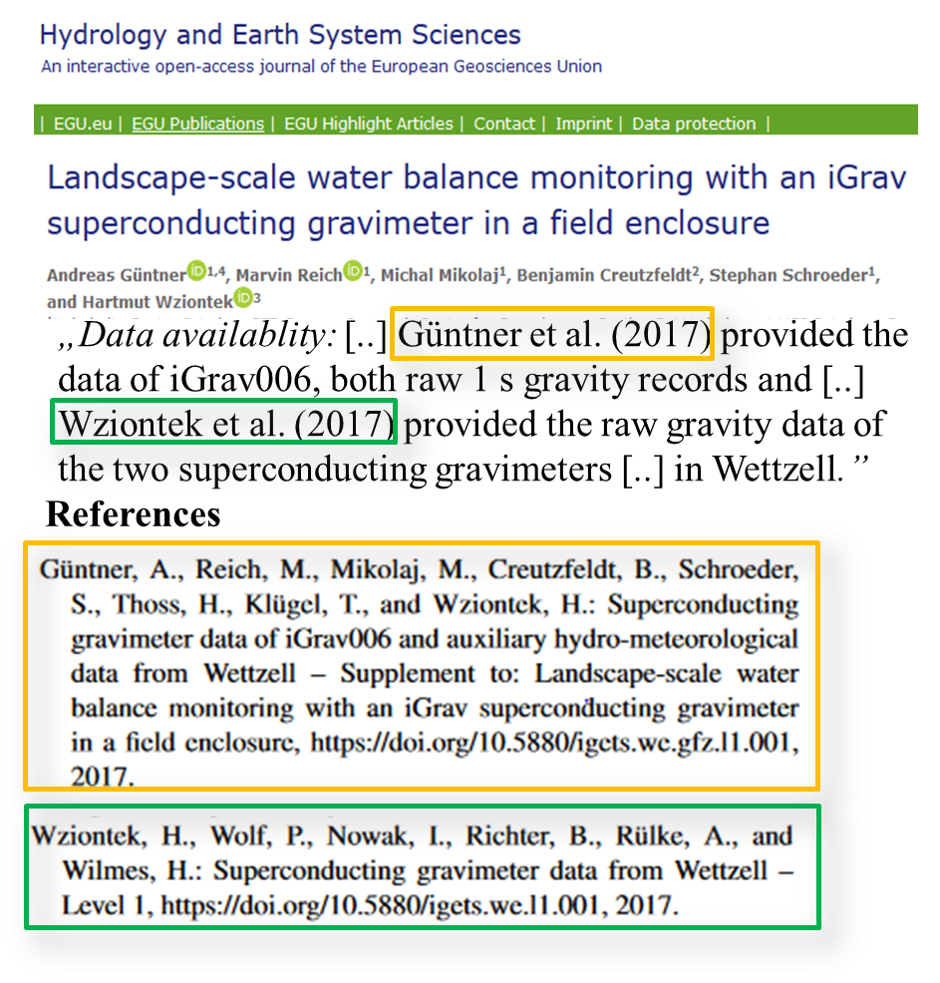
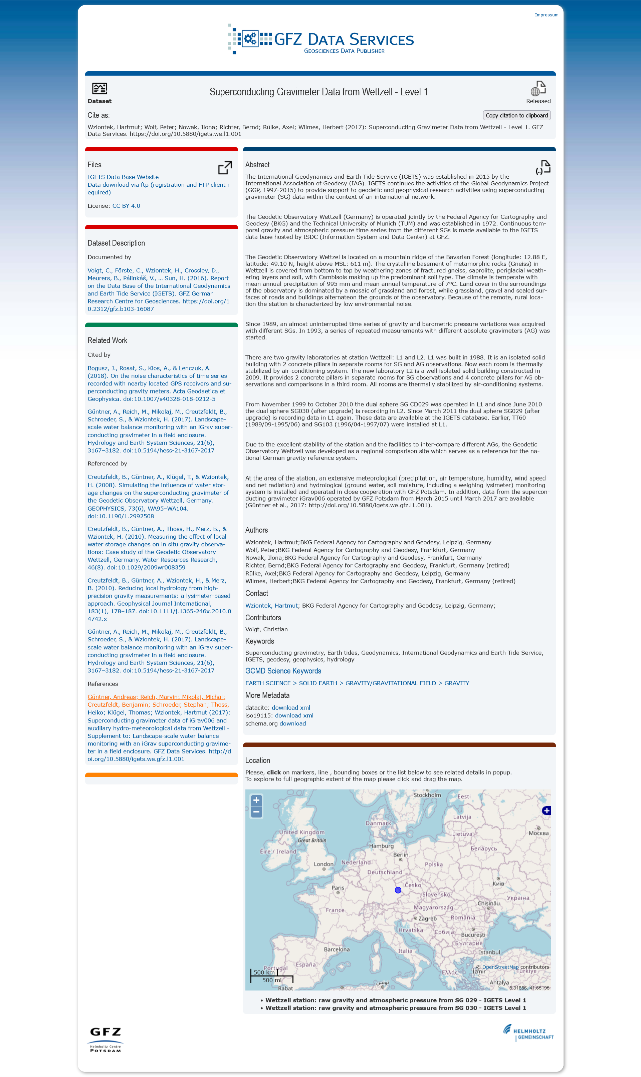
How do I cite a dataset in an article and vice versa?
Research Article
(https://doi.org/10.5194/hess-21-3167-2017)
Data Publication
(https://doi.org/10.5880/igets.we.l1.001)
link to article
link to data

Slide 27
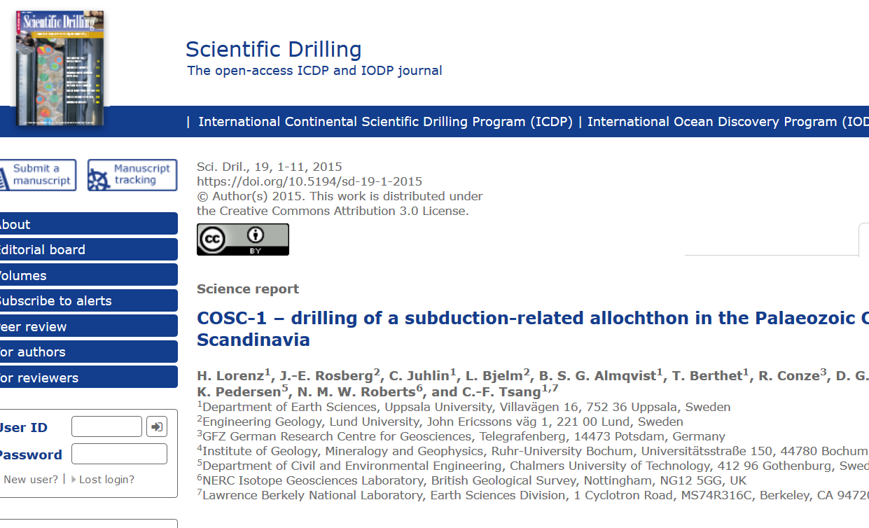
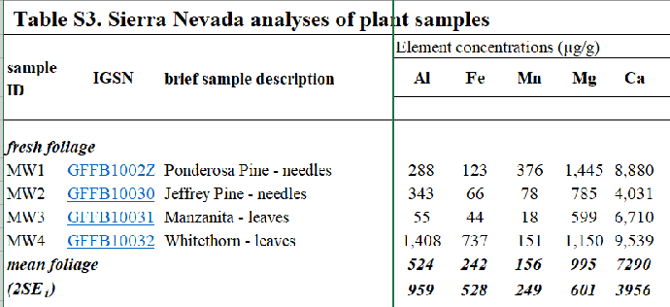


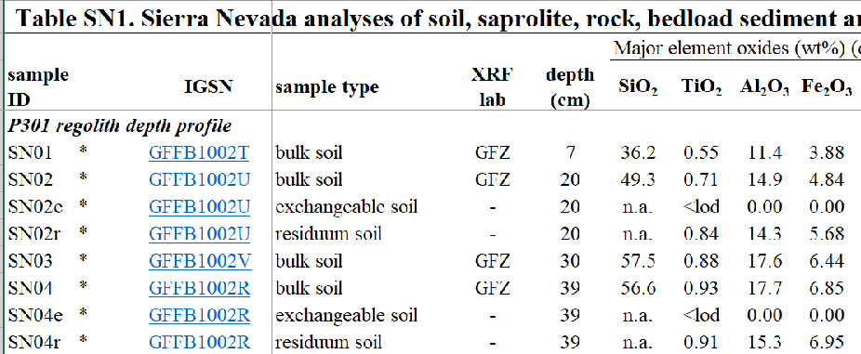
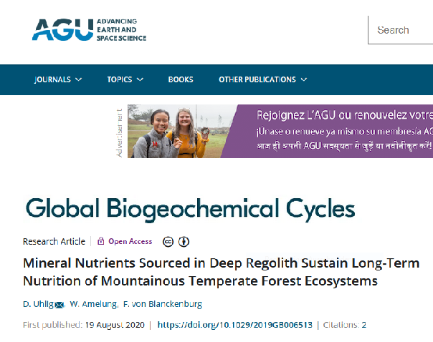
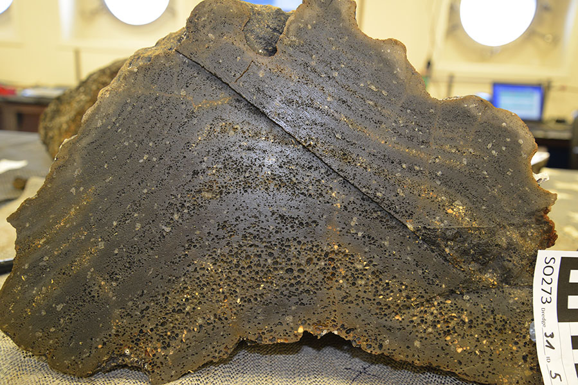
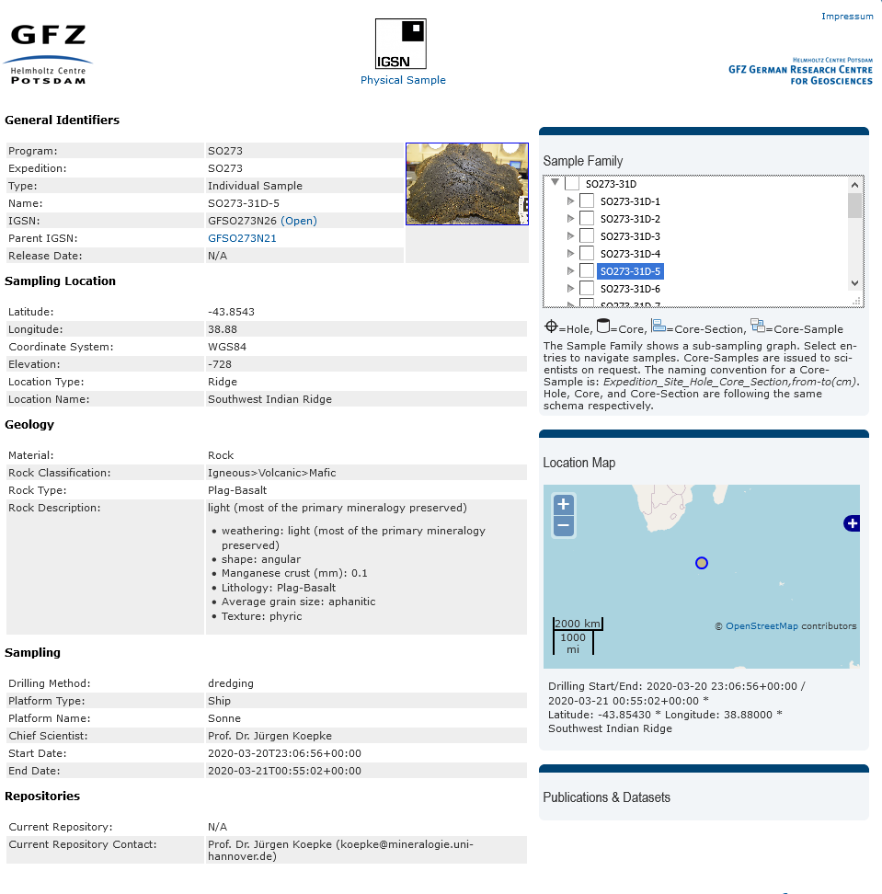
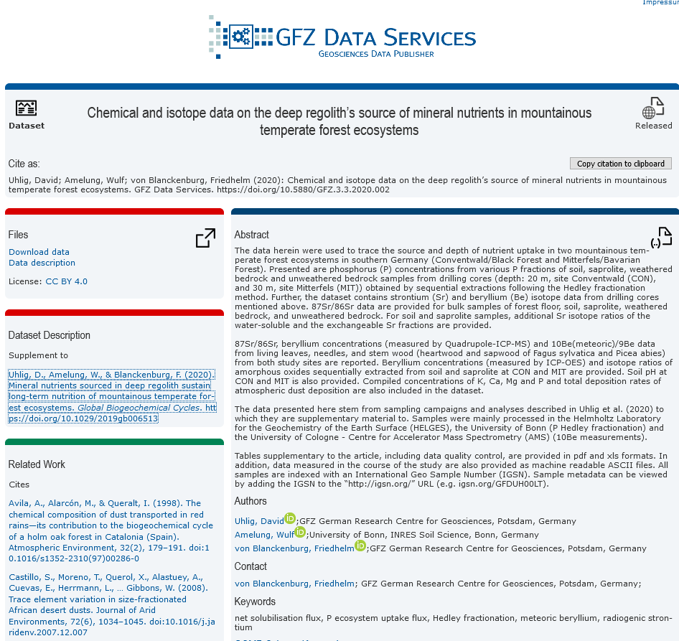
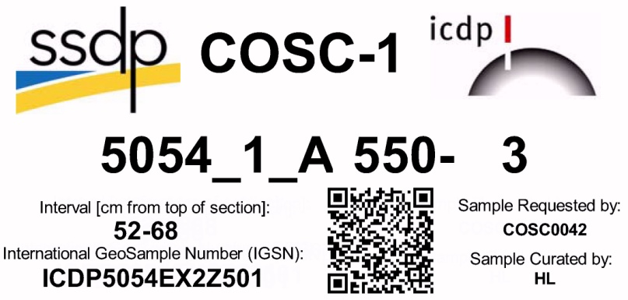
The aim: connecting research outcomes via PIDs
code
data
papers
PIDs connect everything → FAIR
sample
The classical way
The new way
Sample description
Data publication

