Slide 1
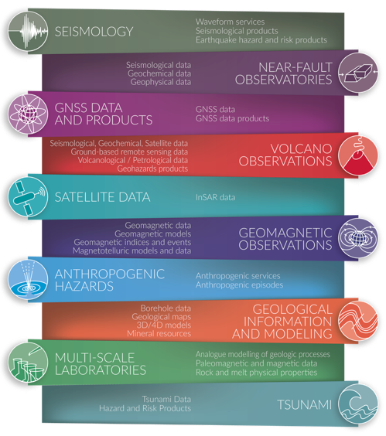
for
Perspectives TCS
from
Contributing to EPOS by
Increasing data quantity, coverage, FAIRNESS
Exposing new data and products through new services
Integrating scripts (JN) to foster data retrieval and usage
Contributing to roadmaps for new transformative DDSS (software, SDL, DAS data, TNA)
Enlarging Earth Science community – with new actors and potentially new communities.
Cross-TCS activities (SRA, projects)
TCS
ICS
Notes:
Content slide

Slide 2

International collaboration

Slide 3
Drivers for international collaboration
Efficiency in research
Maximising use of resources
Avoiding duplication of effort
Pursing common goals e.g. global RI for the solid Earth
Barriers to collaboration, evidenced by the preliminary survey results are:
Resourcing (staff and funding)
Alignment of scientific priorities

Slide 4
International collaboration and capacity building identified as a priority. e.g. specifically identified in the national strategy for management of natural disasters in Morocco
Initiatives such as AMHEWAS and UNDRR illustrated the added value of international collaboration and highlighted the importance of access to tools and services for local actors in Africa
Training and capacity building ensures the valid use of available tools and services, which in turn build trust in results.
Open data is essential. e.g. availability of data has helped to remove the risk of cascading disasters in Sudan.

Slide 5
Increasing need to broaden the range of stakeholders to include the private sector. Area where EPOS can benefit from knowledge exchange with initiatives that have successful industrial partnerships.
EPOS provides critical information for the deployment of this large infrastructure and, once operational, EPOS can expose the data.

Slide 6
Alignment between EPOS, AuScope, EarthScope and Earth Sciences New Zealand and a formalised partnership through MoUs are laying the foundations for a global RI for the solid Earth
Breadth of contributions illustrates the global reach of EPOS collaborations and the future opportunities for additional partnerships that extend beyond RIs e.g. with universities in Japan where there isn’t the equivalent of EPOS RI.

Slide 7
Thank you!

Slide 8
Halfway Through EPOS Science Program 2024–2028
Achievements and Next Steps
Notes:
Colour code: Verde (già fatte; arancioni (on-going with the support of EU projects, rosse azioni non ancora iniziate perchè non abbiamo risorse e quindi prioritizzare)

Slide 9
The EPOS Science Program at a glance
Part of the EPOS Strategy 2024-2028
6 strategic objectives to meet the challenge of operating a sustainable and resilient Research Infrastructure in the rapidly evolving domain of solid Earth sciences
SO1: Ensuring smooth and seamless access to solid Earth science data and services
SO2: Enhancing and advancing services for solid Earth science
SO3: Enlarging, widening and empowering the user community
SO4: Implementing principles of Open Science and FAIR data management, and contributing to e-science innovation
SO5: Amplifying and spreading the societal value of EPOS
SO6: Boosting global cooperation

Slide 10
Code Color
Achieved
Ongoing, by design
Ongoing
Still a lot to do
Notes:
Colour code: Verde (già fatte; arancioni (on-going with the support of EU projects, rosse azioni non ancora iniziate perchè non abbiamo risorse e quindi prioritizzare)

Slide 11
Strategic Objective 1 Ensuring smooth and seamless access to solid Earth science data and services
Operating the EPOS Data Portal via the ICS-C
Ensuring the integration of TCS data and services through the ICS-TCS System
Ensuring long-term provision of TCS data and services by consolidating the TCS governance and coordination
Strengthening engagement with data and service providers and National Research Organizations, including strengthening internal communication with EPOS national nodes
Actions to implement the objective
Continuos development cycles for the EPOS Platform, supported through the ICS-TCS system
Integration of new features and services, major technology refactoring planned
Forum on National participation
Instruments to support implementation
Notes:
Colour code: Verde (già fatte; arancioni (on-going with the support of EU projects, rosse azioni non ancora iniziate perchè non abbiamo risorse e quindi prioritizzare)

Slide 12
Strategic Objective 2 Enhancing and advancing services for solid Earth science
Continuously enhance the EPOS portfolio by integrating new and improving existing services
Enhance the EPOS Platform’s functionality based on user feedback
Identify and engage emerging thematic communities
Finalize the framework for trans-national access in EPOS
Implement distributed multi-purpose platforms (ICS-D)
Prepare the EPOS research infrastructure for the growing demand for AI applications
Actions to implement the objective
EPOS ON, Specifically WP2 – Enhancing Services for Science
EPOS ON, Specifically WP4 – Strenghtening Impact through User Engagement
Sponsored Research Activities
Other EU-funded projects (e.g. GEO-Inquire, DT-GEO)
New Projects (HIAOO-S2, EarthAID…)
Instruments to support implementation
Notes:
Colour code: Verde (già fatte; arancioni (on-going with the support of EU projects, rosse azioni non ancora iniziate perchè non abbiamo risorse e quindi prioritizzare)

Slide 13
Strategic Objective 3 Enlarging, widening and empowering the user community
Actions to implement the objective
Identifying potential user groups of the EPOS infrastructure and establishing a framework of interaction
Identifying potential barriers or gaps that hinder the efficient and widespread usage of the EPOS data and services portfolio
Reinforcing user engagement through actions
Participation to EOSC: EOSC Mesh and candidate EOSC ENVRI Node
EPOS ON, Specifically WP4 – Strenghtening Impact through User Engagement
Operational communication plan 2024-2028, aligned with the EPOS Strategy
Instruments to support implementation
Notes:
Colour code: Verde (già fatte; arancioni (on-going with the support of EU projects, rosse azioni non ancora iniziate perchè non abbiamo risorse e quindi prioritizzare)

Slide 14
Strategic Objective 4 Implementing principles of Open Science and FAIR data management, and contributing to e-science innovation
Actions to implement the objective
Enhancing the implementation of open data principles by reinforcing the implementation of FAIR principles and open licenses
Releasing the EPOS Data Portal code Open-Source, and fostering the reuse of any code developed at TCS level, either for data modelling or processing or any other purposes, in an open source fashion
Promoting the dissemination of EPOS-based research in open access publications
Fostering the adoption of shared practices and solutions for FAIR data management by disseminating the EPOS Data Policy within data and service providers
EPOS Citation Guidelines - EPOS Data Policy
EPOS Open Source releases
FAIR Assessment
New projects (HIAOOS-2, EOSC Mesh)
Instruments to support implementation
Notes:
Colour code: Verde (già fatte; arancioni (on-going with the support of EU projects, rosse azioni non ancora iniziate perchè non abbiamo risorse e quindi prioritizzare)

Slide 15
Strategic Objective 5 Amplifying and spreading the societal value of EPOS
Ensuring the continuous enhancement of the EPOS service portfolio to enable trans-disciplinary research in hazard assessment and risk management, sustainable stewardship of geo-resources, climate change and clean energy transition
Promoting innovation, learning opportunities and constructive dialogue between EPOS and key stakeholders. Participants in civil protection, disaster risk management, and the private sector.
Implementing the EPOS Ethical Guidelines and constructing a comprehensive code to delineate the attributes of EPOS services
Disseminating the societal value of the EPOS infrastructure
Actions to implement the objective
EPOS ON – Specifically Work package WP3 – Contribution to tackle societal challenges.
New projects (EarthAID)
EPOS Sponsored Research Activities
Instruments to support implementation
Notes:
Colour code: Verde (già fatte; arancioni (on-going with the support of EU projects, rosse azioni non ancora iniziate perchè non abbiamo risorse e quindi prioritizzare)

Slide 16
Strategic Objective 6 Boosting global cooperation
Sustaining and expanding collaborations with European Research Infrastructures within the ESFRI framework
Continuously cultivating and expanding partnerships with ENVRI
Enhancing international cooperation in solid Earth science across diverse regions (Africa, Latin America, USA, Australia)
Contributing to the global dimension of open science and data science, advancing the broader scientific community's access to knowledge and collaboration on a global scale
Actions to implement the objective
Active participation in ERIC Forum;
MoUs with specific ESFRI Ris (e.g. ECCSEL)
New projects (EOSC Mesh) and initiatives (Candidate EOSC ENVRI Node)
Multilateral MoU with Auscope (Australia) Earth Sciences NZ (NZ) and Earthscope (US)
EPOS ON, Specifically WP5 – Enlarging European and International Collaborations
Instruments to support implementation
Notes:
Colour code: Verde (già fatte; arancioni (on-going with the support of EU projects, rosse azioni non ancora iniziate perchè non abbiamo risorse e quindi prioritizzare)

Slide 17
Key Messages
Science Program implemented according to the current EPOS Strategy 2024-2028
Many actions in progress, by design
Ensure sustainability for the remaining period of the current EPOS Science Program 2024-2028 and very soon start planning the next EPOS Science Program 2029-2033

Slide 18

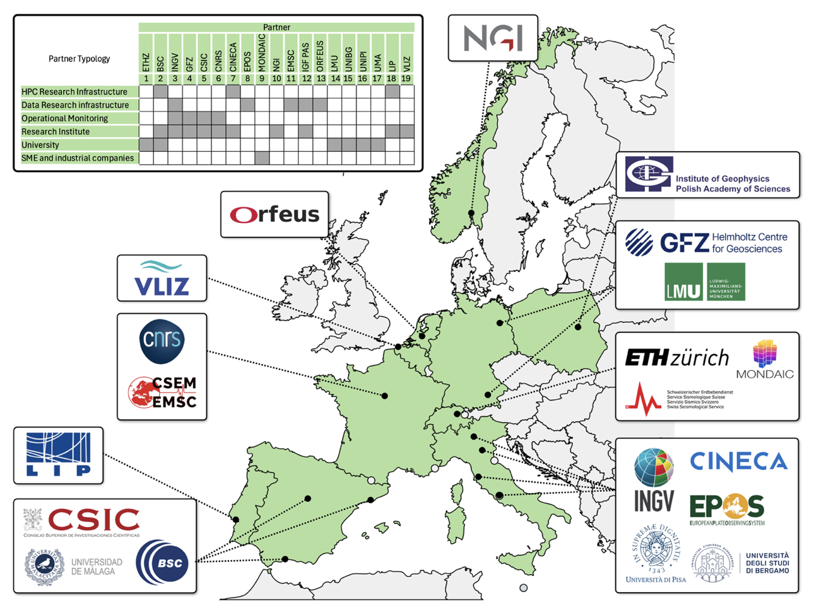





HORIZON-INFRA-2025-01 — TECH-03
Coordinated by ETHZ – Swiss Seismological Service (Wiemer)
Builds on top of DT-GEO, Geo-INQUIRE, and targets integration in Destination Earth
The core objective is to develop an explainable AI-powered system for local impact simulations and decision support that will orchestrate existing Digital Twins, federated data lakes, domain knowledge and real-time sensing to deliver transparent, trustworthy end-to-end operational services for geohazards and georesources.

Slide 19


EPOS GO!
Prize for ECRs with an accepted abstract at EGU26
Valid for contributions under ITS1 – Digital Geosciences sessions using the keyword “solid Earth”
Up to 3 prizes of €2,000 €
Apply until March 30th

Slide 20




EPOS ON & KMT at World Geothermal Congress 2026
Workshop on Superhot Geothermal Energy
Date & time: Tuesday, 9th of June, 14:00-17:00
Venue & room: Calgary TELUS Convention Centre, Calgary, Canada
Registration: https://forms.office.com/e/ebCnRY83eQ
Travel grants for early-career scientists – EUR 2,000
Scan me and register!

Slide 21


EPOS Summer School 2026
Date & time: 28 June - 4 July
Venue: Espai Cràter Museum
Olot, Spain
Applications by 20 April
Topic: geoscience research data and their practical applications, research data management
Total and partial travel grants are available for early-career scientists

Slide 22
Making an appointment for next edition …
The next EPOS Days will be held in June 2027 and will include
the EPOS ON Final Conference
Save the date to be announced soon, target dates are the 3 central weeks of June:
7-11
14-18
21-25
If you are aware of any major event planned one of the three please let the Communication Unit know before we confirm the dates!

Slide 23
Thank you…
And looking forward to seeing you again next year!

