Slide 1

Introducing the EPOS Data Policy
Policy Working Group

Slide 2
Introducing the EPOS Data Policy
09.30 – 09.40 | Introduction and context: the EPOS Policy WG and the new EPOS Data Policy | Daniela Mercurio
09.40 – 09.50 | Founding values and EU legal framework | Helen Glaves
09.50 – 10.10 | The EPOS Data Lifecycle | Rossana Paciello
10.10 – 10.20 | Data security and protection | Federica Tanlongo
10.20 – 10.30 | Intellectual Property Rights | Mario Locati
10.30-11.00 | Q&A from the audience - Interactive discussion | Daniela Mercurio and the EPOS Data Policy WG

Slide 3
Introduction and context: the EPOS Policy WG and the new EPOS Data Policy
Daniela Mercurio

Slide 4
The EPOS Policy Working Group (WG)
The EPOS Policy WG supports the development of the EPOS Policies in line with the EPOS ERIC Statutes
With its diverse expertise, the WG ensures that EPOS policies align with EU RI frameworks and Open Science principles, while addressing the operational needs of the EPOS RI.
Members: Carine Bruyninx; Otto Lange; Rossana Paciello; Federica Tanlongo; Mario Locati; Lucio Badiali; Fulvio Galeazzi; Alessandro Turco; Ornela De Giacomo; Daniela Mercurio.
The activities and outputs of the WG are developed in coordination with the relevant EPOS ERIC Governance Bodies (EPOS ERIC Executive Committee and the Service Coordination Committee).

Slide 5
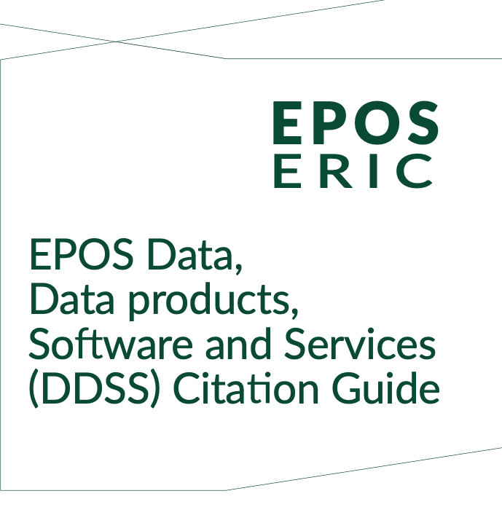
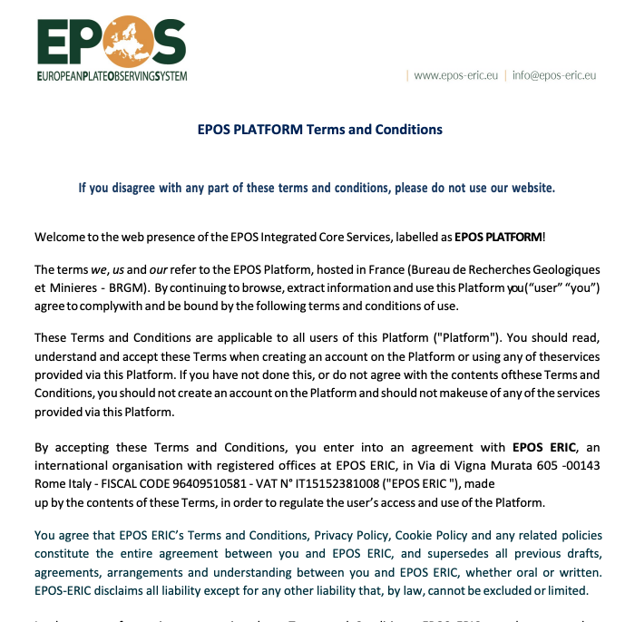
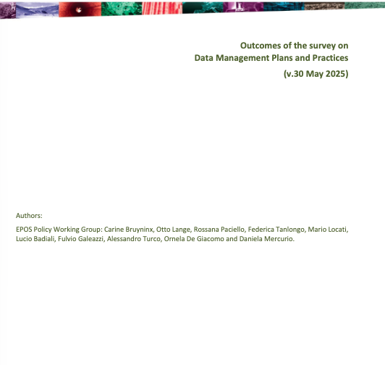
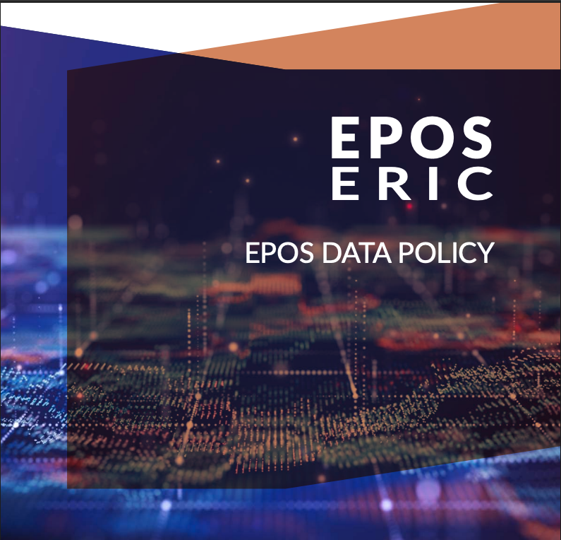
The EPOS Policy WG: the latest products
It defines how to correctly cite EPOS datasets, data products, software and services, ensuring proper recognition of providers and supporting transparency and reproducibility of research.
It define the rules governing users’ access to and use of the EPOS Platform. They establish the legal agreement between users and EPOS ERIC, including provisions related to data use, privacy and platform services.
The EPOS Survey on Data Management Practices maps current data management approaches within the EPOS Delivery Framework. It identifies areas for improved alignment with the EPOS Data Policy and the EPOS ERIC Digital Assets Management Policy.
…in the pipeline
EPOS ERIC Data Management Plan
Recommendation on machine-actionable tools to support a federated DPMs within the EPOS community
https://www.epos-eu.org/epos-eric/documents

Slide 6
Policies in a European Research Infrastructure
European Research Infrastructures operate in complex, distributed environments, where shared policies are essential for transparency, coordination and sustainability.
Within EPOS, policies define how data and services are managed, shared and reused, guiding responsibilities, standards and good practices across the infrastructure.
The EPOS policy framework ensures that data and services maximize scientific and societal benefit, in line with Open Science and FAIR principles.

Slide 7
The EPOS Data Policy
provides the overarching framework for the management, sharing and reuse of data within the EPOS Research Infrastructure.
It establishes the core principles governing the provision, integration, access, use and exploitation of EPOS data and related digital assets.
The policy also defines the roles and responsibilities of the key stakeholders involved in the EPOS data lifecycle, ensuring consistent and transparent data management across the infrastructure.
Notes:
The new Data Policy has been published in September 2025 and replace the first edition elaborated in 2018. The new version introduces a new aspect compared to the previous edition, defining the roles and responsibilities of all key stakeholders within the EPOS Research Infrastructure who are involved in the data lifecycle.

Slide 8
Founding values and EU legal framework
Helen Glaves

Slide 9
EPOS Data Policy
EPOS Data Policy is relevant for anyone seeking to reuse solid Earth Science data accessible via EPOS
Data policies introduce common principles, guidance and approaches for data management, standards, quality and interoperability.
References relevant European legal instruments relating to environmental data, information, databases, software and relevant technologies such as artificial intelligence (AI)
Notes:
The EPOS Data Policy is relevant to anyone interested in the reuse of EPOS solid Earth science data, especially from the perspective of open science
EPOS Data Policy considers the relevant European legal framework related to environmental data, information, and databases
Range or European regulations and directives relevant for EPOS data
Data policies introduce common principles, guidance and working practices in the areas of data management, data interoperability and standards, and data quality.

Slide 10
EPOS Data Policy: Founding values
Comprehensive framework for managing , protecting and using data with the EPOS research infrastructure
Based on the values of:
Openness: promotes unrestricted sharing and access to data for stakeholders
Innovation: generating new and creative solutions to different and/or complex challenges
Collaboration: fostering cooperation across diverse research communities
Efficiency: effective data management to maximise impact and reduce duplication of effort
Accountability: encourages verification and validation of data, including provenance
Capacity Strengthening: facilitating education of next generation of researchers and expanding data availability, especially in low / middle income countries
Notes:
Open science / openness: allows transparent research practices, encourages reproducibility, accelerates science innovation, facilitates collaboration,
Founidng values also extend to: efficiency and accountability, which fosters trust and ensures information and knowledge is available to everyone including next generation of researchers and those in low/middle income countries.

Slide 11
EPOS Data Policy: Guiding principles
Open access to data and knowledge: ensuring data availability of data and knowledge
Timely availability of data without unnecessary delay
Community Licensing: promoting use of widely accepted licensing schemes e.g. Creative Commons
Acknowledgement and Credit: ensuring contributors receive appropriate credit for their work, including citation and acknowledgement
Notes:
Acknowledgement and Credit: recognition for research incentivises data sharing, which in turn enhances transparency and reproducibility of outputs

Slide 12
EPOS Data Policy: Guiding principles
Promoting relevant principles:
OECD Principles and Guidelines for publicly funded research data
FAIR Principles: to ensure data is Findable, Accessible, Interoperable Re-useable
TRUST Principles: Transparency, Responsibility, User focus, Sustainability and Technology repository
CARE Principles: Collective Benefit, Authority to Control, Responsibility, Ethics for indigenous data
GEO Data Sharing and Data Management Principles

Slide 13
European Directives and Regulations: environmental data
INSPIRE Directive (2007/2/EC) aims to make environmental spatial data more accessible and interoperable across Europe
Access to Environmental Information Directive (2003/4/EC) implementing Aarhus Convention (1998) granting public access to environmental information and fostering environmental democracy
Notes:
EPOS Data Policy also uses relevant legislation and regulations as its foundation.
The Aarhus Convention is an international treaty that grants the public rights to access environmental information, participate in decision-making, and seek justice in environmental matters, promoting transparency, accountability, and environmental democracy.

Slide 14
European Directives and Regulations: relevant for environmental data
Open Data Directive (2019/1024/EU): promotes availability pf public sector data for re-use
Regulation (EU) 2022/868 (Data Governance Act): Establishes framework for data sharing and governance across European Union to facilitate re-use, promote research and innovation, and ensure responsible data stewardship
Regulation (EU) 2023/2854 (Data Act): Fostering digital innovation on the EU, and facilitation data sharing and access
Regulation (EU) 2023/138 (High-Value Datasets): defines set of high-value datasets ensuring free publication and reusability to boost innovation and boost economic growth
Notes:
The Aarhus Convention is an international treaty that grants the public rights to access environmental information, participate in decision-making, and seek justice in environmental matters, promoting transparency, accountability, and environmental democracy.

Slide 15
European Directives and Regulations: other relevant legislation
General Data Protection Regulation (GDPR - 2016/679): governs the processing of personal data
Regulation (EU) 2024/903 (Interoperable Europe Act): establishes measures to enhance cross-border interoperability of digital public services across EU.
Regulation (EU) 2024/1689 (Artificial Intelligence Act or AI Act): defines harmonised rules on artificial intelligence (AI)
Database Directive (96/9/EC): provides legal protection for databases through copyright and sui generis (unique) rights.
Software Directive (2009/24/EC): legal protection for computer programs, ensure software is protected under EU copyright law
Notes:
Database Directive safeguards against unauthorised abstraction and reuse of substantial parts of a database
Software directive protects software, including that used manage and manipulate environmental data

Slide 16
EPOS Data Policy: other relevant initiatives and regulatory frameworks
Recognises relevant international initiatives e.g GEO, COPERNICUS
References national policies and legislation where appropriate
Focuses on open and free exchange of data, metadata and derived products (with only minimal costs in exceptional cases for cost recovery
Notes:
EPOS Data Policy also recognises relevant international observation system initiatives and national policies
and legislation with the aim of full and open exchange of data, metadata and derived data products being
made available with minimum delay and at no cost, except in exceptional cases where a minimal cost
recovery is necessary.

Slide 17
The EPOS Data Lifecycle
Rossana Paciello

Slide 18
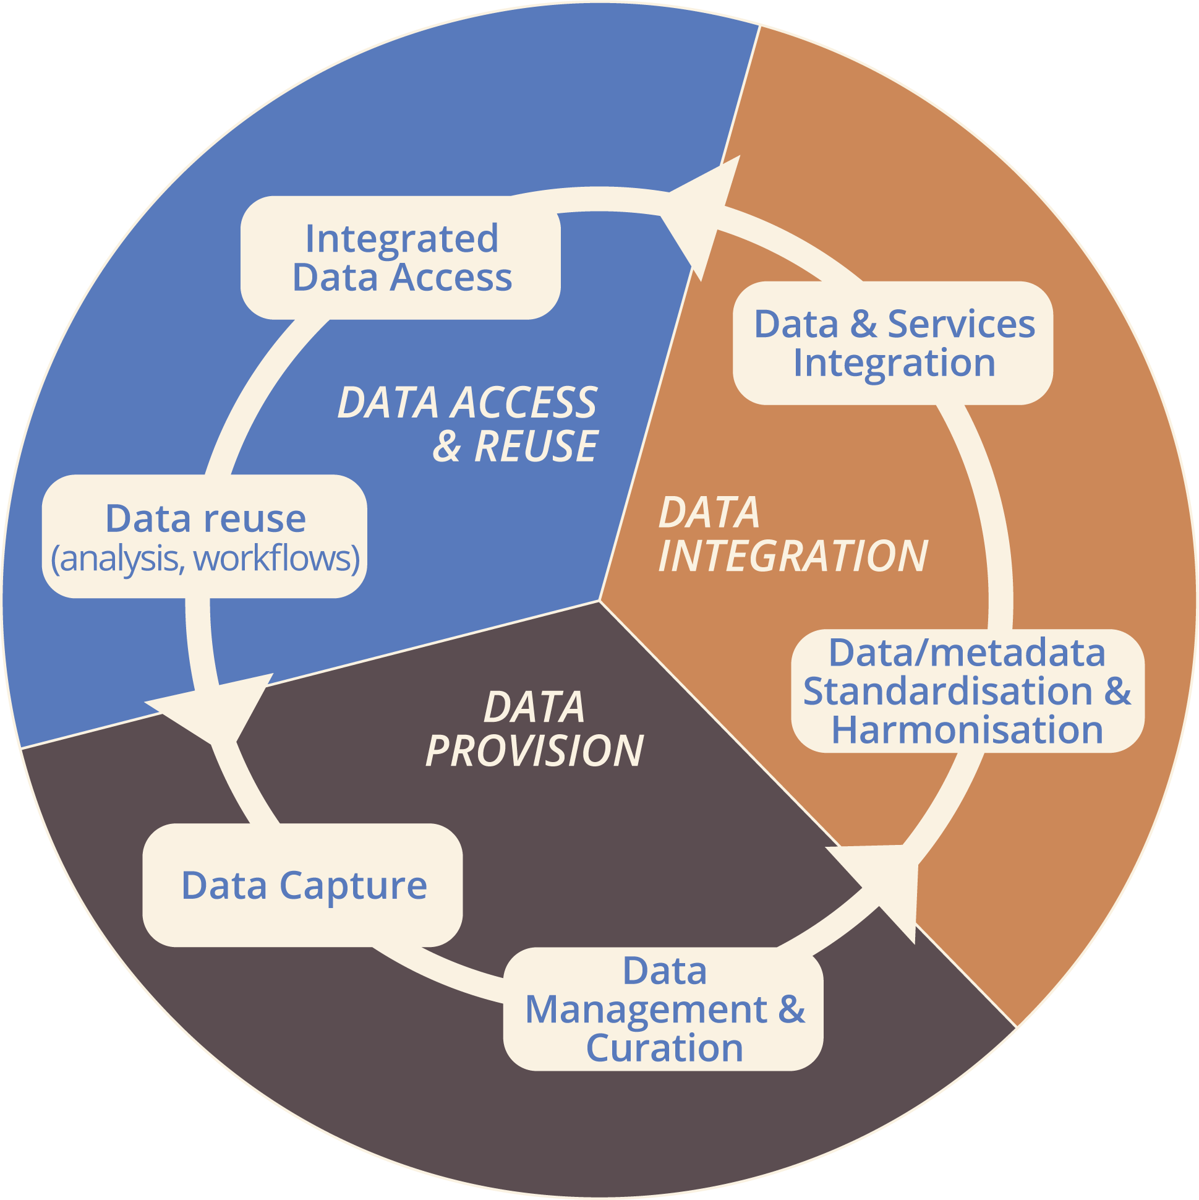
Why the EPOS Data Lifecycle is included in the Data Policy
Describe how EPOS works in a federated setting: data stay with providers; access is through web services.
Clarify roles and responsibilities across EPOS actors.
Provide a common reference to ensure consistent management and use of data.

Slide 19
The EPOS Data Taxonomy
L0
Raw Data
Seismograms
Instrument data as collected from a data source, without any processing
Time series
L1
Automated Products
Earthquake locations
Level 0 data processed and organized. Formats are domain standards.
Magnitudes
L2
Scientific Investigation
Crustal models
Results from analysis of Level 1 data. Monodisciplinary, community standards.
Strain maps
L3
Integrated Products
Hazard maps
Complex outputs combining data from different subdomains. Multi/interdisciplinary.
Fault catalogues
L4
Software & Tools
Jupyter notebooks
Reusable code and applications for automating workflows.
Processing scripts

Slide 20
Data Provider
A legal entity, typically a research organization, university, or private company, responsible for supplying data across various levels of the EPOS data taxonomy.
Data provider retains the data ownership.
Key Responsibilities
Collect data in compliance with established protocols and standards
Ensure data accuracy, relevance, and quality
Ensure proper data management
Assign proper license for data distribution through the EPOS Platform

Slide 21
Service Provider
A legal entity operating within a TCS, responsible for aggregating, managing, and ensuring access to data from multiple Data Providers through the EPOS Platform.
The Service Provider represents the link between Data Providers and the EPOS Platform, enabling seamless data flow and access.
Key Responsibilities
Ensure that data is discoverable through web services
Ensure that underlying systems are available, reliable, and scalable
Ensure the adoption of standardized access protocols for interoperability

Slide 22
Data Provision
Data is generated, collected, and managed in accordance with established protocols, standards, and policies.

Slide 23
Data Provision
Key Aspects
Ensure long-term preservation and availability of data
Implement measures to guarantee data integrity across the lifecycle
Provide access to data and metadata through web services/APIs
Data is generated, collected, and managed in accordance with established protocols, standards, and policies.

Slide 24
Data Integration
Data and services go through a community-driven process of standardisation, harmonisation, and enrichment within TCS.

Slide 25
Data Integration
Key Aspects
Data and services go through a community-driven process of standardisation, harmonisation, and enrichment within TCS.
Data are not copied centrally; data access is provided via web services
Rich metadata describe how to access and use services
Metadata comply with EPOS-DCAT-AP to ensure interoperability and enhance FAIRness
Metadata are stored in a central catalogue

Slide 26
Data Access & Reuse
Data provided through services are made available via the EPOS Platform for access and reuse.

Slide 27
Data Access & Reuse
Key Aspects
Data provided through services are made available via the EPOS Platform for access and reuse.
Access conditions: Open, Restricted, Embargoed
Metadata remain openly available even when data are restricted or embargoed.
Data distribution modes via the EPOS Platform: Anonymous, Registered/Authenticated, Authorised
Software distribution: acquired, contributed and generated

Slide 28
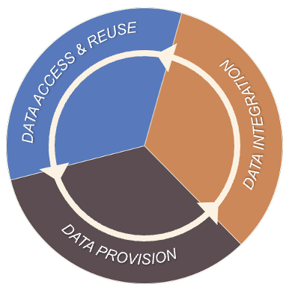

From Activities to Accountability
The data lifecycle defines what needs to be done; functional roles define who ensures it gets done.
EPOS relies on functional roles and responsibilities covering all stages of the data.
These role definitions are guidelines to clarify responsibilities and foster alignment across diverse contexts.
Roles are flexible: they may be assigned to individuals or teams, and one person may cover multiple responsibilities.

Slide 29
Functional Roles
Data Producer
Data Manager
Data Curator
Data Steward
IT Specialist
Creates data and collaborates with Data Manager to ensure accuracy, completeness, quality
Organizes and documents datasets, ensures well-structured, high-quality data
Ensures compliance with policies, ethical guidelines, and legal standards
Manages technical infrastructure for data collection, processing, accessibility
Oversees operational activities: collection, storage, security, and maintenance
Depending on organizational needs, these roles may be assigned to individuals or teams.
A person may take on multiple responsibilities (e.g., Data Curator and Steward).

Slide 30
Data Provision: Roles & Responsibilities
Data Manager
Data Curator
Data Steward
IT Specialist
National Organizations
Organise datasets, metadata, ensure quality and suitability for sharing.
Ensure local governance and compliance with national policies and GDPR.
Ensure functionality and security of hardware, software, networks.
Data Provider
Manage data collection, storage, security.
Harmonise data and metadata. Ensure consistency, proper formatting, standardization.
Ensure governance aligned with EU/international standards.
Manage
infrastructure for aggregation; ensure secure access.
Aggregate and integrate data from multiple data providers.
EPOS TCS
Service Provider

Slide 31
Data Integration: Roles & Responsibilities
Data Manager
Data Curator
Data Steward
IT Specialist
Ensure metadata management follows EPOS standards and data-sharing agreements.
Maintain the core infrastructure integrating services and enabling global access.
Oversee central metadata catalog; ensure robustness, security, and reliability.
Ensure web services metadata is well-structured, and ready for integration.
EPOS ICS
EPOS ECO & HO
Ensure accuracy, quality, completeness, and usability of web services.
Ensure metadata adheres to EPOS standards, using standardized vocabularies.
Ensure web services are available and reliable.
EPOS TCS
Ensure efficient provision of web services metadata and provide technical support.
Service Provider

Slide 32
Summary: The Pillars of the EPOS Data Lifecycle
Federated Data Provision: Data stays with the source providers ensuring local ownership, while web services, provided by service providers, guarantee global access to data through the EPOS Platform.
Community-Driven Standardization: Data and services follow a process of standardization, harmonization, and enrichment within the Thematic Core Services (TCS), guided by domain-specific standards.
Metadata-Driven Integration: The EPOS-DCAT-AP metadata standard enables FAIR-compliant services, allowing users to discover, query, and interact with diverse datasets through a consistent and meaningful interface.
Expert Accountability: The definition of functional roles (Manager, Curator, Steward, IT Specialist) ensures that specialized expertise is applied to guarantee data quality and compliance with the FAIR principles at every stage of the data lifecycle.

Slide 33
Data security and protection
Federica Tanlongo

Slide 34


Data protection and security
EPOS strives to ensure all data security and protection measures are implemented to the highest standards on all systems under its direct control.
Shared responsibility of stakeholders in a federated environment
The data policy encourages actors at all the levels of the data lifecycle to implement:
Best practice implementation
Continuous monitoring
Regular security assessments

Slide 35

Scope: which data are we protecting?
Personal Data
Ensure privacy and compliance with regulations (GDPR).
Scientific Data
Support research integrity and reliability of findings.
Ensure protection against accidental loss, unauthorized handling, and corruption.

Slide 36
Scope: which data are we protecting?
And how?
Personal Data
Ensure privacy and compliance with regulations (GDPR).
Scientific Data
Support research integrity and reliability of findings.
Ensure protection against accidental loss, unauthorized handling, and corruption.
GDPR Compliance
EPOS Privacy policy

Slide 37
Scope: which data are we protecting?
…and how?
Personal Data
Ensure privacy and compliance with regulations (GDPR).
Scientific Data
Support research integrity and reliability of findings.
Ensure protection against accidental loss, unauthorized handling, and corruption.
GDPR Compliance
EPOS Privacy policy
Data Integrity measures
Data loss mitigation & recovery measures
Prevention of accidental losses
Access control

Slide 38



Protecting Personal Data
Personal Data
Ensure privacy and compliance with regulations (GDPR).
Scientific Data
Support research integrity and reliability of findings.
Ensure protection against accidental loss, unauthorized handling, and corruption.
Uphold GDPR principles throughout the data lifecycle
Data Minimization
Transparency
Security
Purpose Limitation
Appropriate Retention Periods
Uphold Data Subject rights:
Access
Rectification
Erasure

Slide 39

Protecting Science Data:
Data Integrity
Personal Data
Ensure privacy and compliance with regulations (GDPR).
Scientific Data
Support research integrity and reliability of findings.
Ensure protection against accidental loss, unauthorized handling, and corruption.
Data Integrity Measures
Essential for the reliability and credibility of research findings.
Data integrity check mechanisms: Checksums, Cryptographic Hashing, Version Control
Follow best practices at all stages of the Data Lifecycle:
Comprehensive Logging of modifications, access, and deletions of data
Audit Trails documenting who accessed data, when, and what changed
Transparency of all actions affecting data integrity
Notes:
Checksum: Mathematical fingerprints used to verify data has not been altered or corrupted during storage or transmission.
Cryptographic hashing: One-way functions producing unique fixed-size outputs for data verification and tamper detection. Version Control: Tracking changes to data over time, enabling recovery of previous versions and audit trails.

Slide 40

Scientific Data Protection:
Data Loss Mitigation, Recovery & Availability
Personal Data
Ensure privacy and compliance with regulations (GDPR).
Scientific Data
Support research integrity and reliability of findings.
Ensure protection against accidental loss, unauthorized handling, and corruption.
Data Loss Mitigation and Recovery Measures
Different scenarios: Hardware failure, Cyberattacks, Natural Disasters, even Policy contingencies….
Periodic automated backups essential to safeguard against accidental data loss or corruption.
Maintain disaster recovery plans at all levels (Data Providers, Service Providers, and ICS managers), to guarantee data can be recovered quickly and efficiently.
Follow best practices (e.g. copies off-site)
Design systems with high availability in mind to guarantee data access!
Notes:
Checksum: Mathematical fingerprints used to verify data has not been altered or corrupted during storage or transmission.
Cryptographic hashing: One-way functions producing unique fixed-size outputs for data verification and tamper detection. Version Control: Tracking changes to data over time, enabling recovery of previous versions and audit trails.

Slide 41

Scientific Data Protection:
Accidental Data Loss
Personal Data
Ensure privacy and compliance with regulations (GDPR).
Scientific Data
Support research integrity and reliability of findings.
Ensure protection against accidental loss, unauthorized handling, and corruption.
Preventing Accidental Losses
Different scenarios: Human error, entry errors, improper handling (by machine and humans).
Adopting mechanisms to minimise material errors (e.g.Multi-step confirmation, “soft” deletion…)
Implement validation checks to prevent corruption from improper handling
Train users
Notes:
Checksum: Mathematical fingerprints used to verify data has not been altered or corrupted during storage or transmission.
Cryptographic hashing: One-way functions producing unique fixed-size outputs for data verification and tamper detection. Version Control: Tracking changes to data over time, enabling recovery of previous versions and audit trails.

Slide 42

Scientific Data Protection:
Sensitive Data
Personal Data
Ensure privacy and compliance with regulations (GDPR).
Scientific Data
Support research integrity and reliability of findings.
Ensure protection against accidental loss, unauthorized handling, and corruption.
Implementing Access Control
Robust AAI mechanisms are implemented to prevent unauthorised access or manipulation of sensitive data/products.
Role- or privilege-based authorisation adopted where required by the nature of the data, services, or provider policies.
Notes:
Checksum: Mathematical fingerprints used to verify data has not been altered or corrupted during storage or transmission.
Cryptographic hashing: One-way functions producing unique fixed-size outputs for data verification and tamper detection. Version Control: Tracking changes to data over time, enabling recovery of previous versions and audit trails.

Slide 43
Intellectual Property Rights
Mario Locati

Slide 44

The Basics
Scope of the Policy
Data, services, software, and any other research outputs. (I will collectively referred to as "resources")
The Golden Rule
Only the owner(s) have the authority to decide the terms associated with a resource, including its license, metadata, and any limits to access, use, and reuse.

Slide 45

The Open Science principle
A collaborative vision
Open Science relies on efficiently sharing resources
to increase overall scientific knowledge.
Integrating knowledge
The creation of new knowledge inherently requires the reuse and integration of shared resources from different origins.
Aligned goals
Owners who choose to make their resources available via EPOS actively share and support this collaborative view.

Slide 46

Providing resources vs. ownership
Ownership is retained
Providing data to EPOS does not affect or transfer
the original ownership of the resource.
Accepting the policy
Data Providers accept the EPOS Data Policy,
which is firmly rooted in the Open Science paradigm,
encompassing Open Access and FAIR principles.

Slide 47

Navigating shared ownership
Establish agreements: When multiple parties create a new resource together,
an ownership agreement should be established in advance.
Default status: By default, jointly generated scientific outputs
lead to joint ownership unless agreed otherwise.
Evaluating origins: Assessments must distinguish whether the used resources are pre-existing or generated outside the collaboration.
Protecting underlying knowledge: Evaluation may justify allocating sole ownership to the owner of the underlying resources.

Slide 48

Terms of use and acknowledgment
Applying licenses
Owners must explicitly state their terms of use by applying a license.
The need for credit
Most licenses require users to formally acknowledge the work of the owner(s).
Structured citations
Providing this credit through properly structured citations
is the most effective way to fulfill this requirement.
EPOS support
To make life easier for users and ensure compliance,
EPOS provides ready-to-use citations.

Slide 49

Selecting an appropriate license
Open Science compatibility
Owners must select a license that is fully compatible
with the Open Science paradigm.
Key requirements
It must allow the creation of derivative works.
It must be standardized to permit the seamless combination of resources from different origins.

Slide 50






Recommended licenses by resource type
Metadata: Creative Commons Zero (CC0): no restrictions, no requirements.
Software: Any standard Open Source license, including copyleft options.
Other content: Creative Commons Attribution (CC BY 4.0), requires credit only.
High-Value datasets
Under EU Regulation 2023/138 must strictly be licensed under CC0 or CC BY 4.0.
Geospatial
Environmental
Meterological
Statistical
Commercial
Mobility

Slide 51
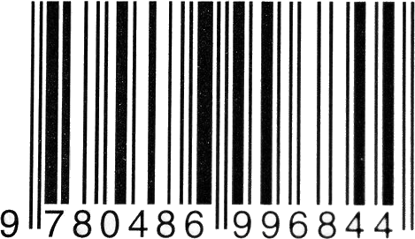
Identification for proper attribution
Clear identification
To cite a resource properly, it must be clearly and unambiguously identified.
Freedom of choice
Owners are free to choose whichever Persistent Identifier (PID) they wish to use.
EPOS minting service
For owners who are unable to self-assign an identifier,
EPOS provides support by offering a DOI minting service.

Slide 52


Service provider responsibilities
Ensuring compliance
Service providers are responsible for verifying that
the applied licenses are entirely consistent with the EPOS policy.
Technical propagation
They must also ensure the correct technical propagation
of these licenses throughout all EPOS services.

Slide 53
Q&A from the audience
Interactive discussion

Slide 54
Thank you!

