Slide 1

Welcome and introduction to day 4
Lilli Freda
EPOS ERIC Executive Director

Slide 2

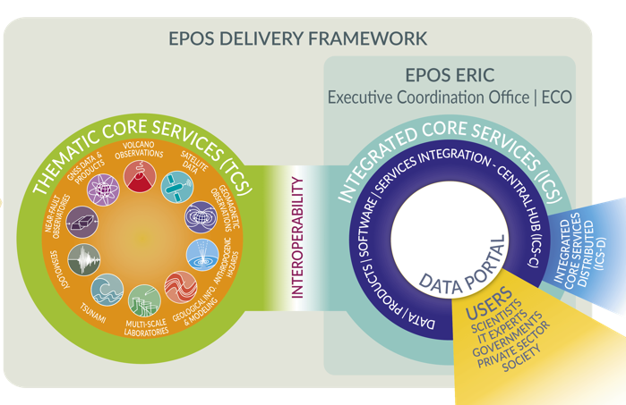
The EPOS Ecosystem and the EPOS Days 2026 Programme
Day 5: EPOS Data Policy
DATA Generation
DATA Integration
DATA Access
Day 4: Technical challenges, opportunities and solutions
Day 4:
EPOS in National Landscapes
Day 2: Societal Impact and Responsible Research Infrastructures
Day 4: UFG report
Day 1: Early Career Researchers, Thematic Core Services
Day 2: New Services and communities
Day 3: International Collaboration

Slide 3

The EPOS Ecosystem and the EPOS Days 2026 Programme
Day 5: EPOS Data Policy
DATA Generation
DATA Integration
DATA Access

Slide 4
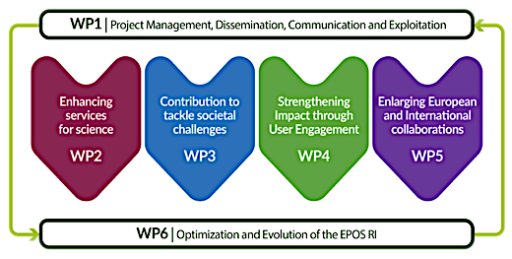
EPOS ON objectives covered in today’s sessions
09:00-11:30
EPOS Data Policy

Slide 5



Day 5 Agenda: Morning Sessions
09.00-13.30 | Introducing the EPOS Data Policy - Chair: Daniela Mercurio
Welcome and Introduction of the day's agenda |  | L. Freda
Introduction and context: the EPOS Policy WG and the new EPOS Data Policy |  | D. Mercurio
Founding values and EU legal framework |  | H. Glaves
The EPOS Data Lifecycle |  | R. Paciello
Data security and protection |  | F. Tanlongo
Intellectual Property Rights |  | M. Locati
Q&A from the audience - Interactive discussion
Coffee break11.00-11.45 | Coffee break
11.45-13.00 | Conclusions and vision towards the future - Chair: Lilli Freda
11.45-12.30 - Conclusions from the EPOS Days | G. Festa, O. Lange, H. Ciechowska, F. Monterroso, H. Glaves, J. Fonseca, D. Mercurio, M. Fredella
Event wrap-up and way forward | L. Freda
Future outlook - Interactive discussion
13.00 | End of sessions

Slide 6

Feedback form: help us making the next edition better!

Slide 7
Enjoy the programme!

