Slide 1

EPOS-ES: Strengthening the Spanish Geoscience Community through EPOS
Adelina Geyer
EPOS-ES Coordinator

Slide 2
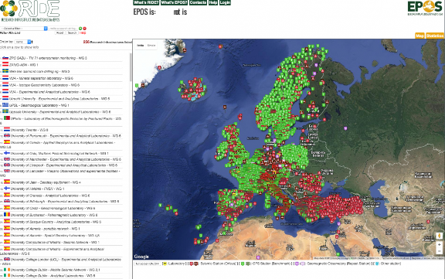
EPOS-ES
General Assembly
20-21 May
EPOS-ES
EPOS-ON
EPOS-ES
TRAJECTORY…
EPOS-ES
Summer School
Kick-off meeting
Summer Schools
17 may
8 July
June-July
TCS meetings
EPOS - RIDE
TCS meetings
Coordination meetings (national & european level)
EPOS - PP
EPOS - IP
EPOS - SP
Presentations in universities, research centers and conferences
Training and educational activities
2008
2011
2014 / 2015
2019 / 2020
2023
2024
2025
2026
EUROVOLC
EUROPEAN FUNDING
DT-GEO
GEO-INQUIRE

Slide 3







How does Spain contribute to EPOS ERIC?
Agreement for economic funding of membership fees and the participation of Spain in the ESFRI EPOS-ERIC (5 year credit renewal):
Ministerio de Ciencia, Innovación e Universidades (MICIU) –
former Ministerio de Ciencia e Innovación (MICINN)
Consejo Superior de Investigaciones científicas (CSIC)
Centro Nacional de Información Geográfica (CNIG)
Instituto Geográfico Nacional (IGN)
Universidad de Granada (UGR)
Universidad de Alicante (UA)
Universidad de Salamanca (USAL)
Universidad de Barcelona (UB)
Current Spanish ESFRI policy requires the membership fees to be covered by one (or more) institution(s). In case of EPOS-ERIC, the Ministry of Science, Innovation and Universities does not provide any economic support.

Slide 4



Other national funding sources:
National collaboration network
(i.e. organization of meetings, coordination activities)
EPOS-Spain network
CGL2016-81965-REDT
P. Fernández (CSIC)
EPOS-ES network
RED2022-134516-E
A. Geyer (CSIC)
EPOS-ES network
RED2024-153951-E
P. Fernández (CSIC)
158.000 euros
18.000 euros
70.000 euros
70.000 euros
2018-2027
2018-2019
2023-2025
2025-2027
CSIC Project calls for:
Large European Research Infrastructures
CSIC support for:
Large European Research Infrastructures
200.000 euros
100.000 euros
2023-2025
100.000 euros
2025-2027
2023-2027

Slide 5
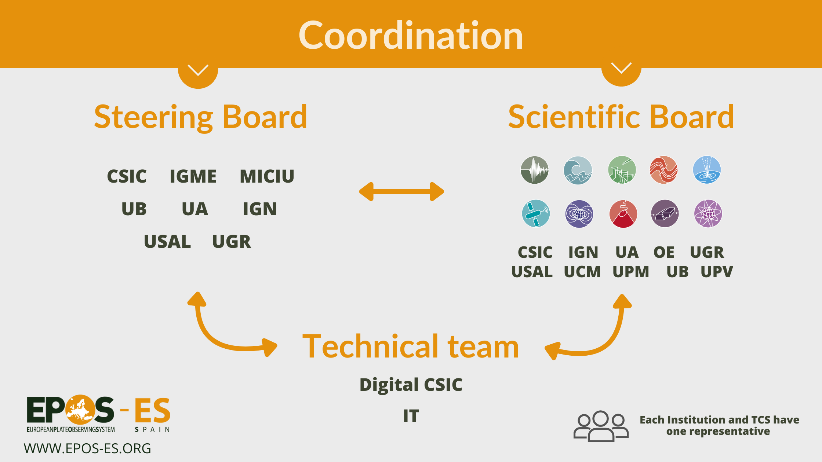
Model of
Organization:

Slide 6



EPOS-ES Coordination
Adelina Geyer (CSIC)
Project Manager
Joaquin Hopfenblatt (CSIC)
Juan Vicente
Cantavella
(IGN)
Antonio Azor
(UGR)
José Antonio Sánchez
(IGN)
Itahiza Domínguez (IGN)
Adelina Geyer
(CSIC)
Carlos Garrido (CSIC)
National Scientific Advisor for the Spanish Representative at the National Authorities Consultation Board
Adelina Geyer (CSIC)
Coordinators and TCS representatives are envisaged to rotate among the different institutions signing the general agreement.
José Fernández
(UCM – CSIC)
Juan José Curto
(OE)
Diana Nuñez
(UCM)
Ignacio Aguirre(UNICAN)
Jorge Macías (UM)
José Román Hernández
(IGME)

Slide 7
EPOS: A way to strengthen the solid Earth Sciences community

Slide 8
EPOS: A way to strengthen the solid Earth Sciences community
Identify the working groups and research teams.

Slide 9
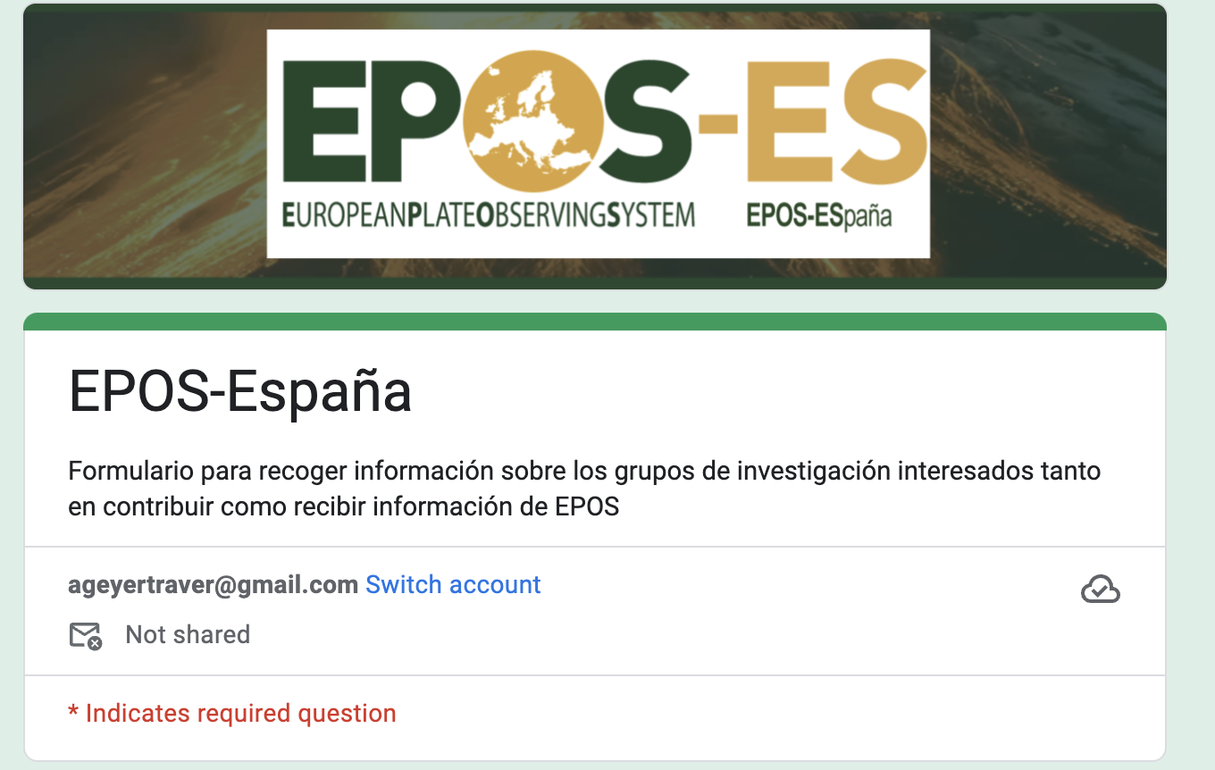
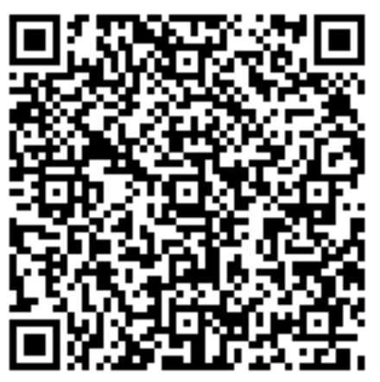

Database of specialists and working groups
Expression of interest form
Specific mailing lists for each TCSs and also for the entire network
https://epos-es.org/

Slide 10
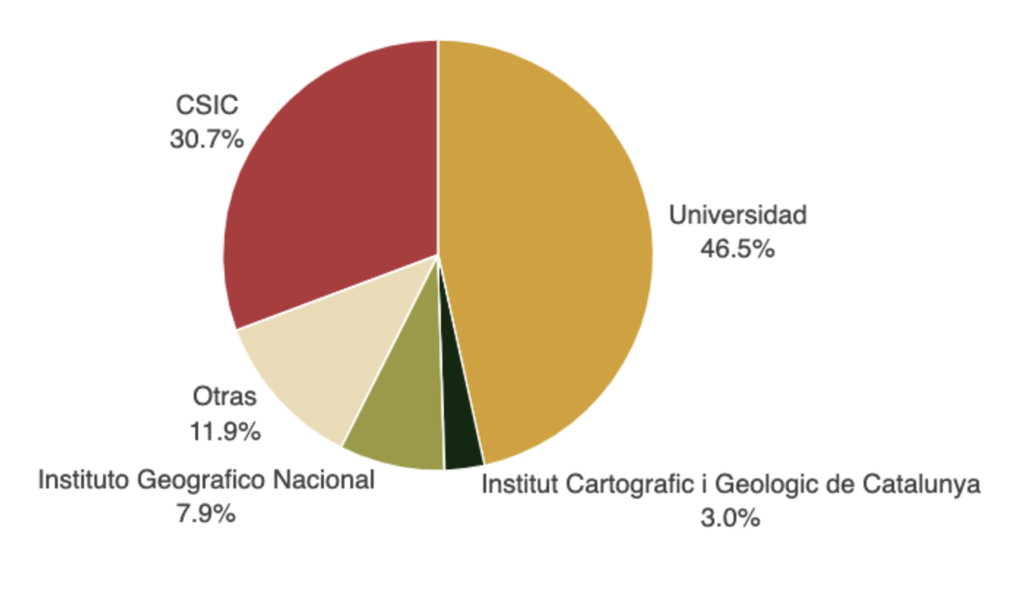
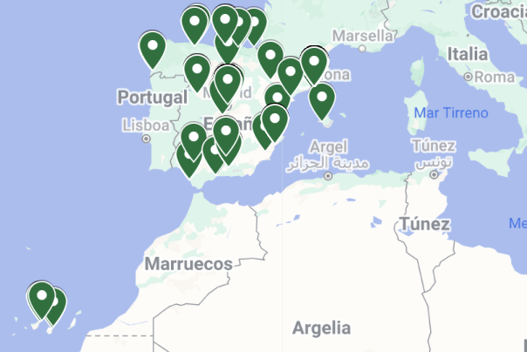
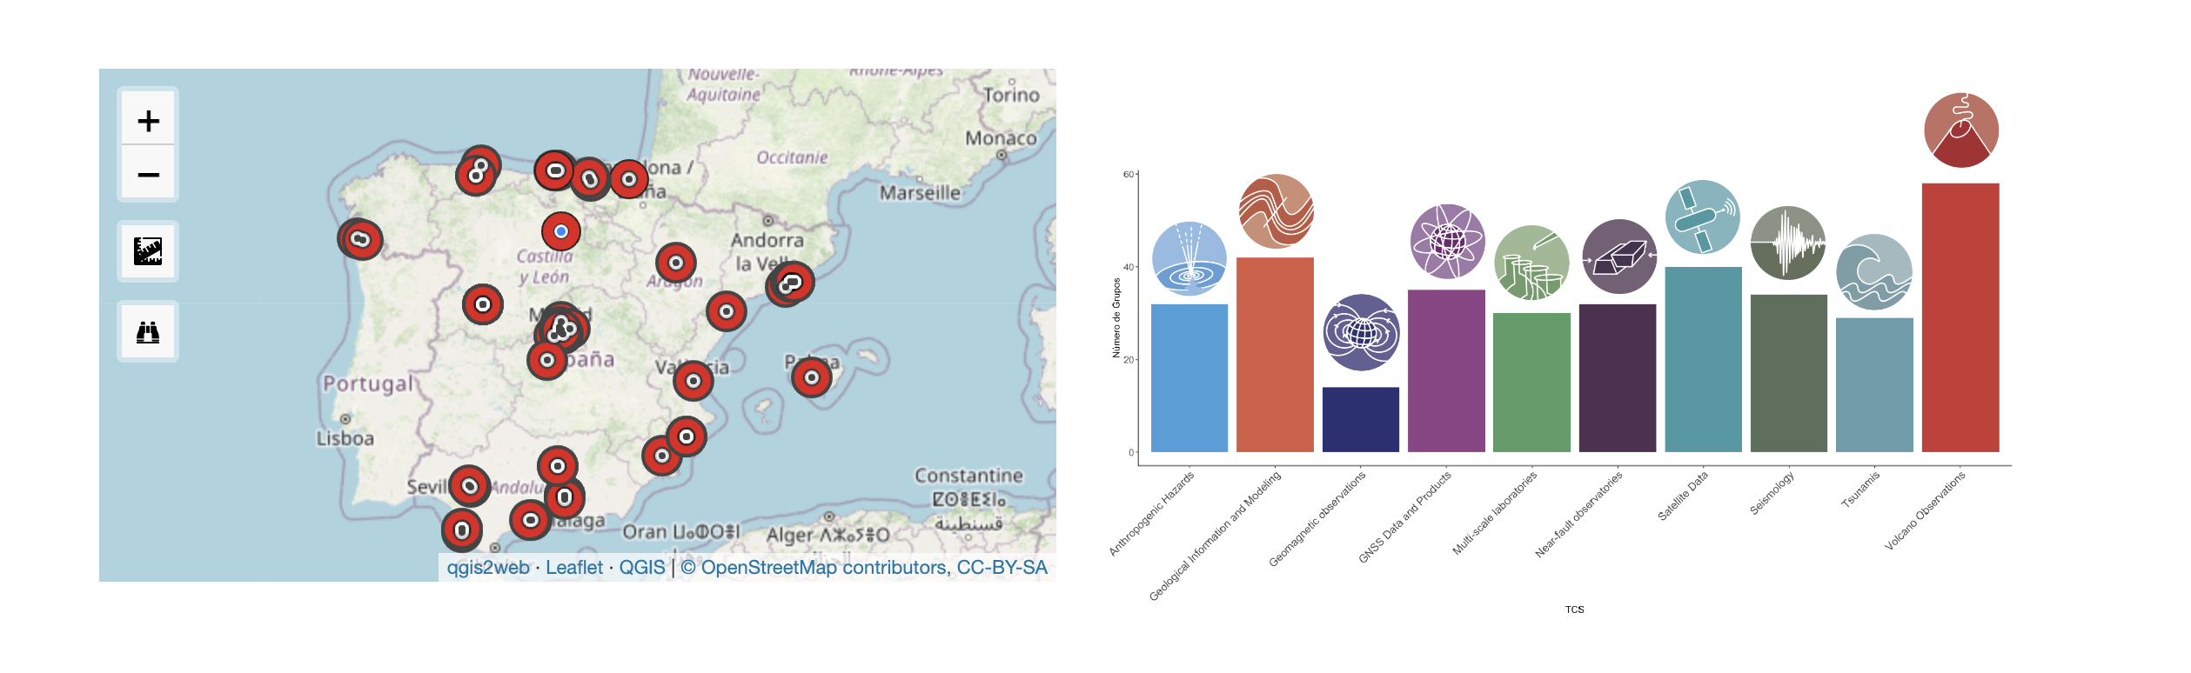
Database of specialists and working groups
96 groups!
https://epos-es.org/

Slide 11
EPOS: A way to strengthen the solid Earth Sciences community
Identify the working groups and research teams.
Create communication channels

Slide 12
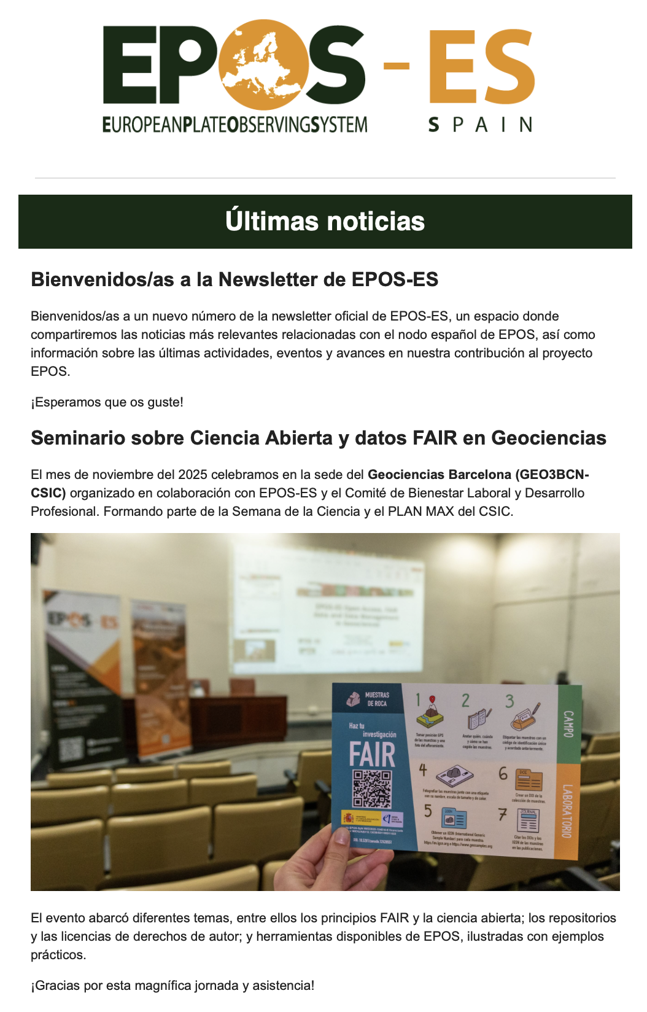
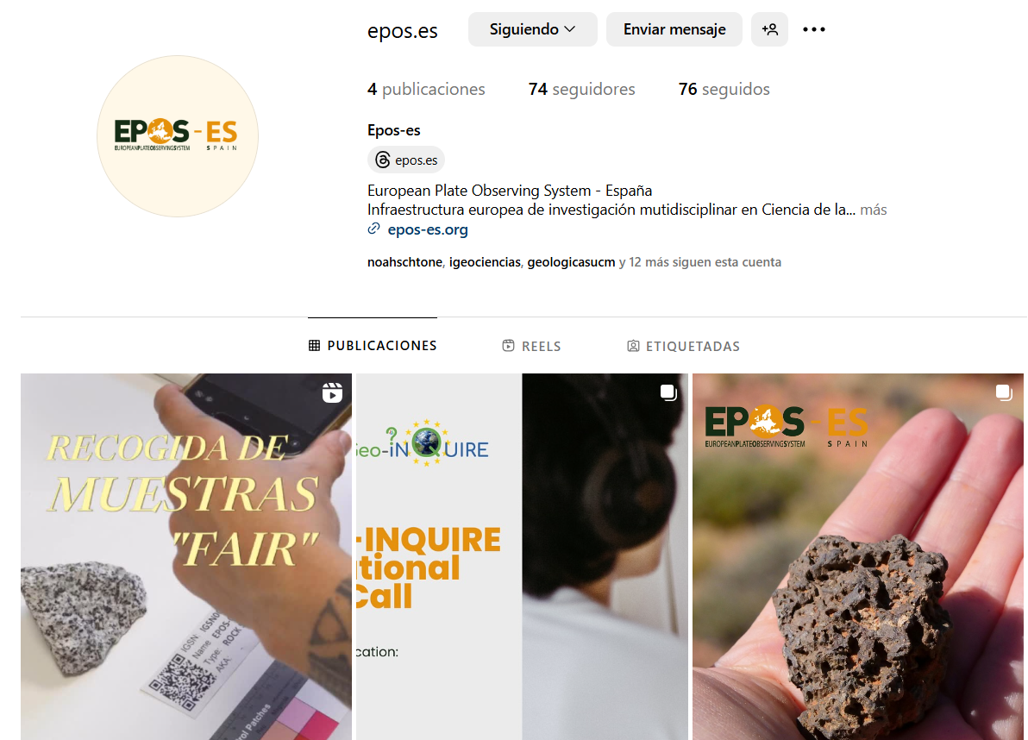

Mailing lists per TCS and the whole community
EPOS-ES in social Networks.
EPOS-ES Newsletter

Slide 13
EPOS: A way to strengthen the solid Earth Sciences community
Identify the working groups and research teams.
Create communication channels
Open Science education and EPOS Portal training

Slide 14

Education and Training: Principal Challenges
EPOS… MORE THAN A DATA PORTAL!!
Pillars of Open Science, UNESCO (2021) - CC BY-SA 4.0
Lack of FAIR data management culture in part of the Spanish geoscientific community
Lack of variety and visibility of training resources and poor connection with institution.
Need for coordination between different TCS, institutions and research groups to organize joint trainings.
➜ Starting Point: Training and outreach to encourage participation and adoption of FAIR practices.

Slide 15
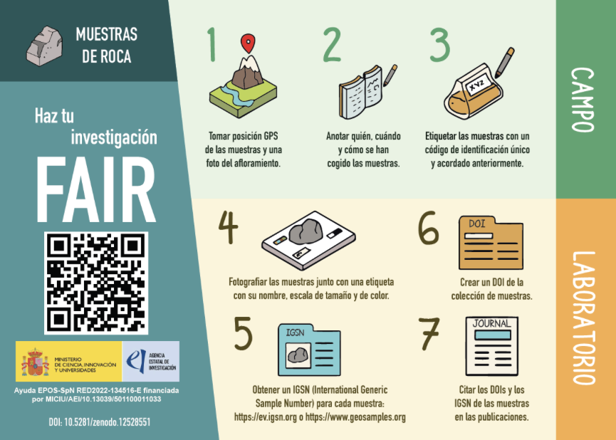
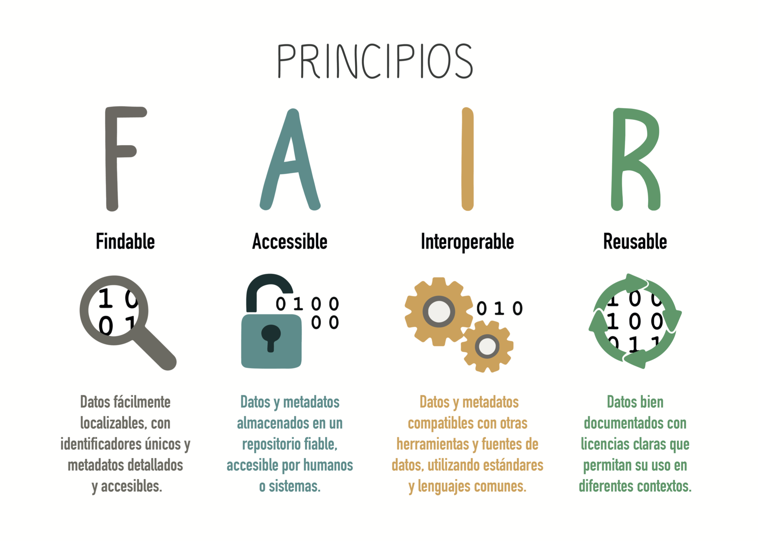
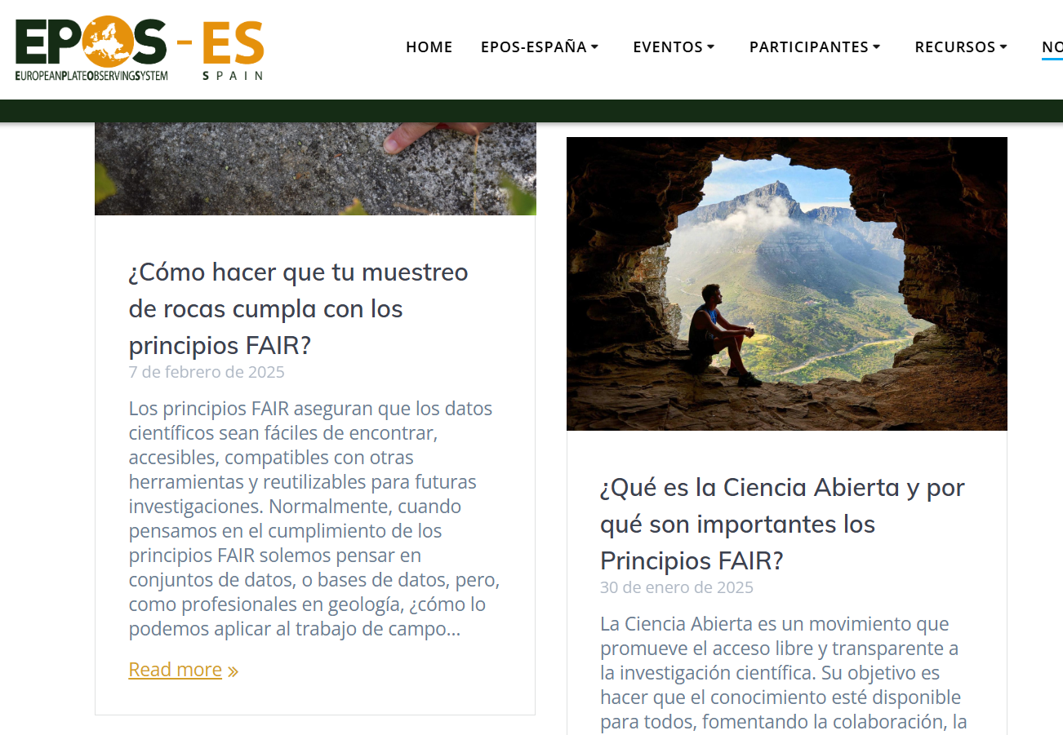
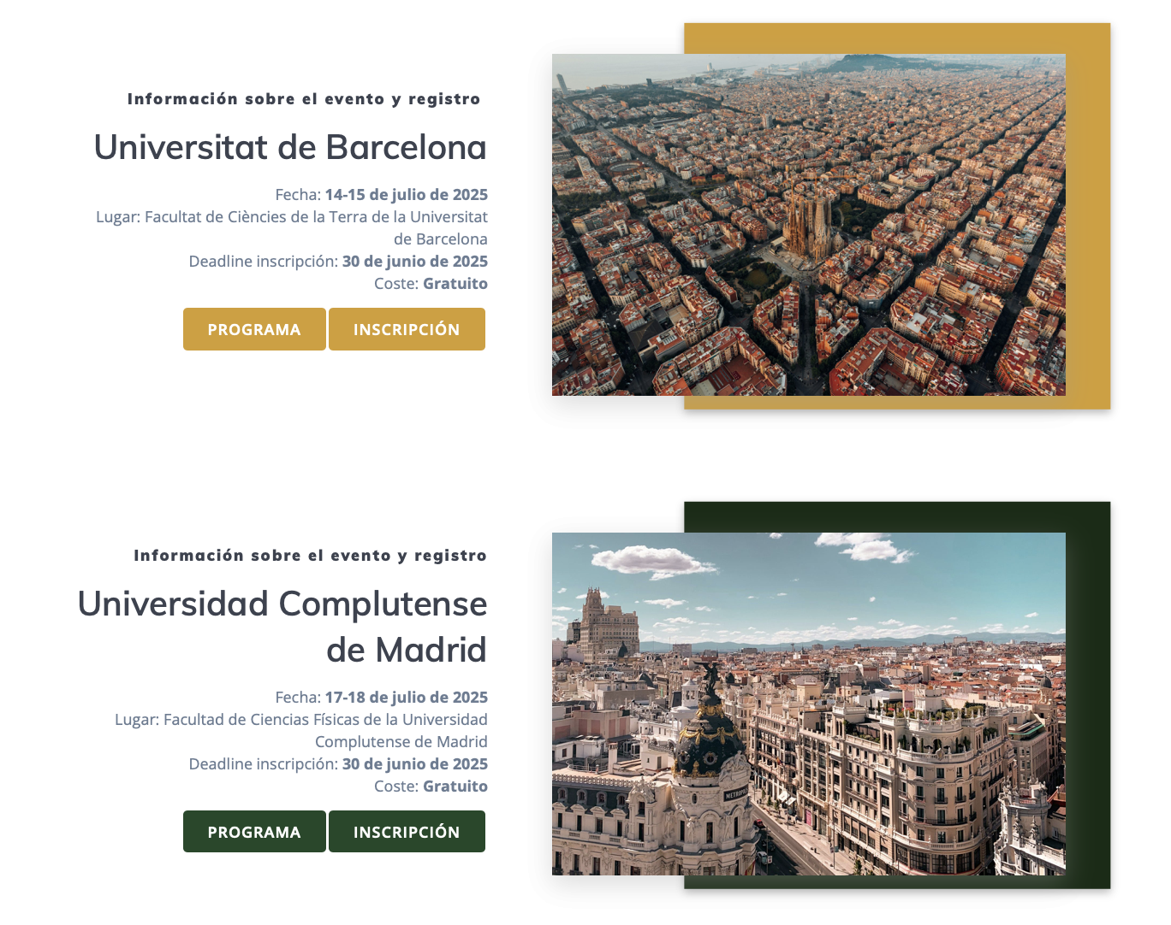

Educational material:
OPEN SCIENCE , FAIRness and EPOS training
Summer Schools:
University of Salamanca (July, 2024)
University of Barcelona (July, 2025)
University Complutense of Madrid (July, 2025)
FAIR flyers
EPOS-ES blog with Open Science content.
Seminars:
Open Science and FAIR Data in Geosciences (14/11 and 28/11/2025)
New edition May-June 2026!!
EPOS-ES in social Networks. Ej. Instagram (@epos.es),
YouTube

Slide 16
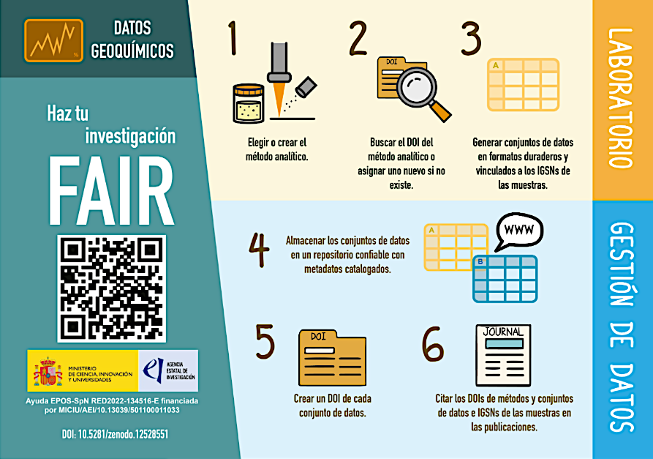


NOW IN ENGLISH!!

Slide 17

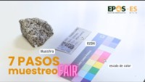
Videos
Youtube video explaining how to do rock sampling FAIR

Slide 18

EPOS: A way to strengthen the solid Earth Sciences community
Identify the working groups and research teams.
Create communication channels
Open Science education and EPOS Portal training
Provide guidance and mentoring to support participation in competitive research funding calls.

Slide 19







Working group EU proposals
Consejo Superior de Investigaciones científicas (CSIC)
Instituto Geográfico Nacional (IGN)
Universidad de Granada (UGR)
Universidad de Alicante (UA)
Universidad de Salamanca (USAL)
Universidad de Barcelona (UB)
Universidad Complutense de Madrid (UCM)
Universidad Politécnica de Madrid (UPM)
Universidad Politécnica de Valencia (UPV)

Slide 20
Outcomes since 2023:
EPOS-ESDEPA Strategic Network
Strengthening Satellite Data and Anthropogenic Hazards Thematic Services within EPOS ERIC
Host Institution: Institute of Geosciences (IGEO-CSIC), Spain
Funding Programme: Spanish Research Networks Programme (2024 call)
Funding Agency: State Research Agency (AEI), Ministry of Science, Innovation and Universities
Project Reference: RED2024-153951-E
Duration: May 2025 – April 2027
Total Budget: €70,000
Principal Investigator: J. Fernández (IGEO-CSIC)
Consortium Size: 15 researchers
Context
Increase of national collaboration with dedicated funding
Strategic Spanish collaboration network supporting participation in EPOS ERIC (European Plate Observing System) and strengthening national contributions to the Satellite Data, Anthropogenic Hazards, and emerging Gravimetry Thematic Core Services.

Slide 21





EPOS-ESDEPA Strategic Network: Objectives
Strengthen Spanish participation in EPOS ERIC
Reinforce Spanish contributions to the Satellite Data and Anthropogenic Hazards Thematic Core Services
Support Spanish involvement in the development of the new Gravimetry TCS
Build a coordinated national research community
Foster collaboration between Spanish research groups and institutions
Promote synergies with the EPOS-SpN network and international partners
Increase scientific and economic return from EPOS participation
Promote joint proposals to national, European and space-agency funding calls
Enhance international collaboration within the EPOS framework
Develop strategic scientific infrastructure
Define a distributed laboratory for Anthropogenic Hazards studies, integrating satellite observations and geophysical data
Contribute to future research infrastructures linked to EPOS-ES
Promote knowledge exchange and strategic coordination
Establish communication channels between EPOS TCS communities
Support dialogue with national institutions, space agencies, and international research initiatives

Slide 22
EPOS-ES: Next steps

Slide 23




EPOS-ES: Next steps
Contribute to support EPOS ON project to guarantee its success
Other national nodes
Encourage and support national initiatives
Improve collaboration with other national nodes

Slide 24
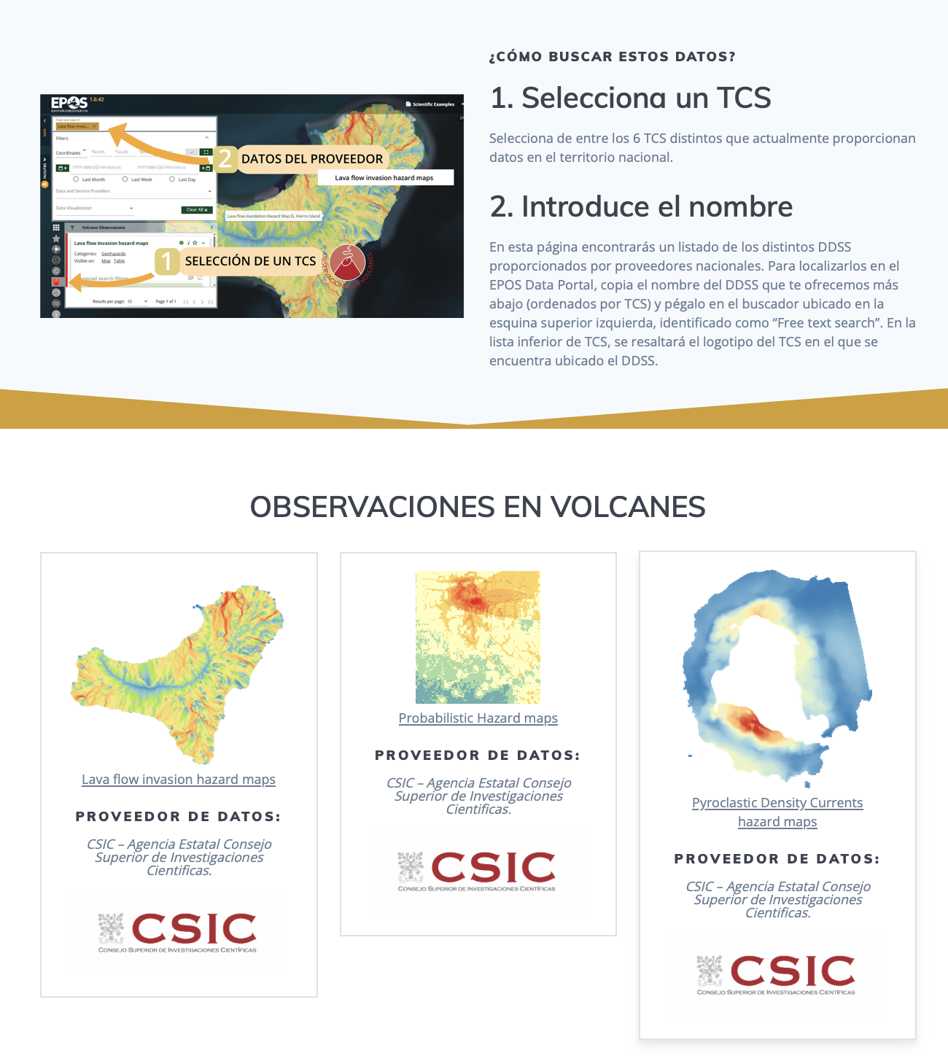
EPOS-ES: Next steps
Improve dissemination
Presentations in institutions
Summer Schools and other training initiatives
Participation in conferences at national level
Meetings and working groups
Strengthen EPOS-ES and expand the scientific community.
Increase the number of committed research groups.
Connect with ESFRIs, ICTSs, and the Geosciences HUB.
Engage other communities
Enhance Open Science and FAIRness knowledge
EPOS-ES DDSS

Slide 25
EPOS-ES: Next steps
Working group with EPOS-EU on social data.
Roadmap for integrating social science studies.
Inclusion of social users and data providers.
Identification and integration of polar datasets.
Meetings with the Polar Committee, POLARCSIC, and the Spanish Polar Data Centre.

Slide 26
EPOS-ES: Next steps
Internationalization of EPOS to Spanish-speaking countries
Joint activities with other national nodes

Slide 27
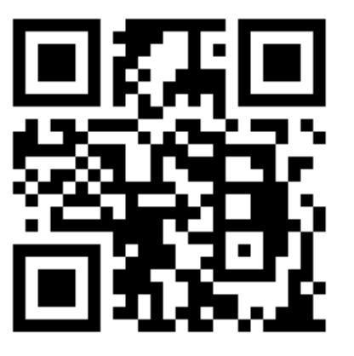
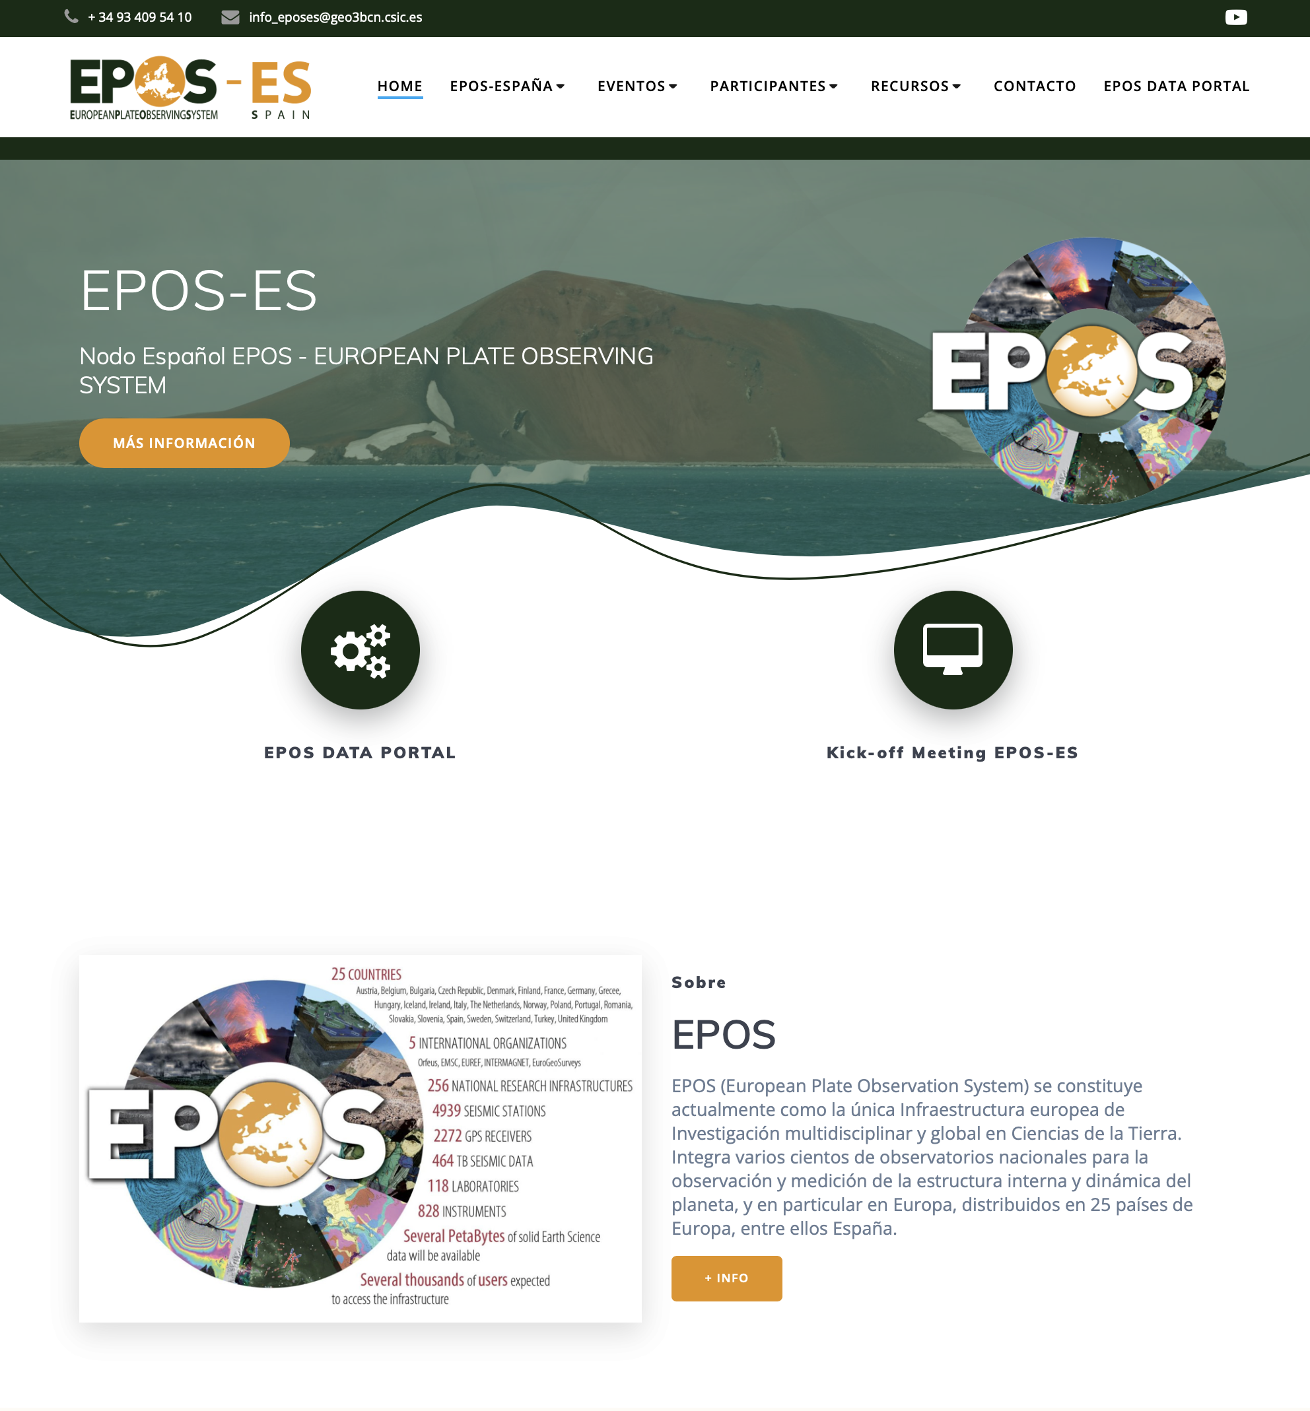
www.epos-es.org
EPOS-ES

Slide 28
Thank you!

