Slide 1
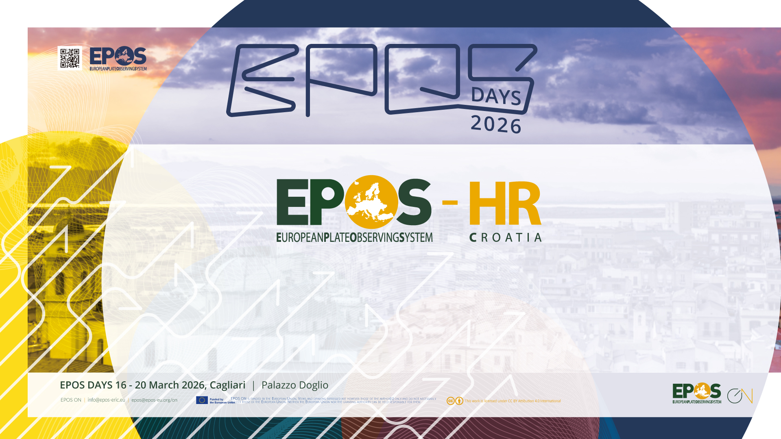
EPOS-HR in Its First Phase: Structure, Challenges, and Opportunities

Slide 2
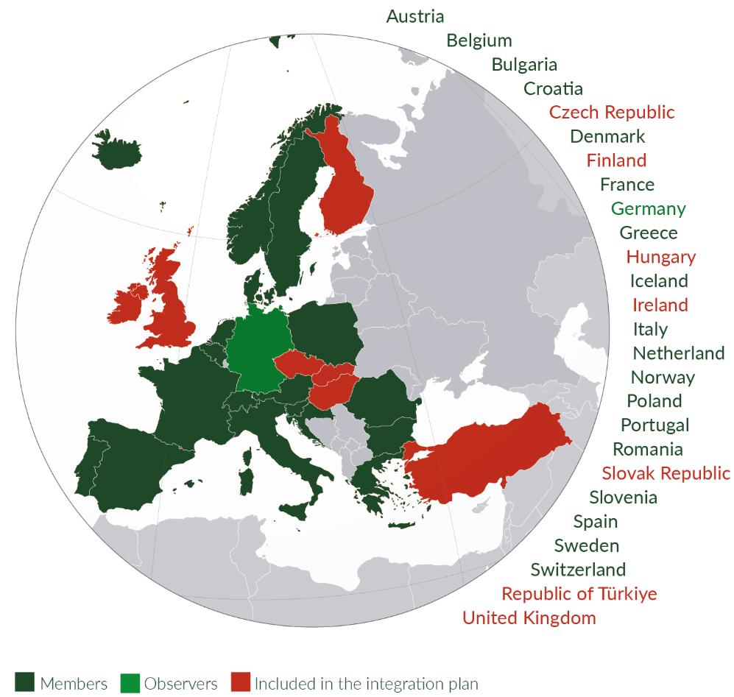
January 2024: full member of EPOS ERIC
The Republic of Croatia has become a full member of the pan-European research infrastructure EPOS ERIC (European Plate Observing System – European Research Infrastructure Consortium).
Croatia's candidacy was officially accepted at the EPOS ERIC General Assembly held in Rome on 6 and 7 December 2023, while the European Commission confirmed full membership in January 2024.

Slide 3









Structure
Official representation: Ministry of Science, Education and Youth
Coordinator: Croatian Geological Survey (HGI)
Consortium:
Department of Geophysics, Faculty of Science, University of Zagreb
Faculty of Mining, Geology and Petroleum Engineering (FMG), University of Zagreb
Faculty of Geodesy, University of Zagreb
State Geodetic Administration (DGU)
Faculty of Civil Engineering, University of Zagreb and Croatian Center for Earthquake Engineering
Ruđer Bošković Institute (RBI)
University Computer Center (SRCE)

Slide 4

EPOS-HR activities
Several activities are underway:
Securing long-term funding for EPOS Croatia with the Ministry
Including EPOS ERIC within the Croatia's Research Infrastructure Development Plan for 2023–2027
Developing research infrastructure for the GNSS network through smaller scientific projects: 12 receivers to date, with the public procurement process still underway.
Preparing legal documents to establish the infrastructure: seismological service received government funding in 2020 to build a station network following a series of moderate earthquakes, and the project is ongoing
Planning to construct a network of geodetic and seismological instruments in the Dubrovnik area: data to be shared via the EPOS platform

Slide 5

Challenges
Due to a lack of understanding of the complex EPOS structure, the following challenges have been faced:
delay in the financing of the EPOS-HR node by the ministry
delay in the integration of the Croatian institutes within the EPOS TCSs
delay of the EPOS-related activities in Croatia

Slide 6

Opportunities – EPOS ERIC
I am personally advocating for the creation of a document/presentation/webapp/etc. facilitating the integration and clarifying the role of new national nodes within the complex EPOS structure.
I suggest to base this document on success stories of other (older) national nodes (e.g., EPOS-ES) to illustrate what can be done in practice and how it can be done step-by-step.
I am not volunteering for this task!

Slide 7

Opportunities – TCS
I will be available this week to discuss with the TCS representatives to speed up the integration of the Croatian institutions involved in EPOS-HR.
I will now briefly present them and how they wish to contribute …

Slide 8
Croatian Geological Survey (HGI)
Central national institution for geological research and geoscientific data in Croatia
Responsible for geological mapping, geohazards, hydrogeology and national geological databases
TCS contributions:
GNSS Data and Services, Satellite Data, Geological Information and Modelling (GIM), Near-fault observatory

Slide 9
Department of Geophysics – Faculty of Science (PMF)
Leading national institution for geophysics education and research
Operates the Seismological Service of Croatia and national seismic network
Contributes seismic data for European earthquake monitoring
Already share data from 11 seismological stations through ORFEUS platform
TCS contributions:
Seismology, Near-Fault Observatory

Slide 10
Faculty of Mining, Geology and Petroleum Engineering (RGNF)
Leading Croatian institution in geology, geotechnics and subsurface engineering
Research in geological structure, tectonics, geomechanics and geohazards
Supports understanding of subsurface processes relevant for hazards and infrastructure
Contributes geological knowledge and modelling of Earth processes
Already participate in working groups within EFEHR for the development of earthquake risk models in Europe
TCS contributions:
Geological Information and Modelling (GIM)

Slide 11
Faculty of Geodesy – University of Zagreb
National centre for geodesy, geoinformatics and spatial technologies
Research in satellite geodesy, remote sensing and GIS
Focus on monitoring surface deformation and spatial changes
Applies satellite radar techniques (InSAR) for deformation monitoring
TCS contributions:
Satellite Data

Slide 12
State Geodetic Administration (DGU)
National authority responsible for geodetic reference systems and spatial data
Maintains national network of permanent GNSS stations
Provides high-precision positioning data and geodetic infrastructure
GNSS data used for geodynamics, tectonic monitoring and hazard studies
Already share data from five stations of the CROPOS network within the EPN/EUREF network (https://www.epncb.oma.be/)
TCS contributions:
GNSS Data and Products

Slide 13
Faculty of Civil Engineering – University of Zagreb
Croatian Centre for Earthquake Engineering (HCPI)
Leading Croatian institution for earthquake engineering and structural safety
Research on seismic behaviour of buildings and infrastructure
Development of vulnerability models and seismic risk assessment methods
Supports post-earthquake damage assessment and resilience planning
TCS contributions:
Built Environment Data

Slide 14
University Computing Centre (SRCE)
National centre for academic and research e-infrastructure
Provides computing, data storage and digital services for research community
Supports management and sharing of large scientific datasets
Ensures interoperability and integration with EPOS digital infrastructure
EPOS contributions:
Digital infrastructure and data services supporting EPOS Croatia, Integrated Core Services

Slide 15
Thank you!

