Slide 1
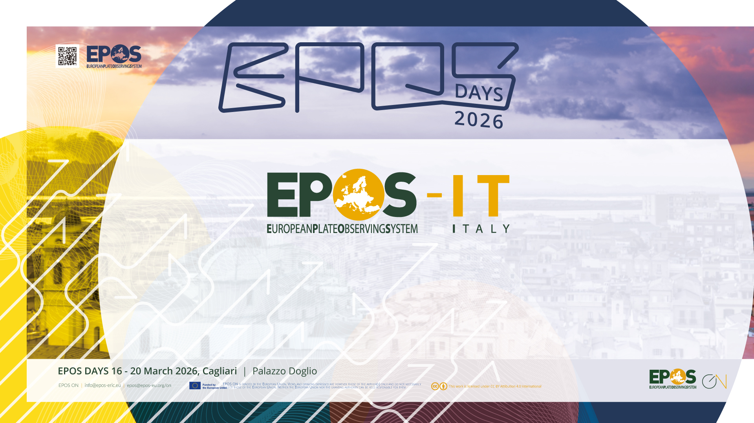
EPOS-IT, Italy: Ten years on
Notes:
Massimo cocco, lilli, stefano salvi
Agata e silvia

Slide 2













History and rationale
EPOS-IT was established in 2016 as a Joint Research Unit among 10 partners (academia, research centres, foundations). In 2024, we have engaged three new partners through a specific call.
The main objective of EPOS-IT is to promote Italian participation in the development of the EPOS RI through a coordination activity and funding of specific activities.
The Italian Ministry of Research has recognised EPOS-IT as a collaborative partnership aiming to develop a sustainable organization of the national research infrastructures in the Solid Earth sciences.

Slide 3
JRU Governance & Operational Framework (2025–2028)
1. Legal & Strategic Foundation
  Collaboration Agreement: A four-year legal framework (2025–2028) signed by all partner representatives.
  Multi-Year Activity Plan: Establishes the operational framework (currently 2026–2028).
  Strategic Alignment: Activities are agreed upon with the EPOS ERIC Executive Director to ensure institutional synergy.
2. Governance & Decision Making
  General Assembly: The primary decision-making body of the partners.
  Coordination Board: Provides technical support via representatives from the TCSs.
  Executive Plans: Implementation is managed through annual plans, discussed and approved by the General Assembly.
3. Leadership & Coordination
  Host Institution: INGV serves as the Representing Entity, providing financial and communication management.
  Coordinator: An INGV researcher (designated by the INGV President and appointed by the Assembly) who acts as the primary liaison with EPOS ERIC to set activity priorities.
Notes:
The framework demonstrates a highly organized, top-down approach. It moves logically from long-term legal foundations (4-year agreements) down to practical execution (annual plans), with very clearly defined roles for decision-making (General Assembly) and day-to-day operations (INGV Coordinator).
The JRU partnership is regulated by a four-year Collaboration Agreement (latest approved in 2024, validity 2025-2028), signed by the legal representative of each partner.
A multi-year Activity Plan sets the operational framework for the JRU Collaboration Agreement (presently 2026-2028).
Strategic activities, agreed upon with the EPOS ERIC Executive Director, are implemented through annual Executive Plans approved by the JRU General Assembly.
The main decision-making body is the General Assembly of the Partners, supported by the Coordination Board formed by members representing the TCSs.
INGV is the Representing Entity and host institution, and the Coordinator is an INGV researcher, designated by the INGV President and appointed by the General Assembly.
The Coordinator interacts with the EPOS-ERIC Executive Director to set the priorities of activity plans.
INGV also provides financial and communication management.

Slide 4
Financial support
In Italy, all activities supporting EPOS are funded by the Ministry of University and Research (MUR). The budget earmarked annually for routine EPOS operations is managed by INGV, and about 1 M€ of this funding is allocated to EPOS-IT.
This funding is dedicated to support the EPOS-IT Executive Plan (more later), in which the JRU partners also provide in-kind resources for a similar amount.
The largest development projects were approved in 2018 (17 M€) and in 2022 (43 M€, under the NPRR).

Slide 5
Multi-Year Activity Plan (2026-2028)
Strategic Activities Categories:
Priority: Defined in TCS Agreements/MYCAs or high-impact for EPOS infrastructure.
Complementary: Supporting strategic initiatives.
Transversal: Cross-cutting strategic activities.
Not less than 3/4 of the annual budget
Up to 1/4 of the annual budget

Slide 6
Priority: Defined in TCS Agreements/MYCAs or high-impact for EPOS infrastructure
Service Provider | Description | Partner | TCS
EIDA | Waveform Access | INGV | Seismology – ORFEUS
European Strong Motion DB | Access to waveforms and products | INGV | Seismology – ORFEUS
AHEAD | Historical earthquake DB | INGV | Seismology – EMSC
EDSF | European databases of seismogenic faults | INGV | Seismology – EFEHR
EFEHR Risk Platform | European risk results and access to vulnerability and exposure data | EUCENTRE | Seismology – EFEHR
Rete Geodetica Nazionale RING | GNSS solutions; Contribution to GLASS; GLASS Node | INGV | GNSS Data and Products
CEGNxEPOS | Geodetic Linking Advanced Software System (GLASS) Node | OGS | GNSS Data and Products
Irpinia & CREW | Irpinia Near-Fault Observatory – access - EEW Test Bed | UNINA | Near-Fault Observatories
TABOO & FRIDGE | Alto-Tiberina Near-Fault Observatory – access – Virtual Observatory | INGV | Near-Fault Observatories
NITRO | North-Eastern Italy Thrust Fault Observatory | OGS/UNITS | Near-Fault Observatories
Access to the Italian volcanoes’ data and services | Volcanological data such as seismic data and products, SAR data products, geochemical data, geological maps, and strainmeter data. | INGV | Volcano Observations
KMT | Krafla Magma Testbed | INGV | Volcano Observations
EPOSAR | Continuous and on-demand SAR processing; on-demand SAR modeling | CNR-IREA | Satellite Data
Tsunami portal | TCS website, portal, and EU node for TCS Tsunami - DDSS for science and coastal hazard management | INGV | Tsunami

Slide 7
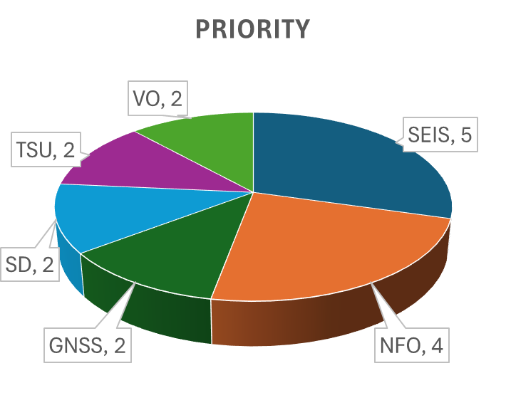
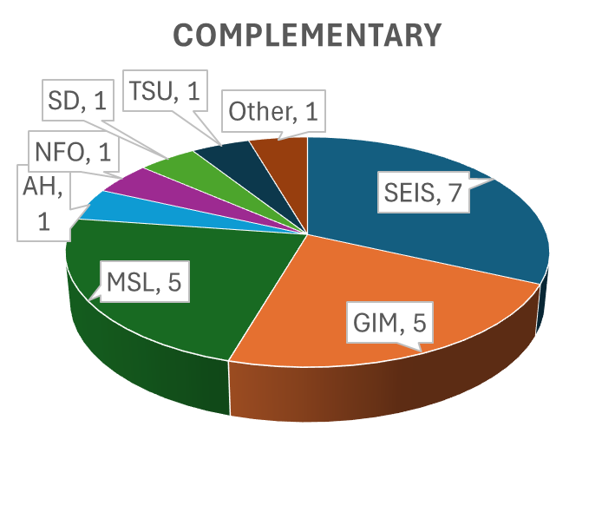
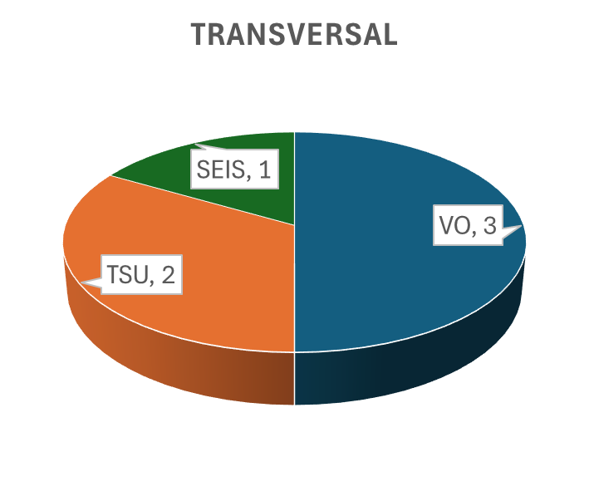
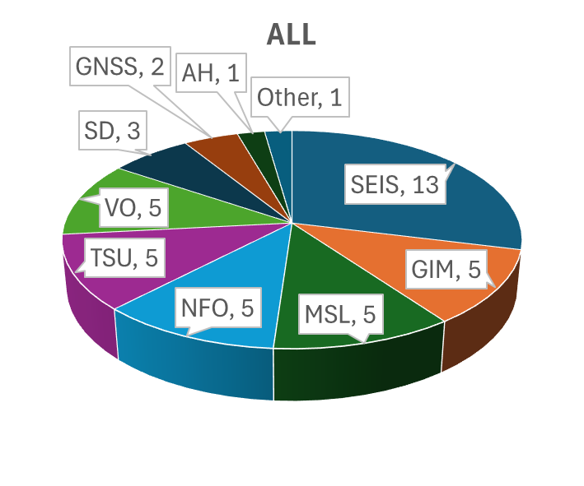
Executive Plan 2026
43 project proposals
17 Priority
22 Complementary
4 Transversal
Notes:
The high number of proposals testify the richness of the community engagement and at the same time the challenge in meeting everyone’s expectations. The larger number of complementary proposals demands for a more structured approach in the evaluation of proposals.

Slide 8
Partner | TCS
CNR-IGG | Multi-Scale Laboratories
CNR-IREA | Satellite Data
Eucentre | Seismology – EFEHR
INGV | Seismology – ORFEUS, Volcano Observations, GNSS Data and Products, Seismology – EMSC, Seismology – EFEHR, Satellite Data, Multi-Scale Laboratories, Anthropogenic Hazards, Tsunami, Controlled Source Seismic Data Community
ISPRA | Tsunami, Geological Information and Modeling
OGS | Seismology – ORFEUS, Near-Fault Observatories, GNSS Data and Products, Multi-Scale Laboratories
UniBO | GNSS Data and Products, Interferometria In-SAR, Tsunami
UniFE | Seismology – EFEHR
UniGE | Seismology – ORFEUS
UniNA | Near-Fault Observatories
UniPG | Near-Fault Observatories, Geological Information and Modeling
UniRomaTre | Multi-Scale Laboratories
UniTS | Seismology – ORFEUS, Multi-Scale Laboratories, Near-Fault Observatories
CINECA | Seismology – EFEHR, Seismology – EMSC, Seismology – ORFEUS, Tsunami
Notes:
Combination of specialized institutions and more versatile institutions.

Slide 9


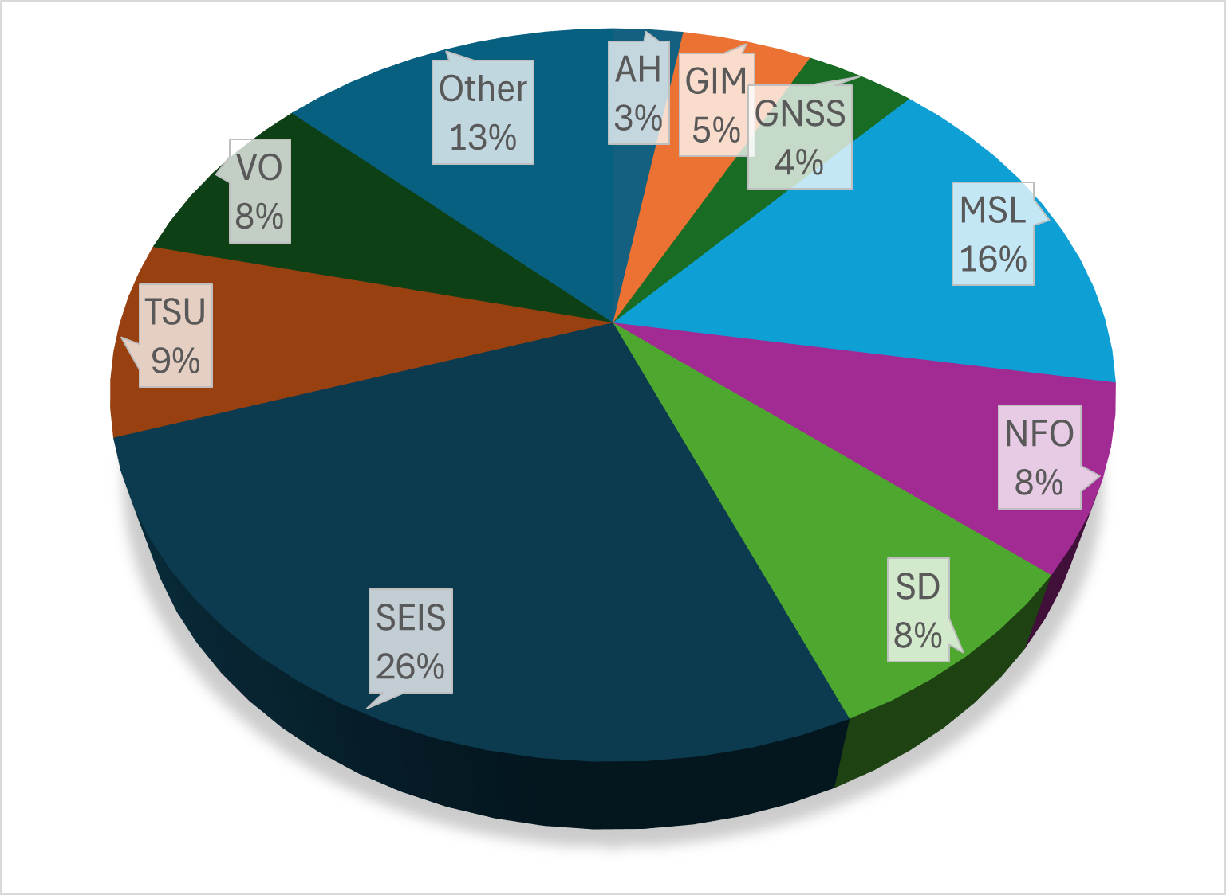








257 people, including scientists, technologists, and technicians, participate 2026
TCS | Partner
Seismology (All pillars) | INGV, OGS, Eucentre, UniGE, UniTS, UniFE, CINECA
Multi-Scale Laboratories | CNR-IGG, INGV, OGS, UniRomaTre, UniTS
Near-Fault Observatories | OGS, UniNA, UniPG, UniTS
Tsunami | INGV, ISPRA, UniBO, CINECA
GNSS Data and Products | INGV, OGS, UniBO
Satellite Data / In-SAR | CNR-IREA, INGV, UniBO
Geological Info & Modeling | ISPRA, UniPG
Volcano Observations | INGV
Anthropogenic Hazards | INGV

Slide 10
Latest Achievements
Over the years, the JRU EPOS-Italy supported various validated EPOS DDSS and several exploratory activities to develop new ones. Importantly, it supported:
the establishment of TCS Tsunami
the North-Eastern Italy Thrust Fault Observatory (NITRO NFO)
the CEGNxEPOS GLASS Node (GNSS Data and Products)
the Italian participation in the Krafla Magma Testbed initiative

Slide 11
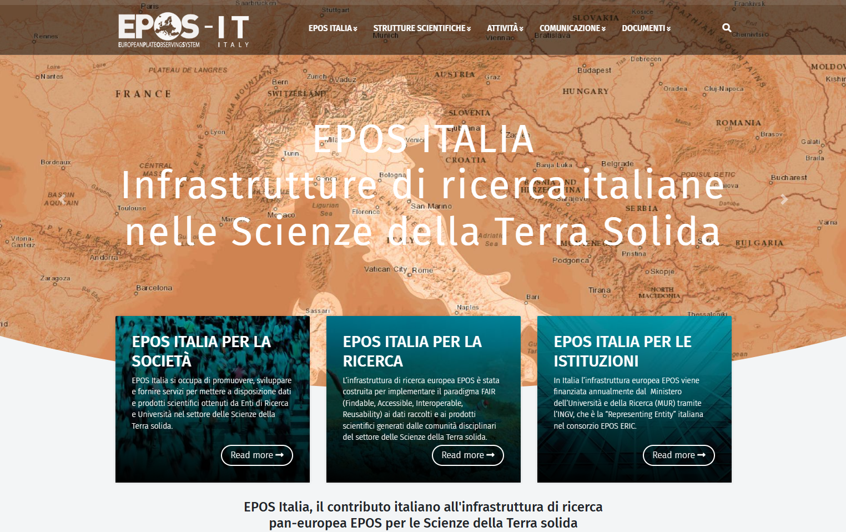
https://www.epos-italia.it/

Slide 12
Thank you!

