Slide 1
National “Implementations” NFDI4Earth
W. zu Castell, L. Bernard, J. Seegert, V. Protopopova-Kakar, K. Elger
for the NFDI Consortium Earth System Sciences
EPOS Days 2026, 16-20 March 2026, Cagliari

Slide 2
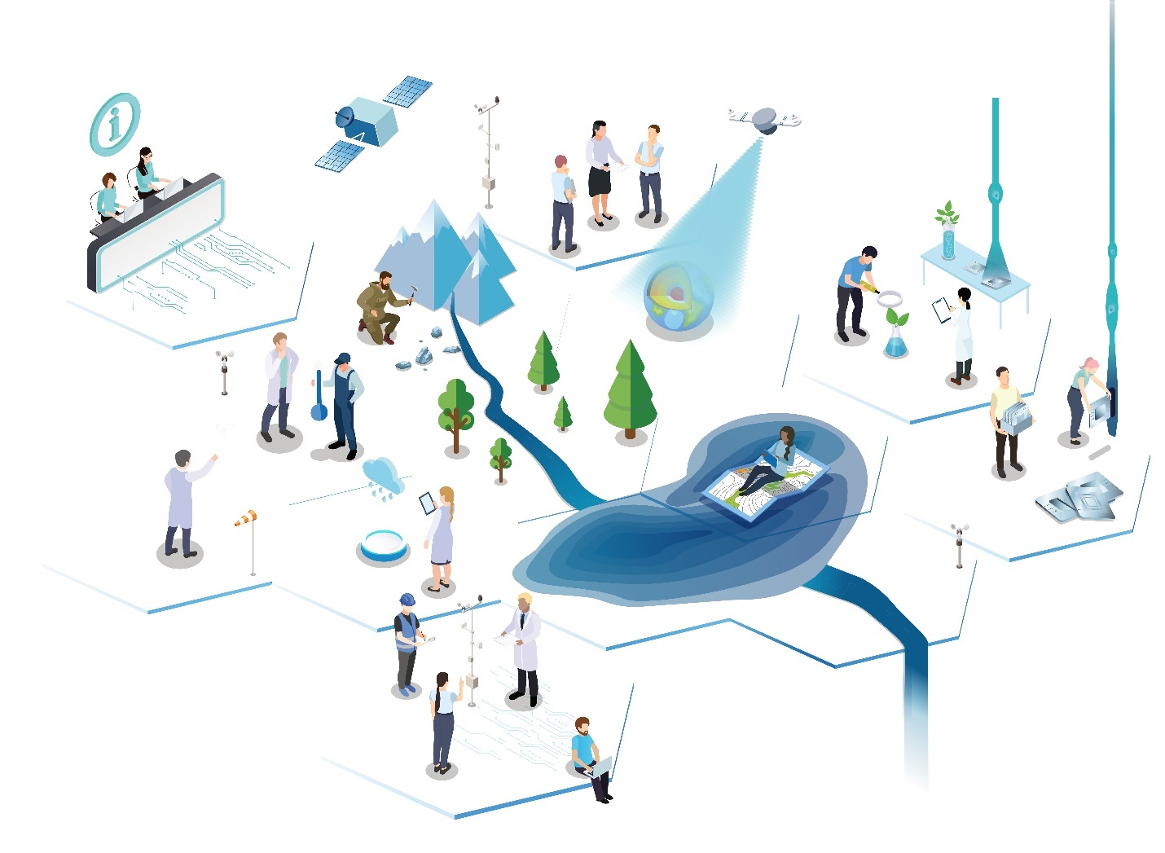
Earth System Sciences (ESS)
Geosphere, Atmosphere, Biosphere, Hydrosphere,
Cryosphere, Anthroposphere and all their interactions
From Local Processes to Global Challenges
Earth systems dynamics, natural hazards,
climate change, environmental pollution,
land use change, scarcity of resources …
Observing, measuring, modelling,
analyzing, predicting the Earth System
In international and interdisciplinary
settings using spatio-temporal
data as the common reference

Slide 3

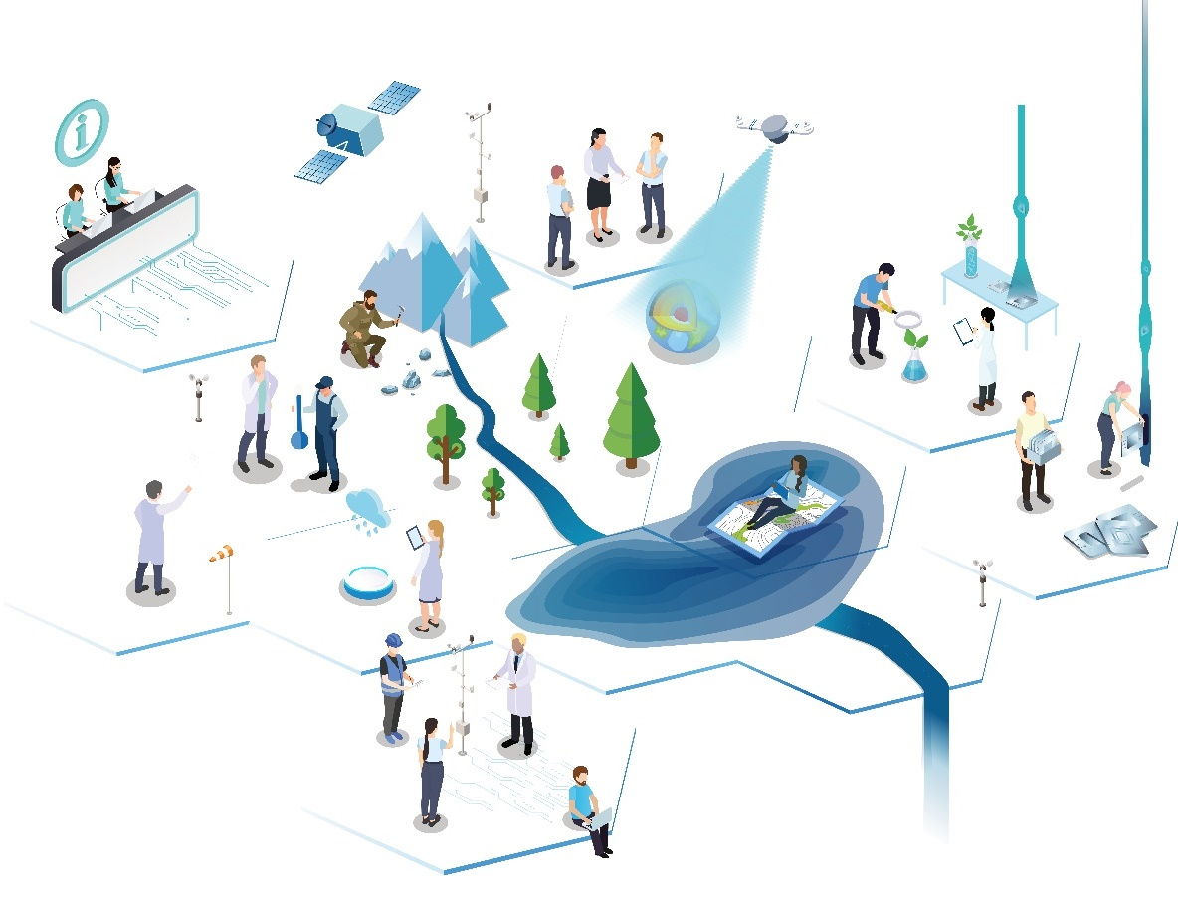
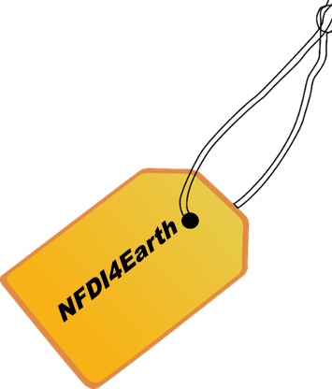
NFDI4Earth Key Goals
One Community for Open and FAIR
Research Data Management (RDM) in
Earth System Sciences (ESS)
Community driven agile development
of data integration and analysis platforms
to enable new levels of synthesis
OneStop4All and User Support Network for ESS RDM
Qualification for people, data, tools and services
as a basis for cultural change, service consolidation and reliability
Driving force to build the National Research Data Infrastructure (NFDI)

Slide 4
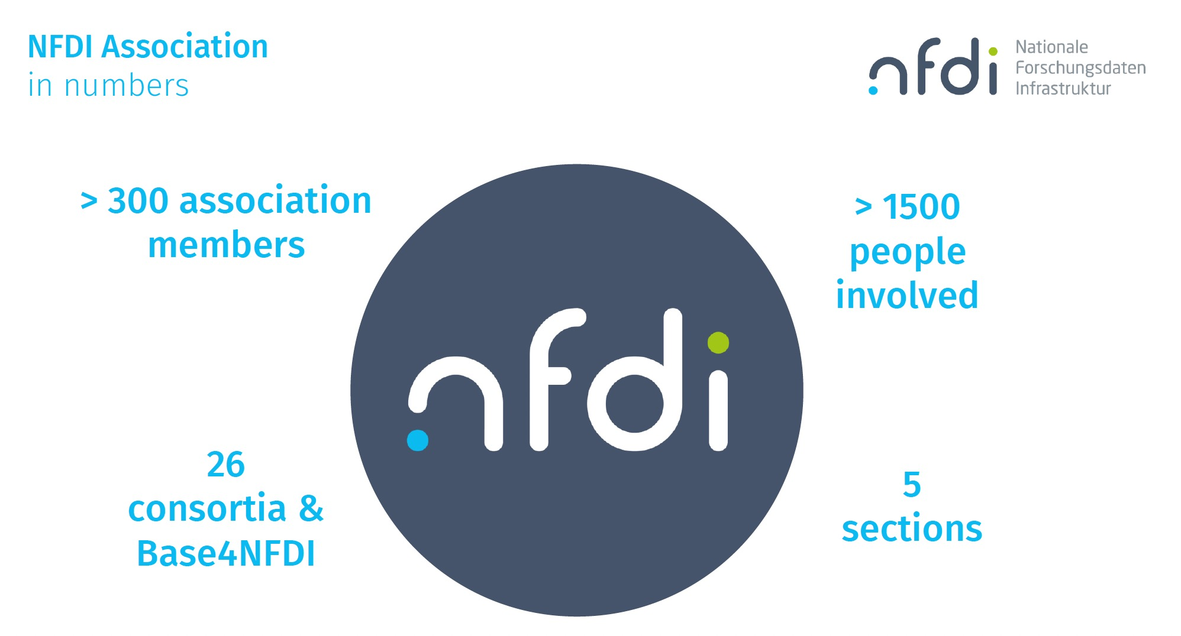
German National Research Data Infrastructure

Slide 5
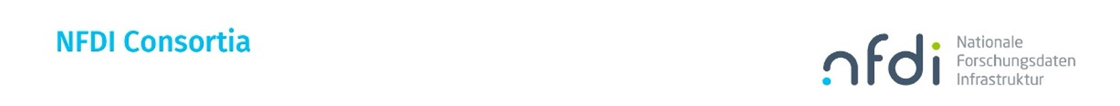
Think of the national analog of TCS

Slide 6

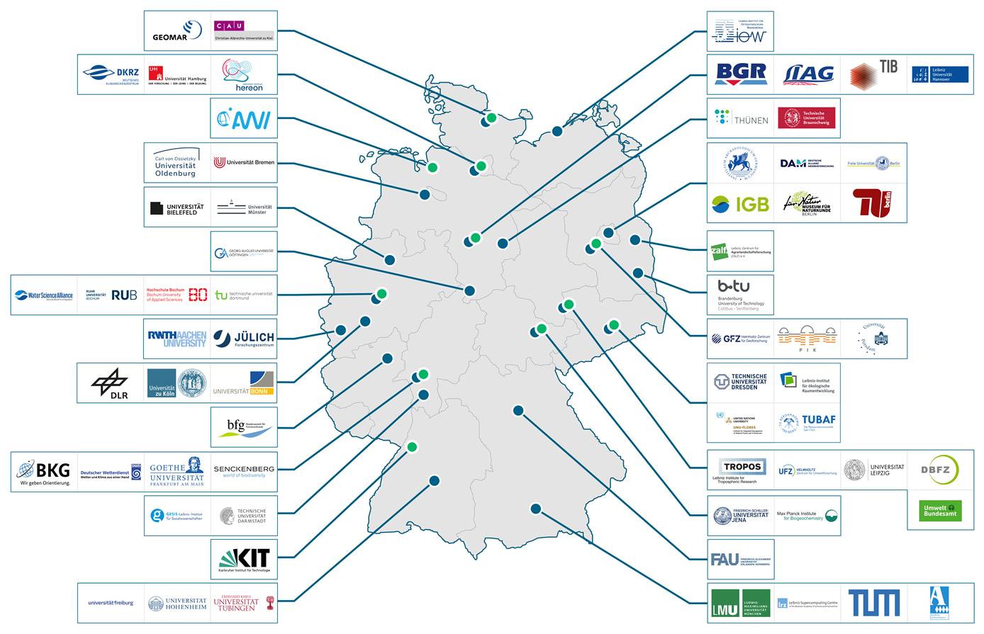
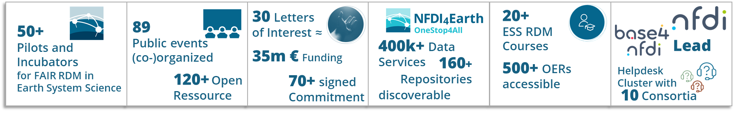
The NFDI4Earth Consortium in 2025
Increased to 65 partners and
covers the breadth of
German Earth System Sciences
Integrates key users,
infrastructure providers
and public administration
Is a key driver within the NFDI
Established an international network – with a European Focus

Slide 7
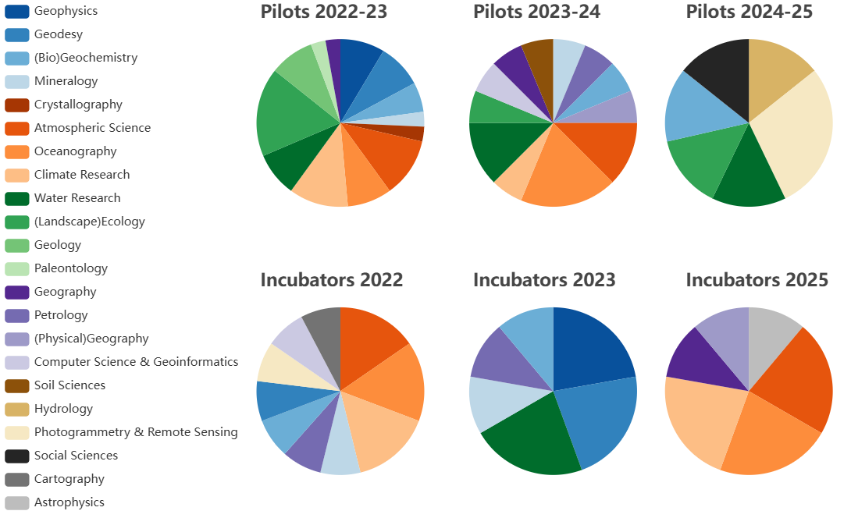
Community Engagement by Pilots & Incubators
Year long projects
Subject Areas
Shorter proof of concepts

Slide 8
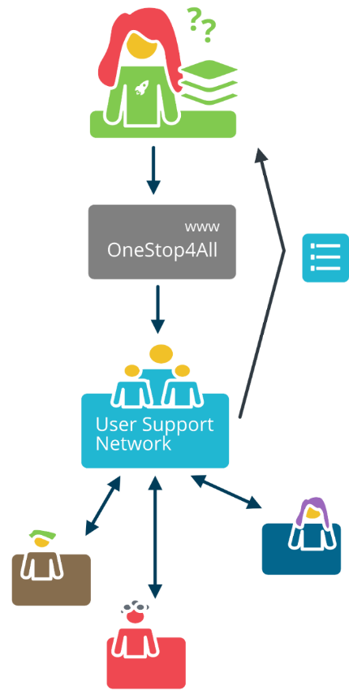
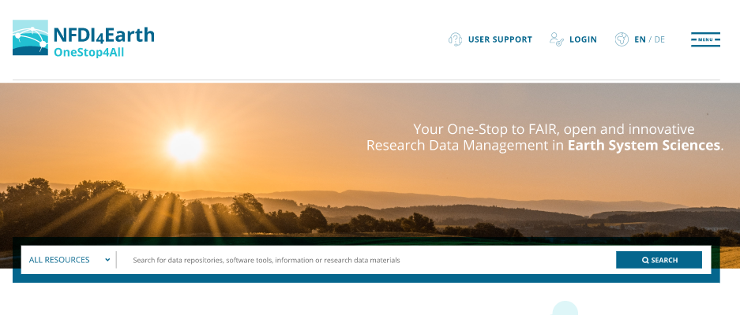
Core Services developed by the Consortium
Knowledge Hub the information backbone offers metadata for broad range of resources including datasets, learning resources, repositories, people, organizations, standards, and research software (since 2023)
User Support Network offers first and second level-support to researchers,
linking and enhancing existing, federated support structures (since 2023)
EduTrain Portal offers courses for ESS-RDM micro-curricula;
getting tested in the NFDI4Earth academy (since 2023)
OneStop4All offers unified exploring
all NFDI4Earth resources (since 2024)

Slide 9
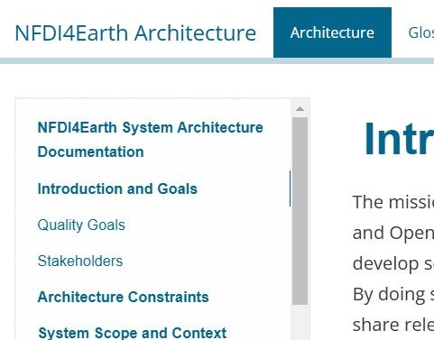
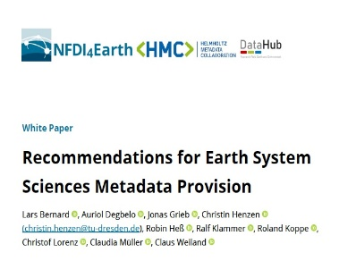
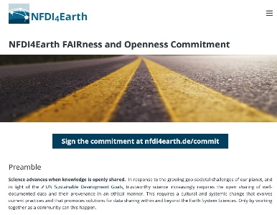
Promoting the ESS FAIRness Culture
Building
  on existing offerings of NFDI4Earth partners (as E&E DataHub)
  widely adopted community standards
  (as Open Geospatial Consortium)
  and other well accepted services
  (as re3data)
Providing Recommendation Papers on best
practices for RDM in Earth System Sciences
Driving cultural change with
  NFDI4Earth Synthesis Architecture
  NFDI4Earth Label
  NFDI4Earth Openness Commitment
Technology
Harmonization
Culture

Slide 10
Specific Aims 2026-31 towards sustainable operation
Increase community usage, co-development and co-ownership
of the NFDI4Earth Service Portfolio
Consolidate training offers in Earth System Data Science and RDM
Consolidate the NFDI4Earth Service Portfolio
Co-build a sustained OneNFDI, progress basic services and commons
Foster Internationalisation and engagement in the EOSC
Support AI in ESS and leverage of GenAI, FM, LLM in the NFDI4Earth Service Portfolio

Slide 11
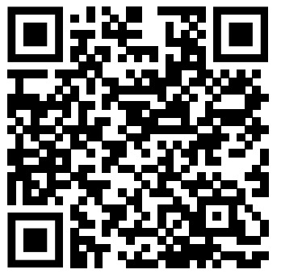
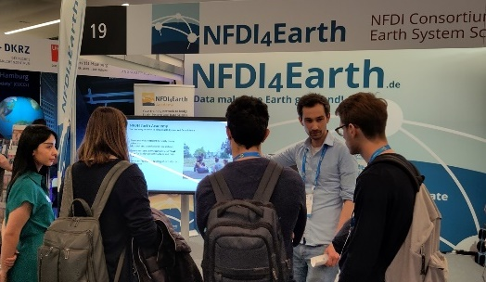








International Networking – current highlights
Tied into the European Geosciences Union (EGU)
MoU with the United Nations University
Sustainability Nexus Analytics, Informatics, and Data Programme
Hosted AGILE Conference 2025
Engaged in Open Geospatial Consortium
and Research Data Alliance
Active in building the European Open Science Cloud,
ESS-related International/European Research
Infrastructures and Initiatives

Slide 12


Data hub vs data warehouse/data lake
Hubs connect what has been there before
Hubs allow to dwell deeper (if needed)
Hubs typically lead to short pathes
(„small world effect“)
Hubs provide obvious entry points
Hubs also need harmonization and standardization
freepik.com

Slide 13
















Embedding into the (inter-)national ecosystem
DataHub is the joint research data
management of the Helmholtz Research Field Earth&Environment
All DataHub partners are enabler and
members of
DataHub provides a bridge to national
agencies
All partners contribute to the implementation of EOSC

Slide 14
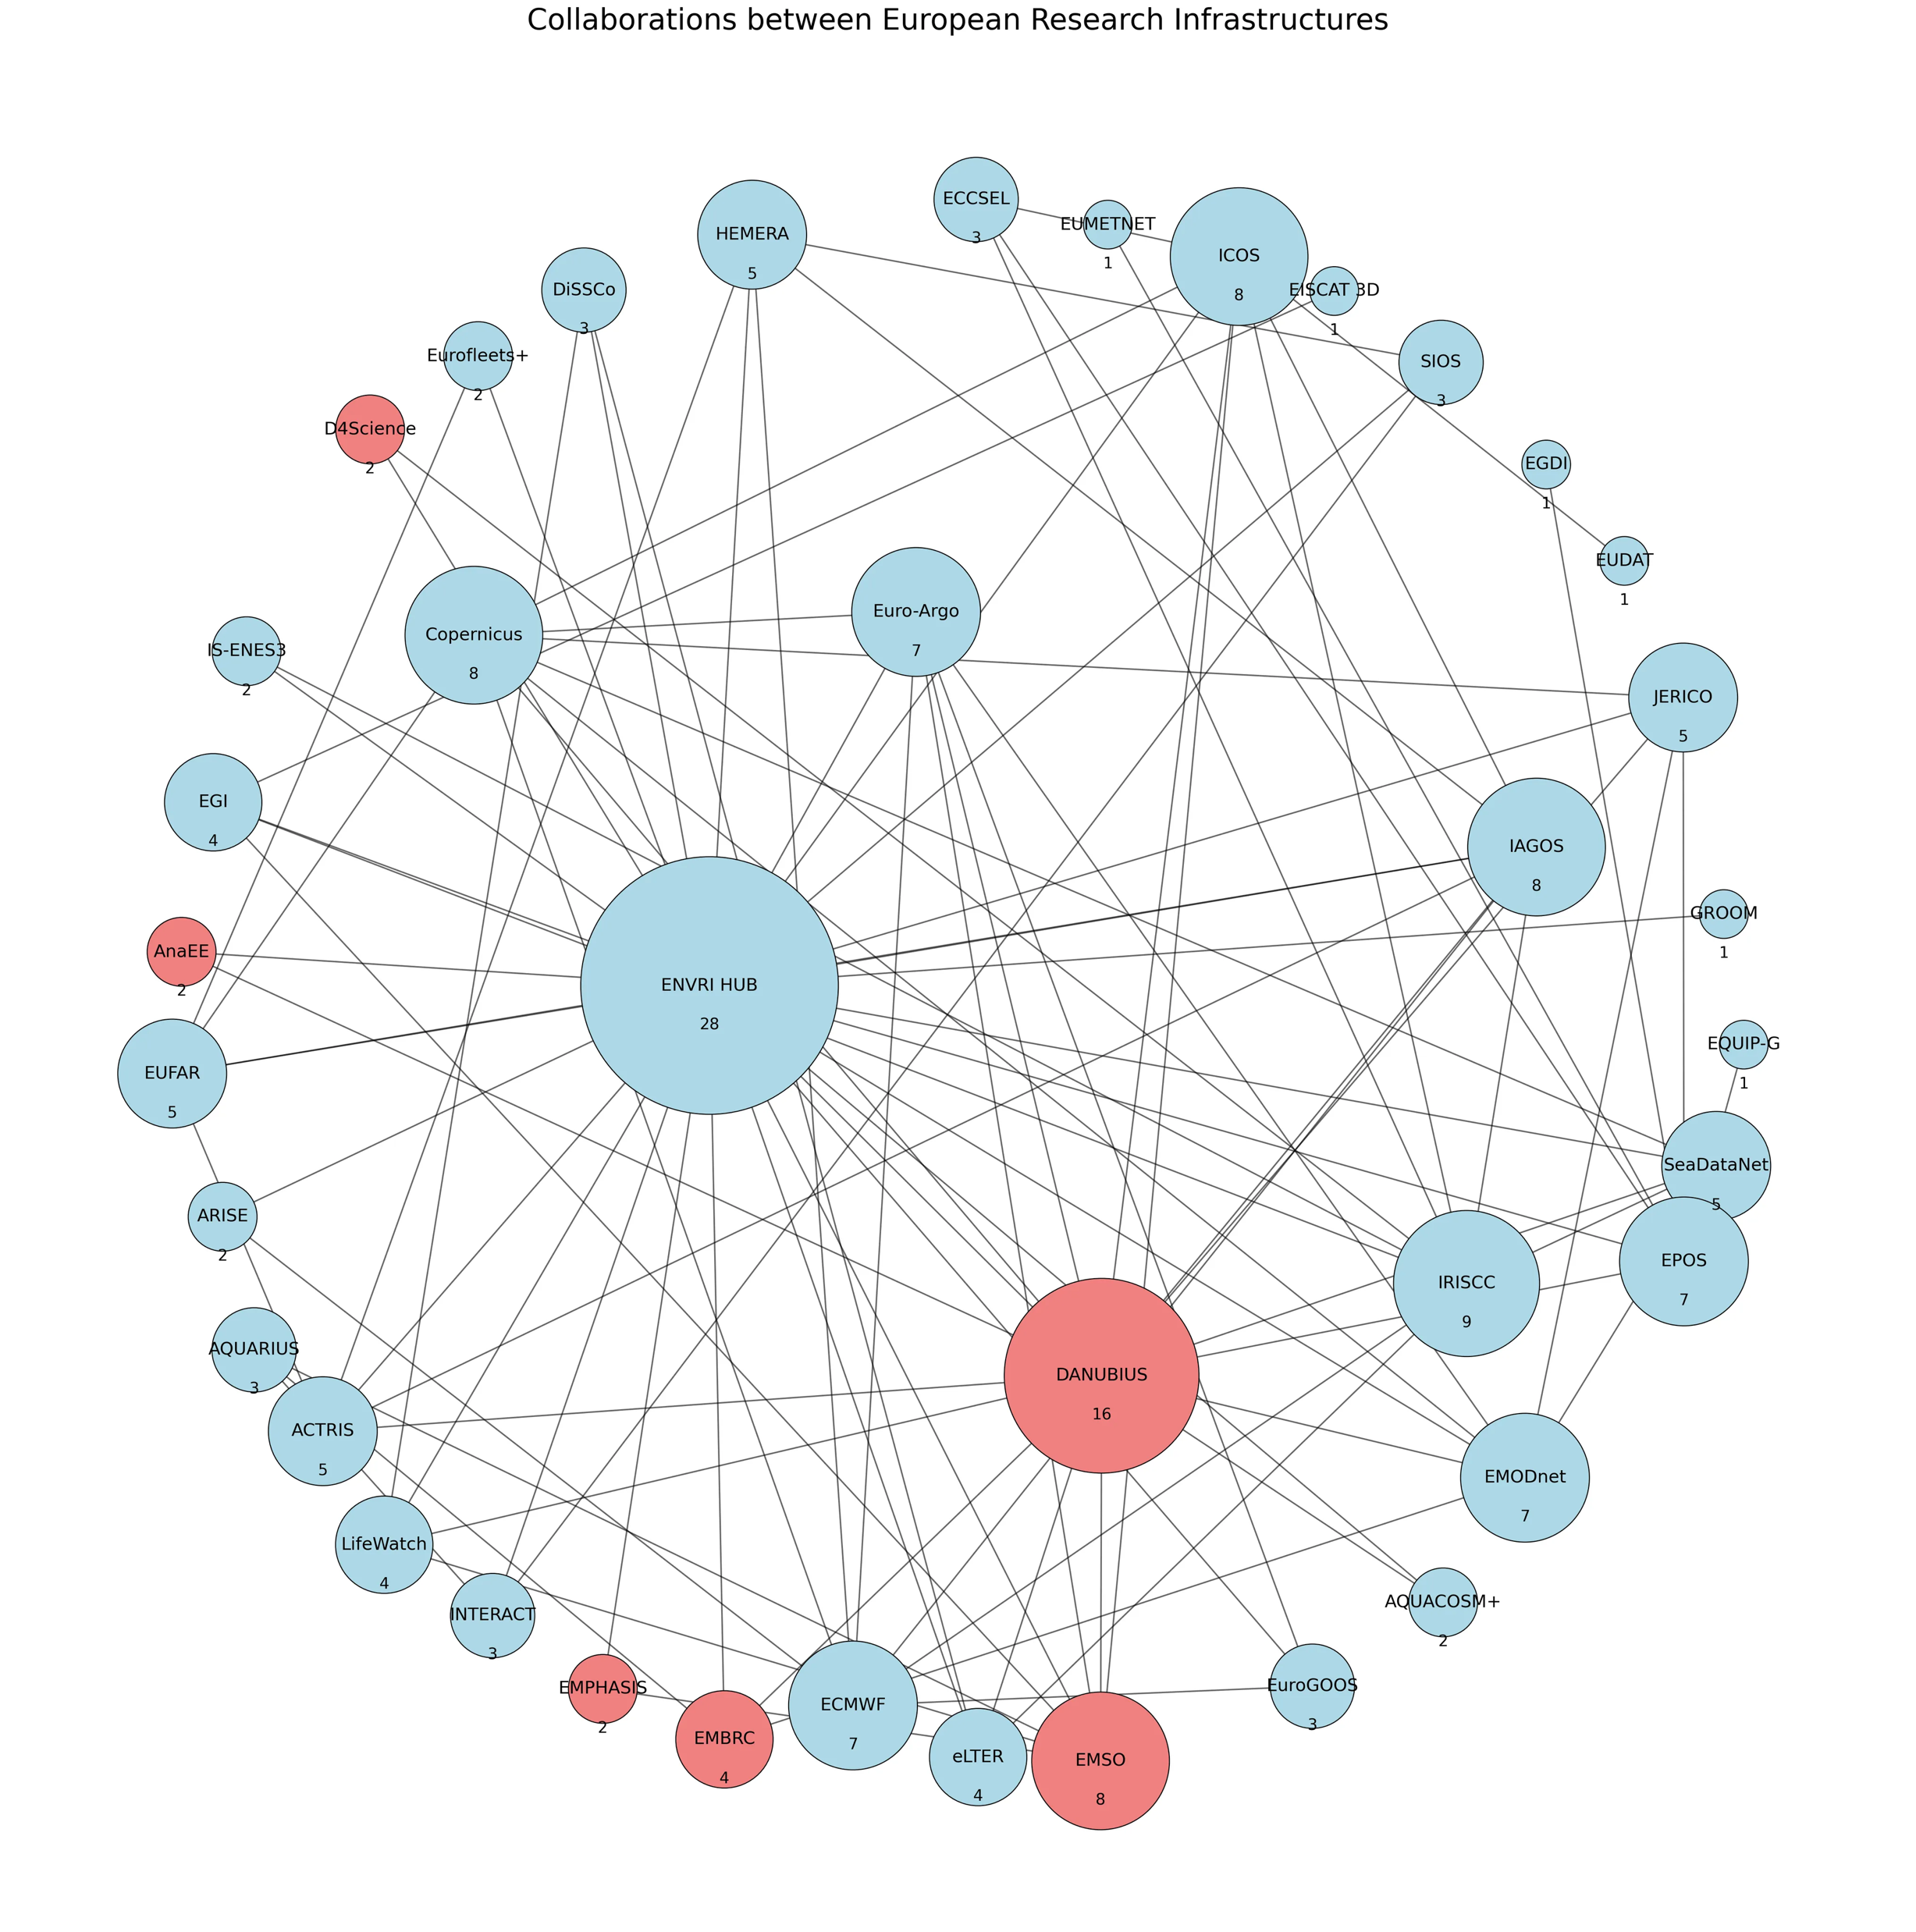




Is it really that easy?
… it should!
freepik.com
recall the hub concept
let‘s cooperate instead of compete!

Slide 15

© NASA 2002

Slide 16
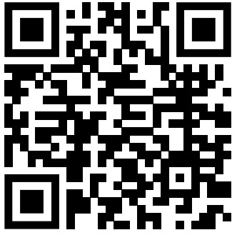
Wolfgang zu Castell wolfgang.castell@gfz.de
Meet us at EGU 2026
Townhall

