Slide 1

Placing users at the core of the EPOS Platform:
Insights from the User Feedback Group (UFG)
Emma Baïz, George Donoso, Federica Tanlongo, Karl Stuebe

Slide 2
Context: the User Feedback Group (UFG)
UFG re-established (21 members)
Balanced mix of senior researchers and early-career scientists
Broad disciplinary coverage: all TCS represented
SCC involved through nominations from the TCS
User representation with the election of the:
  UFG Chair: George Donoso
  UFG Deputy Chair: Hany El Sayed

Slide 3
Who are the 21 members of the UFG?
UFG User Profiles | Members
Scientific user (cross-disciplinary scientist, domain scientist) | 15
Early career scientist or student (below 35 years) | 9
Teacher/lecturer | 3
IT Expert | 2
Industry representative | 1

Slide 4
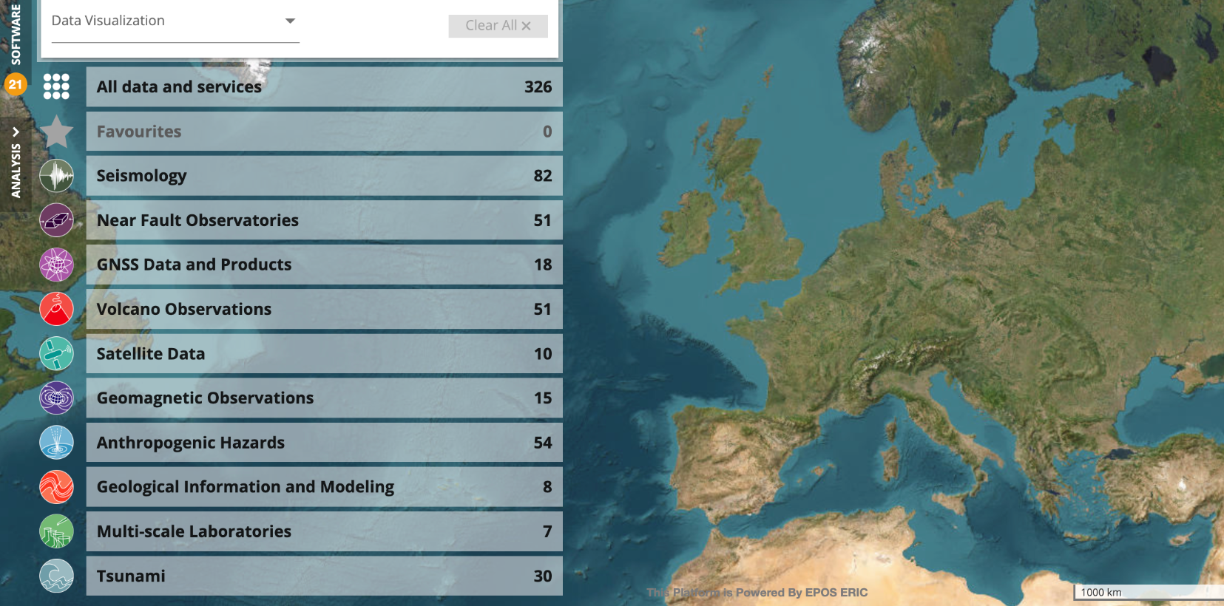

ICS representation & Geographical distribution of the UFG members
Finland
Sweden
Gravimetry
1
3
2
3
2
2
4
2
3
3
2
Denmark
Netherlands
Germany
Luxembourg
France
Switzerland
Romania
Italy
Bulgaria
Spain
Greece

Slide 5
What we implemented
Kick-off meeting (Nov 2025)
Background survey
Training session (Dec 2025)
Usability testing campaign (Dec 2025 to March 2026)
survey → training → testing → feedback

Slide 6
Focus on the usability testing campaign
Placing users at the core of the platform development strategy

Slide 7
Methodology
The usability testing campaign followed the EPOS UFG testing framework, aiming to identify usability issues related to:
Navigation and filtering
Task clarity and workflow completion
Information architecture and findability
Interaction patterns and interface behavior
Terminology and user expectations

Slide 8
Approach
We conducted 17 one-to-one usability interviews
Think-aloud protocol
Observation of behaviors, hesitation, and emotional cues
Task-based testing (~30’ per session)
Qualitative + quantitative feedback (~15’per session)

Slide 9
Objective of the interviews
We wanted to understand:
First-time user experience VS users already acquainted with the platform
Ease of navigation and discovery
Data access and visualization usability
Overall trust and perceived value
👉 Important: We evaluated the platform — not the users

Slide 10
User Groups
Two distinct user groups were tested:
1st round of interviews – Non-expert users (5 participants)
First-time users, no prior exposure to the platform
2nd round of interviews – UFG members (12 participants)
More experienced users, some familiar with EPOS concepts and workflows

Slide 11
Tasks performed
Participants were asked to complete three representative tasks:
Visualize seismogenic faults in Sicily and download associated data
Explore GNSS time series data for Etna volcano
Explore geoscientific data in the Arctic region

Slide 12
George’s experience within EPOS
Postdoc research experience within the TCS Geomagnetic Observations and TCS Anthropogenic Hazards (Sweden EPOS, 2023-2024)
Communication and divulgation within the Balkan Geophysical Society
(Training sessions together with Harald and Jan)
Participation the Controlled Source Seismic community (since 2024), developing a data model and web service for EPOS

Slide 13
George’s user experience during the usability interview
Tried to approach the interview process as a “novel user”
Tasks for finding/exporting particular datasets became more guessing process
Visualization options, such as change to polar coordinates, are straight forward
Expected more of a map-based experience
Interesting to try and make the bridge between data (metadata) cataloguing to final user experience

Slide 14
Overall User Experience (High-Level)
General perception:
Platform seen as valuable and rich in data
Users motivated to use it again
BUT experience is inconsistent and sometimes frustrating
💬 “I would like to use the system frequently… but there are usability challenges”

Slide 15
Things you need to know before we move to the results…
We asked people to be super-honest and told them that the harsher the better for the future usability of the EPOS Platform
Results of usability tests are qualitative and subjective
They have to do with how people perceive the reality and how it interacts with it so they are not universally valid but they are valid for the person experiencing them
  They are useful to understand other users’ needs and expectations and so they can help us in improving the UX
Here we will only show trends/aggregate information but in the interviews we actually collected specific information on real tasks, that can be transformed into actionable items

Slide 16
Key Weaknesses 🔴
#1: Data Visualisation Issues
Datasets not properly visualized on map
Some data only available as static images
Mismatch between expectation vs reality
👉 Impact:
It might create confusion
Potential loss of trust
💬 “It says visible on the map, but I don’t see anything”

Slide 17
Key Weaknesses 🔴
#2: Backend Instability
Frequent service errors / failures
Incomplete or unavailable datasets
Dependency on external providers
👉 Impact:
Breaks user flow
Undermines platform credibility
💬 “Backend keeps failing… I cannot gauge whether the data is there or not”

Slide 18
Key Weaknesses 🔴
#3: Search & Filtering Complexity
Filters reset unexpectedly
Search behavior not intuitive
Difficult to refine results progressively
👉 Impact:
It might lead to frustration
Increased task time
💬 “Applying a timeline resets the search… I have to start again”

Slide 19
Key Weaknesses 🔴
#4: Discoverability & Navigation
Key features not visible:
  Map selection tools
  Metadata access
Two search systems create confusion
👉 Impact:
Users rely on trial-and-error
Requires prior knowledge
💬 Need for onboarding/tutorial repeatedly highlighted

Slide 20
Key Weaknesses 🔴
#5: Data Access & Metadata
License/citation hard to find for some users
Metadata hidden behind icons
Sometimes triggers downloads instead of viewing
👉 Impact:
Reduced usability
Legal/academic uncertainty

Slide 21
Key Weaknesses 🔴
#6. Cognitive Load for New Users
Platform requires:
  Domain knowledge
  Understanding of data structure
Not fully intuitive for non-experts
👉 Users:
Feel moderately confident
But experience complexity

Slide 22
Key Strengths 🟢
#1: High Perceived Value
Rich, high-quality scientific data
Unique integration of multiple data sources
💬 “Beautiful and rich platform from the data side”

Slide 23
Key Strengths 🟢
#2: Stronger User Interest
Users want to use the platform
High willingness to return
👉 Even with issues:
Motivation remains high
💬 “I would like to use this system frequently”

Slide 24
Key Strengths 🟢
#3: Core UX is Promising
Interface generally:
  Understandable
  Learnable over time
No need for constant technical support (for some users)
👉 Indicates good foundation

Slide 25
Key Strengths 🟢
#4: Task Completion is Possible
Users complete most tasks even when struggling
👉 Shows:
System is functional, but not always efficient

Slide 26
Key Strengths 🟢
#5: Visualisation Potential
When working:
  Graphs and data views are appreciated
Strong analytical capabilities
👉 Problem is not concept → but execution

Slide 27
Synthesis 🧠 - Key insight
The platform is powerful but not fully/easily accessible to a first-time user
High value
High complexity
Low guidance
👉 Gap between:
“What the platform can do” vs “What users can actually do”

Slide 28
SWOT Analysis 📊
STRENGHTS | WEAKNESSES
High-quality scientific data • Wide integration of datasets • Strong potential for frequent use • Advanced analytical capabilities | Backend instability • Poor UX consistency (filters, search) • Limited data usability (images vs data) • Low feature discoverability
OPPORTUNITIES | THREATS
Improve onboarding/tutorials • Enhance visualization & interactivity • Optimize search and filtering logic • Strengthen provider integrations | Loss of user trust due to instability • High complexity deterring new users • Competition from simpler tools • Incomplete datasets reducing adoption

Slide 29
What now?
Full report including both quantitative and qualitative information, to be presented to the SCC for validation and goal prioritisation;
Specific issues reported will be integrated in the ICS-TCS regular flow for appropriate action;
The UFG will be involved in focus groups addressing specific topics or use cases
A complementary activity of analysis of the platform through heuristics is planned

Slide 30
Thank you!

