Slide 1

How FAIR are we?
The EPOS FAIR Assessment
Kety Giuliacci

Slide 2
EPOS FAIR Assessment (EFA)
EPOS FAIR Assessment is a tool developed within the EPOS RI to evaluate the quality and FAIRness of metadata provided by the Thematic Core Services (TCS), which describe data services.
  Supports data and service providers in checking compliance with the FAIR principles (Findable, Accessible, Interoperable, Reusable).
  Provides clear and actionable guidance to improve metadata quality and usability.
The methodology is built on a structured set of indicators inspired by international standards such as the RDA Data Maturity Model, GO FAIR, and the Metadata Quality Assessment (MQA) by data.europa.eu.

Slide 3
A Layered Approach for Accessing Data
through the EPOS Platform
FAIR Assessment
ICS Metadata Access
Digital Objects Access (TCS)
It represents ICS web services that provide access to metadata collected in EPOS-DCAT-AP and stored in a centralized metadata catalog.
It represents TCS web services that provide access to digital objects.
Digital Objects
ICS Metadata Description
It represents digital objects provided by data providers. They should be described by metadata and referenced by a persistent identifiers.
It represents a common knowledge representation language, namely EPOS-DCAT-AP, which is used to describe digital objects and how to access them via web services.

Slide 4
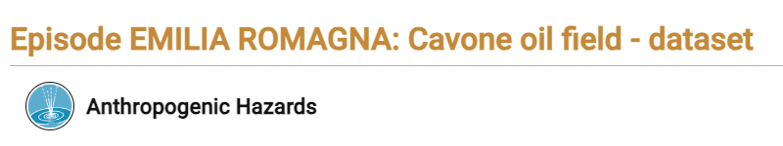
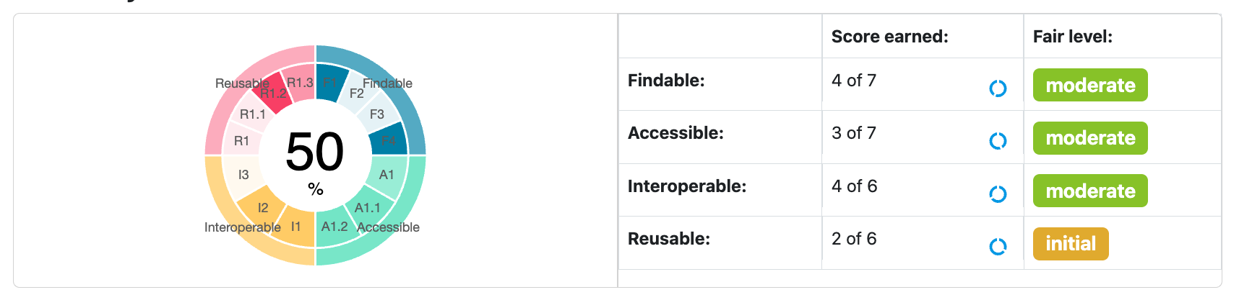
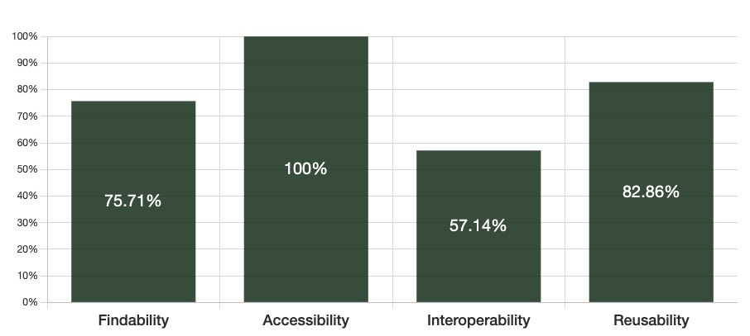
Different FAIRness Assessments Approach
EPOS FAIR Assessment
F-UJI FAIR Assessment
DOI: 10.25171/InstGeoph_PAS_ISEPOS-2019-004
Assessment Input: href (EPOS Platform API)
Metadata Schema Assessed: EPOS-DCAT-AP
Assessment Input: DOI
Metadata Schema Assessed: CROSSREF
Notes:
F-UJI Metric Version: 0.8

Slide 5
EFA Indicators
EFA is based on a structured set of indicators.
Each indicator evaluates specific aspects of metadata quality, such as presence, completeness, and semantic consistency of fields defined in the EPOS-DCAT-AP profile.
Indicators are composed of one or more checks (sub-criteria), each weighted by relevance: Essential, Important, or Useful. These weights reflect the criticality of information, aligned with external best practices and EPOS priorities.
The overall FAIR score is calculated by summing the successful checks.
Results are accessible through dedicated APIs and foster transparency, accountability, and continuous improvement in metadata quality across the EPOS community.

Slide 6
How to Access EFA from the EPOS Platform

Slide 7
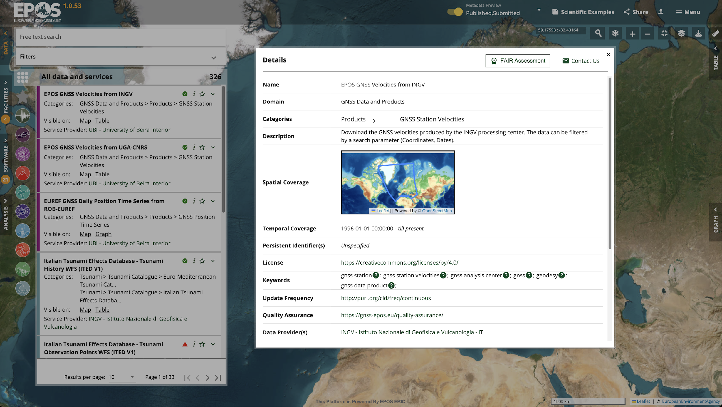

Access EFA through the EPOS Platform (1/2)

Slide 8
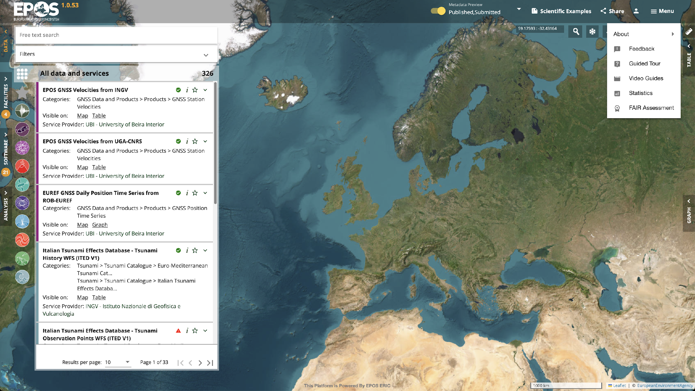
Access EFA through the EPOS Platform (2/2)

Slide 9
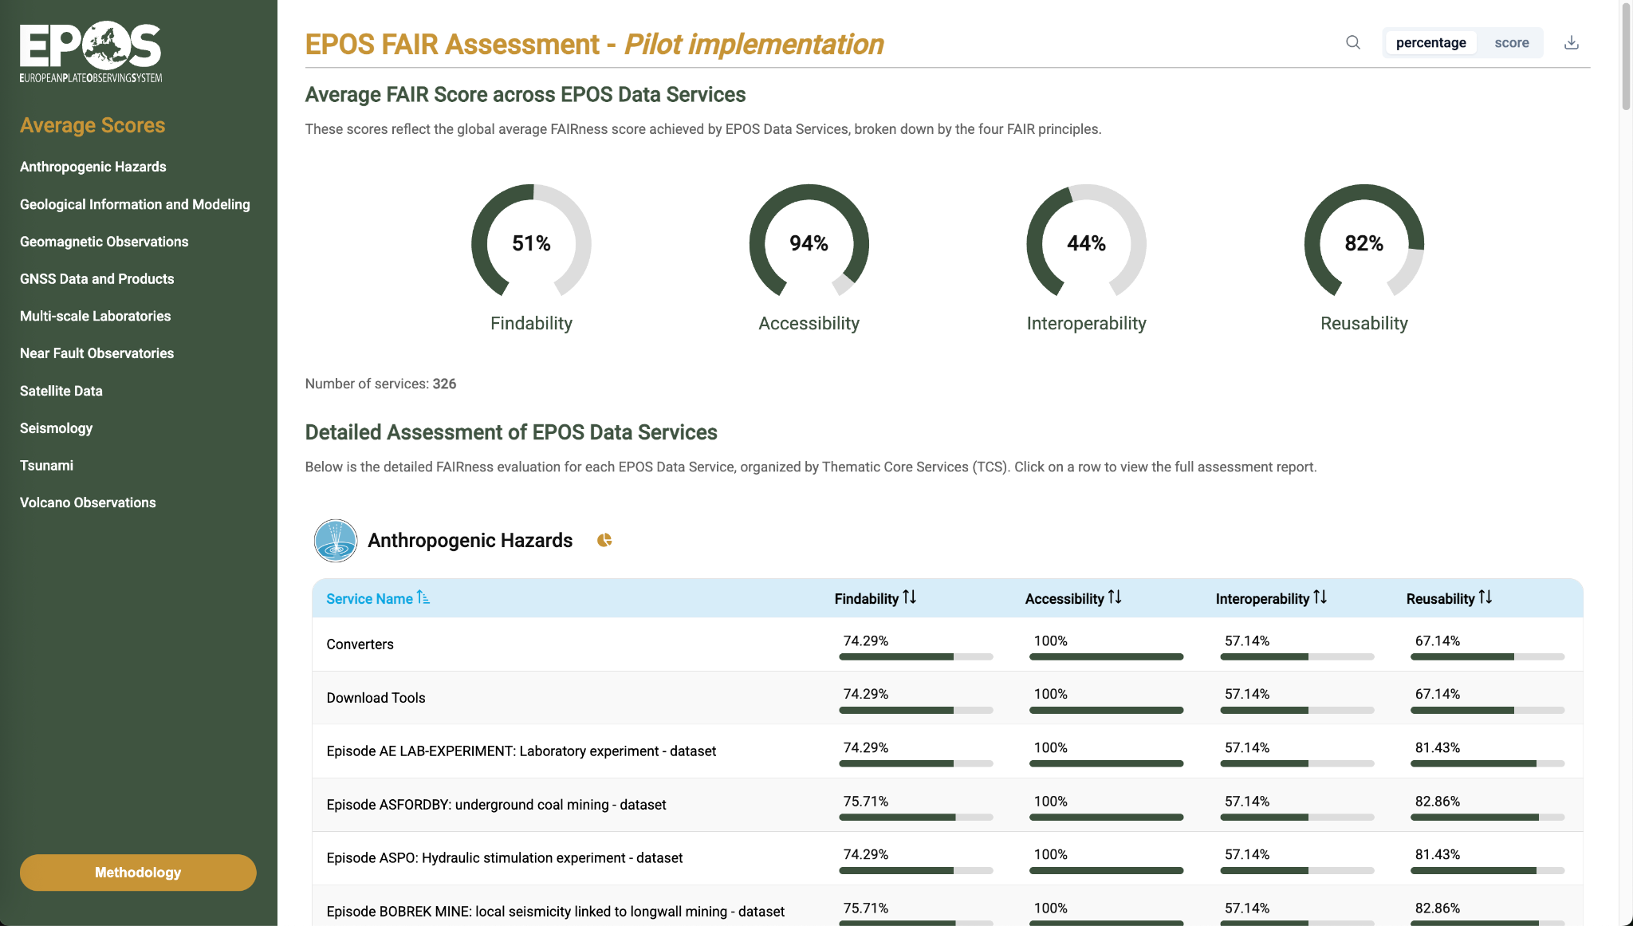
EFA - Homepage (1/2)

Slide 10
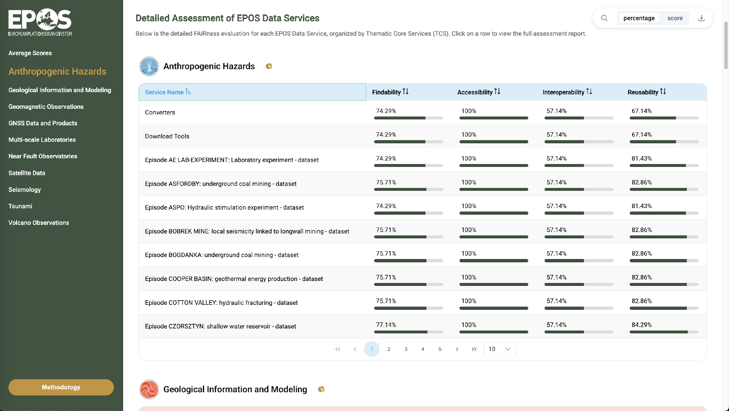
EFA - Homepage (2/2)

Slide 11
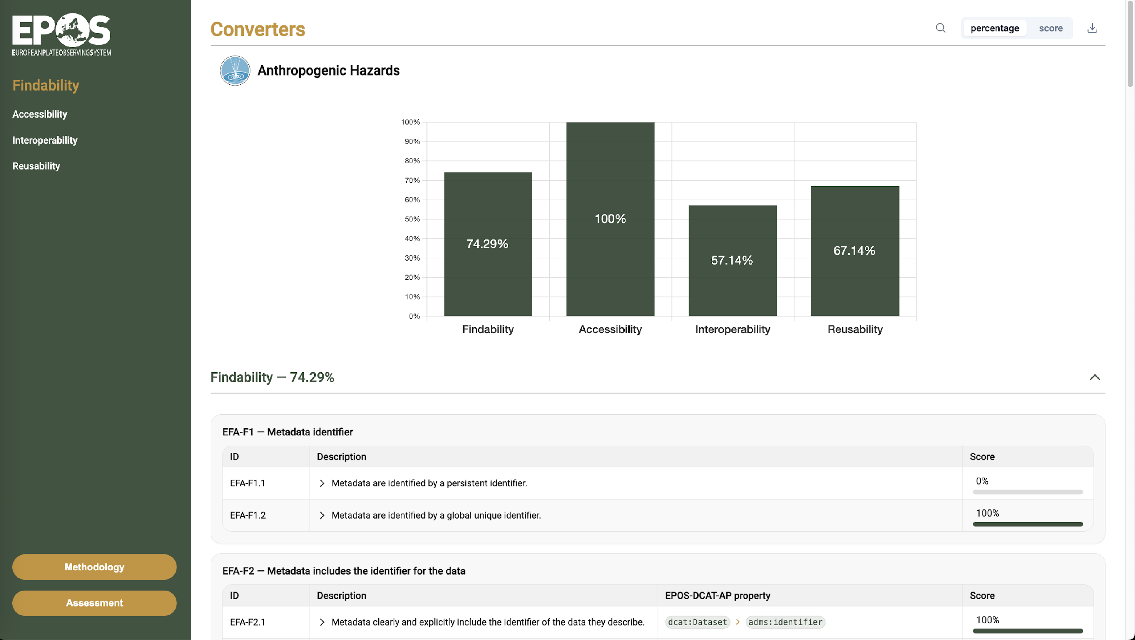
EFA – Detailed assessment (1/2)

Slide 12
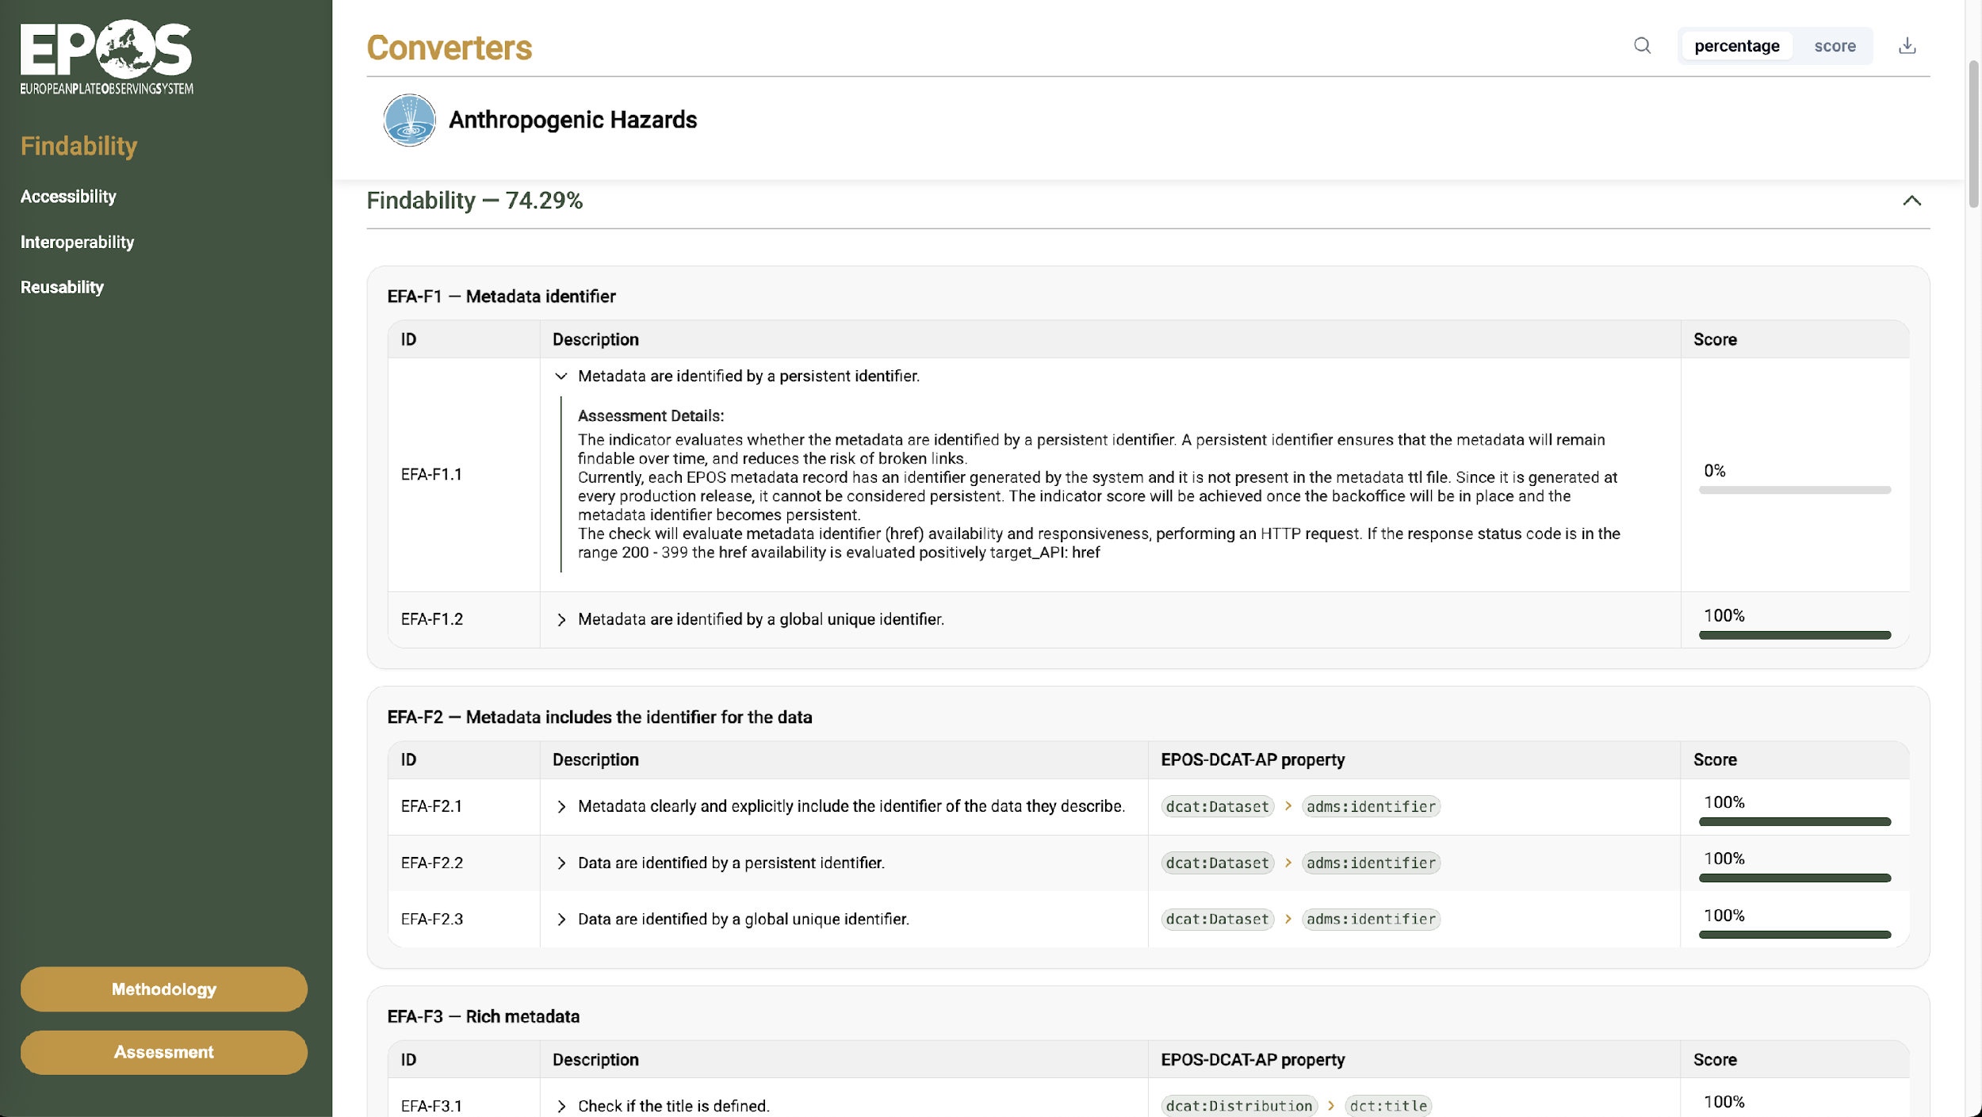
EFA – Detailed assessment (2/2)

Slide 13
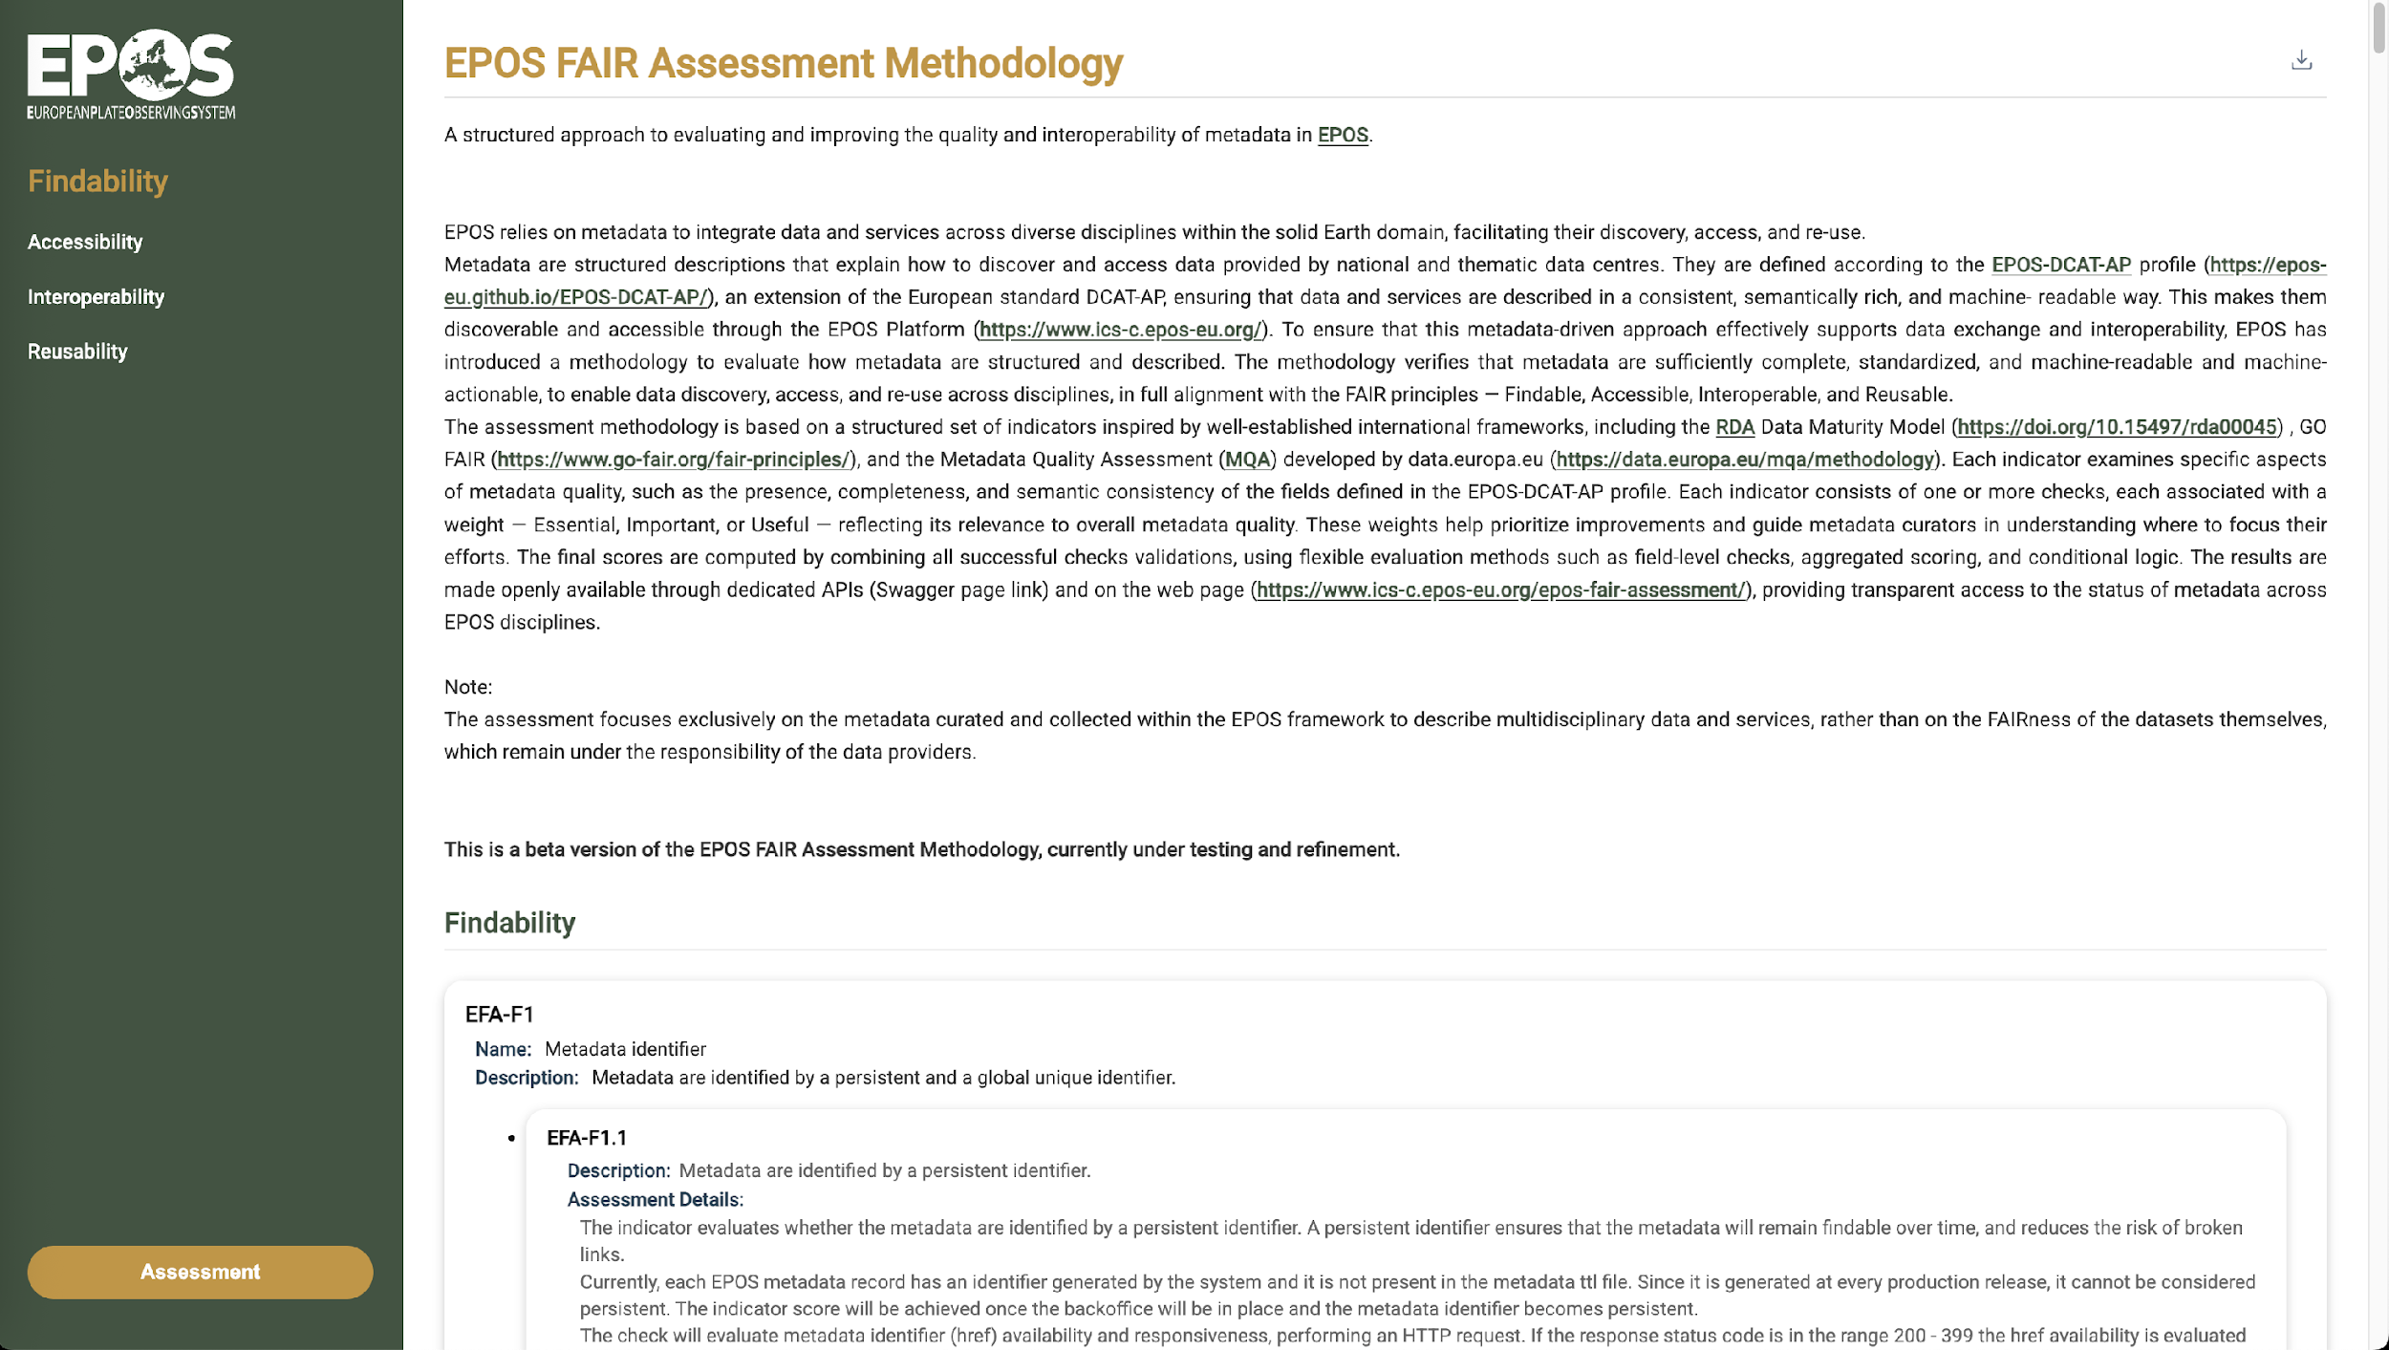
EFA – Methodology (1/2)
!!!

Slide 14
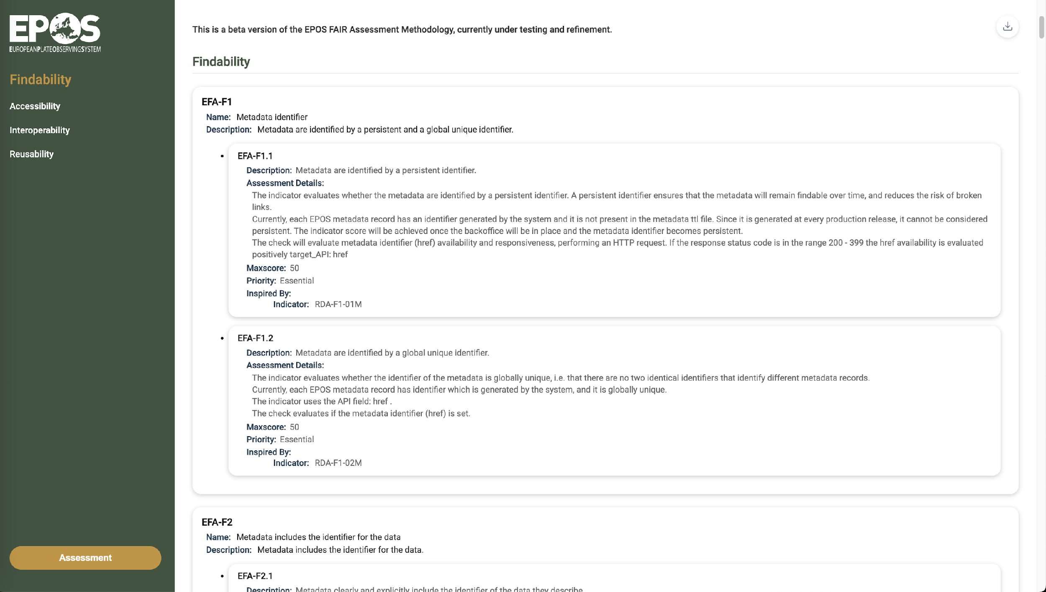
EFA – Methodology (2/2)

Slide 15
How can we be more FAIR?
Data providers assign a DOI to datasets: currently less then 40% of Datasets has a DOI
Data providers enrich metadata with provenance information to improve transparency, traceability, and reusability
EPOS ICS standardize the format of the metadata available via API

Slide 16
EFA - URLs
Homepage:
https://www.ics-c.epos-eu.org/epos-fair-assessment/search
Methodology:
https://www.ics-c.epos-eu.org/epos-fair-assessment/methodology

Slide 17
Thank you!

