Slide 1

EPOS Open Source in Practice
Marco Salvi | marco.salvi@ingv.it

Slide 2

What you just saw is open source
The interface, recent features, and new section are built from EPOS open source components.
The scientific use case shown before runs on the same publicly available foundation.
That foundation can be deployed and adapted outside EPOS; Other organizations already use it to expose their data.

Slide 3
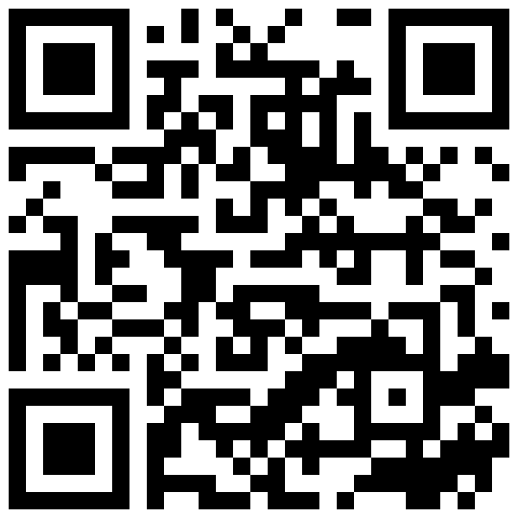
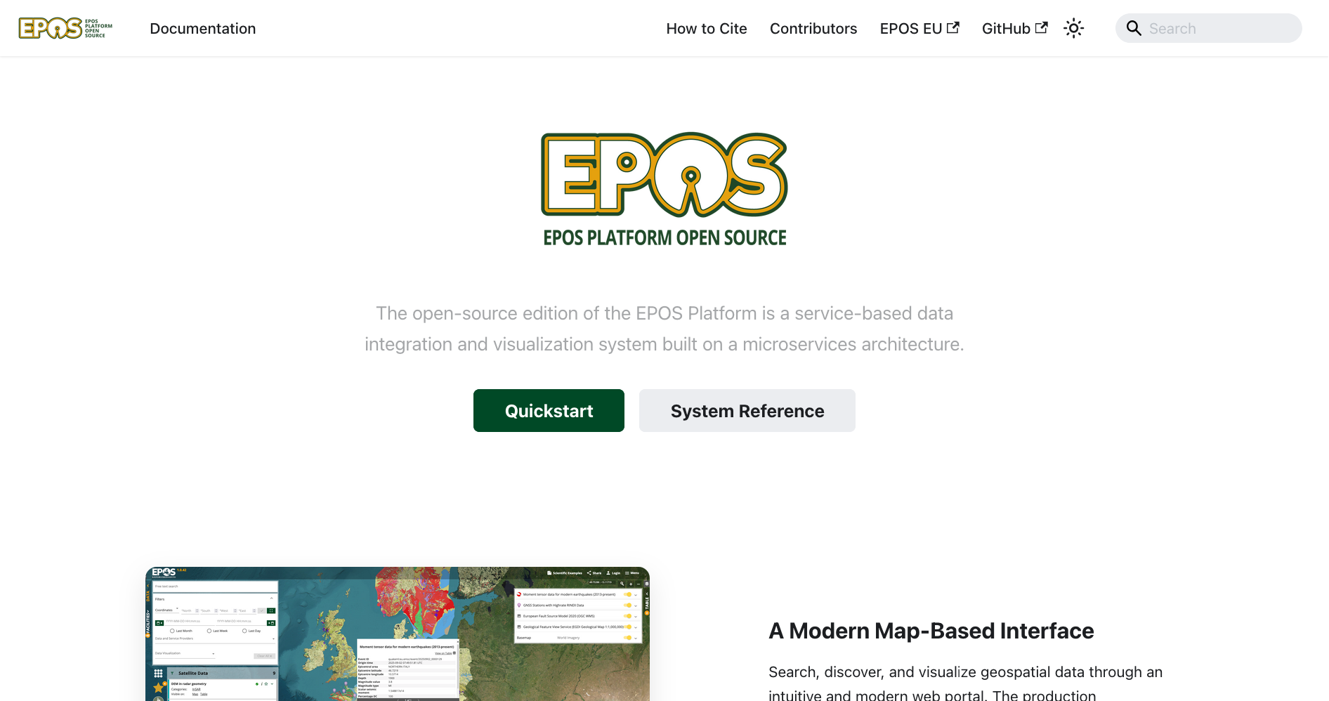
What is already available
Public code repositories for EPOS platform components.
Public documentation for setup, operation, and customization.
Tools to deploy on your own infrastructure.
Open license (GPL v3) for reuse and adaptation.

Slide 4
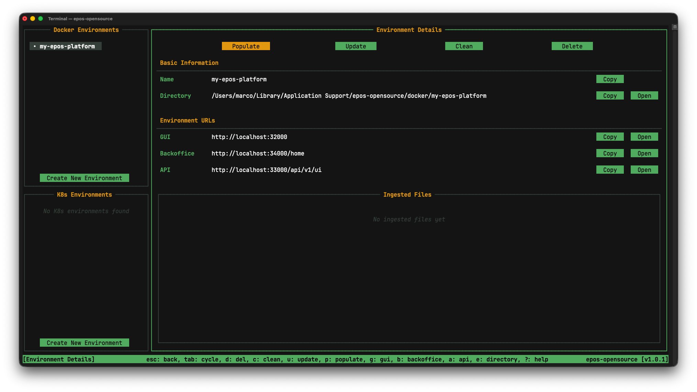
How to reuse it
Start from the open source EPOS core.
Connect your data and map your formats.
Apply focused UI or feature adjustments where needed.
Run and maintain the instance on local or project servers.

Slide 5

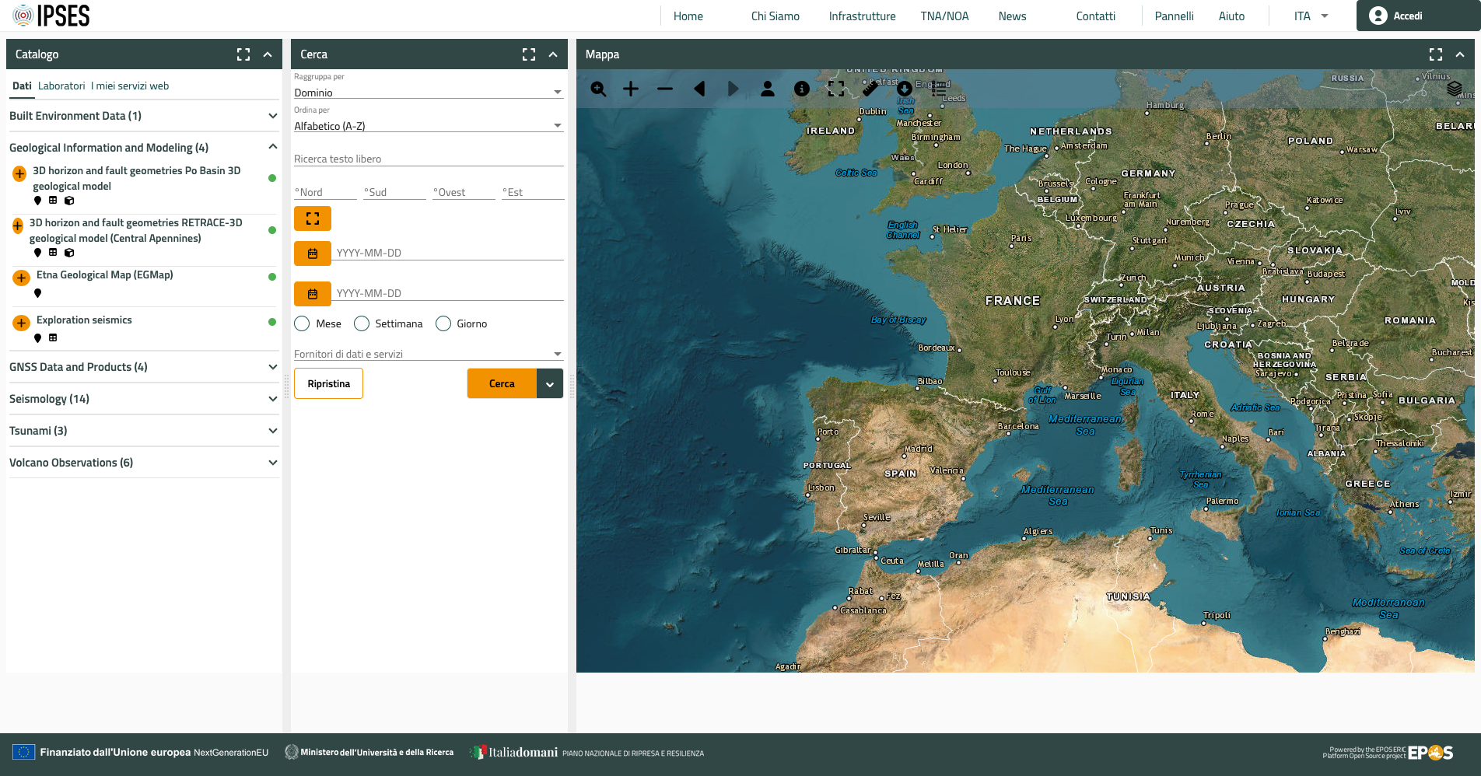
https://www.ipses-ri.it/app/
Reused EPOS open source backend code.
Forked and adapted it to their use case.
Built a custom interface on top.
Result: custom solution based on EPOS core code.

Slide 6

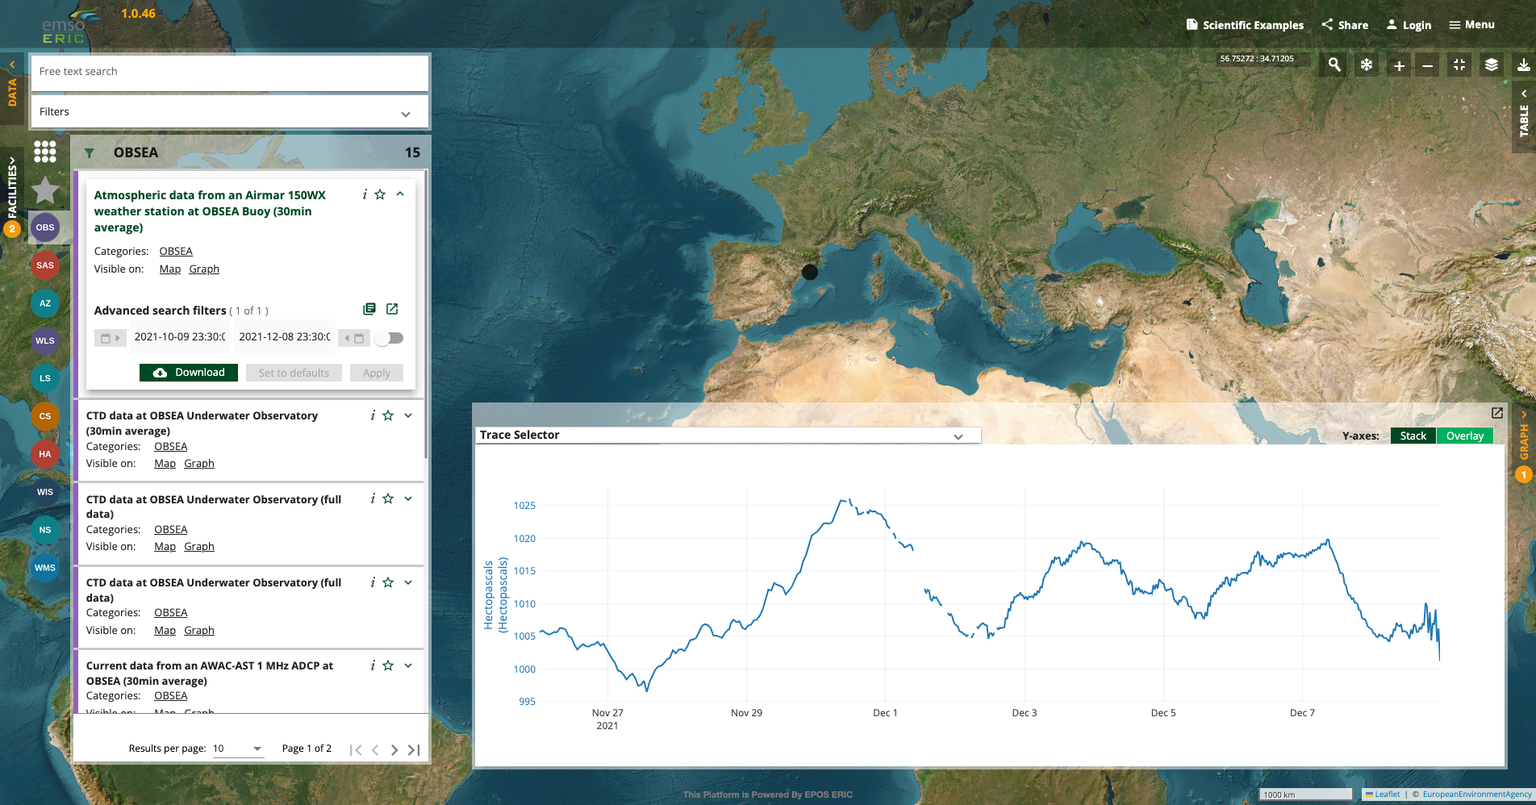
https://portal-dev.emso.eu/
Started using the EPOS open source installer.
Deployed on EMSO infrastructure.
Described services using EPOS-DCAT-AP
Applied small branding changes

Slide 7

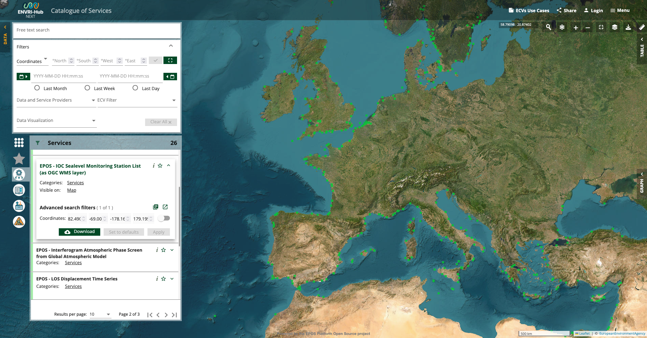
https://catalogue.envri.eu/
EPOS deployed the catalogue of services using the open source installer.
Deployment runs on project servers.
Components were adapted for project needs, including ECV filtering.

Slide 8

Common pattern across IPSES, EMSO, ENVRI
Start from the EPOS open source base components.
Describe your services in EPOS-DCAT-AP and convert your formats
Adapt the platform to your needs

Slide 9
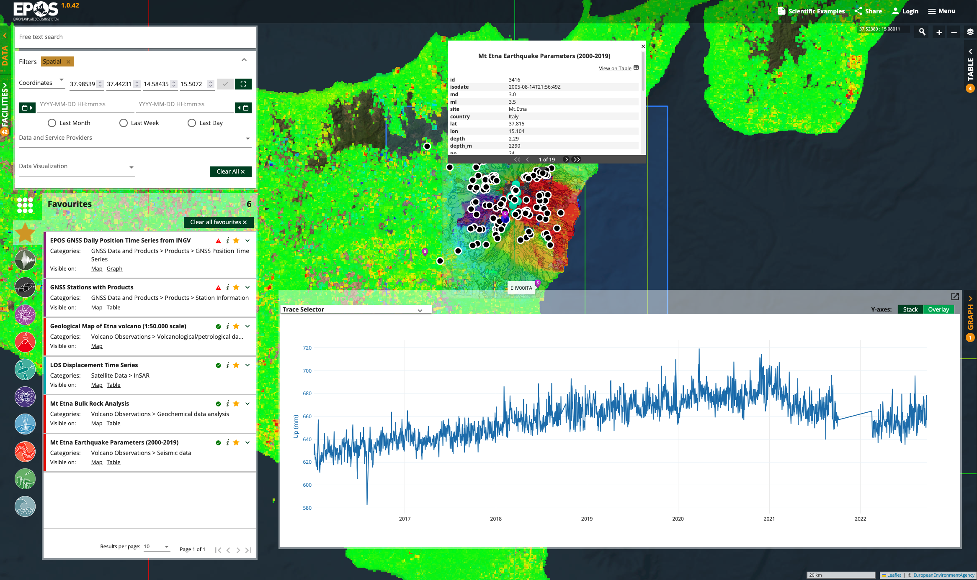
What this means for you
The same code and documentation are publicly available.
Deployments can run on your own infrastructure.
Work can focus on local integration and specific requirements.

Slide 10
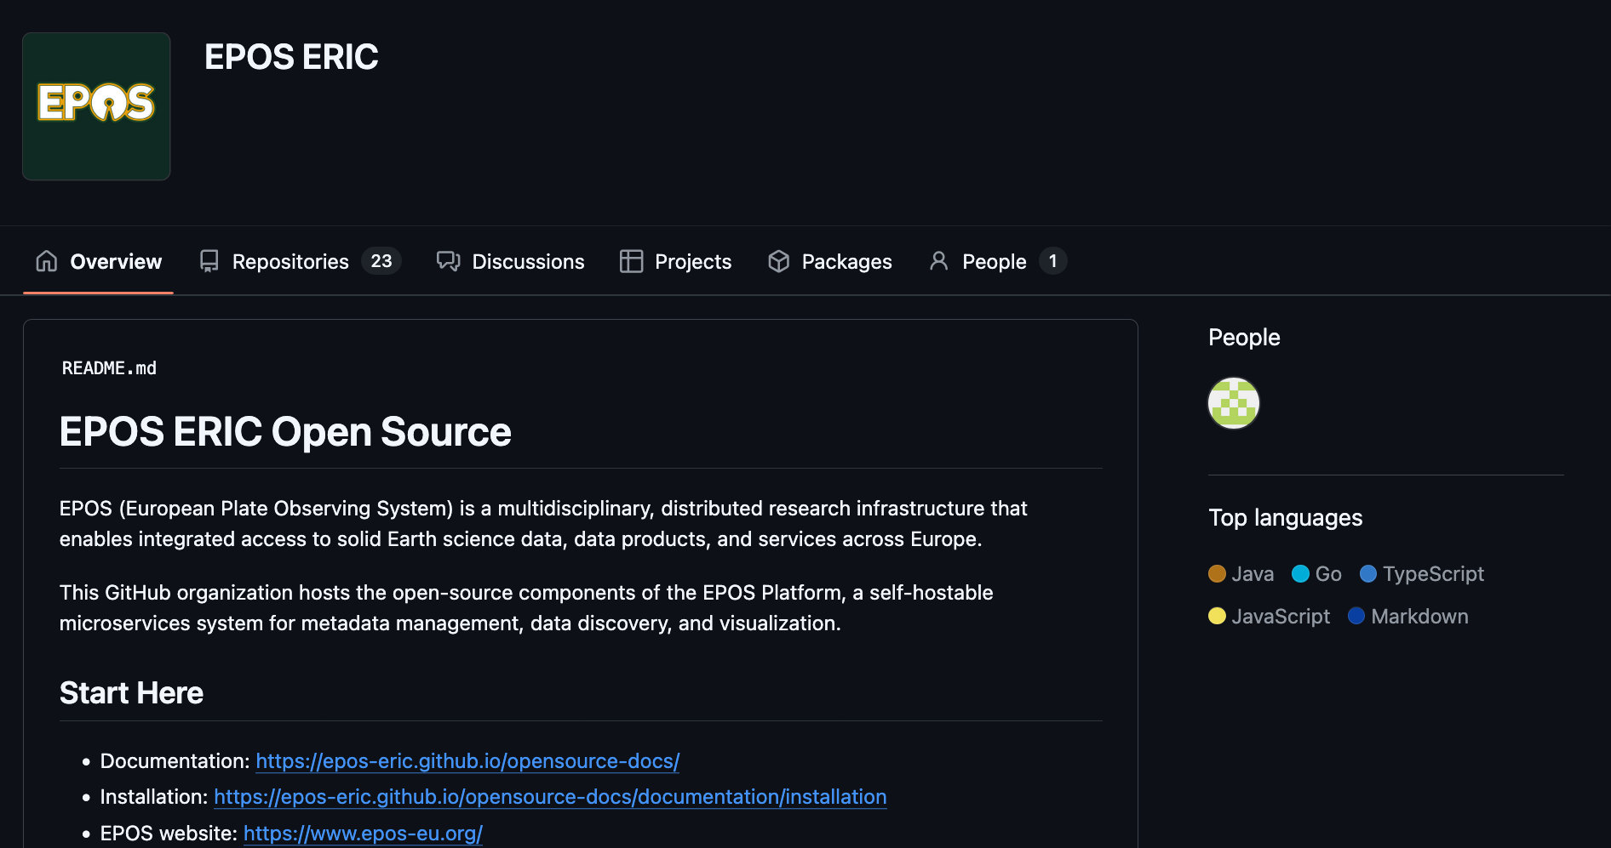
Open development on GitHub
All EPOS development happens in public on GitHub.
Code, issues, pull requests, and releases are fully visible.
Issues, feedback, and contributions are welcome!

Slide 11
Thank you for your attention!
marco.salvi@ingv.it

