Slide 1

EPOS Platform New Features in Action: Scientific Use Case
Jan Michálek

Slide 2
Geodynamic activity near Santorini, Greece Scientific Use Case
Discovery of services in EPOS Platform
Manualy
Search, filtering, configuring services
Sharing link
Predefined Scientific Examples
Shortcut to specific scenarios
Jupyter Notebooks
Customized data processing and visualization

Slide 3
1. Manual discovery of services
Geodynamic activity near Santorini, Greece

Slide 4
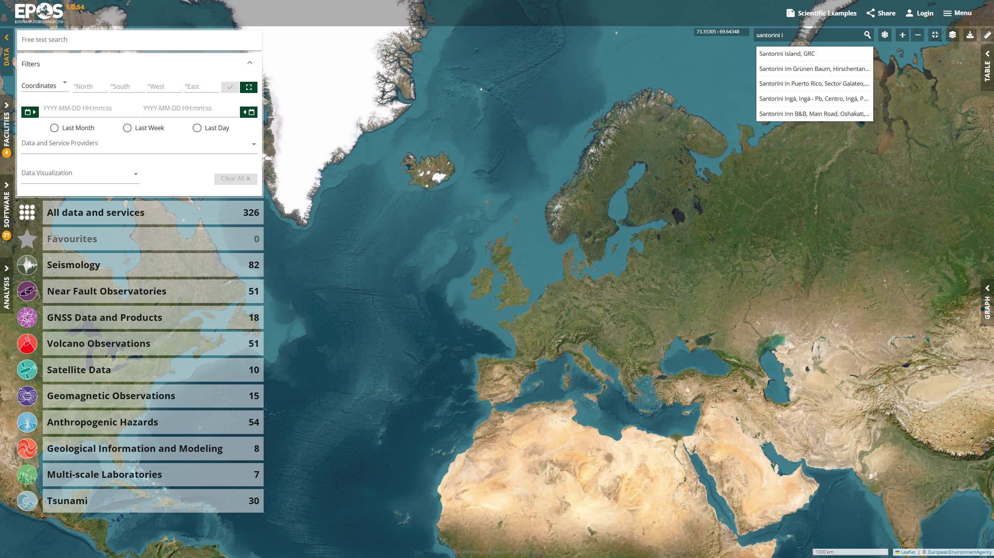

Slide 5
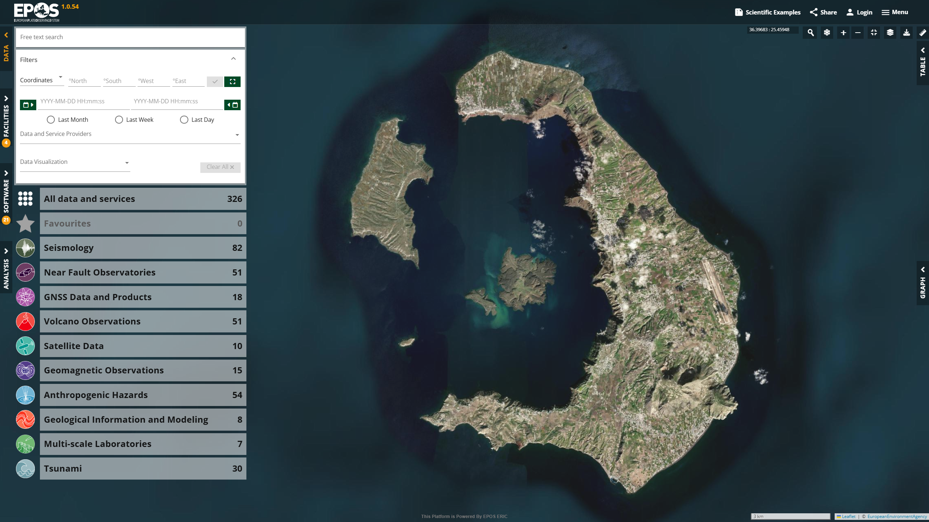

Slide 6
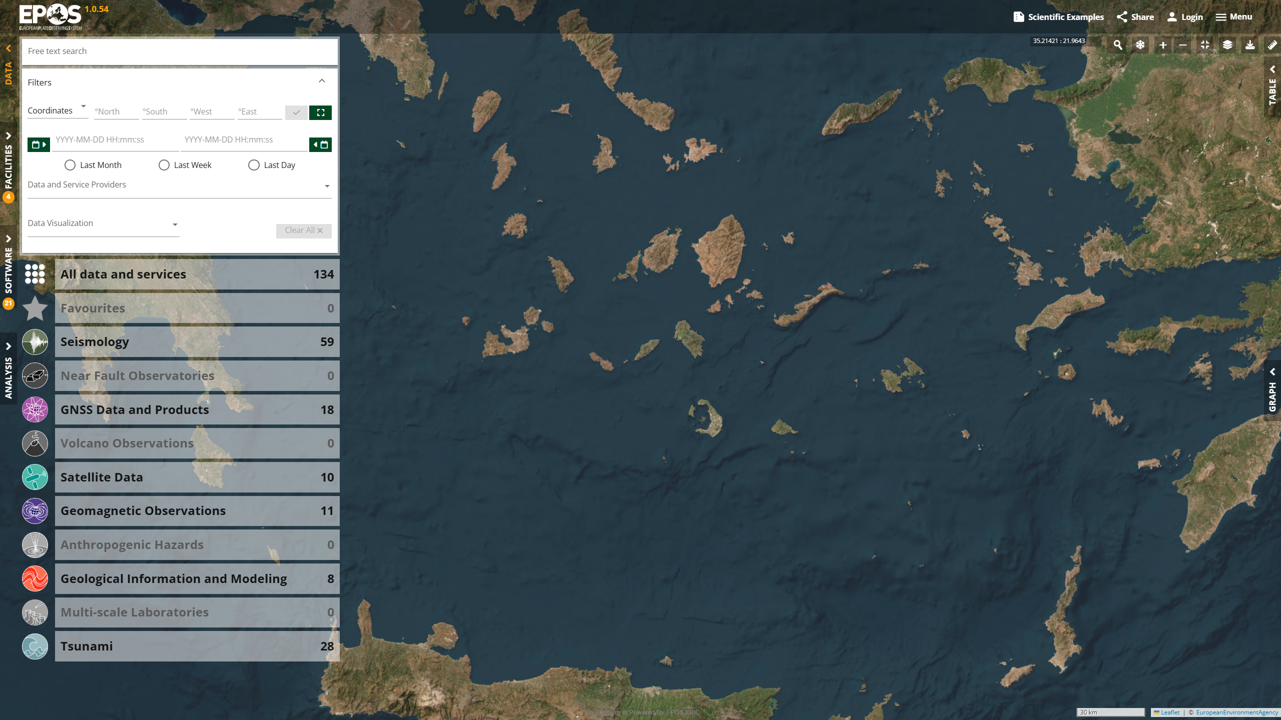
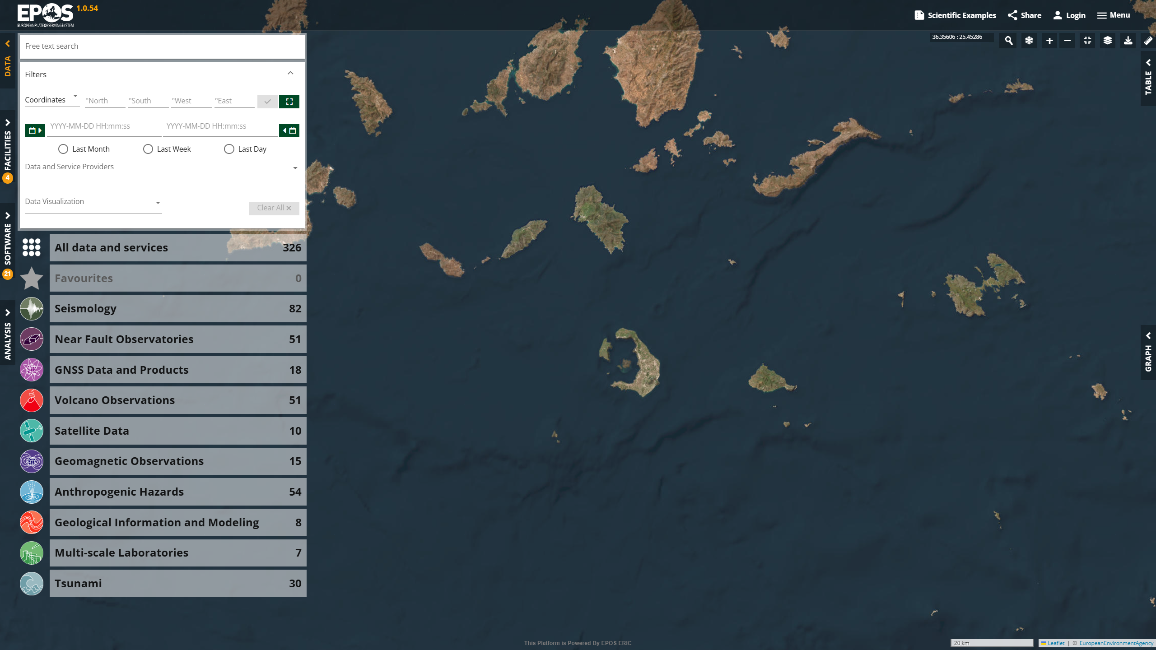

Slide 7
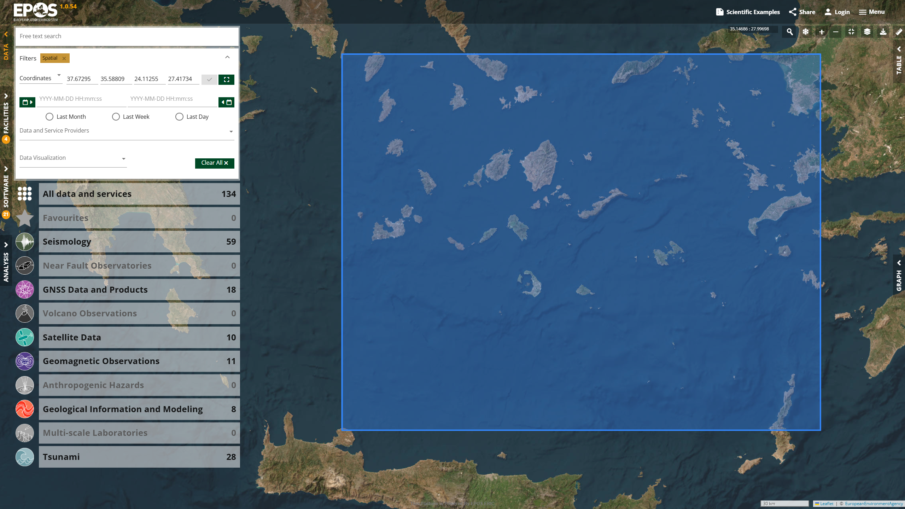

Slide 8
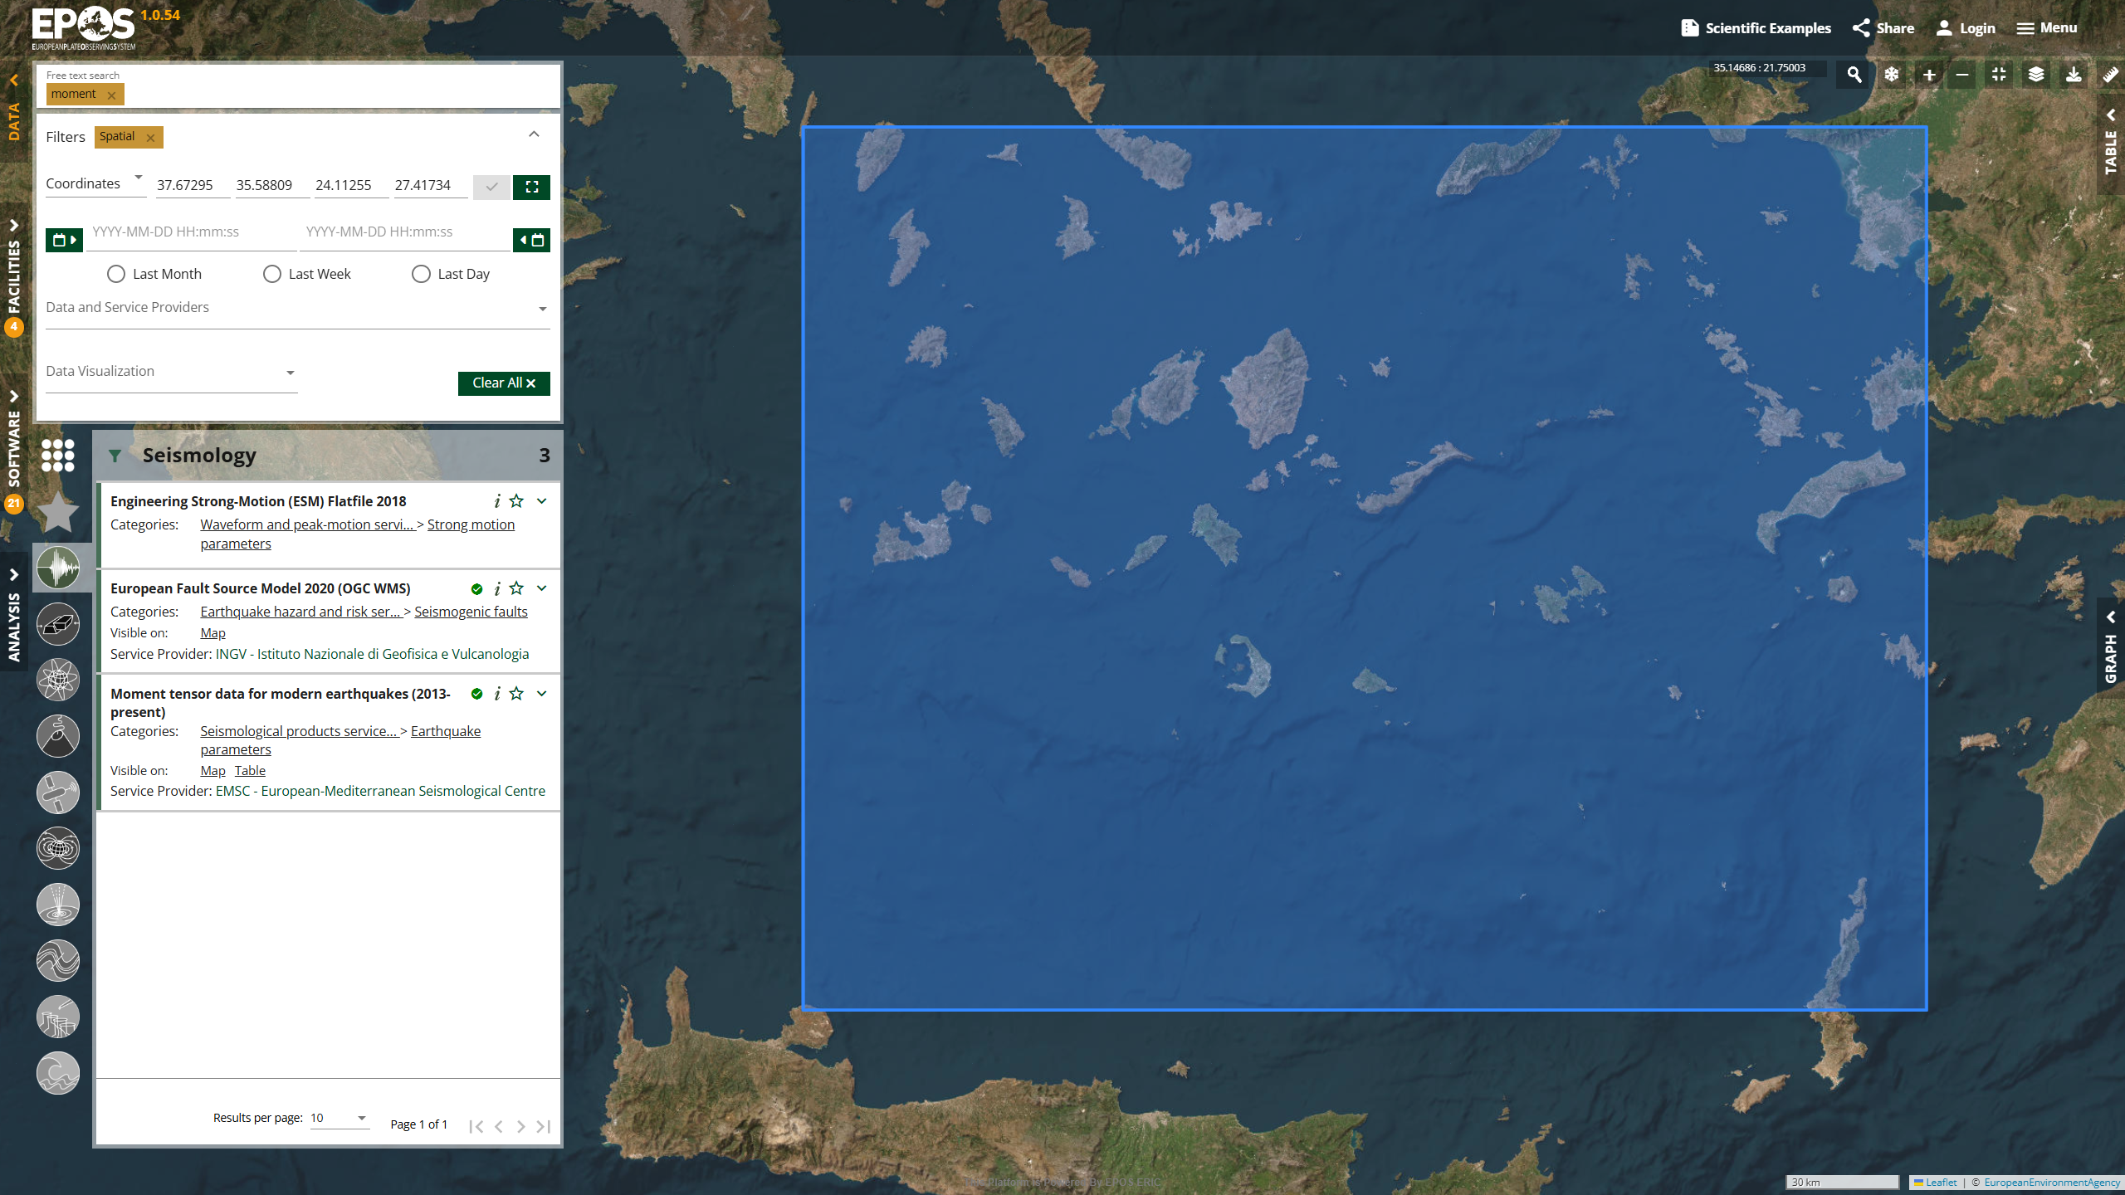

Slide 9
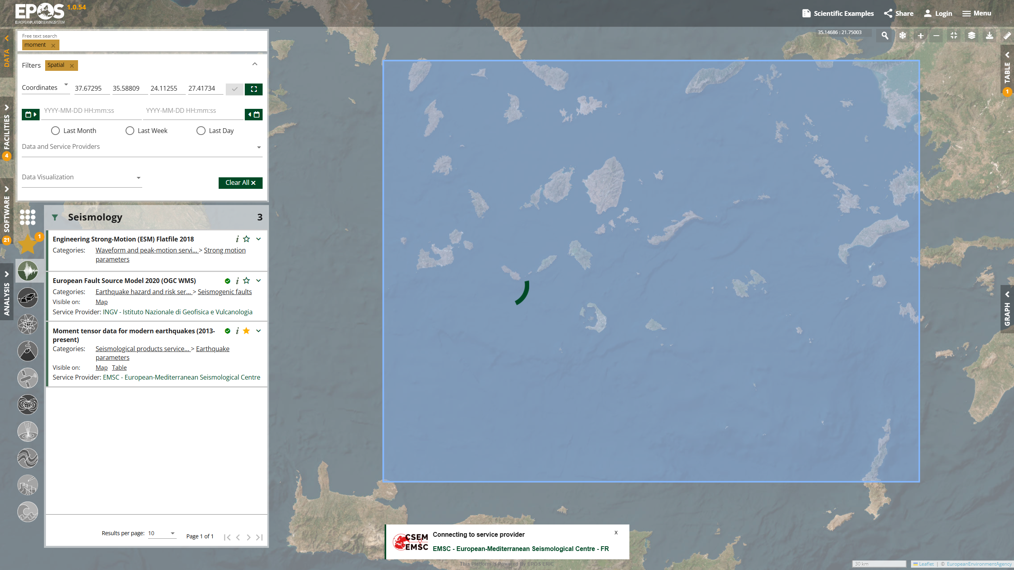

Slide 10


Slide 11
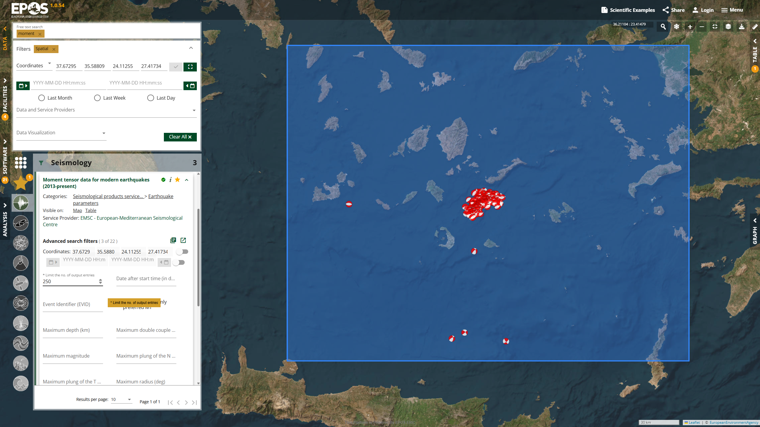

Slide 12
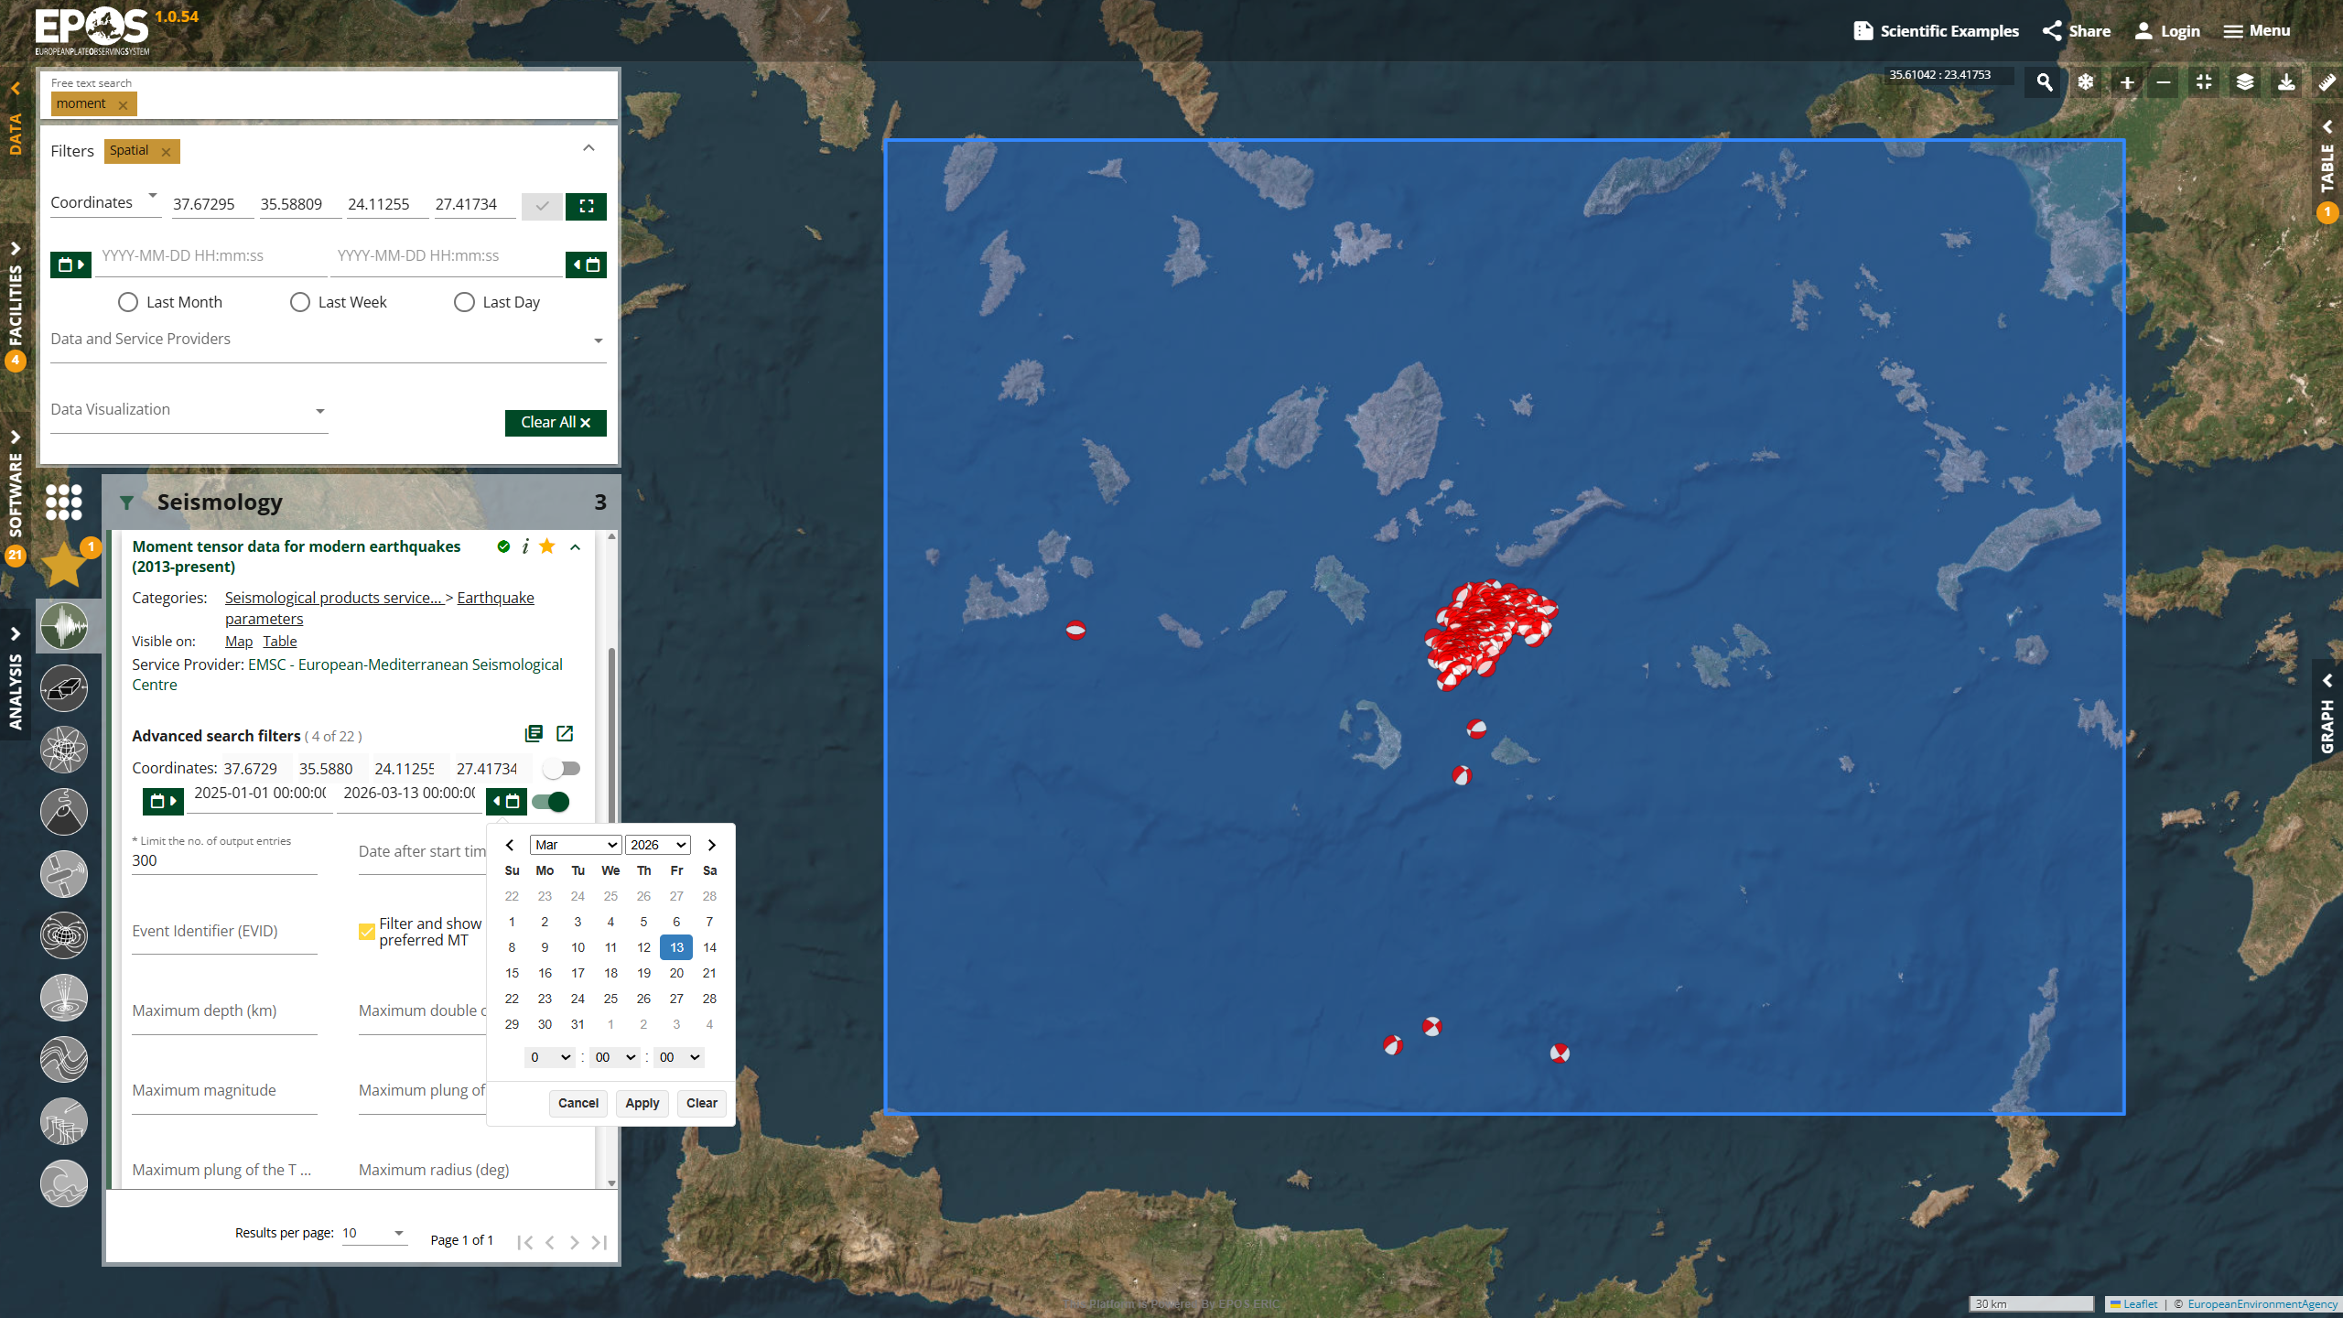

Slide 13


Slide 14
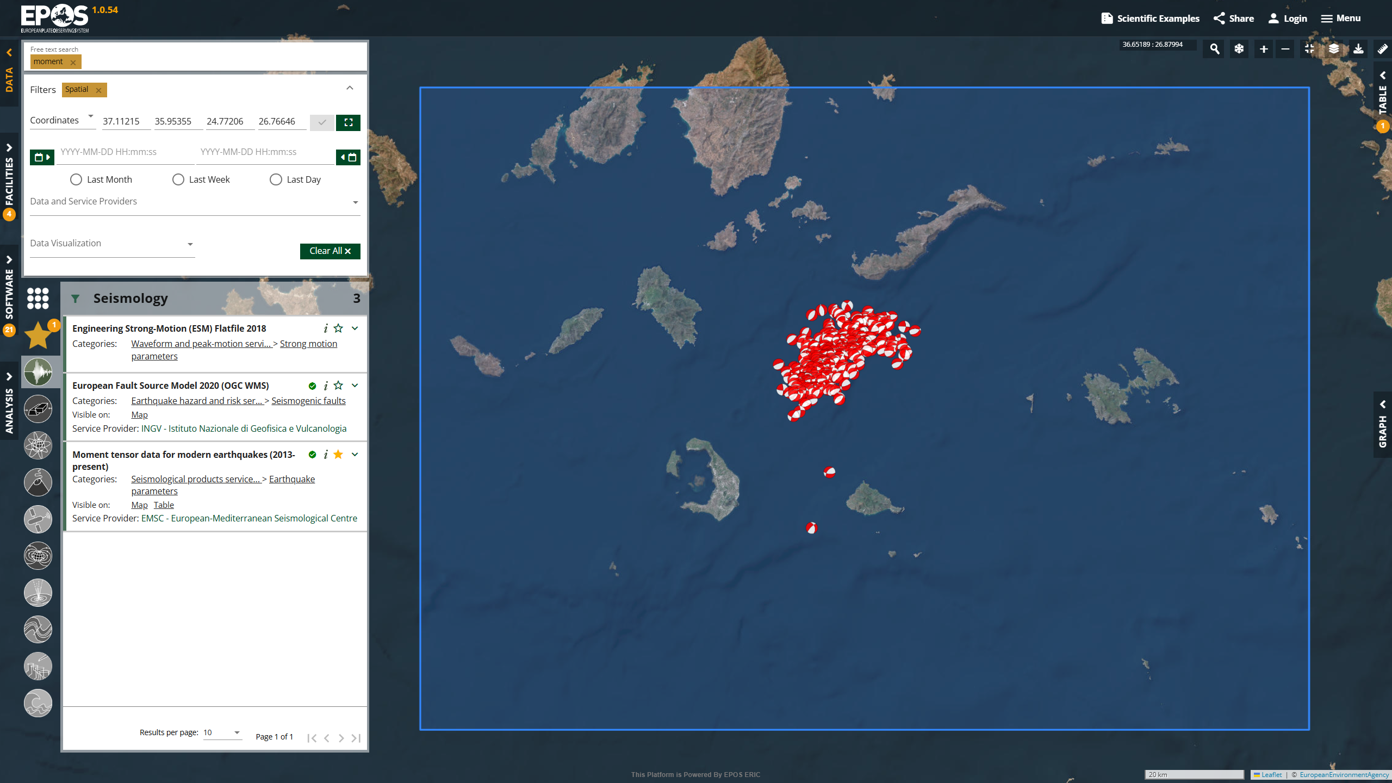

Slide 15
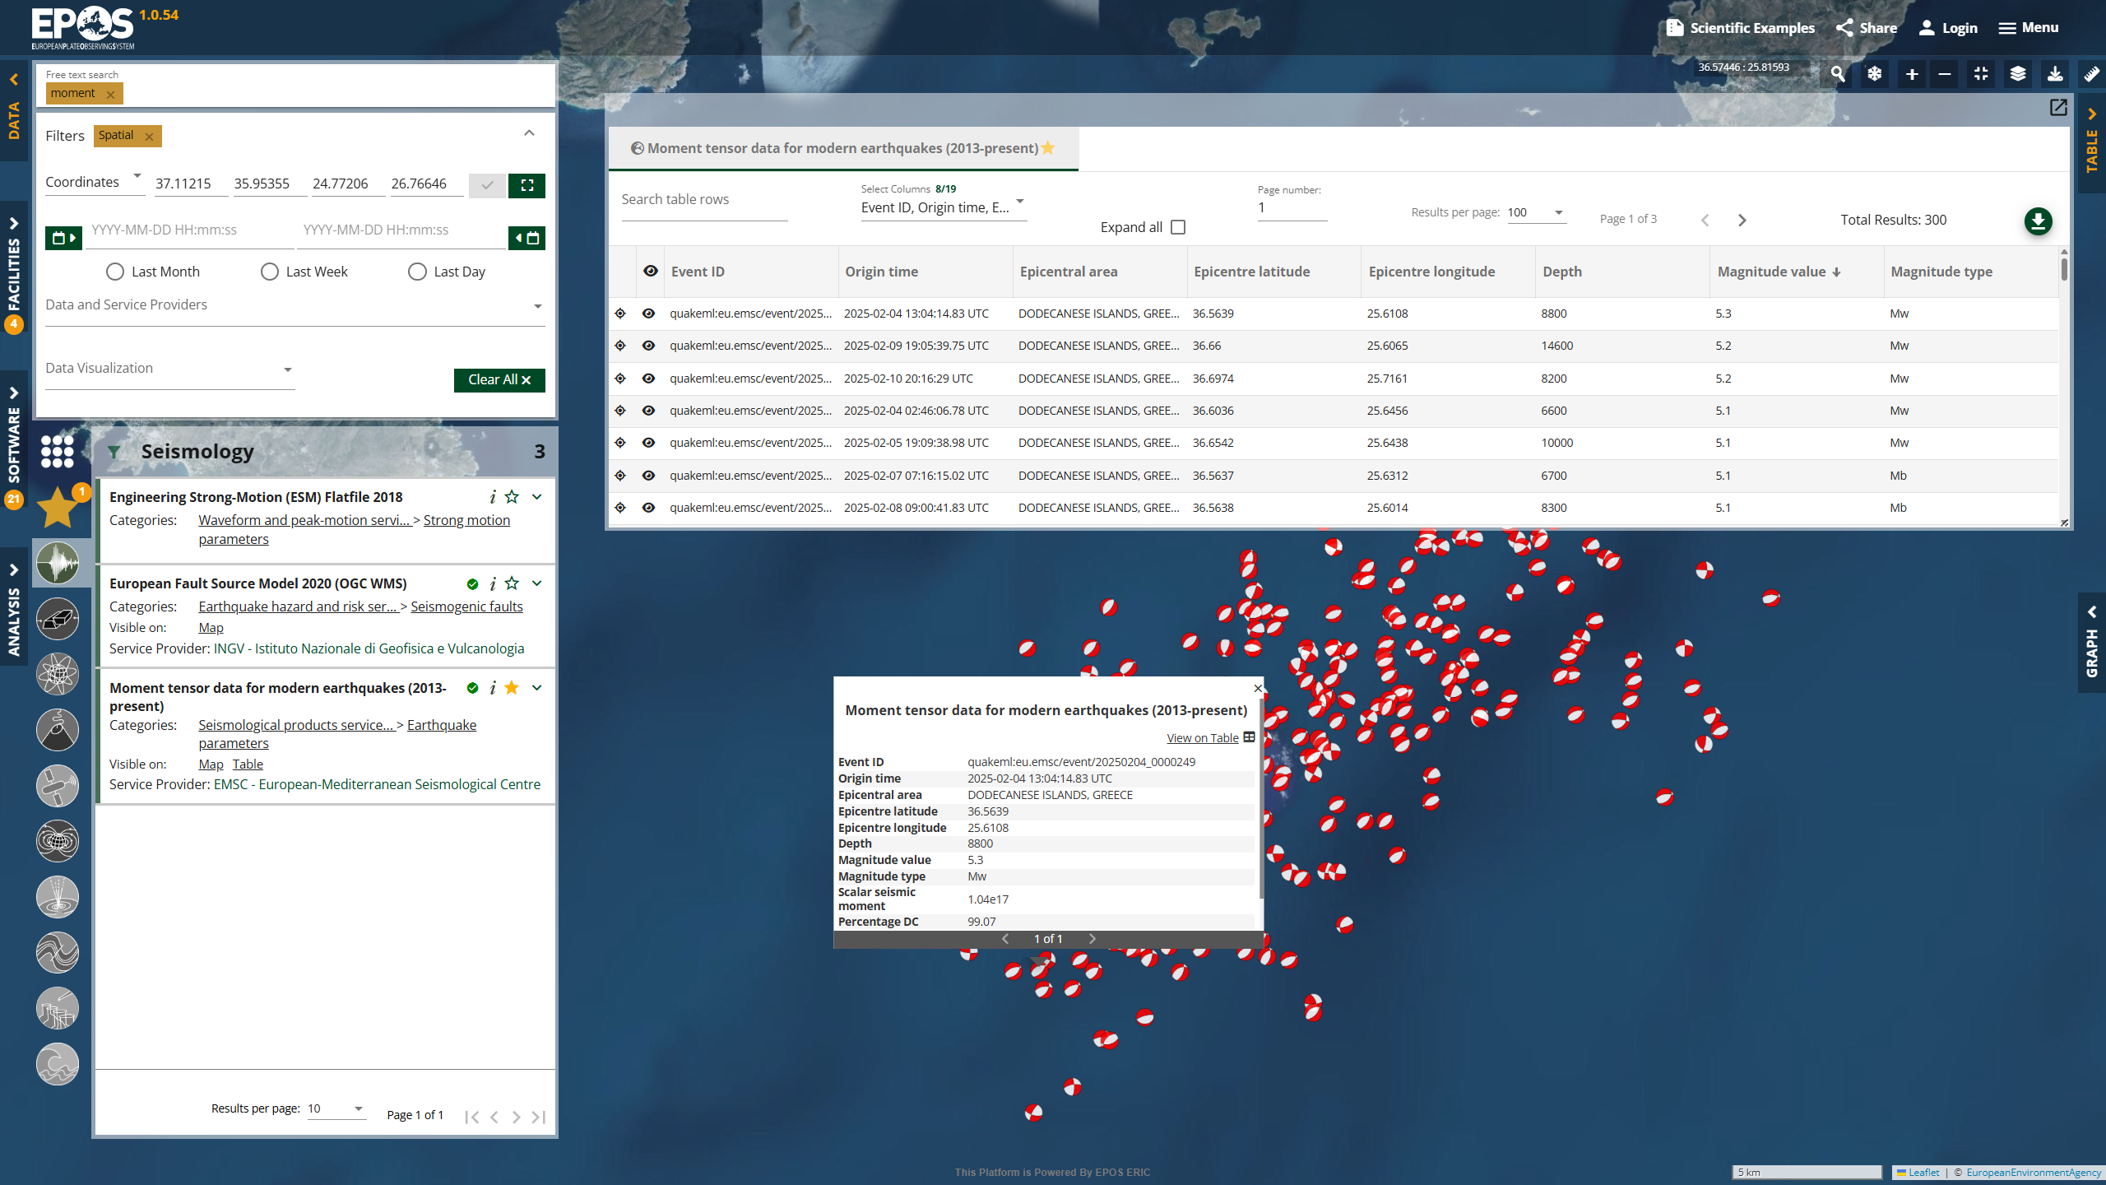
Notes:
Similarly one can sort table by time. To see e.g. only large events above M5 one can make new parametrized request to the service.

Slide 16
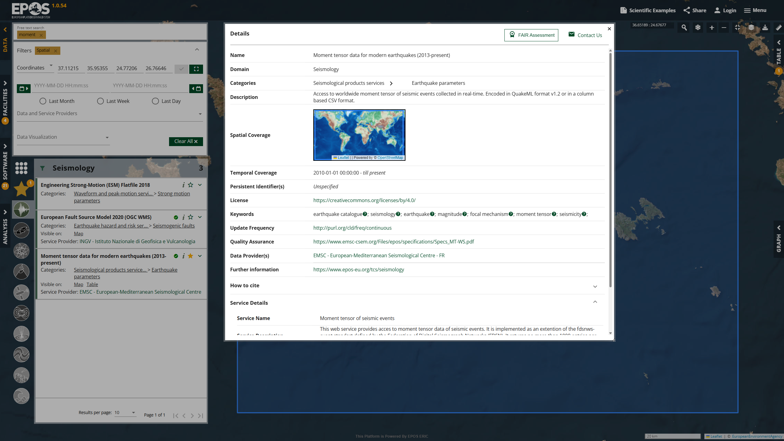

Slide 17
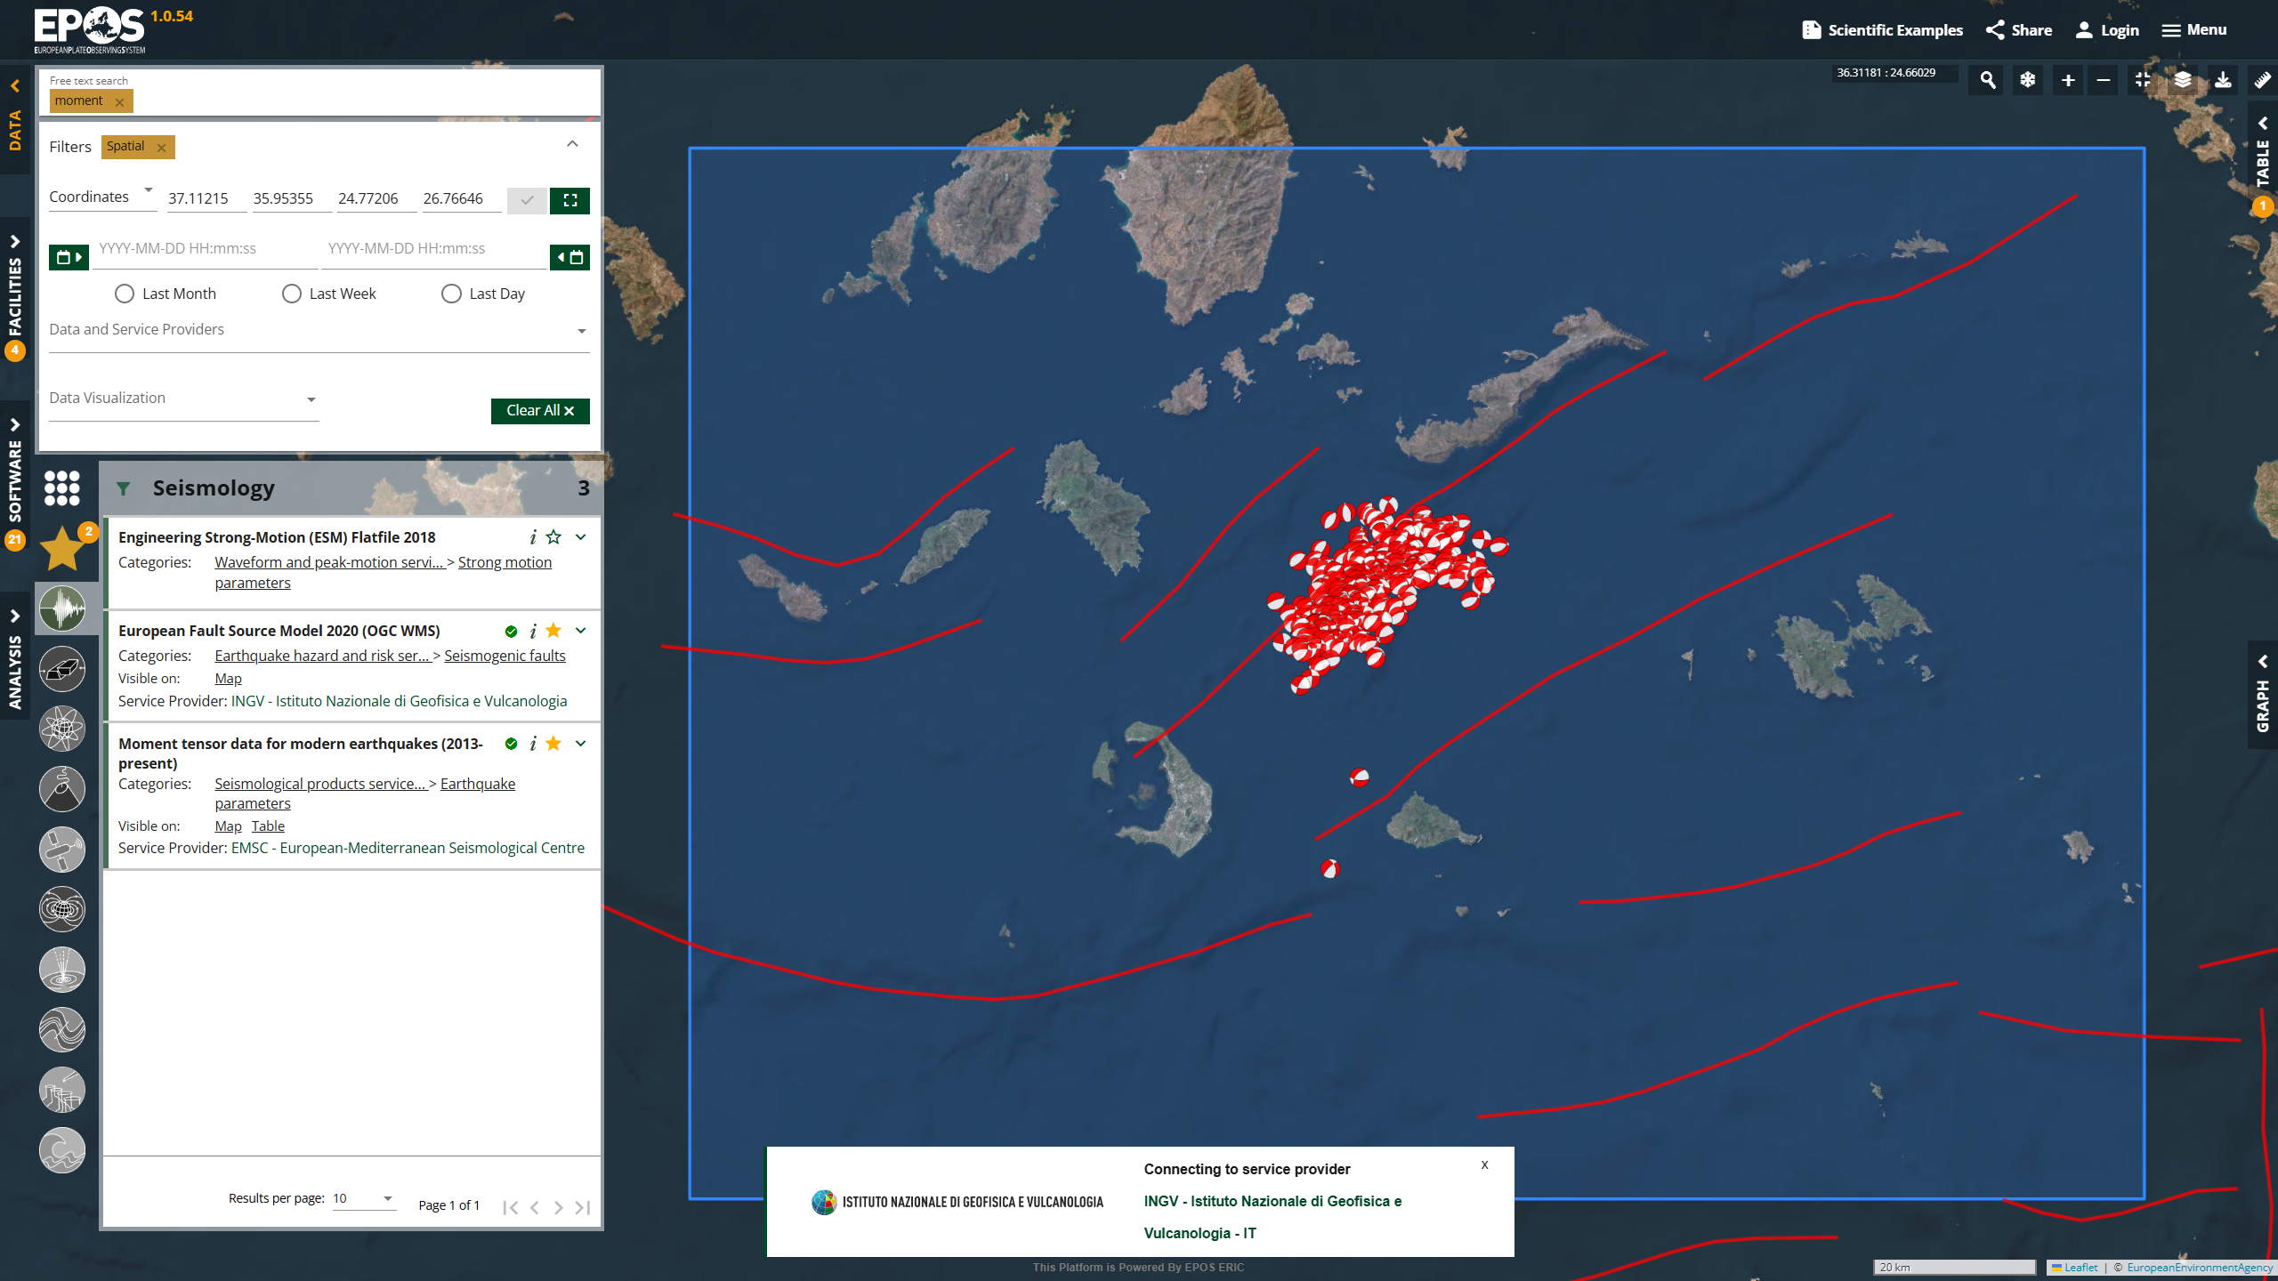

Slide 18
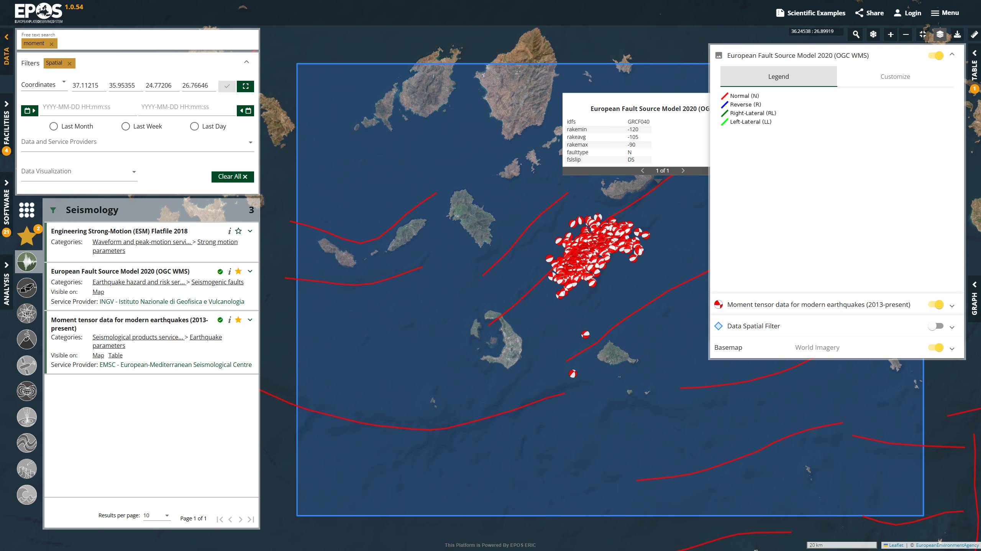

Slide 19
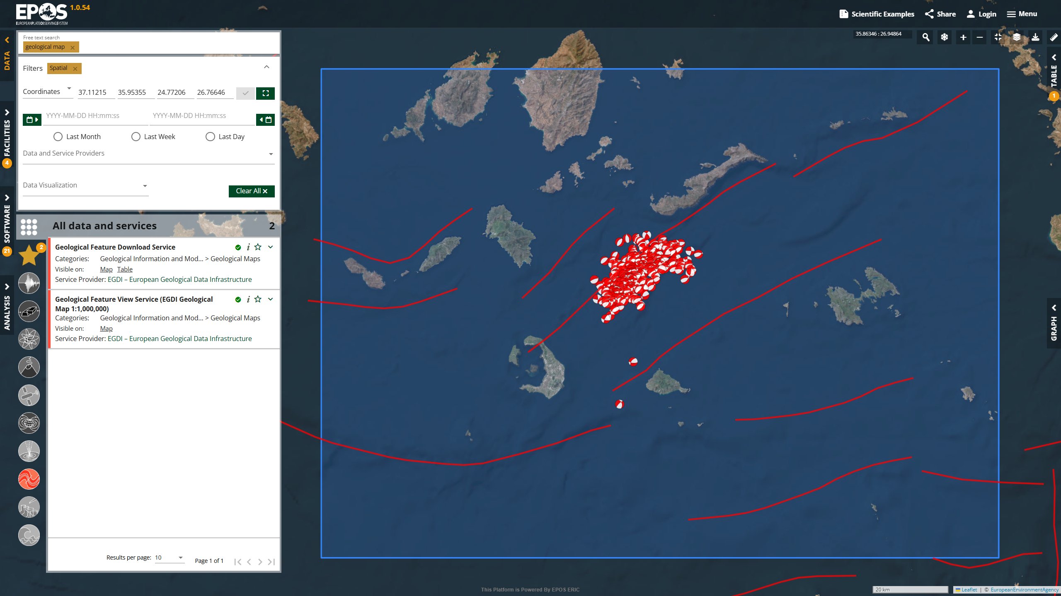

Slide 20
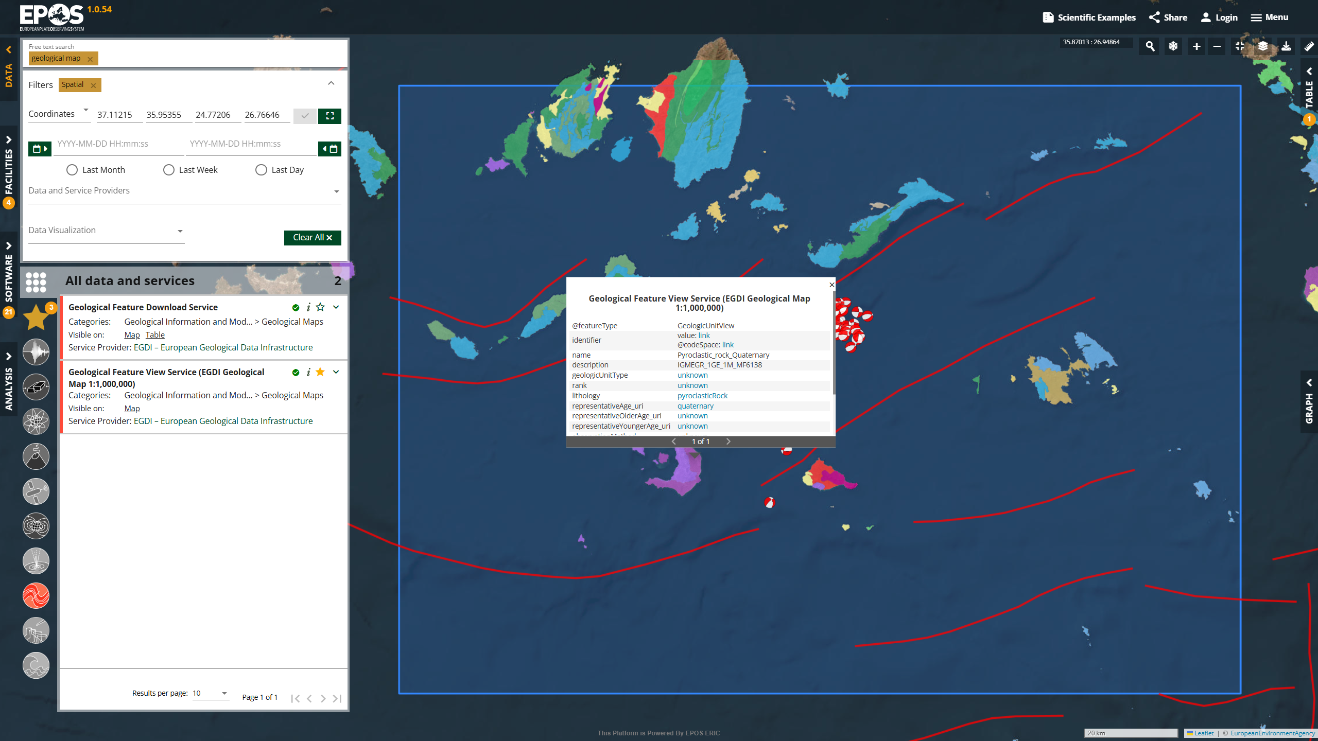

Slide 21
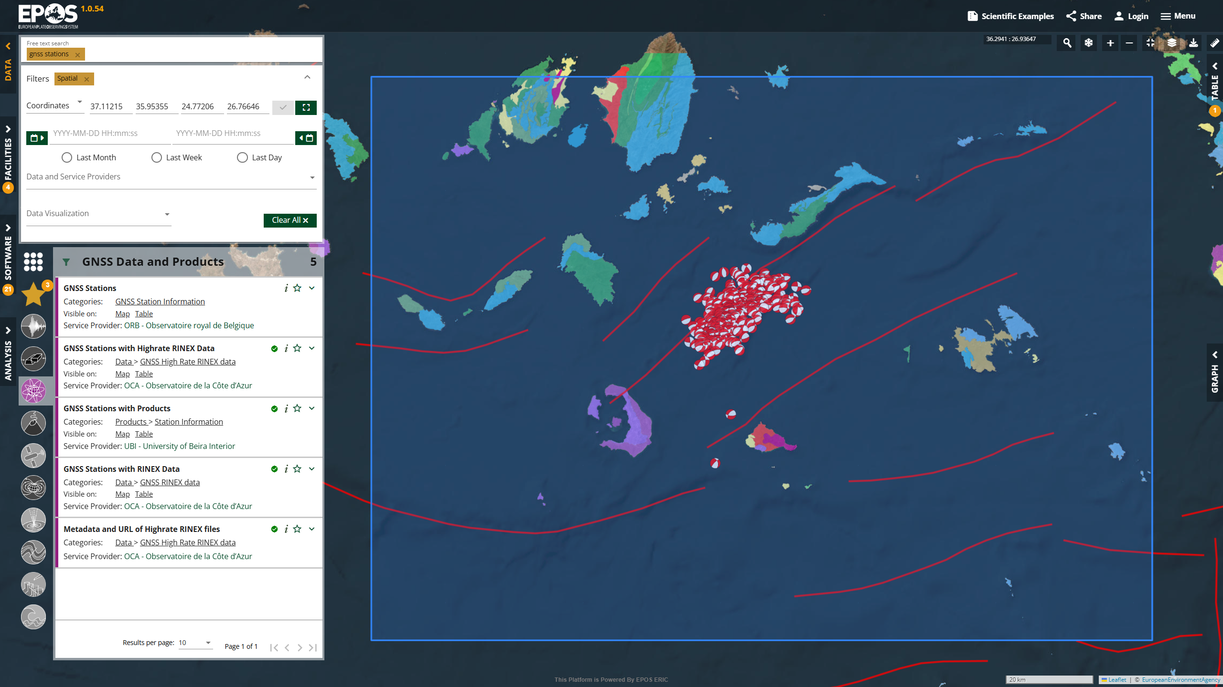

Slide 22
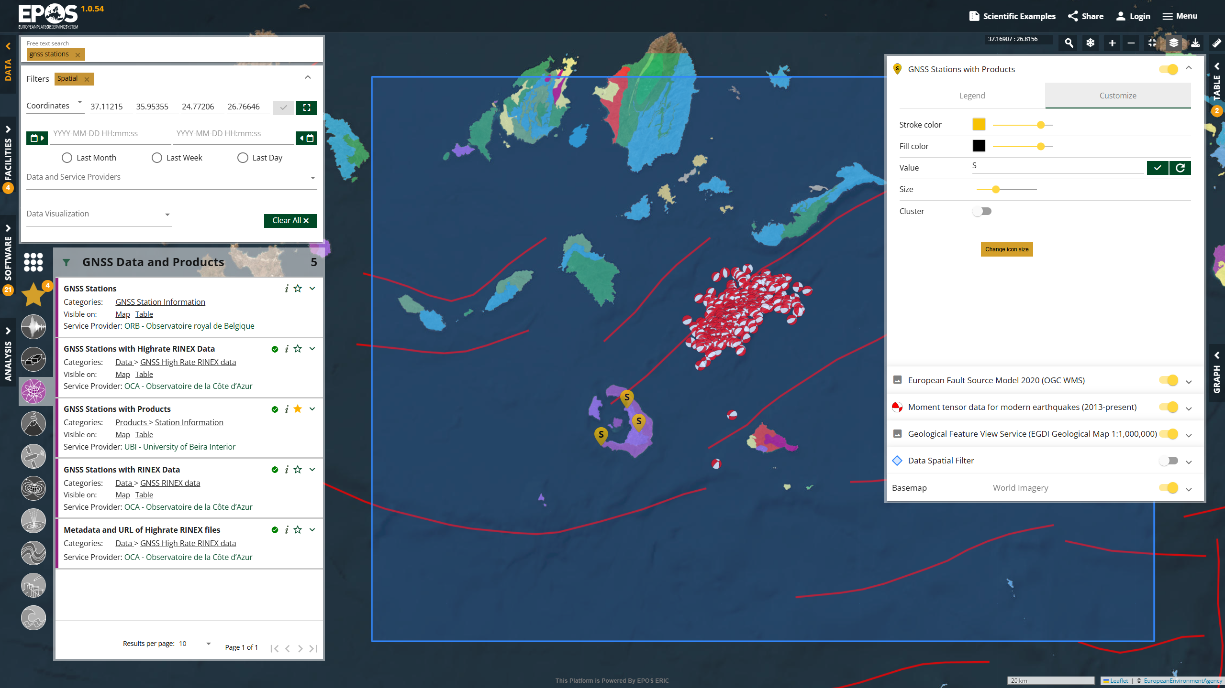

Slide 23
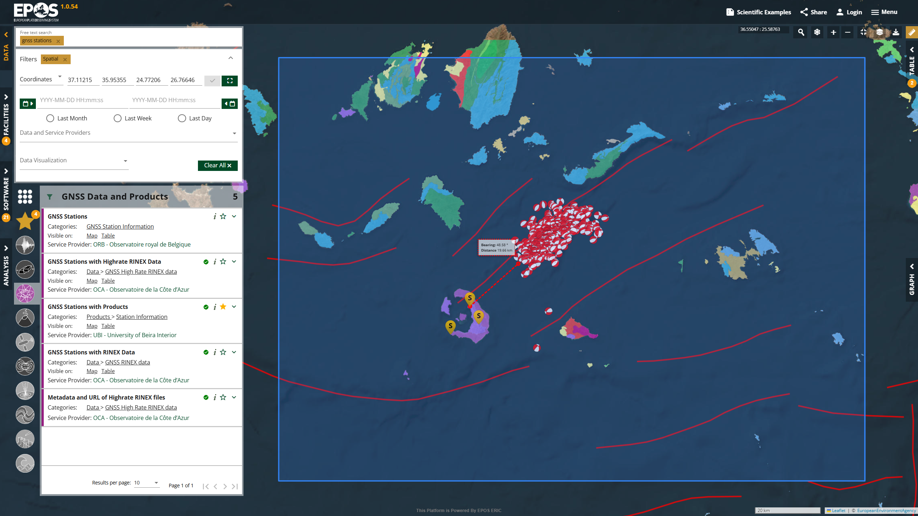

Slide 24
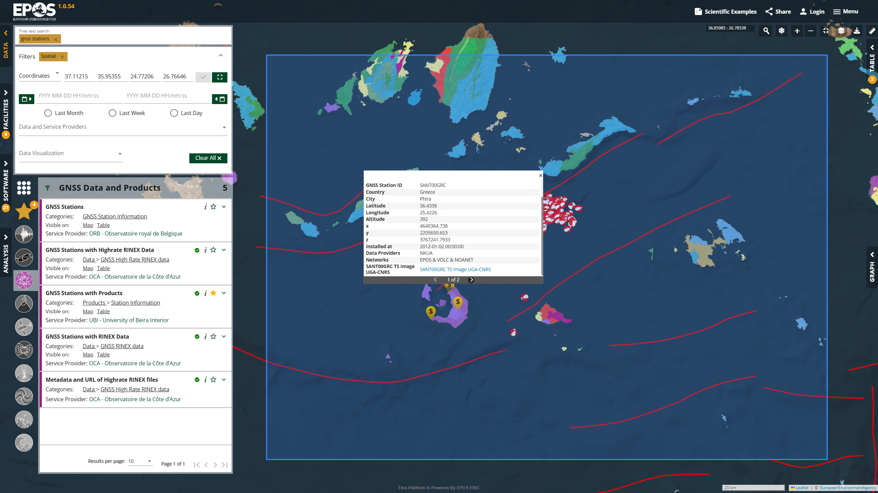

Slide 25
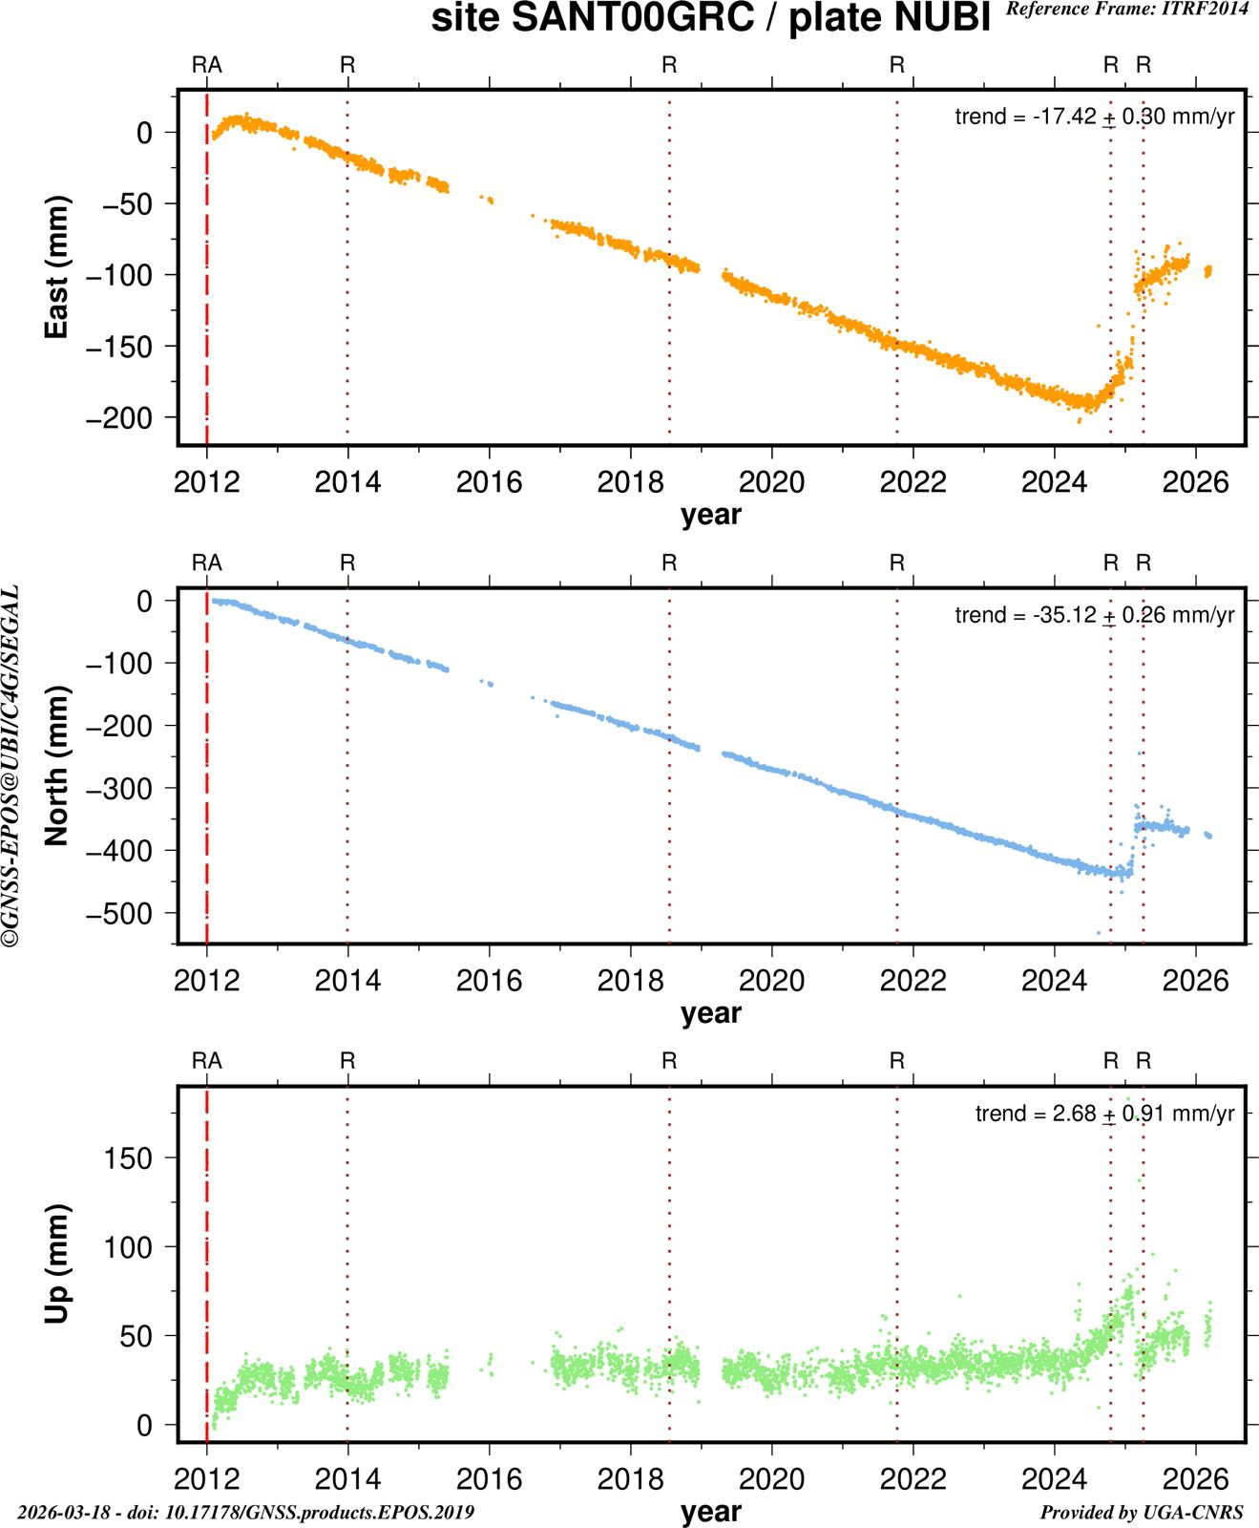

Slide 26
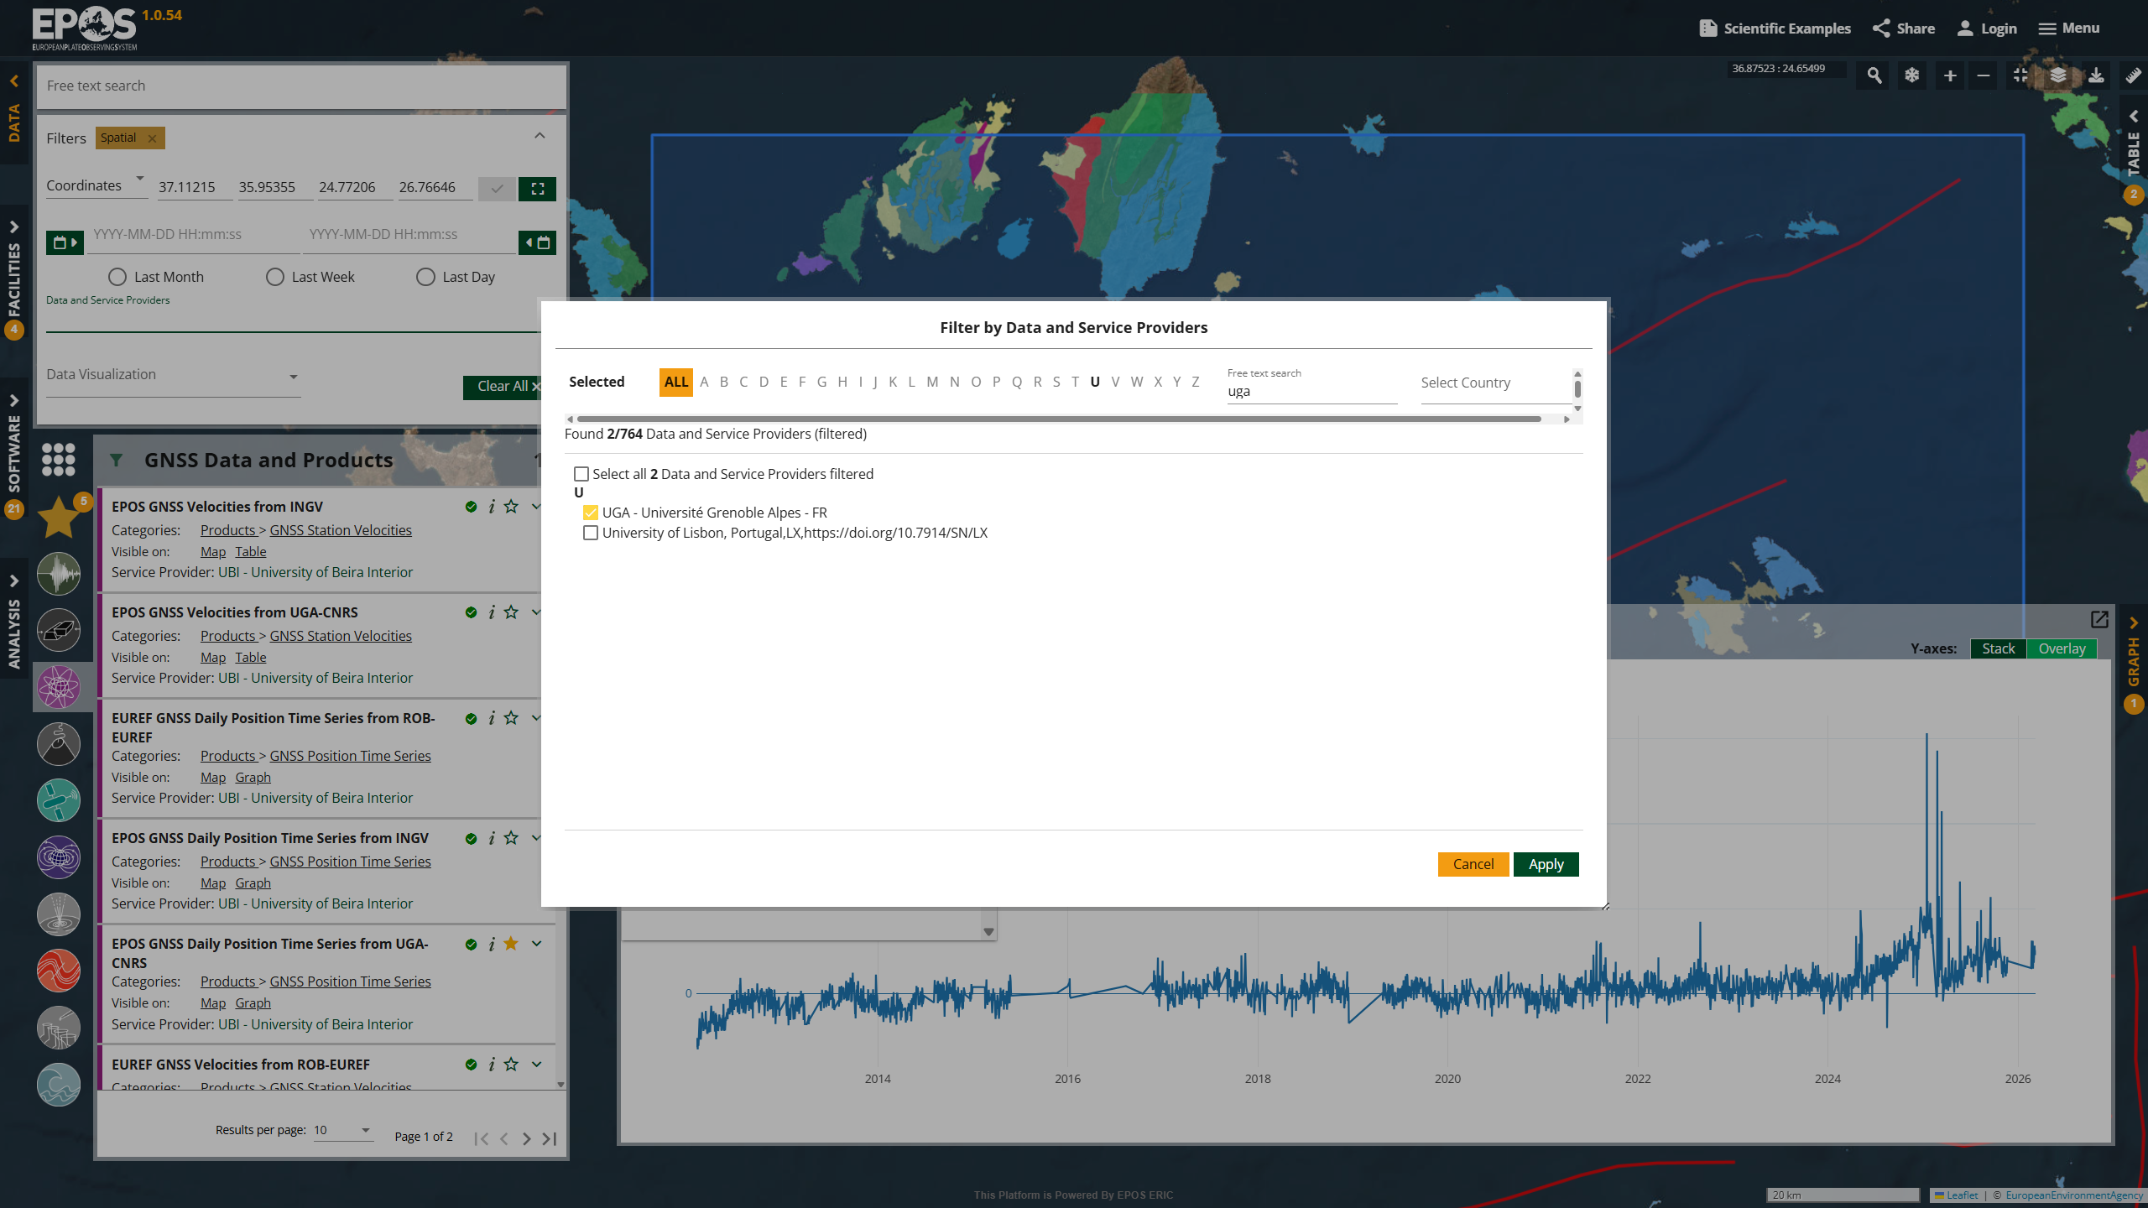

Slide 27
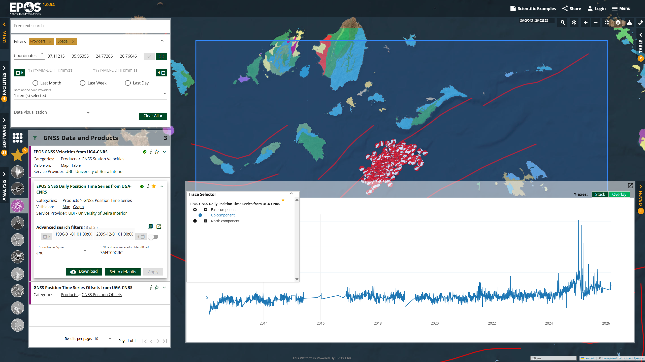

Slide 28


Slide 29
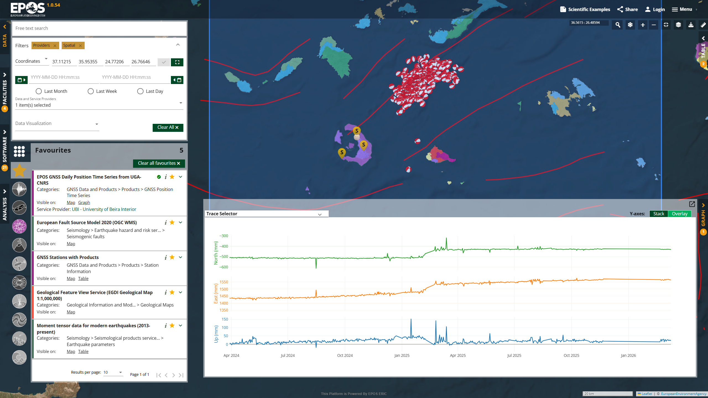
GENERATES PERMANENT LINK
Notes:
https://www.ics-c.epos-eu.org/?share=0bac40cb-5f61-4034-b5a6-907d21878805

Slide 30
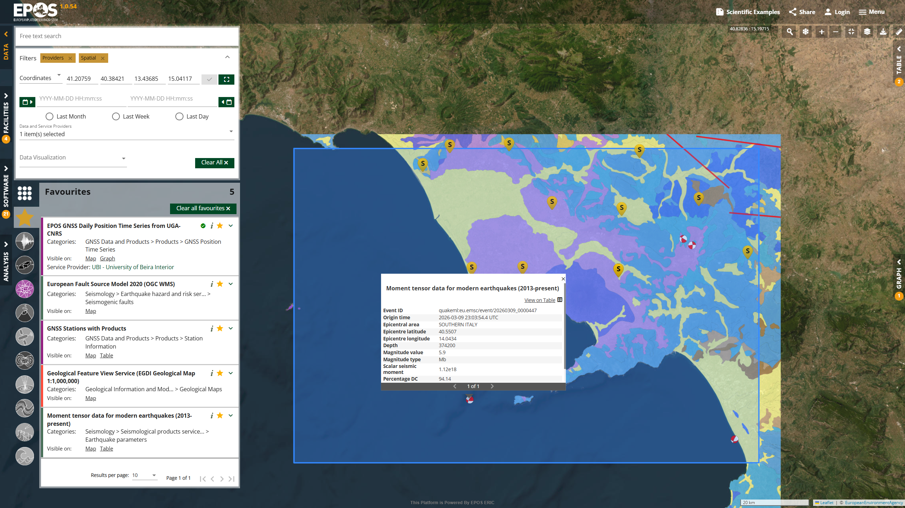
Quick relocation to any area using “favourite“ services

Slide 31
2. „Scientific Examples“ button
Geodynamic activity near Santorini, Greece

Slide 32
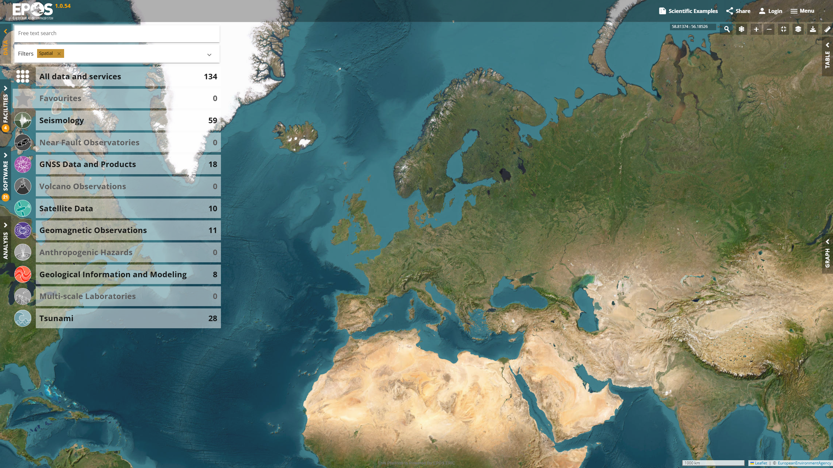

Slide 33
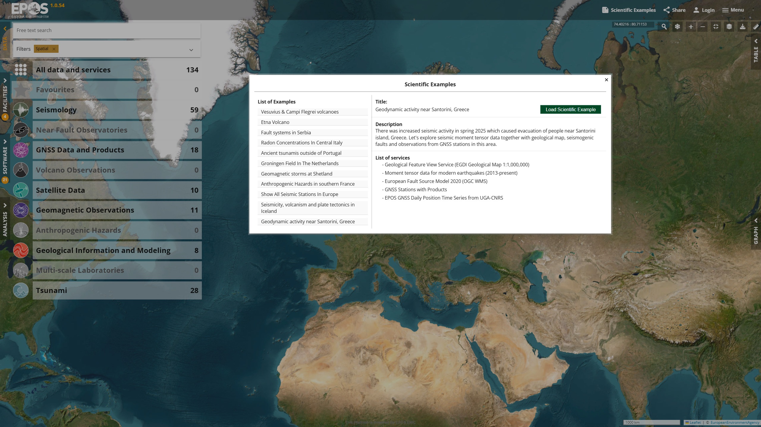

Slide 34
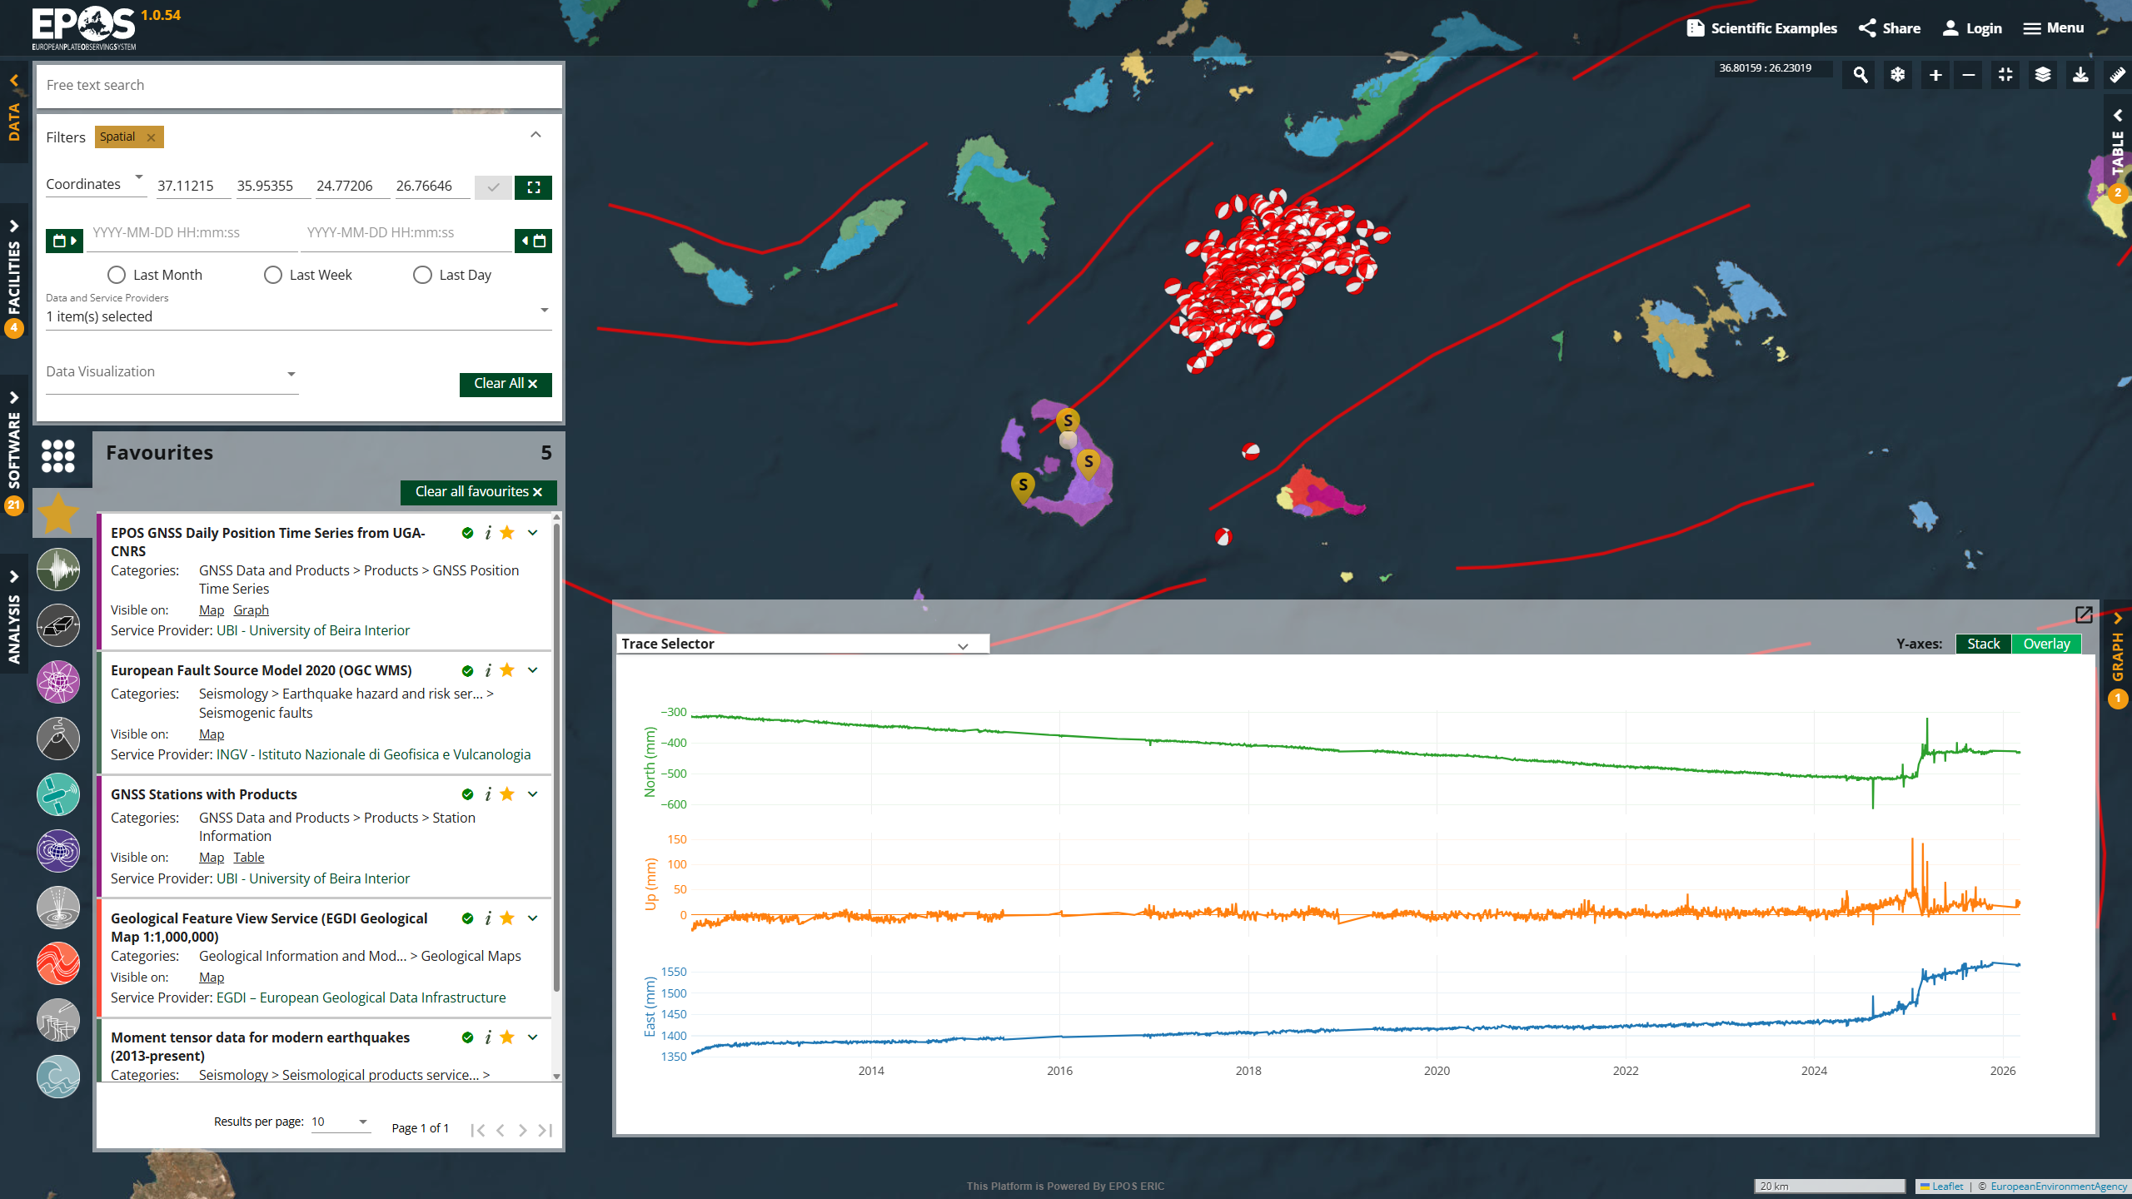

Slide 35

Request to scientific communities
Help us to expand the list of Scientific Examples!
{
"title": "Geodynamic activity near Santorini, Greece",
"description": " There was increased seismic activity in spring 2025 which caused evacuation of people near Santorini island, Greece. Let's explore seismic moment tensor data together with geological map, seismogenic faults and observations from GNSS stations in this area.",
"listOfServices": [
"SERVICE TITLE 1",
"SERVICE TITLE 2"
],
"sharingLinkUrl": "LINK COPIED FROM SHARE BUTTON"
}

Slide 36
3. Jupyter Notebook
Geodynamic activity near Santorini, Greece

Slide 37
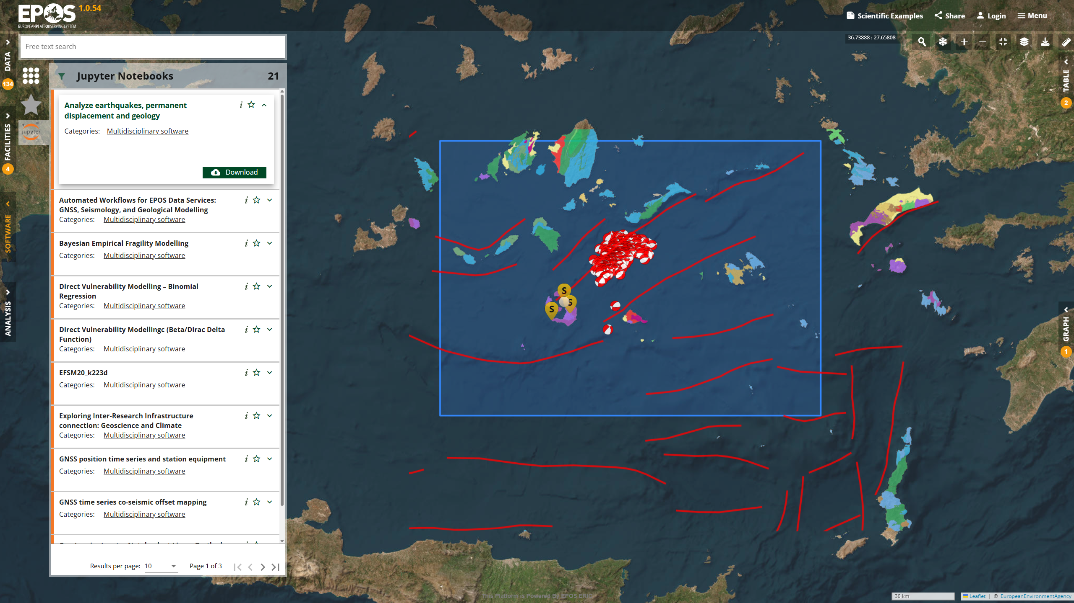

Slide 38
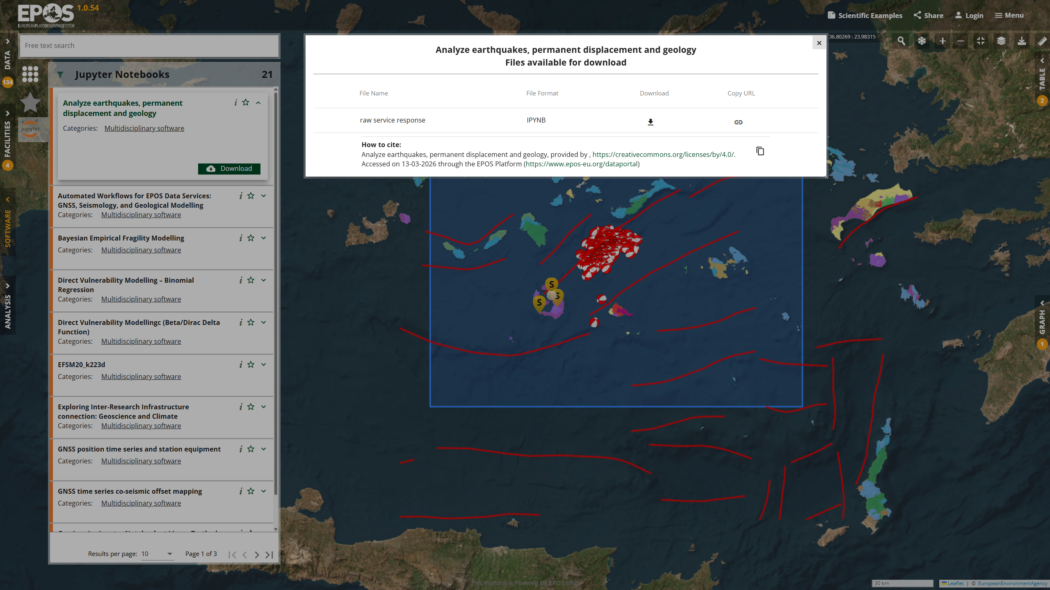

Slide 39
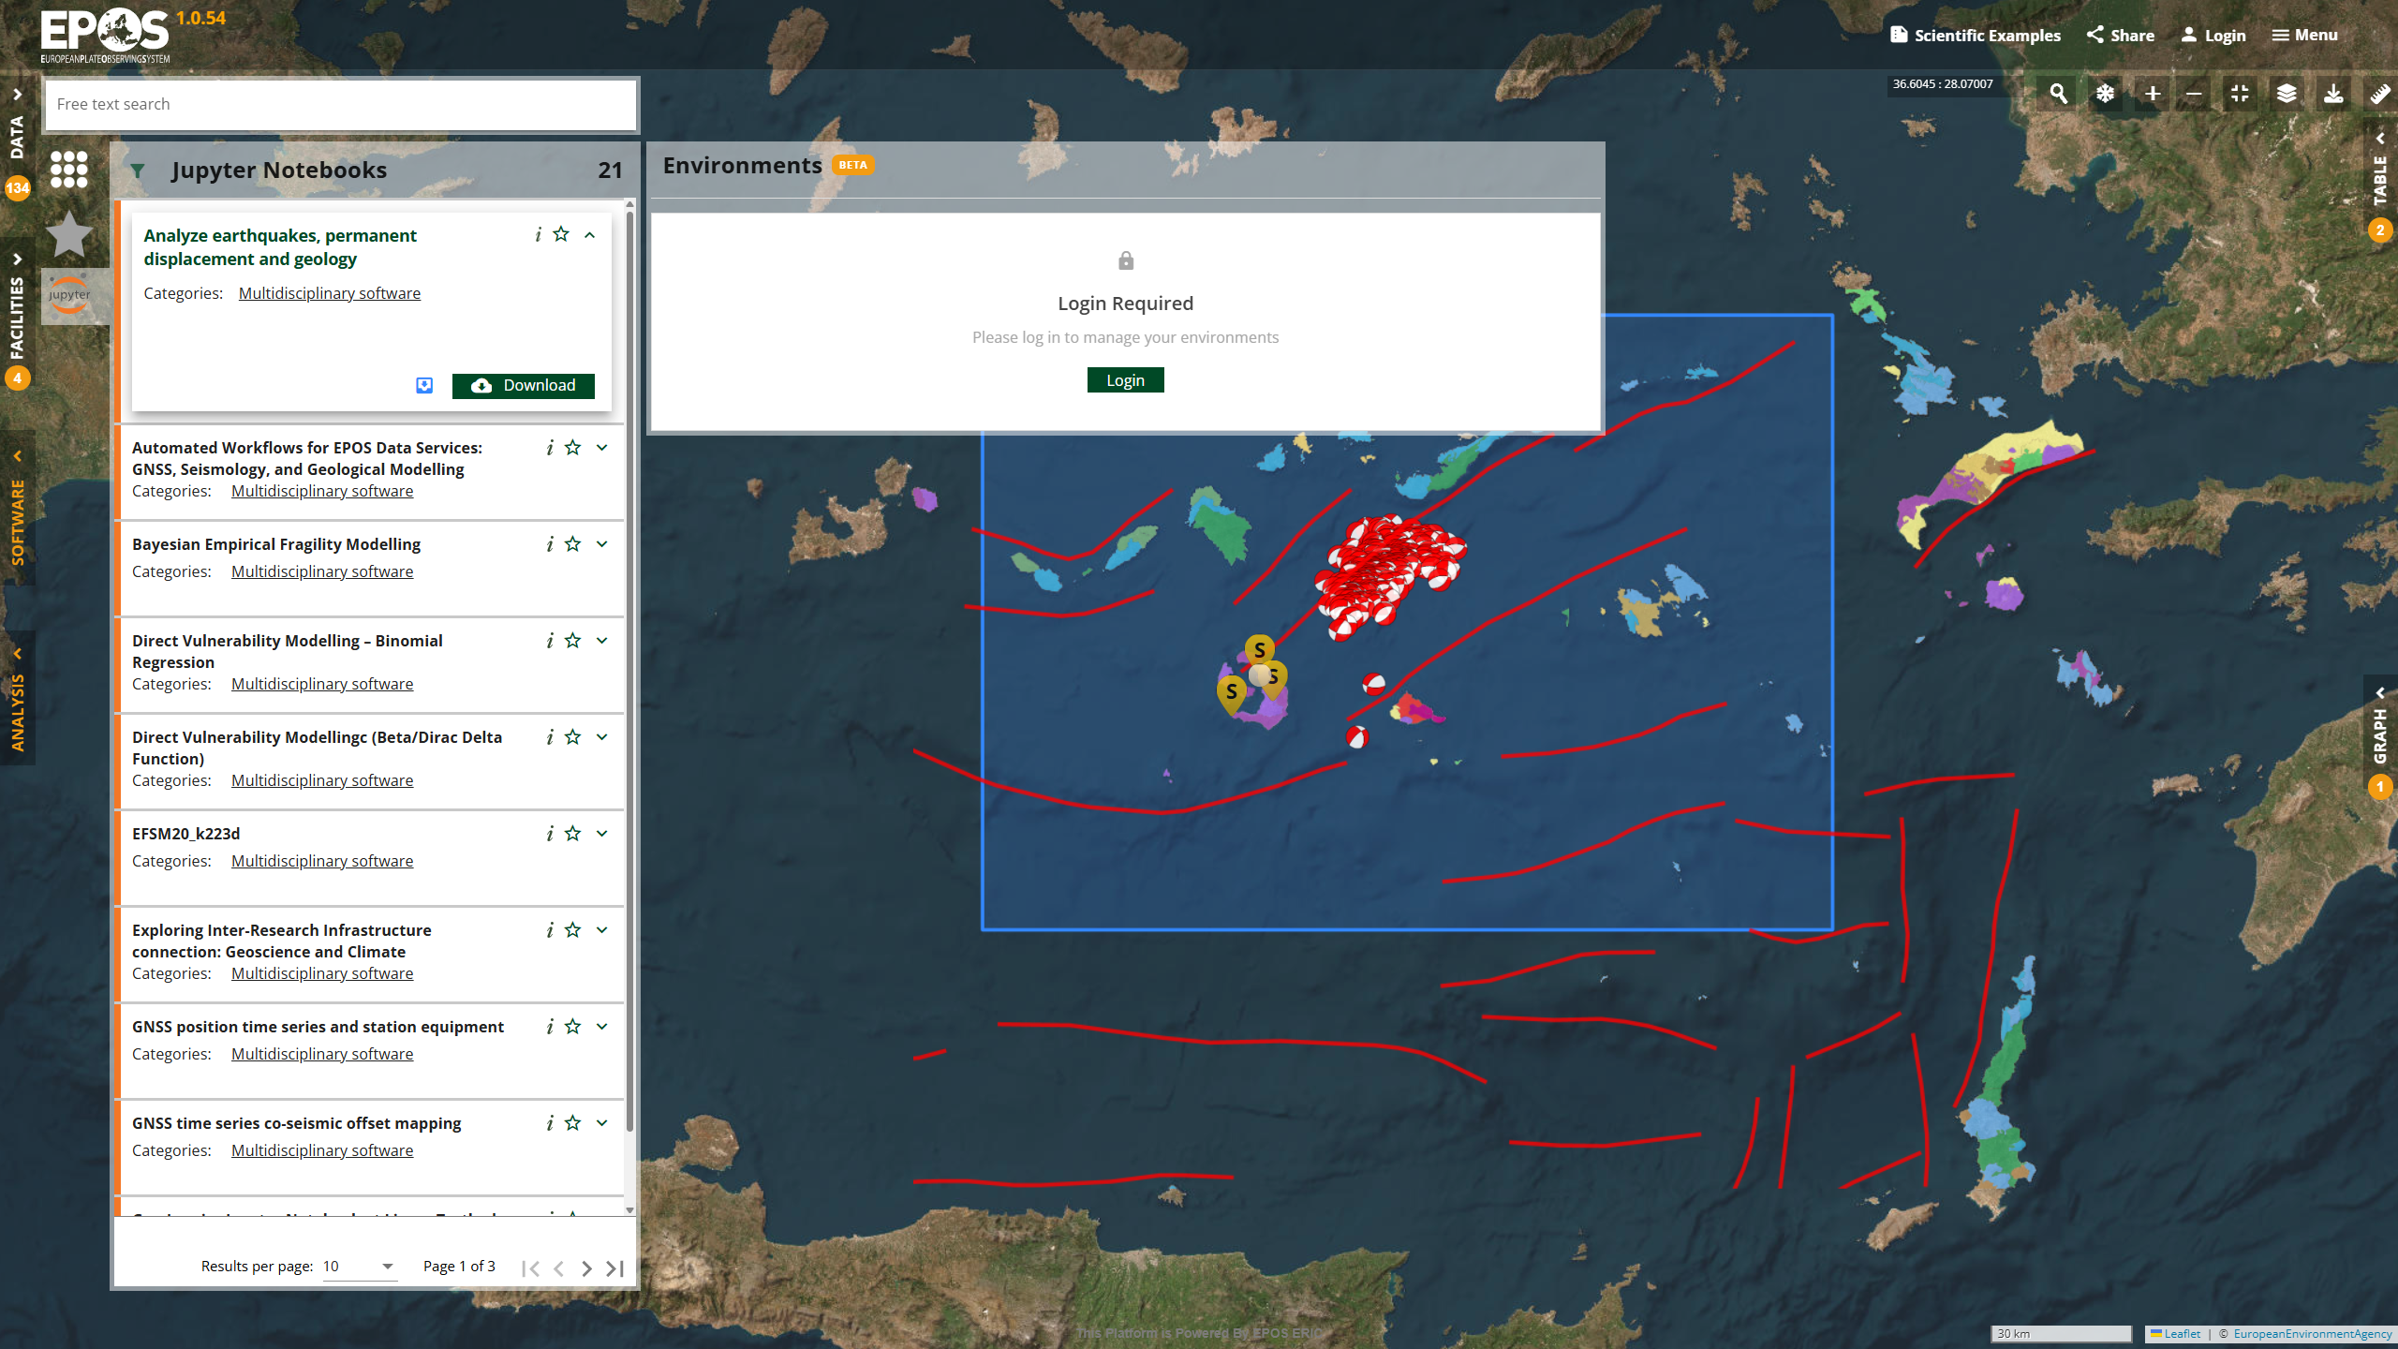
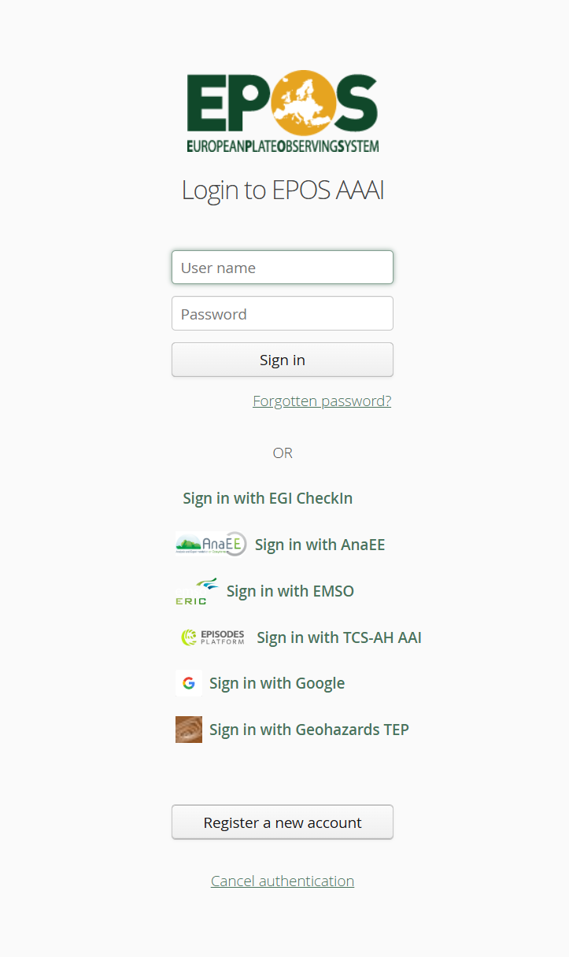

Slide 40
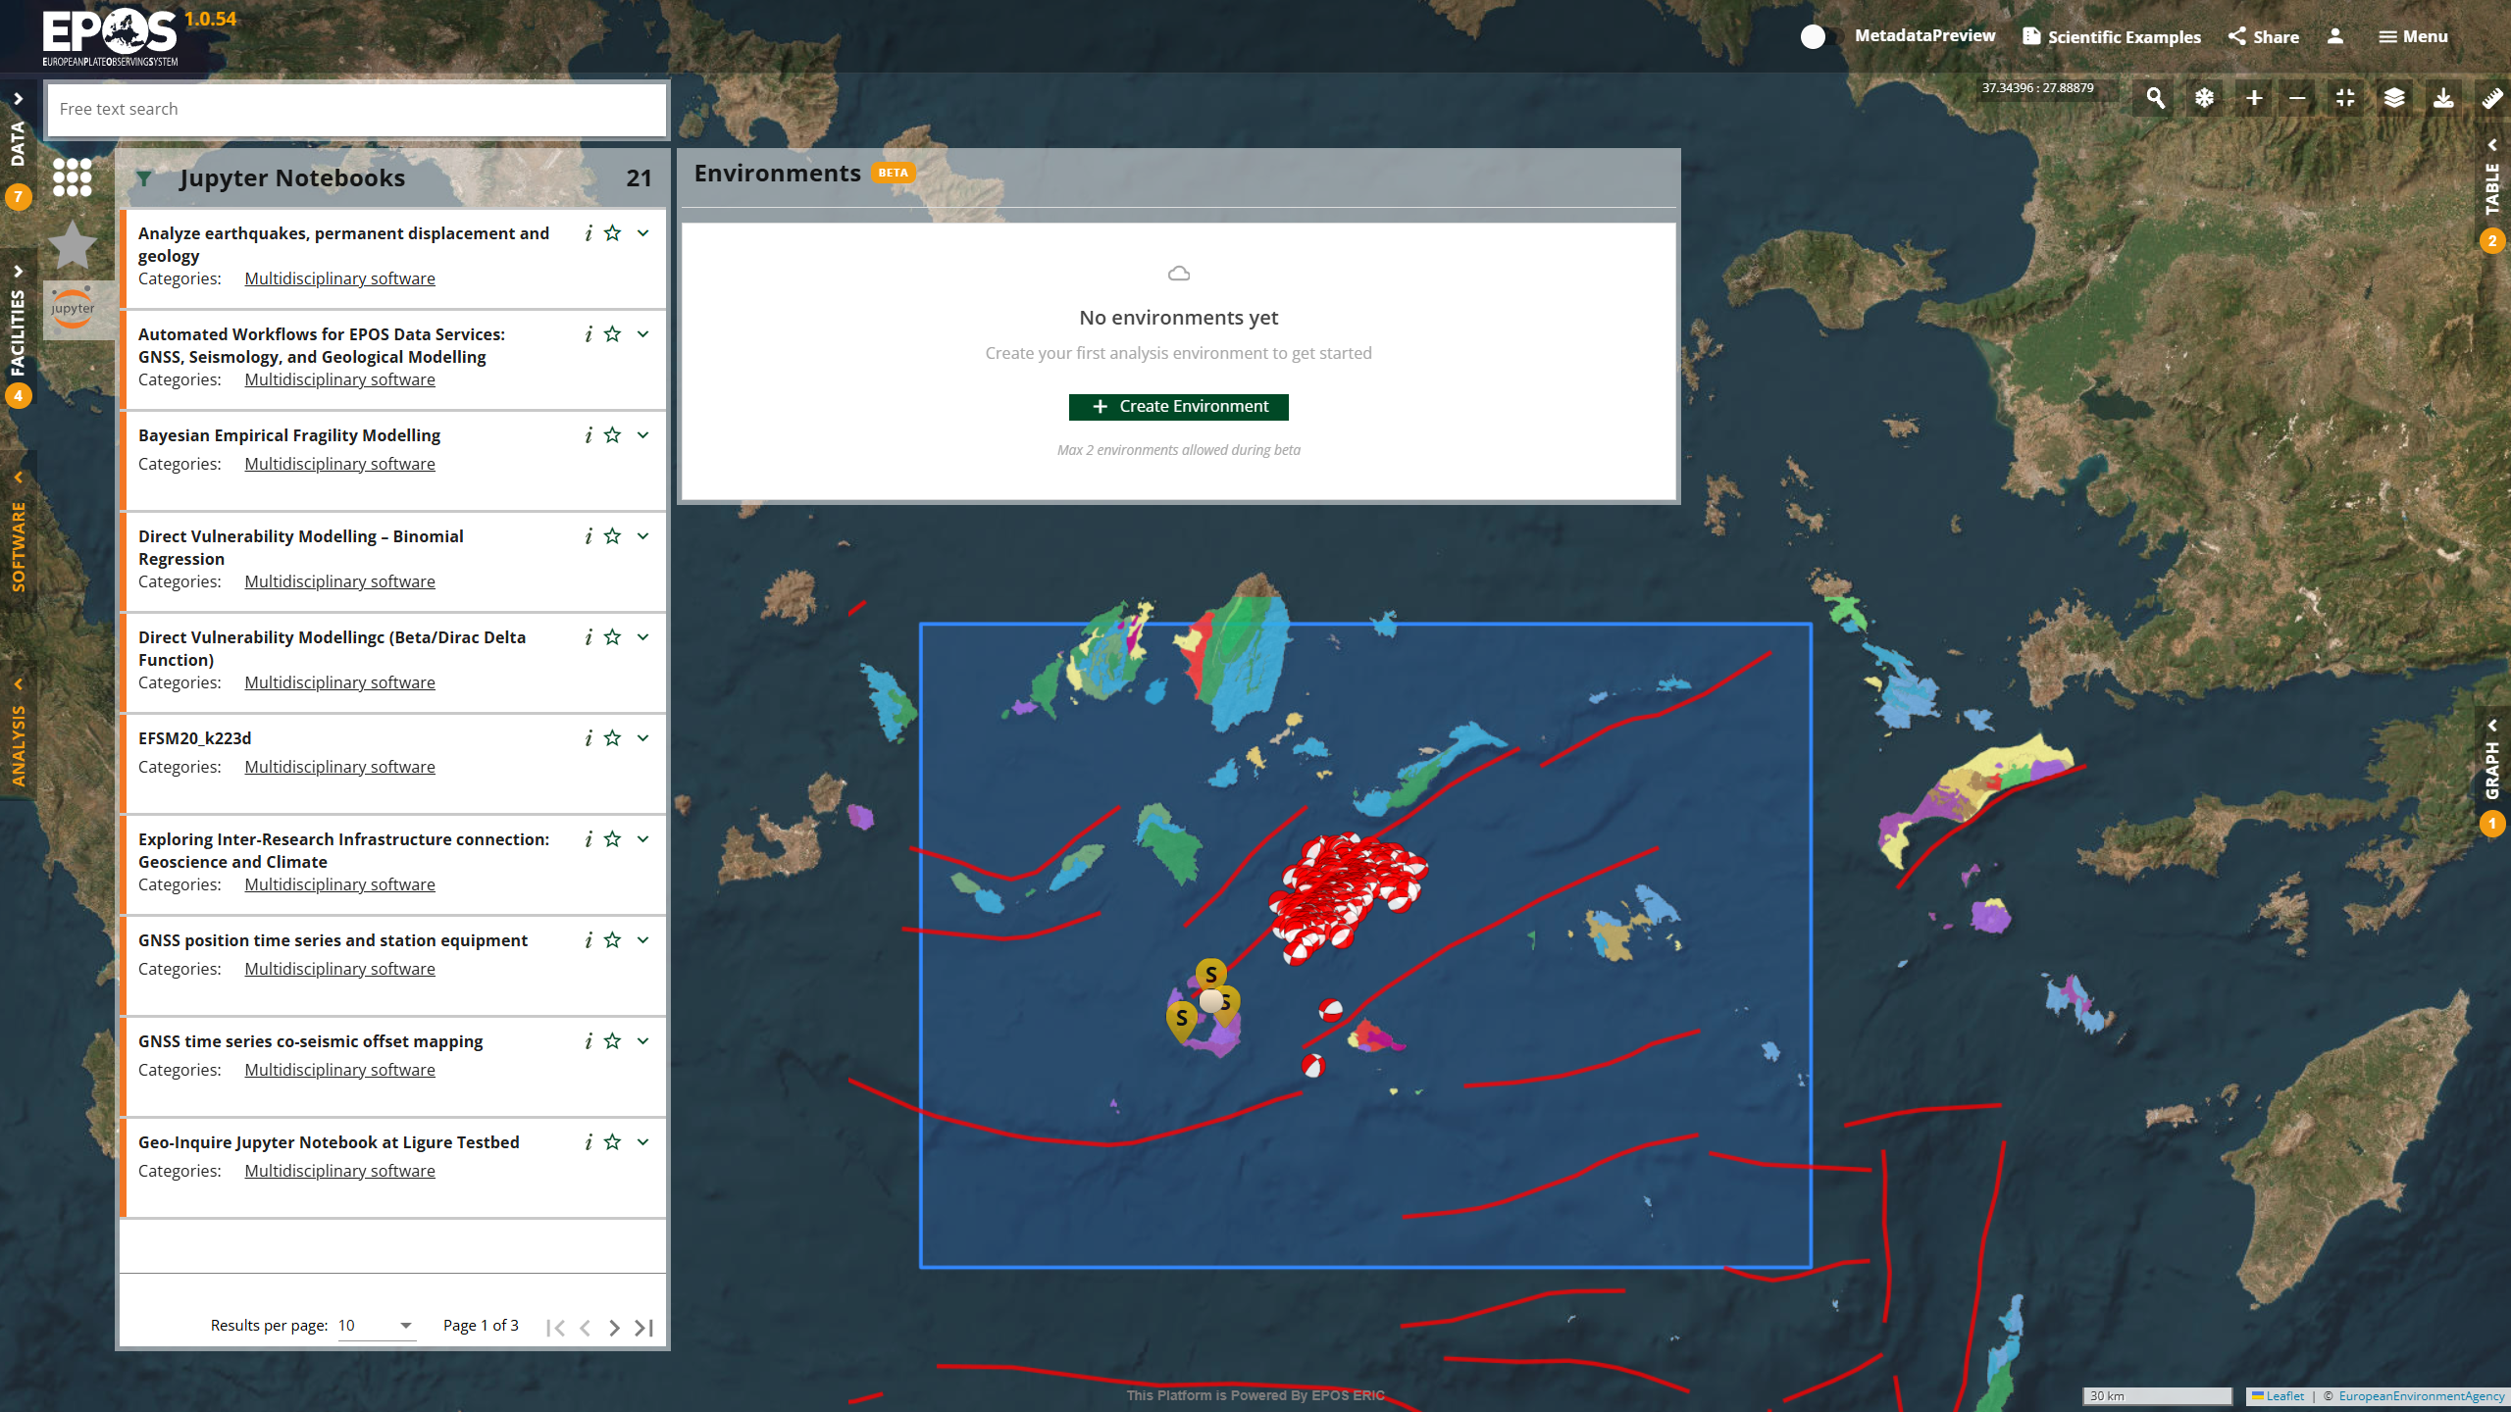

Slide 41
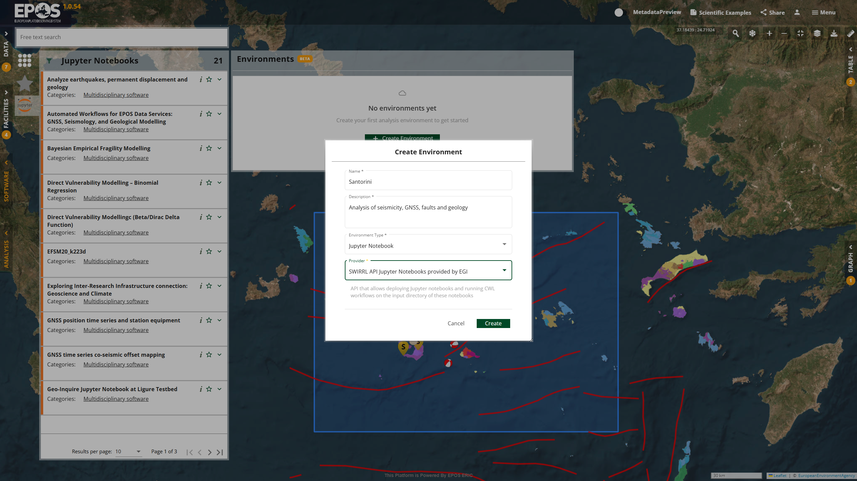

Slide 42
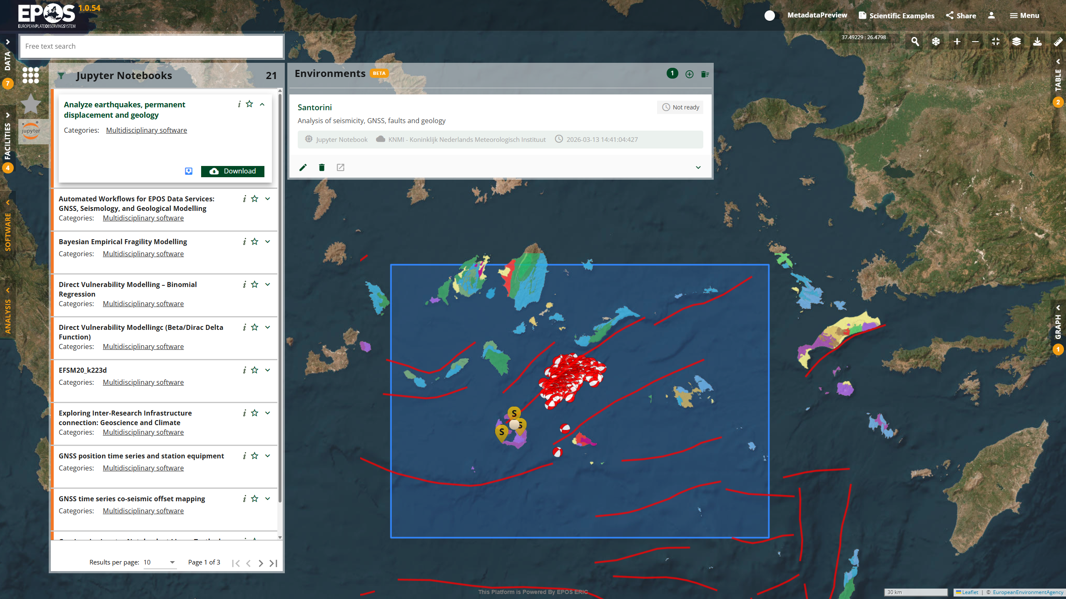

Slide 43
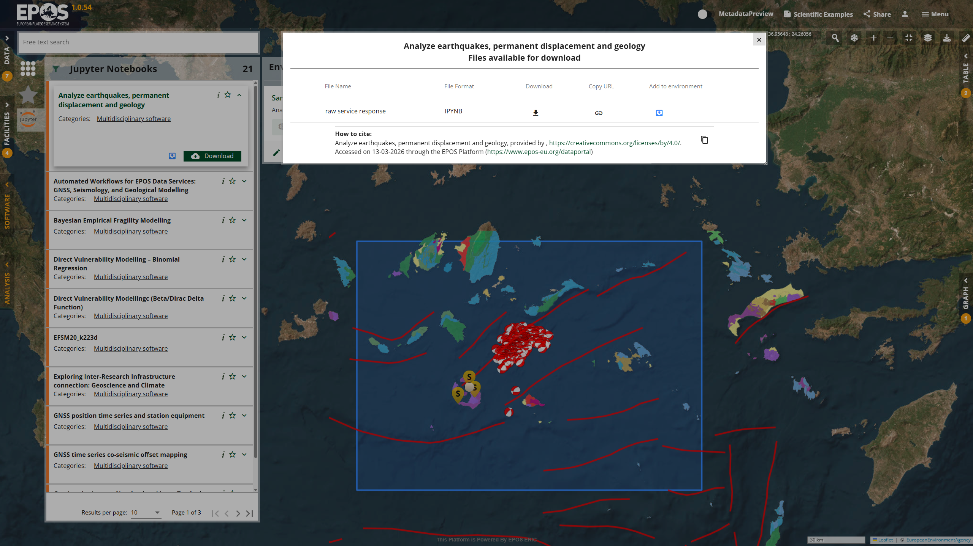

Slide 44
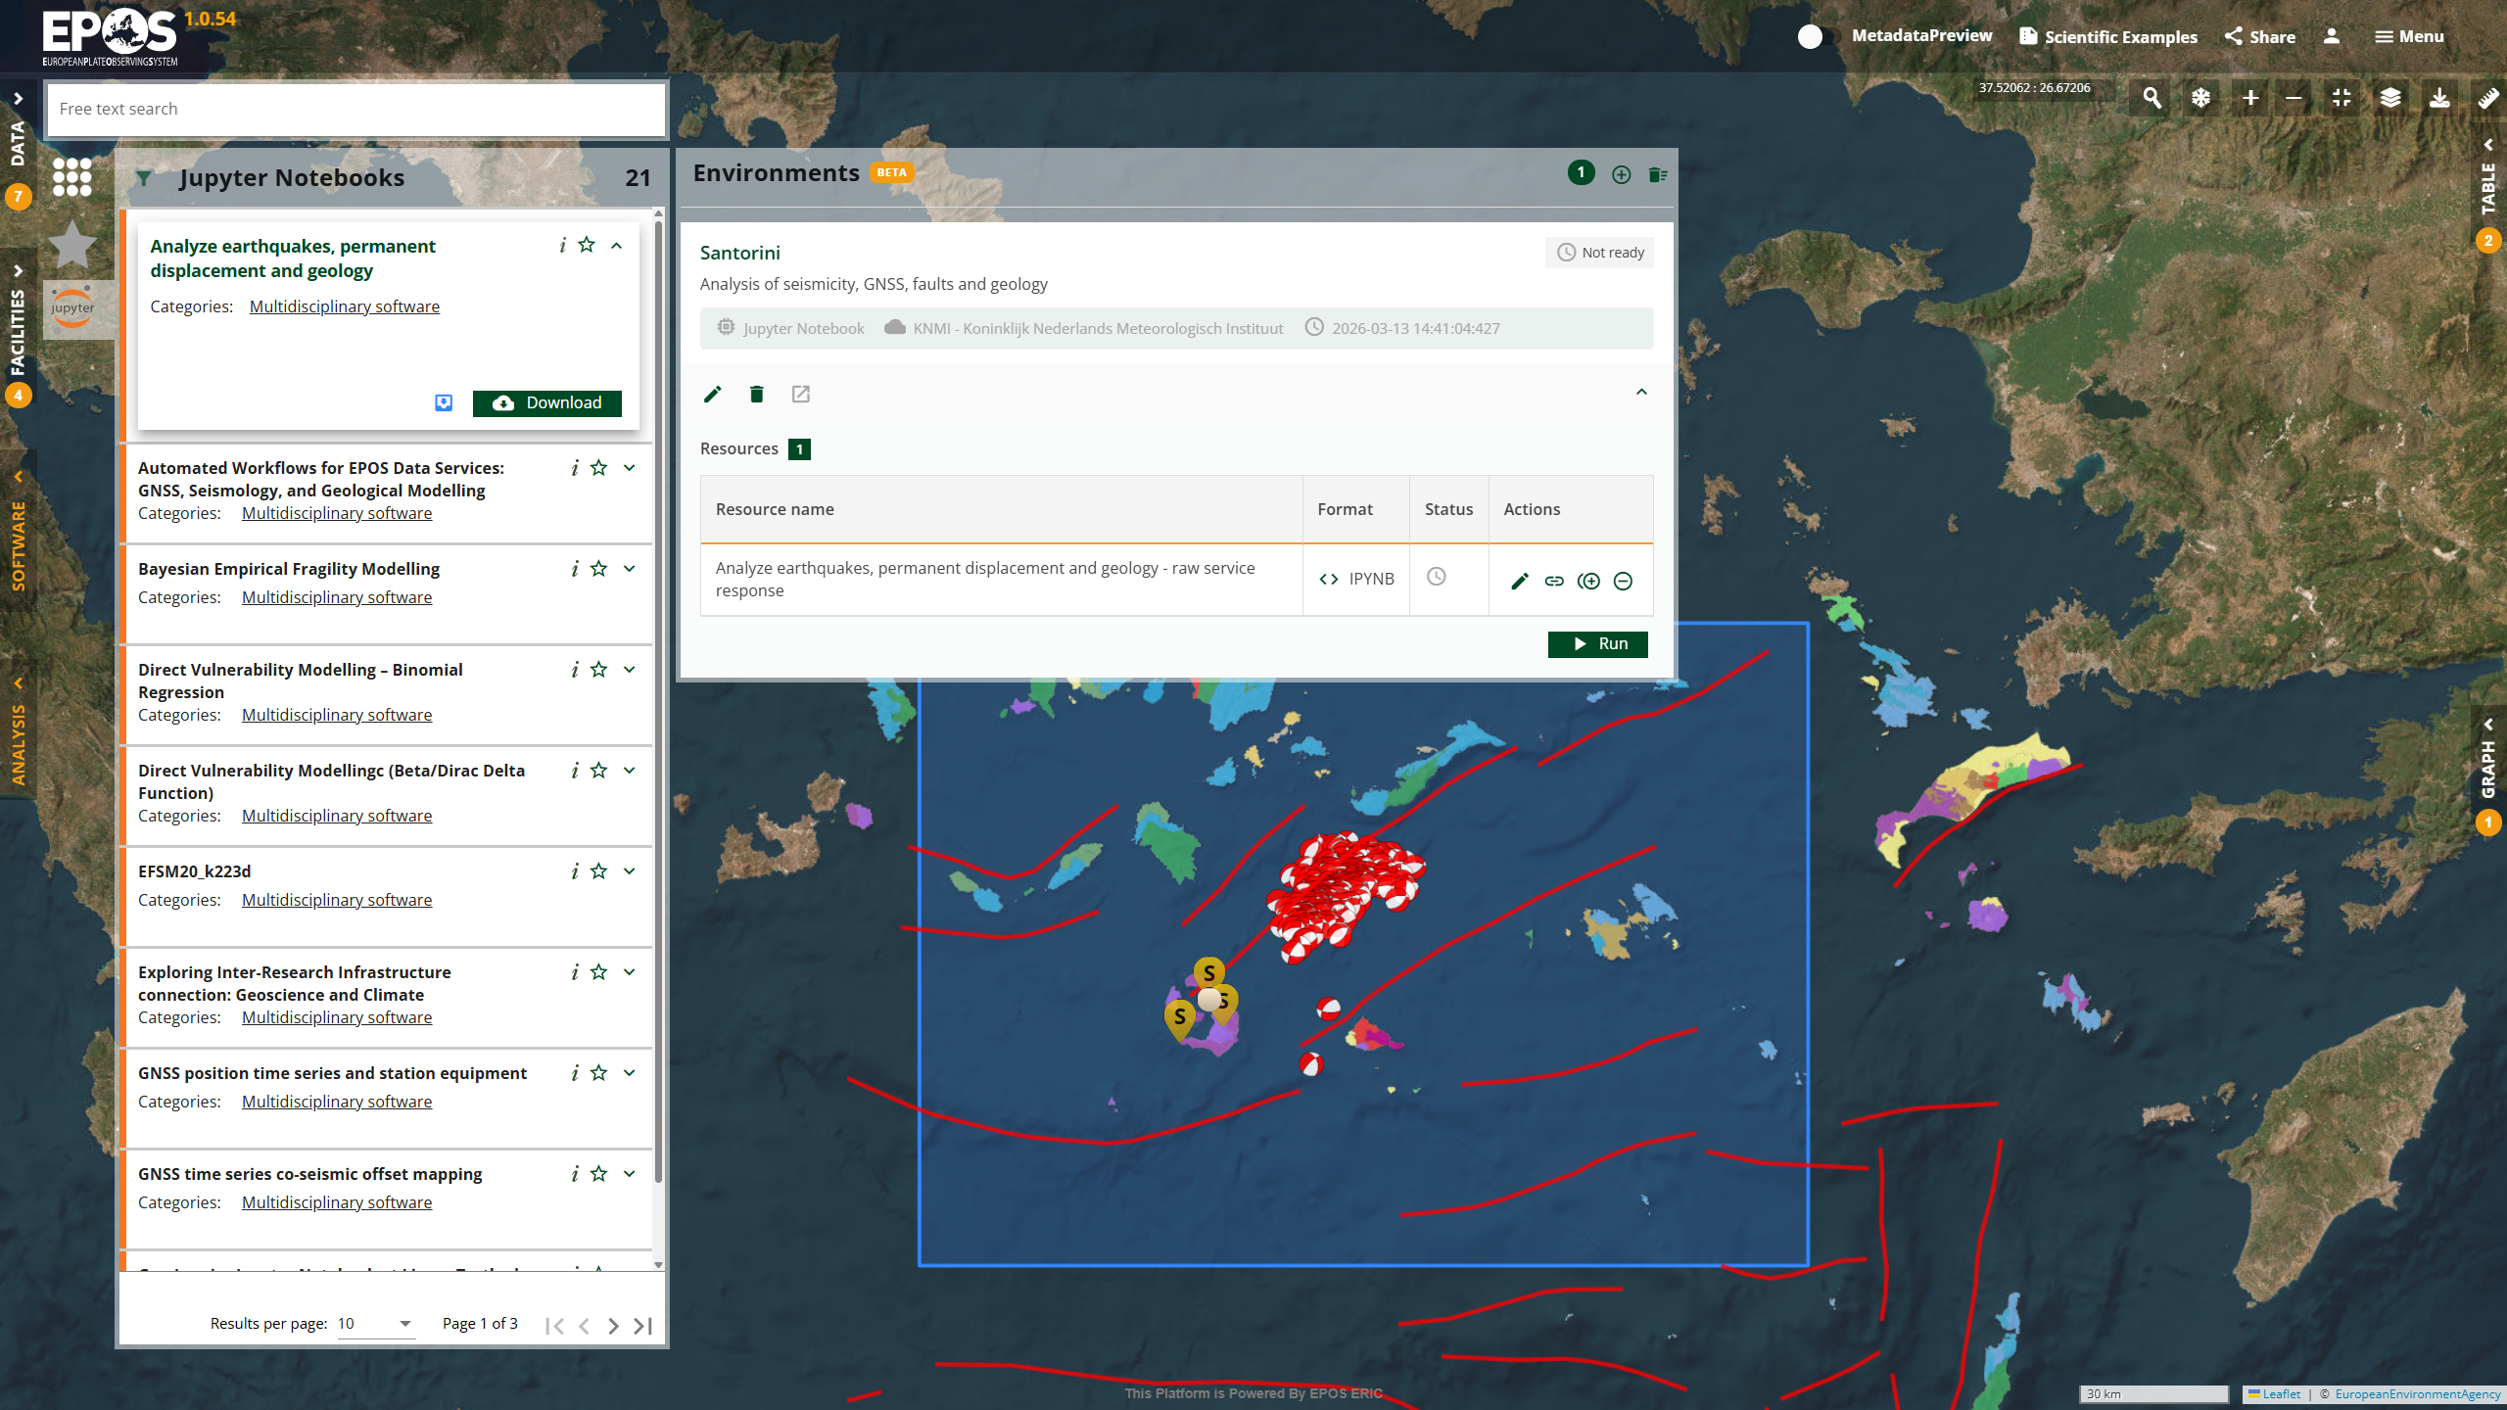

Slide 45
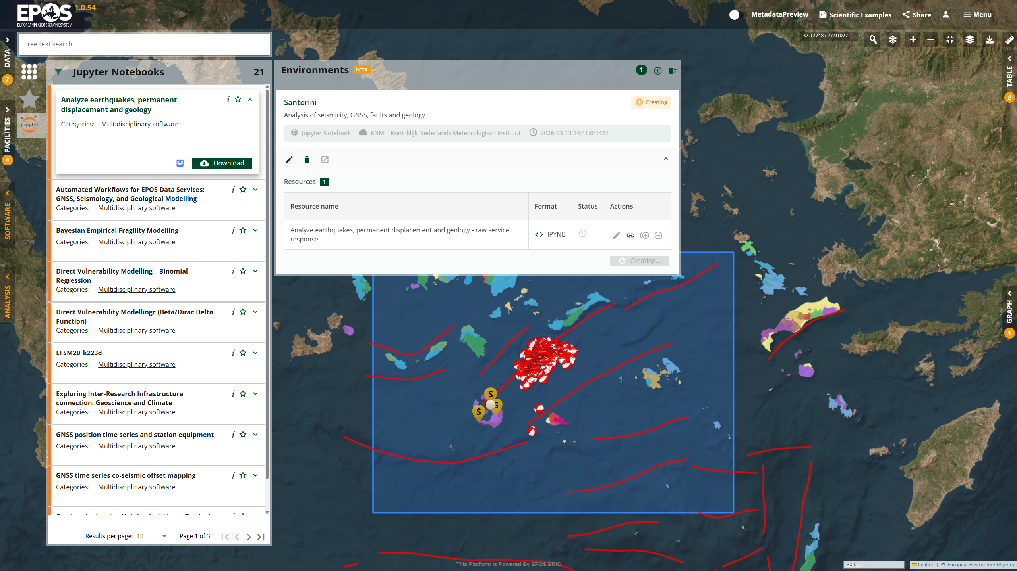

Slide 46
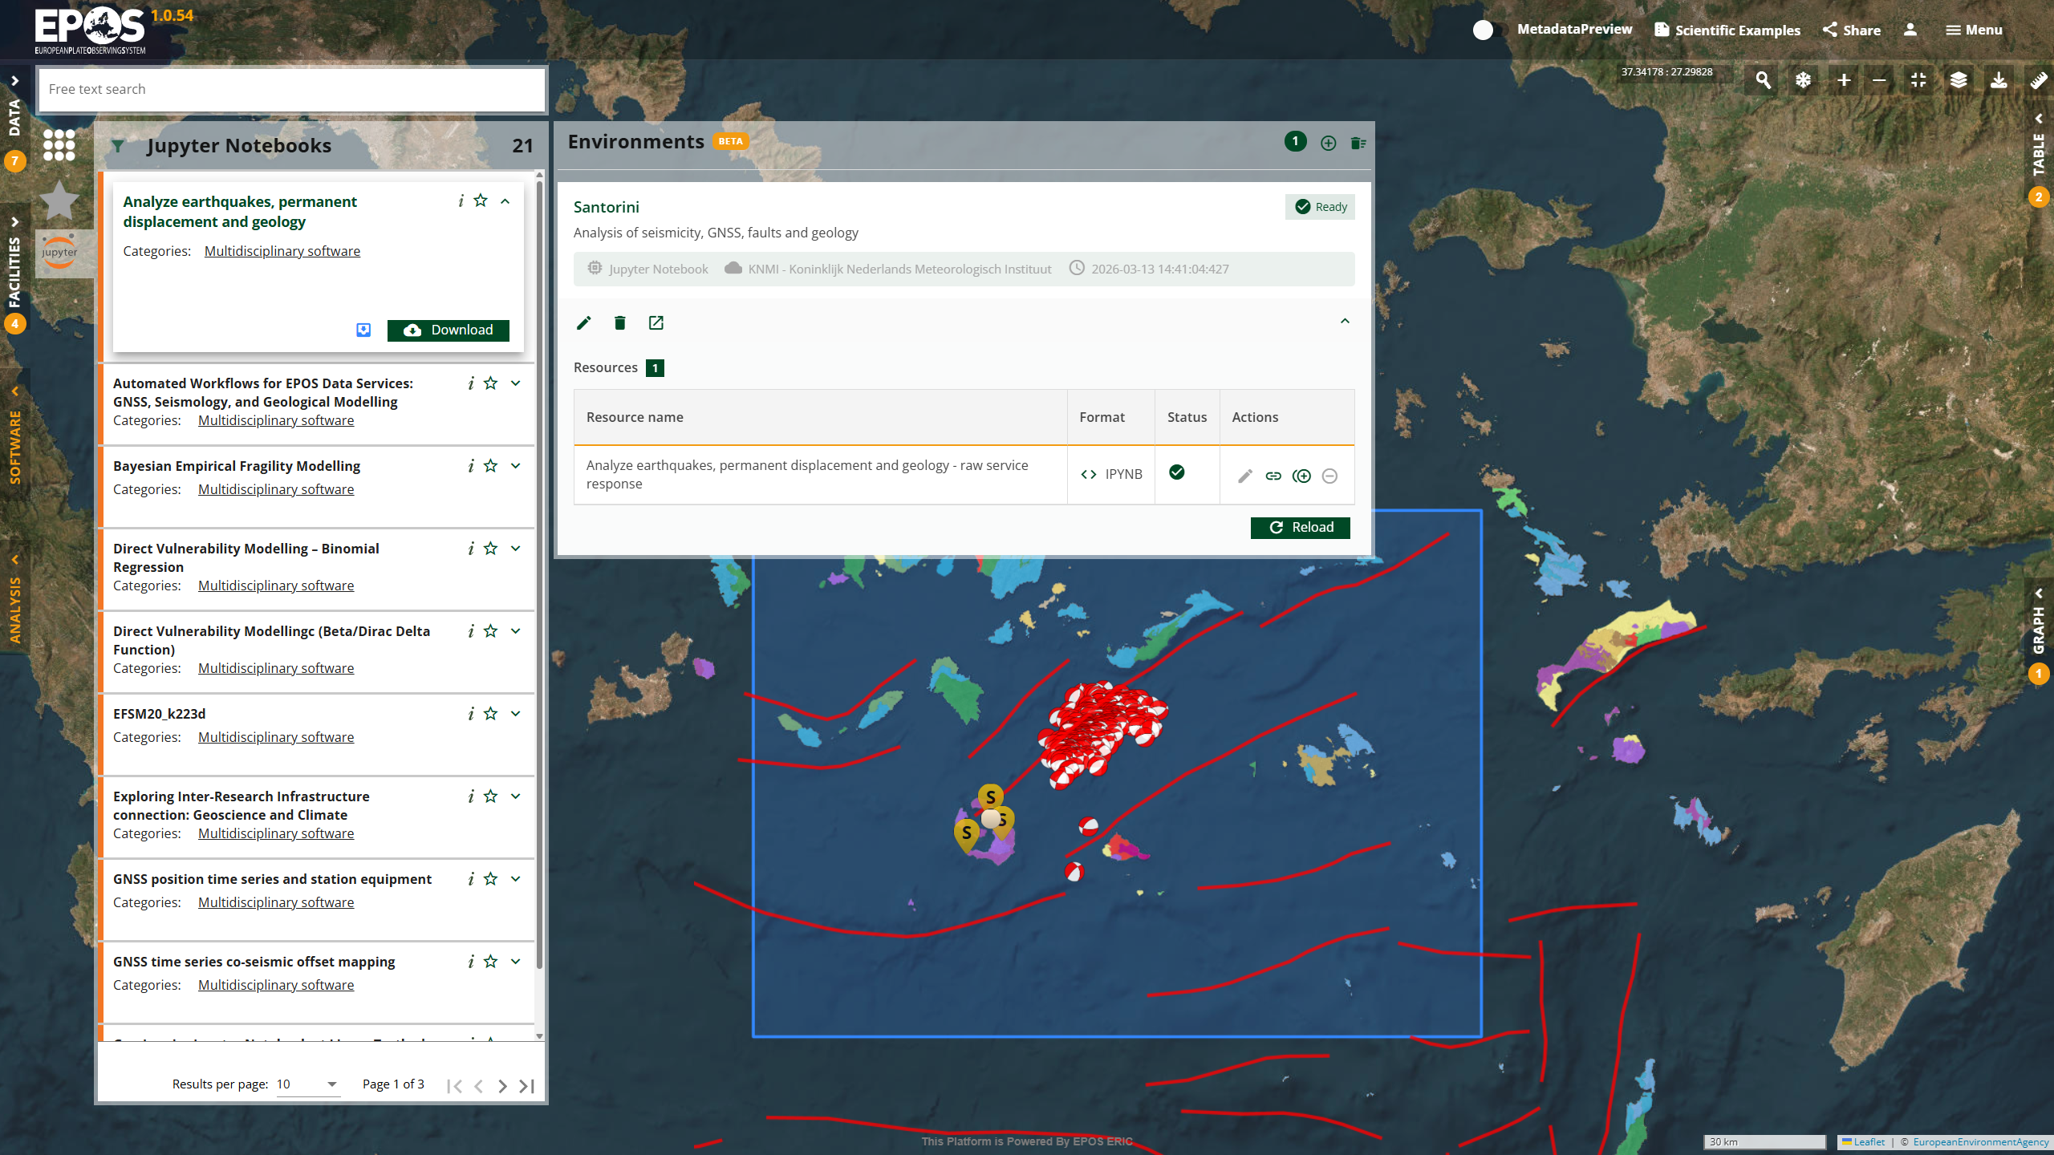
OPENS NEW WINDOW with VRE

Slide 47
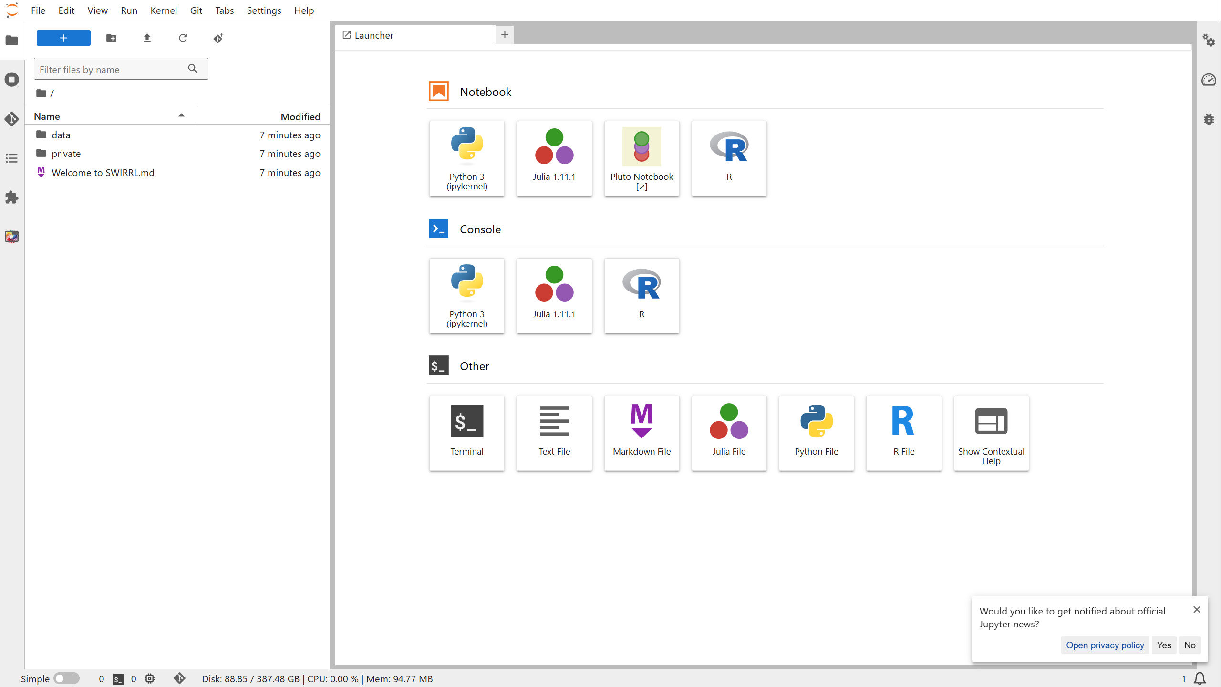

Slide 48
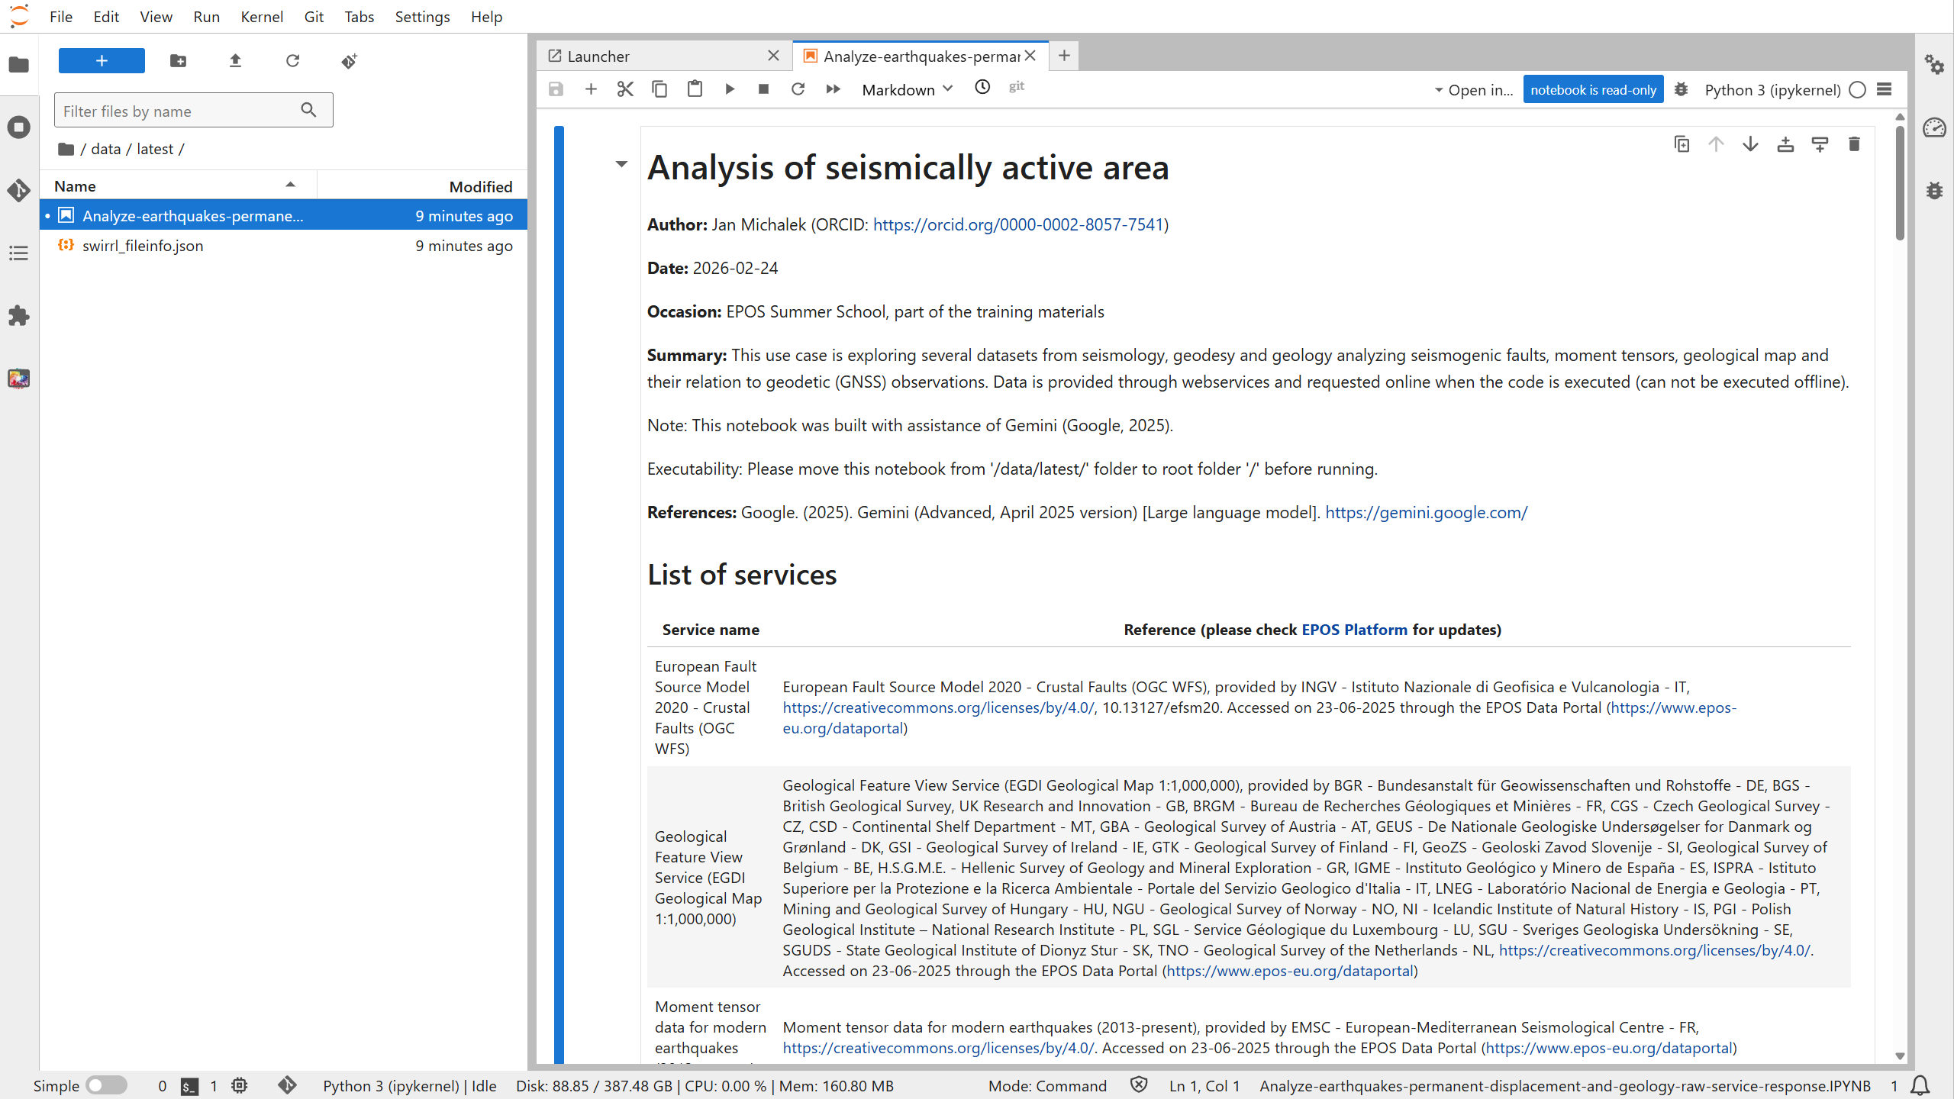

Slide 49
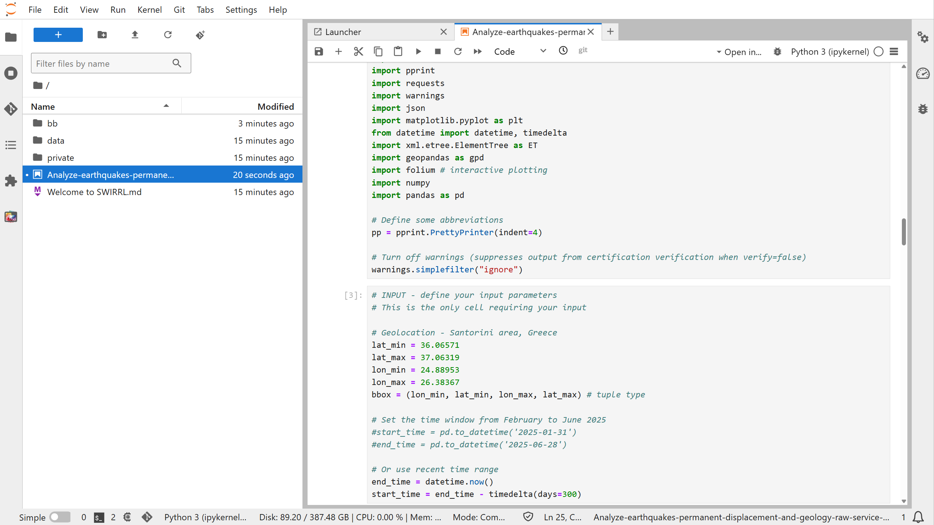

Slide 50
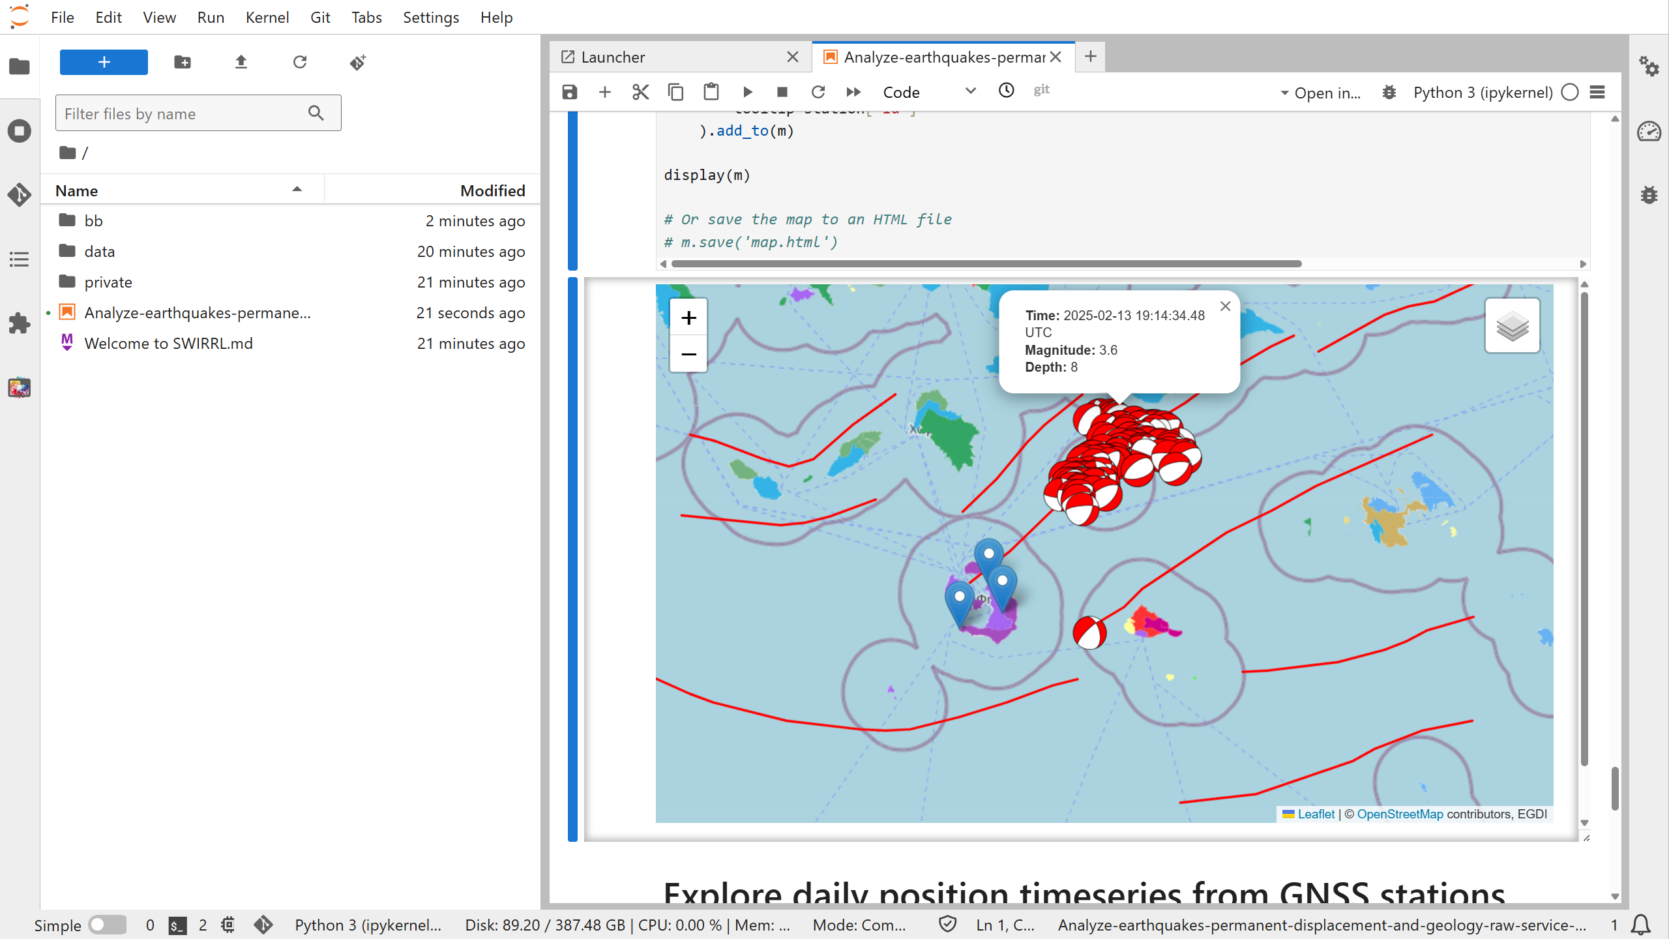

Slide 51
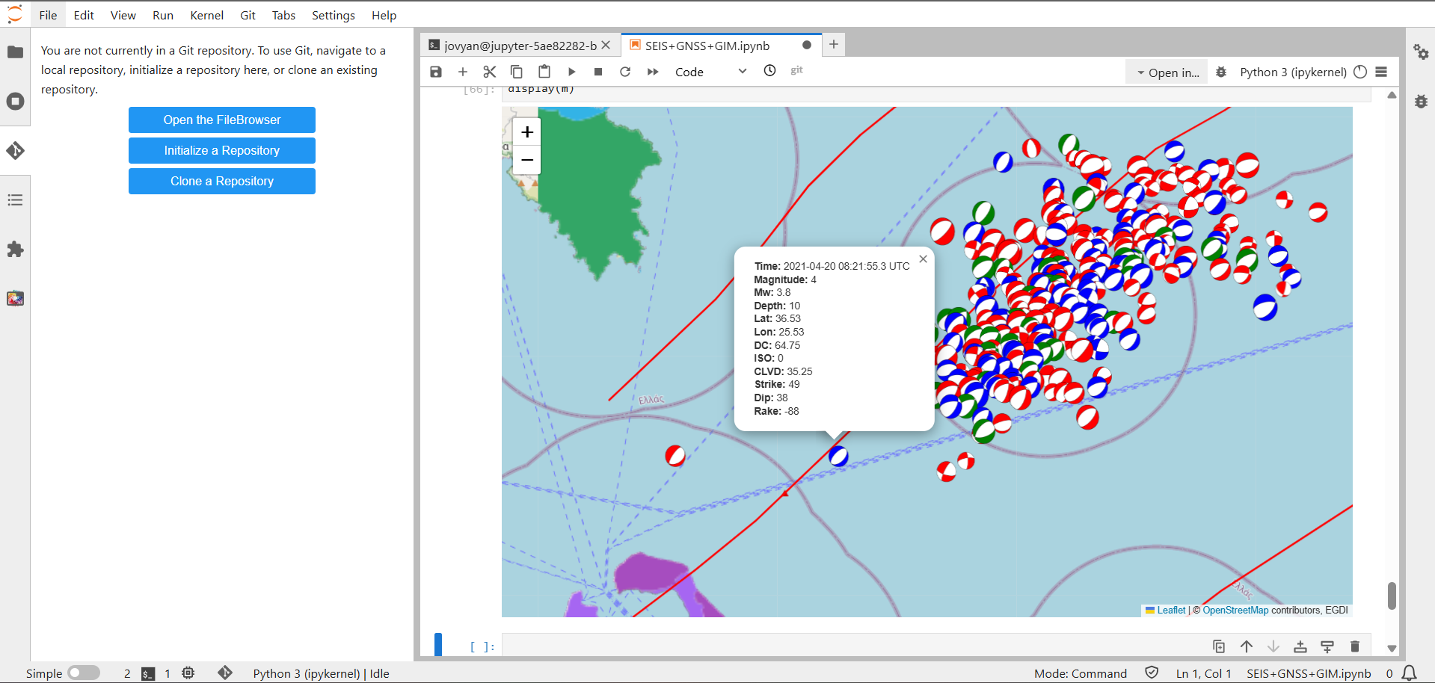
Interactive plot using folium library
Moment tensors scaled by magnitude and categorized by CLVD percentage:
blue … > 20%;
green … 10-20%;
red … < 10%

Slide 52
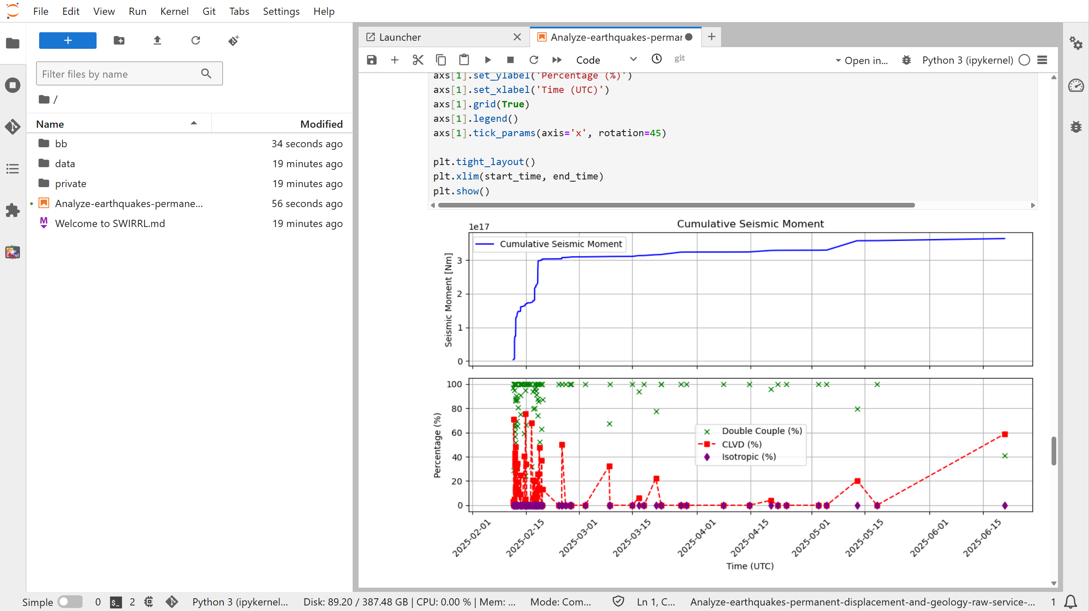

Slide 53
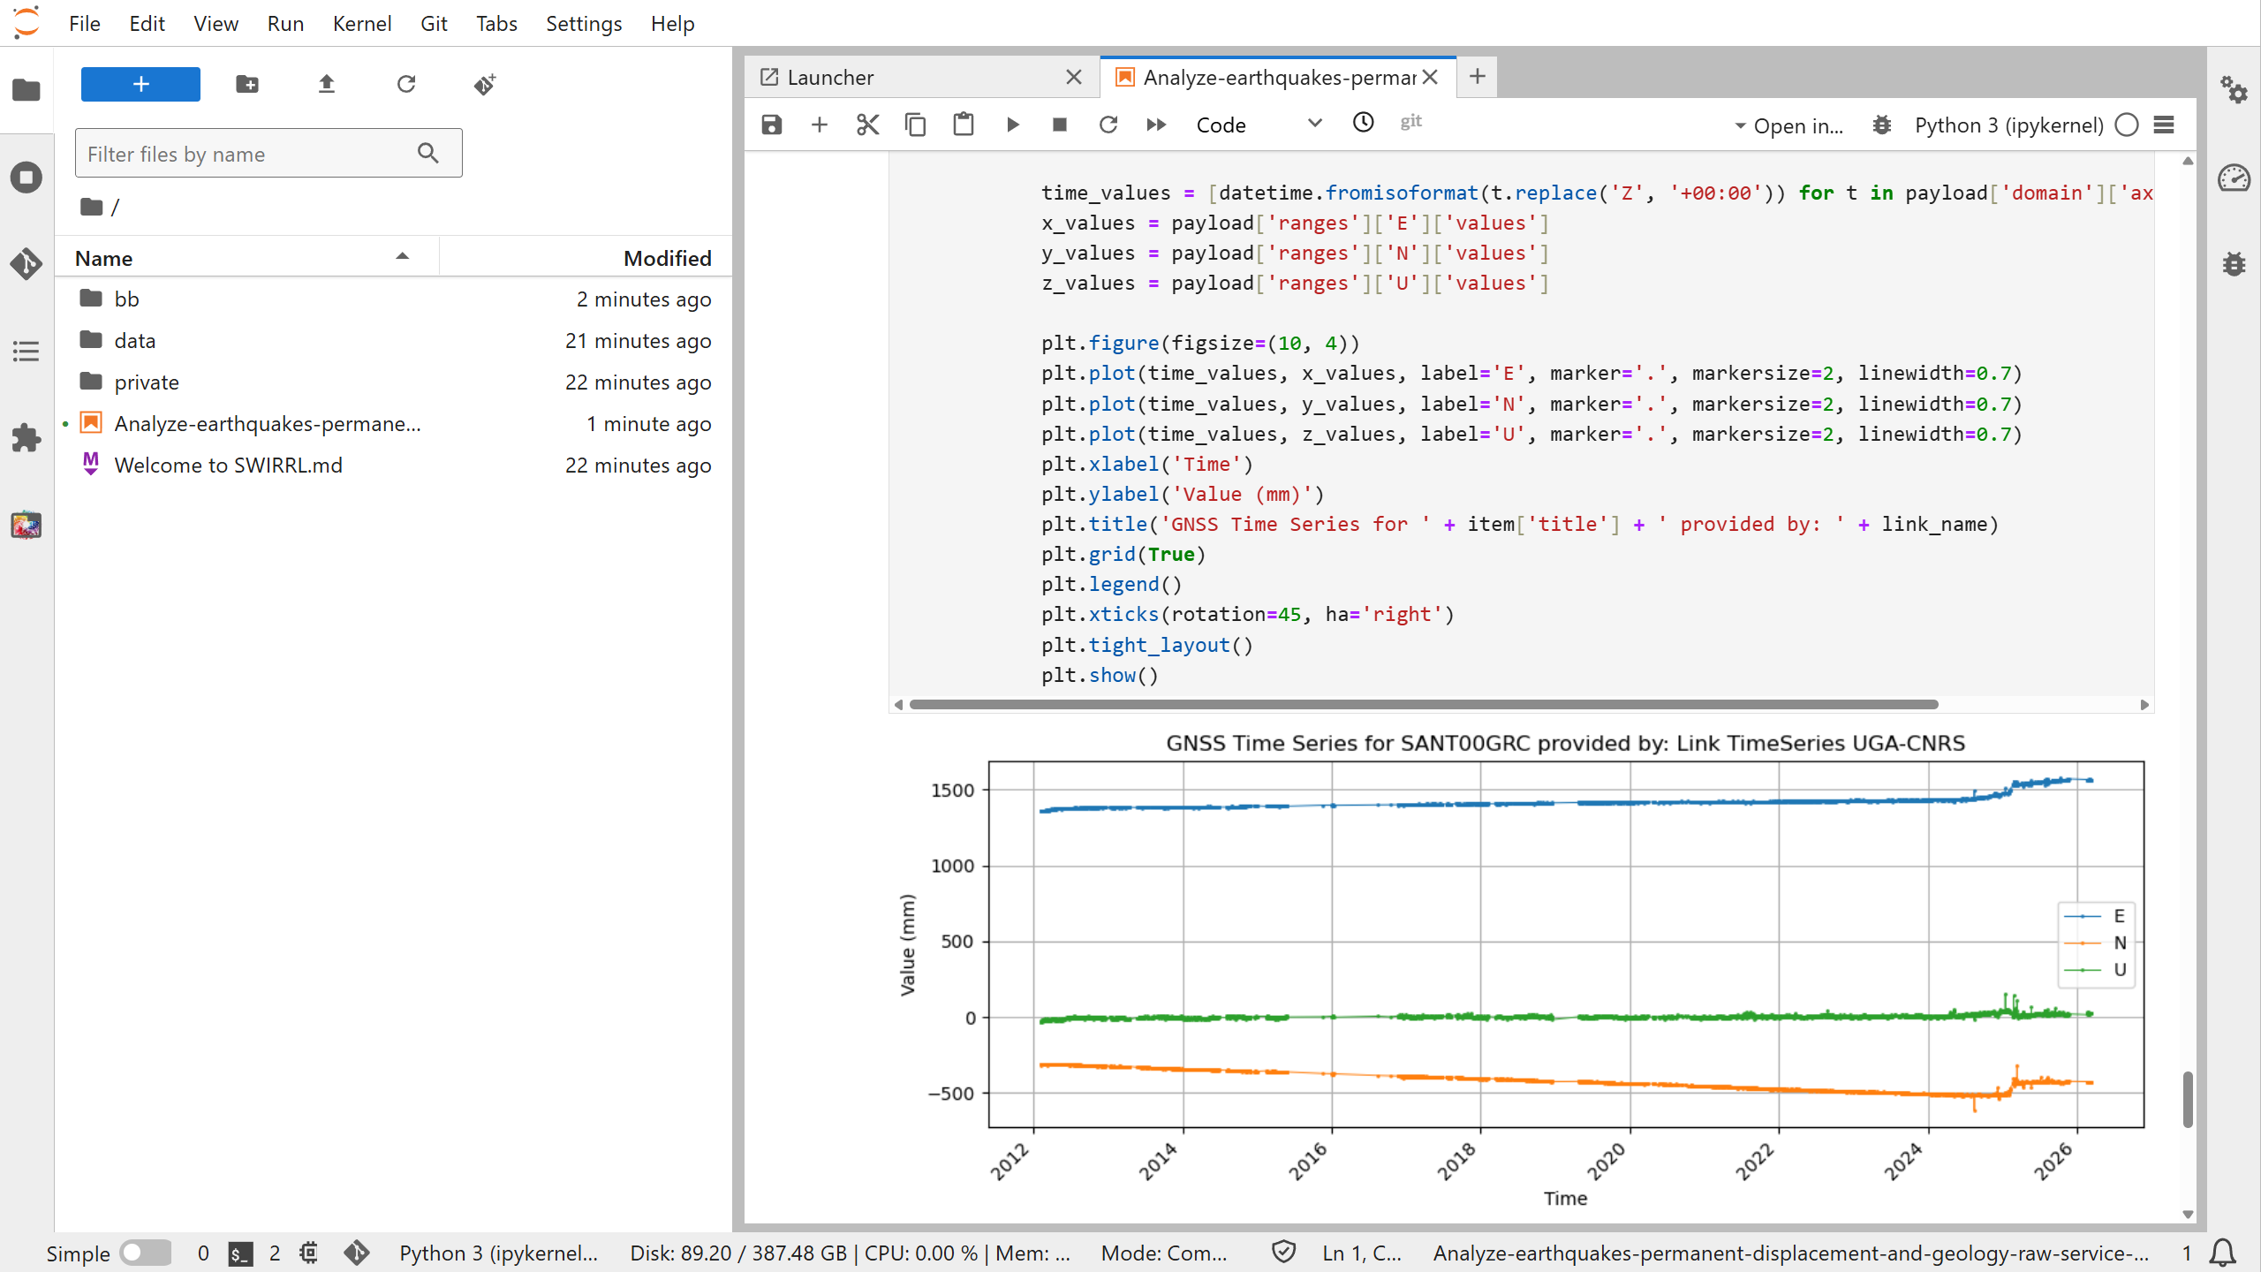
Interactive plot using folium library
Moment tensors scaled by magnitude and categorized by CLVD percentage: blue … > 20%; green … 10-20%; red … < 10%

Slide 54
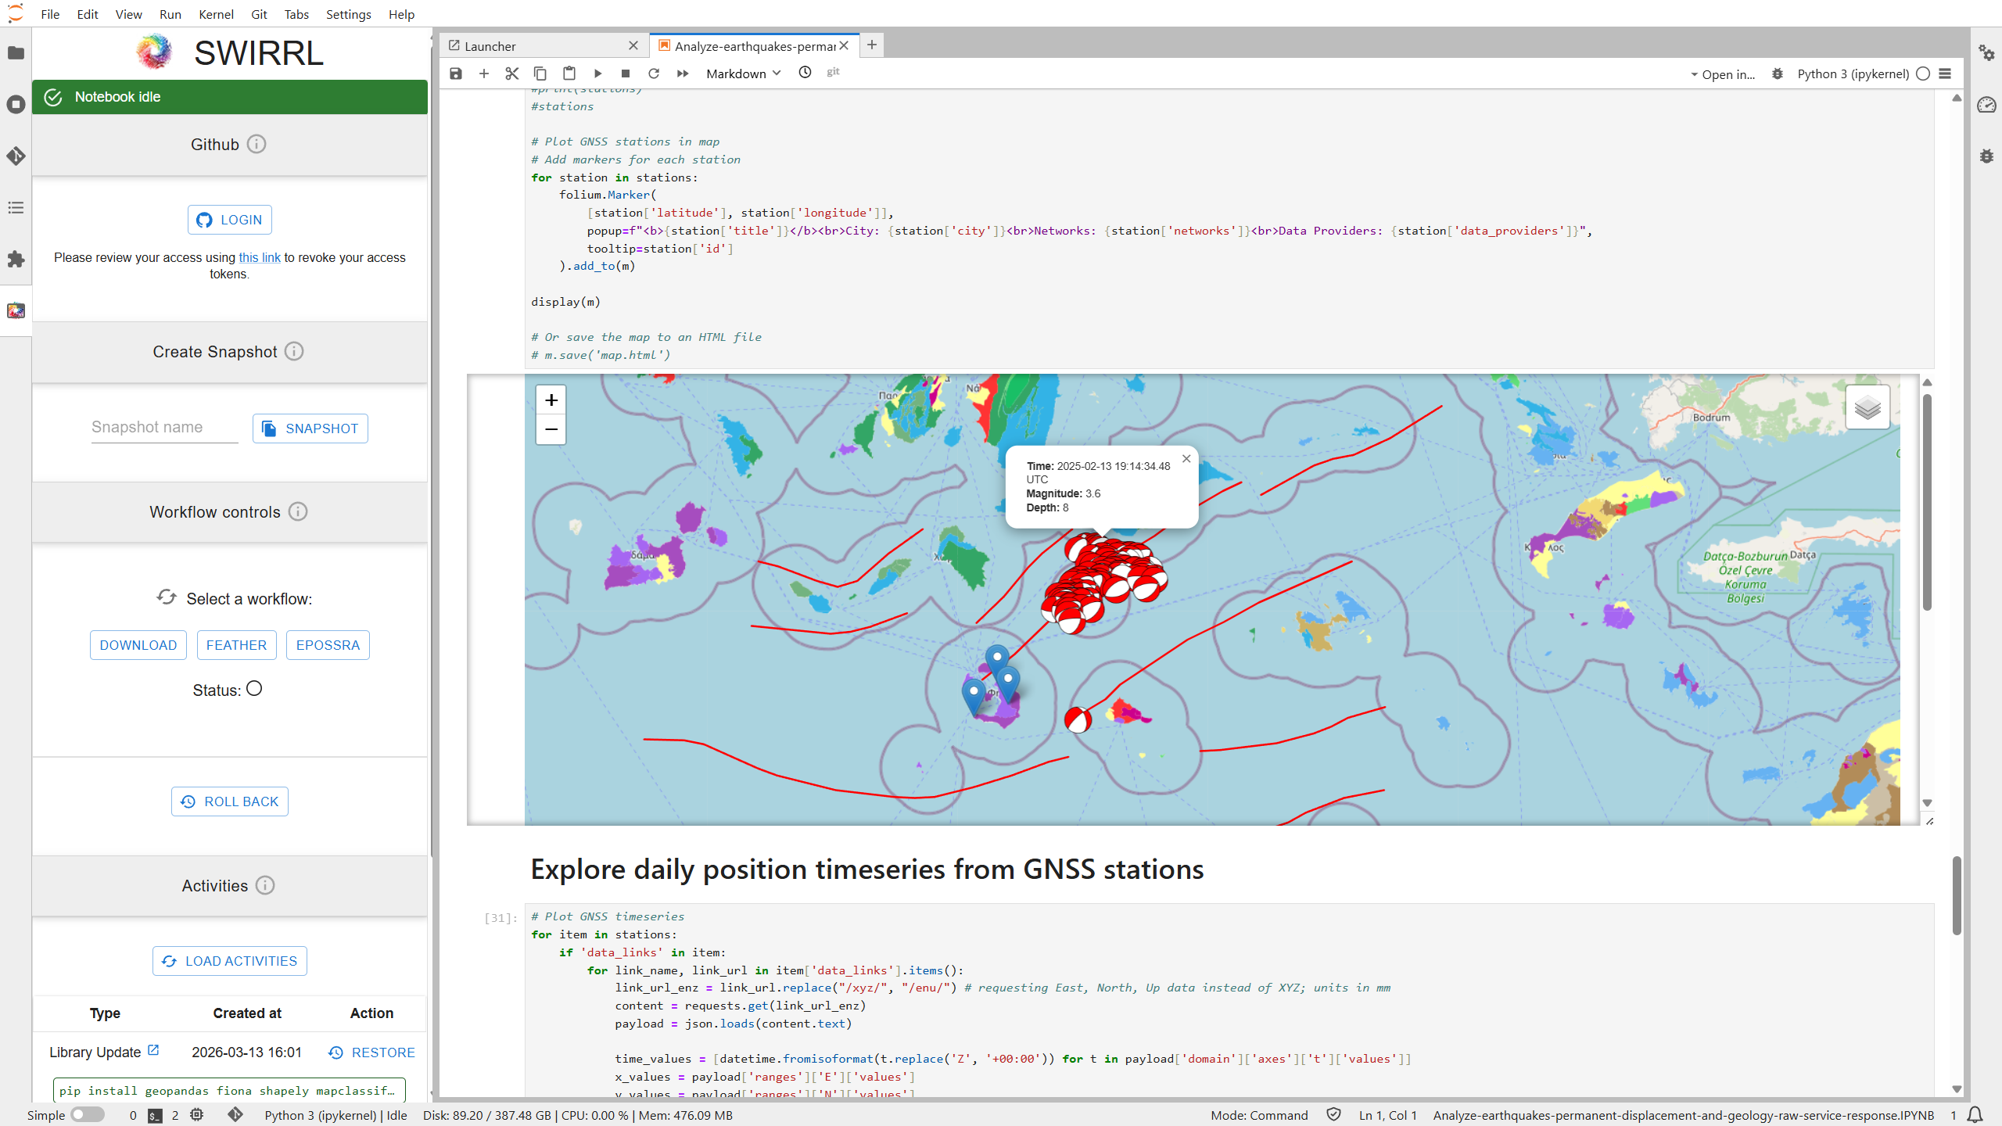

Slide 56
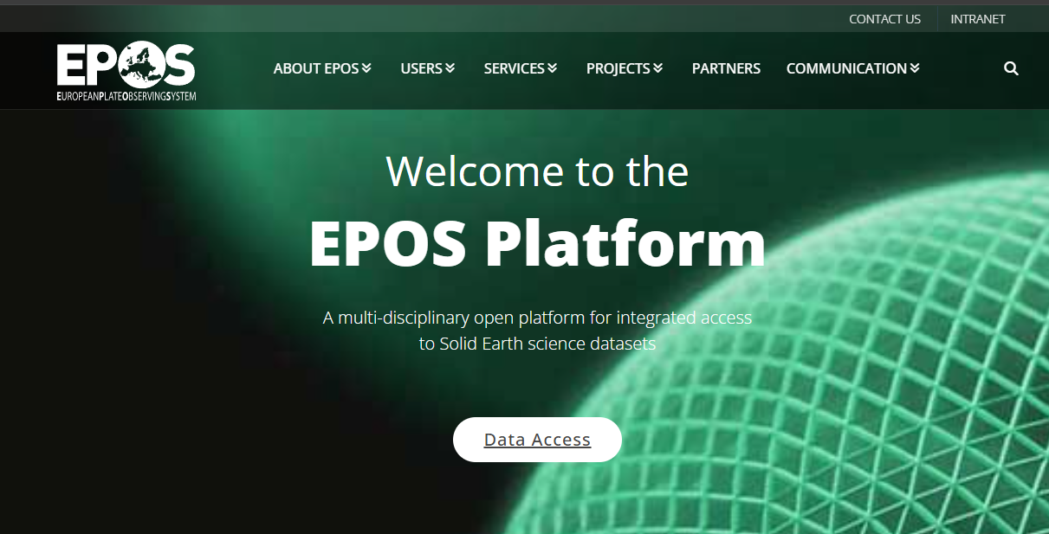

Thank you for your attention!

Slide 57
Thank you!

