Slide 1

EPOS Platform Platform introduction and context
Daniele Bailo

Slide 2
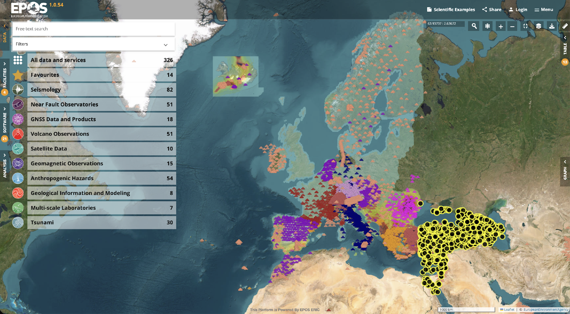
EPOS Platform Today
https://www.ics-c.epos-eu.org/

Slide 3
EPOS Platform Today
🌐 326 Services
📈 38,663 visits since 2020
🧾 ~329,000 lines of source code developed
🔧 ~30,000 GitLab commits every year
🐞 ~20,056 known bugs fixed
☕ ~150 liters of coffee drunk every year per developer
💾 Several Petabytes of data
https://www.ics-c.epos-eu.org/

Slide 4


EPOS Platform wasn’t built in a day
(rather, in more than 10 years)

Slide 5
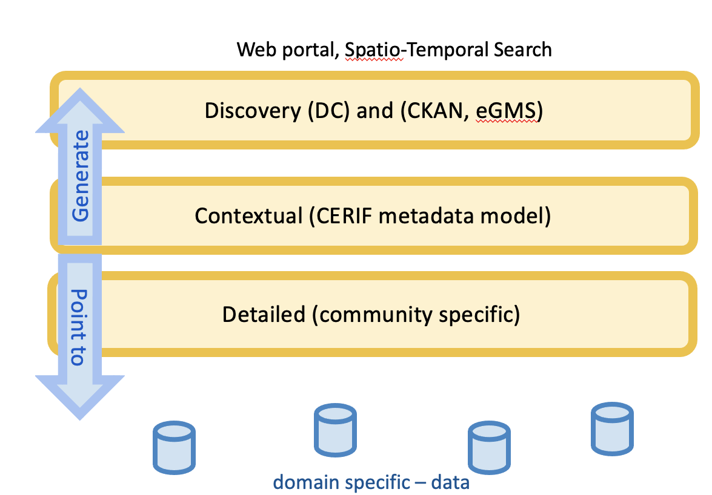
2012
Three layers model

Slide 6
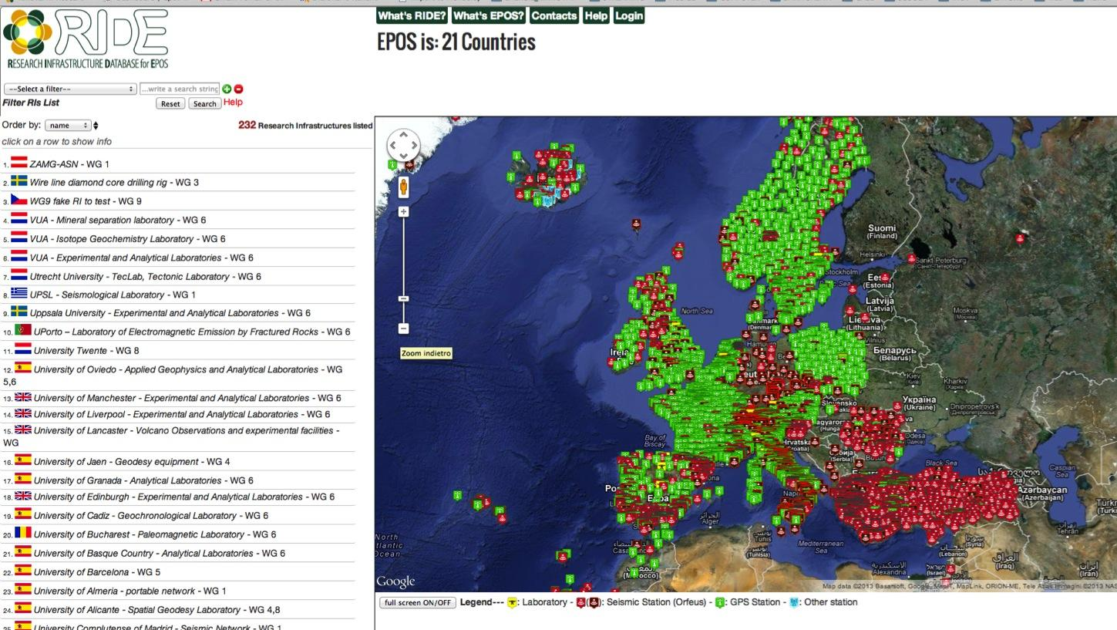
2013
RIDE Database

Slide 7
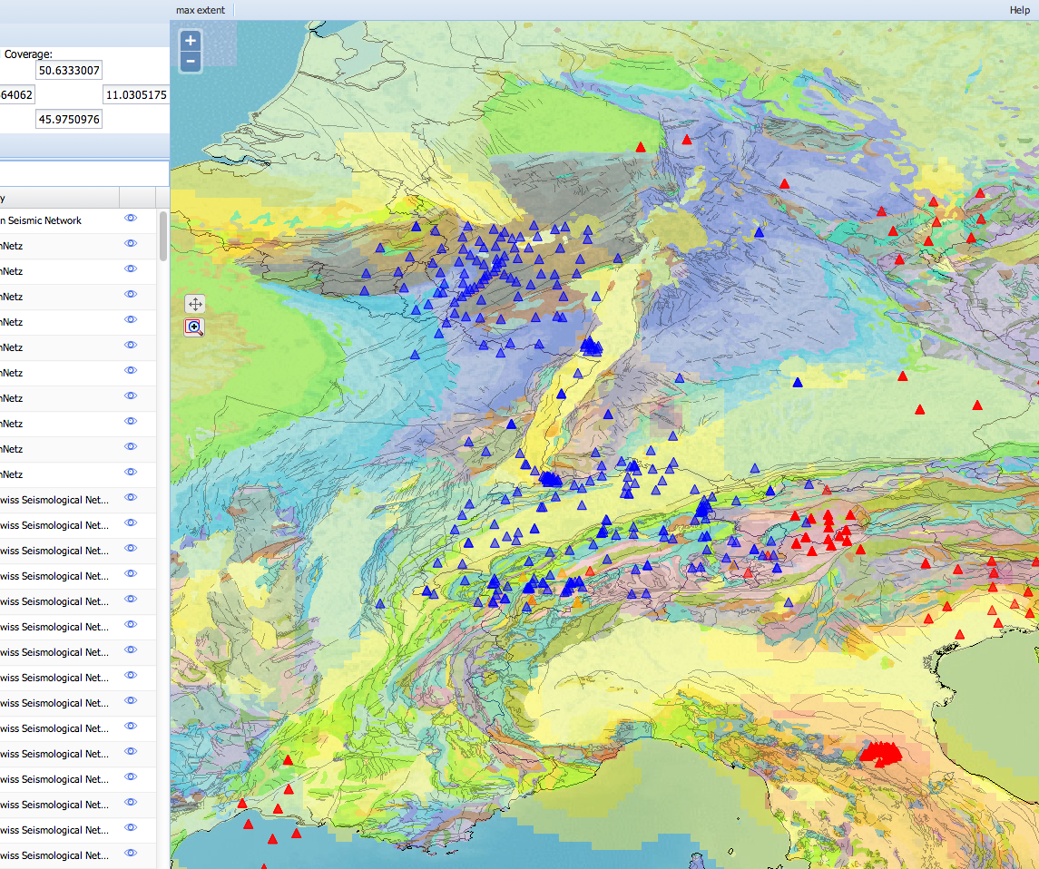
2014
Demonstrator
alpha version

Slide 8
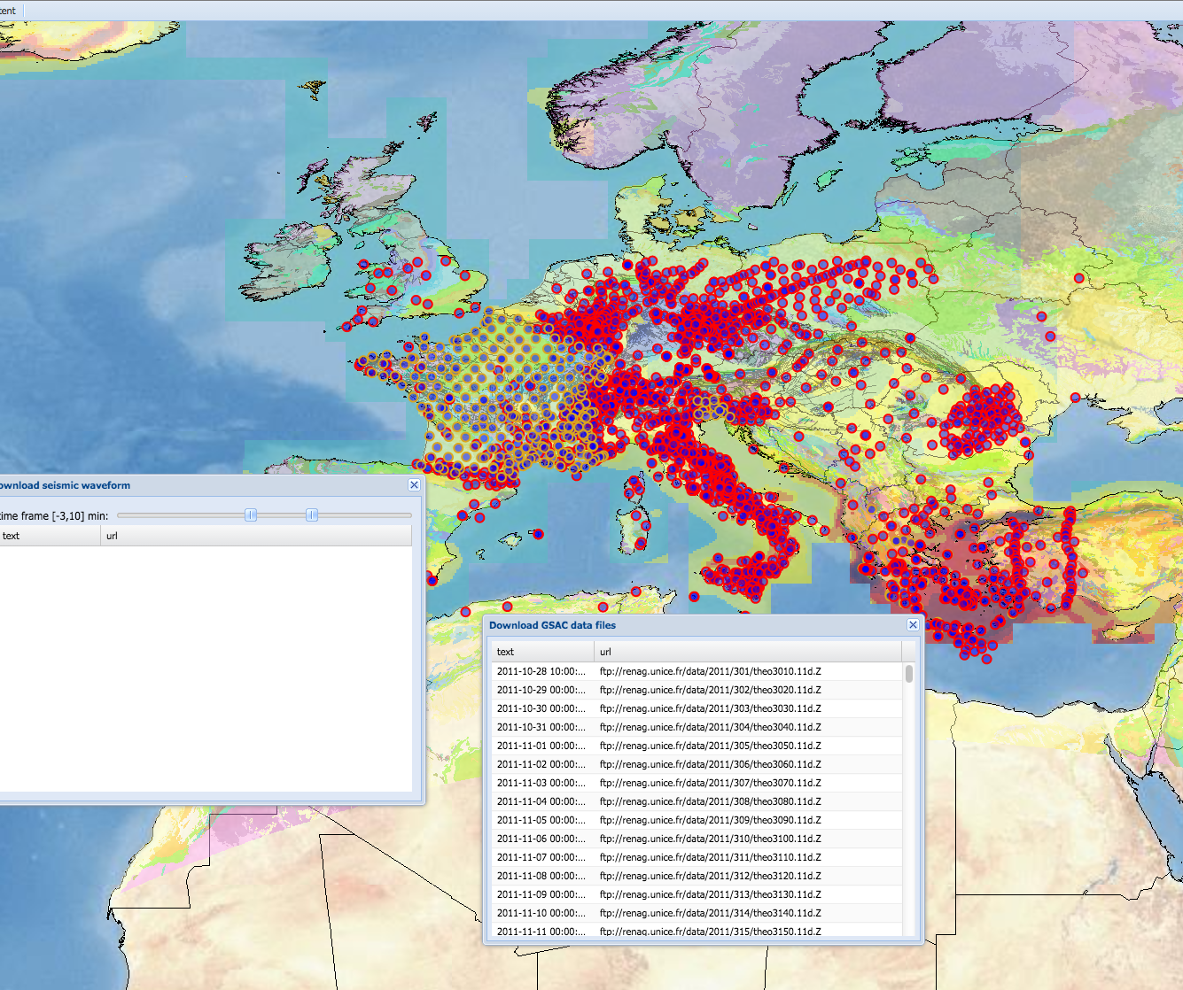
2015
First Prototype
Notes:
Basic integration of
Seismological and GNSS

Slide 9
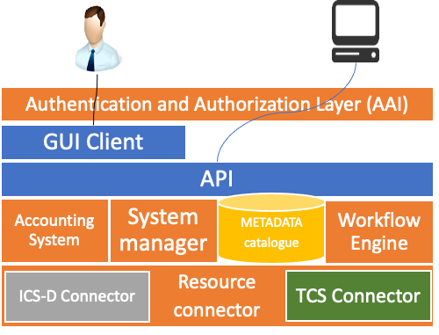
2016
First technical
architecture

Slide 10
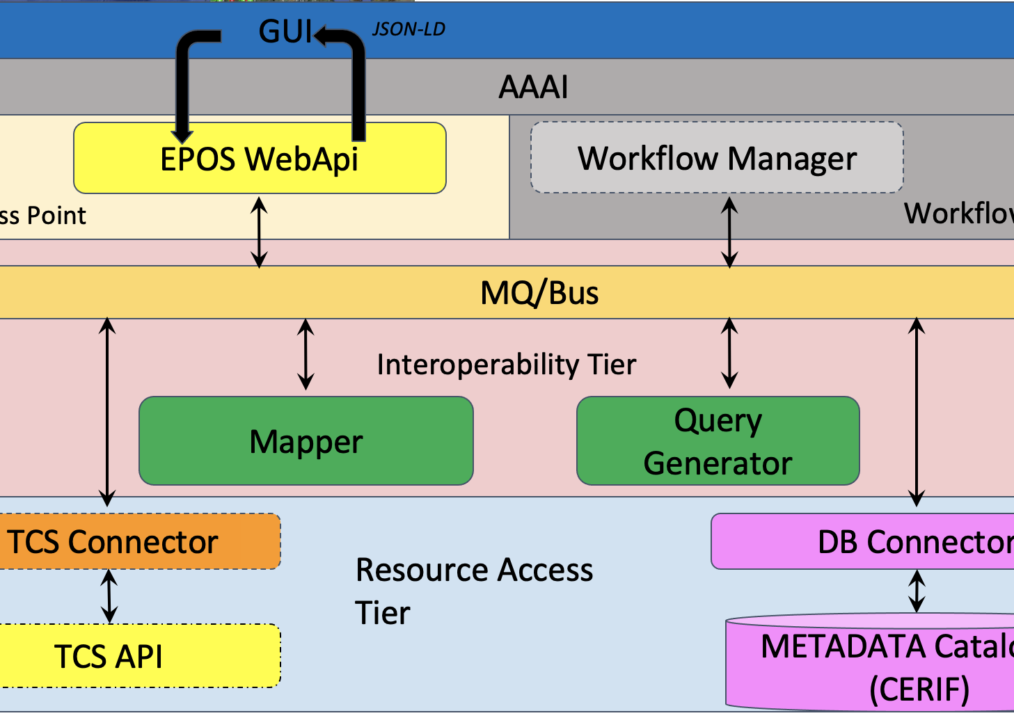
2017
Mature
Architecture

Slide 11
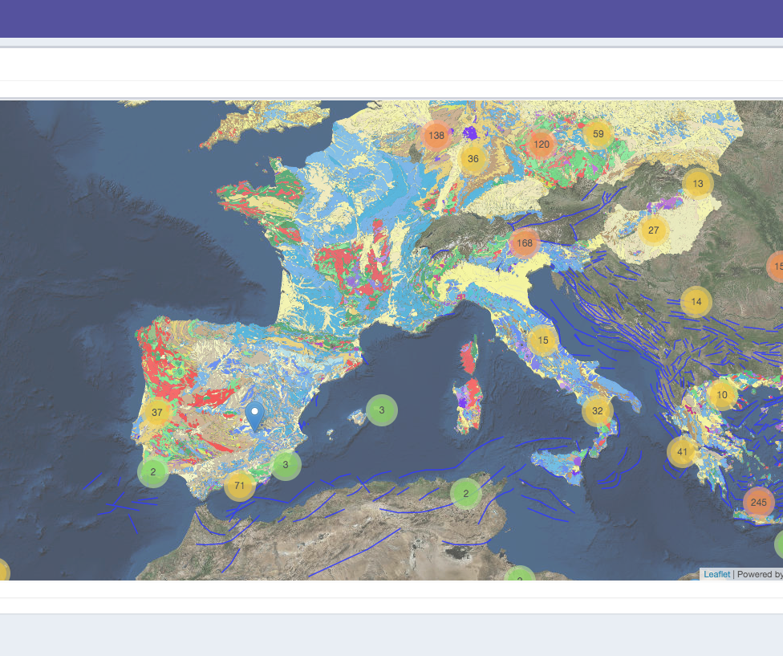
2018
First portal implementation

Slide 12
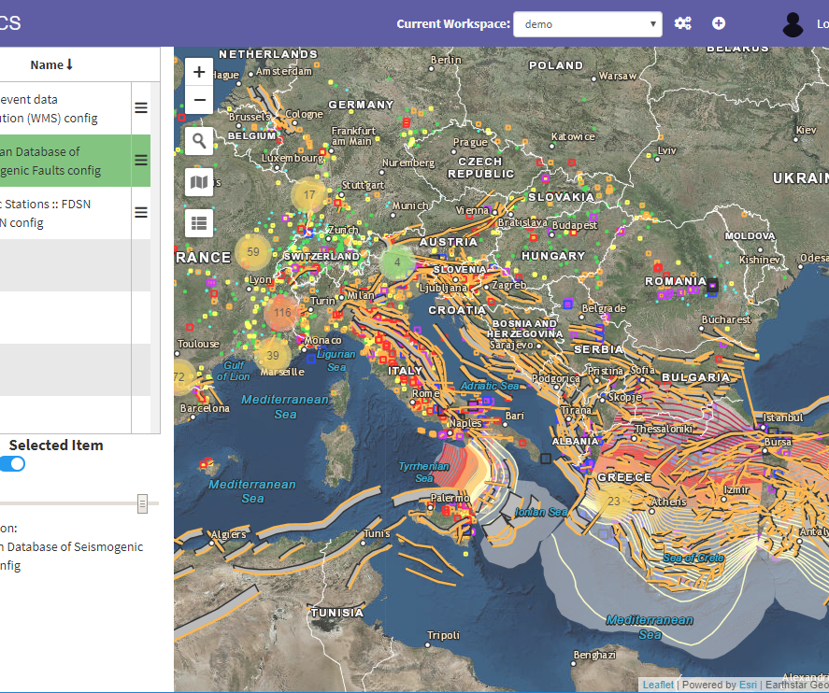
2019
Portal with workspace

Slide 13
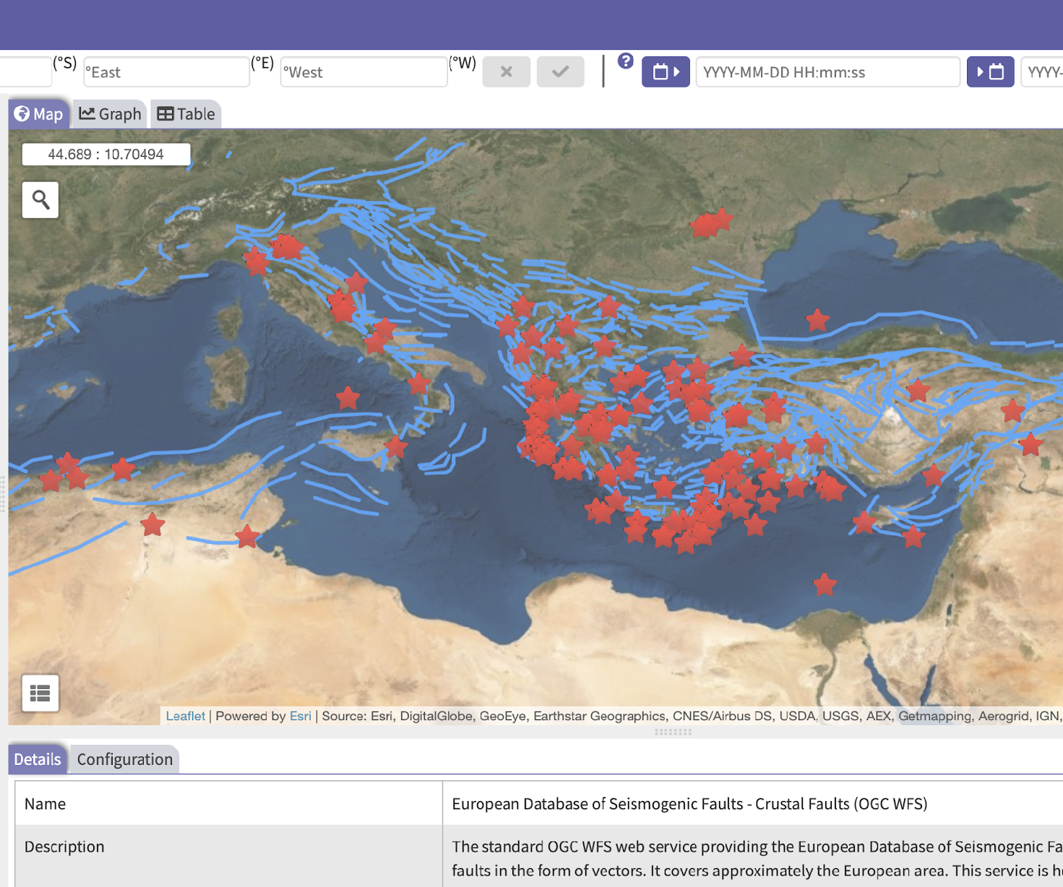
2020
Stable Portal

Slide 14
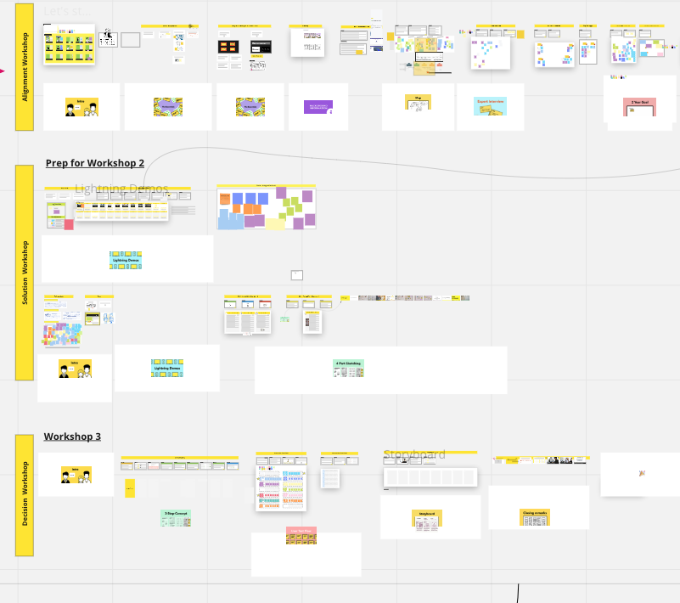
Workshop Workboard
2021
UX Refactoring
Workshop
15 persons from different institutions
2 days
4 sessions
10 hours of tests
8 interviews

Slide 15
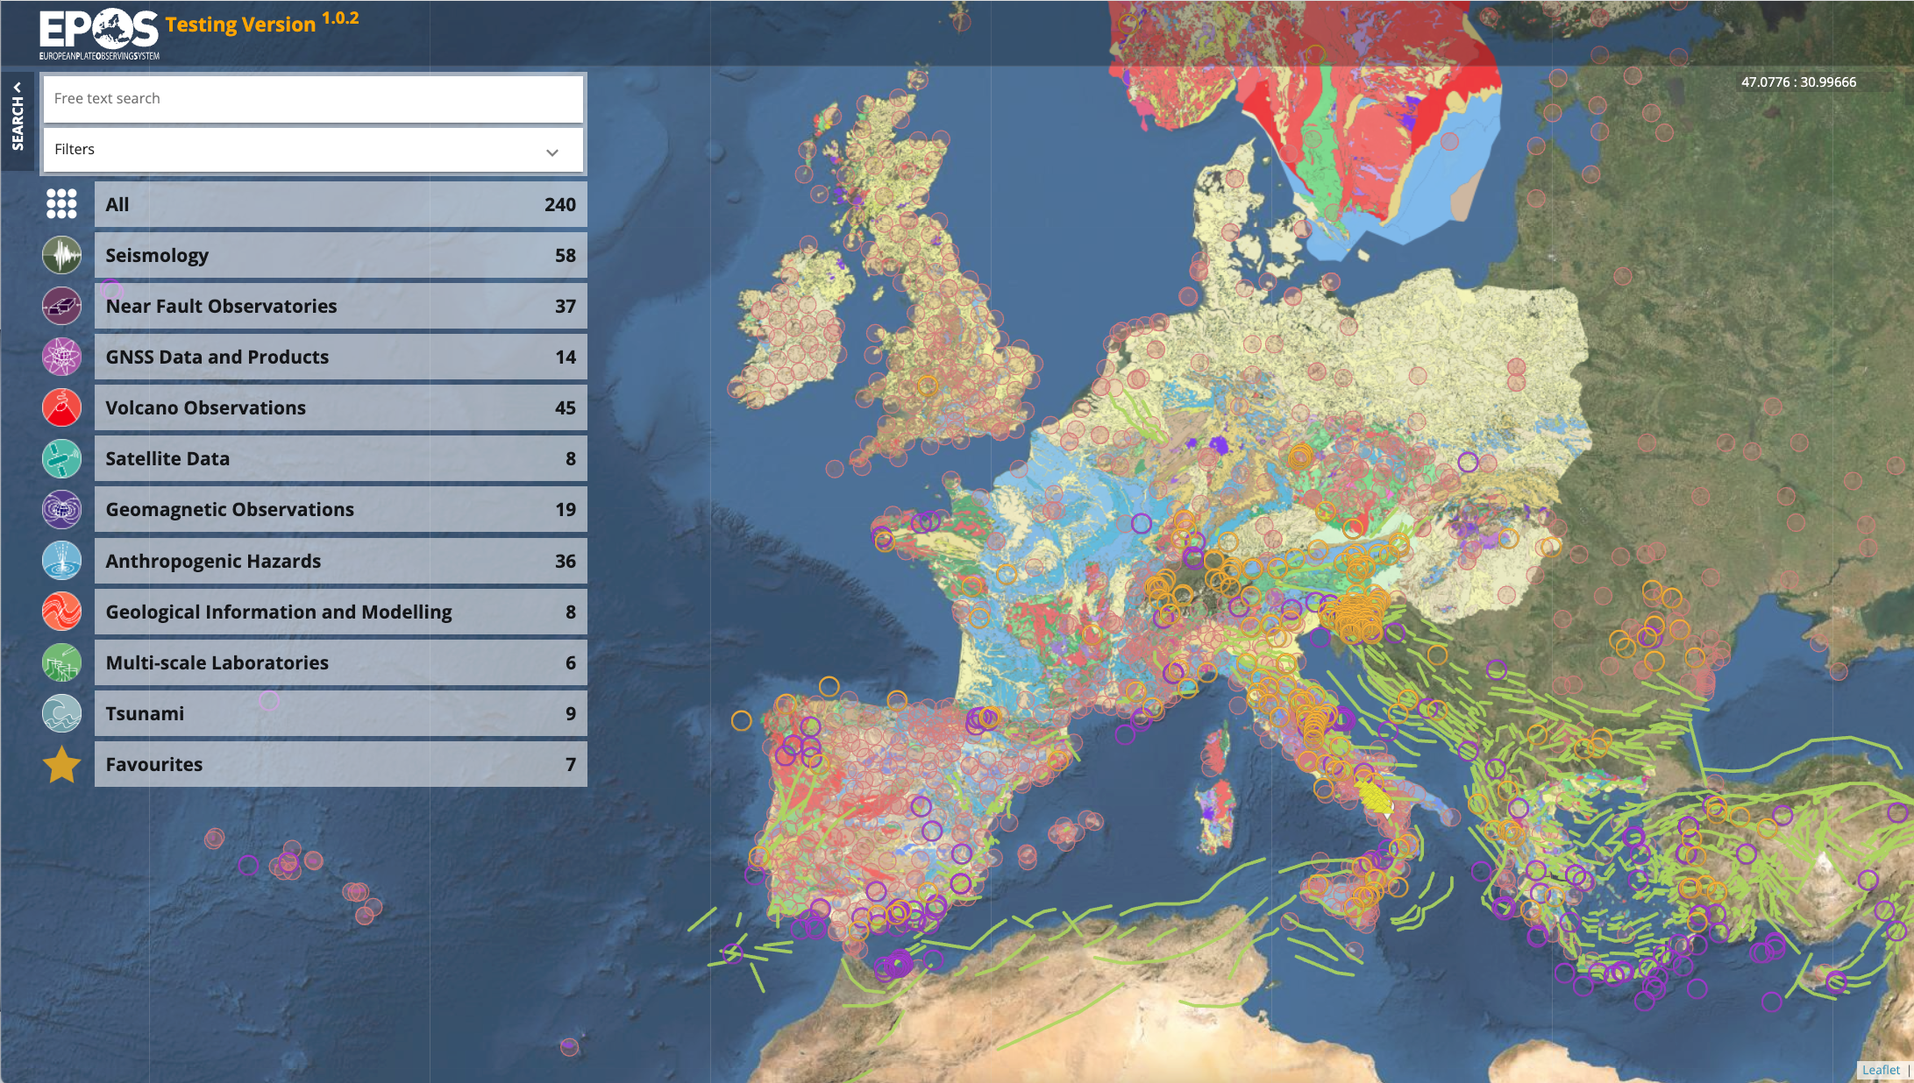
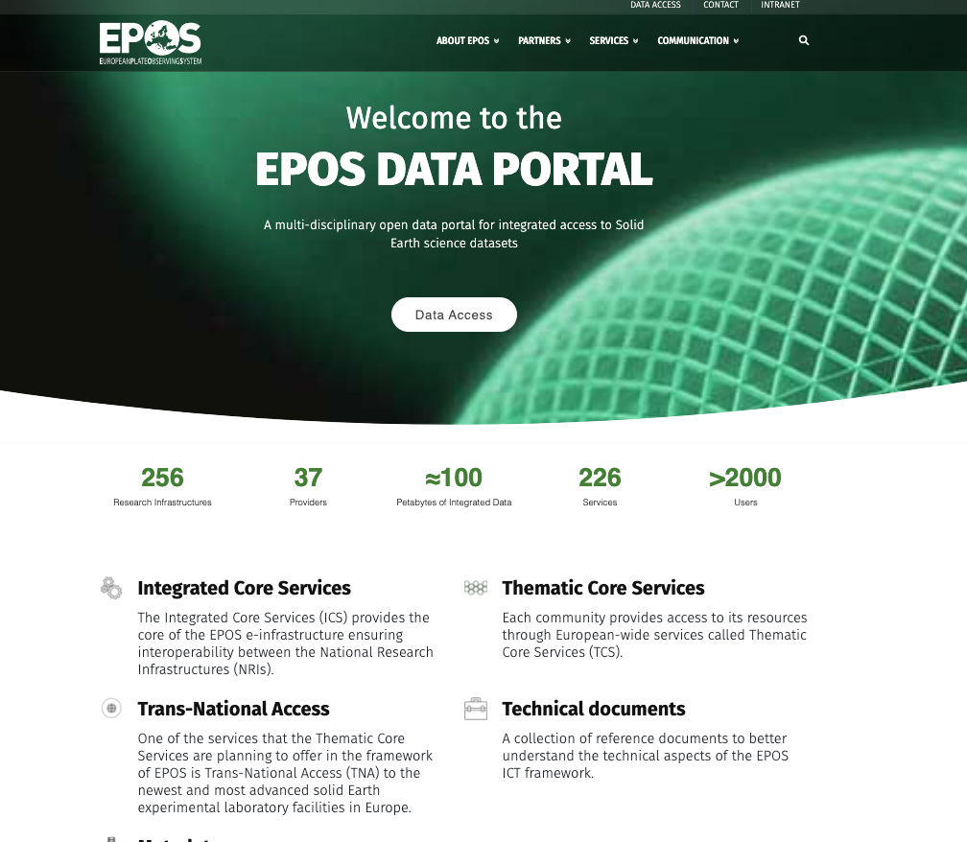
2022
Refactored EPOS Data Portal
goes live
https://www.epos-eu.org/dataportal

Slide 16
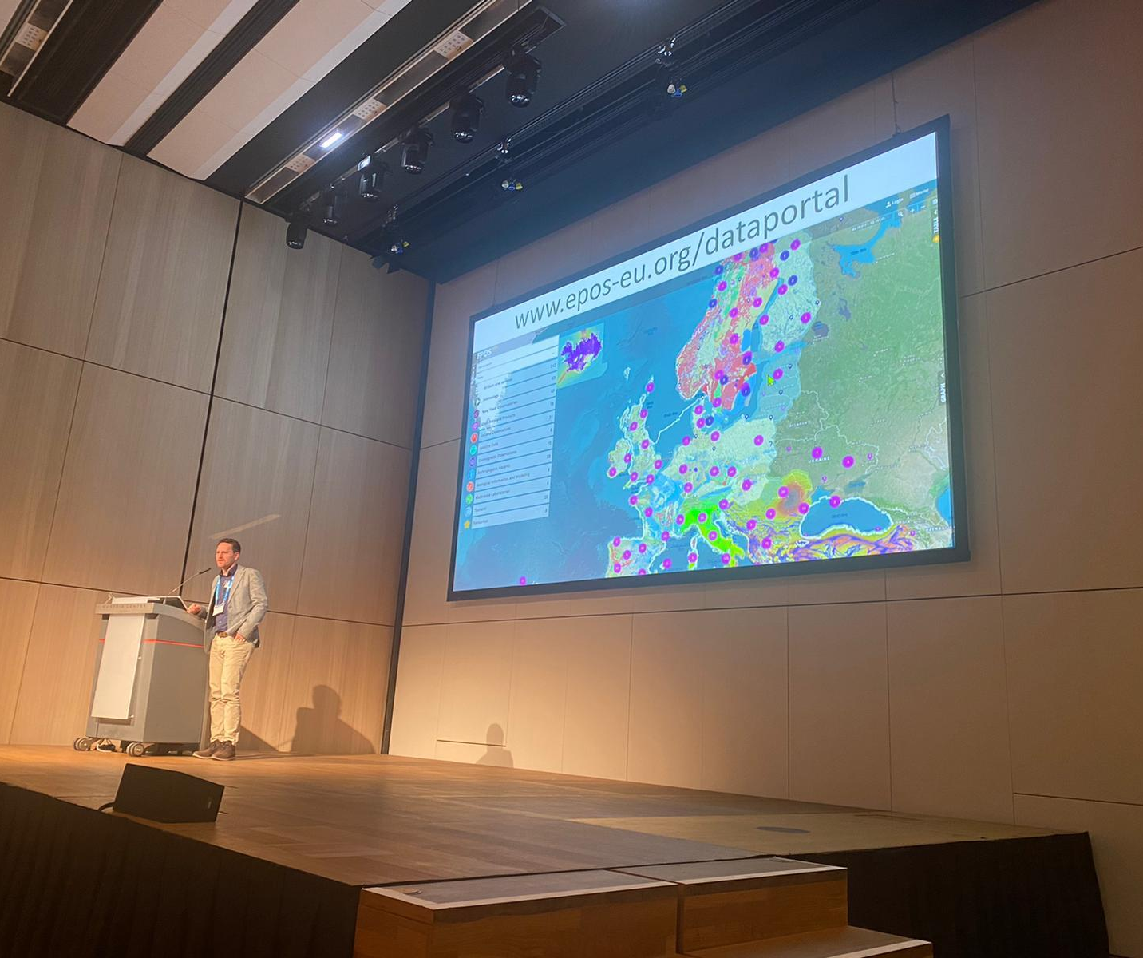
2023
EPOS Data Portal Launch
@EGU

Slide 17
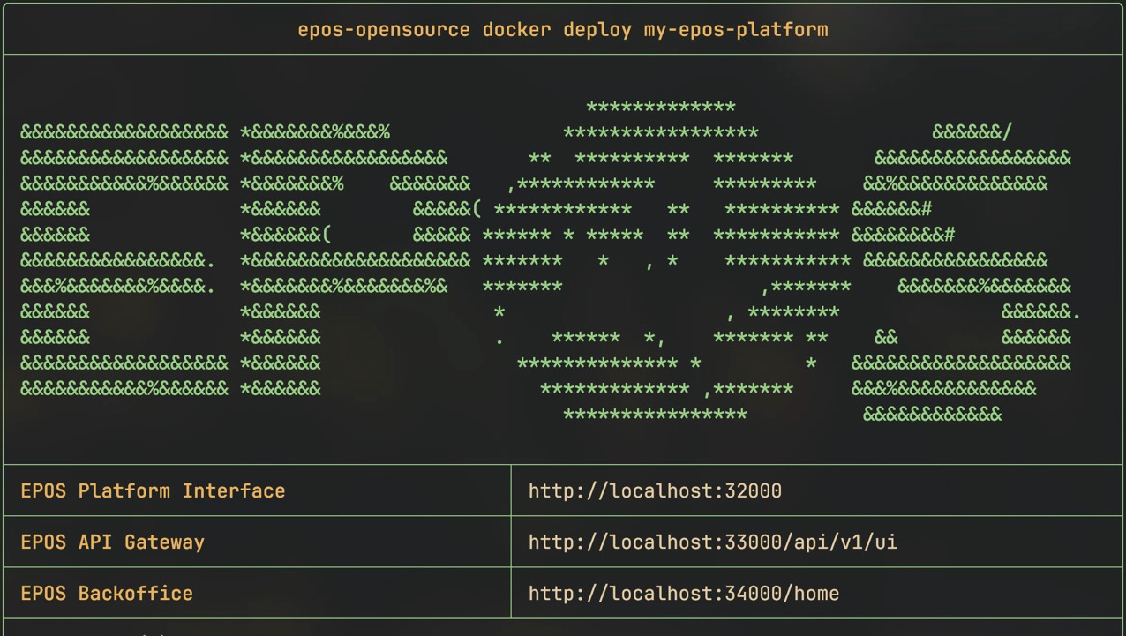

2024
EPOS
Open Source
enlighten web
https://epos-eric.github.io/opensource-docs/

Slide 18
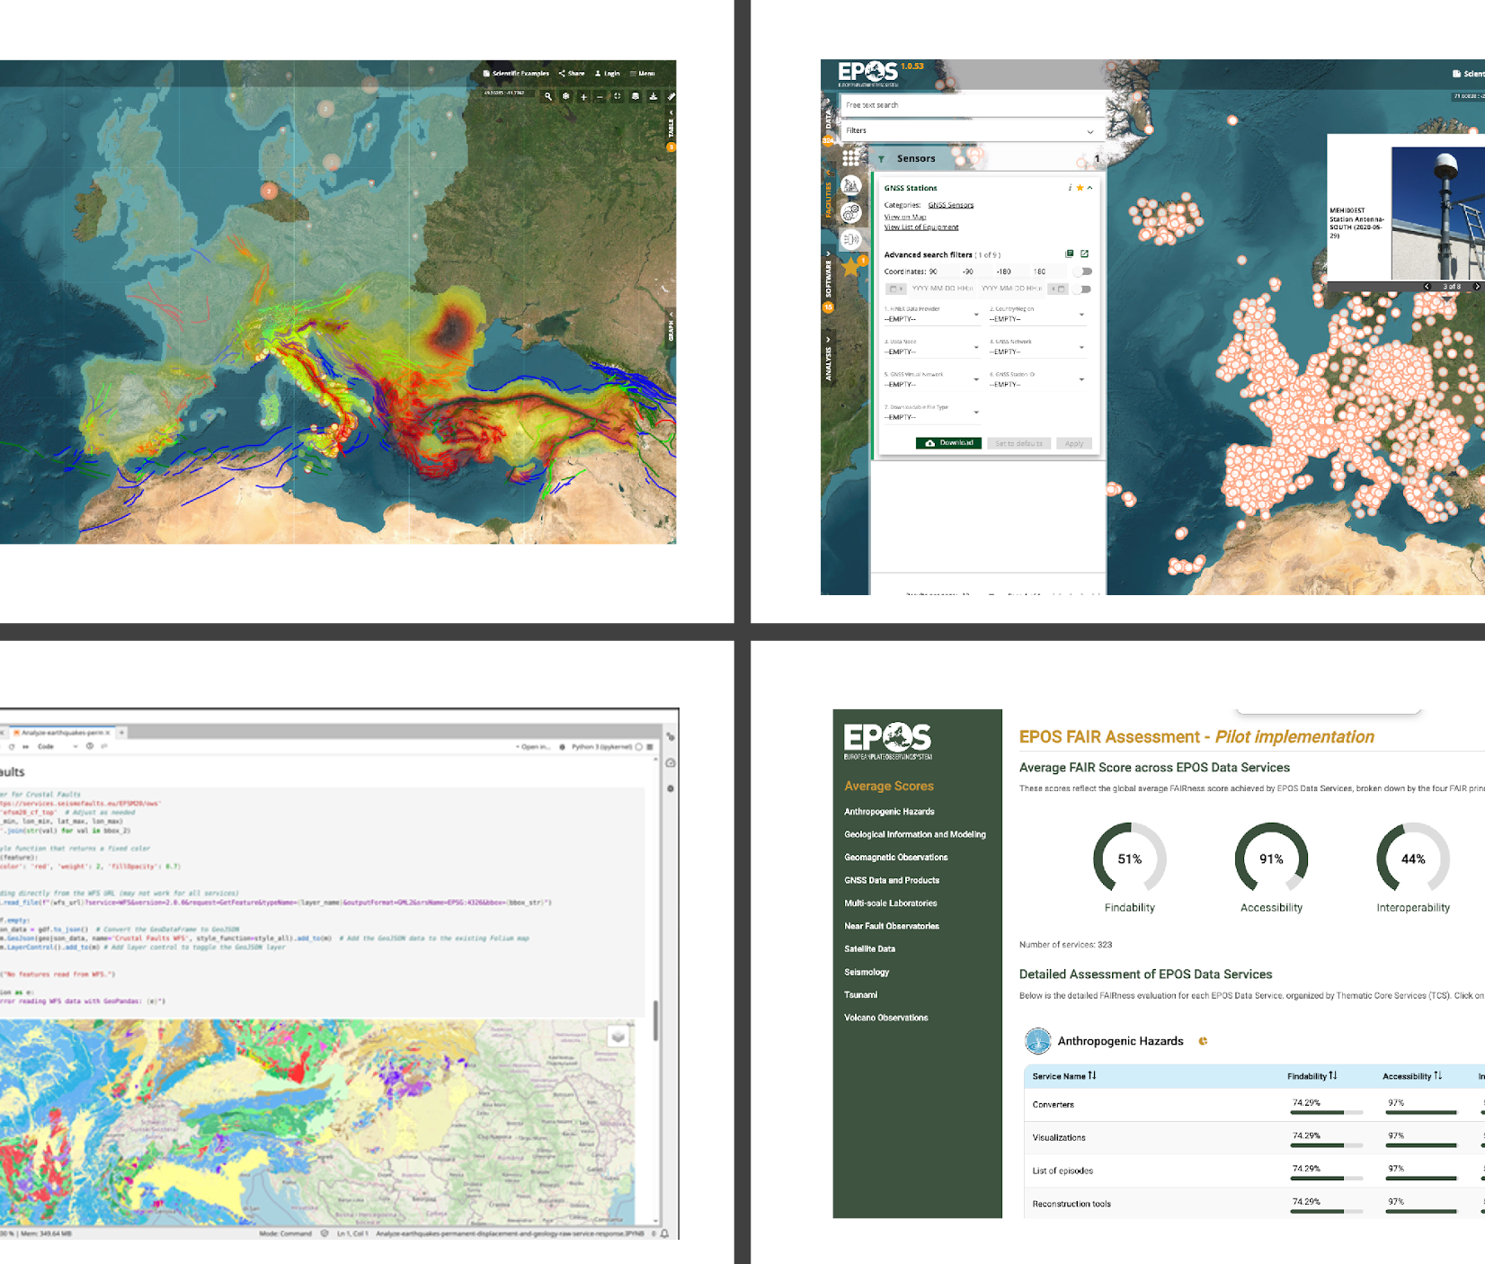
Data Discovery and Access
Facilities and Equipment
2025
From Portal to Platform
Data Processing and Analysis
FAIR Assessment

Slide 19

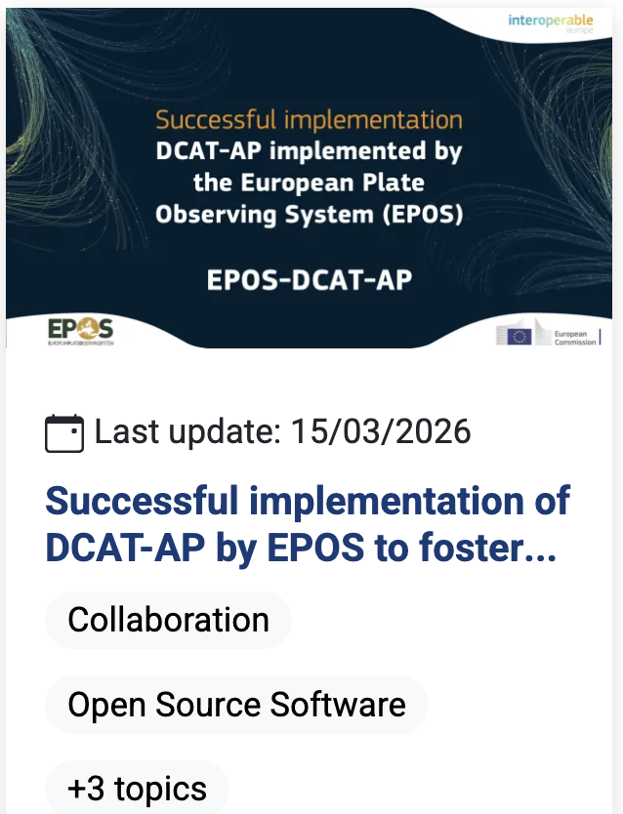


https://www.ics-c.epos-eu.org/
2026
Today…
Not only Platform
From data to computation

Slide 20
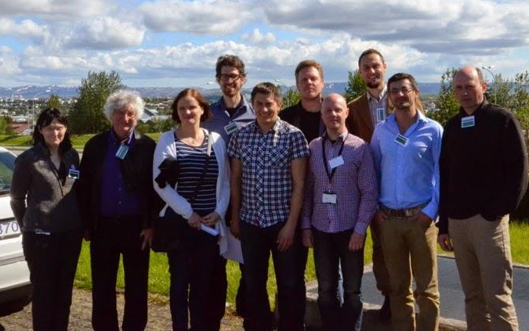
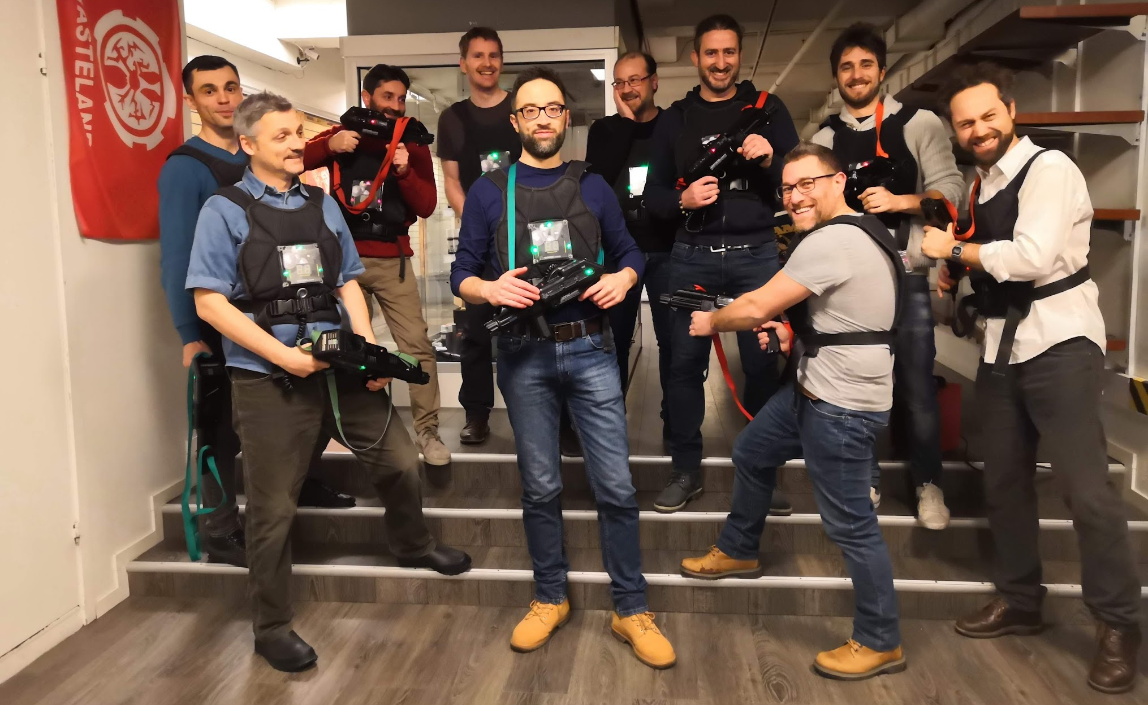
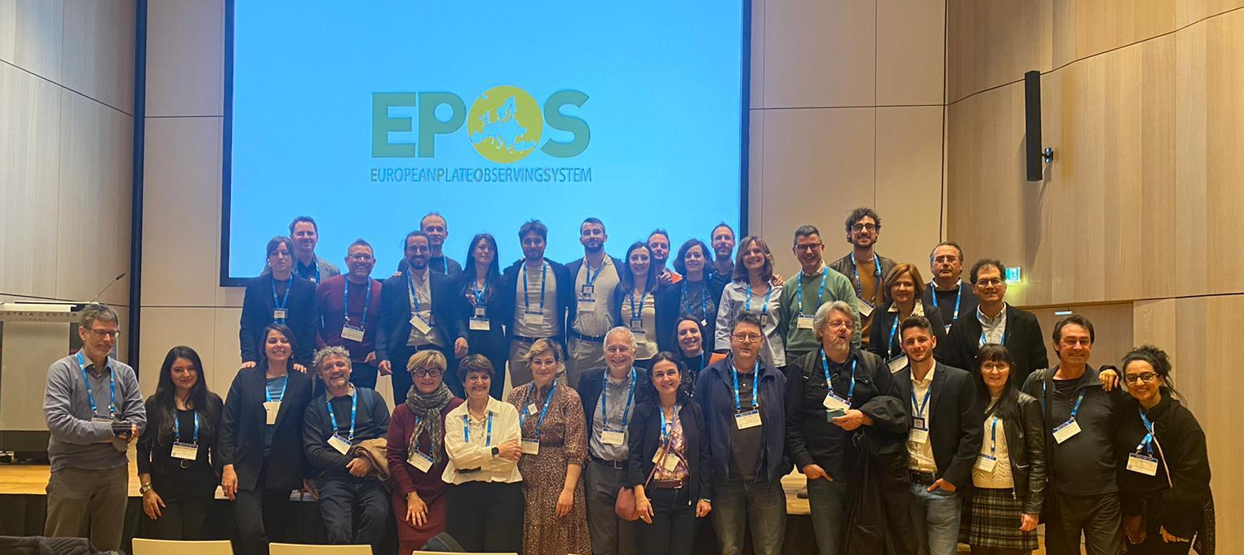
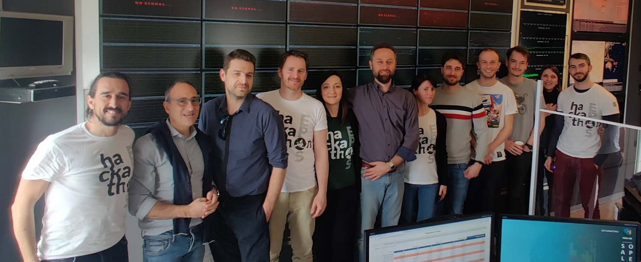
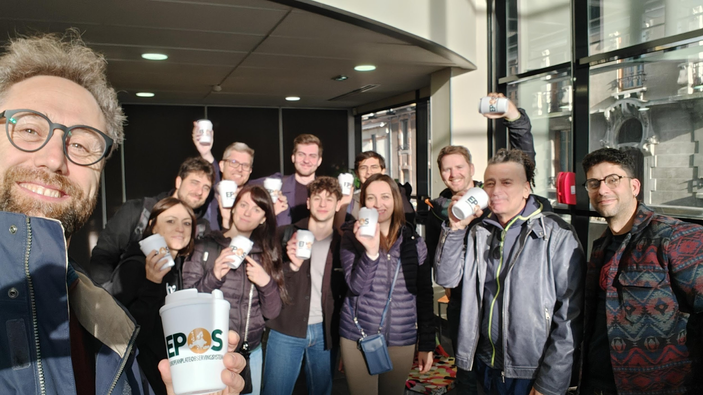
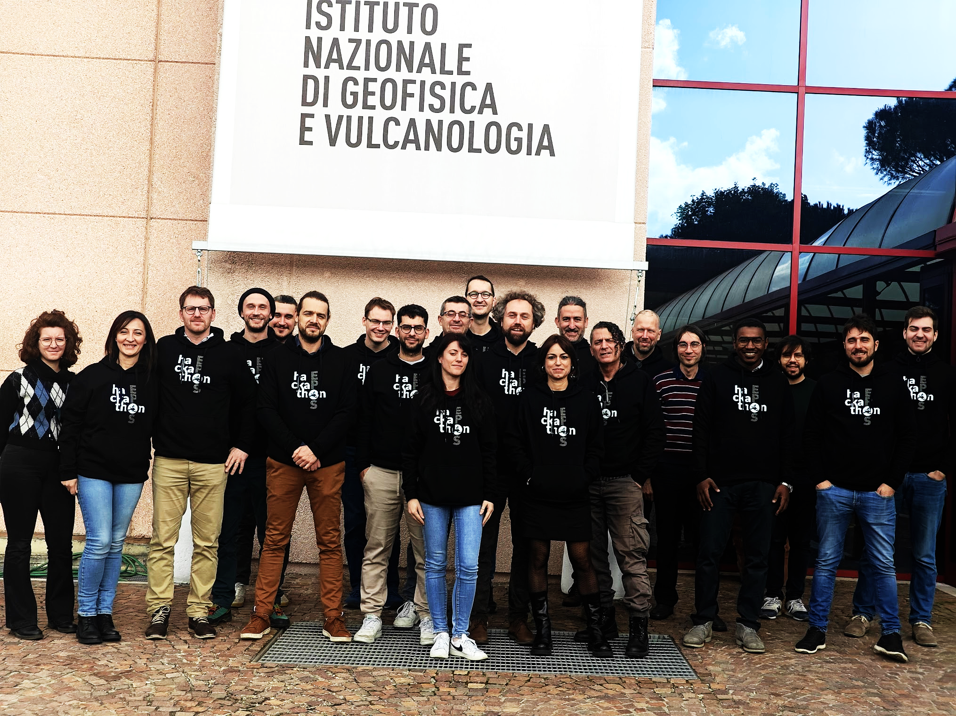
EPOS Platform: a successful teamwork activity
2013
2019
2023
2023
2024
2025

Slide 21


Keith Jeffery
In Memory of
Keith George Jeffery
12th August 1947 – 15th January 2026

Slide 22
Thank you!

