Slide 1
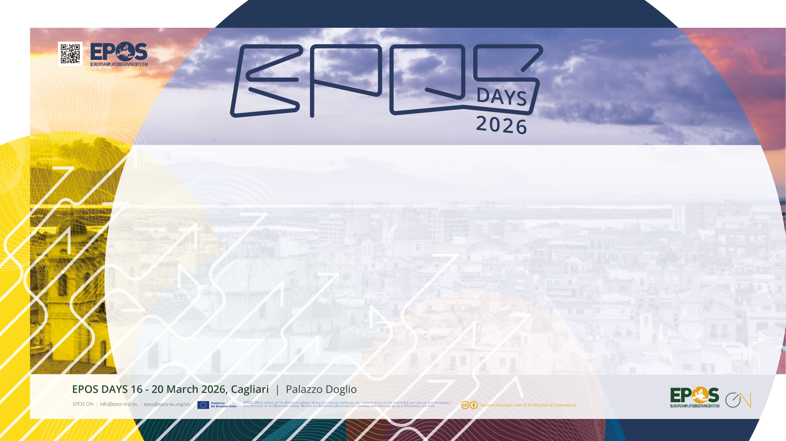
EPOS: building a global network for the solid Earth research

Slide 2

Why do we need international collaboration?
Sharing expertise and lessons learned
Avoiding duplication of effort
Maximising use of resources
Identifying common challenges
Notes:
Scientific/ societal challenges do not respect geographical / political boundaries. Collaboration is vital to effectively address large-scale / global issues.

Slide 3

Why do we need international collaboration?
Addressing large-scale societal and scientific challenges e.g. natural hazards, climate change, food security, disaster mitigation
Supporting regional and global policy initiatives e.g. UN Sustainable Development Goals (SDGs); Sendai Framework for Disaster Risk Reduction
Notes:
Scientific/ societal challenges do not respect geographical / political boundaries. Collaboration is vital to effectively address large-scale / global issues.

Slide 4

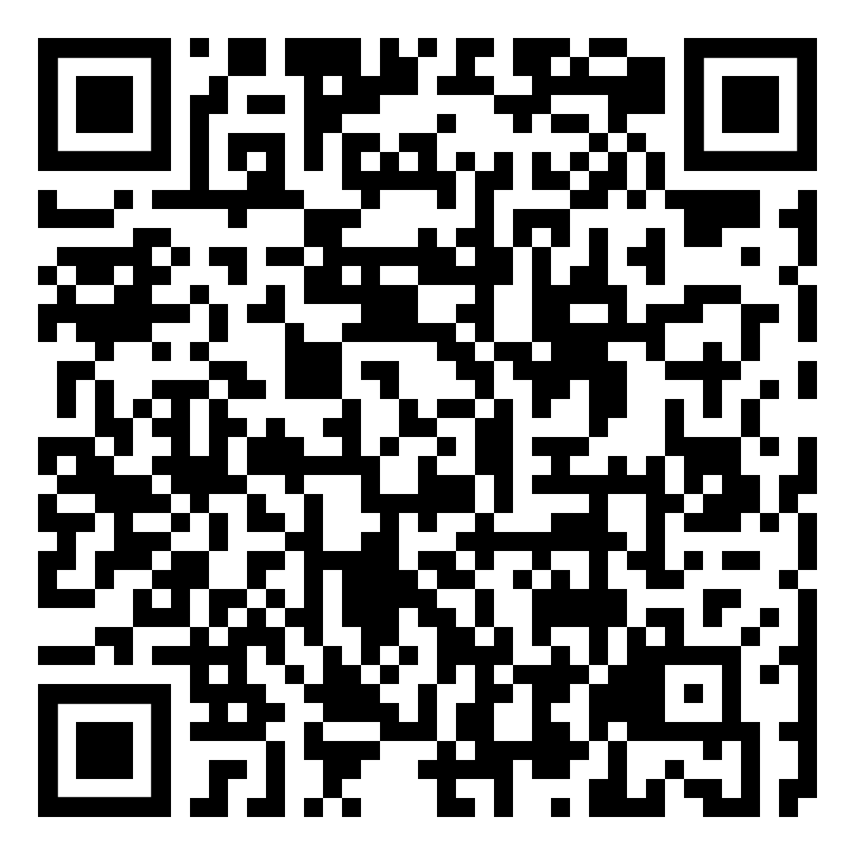
“Ministers signalled significantly strengthened collaboration on research infrastructures that support cutting-edge science and innovation, benefitting researchers worldwide.”
Notes:
e.g. Italian G7 summit in 2024 highlighted the importance of collaboration to support new and innovative research on a global scale, especially with respect to research infrastructures. The importance of research infrastructures to facilitate collaborative research and the role of RIs for capacity building including for early career researchers was also mentioned in the resulting ministerial declaration. (see QR code)

Slide 5
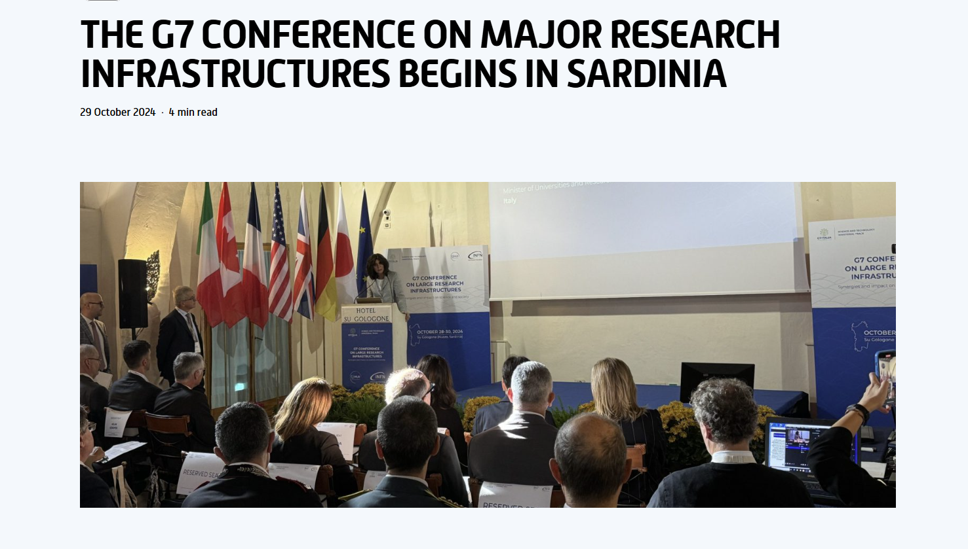
Notes:
G7 conference on large infrastructures held in Sardinia in 2024
Role of large RI in dealing with current issues and challenges considering the scientific, economic, social, and geopolitical impacts of large infrastructures in Europe but also taking into account the contributions from other countries around the world. One of those highlighted is the Einstein Telescope that we will hear more about later today.

Slide 6
Why do we need international collaboration?
Addressing large-scale societal and scientific challenges e.g. natural hazards, climate change, food security, disaster mitigation
Supporting regional and global policy initiatives e.g. UN Sustainable Development Goals (SDGs); Sendai Framework for Disaster Risk Reduction
Moving towards common approaches and developing interoperability to create a unified global framework for the solid Earth
Notes:
Scientific/ societal challenges do not respect geographical / political boundaries. Collaboration is vital to effectively address large-scale / global issues.

Slide 7
Creating a global research infrastructure for the solid Earth: current relevant initiatives
Regional - Europe
  ENVRI Cluster: coordinating European environmental research infrastructures
  ORPHEUS: pan-European seismology infrastructure
  European Open Science Cloud (EOSC): federated ecosystem of tools and services supporting European research
  Destination Earth: EU initiative creating digital twin of the Earth
  Data Terra: research infrastructure for Earth Observation data
Notes:
Who are the key actors in developing a global framework for the solid Earth

Slide 8
Creating a global research infrastructure for the solid Earth: current relevant initiatives
Regional – international
  AuScope: Australian research infrastructure for the solid Earth
  EarthScope: supporting geophysical research community, especially in USA
  Earth Sciences New Zealand: environmental research infrastructure
  Others?

Slide 9
Creating a global research infrastructure for the solid Earth: current relevant initiatives
Global
  Group on Earth Observation (GEO): intergovernmental organisation fostering open access and sharing of EO data (satellite and ground-based networks
  Copernicus: providing free and open access to data from its Sentinel satellites and other contributing missions
  Global Earthquake Model (GEM): improving the understanding of earthquake hazard and risk globally.
  Global Tsunami Model: establishing a global tsunami community and consolidated competence centre for tsunami hazard and risk
Notes:
On a global scale there are organisations such as the Group on Earth Observation (GEO): aim to provide open access to EO data (satellite and ground-based networks. GEO is made up of members state representatives and has a diversity of stakeholders including 151 Participating Organisations – EPOS of one of these.

Slide 10
Creating a global research infrastructure for the solid Earth: relevant coordinating activities
Research Data Alliance (RDA): member organisation building social and technical bridges that enable open sharing and re-use of data.
CODATA: promoting open Science, FAIR data principles and advancing data science policy to address global research challenges
World Data System (WDS): enhancing the capabilities, impact and sustainability of data repositories and data services in support of transparent and reproducible science
Earth Science Information Partners (ESIP): advancing data stewardship practices and principles for Earth science data
Notes:
These organisations provide some of the interoperability building blocks that are essential for building a common framework for solid Earth systems

Slide 11

What are the barriers to creating a global framework for solid Earth science?
Insufficient long-term resourcing for large-scale efforts to support interoperability
Lack of sustained coordination at the global scale
Shifting priorities (both scientific and societal) at national and regional level
Fragmentation and heterogeneity of the global
data landscape

Slide 12

How do we move forward?
Creating networks across different relevant stakeholders
Establishing regional and global partnerships
Organisational memberships e.g. Participating Organisation (PO) in GEO
Joint funding proposals with other partners e.g. upcoming HORIZON-INFRA-2026-DEV calls
Joint outreach activities e.g. ENVRI-Hub at GEO meeting, ENVRI & EPOS booths at EGU 2026
Notes:
Todays session will include presentations that highlight different activities relevant to EPOS

Slide 13
Thank you!

Slide 14
Solid Earth Science International Collaborations
in Thematic Communities:
A survey
Notes:
I will now briefly introduce this survey we have distributed a few months ago in the context of the multilateral collaboration with Auscope, Earthscope and Earth sciences NZ

Slide 15
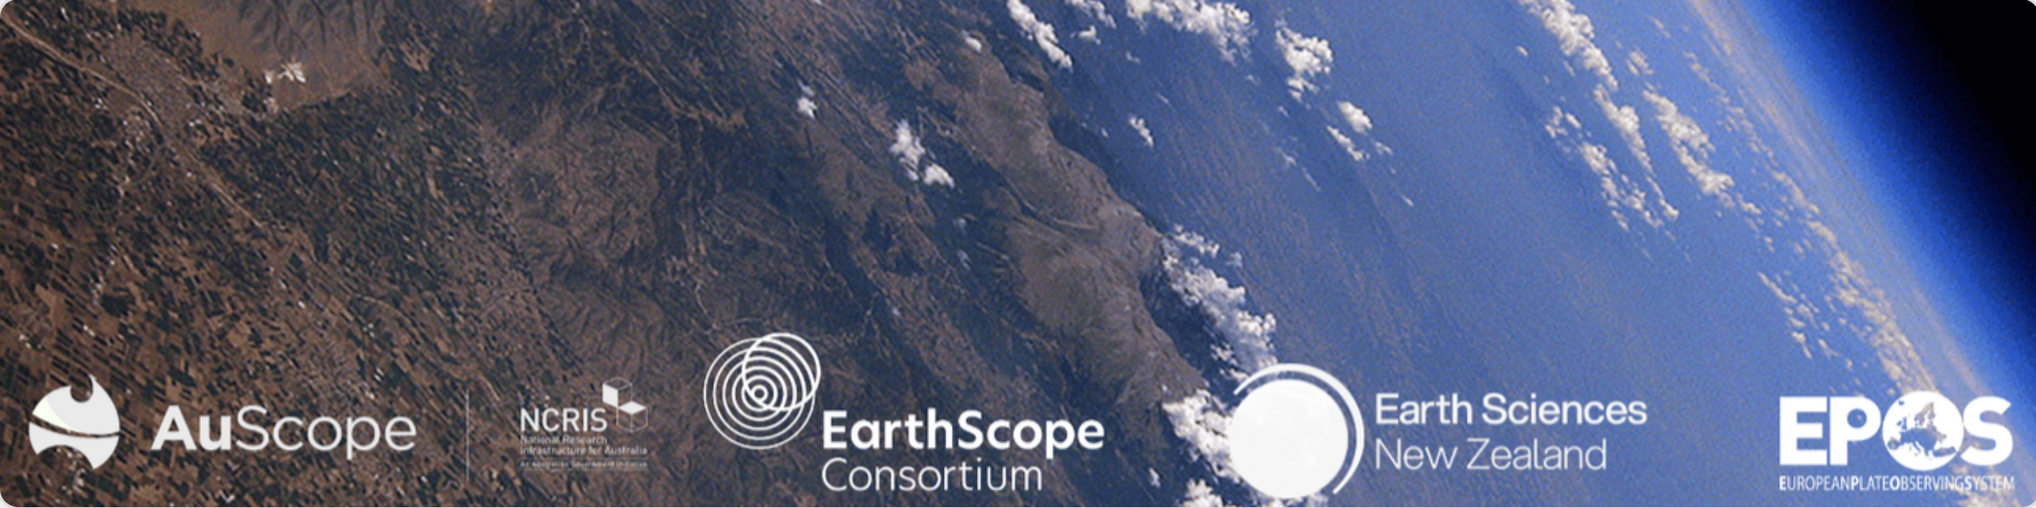
The survey: why and how
Objectives
  Identify large cross-continent collaborations across thematic communities in solid Earth sciences.
  Gauge the level of maturity of different communities to prioritise global collaboration use cases
  Improve liaisons among the RIs in Australia, Europe, NZ, the US, and possibly other world regions.
In the context of the EPOS-AuScope-Earth Sciences NZ-EarthScope multilateral MoU
Addressed to groups/consortia having international collaborations active or
planned for the short-medium term
Notes:
The survey was intended to capture a picture of large cross continento collaborations going on across the thematic communities in solid earth sciences, with a special focus on those currently served by the EPOS, AuScope, EarthScope and Earth Science NZ research infractures. The idea was to assess their level of maturity and find global collaboration use cases we could prioritise for specific collaboration projects in order to improve the level of collaboration/interfederation with these sister infrastructures and possibly with others in other world regions. The survey addressed specifically large groups and consortia and not single researchers or smaller teams, to capture only collaborations that are relatively broad and stable to strat with in this initial mapping phase.

Slide 16
Responses at a glance
33 replies
Responses from consortia/large groups or organisations, not single researchers
Large spectrum of scientific domains and topics
>50% with multiple collaborations
Mostly from the EU
Mostly from the EPOS environment
Widespread geographic coverage of the mentioned collaborations
  Only the US and Australia outstanding
Notes:
Here’s an overview of what we got: 33 replies from such large groups or organisations, that demonstrated a staggering wide spectrum of scientific domains and topics. As we’ll see in a while, also the geographical coverage is very broad. Most of the responses come from Europe, especially from the EPOS context, which on one hand is a good news because it means you participated actively in the survey and have a high degree of internationalisation already, but on the other leads us to believe that the picture is still incomplete and we probably will need to reach out to other world regions through different channels than those we used so far.
Interestingly, more than half of the respondents listed multiple collaborations being active at this moment.

Slide 17
Active and planned collaborations… and their status
Maturity level of the collaboration?
Do you currently have any international collaborations (active or planned) in the short-medium term outside your own region?
Notes:
Here’s a picture of active and planned collaborations and their maturity level. We can see that about half of the reported collaborations are somewhere between active and mature, showing that the community is not engaging in this pursuit from a short time.

Slide 18
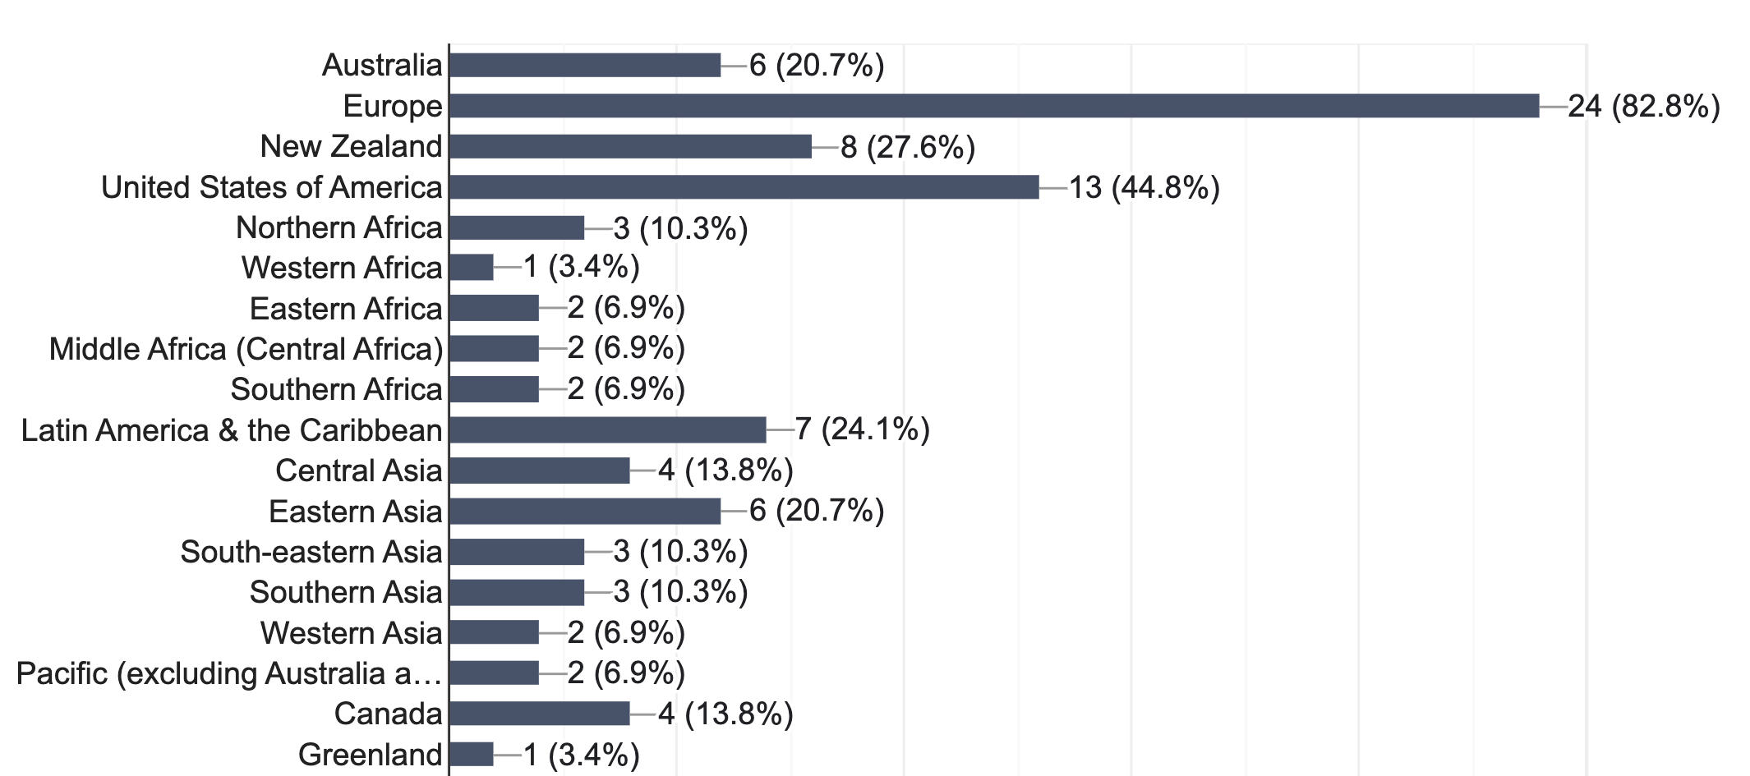
Geographical coverage of the collaborations
Most mentioned countries
EU: Italy, Spain, Greece, Czech Republic, France, Germany, Switzerland.
Americas: USA, Canada, Central and South American countries (Guatemala, Nicaragua, El Salvador, Costa Rica, Chile, Argentina, Colombia, Brazil, Bolivia)
Asia/Oceania New Zealand, Australia, India, Nepal, Japan, China, Philippines, Kazakhstan, Maldives,
Bhutan, Palau, Fiji.
Africa: Egypt, Capo Verde, Nigeria, Ghana, Angola, South Africa, Mozambique, Mauritius, Kenya, Seychelles
Where are your partners based?
Notes:
Here’s the reported geographical coverage. Of course, European partners are prominent in this picture but beyond that the US, Australia, and NZ are the most mentioned – which somehow confirms that starting the conversation about global collaboration with their research infrastructures is backed by existing wide and mature collaborations. However it is interesting to note that the dimension of these collaborartions is truly global, with practically no region excluded except the artic and antarctica – for rather obvious reasons
Key country players are Italy, Spain, Greece, Chzech republic, France, Germany and Switzerland in Europe, the US, Canada, and several Latin America countries in the americas, NZ and Australia, as well as big players such as China, India and Japan in Asia-Oceania, and several countries in Africa too, ranging from Egypt to South africa to Cabo Verde

Slide 19
…and key institutional players
Key role of Solid Earth Science Infrastructures: EarthScope, Earth Sciences NZ and AuScope mentioned as key partners multiple times.
Key EU Players: ETH, INGV, NIEP, University of Naples, OGS, KOERI, University of Trieste, CNRS, Charles University Prague, IRSM Prague/Institute of Rock Structure and Mechanics of the Czech Academy of Sciences, GFZ, Geosphere, LTU, and the Euro-Mediterranean Seismological Centre (EMSC).
Key Non-EU players): Institutions/agencies from the US (UNLV, Cires, Kansas University, NASA JPL, USGS, California Geological Survey), Argentina (Argentinean Antarctic Institute, CEDIAC-UNCuyo), New Zealand (Auckland University), India (CSIR-Central Scientific Instruments Organisation), and Hungary (HUN-REN Institute of Earth Physics and Space Science).
Global Geodetic Services and Groups: Groups like IGS, EUREF, AFREF, APREF, and RMCRD (Africa).
Notes:
And here, in case you are curious you can find some key institutional players mentioned many times by the respondents, mainly located in Europe, the US, Argentina, India and Hungary

Slide 20
Varied collaboration topics
Many different topics mentioned
The first 4 topics amount to almost 50% of the total
Notes:
A wide variety of topics of collaboration was mentioned which is depicted in the graphic. However Data collection and other three topics alone make almost half of the total

Slide 21
The outputs of the collaborations
The two numerically most important topics refer to scientific collaborations rather than technological /RDM
Notes:
This, as well as the different items listed as the main outputs of the collaboration show that most of these active collaborations focus more on scientific aspects than on the technological and research data management side.

Slide 22
…and their openness/FAIRness
Collaboration outputs
identified by PiDs
Primary repository/location for deposit
Notes:
In the survey we also tried to capture the situation in terms of the openness and fairness of these research outputs. What we see is that the situation varies quite a lot depending on which letter of the FAIR acronym, with the F and the A – and the R only in part –doing rather well and interoperability not so much.

Slide 23
…Looking at the future
Notes:
This much for the present. Now for a quick look at the future

Slide 24
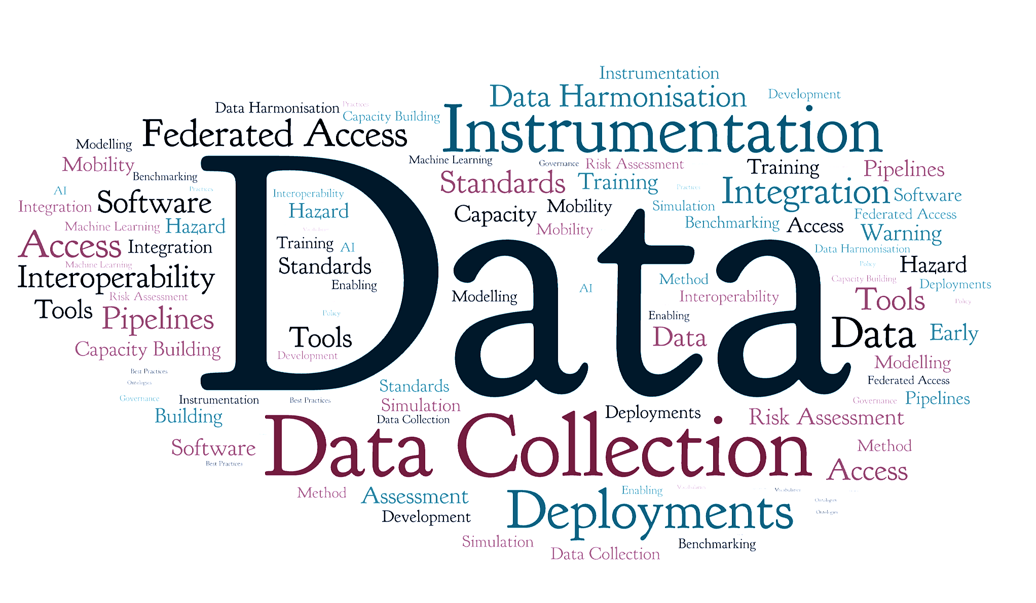
…much interest in expanding collaboration
Are you interested in expanding collaboration at this time?
Notes:
What we saw is that despite the respondents being no newbies in international collaboration, there is much interest in further expanding collaboration, as you can see in the picture.
The word cloud in the other part of the slides shows what this extension of the collaboration should be about in therespondents’ views

Slide 25
Future collaborations: topics
Priority topics for future collaborations
Notes:
Data collection remains a key priority, but topics like data harmonistation, standards, interoperability, and data integration and federation are growing in importance

Slide 26
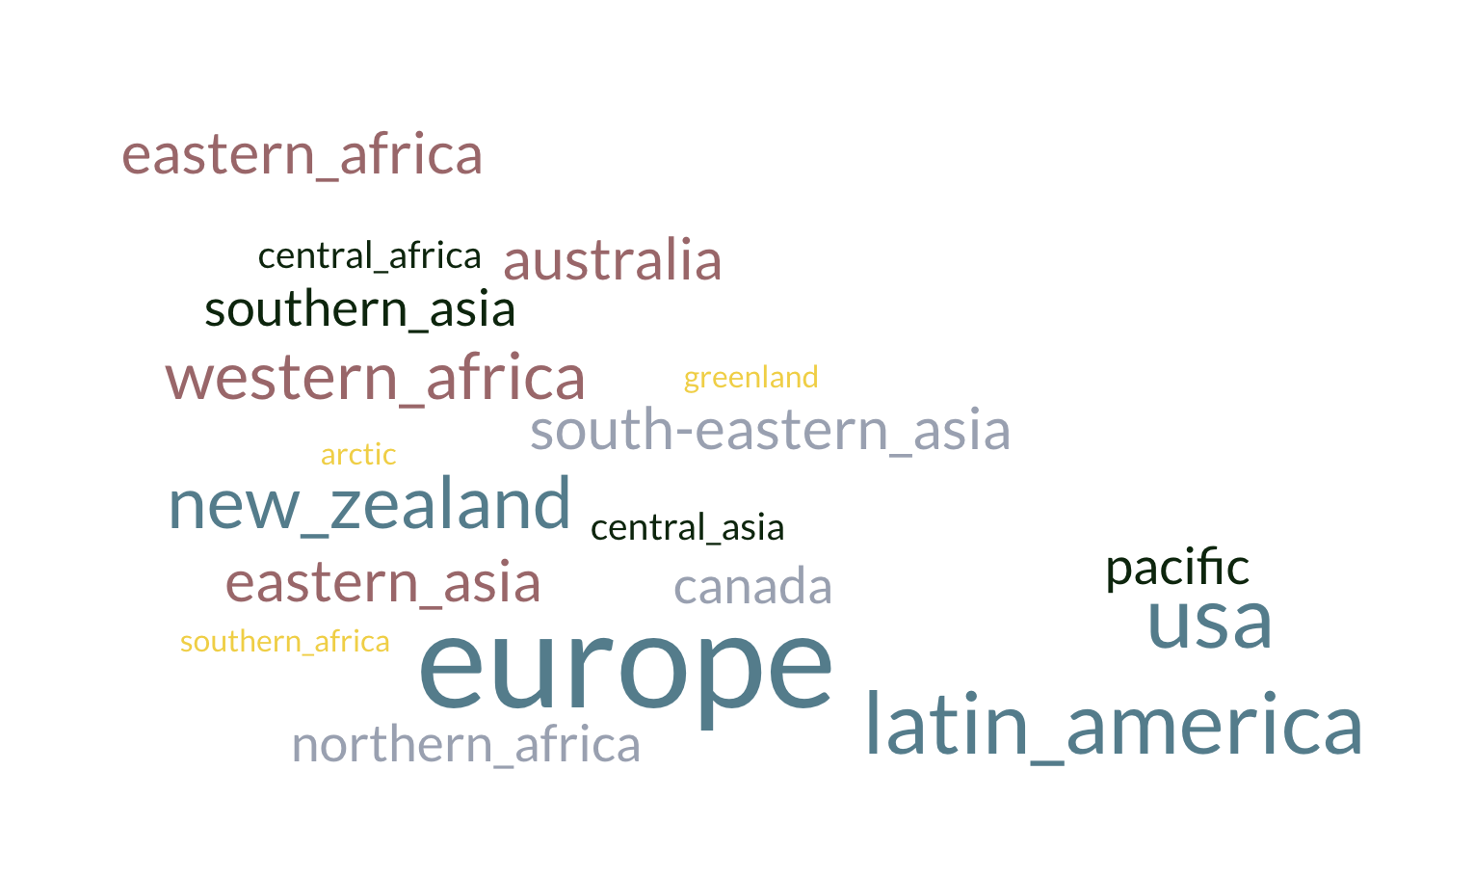
Future collaborations: geographic reach
Priority world regions for expanding / future collaborations
Notes:
In terms of geographic reach, the situation is still quite varied with not a single winner, but it is clear that at least for these respondents the European Research Area remains a priority, togerther with NZ, the US and Australia, while latin america’s importance seems to grow

Slide 27
Future collaborations: geographic reach
Priority world regions for expanding / future collaborations
Notes:
And here’s a more quantitative view of the same thing

Slide 28
Future collaborations: barriers
Most respondents list several concurring barriers
Barriers to future / extending collaborations
Notes:
When we look at the barriers identified to expanding or future collaborations, unsurprisingly resources (in the form of either funds or staff/time) are the top factor, but «soft» aspects such as partner discovery (which mainly depends from consolidated networks of professional contacts) and strategic aspects such as the alignment of priorities are also factors. It should also be noted that 85% of respondents indicated multiple factors as potential barriers

Slide 29
Future collaborations: barriers
…what we can do about them
Which kind of support would help lowering the barriers?
Notes:
We also asked as we could help to overcome these barriers and this is a picture of the answers. Funding intelligence seems definitely something we should work on with our colleagues in the other world regions, while the other interesting thing is the creation and sharing of competences: as the popularity of the training and communities of practices options - which are two faces of this coin – goes to show

Slide 30
Future collaborations: barriers
…and why it matters
Top 10 core themes
Expected benefits of extended collaboration
Community building
Data quality & coverage
Interoperability
Shared software & tools
Joint services
International collaboration
Standards & workflows
Scientific advancement
Training & knowledge exchange
Policy influence &
strategic cooperation
Community Building and Collaboration: frequently mentioned alongside fostering interchange, community standards, promoting Open Science, and supporting the development of SW communities and training for future scientists.
Data and Service Improvement: improved data quality and coverage, data and software sharing, data interoperability, development of joint or improved services.
Operational and Scientific Advancement: scientific advancement, global harmonisation of standards, workflows, and best practices, developing shared software portfolios, innovative instruments, early warning systems, and testbeds.
Policy and Experience: enhance policy influence, provide opportunities for integrating international experience and training, facilitate knowledge exchange.
Notes:
And last but not least here’s a few highlights or the key benefits and core themes identified. Now you may say this is my professional habitm given my role here, but I’d like to point out that community building is an outsanding point of both according to the respondents. Which explains why we are here today and what we want to achieve. This session in particular was designed not only to offer you exciting presentations and updates from colleagues across the globe – it is an occasion to start to work with them or reinforce our mutual collaboration.

Slide 31
Thank you for your attention!
Notes:
With this in mind, I leave the floor to our speakers

