Slide 1
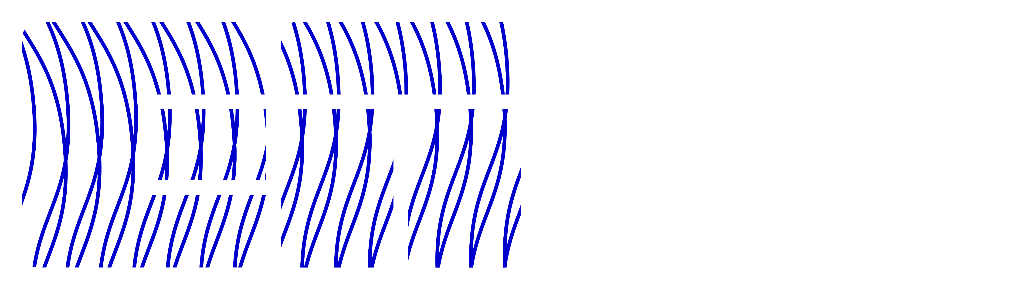
EPOS Days 2026
The Einstein Telescope Project and EPOS ERIC: The Way Forward
Monique Bossi, INFN
Cagliari, March 18 2026

Slide 2
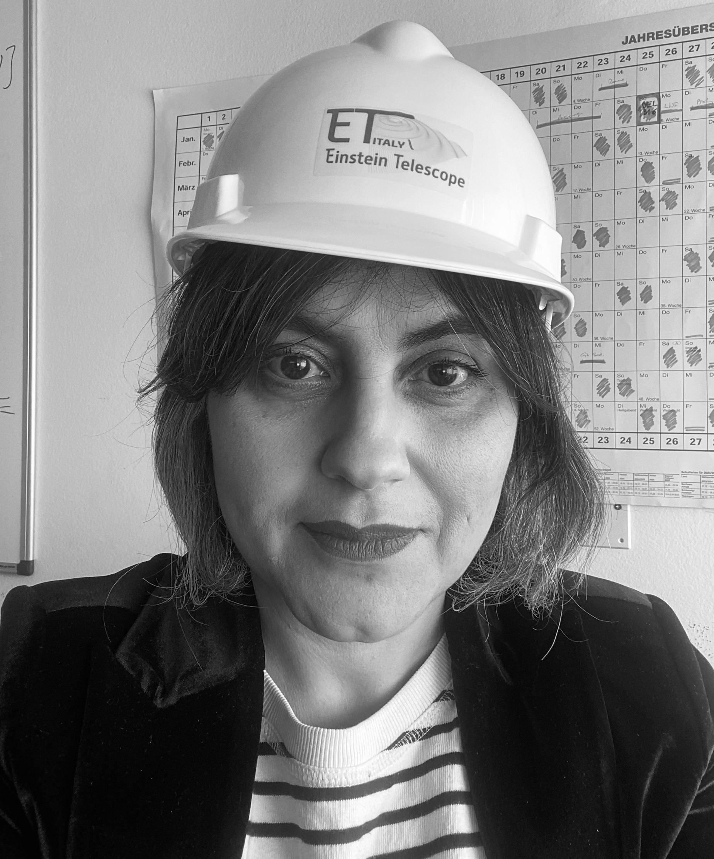

Outline of the talk
EPOS Days 2026
Introduction to the Einstein Telescope
Challenges
Collaborations
Questions
Monique Bossi,
*Executive MBA in Management of Research Infrastructure
National Institute for Nuclear Physics (I)
Monique.bossi@pg.infn.it

Slide 3


ET steps so far
EPOS Days 2026
ESF exploratory workshop 3G GW detectors (Perugia)
2000
2005
Idea
2004
2010
ELiTES (FP7)
2012
ILIAS (FP6)
Networking activity
2015
2011
ESFRI roadmap
ET conceptual
design study (FP7)
2020
2021
ET R&D funded by ASPERA-2
Conceptual Design Report
2022
ET Collaboration formed
ET Preparatory Phase
2025
2027
2030
ET Implementation
Phase
2035/38
Credits:
M. Punturo

Slide 4
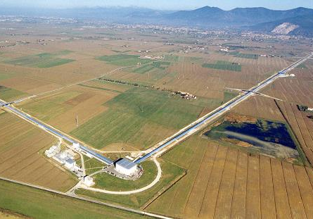
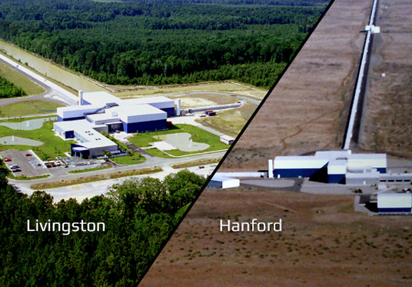
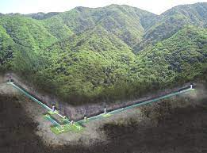
Why a Next-Generation Observatory?
EPOS Days 2026
VIRGO (I)
ET pioneered the idea of a 3rd generation GW observatory
Designed to host future upgrades for decades without limiting the observation capabilities
A dramatic improvement in sensitivity, at least 10 times better
High reliability and improved observation capability
LIGO (US)
Limitations of Current Detectors
Sensitivity and survey volume cap detection rates to roughly one event every few days, with insufficient precision to fully characterize many sources.
ET’s Breakthrough Sensitivity & Reach
With cryogenic mirror cooling and underground siting, ET will detect tens of thousands of events per year across cosmic history.
KAGRA (JP)
Early Warnings & Strategic Impact
Longer-duration signals enable coordinated multi-messenger follow-up and reinforce European leadership, driving advances in optics, cryogenics, quantum tech, and computing.

Slide 5
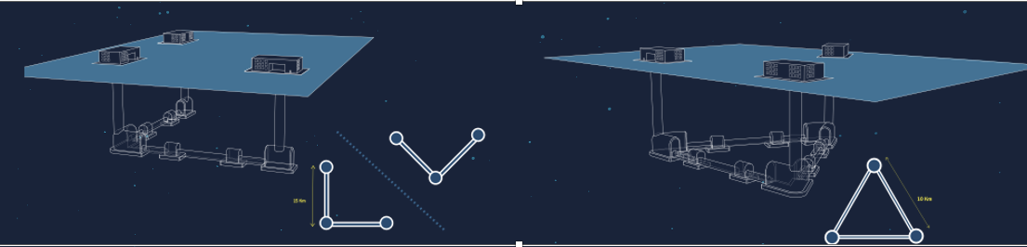
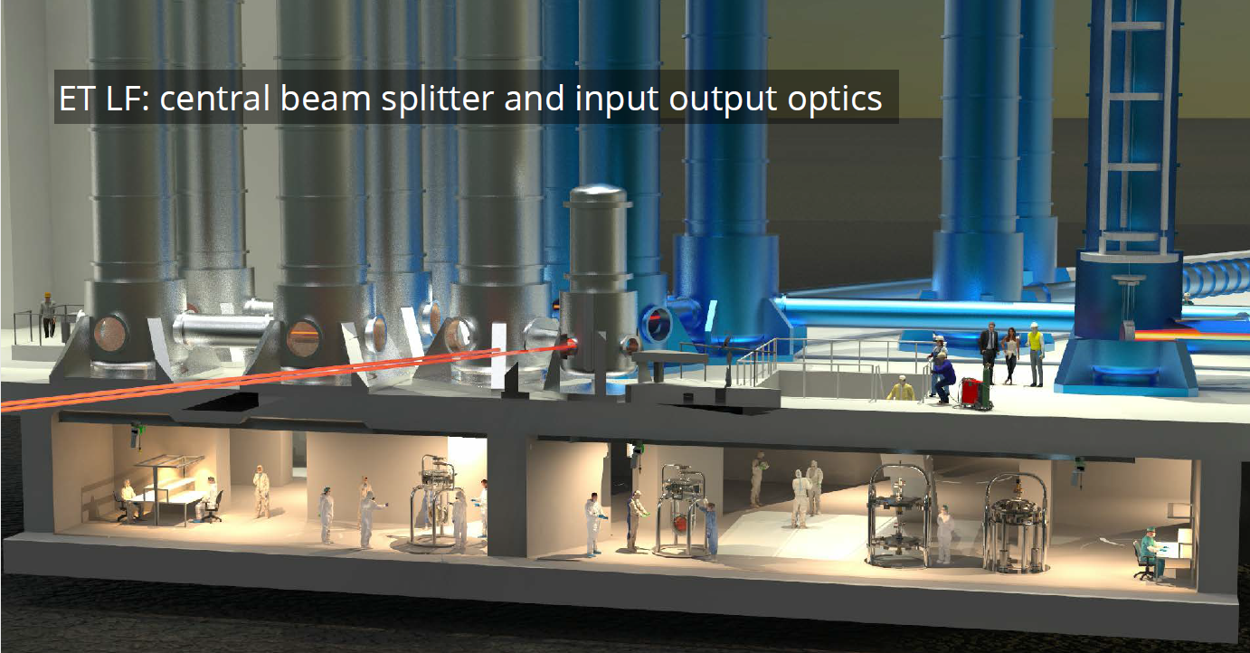
ET: Why underground?
EPOS Days 2026
ET must operate in conditions of absolute silence, far from external interferences.
Seismic stability, in particular, is an essential factor to ensure the high performance of the gravitational interferometer, especially in the search for low-frequency oscillations.
For this reason, it will be located underground, at a depth of between 100 and 300 meters, further shielding it from seismic and environmental noise, which will be significantly reduced compared to the surface.
In both configurations, a series of experimental caverns will house seismic isolation towers, large optical devices, laser systems, cryogenic systems, and vacuum systems, which require advanced electronic and mechanical technologies to ensure optimal performance in detecting gravitational waves.
Credit:s
INFN
A.Freise,

Slide 6
Site Selection and the way foreward
EPOS Days 2026
At present ET is collaborating with several RIs on different aspects. Including
CERN: vacuum
ESO: multimessenger astronomy
CTA ERIC, ESS ERIC, SKA: good – and bad – practices, e.g. site selection procedures, costing etc.
EPOS ERIC
Sensitivity and survey volume cap detection rates to roughly one event every few days, with insufficient precision to fully characterize many sources.
Helle Pedersen is one of the independent experts of the Site Selection Committee established by the Board of Governements for the physics, astrophysics and geophysics related criteria
Long term interdisciplinarity and data sharing

Slide 7
EPOS Days
Thank you!
References:
https://roadmap2021.esfri.eu/projects-and-landmarks/browse-the-catalogue/et/
https://www.esfri.eu/sites/default/files/esfri_roadmap2021_public_guide_public.pdf
https://etpp.ifae.es/deliverables-milestones

