Slide 1


Advanced Geochemical Monitoring Integrated with Geophysical Observations in Seismic Zones of Japan
Hirochika SUMINO
Research Center for Advanced Science and Technology,
The University of Tokyo, JAPAN

Slide 2
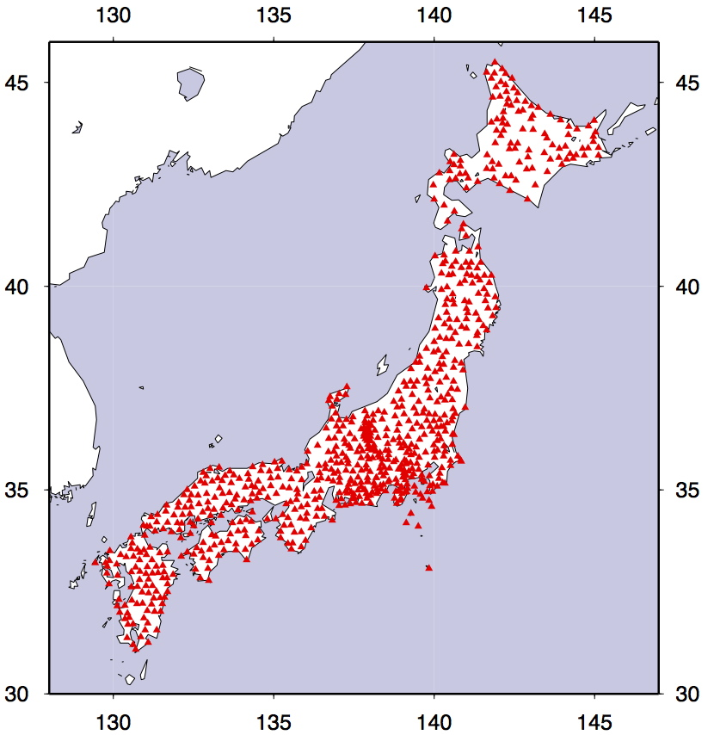
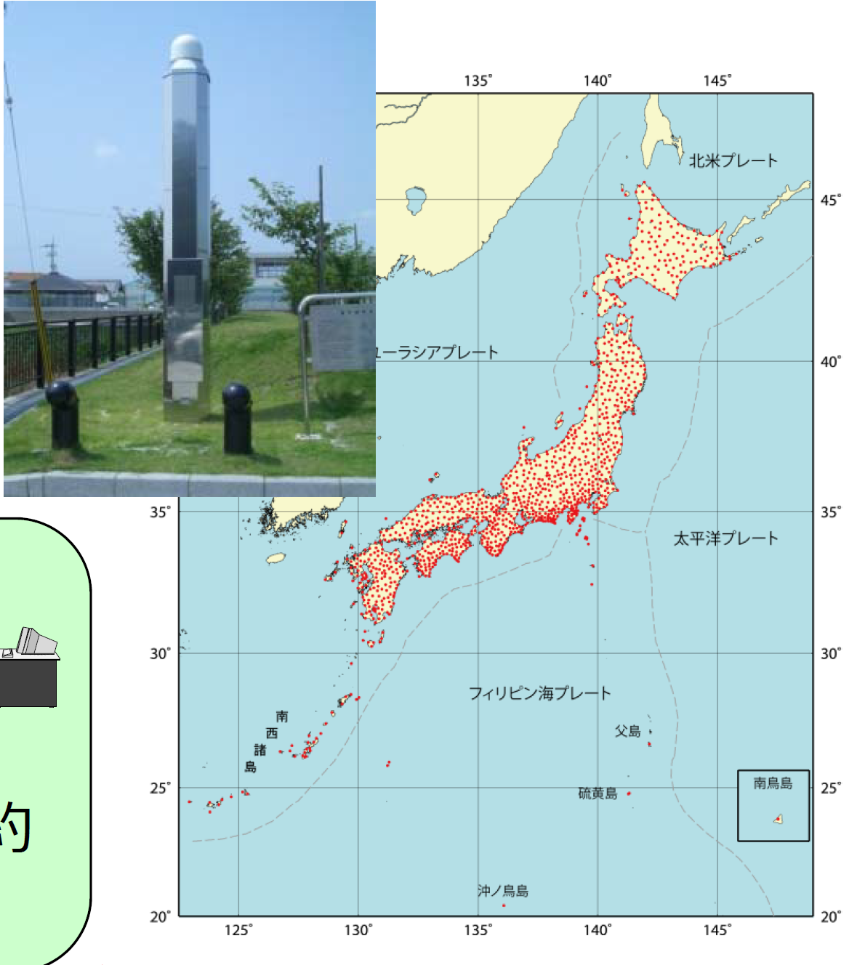
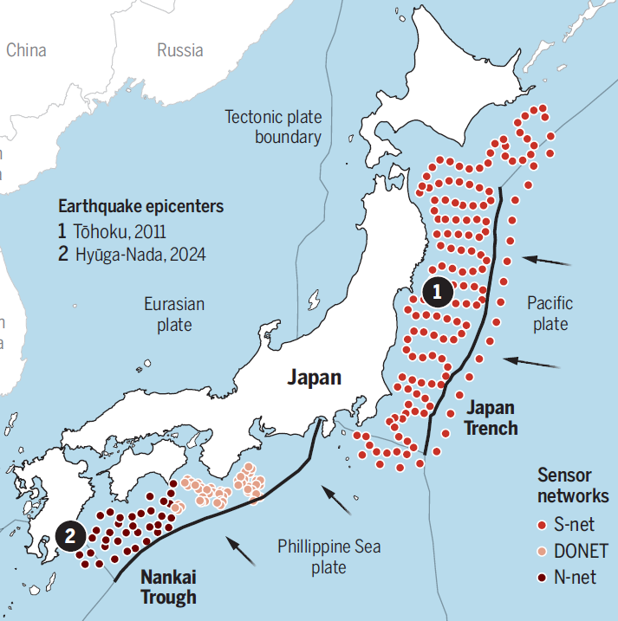
Core Monitoring Networks: Seismic and Geodetic Foundations
Hi-net (1995), S-net (2017), DONET (2011), N-net (2025) by NIED
‒ ~800 inland borehole stations and ~200 offshore station network continuously monitoring microearthquake activity with high sensitivity
GEONET (GNSS Earth Observation Network) by GSI (1994)
– >1,300 continuous GNSS stations providing fundamental data for tracking crustal strain and the accumulation of elastic strain energy
Hi-net
S-net, DONET, & N-net
GEONET
NIED = National Research Institute for Earth Science and Disaster Prevention
GSI = Geospatial Information Authority of Japan

Slide 3
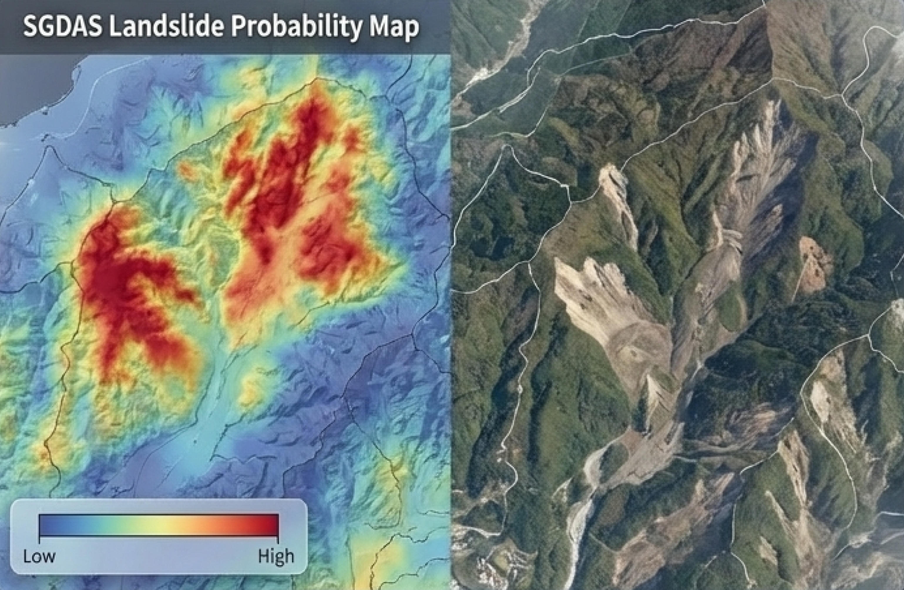
Real-Time Response and Rapid Modeling
REGARD (Real-time GEONET Analysis system for Rapid Deformation)
by GSI (2016)
– provide real-time finite fault models for M≥7 earthquakes using 1Hz GNSS data
SGDAS (Seismic Ground Disaster Assessment System) by GSI (2019)
– rapid landslide and liquefaction assessment
Example: 2024 Noto Peninsula earthquake (M7.6)
6 sec. The first Earthquake Early Warning was announced by JMA
4 min. REGARD successfully estimated a fault model, aiding in immediate initial response and tsunami predictions
8 min. SGDAS completed a map of
potential ground hazards (slope
collapses and liquefaction)
10 min. Fault models and regional crustal
deformation data were automatically
distributed to the relevant agencies
JMA = Japan Meteorological Agency

Slide 4
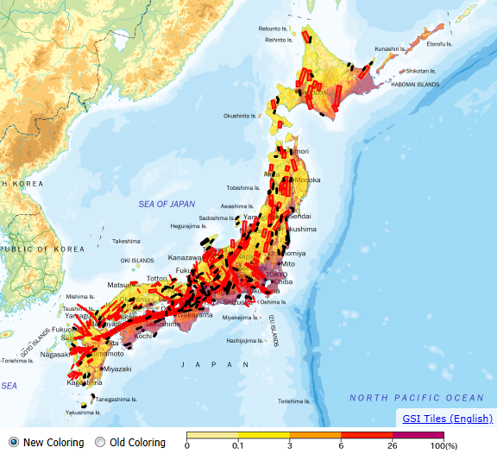
Major Inland Earthquakes During the Past ~30 Years
Active Fault Database
by GSJ (2005)
– organizes faults by "behavioral segments" based on rupture history
and surface geometry
Rupture Probability Map
by GSJ (2005)
– based on the Cascade Earthquake Model for risk assessment
Chuetsu
M6.8 (2004)
Hokkaido East. Iburi
M6.7 (2018)
Noto
M6.9 (2007)
M7.5 (2024)
Iwate-Miyagi
M7.2 (2008)
West. Tottori
M7.3 (2000)
North. Nagano
M6.7 (2014)
Active fault zones everywhere
= difficulty with multidisciplinary and permanent near-fault observatories
North. Osaka
M6.1 (2018)
Kumamoto
M7.3 (2016)
Hanshin-Awaji
M7.3 (1995)
Active fault zones (red), other faults (black) and probability of IJMA≥6-lower in 30 years
GSJ = Geological Survey of Japan

Slide 5
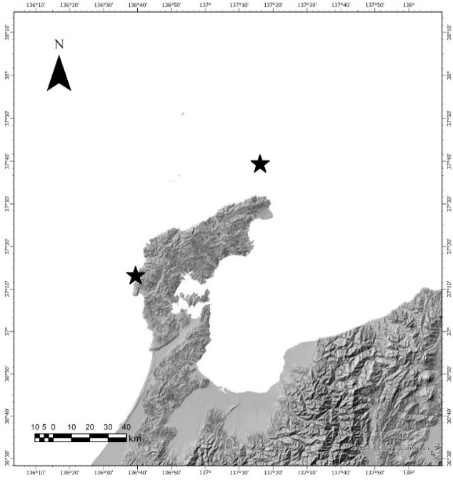

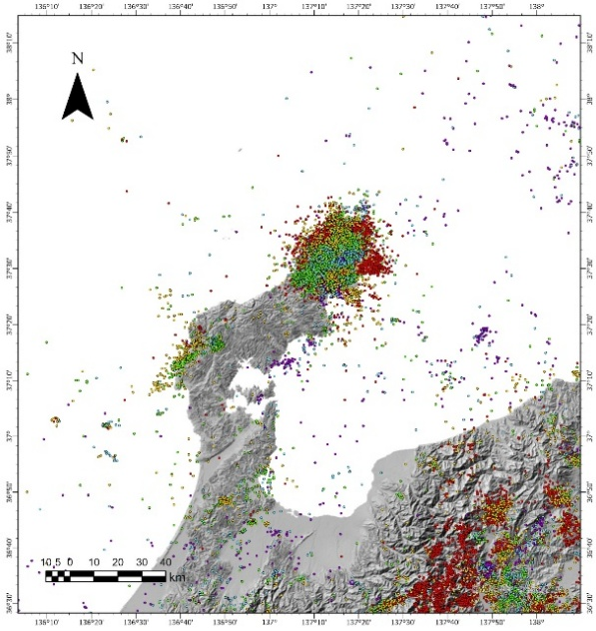
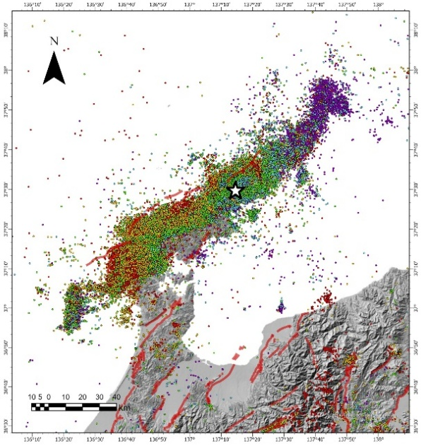

Noto Peninsula Earthquakes
Feb 7, 1993: M6.6
Mar 25, 2007: M6.9
2018~: Earthquake swarm begins
2020~: Earthquake swarm intensifies
Jun 19, 2022: M5.4
May 5, 2023: M6.5
Jan 1, 2024: M7.6 mainshock
(Devastating
damage, tsunami,
over 200 fatalities)
Before 2018
M6.6 (1993)
M6.9
(2007)
2018-2023
2024
M7.6

Slide 6
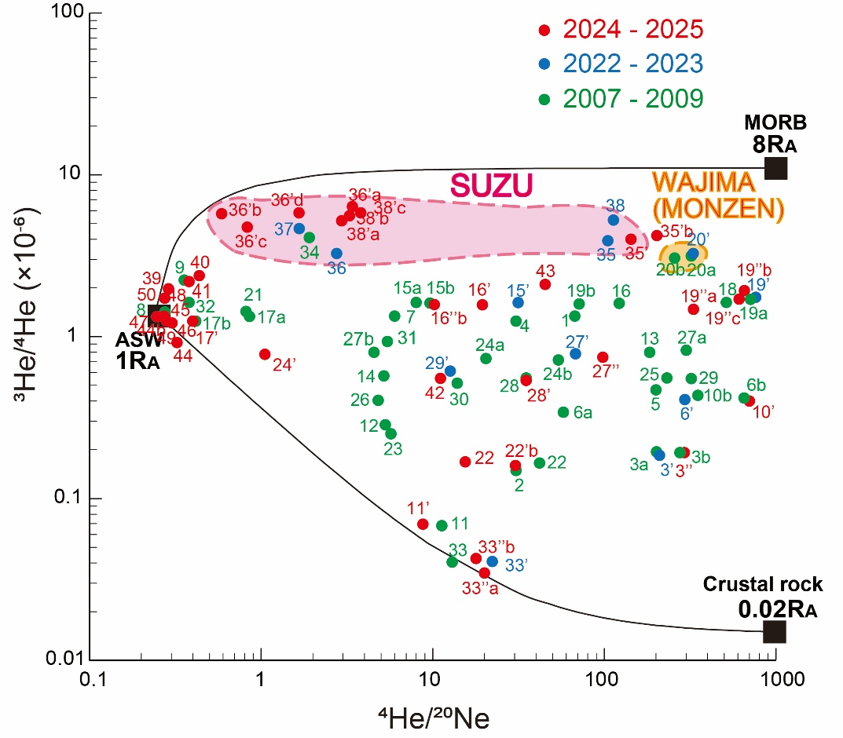
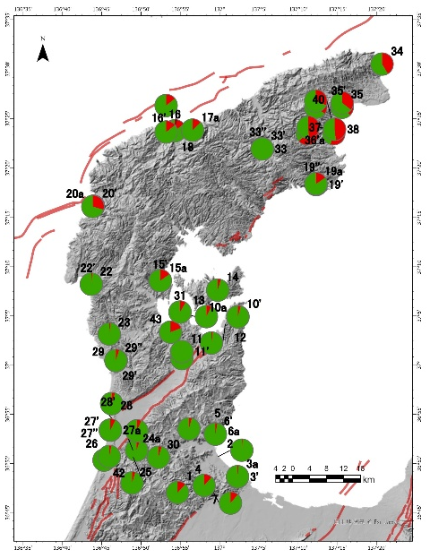
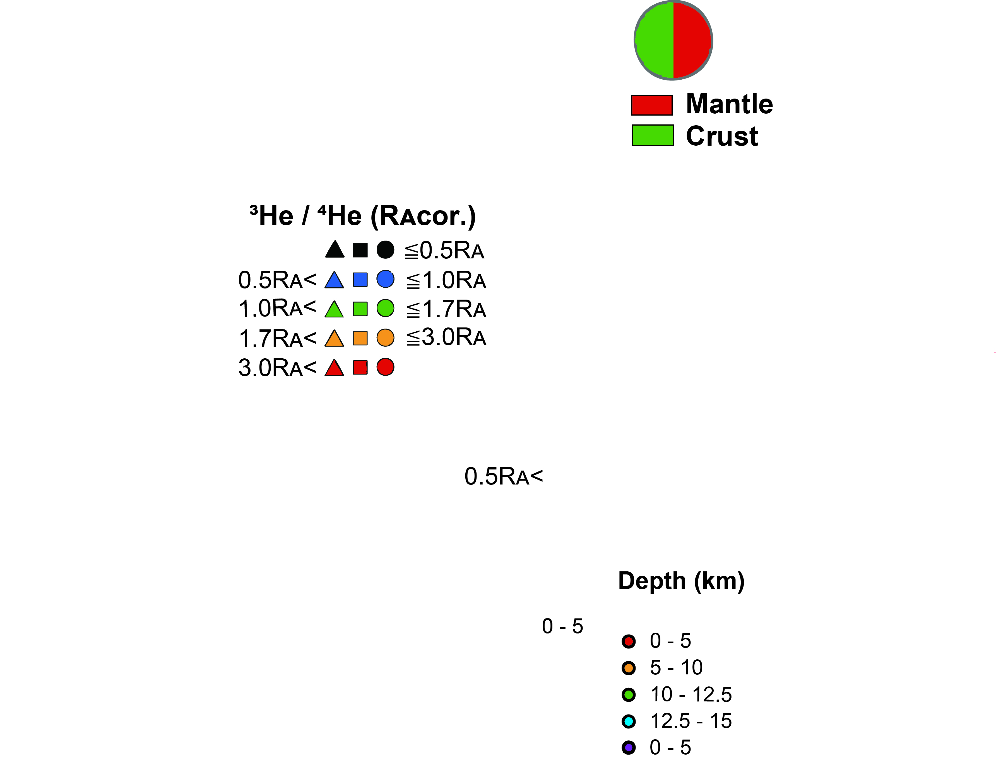
³He/⁴He of hot springs in the Noto Peninsula
High mantle contributions in SUZU and WAJIMA.
Moderate mantle contributions near active faults.

Slide 7
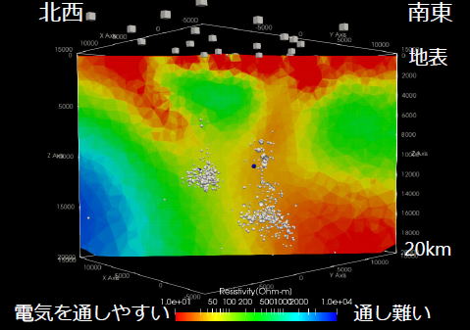
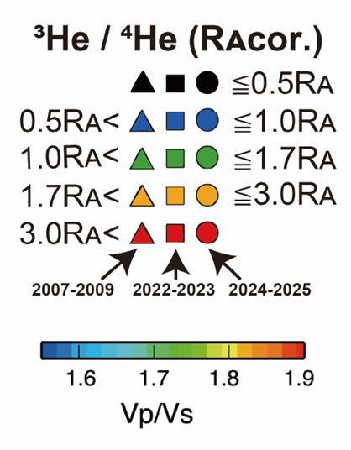

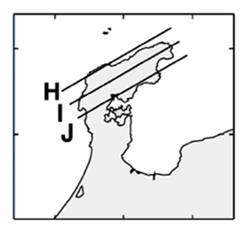
Multidisciplinary Observations Reveal Origin/Role of Fluids
Consistent with the distribution of deep-derived fluids inferred from seismic tomography.
(Nakajima, EPS 2022)
Earthquakes occurred where the low S wave velocity anomaly seems connected to the mantle, and high ³He/⁴He were observed.
⇨ triggered by the ascent of deep- derived fluids
A
B
H
WAJIMA
SUZU
I
Fluids
J
A
B
Black and grey dots: earthquake hypocenters, red circles: M ≥ 5

Slide 8
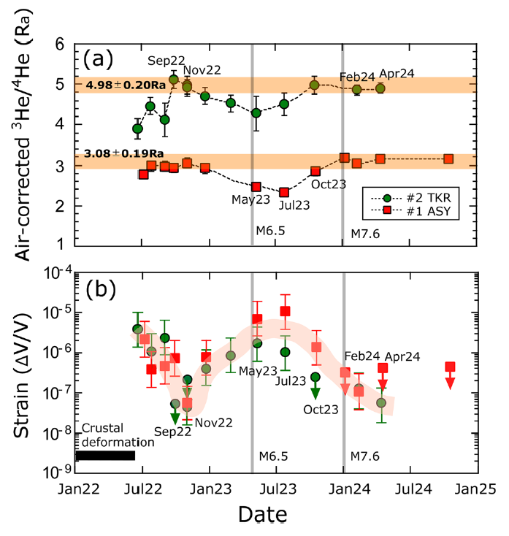
Temporal ³He/⁴He Variations as Precursory Signal
Two hot springs in SUZU showed a decrease in ³He/⁴He before the 2024 M7.6 mainshock, which may have resulted from the addition of radiogenic helium (⁴He) degassed from the aquifer rocks.
This may reflect the volumetric strain change on the bedrock and can be regarded as a precursor to the mainshock.
(Kagoshima et al., Nature Commun. 2025)

Slide 9
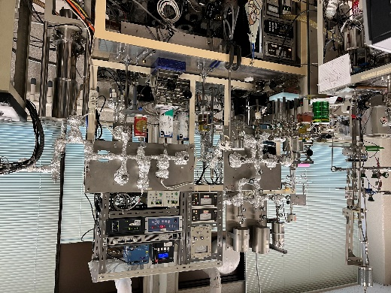
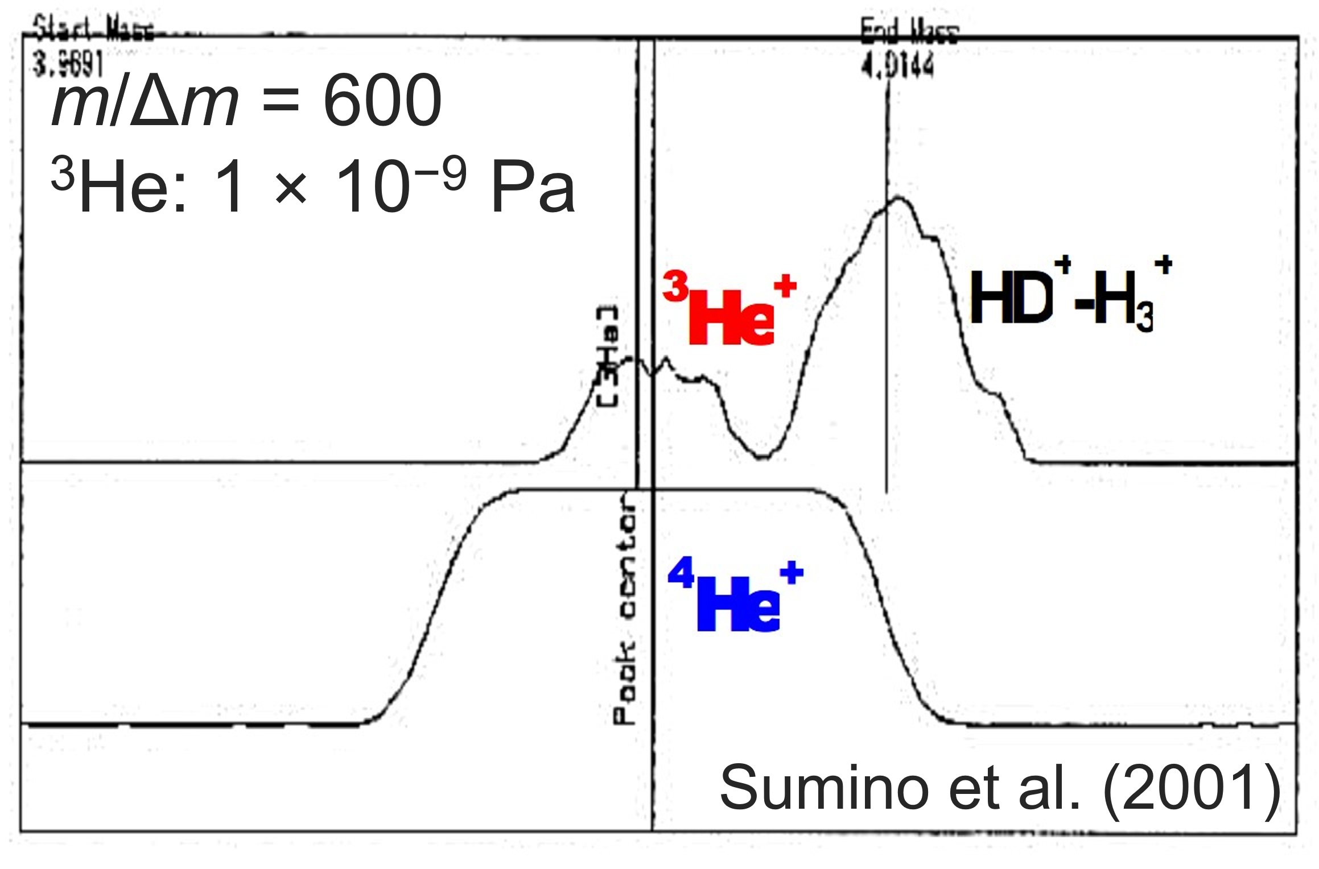
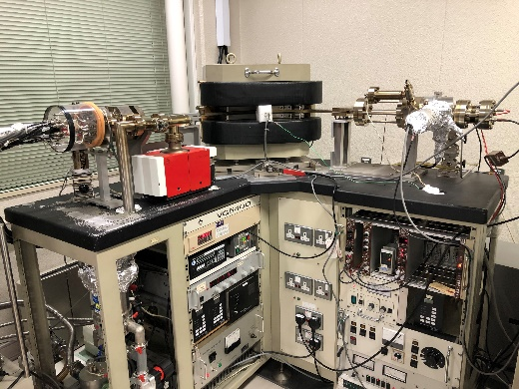
Conventional ³He/⁴He analysis and problems
Helium is generally rare in a volcanic gas sample (1–100 ppm).
  removal of active gases and noble gas separation (particularly Ar) are required.
    Noble gas purification and separation line is necessary.
³He is even more scarce.
³He/⁴He = 10⁻⁷–10⁻⁵ ⇨ ³He in the ppt order
HD⁺ (D: deuterium) is an interference of ³He⁺ detection.
  High sensitivity and high mass resolution are required.
    A magnetic-sector mass spectrometer is generally used.
Purification and separation line
Samples are analyzed after being taken back to the laboratory.
Real-time and continuous measurement is quite difficult.
All the previous ³He/⁴He variations were identified after the eruptions.
A portable mass spectrometer and a compact helium extraction system are necessary.
~2 m
weight：~1 t
Magnetic-sector mass spectrometer
Notes:
まず，ヘリウムは天然試料中の存在度が非常に小さく，ガス試料であれば1–100 ppm程度しか存在しません。
そのため，分析には，窒素や酸素など活性ガスの除去と，希ガス元素ごと分離，特にヘリウムと比べて大気中に1000倍以上存在するアルゴンの分離が必要となります。
これには，金属のゲッターや活性炭トラップを含む希ガス精製ラインが用いられます。
さらに，ヘリウムの同位体の中でも³Heは特に微量で，全試料中だとpptオーダーしか存在しません。
また，重水素を含むHD⁺は³He⁺の妨害イオンとなります。
そのため，同位体比の測定には，微量の³Heを検出できるだけの高い感度と，³HeとHDを識別できるだけの質量分解能が必要となります。
その要件を満たす分析計としては，磁場型質量分析計が用いられています。
これらの設備を持ち運ぶのはほぼ不可能なため，火山ガスのヘリウム同位体比の測定は，現地でサンプリングを行った後，試料を実験室に持ち帰って行うことになります。
したがって，防災への利用に不可欠な，リアルタイム・連続観測は現在の手法では困難です。
これを解決するには，可搬型の質量分析計とコンパクトなヘリウム抽出システムを用いた，オンサイト分析の手法が必要となります。

Slide 10
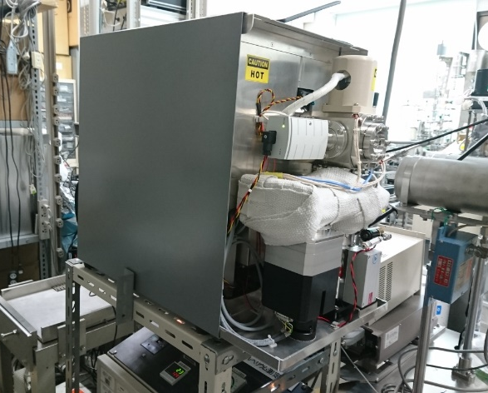
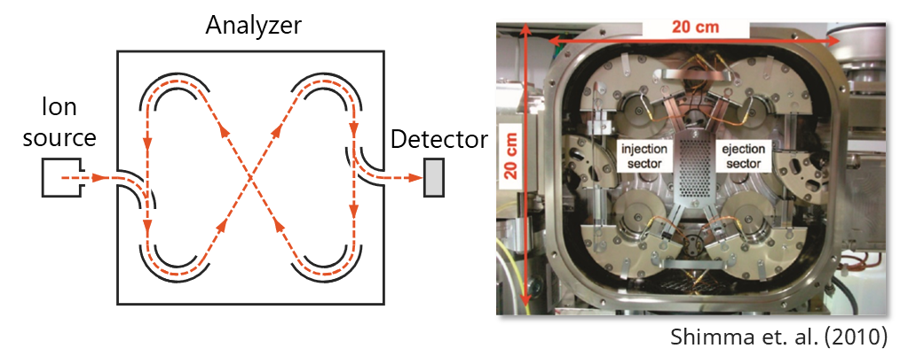
A portable mass spectrometer
35 cm
Multi-turn time-of-flight mass spectrometer
(MULTUM)^{[5]–[7]}
Ions are focused into a closed orbit flight path.
Small and lightweight
(52 × 63 × 35 cm，48 kg including pumping system)
Resolution > 30,000
(theoretically infinite)
52 cm
63 cm
weight：48 kg
Sensitivity improved by 5k times
First ³He detection with a portable instrument
The standard sample size (50 mL) is enough to obtain ³He/⁴He.
Despite lower precision than conventional instruments, pre-eruptive ³He/⁴He variations are expected to be detected.
1:1
Error bars are 1 sigma.
[5] Toyoda et al., J. Mass Spectrom. (2000).
[6] Okumura et al., J. Mass Spectrom. Soc. Jpn. (2003).
[7] Shimma et al., Anal. Chem. (2010).
Notes:
可搬型の質量分析計として，我々はマルチターン飛行時間型質量分析計，通称MULTUMを採用しました。
これは飛行時間型質量分析計の一種で，８の字の飛行経路でイオンを周回させ，質量分析計ごとの飛行時間の差によってイオンを分離し，質量スペクトルを得る分析計です。
一般的な飛行時間型質量分析計では，まっすぐの飛行経路でイオンを質量分離しますが，MULTUMでは飛行経路を電場制御によって８の字に曲げることで，サイズを小さく保ったまま高い質量分解能を実現しています。
そのため，小型・軽量で十分に持ち運びが可能であり，³HeとHDを十分に識別できるだけの質量分解能を有しています。
ただし，感度については天然試料中の微量の³Heを検出するのに必要な水準に遠く及びませんでした。
したがって，MULTUMを用いてヘリウム同位体比を測定するためには，感度を向上させて，³Heの検出および定量を可能にすることが課題でありました。

Slide 11
Summary and Future Perspective
Although geophysical (seismological and geodetic) monitoring has been intensively carried out in Japan, “ubiquitous” faults hinder the establishment of a multidisciplinary and permanent near-fault observatory.
Nevertheless, advanced geochemical studies using helium isotopes have shown their significance for understanding deep fluid migration causing earthquakes and detecting precursory signals.
To realize continuous on-site ³He/⁴He monitoring, the development of portable instruments is ongoing.
for the international collaborations…
MoU between the relevant universities/institutes running NFOs in EPOS and Univ. Tokyo
Application to bilateral funds between the relevant agencies in EU countries and JSPS (Japan Society for the Promotion of Science)
are planned to promote the exchange of monitoring techniques and young researchers between NFO and the Japanese community.

Slide 13
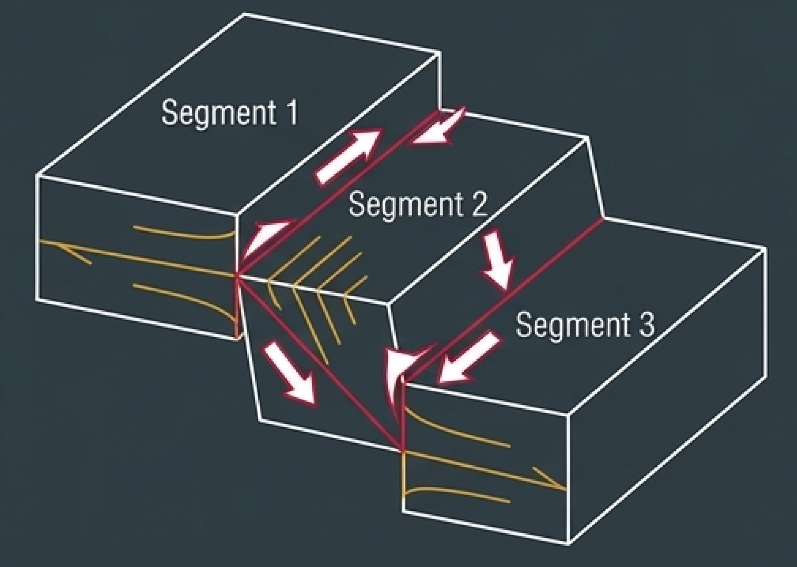
Long-Term Risk Assessment and Databases
Active Fault Database
by GSJ (2005)
– organizes faults by "behavioral segments" based on rupture
history and surface geometry
Rupture Probability Map
by GSJ (2005)
– based on the Cascade Earthquake Model, which assesses the probability that segments will rupture individually or in conjunction with neighbors, for infrastructure planning and
risk assessment
Active fault zones (red), other faults (black) and probability of IJMA≥6-lower in 30 years
GSJ = Geological Survey of Japan

Slide 14
Major Inland Earthquakes During the Past ~30 Years
Chuetsu
M6.8 (2004)
Hokkaido East. Iburi
M6.7 (2018)
Noto
M6.9 (2007)
M7.5 (2024)
Iwate-Miyagi
M7.2 (2008)
West. Tottori
M7.3 (2000)
North. Nagano
M6.7 (2014)
North. Osaka
M6.1 (2018)
Kumamoto
M7.3 (2016)
Hanshin-Awaji
M7.3 (1995)
Active fault zones everywhere
= difficulty with establishing (permanent) near-fault observatories

Slide 15
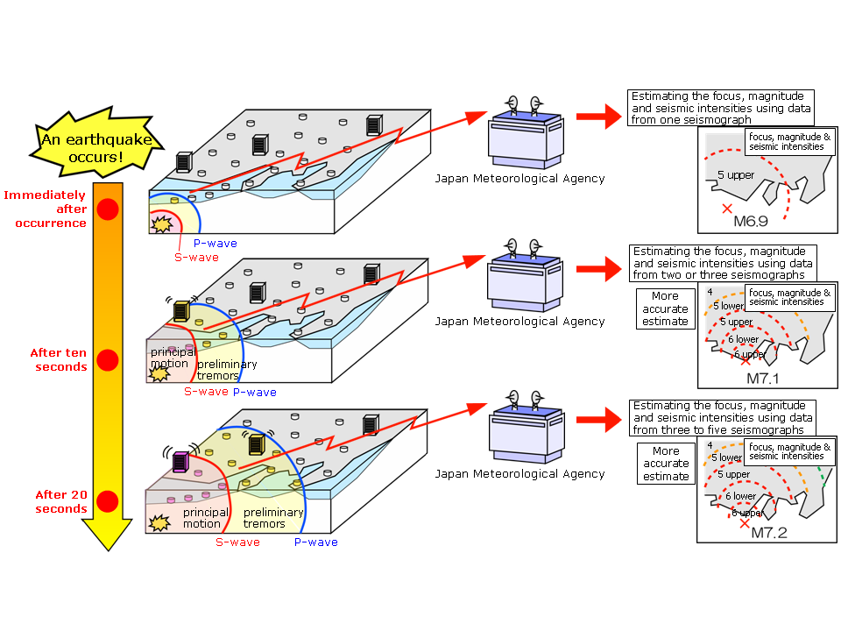
Earthquake Early Warning (EEW)
緊急地震速報 (Kinkyu Jishin Sokuho)
(JMA = Japan Meteorological Agency)
Video (10 min.)
http://www.jma.go.jp/jma/en/Activities/eew.html

Slide 16
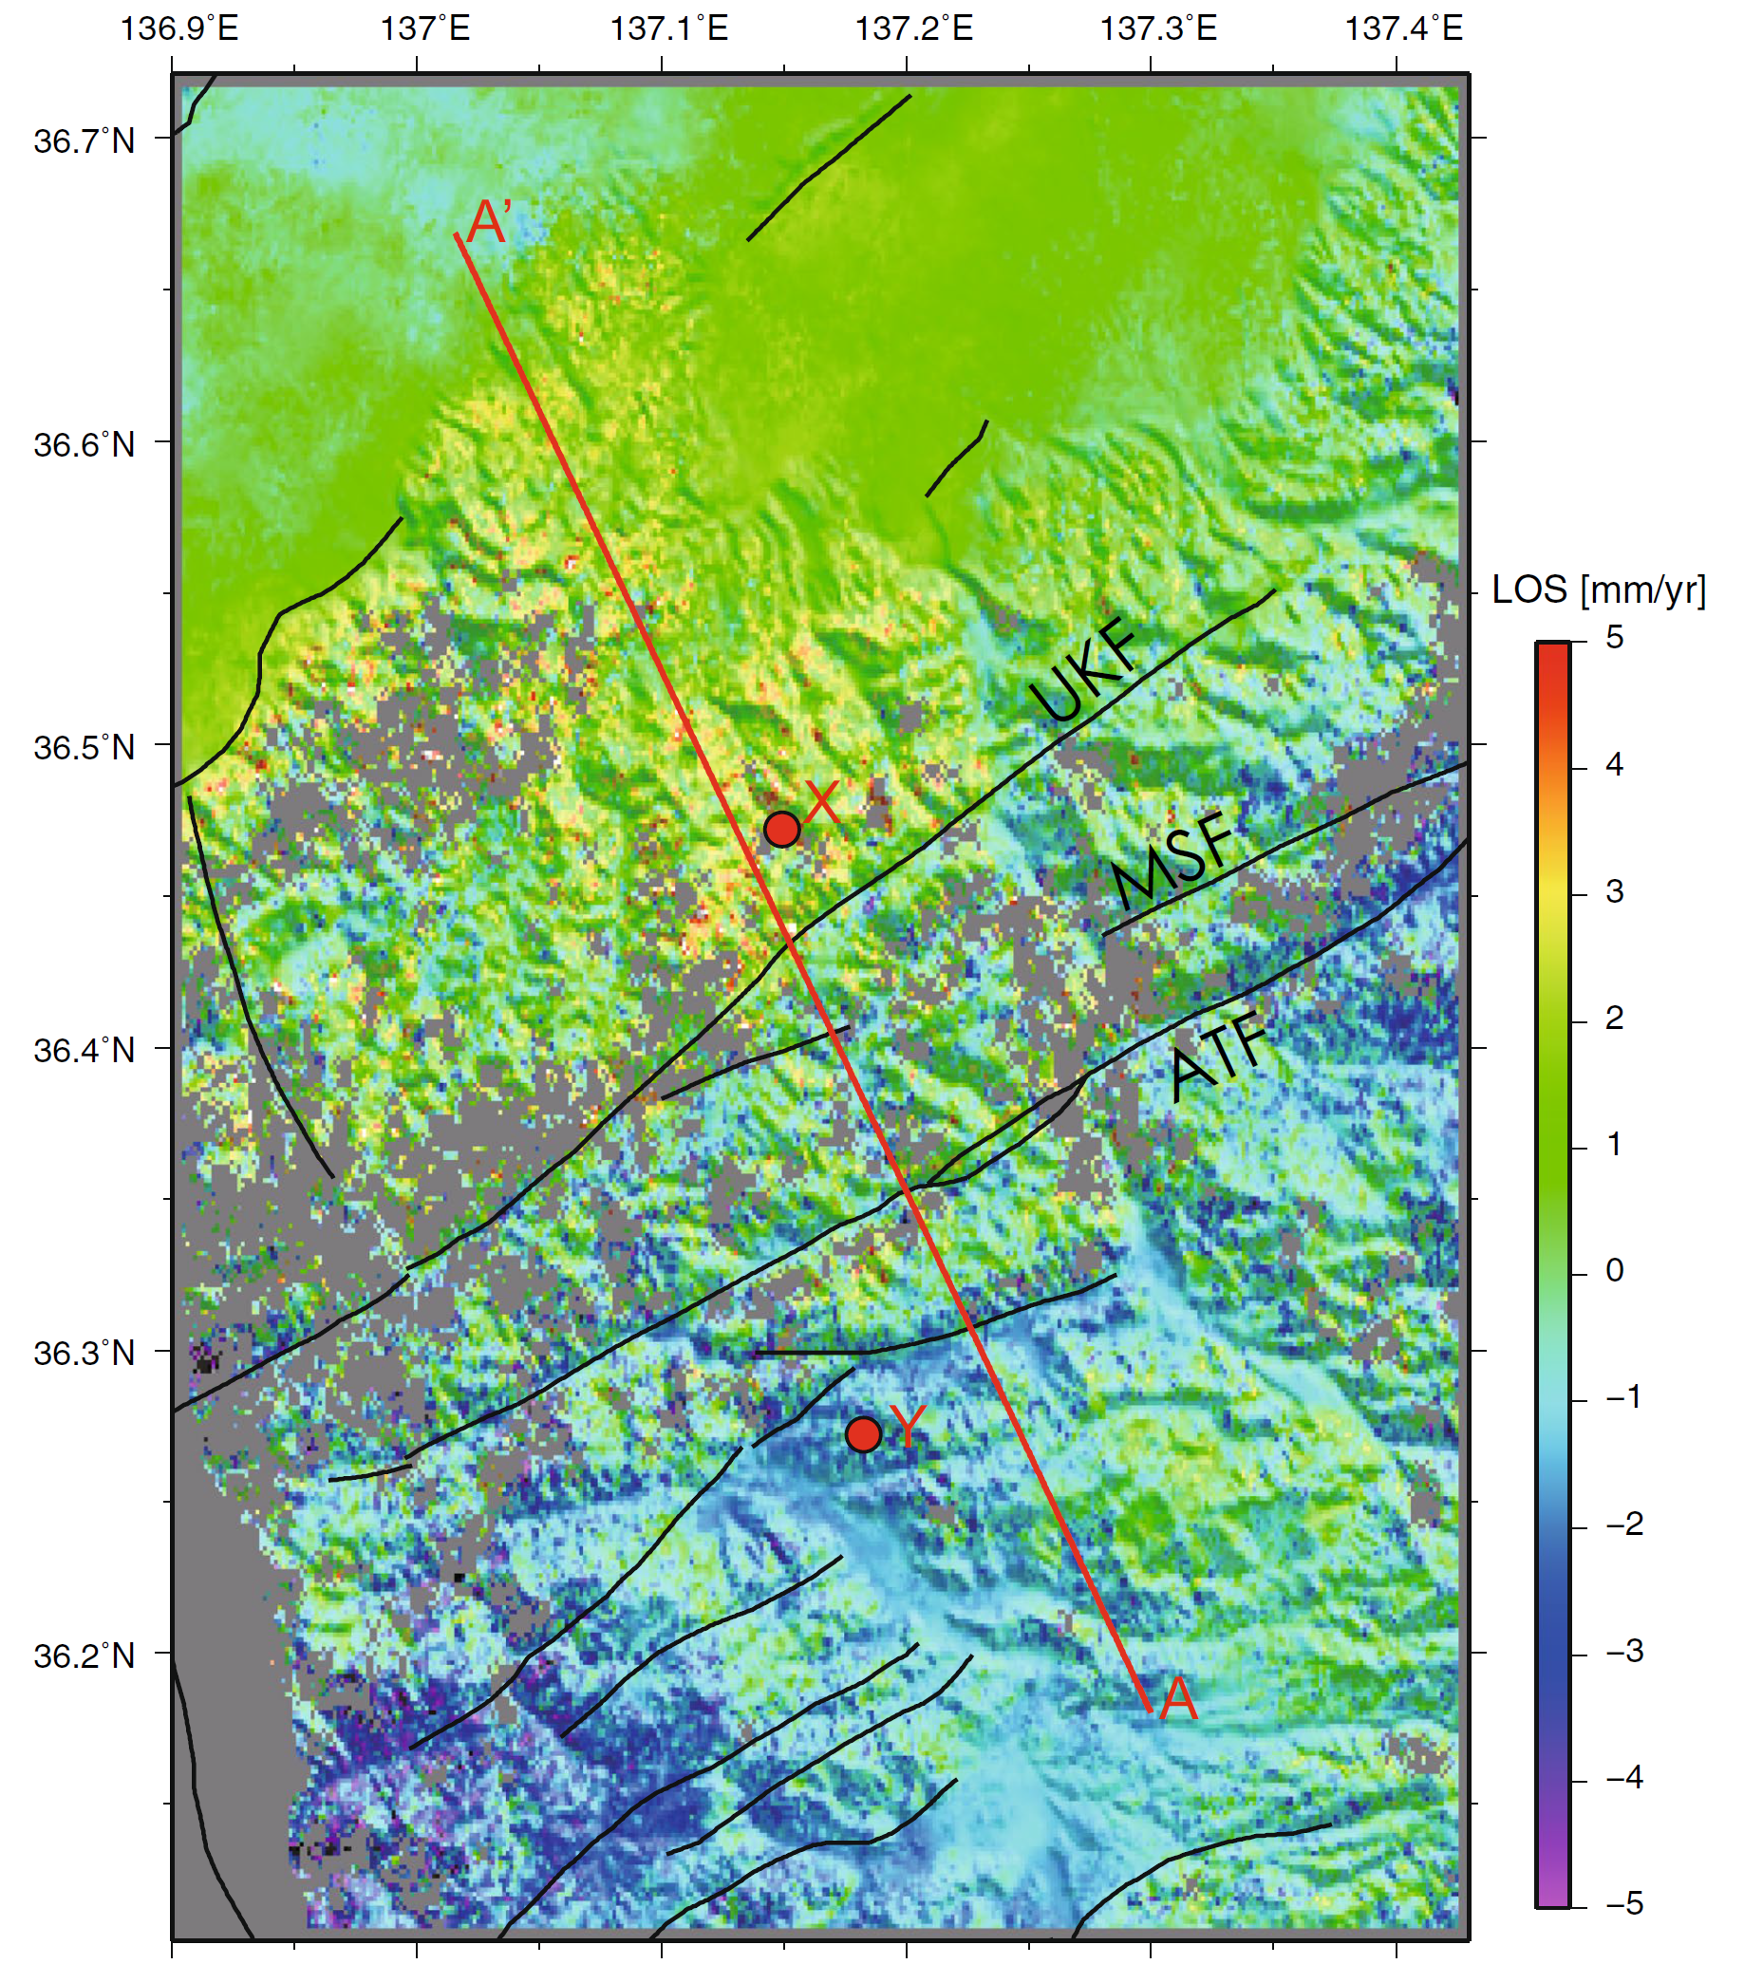
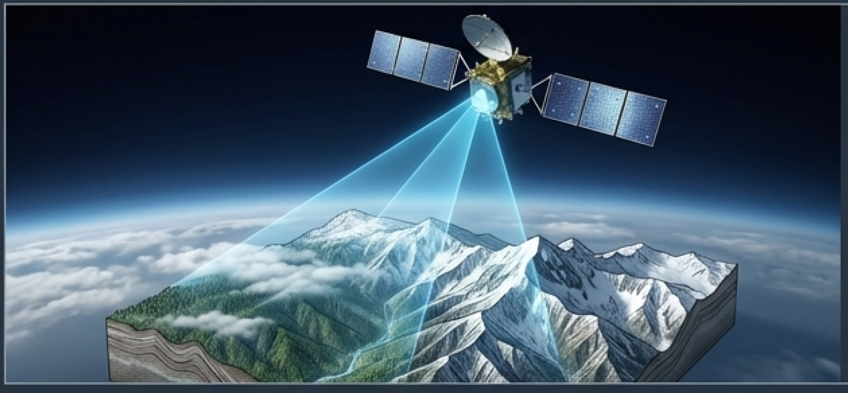
Advanced Geodetic Techniques for Interseismic Strain
InSAR and GNSS Integration:
combination of satellite-based InSAR with GNSS data to overcome
challenges in forested or steep terrain
Example at Atotsugawa Fault System:
detailed interseismic velocity fields were
revealed, and sharp velocity gradients
across major strands like the Ushikubi
fault, which were previously difficult to
map with high spatial resolution, were
identified
Ushikubi
Atotsugawa
(Takada et al., EPS 2018)

Slide 17
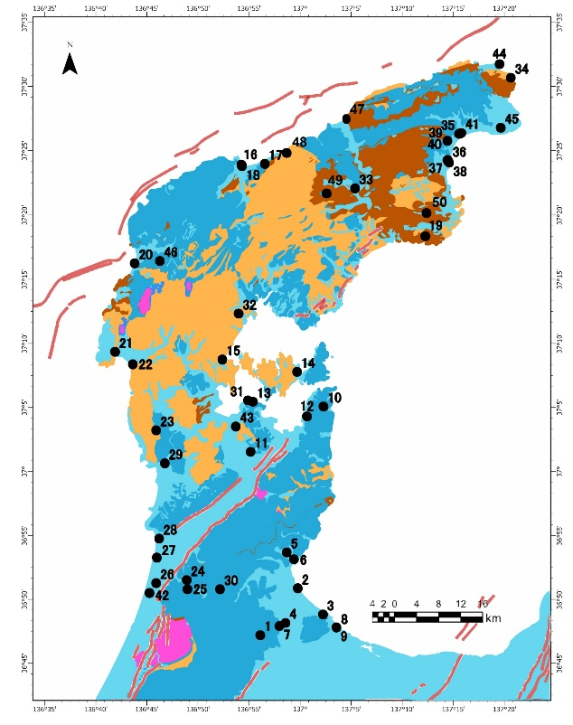
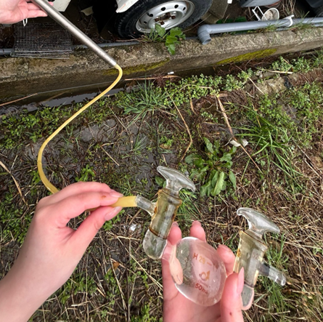

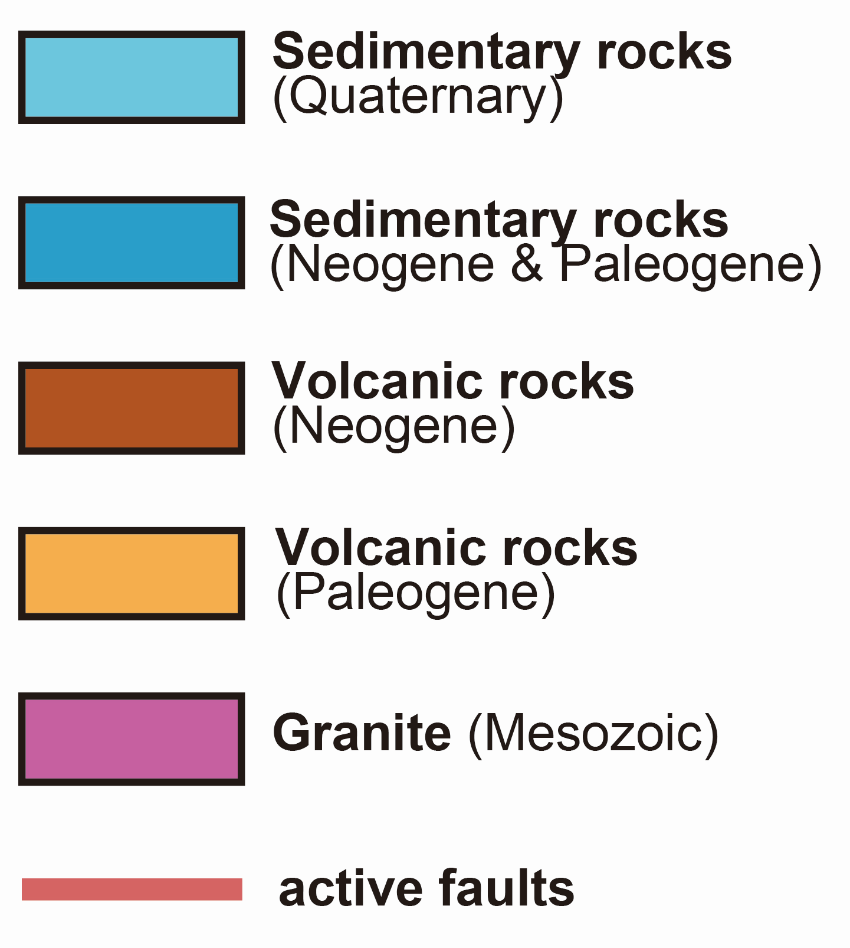
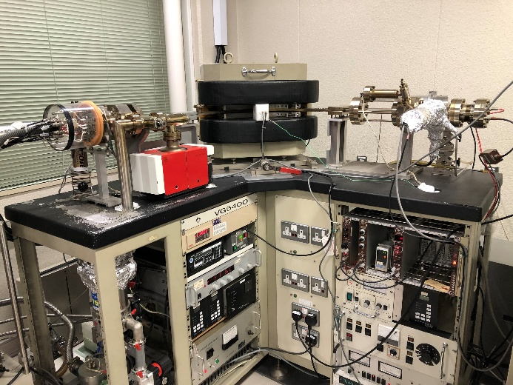
Hot Spring Sampling Sites and ³He/⁴He Analysis
Preparation line
~2 m
weight：~1 t
Magnetic-sector mass spectrometer

Slide 18
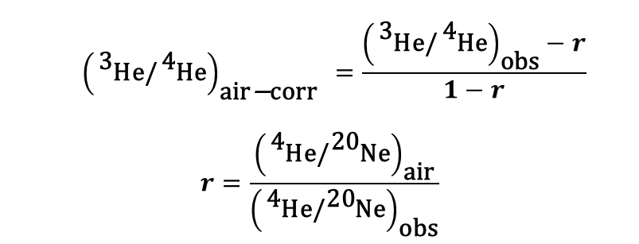
What Does Helium Isotope Ratio Tell?
Chemically inert, thus reflects mixing ratios of several components with different origins
Relative contributions in He from Mantle / Crust / Air
Air contribution can be
corrected based on
⁴He/²⁰Ne
Air- corrected ³He/⁴He
⇨ Mantle / Crust
Geothermal fluids in Japan
Mantle-derived
³He/⁴He
$${\left({}_{}^{\text{3}}{\text{He}\text{/}{}_{}^{\text{4}}{\text{He}}}\right)}_{\text{air}\text{−}\text{corr}} =\frac{{\left({}_{}^{\text{3}}{\text{He}\text{/}{}_{}^{\text{4}}{\text{He}}}\right)}_{\text{obs}}−r}{1−r}$$
$$r=\frac{{\left({}_{}^{\text{4}}{\text{He}\text{/}{}_{}^{\text{20}}{\text{Ne}}}\right)}_{\text{air}}}{{\left({}_{}^{\text{4}}{\text{He}\text{/}{}_{}^{\text{20}}{\text{Ne}}}\right)}_{\text{obs}}}$$
Crust-derived
(Sano & Wakita, JGR 1985)

Slide 19
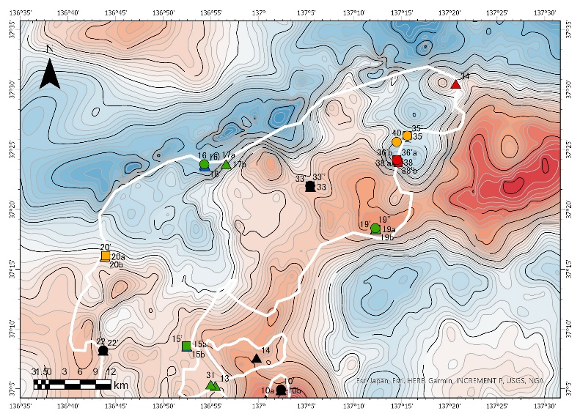
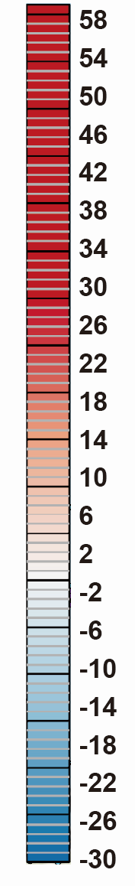
Comparison with Geophysical Observations (2)
High ³He/⁴He were associated with the boundary between high and low gravity anomaly, the latter of which in the northeastern Noto Peninsula is interpreted as a Miocene caldera (Yamazaki and Kono, Bull. Volcanon. Soc. Jpn. 1973).
⇨ fluid migration along caldera wall?
Bouguer gravity anomaly

Slide 20
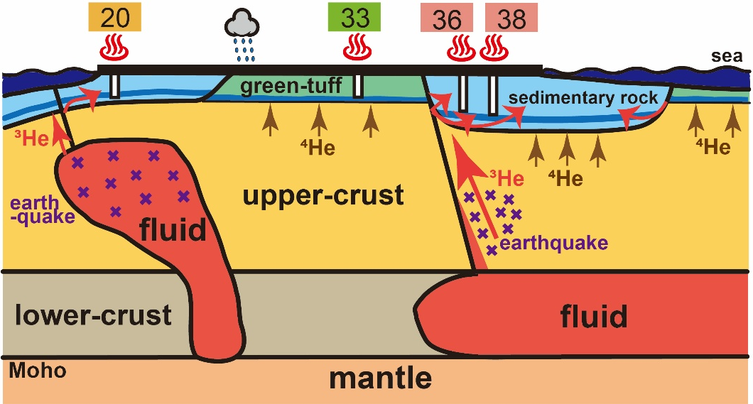
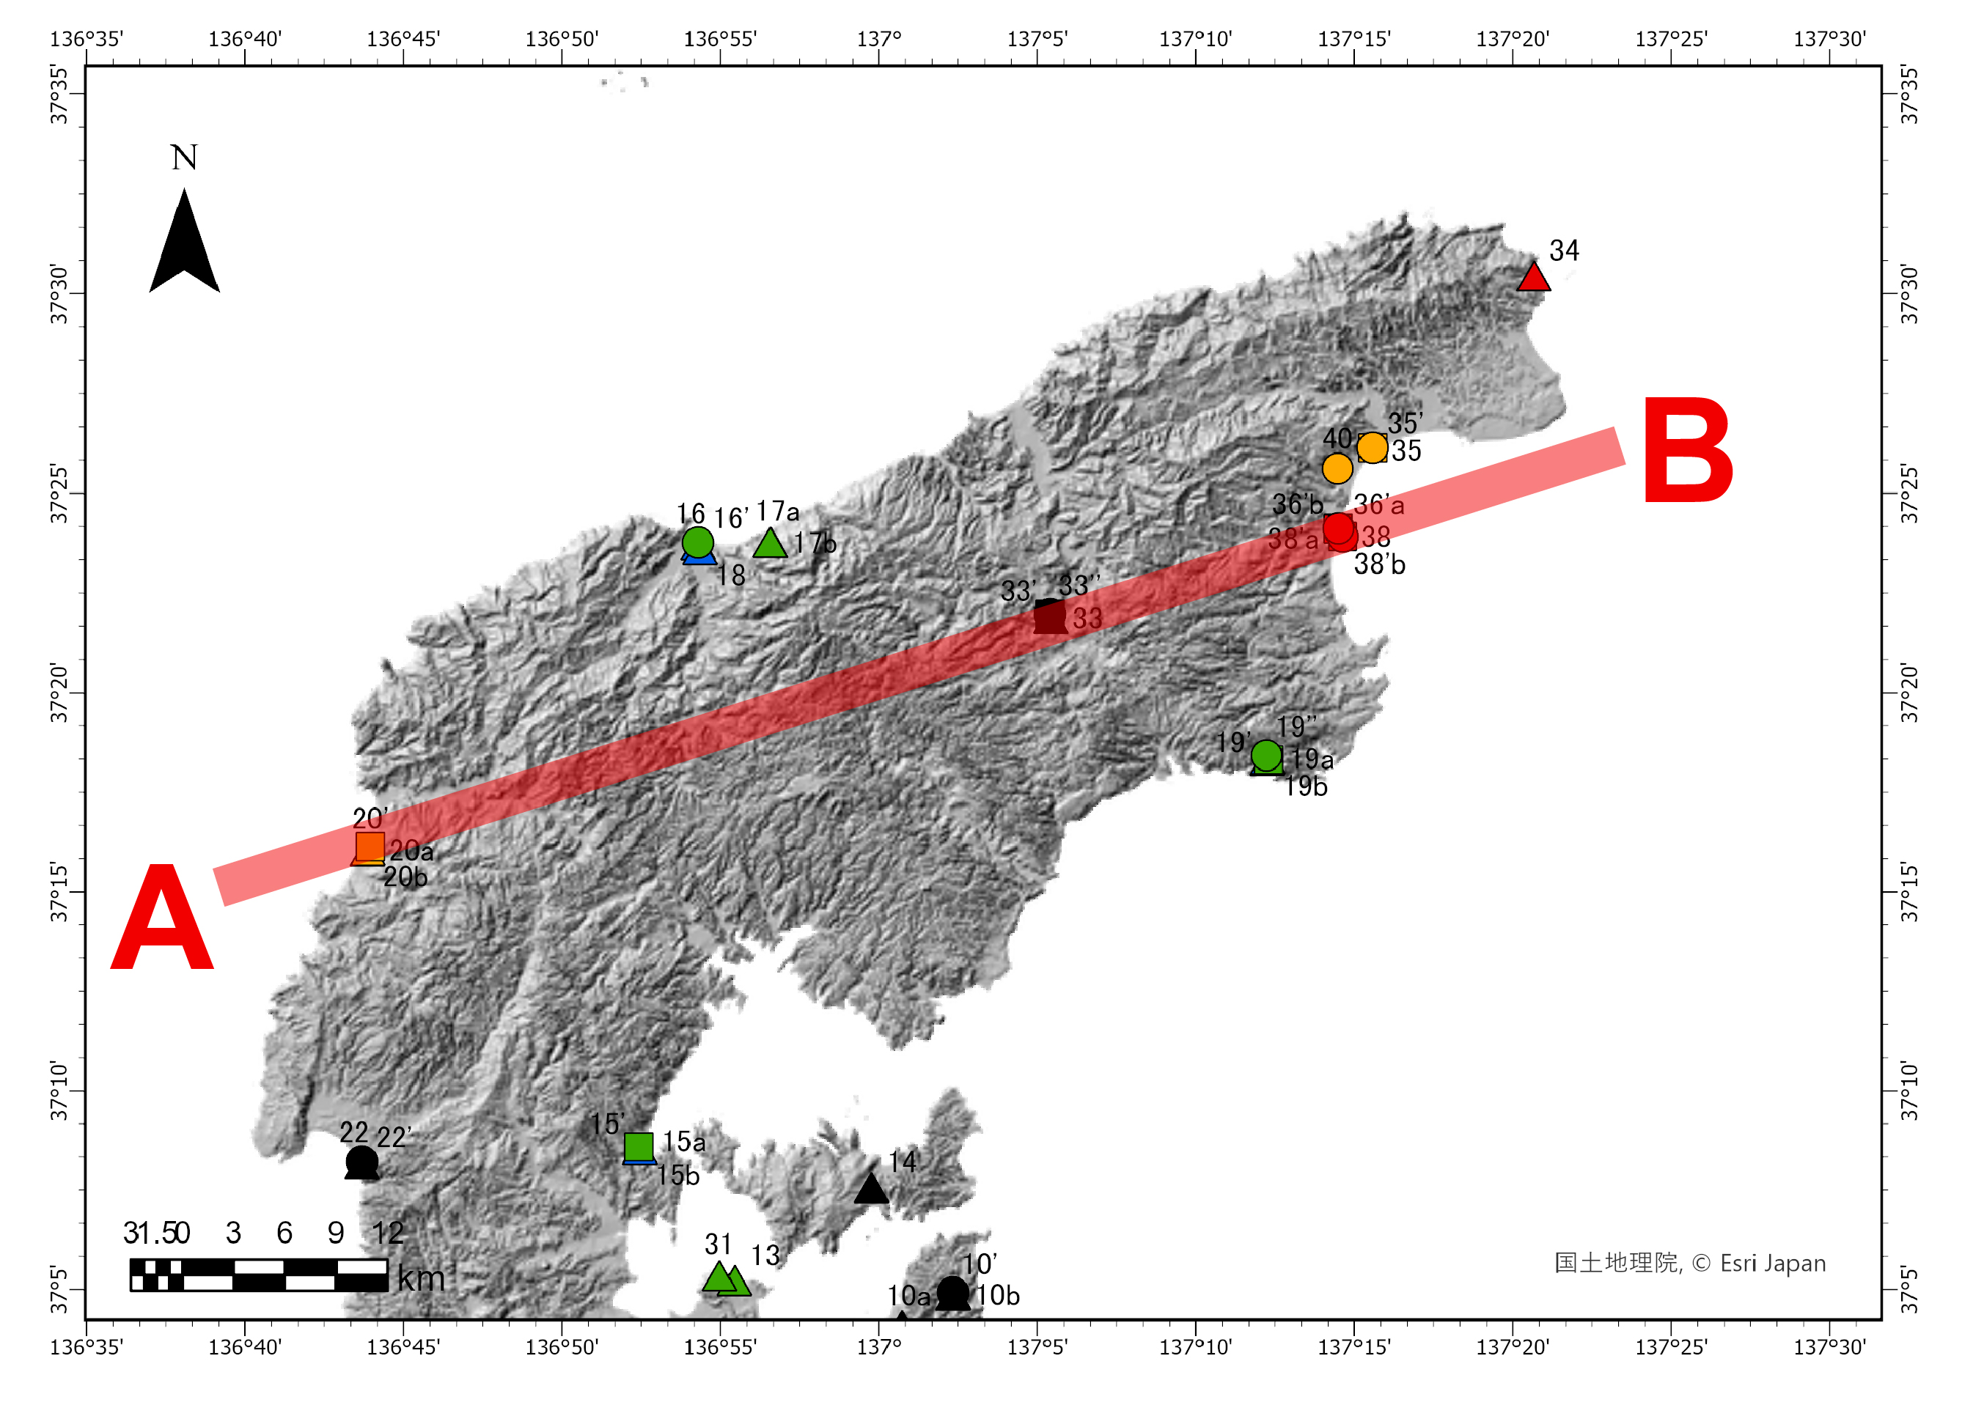
Deep Structure and Fluid Migration
In WAJIMA on the northwestern Noto Peninsula, where deep-derived fluids ascended and triggered the 2007 M6.9 earthquake and subsequent swarms, the fluids reached the surface via active faults.
In SUZU on the northeastern Noto Peninsula, the deep-derived fluid reached the surface via the caldera wall.
2.3 RA
0.02 RA
6.8 RA
4.3 RA
A
B
SUZU
WAJIMA

Slide 21
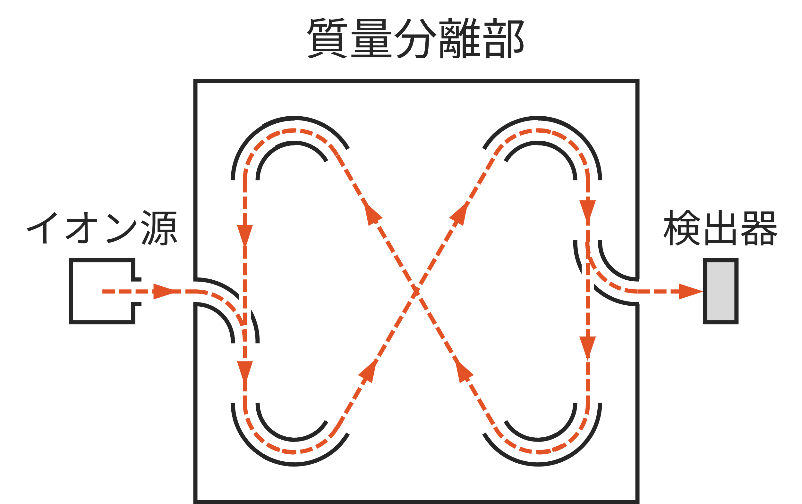
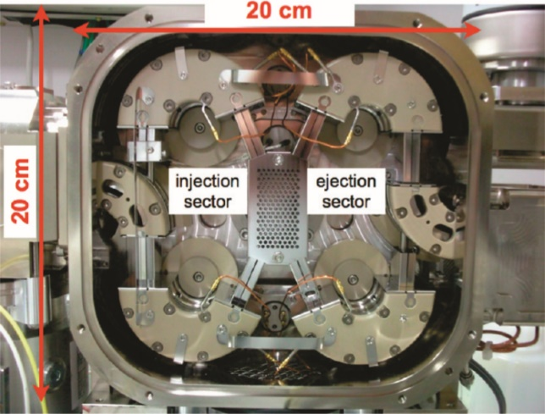
A portable mass spectrometer
Multi-turn time-of-flight mass spectrometer (MULTUM)^{[5]–[7]}
Ions are focused into a closed orbit flight path.
Small and lightweight
(52 × 63 × 35 cm，48 kg including pumping system)
Resolution > 30,000
(theoretically infinite if the ions remained in the flight path)
Sensitivity is not high enough to detect ³He in
natural samples.
35 cm
52 cm
63 cm
weight：48 kg
Analyzer
Improvement in sensitivity to detect ³He is necessary for ³He/⁴He analysis.
Ion
source
Detector
Shimma et. al. (2010)
[5] Toyoda et al., J. Mass Spectrom. (2000). [6] Okumura et al., J. Mass Spectrom. Soc. Jpn. (2003). [7] Shimma et al., Anal. Chem. (2010).
Notes:
可搬型の質量分析計として，我々はマルチターン飛行時間型質量分析計，通称MULTUMを採用しました。
これは飛行時間型質量分析計の一種で，８の字の飛行経路でイオンを周回させ，質量分析計ごとの飛行時間の差によってイオンを分離し，質量スペクトルを得る分析計です。
一般的な飛行時間型質量分析計では，まっすぐの飛行経路でイオンを質量分離しますが，MULTUMでは飛行経路を電場制御によって８の字に曲げることで，サイズを小さく保ったまま高い質量分解能を実現しています。
そのため，小型・軽量で十分に持ち運びが可能であり，³HeとHDを十分に識別できるだけの質量分解能を有しています。
ただし，感度については天然試料中の微量の³Heを検出するのに必要な水準に遠く及びませんでした。
したがって，MULTUMを用いてヘリウム同位体比を測定するためには，感度を向上させて，³Heの検出および定量を可能にすることが課題でありました。

Slide 22
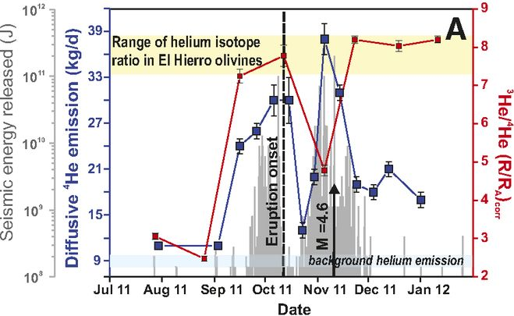
Analyses of volcanic gas samples with modified MULTUM
Pulse counting of detector signals to improve S/N ratio
Static mode operation to keep sample gas in the mass spectrometer
Improved ion transmission
Sensitivity improved by 5000 times!
First ³He detection with a portable instrument
The standard sample size (50 mL) is enough to obtain ³He/⁴He.
Despite lower precision than conventional instruments, pre-eruptive ³He/⁴He variations are expected to be detected.
1:1
Error bars are 1 sigma.
Detectable!
The data obtained with MULTUM are consistent with those obtained with a conventional mass spectrometer within 1σ errors.
Notes:
最後に，MULTUMによる火山ガス試料の測定結果になります。
5つの火山ガス試料の³He/⁴He比をMULTUMを用いて測定しました。
グラフの横軸は磁場型質量分析計による測定値で，縦軸がMULTUMによる測定値を表します。
MULTUMによる測定値は，同じ試料の磁場型質量分析計による測定値とおよそ1σのの範囲内で一致するという結果が得られました。
以上がMULTUMに関する開発概要と評価結果になります。

Slide 23
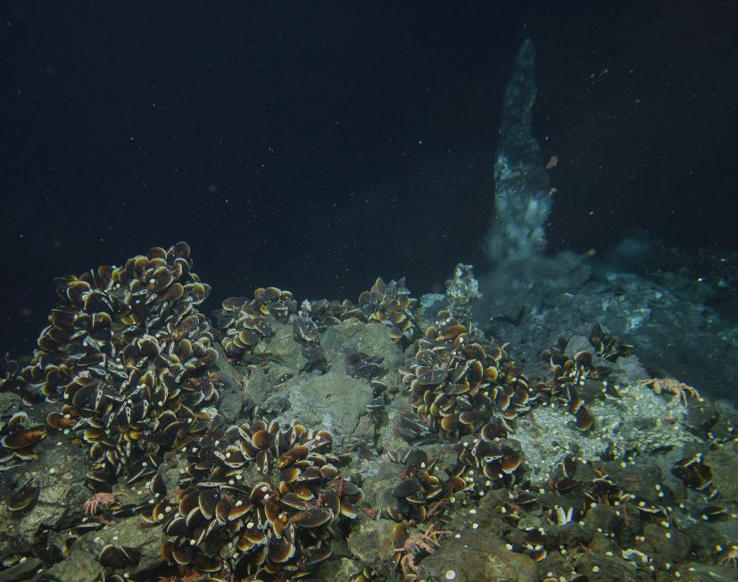
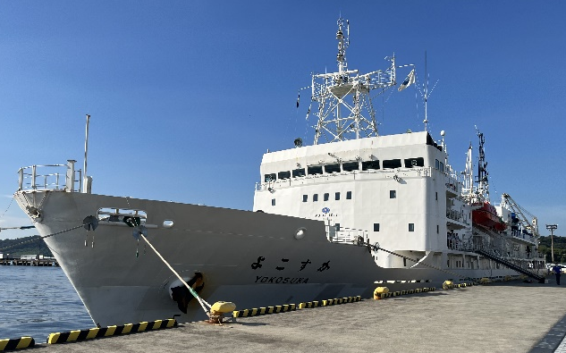
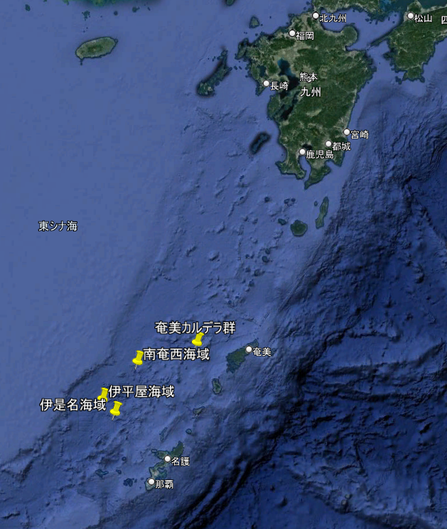
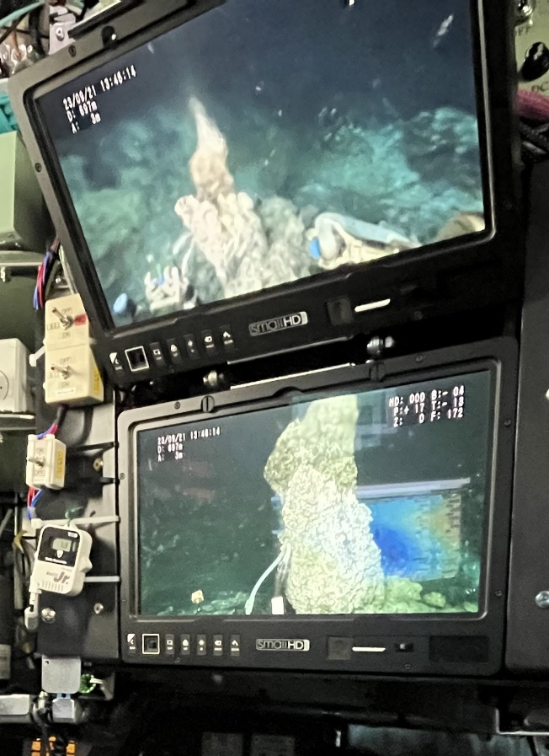
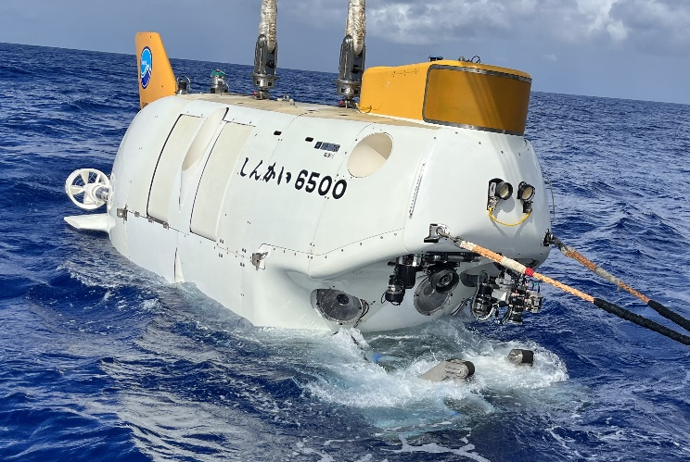
On-board He isotope analysis
JAMSTEC
Yokosuka YK23-16S Cruise (2023. 9. 15-29)
K. Tani (NMNS), Chief Scientist

Slide 24
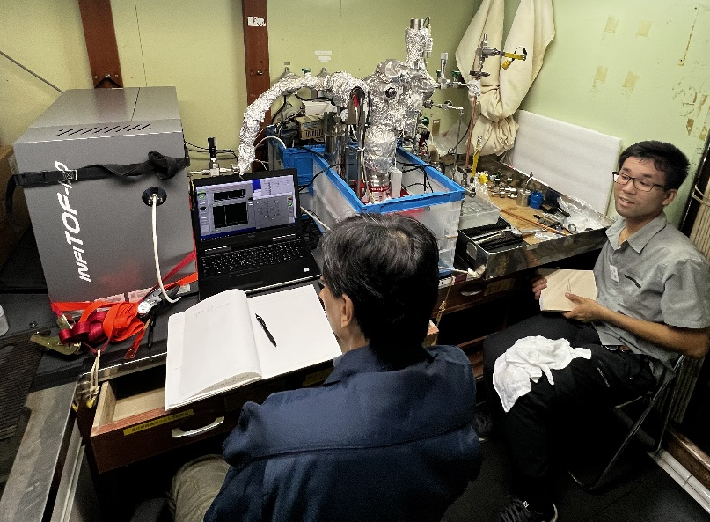
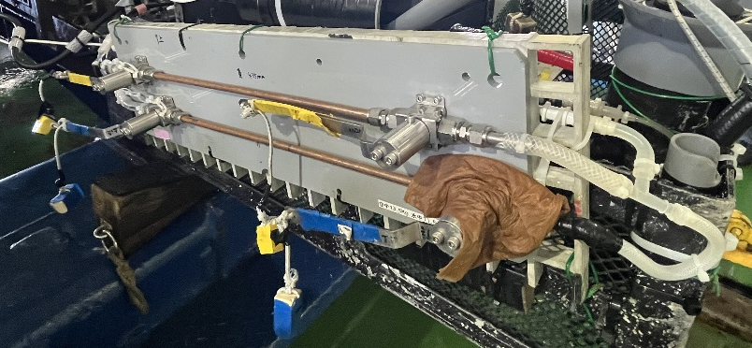
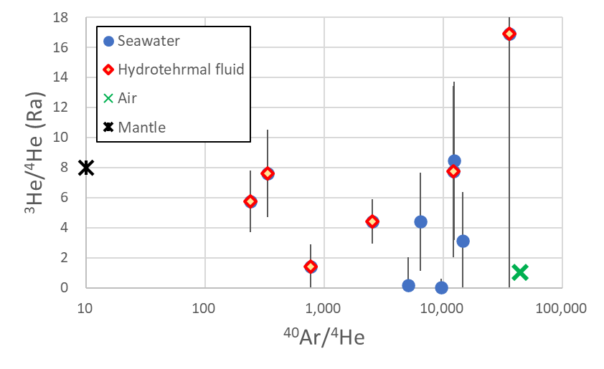
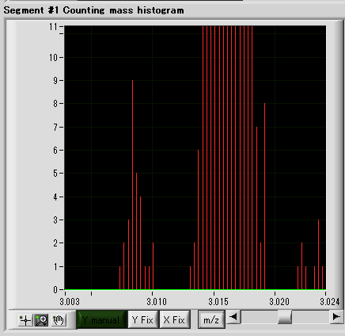
On-board He isotope analysis
³He
HD
First on-board ³He/⁴He data!
He sensitivity decreases with high Ar/He due to suppression of He ionization.

Slide 25
Variations in Helium Isotope Ratios in Hot Spring Water and Groundwater Before and After the 2024 Noto Peninsula Earthquake
Collaboration with:
Miyu HASEGAWA, Koji UMEDA
Hirosaki University, Japan
Noritoshi MORIKAWA
Geological Survey of Japan, AIST, Japan

