Slide 1
EarthScope and EPOS: A Transatlantic Partnership for Geoscience Infrastructure
March 2026

Slide 2
About EarthScope

Slide 3
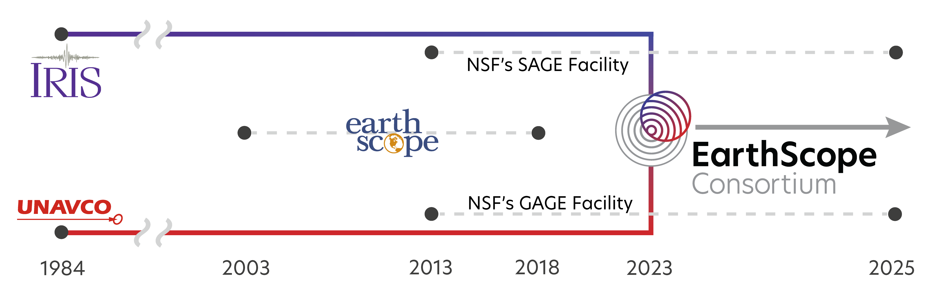

About EarthScope

Slide 4
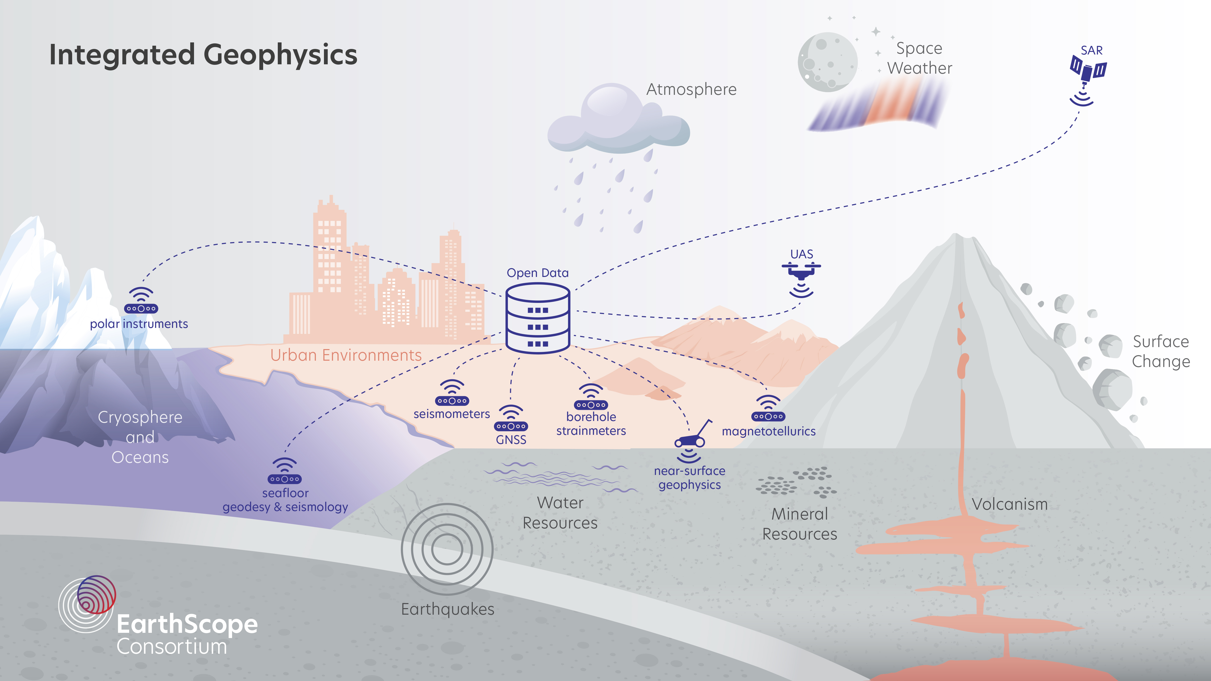
National Geophysical Facility

Slide 5
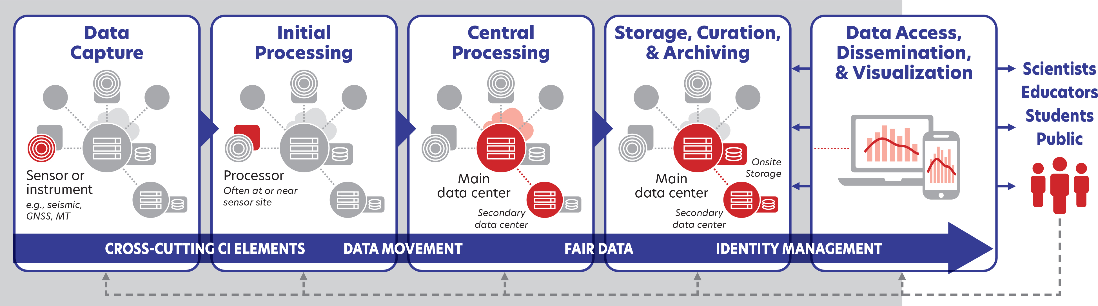
Data architecture
Notes:
Data and data products

Slide 6
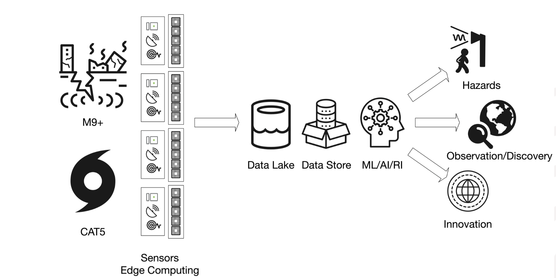
National Geophysical Facility

Slide 7
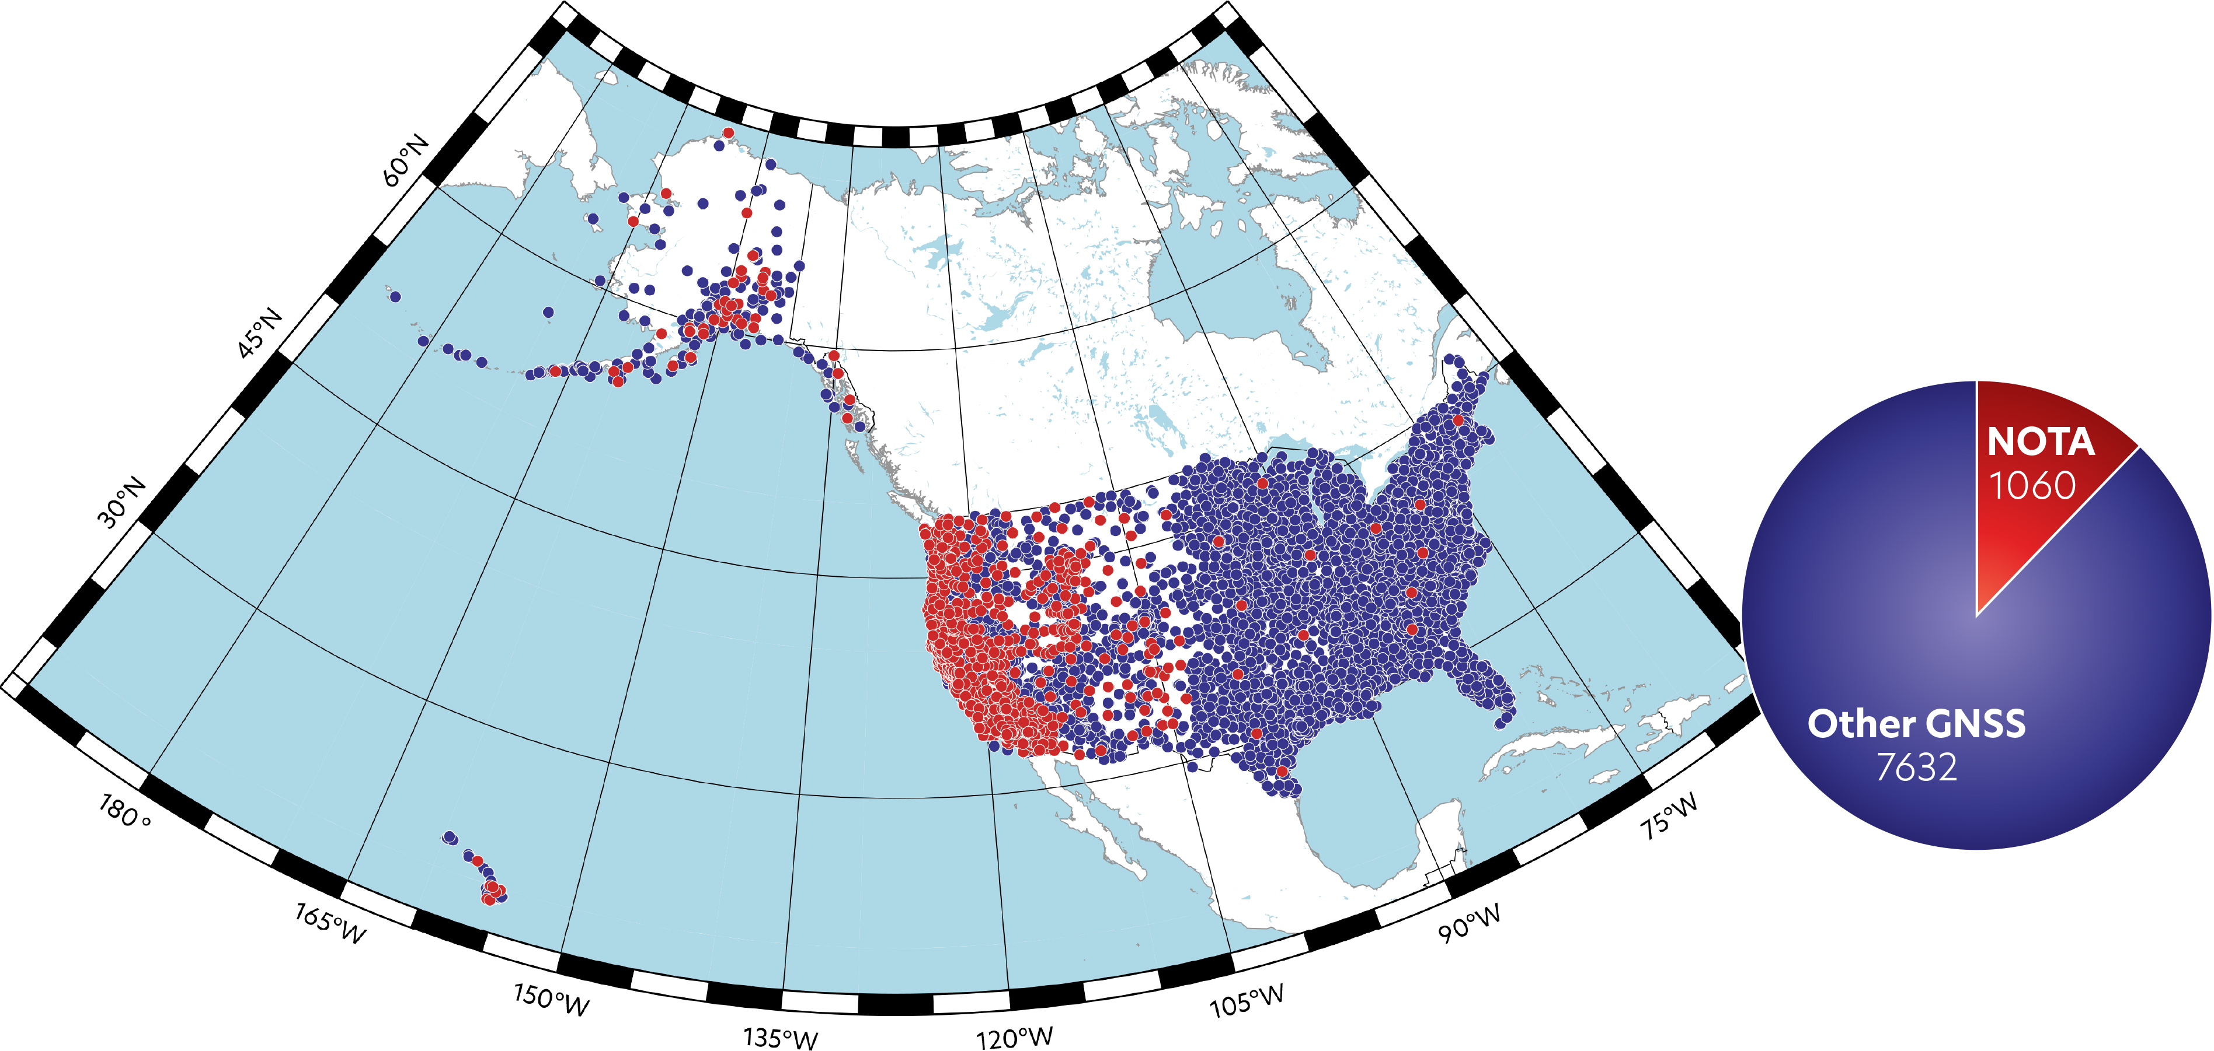
Data federation and aggregation

Slide 8
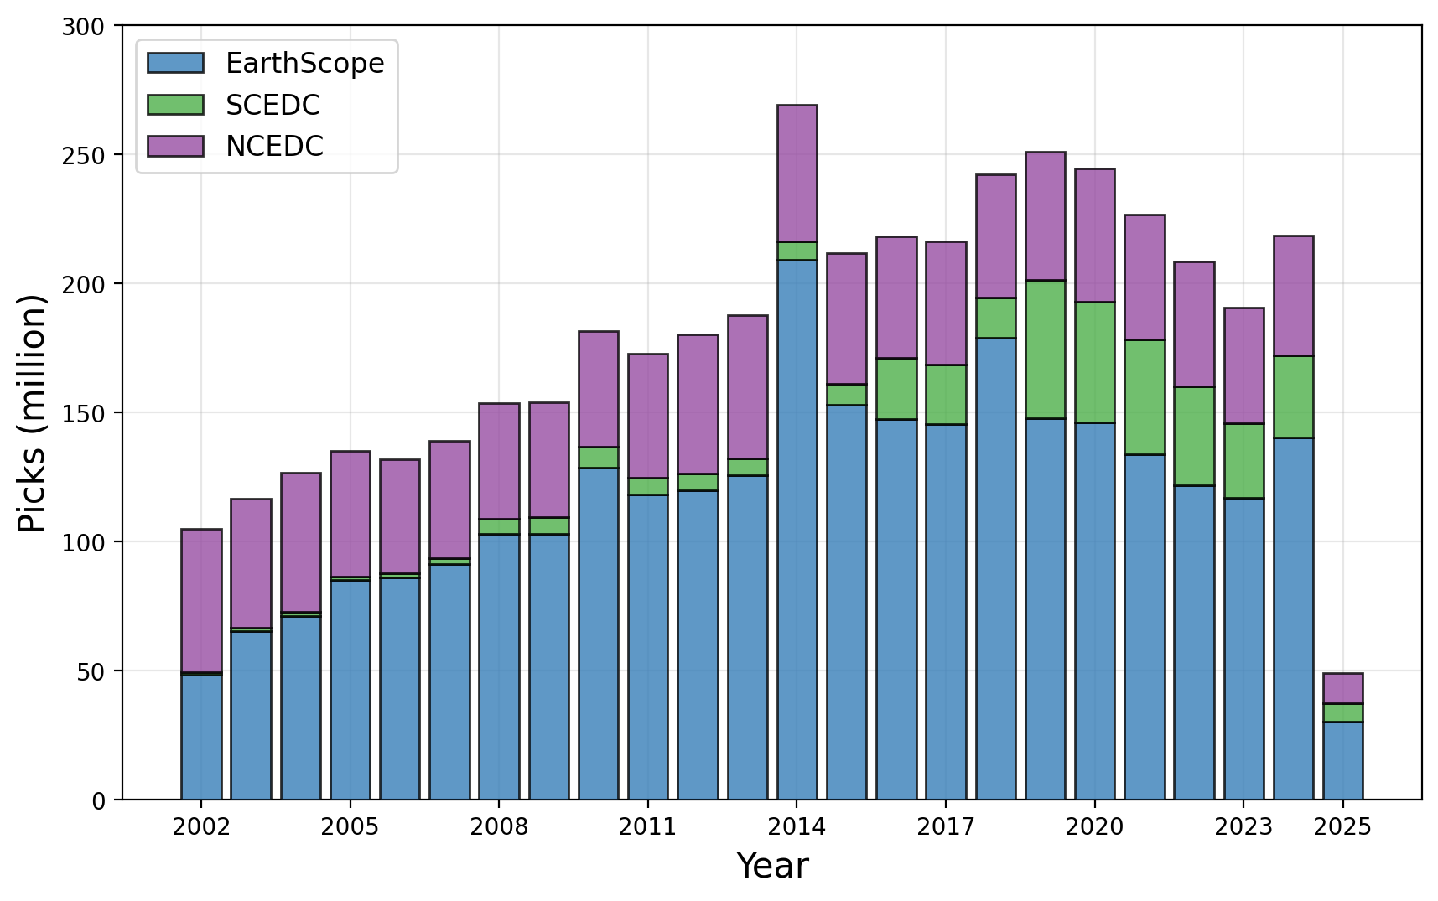
AI/ML ready data and compute
P and S picks
EarthScope: 2.8 billion
NCEDC: 1.1 billion
SCEDC: 0.4 billion
Total: 4.3 billion picks
~ 54M earthquakes
Marine Denolle, Yiyu Ni, Jannes Munchmeyer, Ian Wang, Carlos Suarez, Kuan-Fu Feng, Ian McBreatry, Greg Beroza, Amanda Thomas, Loic Bachelot, Alex Hamilton, Robert Weekly, Chad Trabant, David Mencin

Slide 9







Partnerships
Near-Surface Geophysics
Global Research Infrastructure

Slide 10
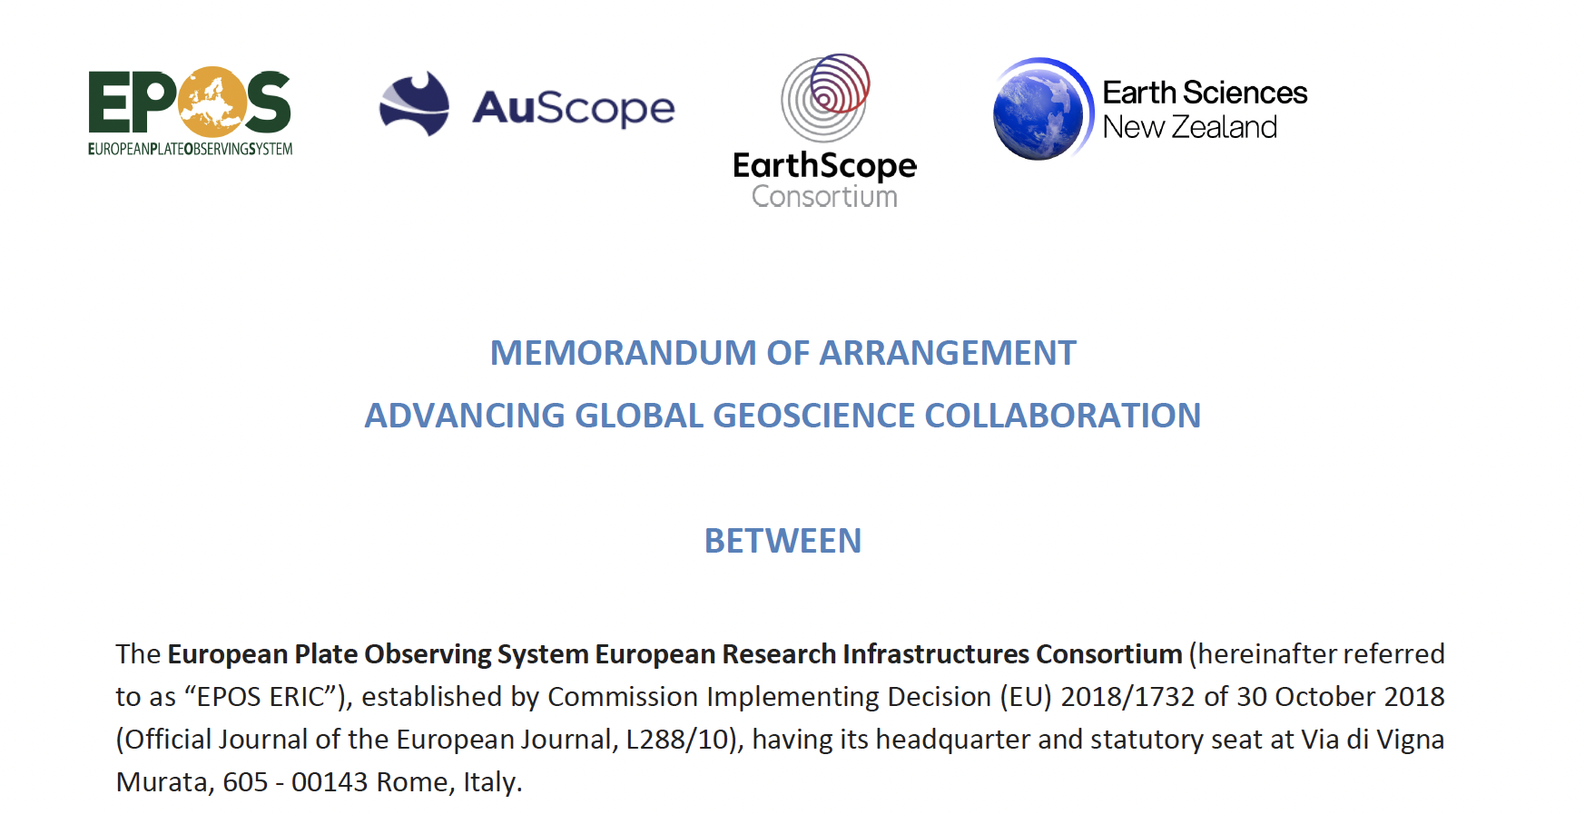
Global Infrastructure Members

Slide 11
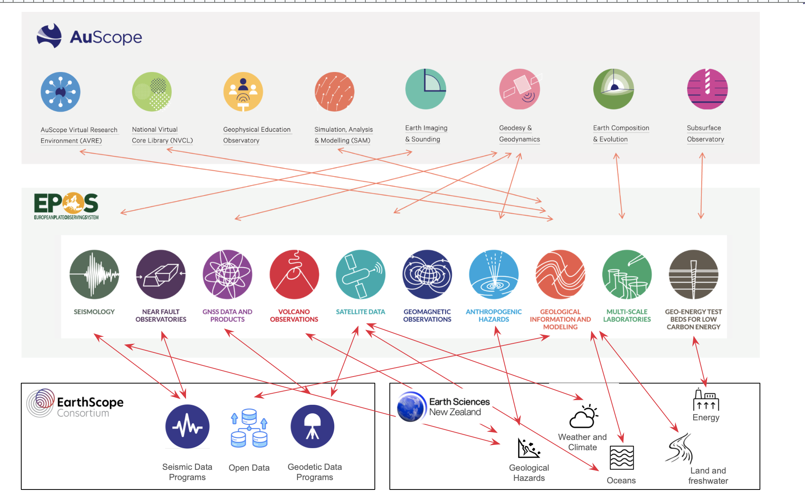
Alignment

Slide 12
GRI 2026 work plan
Mapping the existing international collaboration at thematic level.
Establishing a Steering Committee to guide the collaboration, monitor progress, and ensure alignment with shared goals.
Organizing activities of common interest during the EPOS Days 2026.
Organizing activities of common interest during the General Assembly of the European Geoscience Union (EGU) and/or the American Geophysical Union Annual Meeting (AGU) or any other event of interest of all Parties.
Supporting one in-person leadership meeting, ideally at a professional meeting like AGU or EGU, to align organizational strategies wherever practical and build high-level relationships between the parties.
Engaging with the European Commission to influence the publication of relevant calls and, more broadly, to cooperate in joint proposals under Horizon Europe and other EU funding programs.

Slide 13


GRI 2026 work plan
2026 Storage Formats for GNSS Data
Objective: Develop shared understanding and initial prototype/specification for a cloud-native, efficient, and interoperable GNSS data storage
Dates: 24-26 February 2026
Location:Astronomical Observatory of Coimbra, Portugal

Slide 14



GRI 2026 work plan
Data Containers for Large Datasets
Dates: 2nd to 5th of March 2026
Venue: GeoForschungsZentrum. Albert-Einstein-Str 42-46, 14473 Potsdam

Slide 15
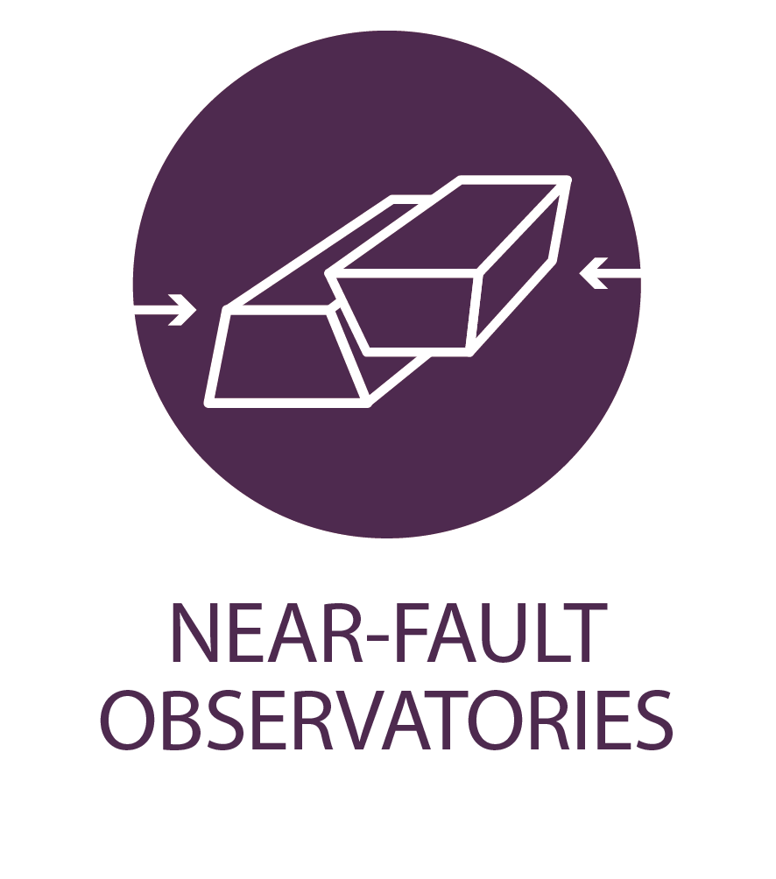
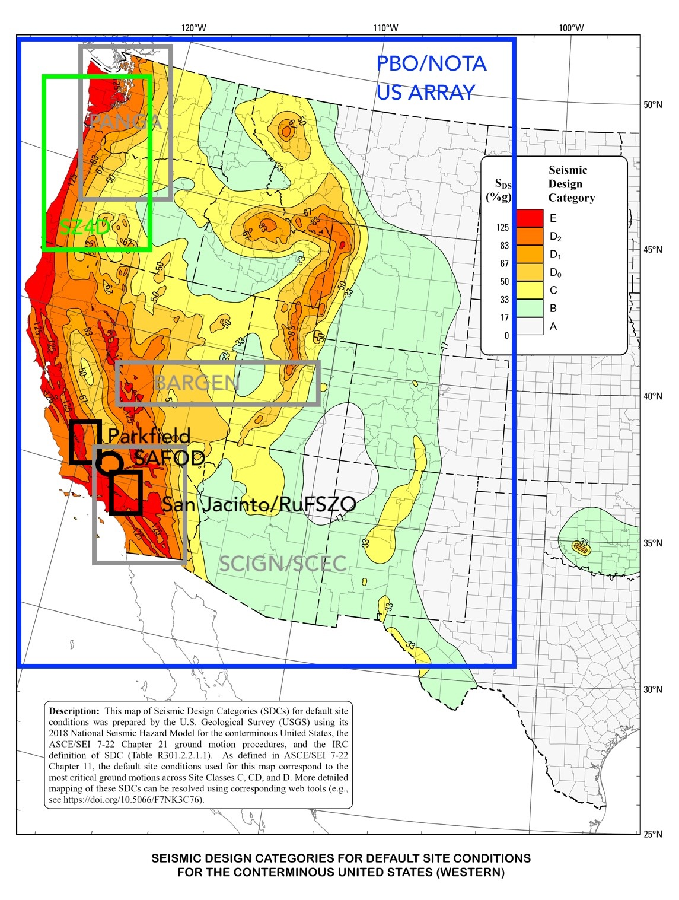
GRI 2026 work plan
ARGONAUT Meeting
Dates: 15-16 March 2026
Venue: EPOS Days 2026, Cagliari, Italy

