Slide 1

The Copernicus In-Situ Component
Lorenzo Solari, Jose Miguel Rubio Iglesias
European Environment Agency, Earth Observation Unit

Slide 2
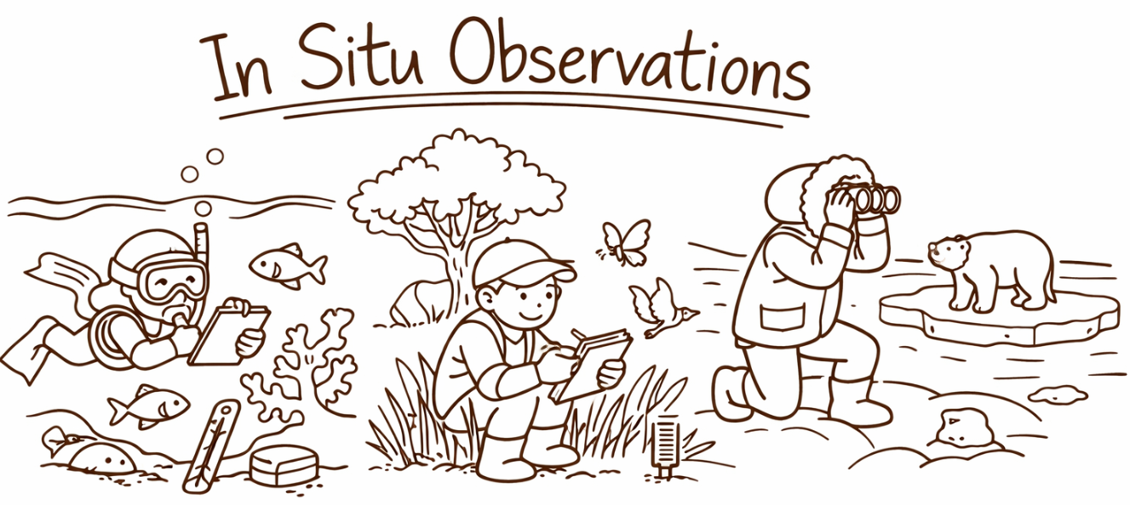
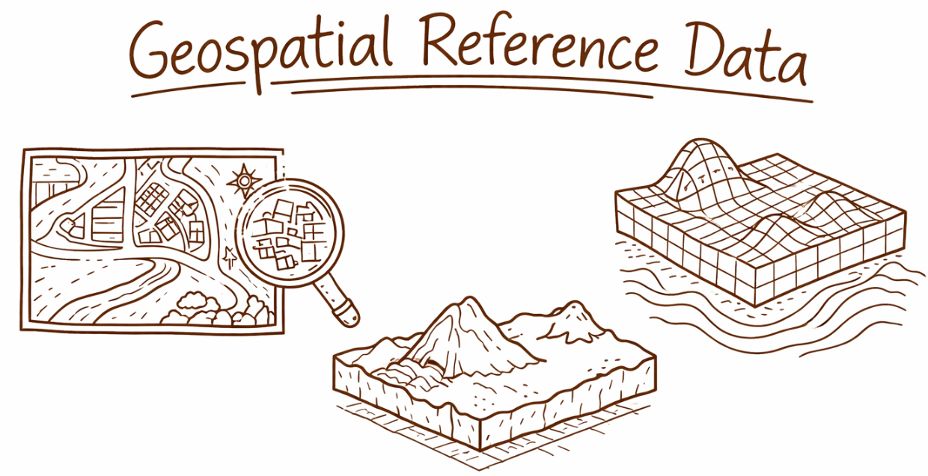
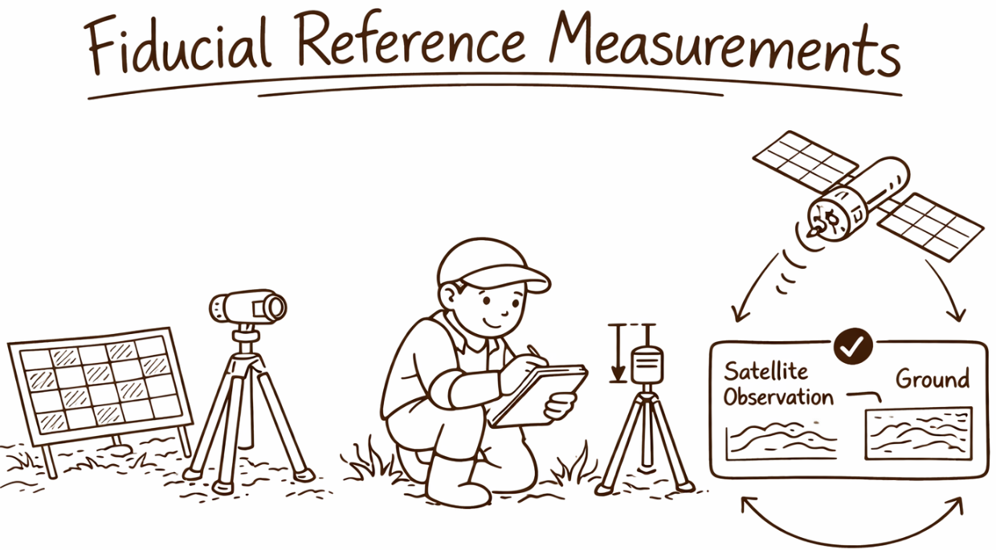
Without in-situ data, Copernicus can’t deliver its products!
Production and validation of Copernicus services
As stand-alone observation products
Cal/Val of satellite sensors

Slide 3
Governance & data access

Slide 4
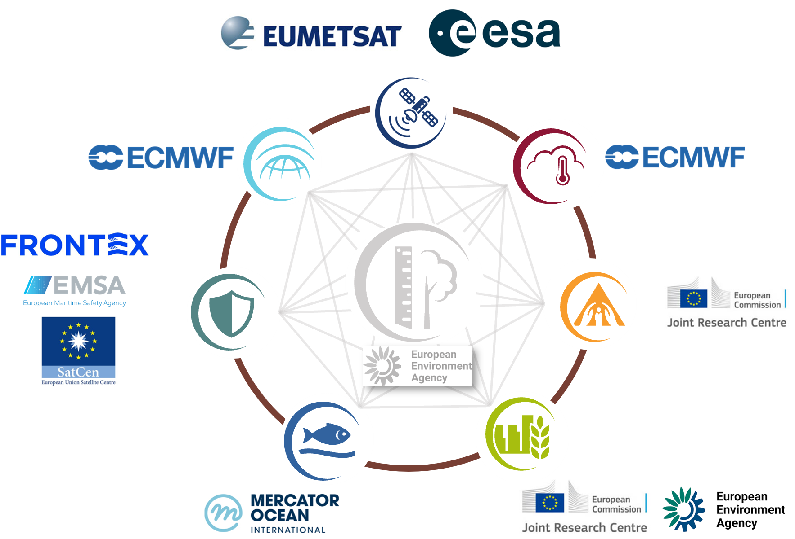
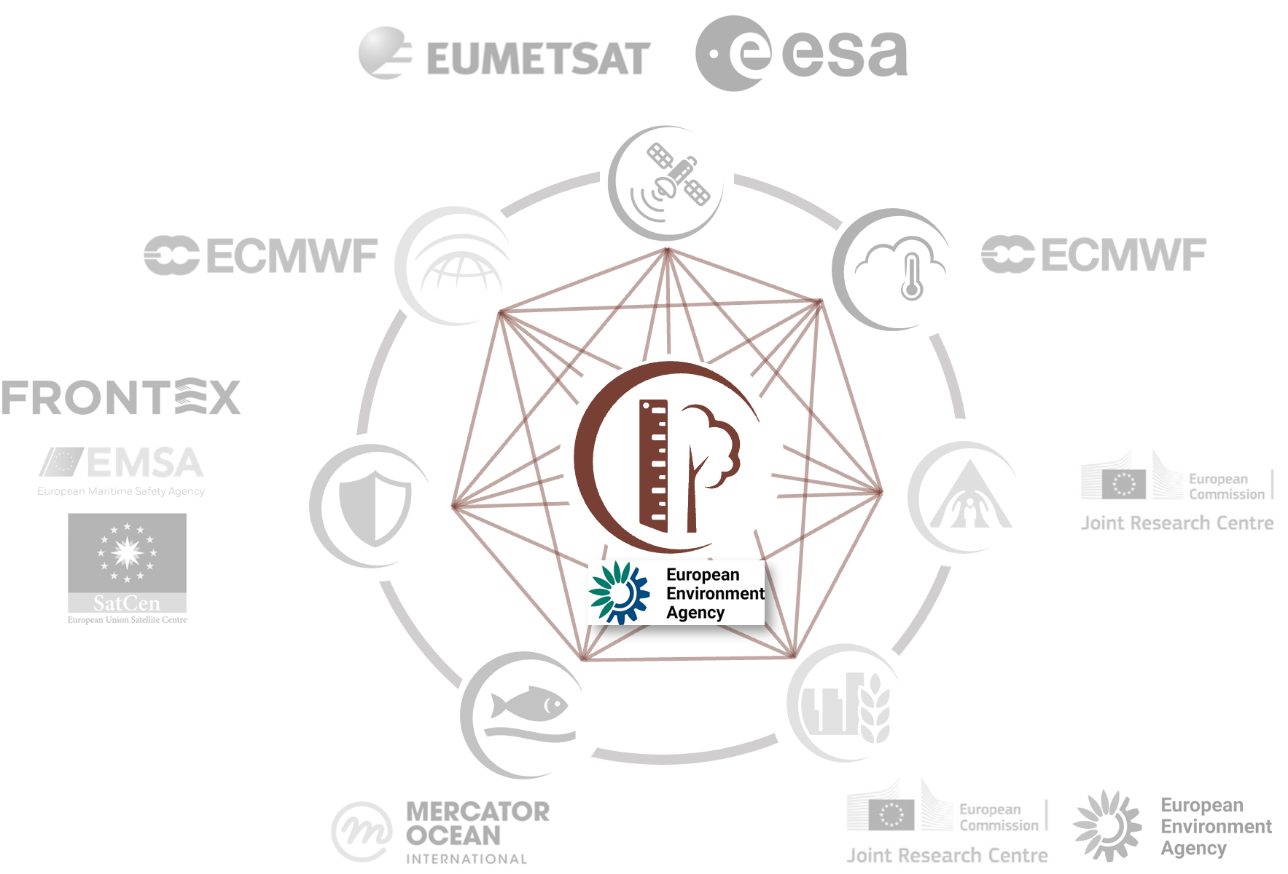
Governance of the Copernicus In-Situ
The Entrusted Entities manage and use in-situ data daily to meet their operational needs.
The EEA steps in when a coordinated, programmatic approach is needed across Copernicus.
Notes:
Entrusted Entities access in-situ data directly – DAY TO DAY OPERATIONS is on the Ees/also in charge of agreements and technical interface with providers
The EEA intervenes in cases where a coordinated approach is required at programme level – DIALOGUE/STRATEGIC ACTIONS/LICENSE AGREEEMENTS

Slide 5
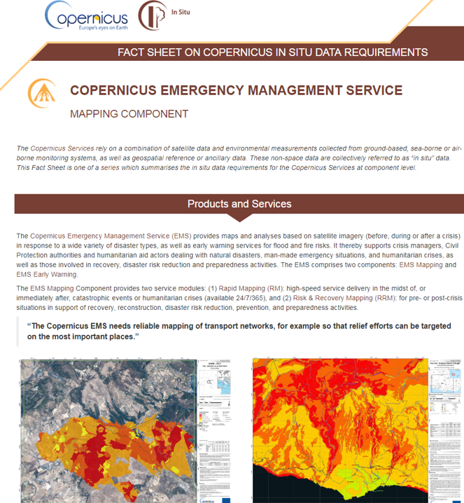

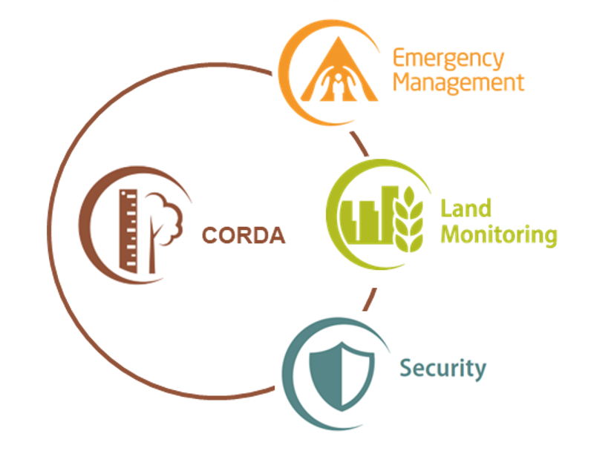

EEA Copernicus In-Situ activities (2021-2028)
  State of Play report
  CIS²
  In-Situ Strategy (2028-2034)
  In-Situ Working groups
  Reports, inventories
  GEO, R&D
State of Play
Support and Advice
Data Access
Engaging
with data providers
  CORDA
  Pilot activities
  Specific in-situ data requests
  Licensing agreements
  Partnerships
  Use Cases

Slide 6
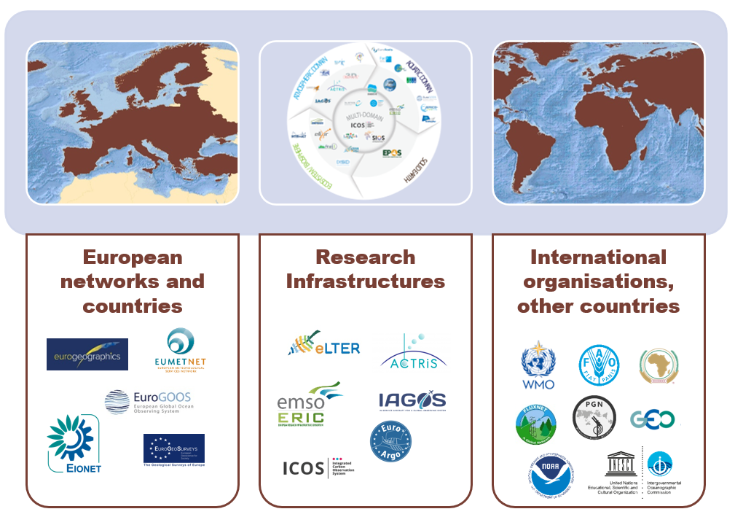

Where does in-situ data come from?
  Collaboration with in-situ data providers is essential!
Notes:
relies almost entirely on existing in-situ data capacities managed at national, European, or Global level
Sources:
public institutions in your country
research infrastructures as EPOS
Long-term, open, and reliable access to essential in-situ data is a prerequisite for the success of Copernicus in terms of meeting key user requirements and societal impact.

Slide 7
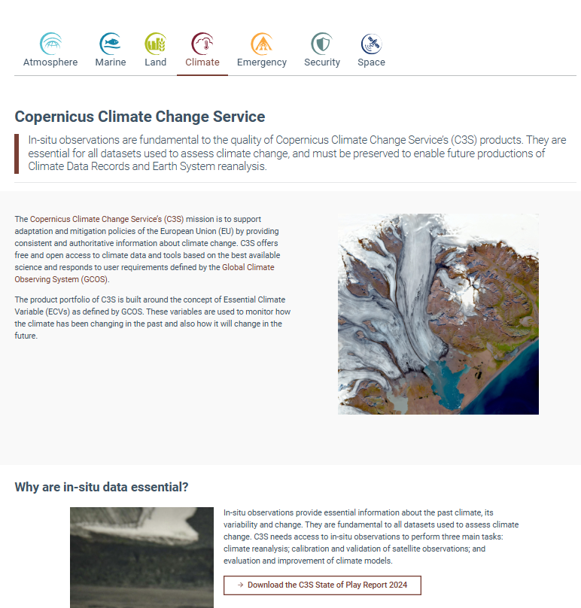
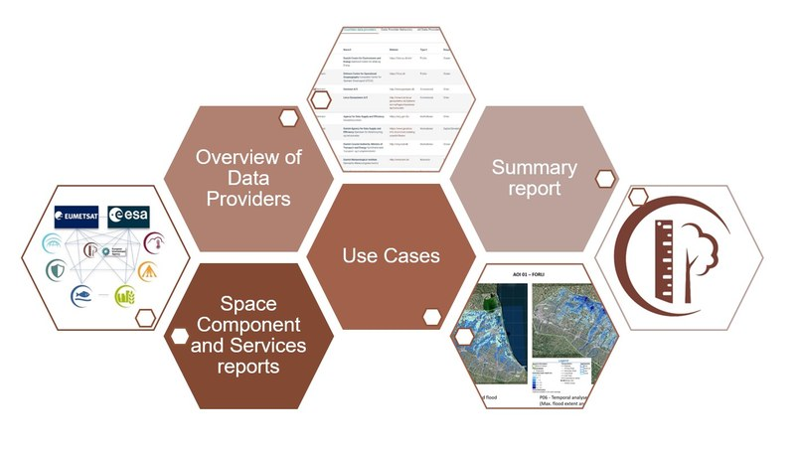
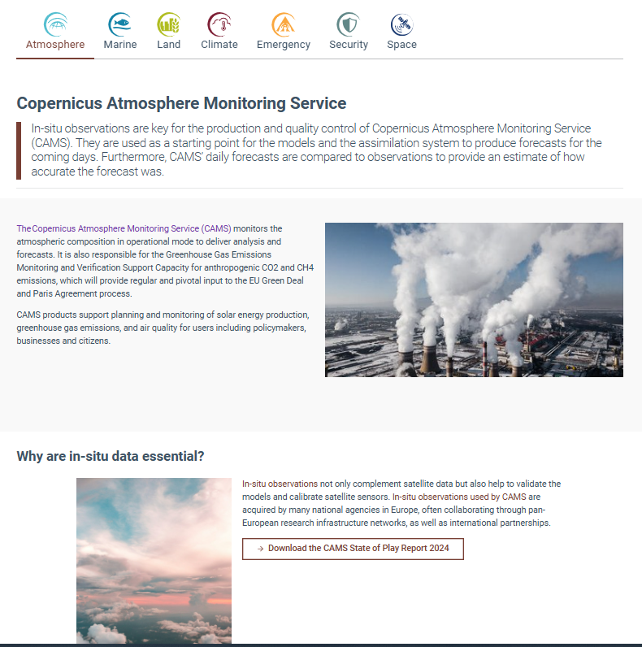
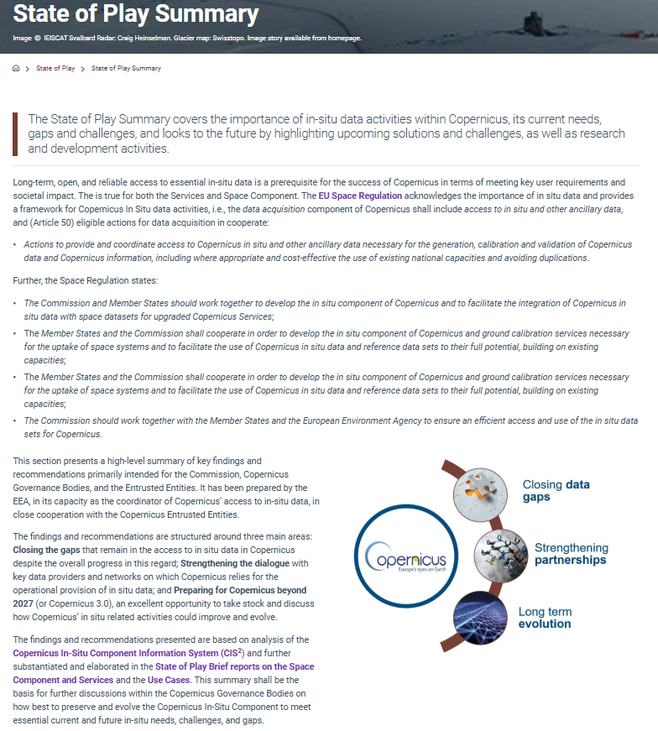
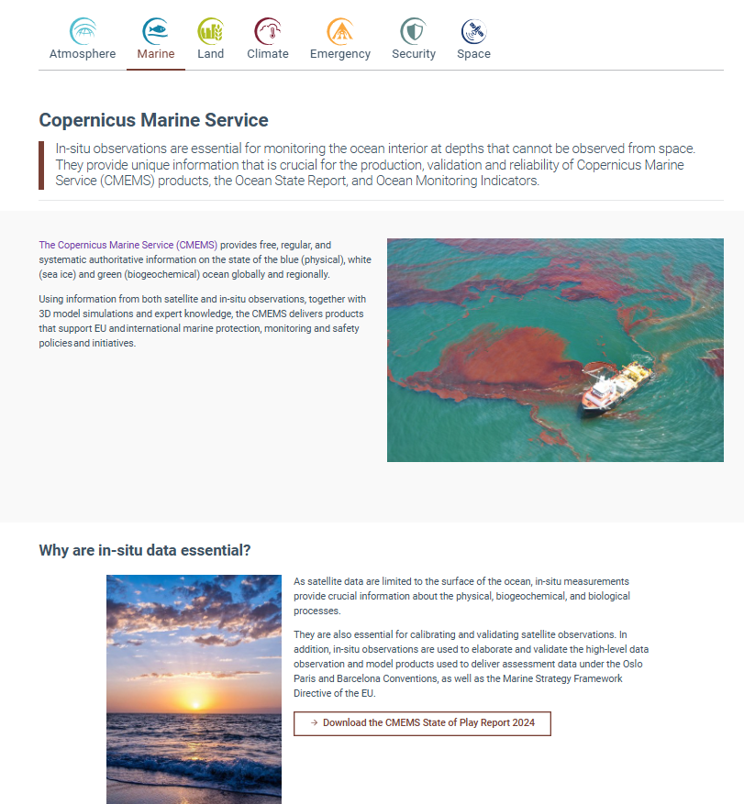
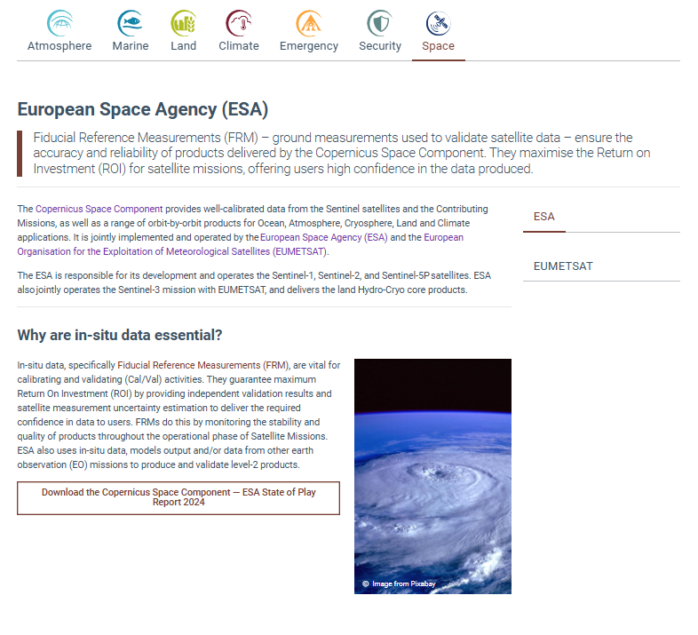
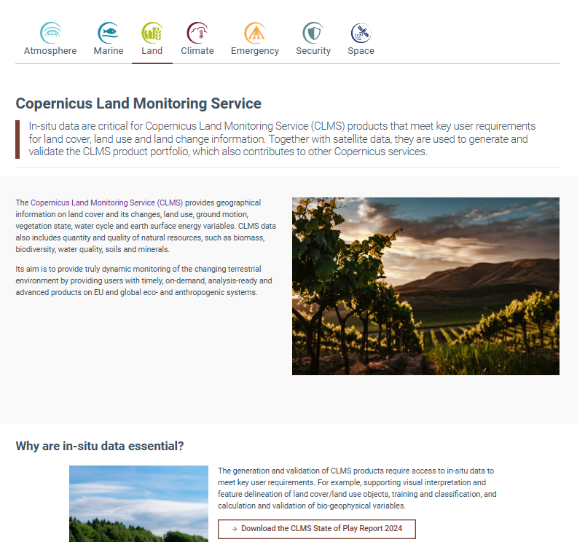

State of Play: In-situ data in Copernicus
https://insitu.copernicus.eu/state-of-play
Notes:
Every 2 years, 2026 under preparation
2024 available

Slide 8







State of Play: key in-situ gaps per service
Global in-situ air quality data are sparse and inconsistent, limiting reliable global assimilation.
Limited ocean data from deep or remote areas (polar/marginal seas), with heavy dependency on research funding.
Access to land data is limited and inconsistent due to national restrictions and different data standards.
Long-term in-situ time-series and many Essential Climate Variables are incomplete and lack consistent global coverage and quality.
Lacking real-time/near-real-time in-situ data in many regions with limited interoperability of national and European hazard observation systems.
Near-real-time in-situ data are scarce, especially outside the EU or in restricted/sensitive regions.
Cal/Val sites and Fiducial Reference Measurements for satellites are poorly covered and not globally harmonised.

Slide 9
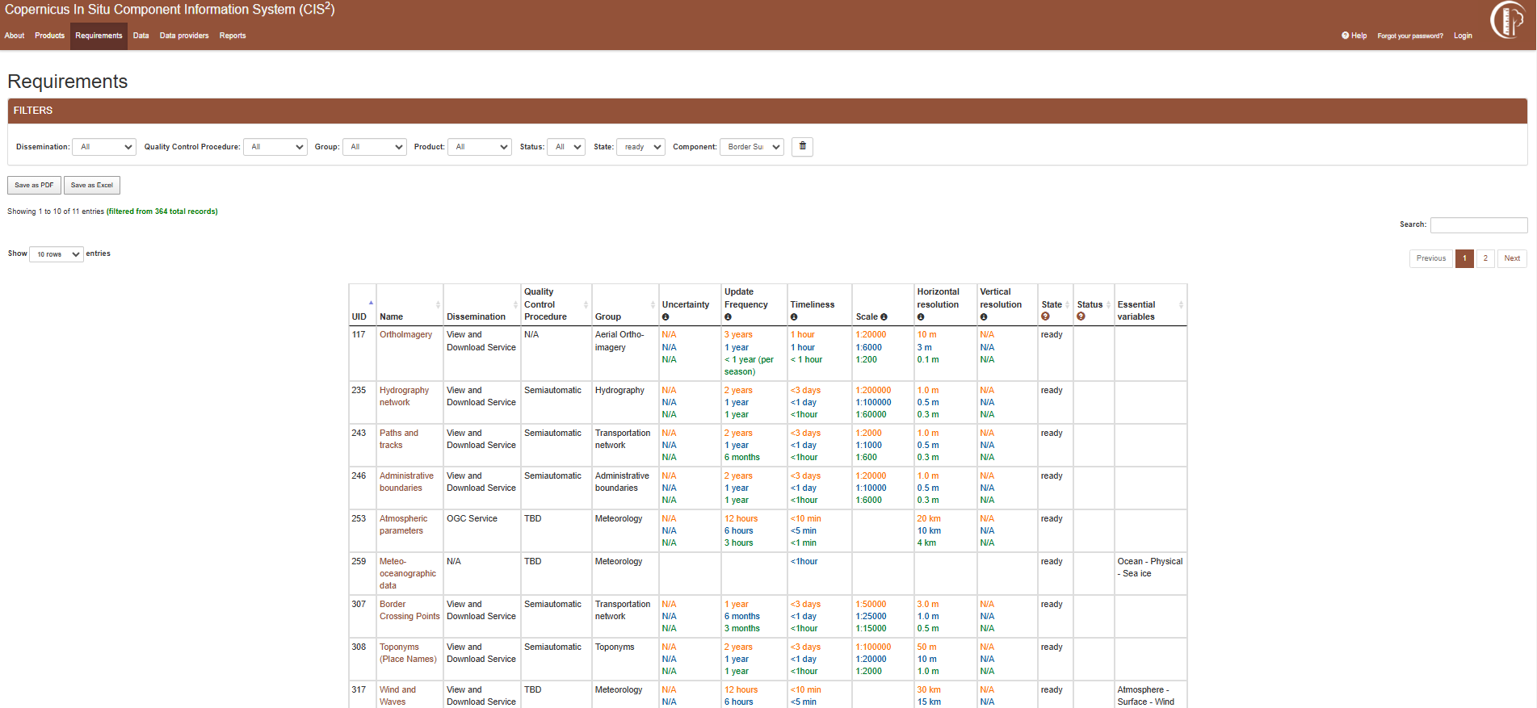
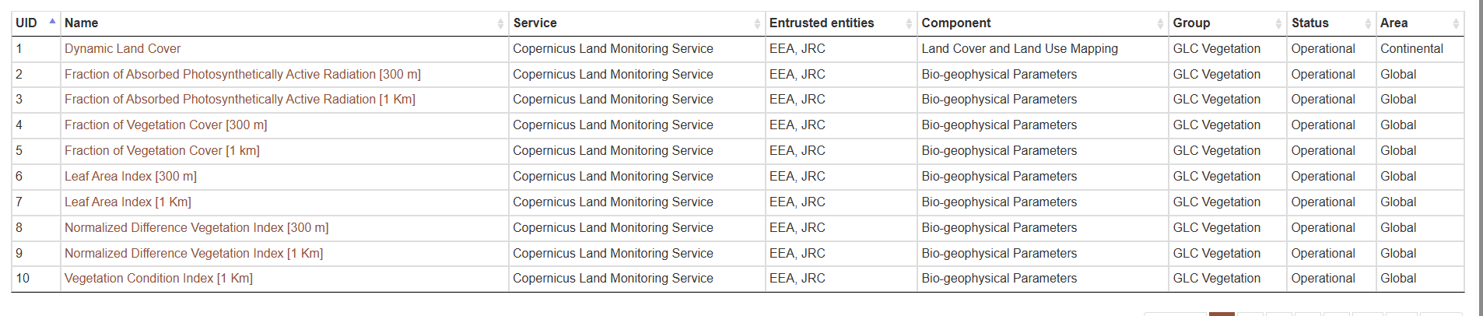

In-situ data requirements – CIS² database
Overview of Copernicus in-situ data requirements and how these are met
Comprehensive list of products, data providers and key datasets (currently focused on services)
Revamping project just launched for enhanced exploitation inc. expansion to Space Component
Ongoing reviews and updates with support from Entrusted Entities (2x per year)
https://cis2.eea.europa.eu/

Slide 10
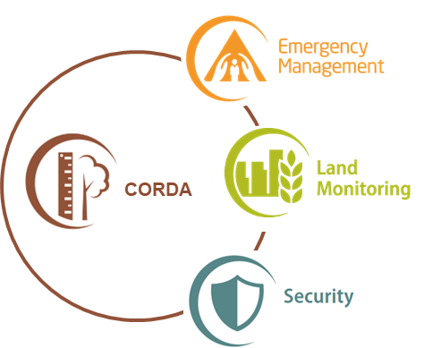
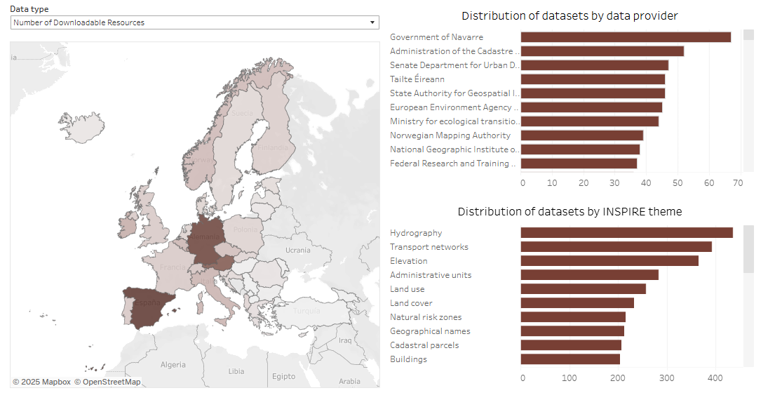

Access to geospatial data: CORDA
  Single entry point node to national and regional authoritative geospatial data
  Data hosted in origin by default
  Continuous monitoring and update
  Semantically harmonised multi-country databases for key topics
  Restricted access for Copernicus service providers and data providers
    Main target users: mapping services (CEMS, CLMS, CSS)
  User Acceptance Test undergoing
42
304
2,185
countries
data providers
datasets
https://corda.eea.europa.eu/
Notes:
We operate and maintain the Copernicus Reference Access Portal (CORDA), a single entry point through which we provide Copernicus services access to selected national or regional reference datasets (building on INSPIRE). Only authorised users (Copernicus Services) have access to the index of URLs. The datasets are NOT hosted by us – but rather by the national and regional authorities in Europe.
CORDA represents the result of an exhaustive search, classification and indexing effort for data sources across Europe, following a thorough methodology for data gathering, validation, registration and maintenance. But CORDA is more than just a catalogue, presenting categorised information; it also provides details on quality and access conditions and supplies direct web links to the data provider. CORDA has a built-in mechanism for making sure that all the links and web services in its vast collection are up-to-date and functional.
Harmonised INSPIRE Annex I datasets will gradually be made available via CORDA, starting with Administrative Units and Transport Networks.
Number of datasets and data services - as per slide (updated last week). Re NMCAs, you can see we have links to 500 datasets by 36 NMCAs (members of EuroGeographics).

Slide 11
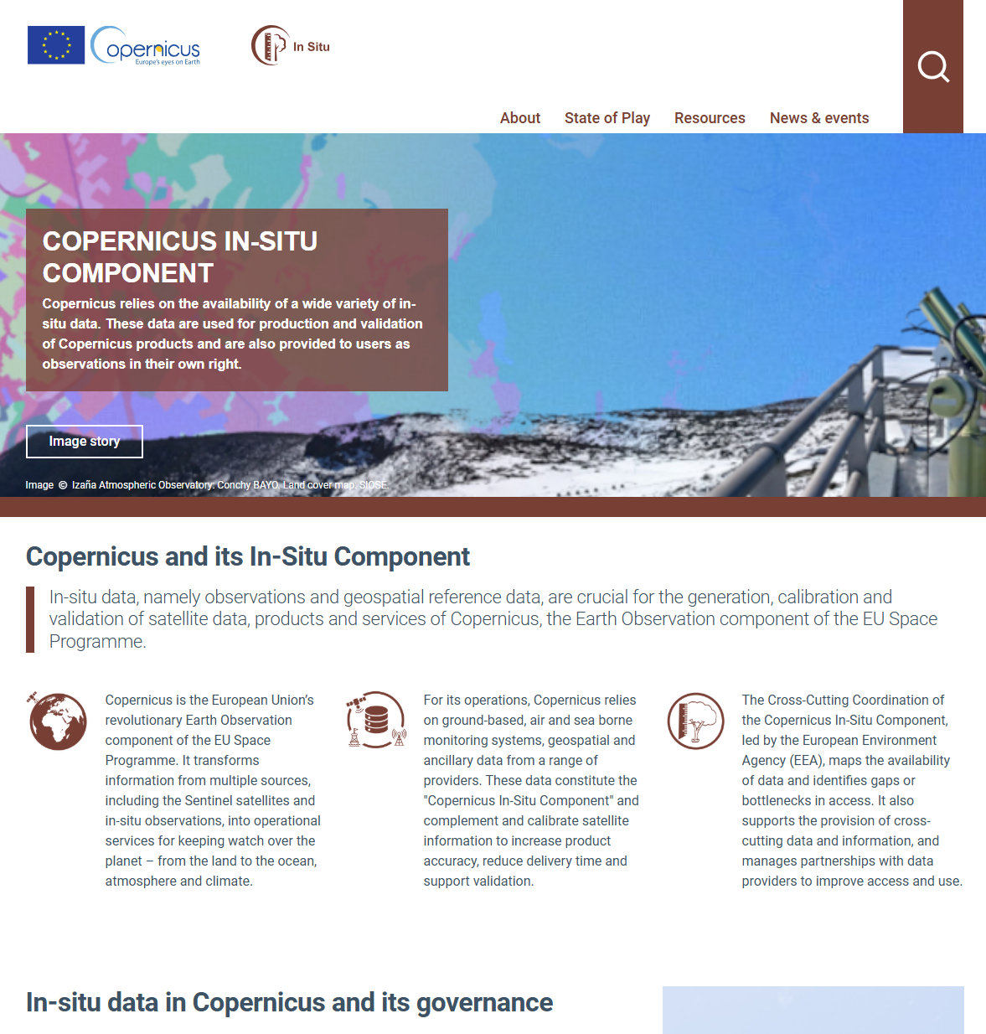
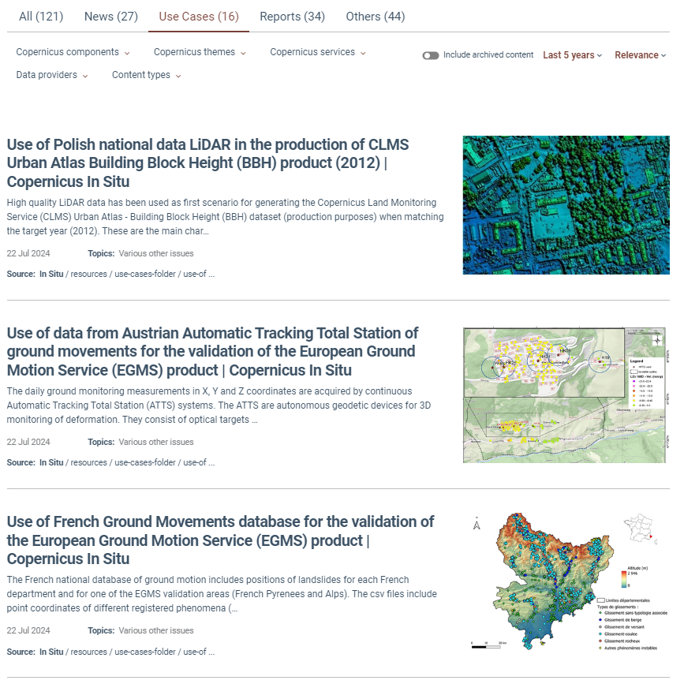
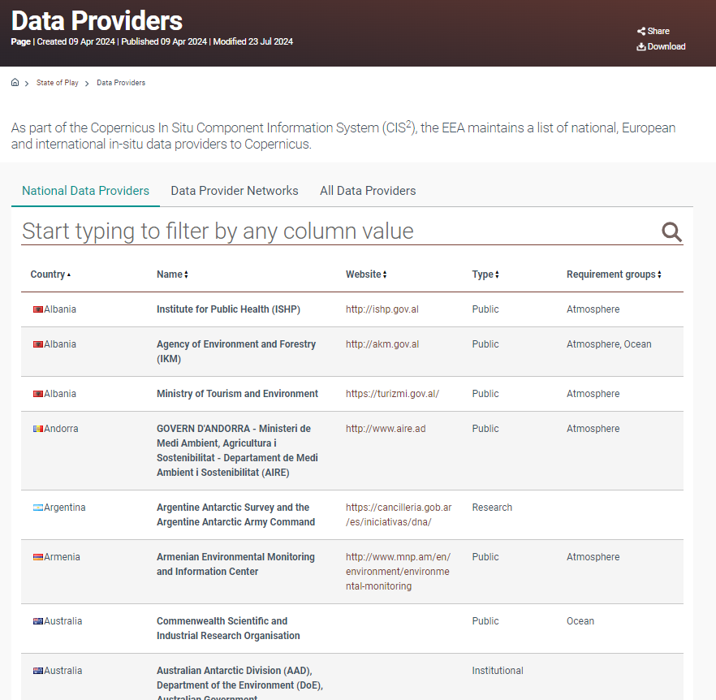
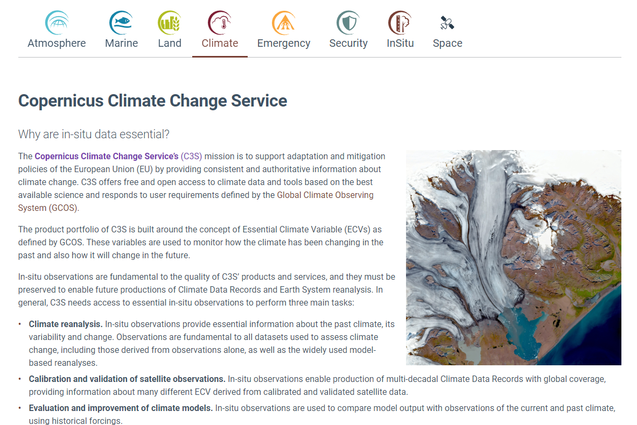
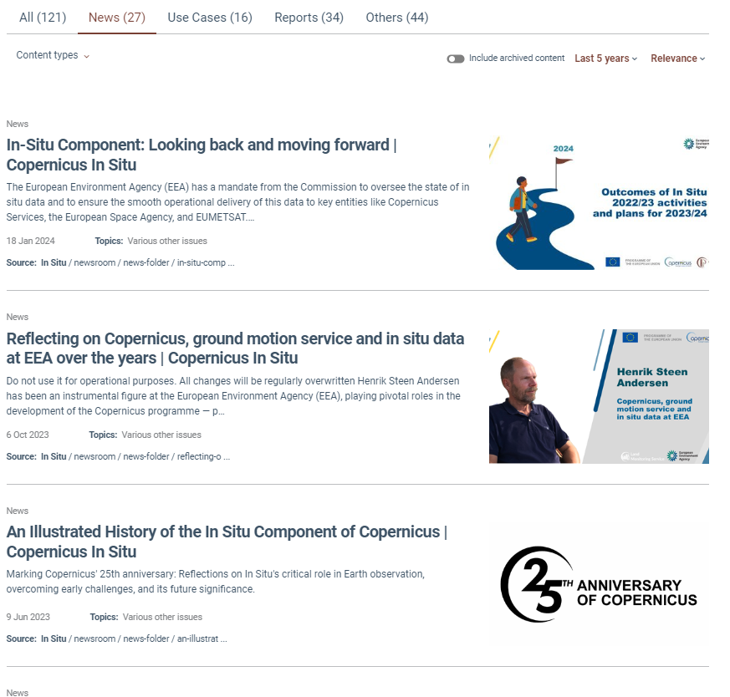
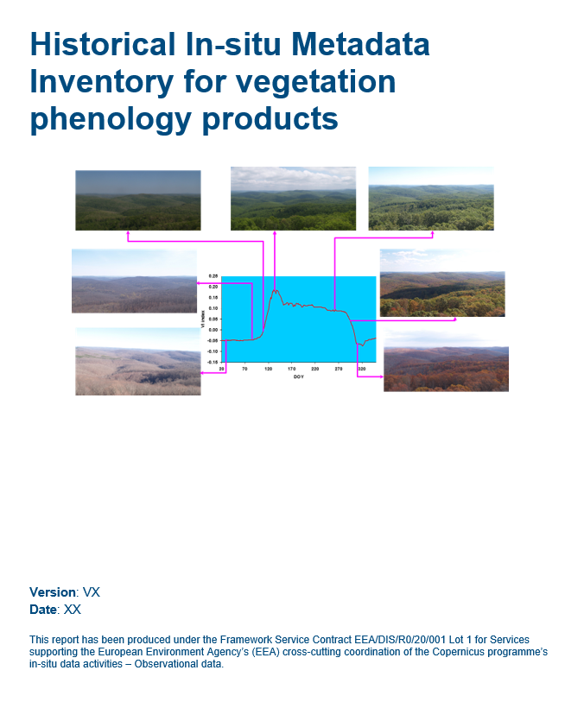
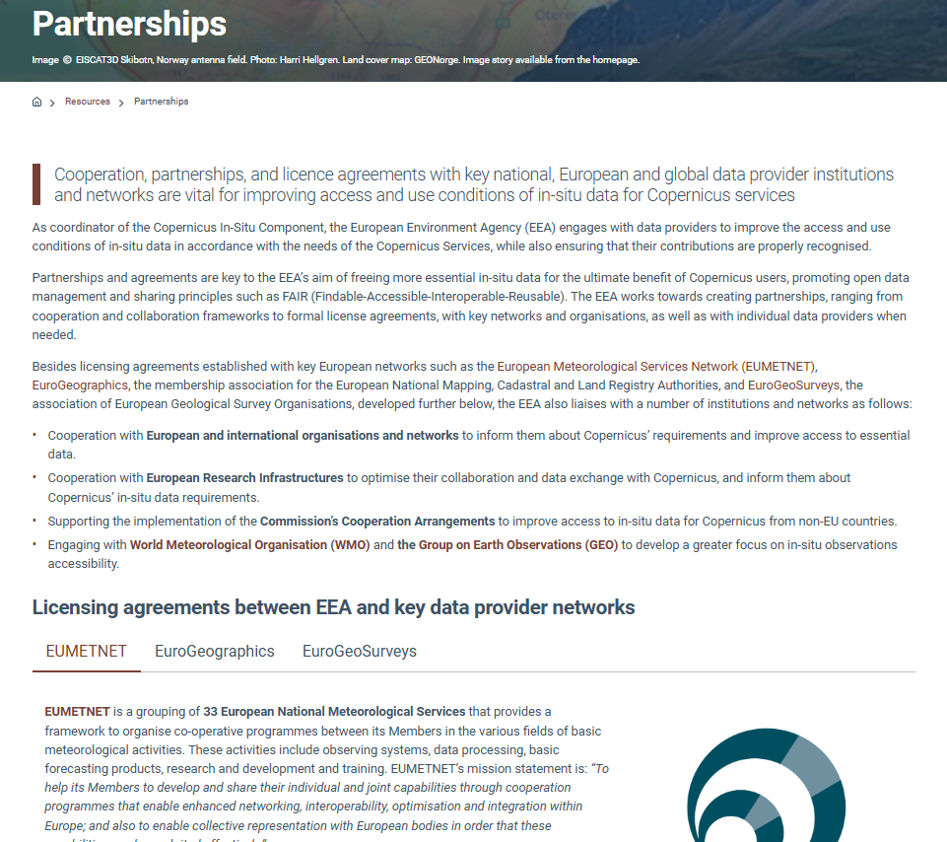
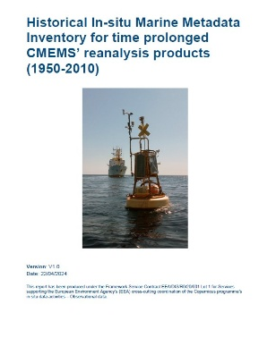
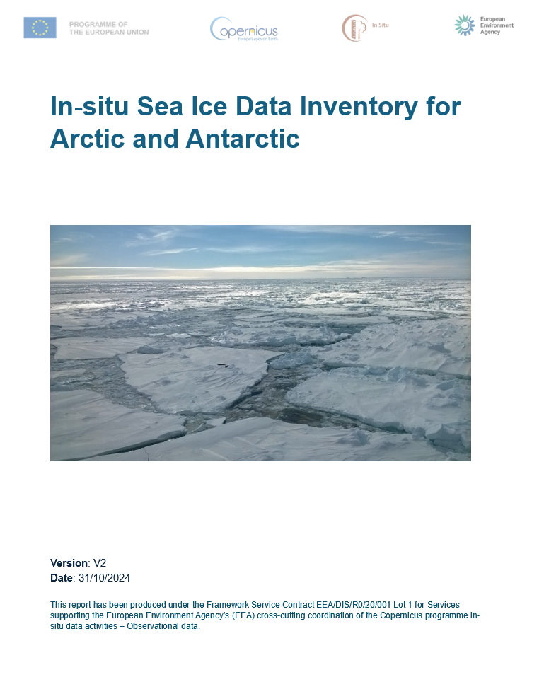


New Copernicus In-Situ website – subscribe!
Use Cases
In-situ data providers
State of Play
Articles and news
Reports and inventories
Partnerships & agreements
https://insitu.copernicus.eu

Slide 12
In-Situ & Research Infrastructures
Notes:
In terms of data provider engagement – RI is FUNDAMENTAL
And EPOS, is part of this system of RIs, providing integrating data, tools, and services from the solid Earth sciences:

Slide 13
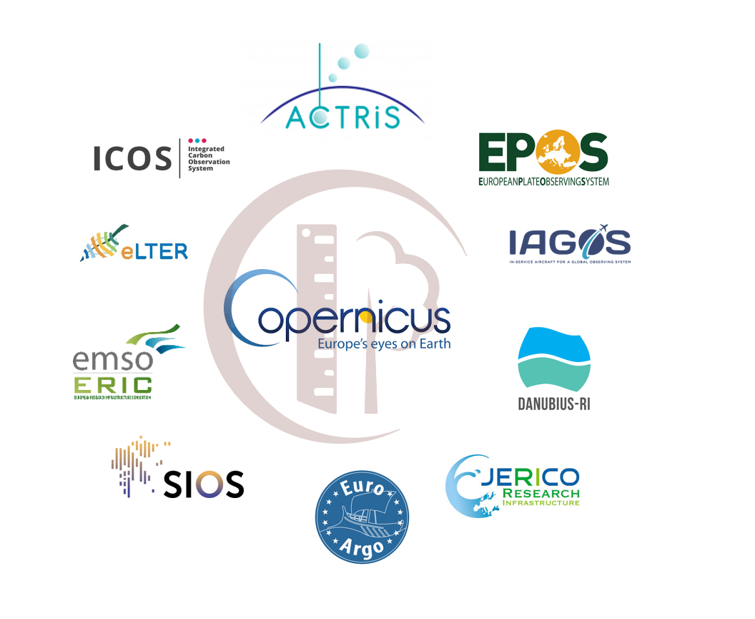
Copernicus and Research Infrastructures
Copernicus depends on data collected, managed and delivered by European Research Infrastructures
The already existing collaboration between Copernicus and RI may benefit from additional dialogue and exchange
There is a need to address the gap between Copernicus requirements and availability of resources for RI
The EEA is advancing on the concept of a “Copernicus-RI Exchange Forum” and is working currently on a ToR
  A first (online) meeting with RI and Copernicus EE took place in November 2025
Notes:
But how the RI and Copernicus in situ interact?
European RIs play a fundamental role in supporting the entire Copernicus programme.
four domains: atmosphere, ecosystems, marine, and solid Earth. Their expertise and high-quality data are essential for generating and continuously improving Copernicus data, products and services.
Through collaboration with these infrastructures, Copernicus benefits from a wealth of scientific knowledge, constantly enhanced data collection methodologies and platforms as well as robust quality control processes.

Slide 14
Copernicus-Research Infrastructures Exchange Forum
Exchange Forum Kick-off Meeting (14 November 2025)
  10 RIs: ACTRIS, EPOS, eLTER, EMSO, Euro-Argo, IAGOS, ICOS (3 TC), JERICO + (DANUBIUS)
  4 EEs: ECMWF, ESA, JRC, MOI (for CAMS, C3S, CLMS and CMEMS)
  European Commission: DG DEFIS, DG RTD, DG MARE
Conclusions of the meeting
  For the EEA, the Exchange Forum is a tool to help implement the Copernicus In-Situ Data Strategy 2028-2034
  Focus on cross-cutting topics and gaps should be addressed
  Terms of reference of the Exchange Forum to be drafted:
  objectives / participants / mandates / scope / frequency
Notes:
…next steps for the Exchange Forum once the summary reports of the Working Group Meetings have been finalised and we have identified concrete next steps.
We expect this to be by the end of March, so stay tuned

Slide 15
Possible topics for an Exchange Forum
Support for sustainability & advocacy
Attribution & Traceability
Operational vs. research roles in countries involved in Copernicus
Copernicus label, DOIs, data passports
Common practices for FRMs
Contribute of EEs to tuning RIs roadmaps
Technology development and geographical expansion
Toward common FRM practices
Common procurement
processes
AI and machine learning
Data access, and emerging requirements
For sensors and services
Notes:
Next steps:

Slide 16
Copernicus In-Situ Component Strategy
2028-2034

Slide 17

Copernicus In-Situ evolution
Three priorities for cross-cutting work:
Closing data gaps
Strengthening partnerships
Long-term evolution
3.0
Notes:
Presented last week in CUF
End of March comments from countries – to decide how to make this open
Comments should pass trough the COP delegate – so, contact the person

Slide 18
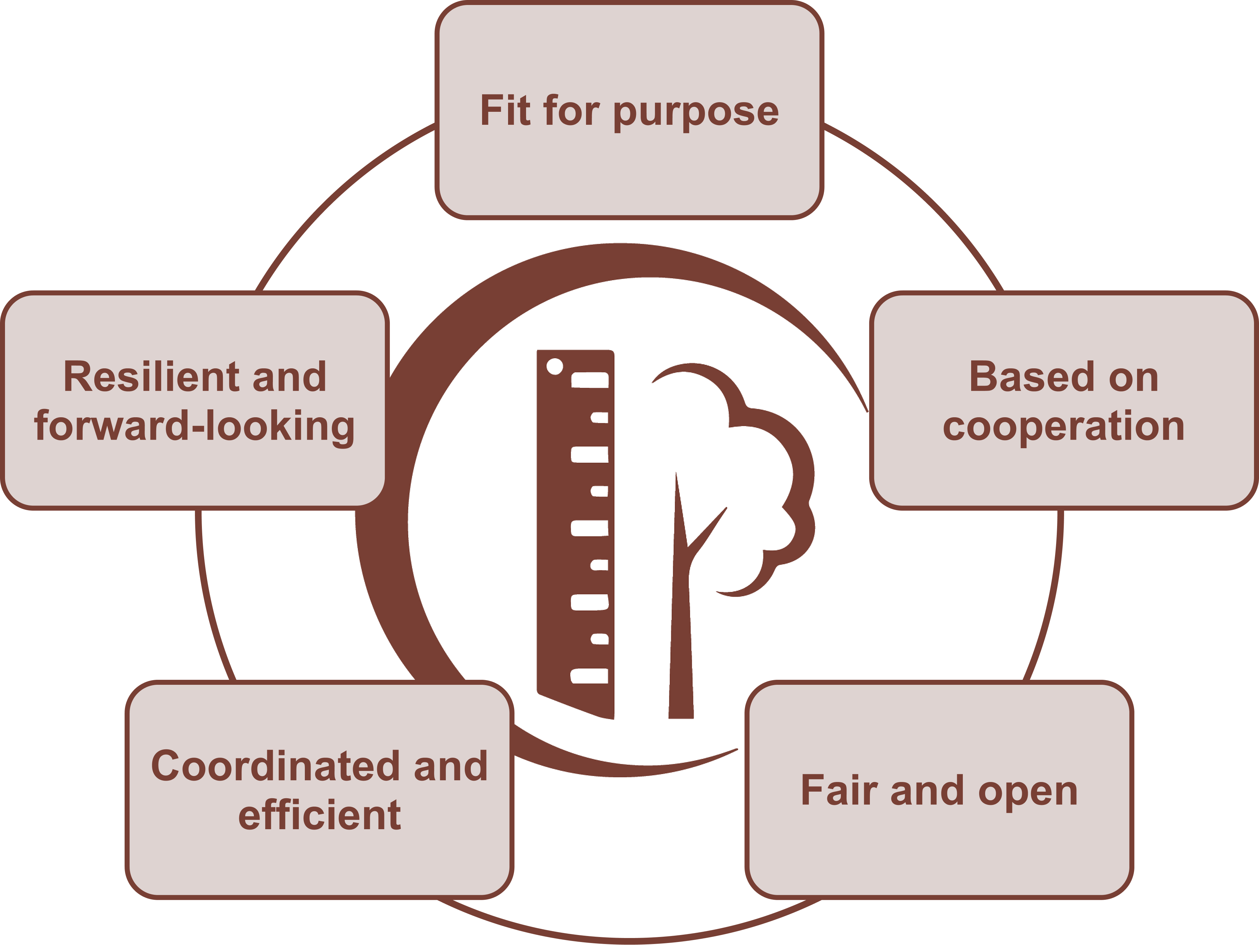
Towards a Copernicus In-Situ Strategy
Notes:
5 strategic areas with 20 recommendations in total
Cooperation: strengthen partnerships with data providers (EU & international)
Fair & Open: promote open access, transparency, metadata & quality standards
Fit for Purpose: sustained, reliable, high-quality in-situ data tailored to service needs
Strategic & Cost-effective: avoid duplication, centralise cross-cutting datasets, optimise resources
Resilient & Forward-looking: embrace innovation (IoT, drones, crowdsourcing) and long-term planning

Slide 19
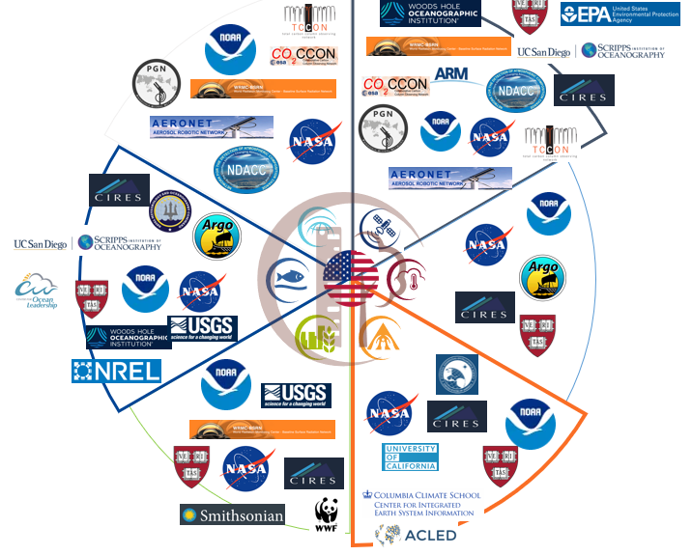
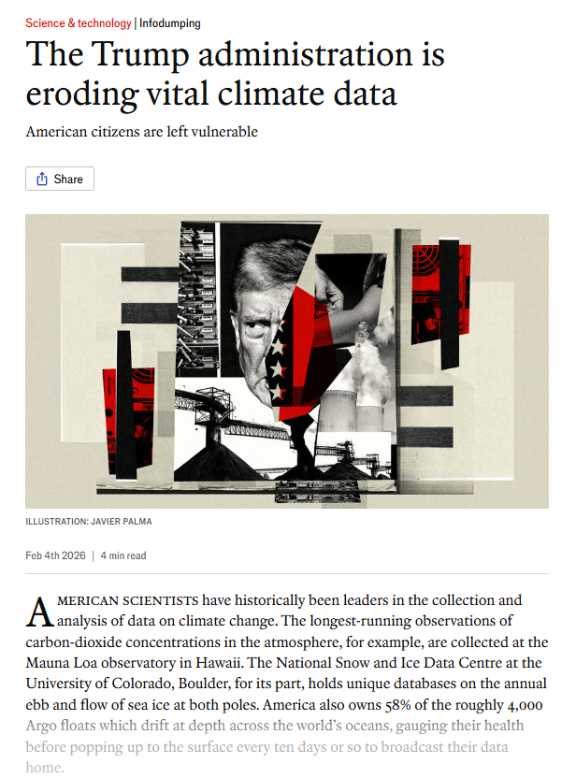
Towards a resilient Copernicus In-Situ
As a global programme Copernicus relies on a strong international cooperation
  Access to in-situ data at the core of this cooperation
This is a strength but can be sensitive to changing policies (e.g. US)
Some examples:
  Copernicus Marine: +50% ARGO floats from US (without them, Pacific Ocean poorly covered!)
  CEMS Exposure Mapping: all major global collections on population census and survey data are hosted by US institutions
  Copernicus Atmosphere: key networks for in-situ observations (e.g. NOAA operating the Global Greenhouse Ref Network)
  Copernicus Land: 40% of in situ calibration sites for the GBOV component are in the US
How to address potential risks in Copernicus beyond 2027?

Slide 20
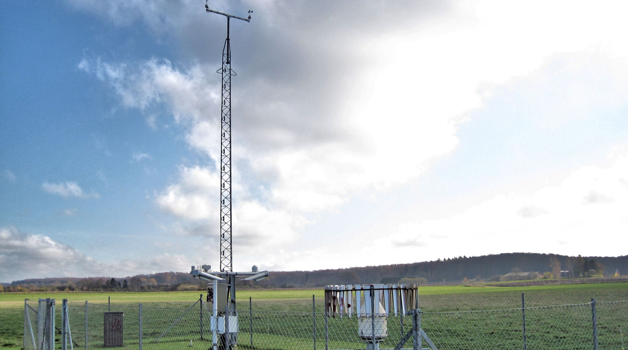

insitu.copernicus.eu
in-situ
copernicus.insitu@eea.europa.eu

