Slide 1
Collaboration with Africa - regional perspective
Leveraging Copernicus to build domestic capacity for resilience in Africa
Luca Rossi, Deputy Chief, Regional Office for Africa
18 March 2026

Slide 2
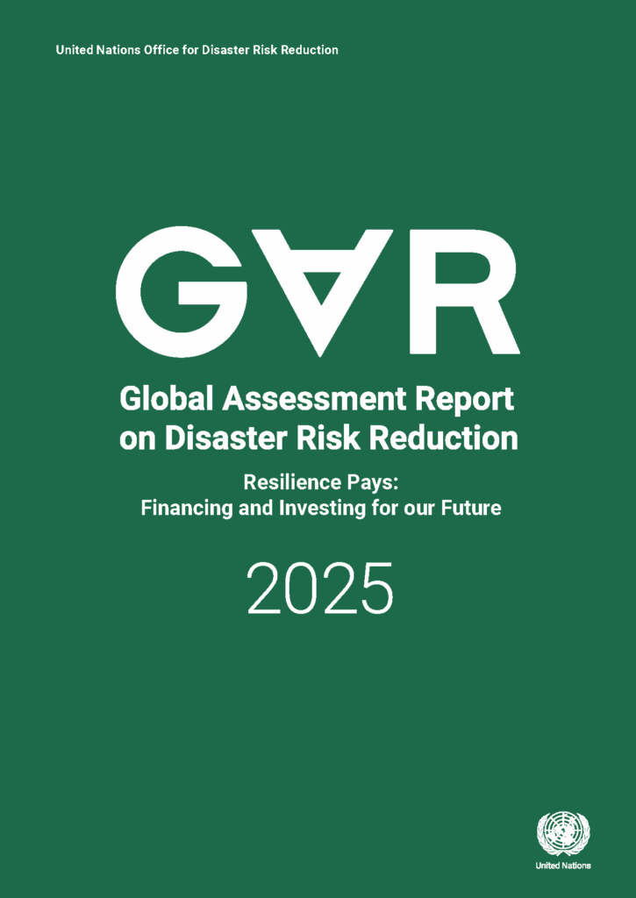
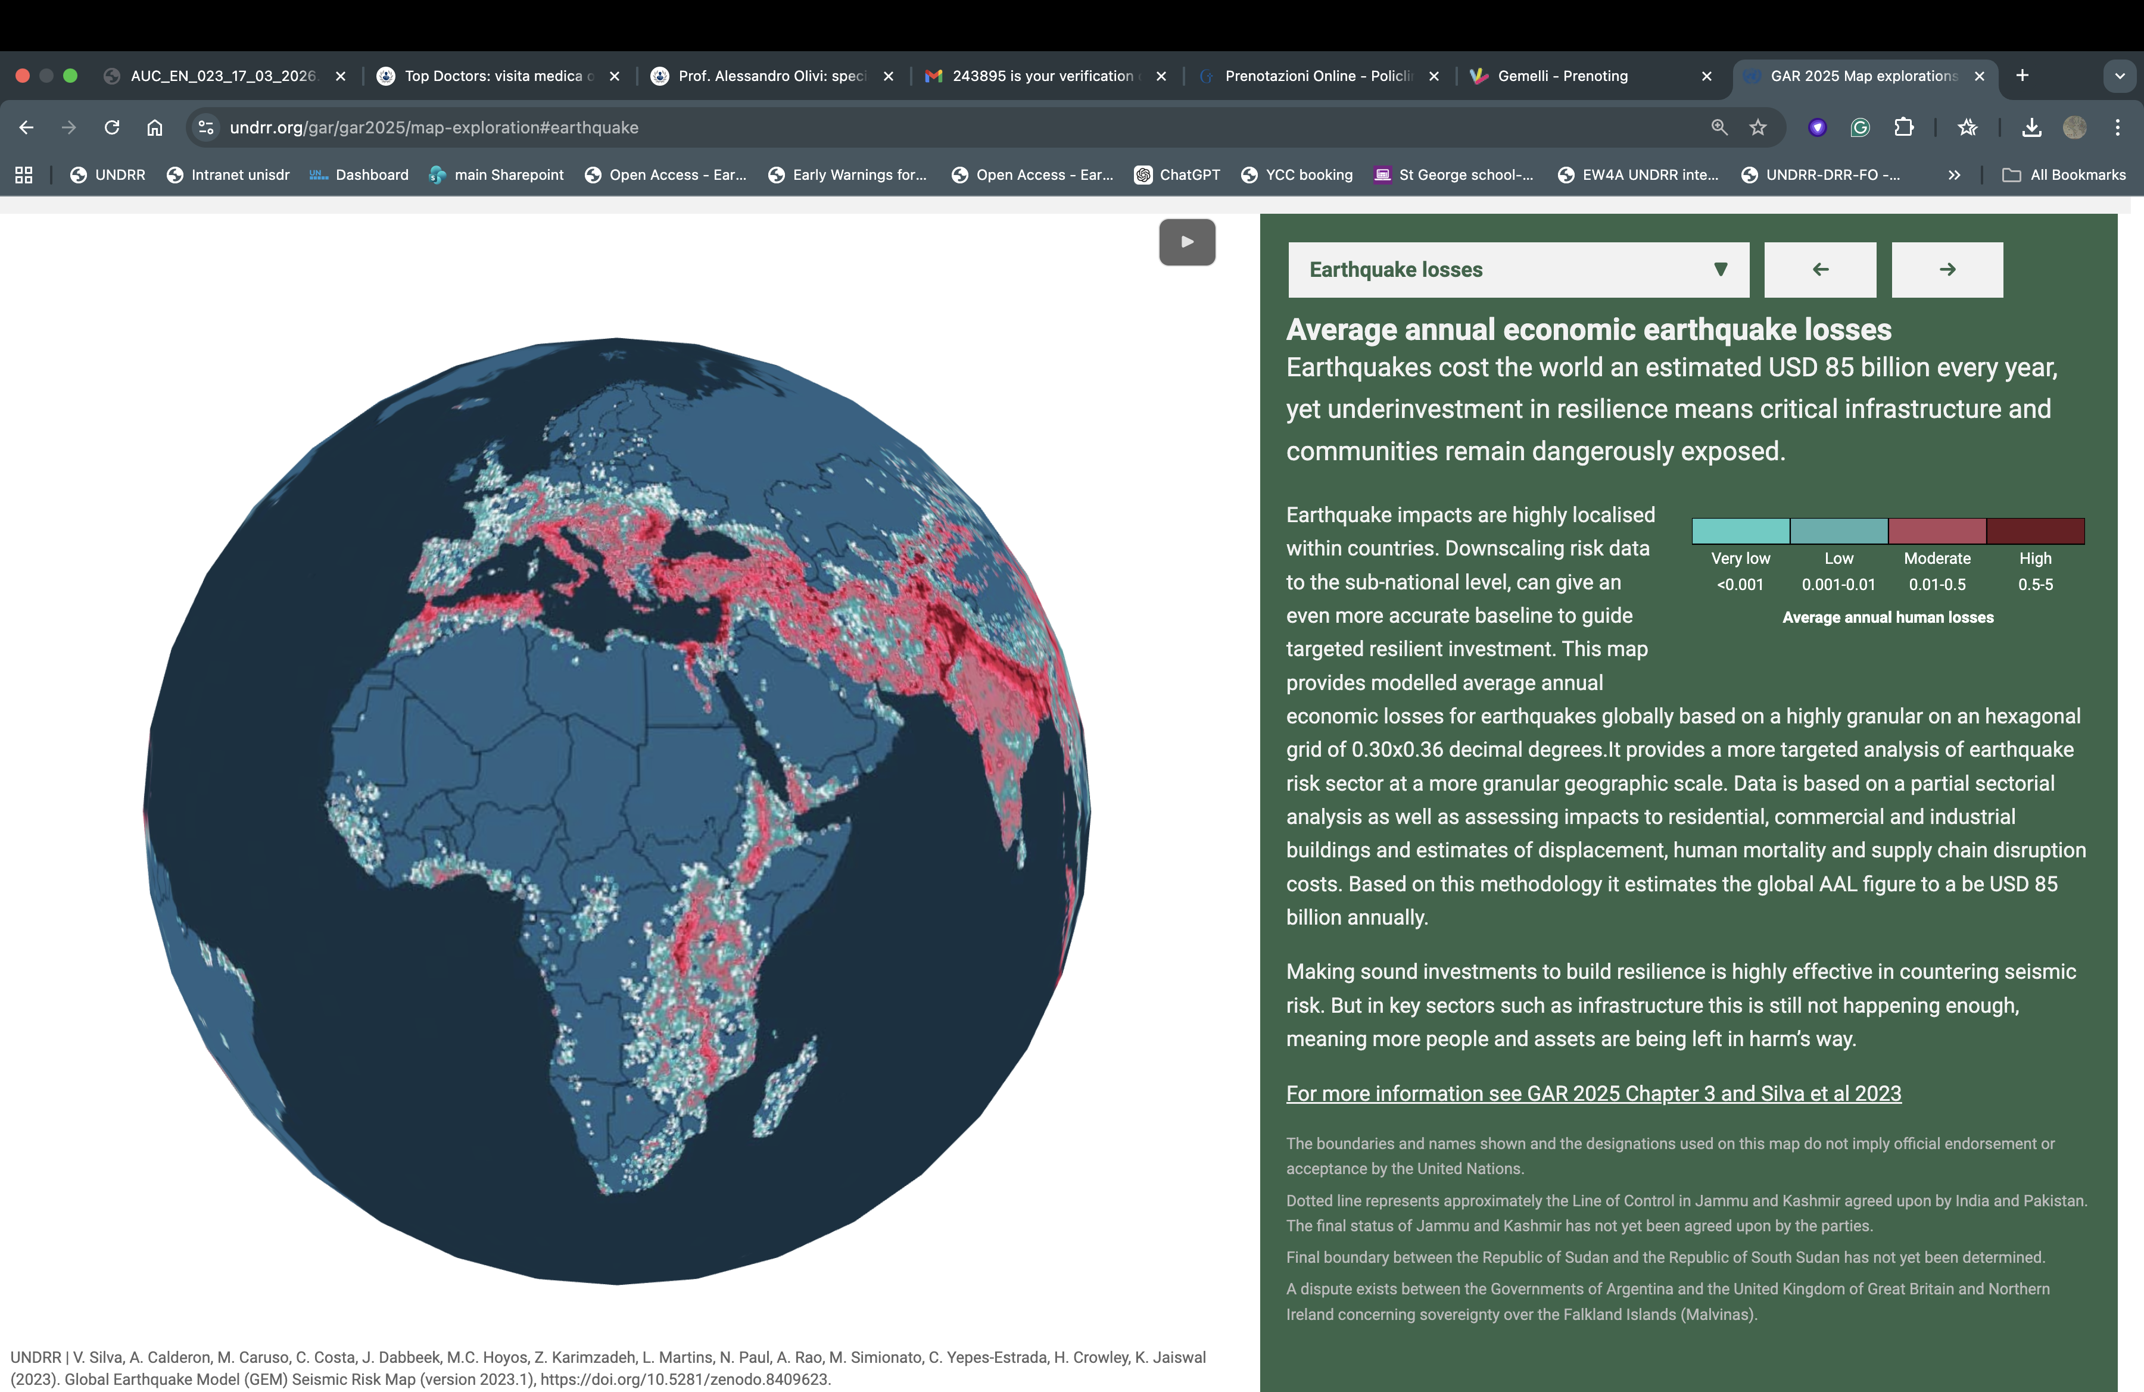
Earthquake impact in Africa

Slide 3
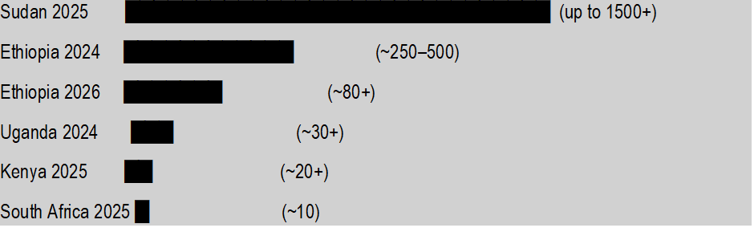
Landslides impact in Africa: 5–10% of global landslide fatalities
Main trigger: Intense rainfall (climate variability increasing risk)
Key Trends
Increasing frequency of reported events
Rising urban landslide risk (informal settlements, waste dumps)
High-impact, low-frequency disasters drive fatalities
Significant underreporting across the continent

Slide 4
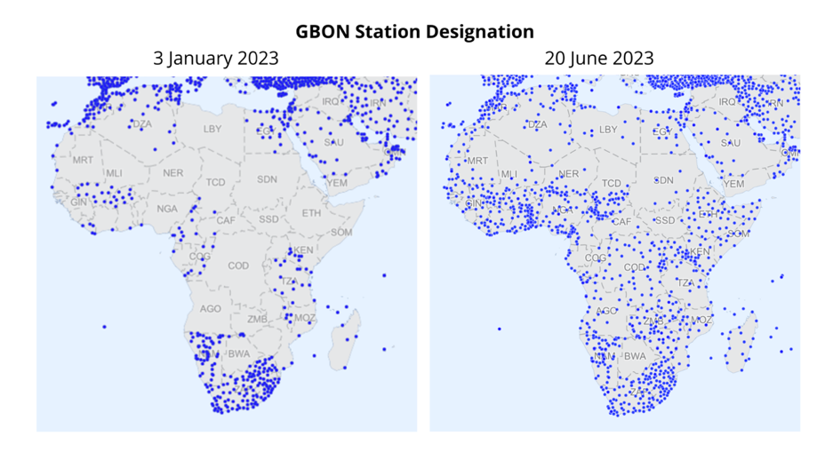
Exacerbated by the Information Gap
Challenges
Coverage
Mainteinance
Infrastructure and capacity for access and use
Notes:
Despite massive investments on infrastructure, gaps are still relevant.
Moreover, the capacity to maintain the infrastructure, to grant access to the broader community of users is limited.

Slide 5
UNDRR approach to mitigate it
Diagnostic Tools
Policy and Strategy Development
Connecting and Coordinating
Across 6 key areas:
Understanding Risk
Disaster Loss Accounting
Risk Governance
[informed] Investing in Disaster Risk Reduction
Resilient Infrastructure
Early Warnings for All
Potential areas of Copernicus engagement
Notes:
What does UNDRR do?
Headquartered in Geneva, with 5 Regional Offices and 2 sub-regional offices, UNDRR is the UN system focal point for disaster risk reduction. We convene partners and coordinate activities to create safer, more resilient communities. By bringing together governments, with the UN system, academia, the private sector and civil society, we work to support some of the world’s most vulnerable countries in achieving the Sendai Framework for Disaster Risk Reduction.
The Regional Office for Africa, works across 44 countries including some of the world’s most climate vulnerable by supporting NDMAs as the Sendai Focal Points. With support to HydroMet services, critical infrastructure sectors, planning and finance ministries, as well as guidance to Regional Economic Commissions and close partnership with the African Union Commission
The AMHEWAS Programme offers the perfect institutional and infrastructural setting

Slide 6
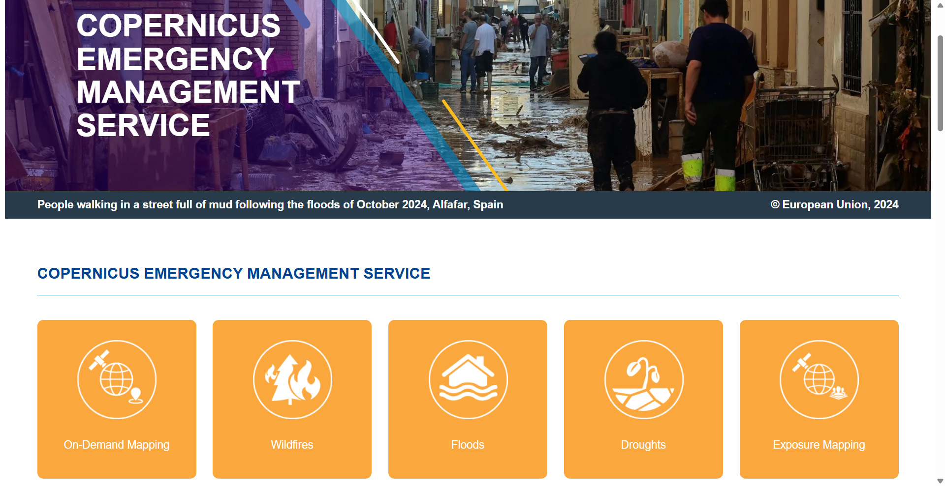
Existing Opportunities

Slide 7
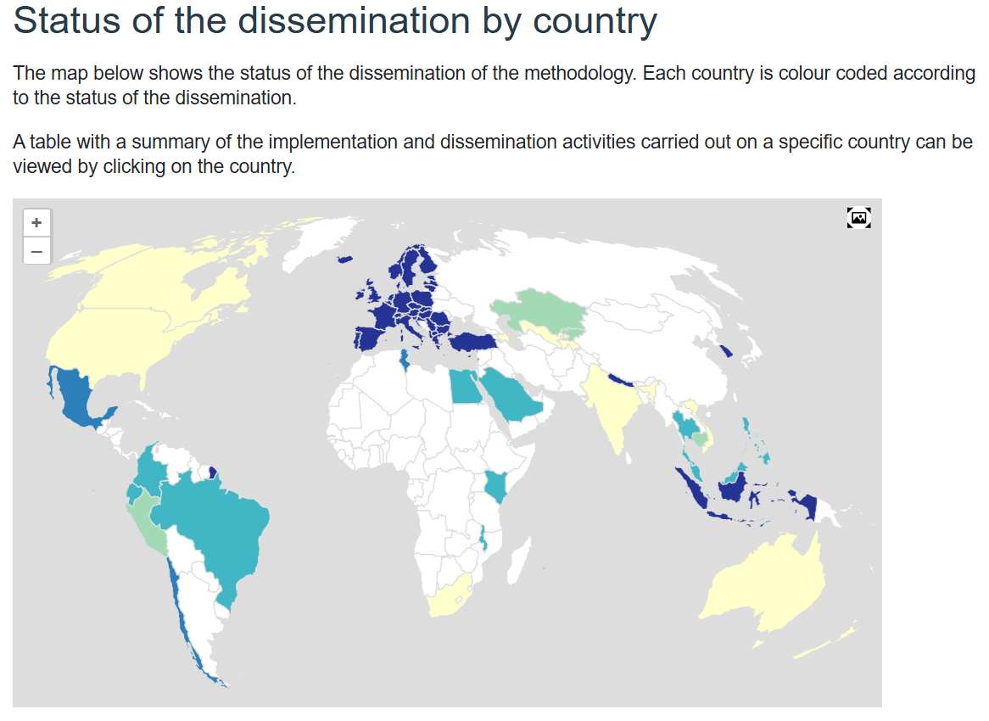
CEMS training programme of the Degree of Urbanisation
Source: GHSL - Global Human Settlement Layer
Notes:
The opportunity:
UNDRR can support Copernicus/CEMS service providers to: strengthen access to African markets + broker partnerships with African private sector; facilitate capacity building to strengthen NoE from peer exchanges
Long term partnership with Copernicus through the NoE can lead to strengthened access for CEMS providers, strengthened capacity of African private sector, and better resilience across Africa

Slide 8
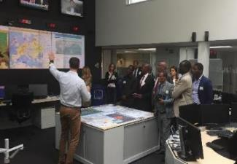
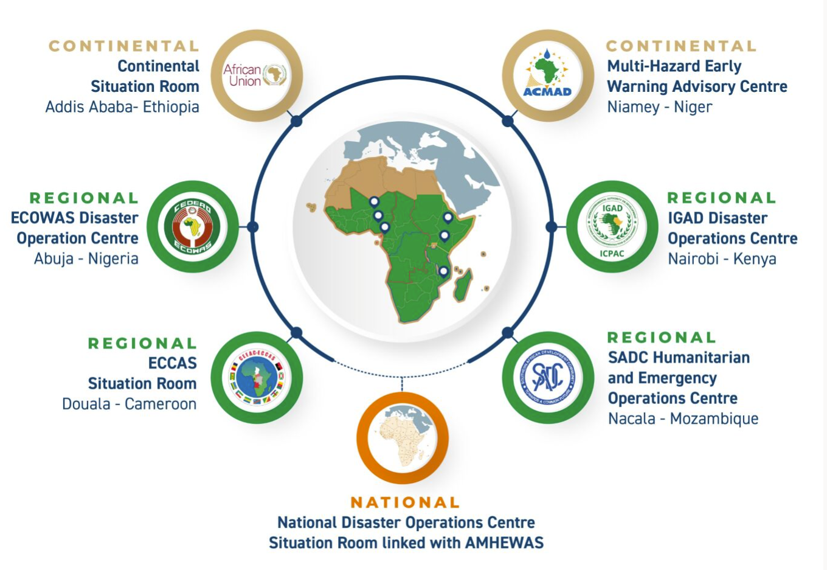
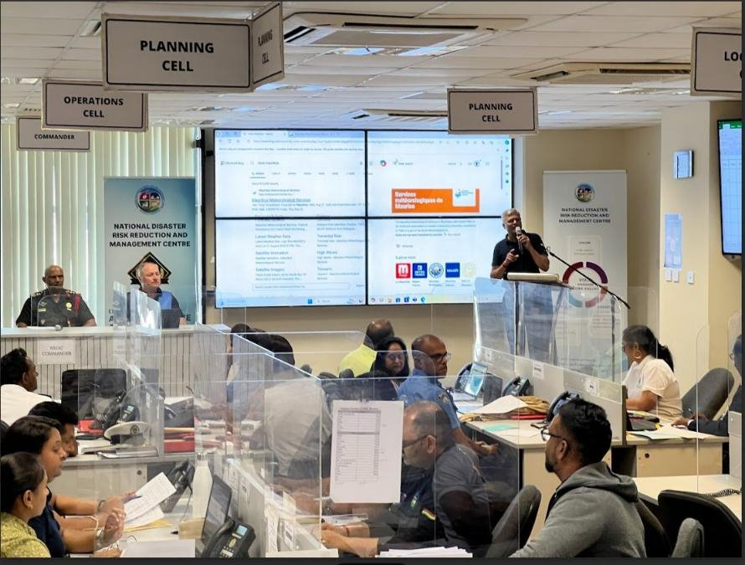
AMHEWAS
Africa Multi-Hazard Early Warning and Action System for DRR
Vital and dynamic space to build resident capacities and long-term partnerships
Notes:
The opportunity:
UNDRR can support Copernicus/CEMS service providers to: strengthen access to African markets + broker partnerships with African private sector; facilitate capacity building to strengthen NoE from peer exchanges
Long term partnership with Copernicus through the NoE can lead to strengthened access for CEMS providers, strengthened capacity of African private sector, and better resilience across Africa
An opportunity to cooperate with the NOE through triangular cooperation mechanisms to train:
Hydromet and NDMA
Environmental institutions
Critical infrastructure planning and management
Resilient urbanization
Water resource management
Energy
Agriculture, livestock, and food security

Slide 9
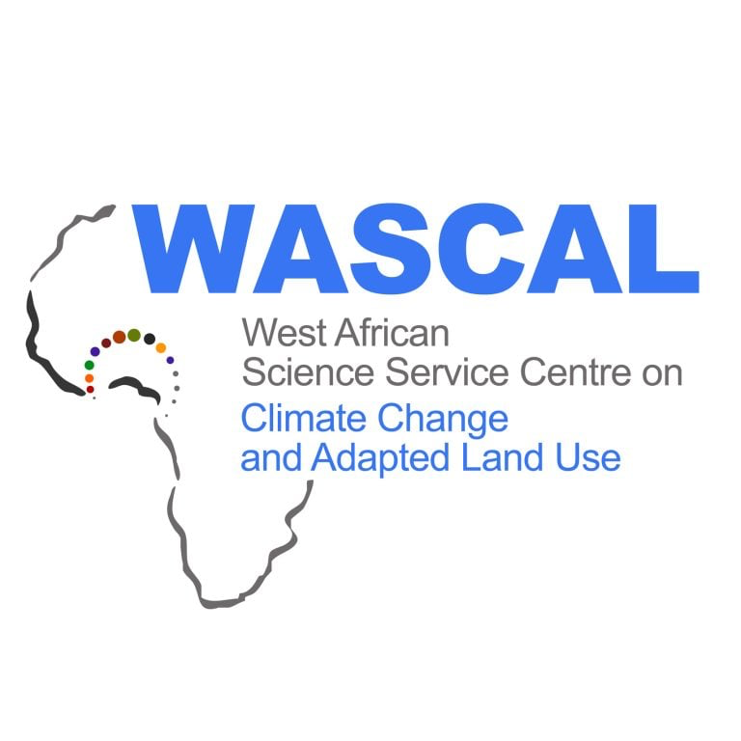


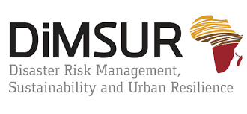



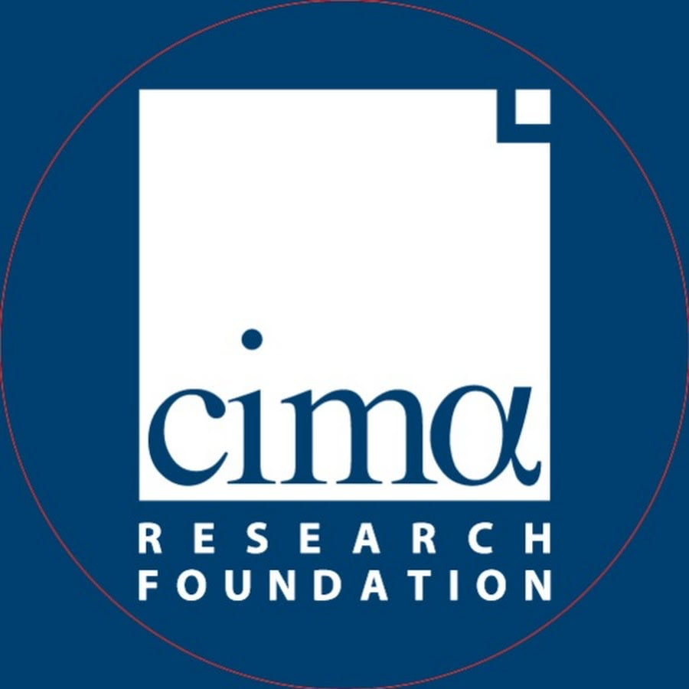

Two key networks
47+ Members of the Network of Centers of Excellence for DRR (NoE) including:
Notes:
Partnerships are at the core of how UNDRR works.
Two of our key partnership networks are the Network for Centers of Excellence for Disaster Risk Reduction and our private sector network: ARISE.
The Africa Network of Centres of Excellence for DRR (NoE) unites African scientific and operational expertise to strengthen disaster risk reduction (DRR) across the continent. It addresses needs across the continent through collaborative knowledge sharing and capacity building. The almost 50 Members include institutes with expertise on anticipatory action, hazard mapping, flood mapping, training of public institutions, and early warnings systems.
UNDRR’s private sector networks through ARISE and beyond, broker relationships between private sector associations, governments, and international private sector entities to strengthen business resilience and DRR capacity in Africa. ARISE Africa has more than 30 members including chambers associations and subregional business associations. It includes companies as large as multinational insurance firms and telecommunications providers, food and agricultural sector representatives as well as city level construction service providers and the logistics and supply chain management industry.
The NoE brings together almost 20 African science and technology institutions to build capacity on science-based DRR to inform risk-based decision making, policy,
and practice; ultimately aiming for a network of disaster risk reduction experts that can collaboratively work towards addressing challenges faced by local, national, and regional
institutions in Africa, linked to early warning, anticipatory action, and disaster preparedness. Ultimately, we are working with African resident institutions to harness tools like those provided by Copernicus, and position themselves as service providers to governments and public institutions across the continent. Through the ARISE Private Sector Network, we are also working to strengthen peer-to-peer relationships between African private sector companies and their international counterparts, to build capacity on tools, risk-informed planning, and developing capacity in order to build new partnerships with African governments
Advocacy and Outreach:
● Work in collaboration with other major groups such as STAG to ensure continued space for science and technology engagement in the DRR sphere and other related global and/or regional processes and coordinated positions, as necessary
● Raise awareness on international, regional, national efforts in DRR, and inform the Group constituencies at all levels of activities and strategies of its members.
Capacity Building:
● Organize, manage and disseminate data and capacity building products amongst different audiences targeted
● Collaborate with national governments in implementing regional and national strategies and commitments and assisting in enhancing institutional capacities on Disaster Risk Reduction, including disaster preparedness, early warning, and anticipatory action
● Strengthen south-south and south-north knowledge exchange and sharing of best practices, including promoting localized learning and brokering the integration of local wisdom and indigenous knowledge systems with external technological and scientific knowledge
Working Groups implement specific activities and ensure everything aligns with the NoE's broader objectives.
NWG 1: Risk information generation and innovation for Early Warning /Early Action and Anticipatory Actions
Co-Chairs: The CIMA Foundation
NWG 2: Capacity Development on Risk Information for Early Warning and Anticipatory Action
Co-Chairs: WASCAL and UNU-EHS

Slide 10
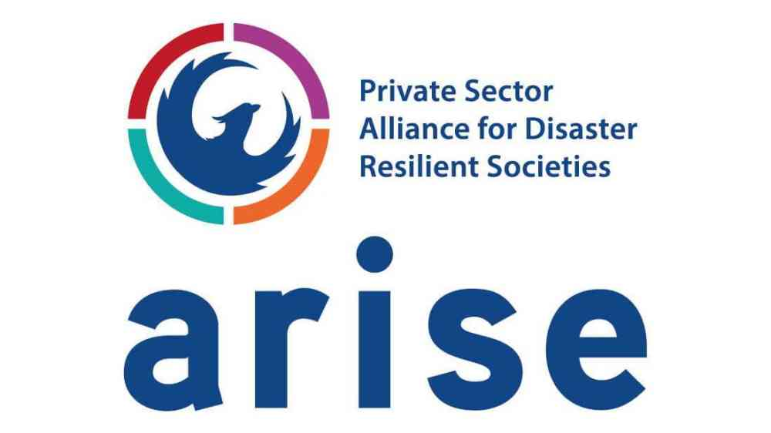
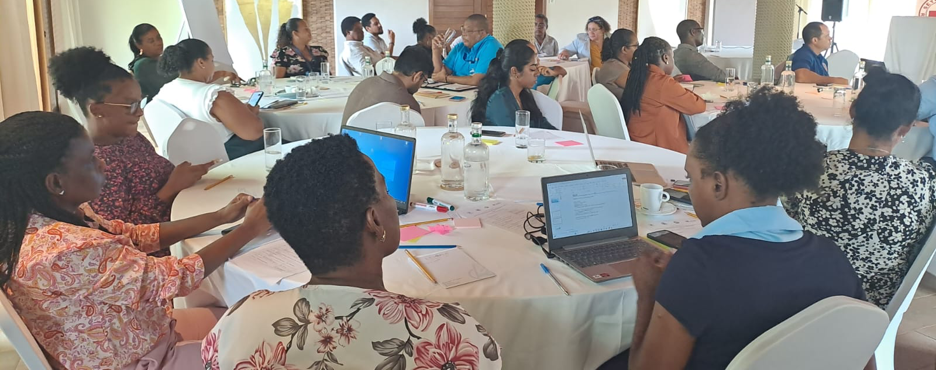
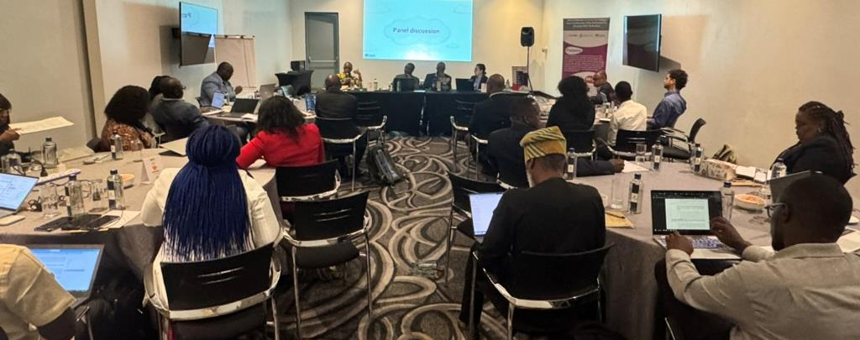
ARISE: Private Sector Networks
ARISE Africa; ARISE Kenya; ARISE East Africa; ARISE West Africa
42 Members and counting
Multi-sectoral by design
Notes:
To enhance long-term sustainability and domestication of the financial resources, private sector engagement is critical.
UNDRR’s private sector networks through ARISE and beyond broker relationships between private sector associations, governments, and international private sector entities to strengthen business resilience and DRR capacity in Africa.
ARISE Africa has more than 30 members including chambers associations and subregional business associations. It includes companies as large as multinational insurance firms and telecommunications providers, food and agricultural sector representatives as well as city level construction service providers and the logistics and supply chain management industry.
In partnership with the Africa Union Commission and RECs, we are also working to strengthen the public policy – science – private sector interface.

Slide 11
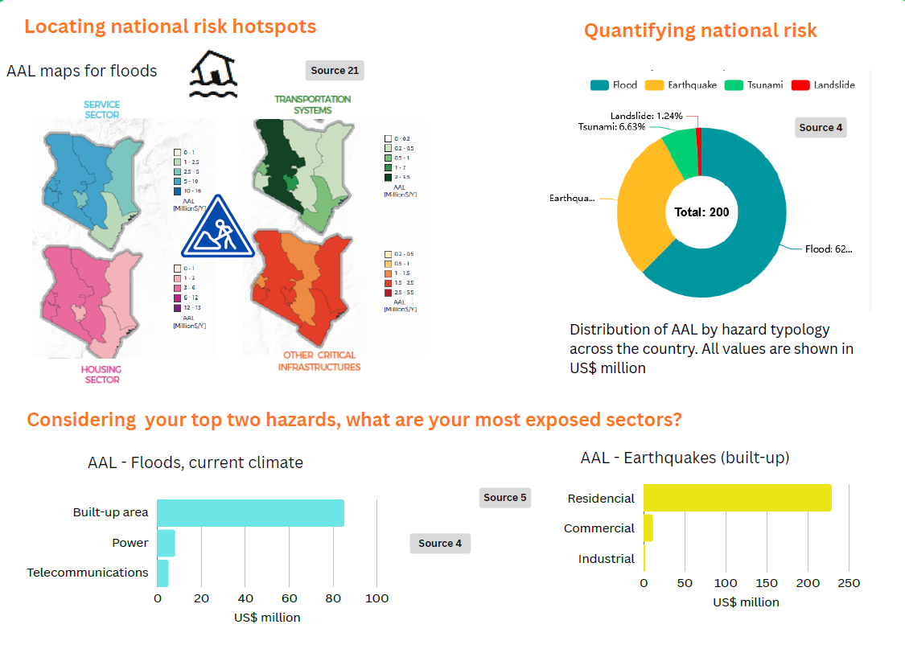
Kenya Risk Metrics

Slide 12
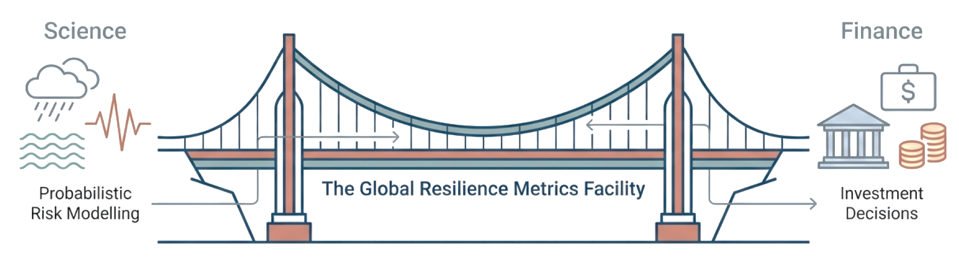
Closing the gap between risk measurement and action
Increasing access to quality probabilistic risk and resilience information as a prerequisite for effective public and private decision making.
Notes:
The Global Resilience Metrics Facility makes resilience investment predictable, evidence‑based, and scalable.
−Lower due‑diligence costs for financiers
−Stronger justification for ex‑ante financing
−Greater absorption of resilience and climate finance

Slide 13
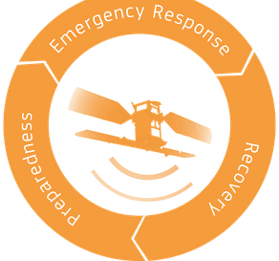
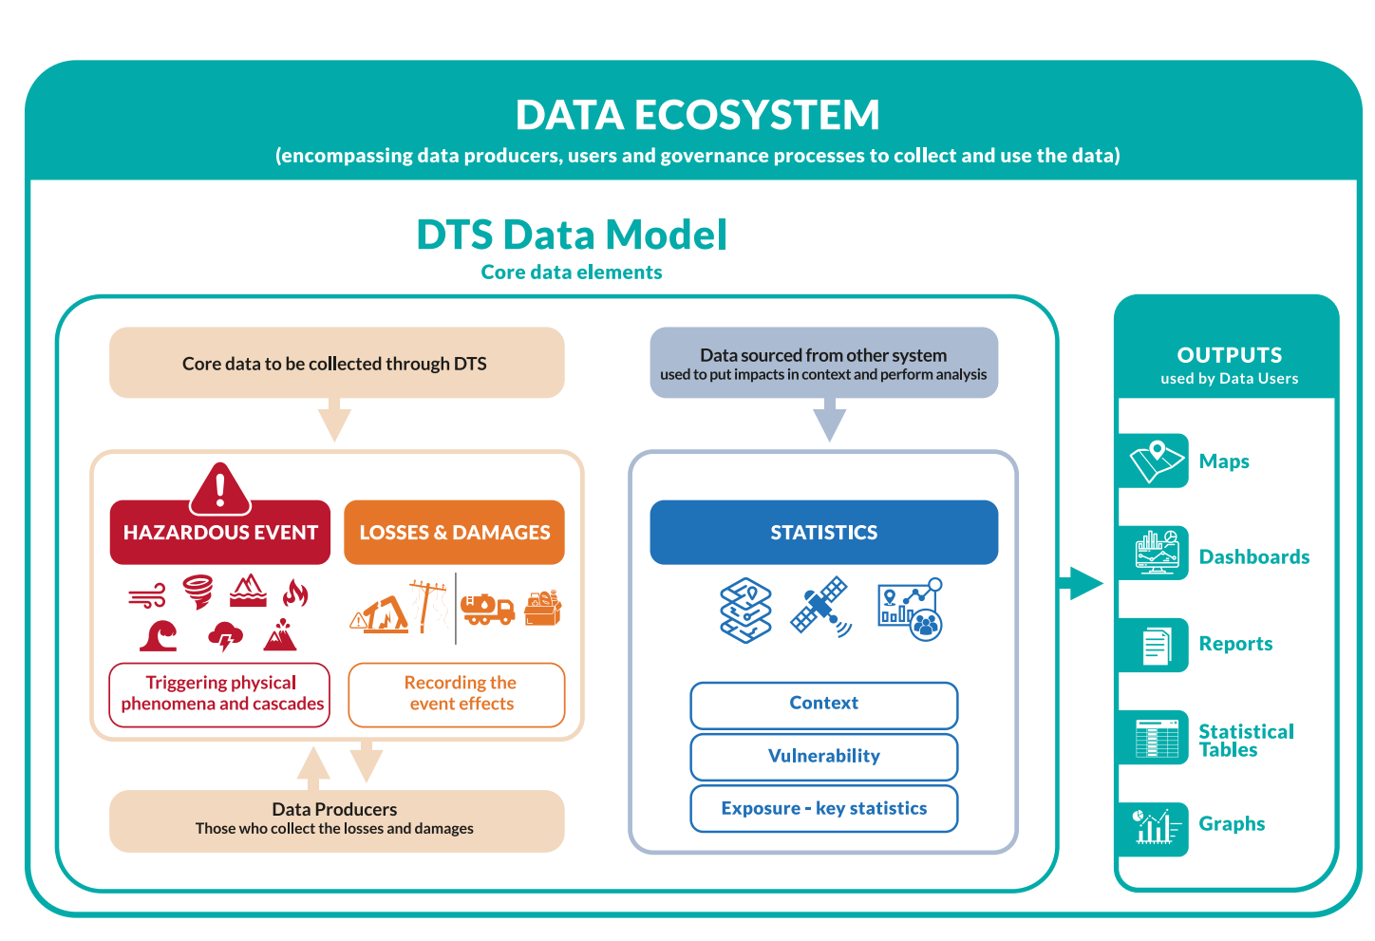
Practical Applications for Emergency Management … …and Beyond
Strengthening the understanding of (differentiated) impacts of climate change and disasters .Building, informing, and calibrating vulnerability and risk models
Financing: Assessing losses and damages, DRR and adaptation financing
Risk-informing planning: development and sectoral planning ( e.g. Infrastructure, agriculture, etc.)
Better ( inclusive, gender-responsive, effective) disaster risk reduction & climate financing
Informing early warning systems (impact-based forecasting), anticipatory action, identification, preparedness for response and contingency planning. Measuring effectiveness
Informing resilient recovery - post-disaster needs assessments
Benchmarking success (or failure) of resilience building measures: monitoring progress, assessing effectiveness ( Disaster risk reduction, adaptation, L&D)
Notes:
The opportunity:
UNDRR can support Copernicus/CEMS service providers to: strengthen access to African markets + broker partnerships with African private sector; facilitate capacity building to strengthen NoE from peer exchanges
Long term partnership with Copernicus through the NoE can lead to strengthened access for CEMS providers, strengthened capacity of African private sector, and better resilience across Africa
An opportunity to cooperate with the NOE through triangular cooperation mechanisms to train:
Hydromet and NDMA
Environmental institutions
Critical infrastructure planning and management
Resilient urbanization
Water resource management
Energy
Agriculture, livestock, and food security

Slide 14





Strengthening Regional Cooperation and Solidarity to Reduce Disaster Impacts and Humanitarian Needs in West Africa
Result 1
Policy Framework for a Regional Cooperation Mechanism
Result 2
Improved availability of and access to risk information for preparedness and response to disasters.
Result 3
Enhanced operational capacity for disaster preparedness, anticipatory action and disaster response
Cooperation with UCPM and Copernicus Services
Peer learnings with other regional mechanisms, EU, SADC, AUC, etc.
Piloting of a secondment programme from specialized institutions from Europe and Africa to support the ECOWAS DOC
Notes:
Approach replicated in other projects funded by EU Member States and CREWS,

Slide 15

Scale up to the Global Level
Identification of blockers to adoption of Copernicus products
Matchmaking Copernicus services with African private sector/academia
Strengthened resilience in Africa, access to new markets + domestic DRR capacity
Global Multi-Stakeholders Forum
Approach presented, discussed, and endorsed at the first Global Multi Stakeholders Forum of the EW4All initiative, within the GPDRR 2025
Notes:
The opportunity:
UNDRR can support Copernicus/CEMS service providers to: strengthen access to African markets + broker partnerships with African private sector; facilitate capacity building to strengthen NoE from peer exchanges
Long term partnership with Copernicus through the NoE can lead to strengthened access for CEMS providers, strengthened capacity of African private sector, and better resilience across Africa

Slide 16

Thank you
Luca Rossi, Deputy Chief, Regional Office for Africa
rossil@un.org
NOE & ARISE Focal Point: Nehali Anupriya, Programme Management Officer (Partnerships)
nehali.anupriya@un.org

