Slide 1

Africa-EPOS Synergy: Co-Developing Open-Source Frameworks for EO Data and Disaster Resilience
Mohamed ElGabry
African Disaster Mitigation Research Center ADMiR
National Research Institute of Astronomy and Geophysics NRIAG, Egypt

Slide 2
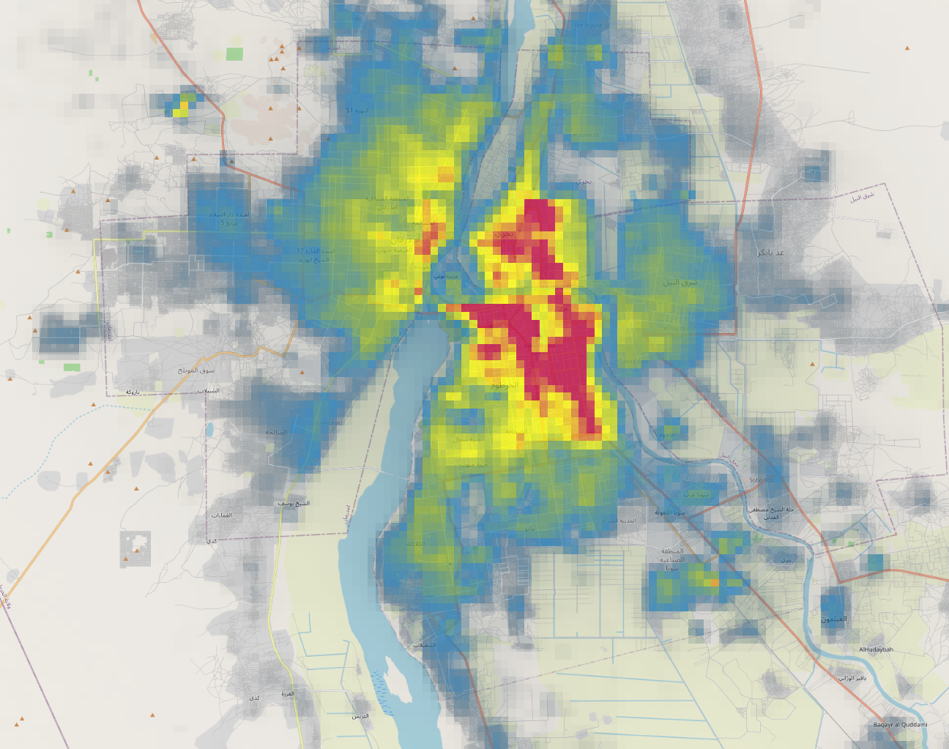

Slide 3
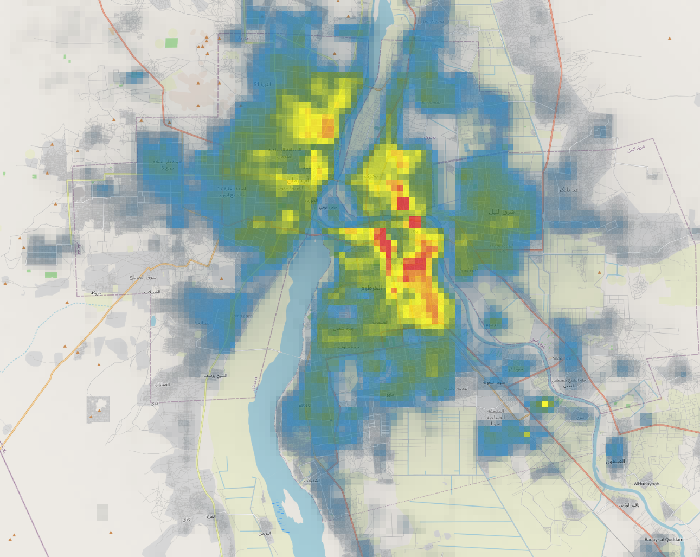
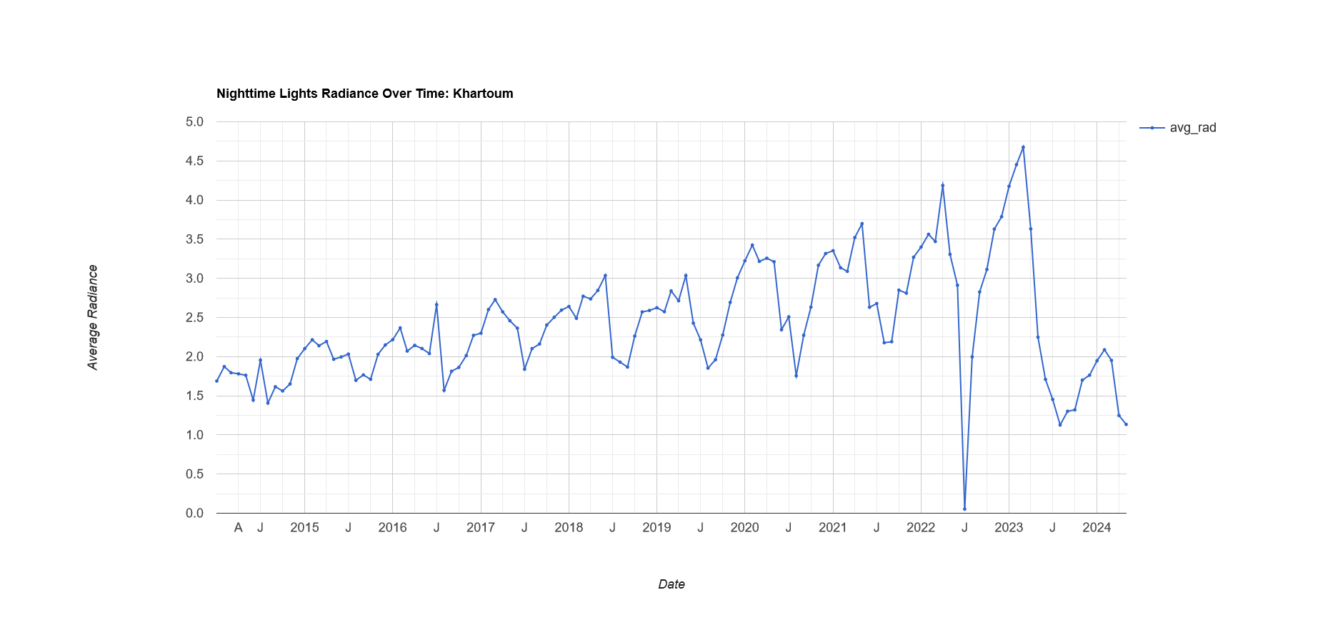

Slide 4
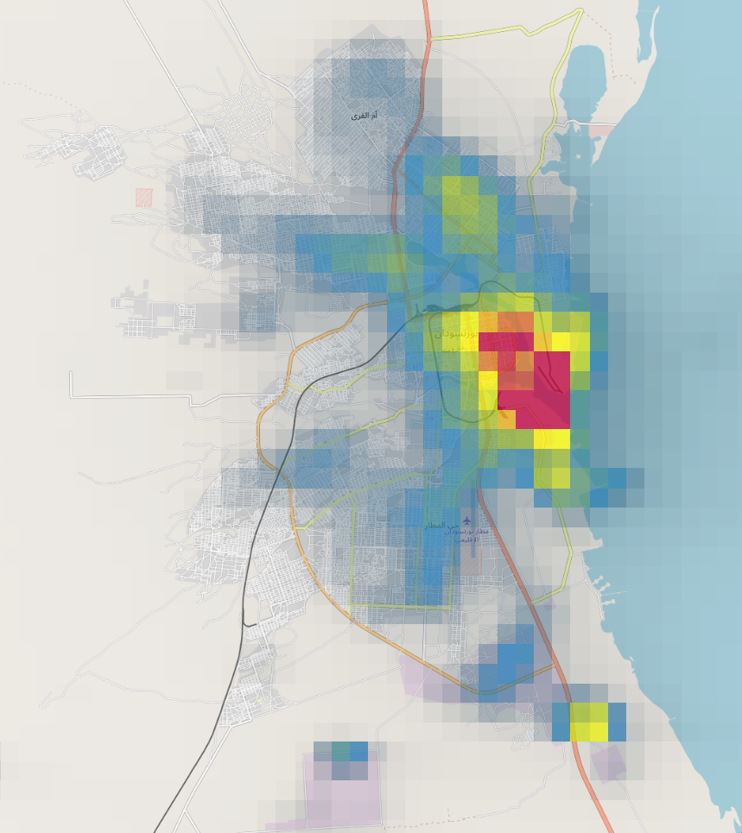

Slide 5
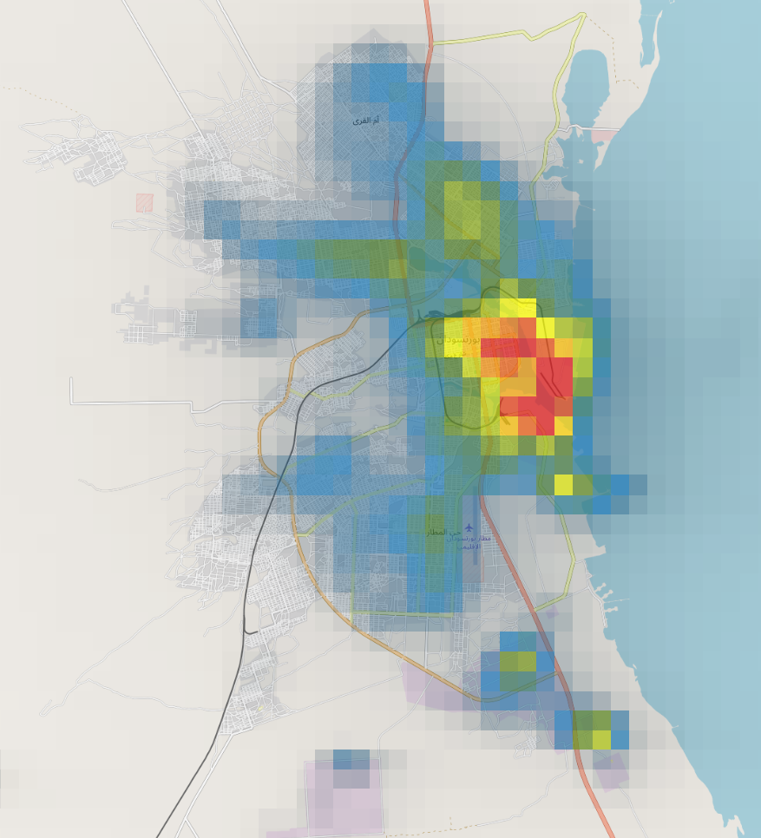
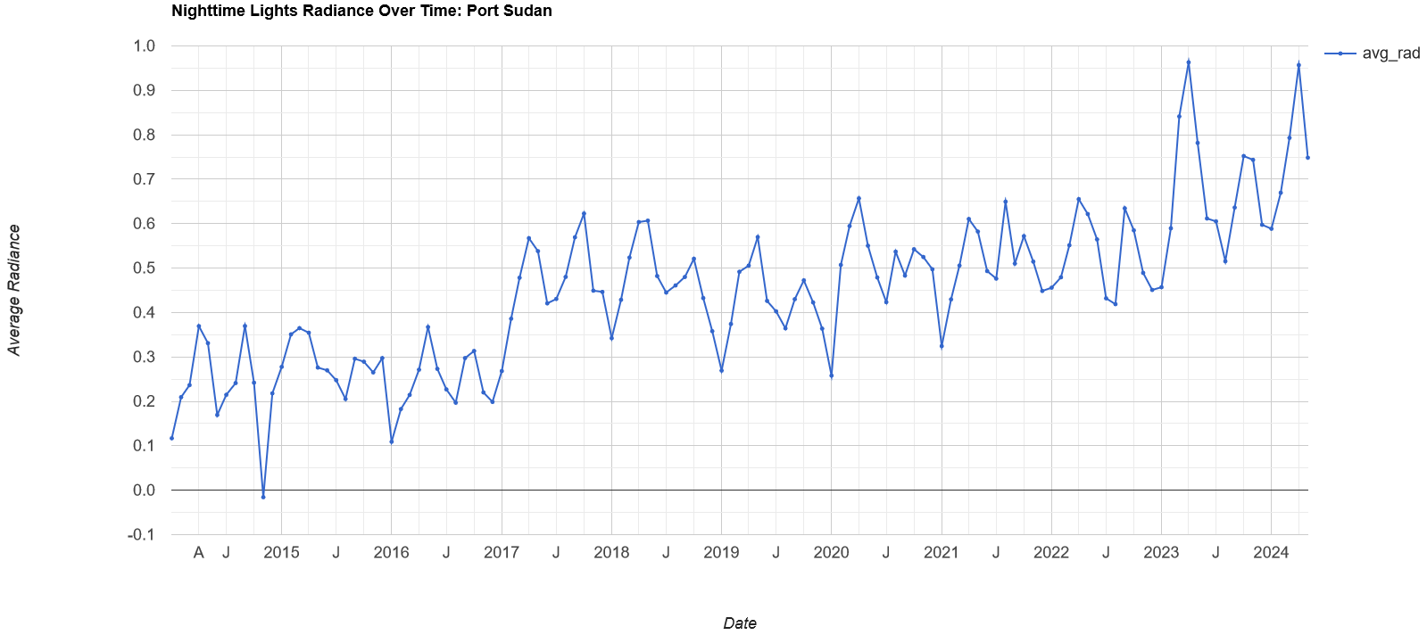

Slide 6
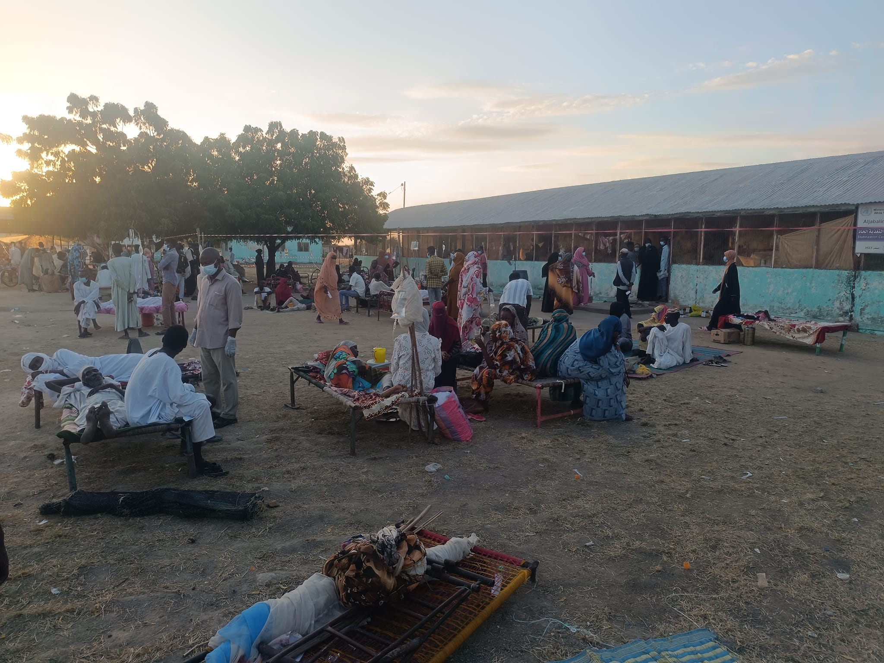
Sudan
Systemic Vulnerability: Ongoing armed conflict severely restricts infrastructure maintenance and forces mass displacement. Hundreds of thousands of Internally Displaced Persons (IDPs) flee to Port Sudan, straining city resources.

Slide 7
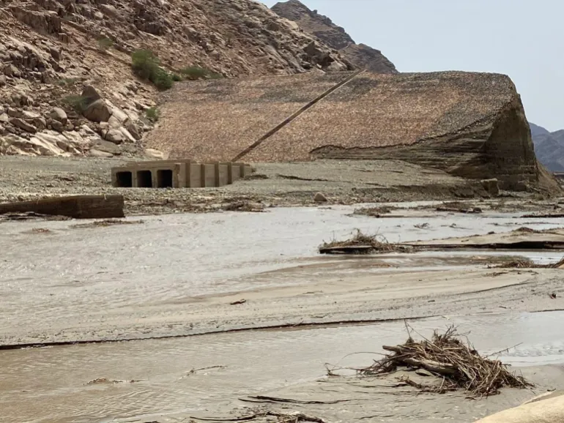
Sudan
Infrastructure Failure (August 2024): Extreme rainfall overwhelms the unmaintained Arbaat Dam. The dam collapses, unleashing catastrophic flash floods that wipe out downstream villages.

Slide 8
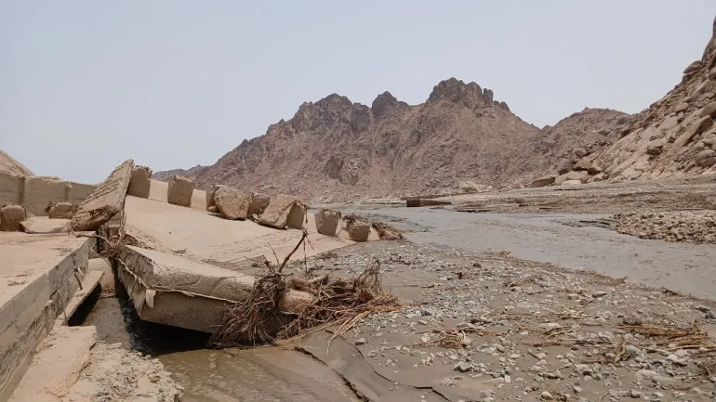
Sudan
Critical Lifeline Disruption: The dam was the primary freshwater reservoir for Port Sudan. Its destruction instantly cuts off safe drinking water for a city already operating far beyond its carrying capacity.

Slide 9
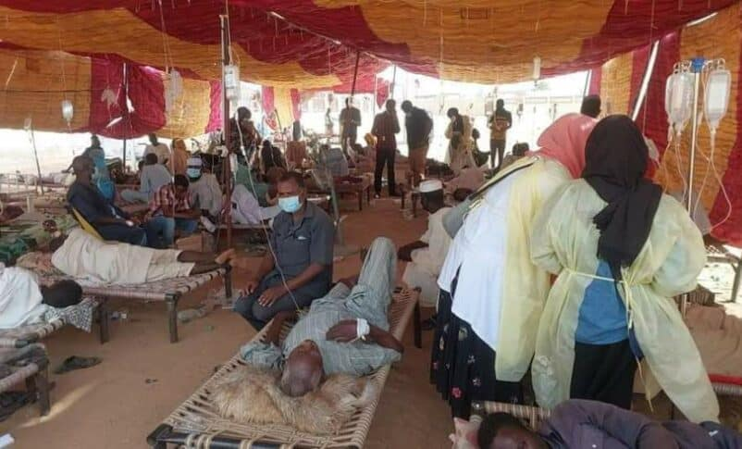
Sudan
Biological Hazard: The total loss of clean water, combined with contaminated floodwaters and overcrowded IDP camps, triggers a secondary public health disaster: a severe and deadly Cholera outbreak.
https://sudantribune.com

Slide 10
War
Floods
Cholera

Slide 11
The Hard Question: Could Open Science with Local Expertise Break the Cascade?

Slide 12
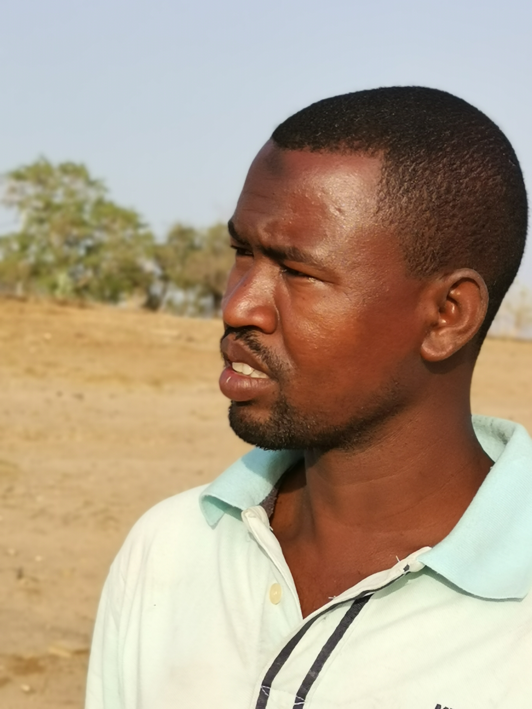
The Hard Question: Could Open Science with Local Expertise Break the Cascade?
Alhaj Moussa,
Geophysicist, Sudan Geological Research Authority
Guest Scientist @ADMiR 2024-2025

Slide 13
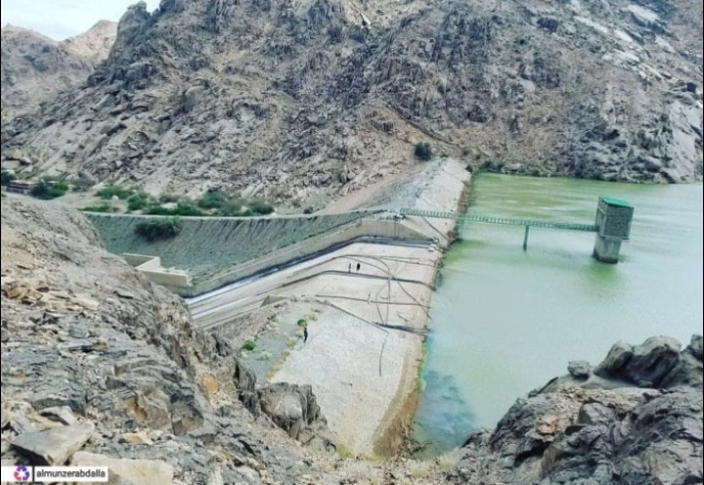
The Hard Question: Could Open Science with Local Expertise Break the Cascade?
The Operator's Dilemma: Port Sudan’s population boom created desperate water demand. Without accurate upstream forecasting, operators kept the Arbaat Dam at maximum capacity to ensure drinking water supply.

Slide 14
The Hard Question: Could Open Science with Local Expertise Break the Cascade?
Hydrological Modelling
Meteorological Data
Rainfall prediction
Weather Models
DEM
Flow Direction
Flow accumulation
Catchment Areas
Inundation
Risk Assessment
Notes:
we didn't rely on expensive, proprietary black-box software. We used an entirely open-source stack. We took open terrain data at a 3 Arc-second resolution and combined it with 10-kilometer resolution rainfall data. To process this, we used QGIS alongside Python packages like GDAL and PySHEDS to set up our catchments. Then, we ran the simulation through the Rainfall-Runoff-Inundation (RRI) model. What does this workflow tell us? It tells us that the financial barrier to disaster resilience is a myth. We built a highly accurate Early Warning System at virtually zero software cost. As you can see on the slide, this work demonstrates that the true cost of an early warning system is the human experience required to run it.

Slide 15
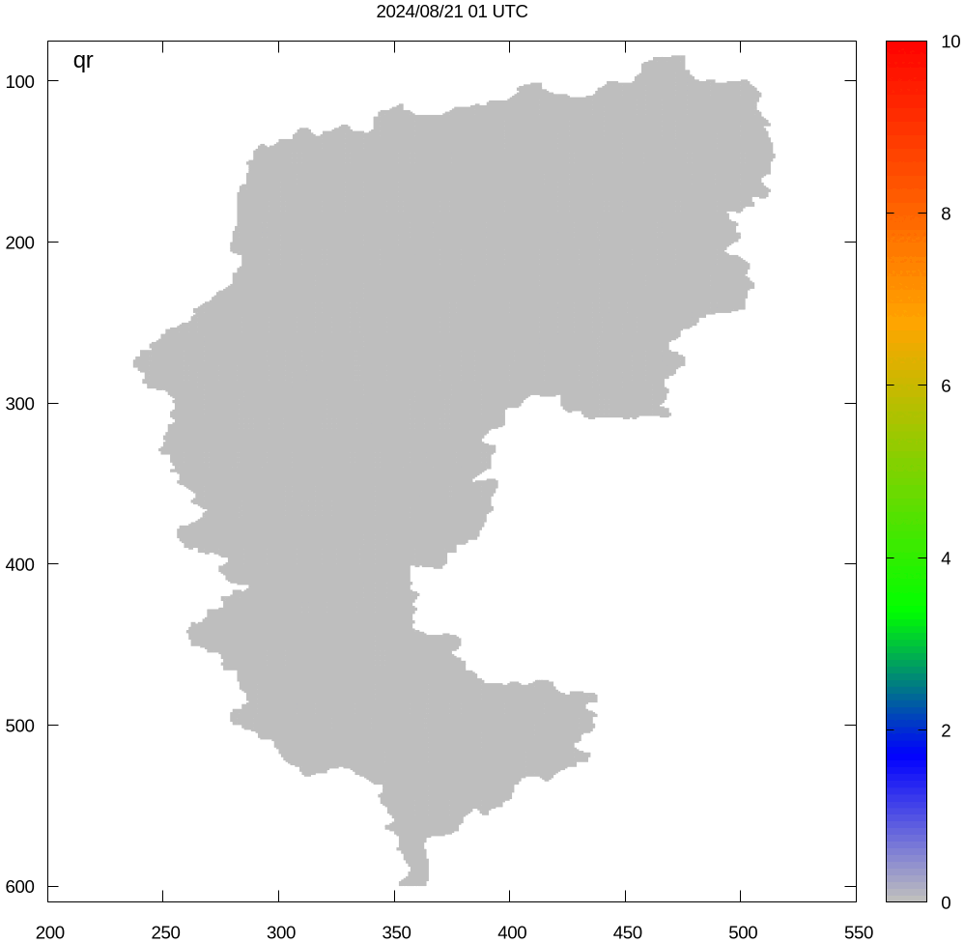
The Hard Question: Could Open Science with Local Expertise Break the Cascade?
The Open-Source Revelation: Our retrospective modeling, using open-source meteorological and hydrological data, shows the catastrophic flood volume could have been predicted 14 days in advance

Slide 16
The Hard Question: Could Open-Source Data Have Prevented This?
YES
,but only when the primary investment is in human expertise.

Slide 17
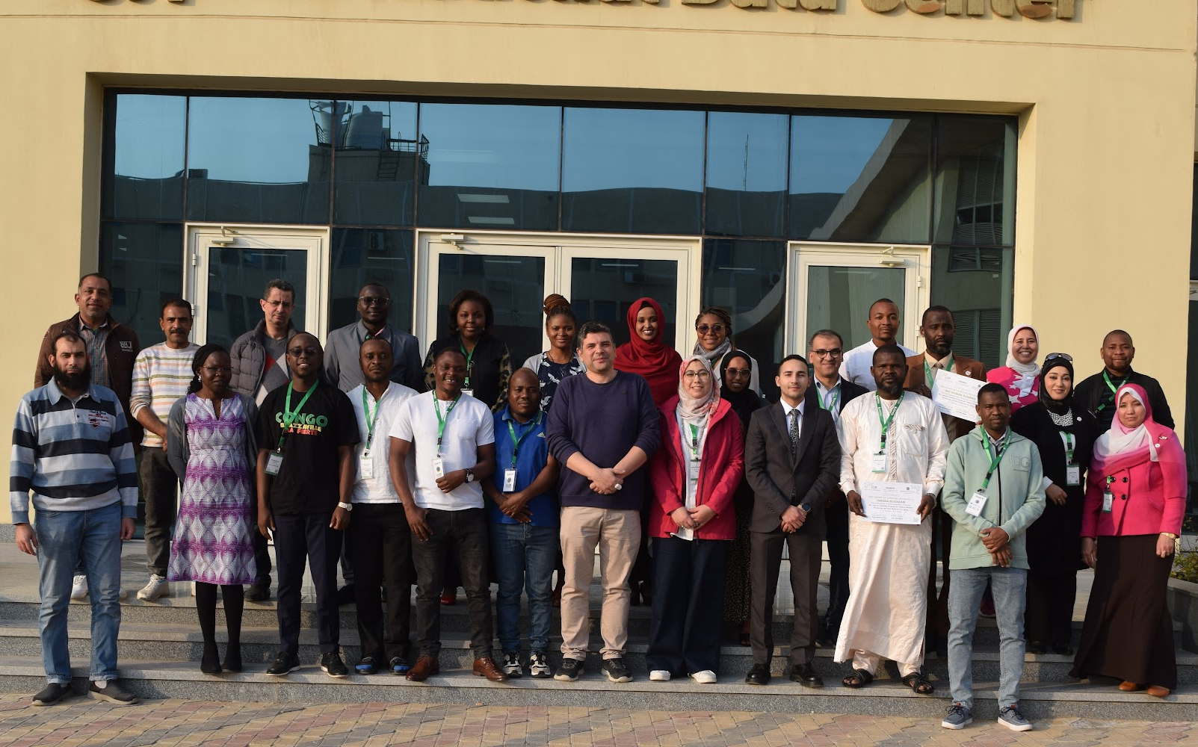
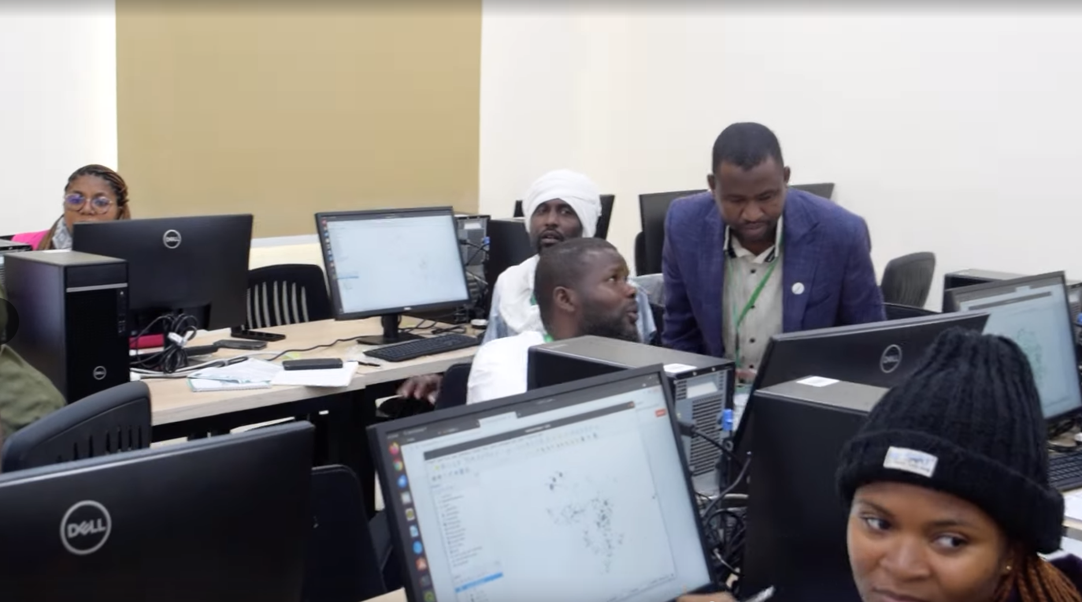

Slide 18
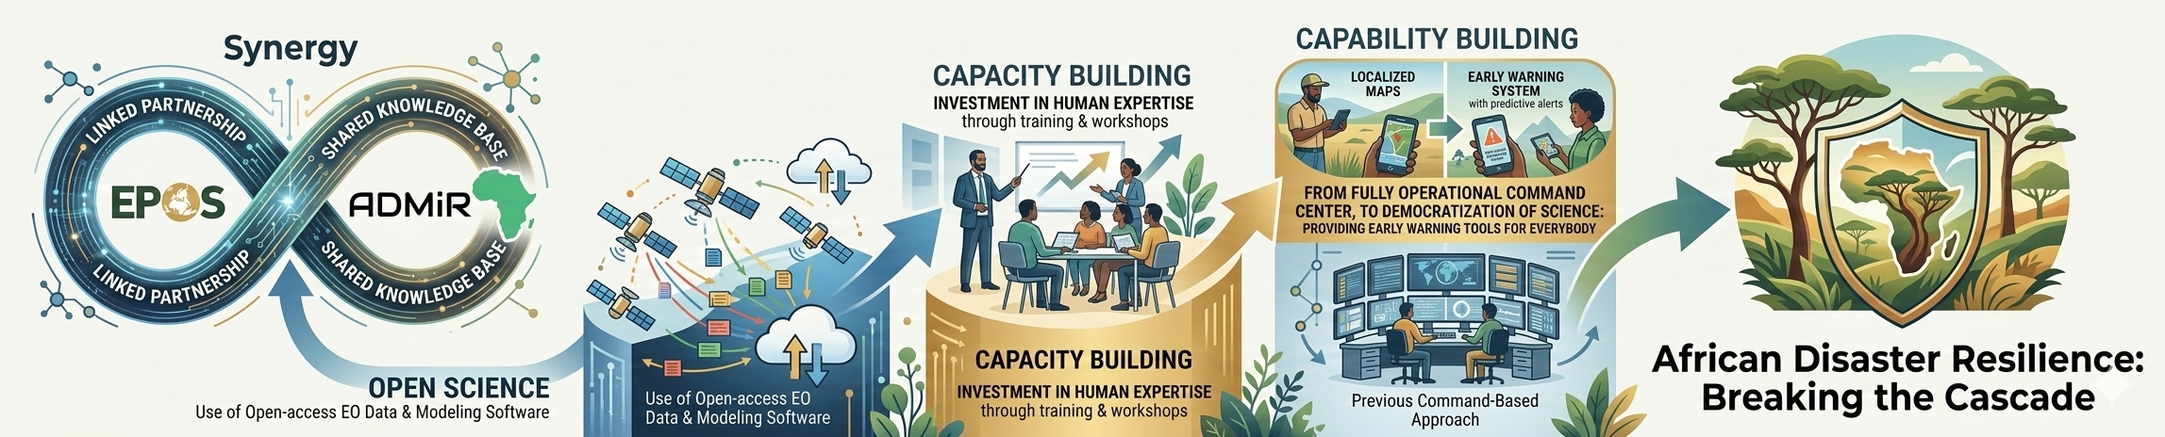

Slide 19
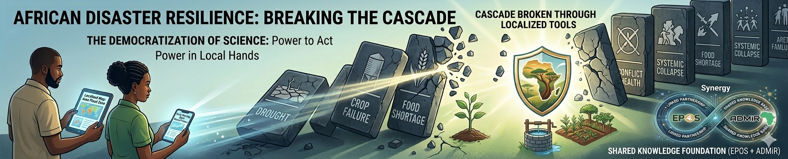
Thank you, Merci, Danke, Gracias, Grazie, Спасибо, Благодаря, Gràcies, Obrigado, Ευχαριστώ, Dziękuję, Hvala, Tack, Mulțumesc, Děkuji, Takk, Dank je, Kiitos, Ďakujem, Tak, ありがとう, Teşekkürler, Asante شكراً,

