Slide 1
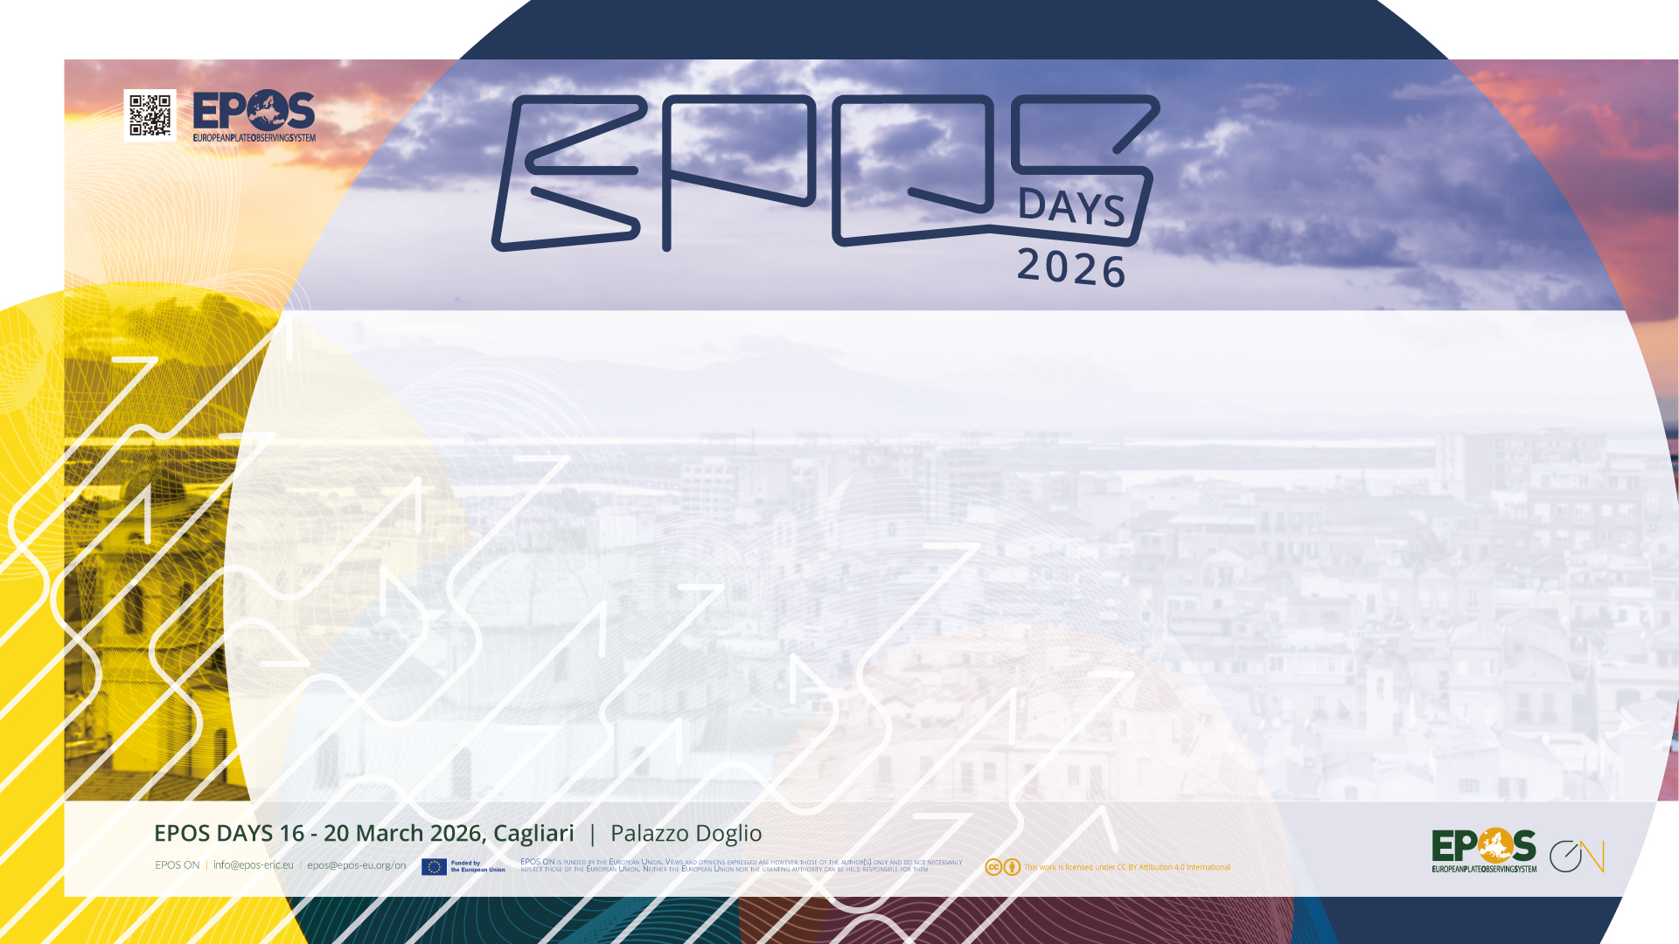
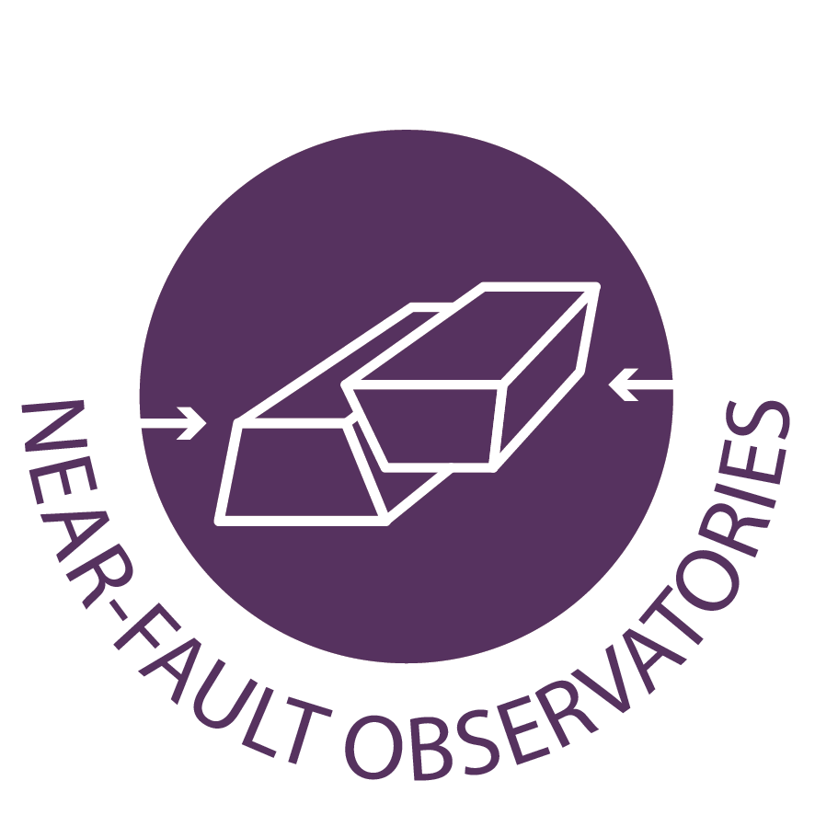
Report from the ARGONAUT meeting:
A collaboration perspectives among global NFO infrastructures
L. Chiaraluce and NFO-ARGONAUT team

Slide 2
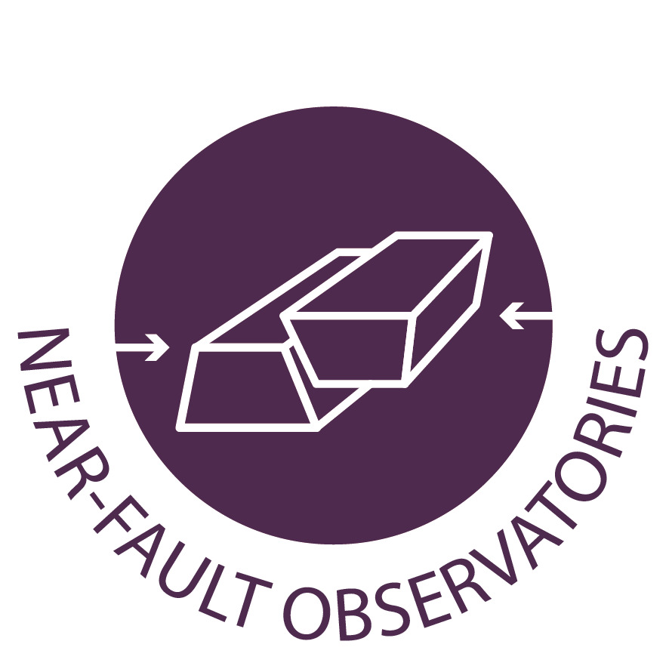
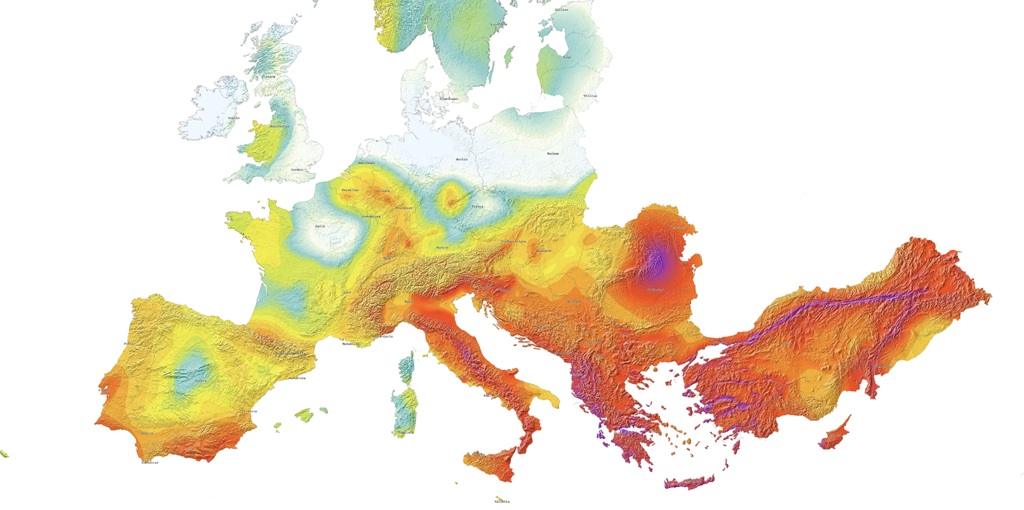

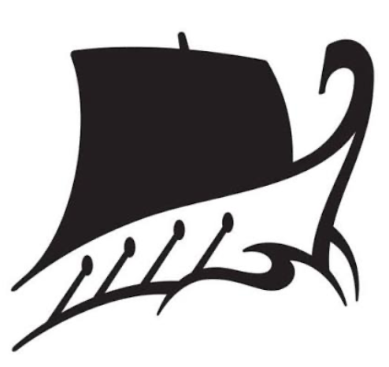
ARGONAUT
Towards a new generation of observatories close to faults
15-16 March – Palazzo Doglio (Sala Castello)
Task 5.2
Cooperation with international initiatives
Danciu et al., 2021
NITRO
VRANCEA
VALAIS
KARST
TABOO
MARMARA
INFO
ADMIRAL
CRL
In Greek mythology, the Argonauts were a group of heroes who, before the Trojan war, accompanied Jason aboard the ship Argo.
Notes:
In Greek mythology, the Argonauts were a group of heroes who, before the Trojan War, accompanied Jason aboard the ship Argo.

Slide 3
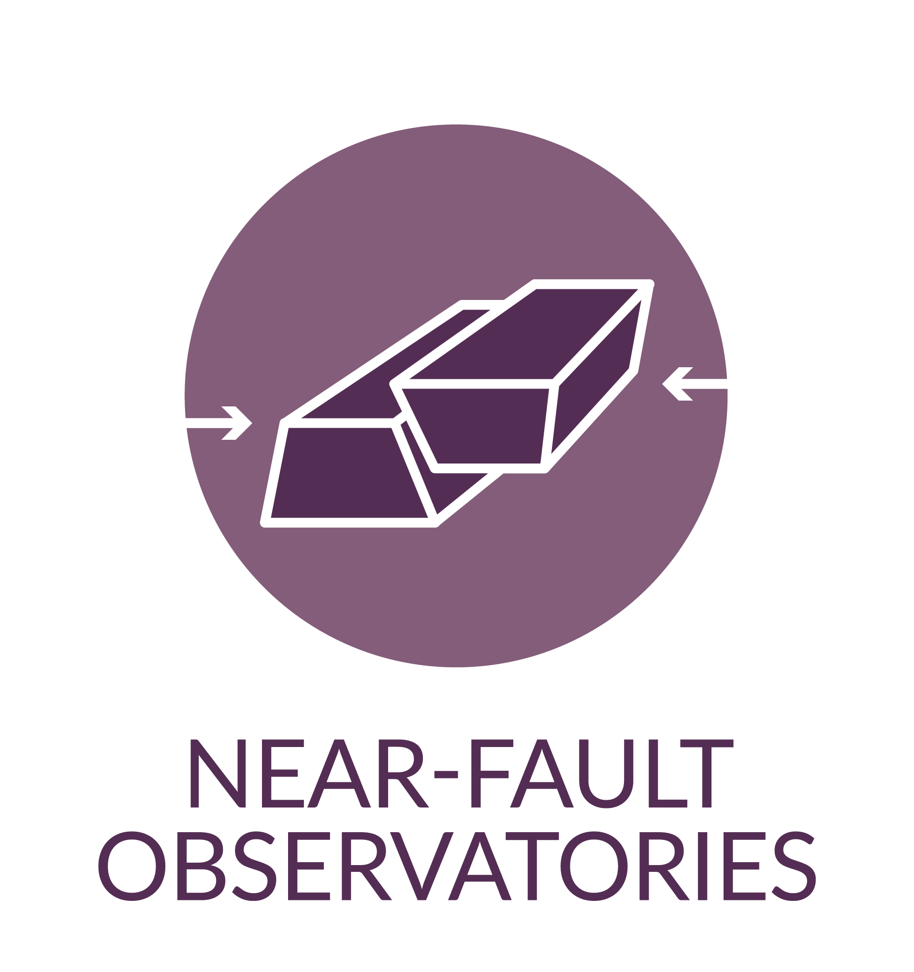
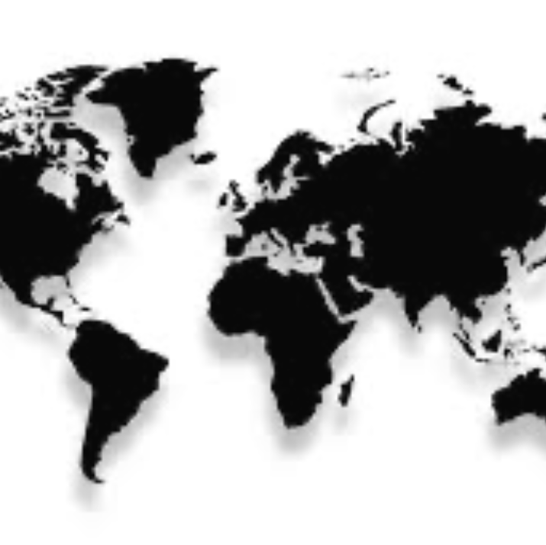
ARGONAUT in the EPOS ON context
Align European NFO community with some global leaders (in JAPAN, USA, CHINA and NEW ZEALAND) to embrace a holistic approach in Earth system monitoring integrating in situ high-resolution multidisciplinary data collected near fault zones to transform a novel understanding of earthquake physics in societal safety.
Discuss scientific ideas and identify common challenges;
Share common experiences and strategies about innovative research infrastructures (→white paper);
Lead to further integration of data and services.
Notes:
A major takeaway was the gap in how different countries define "near-fault" research. In the US they tend to see an NFO as a focused part of a larger observatory (e.g. NOTA). In some EU nations NFO is an individual infrastructure.

Slide 4
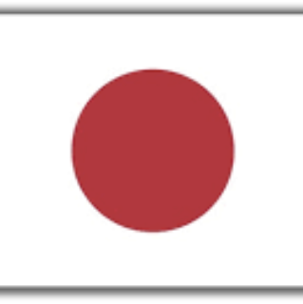
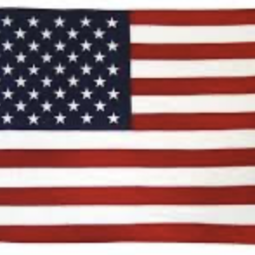
Different approaches in the global landscape
The Challenge of "Ubiquitous" Faults in JAPAN - Look for specific sites to demonstrate the innovative Science that can be made via a truly multidisciplinary approach. Need for a deeper integration of the state of art seismological and geodetic networks (Hi/KiK/GEO) with geochemical and other new type of data.
The Digital & Offshore Frontier in U.S. - NFO is a focused part of a larger observatory (e.g. NOTA). Pushing toward harmonization of data into ARCO Analysis Ready Cloud Optimized to drive multidisciplinary Science and bring computer scientist into the game (AI/ML). New Digital Twin including literature and codes. Large technological implementation such as seafloor geodesy and DAS in subduction zone.
Notes:
A major takeaway was the gap in how different countries define "near-fault" research. In the US they tend to see an NFO as a focused part of a larger observatory (e.g. NOTA). In some EU nations NFO is an individual infrastructure.

Slide 5
NEXT STEPs
International Networking
Launching a joint (EPOS) effort for webinar to foster direct collaboration between EU, American and Asian scientists.
Capacity and Community Building
Evaluate the possibility to establish international PhD projects, training networks and visiting.
Common technological development
Working toward common installation standards for specialized equipment like fibre optic cables, strainmeter and geochemical instruments to ensure data quality across borders.
Notes:
Bridging the Gap: Innovation and Integration
The community recognized that for NFOs to be more effective, they must move toward 4D information and a better integration of "non-traditional" data like geochemical fluxes, strainmeter signals and DAS derived results. There is a clear call from young researchers to break down silos; they want to integrate data from across the diverse NFO covering different tectonic framework, not just their local study areas.
The discussion also highlighted a need to gently rebalance a bit our strategy. We need a shift from purely stakeholder-oriented plan (needed in a first phase devoted to the service generation) back to core Science. Writing a “white paper” can certainly help define and share the goals of communities both within and outside the EU.

Slide 6
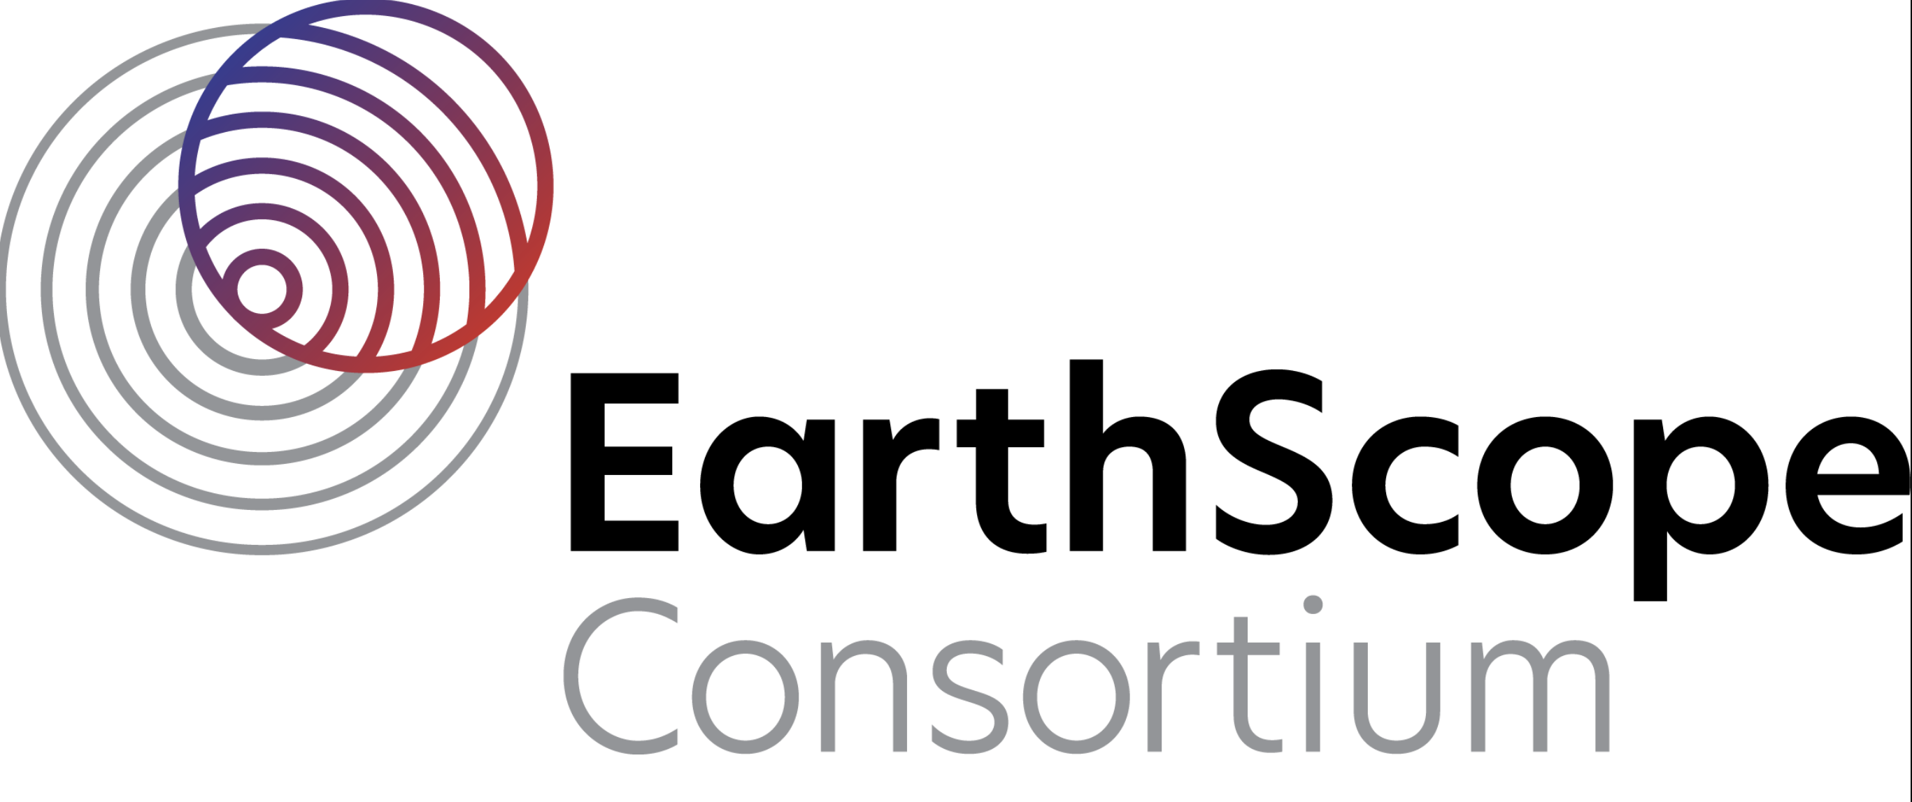

David MENCIN
EarthScope, USA
Vice-President of Data Services
Hirochika SUMINO
Research Center for Advanced Science and Technology
The University of Tokyo, JAPAN
Notes:
Bridging the Gap: Innovation and Integration
The community recognized that for NFOs to be more effective, they must move toward 4D information and a better integration of "non-traditional" data like geochemical fluxes, strainmeter signals and DAS derived results. There is a clear call from young researchers to break down silos; they want to integrate data from across the diverse NFO covering different tectonic framework, not just their local study areas.
The discussion also highlighted a need to gently rebalance a bit our strategy. We need a shift from purely stakeholder-oriented plan (needed in a first phase devoted to the service generation) back to core Science. Writing a “white paper” can certainly help define and share the goals of communities both within and outside the EU.

