Slide 1
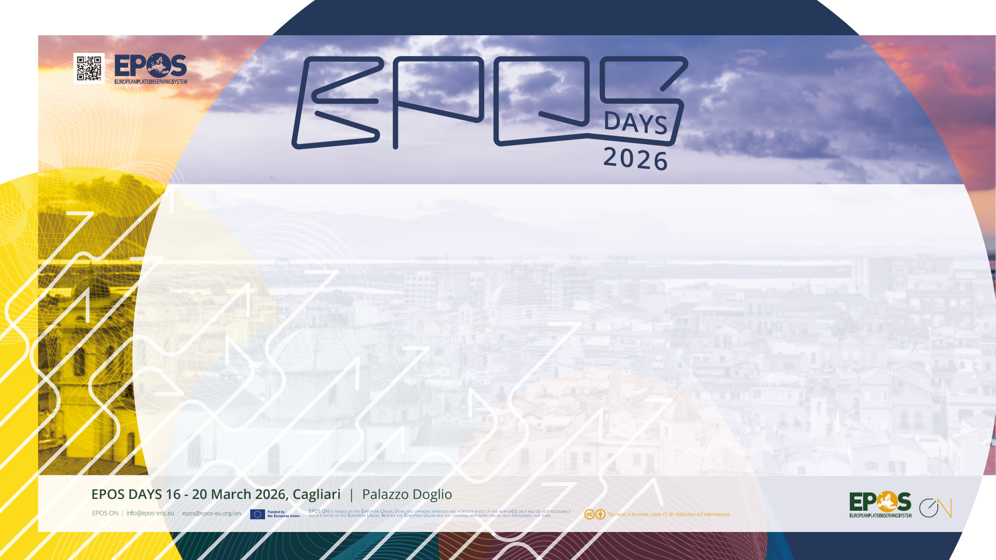
EPOS collaboration with GEM and GTM – potential services and licencing models for both research, public, and commercial use
Finn Løvholt (GTM) and Helen Crowley (GEM)

Slide 2
Global Tsunami Model (GTM)

Slide 3

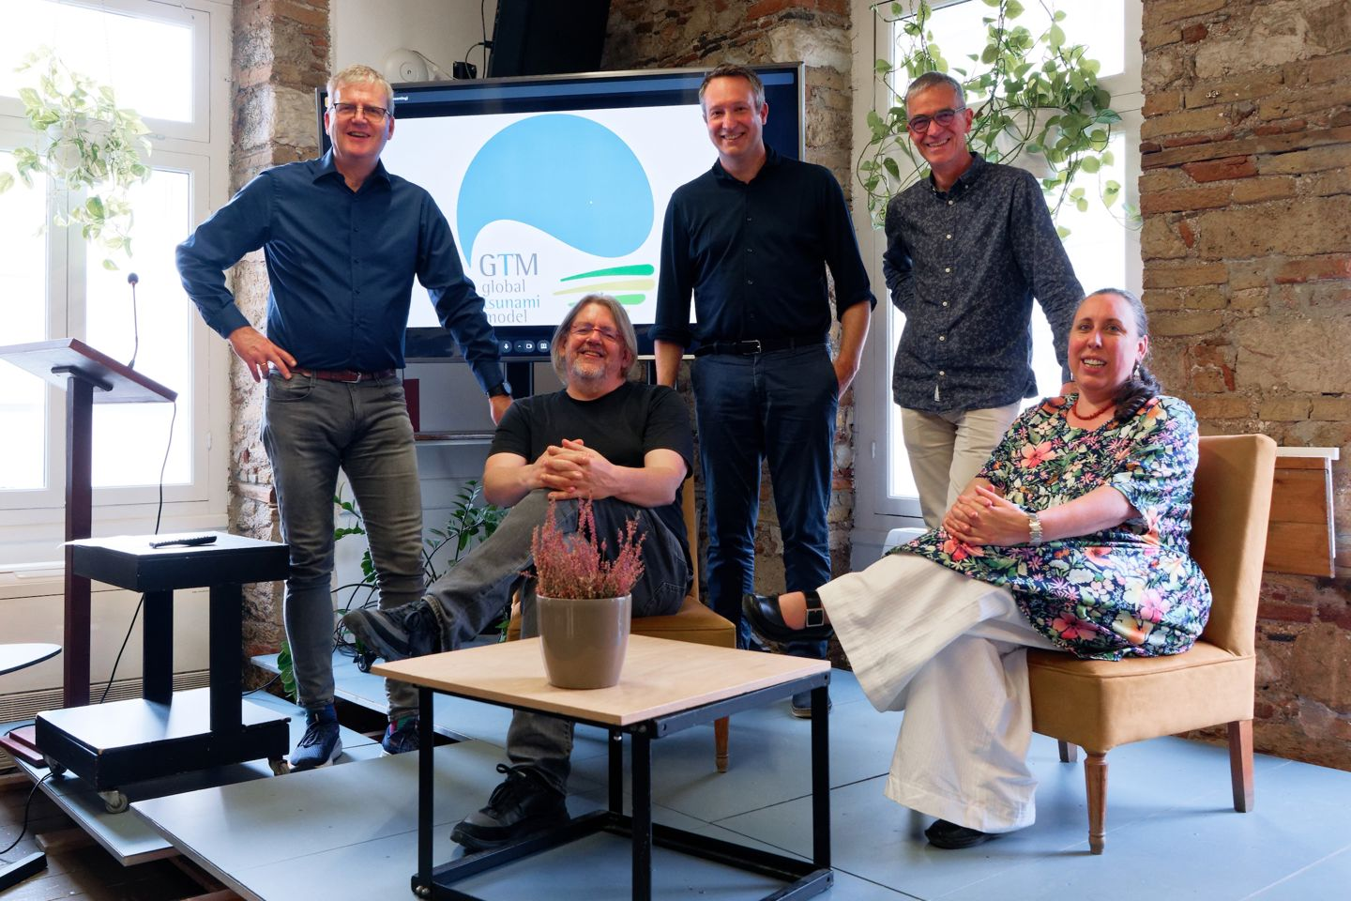
The Global Tsunami Model (GTM): A Growing Global Foundation
General Assembly
Organizational structure:
Board
Legal
Marketing
R & D
Quality
HR
Established August 2025
18 Founding members
Growing community with 40+ members
Diversifying beyond Europe
Operating as formal non-profit (e.V.)
Membership management
Units and working groups
Product development
Possibility to conduct projects
GTM Board, from left:
Alexander Rudloff (Treasurer), Stefano Lorito, Finn Løvholt (Rapporteur), Jörn Behrens (Chair), Clea Denamiel
F. LØVHOLT
CAGLIARI– MARCH 18, 2026

Slide 4
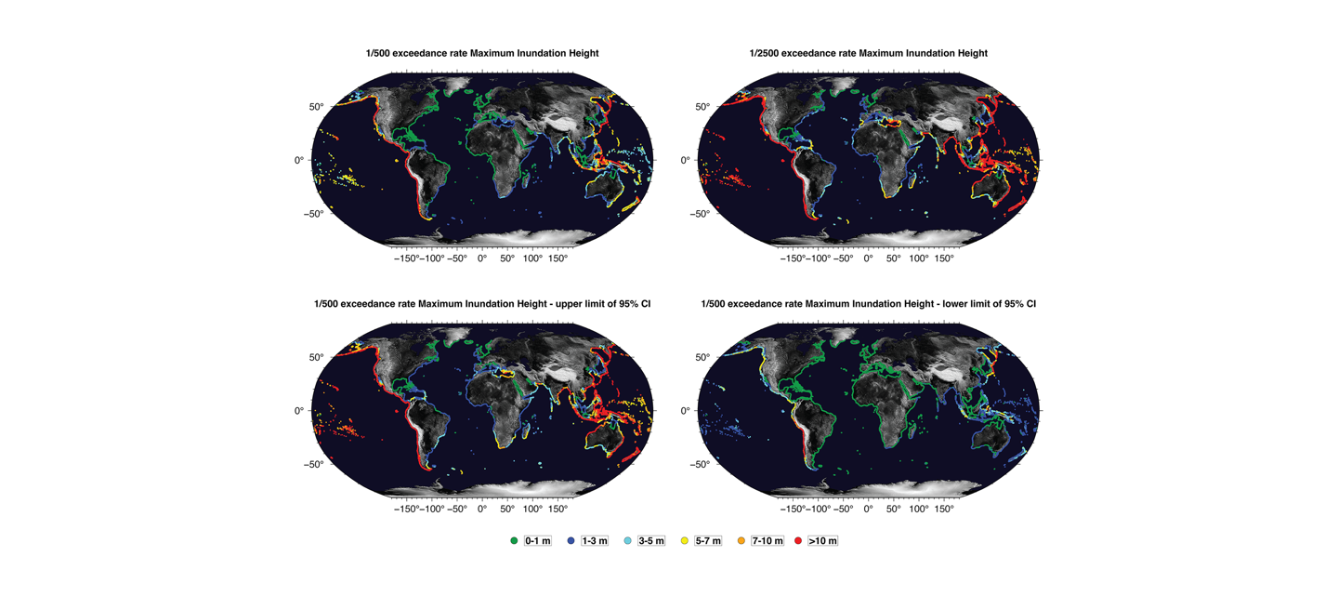




GTMs Core Products
Existing Global hazard model
(Davies et al., 2018)
High TRL products and services
Global and regional Probabilistic Tsunami Hazard Analysis (PTHA) Models
Tailored Local PTHA Service
Expert Brokerage and Facilitated Consultancy
Training and Model Evaluation
Data and Requirements
Seismic Hazard Model
HPC
Simulation
Results and Products
User Thresholds
Topo-bathymetry
Resources and Experts
Seismic Sources
Scenario and Probabilities
Refined Sources
Local Inundation Simulation
Local Hazard
Risk Products
F. LØVHOLT
CAGLIARI– MARCH 18, 2026

Slide 5





GTM PTHA Engine
Any Input Seismic Source Model
PTHA Engine and Workflow
PTHA Engine
Next-Generation global model model under development
Towards interoperability with GEM’s OpenQuake engine as input and outputs
Global to local scalability
Supporting scenario based probabilistic loss modelling
HPC Resources
Prob. Hazard Model
Damage and Loss Modelling
F. LØVHOLT
CAGLIARI– MARCH 18, 2026

Slide 6
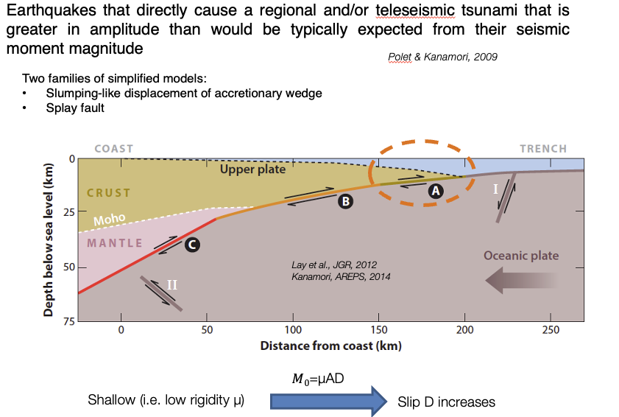
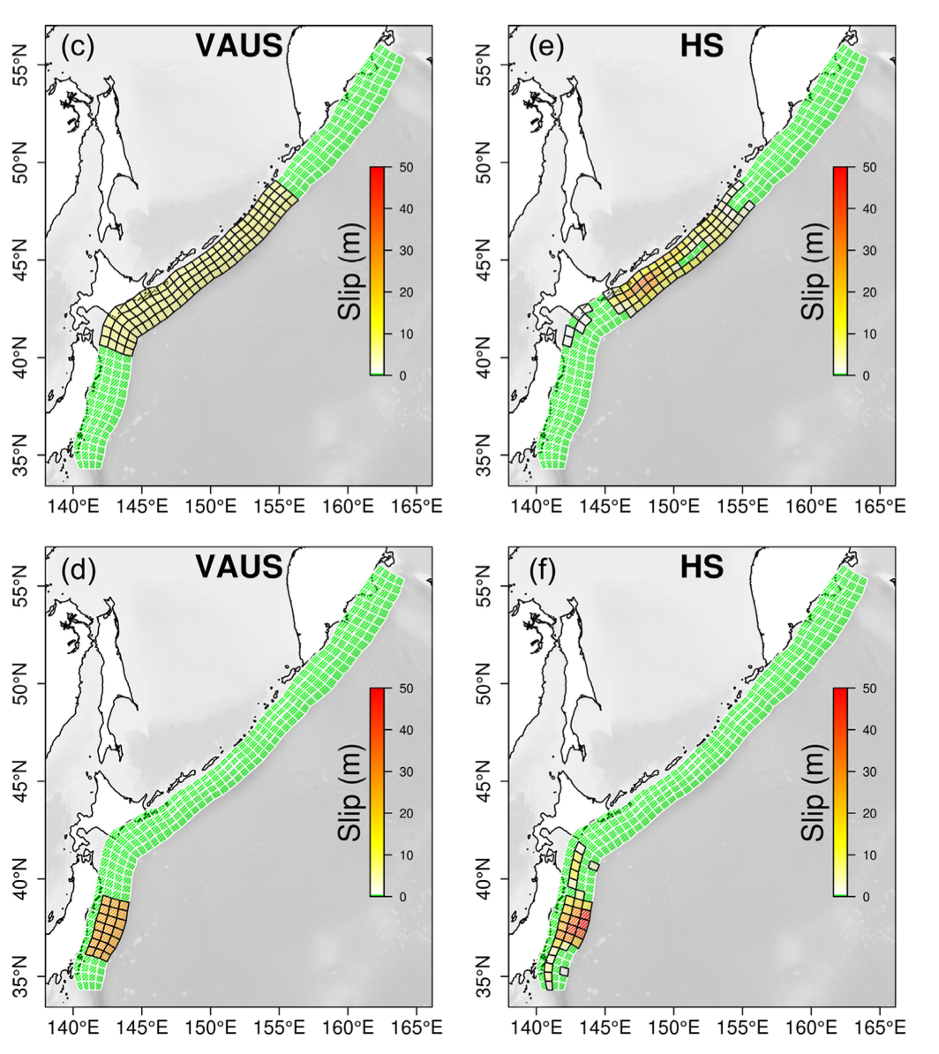
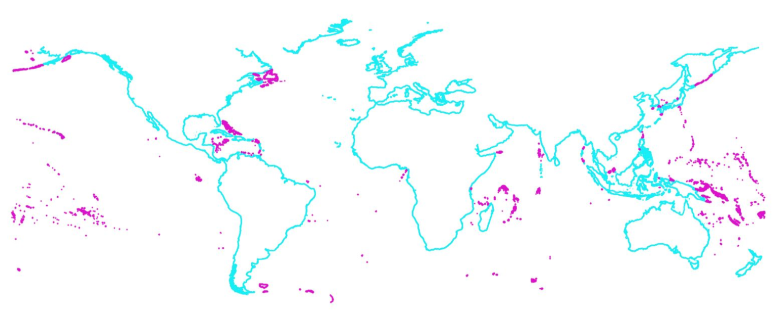
Global Hazard Model
Ongoing Developments
Depth-dependent subduction properties
Heterogeneous rupture
Strike slip contributions
Interactions with hydro-met induced flow (floods, tides, SLR, climate induced hazards)
Denser representation of SIDS impact points
Multi expert protocols
Depth dependent subduction properties (Lay et al., JGR, 2012)
Heterogenouse rupture
(Davies, GJI, 2019)
Improved coverage of SIDS
F. LØVHOLT
CAGLIARI– MARCH 18, 2026

Slide 7
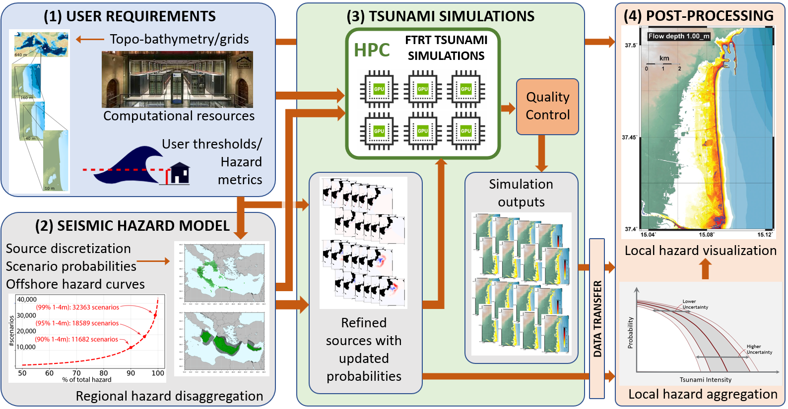
Local PTHA Workflow
High-Resolution Local Tsunami Modelling
HPC Workflow for local PTHA
Converts broad regional into high resolution local hazard assessment
HPC resources to execute 10,000 -100,000+ scenarios
Zoom into densely populated and high exposure areas
F. LØVHOLT
CAGLIARI– MARCH 18, 2026

Slide 8
Global Tsunami Model – potential added value for EPOS-ERIC
Strongly linked with TCS community on the science products
GTM focused on hazard and risk products
PTHA and PTRA typically combines elements from different services – and aim towards high TRL
May attract more end users from different segments to EPOS, e.g.
Public – civil protection, TSP’s
Private – insurance sector, engineers, planners
Needs long term sustainable funding mechanism
F. LØVHOLT
CAGLIARI– MARCH 18, 2026

Slide 9
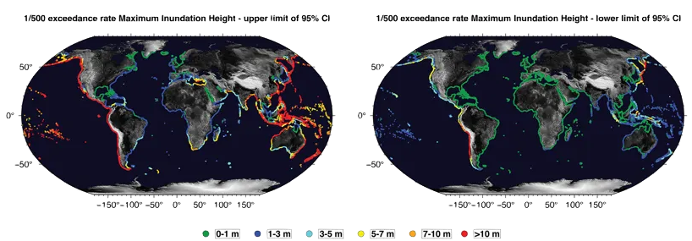
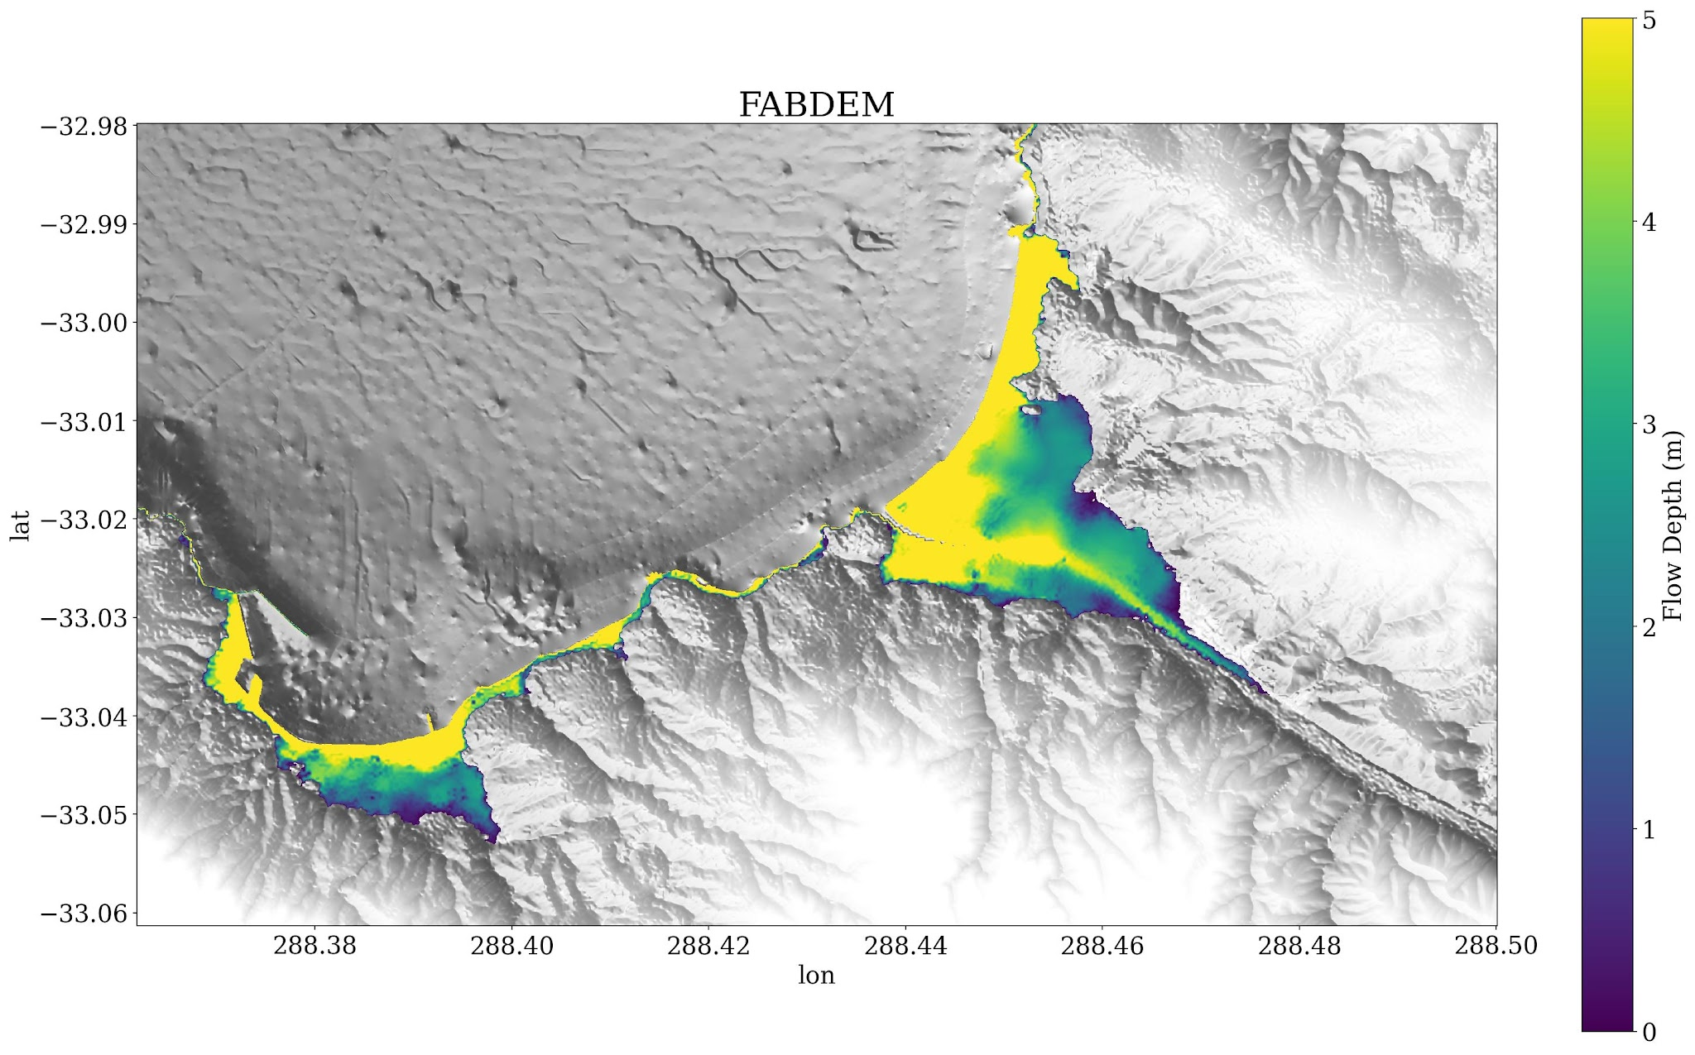
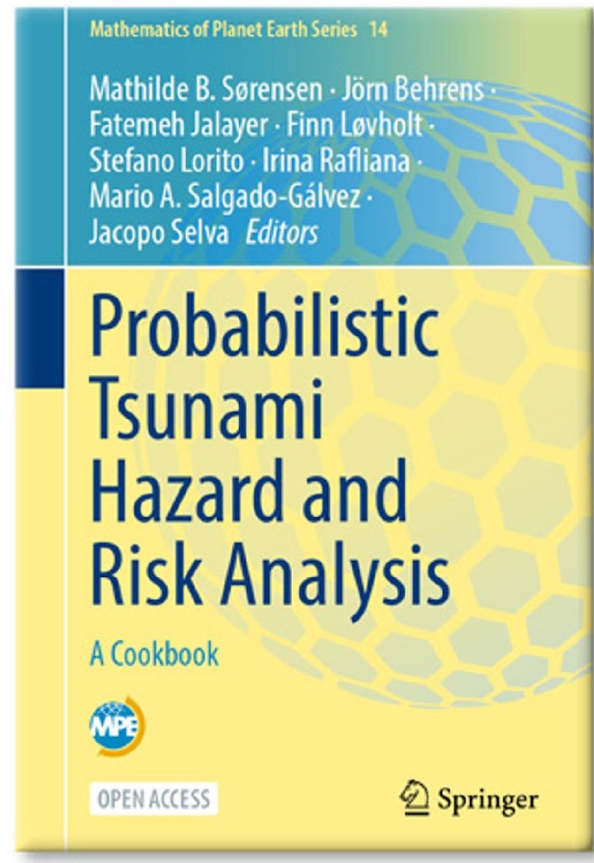
GTM – Bridging Gap between Science and Society
Executing and communicating best practices
Guidelines and standards
OA tsunami cookbook recently published
https://doi.org/10.1007/978-3-031-98115-9
Work with stakeholders
License policy still under development
Different licensing related to different use envisioned
Free for public good and research
License fee for commercial use
GTM is still formable and invites contributions
F. LØVHOLT
CAGLIARI– MARCH 18, 2026

Slide 10
Global Earthquake Model (GEM)

Slide 11
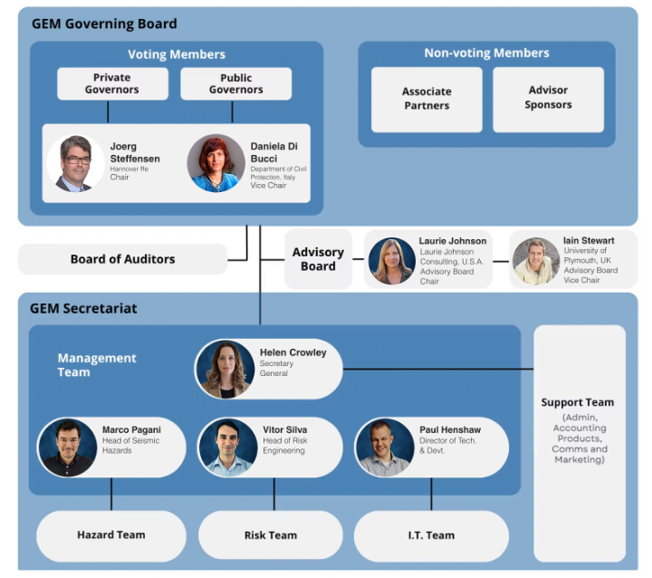
The Global Earthquake Model (GEM): An Established Global Foundation
GEM was founded in 2009, a non-profit foundation and NGO, governed as a public-private partnership (currently 15 Private and 10 Public Governors)
Our mission is to develop, together with the community, scientific resources for transparent earthquake hazard & risk assessment, anywhere in the world

Slide 12
GEM’s connections to EPOS
Support for EPOS Seismology / EFEHR (GEM’s OpenQuake Engine used for European seismic hazard and risk assessment, model support)
EPOS ON project WP3: Scientific products exploitable in evidence-based decision making
Subtask 3.1.4 Data products and services for rapid post-event assessment
Subtask 3.1.5 Data products and services for seismic risk
Service provider for the potential candidate TCS Built Environment Data

Slide 13
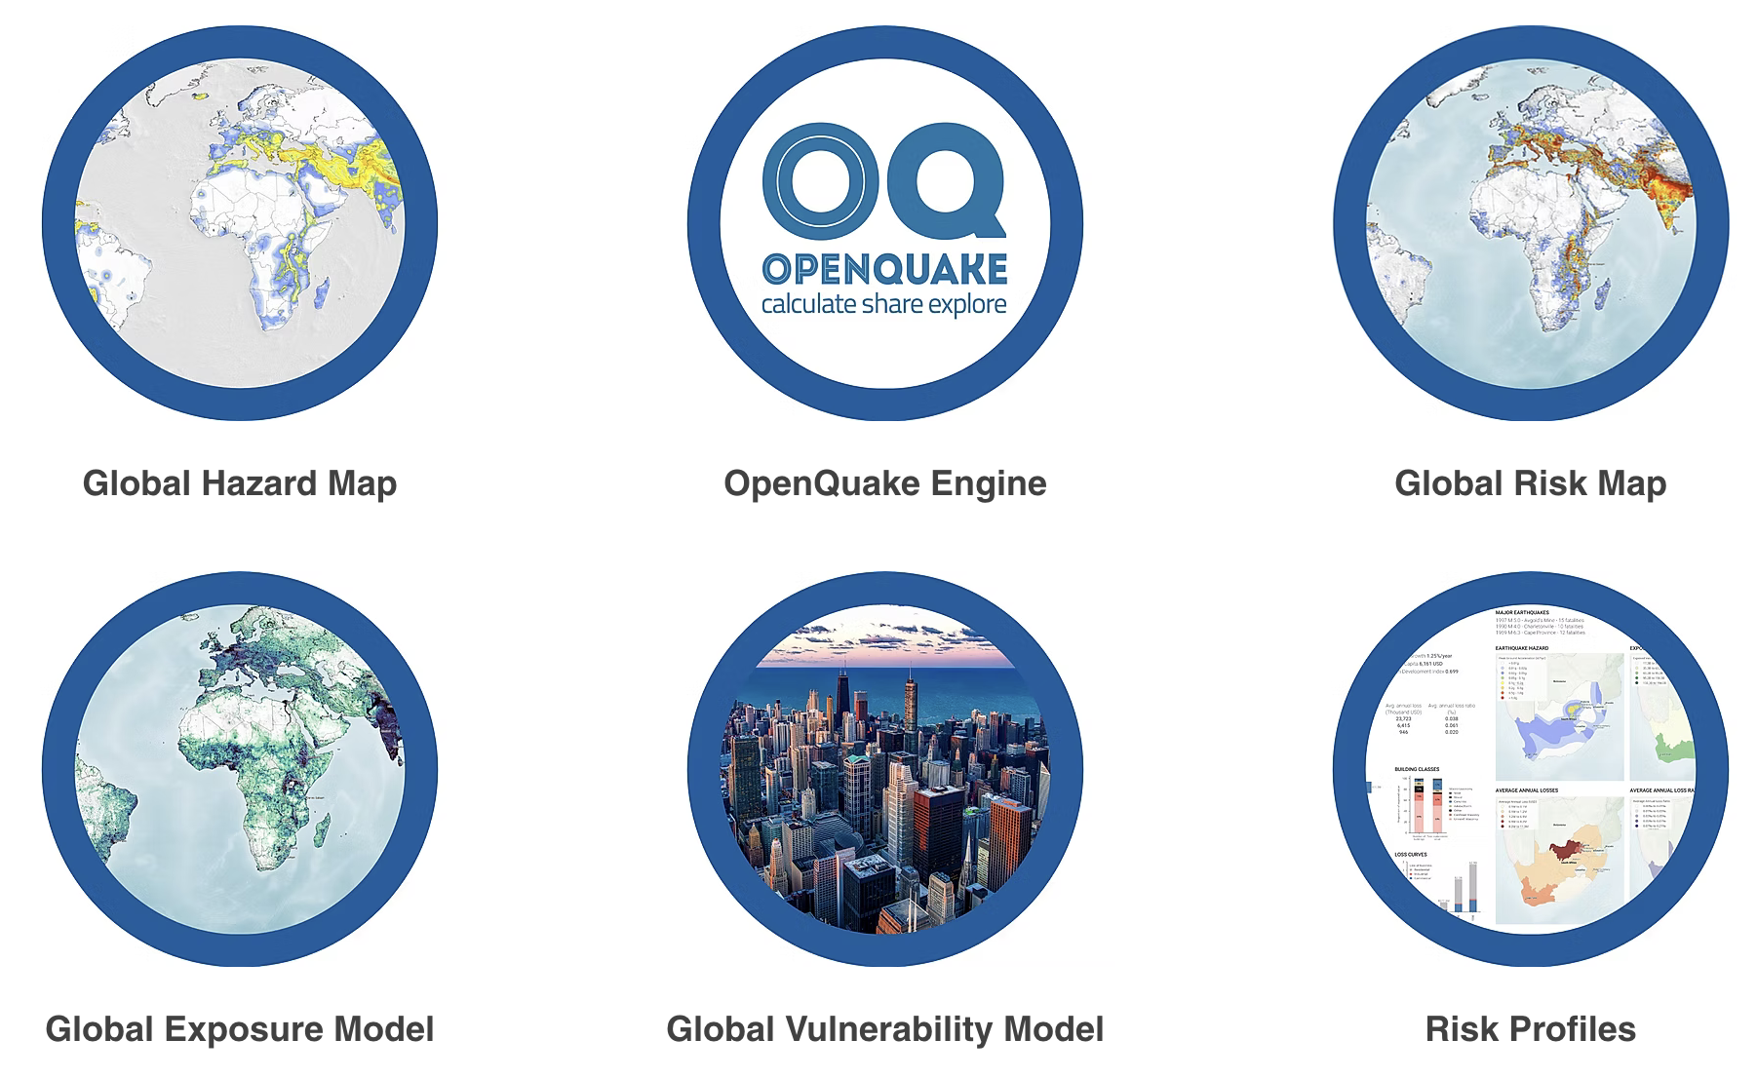
GEM’s products and services
GEM Website: https://www.globalquakemodel.org/products
GEM GitHub: https://github.com/gem
GEM Zenodo:
https://zenodo.org/communities/globalquakemodel

Slide 14
GEM’s licensing policy
Based on decisions of GEM’s Governing Board, GEM’s products and services are released through different mechanisms depending on the product, and these can be simply categorized in three ways:
open software, data and models (under different open license conditions, typically CC BY-SA or CC BY-NC-SA for data/models and AGPL for software);
freely available software, data and models available for non-commercial, public good use, following a license request;
commercial-use products and services (i.e. subject to a license fee)
N.B. GEM’s products are always freely available (i.e. without cost) for non-commercial, public good use, regardless of the mechanism under which they are primarily released.

Slide 15
GEM’s licensing policy
Why CC BY-SA or CC BY-NC-SA?
BY - for Attribution
NC - when we want to restrict Commercial use
SA - Share-Alike means that the product and any modified or derived products may only be (re)distributed under the terms of the same license. In essence this means that GEM models that are released openly must remain open and cannot be made into closed products without permission.

Slide 16
GEM’s licensing policy
In 2023 we released a number of open products, including GEM’s global seismic hazard map as a downloadble csv and raster with CC BY-NC-SA license and we released GEM’s global exposure model (admin level 1) with CC BY-NC-SA license on GitHub.
Around 10% of GEM’s annual budget now results from selling commercial licenses to its global seismic hazard and global exposure model, which we reinvest in maintaining our global resources and supporting and building capacity in the Global South.

Slide 17
Thank you!

