Slide 1

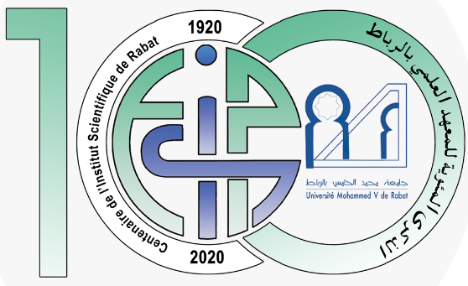


Strengthening Morocco's integration into EIDA
Institutional Collaboration For Advanced seismic and Geodetic Monitoring Through The national Observatory Of Natural Hazards March 18, 2026
3/18/26 12:44 AM

Slide 2
Introduction
ISRABAT : As one of the first institutions in Morocco for seismic research, it plays a crucial role in collecting data and seismic research across different regions.
Core Research Areas:
Geophysics & Geology: Research into seismic activities and the geological composition of the region.
Botanical and Ecological Sciences: Investigation of Morocco's diverse flora and ecological systems.
Zoology and Environmental Studies: Studies on Morocco's animal biodiversity and the impact of human activity on the environment.
Geomorphology and Geomatics : Study of landforms, their processes, and application of geographic information systems and remote sensing for the mapping and analysis of natural hazards in Morocco.

Slide 3
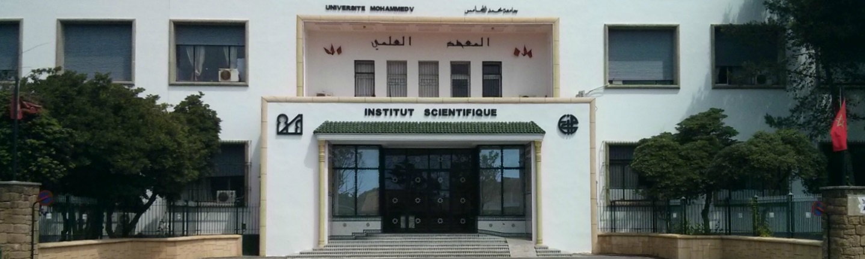
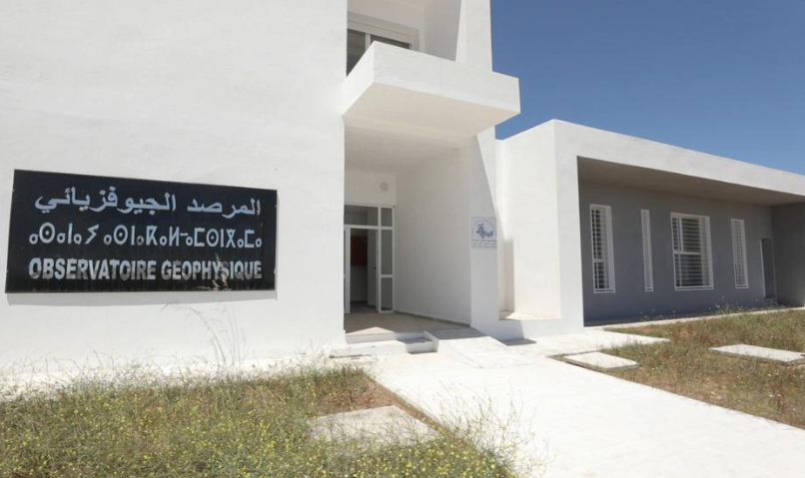
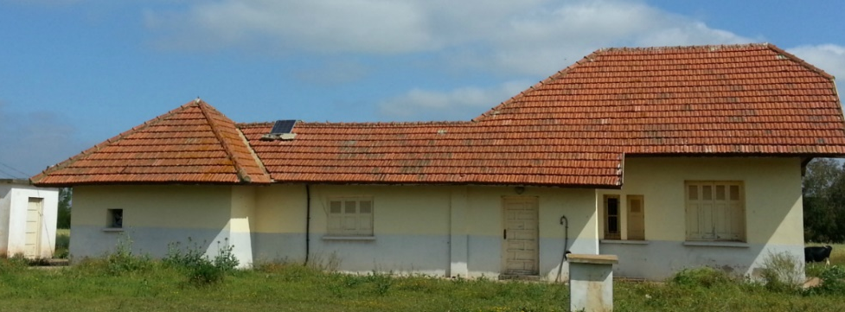
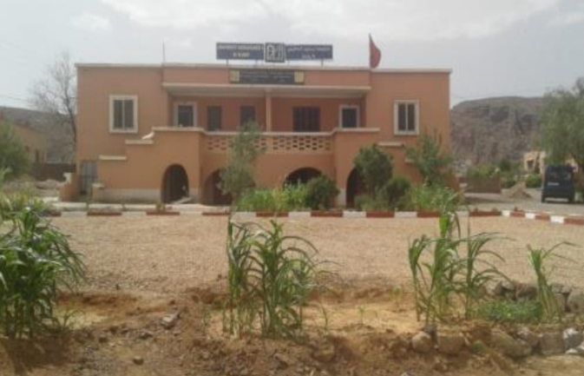
2. Current Status of ISRABAT’s Seismic Network:
Al Hoceima
IS Rabat
Ifrane
Averroès
Tiouine
Aouinet Torkoz
Scientific Institute
Observatories

Slide 4
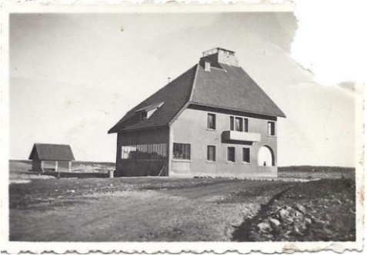
2. Current Status of ISRABAT’s Seismic Network:
Ifrane
Constructed In 1964
Middle Atlas
Ifrane
Averroès
Berrchid – Casablanca
Constructed In 1930
First seismic station in 1937
2006 seismic broad band station
2007 seismic broad band station similar to Averroes seismometer
Scientific Institute
Observatories

Slide 5
2. Current Status of ISRABAT’s Seismic Network:
40 Km to Ouarzazat
Constructed In 1971
High and Anti-Atlas
Assa - Zag
Constructed In 1991
2008 seismic broad band station
the Western Anti-Atlas and Moroccan Sahara
Tiouine
2007 seismic Very broad band station
Aouinet Torkoz
Scientific Institute
Observatories

Slide 6
2. Current Status of ISRABAT’s Seismic Network:
Al Hoceima
IS Rabat
Ben Hadifa – Al Hoceima
Constructed In 2020
Rabat
Constructed In 1930
1966 first seismic station
2005 seismic broad band station
2024 seismic broad band station
Scientific Institute
Observatories

Slide 7


3. New Seismic network of El-Hociema region :
OBSE BHDF
RBT
IFR
AVE
TIO
JBHA
LAZB
Assa
BHDF
MDAR
ISGN
BART
TOSL
Permanent Network
BHDF Network
Scientific Institute
Current Seismic Stations

Slide 8
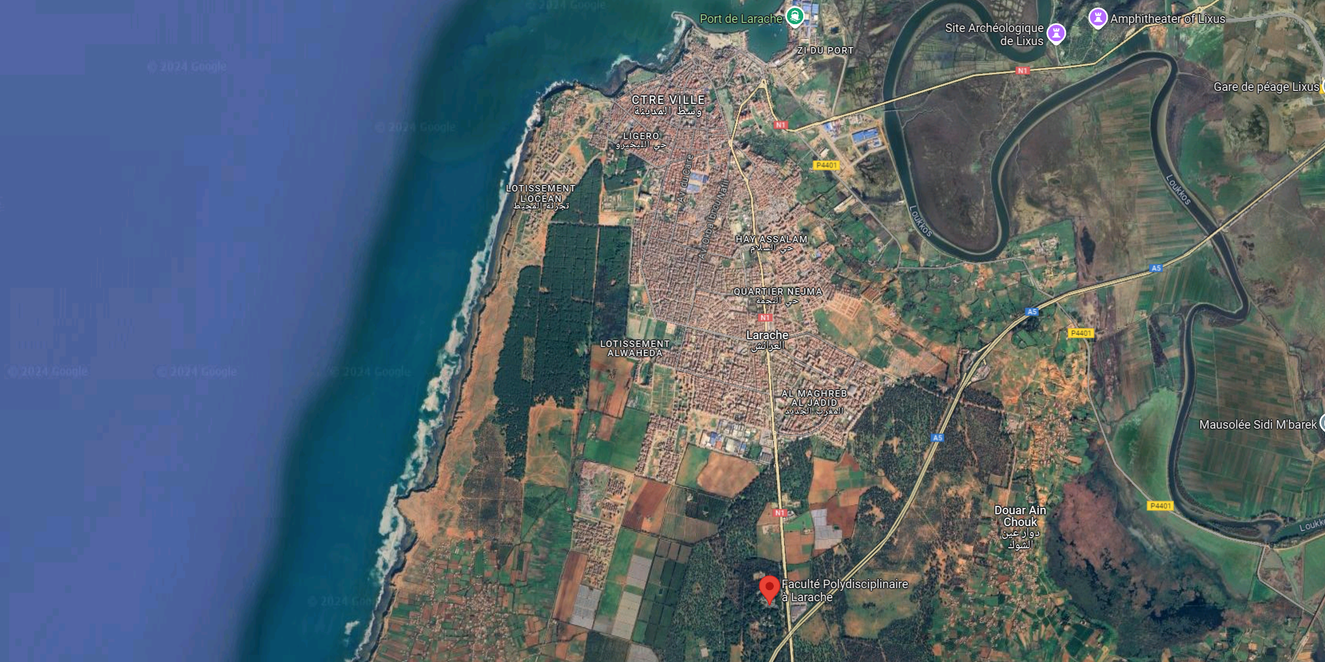
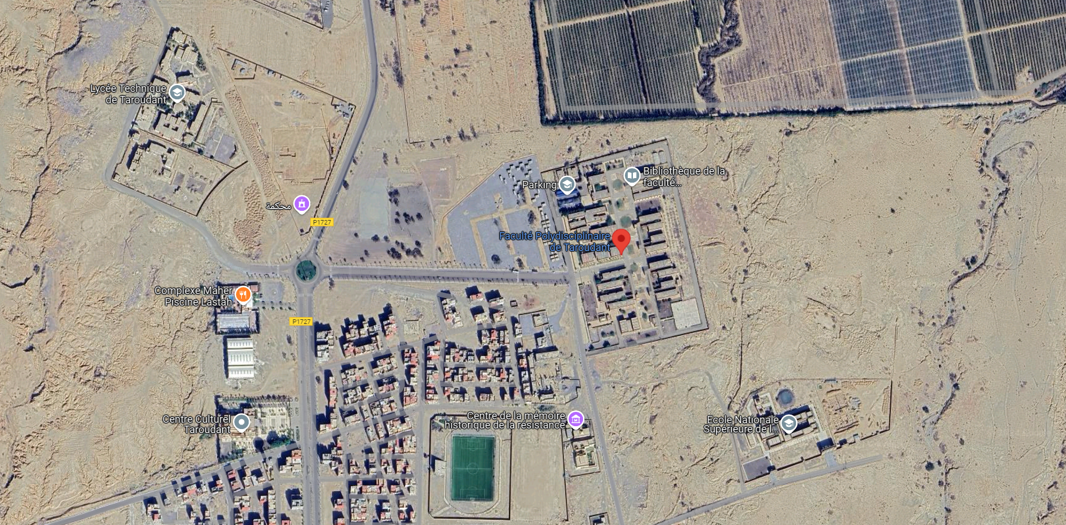
4. Options for the new site installation :
Option 1
LARACHE
RBT
Option 2
Polydisciplinary Faculty, Larache
AL Haouz Region
Polydisciplinary Faculty,
Taroudante
Aouinet Torkoz
Permanent Network
Scientific Institute
Current Seismic Stations
Future Seismic Stations

Slide 9
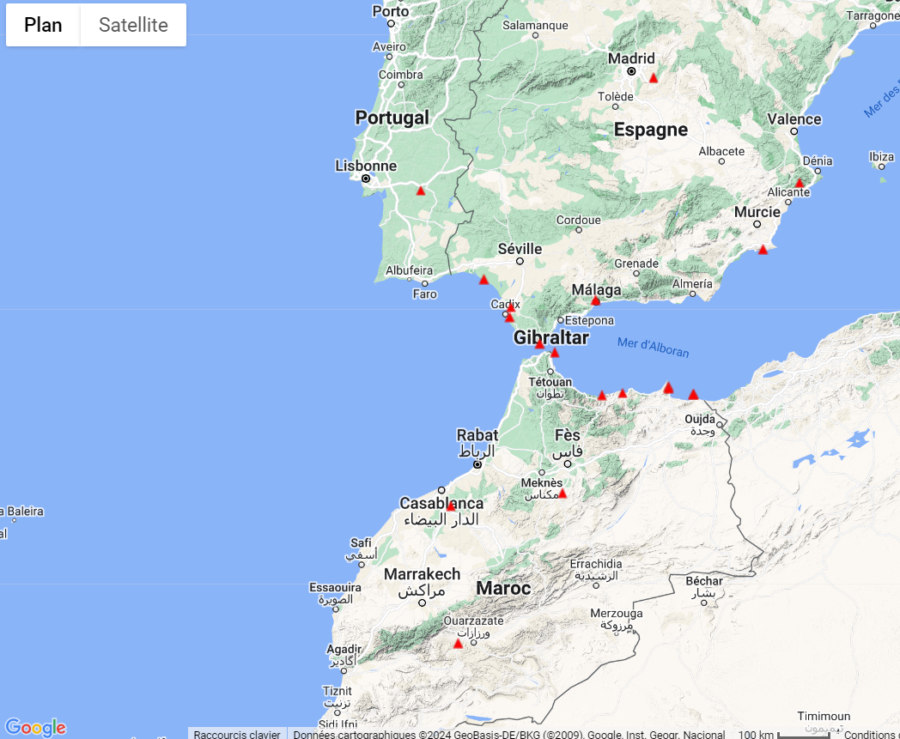


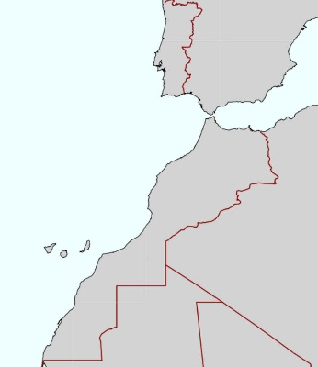
5. Western Mediterranean Seismic Network
The Western Mediterranean Seismic Network (WM), operating since 1996 with 20 stations
Currently, the only Moroccan WM stations openly available in EIDA via GFZ are TIO and AVE.
Spain
Morocco
WM is a permanent geophysical network managed by a consortium including: San Fernando Royal Naval Observatory (ROA); Universidad Complutense de Madrid (UCM); Helmholtz-Zentrum Potsdam Deutsches GeoForschungsZentrum (GFZ); Universidade de Évora (UEVORA, Portugal); Institute Scientifique of Rabat (ISRABAT, Morocco) (1996): The Western Mediterranean BB seismic Network. GFZ Data Services. Dataset/Seismic Network. doi:10.14470/JZ581150.

Slide 10
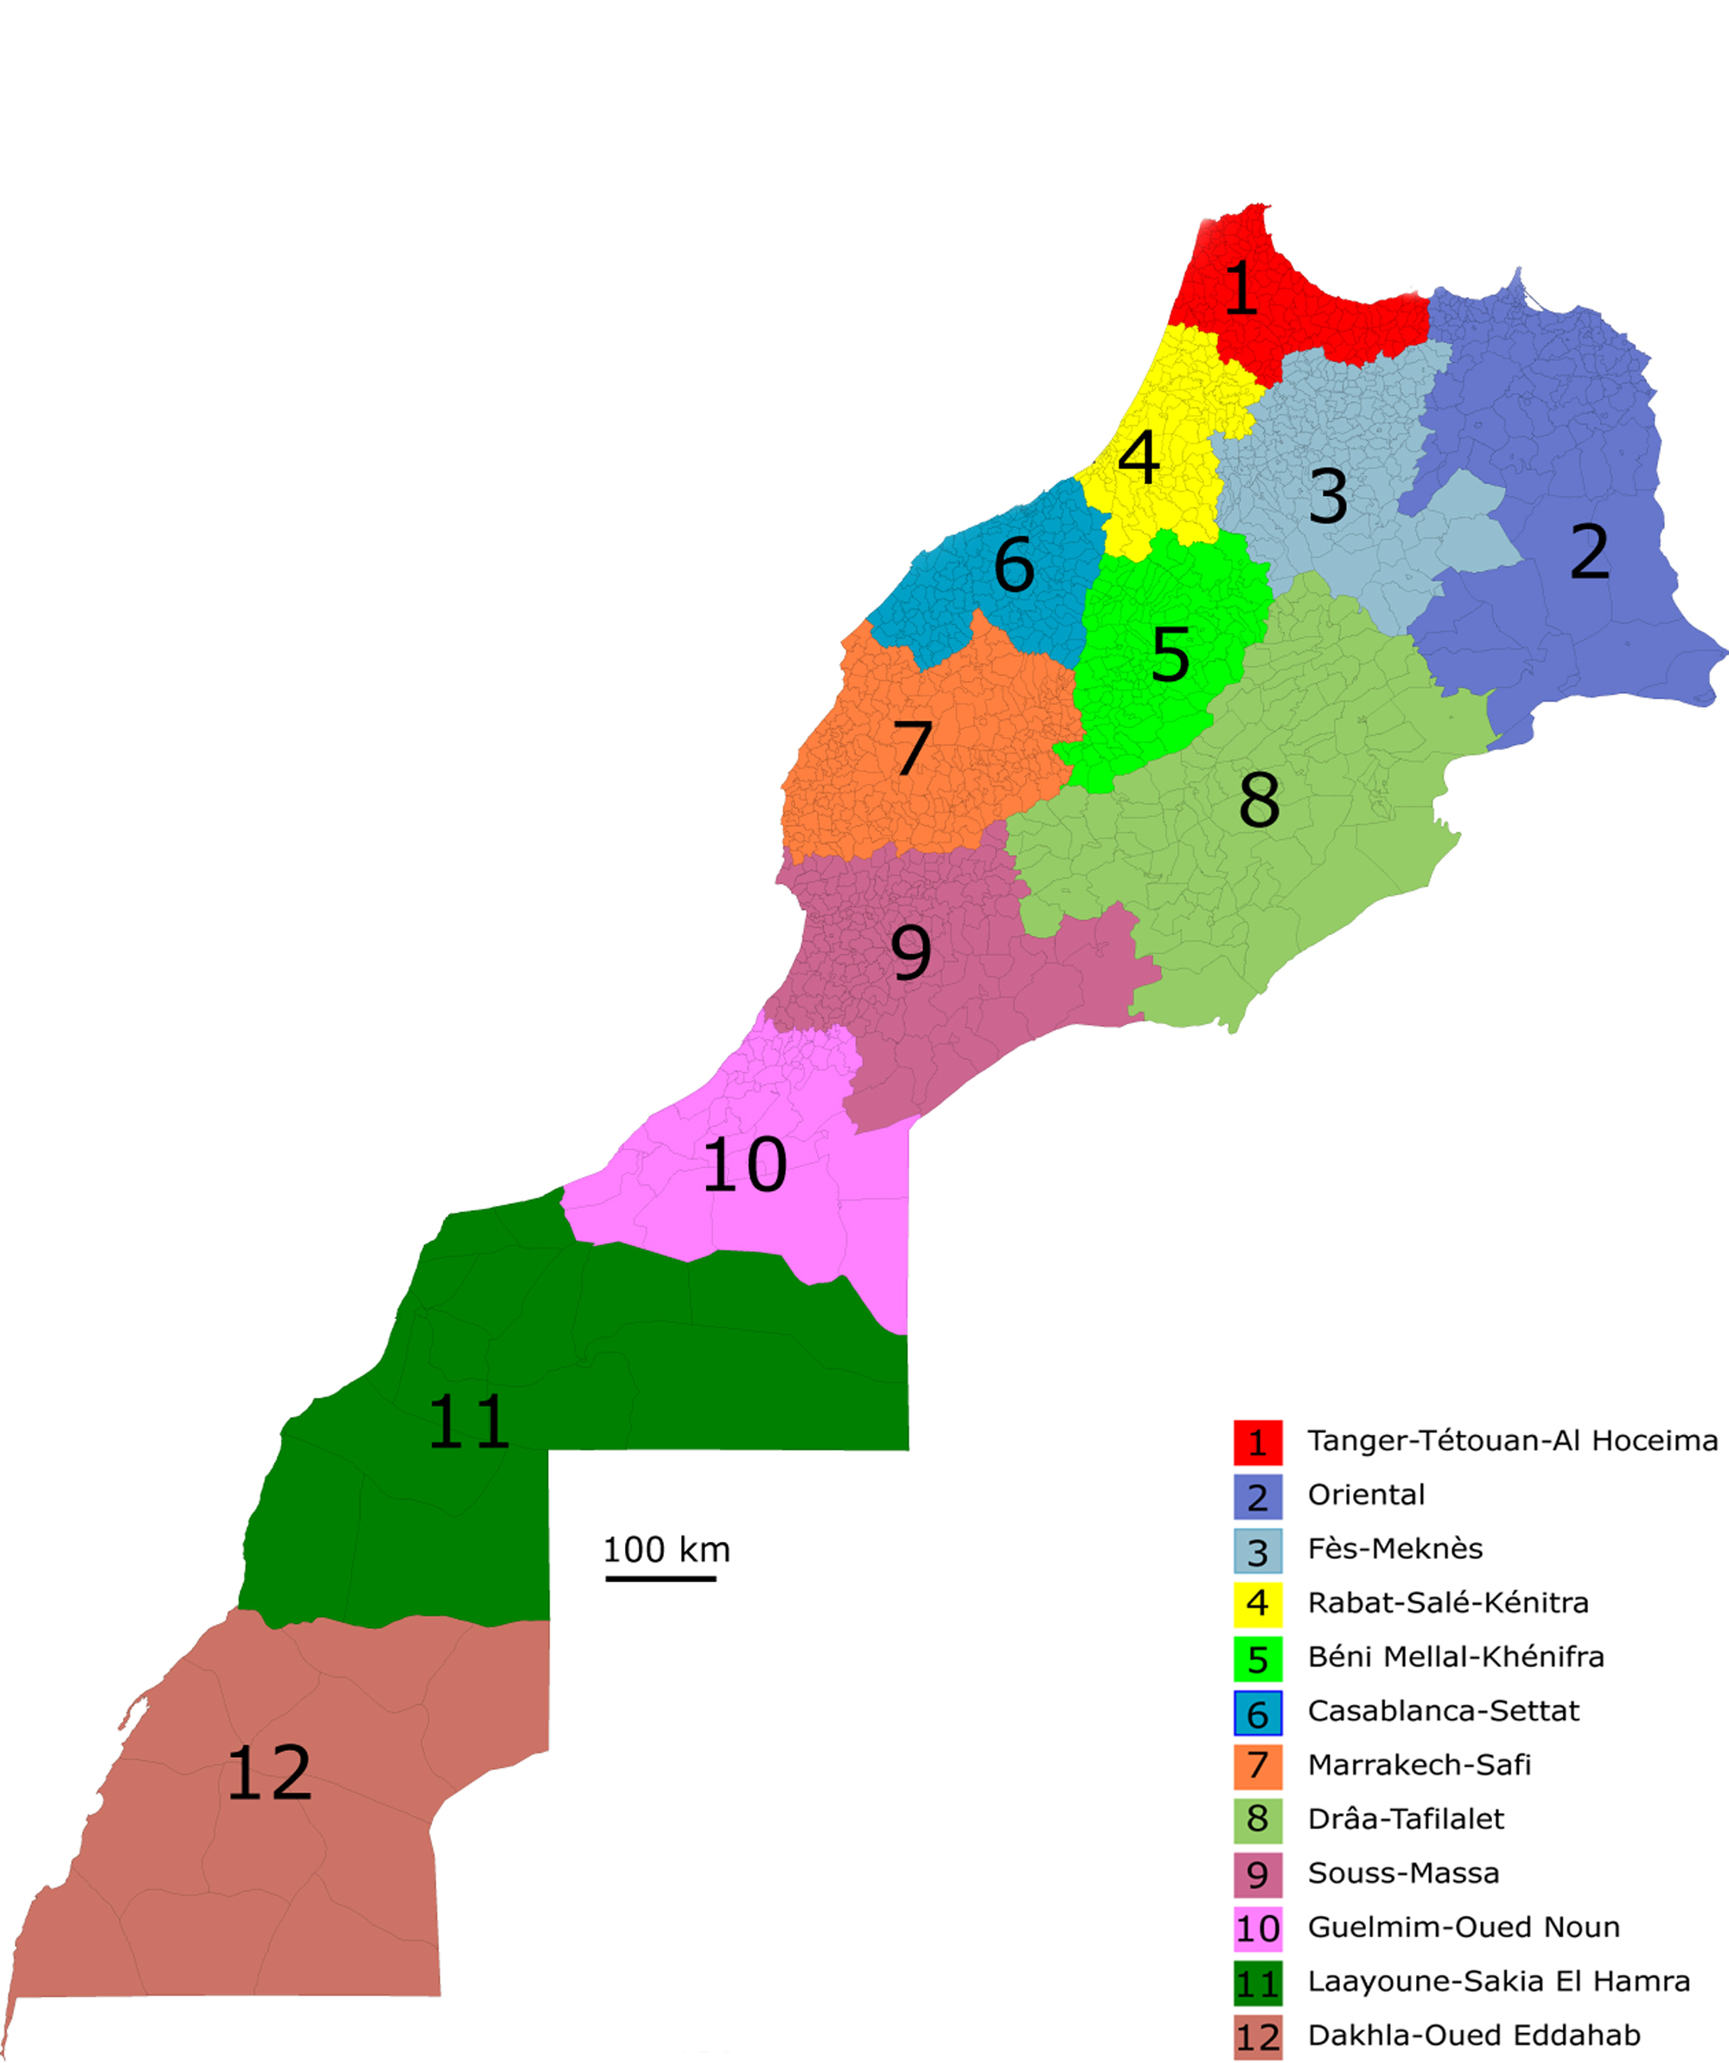
Al Hoceima
Currently, the University is present in six regions through its existing observatories (1*, 3, 4*, 6, 8, and 10), with plans to expand into the remaining six (2, 5, 7, 9, 11, and 12).
Rabat
Berrechid
Chichaoua
Regional Observatories:Two additional observatories are planned for Larache and Tetouan (1*), with another planned for the province of Khemissat (4*).
Ifrane
Figuig
Assa Zag
Beni Mellal
Ouarzazate
Boujdour
Tiznit
Ouad Eddahab

Slide 11
6. Geodetic network :
Taza
berrchid
Ifrane
Beni-Melal
Errachidia
Tiouine
Agadir
Existed stations
No info
Reparation needed

Slide 12
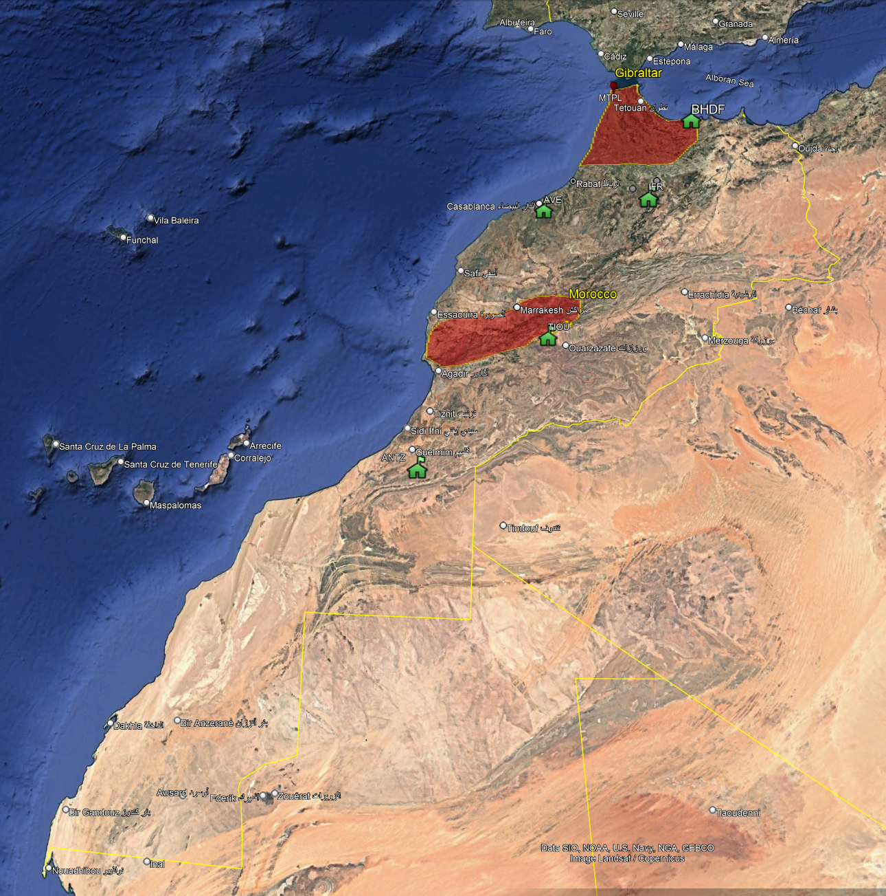
7. Challenges Facing the Seismic Network
Equipment Obsolescence: Some stations still use outdated equipment that may not provide accurate readings in today's environment.
Coverage Gaps: Regions such as Al Haouz do not have sufficient seismic coverage. Earthquake-prone areas such as the western Rif part and the western Anti-Atlas also need to be taken into account.
Data Integration: The challenge of integrating data from different systems across different sites and improving the real-time response.

Slide 13
8. Future Plans for ISRABAT's Seismic Network
Expansion Plan for 2025–2029:
-New seismic stations in under-monitored regions such as Al Haouz and Larache.
-Introduction of high-resolution GPS stations to enhance geodetic data accuracy.
-Plans to replace older sensors with next-generation broadband and accelerometer sensors.
Proposition 1: Seismic Hazard Assessment:
Launch a national seismic hazard assessment project in collaboration with europeen parteners. This can include seismic risk mapping for cities like El-Hociema, Fes, Rabat, Agadir and Marrakech.
Proposition 2: Earthquake Early Warning System (EEWS):
Develop a seismic early warning system, where real-time geodetic data can be integrated into a warning system that notifies the public before tremors reach cities.

Slide 14
10.Morocco's Natural Risk Management Evolution Summary of Reforms (2008–2030)
2008: Creation of the CVC — improved monitoring, early warning, coordination
2009: CAS‑FLCN established — stable financing for prevention & response
2014: FLCN shift – From Post-damage repairing funds to risk reduction financial support
2016: PGIR established — supported by the word bank → public institutions calls for project framework
2020 – 2030: Establishment of the National Risk Management Strategy & its 5 strategic pillars
2020: The creation of the DGRN, so as to coordinate stakeholders, promoting standardization and share data.

Slide 15
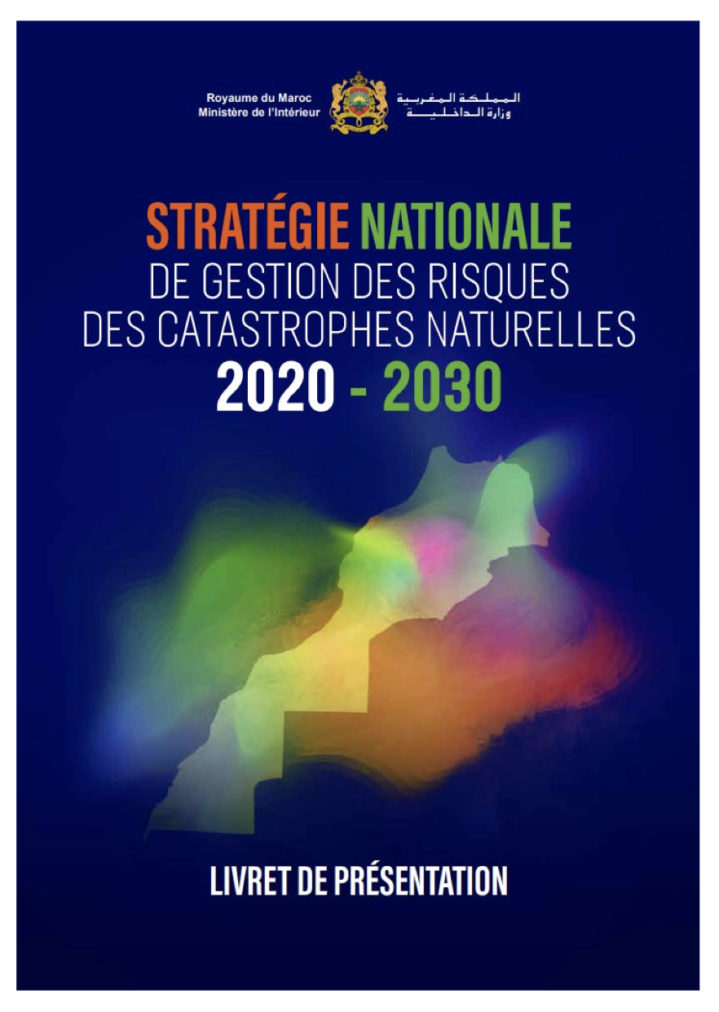
10.Morocco's Natural Risk Management Evolution Summary of Reforms (2008–2030)
2020 – 2030: Establishment of the National Risk Management Strategy & its 5 strategic pillars
Strengthening Governance of natural risk management.
Improving Knowledge and evaluation of natural risks.
Promotion of Scientific Research, international cooperation, and capacity building.
Prevention of Natural Risks and development of resilience.
Disaster Preparedness for rapid recovery and better reconstruction.
Strategic axis

Slide 16
10.Morocco's Natural Risk Management Evolution Summary of Reforms (2008–2030)
Axis V: Promoting scientific research, international cooperation, and capacity building for natural risk management
PROGRAM 16
PROGRAM 17
PROGRAM 18
Promotion of scientific research
Promotion of international cooperation and creation of an expert network
Capacity building in the field of natural risk management

Slide 17
10.Morocco's Natural Risk Management Evolution Summary of Reforms (2008–2030)
DATA EXCHANGE
CAPACITY BUILDING
Specialized Master's level training in "Natural Disaster Risk Management" for 150 officials and stakeholders from Provinces and prefectures.
Morocco's contribution to feeding the global platform, established by UNDRR, for monitoring the progress indicators of the Sendai Framework objectives.
SCIENTIFIC RESEARCH
Launch of doctoral research programs focused on risk management (INAU).

Slide 18
10.Morocco's Natural Risk Management Evolution Summary of Reforms (2008–2030)
Axis II: IMPROVING KNOWLEDGE AND ASSESSMENT OF NATURAL RISKS
Improvement of the national institutional framework of reference for risk assessment
Studies and risk scenarios for single or multiple hazards in areas with priorities
PROGRAM 4
PROGRAM 5

Slide 19
10.Morocco's Natural Risk Management Evolution Summary of Reforms (2008–2030)
Risk Assessment
Definition of Standards
• Define national standards for vulnerability and risk
• Coordinate, guide, and advise the risk assessment actions of different institutes
Data Processing and Sharing
• Maintain a central information directory concerning hazards, vulnerability, and risks, including those potentially induced by climate change
• Host the national geographic information system for vulnerability and risks

Slide 20
11. Perspectives and Conclusion
Strengthening Morocco’s integration into the European Integrated Data Archive (EIDA) to ensure open access and interoperability of seismic data is a must
Enhancing national monitoring capacities and data sharing quality through the National Observatory of Natural Hazards (Ministry of interior) in collaboration with Mohammed V University in Rabat
Integration of additional Moroccan stations into EIDA (EPOS) is planned once station upgrades are completed (Outdated hardware)
Supporting the development of the network through national funding mechanisms such as the Natural Disaster Relief Fund (FLCN)
Expanding cooperation through new funding opportunities form to strengthen scientific collaboration, infrastructure and data sharing.

Slide 21
Thank you

