Slide 1
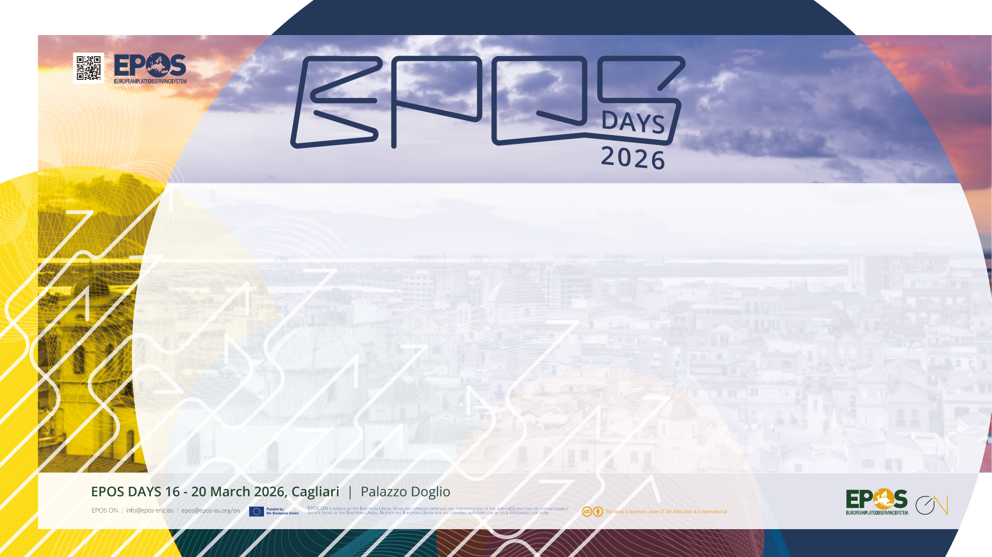
EPOS: building a global network for the solid Earth research

Slide 2

Why do we need international collaboration?
Sharing expertise and lessons learned
Avoiding duplication of effort
Maximising use of resources
Identifying common challenges
Notes:
Scientific/ societal challenges do not respect geographical / political boundaries. Collaboration is vital to effectively address large-scale / global issues.

Slide 3

Why do we need international collaboration?
Addressing large-scale societal and scientific challenges e.g. natural hazards, climate change, food security, disaster mitigation
Supporting regional and global policy initiatives e.g. UN Sustainable Development Goals (SDGs); Sendai Framework for Disaster Risk Reduction
Notes:
Scientific/ societal challenges do not respect geographical / political boundaries. Collaboration is vital to effectively address large-scale / global issues.

Slide 4

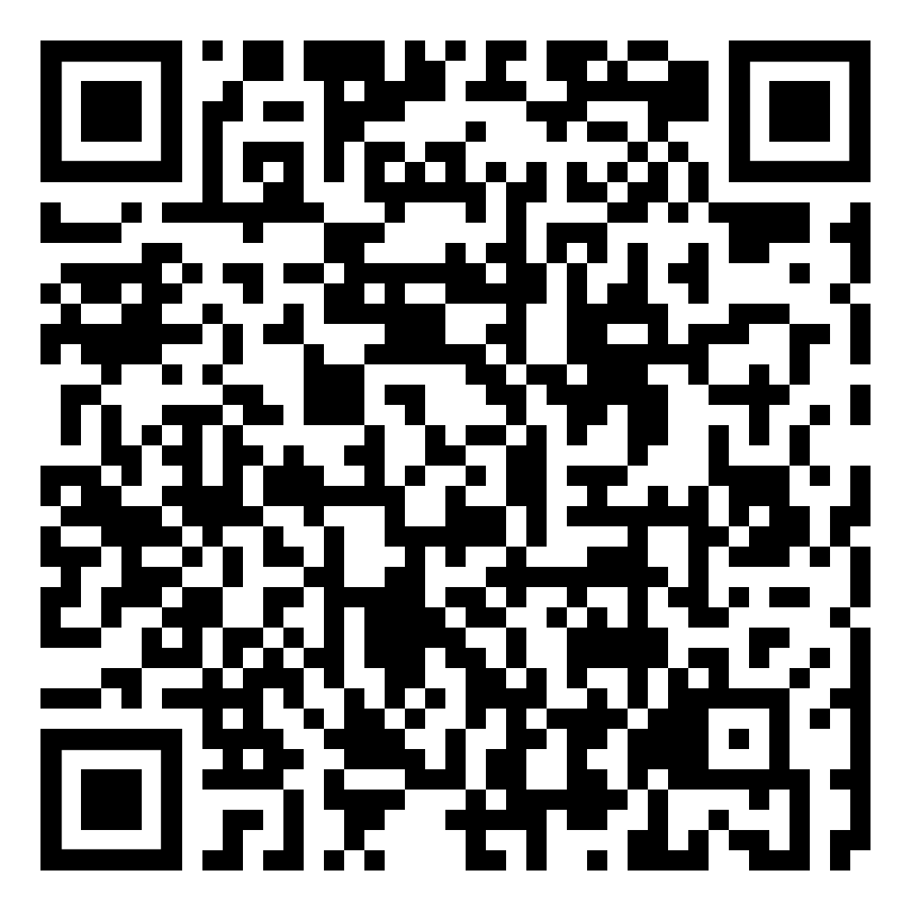
“Ministers signalled significantly strengthened collaboration on research infrastructures that support cutting-edge science and innovation, benefitting researchers worldwide.”
Notes:
e.g. Italian G7 summit in 2024 highlighted the importance of collaboration to support new and innovative research on a global scale, especially with respect to research infrastructures. The importance of research infrastructures to facilitate collaborative research and the role of RIs for capacity building including for early career researchers was also mentioned in the resulting ministerial declaration. (see QR code)

Slide 5
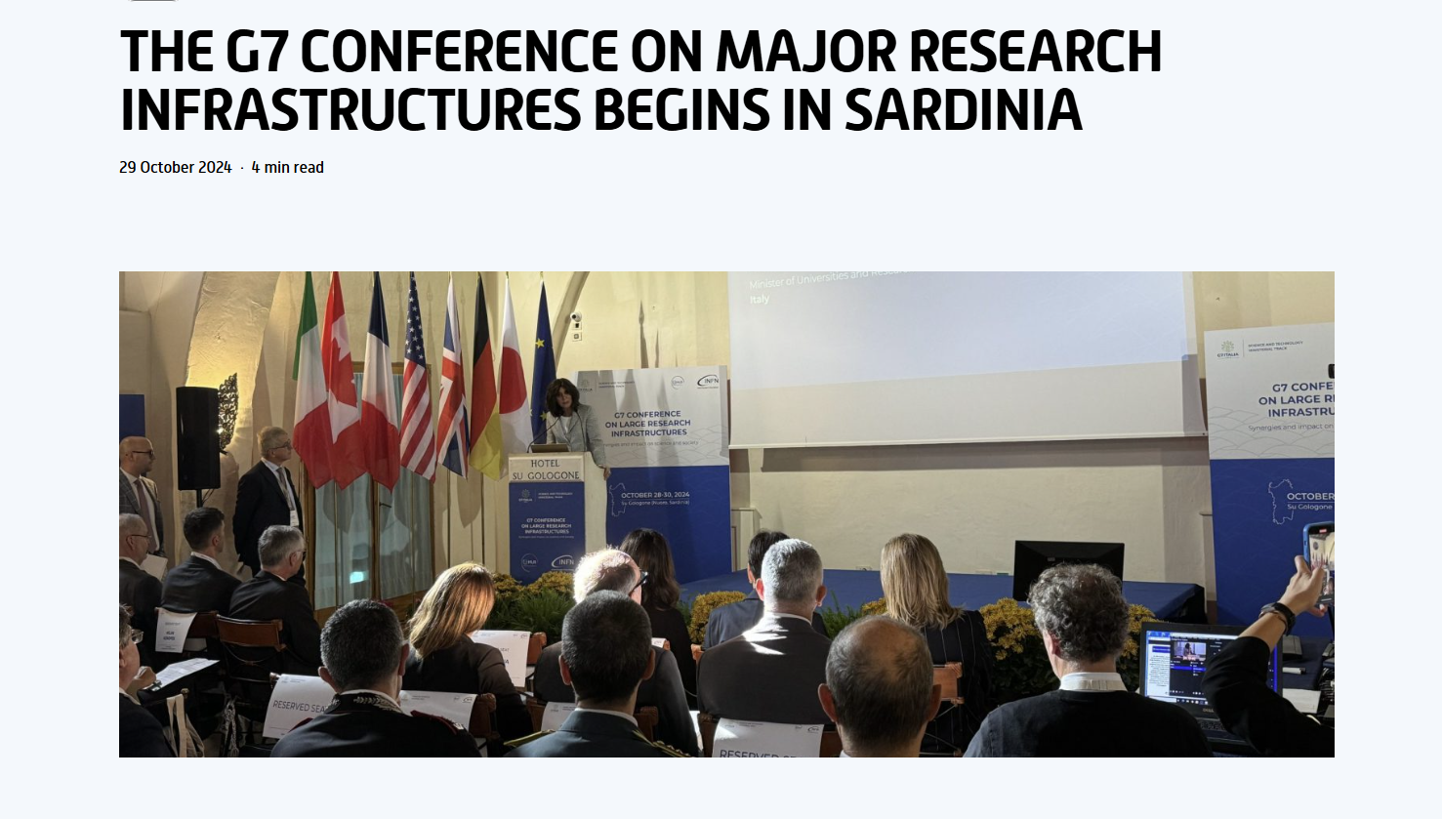
Notes:
G7 conference on large infrastructures held in Sardinia in 2024
Role of large RI in dealing with current issues and challenges considering the scientific, economic, social, and geopolitical impacts of large infrastructures in Europe but also taking into account the contributions from other countries around the world. One of those highlighted is the Einstein Telescope that we will hear more about later today.

Slide 6
Why do we need international collaboration?
Addressing large-scale societal and scientific challenges e.g. natural hazards, climate change, food security, disaster mitigation
Supporting regional and global policy initiatives e.g. UN Sustainable Development Goals (SDGs); Sendai Framework for Disaster Risk Reduction
Moving towards common approaches and developing interoperability to create a unified global framework for the solid Earth
Notes:
Scientific/ societal challenges do not respect geographical / political boundaries. Collaboration is vital to effectively address large-scale / global issues.

Slide 7
Creating a global research infrastructure for the solid Earth: current relevant initiatives
Regional - Europe
  ENVRI Cluster: coordinating European environmental research infrastructures
  ORPHEUS: pan-European seismology infrastructure
  European Open Science Cloud (EOSC): federated ecosystem of tools and services supporting European research
  Destination Earth: EU initiative creating digital twin of the Earth
  Data Terra: research infrastructure for Earth Observation data
Notes:
Who are the key actors in developing a global framework for the solid Earth

Slide 8
Creating a global research infrastructure for the solid Earth: current relevant initiatives
Regional – international
  AuScope: Australian research infrastructure for the solid Earth
  EarthScope: supporting geophysical research community, especially in USA
  Earth Sciences New Zealand: environmental research infrastructure
  Others?

Slide 9
Creating a global research infrastructure for the solid Earth: current relevant initiatives
Global
  Group on Earth Observation (GEO): intergovernmental organisation fostering open access and sharing of EO data (satellite and ground-based networks
  Copernicus: providing free and open access to data from its Sentinel satellites and other contributing missions
  Global Earthquake Model (GEM): improving the understanding of earthquake hazard and risk globally.
  Global Tsunami Model: establishing a global tsunami community and consolidated competence centre for tsunami hazard and risk
Notes:
On a global scale there are organisations such as the Group on Earth Observation (GEO): aim to provide open access to EO data (satellite and ground-based networks. GEO is made up of members state representatives and has a diversity of stakeholders including 151 Participating Organisations – EPOS of one of these.

Slide 10
Creating a global research infrastructure for the solid Earth: relevant coordinating activities
Research Data Alliance (RDA): member organisation building social and technical bridges that enable open sharing and re-use of data.
CODATA: promoting open Science, FAIR data principles and advancing data science policy to address global research challenges
World Data System (WDS): enhancing the capabilities, impact and sustainability of data repositories and data services in support of transparent and reproducible science
Earth Science Information Partners (ESIP): advancing data stewardship practices and principles for Earth science data
Notes:
These organisations provide some of the interoperability building blocks that are essential for building a common framework for solid Earth systems

Slide 11

What are the barriers to creating a global framework for solid Earth science?
Insufficient long-term resourcing for large-scale efforts to support interoperability
Lack of sustained coordination at the global scale
Shifting priorities (both scientific and societal) at national and regional level
Fragmentation and heterogeneity of the global
data landscape

Slide 12

How do we move forward?
Creating networks across different relevant stakeholders
Establishing regional and global partnerships
Organisational memberships e.g. Participating Organisation (PO) in GEO
Joint funding proposals with other partners e.g. upcoming HORIZON-INFRA-2026-DEV calls
Joint outreach activities e.g. ENVRI-Hub at GEO meeting, ENVRI & EPOS booths at EGU 2026
Notes:
Todays session will include presentations that highlight different activities relevant to EPOS

Slide 13
Thank you!

