Slide 1

Welcome and introduction to day 3
Lilli Freda
EPOS ERIC Executive Director

Slide 2

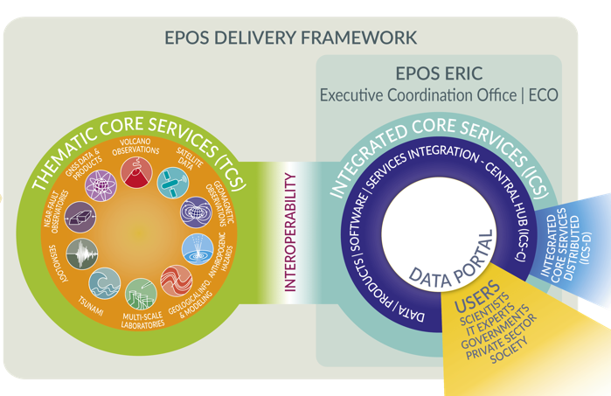
The EPOS Ecosystem and the EPOS Days 2026 Programme
Day 5: EPOS Data Policy
DATA Generation
DATA Integration
DATA Access
Day 4: Technical challenges, opportunities and solutions
Day 4:
EPOS in National Landscapes
Day 2: Societal Impact and Responsible Research Infrastructures
Day 4: UFG report
Day 1: Early Career Researchers, Thematic Core Services
Day 2: New Services and communities
Day 3: International Collaboration

Slide 3

The EPOS Ecosystem and the EPOS Days 2026 Programme
DATA Generation
DATA Integration
DATA Access
Day 1: Early Career Researchers, Thematic Core Services
Day 2: New Services and communities
Day 3: International Collaboration

Slide 4
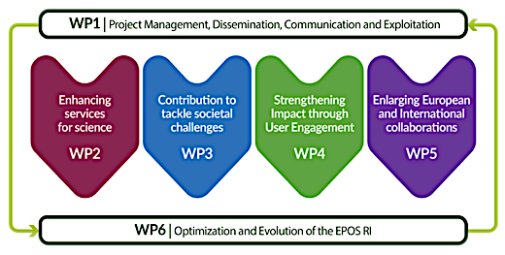
EPOS ON objectives covered in today’s sessions
09:00-13:30
International Collaboration

Slide 5



Day 3 Agenda
09.00-13.30 | International Collaboration - Chairs: J. Fonseca, H. Glaves
Welcome and introduction of the day's agenda | L. Freda
Building a global network for the solid Earth research | H. Glaves
Strengthening Morocco's Integration into EIDA | O. Arab, M. Mastere
EPOS collaboration with GEM and GTM: potential services and licencing models for both research and commercial use | F. Løvholt, H. Crowley
Report from the ARGONAUT network: collaboration perspectives among global NFO infrastructures | The ARGONAUT team
EPOS and EOSC: where are we and who are we working with? | A. Turco
11.00-11.45 | Coffee break
Leveraging Copernicus to build domestic capacity for resilience in Africa | Luca Rossi, UN
Africa-EPOS Synergy: Co-Developing Open-Source Frameworks for EO Data and Disaster Resilience | M. El Gabri, ADMIR
The Copernicus In-Situ Component | L. Solari, EEA
The Einstein Telescope Project and EPOS ERIC: The Way Forward | M. Bossi, INFN
Interactive discussion
13.30 -15.00 | Lunch break
Free afternoon – Cagliari Walking Tour

Slide 6


Feedback on the ECR session.
Please take a moment to scan the relevant form.
Other Participants
ECRs

Slide 7
Enjoy the programme!

