Slide 1





An Integrated Tsunami Impact Assessment Workflow within ARISTOTLE: A Collaborative Use Case for Emergency Management
F. Løvholt, S. Glimsdal, I. Drøsdal, K. Sverdrup-Thygeson – Norwegian Geotechnical Institute (NGI)
J. Gonzalez-Vida, J. Macias, S. Ortega – Univ Malaga (UMA)
L. Faenza, A. Michelini, F. Romano, I. Oliveti, G. Forlenza – INGV
R. Dinescu - INFP
C. Özer Sözdinler - Gebze Teknik Üniversitesi

Slide 2
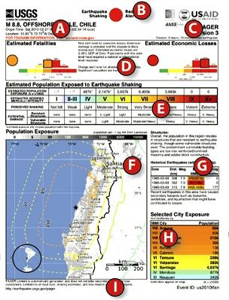
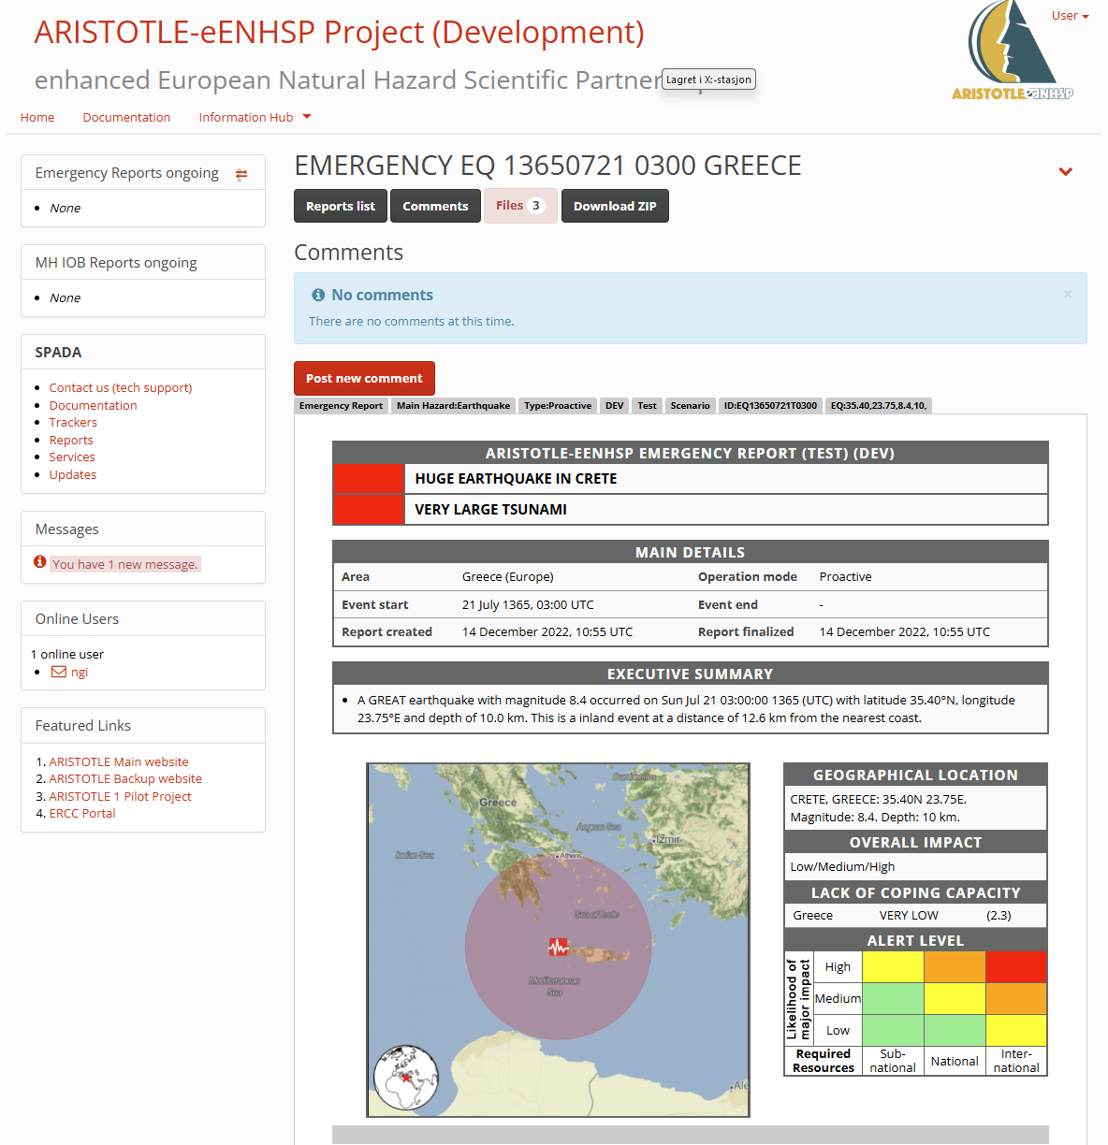
Background – need for rapid post event tsunami exposure analysis
Need to quickly getting an estimate of the severity and extent of an event right after it has occurred
In Europe, the EU ERCC (Emergency Response Coordination Centre) under the civil protection mechanism DG-ECHO have this responsibility
  The ARISTOTLE consortium tasked by ERCC to perform post assessment analysis within three hours after an event has occurred – globally
Services for estimating impact exists for earthquakes (e.g. USGS PAGER, GEMs impact analysis)
Present tsunami service limited to tsunami propagation
Objective for this work: Provide a global model extending the present service to population exposure for tsunami three hours after it has been recorded
https://earthquake.usgs.gov/data/pager/onepager.php

Slide 3
Technical outline of the impact assessment workflow
Combined set of service provides operated by the TSPs service providers in Europe
Global geographical coverage
Institutional collaboration
  TSPs from ARISTOTLE consortium operates the post event assessment analysis
  Univ Malaga delivers automated tsunami service through the HySEA tsunami simulation output
  NGI estimates the population exposure estimates
Motivation - leverage past development for global hazard analysis model for use in acute situations for rapid population exposure estimation
Globally unique service – combining numerical models (UMA), the ARISTOTLE SPADA platform, and a new inundation and exposure calculation procedure (NGI)
The model is tested globally and is operational

Slide 4
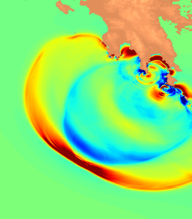
Tsunami propagation model - Tsunami HySEA
Highly efficient Shallow water solver using GPUs (CUDA implementation) – developed and maintained by UMA
Stable implementation using Finite Volumes, Riemann solvers
Interface established on the ARISTOTLE SPADA platform
European TSPs on duty operates the service
Users can set arbitrary simulation domain size
Execution of scenario simulations takes a few minutes
Outputs offshore tsunami water heights both as field and at POIs, and travel time

Slide 5
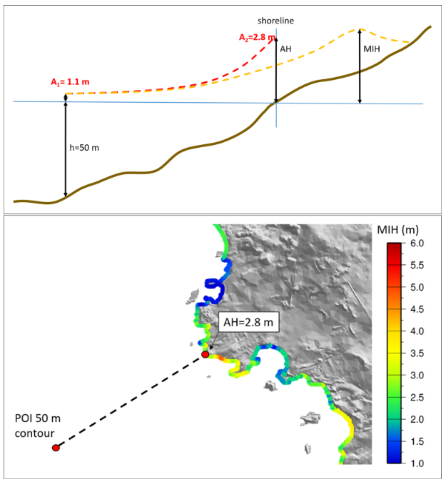
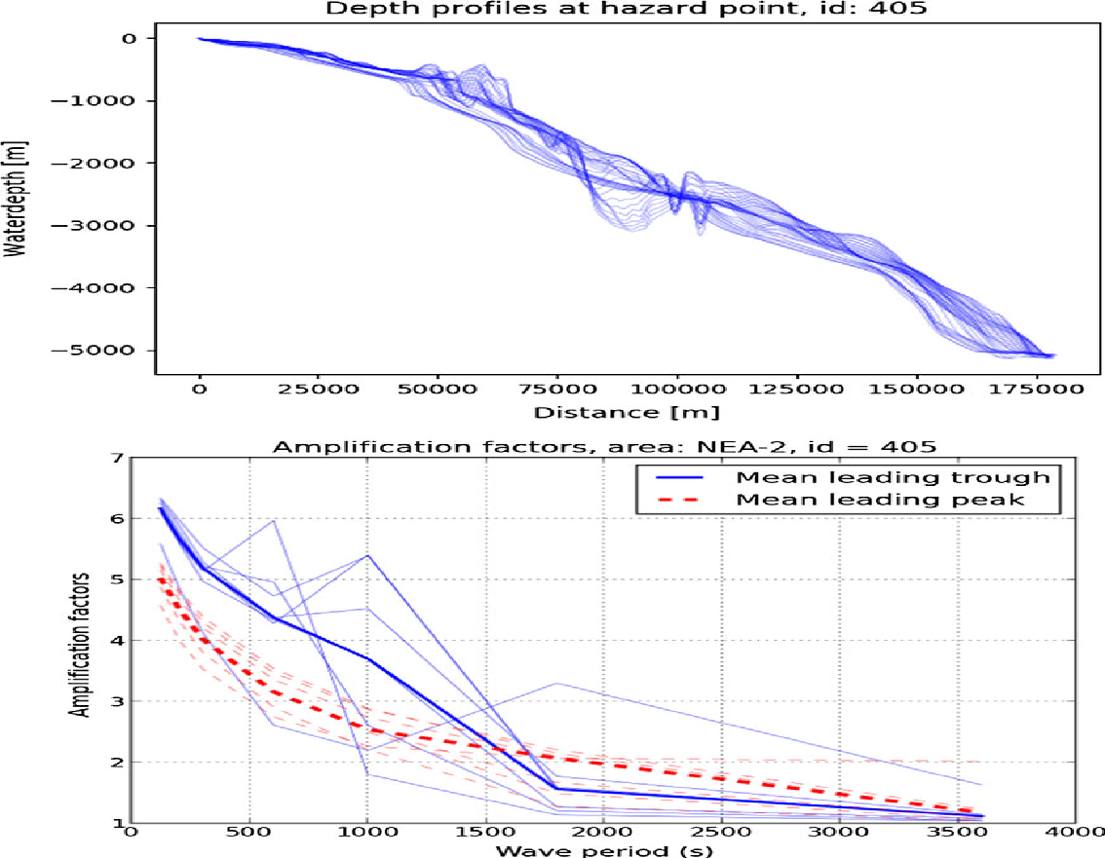
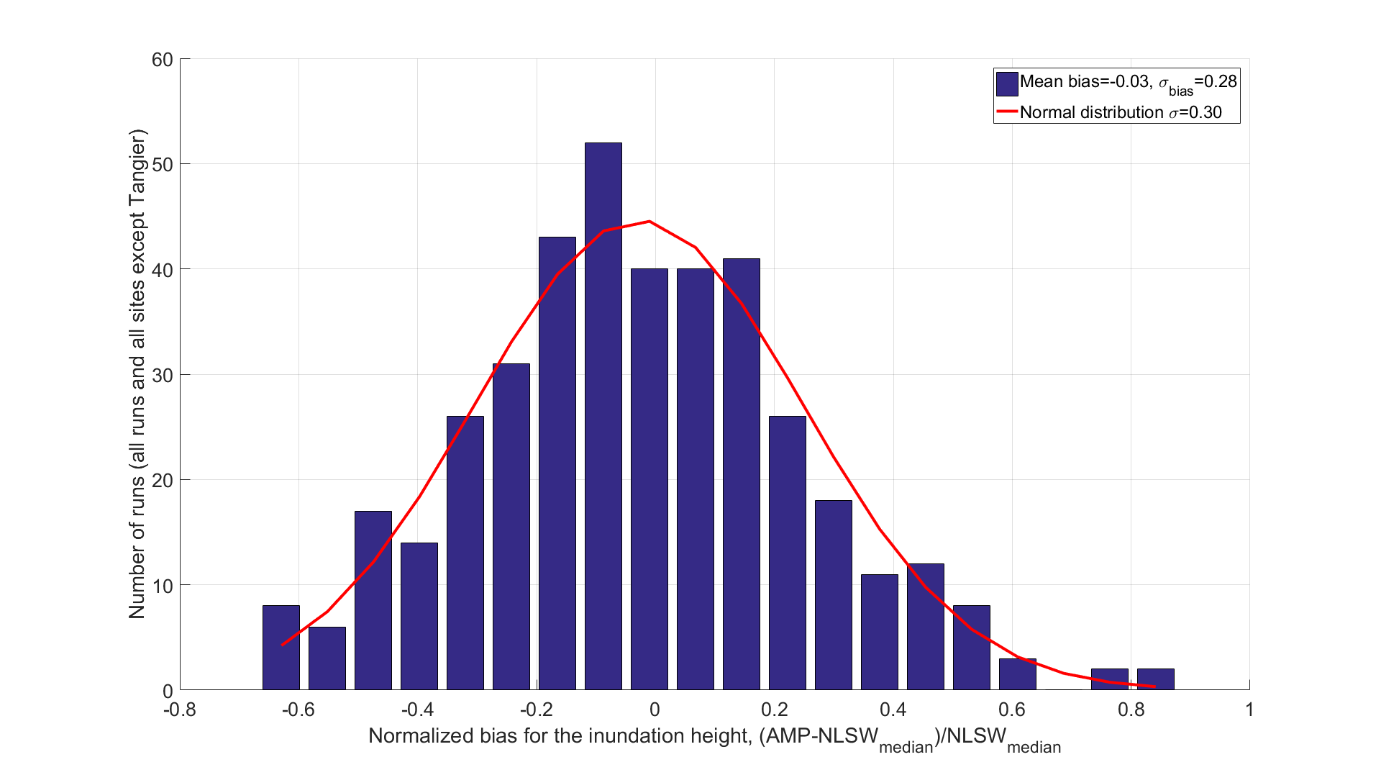
Global amplification factors
Estimates the coastal Maximum Inundation Height (MIH)
Amplification Factor between for tsunami amplitude deep water and coastal points
Non-local approach – highly approximate
Based on a large set of plane wave linear shallow water model simulations
Look up table based on wave period and polarity
Calibrated via many high-resolution inundation simulations acting as reference models providing
  Bias correction
  Uncertainty
Takes time series outputs from Tsunami-HySEA as input to compute the MIH
Repository available via Geo-INQUIRE:
  https://github.com/norwegian-geotechnical-institute/global-tsunami-amplification-factors/tree/v2.0.0
Factors as function of period
Lognormal uncertainty

Slide 6
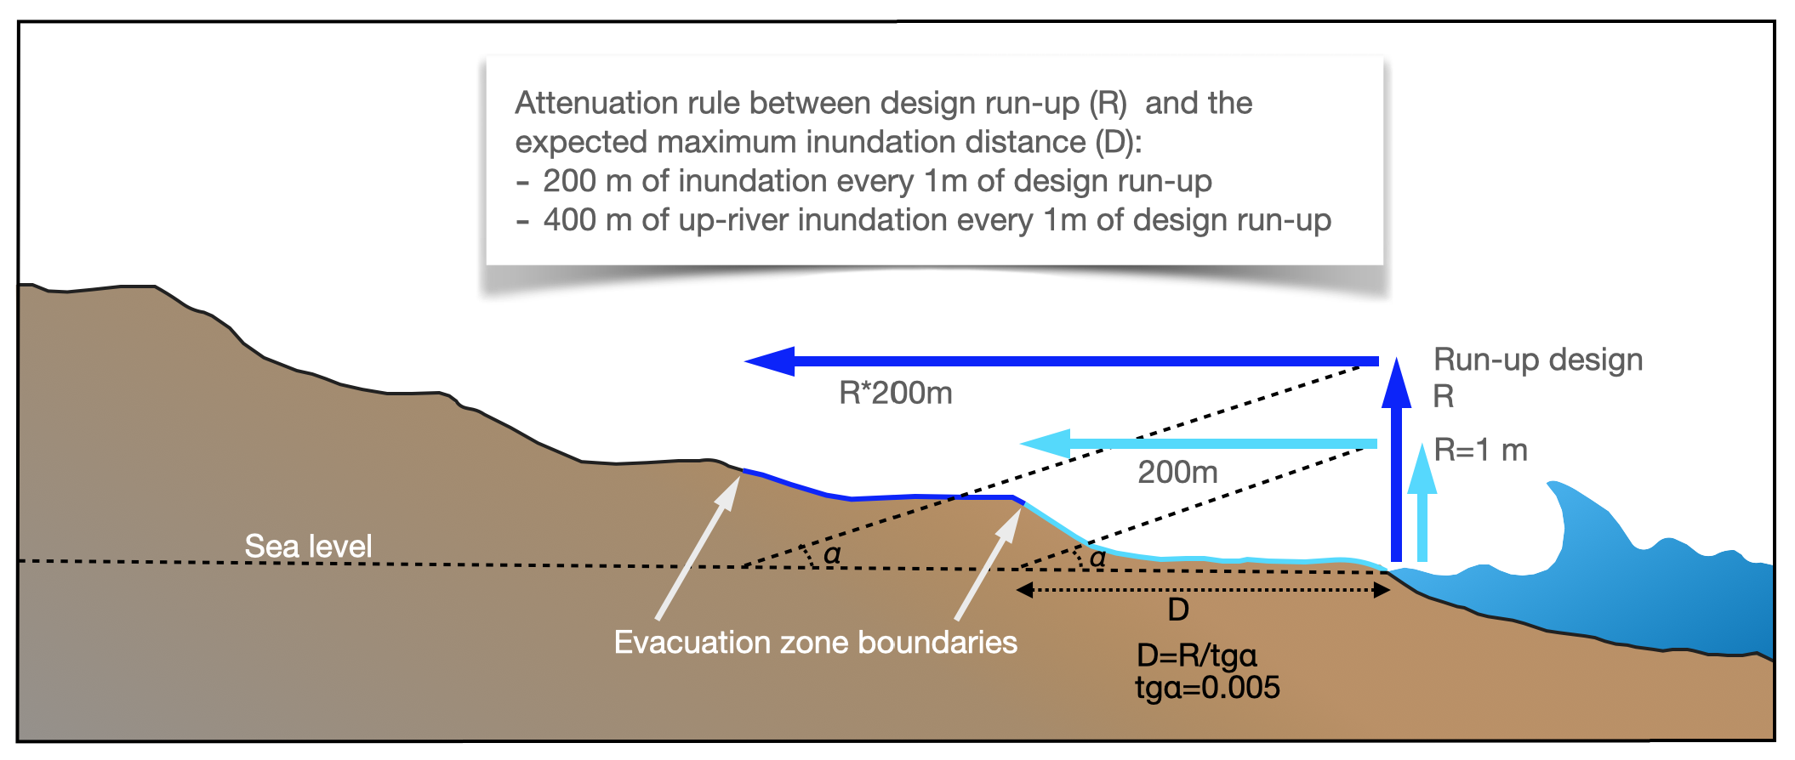
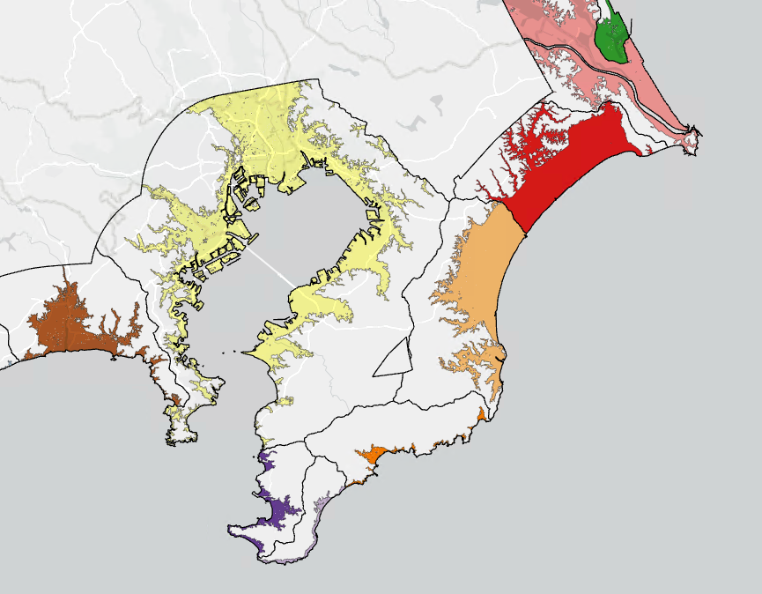
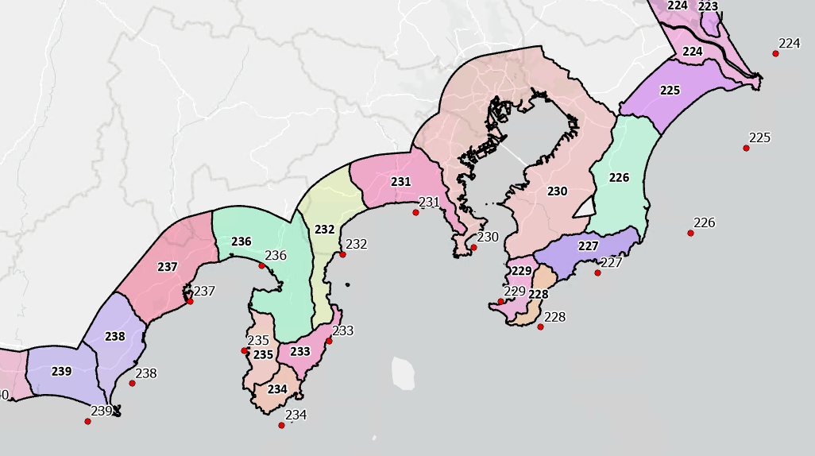
Inundation model
Shoreline value for tsunami flow depth set to equal to calculated MIH
Extrapolated onshore over open-source DEM
Assume small friction loss for the inland flow
Discrete inundation look up tables predetermined via GIS
Link between tsunami propagation model output and predefined inundation areas
h_{min}
h_{min}+
Δh
…
h_{max}
Notes:
We use an automated procedure for projecting the overland flow
The technique is similar to a GIS technique used for PTHA
In the tests so far, we have used a relatively conservative friction value that gives high inundation areas and exposure
The reason for this is that by using open source DEMs previously we have underestimated inundation. This seems not to be the case with the present DEM.
Some reduction will likely be implemented to get a better match with observations.

Slide 7
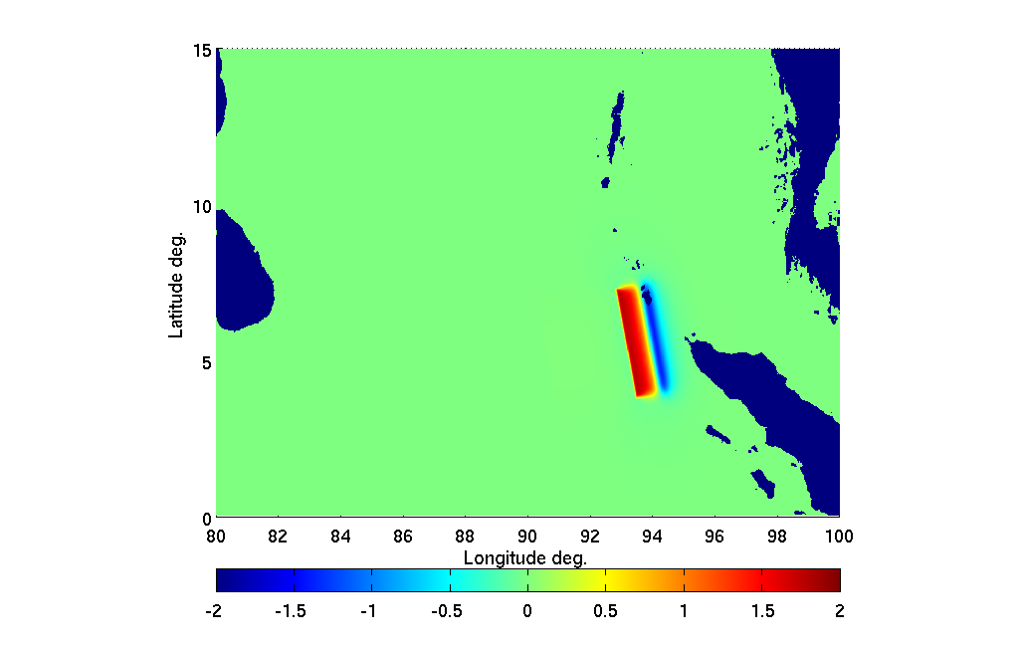
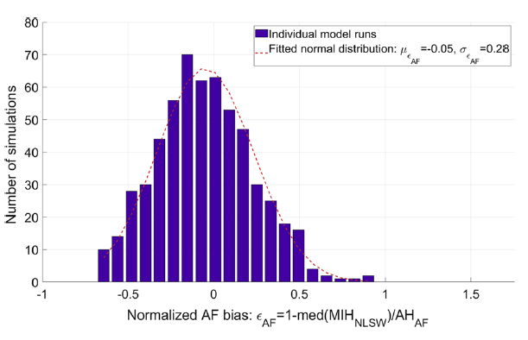
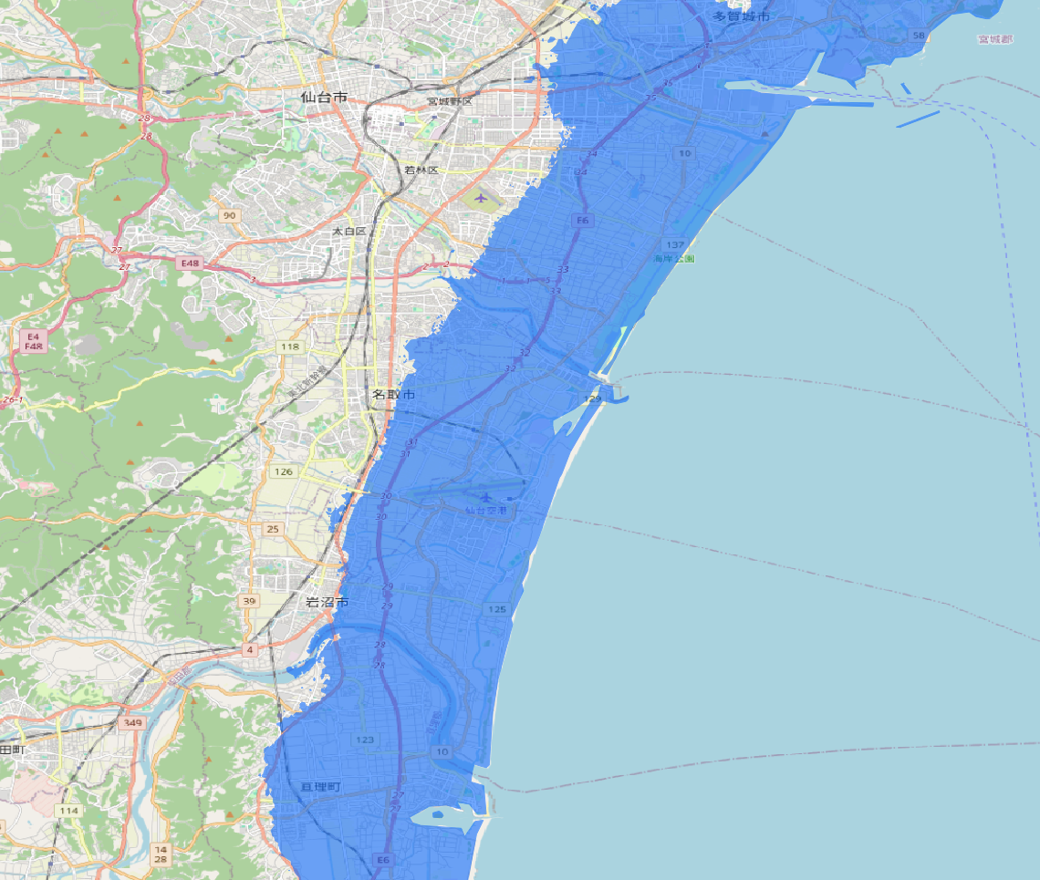
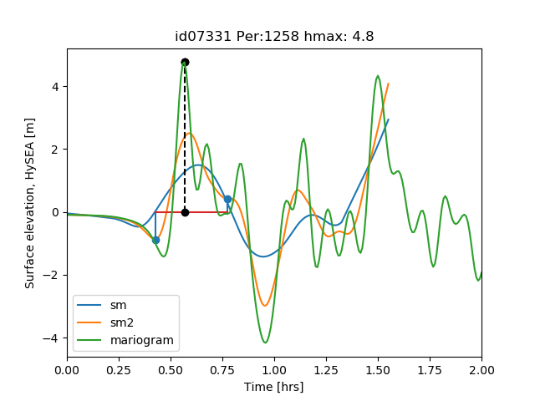
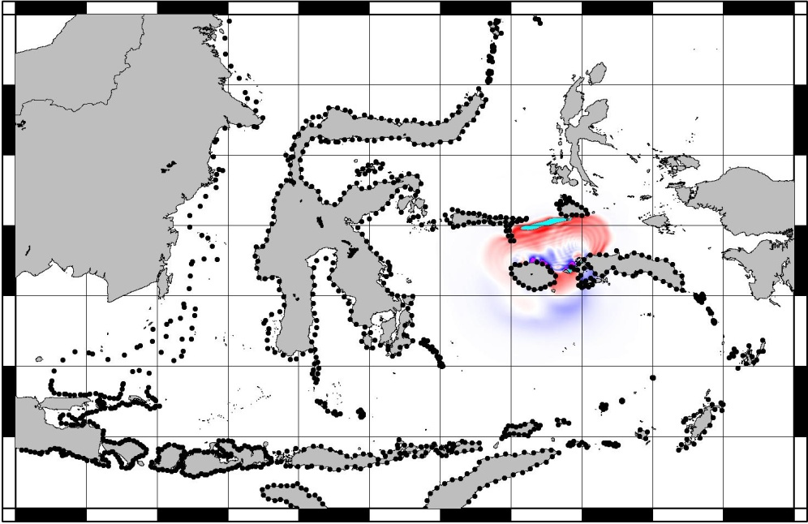
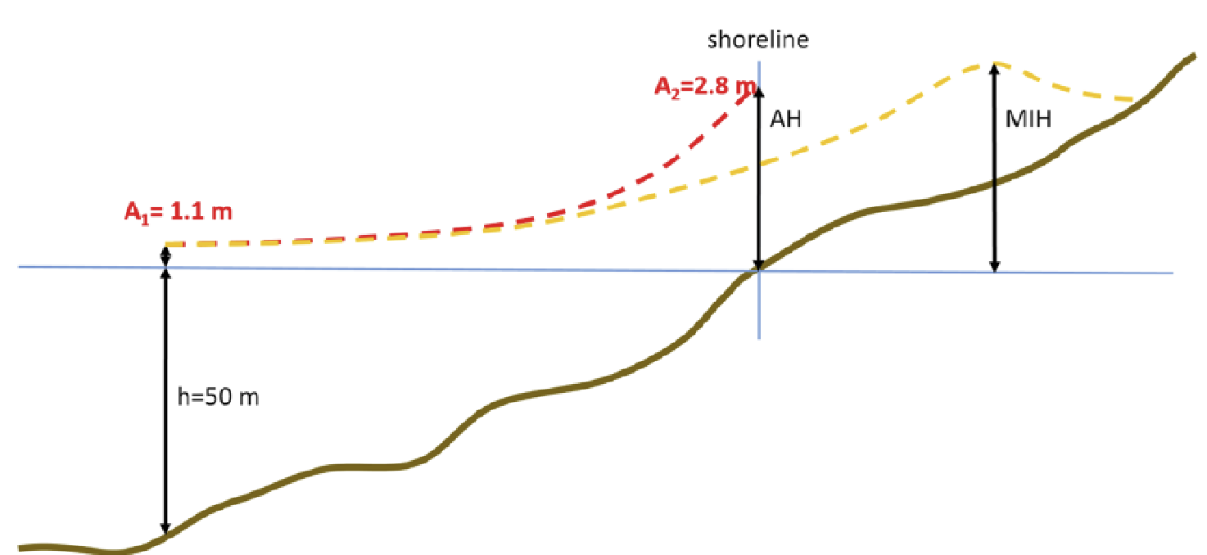
Combined: Stepwise exposure estimation procedure
1
Time series analysis - extract wave characteristics
Exposure
estimation
5
7
Uncertainty treatment
Uniform slip
Okada model
3
Tsunami simulation
HySEA initiation via ARISTOTLEs SPADA platform
6
2
4
Exposure
Estimate
the inundated area
Amplification factors
Extract tsunami time series

Slide 8
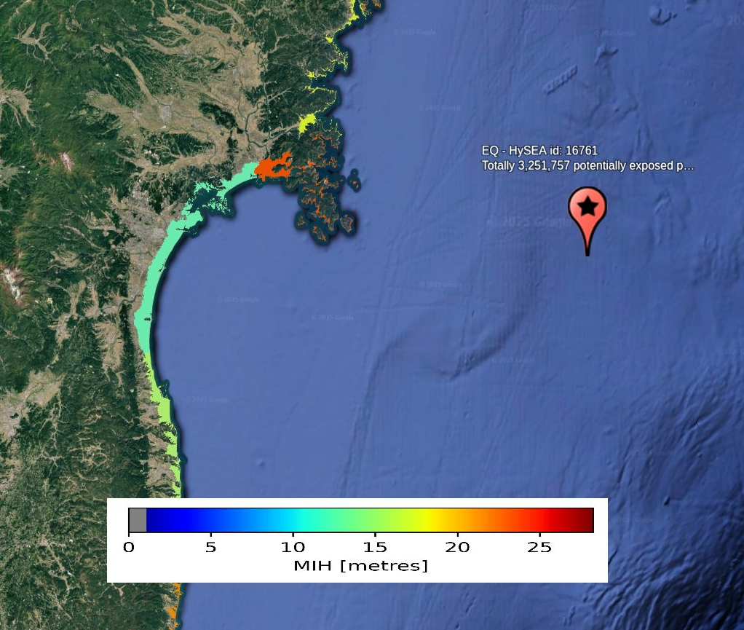
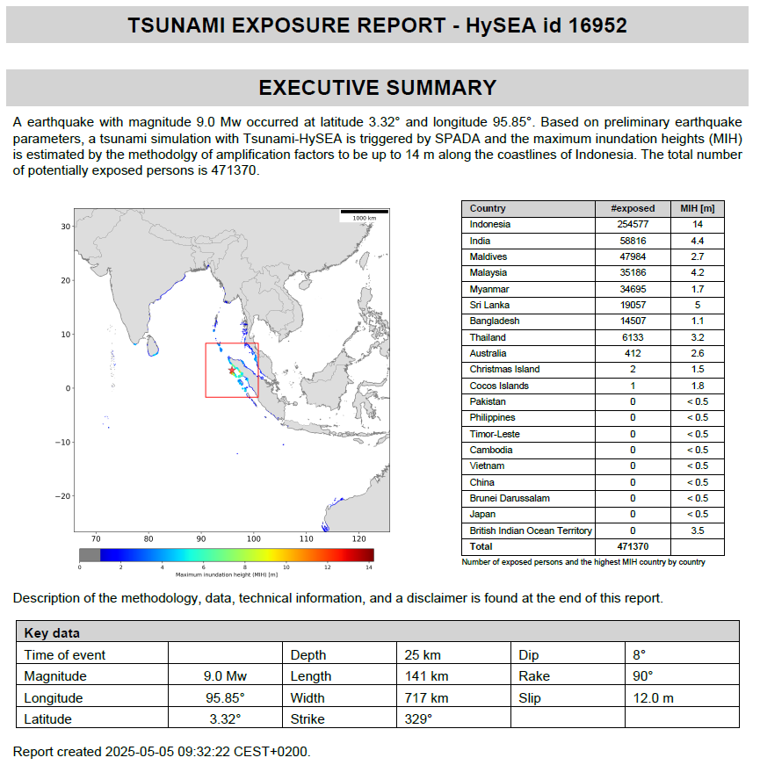
How the service works
24/7 service that can be activated by ARISTOTLE operator on duty
Tsunami propagation model first run by TSP operator
Exposure service triggered consecutively by TSP user after the propagation model run
Service run in Azure cloud through rabbitMQ
Automatic report and maps for exposure and affected areas
Uncertainty estimate for exposure for given percentiles

Slide 9
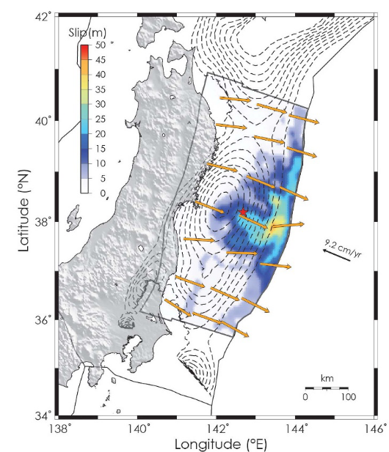
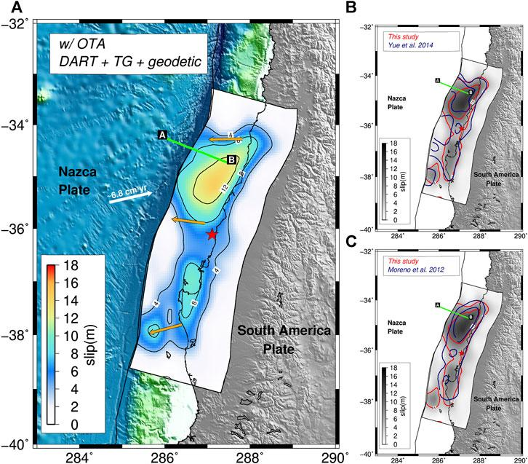
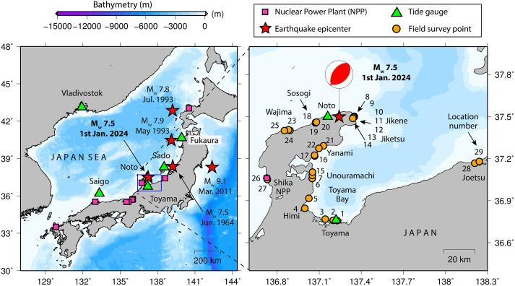
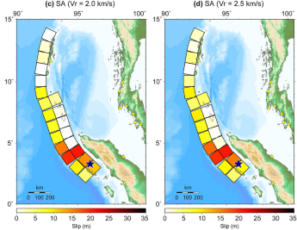
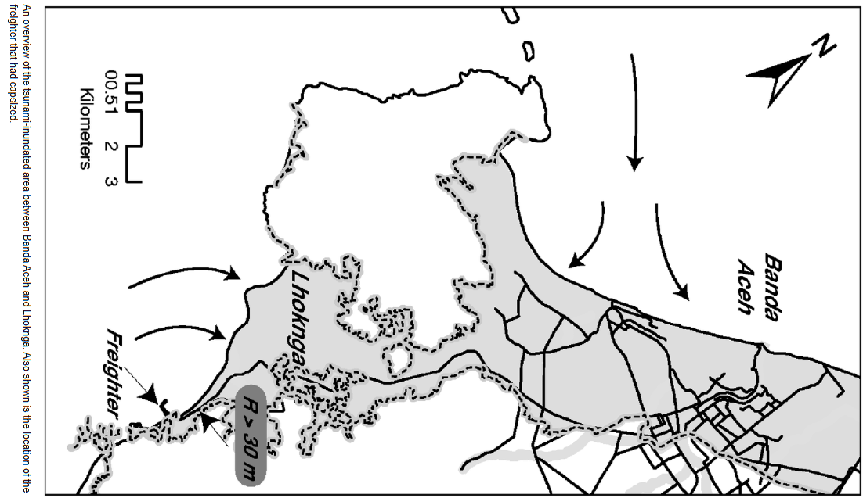
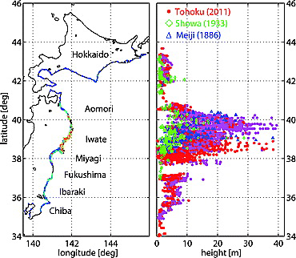
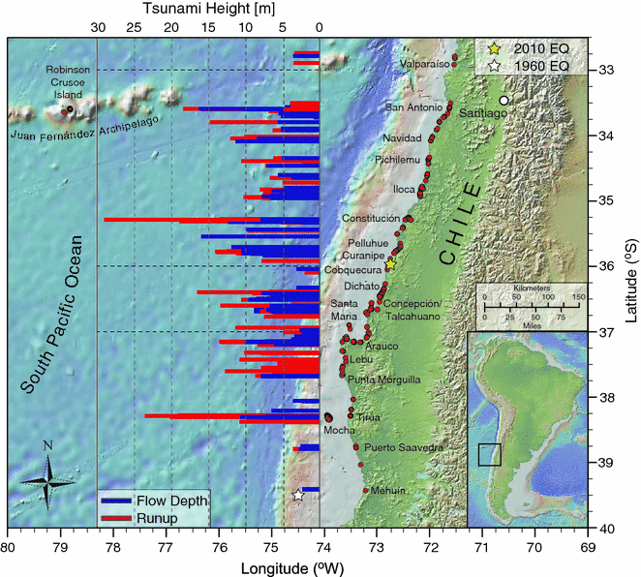
The model has been tested towards real events
Example#1:
Tohoku 2011
Example#2:
IOT 2004
Example#3:
Maule 2010
Example#4:
Noto 2024
Romano et al. (2014), Sci Rep, 4(1), 5631.
Fuiji et al. (2021),
PAGEOPH, 178(12), 4777-4796
Romano et al. (2020),
Front Earth Sci, 8, 585429.
Source – ARISTOTLE, uniform slip source
Borrero et al. (2026),
Earthquake Spectra 22(3),
https://doi.org/10.1193/1.2206793
Mori et al. (2011), GRL,
https://doi.org/10.1029/2011GL049210
Fritz et al. (2011),
PAGEOPH, 168(11), 1989-2010

Slide 10
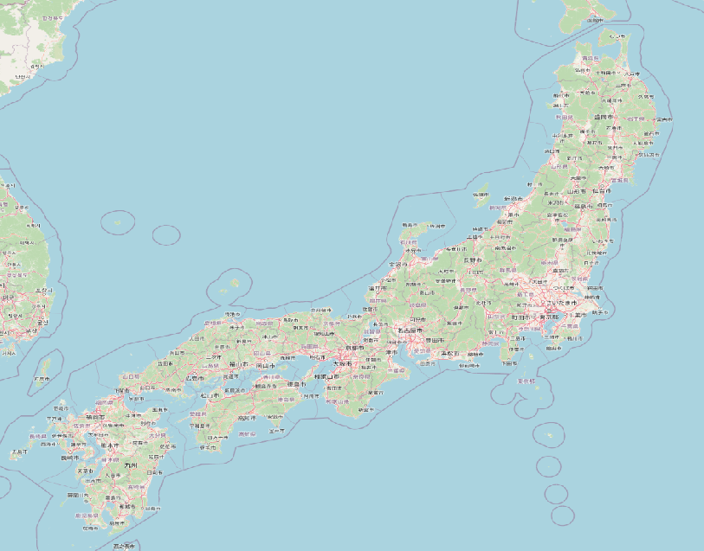
Example #1: Tohoku 2011 inundation
 | Calculated median MIH [m] | Calculated mean MIH [m] | Observed [m]
Rokkasho | 6 | 8 | 2-8
Noda | 22 | 28 | 10-27
Miyako | 21 | 27 | 6-32
Rikuzentaka | 43 | 56 | 13-20
Sendai | 23 | 30 | 12-23
Kashima | 8 | 10 | 3-8
Tokyo | 2.3 | 3 | 1-2
Nagoya | 2.3 | 3 | 0.6-1.1
Osaka | 0.7 | 0.9 | 0.3-0.6
Favourable comparison with run-up observation from NOAA-NCEI database

Slide 11
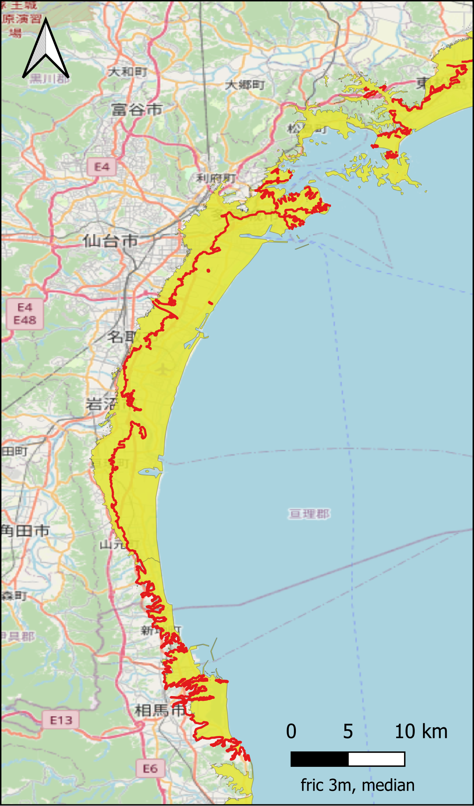
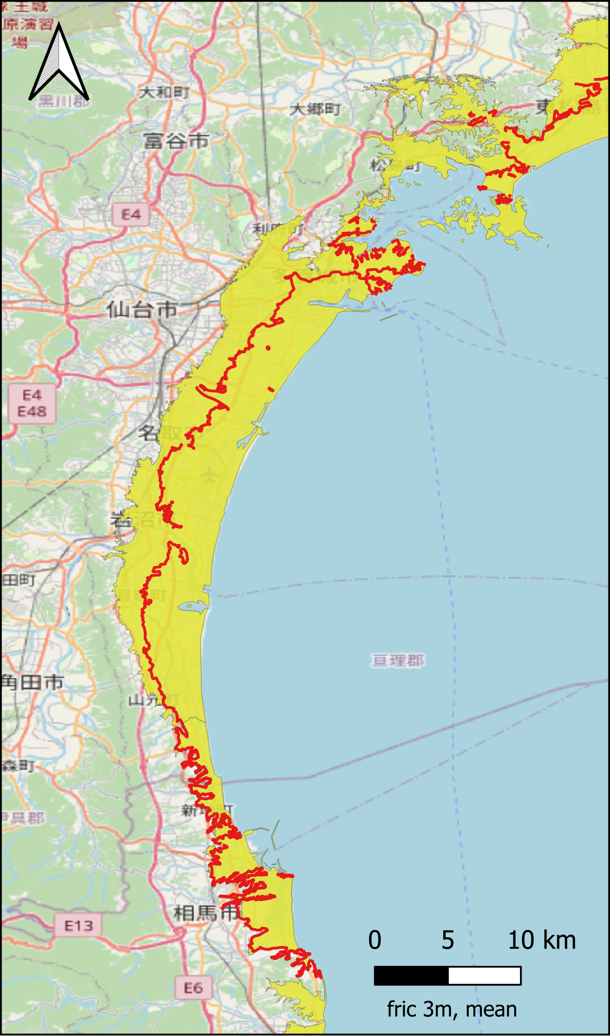
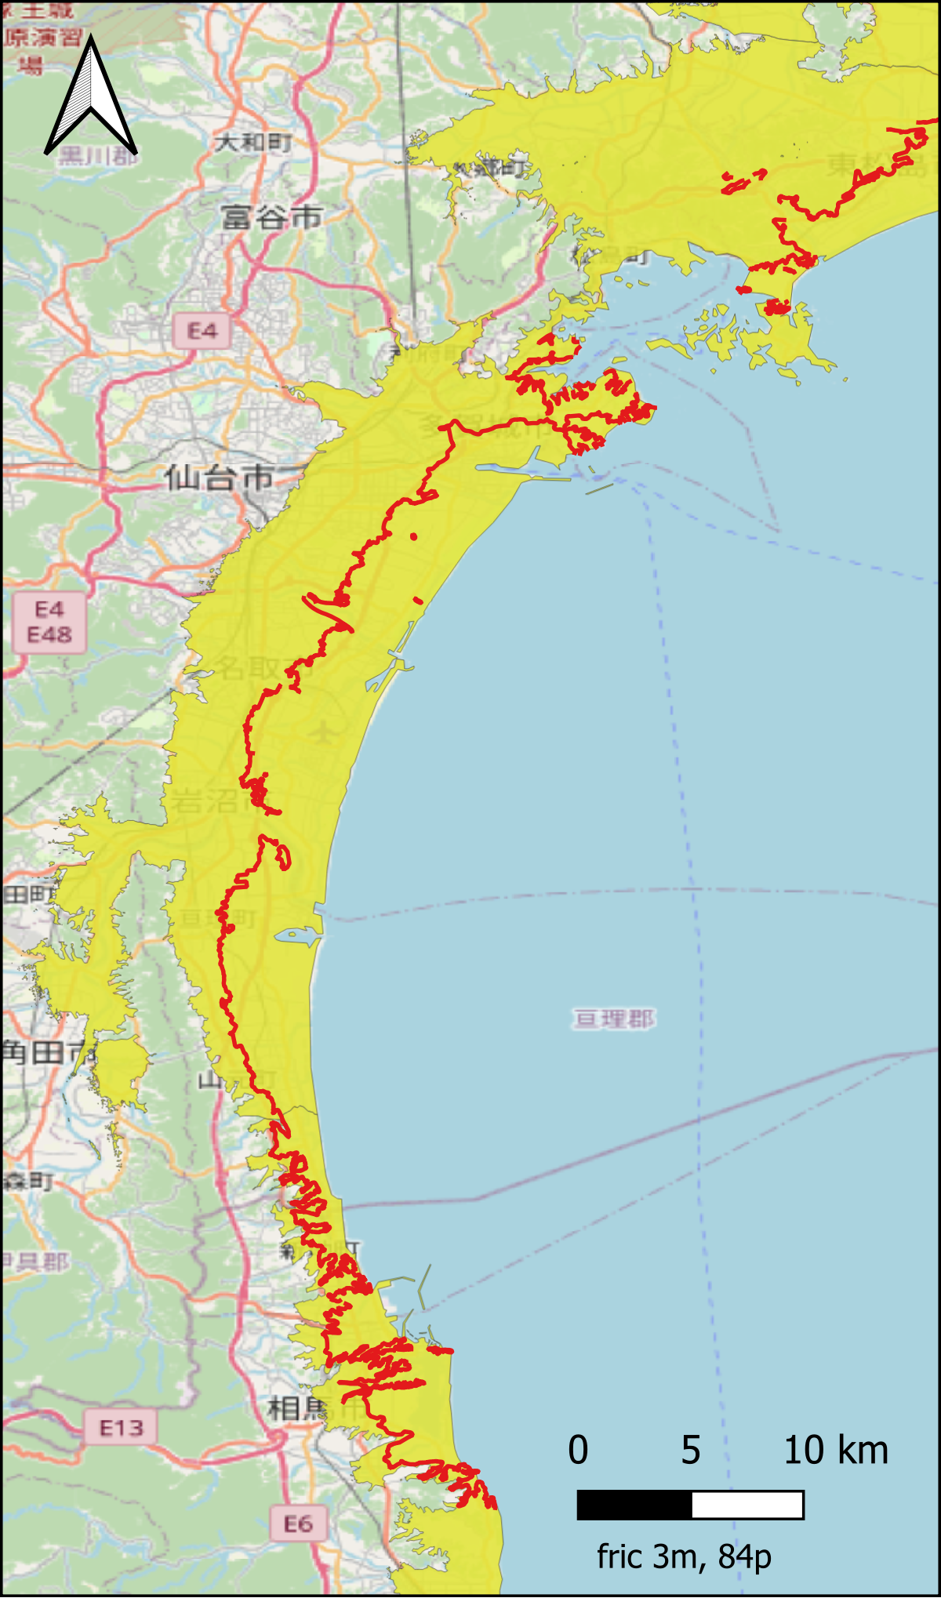
Example #1: Tohoku 2011 Calculated exposure
Median value inundation
Mean value inundation
Police report Japan: observed about 1.100.000 "doors" were damaged (statista.com says 2.2 persons per household)
  Implies 2.42 million persons potentially exposed
Calculated exposure assuming a friction loss of 3m height reduction per km
  Median value: 2.45 million persons
  Mean, value: 3.4 million persons
  84 percentage, value: 6.3 million person
(Observed number of fatalities is 19.759 - emdat.be -
< 1% of the potential exposure)
84 percentile
inundation

Slide 12
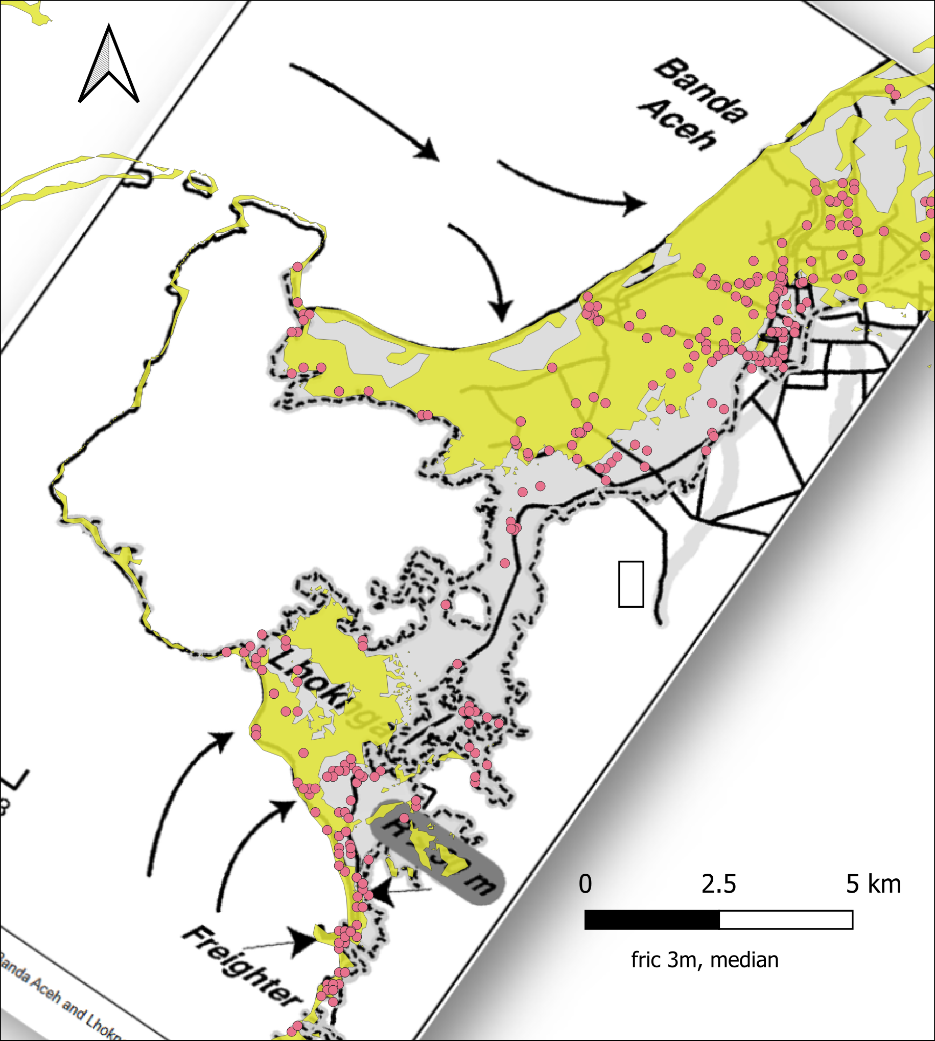
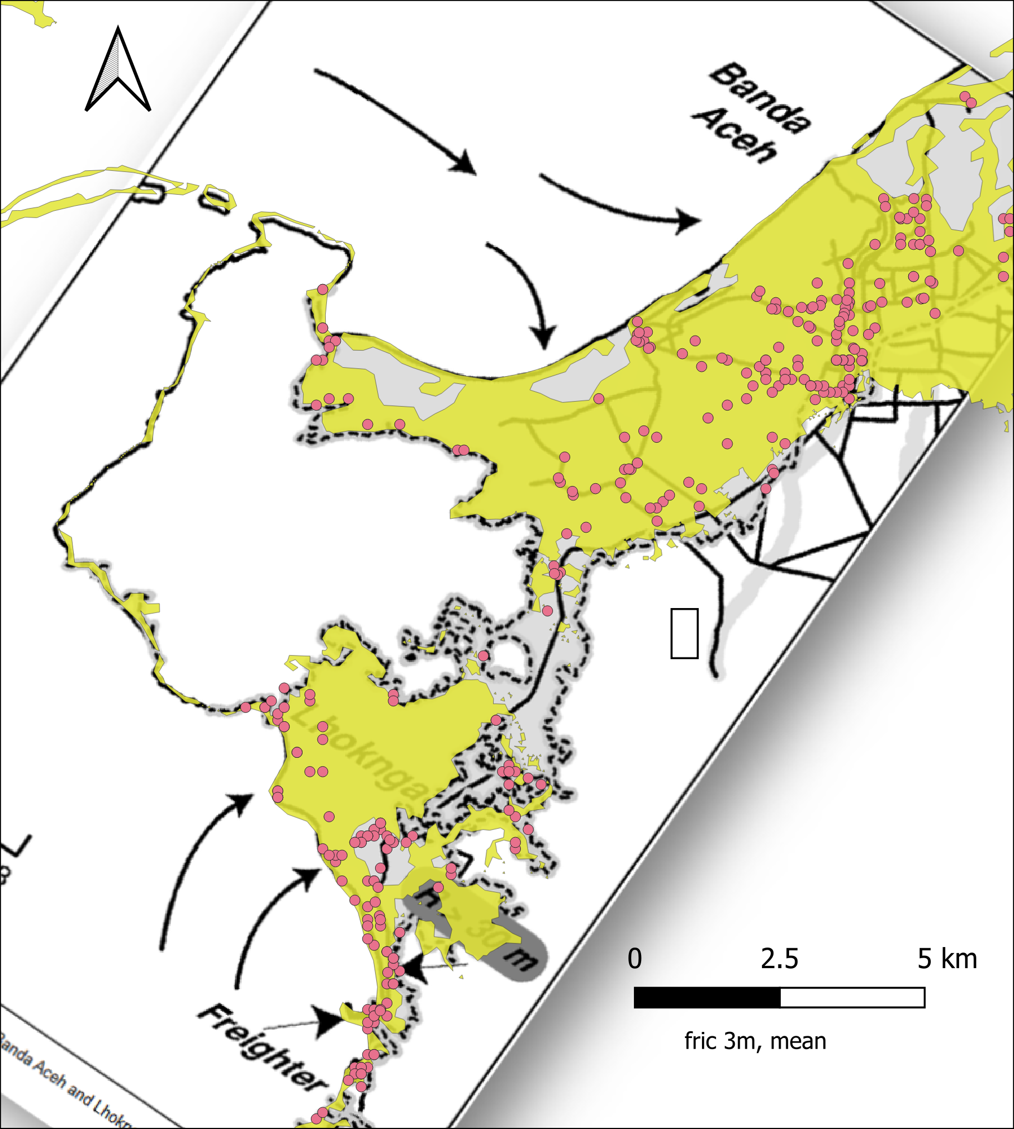
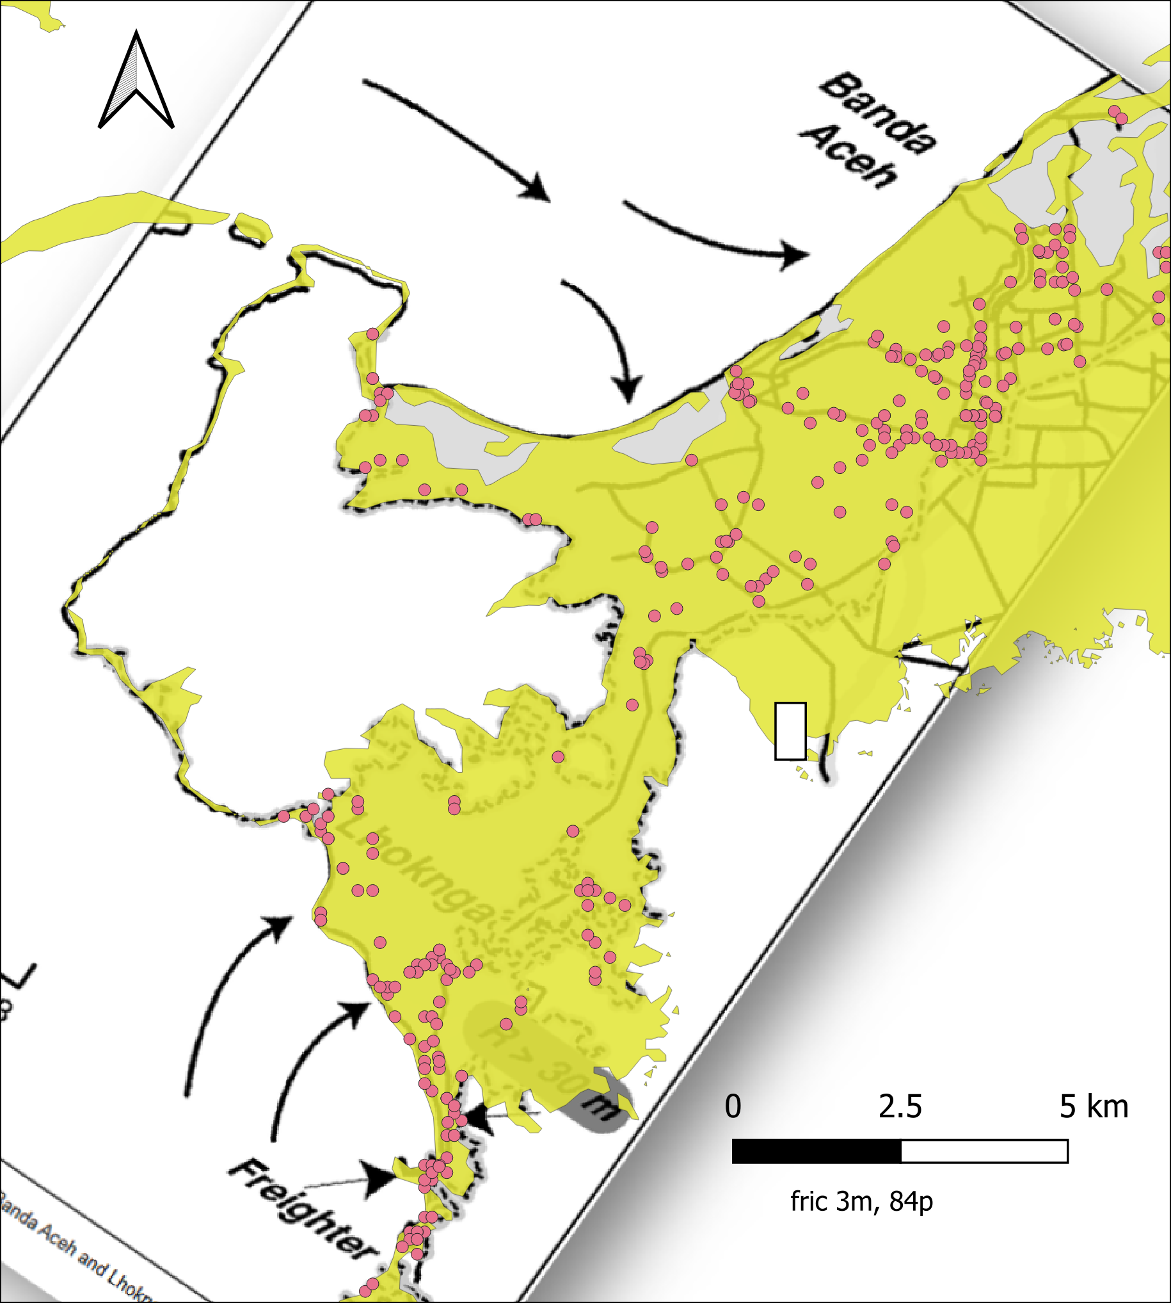
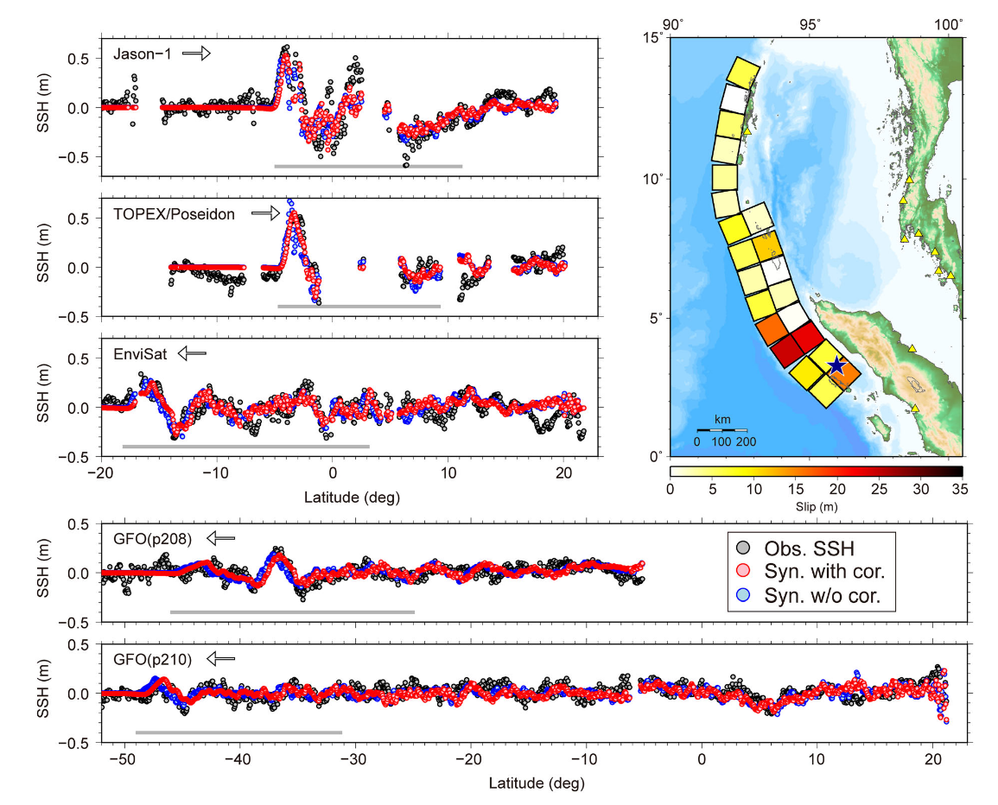
Example #2: Indian Ocean Tsunami 2004
Good agreement in inundation and exposure estimates for Thailand, Indonesia, Maldives
Need high percentile to match observations
Overestimation for Myanmar
Significant underestimation of population exposure for
    Sri Lanka and India
    Mainly due to too limited slip in the applied earthquake source northwards
Median value inundation
Mean value inundation
84 percentage inundation
Background figure: Borrero et al. (2026), Earthquake Spectra 22(3), https://doi.org/10.1193/1.2206793

Slide 13
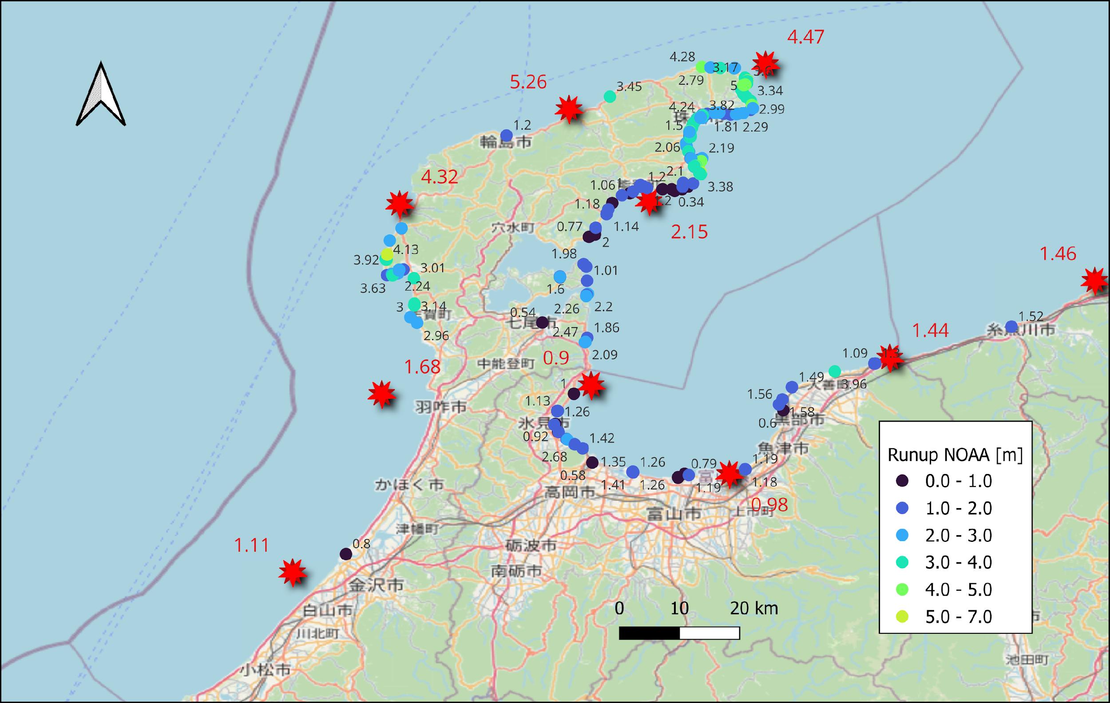
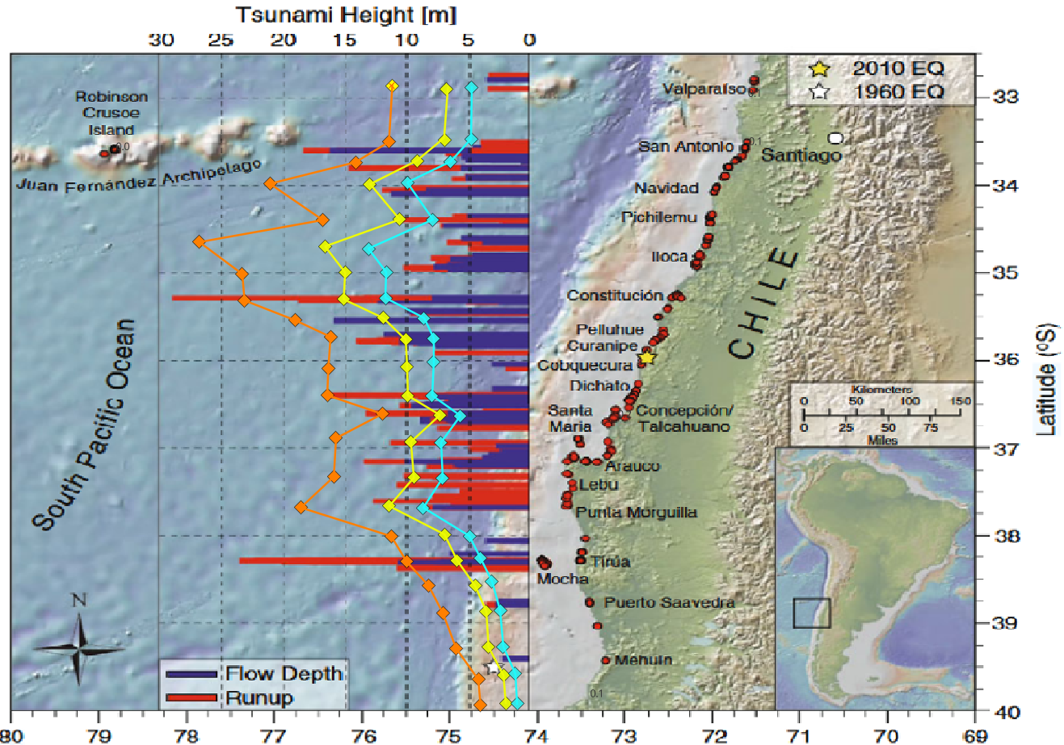
Example #3: 2010 Maule
Example #4: 2024 Noto
84 %
Mean
Median
Simulation based MIH’s 1-5m
Observations within the same area 1-4 m
Roughly similar inundation heights compared to observations
Simplified source (homogeneous rupture)
Mean run-up roughly coincides with observation
Calculated exposure – 28k

Slide 14
Outlook
The Tsunami Impact Assessment Workflow shows how individual services can be combined for use for emergency management
It necessitates collaboration between several institutions and integration of individual services
Several individual components included in TCS tsunami already, among others via Geo-INQUIRE
  Tsunami-HySEA
  Amplification factor service
The service is being finalized and is becoming operational in ARISTOTLE
Added value for EPOS
  Integration code tying together tsunami simulations and amplification factors
  A new precomputed exposure database, and automated deployment and testing
  ARISTOTLE serves as an accelerator for service implementation

Slide 15
Thank you!

