Slide 1

The Ethical Label to identify ethical
and social implications of project outputs
EPOS ON project: WP3 - Task 3.3
Giuseppe Di Capua and Silvia Peppoloni
Istituto Nazionale di Geofisica e Vulcanologia
Rome, Italy

Slide 2
Overview 1/2
Development and Standardization
Customization: The initial version of the Ethical Label has been refined and specifically tailored for EPOS products and services.
Consistency: A categorization scheme based on predefined fields was introduced to ensure standardized, consistent, and comparable descriptions across the community.
Objectives and Communication
Evaluative Framework: The label provides a structured framework to analyze key information, expected impacts, and potential ethical or misuse risks.
Trust and Dialogue: It supports transparency for both internal and external stakeholders, facilitating responsible communication and strengthening trust.
Informed Innovation: It assists researchers and technicians in identifying the scientific and societal implications of their work, aligning with FAIR principles and EPOS core values.

Slide 3
Overview 2/2
Structure and Sustainability
Promoting Open Science: The label is designed to encourage the responsible, informed, and sustainable use of EPOS data, data products, and services, while supporting open science and protecting the rights of involved parties, as well as social and environmental balance.
Detailed Sections: The scheme covers various areas, including:
General product information and product type.
Scientific, technical, and social/public areas.
End users and accessibility conditions.
Potential impacts, ethical and misuse risks.
Traceability and Accountability: A dedicated internal validation section ensures traceability and accountability in the adoption of the label.

Slide 4
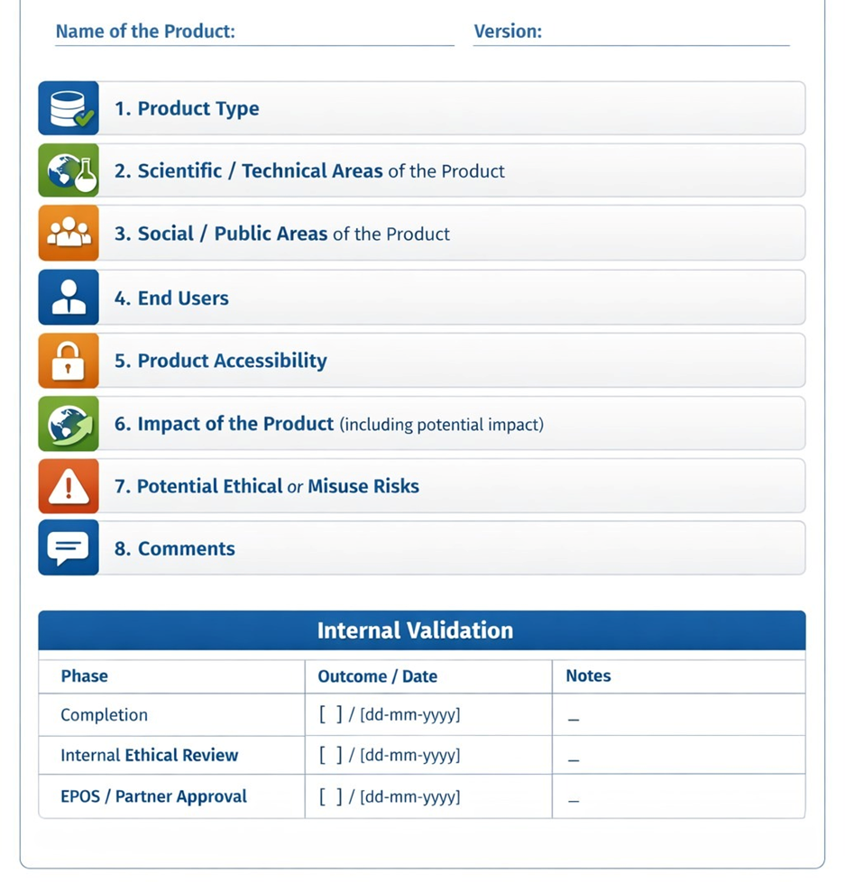
Ethical Label Summary
(AI-generated image)

Slide 5
Validation process
Completion phase
Internal ethical review
EPOS ERIC approval
The product creator or designated contact person initiates the process by documenting the product’s attributes and completing the label.
A peer or internal reviewer examines the label.
This review can be conducted by the Ethics Working Group, which comprises representatives from all TCS.
The final step formalizes the label, establishing it as a trusted tool for communication both within and outside the EPOS community.
This approval is granted by the Ethics Board of EPOS ERIC.
Traceability and Accountability: A dedicated internal validation section ensures traceability and accountability in the adoption of the label.

Slide 6
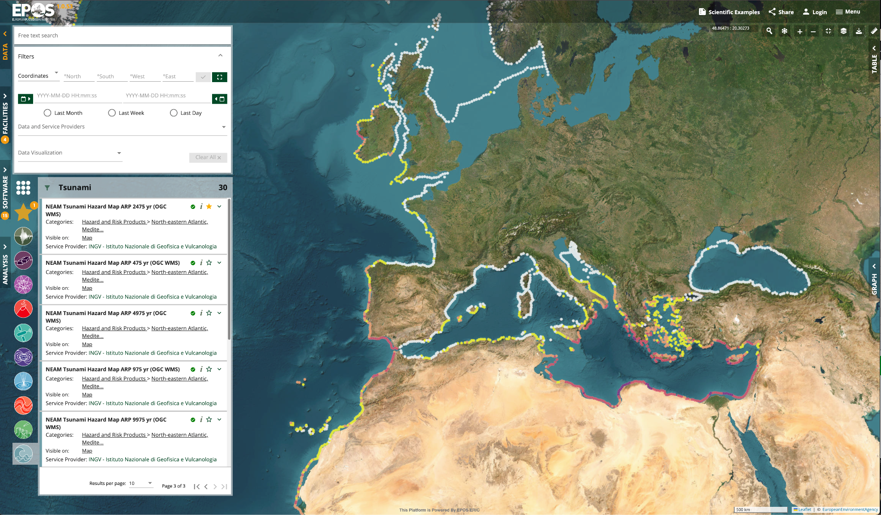
Ethical Labelling Scheme
0. General Information
Name of product:
Author(s) – Contact Person(s):
Completion date:
Version:
Link to the product:
Contacts for inquiries:
Example
NEAMTHM18 is a long-term probabilistic hazard model for tsunamis generated by earthquakes. It covers the coastlines of the North-eastern Atlantic, the Mediterranean, and connected seas (NEAM).

Slide 7
Ethical Labelling Scheme example: NEAMTHM18
0. General Information
Name of product: NEAMTHM18
Author(s) – Contact Person(s): INGV, Author #1, Author #2,....
Completion date: 31/01/2018
Version: 1.0
Link to the product: https://tsumaps-neam.eu/neamthm18/
Contacts for inquiries: Author #1, email,.....

Slide 8
Ethical Labelling Scheme
1. Product type
(select all options that describe the product)
[ ] Dataset (raw or processed)
[ ] Database (thematic or integrated)
[ ] Classification tool
[ ] Metadata / Ontologies
[ ] Software code for data processing
[ ] Workflows / Automated analysis pipelines
[ ] Simulation models / Numerical models
[ ] API / Web service / Data portal
[ ] Website
[ ] Technological device
[ ] Technological facility
[ ] System design
[ ] Prototype
[ ] Services
[ ] Digital twins / Virtual laboratories
[ ] Methods and Strategies
[ ] Guidelines / Acquisition and processing standards / Protocols / Procedures
[ ] Technical documentation (e.g., user manuals)
[ ] Dissemination materials
[ ] Training course / Educational activity or tool
[ ] Project report
[ ] Other: (please provide a brief description)

Slide 9
Ethical Labelling Scheme example: NEAMTHM18
1. Product type
(select all options that describe the product)
[ ] Dataset (raw or processed)
[ ] Database (thematic or integrated)
[ ] Classification tool
[ ] Metadata / Ontologies
[ ] Software code for data processing
[ ] Workflows / Automated analysis pipelines
[X] Simulation models / Numerical models
[X] API / Web service / Data portal
[X] Website
[ ] Technological device
[ ] Technological facility
[ ] System design
[ ] Prototype
[ ] Services
[ ] Digital twins / Virtual laboratories
[ ] Methods and Strategies
[ ] Guidelines / Acquisition and processing standards / Protocols / Procedures
[ ] Technical documentation (e.g., user manuals)
[ ] Dissemination materials
[ ] Training course / Educational activity or tool
[ ] Project report
[ ] Other: (please provide a brief description)

Slide 10
Ethical Labelling Scheme
2. Scientific / Technical Areas of the Product
(select areas)
Earth and Environmental Sciences
[ ] Geology, Geophysics, Volcanology, Seismology
[ ] Hydrogeology, Geochemistry, Soil Science
[ ] Climate science, Meteorology, Oceanography
[ ] Environmental monitoring and sustainability studies
Data Science / Computational Science
[ ] Data management and curation (including structured datasets)
[ ] Machine learning / AI applications
[ ] Simulation and numerical modeling
[ ] Visualization, dashboards, and digital twins
[ ] Workflow automation / computational pipelines
Engineering and Technology
[ ] Instrumentation and technological devices
[ ] Laboratory techniques and process monitoring
[ ] System design, prototypes, and technological facilities
Biosciences / Life Sciences
[ ] Biological/geochemical data when datasets include living systems
Educational & Methodological Development
[ ] Training courses, methods, strategies
[ ] Guidelines, protocols, and standard operating procedures
[ ] Metadata and ontologies for reproducible science
[ ] Professional skills development

Slide 11
Ethical Labelling Scheme example: NEAMTHM18
2. Scientific / Technical Areas of the Product
(select areas)
Earth and Environmental Sciences
[X] Geology, Geophysics, Volcanology, Seismology
[ ] Hydrogeology, Geochemistry, Soil Science
[ ] Climate science, Meteorology, Oceanography
[ ] Environmental monitoring and sustainability studies
Data Science / Computational Science
[ ] Data management and curation (including structured datasets)
[ ] Machine learning / AI applications
[X] Simulation and numerical modeling
[ ] Visualization, dashboards, and digital twins
[ ] Workflow automation / computational pipelines
Engineering and Technology
[ ] Instrumentation and technological devices
[ ] Laboratory techniques and process monitoring
[ ] System design, prototypes, and technological facilities
Biosciences / Life Sciences
[ ] Biological/geochemical data when datasets include living systems
Educational & Methodological Development
[ ] Training courses, methods, strategies
[ ] Guidelines, protocols, and standard operating procedures
[ ] Metadata and ontologies for reproducible science
[ ] Professional skills development

Slide 12
Ethical Labelling Scheme
3. Social / Public Areas of the Product
Disaster Risk Management /Risk Prevention
[ ] Support for natural hazard assessment, mitigation, and emergency response
[ ] Risk prevention and resilience initiatives
[ ] Safety in natural hazard and civil protection contexts
Public Safety and Civil Protection
[ ] Earthquake, volcanic eruption, flood, or landslide monitoring
[ ] Emergency management and preparedness
Policy and Governance
[ ] Evidence-based decision-making
[ ] Data-driven planning
[ ] Resource management
[ ] Sustainability-focused policies
Education and Outreach
[ ] Public engagement and citizen science initiatives
[ ] Social well-being and community education
[ ] Training materials and dissemination products
[ ] Professional skill-building for geoscientists and practitioners
Socioeconomic Impact
[ ] Resource exploration (minerals, water, geothermal)
[ ] Infrastructure planning and environmental monitoring
[ ] Environmental protection and sustainability

Slide 13
Ethical Labelling Scheme example: NEAMTHM18
3. Social / Public Areas of the Product
Disaster Risk Management /Risk Prevention
[X] Support for natural hazard assessment, mitigation, and emergency response
[X] Risk prevention and resilience initiatives
[X] Safety in natural hazard and civil protection contexts
Public Safety and Civil Protection
[X] Earthquake, volcanic eruption, flood, or landslide monitoring
[X] Emergency management and preparedness
Policy and Governance
[ ] Evidence-based decision-making
[X] Data-driven planning
[ ] Resource management
[ ] Sustainability-focused policies
Education and Outreach
[X] Public engagement and citizen science initiatives
[X] Social well-being and community education
[X] Training materials and dissemination products
[X] Professional skill-building for geoscientists and practitioners
Socioeconomic Impact
[ ] Resource exploration (minerals, water, geothermal)
[X] Infrastructure planning and environmental monitoring
[X] Environmental protection and sustainability

Slide 14
Ethical Labelling Scheme
4. End Users
(Who will actually or potentially use this product?)
Academic & Research
[ ] Universities / Academic Institutions / Research Institutes [ ] Research Infrastructures [ ] Researchers (scientists) and/or Technicians [ ] Infrastructure operators / technical staff
Public & Governmental
[ ] Public Institutions (Civil Protection, National or Local Agencies) [ ] Regional and/or Local Authorities [ ] European and/or International Agencies (e.g., GEOSS, EEA, Copernicus) [ ] Public officers [ ] Decision makers / Policy makers [ ] Policy advisors / consultants
Industry & Professional
[ ] Industry [ ] Public companies [ ] Private companies [ ] Industrial R&D teams [ ] Professionals
Education & Communication
[ ] Teachers / Educators [ ] Students [ ] Science Communicators [ ] Media
Civil Society & Public Engagement
[ ] Citizens / Local communities [ ] NGOs / Environmental Associations

Slide 15
Ethical Labelling Scheme example: NEAMTHM18
4. End Users
(Who will actually or potentially use this product?)
Academic & Research
[X] Universities / Academic Institutions / Research Institutes [X] Research Infrastructures [X] Researchers (scientists) and/or Technicians [ ] Infrastructure operators / technical staff
Public & Governmental
[X] Public Institutions (Civil Protection, National or Local Agencies) [X] Regional and/or Local Authorities [X] European and/or International Agencies (e.g., GEOSS, EEA, Copernicus) [X] Public officers [X] Decision makers / Policy makers [X] Policy advisors / consultants
Industry & Professional
[ ] Industry [ ] Public companies [X] Private companies [ ] Industrial R&D teams [ ] Professionals
Education & Communication
[X] Teachers / Educators [X] Students [X] Science Communicators [X] Media
Civil Society & Public Engagement
[X] Citizens / Local communities [X] NGOs / Environmental Associations

Slide 16
Ethical Labelling Scheme
5. Product Accessibility
[ ] Open access (unrestricted) - Full access without any barriers
[ ] Open access (registration required) - Free access, but requires a user account
[ ] Partial access - Only specific subsets or samples of the product are available
[ ] Metadata-only access - Only descriptions (tags, titles, dates) are visible
[ ] Embargoed access - Product is currently locked but will be released on a specific date
[ ] Restricted access - Access is limited and requires manual approval or specific permissions

Slide 17
Ethical Labelling Scheme example: NEAMTHM18
5. Product Accessibility
[X] Open access (unrestricted) - Full access without any barriers
[ ] Open access (registration required) - Free access, but requires a user account
[ ] Partial access - Only specific subsets or samples of the product are available
[ ] Metadata-only access - Only descriptions (tags, titles, dates) are visible
[ ] Embargoed access - Product is currently locked but will be released on a specific date
[ ] Restricted access - Access is limited and requires manual approval or specific permissions

Slide 18
Ethical Labelling Scheme
6. Impact of the Product (including potential impact)
Expected or desirable effects (please select all that apply)
Scientific and Technical Impact
[ ] Advancement of scientific knowledge [ ] Technological development and innovation [ ] Strengthening of scientific collaboration
[ ] Enhancement of research infrastructure capabilities
Environmental Impact
[ ] Support for environmental and climate policies [ ] Enhancing territorial resilience and sustainability [ ] Contribution to risk prevention and disaster mitigation policies
Societal and Educational Impact
[ ] Increase in transparency and public trust in science [ ] Promotion of science education and public engagement [ ] Strengthening social inclusion and community resilience
Economic and Industrial Impact
[ ] Economic growth and industrial competitiveness [ ] Creation of new market opportunities and jobs [ ] Indirect economic and industrial benefits through innovation diffusion
Policy and Governance Impact
[ ] Support for evidence-based policy making [ ] Strengthening governance and political frameworks related to science and environment [ ] Facilitation of international cooperation and policy harmonization
Project and Infrastructure Management
[ ] Improvement in project management practices and efficiency [ ] Capacity building and training for infrastructure operation [ ] Development of sustainable management models for research infrastructures
Other (please specify): _____________

Slide 19
Ethical Labelling Scheme example: NEAMTHM18
6. Impact of the Product (including potential impact)
Expected or desirable effects (please select all that apply)
Scientific and Technical Impact
[X] Advancement of scientific knowledge [ ] Technological development and innovation [X] Strengthening of scientific collaboration
[ ] Enhancement of research infrastructure capabilities
Environmental Impact
[X] Support for environmental and climate policies [X] Enhancing territorial resilience and sustainability [X] Contribution to risk prevention and disaster mitigation policies
Societal and Educational Impact
[X] Increase in transparency and public trust in science [X] Promotion of science education and public engagement [X] Strengthening social inclusion and community resilience
Economic and Industrial Impact
[ ] Economic growth and industrial competitiveness [ ] Creation of new market opportunities and jobs [X] Indirect economic and industrial benefits through innovation diffusion
Policy and Governance Impact
[X] Support for evidence-based policy making [X] Strengthening governance and political frameworks related to science and environment [X] Facilitation of international cooperation and policy harmonization
Project and Infrastructure Management
[X] Improvement in project management practices and efficiency [X] Capacity building and training for infrastructure operation [ ] Development of sustainable management models for research infrastructures
Other (please specify): _____________

Slide 20
Ethical Labelling Scheme
7. Potential Ethical or Misuse Risks (Warnings / Ethical Concerns)
Risks that must be considered, even if only theoretically:
[ ] Misuse or manipulation of data for political, economic, or ideological purposes [ ] Conflict of interests [ ] Uncontrolled dissemination of sensitive, confidential, or personal data [ ] Generation of unjustified alarms, false warnings, or misinterpretations [ ] Underestimation or neglect of uncertainties and limitations of the data/product [ ] Unauthorized or illegal commercial use [ ] Negligence or improper use of the product by users or stakeholders [ ] Potential harm to local communities or environments [ ] Privacy violations (e.g., data collected from private land or individuals without consent) [ ] Interpretative ambiguity, especially in non-expert or public contexts [ ] Risks related to terrorism, criminal activities, or industrial espionage [ ] Financial speculation or misuse of data for market manipulation [ ] Controversial or misleading media coverage leading to public misunderstanding [ ] Scientific controversies or disputes related to data validity or interpretation [ ] Other (please specify): _____________ [ ] No risks identified
8. Comments
Insert notes on mitigation strategies, disclaimers, and guidelines for responsible use.

Slide 21
Ethical Labelling Scheme example: NEAMTHM18
7. Potential Ethical or Misuse Risks (Warnings / Ethical Concerns)
Risks that must be considered, even if only theoretically:
[X] Misuse or manipulation of data for political, economic, or ideological purposes [ ] Conflict of interests [ ] Uncontrolled dissemination of sensitive, confidential, or personal data [X] Generation of unjustified alarms, false warnings, or misinterpretations [ ] Underestimation or neglect of uncertainties and limitations of the data/product [X] Unauthorized or illegal commercial use [X] Negligence or improper use of the product by users or stakeholders [X] Potential harm to local communities or environments [ ] Privacy violations (e.g., data collected from private land or individuals without consent) [X] Interpretative ambiguity, especially in non-expert or public contexts [ ] Risks related to terrorism, criminal activities, or industrial espionage [X] Financial speculation or misuse of data for market manipulation [X] Controversial or misleading media coverage leading to public misunderstanding [X] Scientific controversies or disputes related to data validity or interpretation [ ] Other (please specify): _____________ [ ] No risks identified
8. Comments
Insert notes on mitigation strategies, disclaimers, and guidelines for responsible use.

Slide 22
Key message
The Ethical Label represents a practical tool to integrate ethical, social, and environmental considerations into scientific data, data product, and services.
By providing a clear and structured description of impacts, users, and risks, the label helps promote:
responsible science,
transparency,
and stronger connections between EPOS and society.
We look forward to receiving your feedback

Slide 23
Thank you for your attention!
giuseppe.dicapua@ingv.it
silvia.peppoloni@ingv.it

