Slide 1
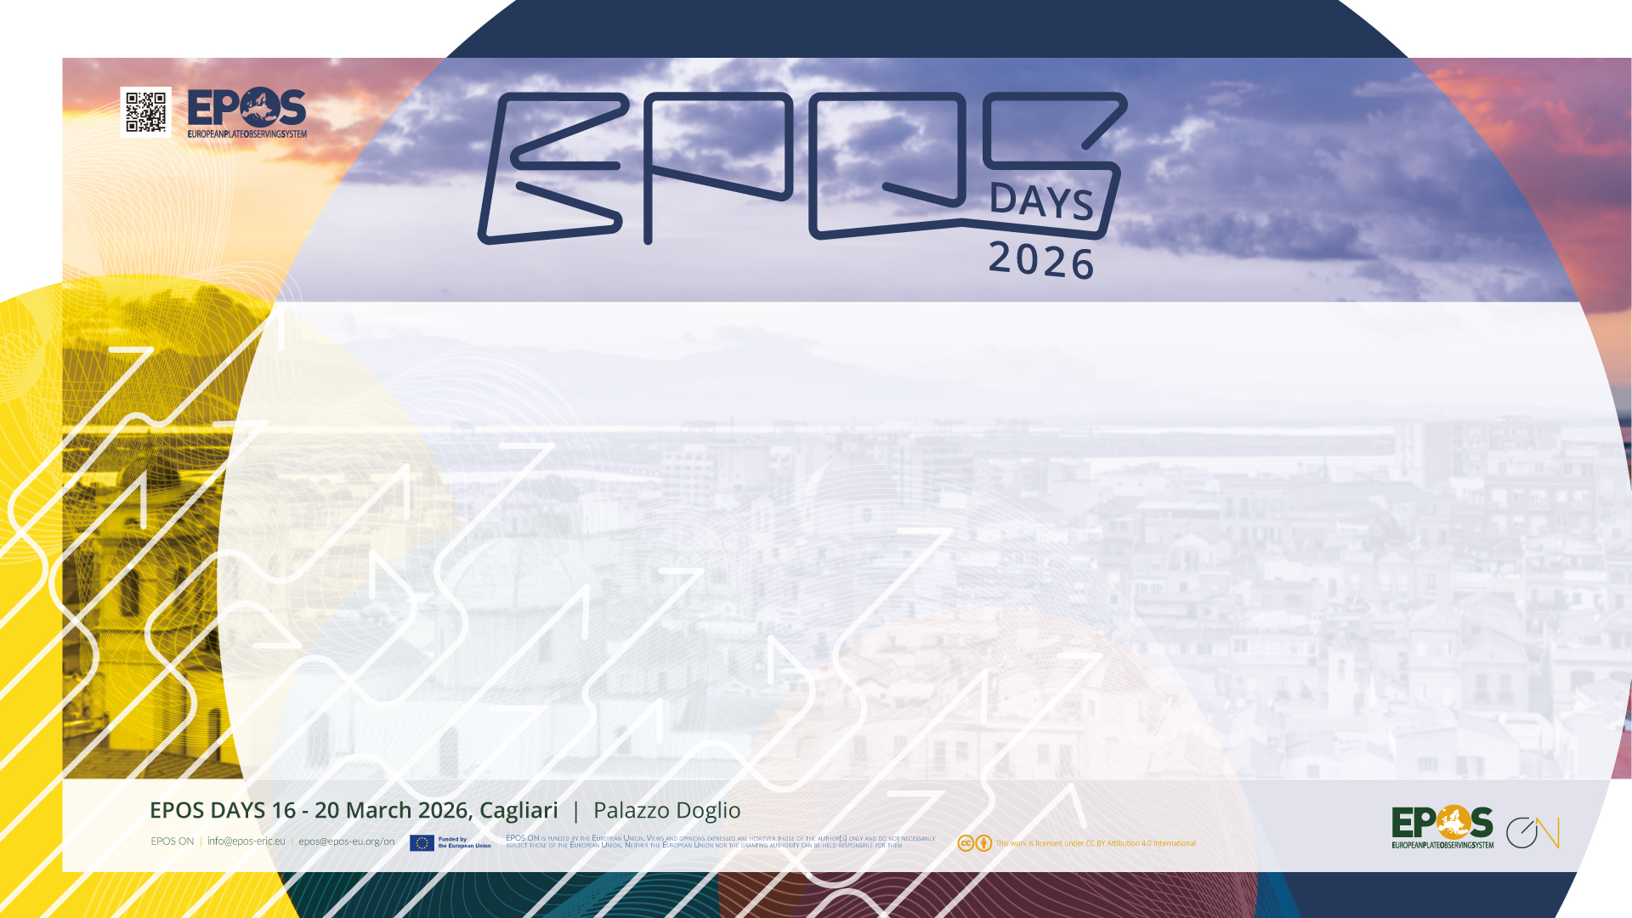
Rapid Earthquake Impact Assessment: Understanding Uncertainty from Source and ShakeMap Variability
EPOS ON WP3 Achievements during project first period
Helen Crowley, Vitor Silva & Catarina Costa (GEM)
Licia Faenza & Ilaria Oliveti (INGV) & the Earthquake Hazard Group of the ARISTOTLE-ENHSP

Slide 2
Rapid Earthquake Impact Assessment and connection to EPOS ON
…the process of using earthquake observations together with exposure and vulnerability models immediately after an event to quickly estimate the likely human, physical, and economic impacts, in support of emergency response and situational awareness.
This is relevant to EPOS ON WP3 in:
Subtask 3.1.4: Data products and services for rapid post-event assessment
Task 3.2: Interaction with operational stakeholders in civil protection and disaster risk management

Slide 3
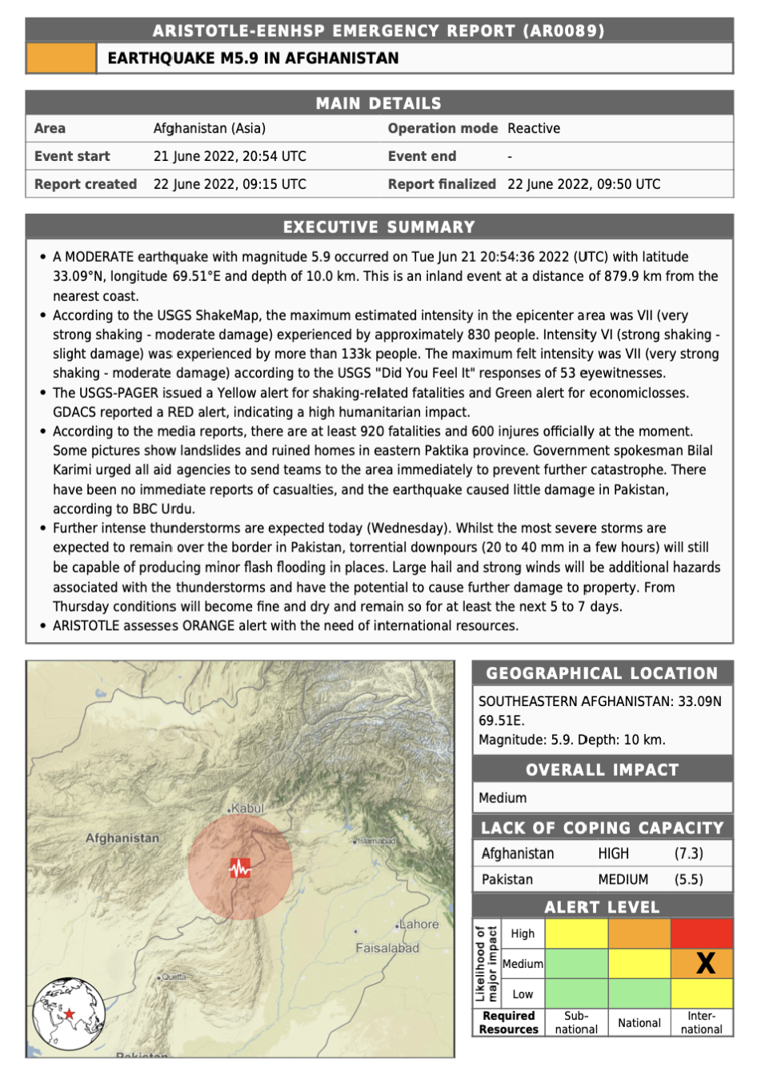

Who are these impact assessments for?
INGV leads the ARISTOTLE Consortium, a European multi-hazard scientific partnership that provides the European Union’s Emergency Response Coordination Centre (ERCC) with 24/7 expert monitoring, rapid analysis, and situation assessment to support decision-making during natural disasters.
INGV is also part of the operational team for earthquake hazards.
GEM provides rapid impact assessments for earthquakes anywhere in the world (not operational).

Slide 4
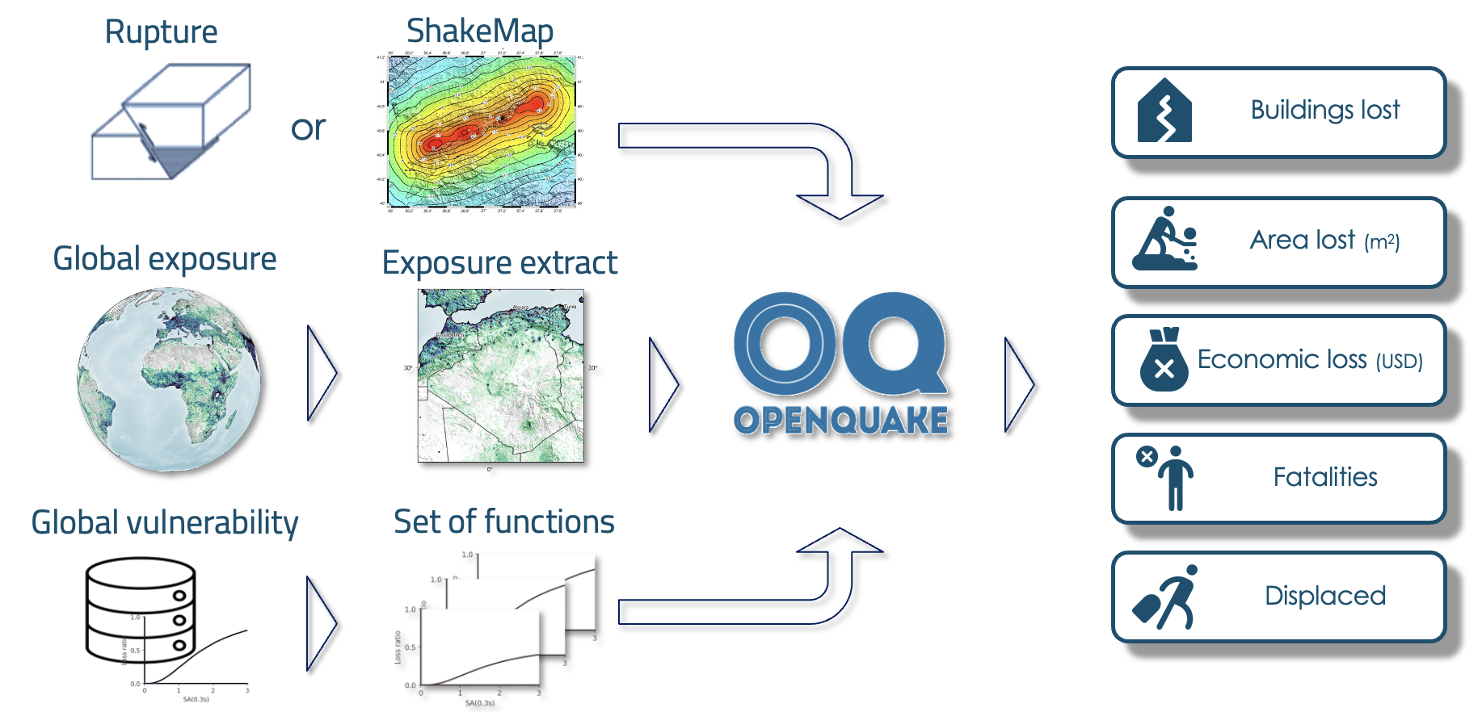
How does GEM assess impacts after an earthquake?

Slide 5
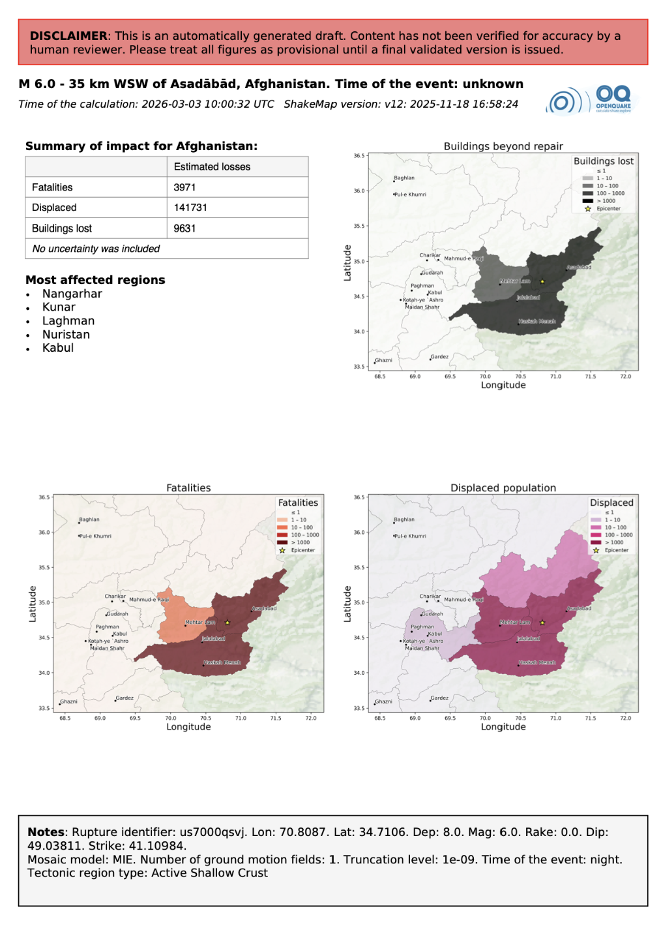
How does GEM assess impacts after an earthquake?

Slide 6
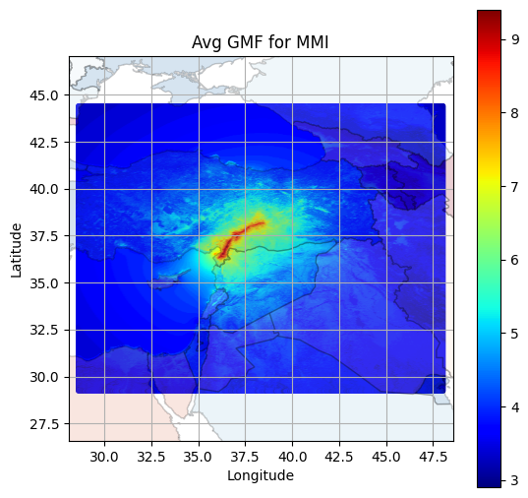
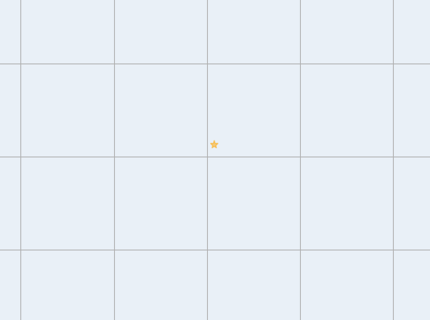
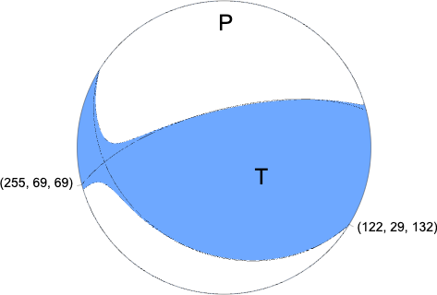
How does GEM assess impacts after an earthquake?
Currently we can follow six approaches to model the seismic rupture
ShakeMap
Point rupture
Nodal planes planes planes
Nodal 1
Finite rupture rupture
Rupture from PSHA
Rupture parameters
Mag
Depth
Strike
Rake
Dip
Notes:
Some issues - when use nodal planes or oq rupture or rupture parameters, often need to assume epicentre is in middle of rupture, need to assume aspect ratio (not always 2)

Slide 7
What are the key sources of uncertainty in assessing the shaking?
Magnitude
Location
Fault rupture geometry
Epistemic uncertainty & aleatory variability in ground motion models
Macroseismic intensity conversion to ground motion
Unreliable strong motion recordings

Slide 8
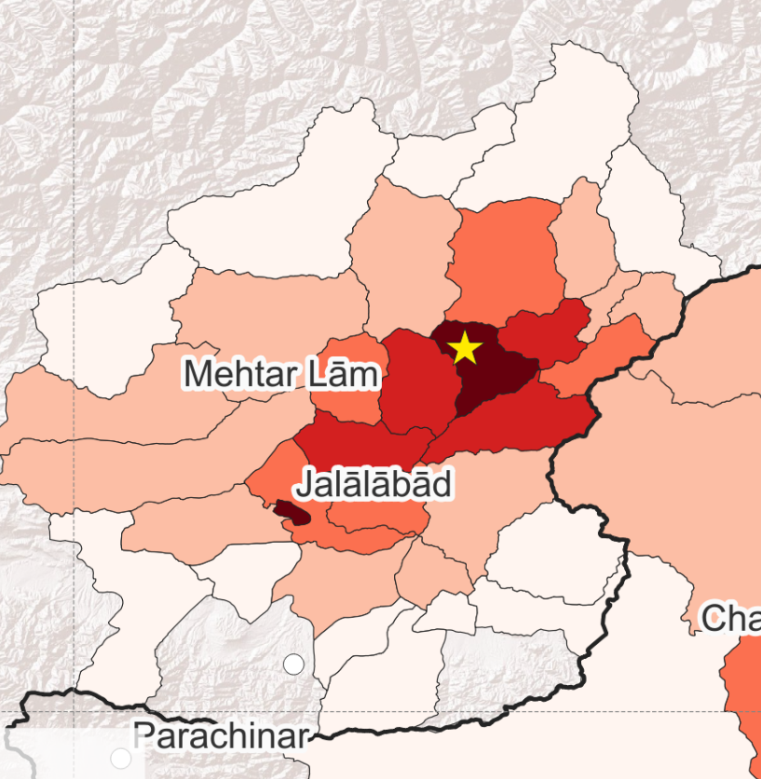
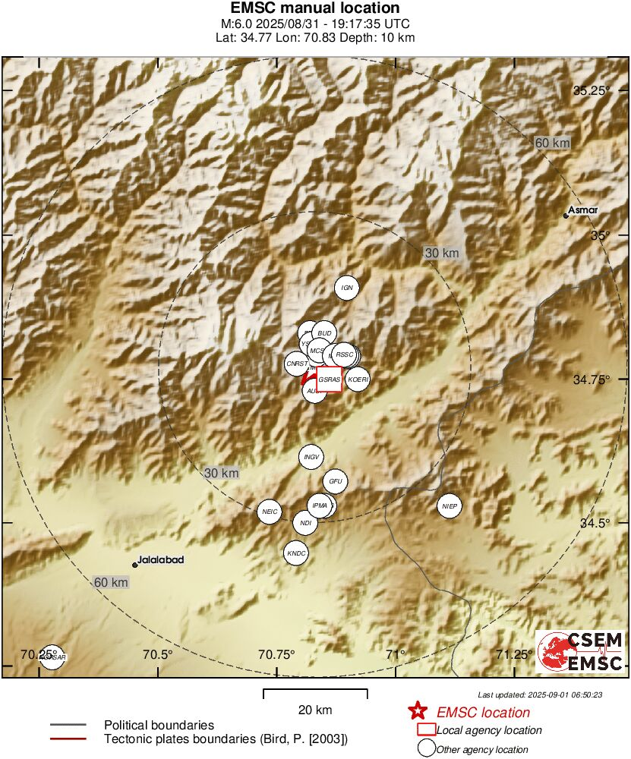
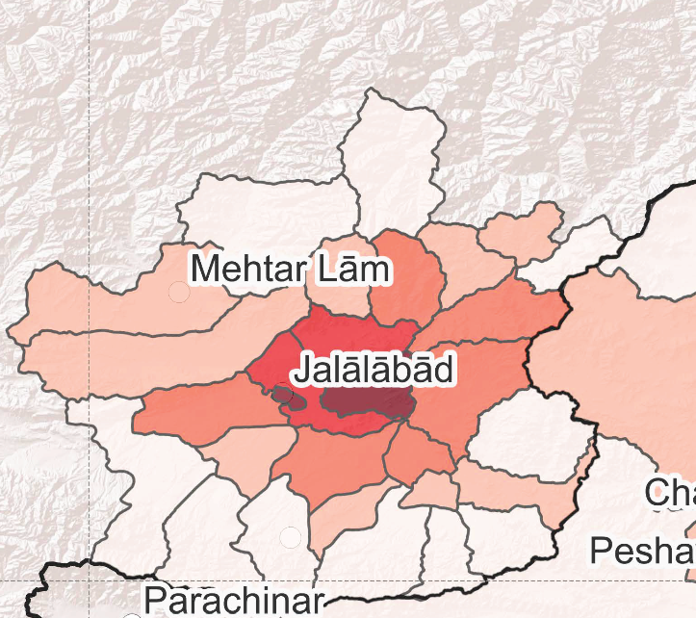
Influence of location uncertainty
M6.0 Jalalabad (which became Asadābād) earthquake
1st September 2025
Damage pattern from initial epicentre reported by USGS and used in first ShakeMap
Damage pattern based on updated epicentre reported by GFZ and other agencies

Slide 9
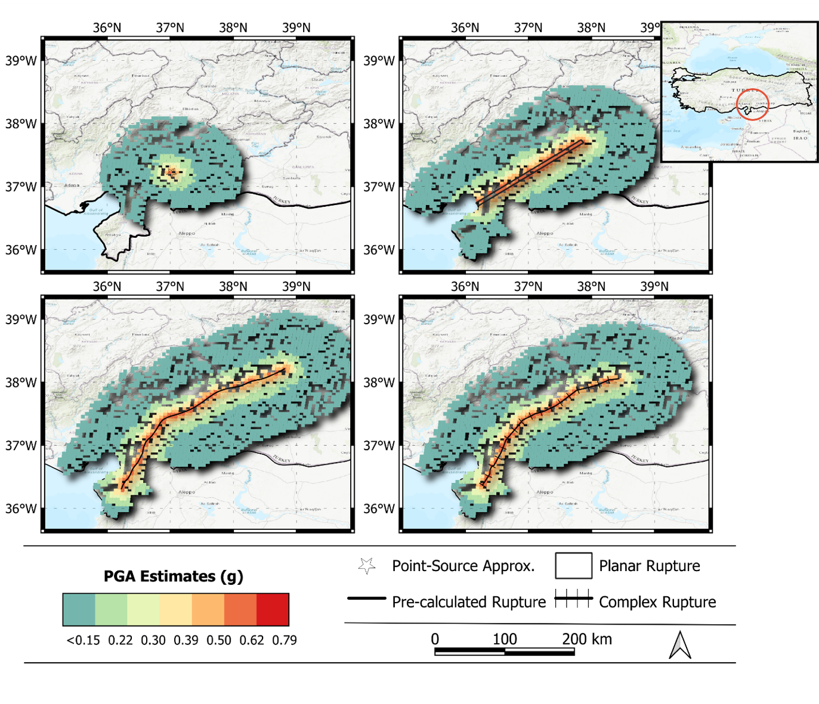
Influence of rupture geometry on shaking and losses
Point source
Planar rupture
2023 M7.8 Türkiye earthquake
Rupture from PSHA model (GEESE)
Benchmark rupture
Narlitepe et al.. (2026) SDEE, https://doi.org/10.1016/j.soildyn.2026.110207

Slide 10
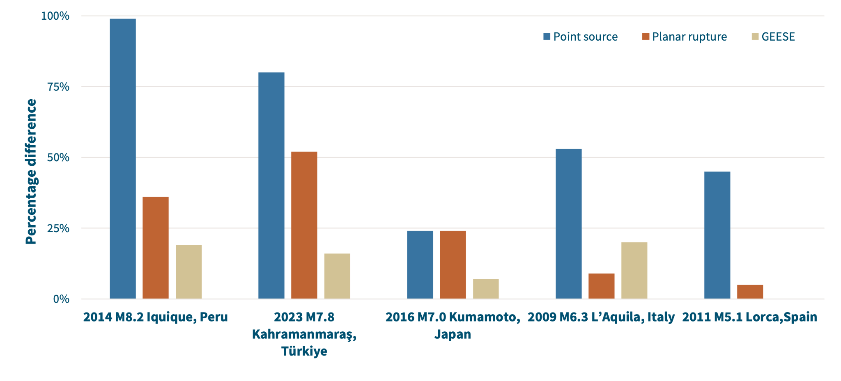
Influence of rupture geometry on shaking and losses
% difference in comparison with the impact estimates using the benchmark rupture
Narlitepe et al.. (2026) SDEE, https://doi.org/10.1016/j.soildyn.2026.110207

Slide 11
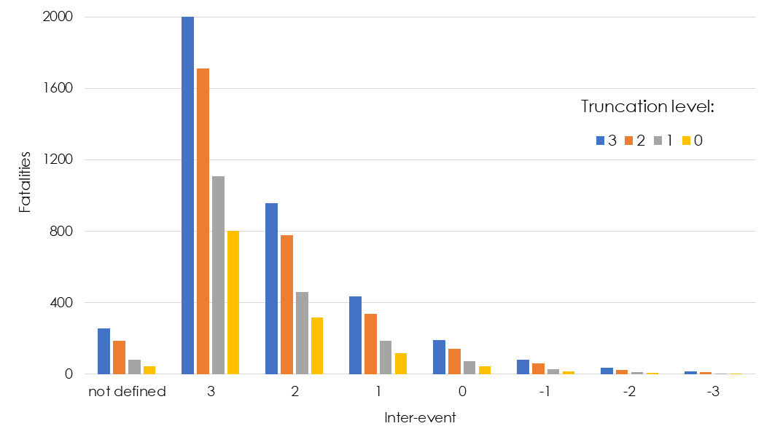
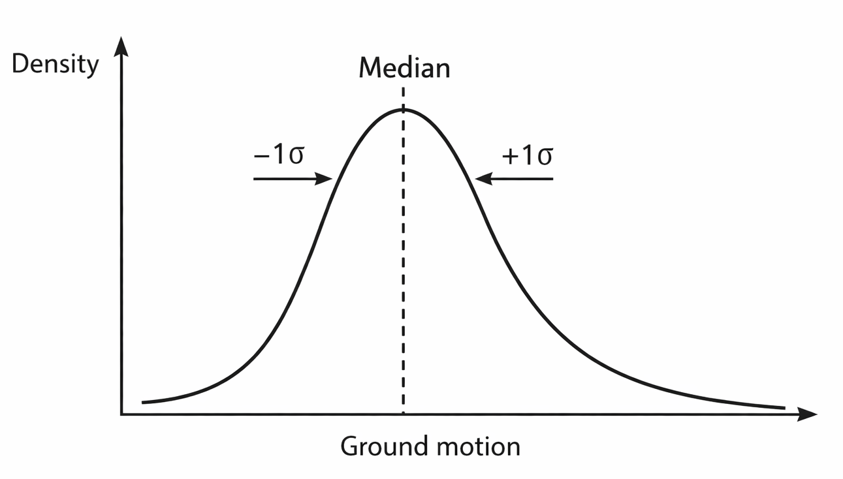
Influence of aleatory variability in ground motion model
Fatality estimations for the 2025 M6.3 Venezuela earthquake
Notes:
Epistemic uncertainty from GMMs
Aleatory - can go from 2000+ to 0 losses

Slide 12
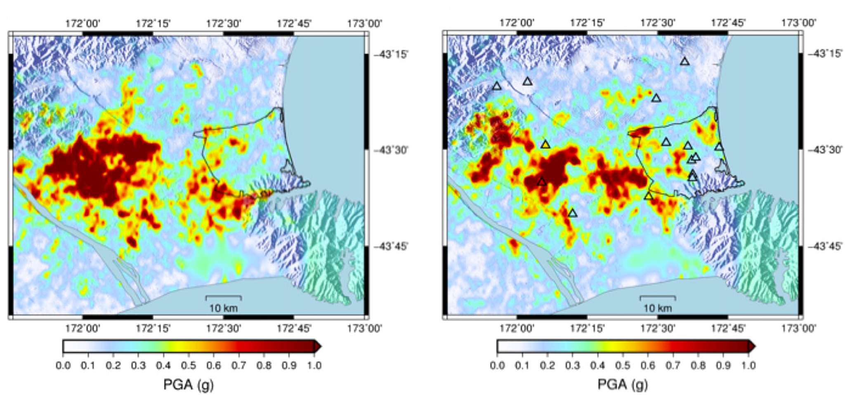
Influence of conditioning on station data to reduce uncertainty and bias
2010 Darfield (New Zealand) earthquake
No stations
With stations
Seismic stations
Mean loss: NZ$ 2.45 b | Mean loss: NZ$ 1.66 b
Standard deviation: NZ$ 0.93 b | Standard deviation: NZ$ 0.47 b
Actual loss: NZ$ 1.57 b
Notes:
Condition on gms (New Zealand) and get losses which are closer
Should condition but often don’t know recordings, macroseismic intensity

Slide 13
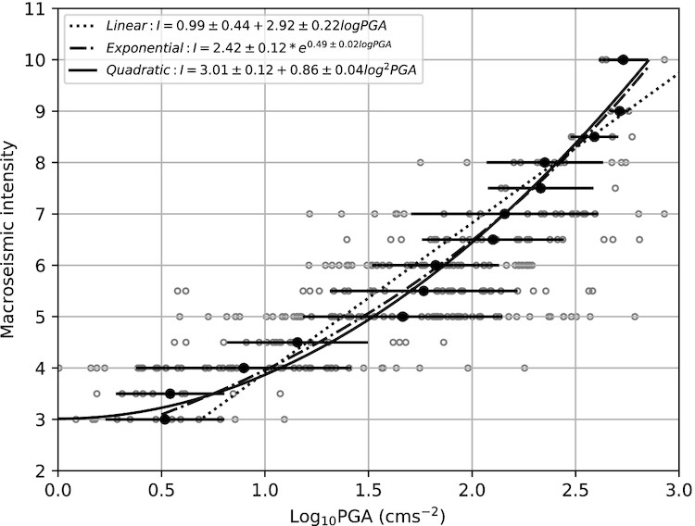
But what if we don’t have enough stations?
We could use Did You Feel It data (which is what ShakeMap does), but there is significant uncertainty in the conversion equations which should be propagated
E.g. from Did You Feel It

Slide 14
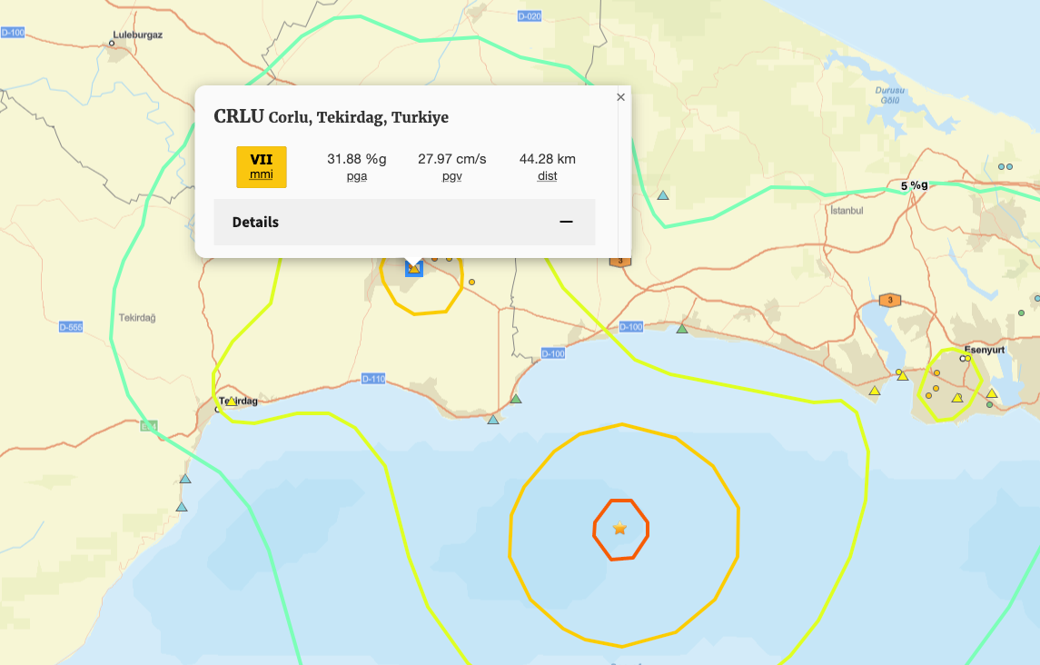
And what if the stations malfunction?
In the 2025 M6.2 Istanbul event, we identified a very unusual station recording being used in the USGS ShakeMaps. This station was not used in local reports from KOERI.

Slide 15
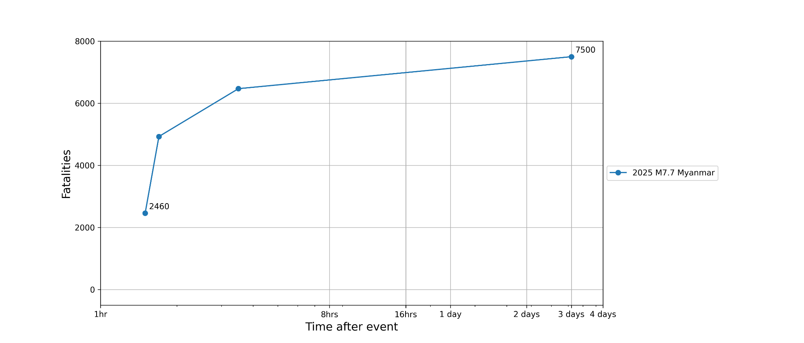
Examples of the evolution of impact assessments over time
Note: first estimate is always based on USGS ShakeMap

Slide 16
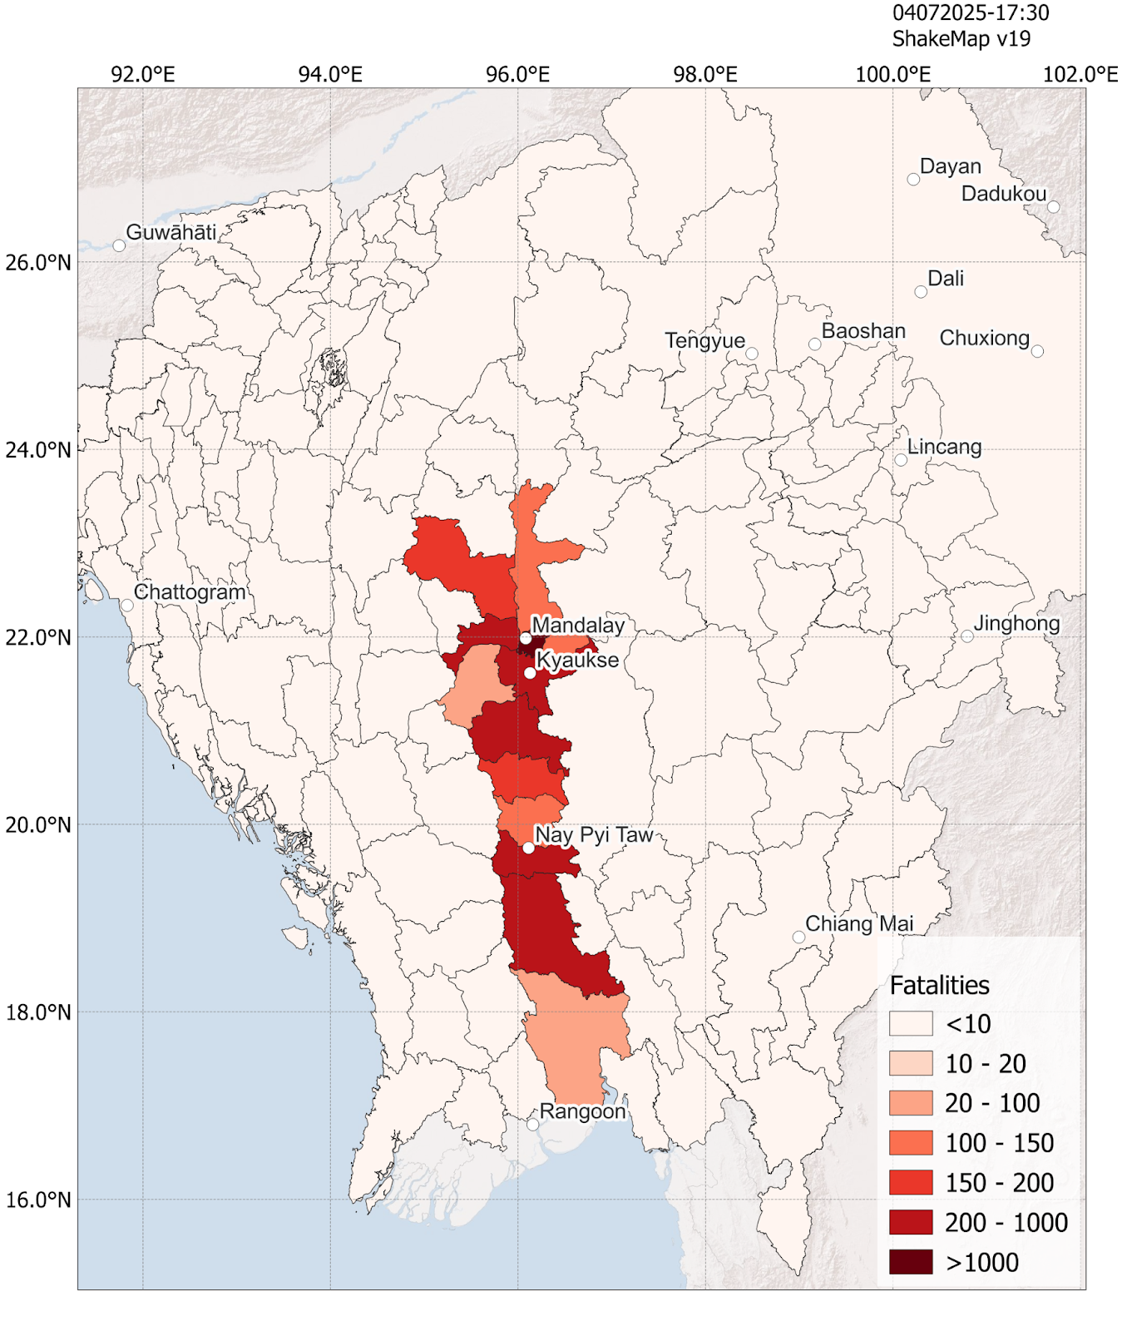
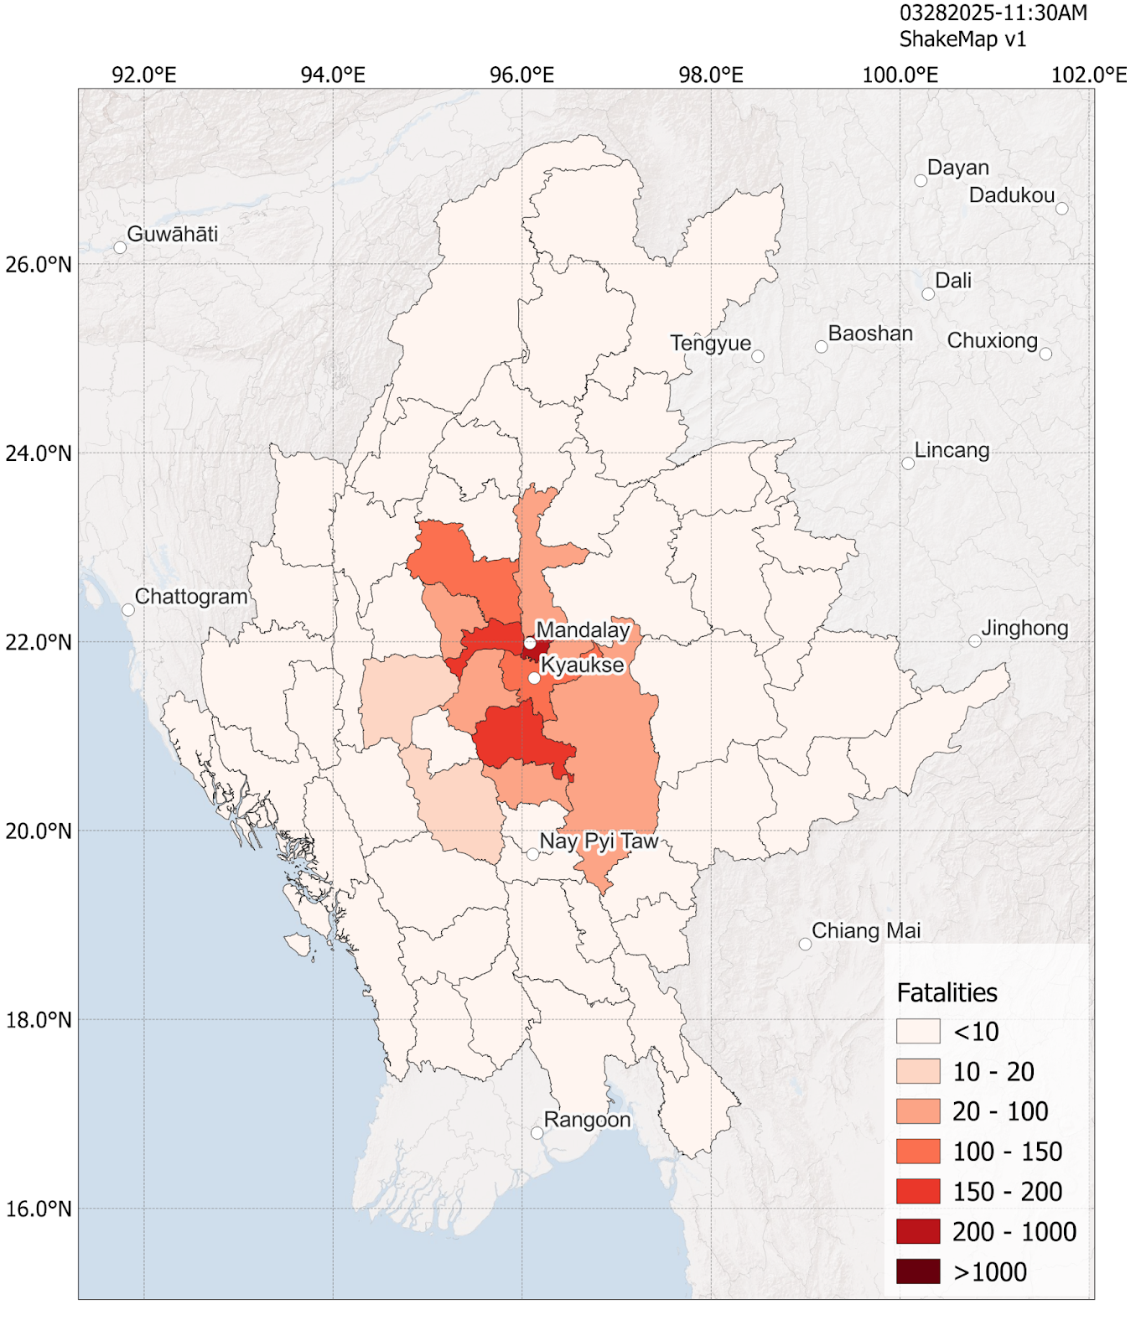
Examples of the evolution of impact assessments over time
USGS finite rupture
OpenQuake rupture based on hazard model
Rupture based on nodal plane
ShakeMap with point source
Note: first estimate is always based on USGS ShakeMap

Slide 17
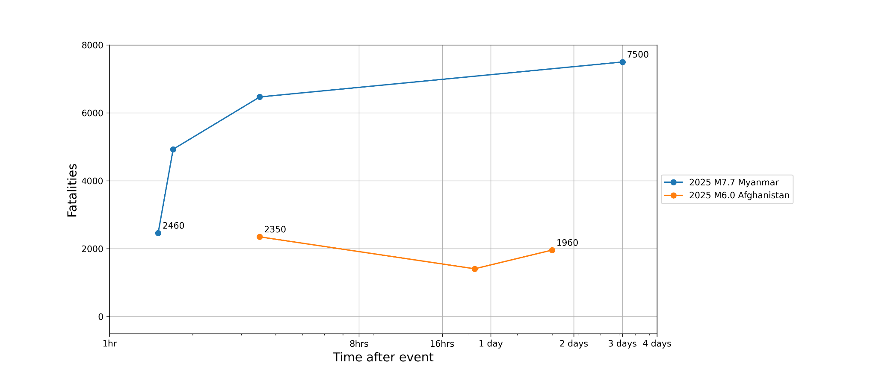
Examples of the evolution of impact assessments over time
Changes to epicentre (which affected also spatial pattern)
Note: first estimate is always based on USGS ShakeMap

Slide 18
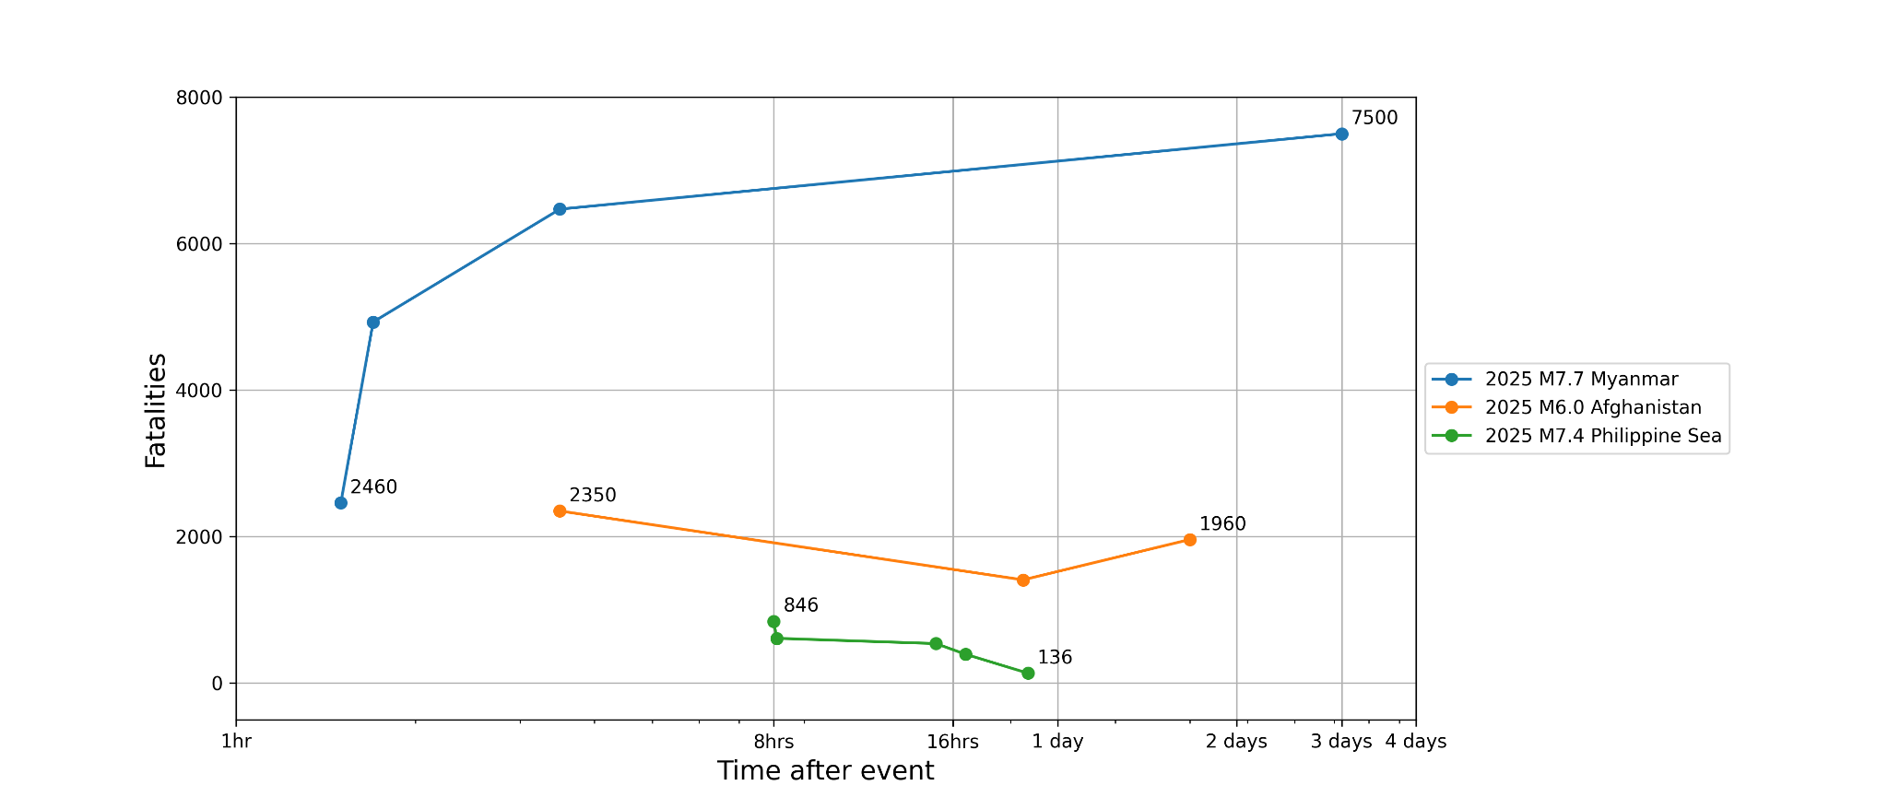
Examples of the evolution of impact assessments over time
Better modelling of vulnerability and occupancy of commercial buildings
Note: first estimate is always based on USGS ShakeMap

Slide 19
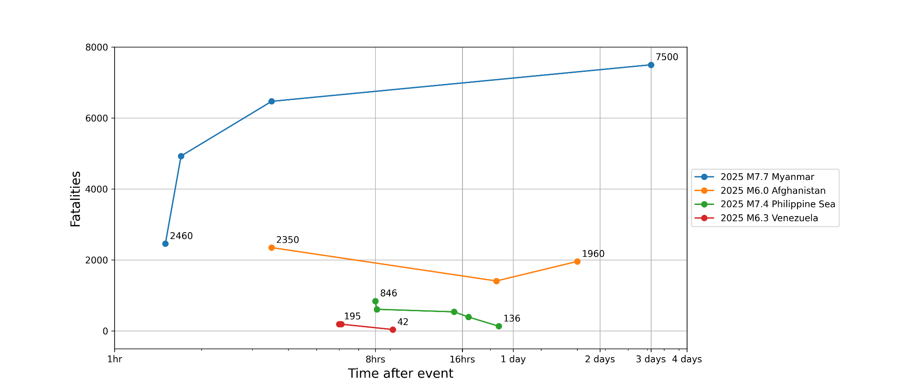
Examples of the evolution of impact assessments over time
Removal of a “problematic” ground motion model
Note: first estimate is always based on USGS ShakeMap

Slide 20
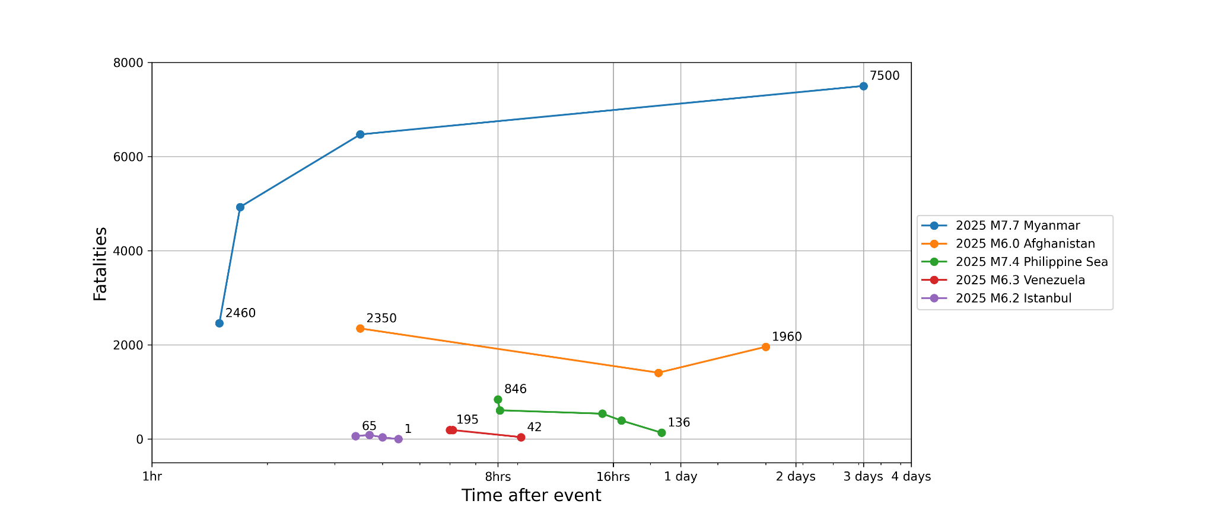
Examples of the evolution of impact assessments over time
Removal of ‘dubious’ recording station
Note: first estimate is always based on USGS ShakeMap

Slide 21
Key Takeaways
There are large uncertainties in the impact assessments which are particularly high in the first few hours when we rely on automated procedures that are based on ShakeMap
In many cases the analyses need to be checked by experts to select the most reasonable and reliable inputs, which is why we built the oq-impact platform with advanced user features (e.g. input rupture, select GMM..)
The more information we gather in the early stages, the better we can constrain the ground motions - can we use damage from satellite imagery or crowdsourced photos?
However, even with highly constrained ground motion fields, there are still uncertainties in the exposure and vulnerability models, and thus we continue to validate and update our models based on what we learn from running scenarios

Slide 22
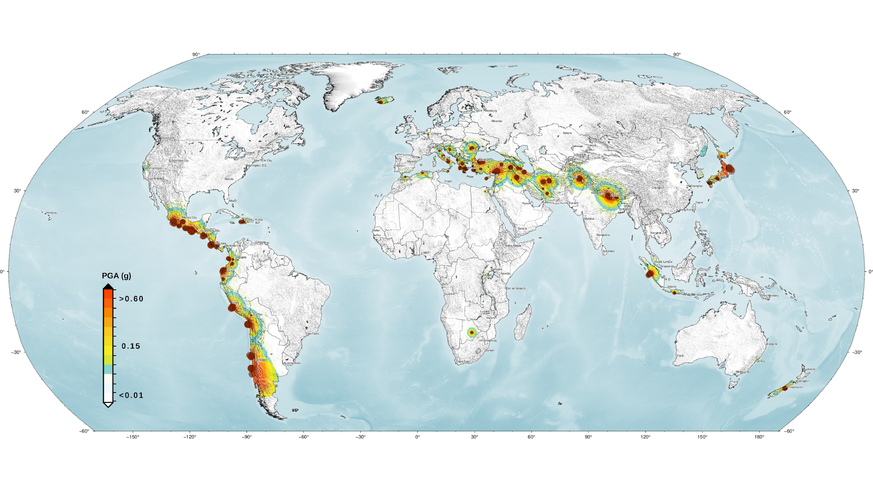
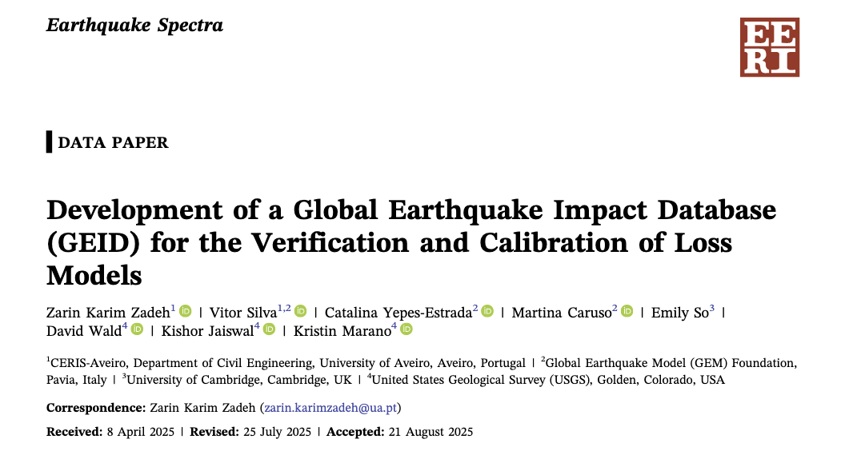
Where do we go from here?
https://github.com/gem/geid
Continue to grow GEM’s Global Earthquake Impact Database, with these recent events that we run in OQ-impact platform but also with more historical events

Slide 23
Thank you!

