Slide 1






Next-Generation Earthquake Early Warning: From Public Alerts to Multi-Hazard Integration
Alexandru Marmureanu - Antonio Scala
John Clinton - Vasilis Kapetanidis - George Kaviris et al.

Slide 2
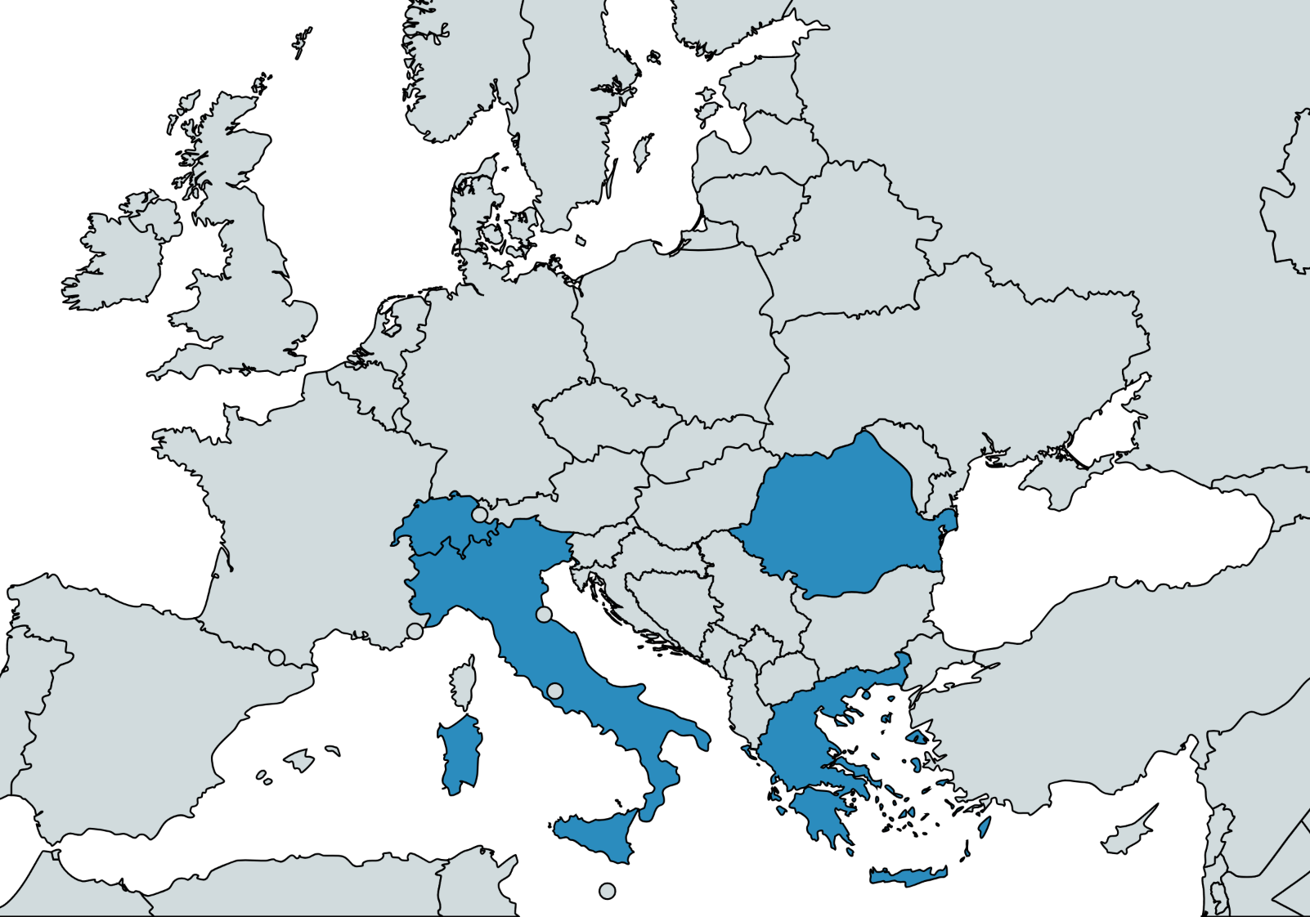
EEWS (Earthquake Early Warning Systems) Status in Europe
EEWS operational or under implementation:
Switzerland
Italy
Romania
Greece
Two algorithms available:
VS (ESE)
PRESTo / QuakeUp

Slide 3

ESE - a modular early warning package
ESE and notifications architecture SeisComP extensions modules:
● Real time envelope feed
● VS and FinDer algorithms
● Decision module
● Alert dissemination

Slide 4
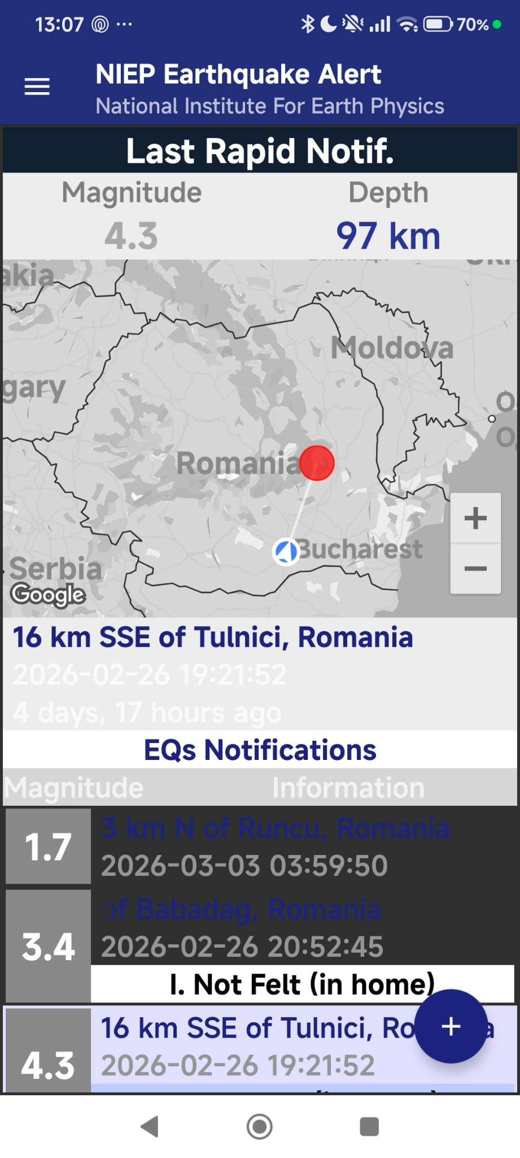
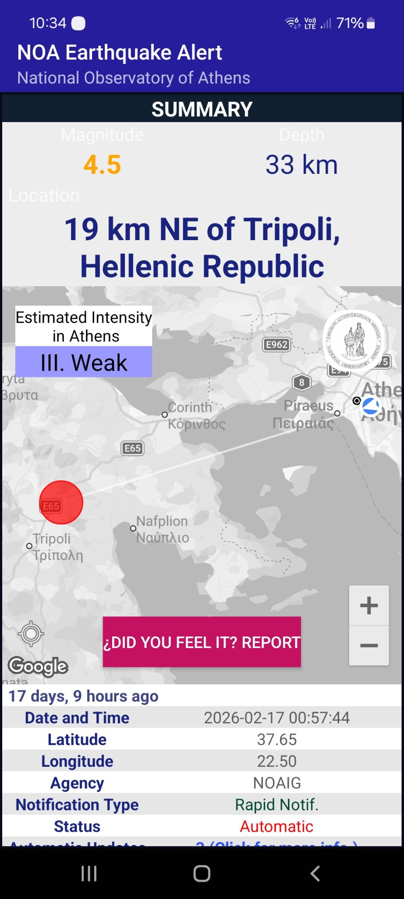
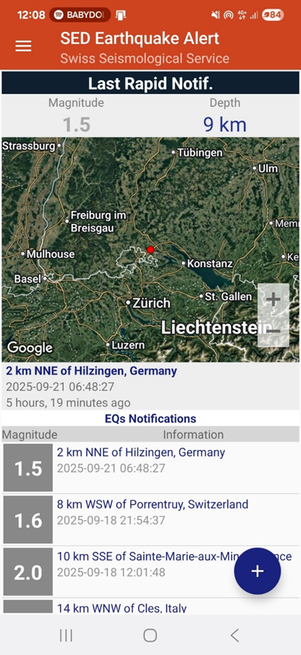
ESE real-time implementation
Romania Greece Switzerland
(mobile app) (mobile app)

Slide 5


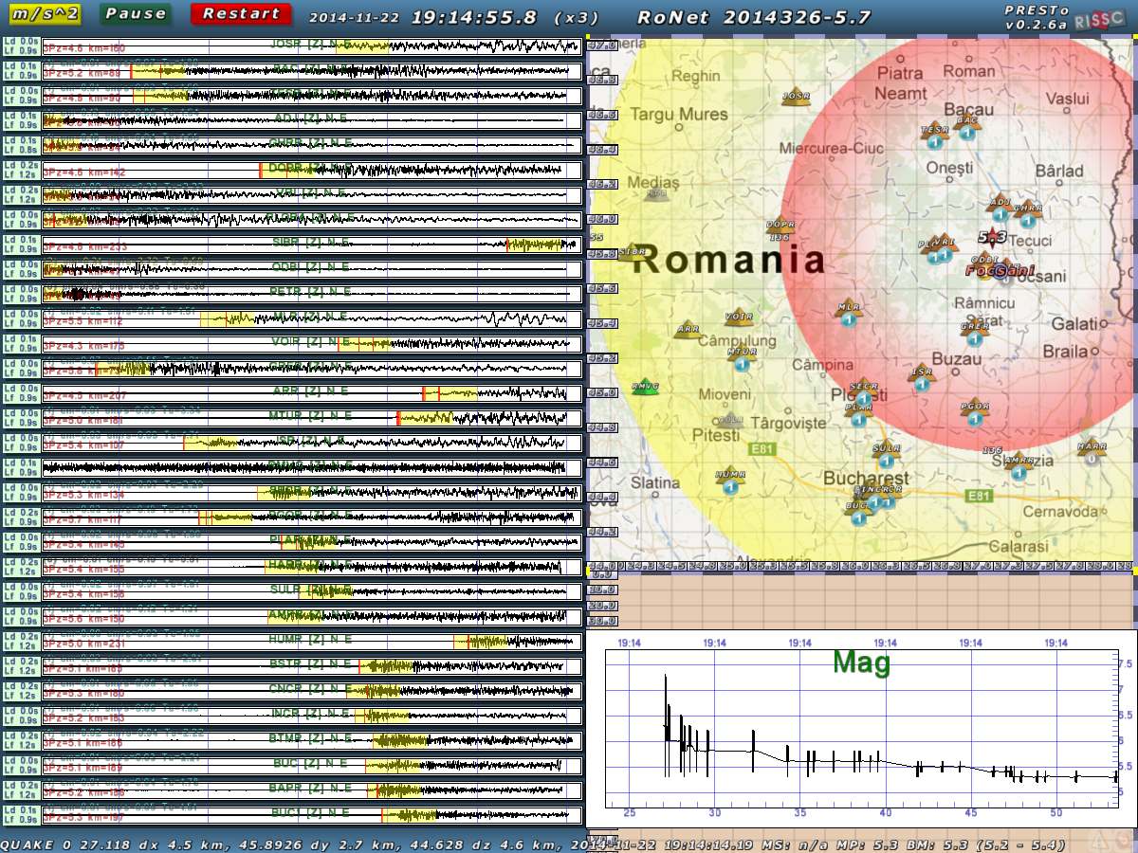
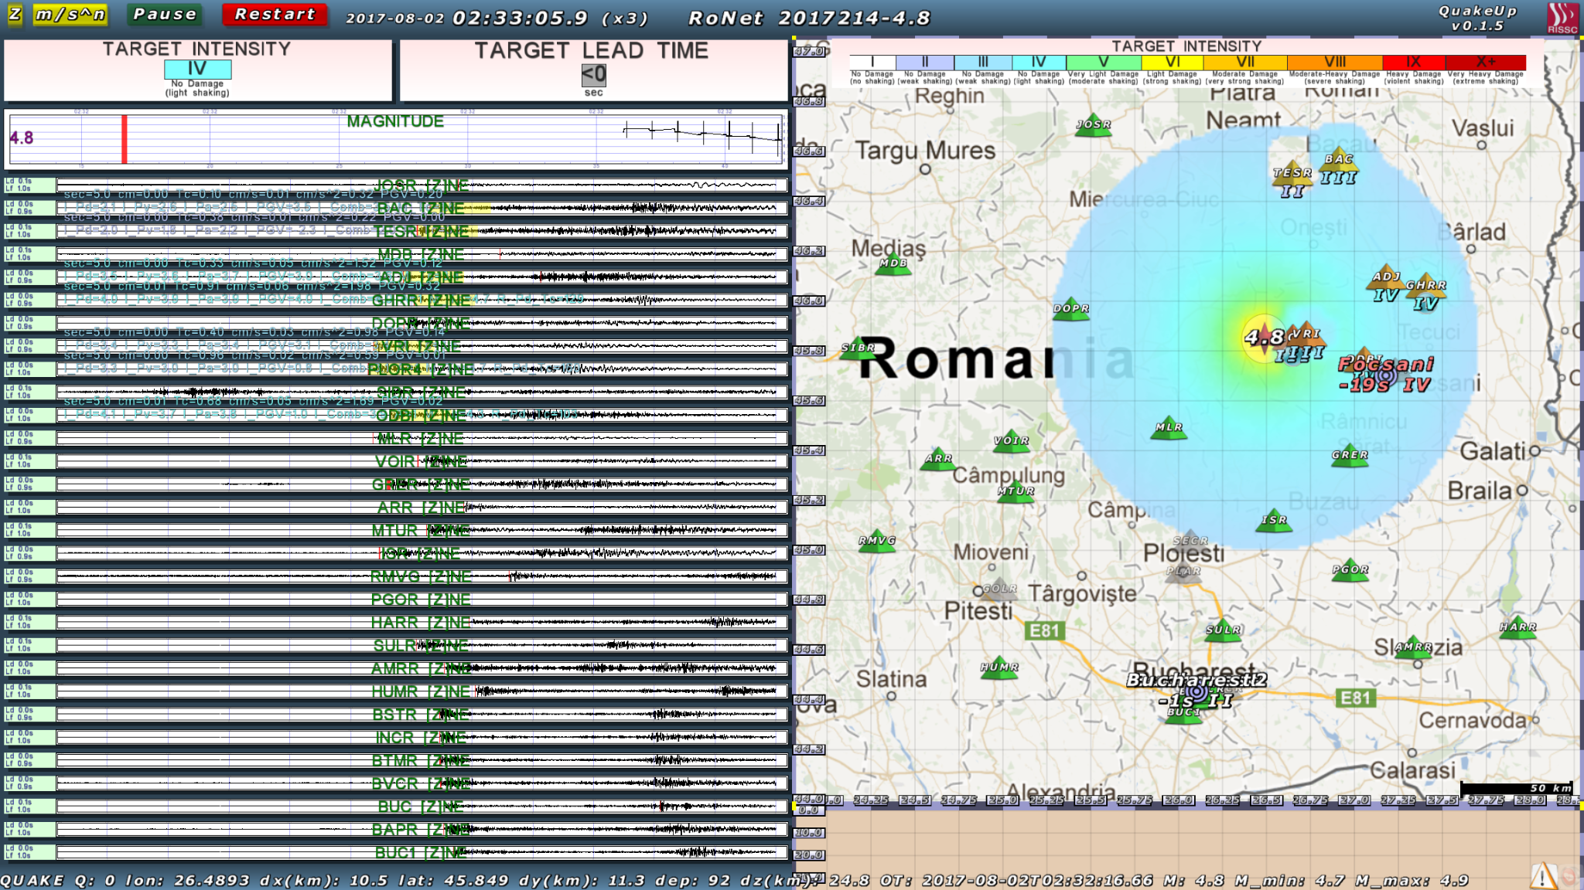
PRESTo and QuakeUp
PRESTo/QuakeUP software platforms for EEWS that integrates:
recent algorithms for real-time
rapid earthquake location
magnitude estimation and damage assessment
In ROMANIA the target is mainly Vrancea area:

Slide 6
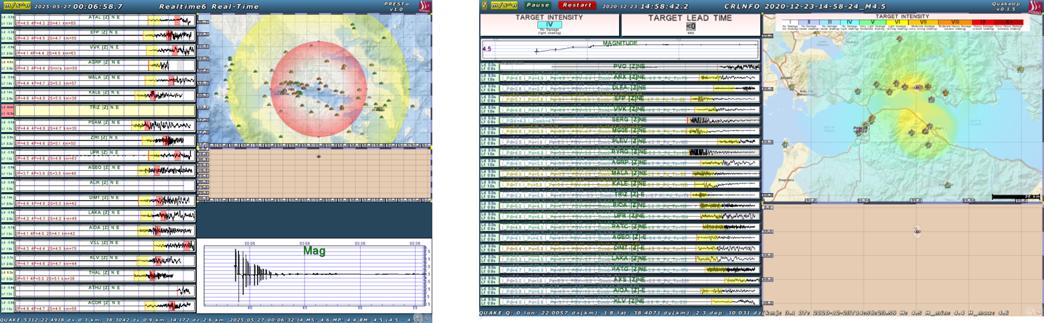

PRESTo and QuakeUp
In Greece, PRESTo is applied in real-time for the area of Central Greece, mainly focusing in the Gulf of Corinth, and particularly the Corinth Rift Laboratory (CRL) Near Fault Observatory (NFO).
QuakeUp is currently being tested offline with archived data from the CRL NFO.

Slide 7
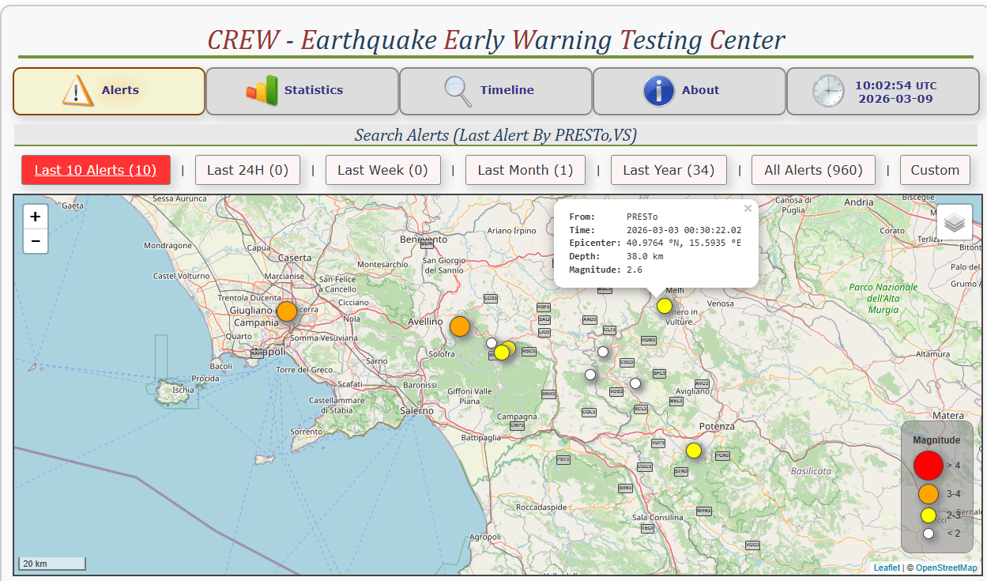
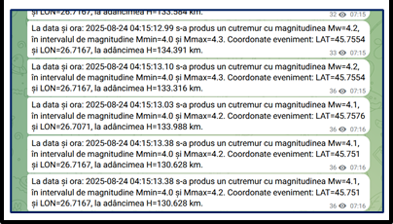
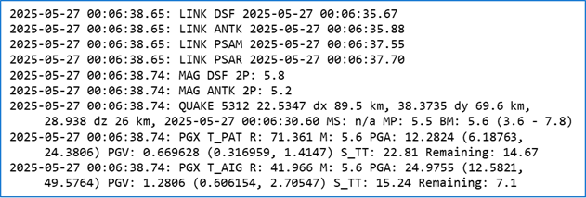
PRESTo/ QuakeUP real-time implementation
Romania
Since 2013 operational
85 alerts to authorities (M>4)
Alerts available for free to general public via Telegram channels
Greece
In 2025, 152 PRESTo alerts for confirmed M≥2.0 events in the CRL NFO area were issued internally at NKUA.
Italy
960 alerts from PRESTO since 2016, publicly accessible through CREW
QuakeUp in implementation
Since May 2025, 20 real-time alerts internally issued for testing

Slide 8

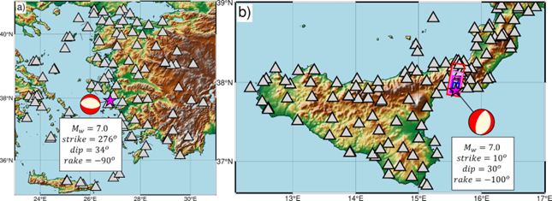
Earthquake & Tsunami coupled EW
Real case
Samos earthquake
Simulated case
Messina earthquake
Can EEW support multi-hazard disaster risk management?→ TEW
Near coastal offshore events
Dense network with azimuthal gap
Reduced tsunami lead time
Between Greece and Turkey
30 October 2020
Southern Italy
Proxy of 1908 event scenario

Slide 9
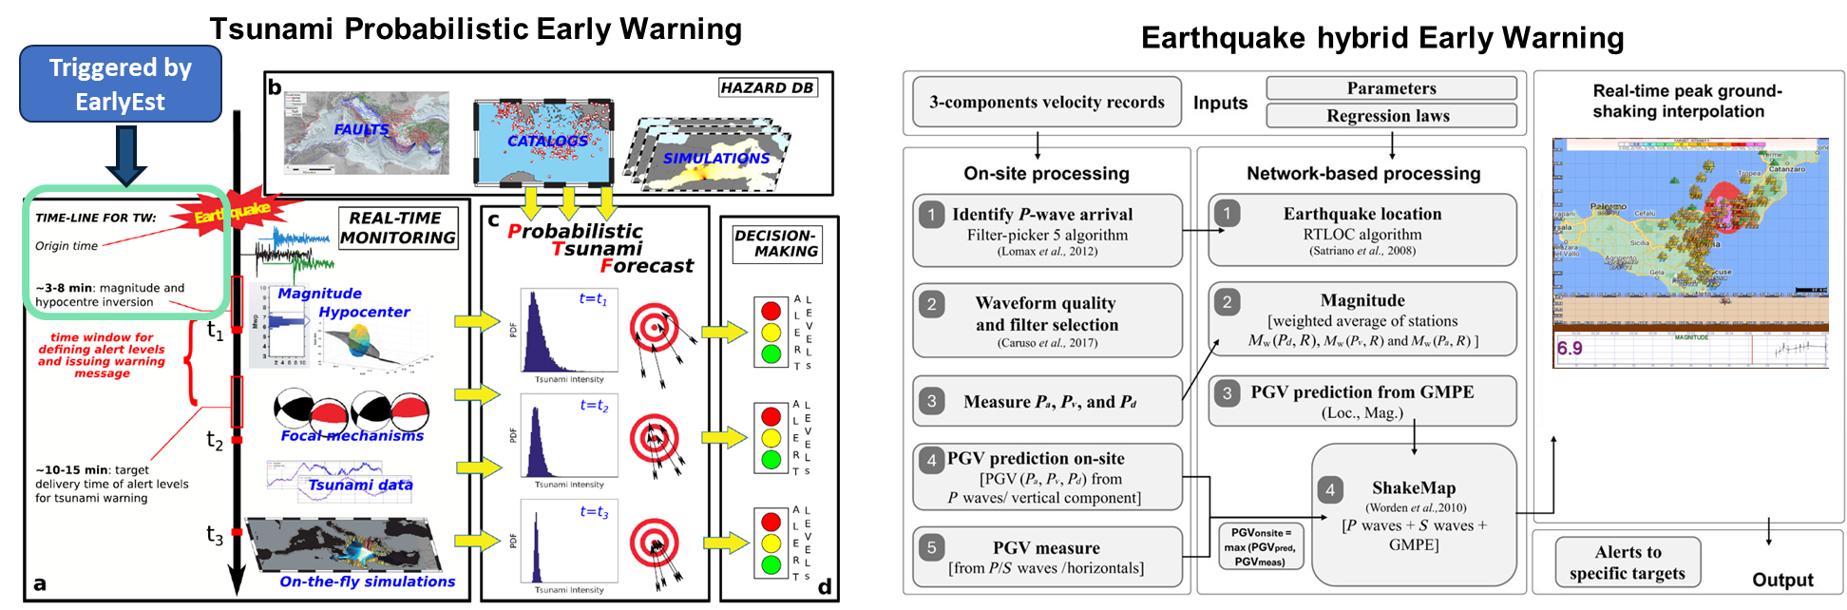
QuakeUp → Probabilistic Tsunami Forecasting (PTF)
QuakeUp block diagram
Source parameters
+
Potential Damage zone

Slide 10
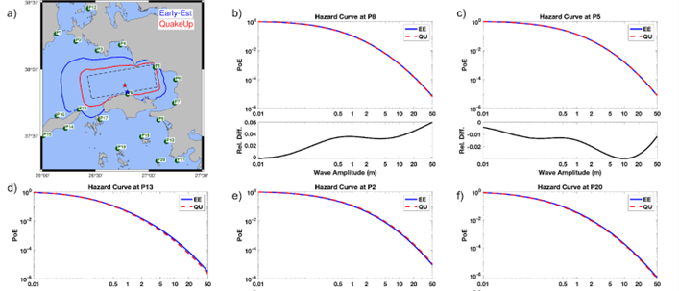
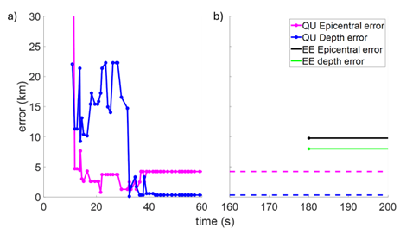
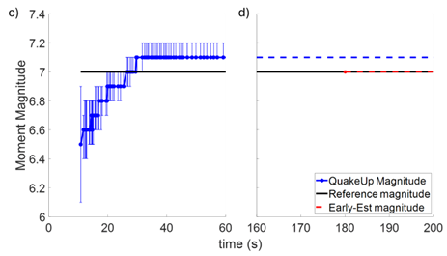
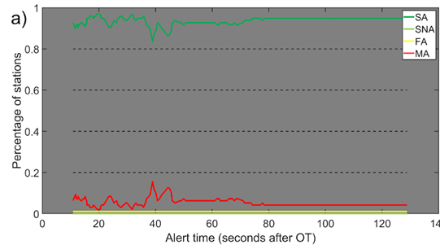
Source and shaking estimation
Faster and robust
seismic source estimates
Robust
shaking predictions

Slide 11
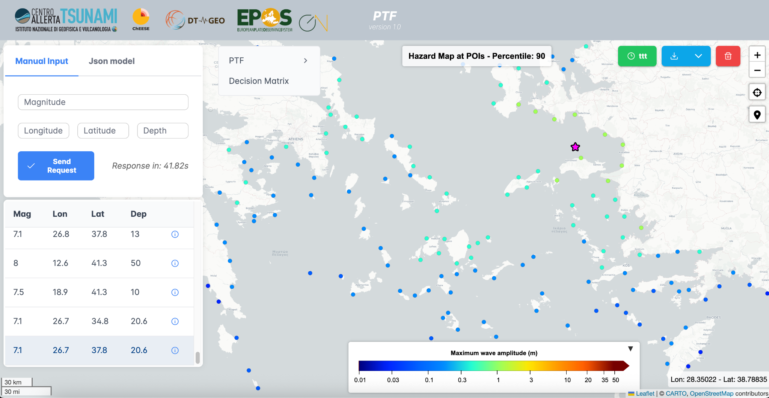
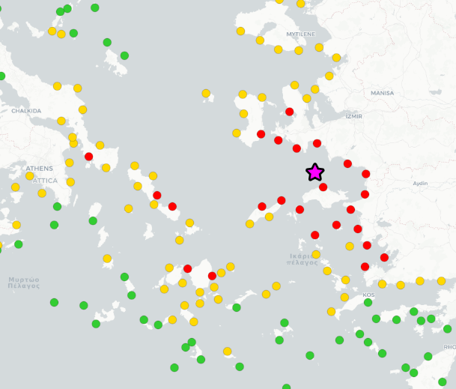
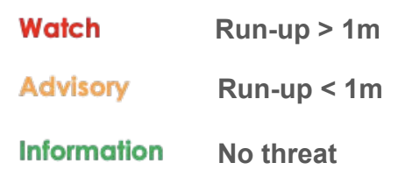
Probabilistic Tsunami Forecasting
Decision makers can decide the
level of conservativeness based on the forecast uncertainty
Warning based on predicted inundation level

Slide 12
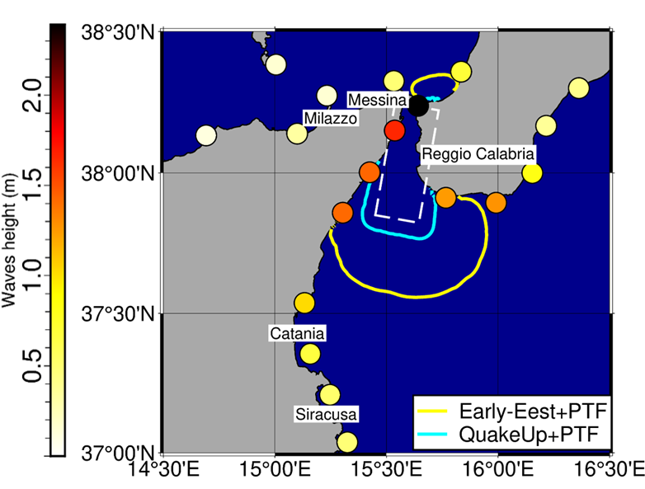
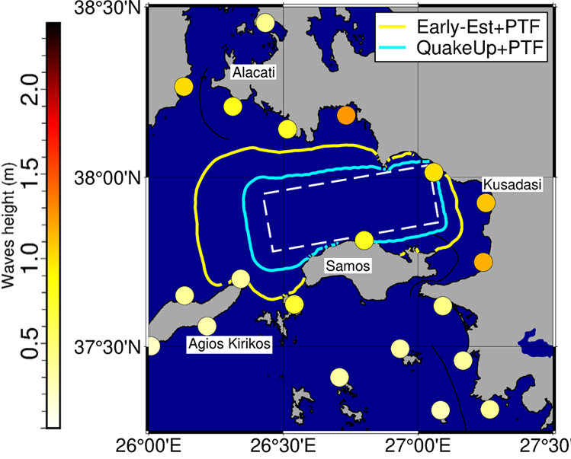
Tsunami inundation forecast & lead time
Faster and consistent tsunami alerts
Longer lead time for populated areas

Slide 13
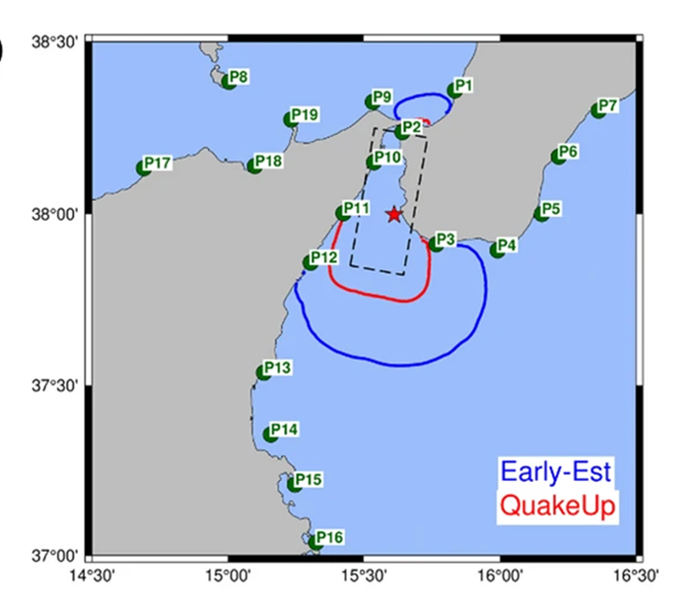
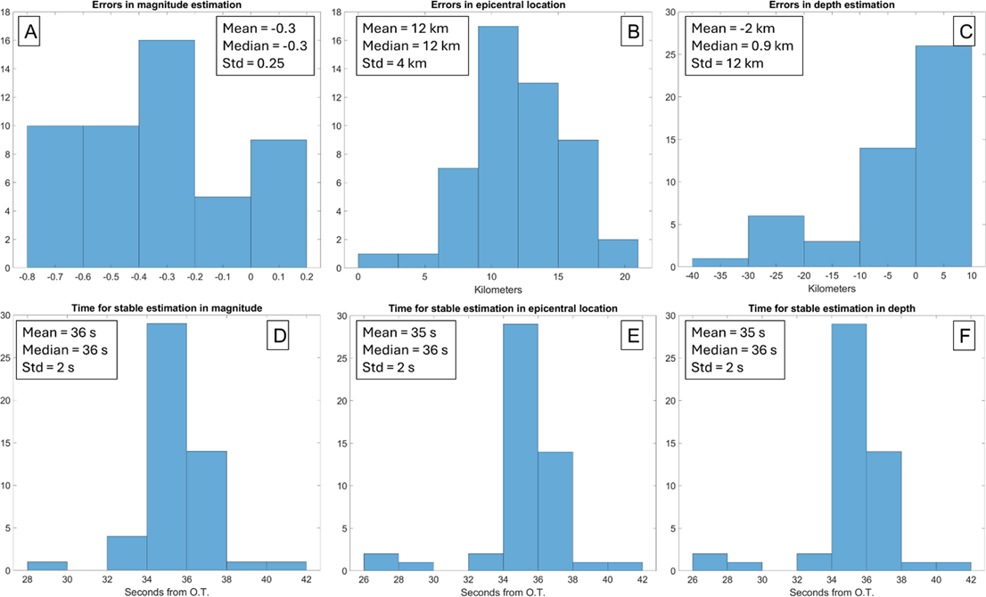
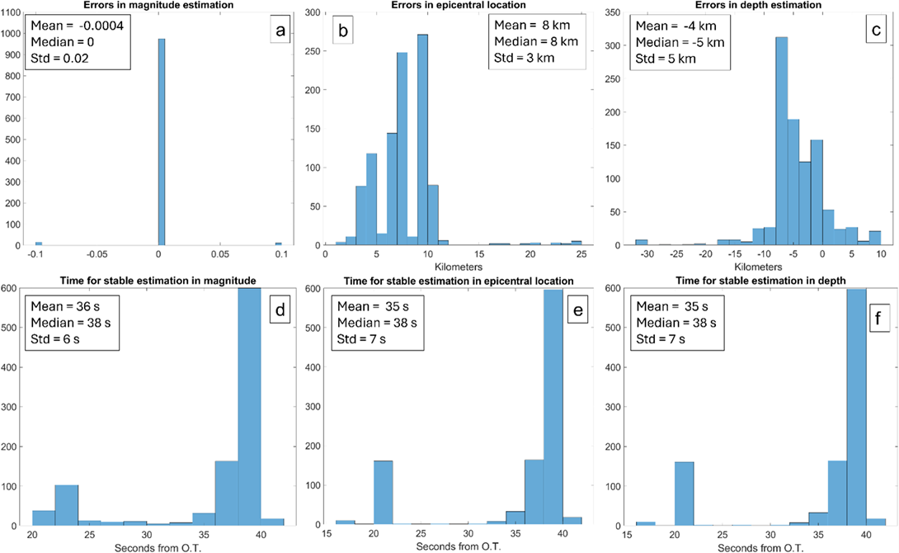
Sensitivity analysis & robustness
Source variability
Network degradation
Mw
Epi
Loc
Depth
Epi
Loc
Depth
Mw
Robustness across…

Slide 14

Conclusions
- Greece:
Preliminary offline tests with QuakeUp in the CRL NFO show a promising improvements
Further testing is required to optimize its parameters.
- Romania, Italy and Switzerland:
Operational systems are already in place.
Testing and improving the systems using different methodologies.
Ready for decision module development
- EEW + TEW (CAT):
EEW systems might efficiently enhance Tsunami Early Warning operational approach.
DEMO to be presented to EUCPM initiatives for DRM

Slide 15


Thank you!

