Slide 1
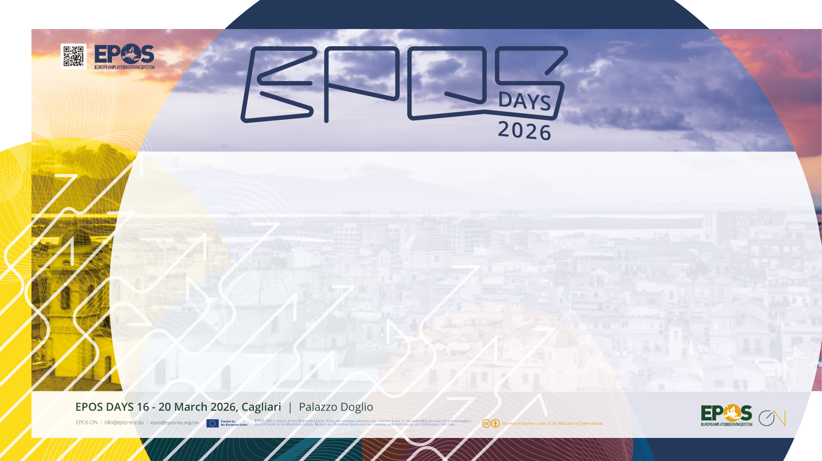
EPOS ON WP3
Achievements during project first period
F. Romano, A. Scala

Slide 2


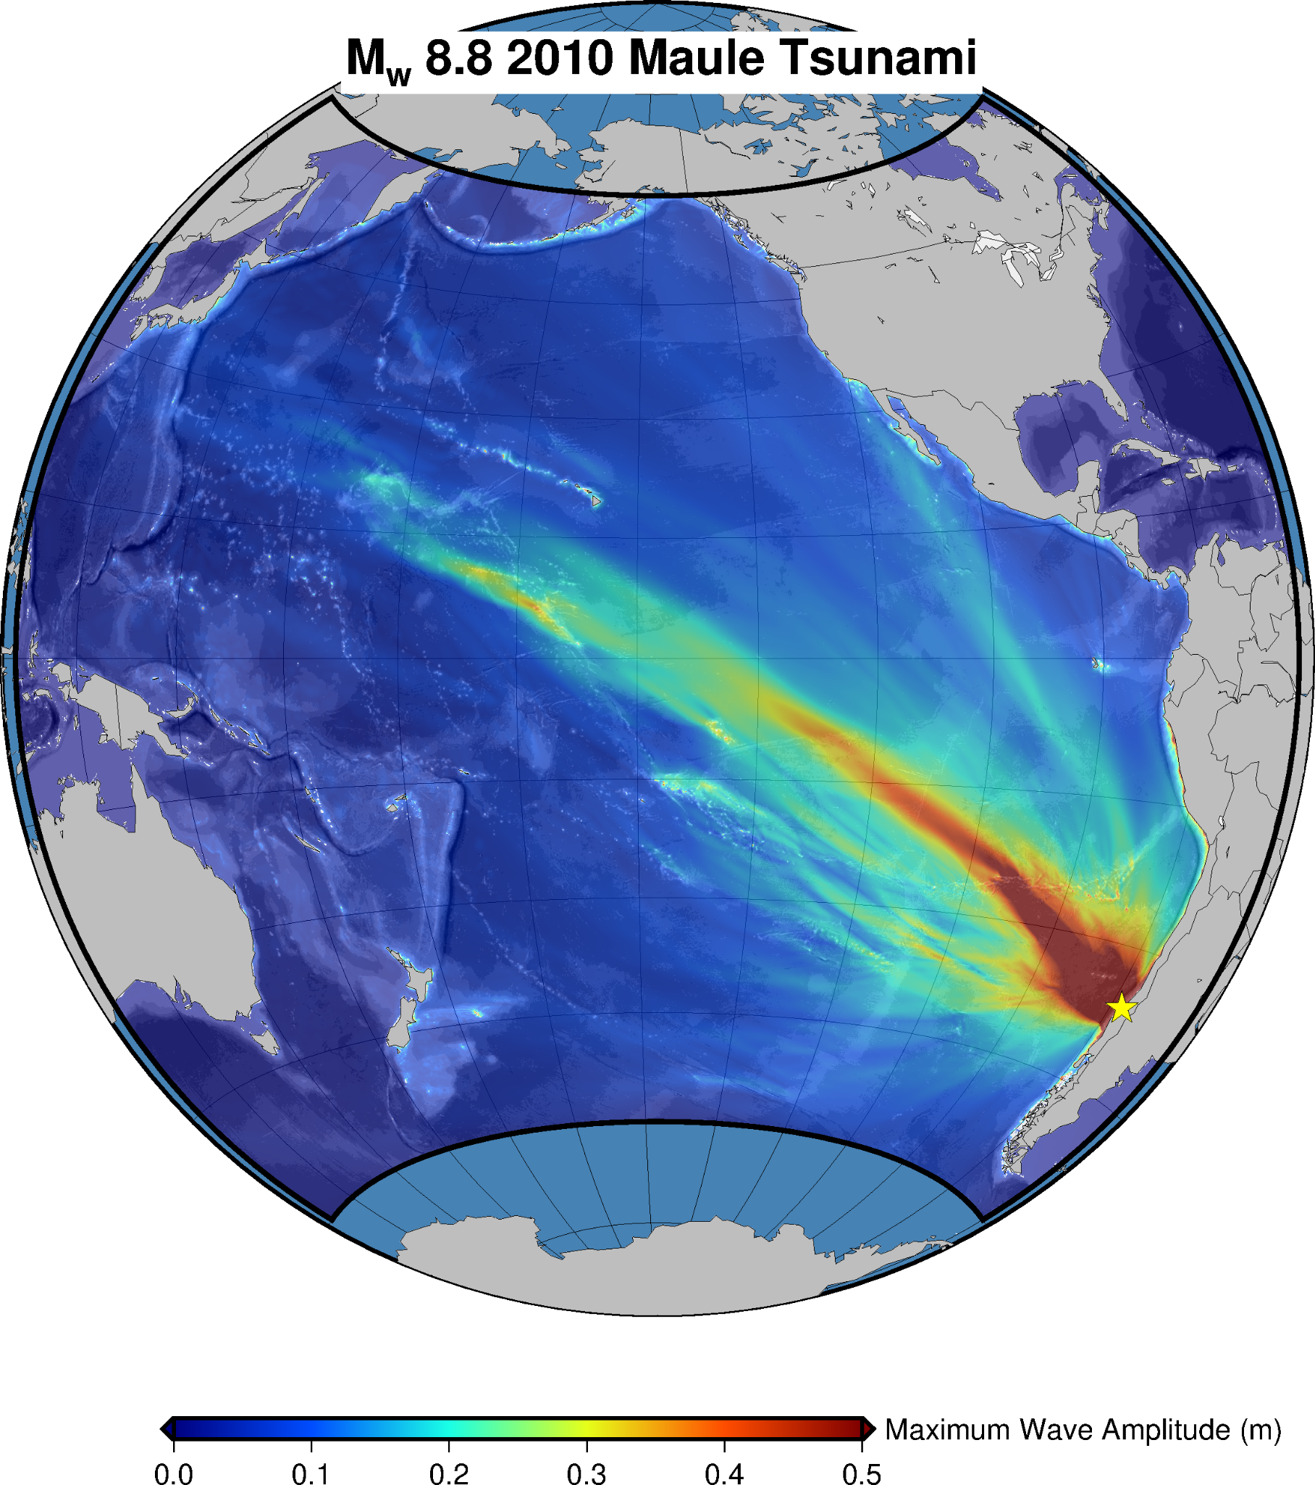
WP3 in a nutshell
WP3 aims to contribute to tackling societal challenges to make a step forward in defining concrete actions in which EPOS may provide added value for society.
Task 3.3
Enhancement + Interoperability
of services for several natural hazards
Task 3.1
Definition of ethical guidelines
Task 3.4
Interaction w/ operational stakeholders
Environmental impacts of the EPOS RI
Task 3.2

Slide 3
WP3 in a nutshell
WP3 aims to contribute to tackling societal challenges to make a step forward in defining concrete actions in which EPOS may provide added value for society.
This objective will be achieved:
Through both the enhancement and the integration of a suite of services existing inside some EPOS Thematic Core Services (TCS) to tackle specific societal challenges related to risk management. We will work towards the interoperability, achieved through the EPOS ICS-C or the new ICS-D, of: Earthquake, Tsunami, and Volcano Monitoring and Alerting; Operational Earthquake Forecasting; Rapid Multi-Hazard Post-Event Assessment. [Task 3.1]
By fostering innovation, learning opportunities, and dialogue between EPOS and the EU Union Civil Protection Knowledge Network (UCPKN) and other operational stakeholders in civil protection and disaster risk management. [Task 3.2]
Through the definition of ethical guidelines to direct EPOS actions towards society and through the development of a codified form aimed at describing the characteristics of products/services, their scientific/technological value for the benefit of society, their opportunities/risks when used by users. [Task 3.3]
By identifying how the environmental impacts of the EPOS RI over its technological life cycle can be reduced and how the data made available by the thematic communities can contribute to the monitoring of climate. [Task 3.4]

Slide 4
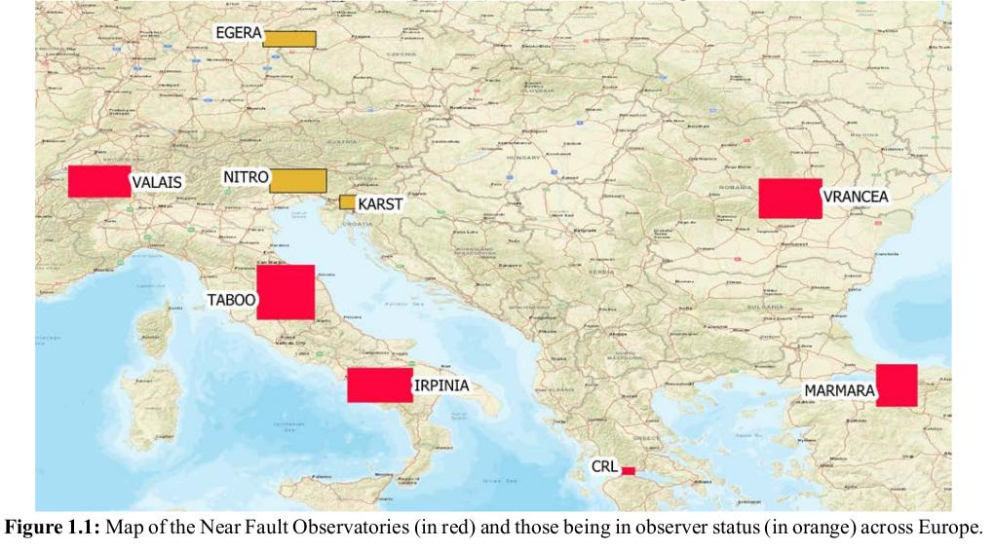





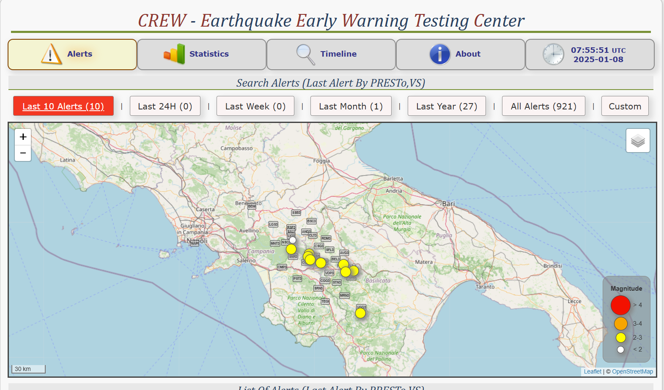
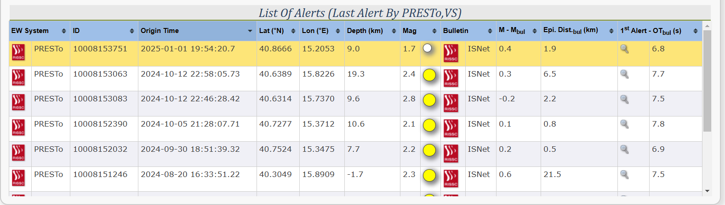
Subtask 3.1.1
Earthquake Early Warning Support (EEWS) services (UNINA, INCDFP-RA, NOA, ETH Zürich) - The activity is grounded on the existing Early Warning Testing Center (CREW) and Near-Fault Observatories (NFO) infrastructures. We want to enhance the service by: including the capacity of manage data from different NFOs and extending the testing center to other NFO; including and testing different EEWS algorithms (e.g., Finder, QuakeUp); developing a Decision Module to compare outputs and select the optimal EW message.
Extensive online & offline playback tests with PRESTo and other novel approaches
The NFOs are long term RIs that strive to provide multidisciplinary and high resolution near fault data.
improved lead times and promising reductions
in alert delays + decision module
CREW is the testing center for EEW techniques managed by TCS-NFO within EPOS
Can EEW support multi-hazard (e.g. earthquake+tsunami) disaster risk management?

Slide 5
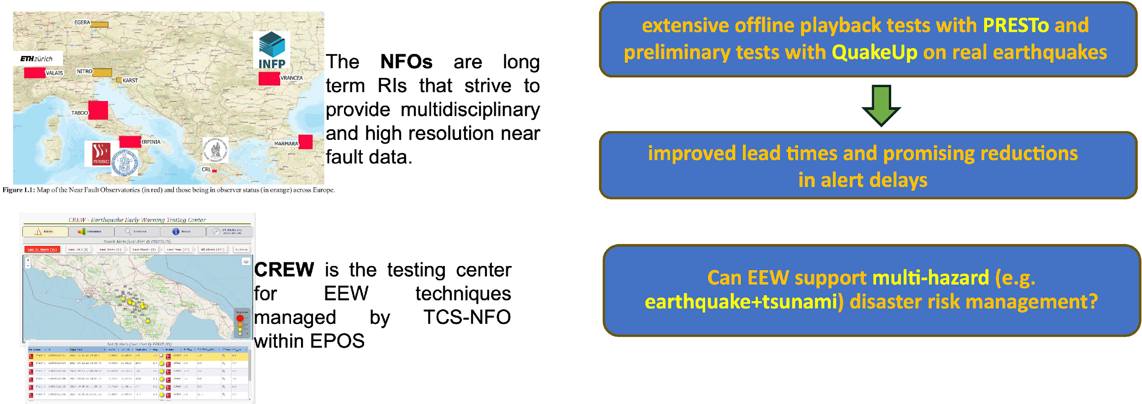
Subtask 3.1.1
Earthquake Early Warning Support (EEWS) services (UNINA, INCDFP-RA, NOA, ETH Zürich) - The activity is grounded on the existing Early Warning Testing Center (CREW) and Near-Fault Observatories (NFO) infrastructures. We want to enhance the service by: including the capacity of manage data from different NFOs and extending the testing center to other NFO; including and testing different EEWS algorithms (e.g., Finder, QuakeUp); developing a Decision Module to compare outputs and select the optimal EW message.
12.00-12.15 | Next-Generation Earthquake Early Warning: From Public Alerts to Multi-Hazard Integration | Antonio Scala, Alexandru Marmureanu

Slide 6
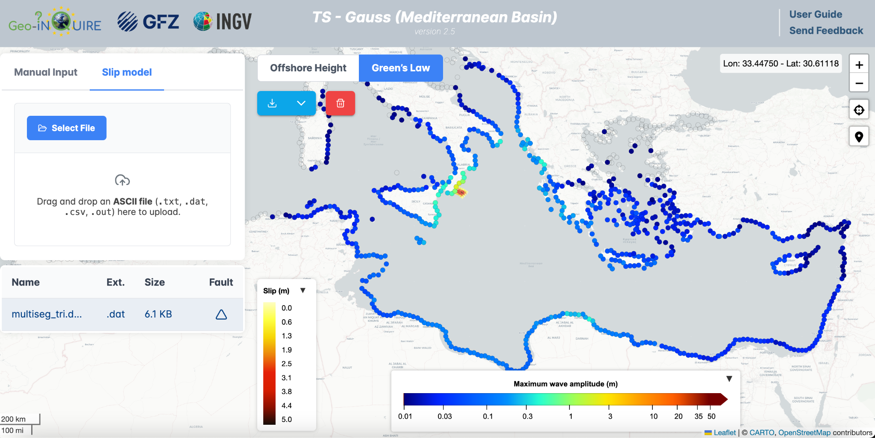
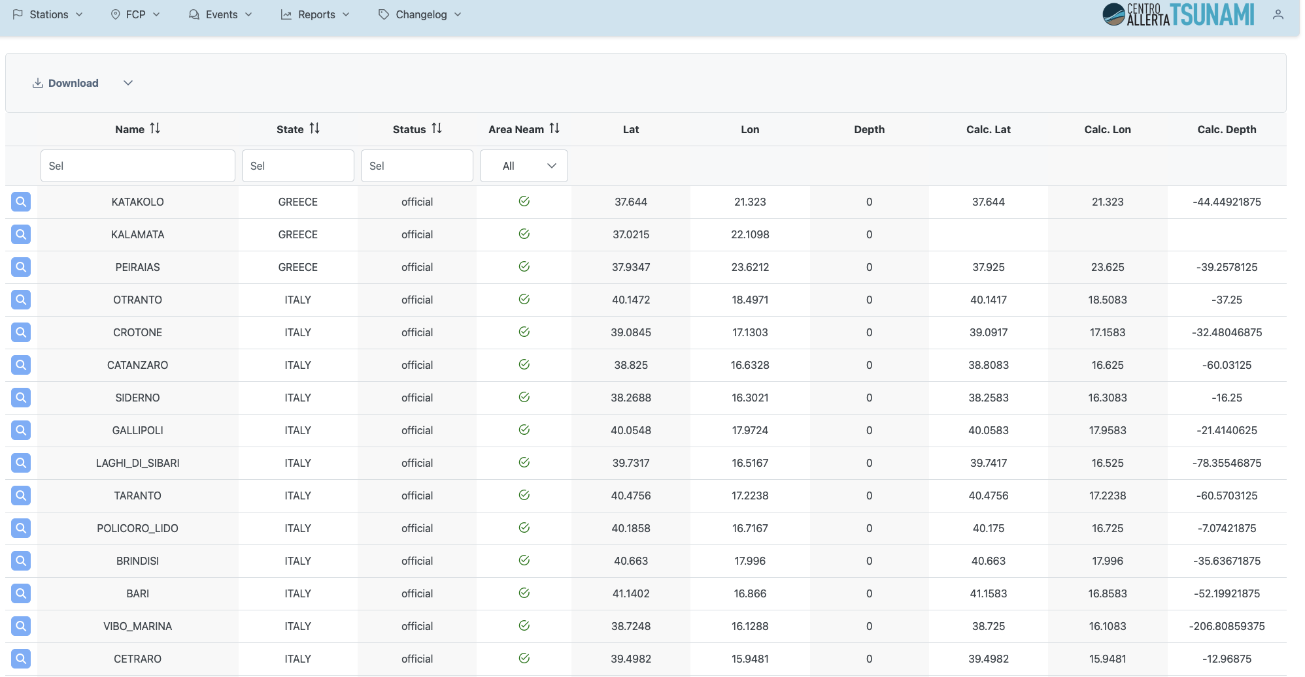
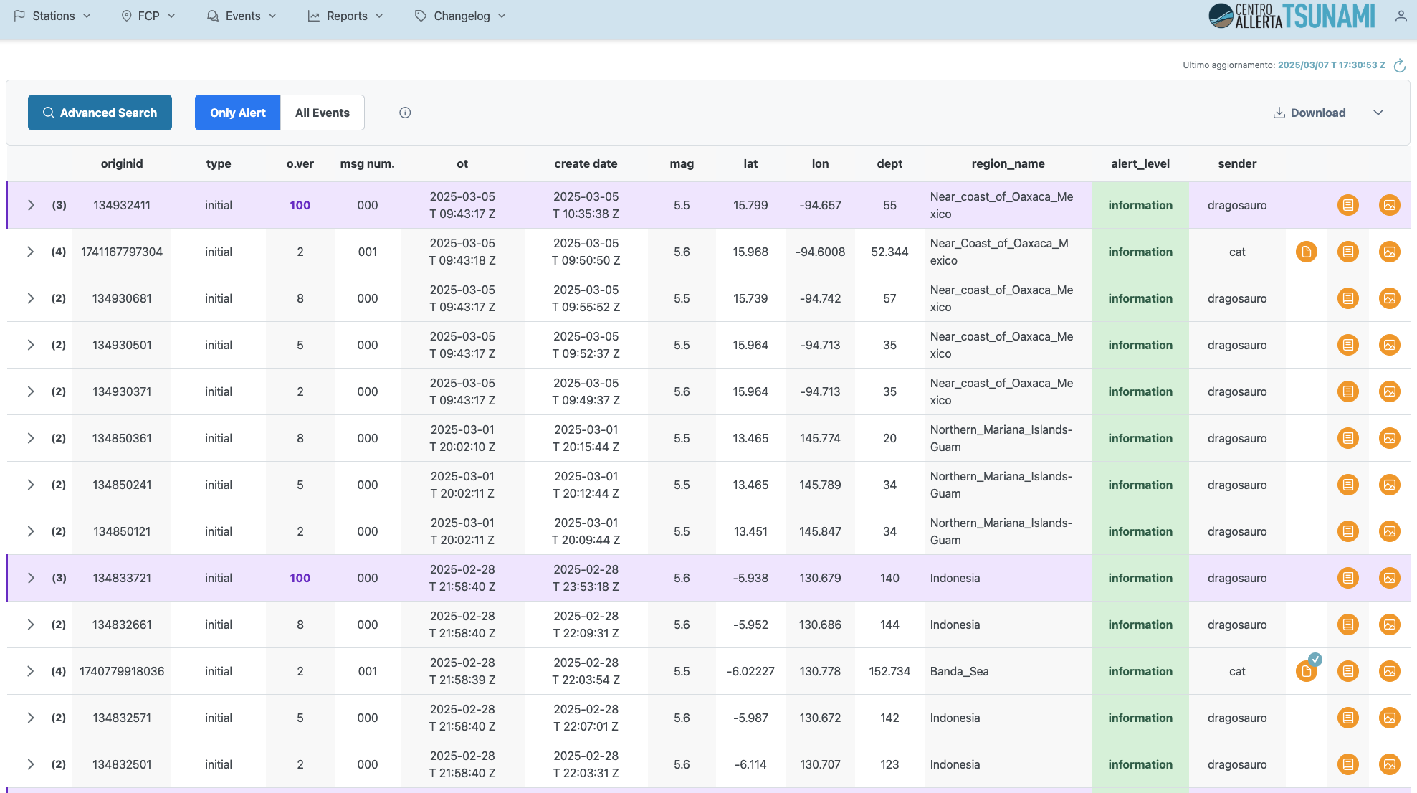
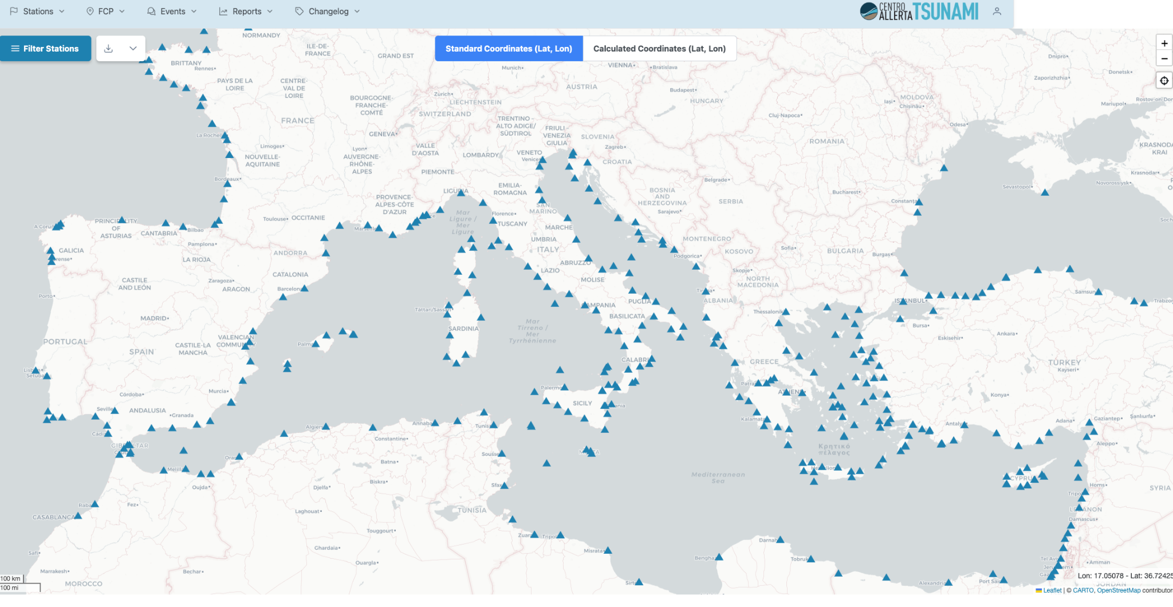
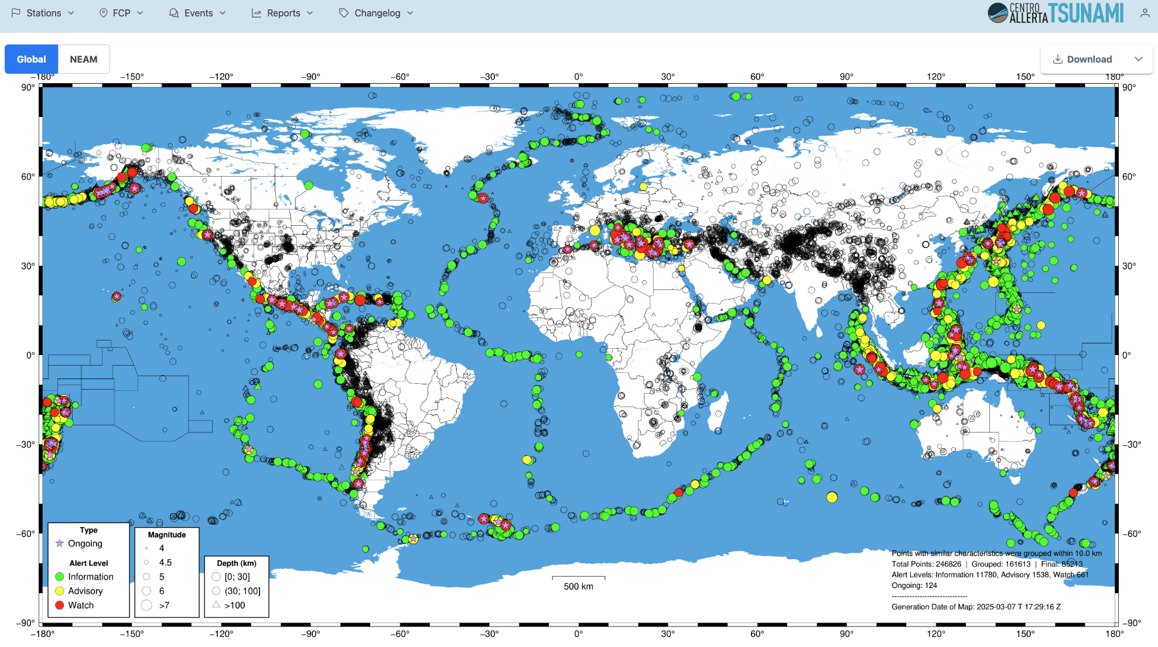
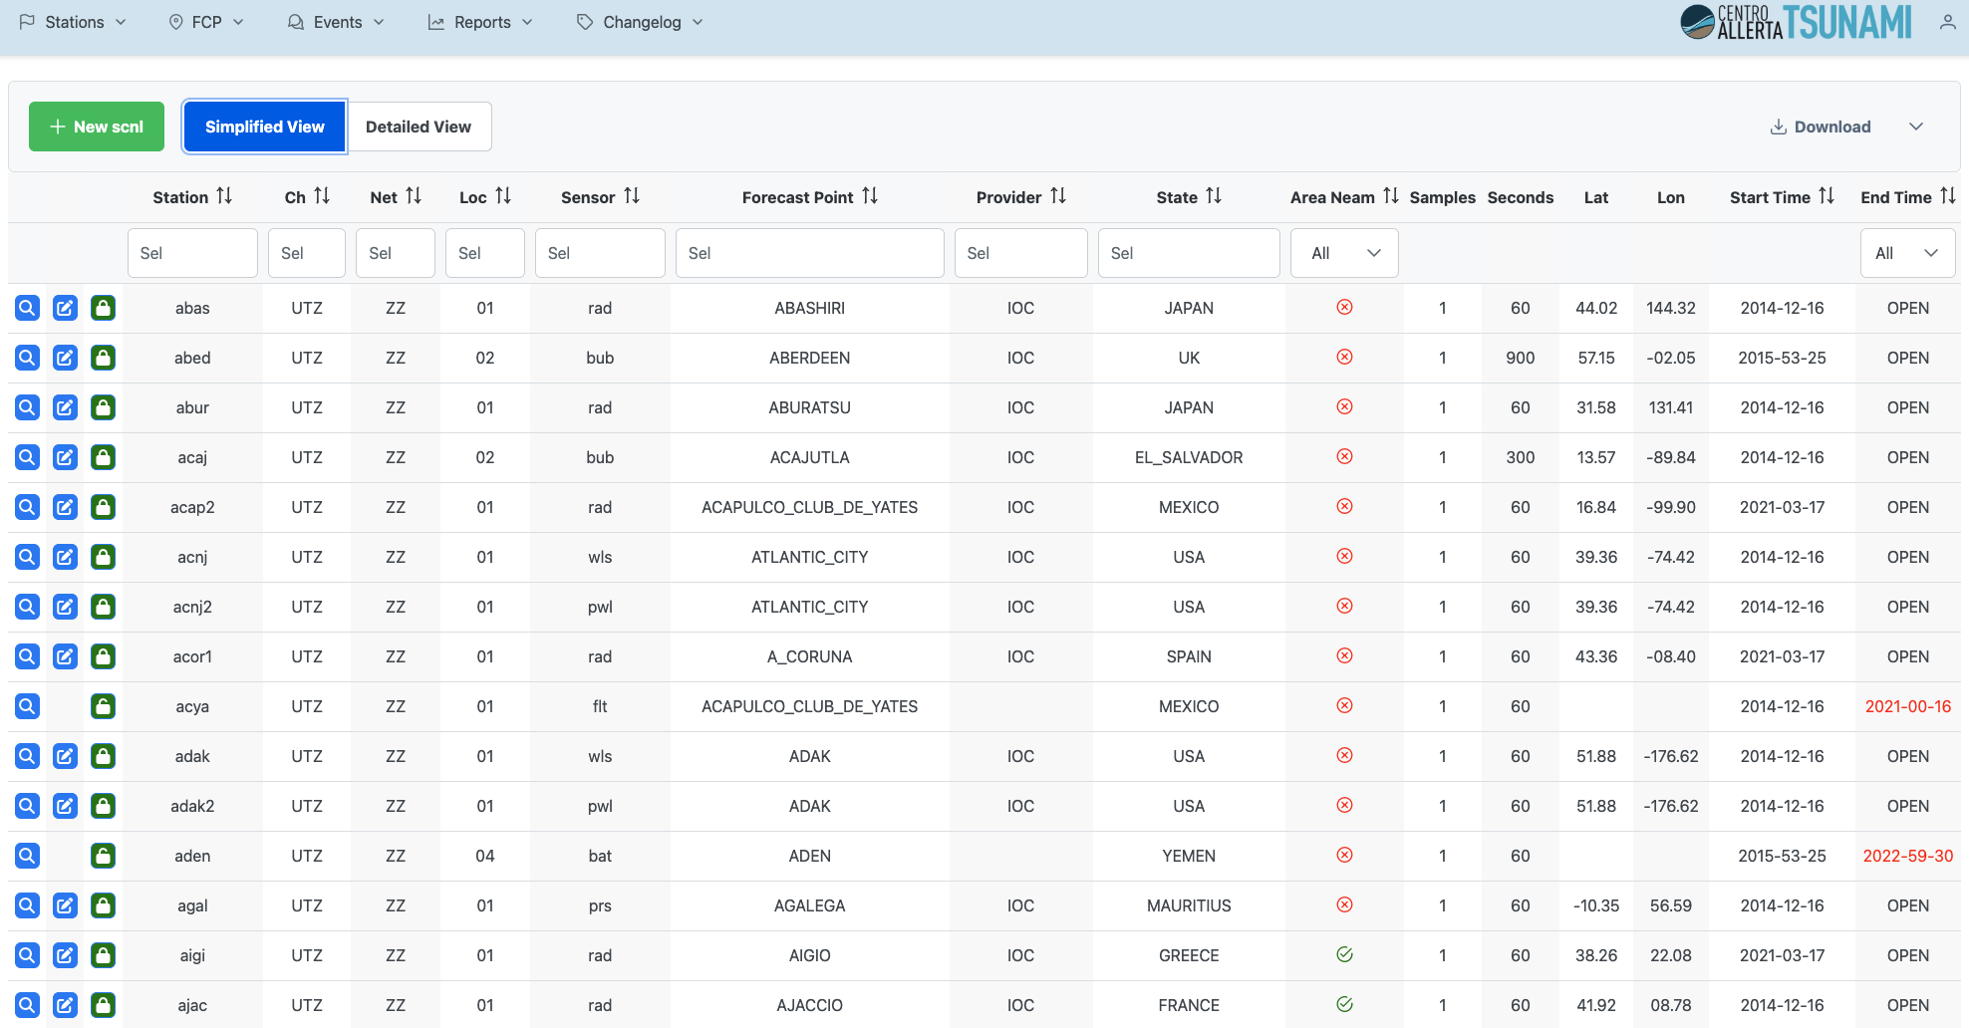
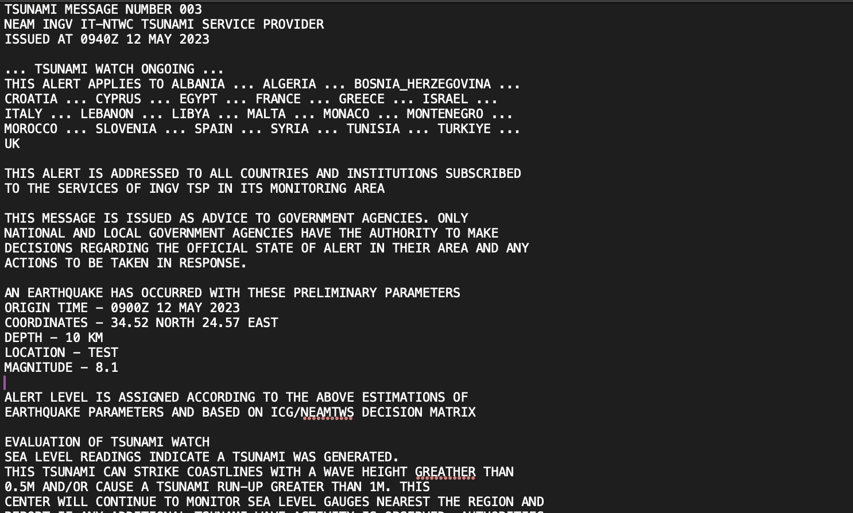
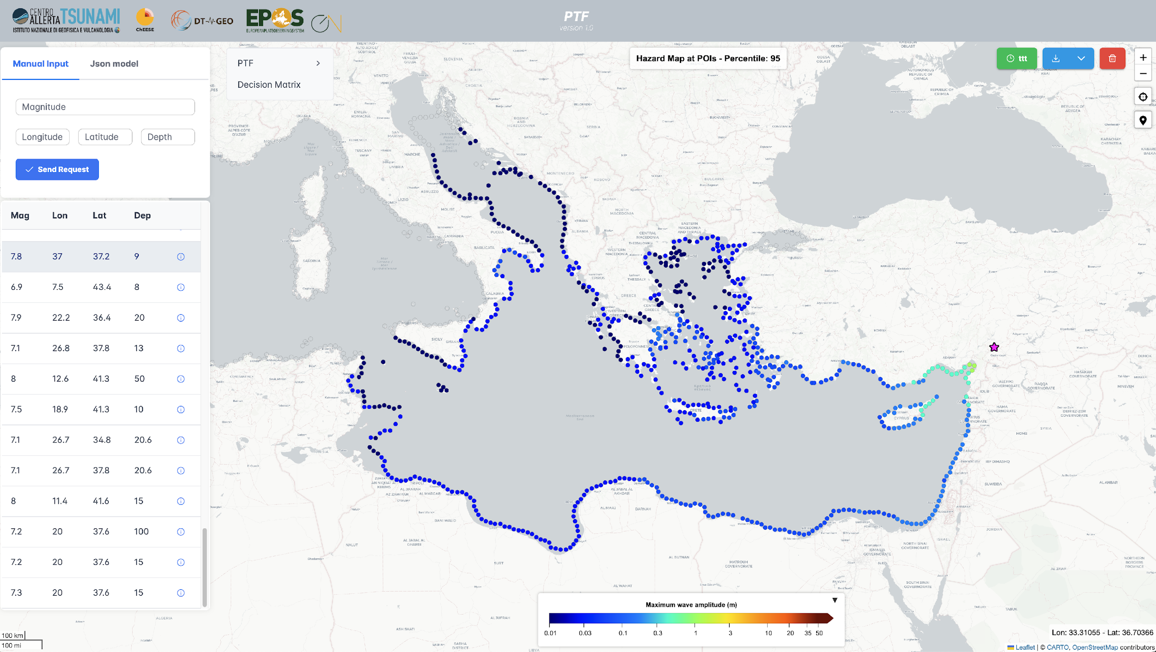
Subtask 3.1.2
Tsunami Early Warning Support services (INGV , NOA, KOERI, VLIZ, GFZ) - The activity regards the enhancement of the TSP-IOT (Tsunami Service Provider InterOperability Tool) running prototype for Tsunami Early Warning support services virtual access (VA).
TS-GAUSS
Simulations
PTF
Forecast points and sensors, bathymetry
Earthquake parameters and alert messages
helps Tsunami Service Providers to be more
increases
TSP-IOT
Redundancy
Fallback solutions
Interoperable
Consistent

Slide 7
Subtask 3.1.2
Tsunami Early Warning Support services (INGV , NOA, KOERI, VLIZ, GFZ) - The activity regards the enhancement of the TSP-IOT (Tsunami Service Provider InterOperability Tool) running prototype for Tsunami Early Warning support services virtual access (VA).
TS-GAUSS
Simulations
From the Repository to the Transformer Module
Forecast points and sensors, bathymetry
PTF
Earthquake parameters and alert messages

Slide 8
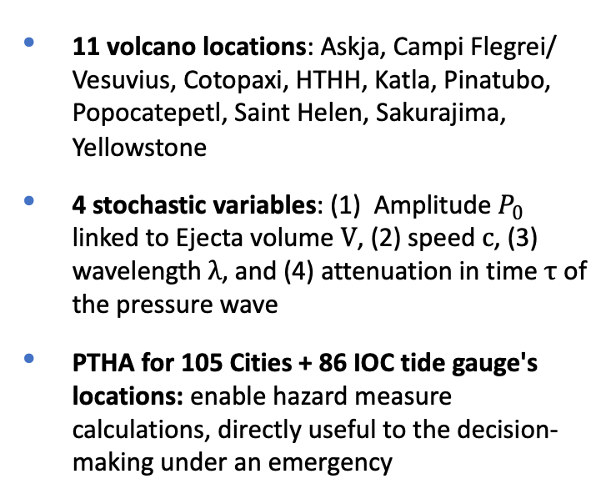

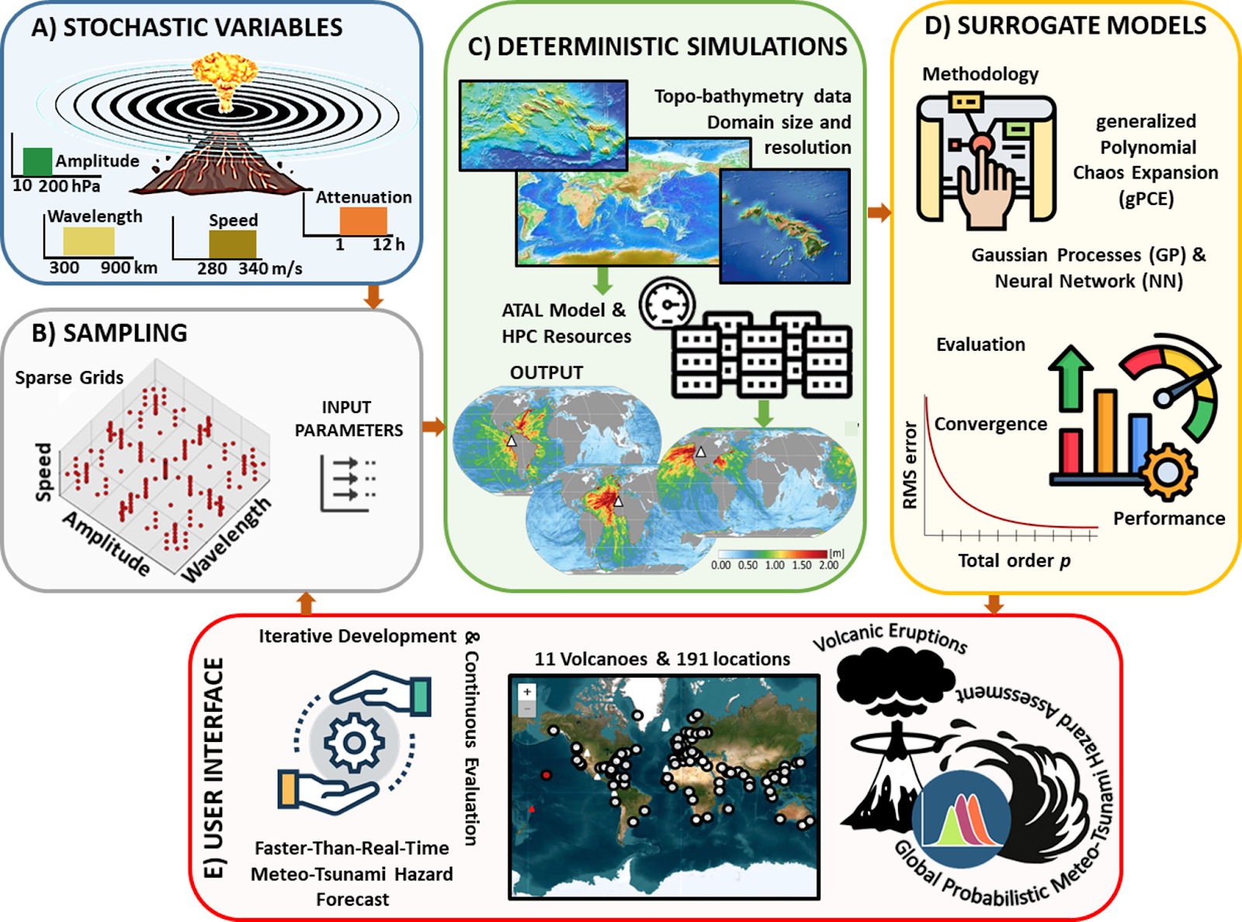
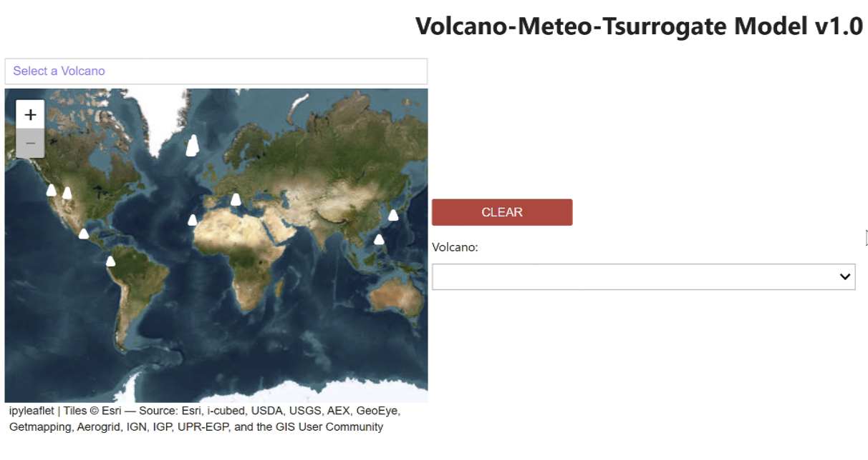
Subtask 3.1.3
Prototype service for meteotsunami warnings (RBI, VLIZ) - Prototype services for improved meteotsunami early warnings to be implemented and tested on specific areas along the Croatian coastline and surrogate models for meteotsunamis at global scale.
Milestone MS9 DONE!!

Slide 9
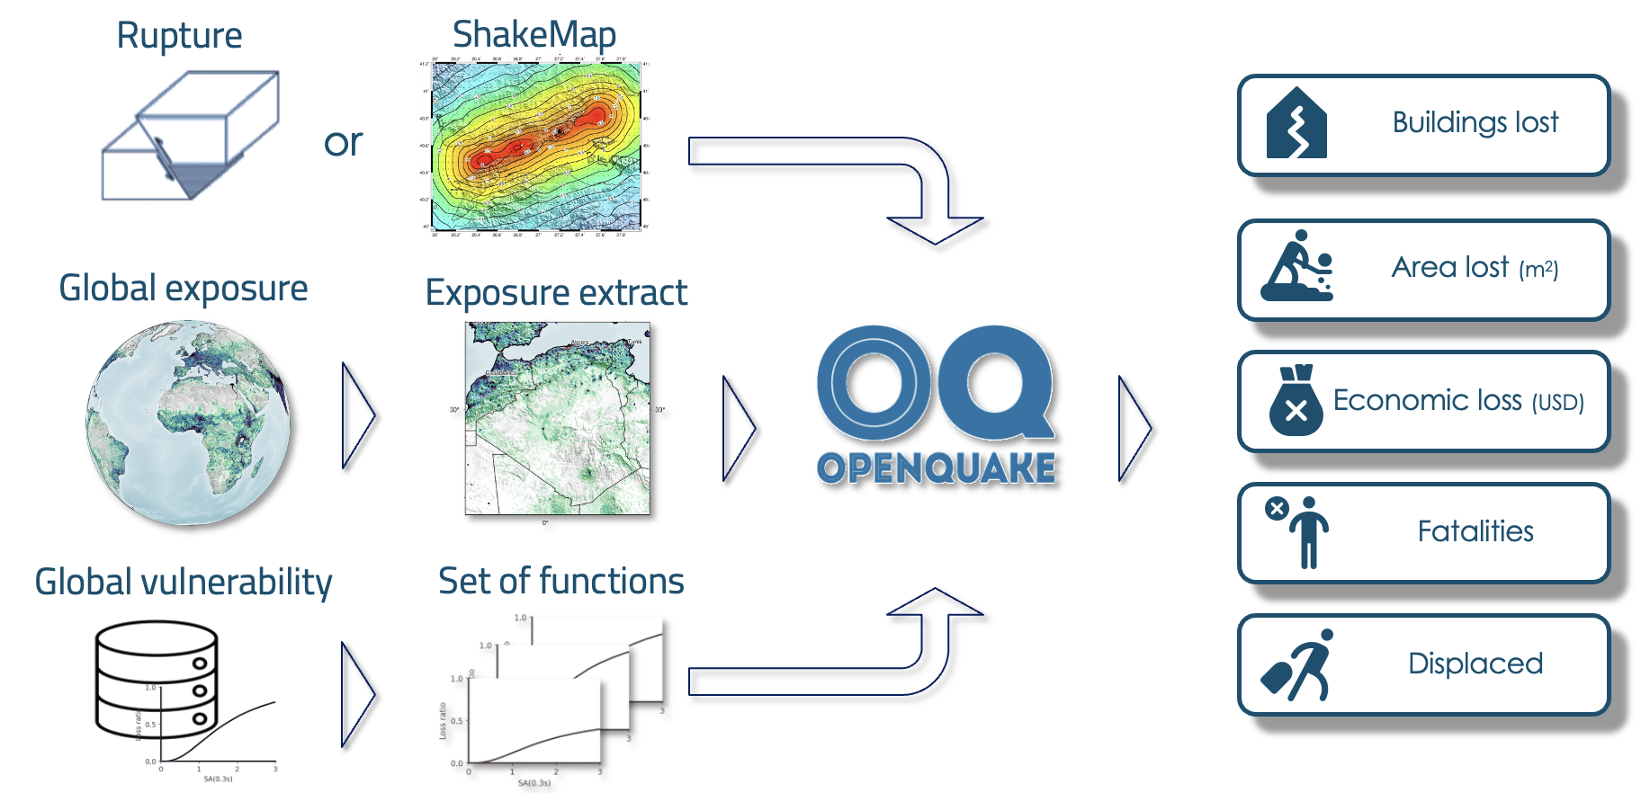
Subtask 3.1.4
Data products and services for rapid post-event assessment (EUCENTRE, GEM, ETH Zürich, INGV , NGI, GFZ) - Improvement of existing tools and services for a rapid post-event assessment of the impact of the earthquake and associated secondary hazards

Slide 10
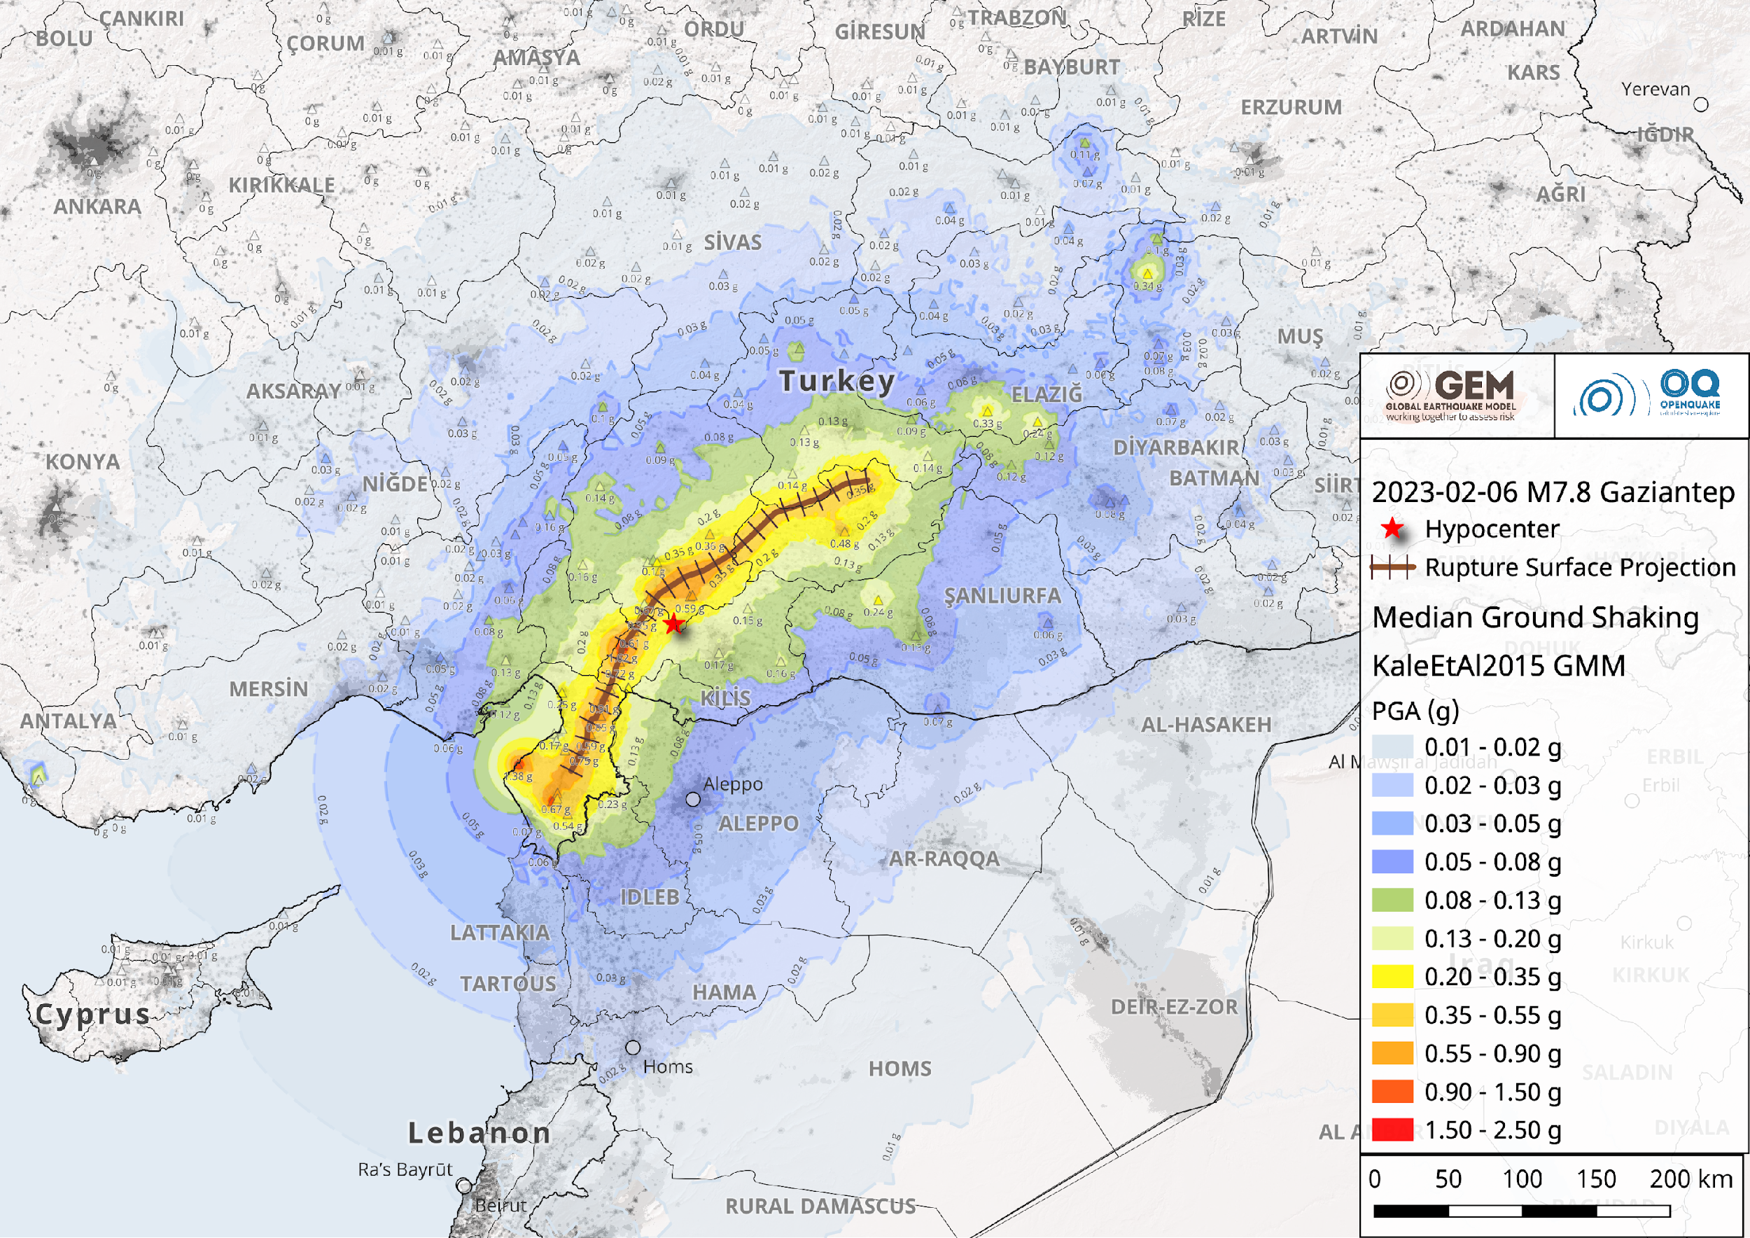
Subtask 3.1.4
Data products and services for rapid post-event assessment (EUCENTRE, GEM, ETH Zürich, INGV , NGI, GFZ) - Improvement of existing tools and services for a rapid post-event assessment of the impact of the earthquake and associated secondary hazards
Example of a post-event impact assessment after the 2023 M7.8 Türkiye-Syria earthquake
In the immediate aftermath of the Türkiye-Syria events (Feb 2023), GEM produced estimates of the impact by generating humanitarian metrics, useful to aid resource prioritization

Slide 11
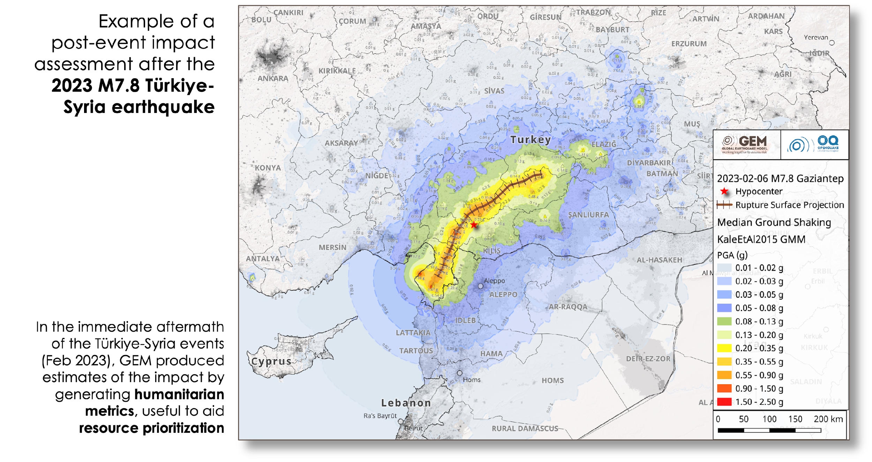
Subtask 3.1.4
Data products and services for rapid post-event assessment (EUCENTRE, GEM, ETH Zürich, INGV , NGI, GFZ) - Improvement of existing tools and services for a rapid post-event assessment of the impact of the earthquake and associated secondary hazards
12.15-12.30 | An Integrated Tsunami Impact Assessment Workflow within ARISTOTLE: A Collaborative Use Case for Emergency Management | Finn Løvholt
12.30-12.45 | Rapid Earthquake Impact Assessment: Understanding Uncertainty from Source and ShakeMap Variability | Helen Crowley
12.45-13.00 | Operational ShakeMap Services: Applications and Societal Impact | Ilaria Oliveti

Slide 12
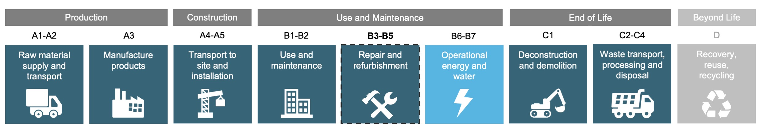
Subtask 3.1.5
Data products and services for seismic risk (EUCENTRE, GEM) – Expansion of the European seismic risk services to include the environmental impact of earthquakes, measured as eCO₂ emissions from damage and reconstruction.
Quantification of the environmental impact of earthquake damage and consequent repair/reconstruction in Europe based on state-of-art exposure, vulnerability and hazard models
Data publicly available on a dedicated GitHub repository: https://github.com/gem/global_embodied_carbon_model
Web platform accessible via the EPOS Built Environmental Data (BED) service: https://builtenvdata.eu
Preliminary development of embodied-carbon vulnerability curves for diverse building types
Caruso, M., Silva, V., Aljawhari, K. et al. Unveiling the environmental impact of earthquakes in Europe. Nat Commun 17, 1366 (2026). https://doi.org/10.1038/s41467-025-68120-6.

Slide 13
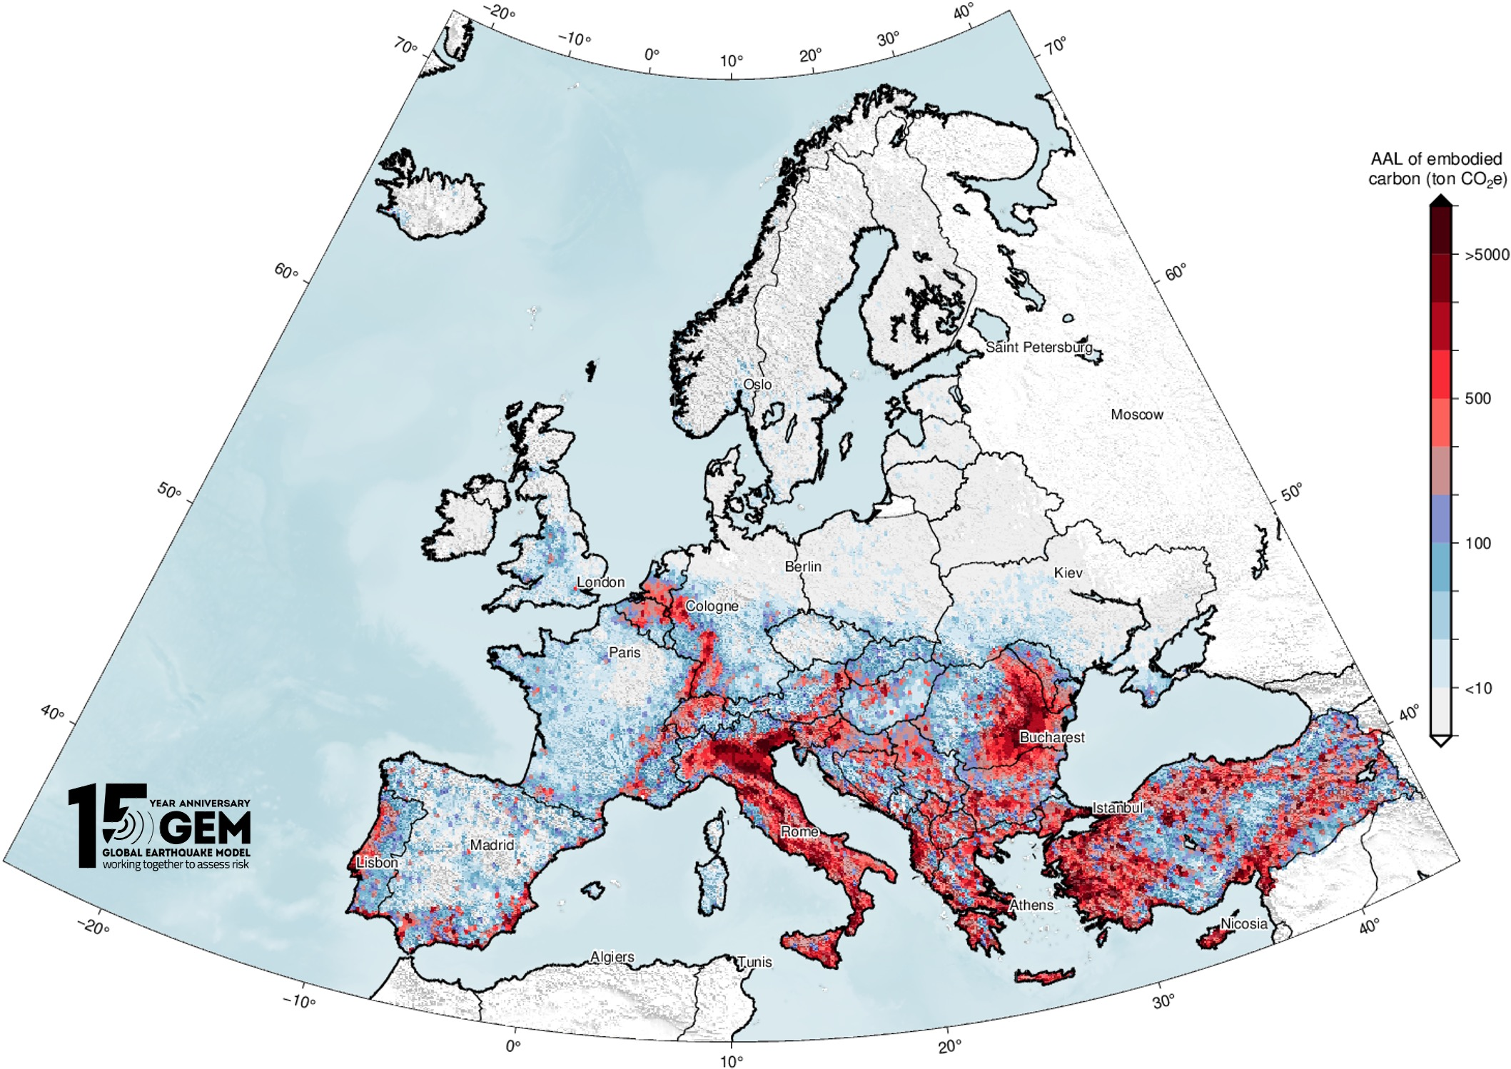
Subtask 3.1.5
Data products and services for seismic risk (EUCENTRE, GEM) – Expansion of the European seismic risk services to include the environmental impact of earthquakes, measured as eCO₂ emissions from damage and reconstruction.
Embodied-carbon seismic risk map for Europe
6.6 million ton CO₂e
Replacement Embodied Carbon
[kg CO₂e]
Average Annual Loss Ratio (AALR)
[-/yr]
Caruso, M., Silva, V., Aljawhari, K. et al. Unveiling the environmental impact of earthquakes in Europe. Nat Commun 17, 1366 (2026). https://doi.org/10.1038/s41467-025-68120-6.

Slide 14
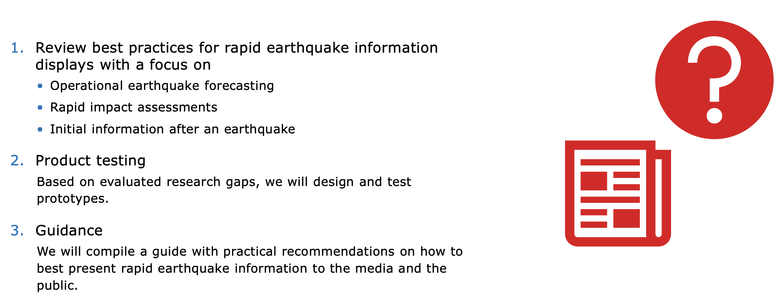
Subtask 3.1.6
Support services and data products for rapid earthquake infographic (ETH Zürich) - Development of a rapid infographic for media in the context of a destructive earthquake occurrence; that tool will be useful tool for conveying information to the public in an easily digestible and visually compelling format

Slide 15
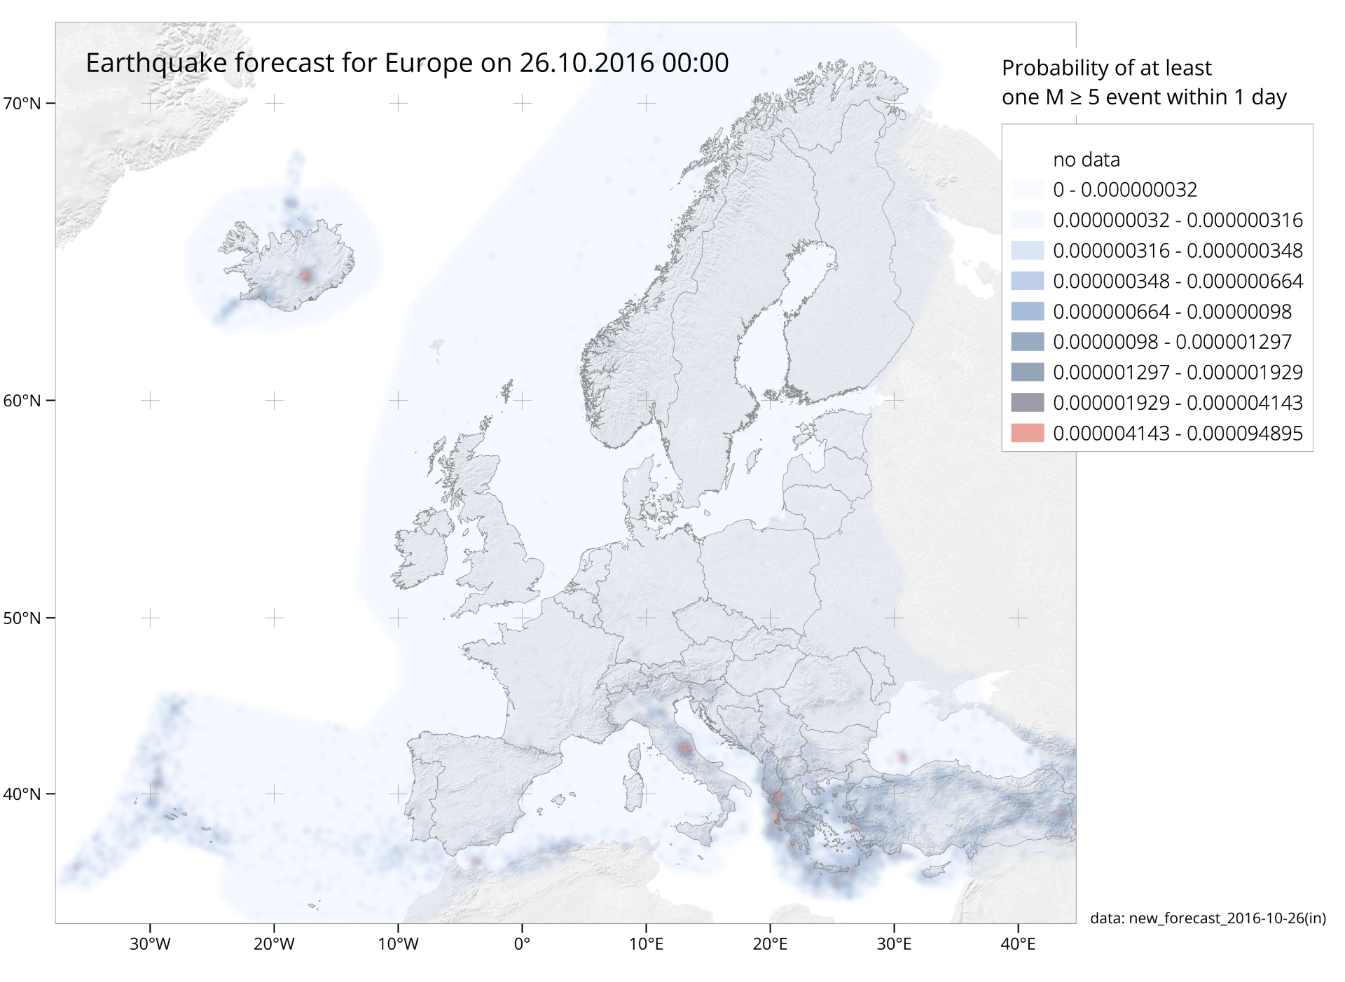
Subtasks 3.1.6-3.1.7
Support services and data products for rapid earthquake infographic (ETH Zürich) - Development of a rapid infographic for media in the context of a destructive earthquake occurrence; that tool will be useful tool for conveying information to the public in an easily digestible and visually compelling format
Support services and data products for earthquake forecasting (ETH Zürich) - Development of an online platform for earthquake forecasting standard models.
OEF
  Definition of boundary conditions for our forecasts: 7 days, magnitudes 2.5 and 5
  Start to develop prototypes to visualise the probability changes
  Continue in developing aftershock information
Rapid impact assessments
  Main focus on technical development to cover all of Europe.
Blueprint a for European Rapid Earthquake Assessment (Erea)
  Drafted an initial mock-up for a European Rapid Earthquake Assessment (Erea)
  Developed a survey to be shared within EPOS to assess the potential of Erea and the associated requirements.

Slide 16
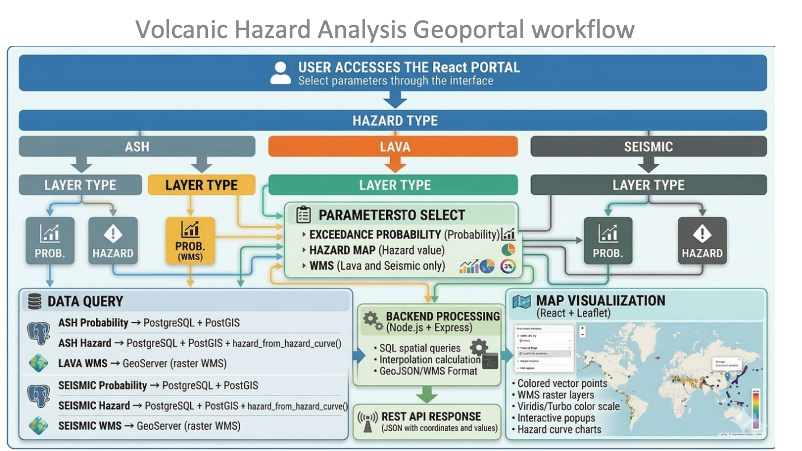
Subtask 3.1.8
Prototype service for early ash-/gas-dispersion warning (UCA, IMO, INGV) - The activity will be based on HOTVOLC, a real-time 24/7 WebGIS monitoring system of active volcanoes in real-time

Slide 17
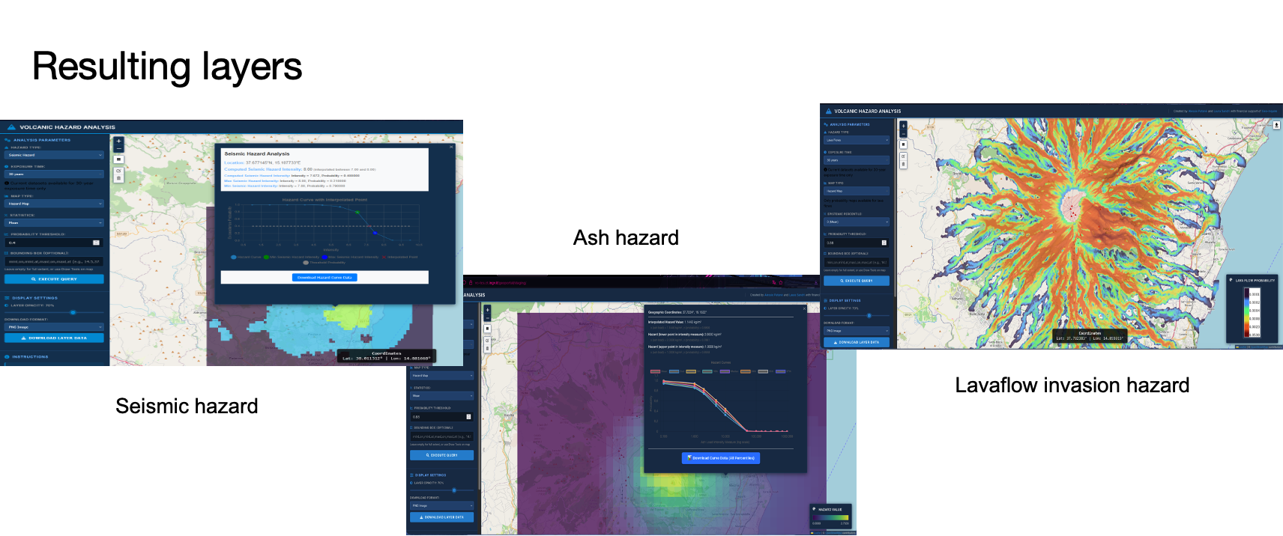
Subtask 3.1.8
Prototype service for early ash-/gas-dispersion warning (UCA, IMO, INGV) - The activity will be based on HOTVOLC, a real-time 24/7 WebGIS monitoring system of active volcanoes in real-time

Slide 18
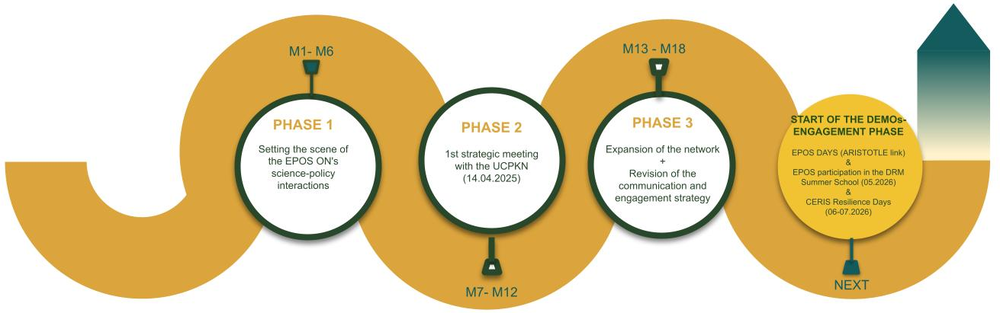
Task 3.2
Interaction with operational stakeholders in civil protection and disaster risk management (EPOS ERIC, INGV , UNINA, RBI, EUCENTRE) - promoting innovation, learning opportunities and dialogue between EPOS and operational stakeholders in civil protection and disaster risk management

Slide 19
Task 3.2
Interaction with operational stakeholders in civil protection and disaster risk management (EPOS ERIC, INGV , UNINA, RBI, EUCENTRE) - promoting innovation, learning opportunities and dialogue between EPOS and operational stakeholders in civil protection and disaster risk management
12.00-12.10 | Scientific products exploitable in evidence-based decision making – introduction | Giovanna Forlenza

Slide 20
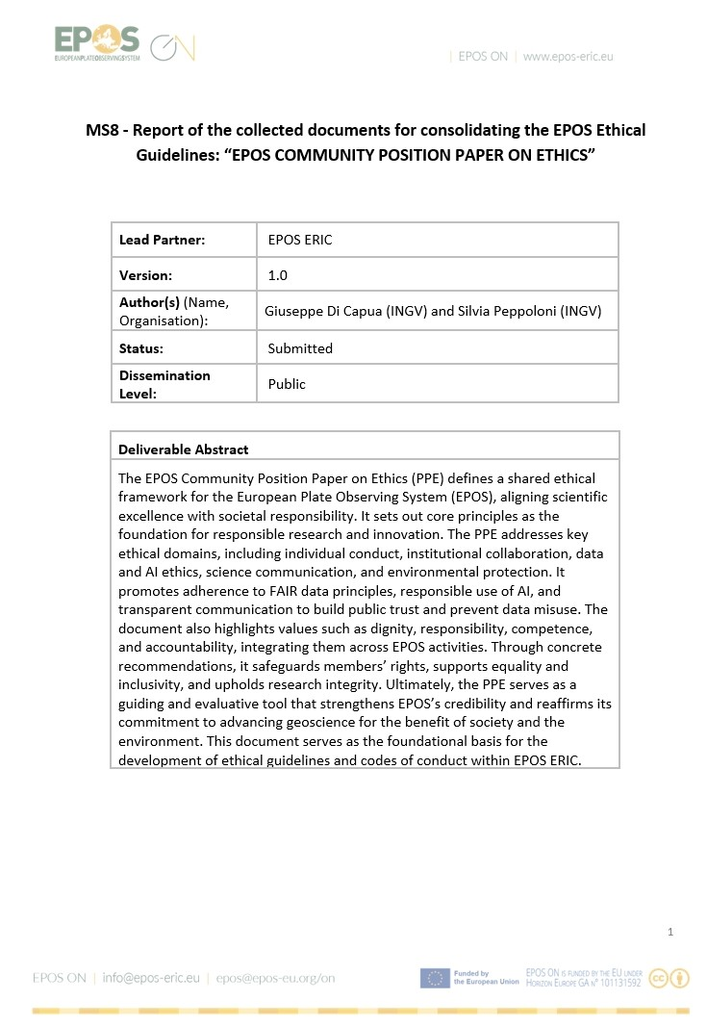
Task 3.3
Methodology for an ethical label applicable to services (EPOS ERIC, AUTH, INGV , UBI, LTU, IGF PAS, BRGM, UU, CNR, GFZ) - Consolidating and improving an ethical framework for the EPOS community
Submitted the MS8 “EPOS COMMUNITY POSITION PAPER ON ETHICS”
This is a fundamental step toward releasing the final version of the EPOS Position Paper on Ethics (PPE), which sets out the principles and values that ensure research is responsible, transparent, and serves the public good.
This document serves as a guiding and evaluative tool that could strengthen EPOS’s credibility and reaffirms its commitment to advancing geoscience for the benefit of society and the environment.
It serves as the foundational basis for the development of ethical guidelines and codes of conduct within EPOS ERIC.
Milestone MS8 DONE!!

Slide 21
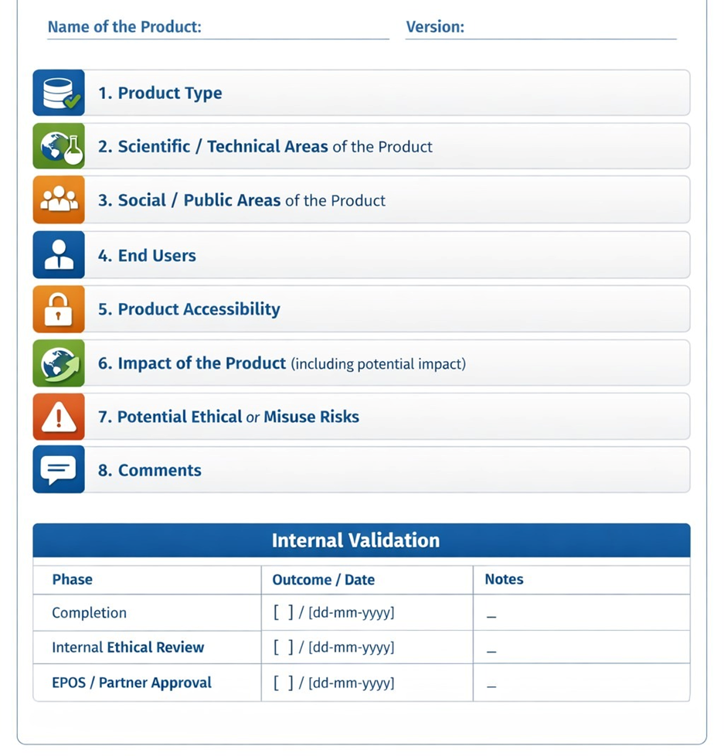
Task 3.3
Methodology for an ethical label applicable to services (EPOS ERIC, AUTH, INGV , UBI, LTU, IGF PAS, BRGM, UU, CNR, GFZ) - Consolidating and improving an ethical framework for the EPOS community
A version of the Ethical Label has been developed as a tool to identify and communicate the ethical and societal implications of products developed within the EPOS framework.
The label provides a structured and standardized framework for describing scientific data, products, and services, thereby facilitating their understanding and comparability. The tool supports the evaluation of potential impacts, ethical risks, and possible misuse, while promoting transparency toward researchers, institutions, and society at large.
The overall objective is to strengthen both internal and external communication of EPOS products, foster responsible innovation, and increase awareness of the scientific and societal implications associated with research outputs.

Slide 22
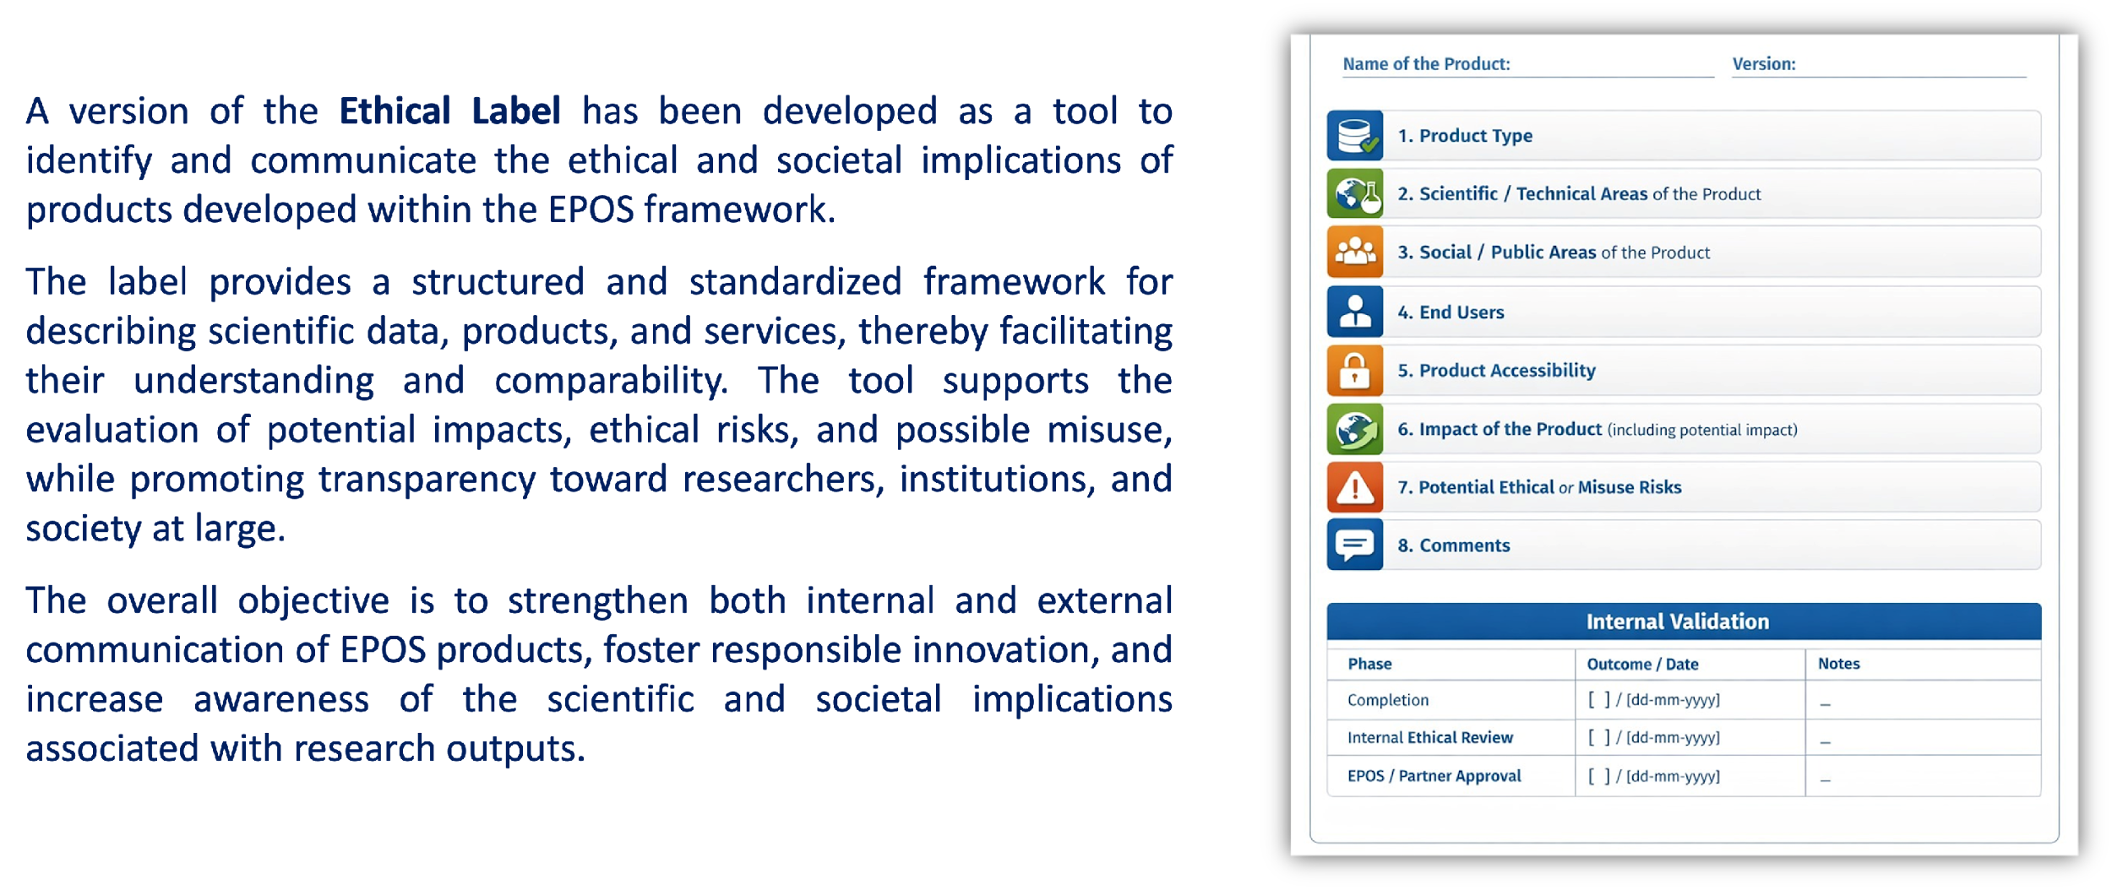
Task 3.3
Methodology for an ethical label applicable to services (EPOS ERIC, AUTH, INGV , UBI, LTU, IGF PAS, BRGM, UU, CNR, GFZ) - Consolidating and improving an ethical framework for the EPOS community
13.00-13.15 | The Ethical Label to identify ethical and social implications of project outputs | Silvia Peppoloni

Slide 23
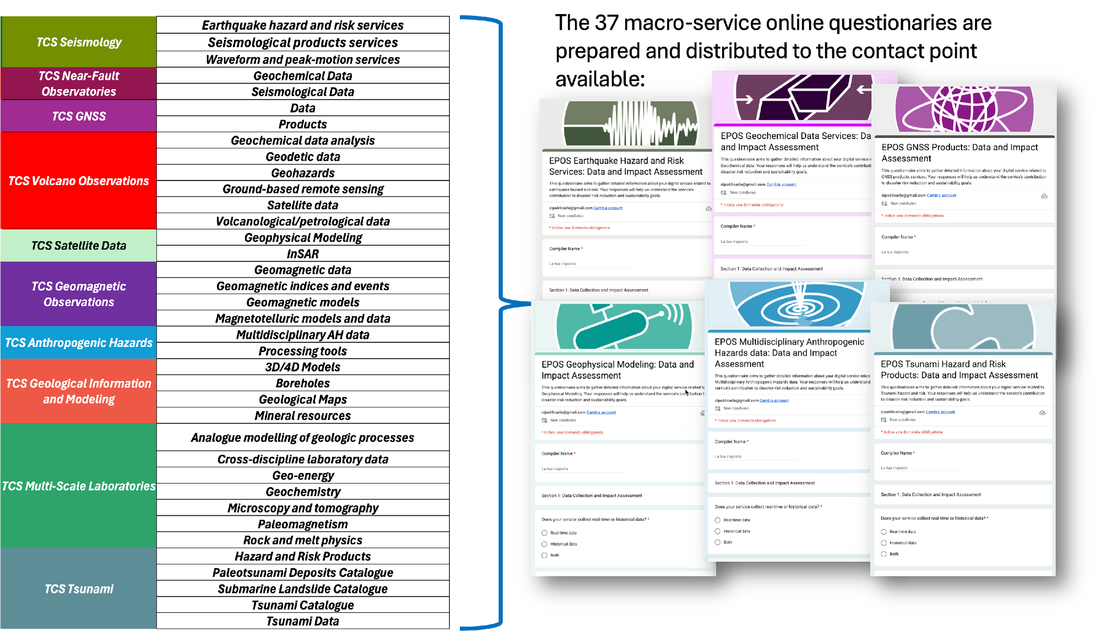
Task 3.4
Environmental analysis of the EPOS service provision (ISPRA, EPOS ERIC, AUTH, INGV , UBI, LTU, IGF PAS, BRGM, UU, CNR, GFZ) - identifying how the technological life cycle of the EPOS RI can reduce the impacts on the environment and how the data made available by the Thematic Core Services can contribute to the monitoring of climate change and environmental impact

Slide 24
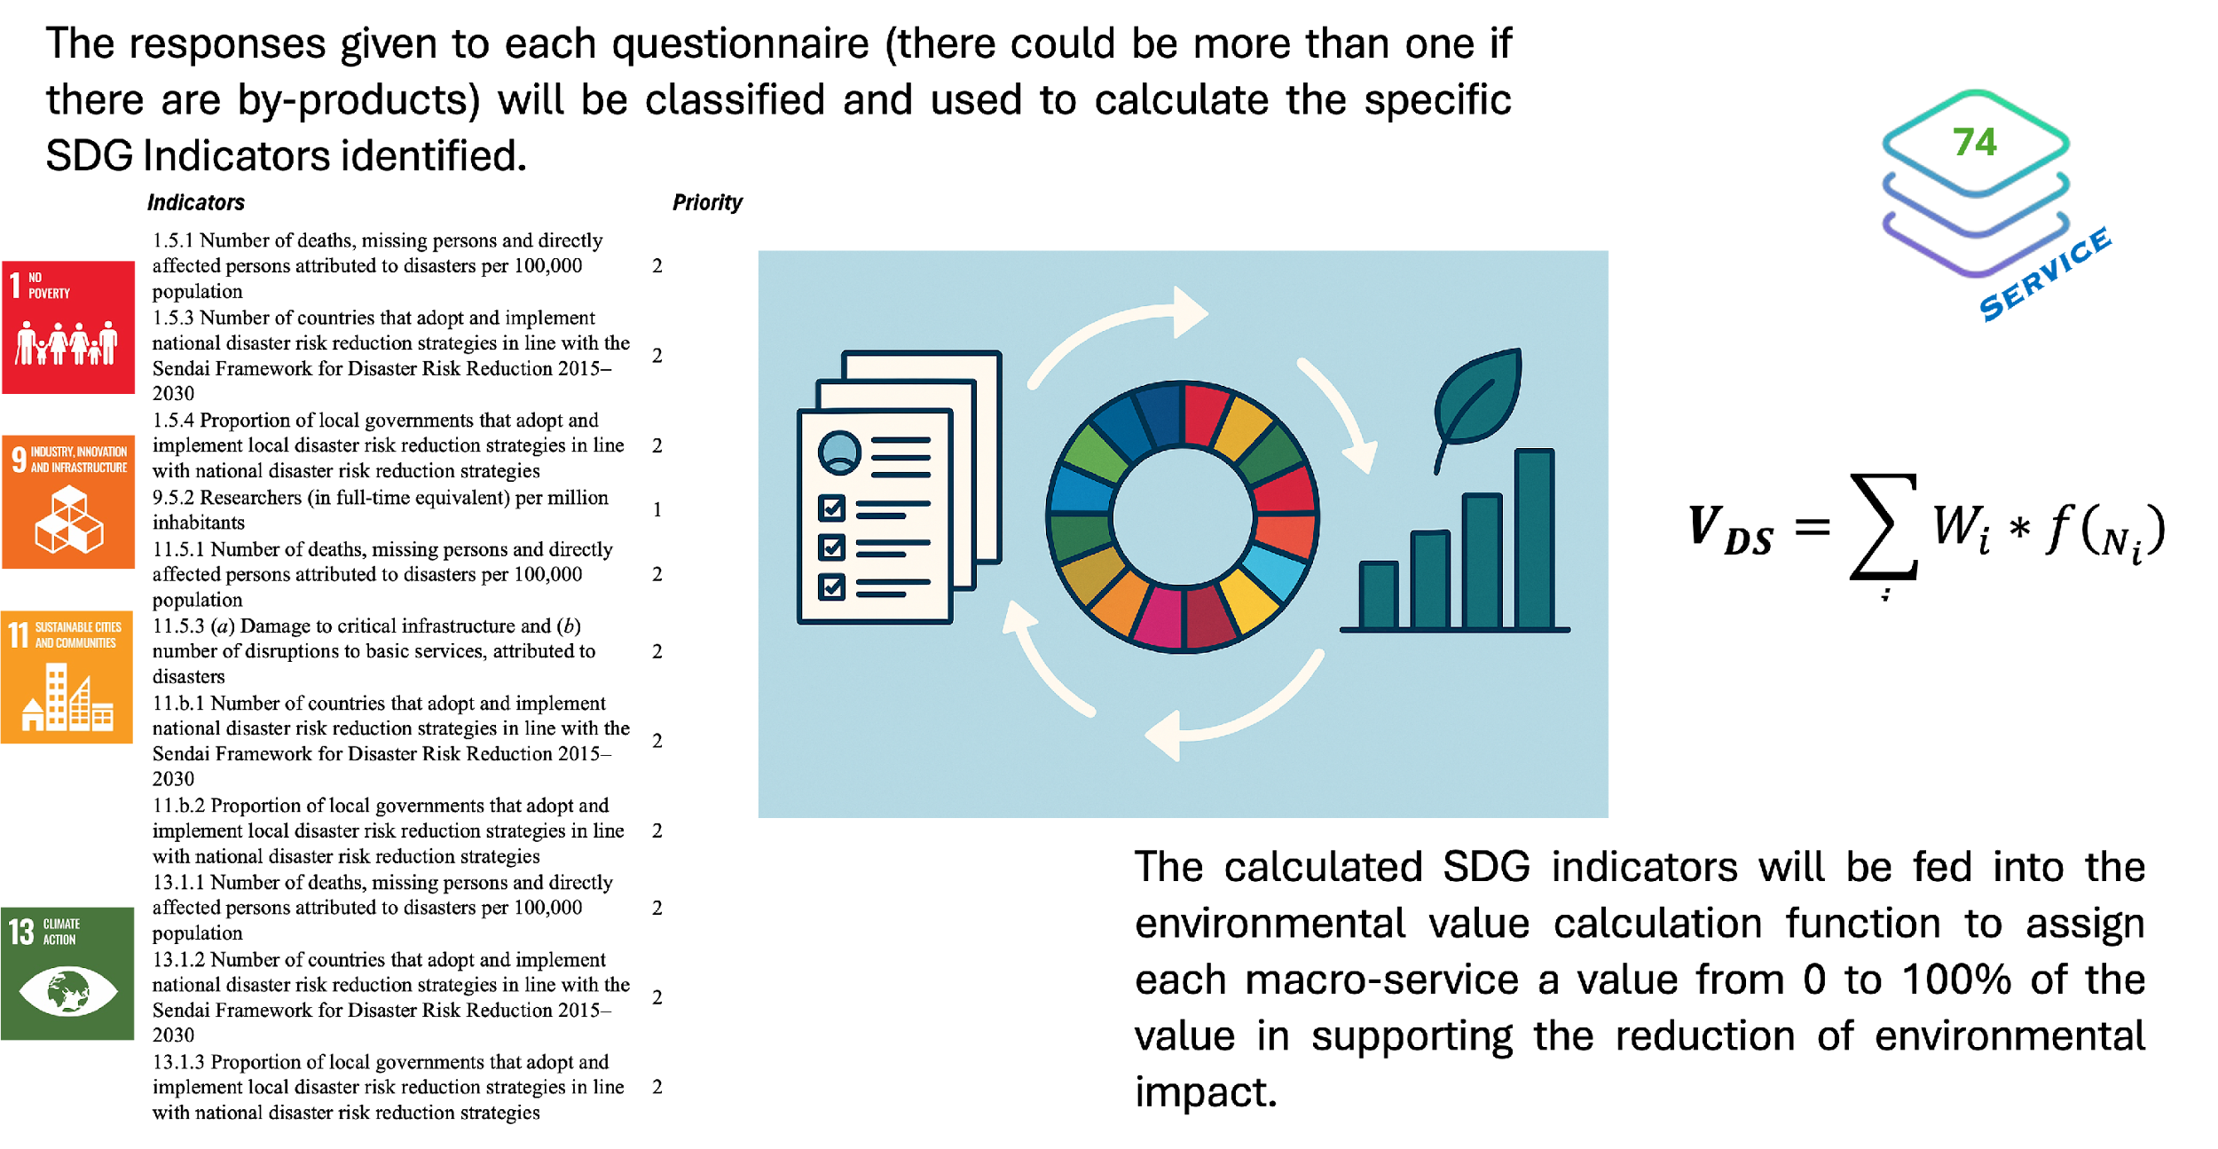
Task 3.4
Environmental analysis of the EPOS service provision (ISPRA, EPOS ERIC, AUTH, INGV , UBI, LTU, IGF PAS, BRGM, UU, CNR, GFZ) - identifying how the technological life cycle of the EPOS RI can reduce the impacts on the environment and how the data made available by the Thematic Core Services can contribute to the monitoring of climate change and environmental impact

Slide 25
Thank you!

