Slide 1

Scientific products exploitable in evidence-based decision-making - Introduction - Giovanna Forlenza Leader of Task 3.2 – EPOS ON
Title

Slide 2

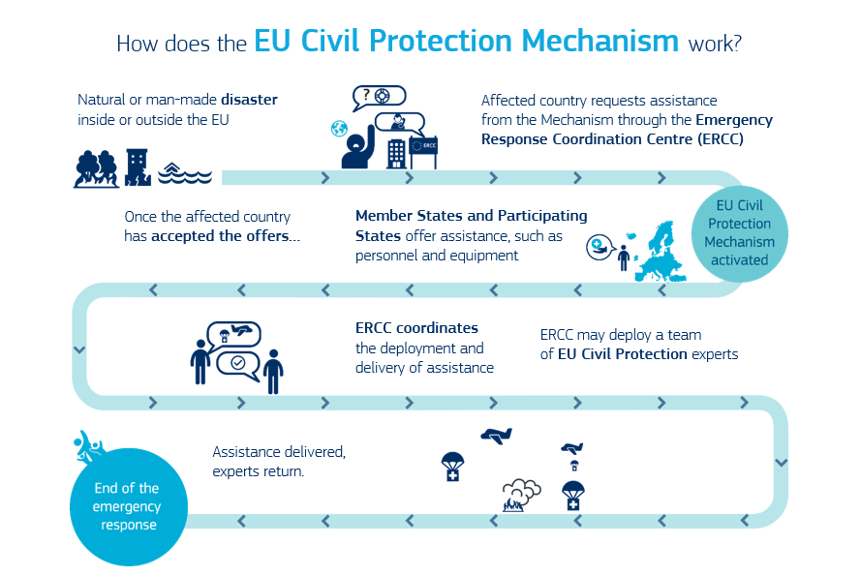
The EU framework

Slide 3
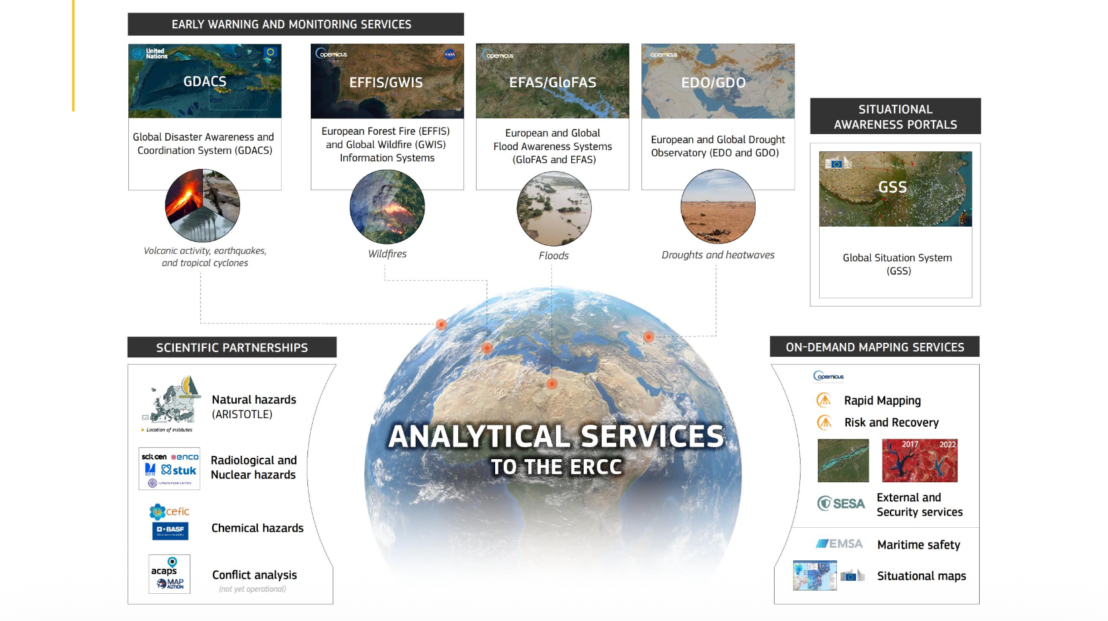


Slide 4

EPOS evolution in DRM
EQ
Earthquake Early Warning Support (EEWS) services
TS
MeteoTS
VO
Data products and services for rapid post-event assessment
Tsunami Early Warning Support services
Prototype service for meteotsunami warnings
Data products and services for seismic risk
Support services and data products for rapid earthquake infographic
Support services and data products for earthquake forecasting
Prototype service for early ash-/gas-dispersion warning
multisciplinariety
interoperability
integration

Slide 5
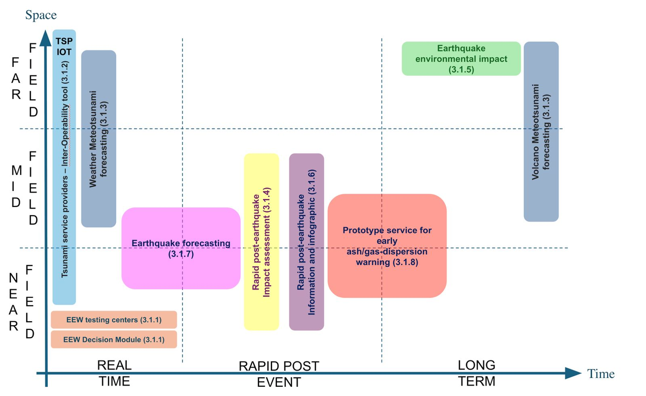
EPOS positioning in the DRM domain

Slide 6
A room for Science-Practitioners interface
To connect the research and operational communities
Share “knowledge for action” by exchanging the state-of-the-art of EPOS high-quality data, tools, methodologies and service solutions to facilitate evidence-based decision-making
Upgrade expertise and know-how through the application of EPOS services in civil protection and disaster risk management planning and operation within the Union Civil Protection Knowledge Network (UCPKN) and specifically within its “Science Pillar”

Slide 7
Key points for a possible next “evolution” of EPOS in the DRM domain: Readiness, Exploitation, and Dialogue
Sustainbaility and scalability of EPOS products and services for operational purposes
Standardisation and interoperability of EPOS products with the operational standards already used by the DRM practitioners
How can EPOS contribute to the “all-of-hazard” approach requested by the EU Preparedness Union Strategy?
How EPOS can implement a feedback loop to funnel operational needs into the future development strategy of the EPOS services?

Slide 8
Thank you!

