Slide 1






European Quantum Infrastructure Project for Gravimetry
Sébastien Merlet for EQUIP-G consortium
Project PI
EQUIP-G has received funding from the EC’s Horizon Europe programme, under the HORIZON-CL4-2024-DIGITAL-EMERGING-02 call.

Slide 2
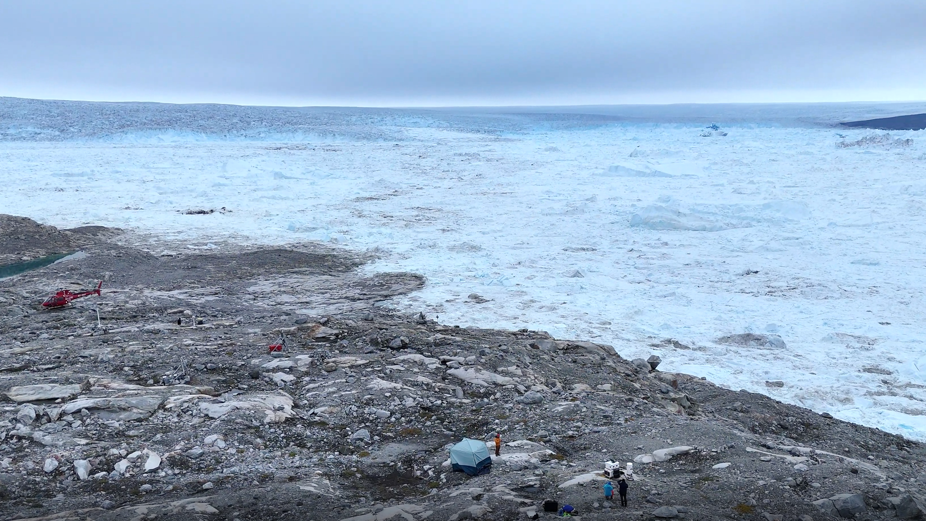

August 2025
A quantum gravimeter successfully operates
in Greenland in the frame of EQUIP-G
Fact
Yet another example that quantum sensors,
for long thought to remain in laboratories
can now operate in the field

Slide 3
Our vision
Quantum gravimeters will play a key role
to monitor the Earth and tackle
our most pressing societal challenges
Our mission
Establish a European perennial Research Infrastructure
managing a shared park of quantum sensors
for the benefit of the entire scientific community

Slide 4

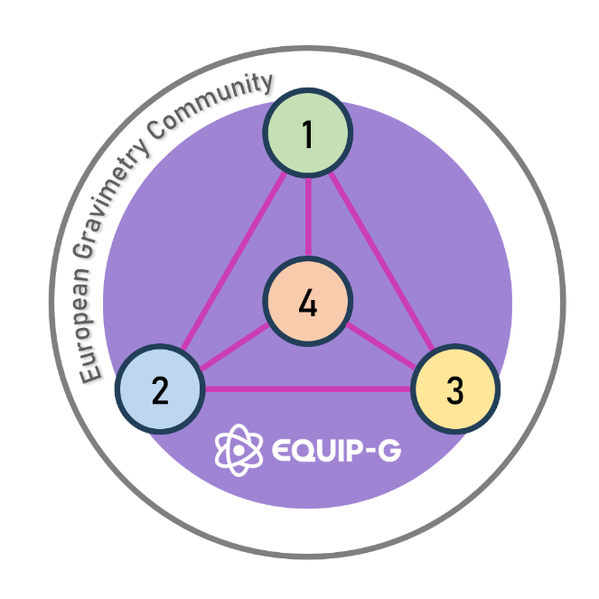


- Activities
A Horizon Europe project towards a future European Research Infrastructure
20 partners, 11 countries
Lead by CNRS, France
4 years (2025 – 2029)
4 pillars:
1. Procuring and testing quantum gravimeters
2. Deploying in the field operational quantum gravimeters addressing identified use cases
3. Collecting, storing and providing high-quality data to a wider scientific community
4. Building-up an EU-wide community of stakeholders for gravimetry
4

Slide 5
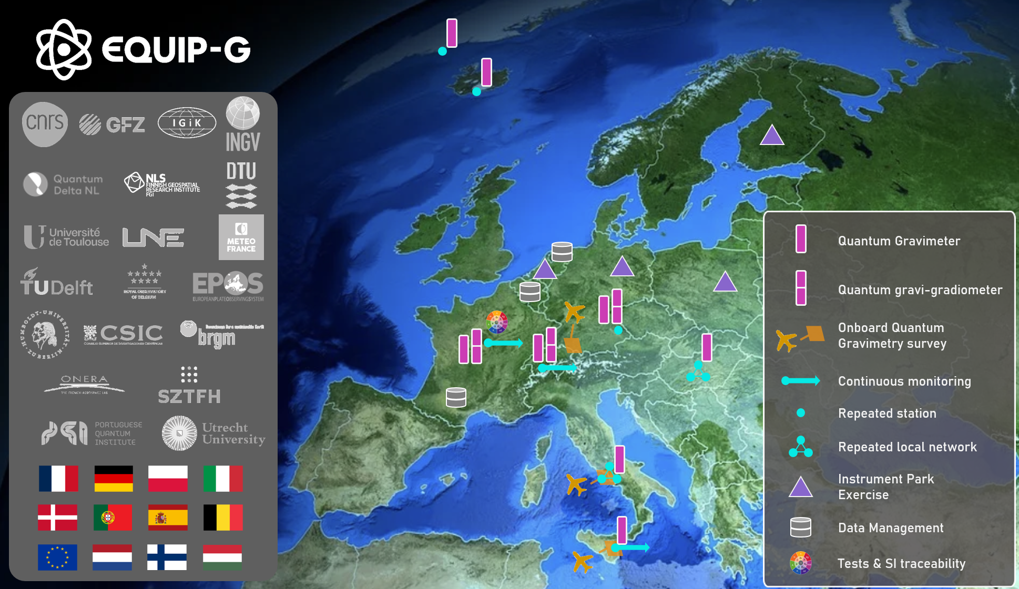
- Consortium
A large and committed community towards a future European Research Infrastructure
Expertise in:
Geophysics, field & onboard
Metrology
Data management
Operation of quantum sensors
Providing key assets:
Very first field quantum gravimeters (4)
Reference laboratory quantum gravimeters (2)
Gravity reference sites (4)

Slide 6
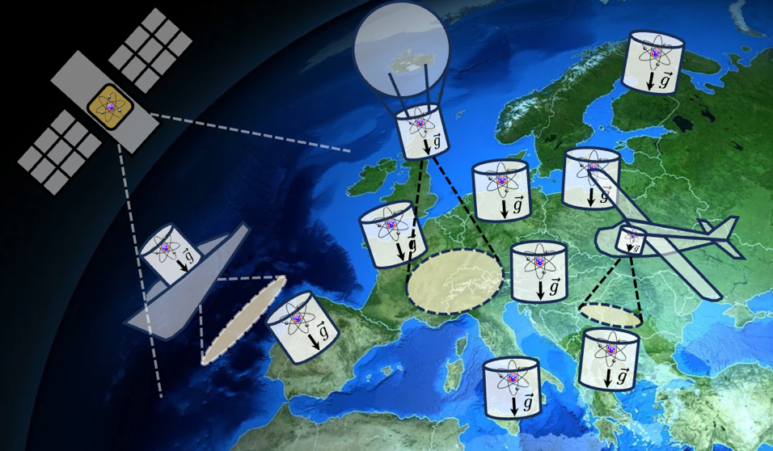



- Quantum EU Strategy
> 2030 and beyond : Pan-European quantum gravimetry infrastructure
EQUIP-G : first step of Terrestrial segment of EU vision
Array of quantum gravimeters (fixed terrestrial and mounted on carriers) at strategic sites
Networked quantum sensing infrastructure covering all Europe, both land and sea
Quantum space gravimetry pathfinder mission (complementing terrestrial network, allowing continuous monitoring of Earth’s surface)

Slide 7
- Board of Advisors
An experienced board of advisors to guide our consortium
EQUIP-G EXTERNAL EXPERT ADVISORY BOARD
First name | Surename | Entity
Joséphine | Boisson Gaboriau | SNCF
Davide | Calonico | INRIM
Thomas | Lévèque | CNES
Martin | Lidberg | Lantmäteriet
Jürgen | Müller | LUH
Laura | Sanchez | TUM

Slide 8
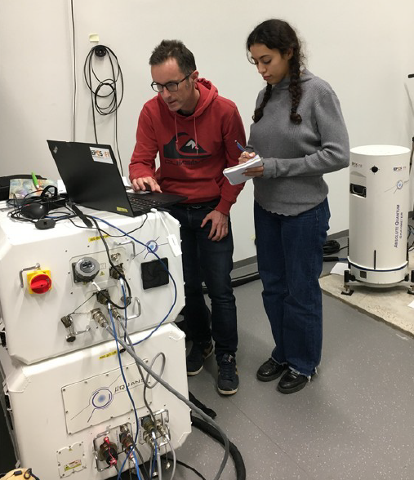
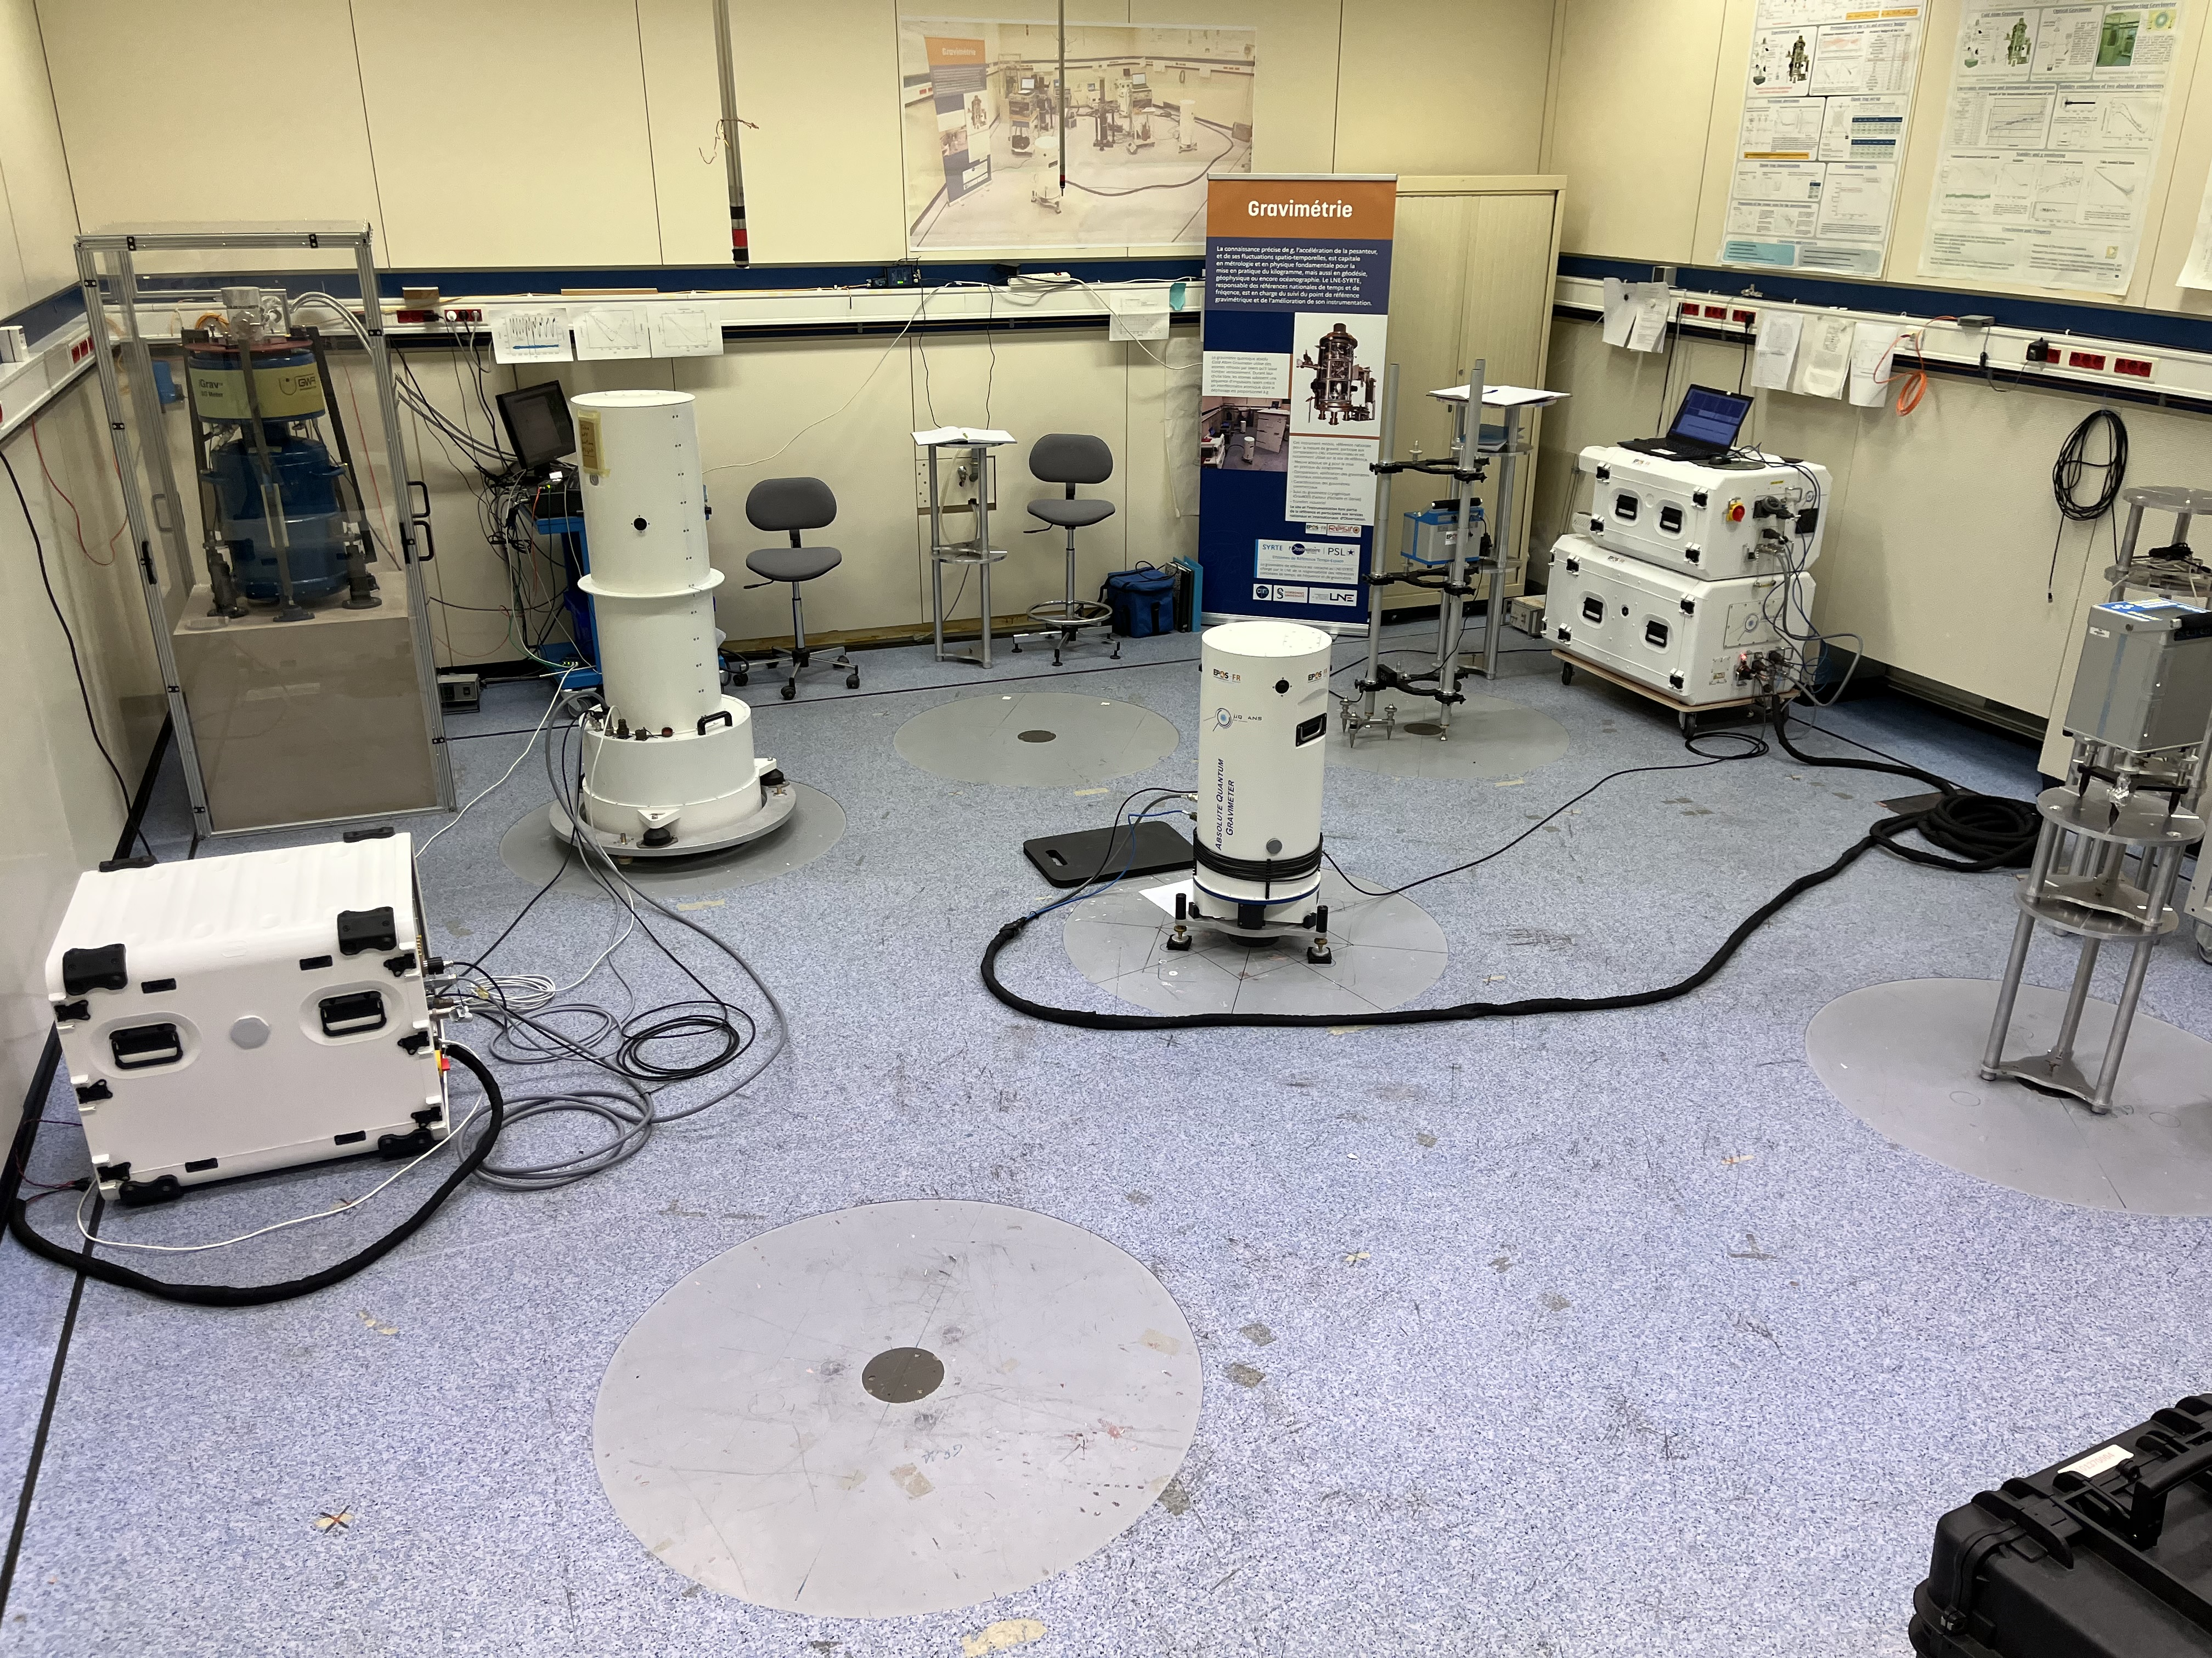
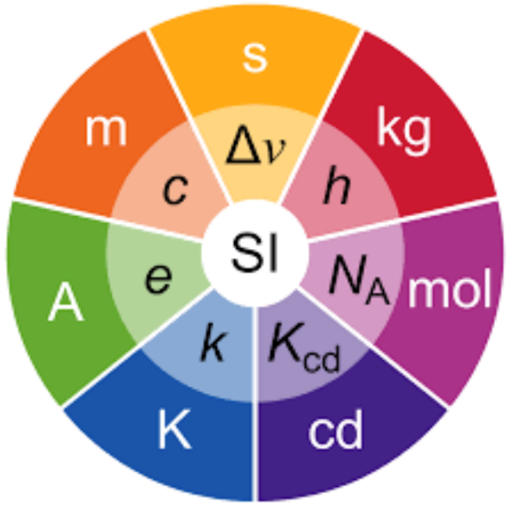
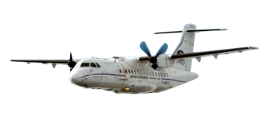
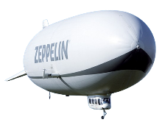
- Instruments
Procuring quantum gravimeters as products, testing and deploying them in the field
Within EQUIP-G we are procuring quantum sensors using atom interferometry to measure the acceleration of the Earth gravity g . Our park of instrument will comprise:
  11 terrestrial Absolute Quantum Gravimeters
  2 terrestrial Differential Quantum Gravimeters
  1 airborne Quantum Gravimeters
We open public procurement procedures to all EU manufacturers
We benefit from a reference infrastructure at French national metrological institute LNE
to test and evaluate all the EQUIP-G sensors part of the park
EQUIP-G activities for instruments:
Procurement
Testing
Establishing measurement protocols and good practices
Trainings of new operators
Development of the airborne quantum gravimeter

Slide 9
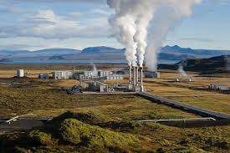
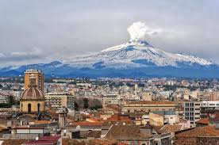
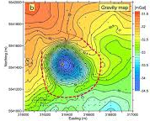
- Use Cases
8 use cases to support some of the most pressing European societal challenges
Water storage assessment
Soil pollutant flow monitoring
Nuclear waste underground storage monitoring
Continuous volcano monitoring
Time-lapse volcano monitoring
Climate change monitoring
Geodesy and national spatial references
Geothermal energy
9

Slide 10
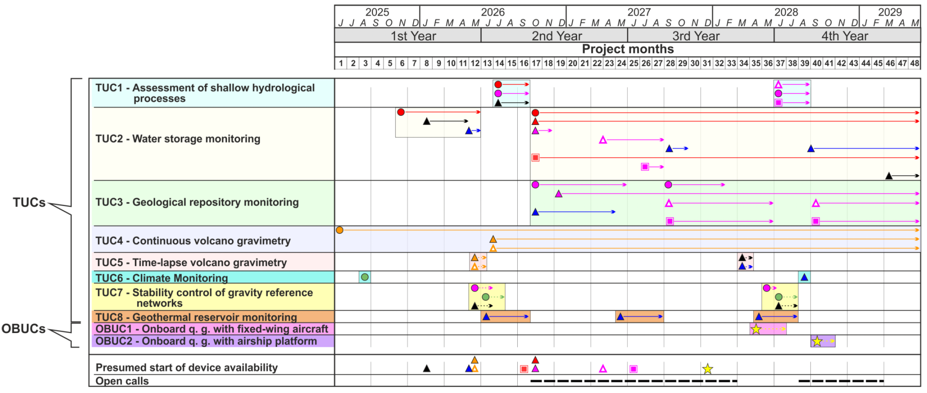
- Use Cases

Slide 11
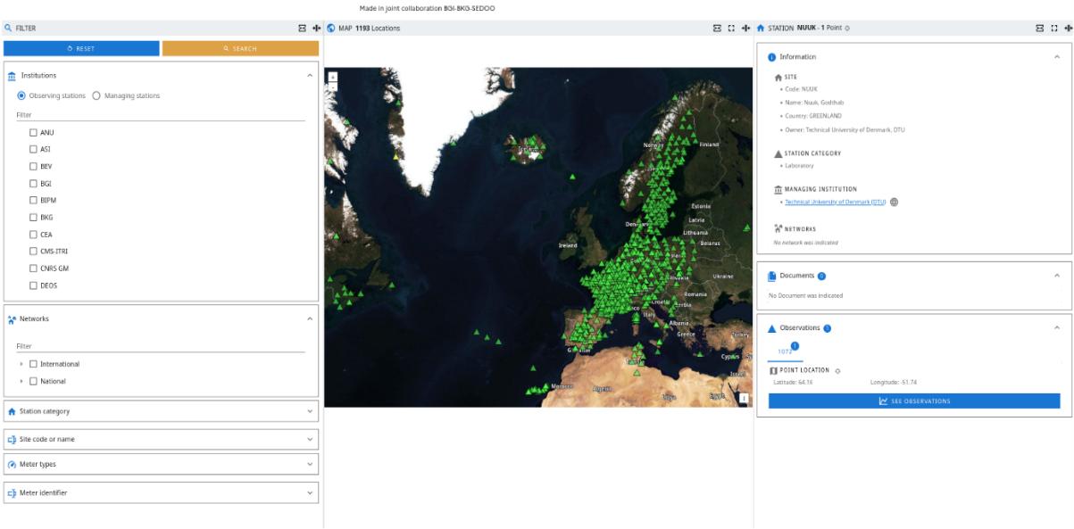

- Data
Collecting, storing and providing access to high-quality data to the entire scientific community
All data collected on the field by EQUIP-G sensors will be stored and provided following the FAIR principles:
  Findable
  Accessible in open source
  Interoperable
  Reusable
We leverage the expertise in existing data repository
Heritage from existing gravity data bases and return on experience of GNSS data
EQUIP-G activities for data access:
FAIR assessment and metrics
Recommendations on community standards for FAIR implementation
Implementation in data repository
Initial data integration within EPOS

Slide 12
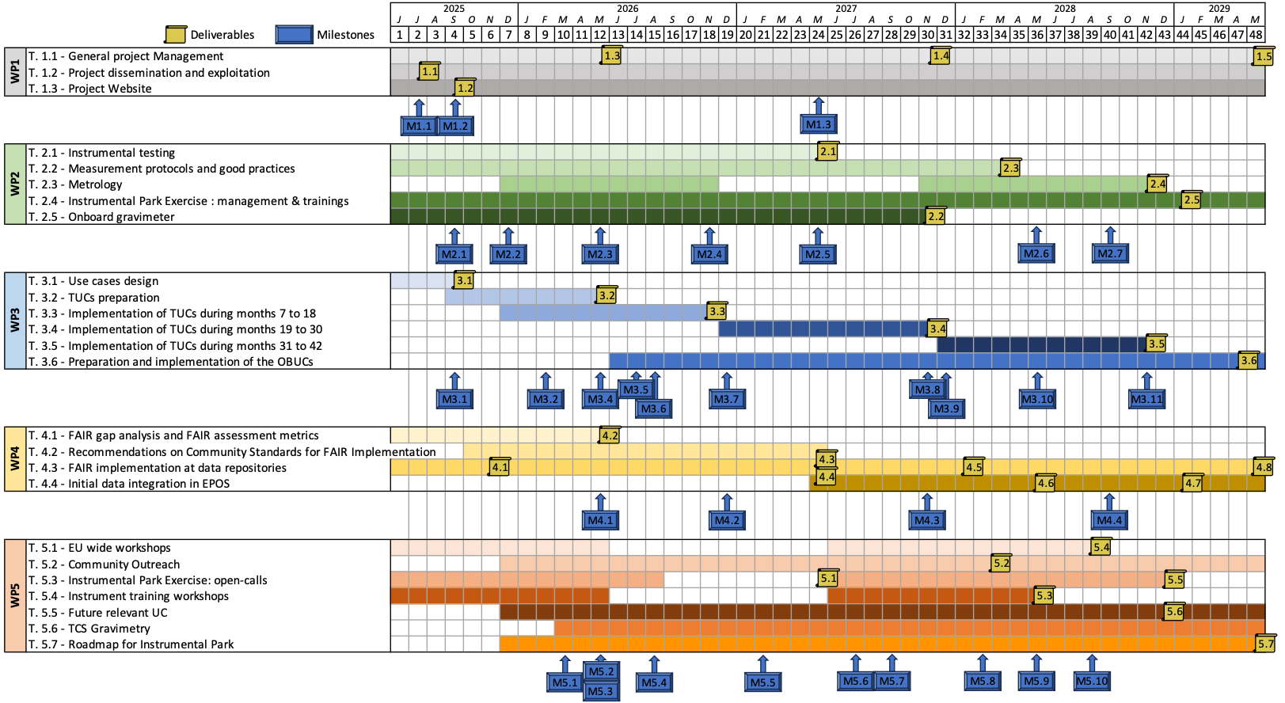
- Data
Collecting, storing and providing access to high-quality data to the entire scientific community
Participants: CNRS, CSIC, DTU, EPOS-ERIC, GFZ, IGiK, INGV, NLS FGI, ORB, UU
Temporary Data Center
Repository SEDOO
Storage on coming data
Backup
Stations visualization
FAIR Assessment Methodology
Collecting, storing and providing high-quality data to a wider scientific community
First Version of
Data Management Plan
FAIR-Aware
Webinars
Performed FAIR gap analysis
DATA availability
. . .
2025
Tests in progress
Validated
Submitted
2026
2029
DMP is a living document and in continuous evolution
Data center updates and developments

Slide 13
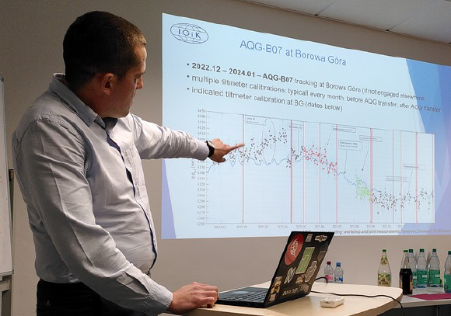
- Community Building
Knowledge transfer and community outreach
Within EQUIP-G we must:
  Raise the awareness of larger community of end users
  Train and educate more technical people
  Bridge the gap with the Industry
Democratize quantum
gravimeter use
We benefit from a large and committed community already active in Geosciences
We engage with both public entities and private companies
EQUIP-G activities for community building:
Two EU-wide community workshops
Two Open Calls to borrow and use quantum gravimeters from the EQUIP-G park
Trainings
Identify future Use Cases
Works towards TCS
To establish a roadmap and recommendations for future European perennial entity

Slide 14
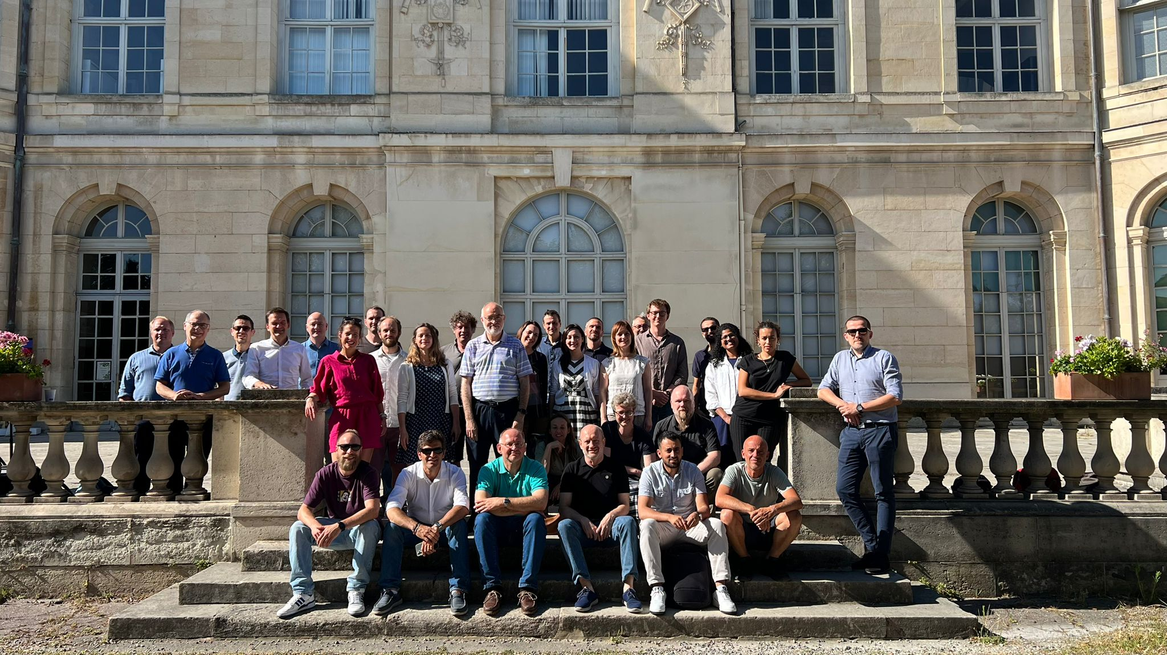
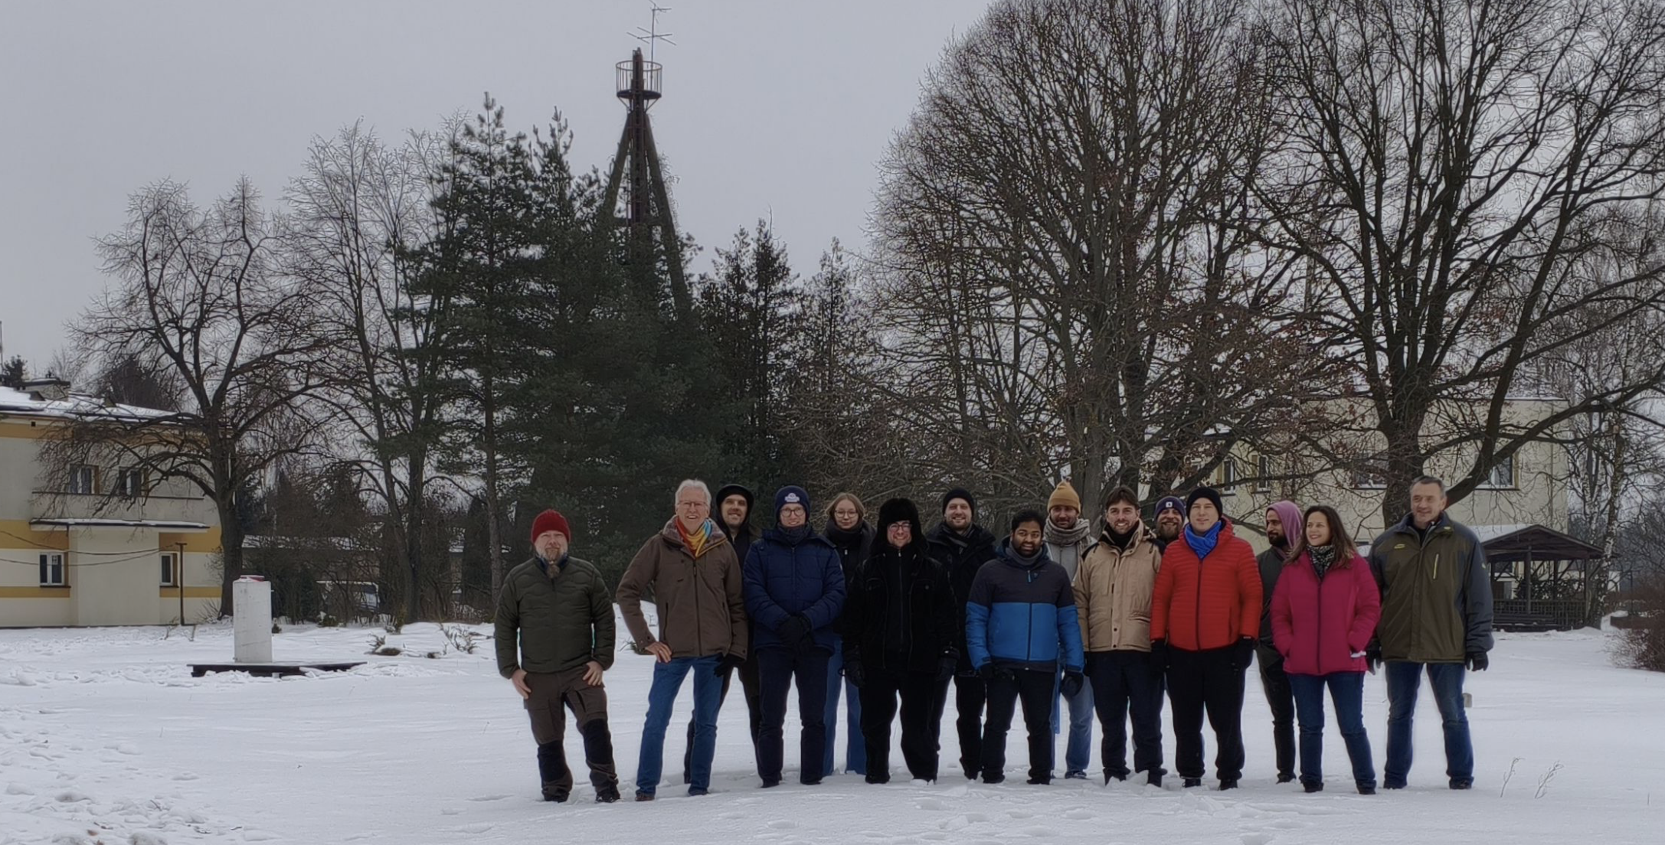
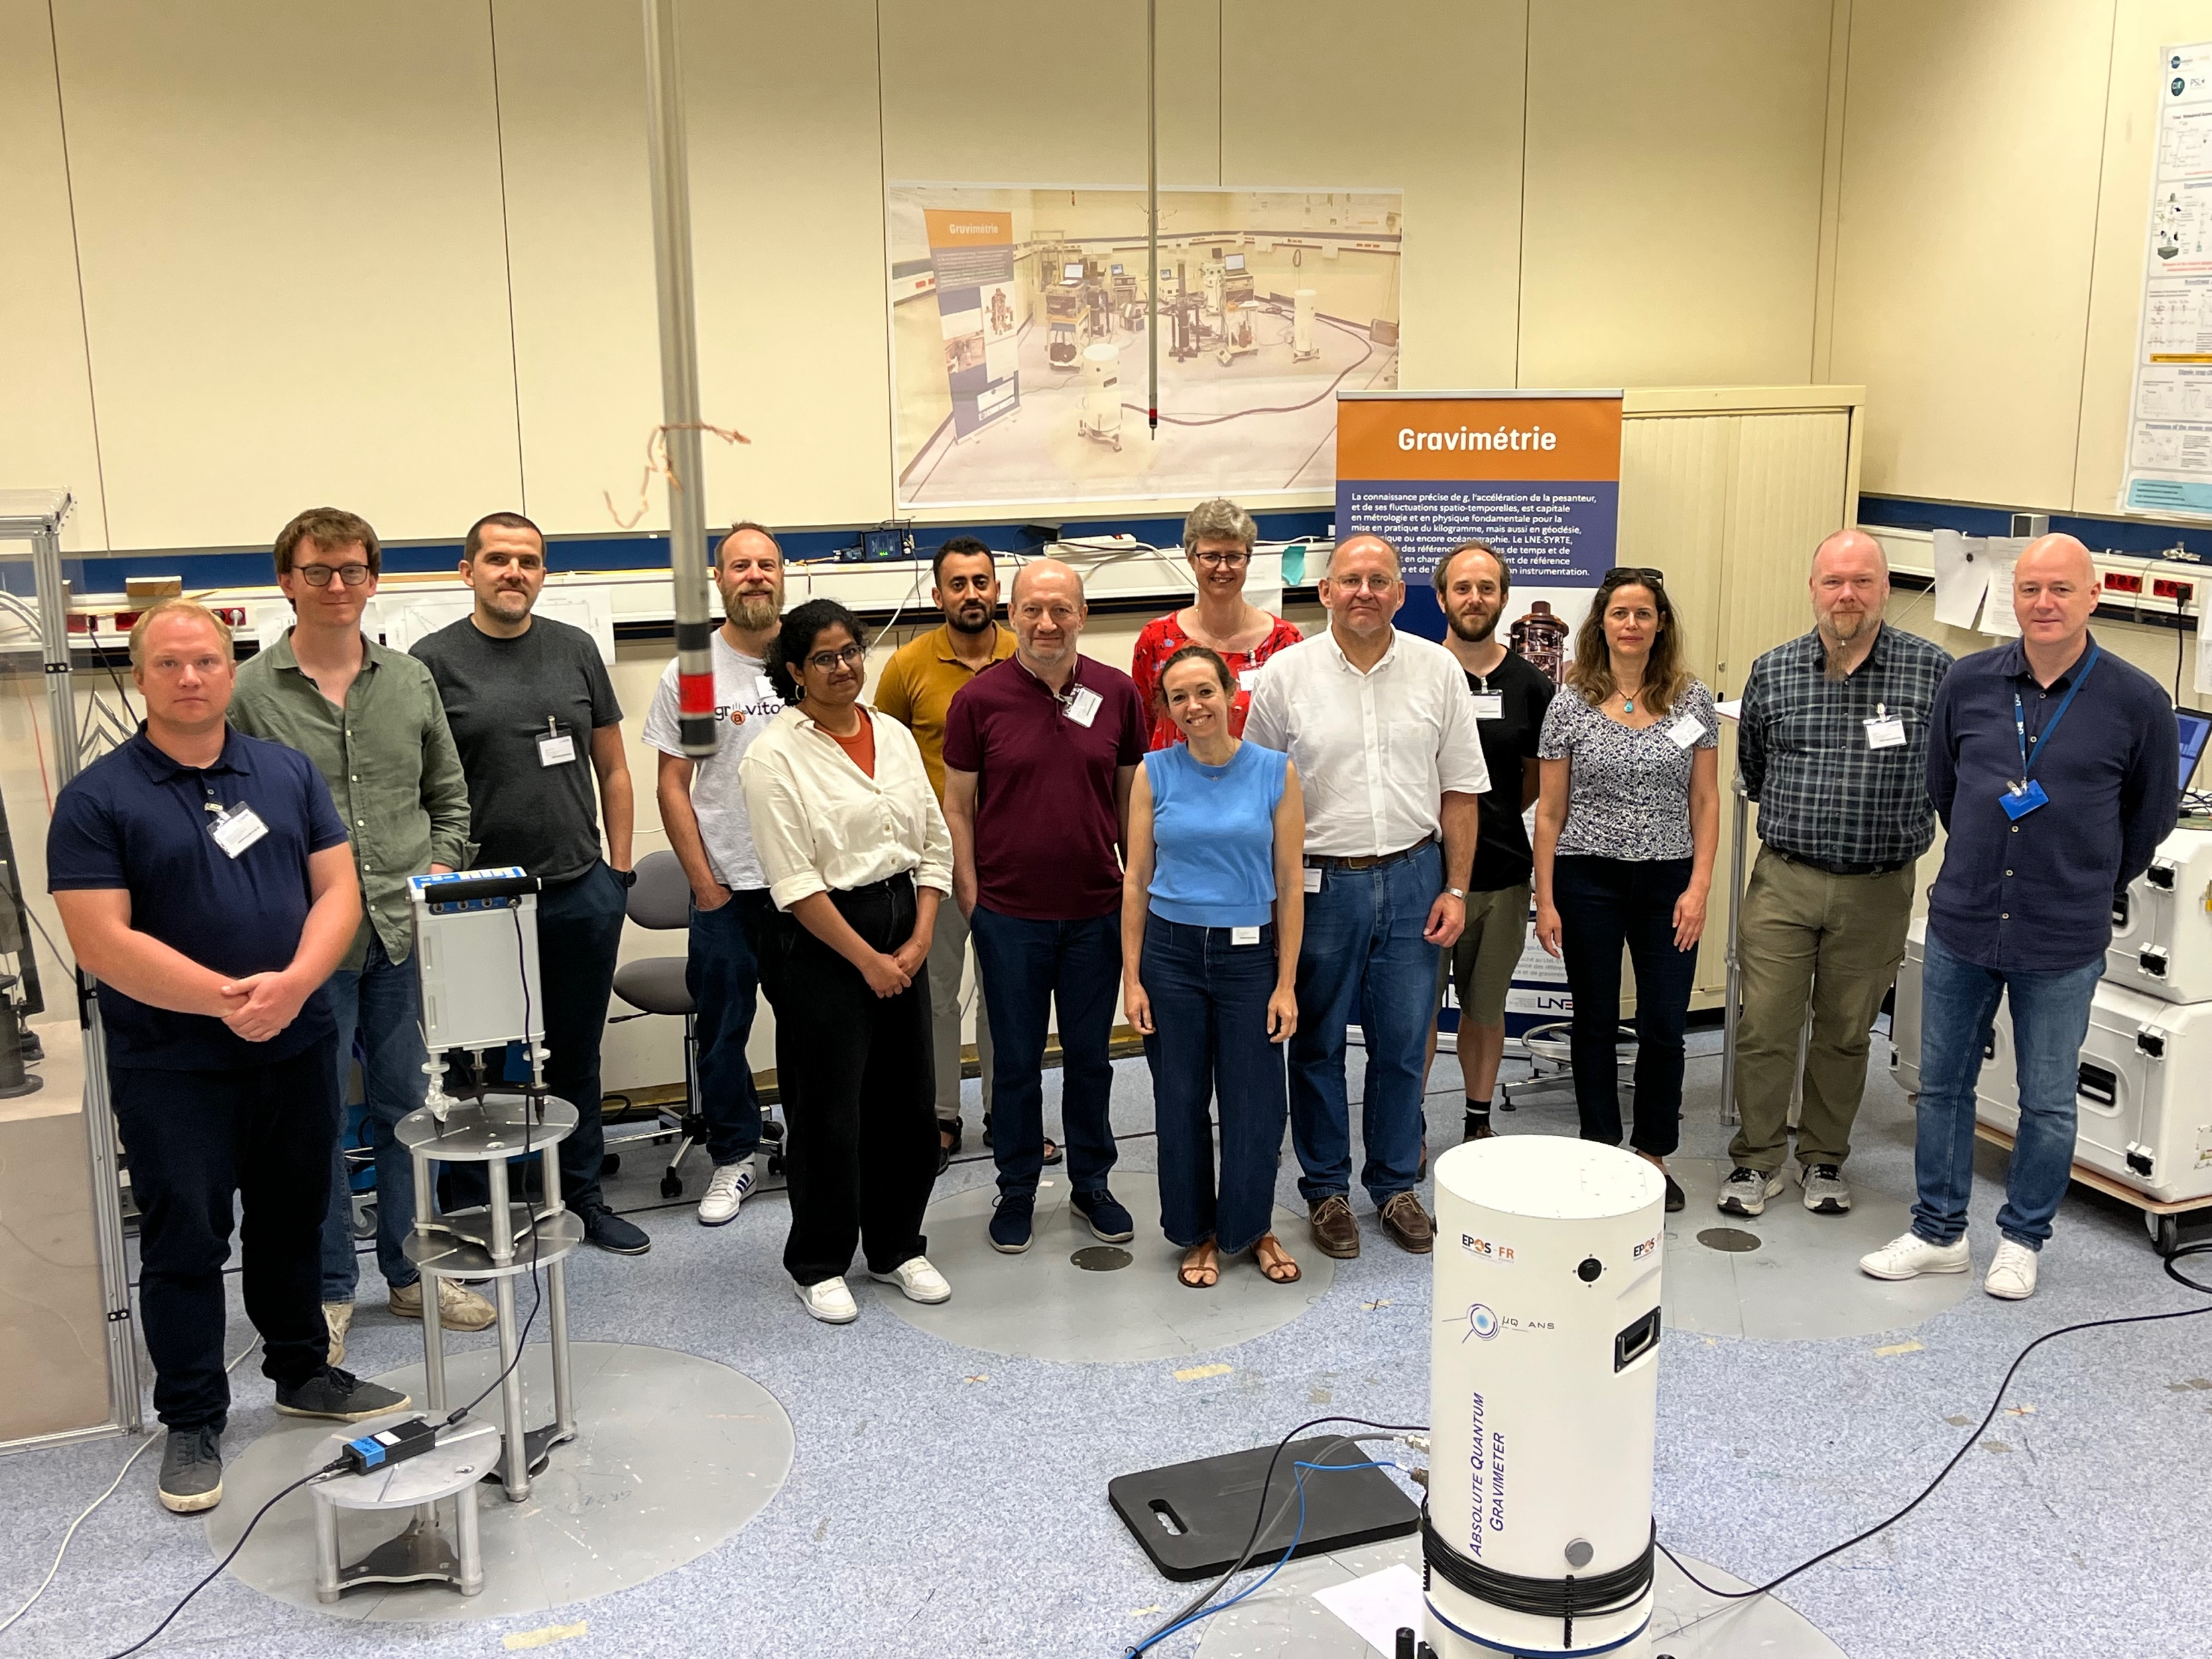

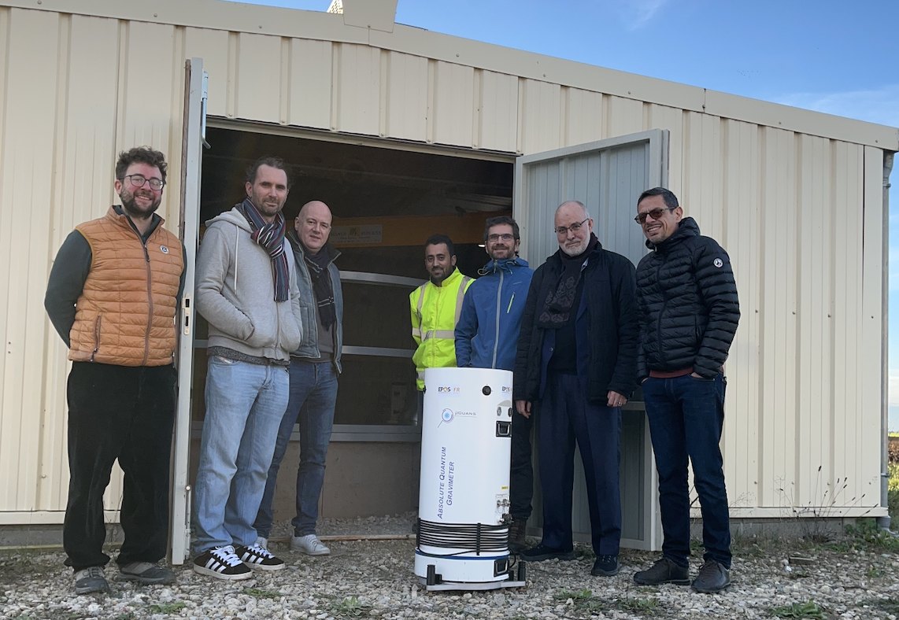
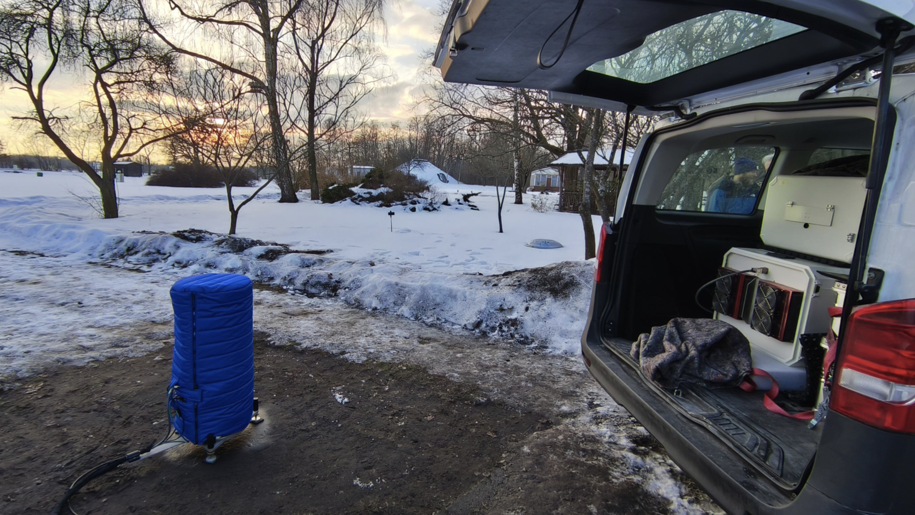
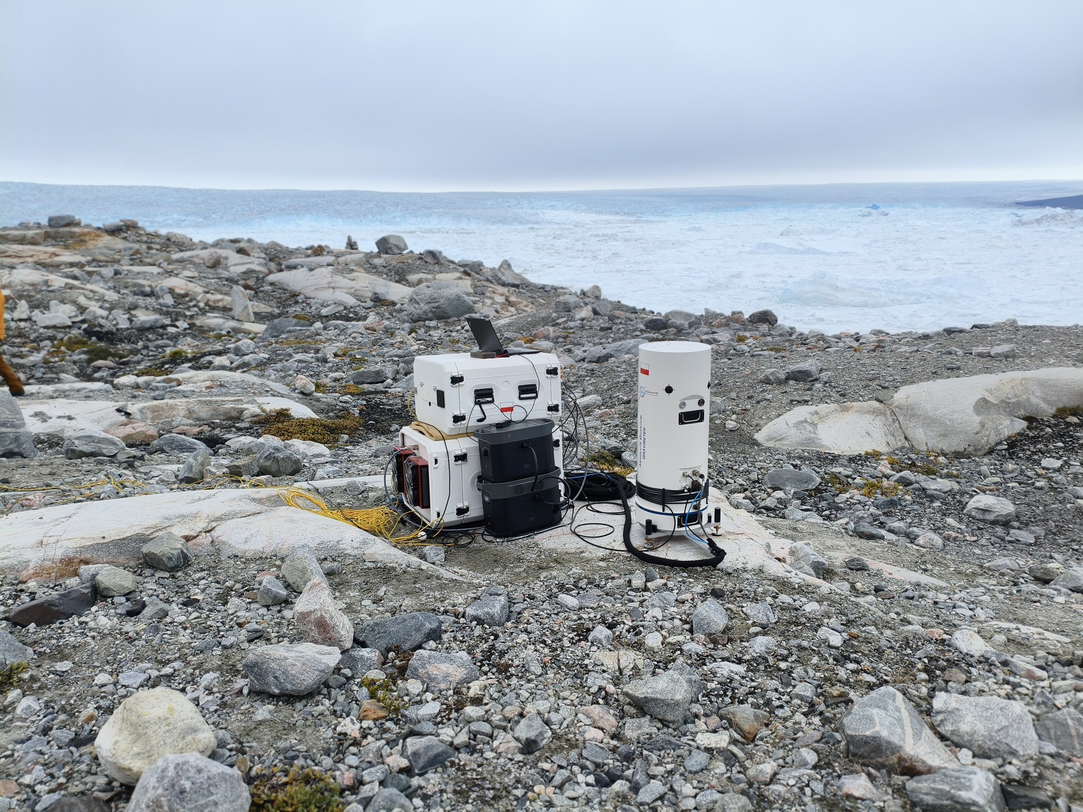
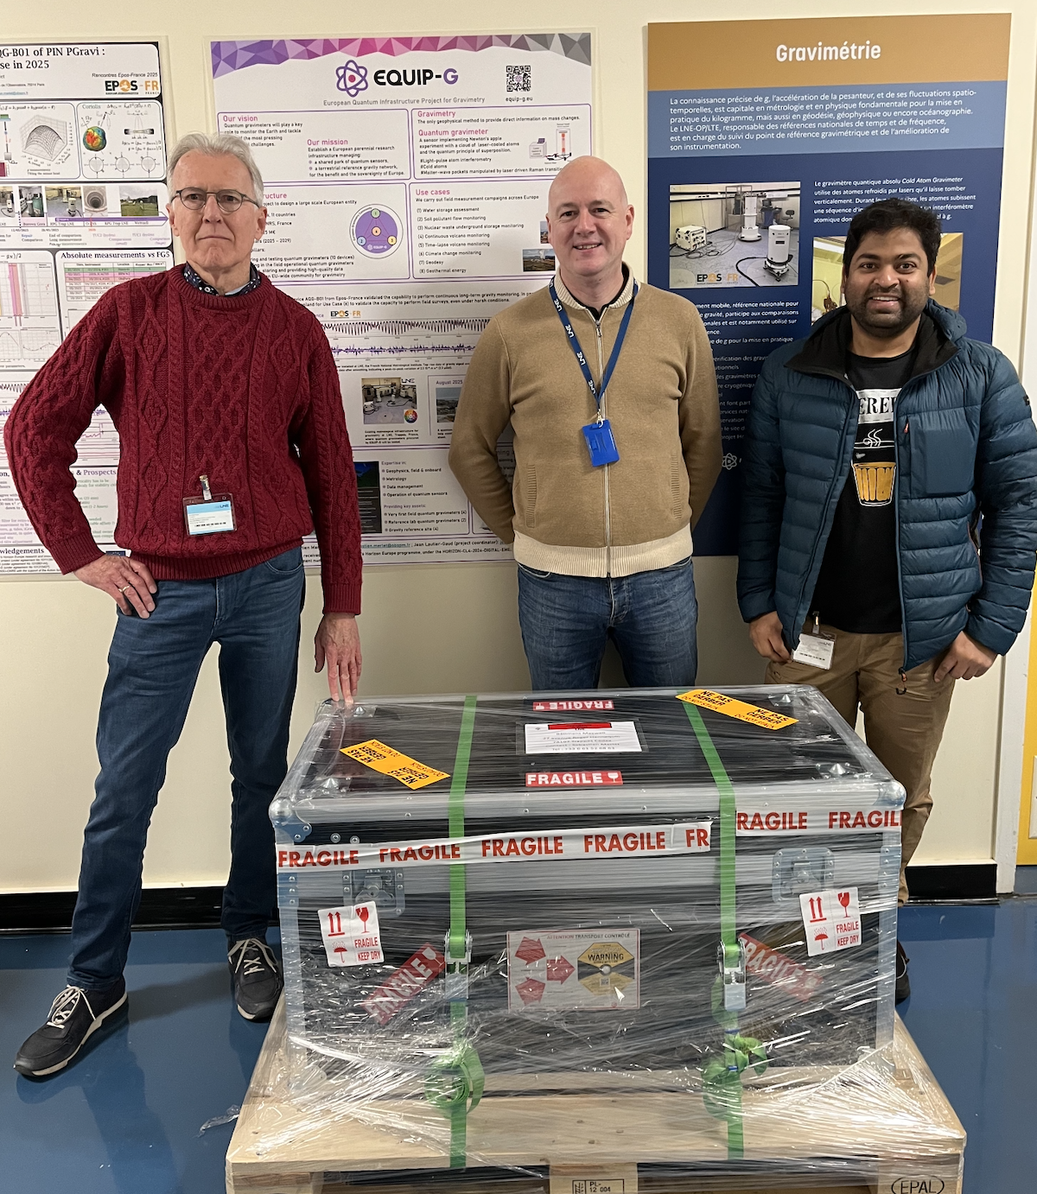
- Next steps
Towards the blueprint of a future European Research Infrastructure
June 2025 KO
February 2026
Instrument training
(closed)
April 2026
Instrument comparison (closed)
Roadmap and recommendations
to the European Commission
for a European entity
managing a shared park of
quantum gravimeters
First EU-wide workshop
03/06/2026 to 05/06/2026
Potsdam, Germany
First Open-call:
External European entities will be able to borrow quantum gravimeters from EQUIP-G
Summer 2026
. . .
2025
2026
Register
Register
2029

Slide 15
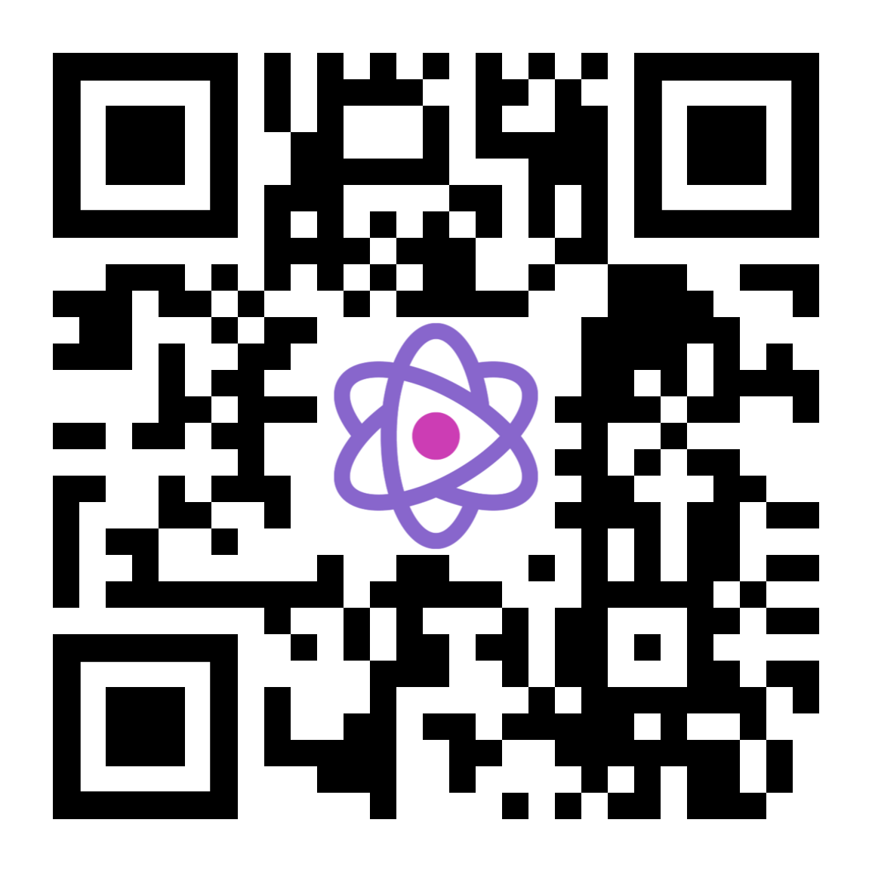



Registration opened
European Quantum Infrastructure Project for Gravimetry
EU-wide community workshop
June 3rd to June 5th 2026
GFZ Helmholtz Center for Geosciences, Potsdam, Germany
Stakeholders of gravimetry for Geosciences
(scientists & engineers from research and private sector)
European and national policy makers
equip-g.eu
Contact (local organizing committee): Marvin Reich, mreich@gfz.de
EQUIP-G has received funding from the EC’s Horizon Europe programme, under the HORIZON-CL4-2024-DIGITAL-EMERGING-02 call.

Slide 16

Coordination:
jean.lautier-gaud@obspm.fr, sebastien.merlet@obspm.fr
WP2: przemyslaw.dykowski@igik.edu.pl
WP3: daniele.carbone@ingv.it
WP4: lucia.seoane@get.omp.eu
WP5: mreich@gfz.de
European Quantum Infrastructure Project for Gravimetry
Follow us! equip-g.eu
EQUIP-G has received funding from the EC’s Horizon Europe programme, under the HORIZON-CL4-2024-DIGITAL-EMERGING-02 call.

Slide 17
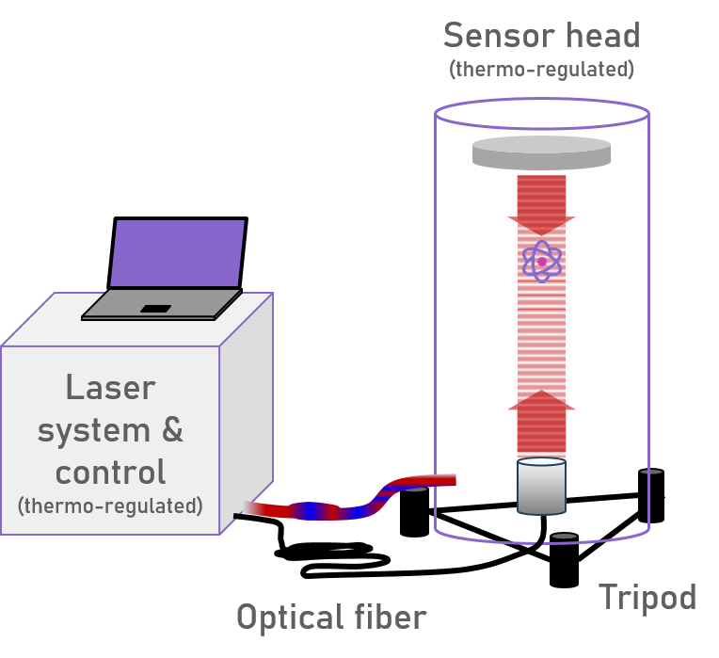
- Instruments
Quantum gravimeters, an attractive technology for Earth monitoring and geodesy
A quantum gravimeter
A sensor implementing Newton’s apple experiment with a cloud of laser-cooled atoms and the quantum principle of superposition. The watter-wave duality of atoms is exploited to perform interferometry with free falling atoms.
The high-precision measurement technique is called light-pulse atom interferometry. The matter-wave packets are manipulated by laser driven Raman transitions.
High-level schematic of the quantum gravimeter used in EQUIP-G
Want to know more ?
Check out a nice review by IAG GGOS (Global Geodetic Observing System)
and an IEEE special issue on gravimetry

