Slide 1

Ground Instability data from Field Laboratories: a new opportunity from EPOS through the TCS MSL
Salvatore Martino

Slide 2

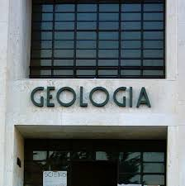

WHO WE ARE

Slide 3

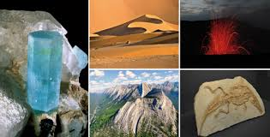
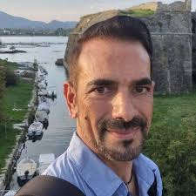



Salvatore Martino
Gian Marco Marmoni
Guglielmo Grechi
Mattia Buglione

Slide 4
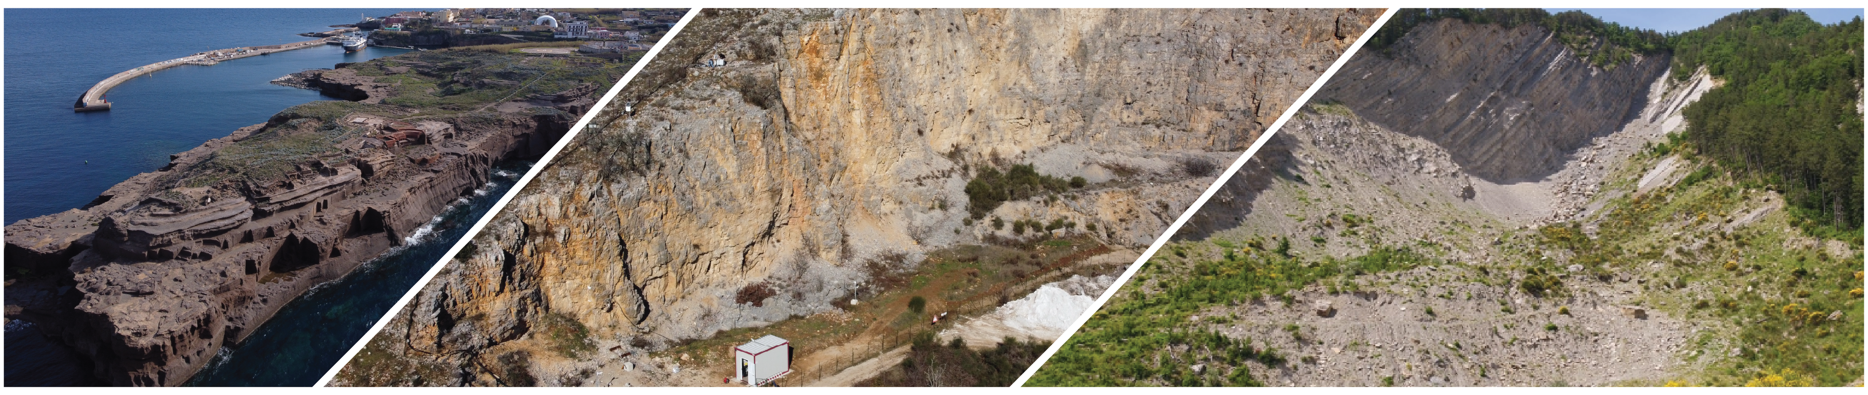
OUR EXPERIENCE BEFORE EPOS

Slide 5
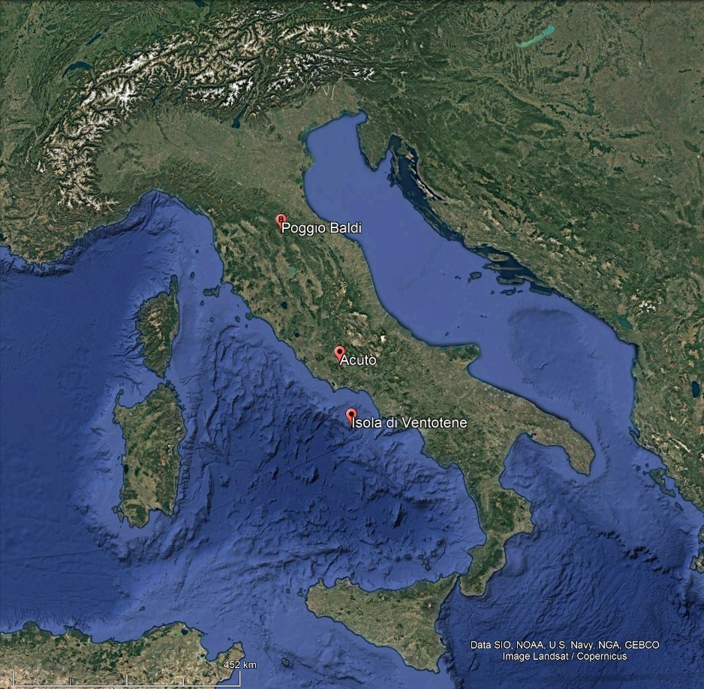
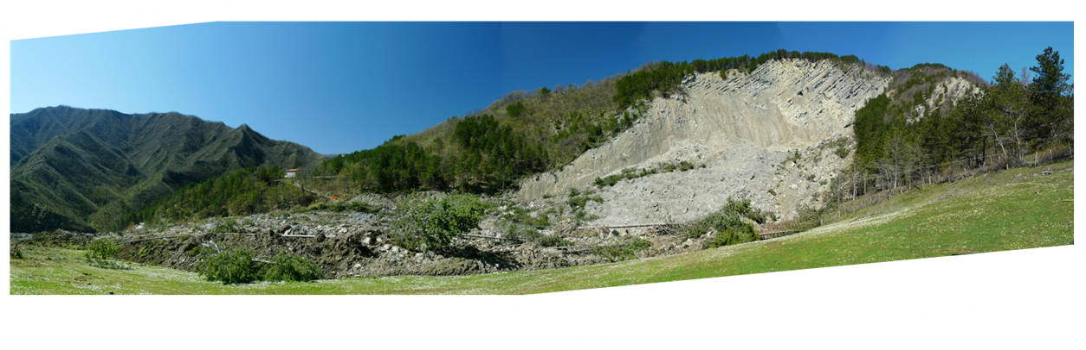
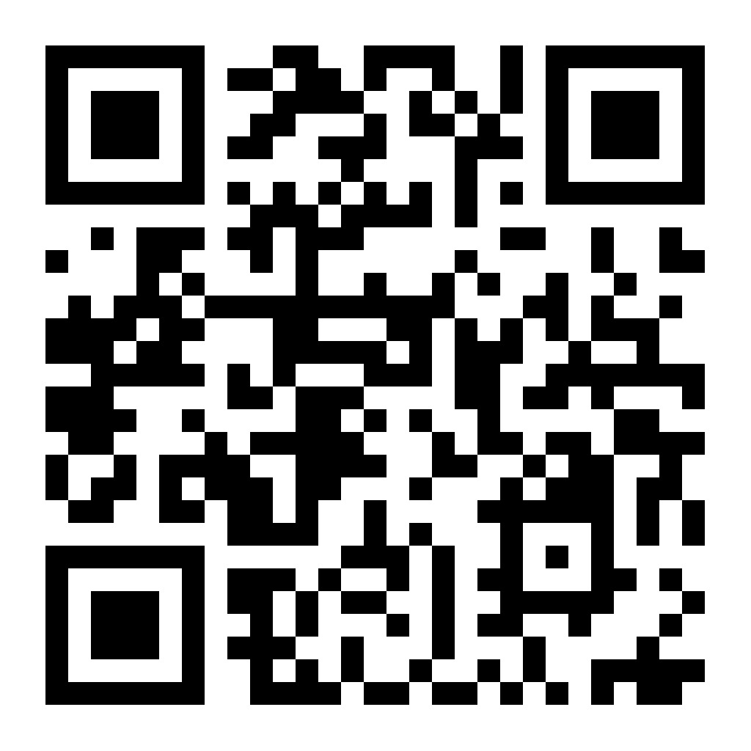



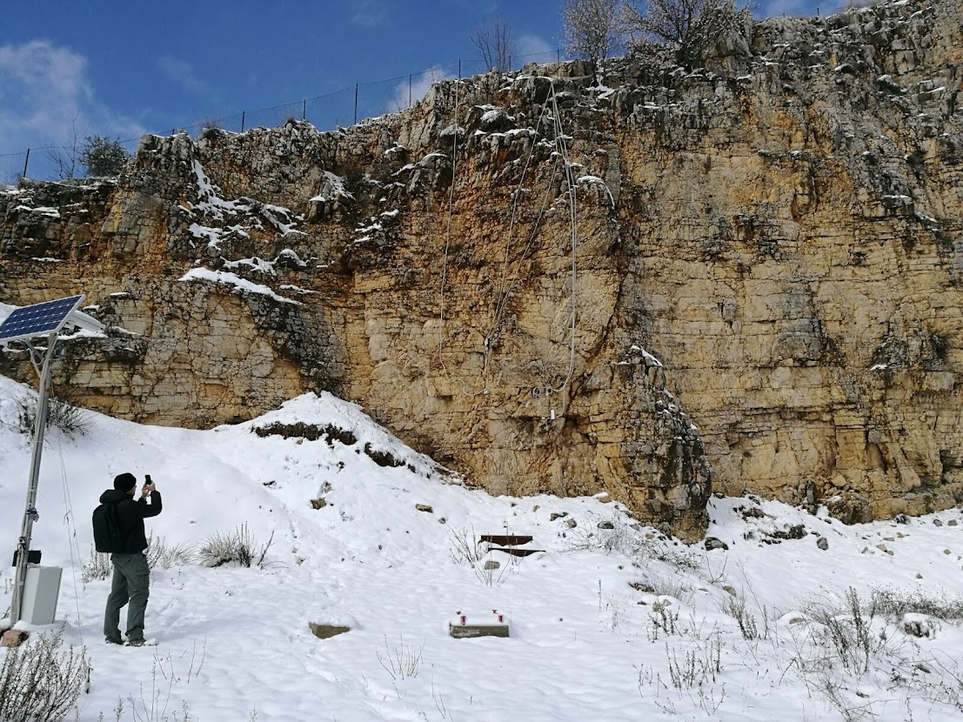



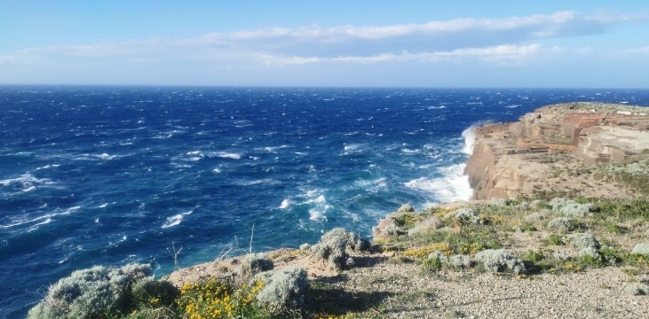


https://dst.web.uniroma1.it/it/laboratorio-naturale-di-poggio-baldi
https://dst.web.uniroma1.it/it/acuto-field-laboratory
https://dst.web.uniroma1.it/it/ventotene-field-laboratory

Slide 6
Ground instabilities, such as landslides, can be studied in their natural context through laboratory-like environments that allow the synchronous monitoring of multiple control parameters of the phenomenon using sensors of different types.

Slide 7
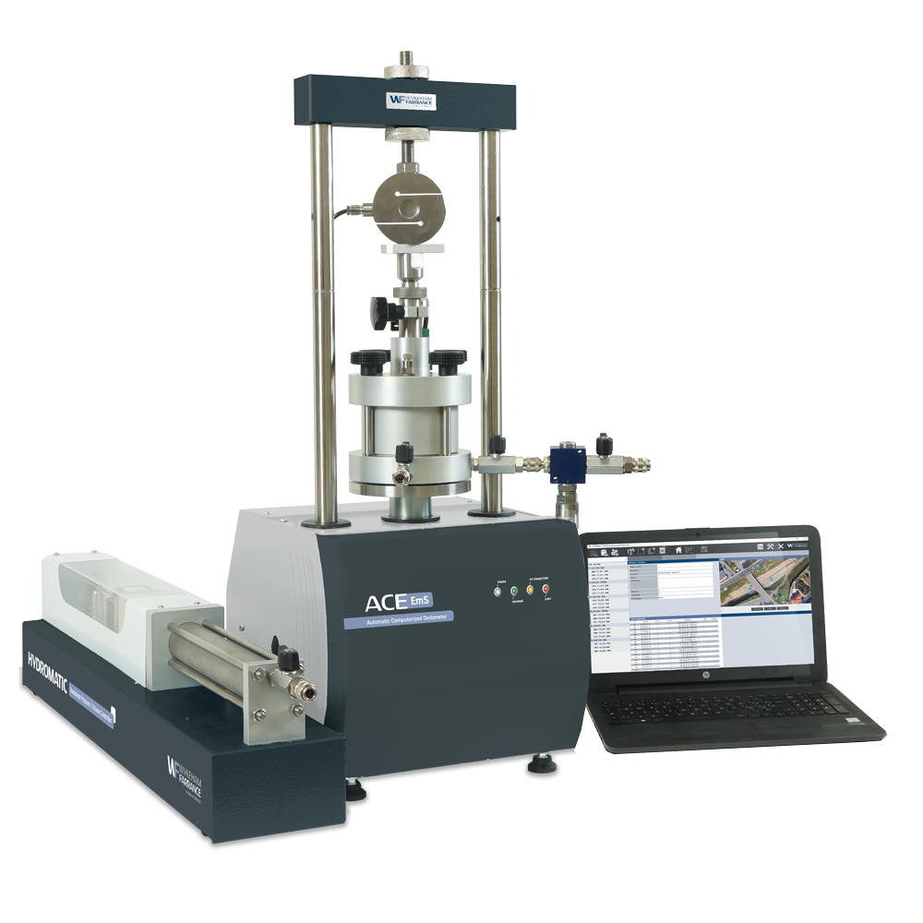
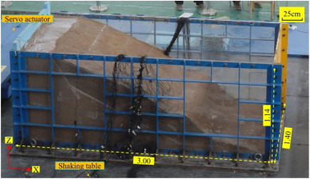
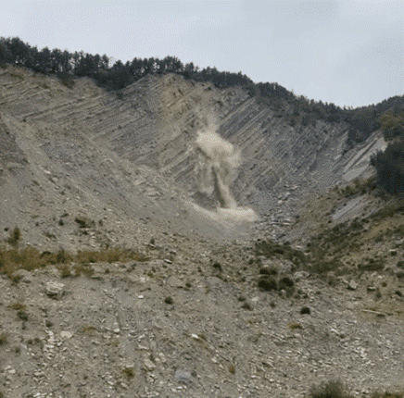
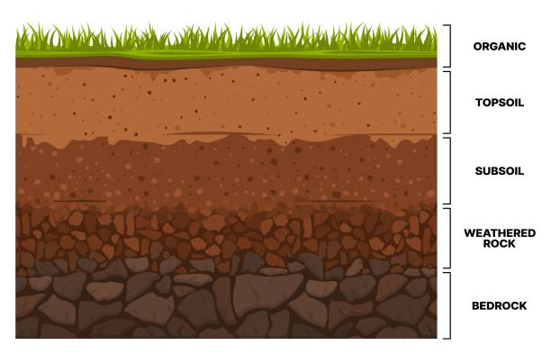
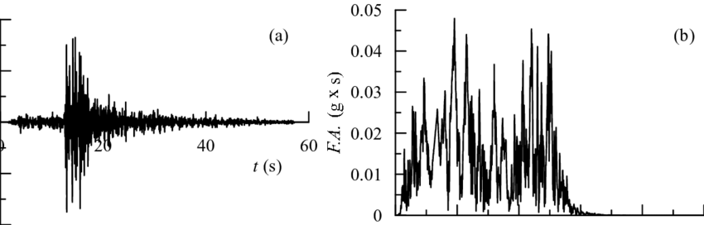
DOWNSCALING
UPSCALING
Multiscale laboratory approaches applied to ground instabilities involve downscaling paths—from the natural process to laboratory testing—and upscaling paths—from laboratory testing back to the natural process. These approaches are not always complementary, since some ground instability processes can be fully analyzed only at real scale

Slide 8
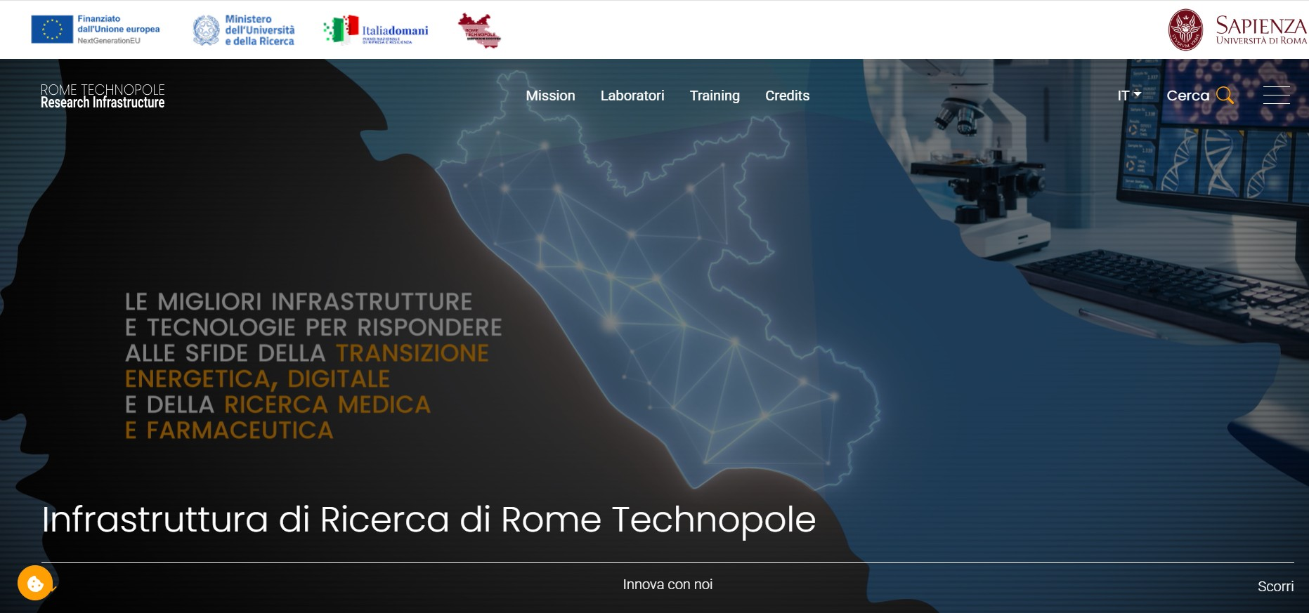

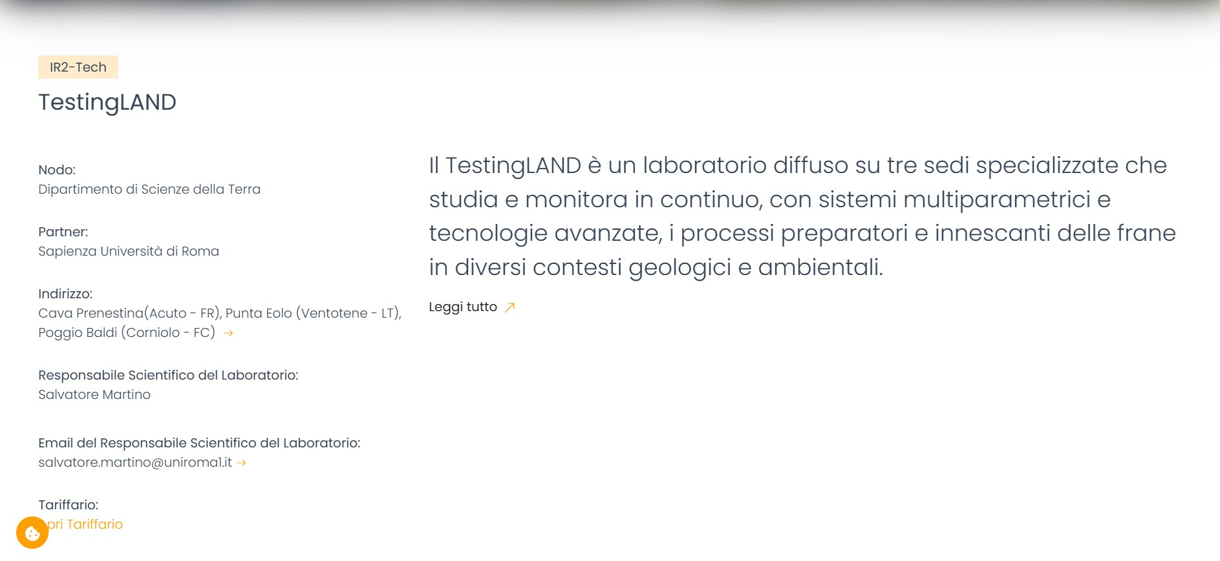
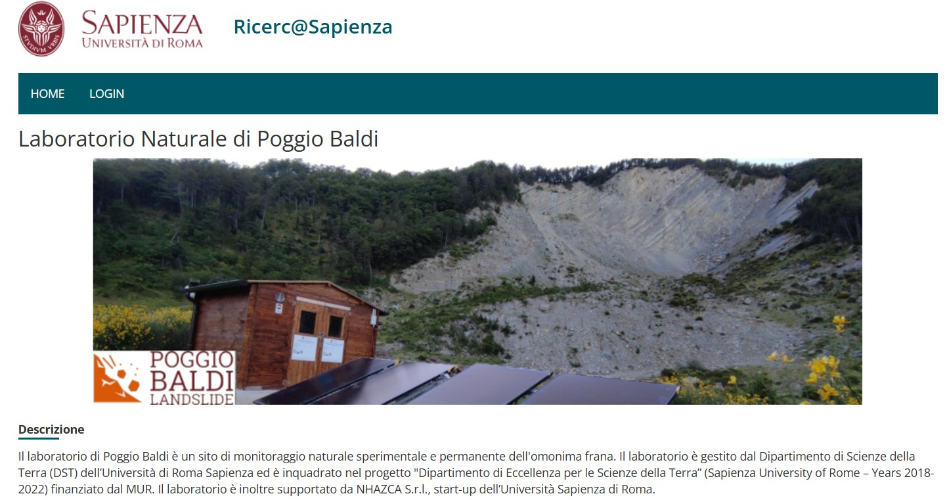
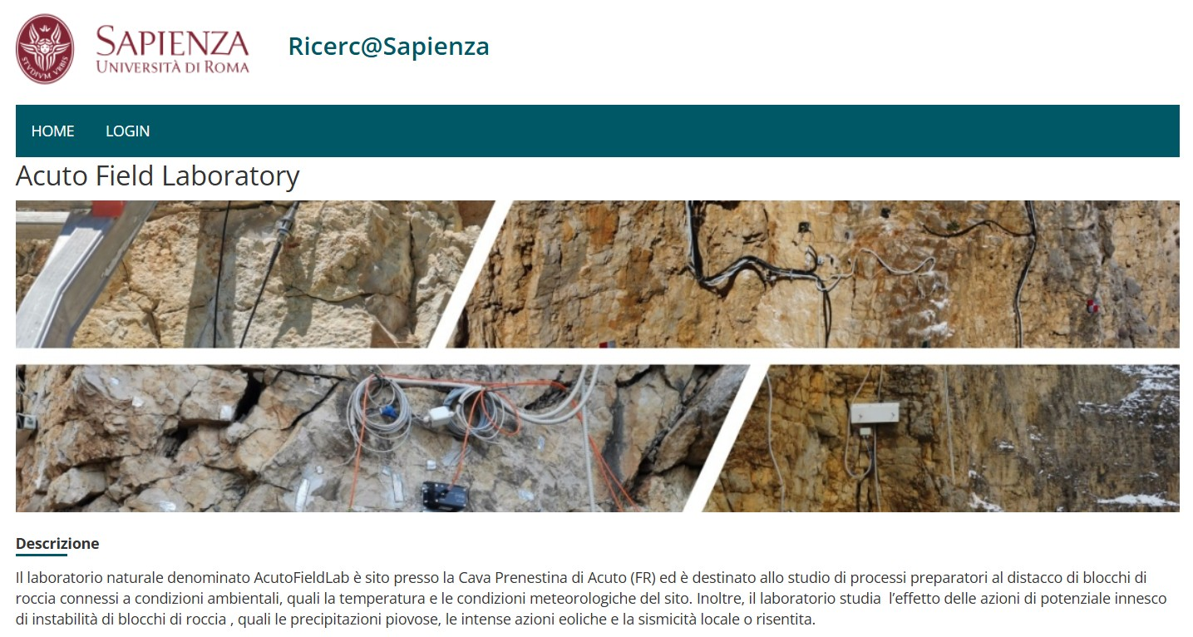
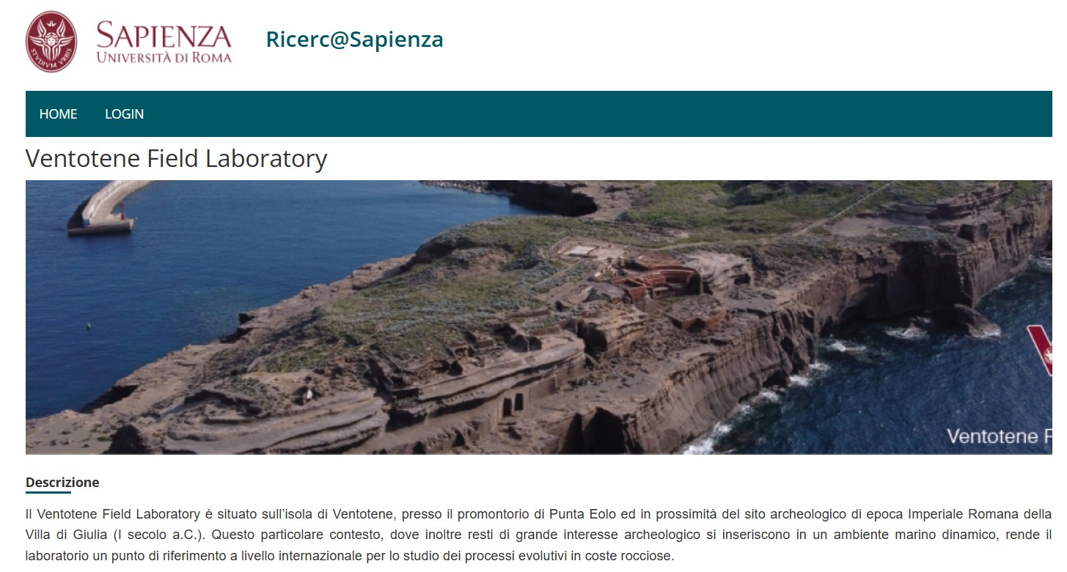

Slide 9
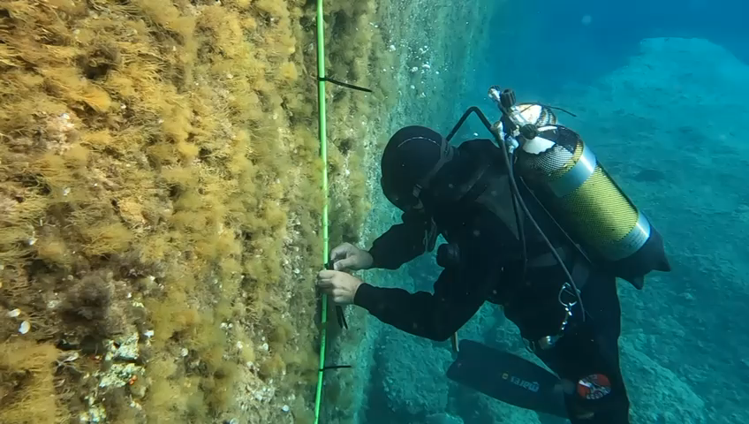
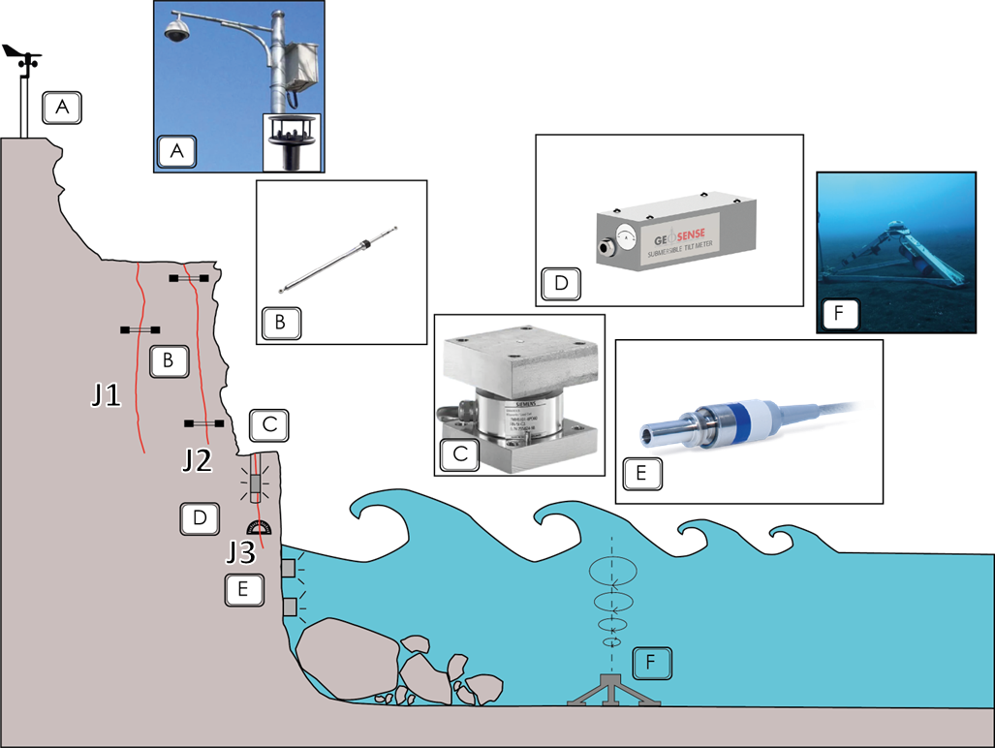
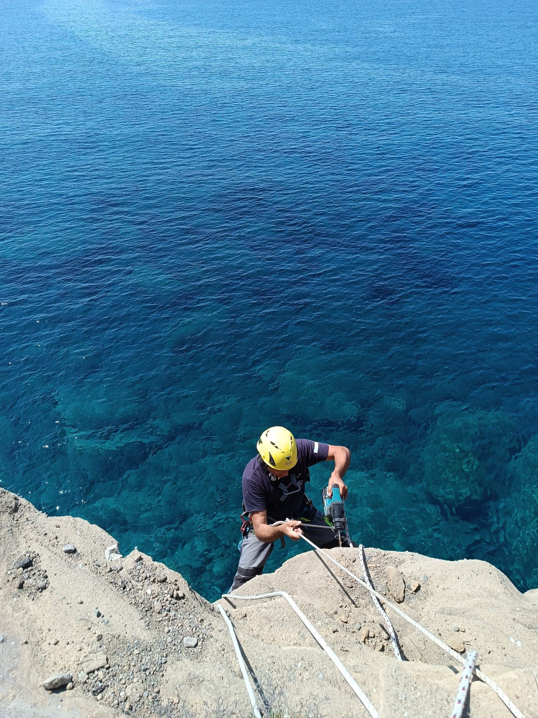
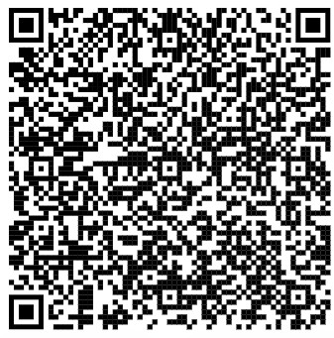
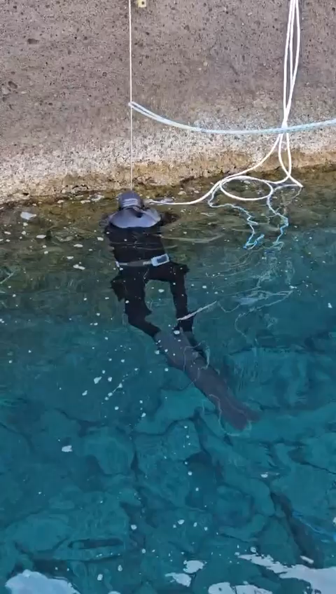

Slide 10
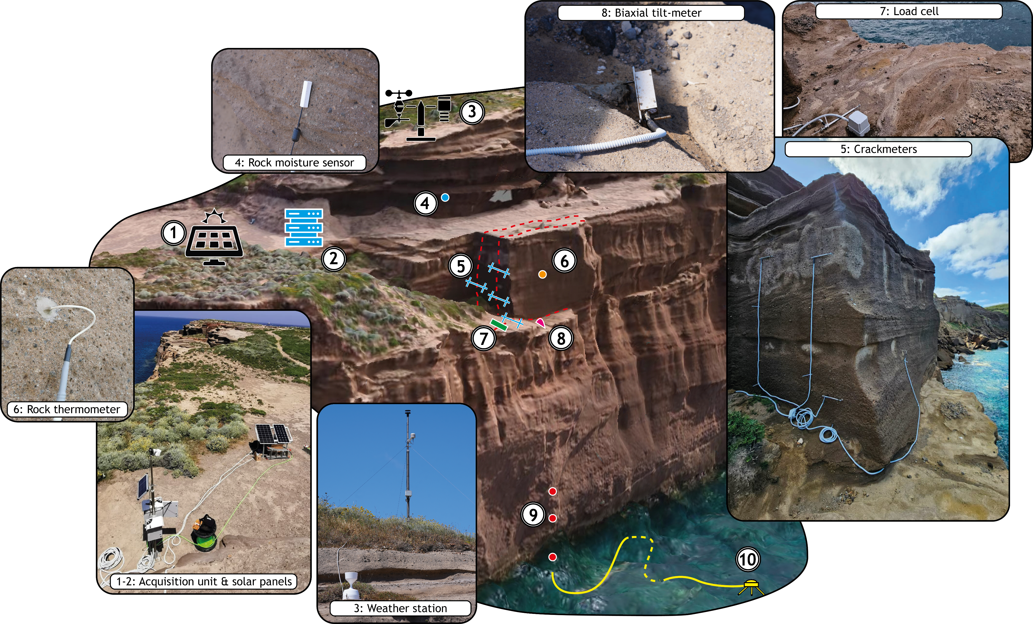
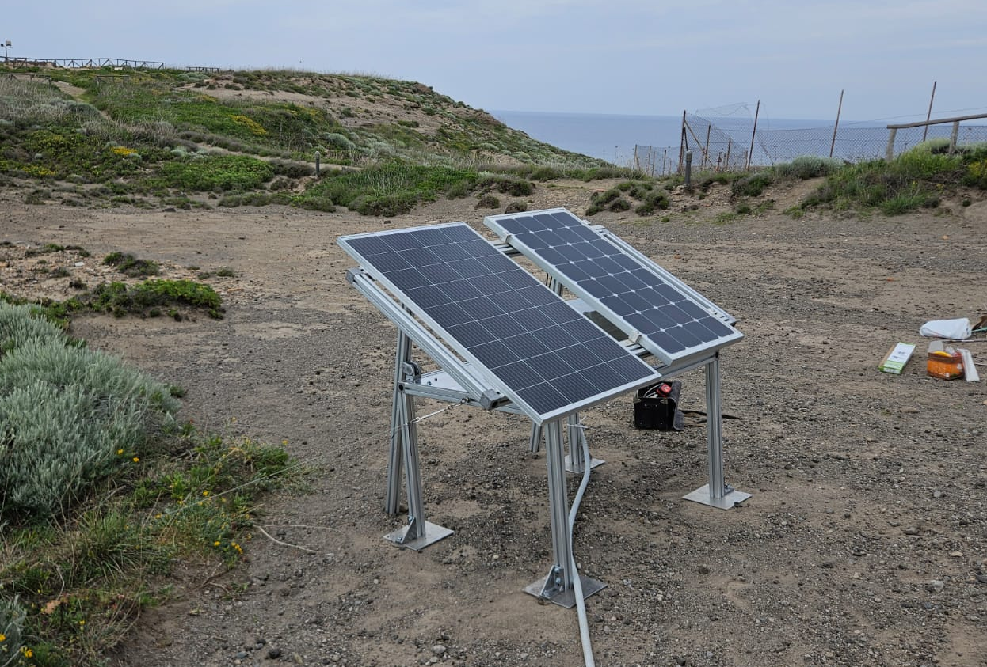
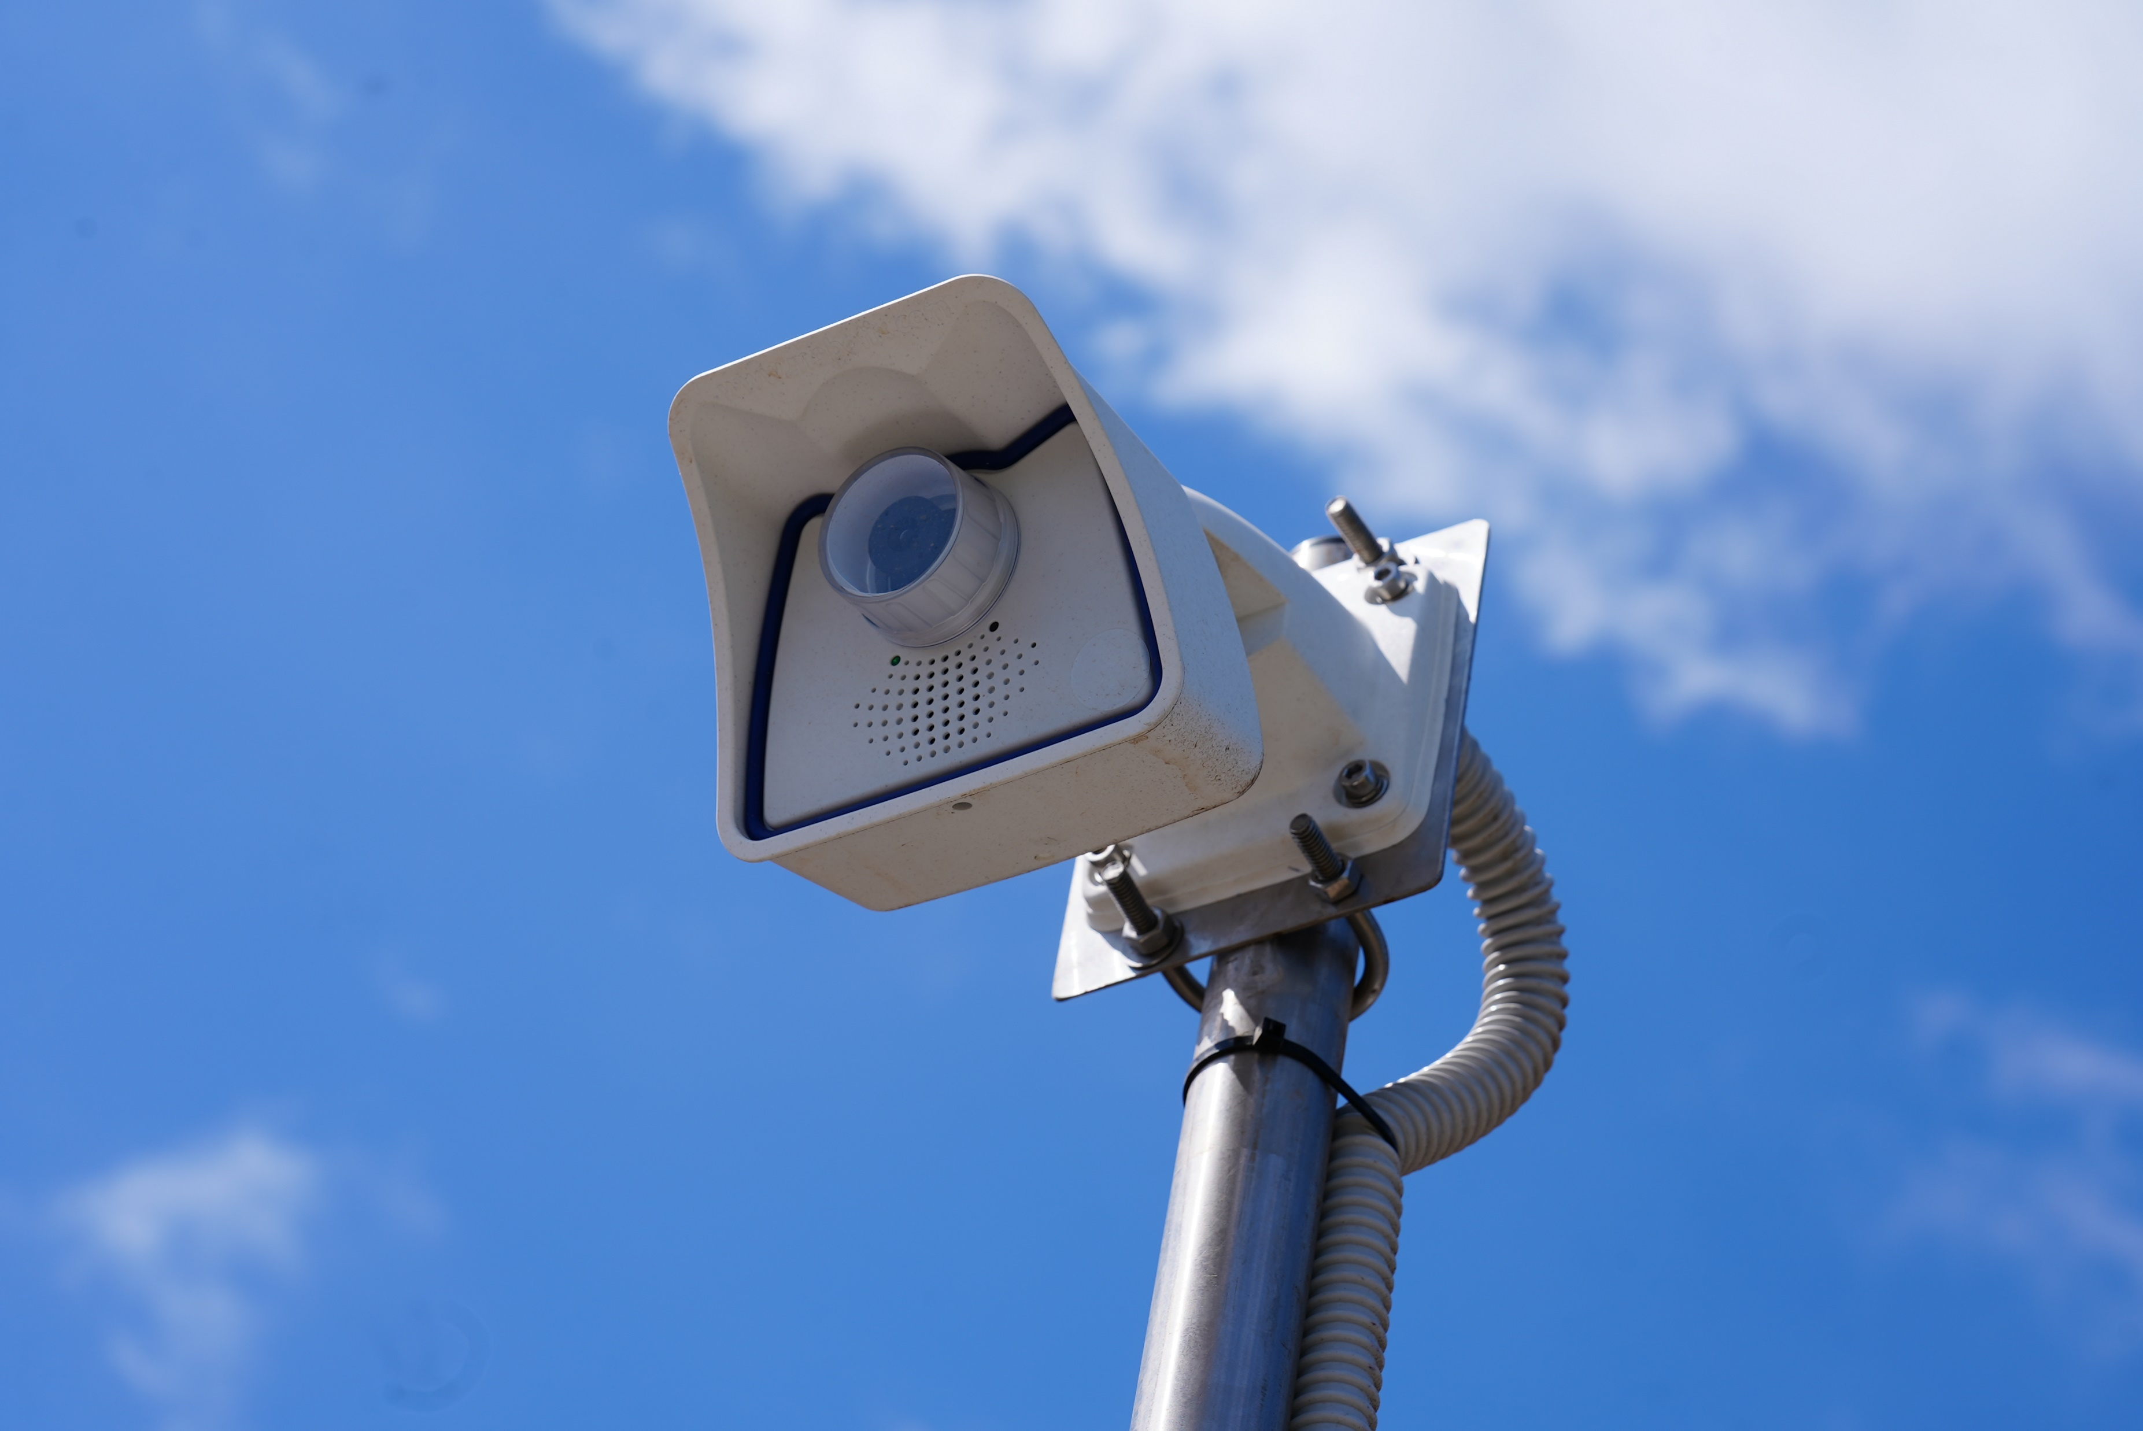
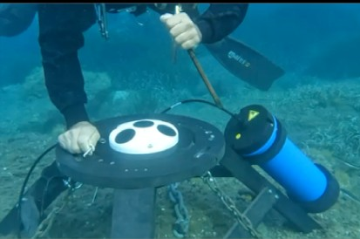
10. Tide gauge

Slide 11
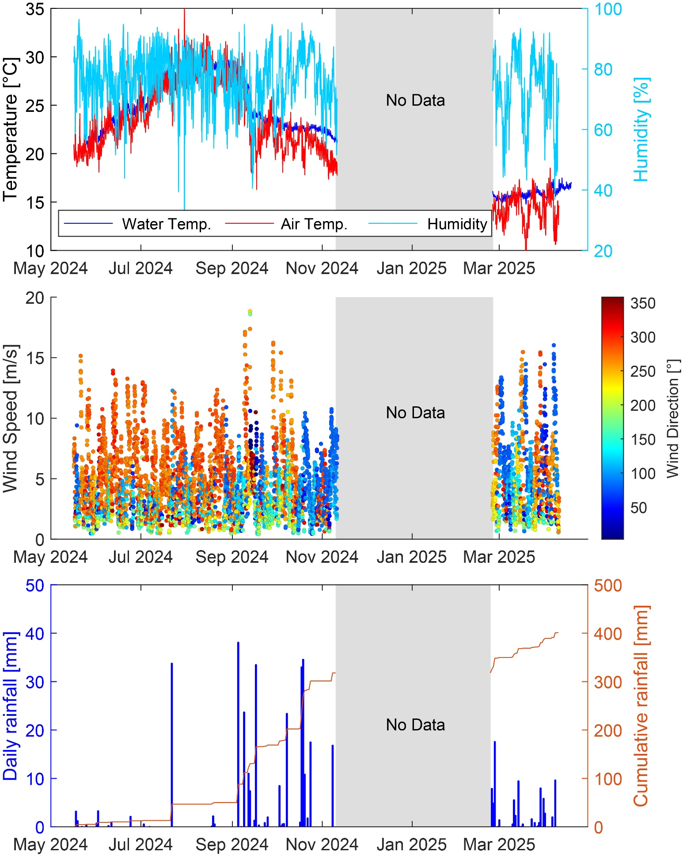
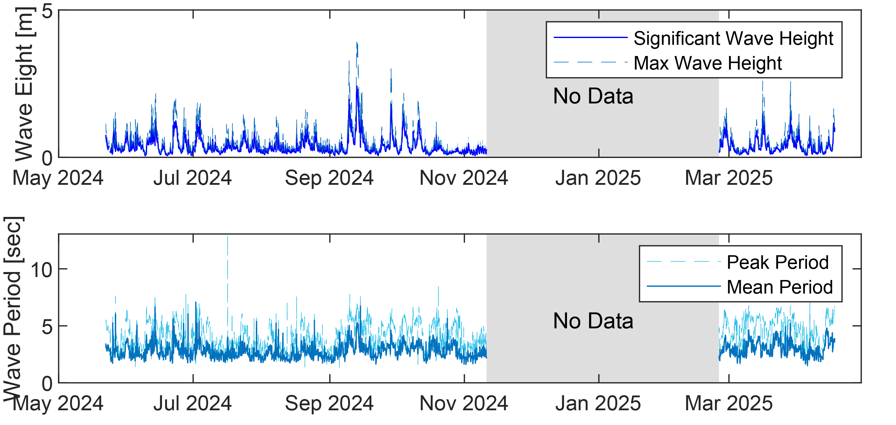
Causative processes: environmental forcing
Action

Slide 12
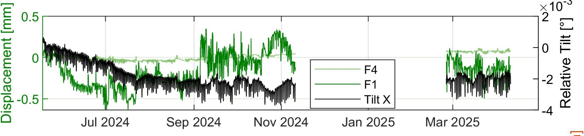
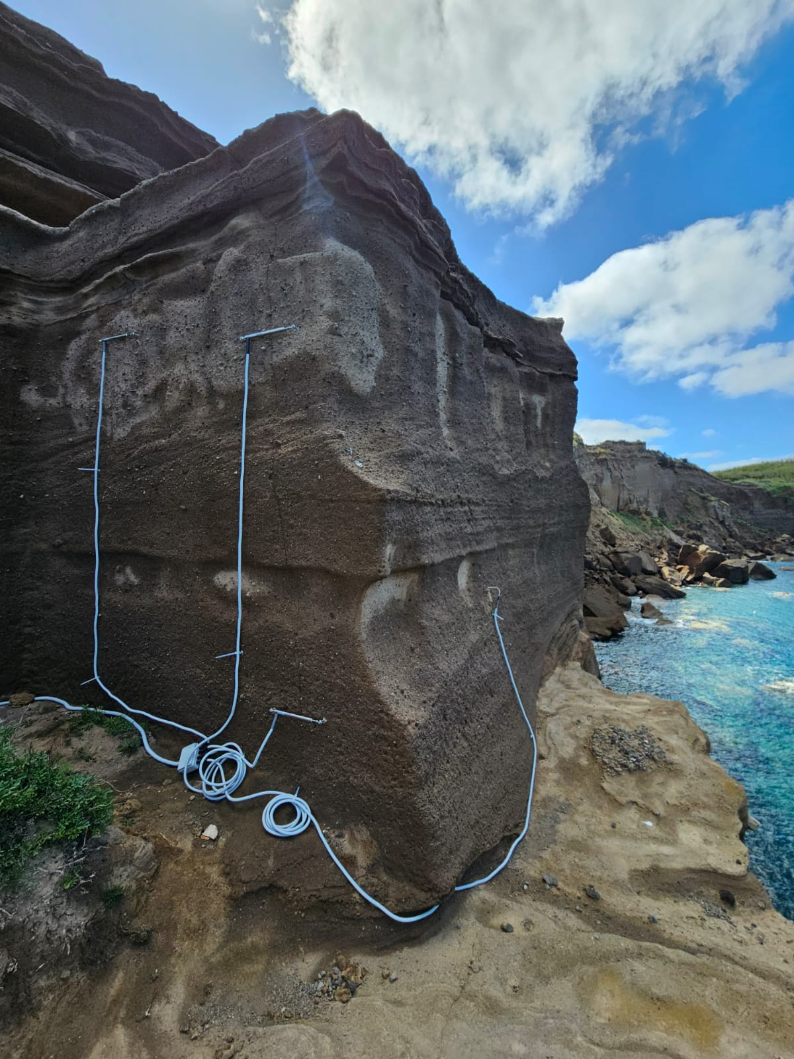
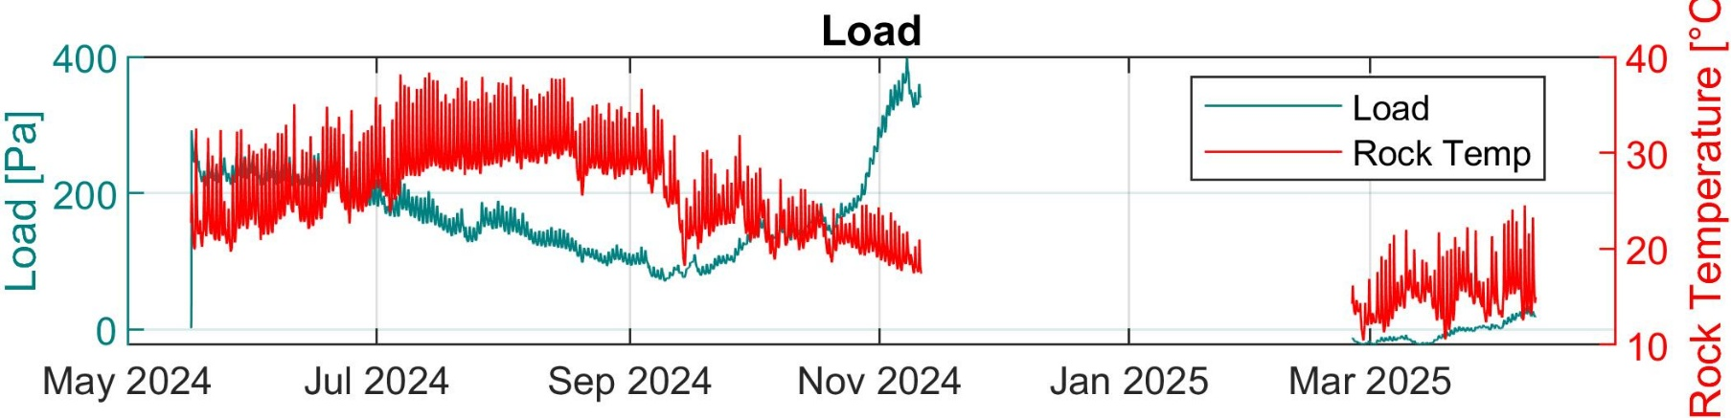
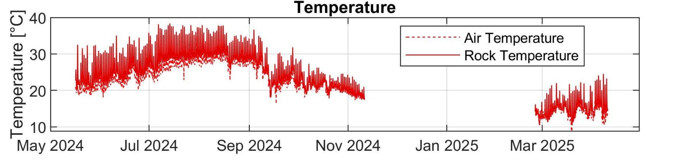
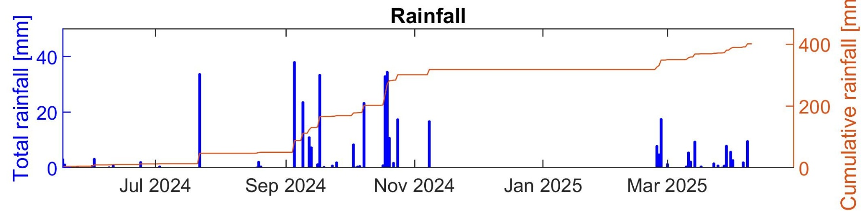
Causative processes: cliff response
F1
F2
Reaction
T1
F3
Tilt
LC
F4

Slide 13
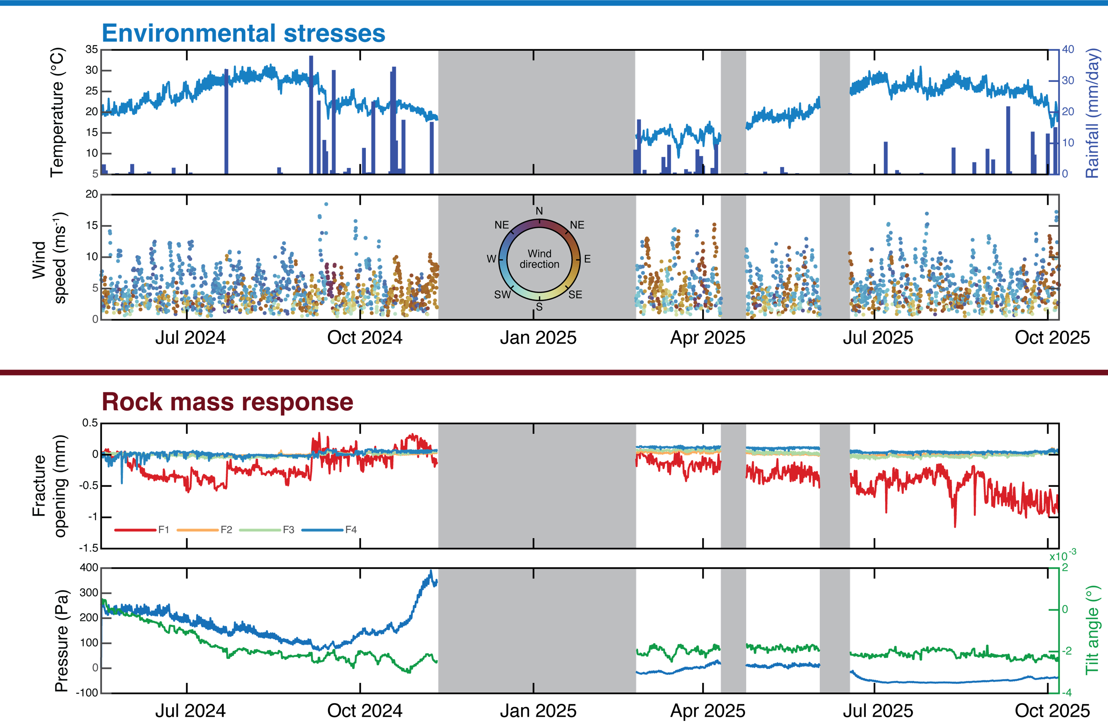
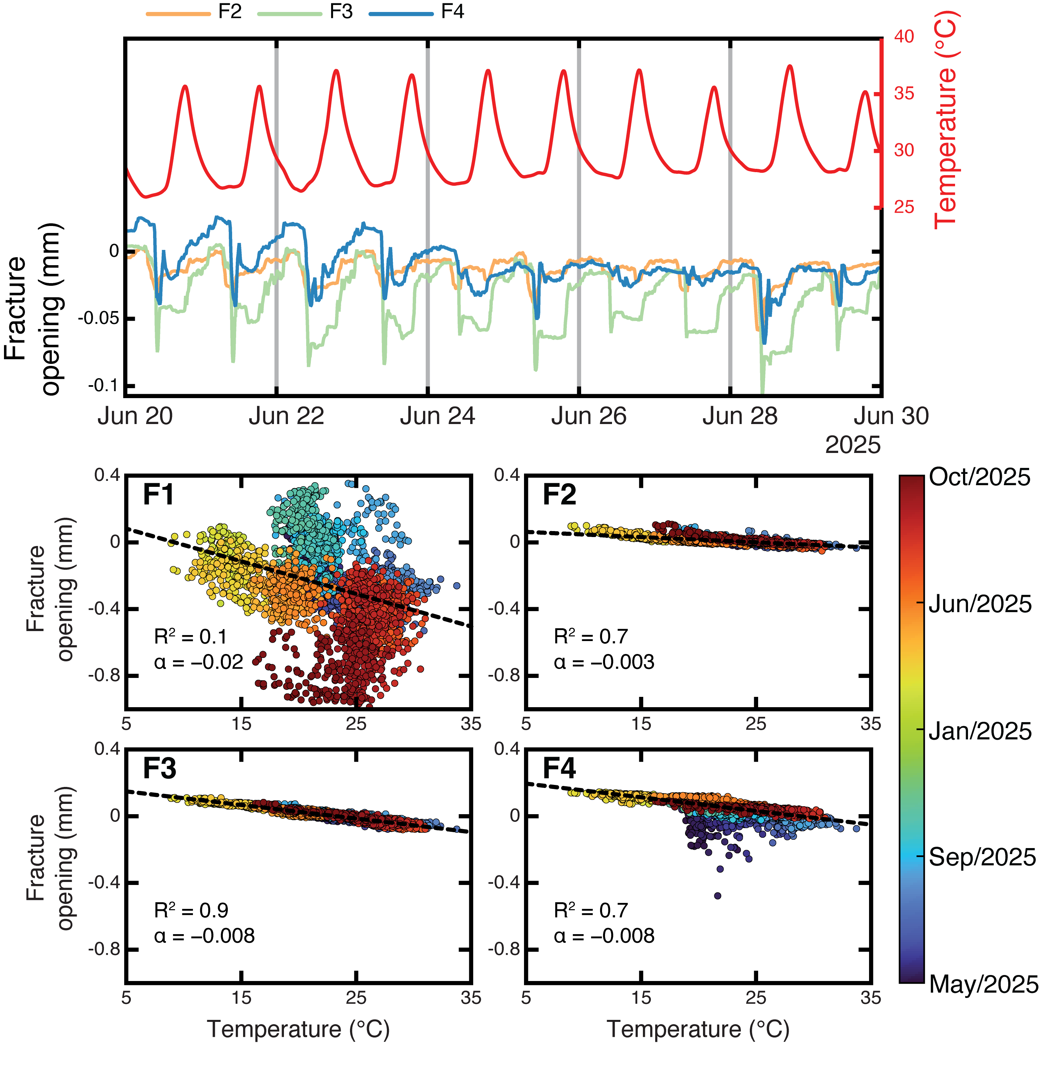
Use of simultaneous and multiparametric data for studies supporting process analysis

Slide 14
OUR EPOS EXPERIENCE UNTIL NOW

Slide 15
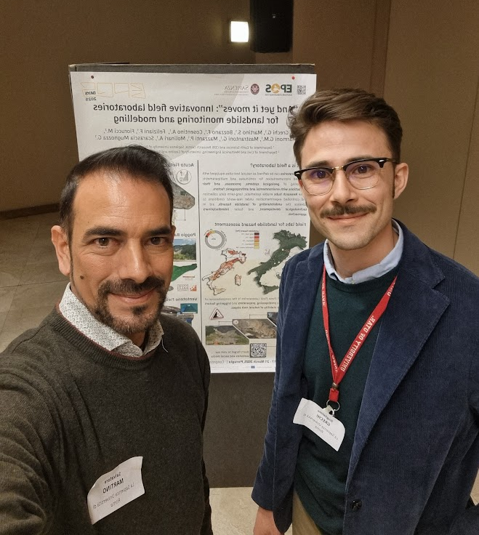
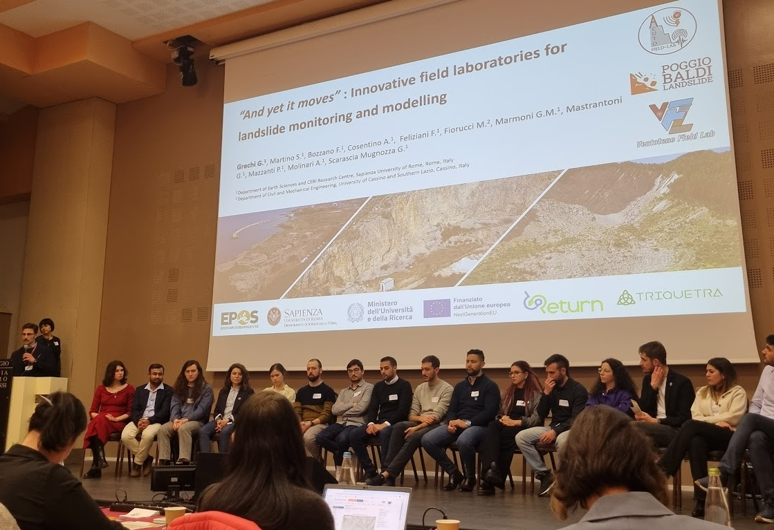
EPOS DAYS 2025

Slide 16

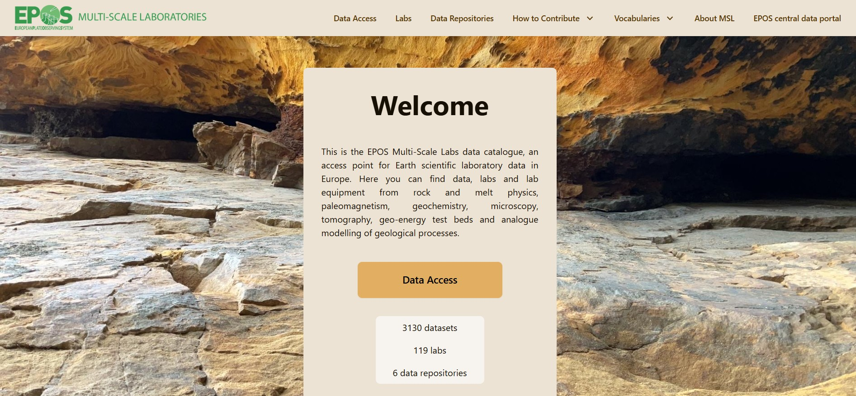
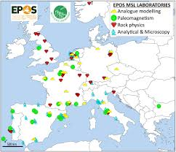
FROM MARCH 2025
(EPOS Days)
TO NOVEMBER 2025
Community hosting

Slide 17
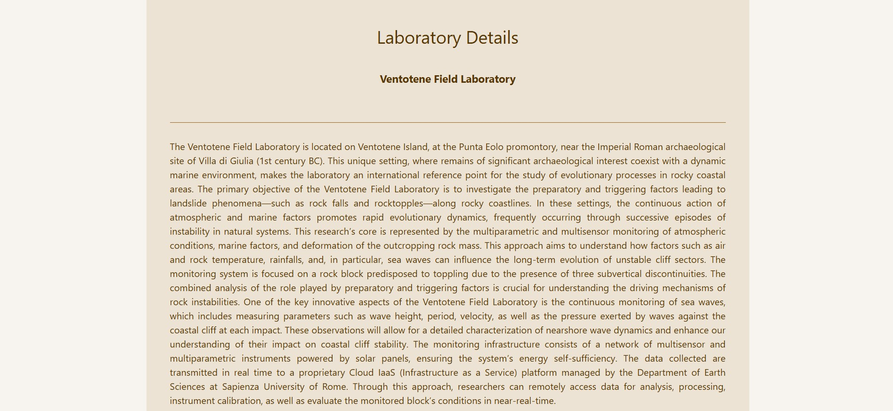
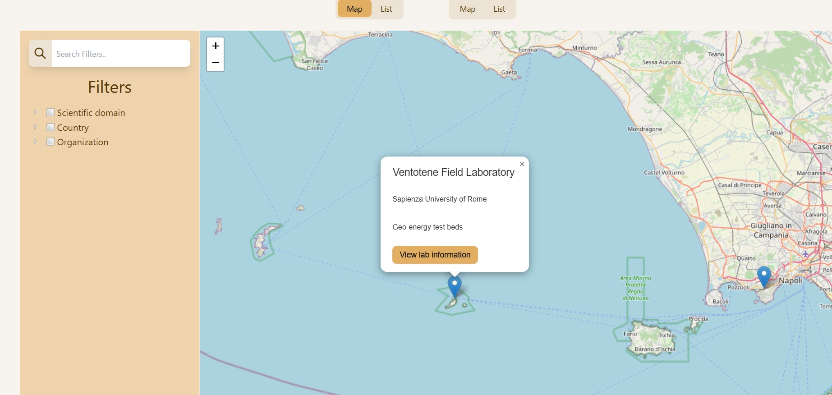
FROM MARCH 2025
(EPOS Days)
TO NOVEMBER 2025

Slide 18
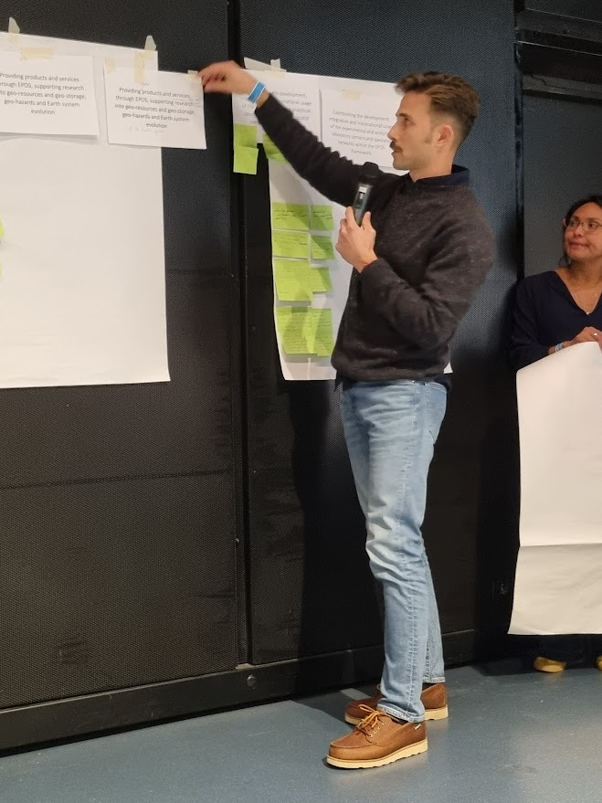
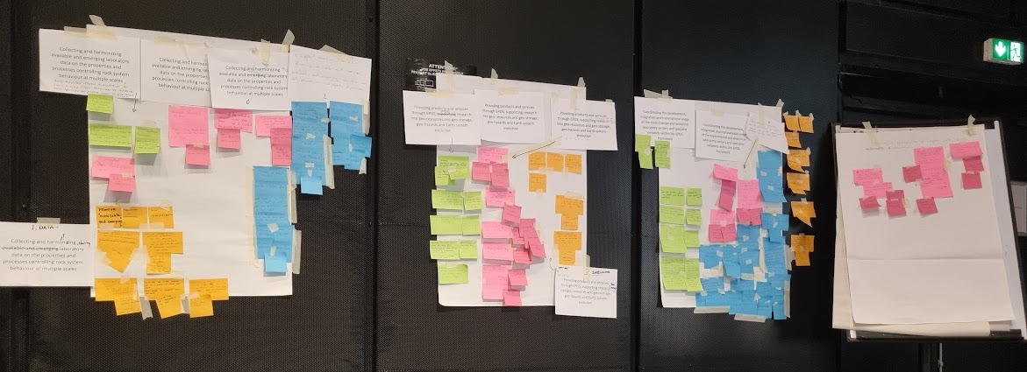
TCS MSL ANNUAL MEETING MONTPELLIER 2025

Slide 19

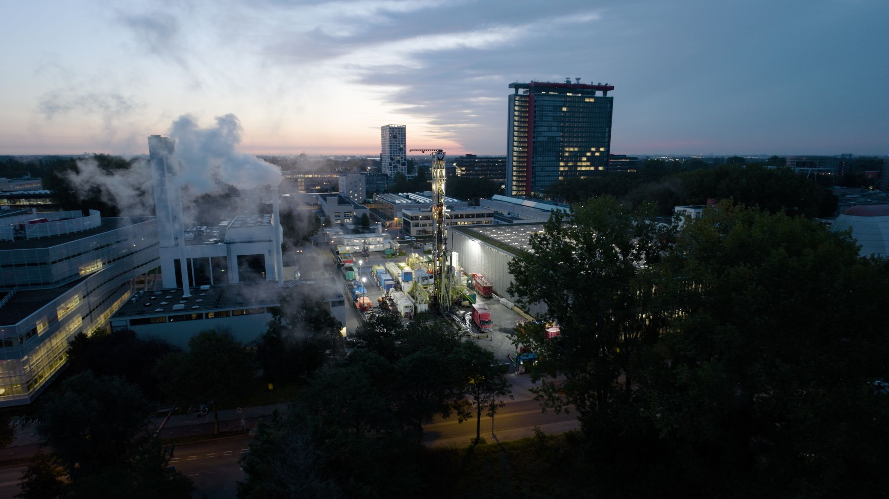
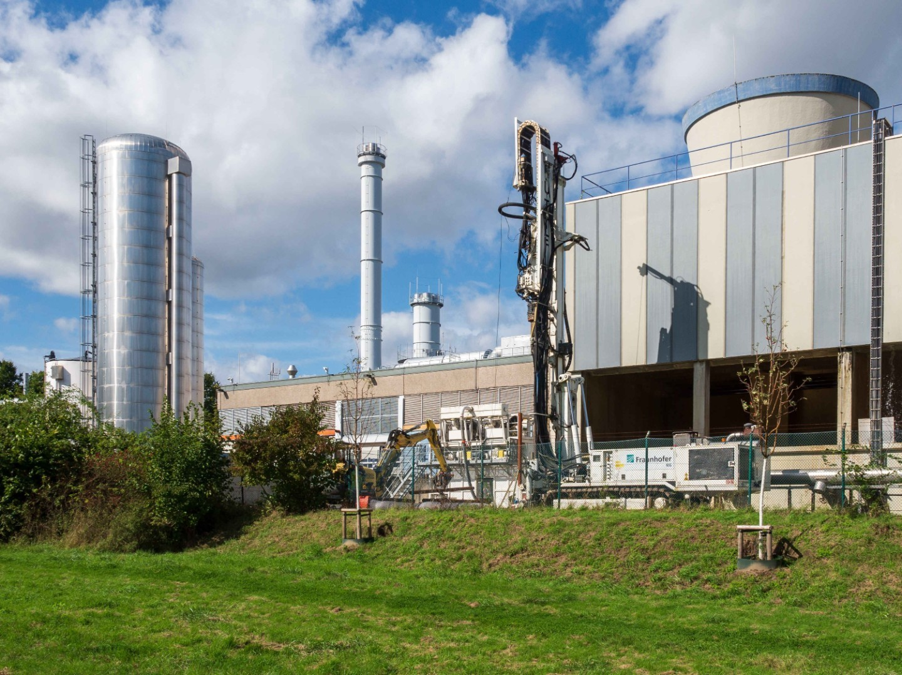
Community building
FROM MARCH 2025
(EPOS Days)
TO NOVEMBER 2025
Field-Scale
Laboratories
in MSL

Slide 20


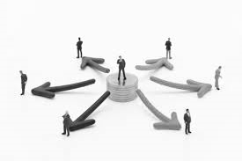
FROM NOVEMBER 2025
(TCS MSL annual meeting)
TO MARCH 2026
(EPOS Days)
Workplan
Scenarios
Goals to be achieved

Slide 21

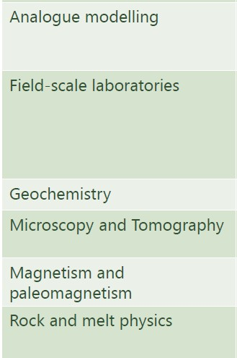
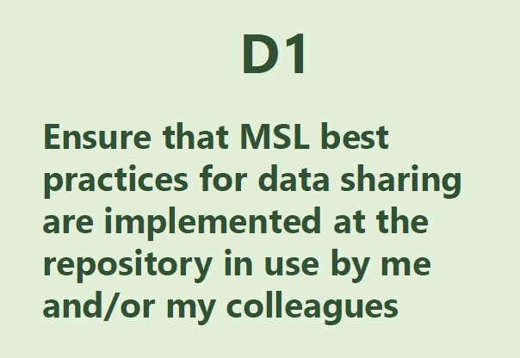



Community building
FROM MARCH 2025
(EPOS Days)
TO NOVEMBER 2025
Gian Marco Marmoni

Slide 22




data downloading
contest selection
data selection
question

Slide 23

Toward an IT service for data providing on EPOS platform

Slide 24



Toward an IT service for data providing on EPOS platform
data availability
short time goal
CONTRIBUTION EXPECTED FROM EPOS
data analysis tools
middle time goal

Slide 25
Thank you!

