Slide 1

Integrating the EuroGeographics Maps
into the EPOS Platform
Kety Giuliacci and Manuela Sbarra
EPOS ERIC IT Unit

Slide 2

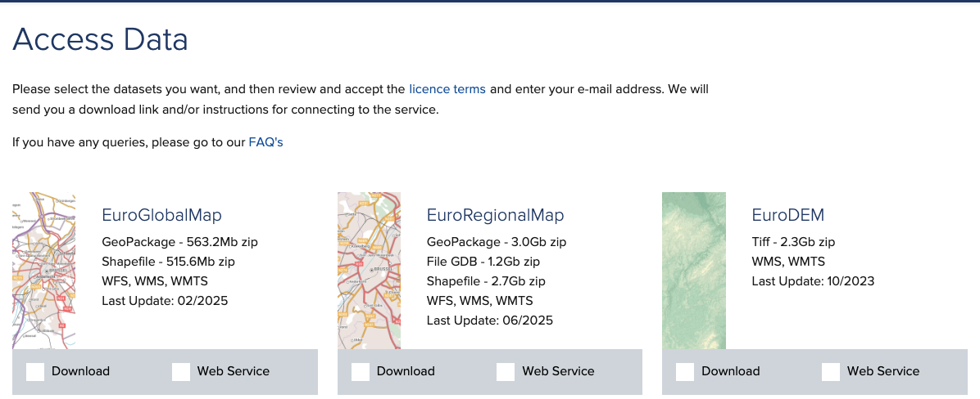
EuroGeographics
EuroGeographics is an independent international not-for-profit organisation representing Europe’s National Mapping, Cadastral and Land Registration Authorities and facilitating access to official, reliable, comparable and verifiable geospatial data provided by these authorities.
https://eurogeographics.org/

Slide 3
EPOS-EuroGeographics Collaboration Timeline
2022–2023:
01 September 2024:
May 2025:
TCS GNSS Data and Products fosters collaboration between EPOS and EuroGeographics.
First exploratory meetings.
Start of EPOS ON project.
EPOS joined the EuroGeographics General Assembly
End 2023:
March 2025:
Collaboration included in the EPOS ON framework (WP5) as a task to establish the collaboration.
EuroGeographics participated in EPOS Days

Slide 4
EPOS-EuroGeographics collaboration: mutual benefits
For EPOS
Collaborate with a community beyond the solid Earth domain to promote synergies for the development and adoption of common approaches, solutions, and services.
Provide new multidisciplinary and interdisciplinary use cases and services connected to maps and geospatial information.
New channel for training opportunities.
For EuroGeographics
Approach a new reservoir of users by exposing data in the EPOS Platform.
Contribute to shaping multidisciplinary and interdisciplinary use cases and services that can be of use for the EuroGeographics community.
Offer OS and RDM-related training opportunities focussed on the EPOS Platform as a part of the EuroGeographics training portfolio.
Notes:
Open Science - Research Data Management

Slide 5

Turning ideas into action
EPOS IT Team tested the integration of EuroGeographic Map services in the EPOS Platform.
Proof of Concept completed →
Fully interoperable data formats and standards → easy interaction.
Future implementation won’t require significant resources.
It works!

Slide 6
Technical Integration of EuroGeographics Maps into the EPOS Platform
EuroGeographics maps are provided via OGC web services (WMS/WFS)
The EPOS Platform natively supports WMS/WFS/WMTS layers
→ no data conversion required
Metadata description created for the EuroGeographics web services using EPOS-DCAT-AP metadata specification (TTL files)
Metadata ingestion into the EPOS catalogue
Test environment created to validate the integration and interoperability
Notes:
Key Steps

Slide 7
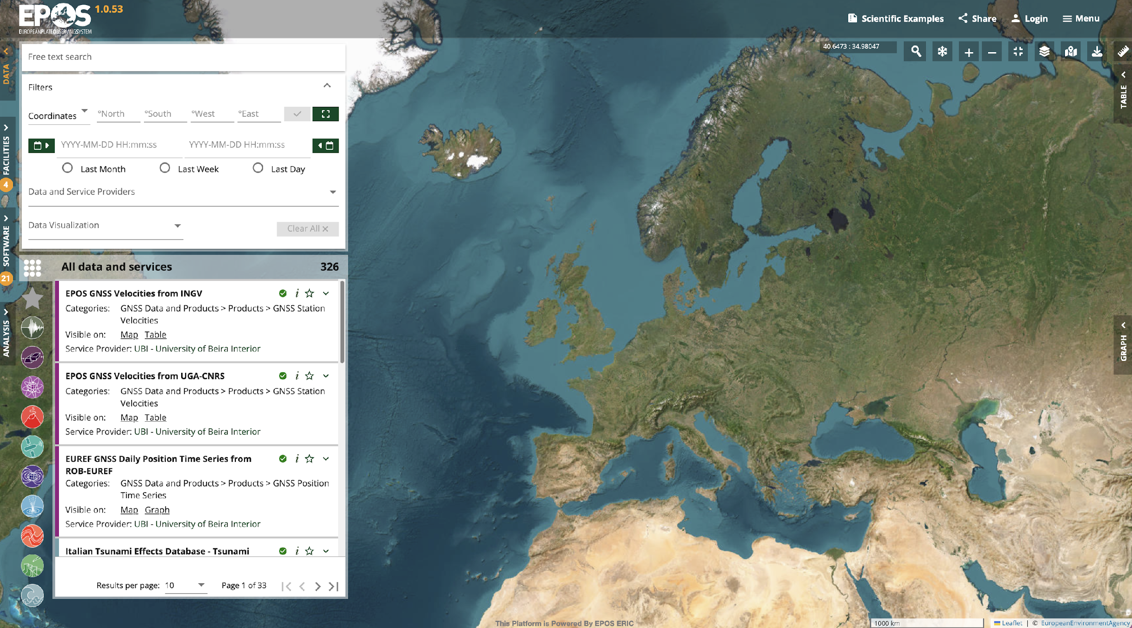

Test Environment: EuroGeographics Maps in EPOS Platform
(1/3)

Slide 8
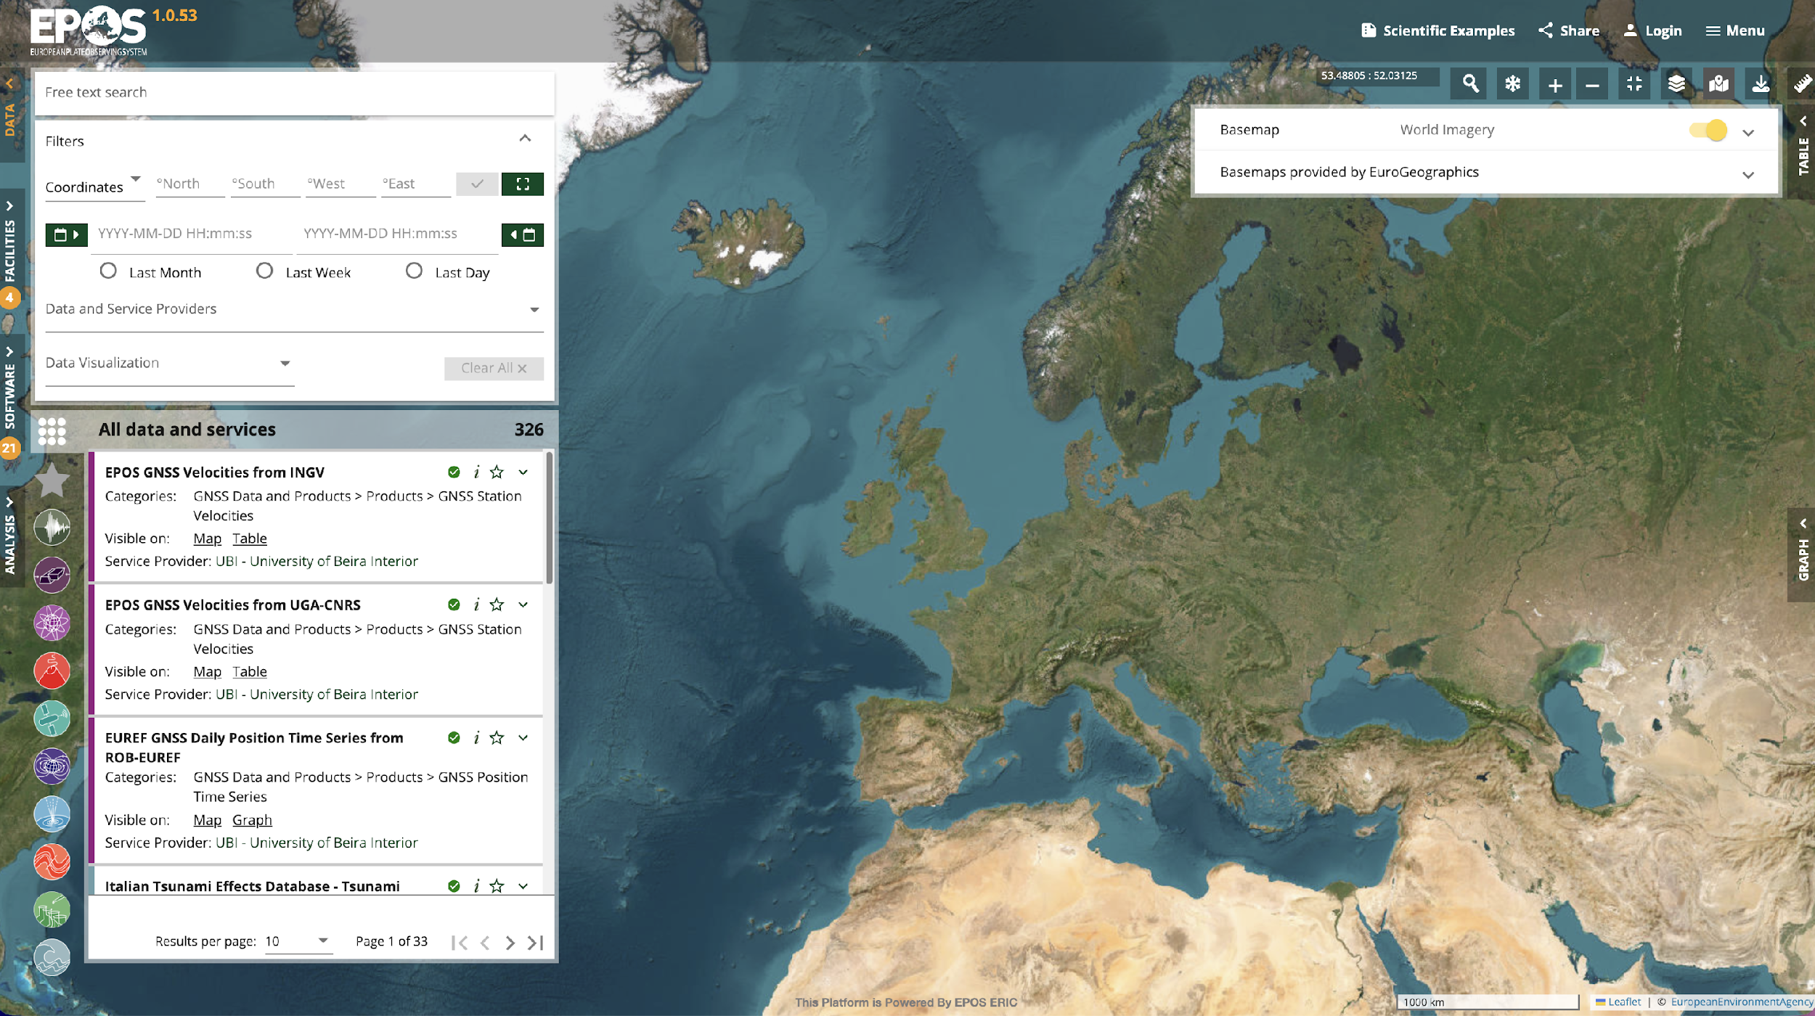
Test Environment: EuroGeographics Maps in EPOS Platform
(2/3)

Slide 9
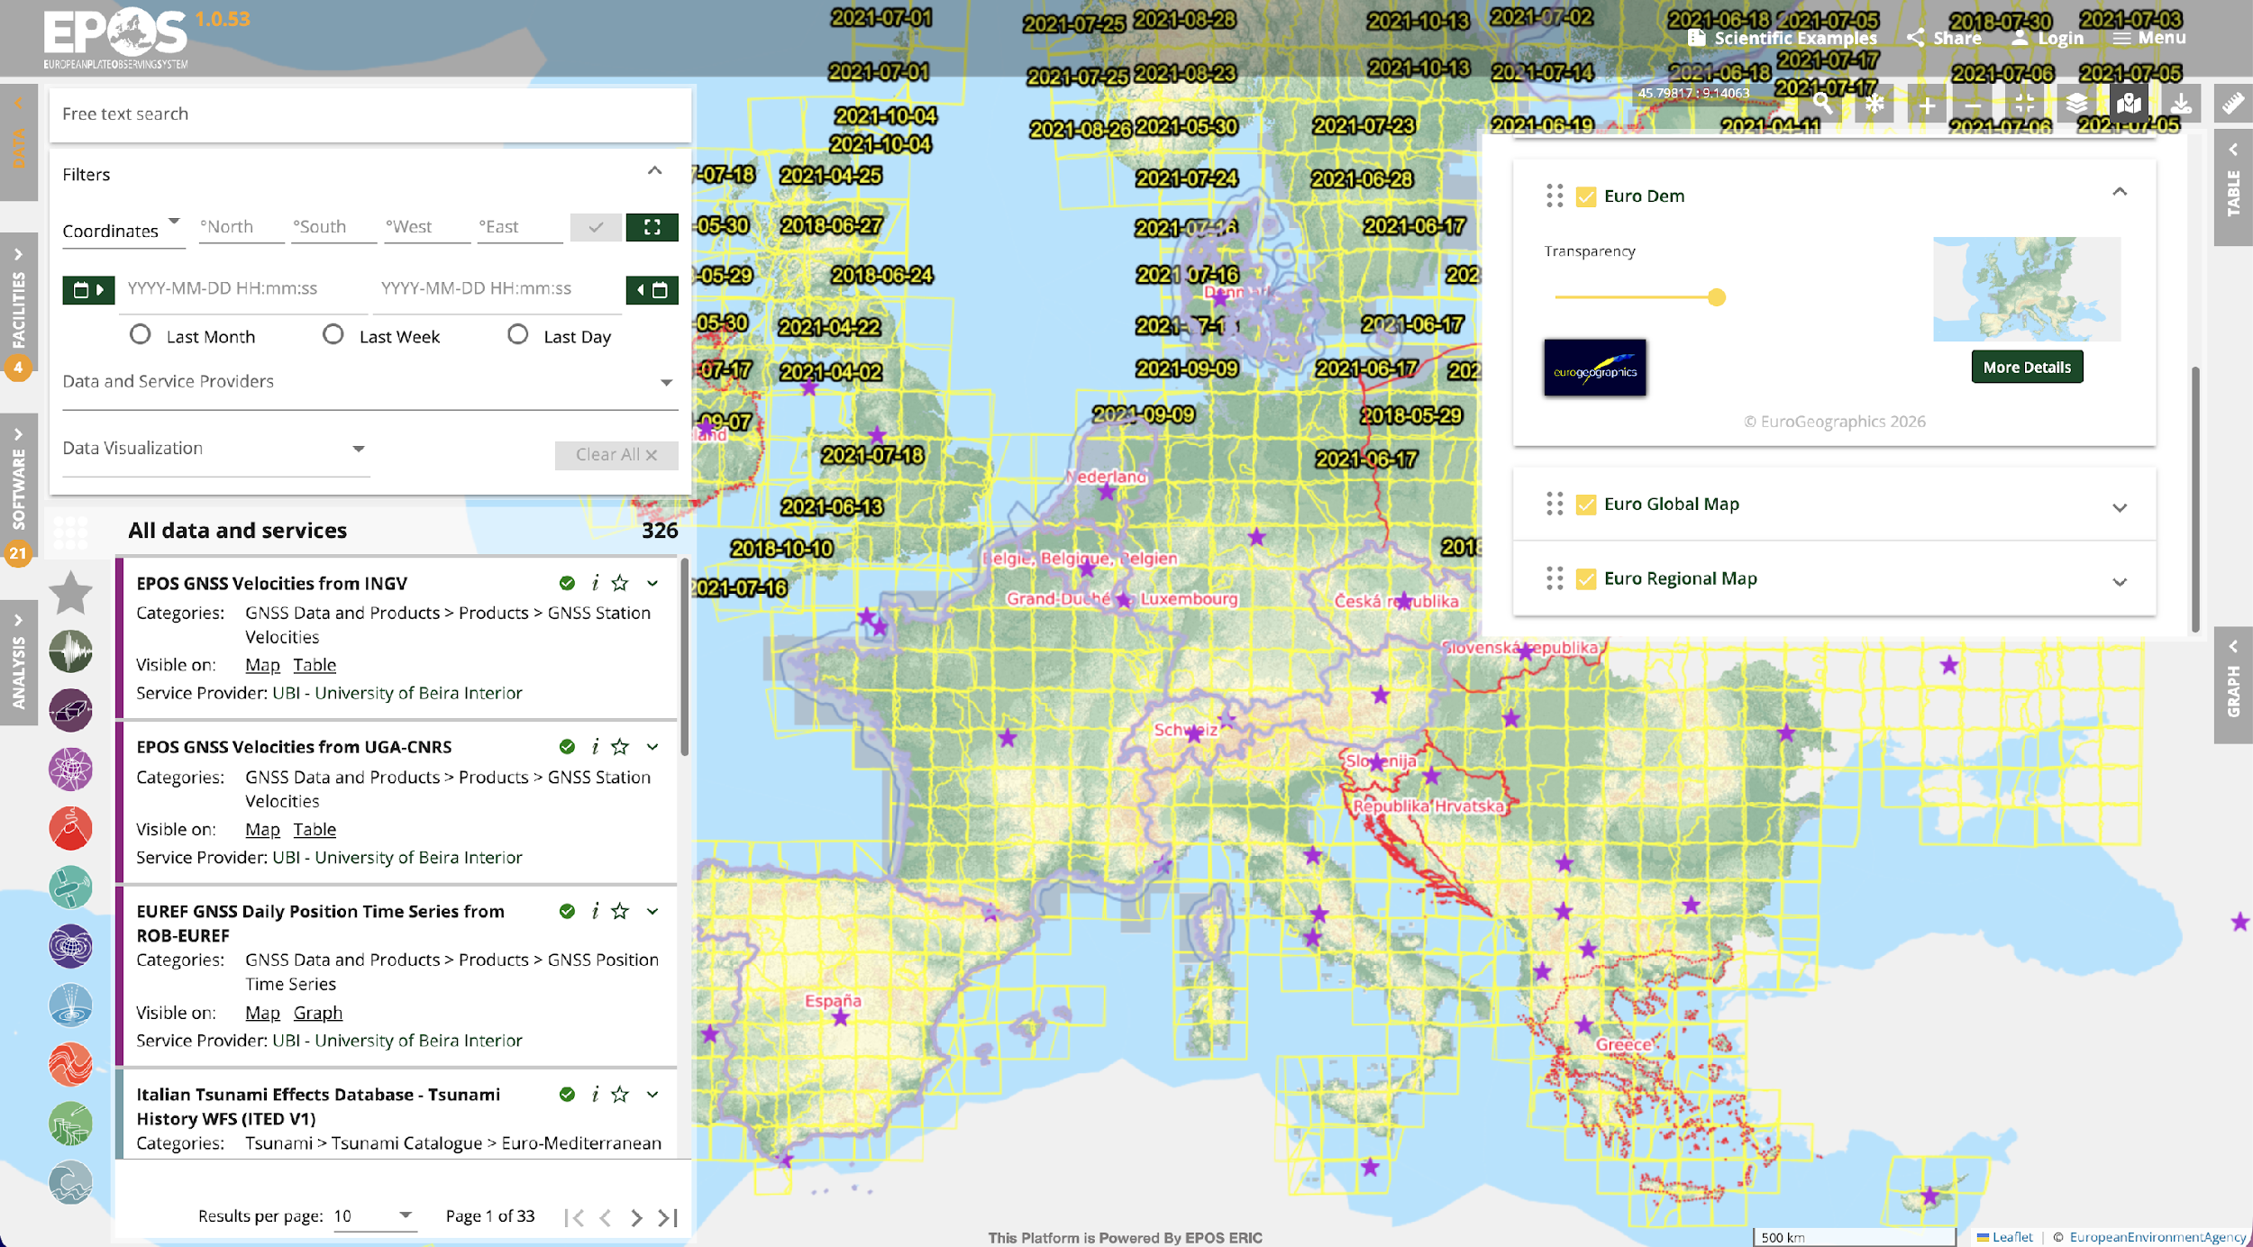
Test Environment: EuroGeographics Maps in EPOS Platform
(3/3)

Slide 10
Next steps
Formalising the collaboration through a MoU
Technical aspects
Refine the test environment for production deployment

Slide 11
Thank you!

