Slide 1

Enhancing Services for Science:
EPOS ON WP2 Achievements during project first period
EPOS-ON WP2
Otto Lange and Jan Michalek

Slide 2
EPOS-ON WP2
T2.1 – Enhanced EPOS catalogue of services for science
T2.2 – Integration of new communities and stakeholders
T2.3 – Computational Earth Science and tools

Slide 3
T2.1 - Enhanced EPOS catalogue of services for science
Service title (subtask number)
Multidisciplinary data: Micro-climatic data from Slovenian Karst (2.1.1) | New WSM database 2025 release (2.1.6)
Multidisciplinary data: Seismic data from Slovenian Karst (2.1.1) | Expansion of the WSM database with stress magnitude and pore pressure data (2.1.6)
Real-time and Discrete Geochemical Data Repository (2.1.2) | Coordinated inventory of mobile instrument pools (2.1.7)
Machine learning-driven Data Validation and Predictive Maintenance System (2.1.2) | Simplified and harmonized litho-stratigraphic maps (2.1.8)
Automatic Alert System for Geochemical Anomalies (2.1.2) | DEM and DEM-derived elements - slopes (2.1.8)
A new MSL service for site-specific GETB data (2.1.3) | Compilation of measured V_{s30} data across Europe (2.1.8)
Services for multi-domain GETB data dissemination (2.1.3) | Test for the integration of a local-scale dataset for site effect characterisation (proof of concept, additional; 2.1.8)
Enhanced magnetotelluric data and models (2.1.4) | Rapid Position Time-Series Computation (2.1.9)
Muography data (2.1.5) | Dissemination of Rapid Position Time-Series (2.1.9)
Development of the new WSM database infrastructure MaRS (2.1.6) | Airborne magnetic survey data (2.1.10)

Slide 4
Status update T2.1
Achievements:
D2.1 – Roadmap for implementation of new services
Implementation of services is now fully tracked through EPOS ON Implementation Level Matrix
Status 2026-Q1:
Enhance magnetotelluric data and models – developments on track
Muography – started; technically advanced, require international coordination
World Stress Map –
  Map released (https://doi.org/10.5880/WSM.2025.001);
  Webservice for WSM under development (collaboration within GFZ)
Coordinated inventory of mobile instrument pools – start postponed to 2026-Q2
Multidisciplinary data – seismic data from Slovenian Karst: started
MSL service for site-specific GETB data – started development of new service

Slide 5
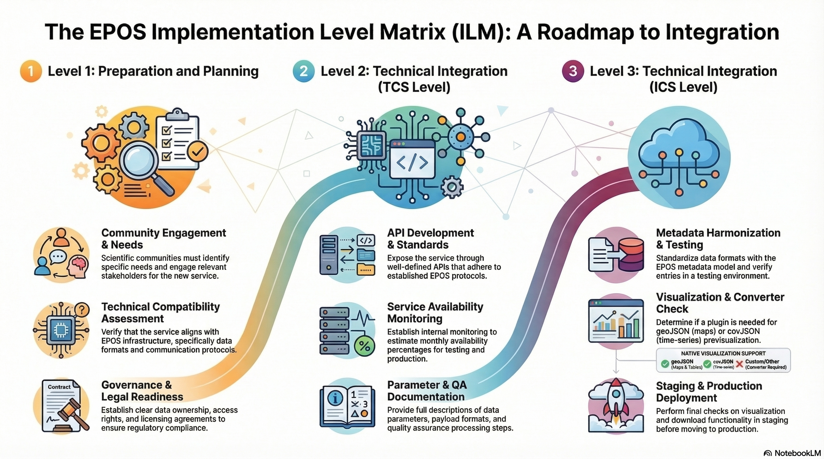

Slide 6
T2.2 - Integration of new communities and stakeholders
Integration Built Environment Data (BED) community
Considerations:
  Guidelines and activities following the EPOS ERIC Implementing Rules
  Technical and governance dimensions must be managed in parallel
Cooperation with industrial sector (Krafla Magma Testbed)
Challenges and lessons to be learned:
How to track/define progress/impact in collaborating with private sector
Bi-directional data provision: how to imagine and elaborate a framework for mutual engagement?

Slide 7
Status update T2.2
Achievements:
D2.2 – Guidelines for new communities integration
Paraphrasing the Advisory Board (AB): Aligns with an important discussion at EU level. Deliverable is detailed and could fit as a guideline for other RIs to follow in making strategic decisions about incorporating new communities. External sharing with relevant fora is encouraged.
Status 2026-Q1:
Extension D2.2 with KPIs for precise measuring of status in preliminary stage (discussion)
Science-industry workshop planned at World Geothermal Congress 2026 in June in Calgary
Time-frame KMT data provision (exceeds EPOS-ON project):
  2027 first dwell planned (as yet)
  Data flow into EPOS depends on when KMT drills (there is relevant uncertainty)

Slide 8
T2.3 - Computational Earth Science and tools
Developing prototypes of selected use cases of the Integrated Core Services – Distributed (ICS-D) in EPOS
Characteristics
Activities largely related to the interoperability layer between EPOS e‑infrastructure and cloud- and HPC infrastructures
Leverage existing scientific workflows and services to enhance the research infrastructure
Alignment with and possible extension of the EPOS architecture design
Sustainable partnerships where applicable: requires definition of technical, legal, and financial aspects under which the ICS-D prototypes and external infrastructure(s) will operate
Adoption of results from DT-GEO and Geo-INQUIRE Horizon Europe projects

Slide 9
Status update T2.3
Achievements:
Relevant use cases identified and described
Landscape analysis performed for the identification of already existing tools and code
Status 2026-Q1:
At the current stage, the EPOS architecture design need not be updated, as it is flexible enough to accommodate the ICS-D use cases.
Technical, legal, and financial aspects under which the ICS-D prototypes and the related external infrastructures will operate: fully consolidated framework still under refinement, but substantial progress has been achieved (e.g. MoU with EGI, access to computational resources at CINECA through EPOS Italy)
DT-GEO results being transferred, Geo-INQUIRE upcoming

Slide 10
Thank you!

