Slide 1

Welcome and introduction to day 2
Lilli Freda
EPOS ERIC Executive Director

Slide 2

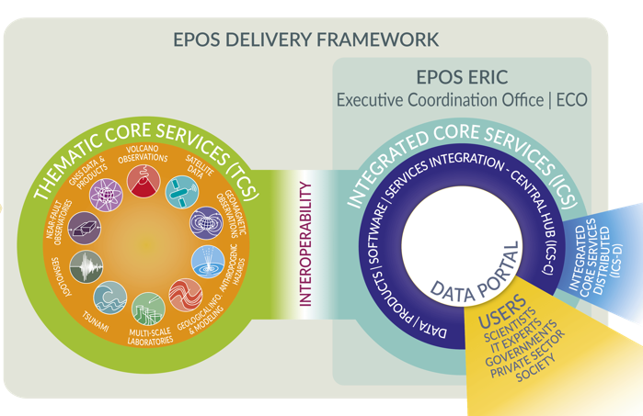
The EPOS Ecosystem and the EPOS Days 2026 Programme
Day 5: EPOS Data Policy
DATA Generation
DATA Integration
DATA Access
Day 4: Technical challenges, opportunities and solutions
Day 4:
EPOS in National Landscapes
Day 1: Thematic Core Services
Day 2: Early Career Researchers, es
Day 2: New Services and communities
Day 3: International Collaboration
Day 2: Societal Impact and Responsible Research Infrastructures
Day 4: UFG report

Slide 3

The EPOS Ecosystem and the EPOS Days 2026 Programme
DATA Generation
DATA Integration
DATA Access
Day 1: Thematic Core Services
Day 2: Early Career Researchers
Day 2: New Services and communities
Day 3: International Collaboration
Day 2: Societal Impact and Responsible Research Infrastructures
Day 4: UFG report

Slide 4
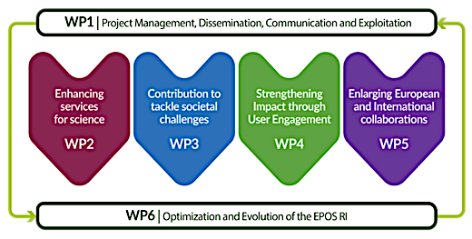
EPOS ON objectives covered in today’s sessions
9.00-11.00
New Services and Communities
11.45-13.30
Societal Impact and Responsible RIs
15.00-18.30
Early Career Researchers

Slide 5

Day 2 Agenda: Morning Sessions 1/2
09.00-11.00 | New Services and New Communities - Chairs: R. Paciello, O. Lange, J. Michalek
Welcome and introduction of the day’s agenda |  | Lilli Freda
EPOS ON WP2: Achievements during project first period |  | O. Lange, J. Michalek
Integrating the EuroGeographics Maps into the EPOS Platform |  | K. Giuliacci, M. Sbarra
Ground Instability data from Field Laboratories: a new opportunity for EPOS through the TCS MSL |  | S. Martino
Development of a European Quantum Infrastructure for Gravimetry |  | S. Merlet
Muography |  | J. Joutsenvaara
The European and global data landscape in Geochemistry |  | M. Klocking
Q&A and interactive discussion
 | 11.00-11.45 | Coffee break

Slide 6

Day 2 Agenda: Morning Sessions 2/2
11.45-13.30 | - Societal Impact and Responsible Research Infrastructures – Chairs: F. Romano, A. Scala
EPOS ON WP3: Achievements during project first period |  | F. Romano
Scientific products exploitable in evidence-based decision making – introduction |  | G. Forlenza
Next-Generation Earthquake Early Warning: From Public Alerts to Multi-Hazard Integration |  | A. Scala, A.Marmureanu
An Integrated Tsunami Impact Assessment Workflow within ARISTOTLE: A Collaborative Use Case for Emergency Management |  | F. Løvholt
Rapid Earthquake Impact Assessment: Understanding Uncertainty from Source and ShakeMap Variability |  | H. Crowley
Operational ShakeMap Services: Applications and Societal Impact |  | L. Faenza
The Ethical Label to identify ethical and social implications of project outputs |  | S. Peppoloni
Q&A and interactive discussion
 | 13.30-15.00 | Lunch break

Slide 7

Day 2 Agenda: Afternoon Sessions
15.00 – 18.30 | Early Career Researchers - Chairs: H. Ciechowska, F. Monterroso
15.00-16.45 | Scientific challenges and use cases – Flash pitches presented by Early Career Researchers from the TCS
16.45- 18.30 | Scientific challenges and use cases – Poster Session presented by Early Career Researchers from the TCS Coffee and refreshments
19.30-22.00 - Social Dinner Obicà Mozzarella Bar Via Roma 143

Slide 8
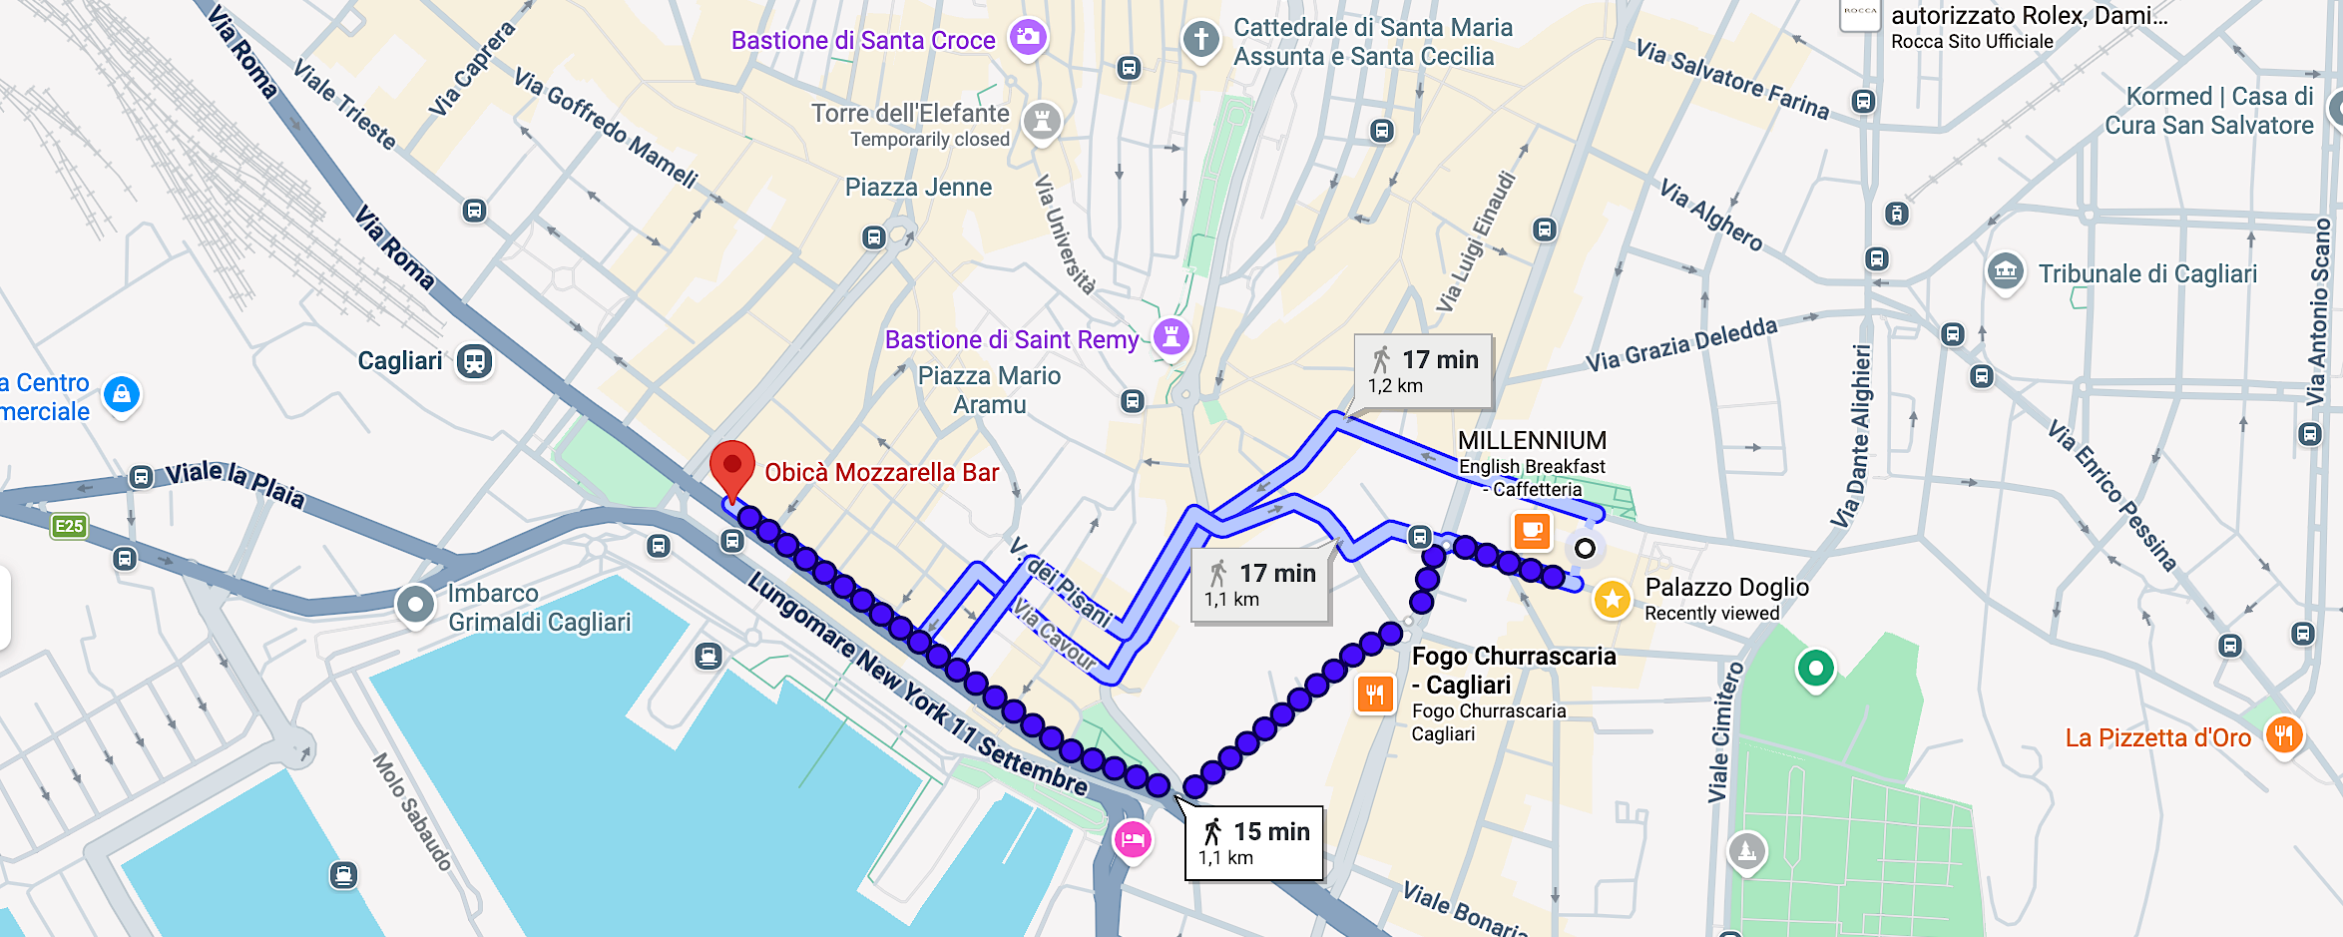
Social Dinner
Tonight @ 19.30-22.00 - Obicà Mozzarella Bar – via Roma 143
Bring your badge!

Slide 9
Enjoy the programme!

